Slide 1
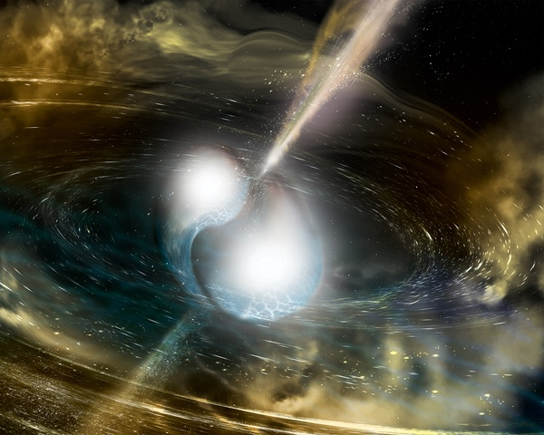
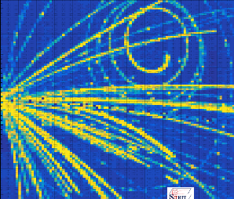
Laboratory Probes of the Neutron-Matter Equation of State
LIGO Detects a Neutron Star Merger
¹³²Sn+¹²⁴Sn @ E/A=270 MeV
Betty Tsang, NSCL
Michigan State University
CIPANP 2018: 5/28-6/3
Palm Springs, USA

Slide 2
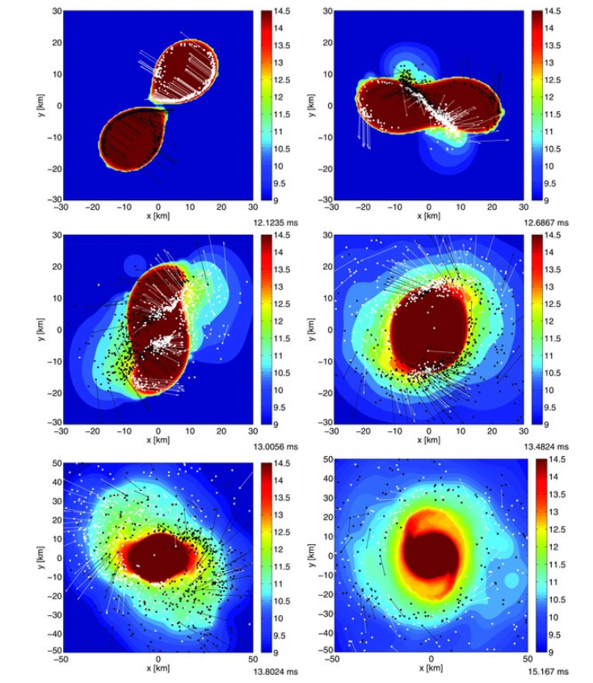


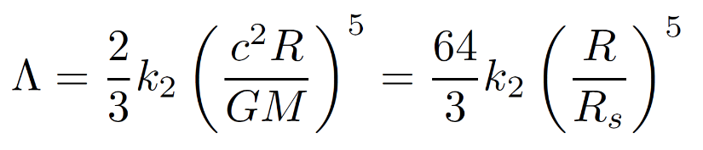
Bauswein, S. Goriely, and H.-T. Janka, APJ, 773, 21 (2013)
Tidal deformation of the Neutron Star
Soft EoS
Large deformation
Stiff EoS
small deformation
Λ<800 (90% confidence)
GW170817 PRL 119 161101

Slide 3
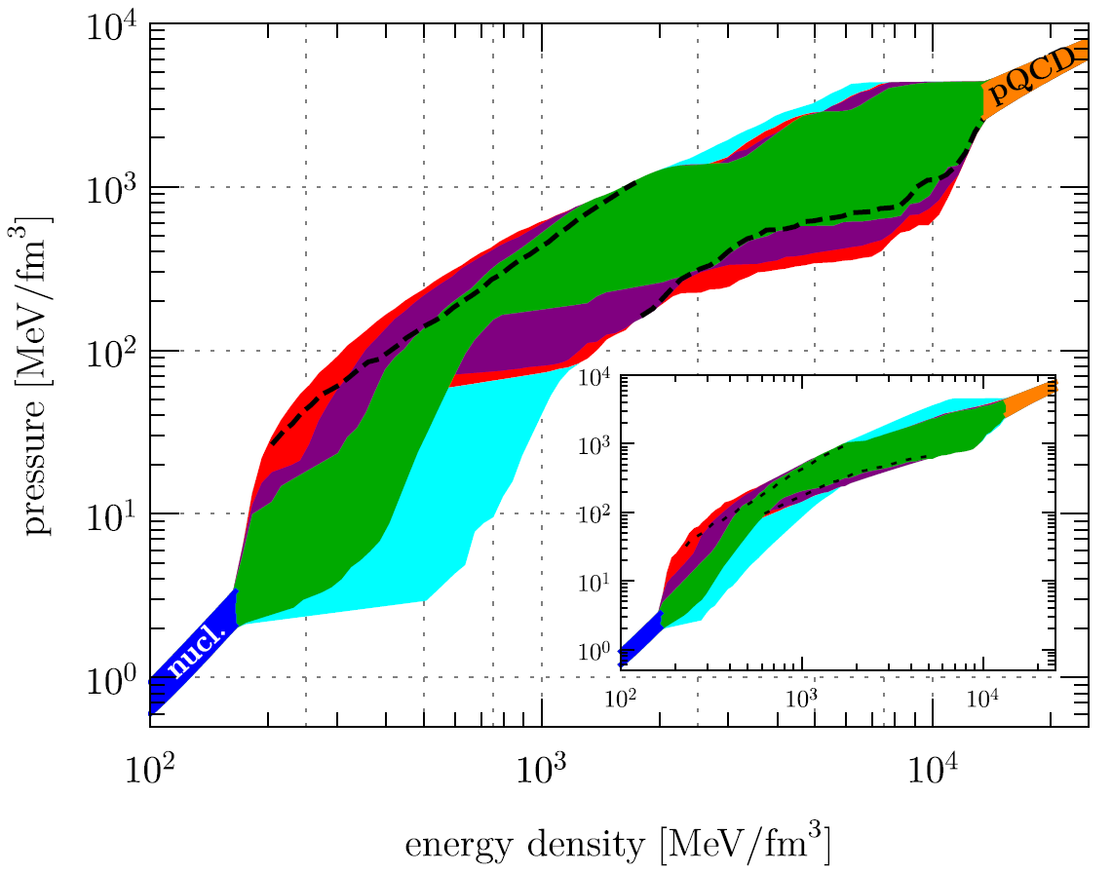
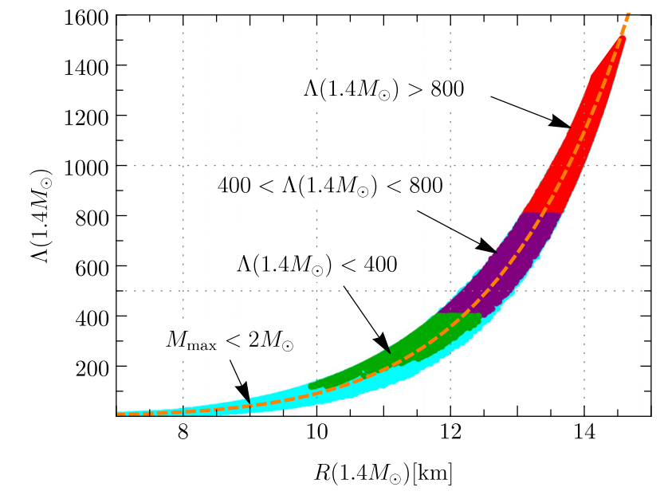
Different forms of EOS: pressure as a function of energy density or E/A vs. density
Annala et al., PRL 120, 172703
Generic neutron star EoS
color: Different assumptions
Deformability
CEFT
Neutron Star Radius
Other calculations (not complete list):
De et al., arXiv:1804.08583v1
Tews et al., arXiv:1804.02783v1
Fattoyev et al., PRL 120.172702
Energy density includes nucleonic rest energy

Slide 4
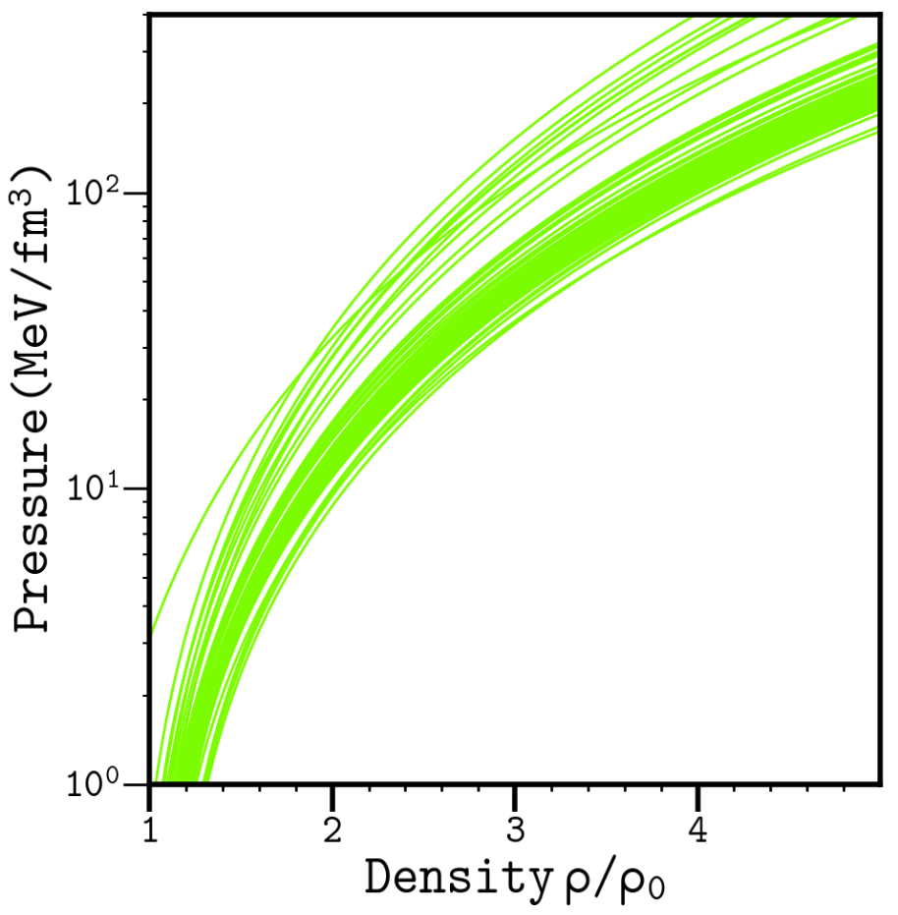
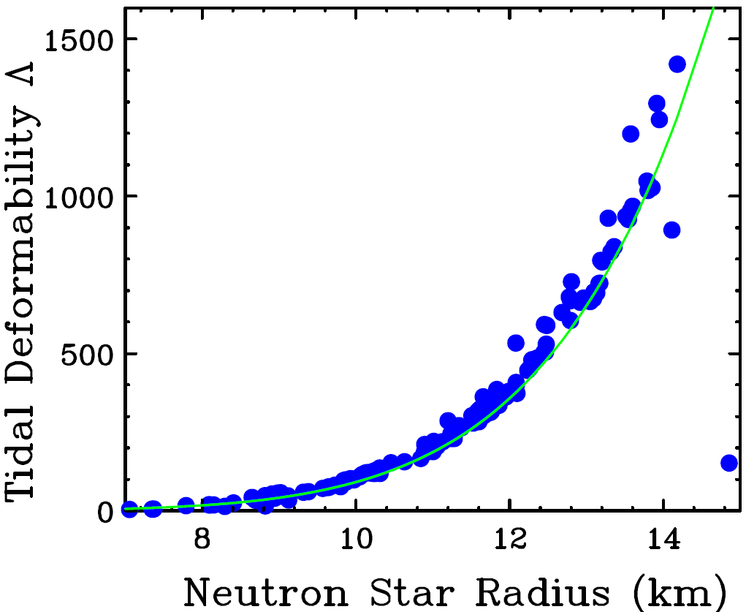
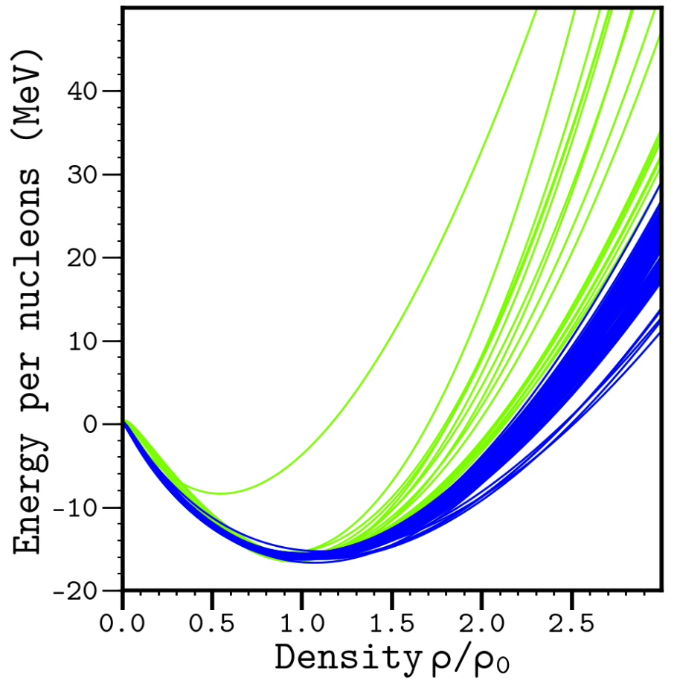
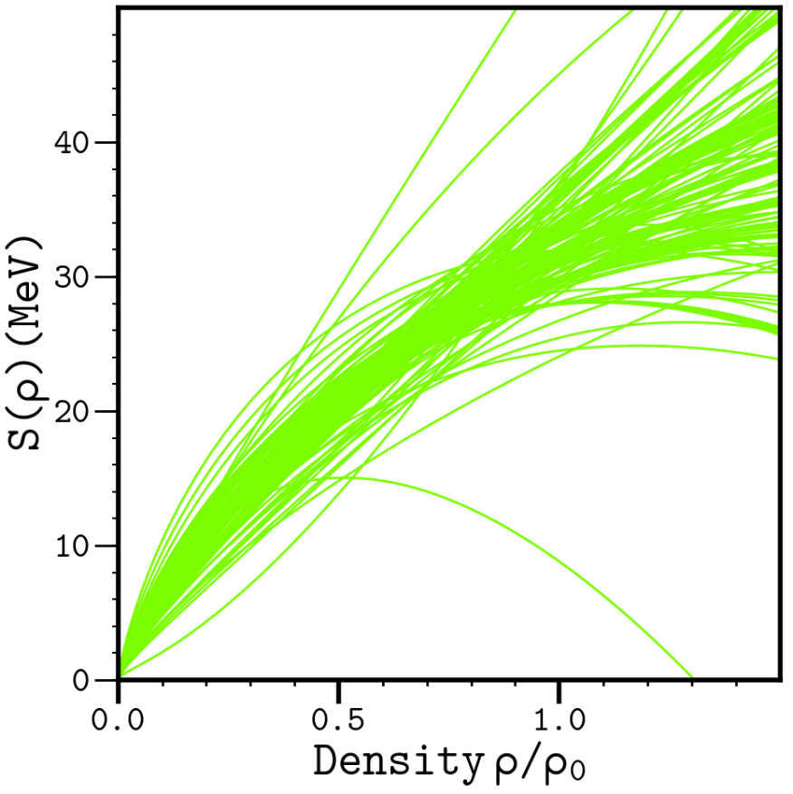
E/A (ρ,δ) = E/A (ρ,0) + δ²⋅S(ρ); δ = (ρ_{n}- ρ_{p})/ (ρ_{n}+ ρ_{p}) = (N-Z)/A
Skyrme interactions
Symmetric matter
Skyrme interactions preferred by Nuclear physicists.-- effective density dependent NN interaction
Parameterized by ~10 variables fitted to various aspects of nuclei properties.
~200 Skyrmes to conduct an overview study of Neutron star properties.
Y.C. Tommy Tsang & Farrukh Fattoyev

Slide 5
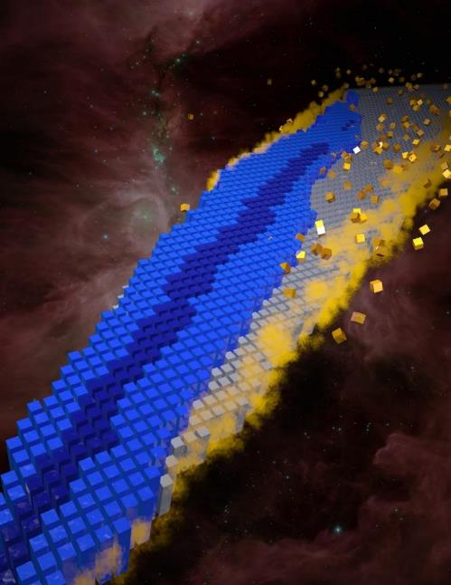
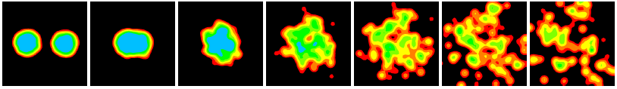

Symmetry Energy from nuclear structure and reaction dynamics
Image by Andy Sproles, ORNL
Proton
Femto-nova explosion created by Heavy Ion collisions
Equation of State of nuclear matter
E/A (ρ,δ) = E/A (ρ,0) + δ²⋅S(ρ)
δ = (ρ_{n}- ρ_{p})/ (ρ_{n}+ ρ_{p}) = (N-Z)/A
Hubble ST

Slide 6
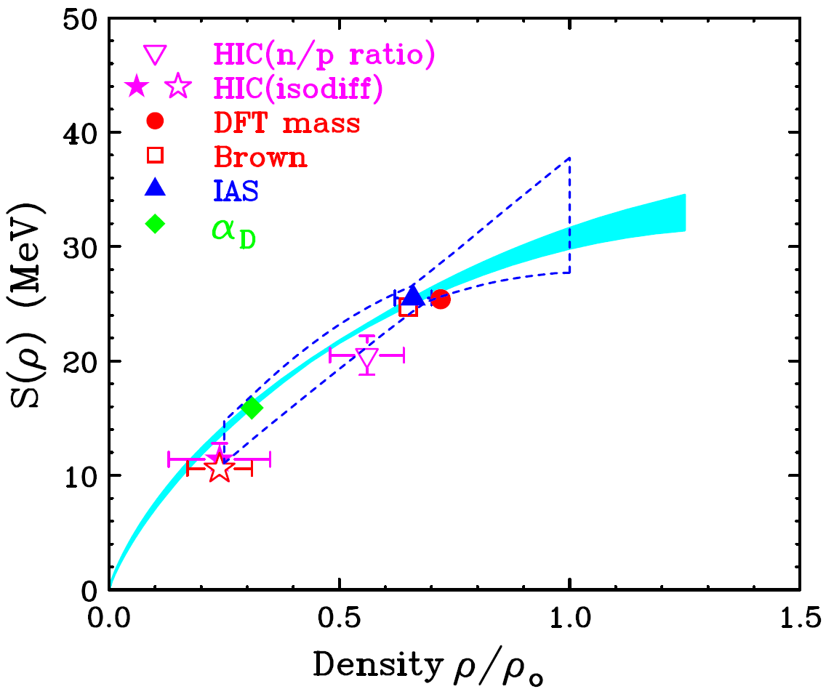
Experimental Symmetry Energy constraints at subsaturation density
ab-initio calculation by C. Drischler et al. (2014)
Lynch and Tsang (2018)
arXiv:1805.10757

Slide 7
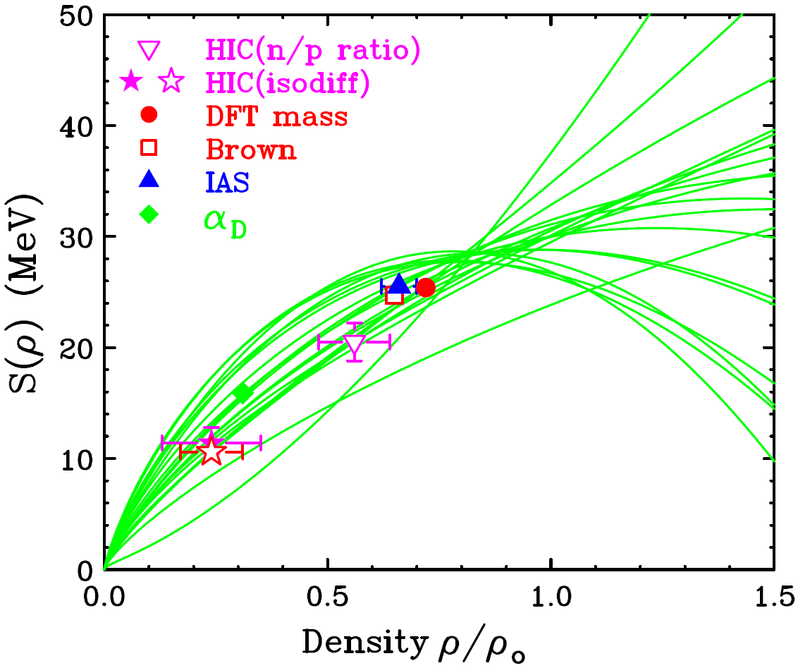
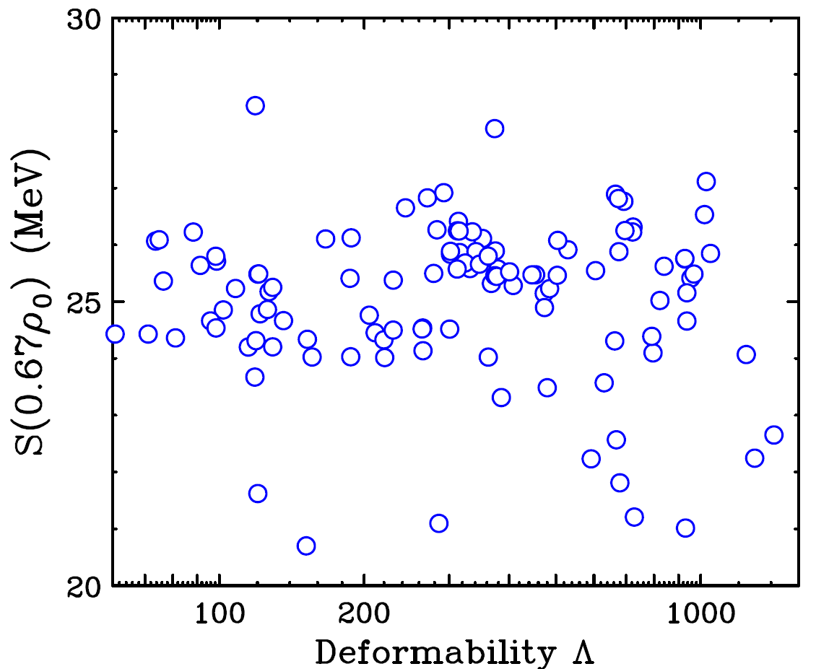
Very little selectivity on tidal deformability at low density
Sub-saturation constraints do not constrain the tidal deformability or neutron star radii. The low density behavior does not constrain the high density behavior such as deformability.

Slide 8
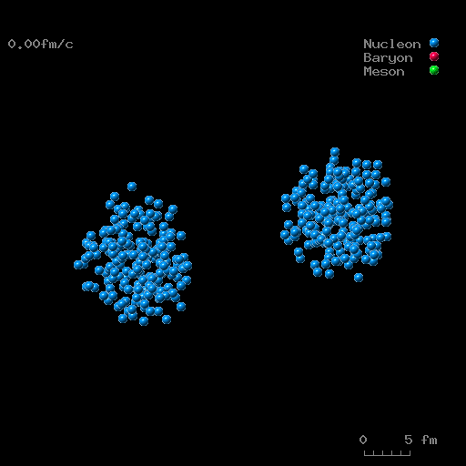
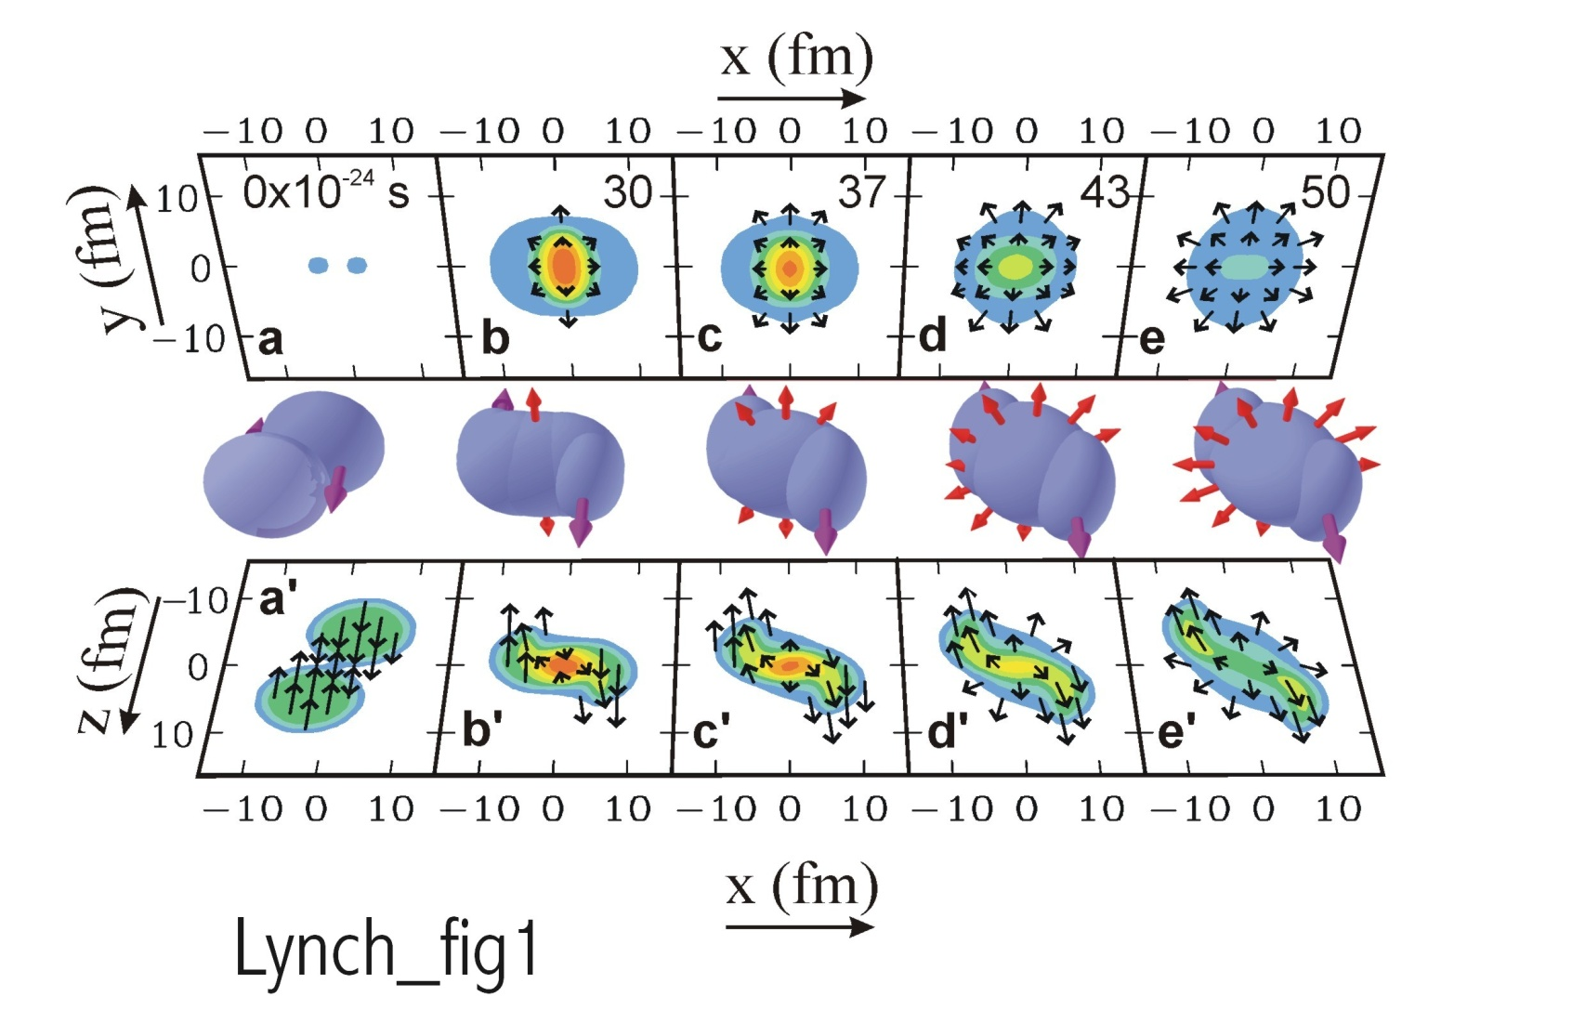
How to squeeze nuclear matter
E/A (ρ,δ) = E/A (ρ,0) + δ²⋅S(ρ); δ = (ρ_{n}- ρ_{p})/ (ρ_{n}+ ρ_{p}) = (N-Z)/A
Au+Au collisions E/A = 1 GeV)
YongJia Wang
pressure contours
density contours
Danielewicz et al., Science 298,1592 (2002)

Slide 9
Determination of symmetric matter EOS from heavy-ion collisions
Danielewicz et al., Science 298,1592 (2002)
Asy_Stiff: S_{int}∝2u²/(1+u)
Asy_Soft: S_{int}∝√u
Two observable from the high pressures formed in the overlap region:
Nucleons are “squeezed out” above and below the reaction plane.
Nucleons from residues are deflected sideways in the reaction plane
u=
The boundaries represent the range of pressures obtained from the Skyrme mean fields that reproduce the data.
High density constraints obtained from addition of two different SE forms

Slide 10
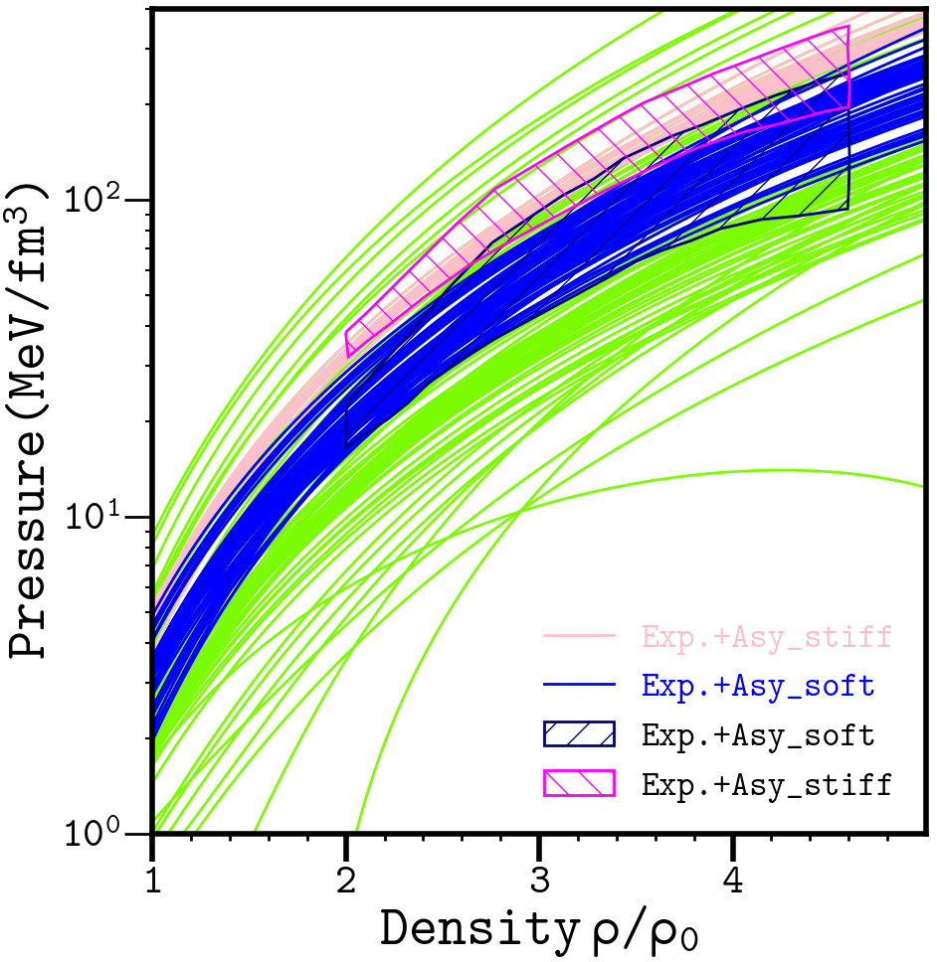
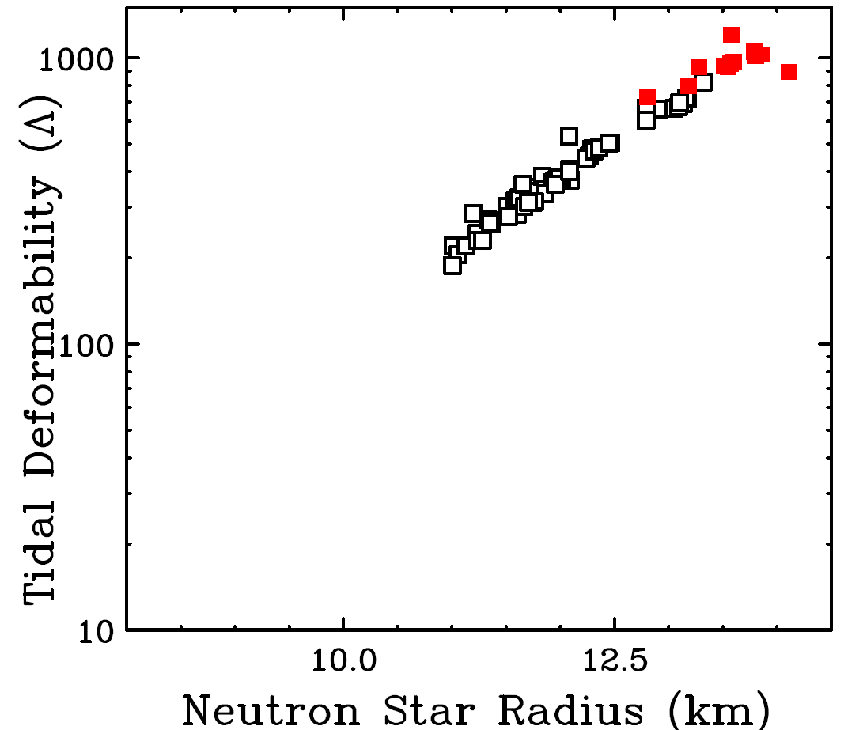
High density constraints from heavy-ion collisions
>2ρ₀
Lower bound in deformability?
Substantial overlaps of stiff EoS

Slide 11
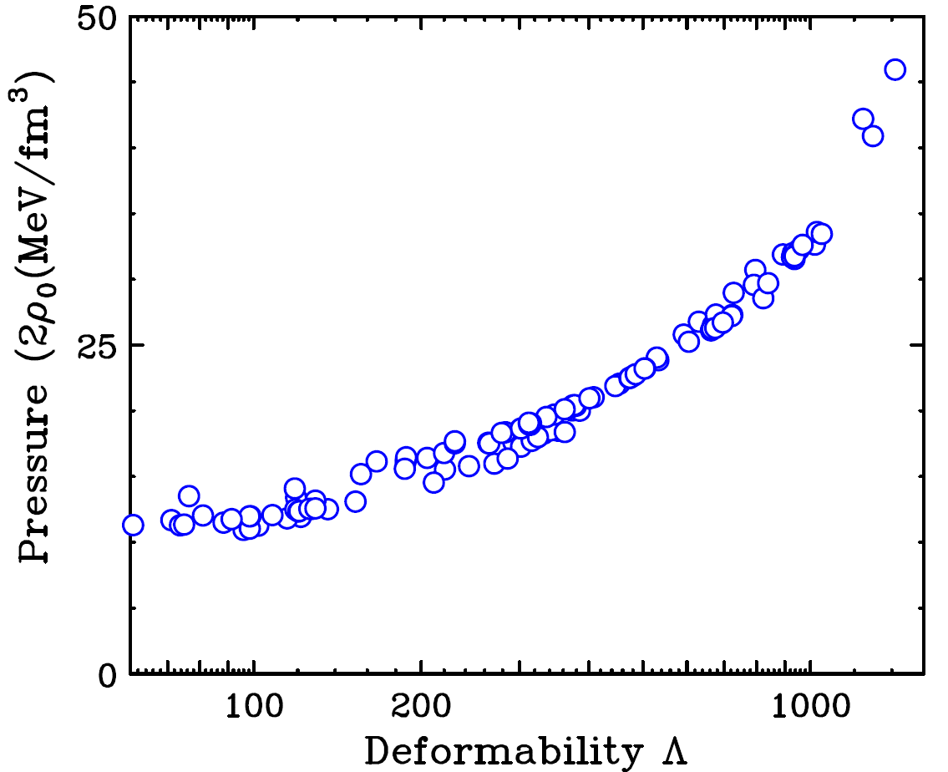
High density constraints from heavy-ion collisions
@2ρ₀
Asy-stiff
Asy-soft
>2ρ₀
Less than 50% error including experimental
and model uncertainties should be achievable.

Slide 12
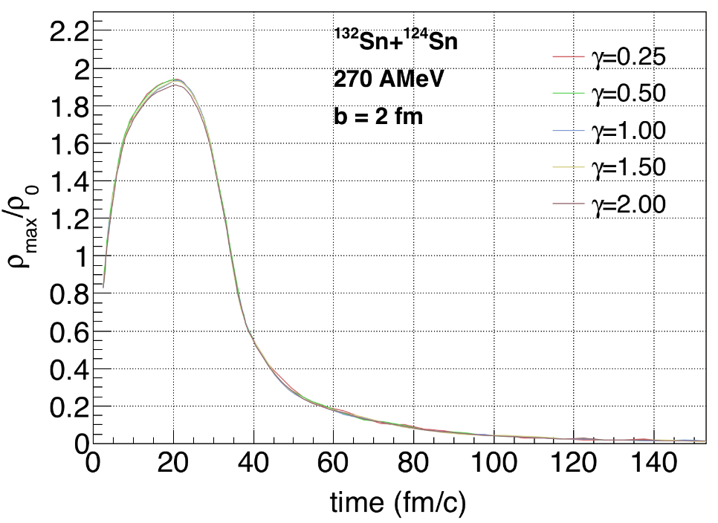
Au+Au collisions
400 MeV/u
b=5 fm
pBUU
YongJia Wang URQMD

Slide 13
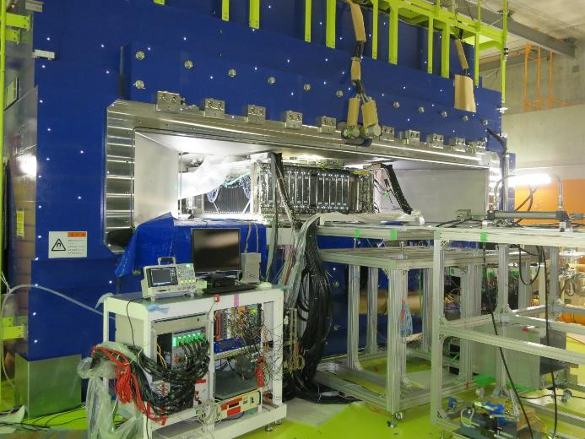
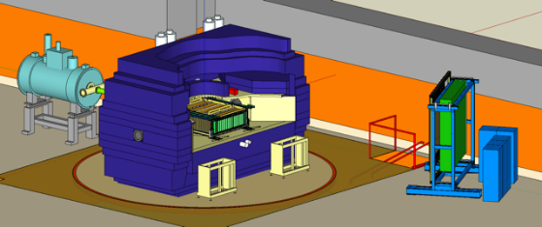
Experimental Setup
Primary | Beam | Target | E_{beam}/A | δ_{sys} | evt(M) | 2016
¹²⁴Xe | ¹⁰⁸Sn | ¹¹²Sn | 269 | 0.09 | 8 | 4/30-5/4
 | ¹¹²Sn | ¹²⁴Sn | 270 | 0.15 | 5 | 5/4-5/6
²³⁸Ｕ | ¹³²Sn | ¹²⁴Sn | 269 | 0.22 | 9 | 5/25-5/29
 | ¹²⁴Sn | ¹¹²Sn | 270 | 0.15 | 5 | 5/30-6/1
Z=1,2,3 |  | 100, 200 |  | 0.6 | 6/1
Easiest thing is spectrometer for pions

Slide 14
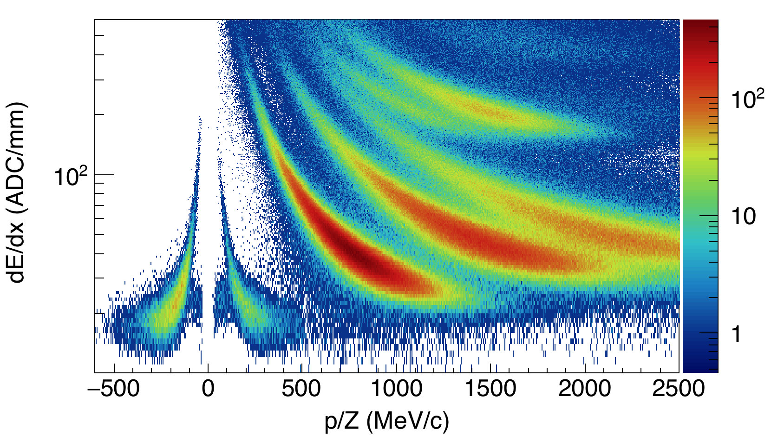
Particle ID spectra
¹³²Sn+¹²⁴ Sn
³He
⁴He
p
d
t
π⁻
π⁺

Slide 15
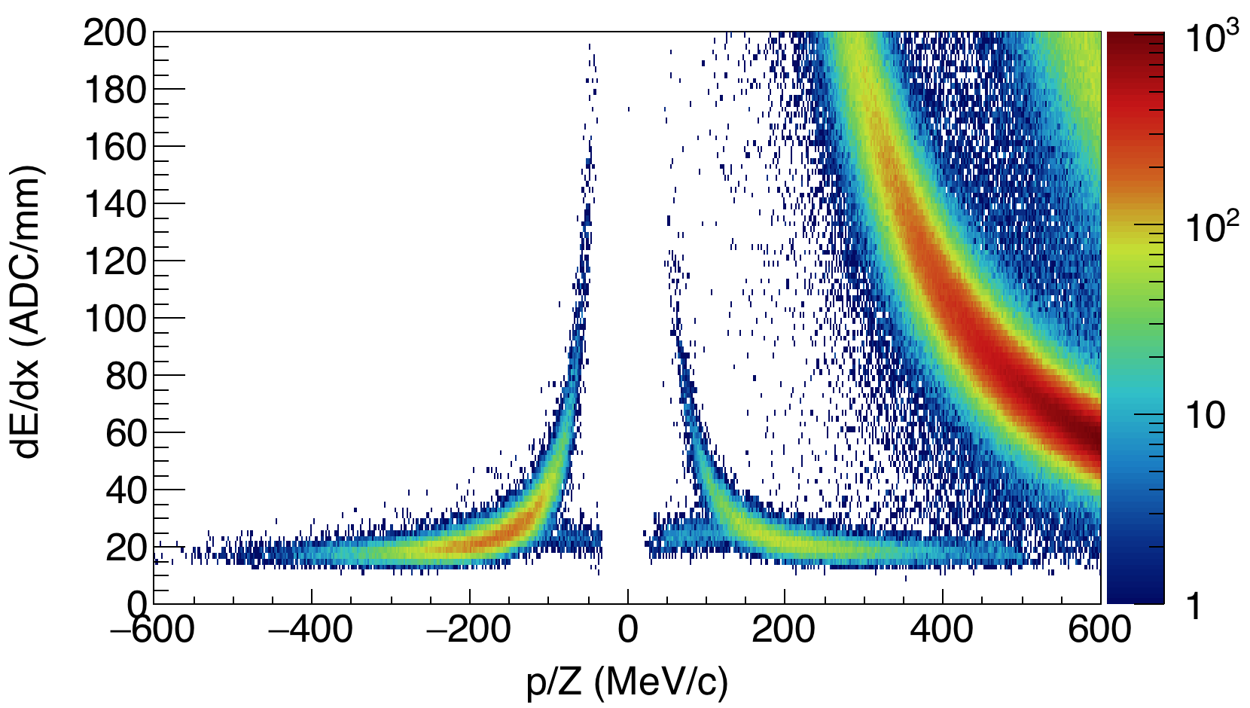
Understanding on detector and analysis efficiencies are underway
Symmetry energy is not an observable.
Need transport models to simulate reactions and compare to data.
Mean field (symmetry energy) plus others parameters are input to the transport models.
Model uncertainties: benchmark different transport models.
p
d
¹³²Sn+¹²⁴Sn
π⁻
π⁺
e- & e+ from π⁰

Slide 16
Code Evaluation Project I, PhysRevC.93.044609
30%
100 AMeV
100 AMeV
13%
400 AMeV
400 AMeV
Writing group
B. Tsang, H. Wolter, Y.X. Zhang², J. Xu¹, M. Colonna, P. Danielewicz, A Ono, Y.J. Wang

Slide 17
Summary I: Differences between sub-saturation and Supra-saturation constraints
Asy-stiff
Asy-soft
>2ρ₀
Less than 50% error including experimental
and model uncertainties should be achievable.

Slide 18
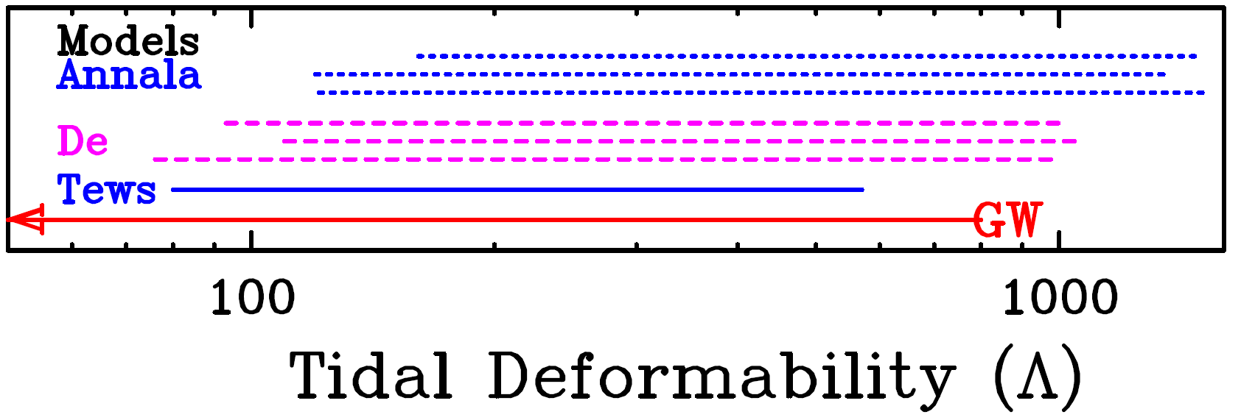
Summary II: expect more stringent constraints from HIC data
Asysoft
Asystiff
GW: PRL 119 161101
Annala et al., PRL 120, 172703
De et al., arXiv:1804.08583v1
Tews et al., arXiv:1804.02783v1
Y.C. Tommy Tsang
&
Farrukh Fattoyev

Slide 19
Summary and Outlook
Laboratory measurements have provided constraints on the symmetry energy and the equation of state for neutron-rich matter.
  Significant constraints at sub-saturation densities.
  Important for crust-core transition but not for NS mergers
The important density range of ρ₀ ≤ ρ ≤2ρ₀ is accessible via heavy ion reaction at NSCL/FRIB ρ<1.5ρ_{0;} ρ<2ρ_{0,} Riken or FRIB upgrade
  Experimental results from SpiRIT!
Improving the reliability of transport theory predictions.
  Code evaluation project is making significant progress in this direction.
  ~10-20% model uncertainties
Connection to the neutron star merger results
  Could provide a more stringent constraint on NS deformability

Slide 20



































Slide 21
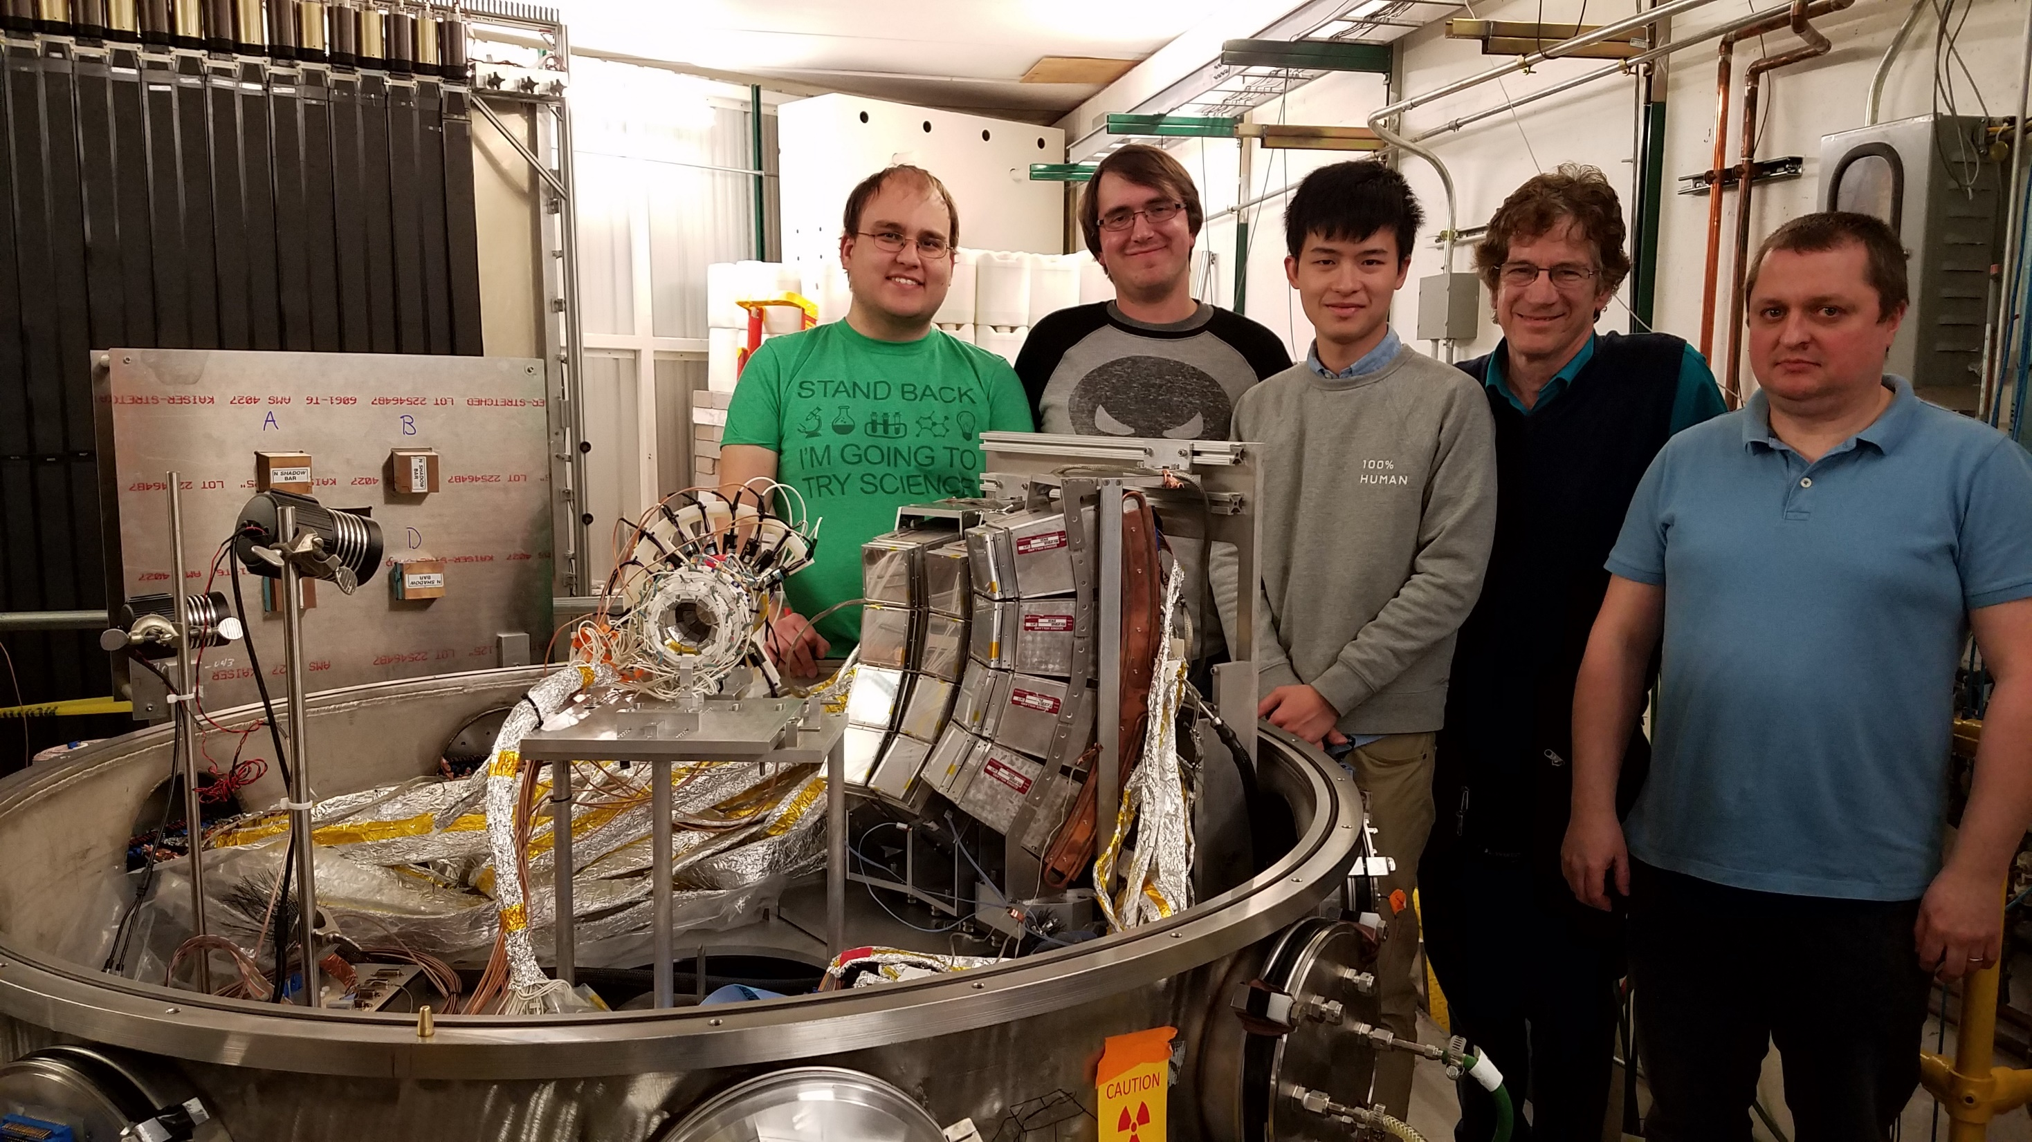

Slide 22
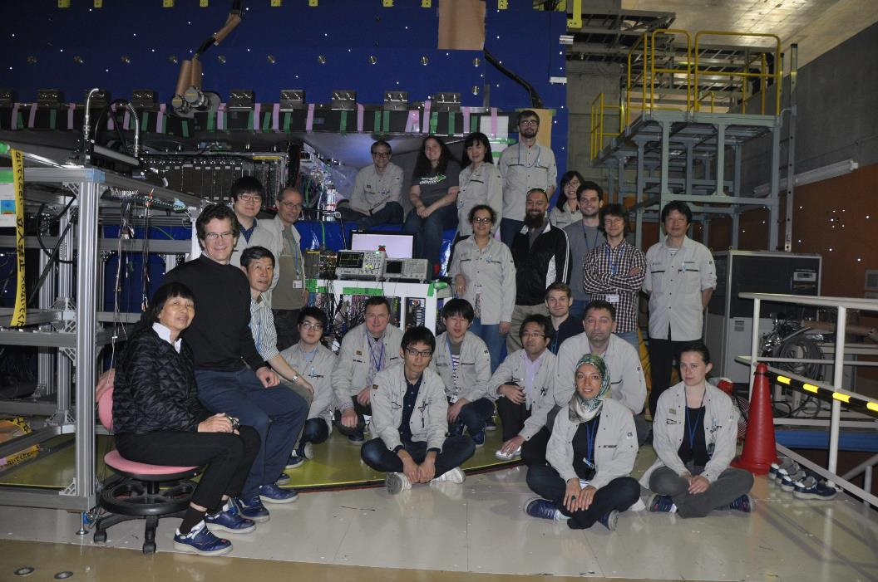


On Site Experimenters
J. Barney (MSU)
G. Cerizza (MSU)
J. Estee (MSU)
B. Hong (Korea U)
T. Isobe (RIKEN)*
G. Jhang (Korea U)
M. Kaneko (Kyoto U)
M. Kurata-Nishimura (RIKEN)
P. Lasko (IFN, Krakow)
H. Lee (RISP)
J. Lee (Korea U)
J. Lukasik (IFN, Krakow)
W. Lynch (MSU)*
A. McIntosh (TAMU)
P. Morfouace (MSU)
T. Murakami (Kyoto U)*
S. Nishimura (RIKEN)
P. Pawlowski (IFN, Krakow)
C. Santamaria (MSU)
R. Shane (MSU)
D. Suzuki (RIKEN)
B. Tsang (MSU)*
Y. Zhang (Tsinghua U)
*spokespersons
collaboration
Other Participants: H. Baba, Chica, Ichihara, Kondo, T. Nakamura, H. Otsu, Saito, Togano
NeuLAND Collaboration: Leyla Atar, Tom Aumann, Igor Gasparic, A. Horvat, H. Scheit

