Slide 1
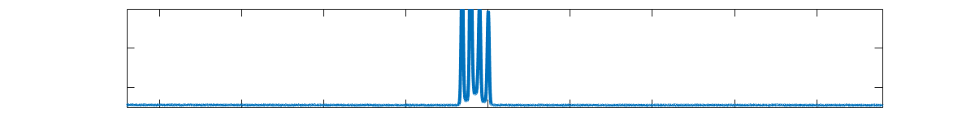
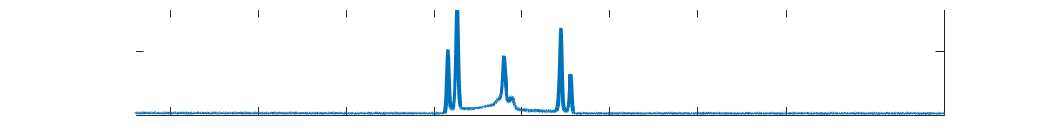
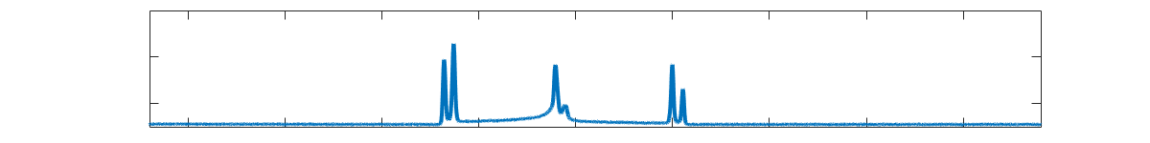
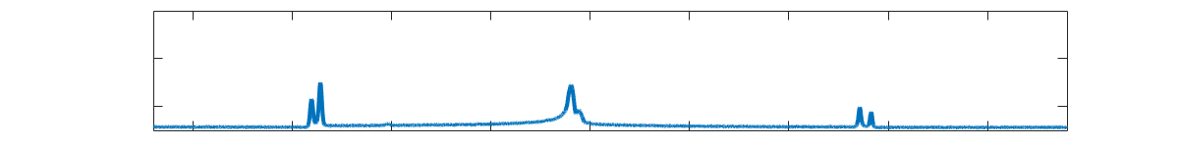
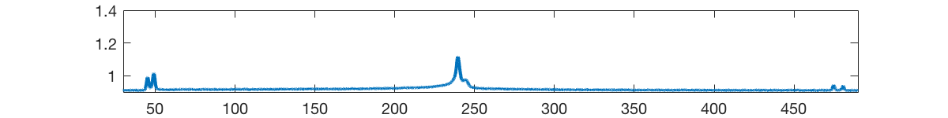



Precision Atomic Tests of Physics Beyond the Standard Model
H. Müller
U.C. Berkeley

Slide 2
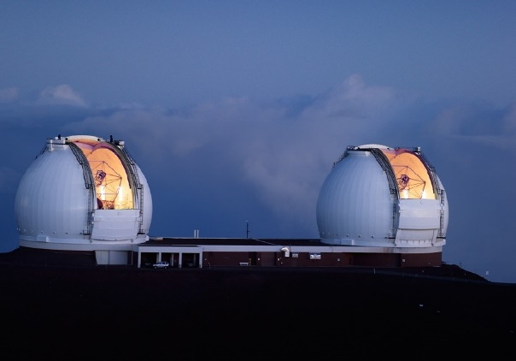
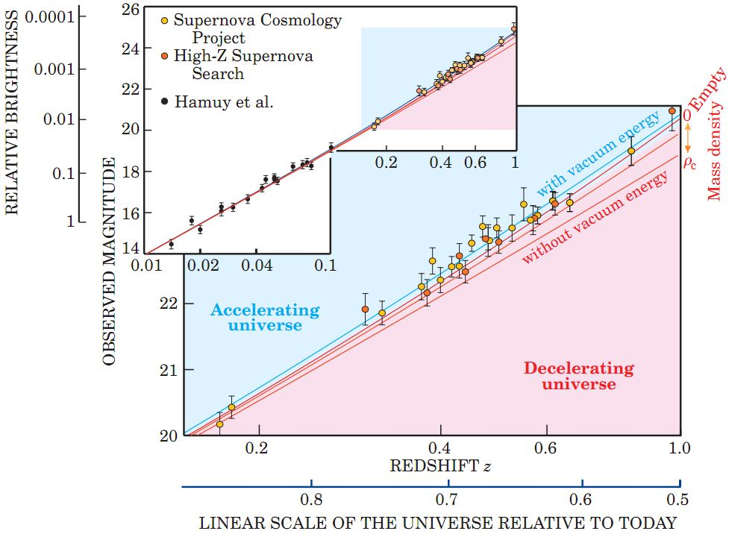
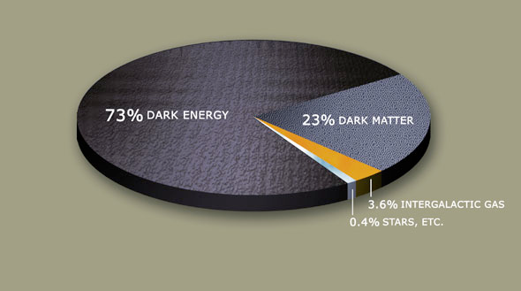
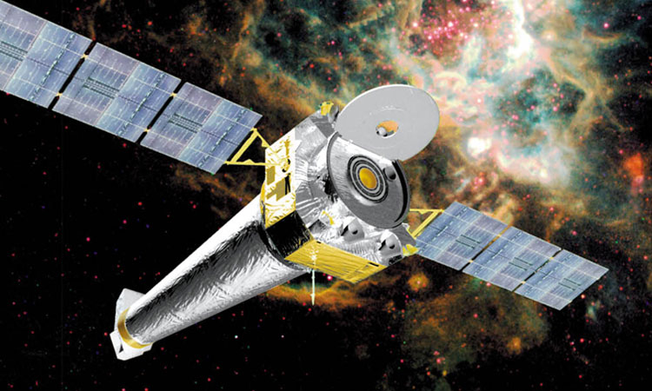

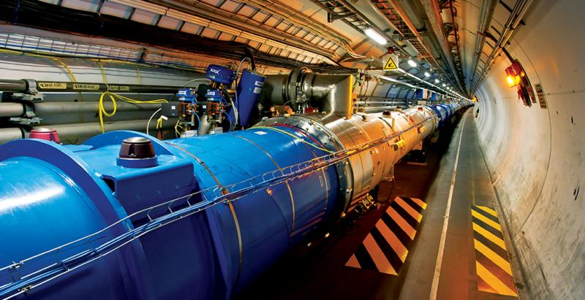


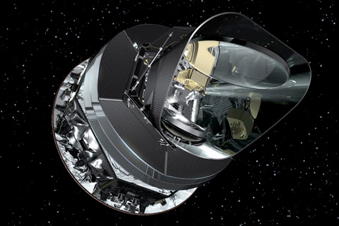
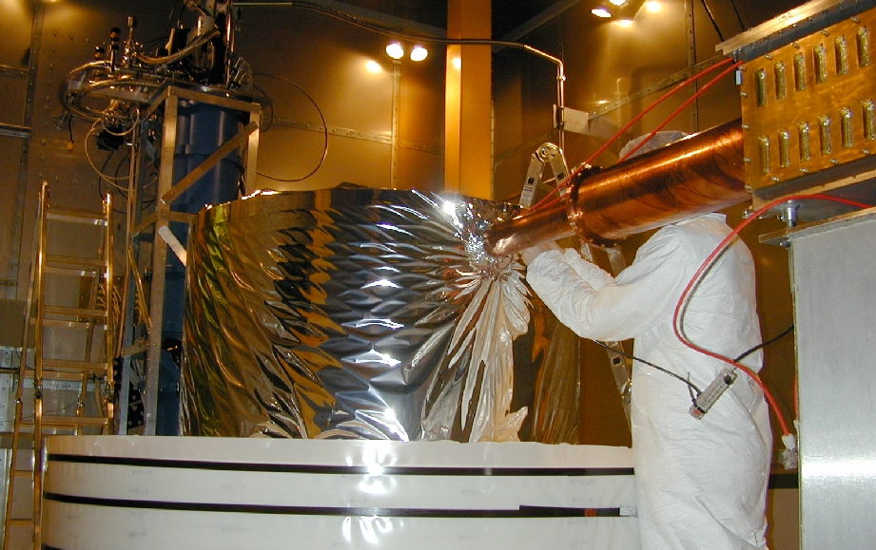
The Era of precision uncertainty
Loud and clear signals from the skies…. …but silence in our detectors
W.M. Keck Observatory
ATLAS
Chandra
LHC
Planck
CDMS
Precise data from astrophysics, but no hint what the dark sector consists of

Slide 3
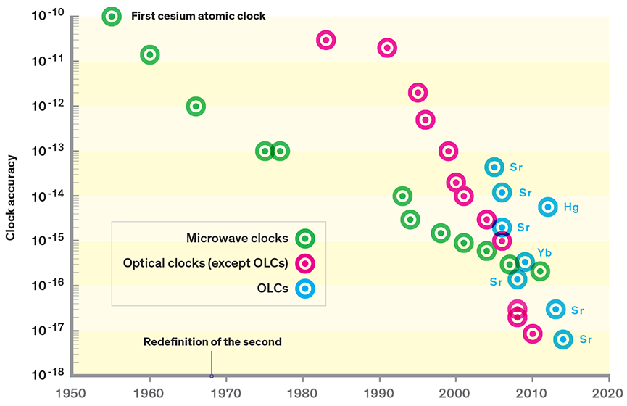
Moore’s law in atomic physics

Slide 4
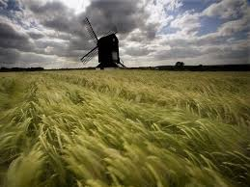
The precision frontier
boson/
fermion
boson
WIMPs
10⁻⁵⁵ gm
10⁻³¹ gm
10⁻²² gm
(100 GeV)
10²⁴ gm
(100 eV)
(Ultra-) light particles are easy to generate, but hard to see.
Collective forces from a large number of particles
Forces are the fundamental effect of light particles
Ultra-sensitive detectors required
Surjeet Rajendran

Slide 5
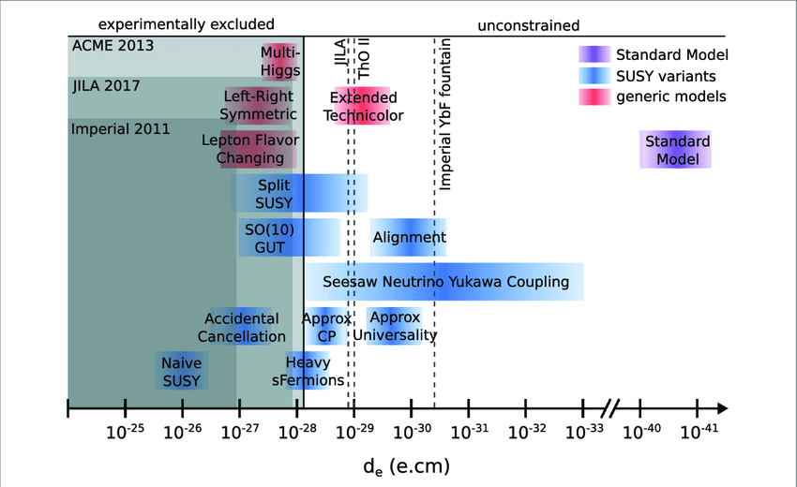
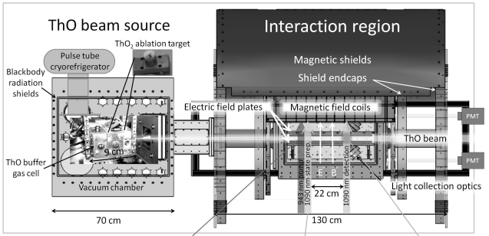
Advanced Cold Molecule Edm experiment (Yale, Harvard)
Figure: B. E. Sauer et al., NJP 19, 071001 (2017)

Slide 6
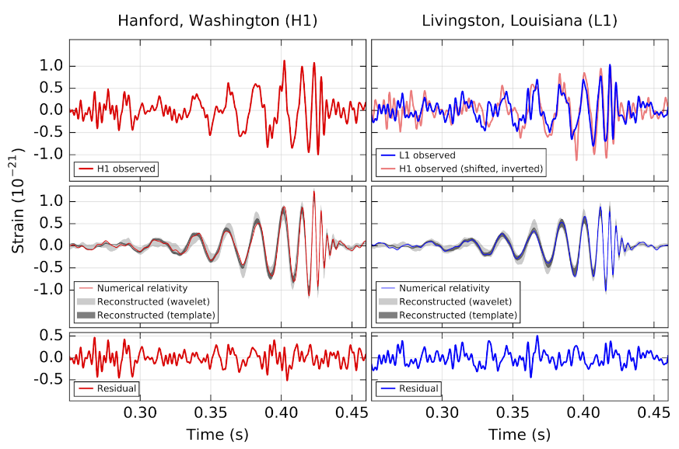
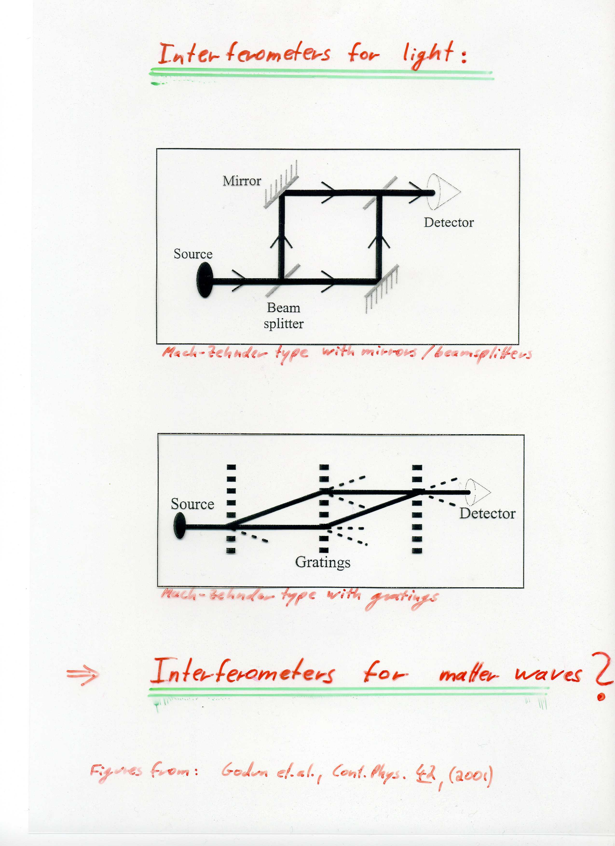
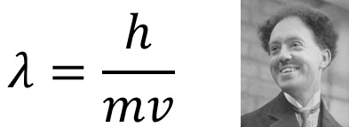
Interferometry…
Light…
Matter …

Slide 7
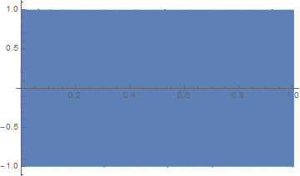
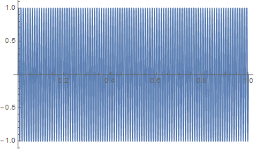
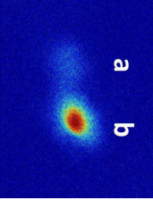
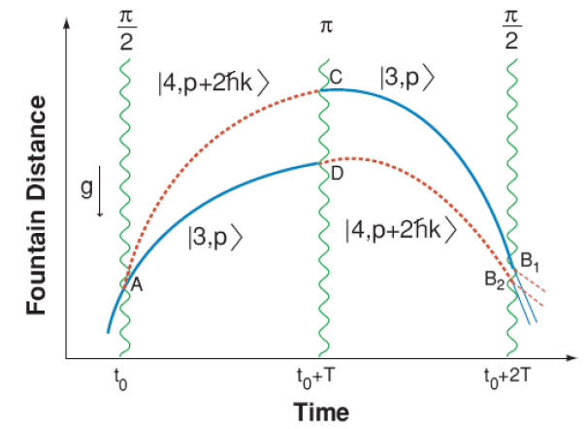
Light pulse atom interferometer
Future?
Particles / waves
Phase determined by Lagrangian, L=E_{kin}-E_{pot},
Laser wavelength as a ruler
X 1000
X 300
Atom number
X 300
X 300
Phase

Slide 8
Recent applications

Slide 9
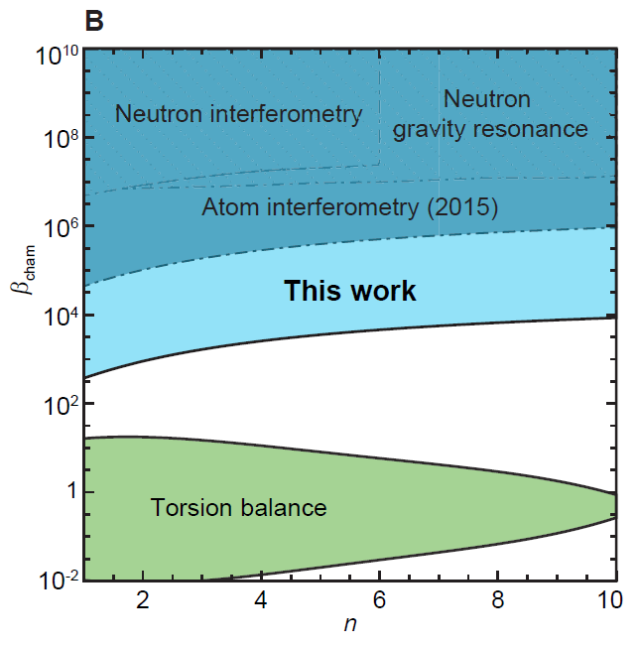
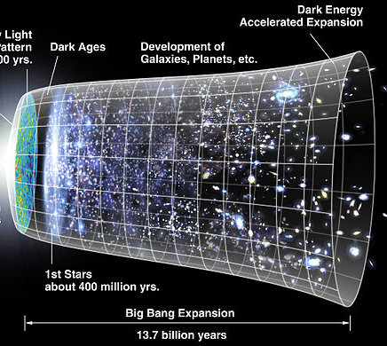
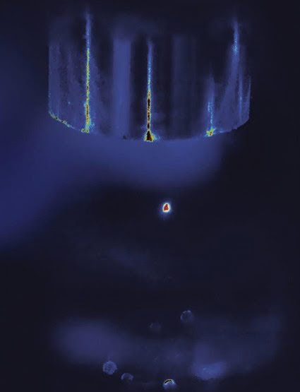
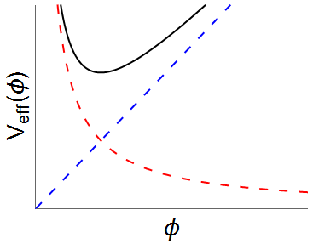
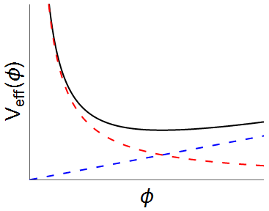
Dark Energy Scalar Fields
Wikipedia
M. Jaffe, P. Haslinger, V. Xu, P. Hamilton, A. Upadhye, B. Elder, J. Khoury, and HM, Nature Physics, doi: 10.1038/nphys4189

Slide 10
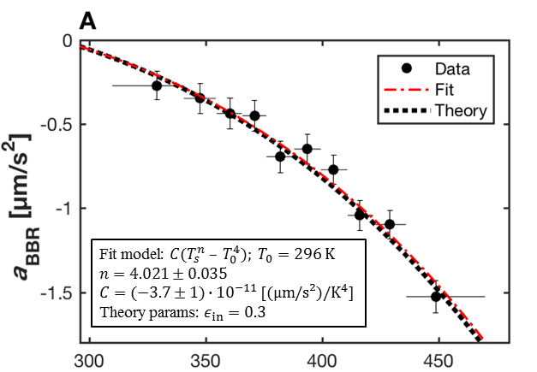
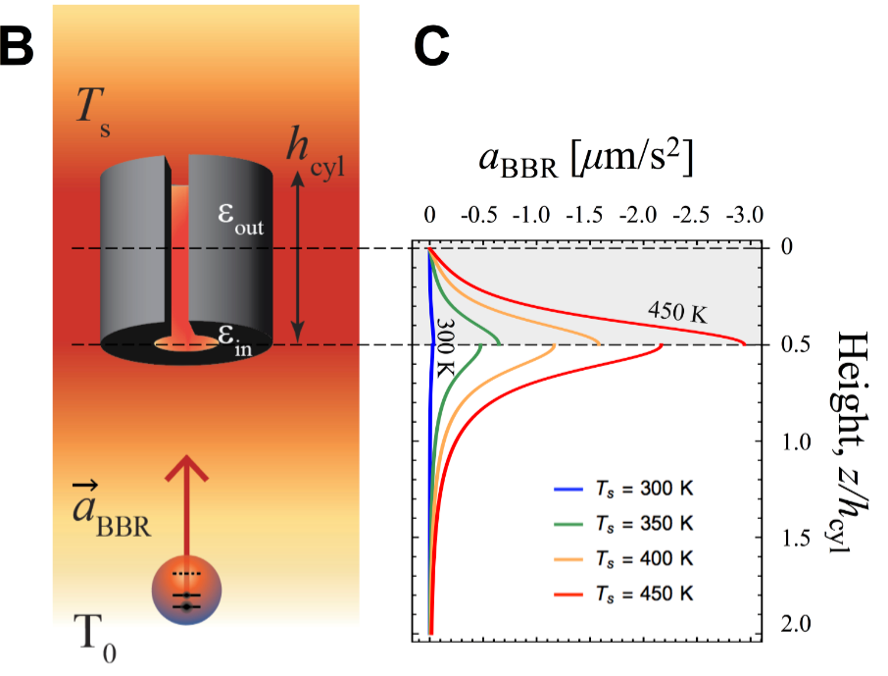
Attractive force from blackbody radiation
Acceleration from 1 K/m
Particle | 10⁻¹² g
Cesium | 52
Rubidium | 63
Glass bead (n=1.4, r<<λ) | 5.4
⁸⁵Rb-⁸⁷Rb | 1.4
P. Haslinger, M. Jaffe, V. Xu, M. Sonnleithner, H. Ritsch, M. Ritsch & HM, Nature Physics 2017

Slide 11
Fine structure constant

Slide 12
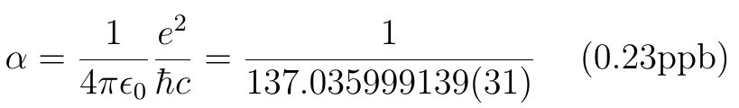
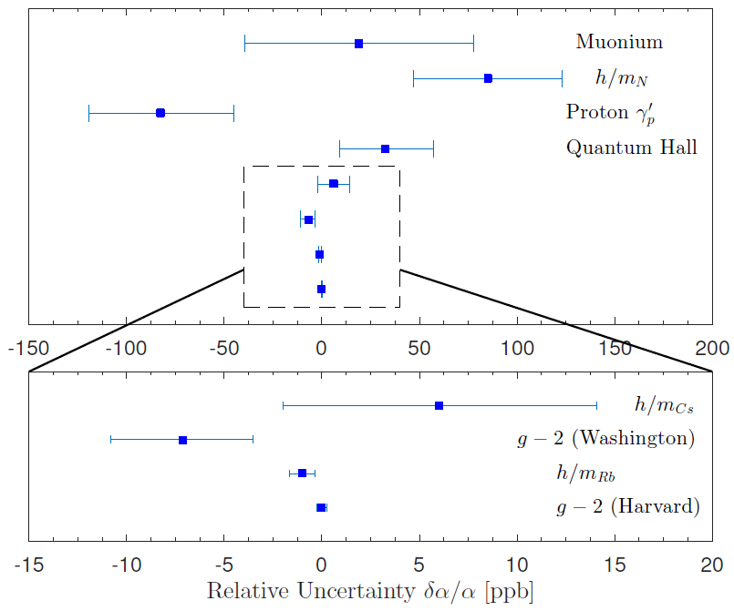
The Fine Structure Constant
Measures the strength of the electromagnetic interaction
2014 CODATA

Slide 13
The Fine Structure Constant
137 is…(https://primes.utm.edu/curios/page.php/137.html)
The numerical value of “Kaballah” (קַבָּלָה)
Genesis 25:17: “And these are the years of the life of Ishmael, an hundred and thirty and seven years. …” It is also the age of Moses father and Levi
The day before his inauguration, President Obama made a 137-mile train trip from Philadelphia to Washington, DC.
There are 137 Hawaiian islands, islets, and shoals
W. Pauli died in room 137 of Rotkreuz Hospital, Zurich.
WMAP’s age of the universe is 13.7 billion years
33rd prime number
The largest prime factor of 123456787654321
Karpov and Kasparov played 137 draws in chess
Chlorophyll (C₅₅H₇₂MgN₄O₅) consists of 137 atoms

Slide 14
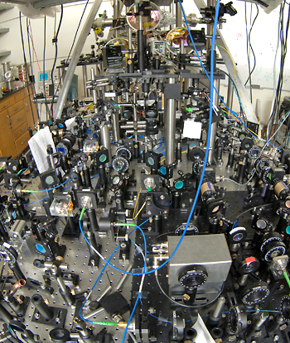
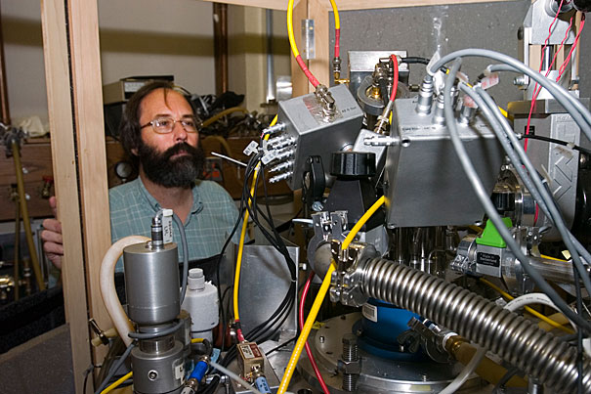
The most precise theory/experiment comparison in science
Fine structure constant Electron gyromagnetic moment
Dark photons shift magnetic moment versus fine structure constant
Measures how strong a magnet an electron is

Slide 15

Alpha in Atom Recoil Frequency
Rydberg Constant
0.007 ppb P. J. Mohr et al., Rev. Mod. Phys. 80, 633 (2008).
Cs mass in u
0.18ppb M. P. Bradley et al., Phys. Rev. Lett. 83, 4510 (1999).
Determined by the atom recoil frequency
Electron mass in atomic mass units u
0.43 ppb P. J. Mohr et al., Rev. Mod. Phys. 80, 633 (2008).
Lowest : 0.23ppb
Cs D2 Transition 0.015ppb
Notes:
Precise measurements and theoretical calculations of
the g-factor of the electron in hydrogenic 12C and in hy-
drogenic 16O lead to values of Ar(e)
Penning trap single ion mass spectrometry
comparing cyclotron frequencies of electrons and single C⁶⁺ ions
frequencies of optical spectral lines in atomic hydrogen and deuterium
measured directly by comparing the cyclotron
frequencies of an electron and fully-ionized carbon-12 (12C6+)

Slide 16
Photon Recoil Measurement
ωr ~ 2π×2 kHz,
Accuracy 10⁻¹⁰
Need to pinpoint resonance to 0.2 μHz or 6x10⁻²²
10,000 times better accuracy than precision of best clocks
Notes:
In the simplest case, photon recoil measurement is a determination of the doppler shift of the atomic resonance caused by the mementum recoil of a simulated absorption or emission process. Consider a two level system metastable state a and b, the wl contain the phoon recoil term, unfortunately, it also include the doppler shift term from the initial velocity of the atoms. We can make a simple modefication. Let’s populate only 50% of the atoms , and scan the frequency of the pulse. We will see two resonance condition, one for state a the other one for state b. the differential measurement can easily take out the initinal velocity term.
However in these

Slide 17
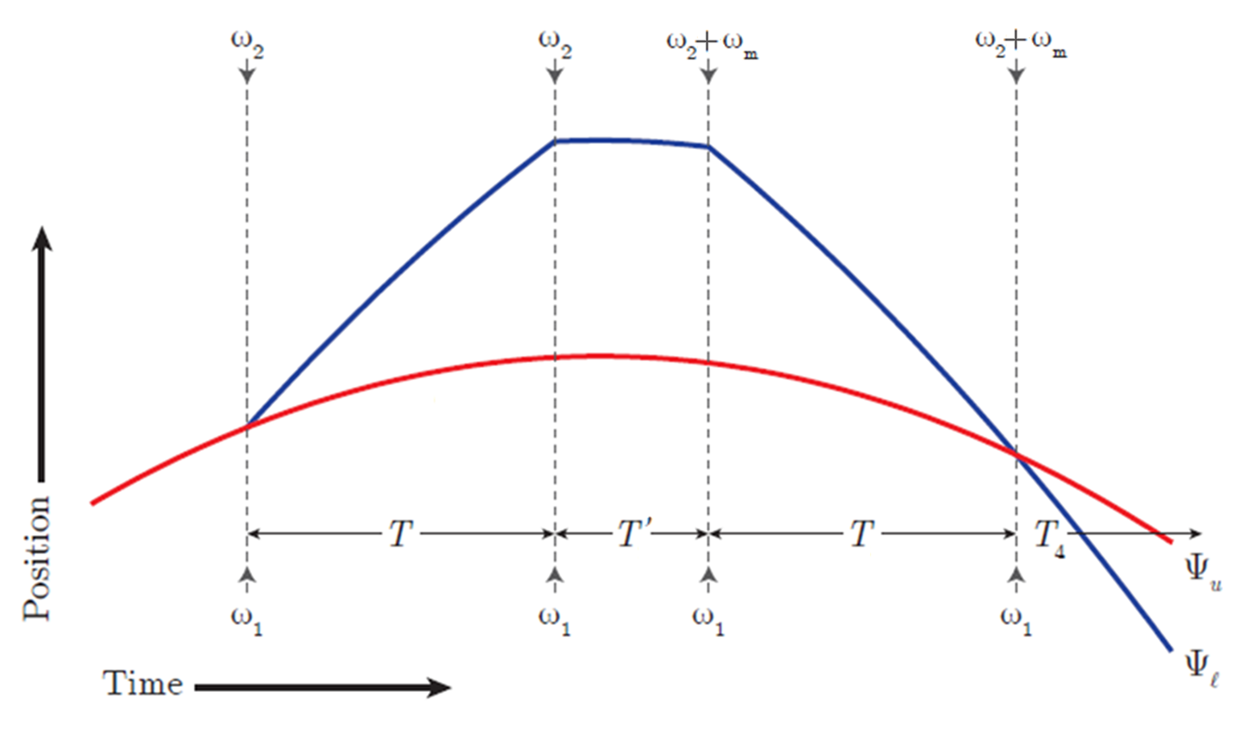
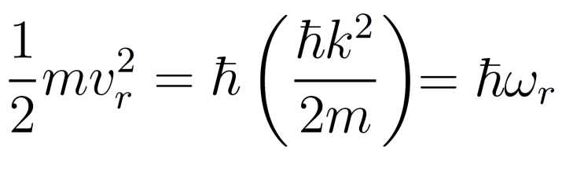
Atom-interferometer measurement of α
Ramsey-Bordé Interferometer
ω_{r}
k
h/m
α

Slide 18










Multi-Photon Bragg Diffraction
Raman (n=1)
Bragg (n=5)
$$\left|e\right\rangle$$
$$Δ$$
$$\left|e\right\rangle$$
Detuning ~1000 Γ
$$Δ$$
$$\left|g,2nℏk\right\rangle$$
$$\left|g_{2},2ℏk\right\rangle$$
energy
$$\left|g_{1},0\right\rangle$$
$$δ$$
$$\left|g,0\right\rangle$$
momentum
Bragg gives you:
More photons transferred per pulse (higher sensitivity)
Atoms stay in same internal state (Zeeman, AC Stark systematics suppressed)
Notes:
Accelerating each interferometer increase the phase
explain multi frequencies
Increase frequency splitting, reduces coupling
Maintain good contrast

Slide 19
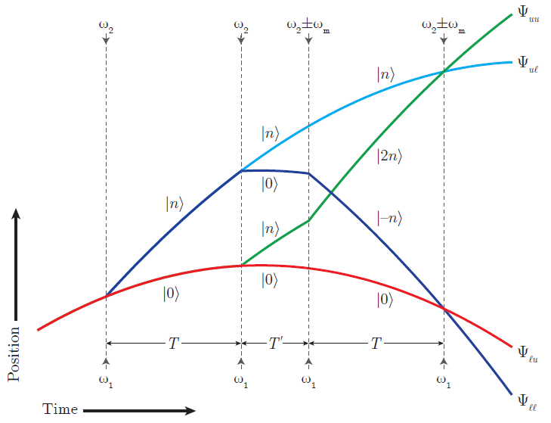
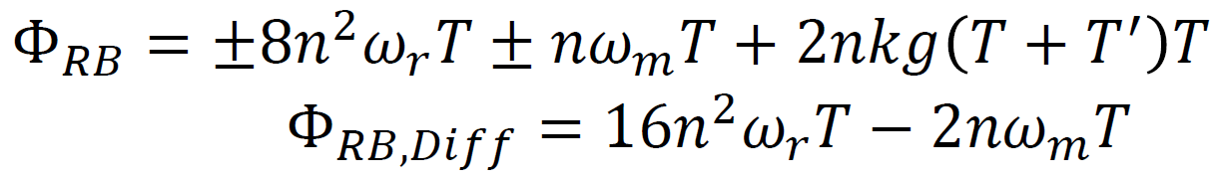
Simultaneous Conjugate Interferometers
Notes:
Accelerating each interferometer increase the phase
explain multi frequencies
Increase frequency splitting, reduces coupling
Maintain good contrast

Slide 20
Bloch Oscillations
$$T$$
$$T$$

Slide 21
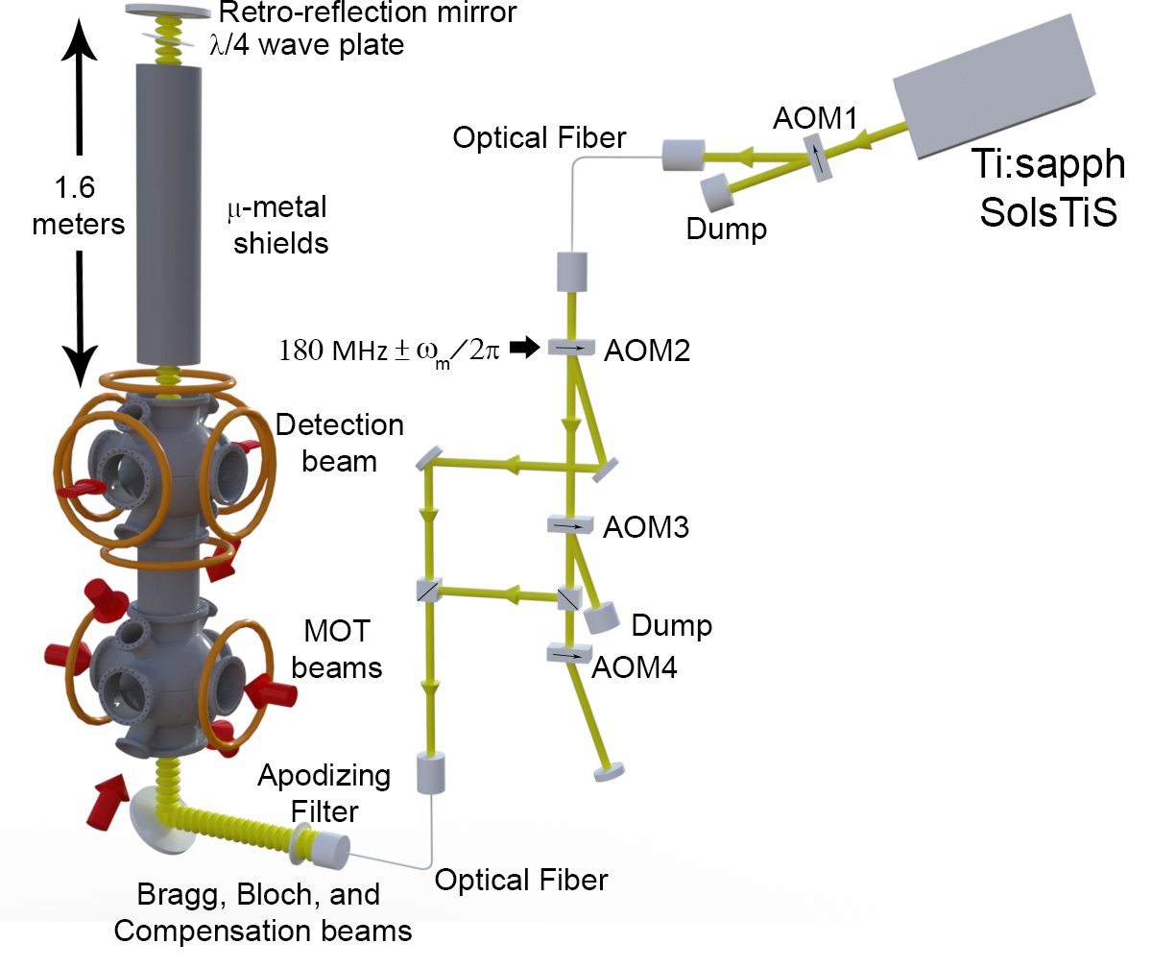
Setup
Notes:
Accelerating each interferometer increase the phase
explain multi frequencies
Increase frequency splitting, reduces coupling
Maintain good contrast

Slide 22
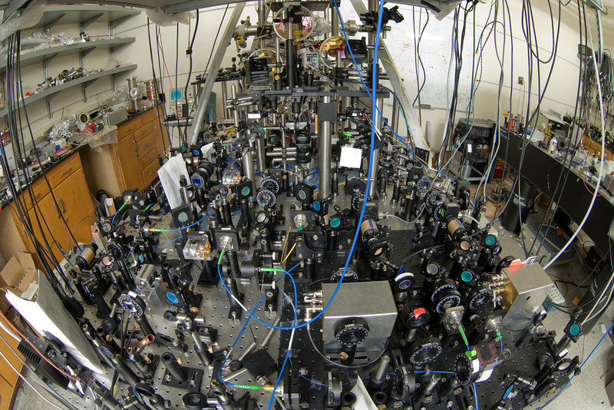

Slide 23
Fluorescence Traces
N=0
N=25
N=50
Fluorescence (V)
N=125
N=200
Time (ms)
Notes:
1. Fluorescence signals of the atom clouds as they fall through the detection region
2. Compromise: Higher BO intensity, deeper lattice, higher transfer efficiency, but lower contrast (single photon scattering, ac Stark effect).
3. Keep the ramp the same, higher N, duration of BO beam longer, higher single photon scattering and higher probability to fall out the lattice;
Bragg effective Rabi 32wr
Bloch Potential depth 6wr

Slide 24
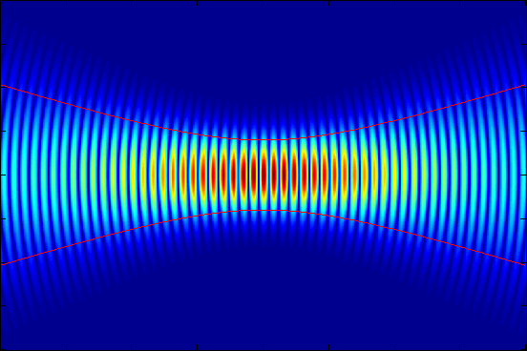
0.16 ppb systematic errors
Effect | Sect. | Value | δα/α (ppb)
Laser Frequency | 1 | N/A | -0.24 ± 0.03
Acceleration Gradient | 4A | =(2.13 ± 0.01)×10⁻⁶/s² | -1.69 ± 0.02
Gouy phase | 3 | w₀=3.21±0.008 mm, z₀=0.5±1.0 m | -3.60± 0.03
Wavefront Curvature | 12 | 〈r²〉^{1/2}=0.58 mm | 0.15 ± 0.03
Beam Alignment | 5 | N/A | 0.05 ± 0.03
BO Light Shift | 6 | N/A | 0 ± 0.004
Density Shift | 7 | ρ=10⁶ atoms/cm³ | 0 ± 0.003
Index of Refraction | 8 | n_{cloud}-1=30×10⁻¹² | 0 ± 0.03
Speckle Phase Shift | 4B | N/A | 0 ± 0.04
Sagnac Effect | 9 | N/A | 0 ± 0.001
Mod. Frequency Wavenumber | 10 | N/A | 0 ± 0.001
Thermal Motion of Atoms | 11 | N/A | 0 ± 0.08
Non-Gaussian Waveform | 13 | N/A | 0 ± 0.03
Parasitic Interferometers | 14 | N/A | 0 ± 0.03
Total Systematic Error |  |  | -5.33 ± 0.12
Total Statistical Error |  |  | ± 0.16
Electron Mass (18) |  | 5.48579909067×10⁻⁴ u | ± 0.02
Cesium Mass (4,17) |  | 132.9054519615 u | ± 0.03
Big
‘New’
Notes:
Accelerating each interferometer increase the phase
explain multi frequencies
Increase frequency splitting, reduces coupling
Maintain good contrast

Slide 25
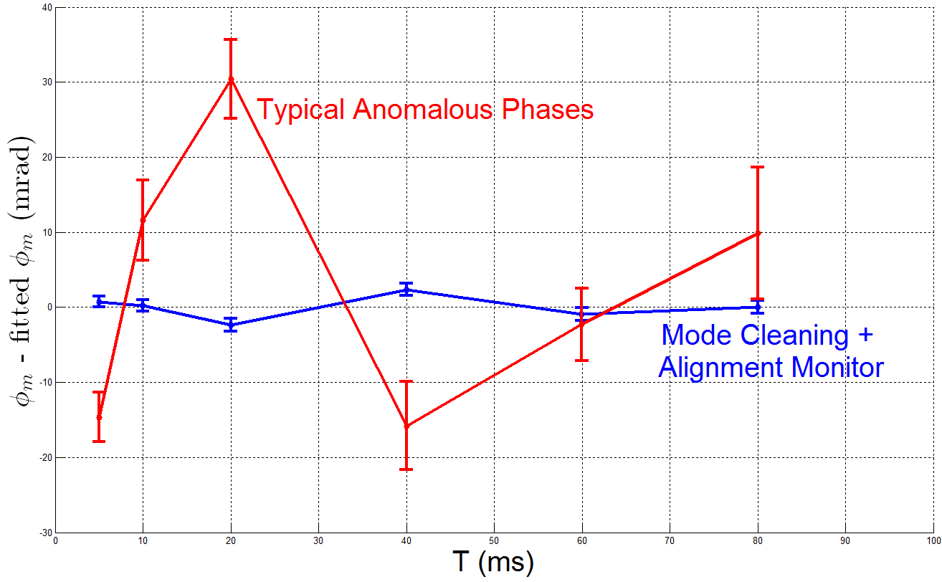
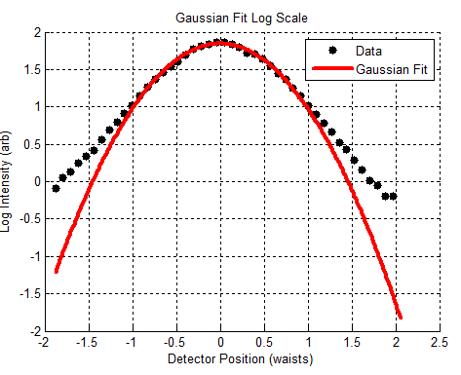
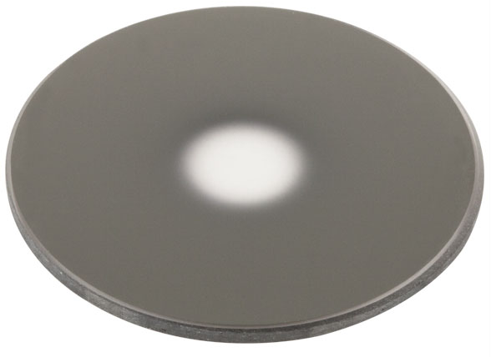
Speckle Phase
30 mrad anomaly → 8 ppb at N=0
>10x suppression by mode filtering
25x suppression by N=125
$200 Apodizing Filter
Fiber doesn’t make Gaussian beams
Spatial Filtering via Apodizer + Fountain Alignment Monitor

Slide 26
Systematic Checks
Variation of alpha w.r.t.:
  Bloch order
  Bloch power
  Contrast
  Detection region
  Pulse intensity: overall and pulse/pulse ratio
  Speckle phase
  ω_{m} mixing (RF)
  ω_{m} mixing (optics)
  Delay of interferometer sequence
  Bias B-field
  Single-photon detuning
  Data Analysis parameters (cuts, fitting, etc.)
  Fountain alignment (launch direction, no spatial filtering)

Slide 27
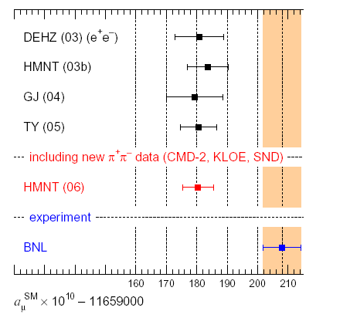
Dark photons
Whatever the dark sector is made of, only three interactions are allowed by standard model symmetries
Vector portal “massive photon”
Higgs portal
Neutrino portal
Hints
Muon g-2
Proton radius puzzle?
⁸Be decay
Astrophysical hints?
  511 keV line
  keV gamma-ray excess
  Galactic center excess
“Arguably, the strongest experimental evidence for physics beyond the standard model”
(David Hertzog)
K. Hagiwara, A.D. Martin, Daisuke Nomura, T. Teubner

Slide 28
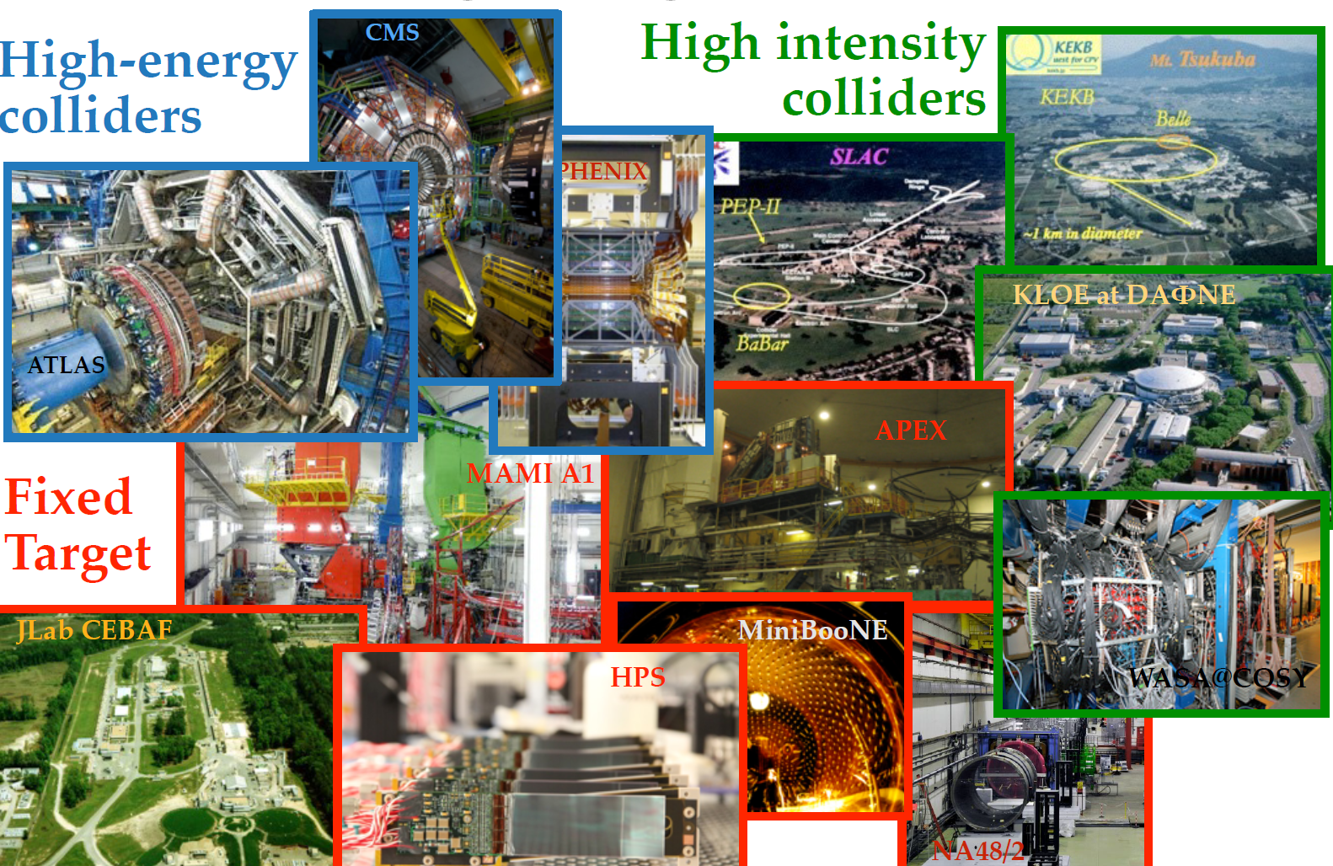
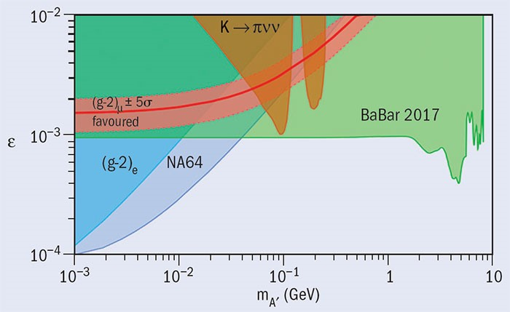
Ongoing dark photon searches
Dave Schuster

Slide 29
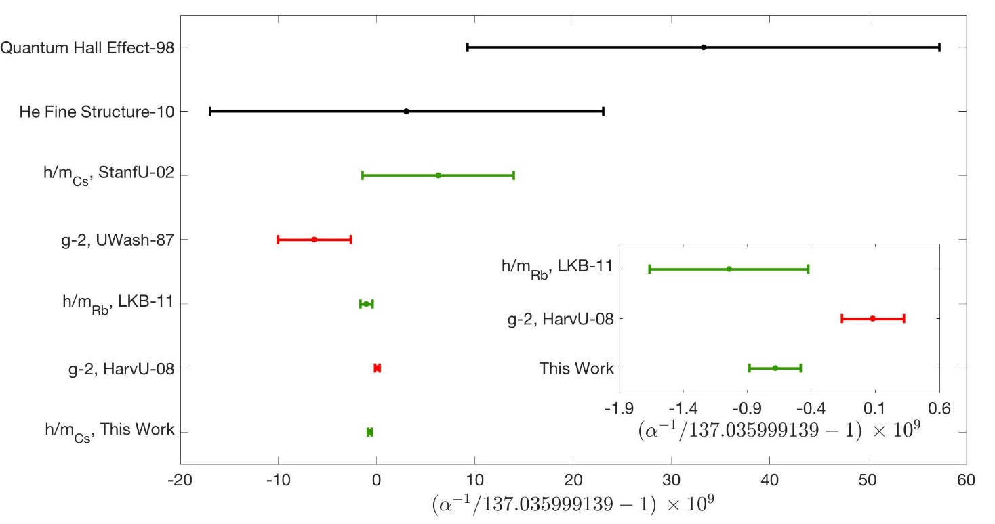
Results

Slide 30
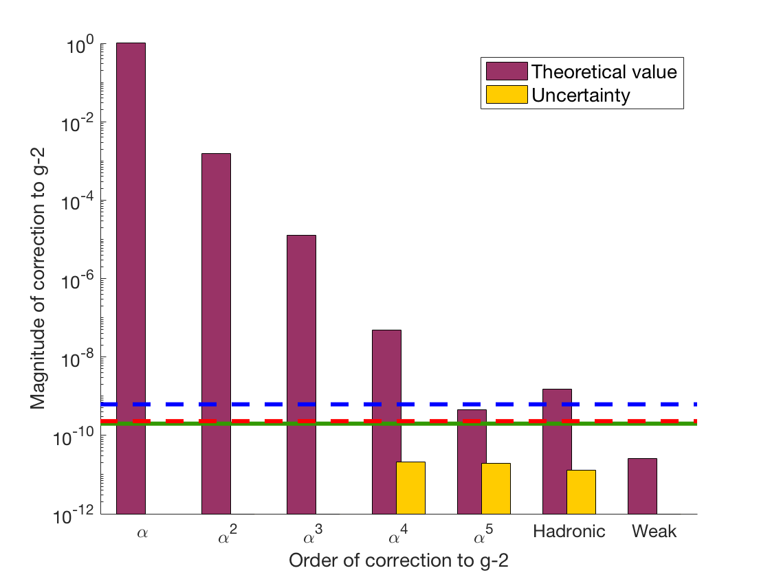



Results
$$0. 20 \text{ppb} {(α}_{Cs}, this work)$$
$0.62 {(α}_{Rb})$ $\text{ppb}$
$$0. 24 \text{ppb} \left(g−2\right)$$

Slide 31
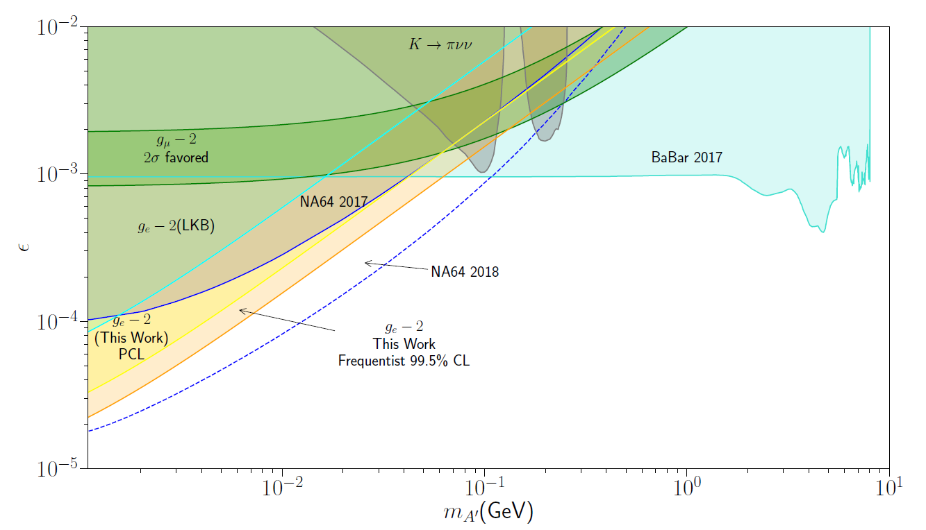
Dark photons are not compatible…

Slide 32

…but axial vectors are.

Slide 33



Future Upgrades
Broad beam
  x20 waist → 1/400 beam-related systematics
  x1000 eff. power
Acoustic Shielded Room
  Controls gravity anomalies by keeping heavy objects out
Science Chamber
  Dark Matter studies

Slide 34


A more nearly perfect laser beam
This project ~ 6 cm radius
Wavelength errors ~(λ/radius)²
400-fold higher accuracy
Beam splitter losses ~(λ/radius)⁴
higher momentum transfer, and thus sensitivity
Thick beam will unleash the potential of atom interferometry

Slide 35


Thank you!
Fine Structure Constant
Postdoc:
Richard Parker
Grads:
Brian Estey,
Chenghui Yu
Weicheng Zhong
Undergrad: Joyce Kwan
Atom interferometry
Postdocs:
Philipp Haslinger,
Xuejian Wu
Grads:
Kayleigh Cassella,
Eric Copenhaver,
Jordan Dudley,
Matt Jaffe,
Zachary Pagel
Victoria Xu
Phase-Contrast TEM
Postdocs:
Sara Campbell
Osip Schwartz
Grad:
Jeremy Axelrod,
Faculty Alumni
Paul Hamilton (UCLA)
Mike Hohensee (LLNL)
Geena Kim (Regis)
Pei-Chen Kuan (NCKU)
Shau-Yu Lan (NTU)
Notes:
34 min at end

Slide 36

Results

Slide 37
Phase Extraction
$$T$$
$$T_{}^{′}$$
$$T$$
Detect
$${Δφ}_{+}$$
c
b
a
Fluorescence [a.u.]
d
$${Δφ}_{−}$$
x
Time [ms]
t
Upper Fringe
Bin Data
Measured Frequency
Lower Fringe
Time

Slide 38






n=5, N=125 Ellipses
T=5 ms
T=10 ms
T=20 ms
T=40 ms
T=60 ms
T=80 ms
Notes:
Contrast decays with T.
New record for RB interferoemeter.

