Slide 1

Studying lanthanide production in r-process nucleosynthesis
Nicole Vassh
University of Notre Dame
CIPANP 6/1/18
Fission In R-process Elements

Slide 2
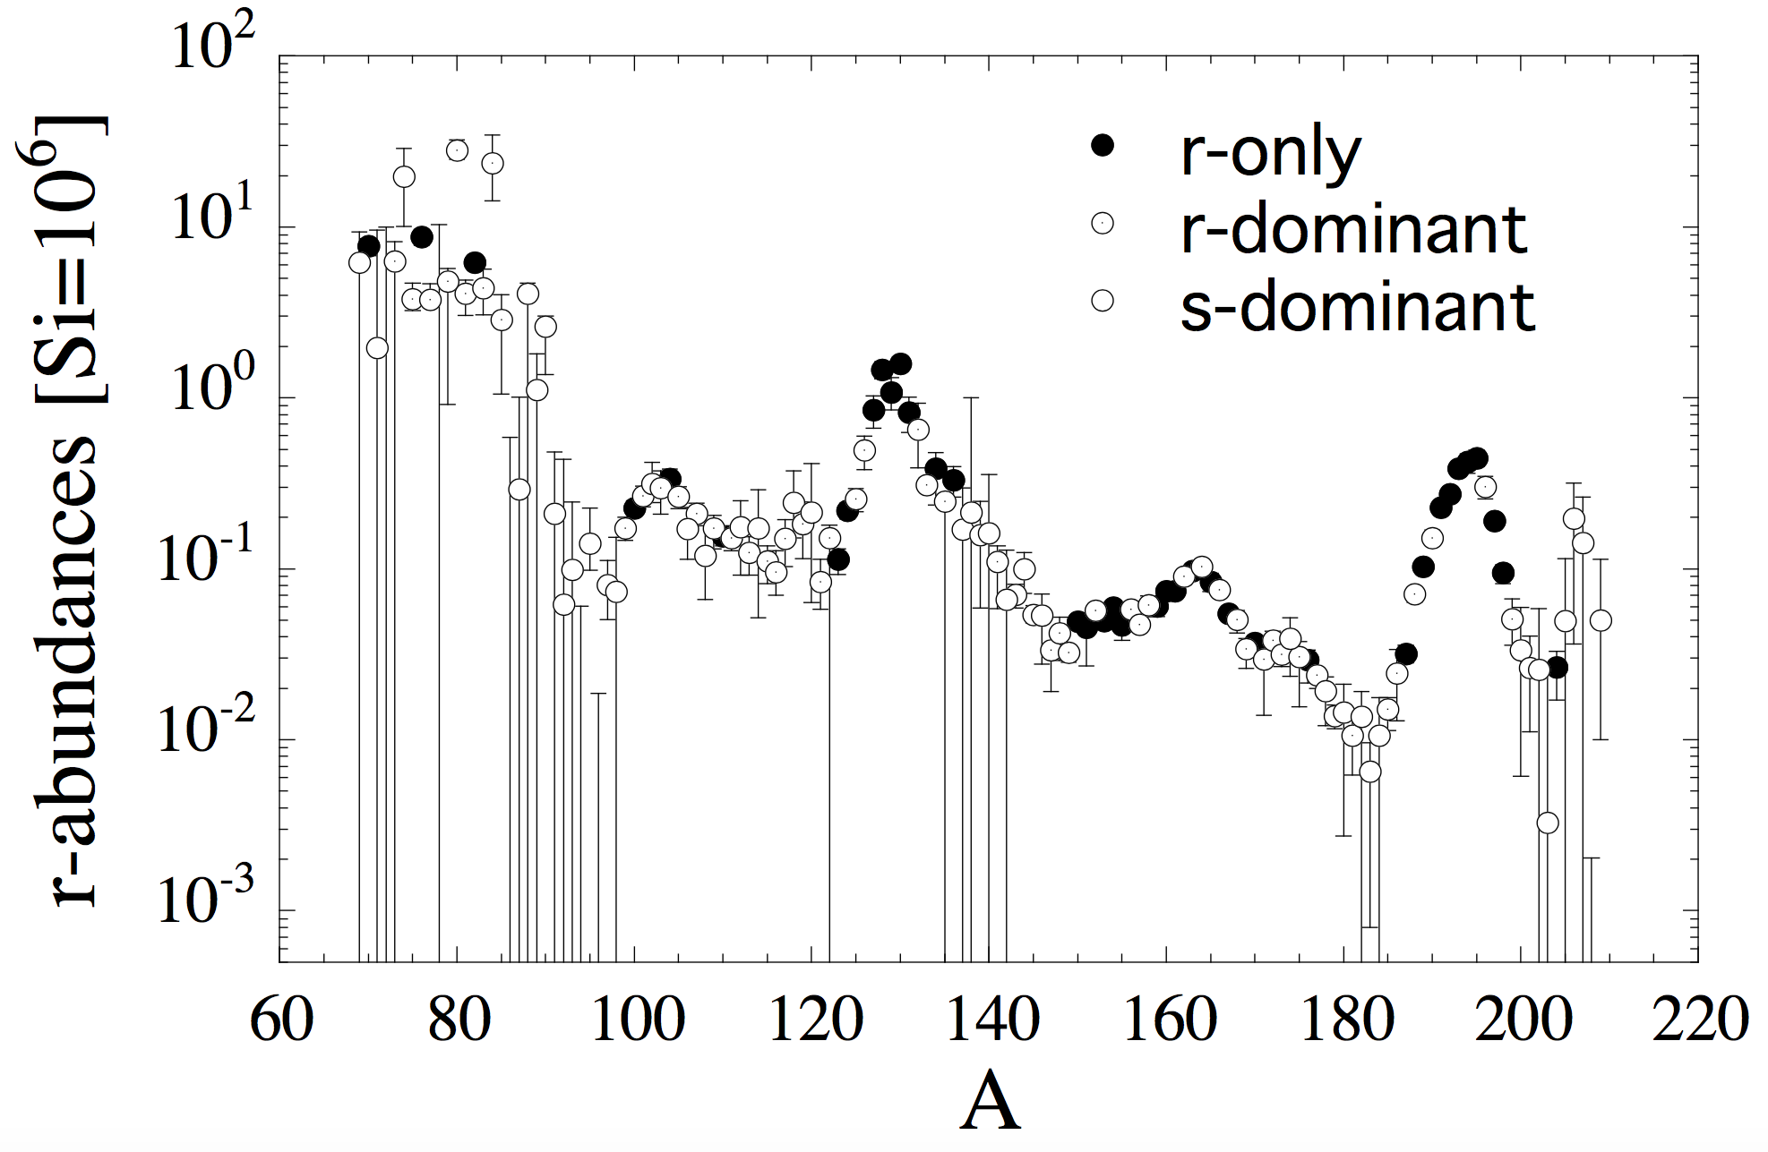

Observed Solar r-process Residuals
Rare-Earth Peak
Depending on the conditions, the r-process can produce:
Poor metals (Sn,…)
Lanthanides (Nd, Eu,…)
Transition metals
(Ag, Pt, Au,…)
Actinides (U,Th,…)
Arnould, Goriely and Takahashi (2007)

Slide 3
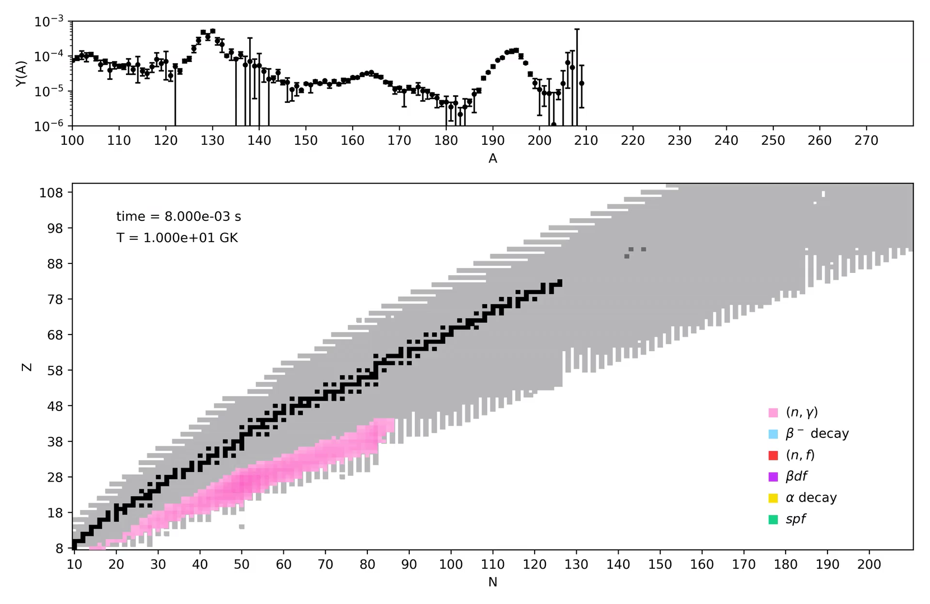

Slide 4
GW170817 and r-process uncertainties from nuclear physics
When nuclear physics uncertainties are considered
From GCE using
Solar Data
Côté, Fryer, Belczynski, Korobkin, Chruślińska, Vassh, Mumpower, Lippuner, Sprouse, Surman and Wollaeger
(ApJ 855, 2, 2018)

Slide 5
r-process Sensitivity to Mass Model and Fission Yields
10 mass models: DZ33, FRDM95, FRDM12, WS3, KTUY, HFB17, HFB21, HFB24, SLY4, UNEDF0
N-rich dynamical ejecta conditions: Cold (Just 2015), Reheating (Mendoza-Temis 2015)
Kodama & Takahashi (1975)
Symmetric 50/50 Split
Côté et al (2018)

Slide 6
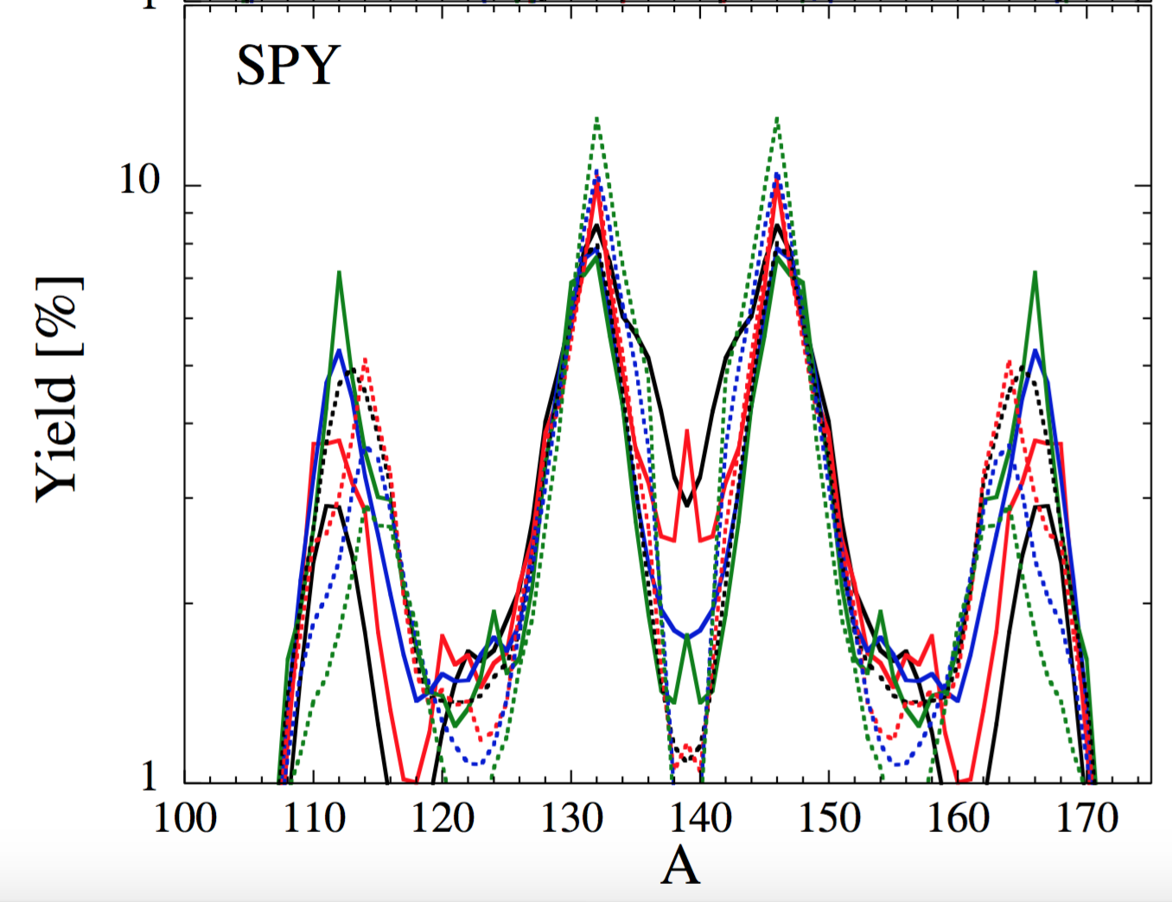
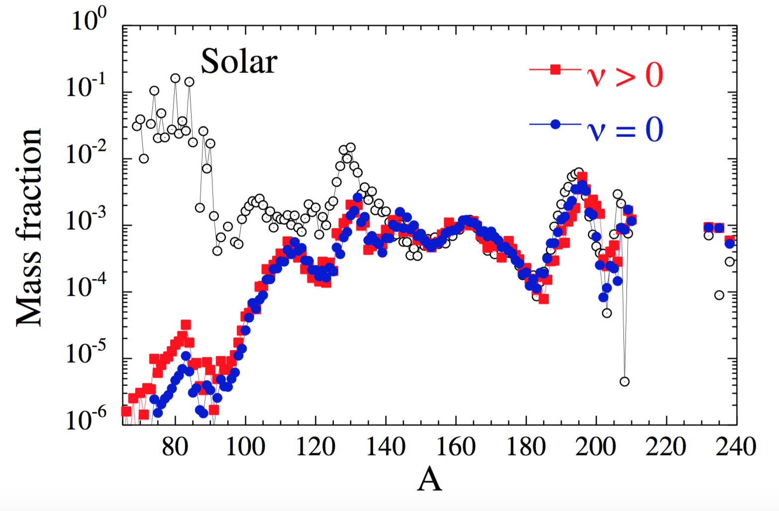
Dependence on the Fission Fragment Distribution
A=278
Z=95, Z=96 , Z=97, Z=98, Z=99, Z=100, Z=101, Z=102 (dotted lines – larger Z)
Rare-earth peak can be populated by fission daughter products of n-rich nuclei
Goriely (2015)

Slide 7
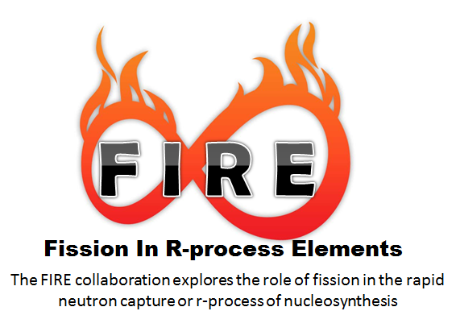
McCutchan and Sonzogni
Vogt and Schunck
Vassh and Surman
McLaughlin and Zhu
Mumpower, Jaffke, Verriere, Kawano, Talou, and Hayes-Sterbenz

Slide 8
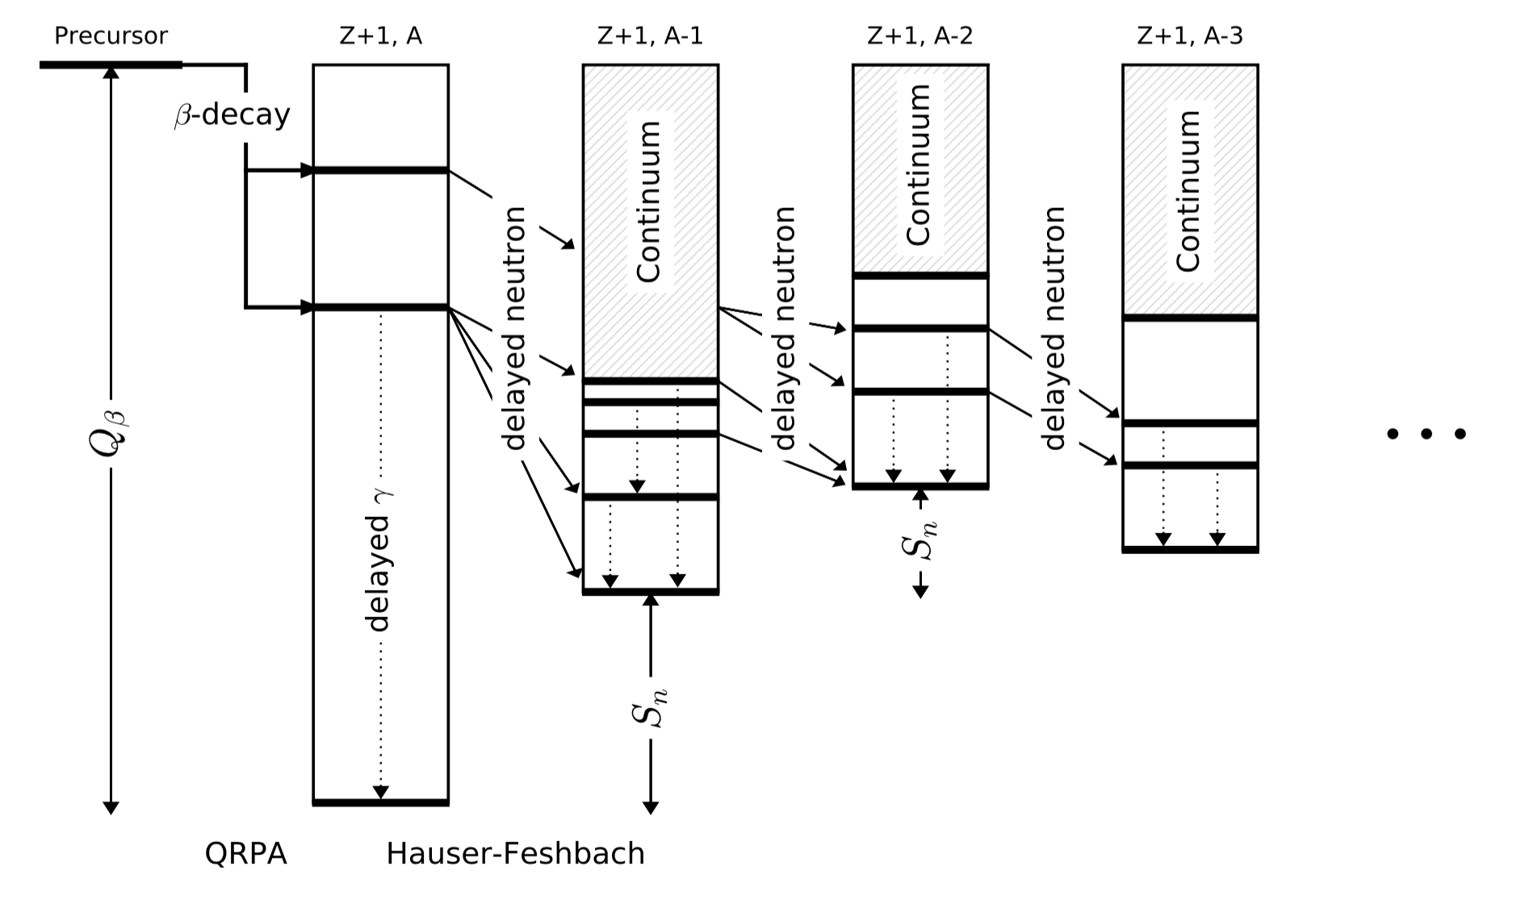
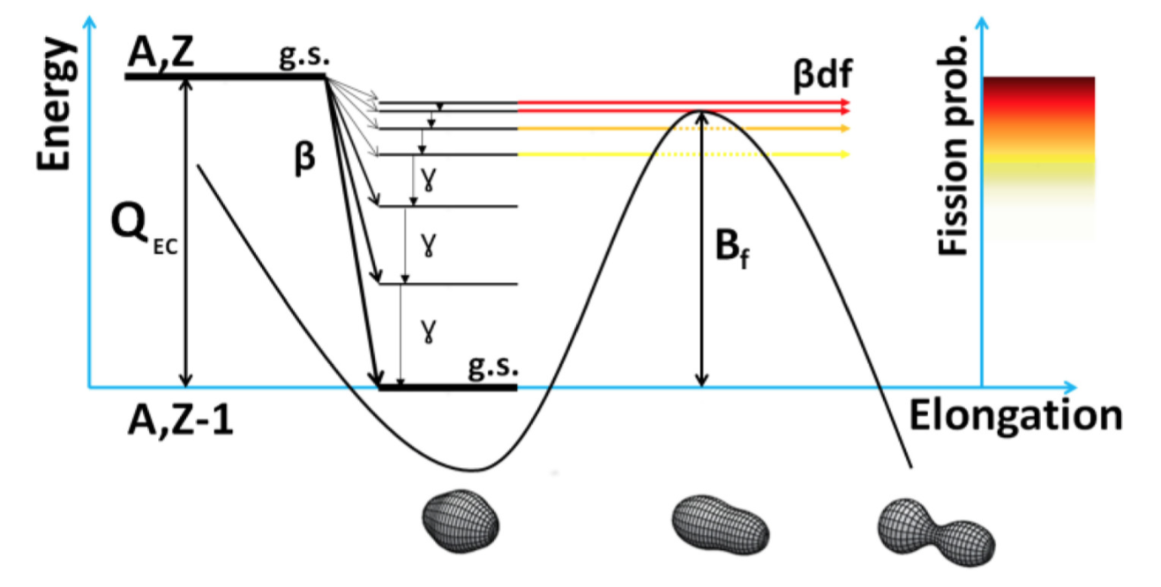
β-delayed fission in r-process nucleosynthesis
Mumpower, Kawano, Sprouse, Vassh, Holmbeck, Surman, and Möller (2018) arXiv:1802.04398
Black outline – probability of multi-chance βdf > 10%
Andreyev, Nishio, and Schmidt (2018)
Mumpower, Kawano, and Möller (2016)

Slide 9
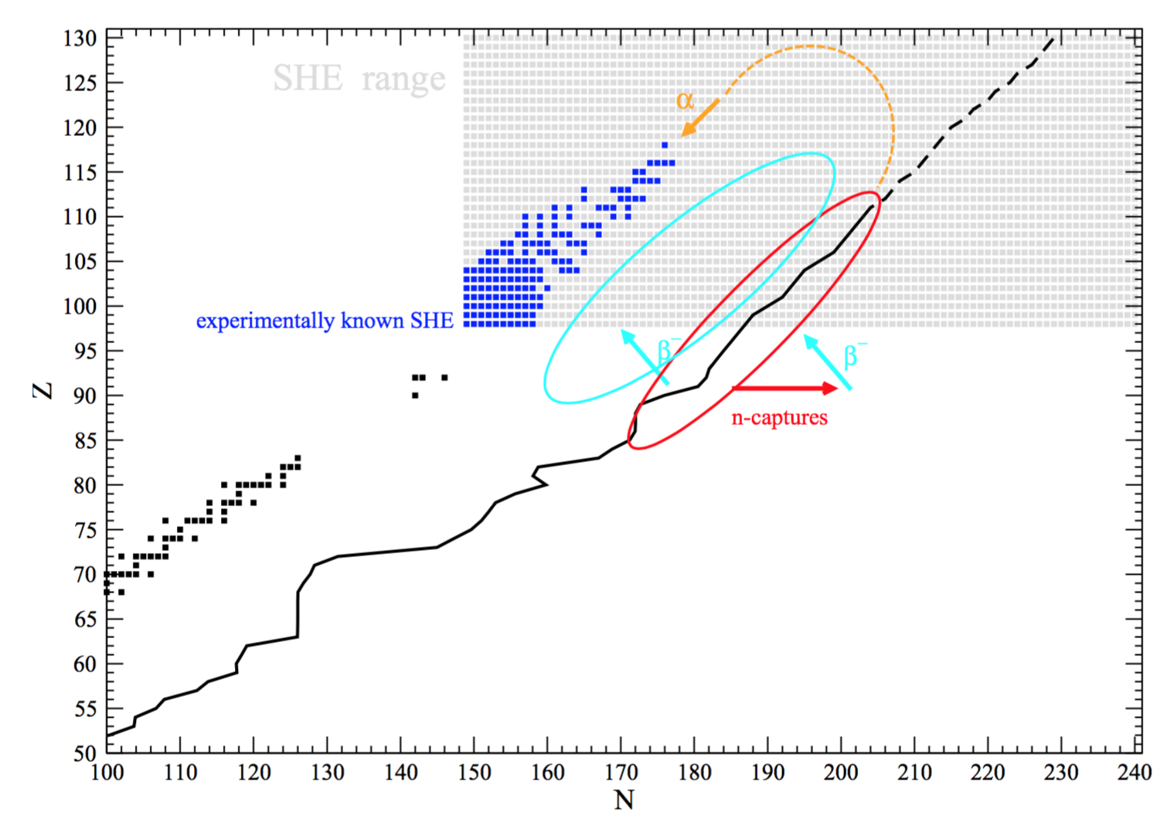
Superheavy island blocked by β-delayed fission
Right: Example - βdf alone can prevent the population of the superheavy island of stability
(purple outline – probability of βdf > 90%)
Below: previous calculations with Z<100 identified possibility to circumvent region with βdf probability ~100%
Petermann, Langanke, Martínez-Pinedo, Panov, Reinhard, and Thielemann (2012)
See also:
Thielemann, Metzinger, and Klapdor (1983)
Mumpower et al (submitted 2018)
Notes:
[trajectory: NSM n-rich dynamical ejecta with nuclear reheating (Mendoza-Temis 2015)]

Slide 10
β-delayed fission yields in r-process nucleosynthesis
Right: keeping a symmetric (50/50) split for neutron-induced fission yields while exchanging βdf yields from Kodama et al to a symmetric split
Mumpower et al (submitted 2018)
Notes:
$β$df yields greatly impact lanthanide abundances due to dominance during late time fission cycling

Slide 11
Shaping the r-process second peak: fission barriers and shell closures
Left: impact of fission barrier heights on the r-process path
Below: dripline mass model comparison and effect on the abundances near N=82 (A~130 peak)
HFB-17
FRDM 2012
Vassh et al (in preparation)

Slide 12
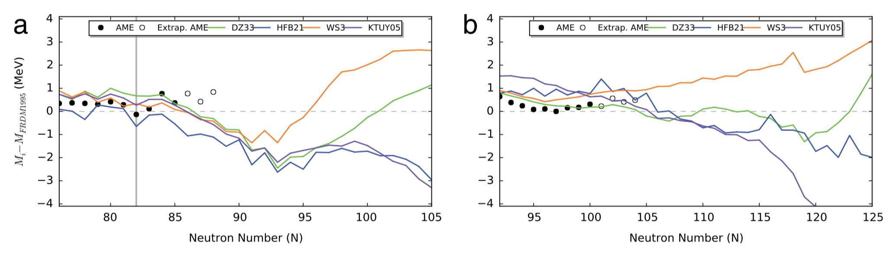
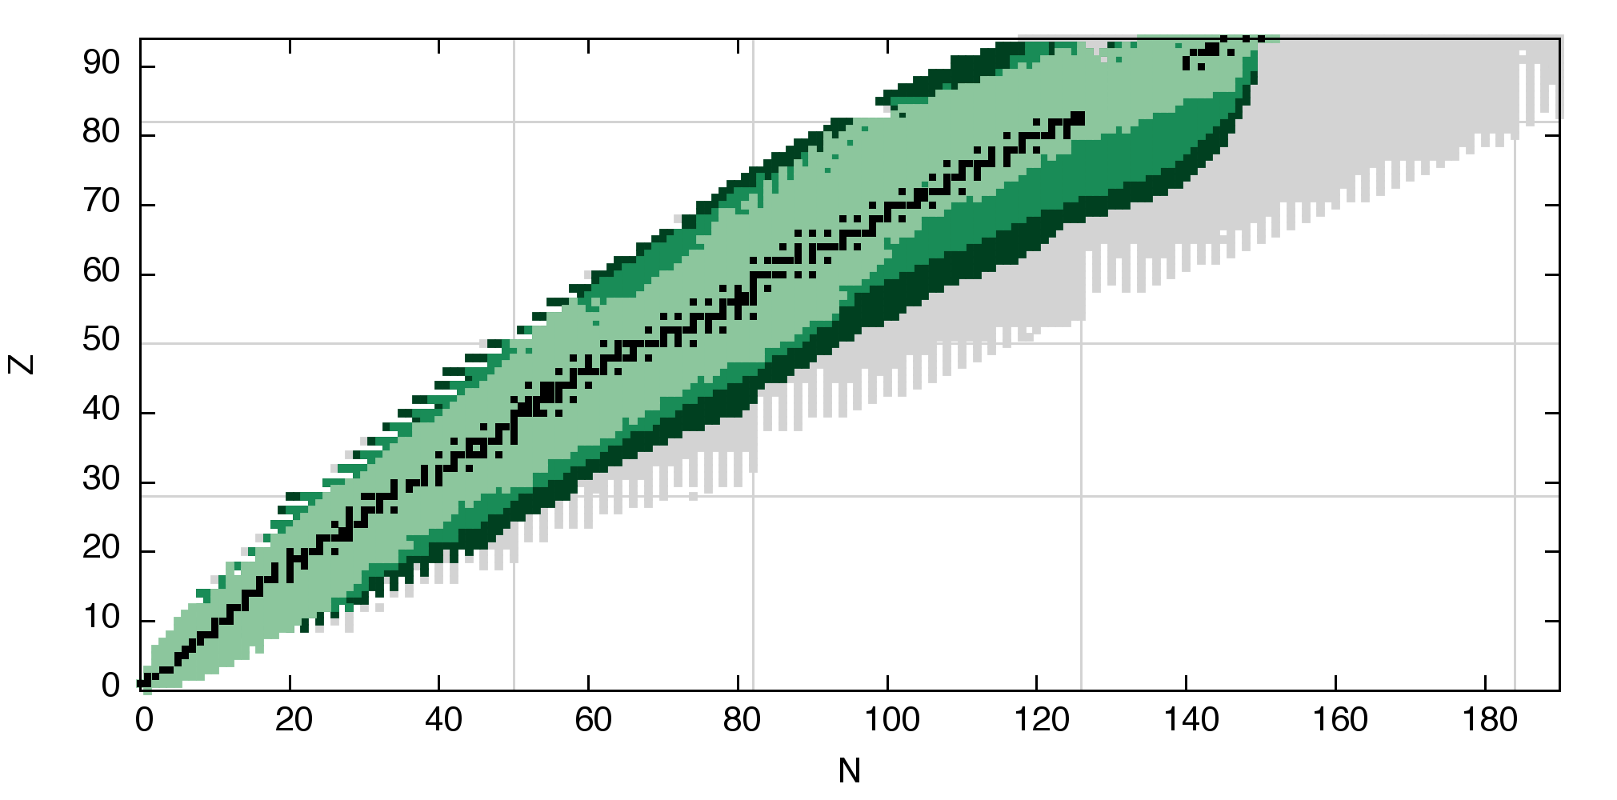
Masses: Model Divergence and FRIB Reach
Sn
Eu
Surman and Mumpower
Experimental Mass Measurements:
AME 2016
FRIB - Day 1
FRIB - Designed Beam Intensity
Mumpower, Surman, McLaughlin, and Aprahamian (2016)

Slide 13
Studying Rare-Earth Nuclei to Understand r-process Lanthanide Production
Experimental Mass Measurements:
AME 2016
Jyväskylä
CPT at CARIBU

Slide 14
Studying Rare-Earth Nuclei to Understand r-process Lanthanide Production
Experimental Mass Measurements:
AME 2016
Jyväskylä
CPT at CARIBU
Theory (ND, NCSU, LANL):
Markov Chain Monte Carlo Mass Corrections to the Duflo-Zuker Model which reproduce the observed rare-earth abundance peak
(right: result with s/k=30, τ=70 ms, Y_{e}=0.2)
N. Vassh et al (in preparation)

Slide 15
Standard r-process calculation
Astrophysical conditions
Fission Yields
Rates (n capture, β-decay, fission….)
Nuclear masses
Nucleosynthesis code
(PRISM)
Abundance
prediction

Slide 16
Reverse Engineering r-process calculation
Astrophysical conditions
Fission Yields
Rates (n capture, β-decay, fission….)
Nucleosynthesis code
(PRISM)
Abundance
prediction
Nuclear masses
Markov Chain Monte Carlo (MCMC)
Likelihood function

Slide 17
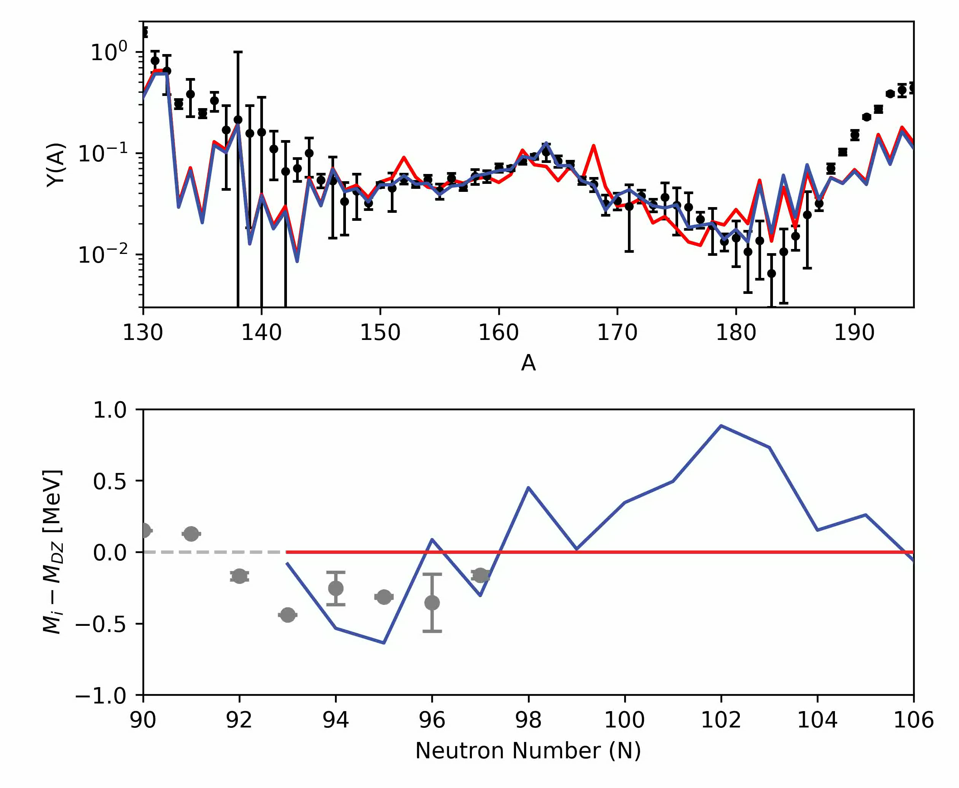
MCMC procedure
Monte Carlo mass corrections
Check:
Check:
Update nuclear quantities and rates
Perform nucleosynthesis calculation
Calculate
Update parameters OR revert to last success
Black – solar abundance data
Grey – AME 2012 data
Red – values at current step
Blue – best step of entire run

Slide 18

Dynamic Mechanism of Rare-Earth Peak Formation
Detailed balance implies
r-process path tends to lie along contours of constant separation energy
Pile-up of material at kinks
Duflo-Zuker
MCMC results
Vassh et al
(in preparation)

Slide 19
Results
Astrophysical trajectory:
hot, low entropy wind as from a NSM accretion disk
(s/k=30, τ=70 ms, Y_{e}=0.2)
50 parallel, independent MCMC runs; Average run χ²∼23
Orford, Vassh, Clark, McLaughlin, Mumpower, Savard, Surman, Aprahamian, Buchinger, Burkey, Gorelov, Hirsh, Klimes, Morgan, Nystrom, and Sharma
(accepted to PRL)

Slide 20
Results
Astrophysical trajectory:
hot, low entropy wind as from a NSM accretion disk
(s/k=30, τ=70 ms, Y_{e}=0.2)
50 parallel, independent MCMC runs; Average run χ²∼23
Orford, Vassh, Clark, McLaughlin, Mumpower, Savard, Surman, Aprahamian, Buchinger, Burkey, Gorelov, Hirsh, Klimes, Morgan, Nystrom, and Sharma
(accepted to PRL)

Slide 21
Rare-Earth Peak with MCMC solutions
Orford, Vassh, et al (accepted to PRL)

Slide 22
Nucleosynthesis in Neutron Star Mergers: Many Open Questions
Can mergers account for most of the r-process material observed in the galaxy?
Are precious metals such as gold produced in sufficient amounts? Are actinides produced?
Where within the merger environment does nucleosynthesis
occur and under what specific conditions?
Does fission of the heaviest nuclei shape the observed second r-process peak?
How does the rare-earth peak form?

Slide 23
Nucleosynthesis in Neutron Star Mergers: Many Open Questions
Can mergers account for most of the r-process material observed in the galaxy?
Are precious metals such as gold produced in sufficient amounts? Are actinides produced?
Where within the merger environment does nucleosynthesis
occur and under what specific conditions?
Does fission of the heaviest nuclei shape the observed second r-process peak?
How does the rare-earth peak form?
Mumpower et al (arXiv:1802.04398)
Vassh et al (in preparation)
Orford, Vassh, et al (accepted to PRL)

Slide 24
Back-up Slides

Slide 25
r-process sites within a Neutron Star Merger
Accretion disk winds –
exact driving mechanism and neutron richness varies
Hot, shocked material
Very n-rich cold, tidal outflows
Foucart et al (2016)
Owen and Blondin

Slide 26
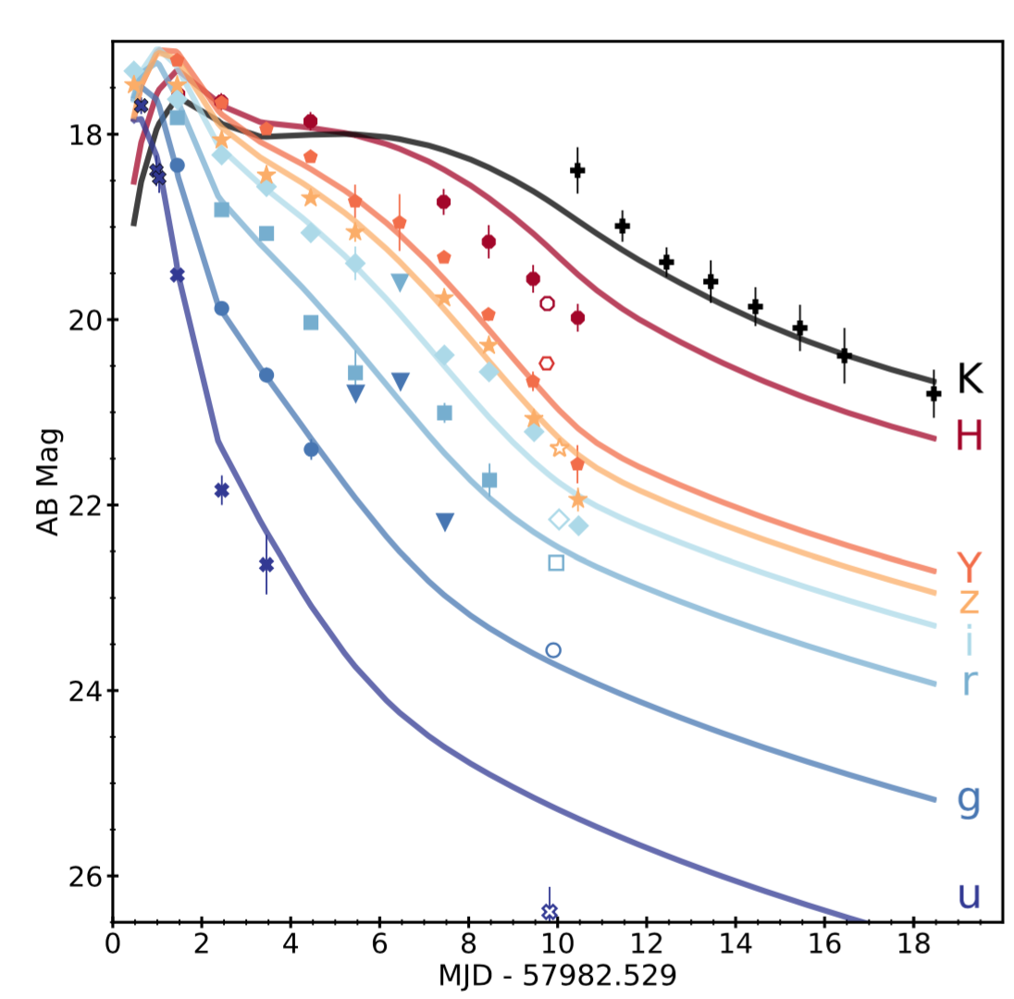
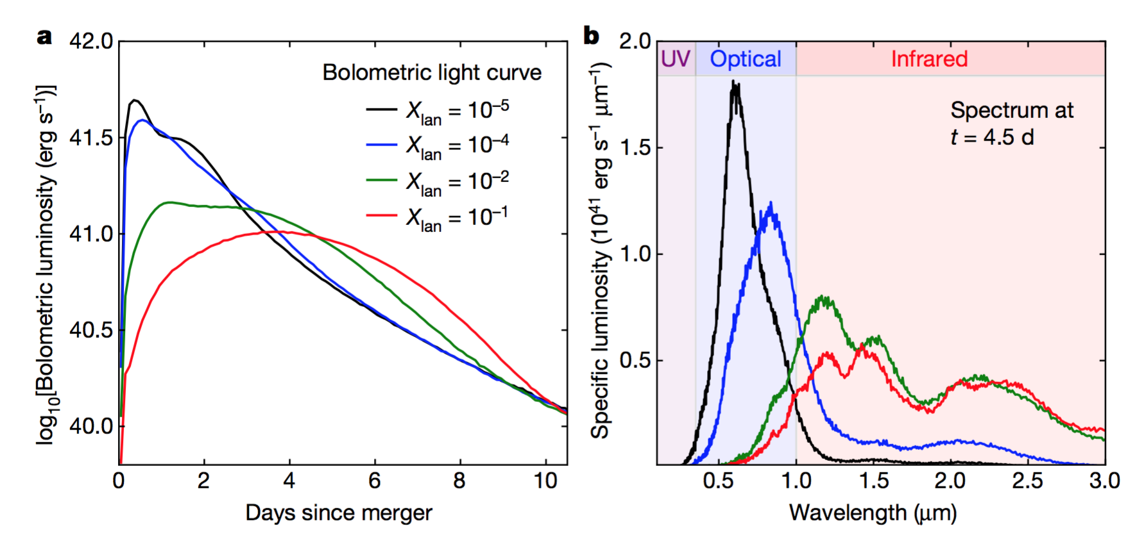
Lanthanide production in GW170817: “red” kilonova
Lanthanide mass fraction ↑ , opacity ↑, longer duration light curve shifted toward infrared
IR
Red
bands
Blue
bands
Cowperthwaite et al (ApJL 2017)
Kasen et al (Nature 2017)

Slide 27
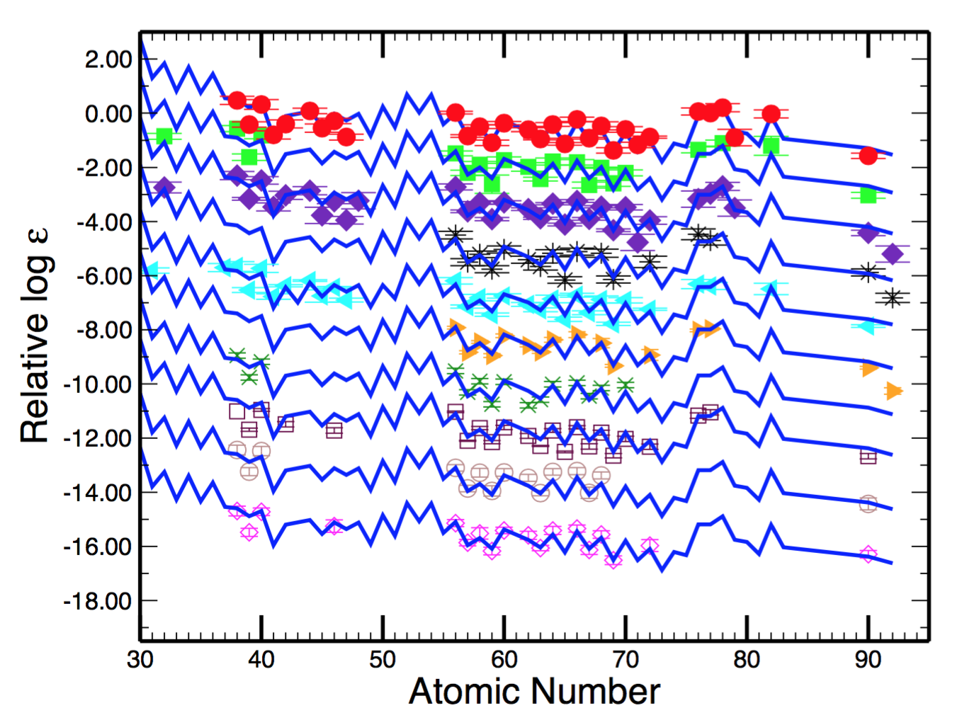
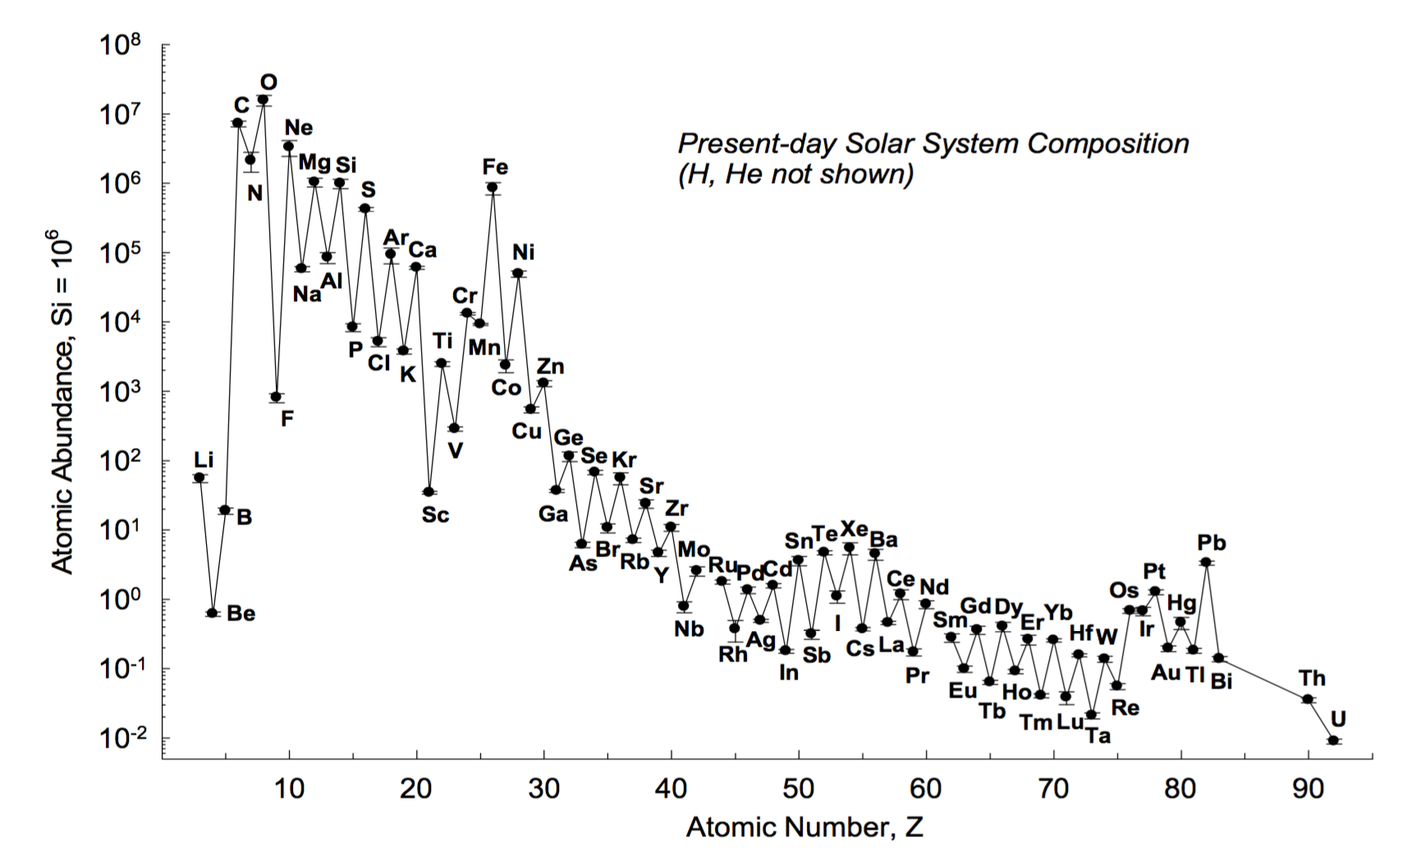
Observed Elemental Abundances
Solar System
10 r-process rich halo stars
Lodders (2010)
Cowan, Roederer, Sneden and Lawler (2011)

Slide 28
r-process Calculations for NSM Ejecta
Côté, Fryer, Belczynski, Korobkin, Chruślińska, Vassh, Mumpower, Lippuner, Sprouse, Surman and Wollaeger (2017)
Arnould et al (2007)
Wind ejecta (s/k=10, Y_{e}=0.27)
Very n-rich dynamical ejecta

Slide 29
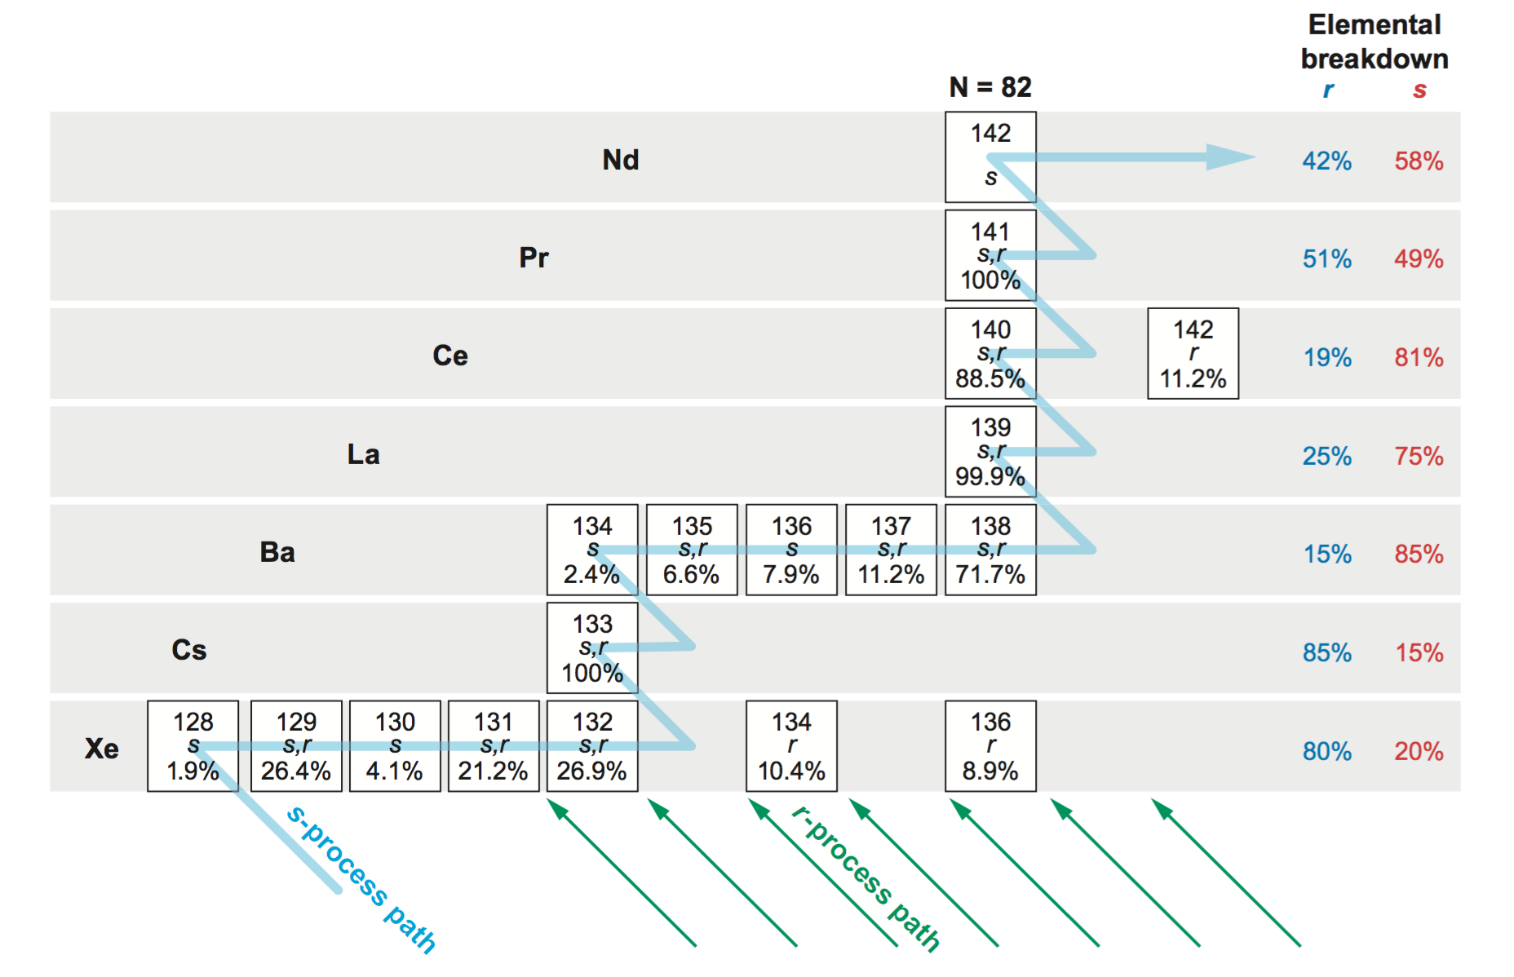
Sensitivity to Solar Data: uncertainty from the s-process subtraction
Sneden, Cowan, and Gallino (2008)
Notes:
Arlandini + 1999 not shown here additional solar data set with very small r residual errors, but the two models they consider, classical and stellar, do not agree within error

Slide 30
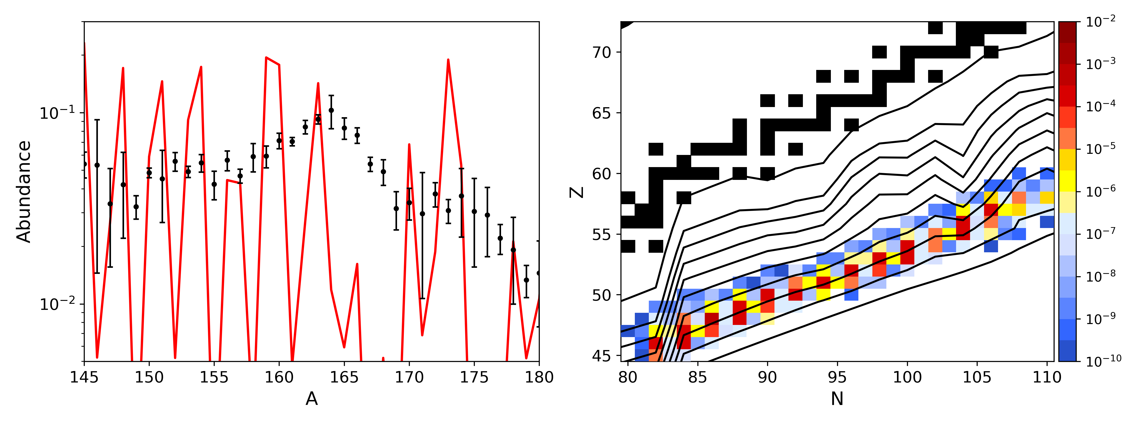
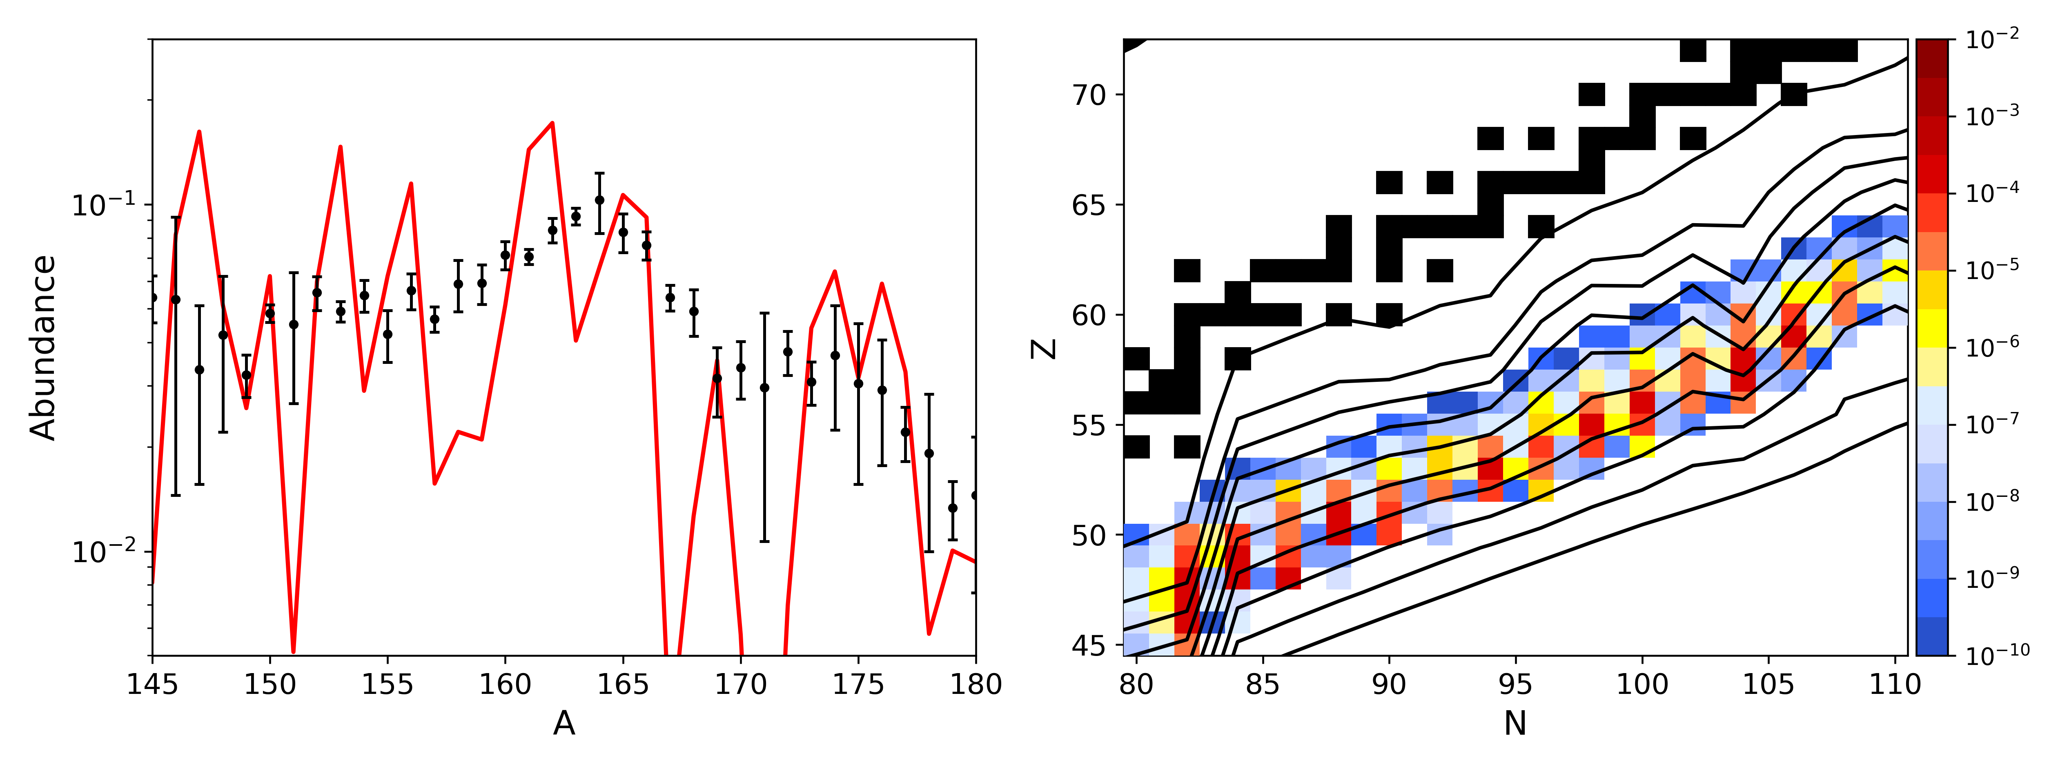
Peak Formation with an MCMC Mass Solution

Slide 31
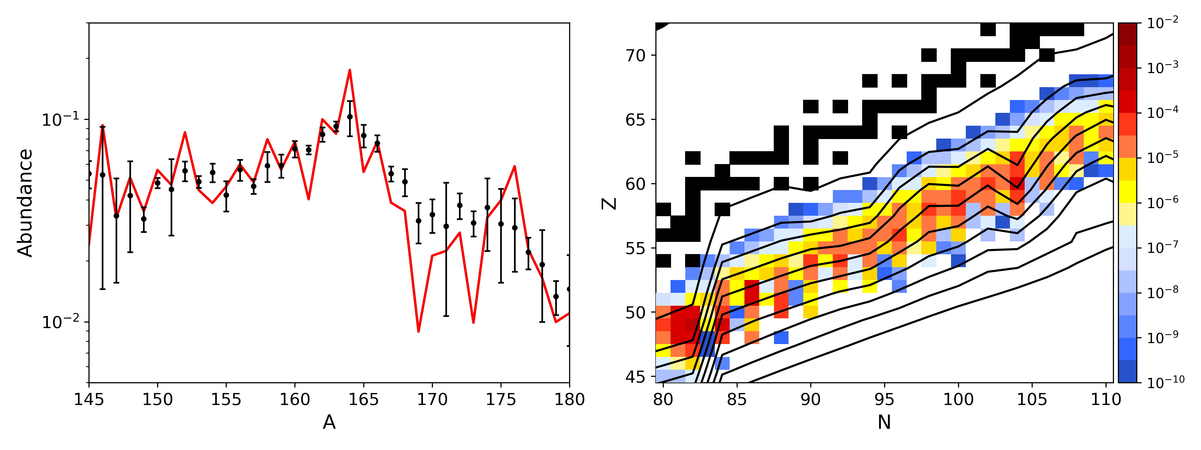
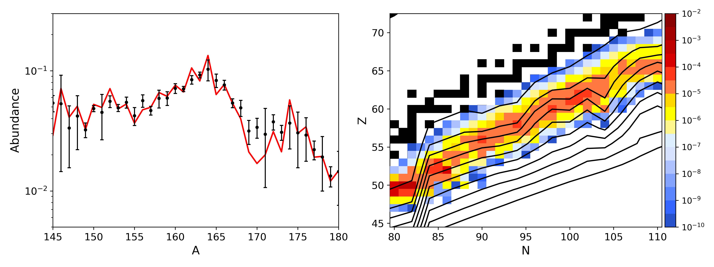
Peak Formation with an MCMC Mass Solution

Slide 32
(Abundance pattern range using the mass values found by our MCMC given disk wind conditions s/k=30, τ=70 ms, Y_{e}=0.2)
Vassh et al (in preparation)

Slide 33
Preliminary Results
30 Runs (Best Step Colored by χ²)
Astrophysical trajectory:
n-rich NSM dynamical ejecta with nuclear reheating
Simple fission prescription:
-spontaneous fission for all A>250 nuclei
-57%,43% fission fragment splits
50 independent MCMC runs complete
Vassh et al
(in preparation)
Notes:
Trajectory: (Mendoza-Temis et al 2015)

