Slide 1
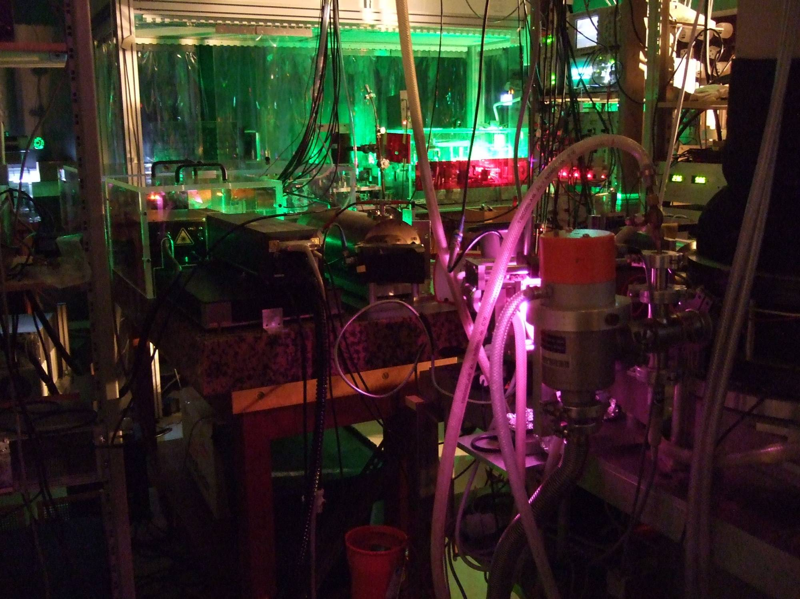
Recent developments
in the
proton radius puzzle
Hélène Fleurbaey
NIST, Gaithersburg
formerly at
Laboratoire Kastler Brossel, Paris
CIPANP2018
May 29, 2018

Slide 2
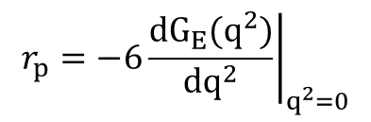

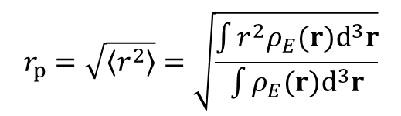

The proton charge radius
Proton structure
u
u
2 quarks up (2/3 e) + 1 quark down (-1/3 e) + strong interaction (gluons)
d
Proton charge radius : r_{p}
$$r_{p}=\sqrt{\left\langle r^{2}\right\rangle }=\sqrt{\frac{\int{r^{2}ρ_{E}(r)d^{3}r}}{\int{ρ_{E}(r)d^{3}r}}}$$
$$ρ_{E}(r)$$
: proton charge distribution
r_{p} from electron-proton scattering
e⁻
p_{f}
e⁻
θ
Form factor
H₂
Rutherford
momentum p_{i}
energy E_{i}
$$r_{p}={\left.−6\frac{dG_{E}(q^{2})}{dq^{2}}\right|}_{q^{2}=0}$$
r_{p} deduced from
extrapolation q² → 0
$$^{2}$$
q = p_{f} - p_{i}
result is model dependent…

Slide 3
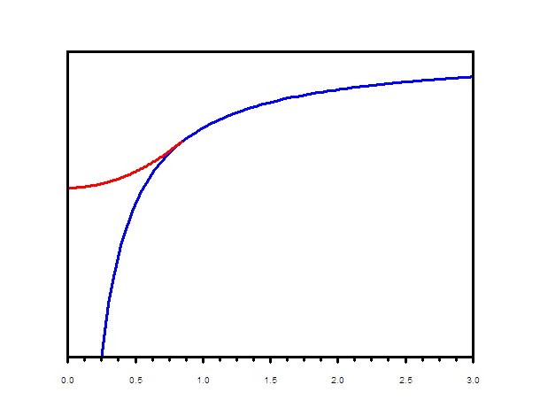
r_{p} from H spectroscopy
e⁻
p
a₀
exact
not well known
Dirac equation
recoil effect
Potential
energy
QED corrections (1/n³)
proton size effect (m_{r}³ r_{p}²/n³)
Unknown quantities : R∞ and L_{n}
linear combinations of exp. data
r_{p}
r
R∞, L^{exp}(1S)
+ QED
→ r_{p}
CODATA : least squares adjustment including H/D spectroscopy and electron scattering

Slide 4

r_{p} from µp spectroscopy
µ⁻
m_{µ} ~ 200 m_{e}
p
Laser
6 µm
2P
~a₀ / 200
2S
ΔE_{µ}(r_{p}) ~ 10⁷ ΔE_{e}(r_{p})
2% of ν_{2S-2P} (µp)
2 keV x-ray
1S
2S-2P in muonic hydrogen µp (Paul Scherrer Institute)
A. Antognini et al., Science 339 (2013) 417
“proton radius puzzle”
r_{p} = 0.84087(39) fm
r_{p} = 0.8751(61) fm
$$5.6σ$$
µp spectroscopy
CODATA 2014
H spectro. average (CODATA 2014)
r_{p} (fm)

Slide 5
The proton radius puzzle
1σ errorbars
2S_{1/2}-2P_{1/2}
RF Lamb shift
2S_{1/2}-2P_{1/2}
2S_{1/2}-2P_{3/2}
2S_{1/2}-4S_{1/2}
2S_{1/2}-4D_{5/2}
2S_{1/2}-4P_{1/2}
2S_{1/2}-4P_{3/2}
2S_{1/2}-6S_{1/2}
2S_{1/2}-6D_{5/2}
2S_{1/2}-8S_{1/2}
2S_{1/2}-8D_{3/2}
2S_{1/2}-8D_{5/2}
2S_{1/2}-12D_{3/2}
2S_{1/2}-12D_{5/2}
1S_{1/2}-3S_{1/2}
µp
H spectro. average (CODATA 2014)
r_{p} (fm)

Slide 6
The proton radius puzzle
1σ errorbars
2S_{1/2}-2P_{1/2}
2S_{1/2}-2P_{1/2}
1S_{1/2}-2S_{1/2} & …
2S_{1/2}-2P_{3/2}
Garching 1995
2S_{1/2}-4S_{1/2}
2S_{1/2}-4D_{5/2}
Yale 1995
2S_{1/2}-4P_{1/2}
2S_{1/2}-4P_{3/2}
2S_{1/2}-6S_{1/2}
2S_{1/2}-6D_{5/2}
2S_{1/2}-8S_{1/2}
LKB 1990’s
2S_{1/2}-8D_{3/2}
2S_{1/2}-8D_{5/2}
2S_{1/2}-12D_{3/2}
2S_{1/2}-12D_{5/2}
LKB 2010
1S_{1/2}-3S_{1/2}
µp
H spectro. average (CODATA 2014)
r_{p} (fm)

Slide 7
Recent hydrogen spectroscopy
1σ errorbars
2S_{1/2}-2P_{1/2}
2S_{1/2}-2P_{1/2}
1S_{1/2}-2S_{1/2} & …
2S_{1/2}-2P_{3/2}
2S_{1/2}-4S_{1/2}
2S_{1/2}-4D_{5/2}
2S_{1/2}-4P_{1/2}
2S_{1/2}-4P_{3/2}
2S_{1/2}-6S_{1/2}
2S_{1/2}-6D_{5/2}
2S_{1/2}-8S_{1/2}
2S_{1/2}-8D_{3/2}
2S_{1/2}-8D_{5/2}
2S_{1/2}-12D_{3/2}
2S_{1/2}-12D_{5/2}
1S_{1/2}-3S_{1/2}
1S_{1/2}-3S_{1/2} (MPQ 2016)
2S_{1/2}-4P_{1/2}
(MPQ 2017)
2S_{1/2}-4P_{3/2}
µp
H spectro. average (CODATA 2014)
r_{p} (fm)

Slide 8
Recent hydrogen spectroscopy
1σ errorbars
2S_{1/2}-2P_{1/2}
2S_{1/2}-2P_{1/2}
1S_{1/2}-2S_{1/2} & …
2S_{1/2}-2P_{3/2}
2S_{1/2}-4S_{1/2}
2S_{1/2}-4D_{5/2}
2S_{1/2}-4P_{1/2}
2S_{1/2}-4P_{3/2}
2S_{1/2}-6S_{1/2}
2S_{1/2}-6D_{5/2}
2S_{1/2}-8S_{1/2}
2S_{1/2}-8D_{3/2}
2S_{1/2}-8D_{5/2}
2S_{1/2}-12D_{3/2}
2S_{1/2}-12D_{5/2}
1S_{1/2}-3S_{1/2}
1S_{1/2}-3S_{1/2} (MPQ 2016)
2S_{1/2}-4P_{1/2}
(MPQ 2017)
2S_{1/2}-4P_{3/2}
µp
1S_{1/2}-3S_{1/2} (LKB 2018)
r_{p} (fm)

Slide 9
Recent hydrogen spectroscopy
1σ errorbars
2S_{1/2}-2P_{1/2}
2S_{1/2}-2P_{1/2}
1S_{1/2}-2S_{1/2} & …
2S_{1/2}-2P_{3/2}
2S_{1/2}-4S_{1/2}
2S_{1/2}-4D_{5/2}
2S_{1/2}-4P_{1/2}
2S_{1/2}-4P_{3/2}
2S_{1/2}-6S_{1/2}
2S_{1/2}-6D_{5/2}
2S_{1/2}-8S_{1/2}
2S_{1/2}-8D_{3/2}
2S_{1/2}-8D_{5/2}
2S_{1/2}-12D_{3/2}
2S_{1/2}-12D_{5/2}
1S_{1/2}-3S_{1/2}
1S_{1/2}-3S_{1/2} (MPQ 2016)
2S_{1/2}-4P_{1/2}
(MPQ 2017)
2S_{1/2}-4P_{3/2}
µp
1S_{1/2}-3S_{1/2} (LKB 2018)
r_{p} (fm)

Slide 10
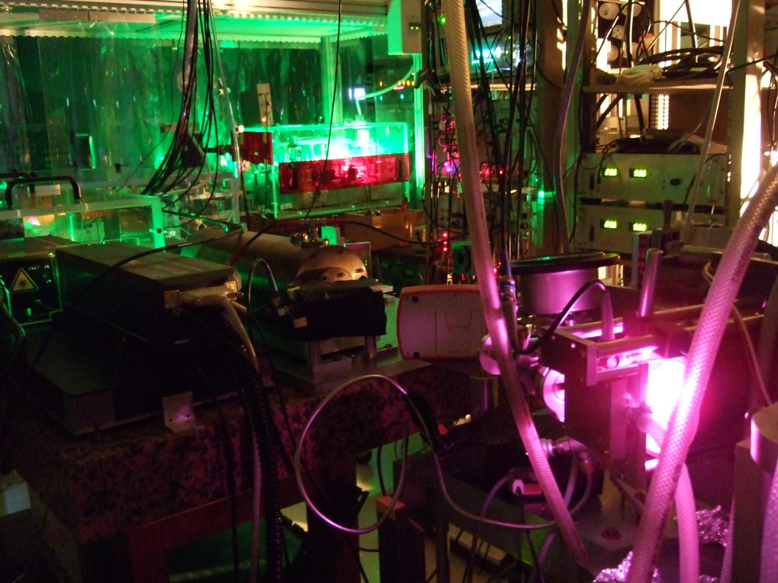


1S-3S two-photon spectroscopy
First order Doppler
effect compensation
→
v
$$ω_{L}\left(1−\frac{\text{v}}{c}\right)$$
$$ω_{L}\left(1+\frac{\text{v}}{c}\right)$$
3S
TiSa laser
656 nm
205 nm
2P
205 nm
1S
205 nm source
532/266 nm laser
Hydrogen (1S) source

Slide 11
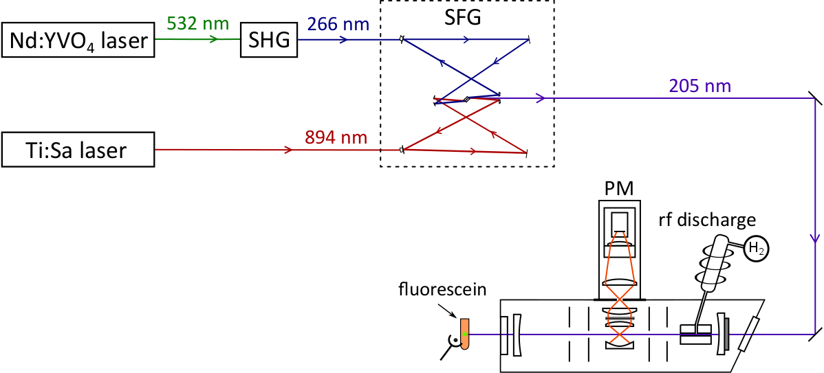
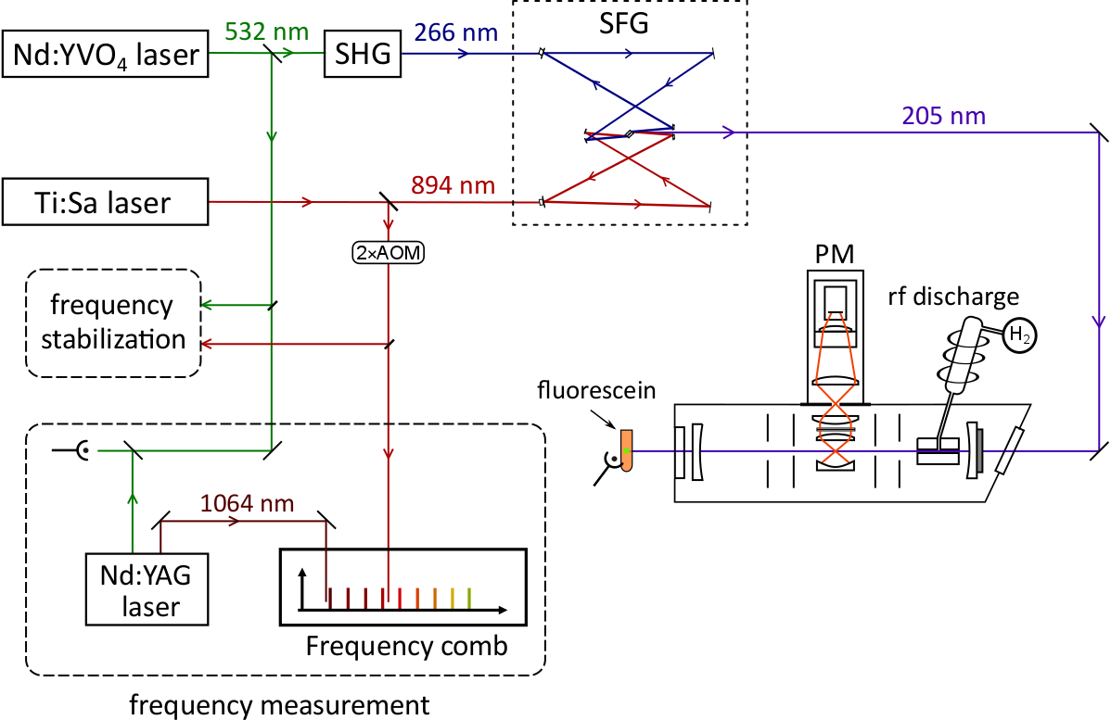

The experimental setup
10 mW, cw
Sum Frequency Generation: $\frac{1}{894}+\frac{1}{266}=\frac{1}{205}$
S. Galtier et al, Opt. Comm. 324 (2014)
detection at 656 nm
3S
656 nm
H maser
205 nm
2P
3 km optical
fiber link
LNE-SYRTE
1S

Slide 12
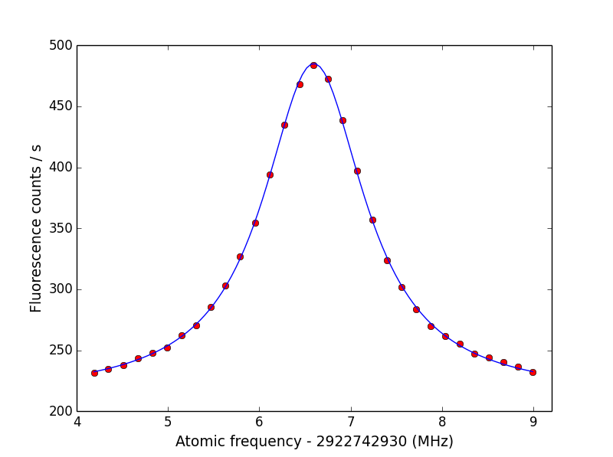
Data acquisition
Dec. 2, 2016
Integration time : 4h
P₂₀₅ = 6.5 mW
Pressure = 3x10⁻⁵ mbar
B = -0.3 G

Slide 13

Data acquisition
Dec. 2, 2016
Integration time : 4h
P₂₀₅ = 6.5 mW
Pressure = 3x10⁻⁵ mbar
B = -0.3 G
Frequency shifting
systematic effects
$Γ_{nat}$ = 1 MHz
Proton puzzle discrepancy: 7 kHz
Statistical uncertainty in 20 h: 1 kHz

Slide 14
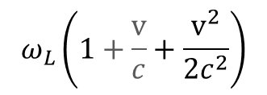
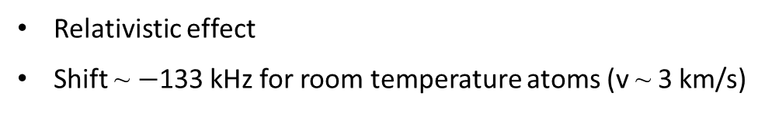
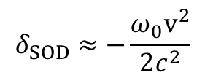
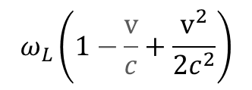
Second order Doppler shift
Relativistic effect
Shift ~ $−$133 kHz for room temperature atoms (v ~ 3 km/s)
→
$$ω_{L}\left(1−\frac{\text{v}}{c}+\frac{{\text{v}}^{2}}{2c^{2}}\right)$$
v
$$ω_{L}\left(1+\frac{\text{v}}{c}+\frac{{\text{v}}^{2}}{2c^{2}}\right)$$
$$δ_{SOD}≈−\frac{{ω_{0}\text{v}}^{2}}{2c^{2}}$$

Slide 15
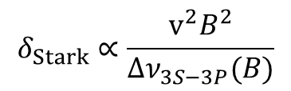
Second order Doppler shift
Relativistic effect
Shift ~ $−$133 kHz for room temperature atoms (v ~ 3 km/s)
→
B
→
$$ω_{L}\left(1−\frac{\text{v}}{c}+\frac{{\text{v}}^{2}}{2c^{2}}\right)$$
v
$$ω_{L}\left(1+\frac{\text{v}}{c}+\frac{{\text{v}}^{2}}{2c^{2}}\right)$$
→ → →
E = v B
x
$$δ_{SOD}≈−\frac{{ω_{0}\text{v}}^{2}}{2c^{2}}$$
$$δ_{Stark}∝\frac{{\text{v}}^{2}B^{2}}{∆ν_{3S−3P}(B)}$$
Motional Stark effect & Zeeman effect Frequency shift (v,B)
Fit for various B values to determine velocity distribution
F. Biraben, L. Julien, J. Plon and F. Nez, Europhys. Lett., 15 (1991) p.831

Slide 16
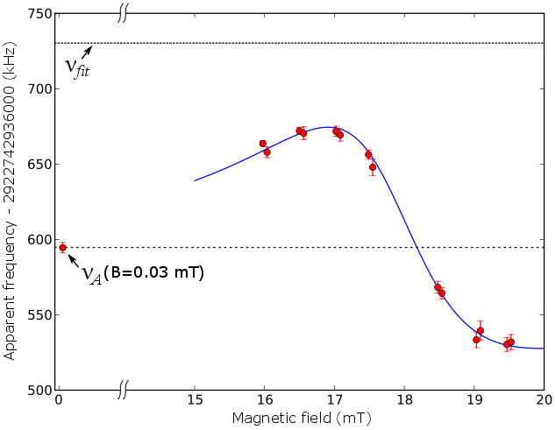

Second order Doppler shift
Relativistic effect
Shift ~ $−$133 kHz for room temperature atoms (v ~ 3 km/s)
$$δ_{SOD}$$
Motional Stark effect & Zeeman effect Frequency shift (v,B)
Fit for various B values to determine velocity distribution
F. Biraben, L. Julien, J. Plon and F. Nez, Europhys. Lett., 15 (1991) p.831

Slide 17
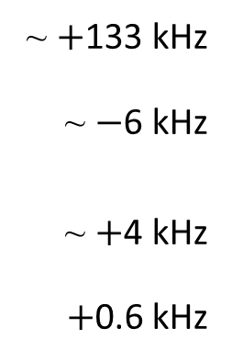
Analysis and result
Correction
Uncertainty
Second order Doppler effect
Light shift
  Extrapolation vs transmitted power
Collisional shift
  Extrapolation vs pressure
Cross-damping (calculated)
~ $+$133 kHz
~ $−$6 kHz
~ $+$4 kHz
$+$0.6 kHz
~ 1.2 kHz
~ 1.3 kHz
~ 2 kHz
0.2 kHz
2013: ν_{1S-3S} = 2 922 743 278 671.6(2.8) kHz
2017: ν_{1S-3S} = 2 922 743 278 671.0(4.9) kHz
2 data sets
ν_{1S-3S} = 2 922 743 278 671.5(2.6) kHz
combine with ν_{1S-2S} (Parthey et al., PRL 107 (2011))
and QED calculations to obtain
r_{p} = 0.877(13) fm
H. Fleurbaey, S. Galtier, S. Thomas et al., Phys. Rev. Lett., 120 (2018) 183001

Slide 18
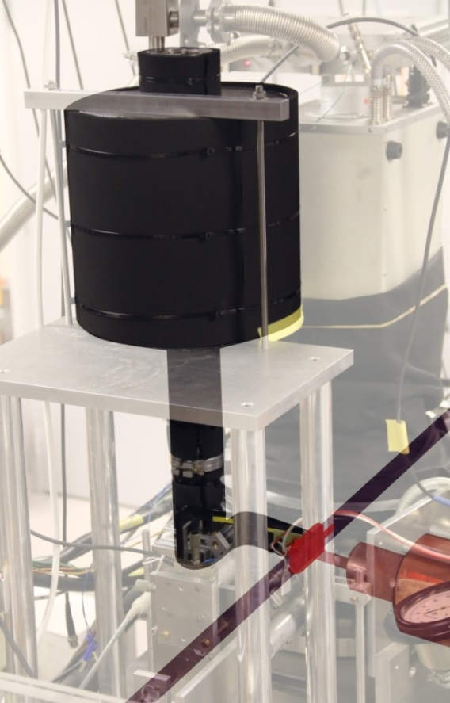
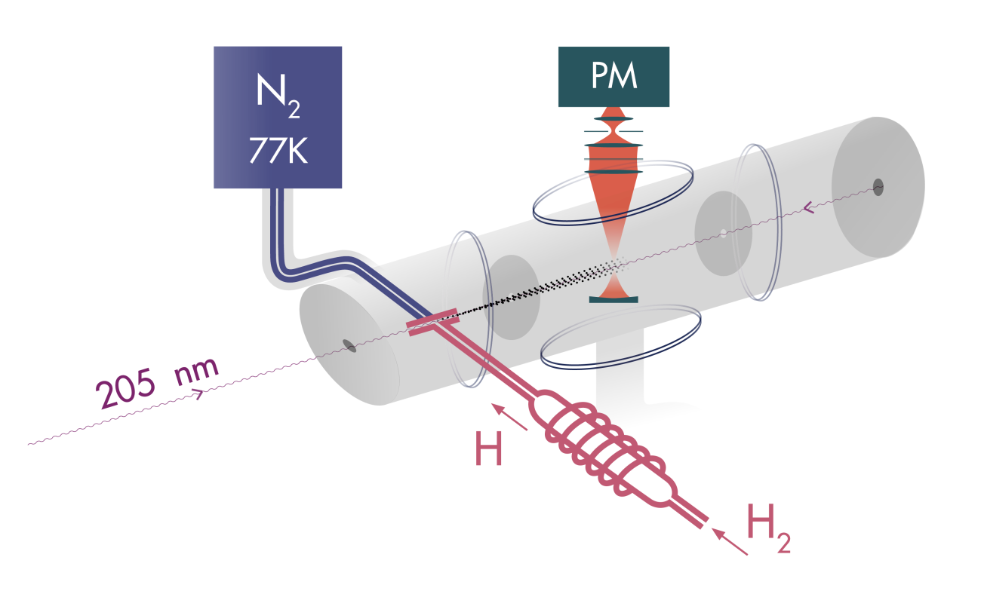

What next? in Paris…
1S-3S spectroscopy at 77 K (liquid nitrogen cooling)
Objective : reduce atomic velocity
second order Doppler shift
$$δ_{SOD}∝{\text{v}}^{2}∝T$$
Later: Spectroscopy of 1S-4S transition
Notes:
18

Slide 19
… and elsewhere
Hydrogen spectroscopy
  Garching: 1S-3S with cold atoms (4K)
    also 2S-6P, etc…
  York U: 2S-2P Lamb shift (E. Hessels)
    independent from Rydberg constant
Hydrogenoid systems
  QED tests
    H₂⁺, HD⁺, He⁺, etc... (Amsterdam, LKB, MPQ, …)
  independent measurement of Rydberg constant
    Rydberg-state ²⁰Ne⁹⁺ at NIST Gaithersburg
Scattering
  Improved experiments: Jefferson Lab (VA), MAMI (Mainz)
  MUSE experiment at PSI
    muon-proton and electron-proton scattering in the same experiment

Slide 20
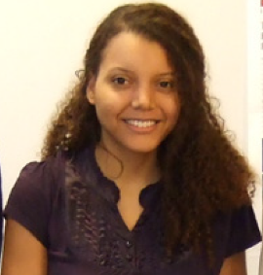
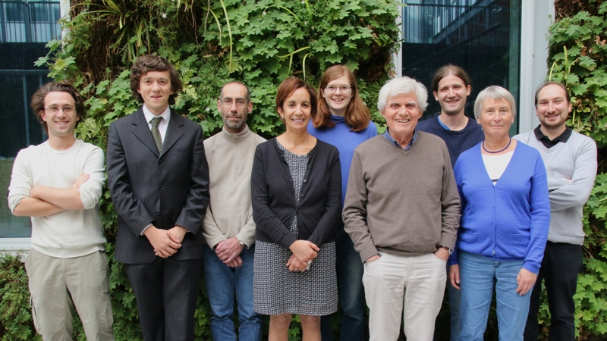
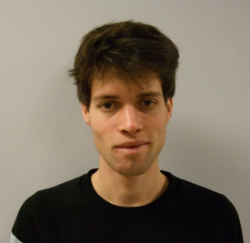
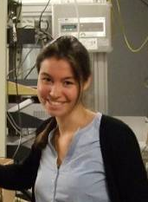







The LKB metrology group
S. Galtier
F. Nez
F. Biraben
L. Julien
S. Thomas
M. Bonnaud
THANK YOU
Notes:
20

Slide 22
What next? in Paris…
1S-3S spectroscopy at 77 K (liquid nitrogen cooling)
Spectroscopy of 1S-4S transition
Never observed yet !
Never observed yet !
4S
3S
3P
532 nm
266 nm
194.5 nm
2S
2P
724 nm
1S-4S
Advantages:
Narrower natural width (700 kHz)
Direct velocity distribution determination possible
by 2S-nP spectroscopy
1S
Notes:
22
This transition has several advantages.
it is narrower (700 kHz) and that there may be a possibility of estimating the vel dist directly by a 1ph transition from the small number of atoms that end up in 2S state… (8% is it ?)
Drawback: dioxygen absorbs at 194 nm so that we would need a vacuum tube for the laser beam…

Slide 23

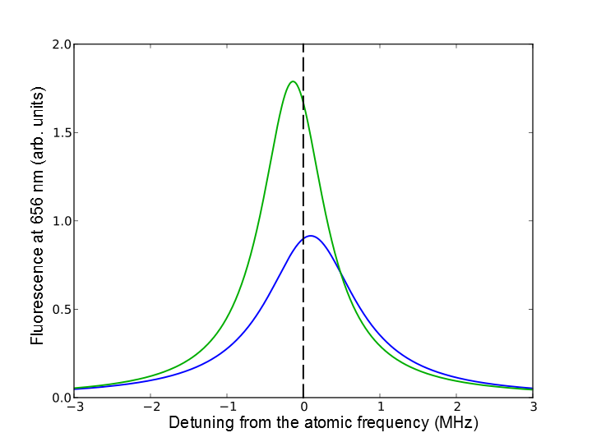
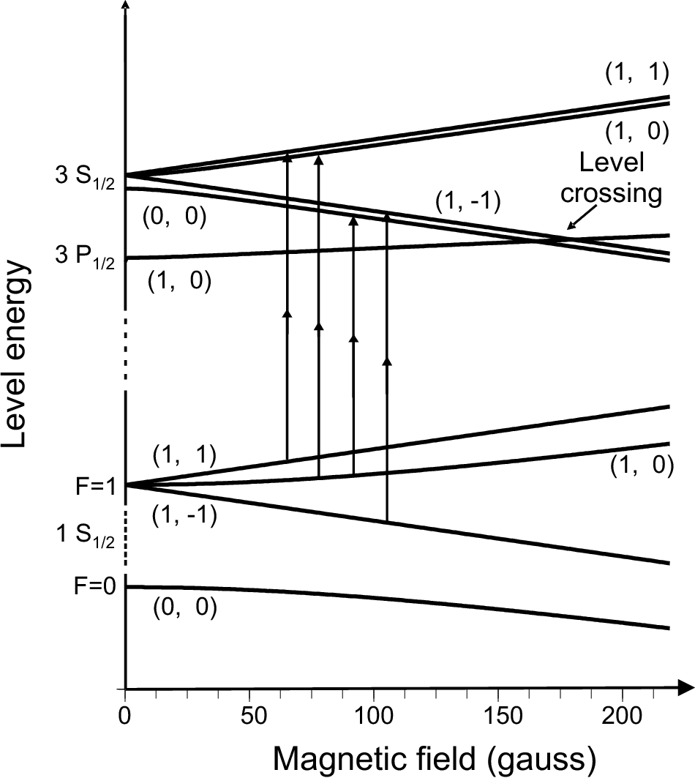
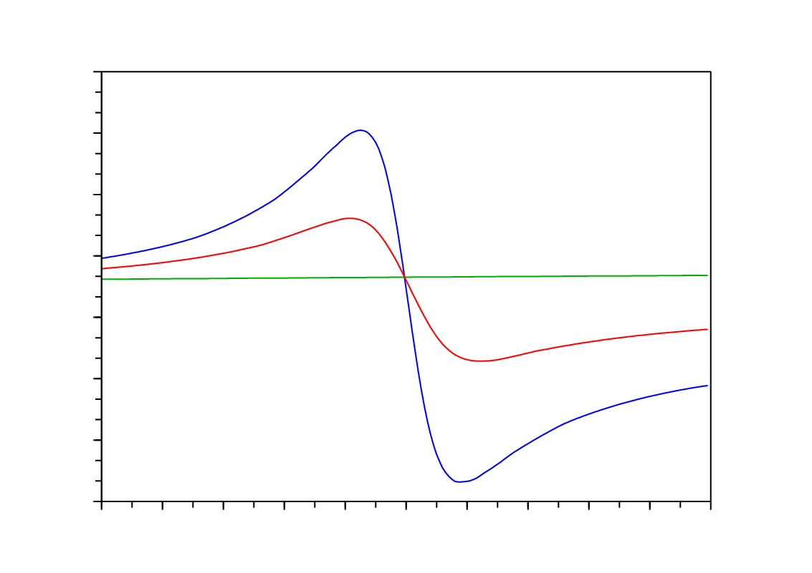
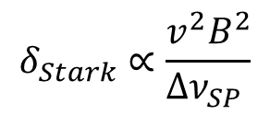
Second order Doppler effect compensation
Δm_{F}= 0
B = 171 G
v = 3 km/s
m_{F}=+1
Level
crossing
m_{F}=-1
Line position (kHz)
200
m_{F}=0 ↔ B calibration
100
0
δ_{dop}
- 100
m_{F}=+1
- 200
m_{F}=+1
-
-
- 300
v = 3 km/s
m_{F}=-1
Partial compensation
- 400
B (G)
Fit of lines for various B values
→ velocity distribution estimation
- 500
130
150
170
190
210
230
G. Hagel et al, Phys. Rev. Lett. 89 (2002) p.203001
Notes:
23
23

Slide 24
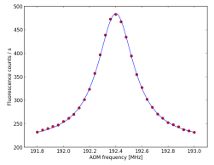
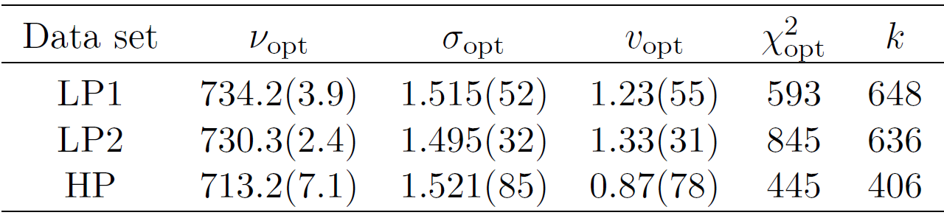
Data analysis: velocity distribution
Data acquisition:
Analysis:
  fit with theoretical profile
  determine velocity distribution
    model: effusive beam & depletion of slow atoms
  minimization
  gives optimal parameters
  and transition frequency corrected from
second-order Doppler effect
motional Stark effect
*
( )
*
number of
recordings
2 922 742 936 xxx.x kHz
km/s
Notes:
24
24

Slide 25
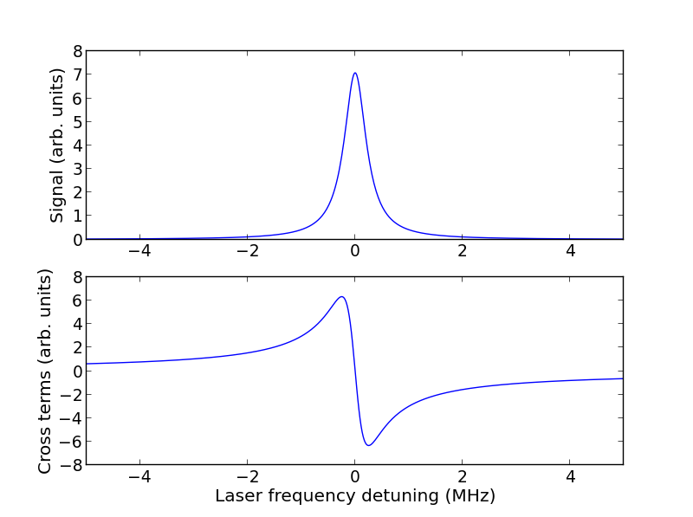
Cross-damping effect
3D
Same initial and final state
Interference between different radiative paths
3S
Coherent sum
2P
1S
Cross terms
Frequency shift
Estimate using
analogy with
scattering
Two-photon excitation
x10⁻³
H. Fleurbaey, F. Biraben, L. Julien, J.-P. Karr and F. Nez,
PRA 95 (2017) 052503
Notes:
25
25

Slide 26
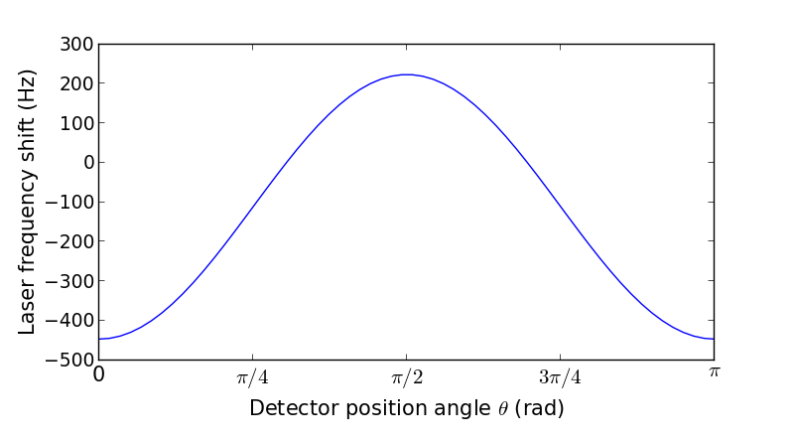
Cross-damping effect
3D
Same initial and final state
Interference between different radiative paths
3S
2P
Shift depends on angle between incident polarization
and detection direction
Shift depends on detection geometry
1S
Point-like detector
for point-like detector:
max shift < 1 kHz
integrate over aperture:
shift ~ - 0.6 kHz
Correction = + 0.6(2) kHz
H. Fleurbaey, F. Biraben, L. Julien, J.-P. Karr and F. Nez,
PRA 95 (2017) 052503
Notes:
26
26

