Slide 1
Radiological Data Fusion (RDF) Workshop Overview & Charge
Brian Quiter (LBNL)
Jai Ray (SNL)
Hank Zhu (NA-22)

Slide 2
Welcome
Safety
  Emergency exits, shelter in place (this is a SAFE building),
  Wildfires, earthquakes
Security
  On Zoom CUI is not allowed. We can audible to Teams if need be.
  CUI level discussions are allowed at LBL without Zoom.

Slide 3
Workshop Goals
Describe the state of the art in terms of fusing radiological data with ancillary data
Identify potential applications of RDF within the context of nuclear non-proliferation and nuclear security missions
Identify and prioritize R&D recommendations

Slide 4
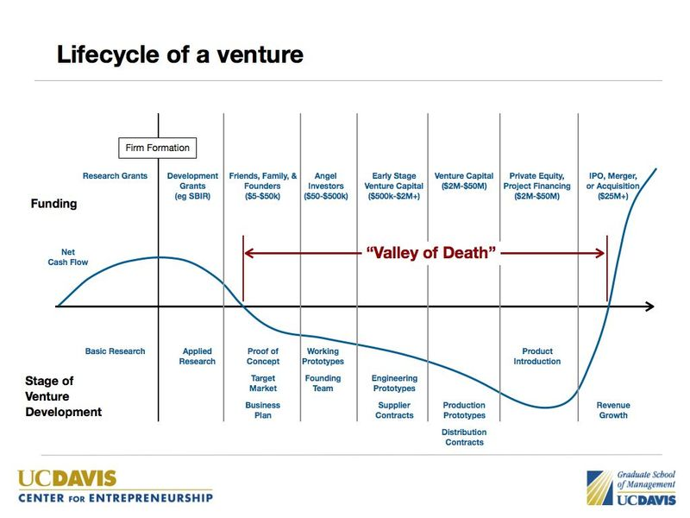
Workshop Goals
How to get radiological data fusion technologies in end users’ hands?
How best to continue to innovate?
$
t

Slide 5

RDF Application Table
RDF Scoping study identified dozens of R&D opportunities – now assessing impact and prioritizing

Slide 6
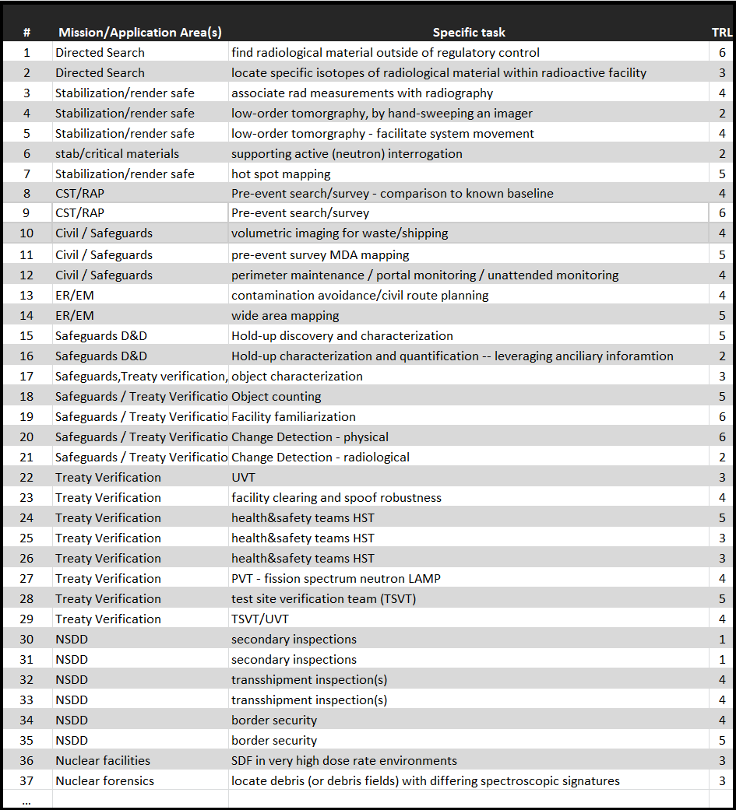
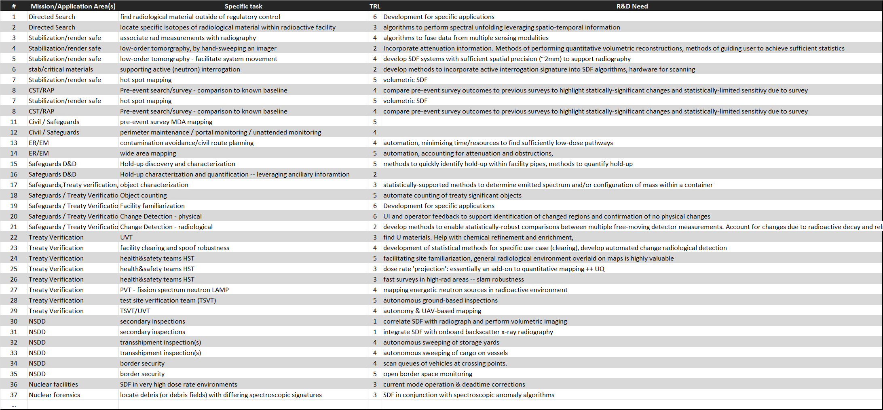

Slide 7
RDF Applications
Radiological search
  Intelligence-driven/accidental loss/wide-area
  Borders/ports/undeveloped areas/urban
Environmental mapping
  Accident/attack, legacy contamination, geological, forensics
Nuclear facilities
  Operations, safeguards, inspections/compliance, decommissioning
  Facility familiarization, change detection, specific materials, configurations, and quantification
Item inspection

Slide 8
RDF Applications - Search
Types of Search
Cross-cutting concepts
Intelligence-driven search
  Isotope-specific?
  Masking sources?
  MDA-driven?
Pre-event search
  MDA-driven?
  Comparisons to prior surveys?
  Borders/ports/undeveloped areas/urban
  Perimeter maintenance
Wide-area search
Autonomy
Multi-measurement / multi-sensor data fusion
Integrating spectroscopic and other priors

Slide 9
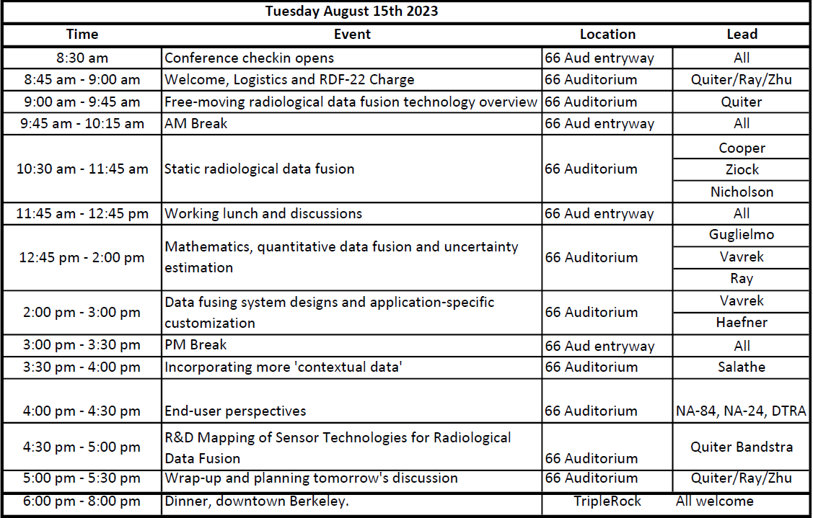
Logistics
Today’s agenda
  Summarize RDF State of the Art and research directions

Slide 10
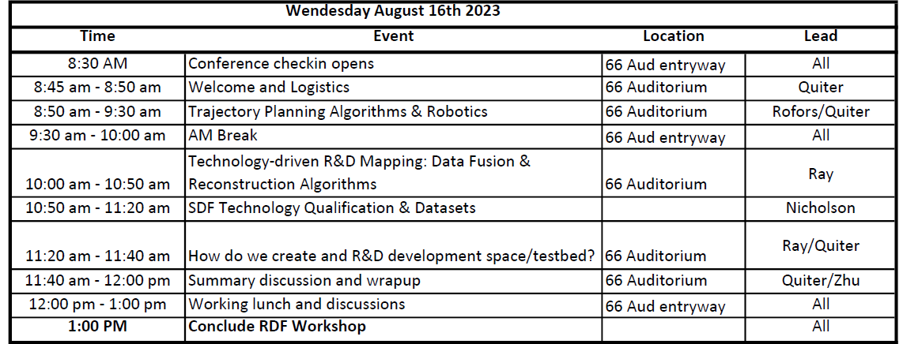
Logistics
Tomorrow’s agenda
  Roadmap for future of rad data fusion R&D
    Needs
    Challenges
    Scientifically interesting stuff

Slide 11
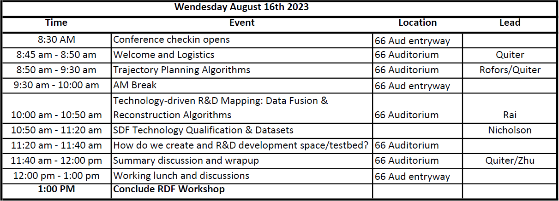
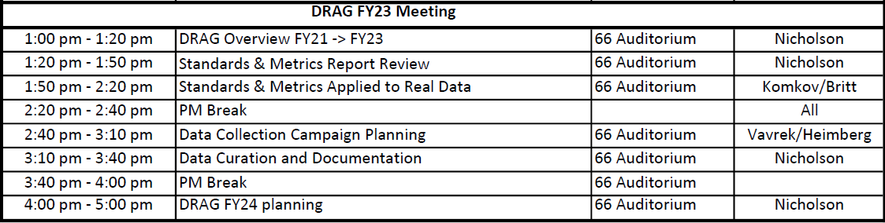
Logistics
Tomorrow’s agenda
  Roadmap for future of rad data fusion R&D
Then meeting of Detecting Radiation Algorithms Group (DRAG)

Slide 12
Logistics
Hybrid
  If you’re online, please mute, don’t be shy on the chat, and break in/raise hand as you see fit.
  Different zoom links for today & tomorrow
    Today • Tomorrow
  Shared online notes document
    This document is NOT secure. Anyone with link can view and any attendee is welcome to edit, but let’s not put CUI on it

Slide 13
Logistics
Problems/comments
  Technical:
    Brian Quiter
      510-631-2317 (cell)
      bjquiter@lbl.gov
  Logistics/access/facility/parking
    Michael Gorin
      510-908-3510 (cell)
      mgorin@lbl.gov (email)
    Jai Ray
      925-784-1247 (cell)
      jairay@sandia.gov
    Brian Quiter
      510-631-2317 (cell)
      bjquiter@lbl.gov

Slide 14
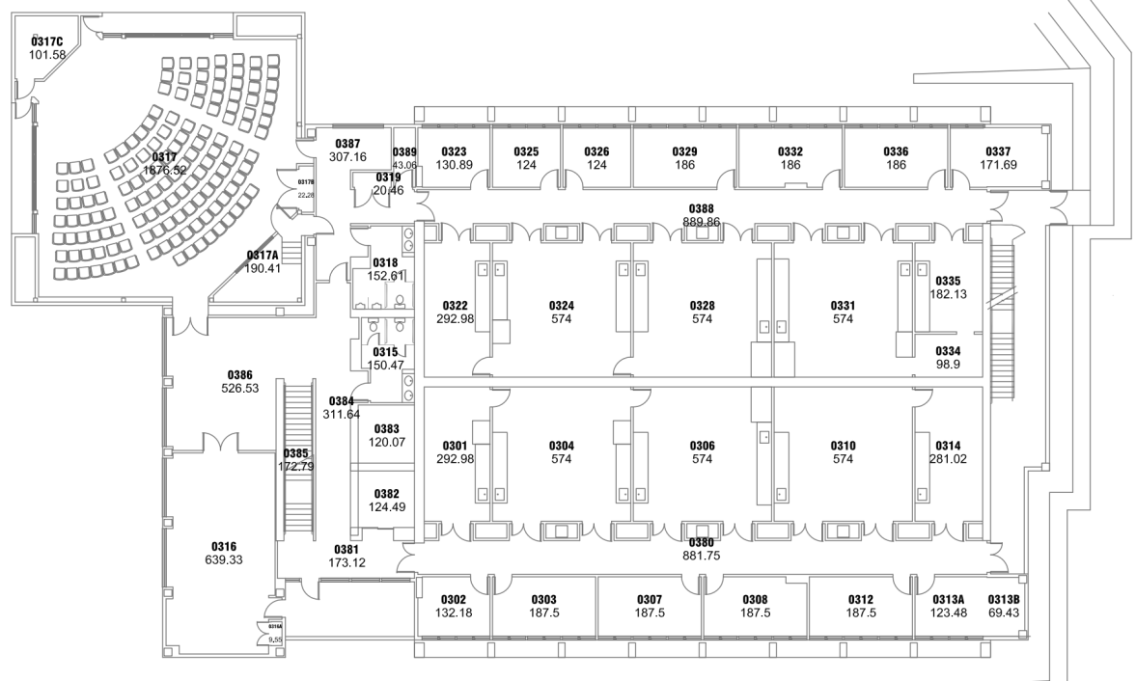
Logistics
Dinner & Meals
  Coffee, snacks and lunch in entry area

Slide 15
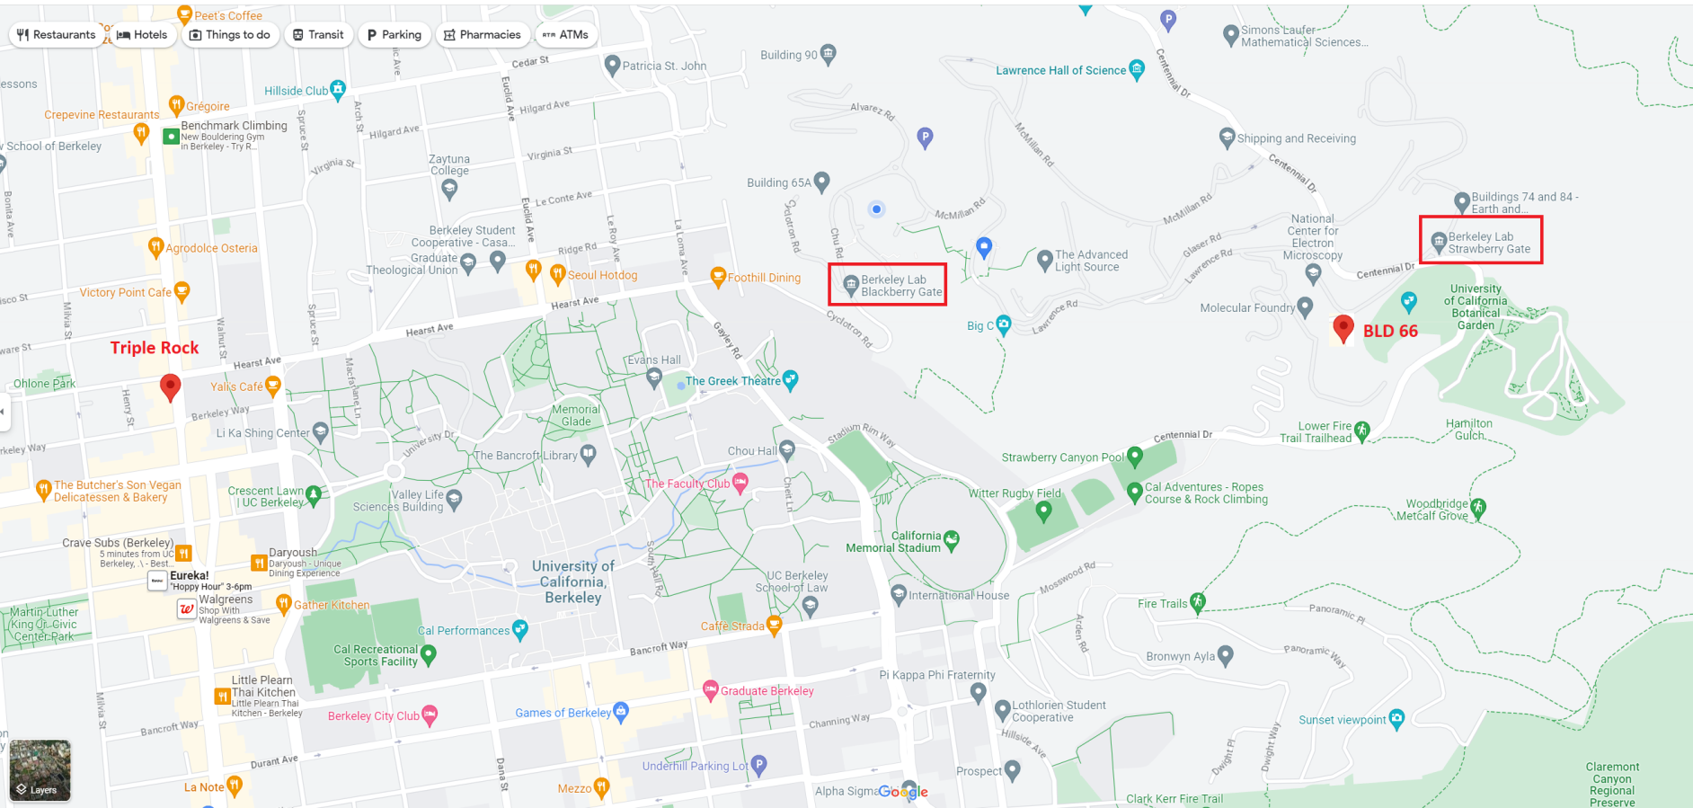
Logistics
Triple Rock for dinner (barring revolt)
Both shuttles will get you 2 blocks away

Slide 16
End of File
Thanks to everyone for joining
  In person and online
Thanks in advance to everyone who participates and presents!
Thanks to our sponsors!!
  Hank Zhu@NNSA DNN R&D
  Also DTRA-NTD, DHS CWMD, NA-20/80

