Slide 1


Compact Radiation Detector Array Fusion for Tracking and Interdiction (CRAFTI)
Dan Archer
John Sparger
Elaine Wong
Ryan Kerekes
John Holliman
Juan Restrepo
Douglas Peplow
Andrew Nicholson
Michael Willis
Jeremy Patterson
Johnathan Dreyer
Noah McFerran
David Chichester

Slide 2
CRAFTI Overview
Problem Statement: Current paradigms in radiation detection systems for counter-smuggling missions typically require undesirable tradeoffs between radiation detection sensitivity, operator burden, and/or impact to local site operations. This project seeks to enhance the usability of radiation detection systems in a wide variety of operational environments while reducing the system’s impact to local operations/operator burden.
CRAFTI Goal - Development of high-sensitivity radiation detection and attributions systems through
  Advanced signal processing and machine learning algorithms for data fusion using data from
  Reconfigurable and portable multimodal sensor systems (contextual and radiological) in two configurations:
    (1) Large single node systems (LLNL) and
    (2) Small compact system networks (ORNL)
to enhance the usability of radiation detection systems in a wide variety of operational environments while reducing the system’s impact to local operations/operator burden.
This all needs to be accomplished while keeping application in mind and involve end users in the process (NSDD, DHS/CWMD)

Slide 3
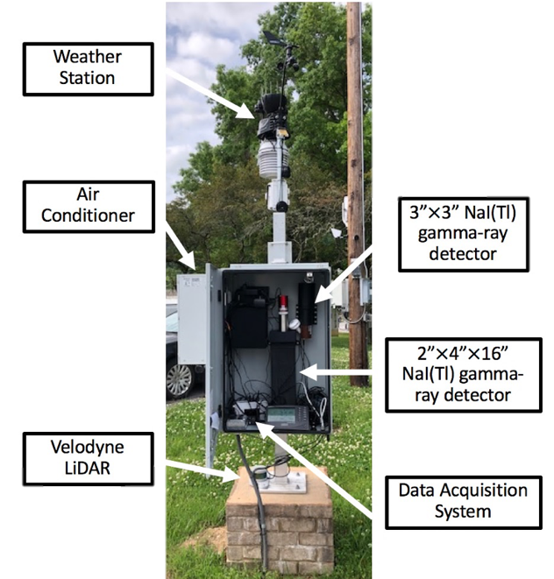
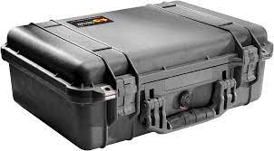

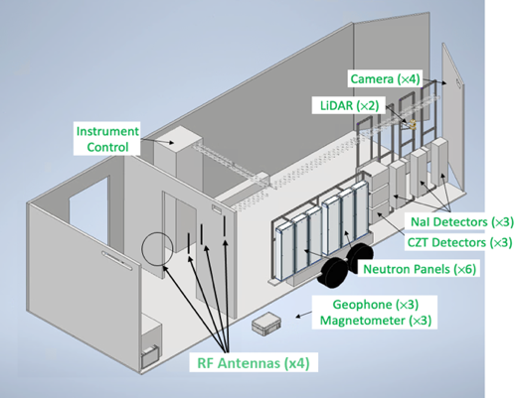
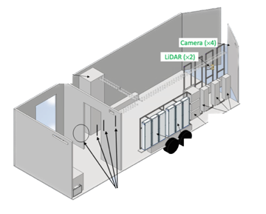
CRAFTI Overview
Where we are
Where we want to go:
MINOS Fixed Nodes
MINOS Fixed Nodes
Reconfigurable, Deployable Node
Multimodal Measurement System

Slide 4
CRAFTI Overview
Where we are
How do we get there?
Where we want to go:
MINOS Fixed Nodes
Questions:
What sensors are actually needed?
How should these sensors be configured to maximize efficacy in a variety of scenarios?
Reconfigurable, Deployable Node
Technology Advancement:
Can we develop or use algorithms developed by others to take advantage multiple modalities on a single node?
Can we fuse data effectively between multiple nodes?
Multimodal Measurement System

Slide 5
To Address These Challenges:
Address these questions and challenges by looking at available datasets and fill in the holes with synthetic data
Existing datasets:
  PANDA (LBNL) - radiation only available right now
  MINOS (ORNL) – radiation and we have local access to video
  Multimodal Measurement System (LLNL)
    Over 30 TB of radiation, camera, lidar, geophone, magnetometer traffic data
Augmenting existing systems and datasets:
  Hybrid synthetic data
    Inject synthetic data to the background collected by the physical sensor
    Allows one to use the wealth of experimental data, but add controlled threat encounters
    Radiation – inject dynamic Monte Carlo to measured backgrounds
    Visual – inject rendered video data into scenes
  Adding new sensors and reconfiguring existing sensors
    event cameras, magentometers, hyperspectral imagers
Great real-world data streams, but lack threat source variability and ground truth

Slide 6

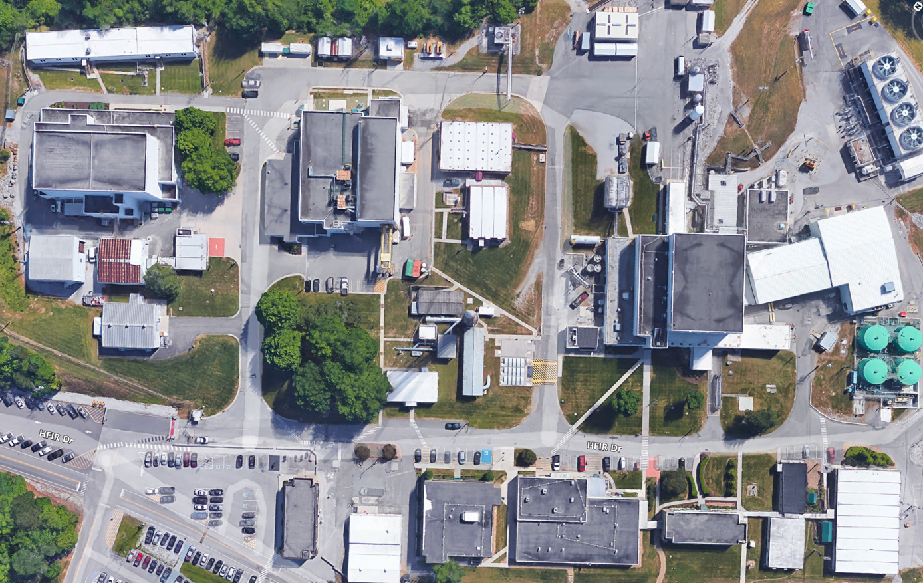
Hybrid Synthetic Data Injection – Radiation @ ORNL
ORNL High Flux Isotope Reactor
Radiochemical Engineering Development Center
MINOS Radiation Node Collection
Real Life:
Model:

Slide 7
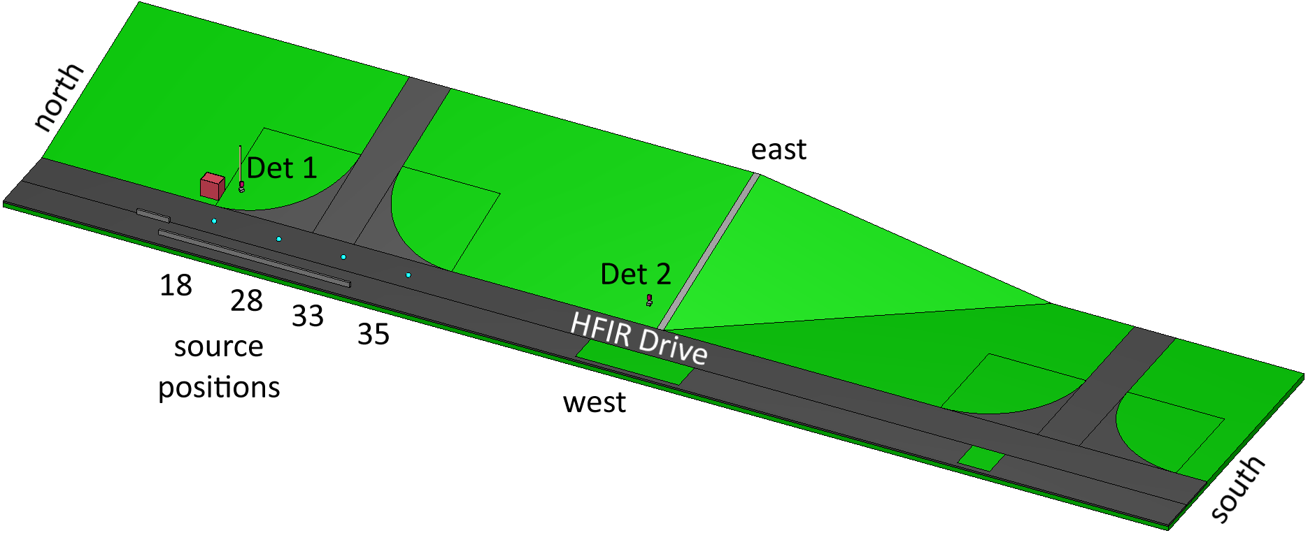
Hybrid Synthetic Data Injection: Radiation @ ORNL
ORNL High Flux Isotope Reactor
Radiochemical Engineering Development Center
MINOS Radiation Node Collection
3D Monte Carlo Model
Real Life:
Model:

Slide 8
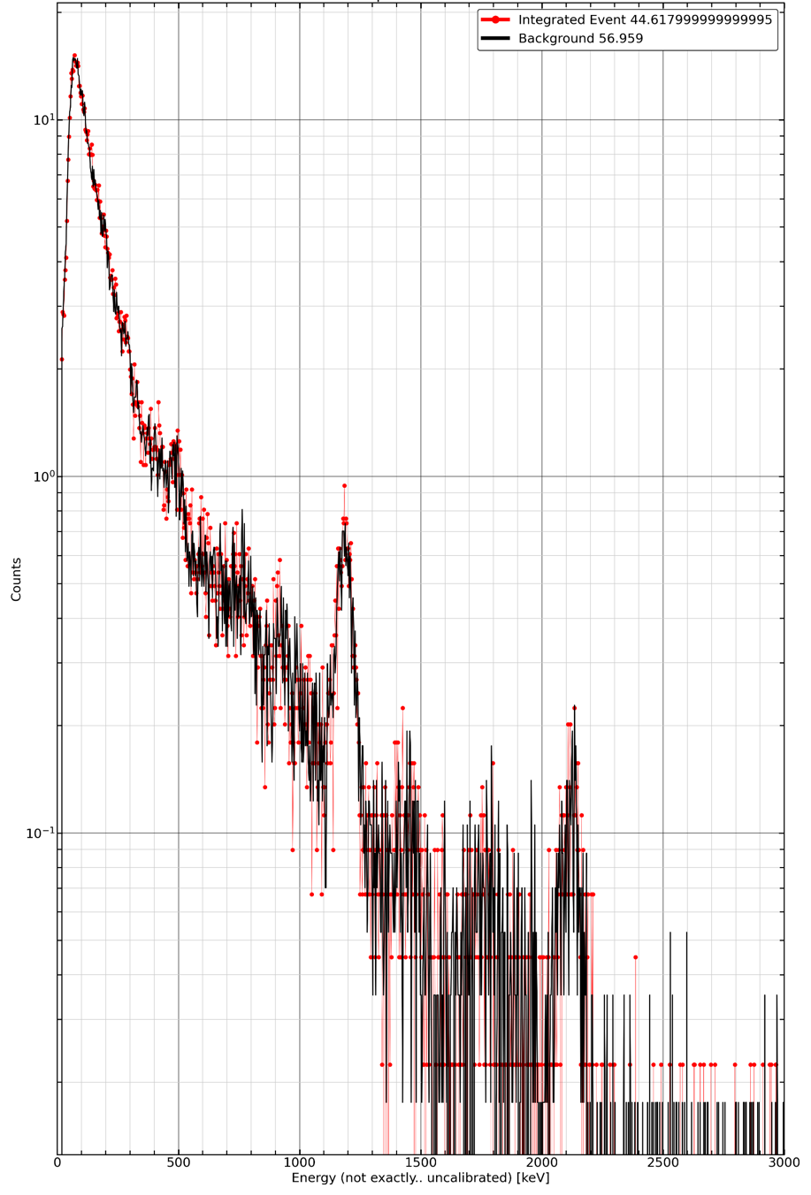
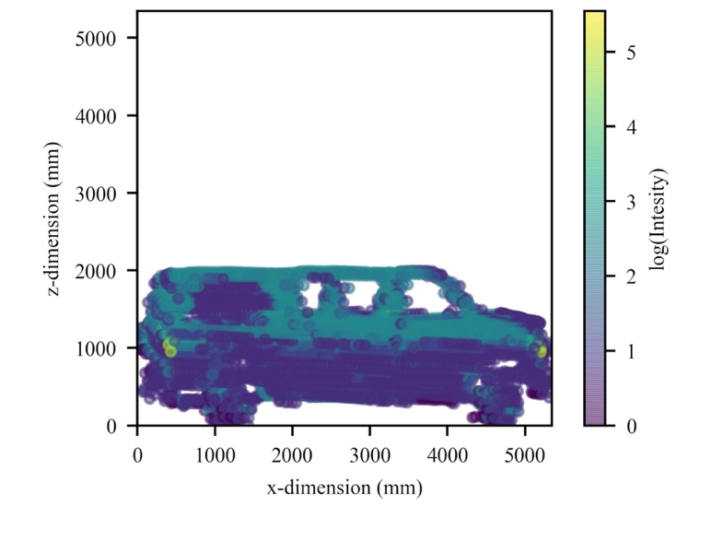
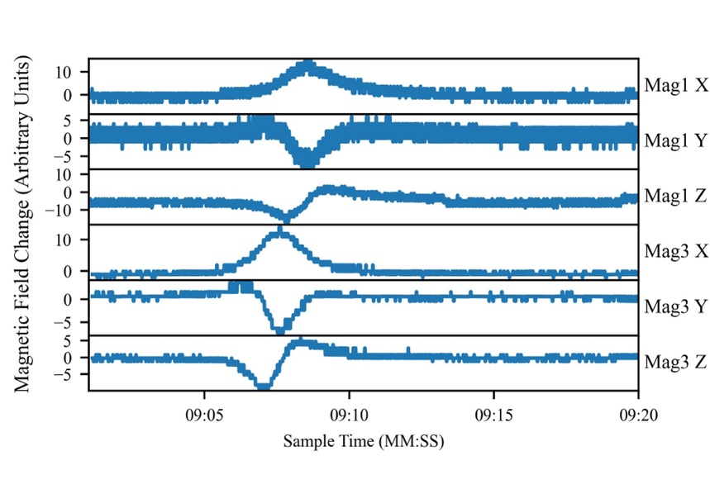
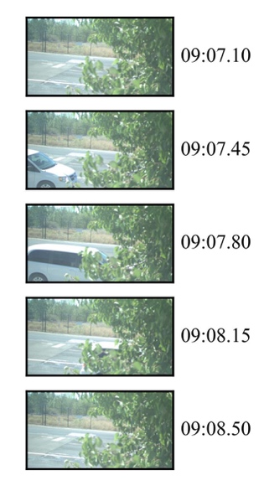
Hybrid Synthetic Data Injection: Radiation @ LLNL
Inject synthetic radiation signatures into true experimental vehicle pass-by events to simulate vehicles transporting radioactive material
  Uses the LLNL spanning source libraries to inject medical, industrial/RDD, fissile, and NORM sources into vehicles
  Includes unclassified LLNL Surrogate Nuclear Models set
Radiation
Camera
Magnetometer
LiDAR
Energy (keV)

Slide 9


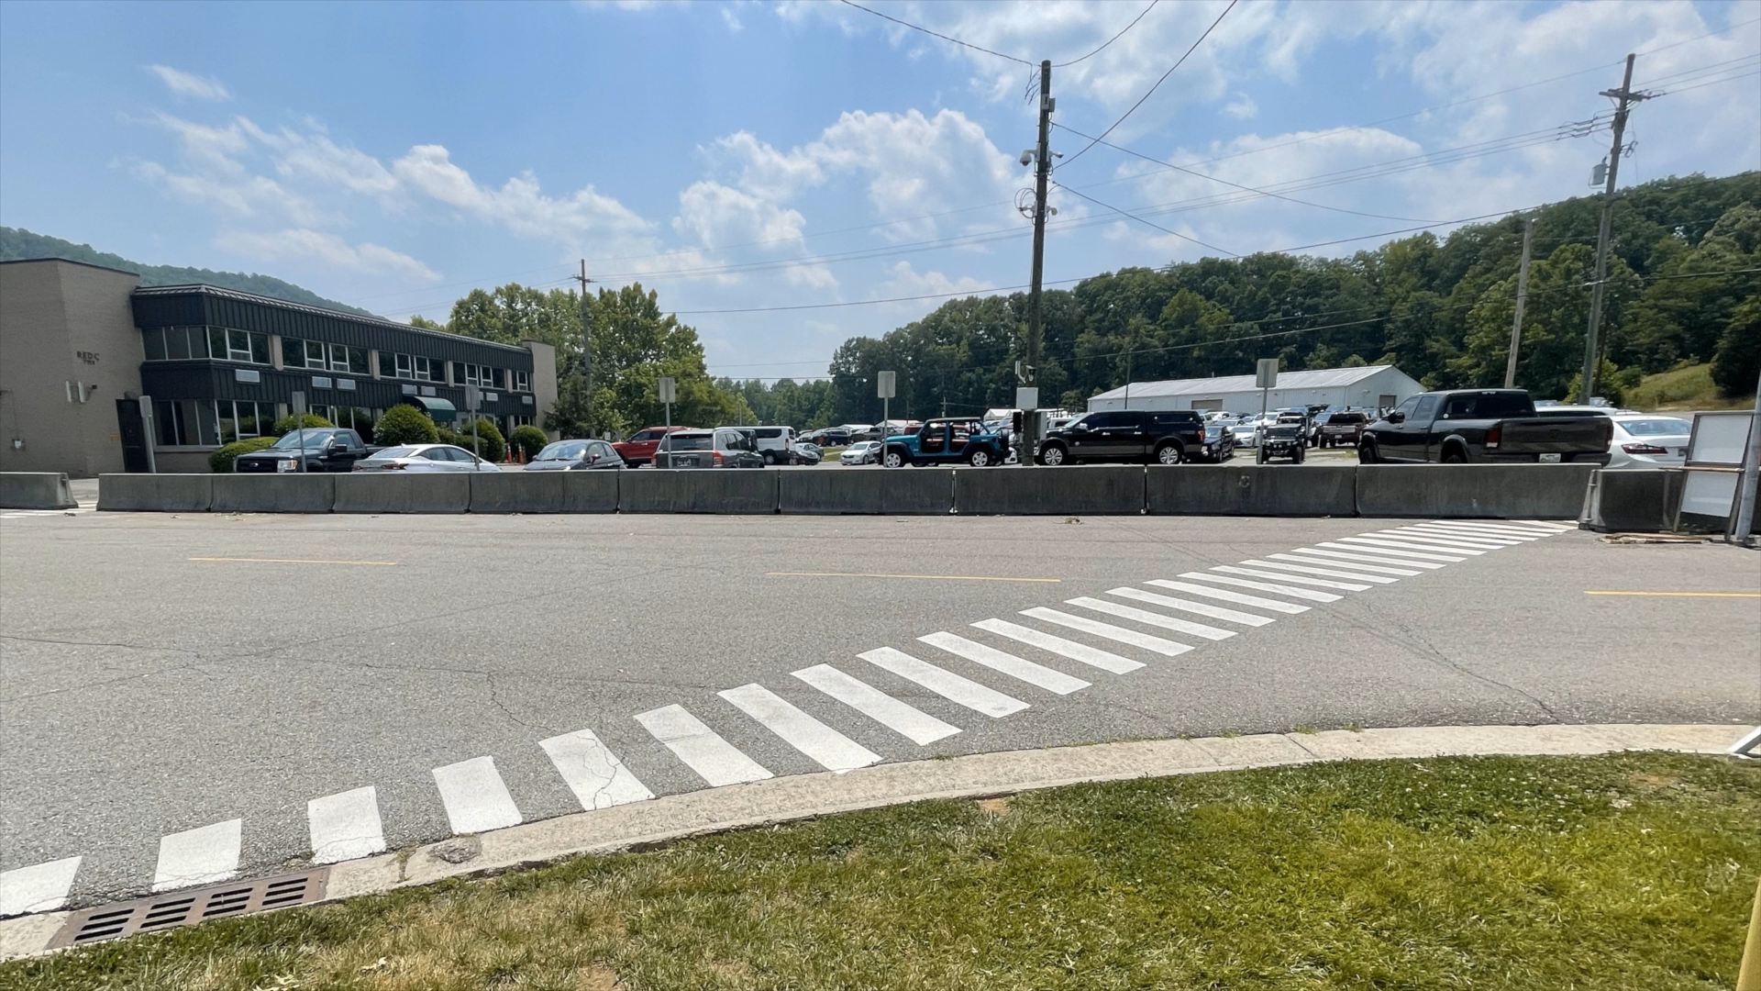

Hybrid Synthetic Data Injection: Video
The using COTS software tools, we can create inject vehicles (or other available 3-D models) into scenes nearby the detector.
Radiation data can be synchronized in time, sped up or slowed down. The radiation data can be a variety of sources that are scaled to develop the ROC curve.
Rendered video of synthetic vehicle using a preexisting video stream

Slide 10
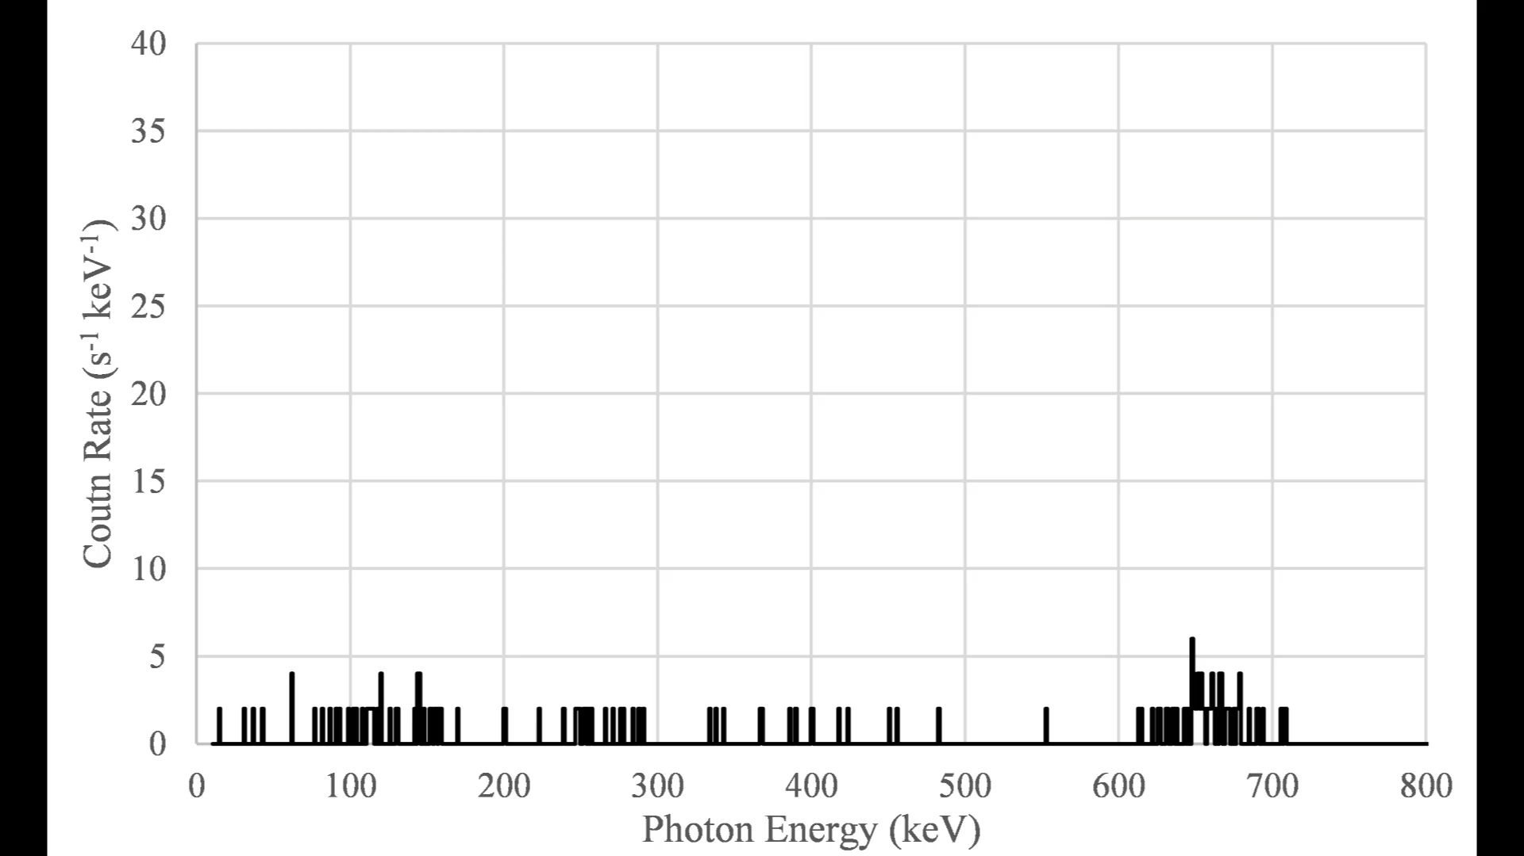
Hybrid Synthetic Data Injection: Video
The using COTS software tools, we can create inject vehicles (or other available 3-D models) into scenes nearby the detector.
Radiation data can be synchronized in time, sped up or slowed down. The radiation data can be a variety of sources that are scaled to develop the ROC curve.
Rendered video of synthetic vehicle using a preexisting video stream
Times series synthetic data from Monte Carlo source Injection (source only)

Slide 11
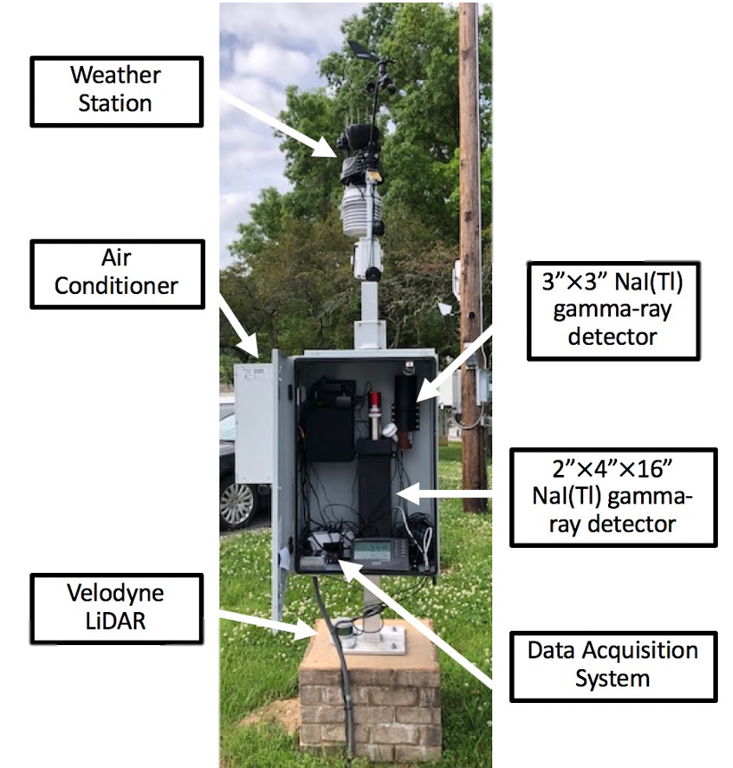
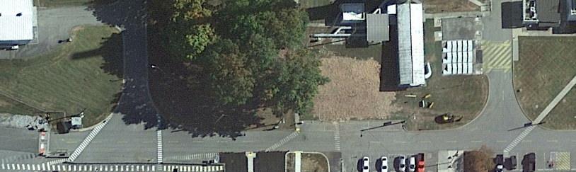
Adding new sensors and configurations
Currently refurbishing/augmenting MINOS
  Radiation
  Video
  *Event Camera
  Lidar
  RF
  *Hyperspectral
More sensors than will ultimately be used to allow for down select in the data fusion tasking
Planning to collect data to validate the model, simulation, and synthetic data where sensor models exist
  Weather
  Seismic
  Acoustic
  *Timing between nodes
  *License Plate Reader
  *Magnetometer
  *new sensor/data types
Node 1
Node 12

Slide 12
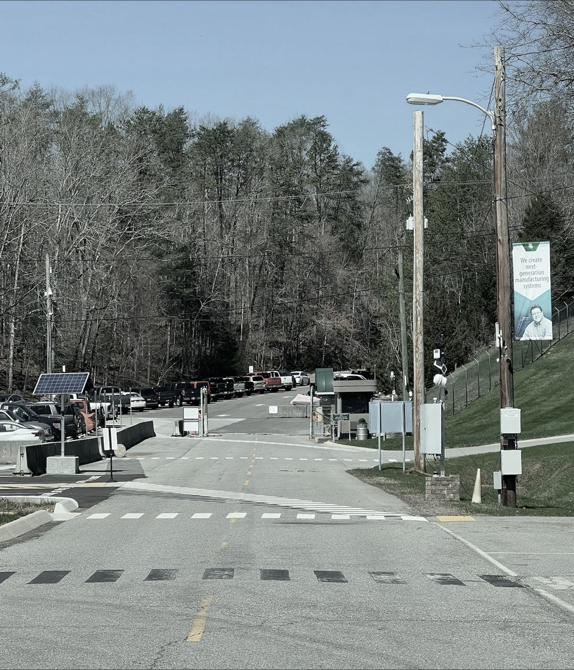
Reconfiguring Sensors
Visual camera reconfiguration
  Understand the limits of uniquely identifying objects based on camera configuration
    Camera angle (horizontal and vertical)
    Standoff
    Image resolution and compression
    Illumination (day/night, ambient light sources)
  Different vehicle features matter:
    Vehicle profile, make and model
    Vehicle wheels (rims, tire profile)
  Find the optimal camera configuration to:
    Detect and track all vehicles that pass by
    Develop a unique signature for each vehicle
    Associate vehicles between sensor locations

Slide 13
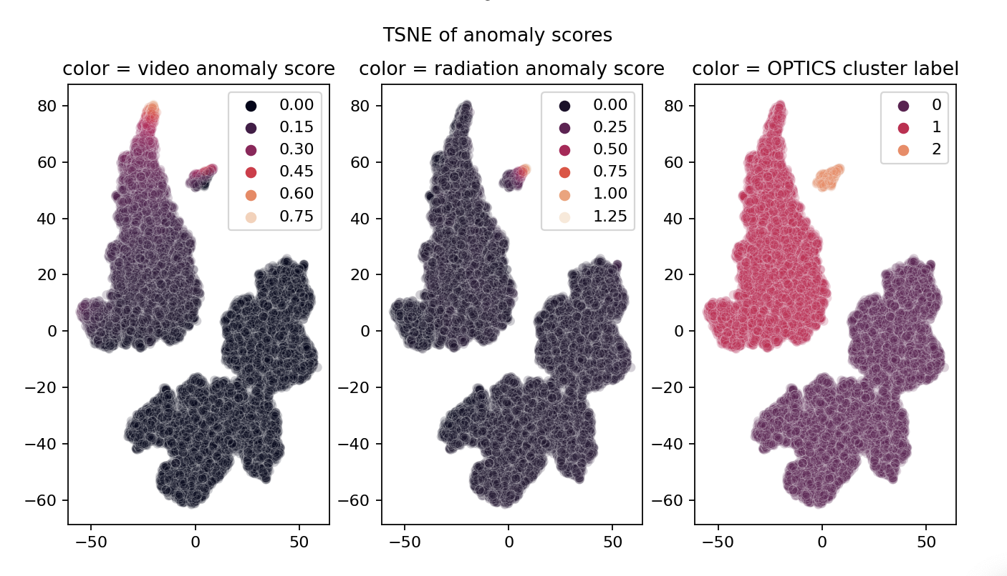
Multi-Modal Data Fusion
TSNE (or t-SNE): T-distributed Stochastic Neighbor Embedding
OPTICS: Ordering Points To Identify the Clustering Structure
Stage One:
Signal Improvement and Calibration
Perform data health checks, time sync across different modalities, improve signal-to-noise ratio.
Stage Two:
A Data Timeline Incorporating Fusion (Data Driven Discovery)
Identify the variables, degrees of freedom, and corresponding units for every sensor.
Fusion: Use a probabilistic graph model to exploit correlations that enhance signals that have been mapped into a finite dimensional space (dictated by the number of variables).
Stage Three:
Interpretability Using a Bayesian Framework
Extract potential features and artifacts of data. Construct priors such that when they are combined with the likelihood timeline, can be used to do statistical inferences on thresholds.
Apply thresholds for anomaly detection and alarm via clustering. Adjust sensitivity and discuss interpretability with domain scientists.

Slide 14
Multi-Modal Data Fusion (Stage 2)
Rolling window anomaly detection/feature extraction algorithms
Dimensionality reduction algorithm (embedding)
Input Data
2x4x16 NaI(Tl) γ-spectra (every 0.1s)
F(x)
2x4x16 Rad Anomaly Score (1 Hz)
3x3 NaI(Tl)
γ-spectra
(every 0.1s)
3x3 Rad Anomaly Score (1 Hz)
x*
t-SNE
Video
640x480
at 15 fps
G(x)
Video Anomaly Score (1 Hz)
y*
Seismic time series data at 2 kHz
H(x)
Seismic Anomaly score (1 Hz)
Each sensor’s time series data converted to an anomaly score
Embedding multi-dimensional anomaly metrics into a lower dimensional space to find patterns

Slide 15
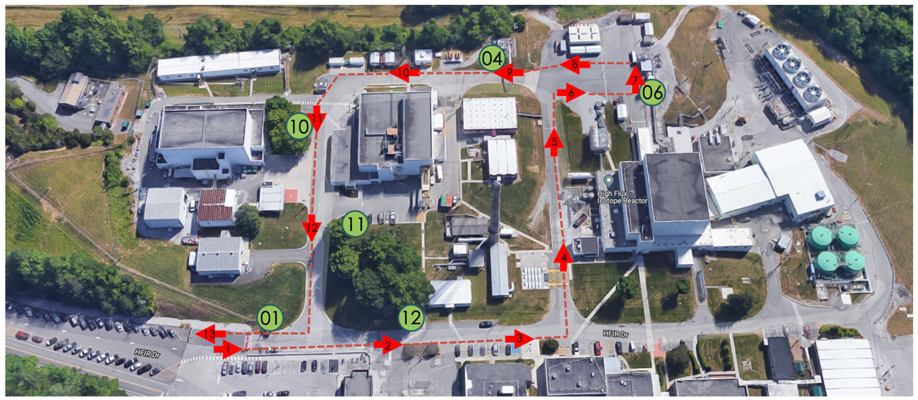
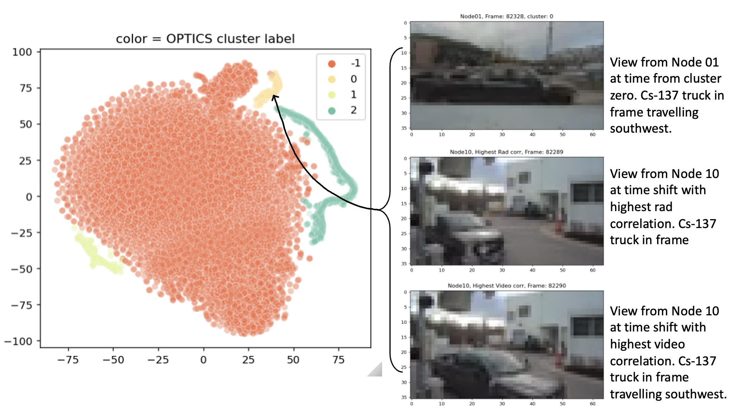
Multi-Node Data Fusion
Cluster 0 contains events where rad and video anomalies were present in both nodes
This should only happen when the Cs-137 truck is driving southwest between node 10 and node 01.

Slide 16
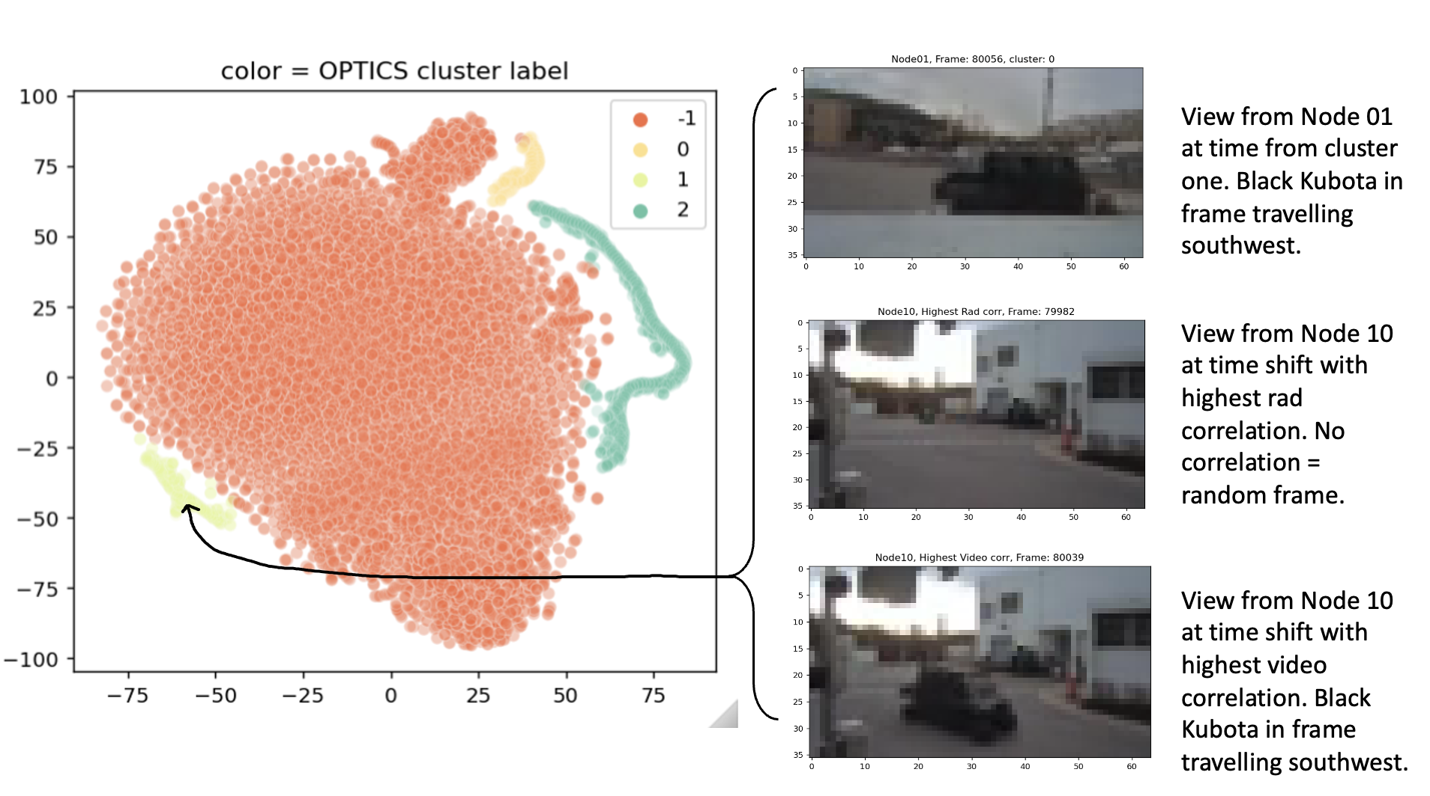
Multi-Node Data Fusion
Cluster 1 contains events where there were only video anomalies in both nodes.
This corresponds to normal vehicle traffic (for example)

Slide 17
Summary
CRAFTI is working towards the development of reconfigurable and portable multimodal sensor systems and fusing data in each node and between sensor systems
We are leveraging and augmenting existing datasets to understand
  which sensors to include in the CRAFTI nodes and how they should be configured
  build a toolset for analyzing the data they produce
We demonstrated data fusion for different sensors types and multiple nodes using data from the MINOS targeted collect.

