Slide 1
Advances in gamma-ray imaging for holdup determination
ORNL: K.P. Ziock, J. Daughhetee, A. Laminack, K. Schmitt
LBNL: M. Folsom, T. Joshi, D. Hellfeld, (Ren Cooper)
H3D: S. Brown, D. Goodman, Willy Kaye
UCB: K. Knecht

Slide 2
Holdup: stuff you don’t want to be there, but is
Material left behind in processing equipment when “all” material is removed:
Wherever you don’t think it should be
Want to know how much and where
NMC&A
Dose
Criticality
Operations

Slide 3
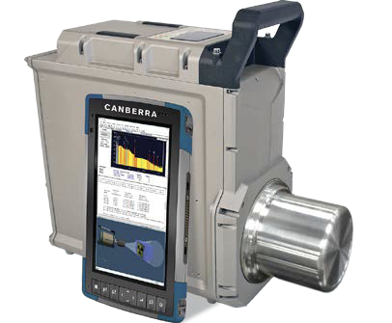
Baseline approach: Generalized Gamma Holdup (GGH)
Assuming a source
Position a detector
Add collimation
Collect data
Analyze
Need:
Efficiency of the detector ✅
Distance to the object ?
Aspect in collimation ?
Point, line, area
Backgrounds ?
Attenuating material ?
Repeat for all sources:
Systematics yield high uncertainties

Slide 4
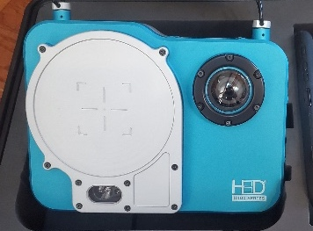
Gamma-Ray Imaging Assay
To perform assay, you need to know:
Efficiency of the detector✅
Backgrounds ✅
Distance to the object ?
Attenuating material ?

Slide 5
Multi-view Imaging Assay with Contextual Information
To perform assay, you need to know:
Efficiency of the detector✅
Backgrounds ✅
Distance to the object ✅
Attenuating material ?

Slide 6
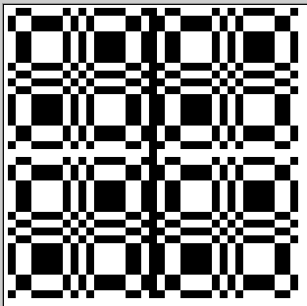
Coded-aperture imaging¹
In coded-aperture imaging a shadow mask is used to encode the scene onto a position-sensitive detector.
This allows one to generate images with radiation not amenable to mirrors or lenses.
The image can be recreated using cross-correlation:
$$I_{i,j}=\sum_{m,n}{M_{i+m,j+n}D_{m,n}; }$$
$$M_{k,l}=\left\{\begin{aligned}1, if mask open \\ −1, if mask closed\end{aligned}\right.$$
¹E.E. Fenimore, T.M. Cannon, Appl Optics, 17, 337, 1978.

Slide 7
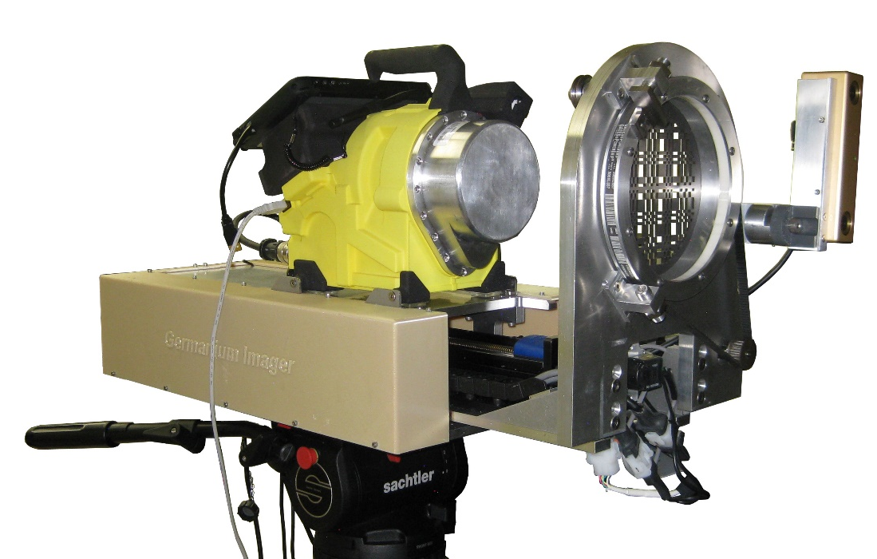
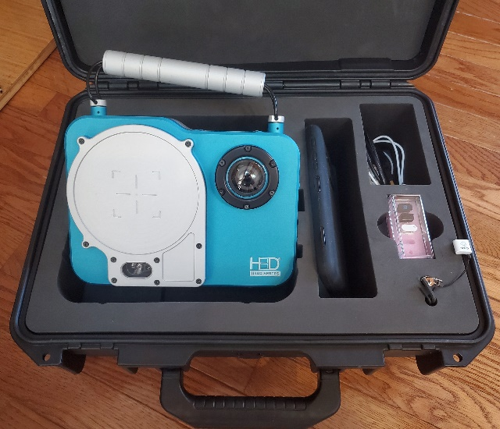
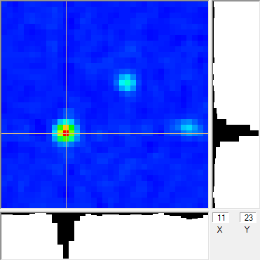
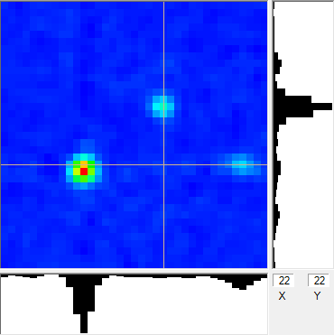
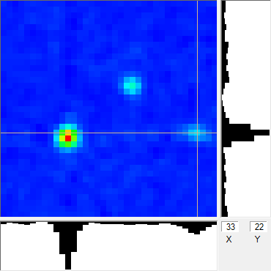
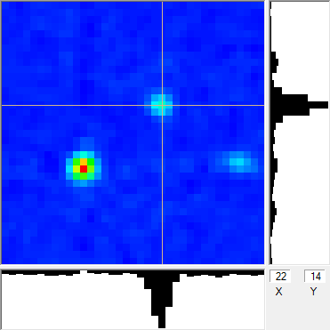
Gamma-Ray Imaging
Commercial imagers are available:
Does spectroscopy survive?
Are things quantitative?
Both are coded- aperture and Compton imagers
H3D, Inc. H420
PHDS/ORNL Imager

Slide 8
Quantitation requires calibration
Absolution detector efficiency vs energy
Imaging efficiency vs energy and source location
Solid angle
Poynting Vector
Mask self collimation
Interaction of mask with detector response
Imager
R
y
θ
r
d
x
Poynting
Vector
term
Mask
Contrast
Mask self
collimation
Solid
angle
det.
eff.
int.
time
N$=I_{s}\frac{A\cos^{2}{θ}}{4πR^{2}}εT\cos{θ}$
$$\frac{(a−x)(a−y) }{a^{2}}$$
$${(1−e}^{−t/λ_{m}})$$

Slide 9
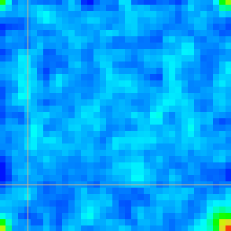
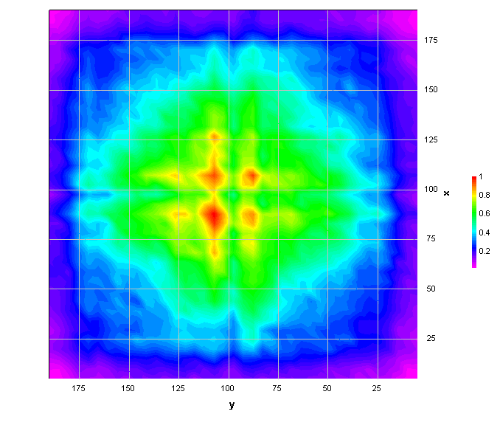
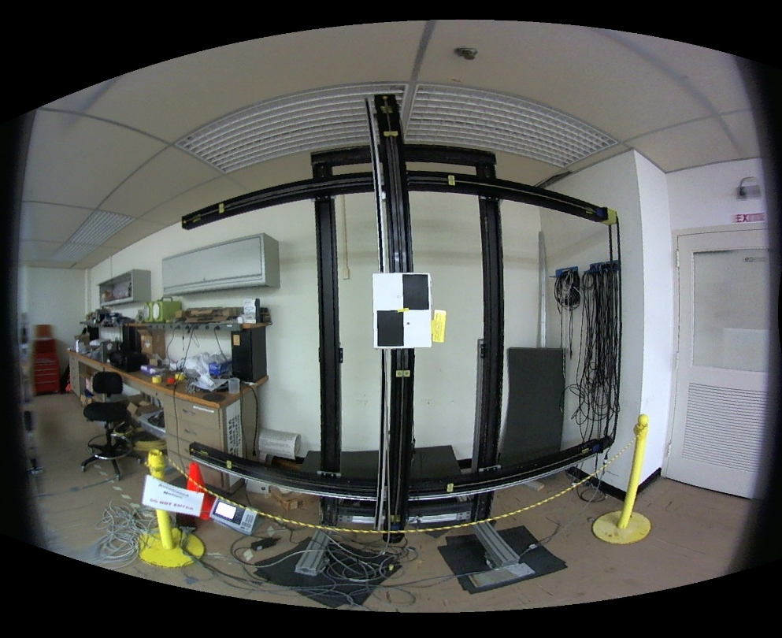
Calibration
Automated scan of a source throughout the field of view
Find each peak location and integrate to get response
Plot result vs location
Response map
Repeat at multiple energies

Slide 10
Simulations
Ideally simulate response at regular energy intervals
Validate with lab data
Use to interpolate at any energy and source distance
Radiation in Monte Carlo in Geant4
Source to detector through the mask
Record energy depositions (location and energy)
Detector response model
Take energy depositions and turn them into events
Energy smearing
Location smearing

Slide 11
Generate scene-specific correction from wide-field cube
For a given zoom generate a 2D correction for each pixel at the simulated energies
2D cubic spline of fraction weighted map
Do for each energy to make a new cube
For arbitrary energy
interpolate using a 1D cubic spline between pixels at simulated energies
Validated for different zooms at 186 keV
Checked variance of 5 × 5 source array throughout valid FoV
Validated E spline
omit an E map and use spline at that location
Variances comparable

Slide 12
Is it Quantitative?
Data from four, 50 × 75 cm² HEU card sources in different configurations
Singly
Side by side
Four
Bare and in duct
Table 3: HEU Card Results*
Card # | Time (h) | Uncert. (%) | In Duct¹ | Flipped² | Total ²³⁵U (g)
 |  |  |  |  | ²³⁵U (g) | Image Analysis (%)
1 A | 15 | 0.9 |  |  | 12.960 | 0.69
3 B | 3.5 | 2.0 |  |  | 11.193 | -3.15
4 C | 3.5 | 2.1 |  |  | 11.106 | 0.31
10 D | 15 | 0.9 |  |  | 11.162 | -1.90
D | 3.5 | 2.4 | x | x | 11.162 | -1.63
A | 3.5 | 2.5 | x |  | 12.960 | 3.09
A, D | 7 | 1.5 | x | 1 | 24.122 | 1.90
A (with D) | 7 | 2.4 | x | x | 12.960 | 0.77
D (with A) | 7 | 2.7 | x |  | 11.162 | 3.12
A, B, C, D | 15 | 0.8 | x | 1, 3, 4 | 46.421 | -0.88
Bare
In Duct
Multiple
Cards
* Updated from: Ziock, et. Al, 2021 Joint ESARDA INMM Annual Meeting

Slide 13
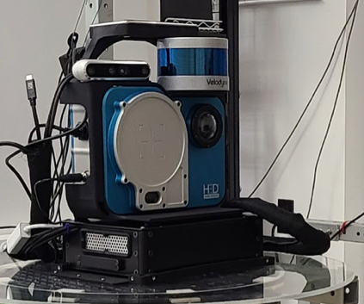
Scene Data Fusion (LBNL)
Gamma-ray images contain a wealth of information.
But quantitative analysis requires knowing where things are.
Ancillary scene-scan instruments can provide a map of the scene:
Laser imaging, detection, and ranging (LIDAR)
Stereo Camera
GPS
Inertial motion sensors (IMU)
LIDAR
Stereo camera
SLAM
Computer
Data fused using Self localization and mapping algorithms (SLAM).
Generates a point cloud of the scene 3D distances to points in the scene.
Pose information (instrument location and pointing with respect to the cloud).

Slide 14
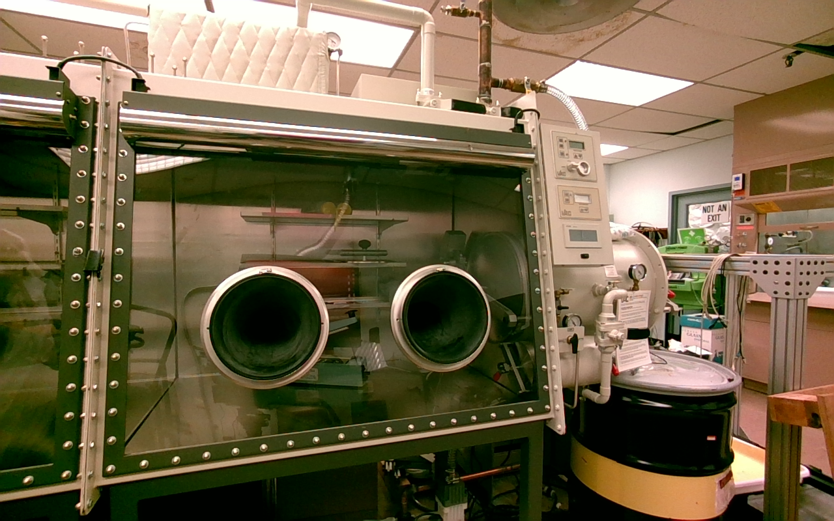
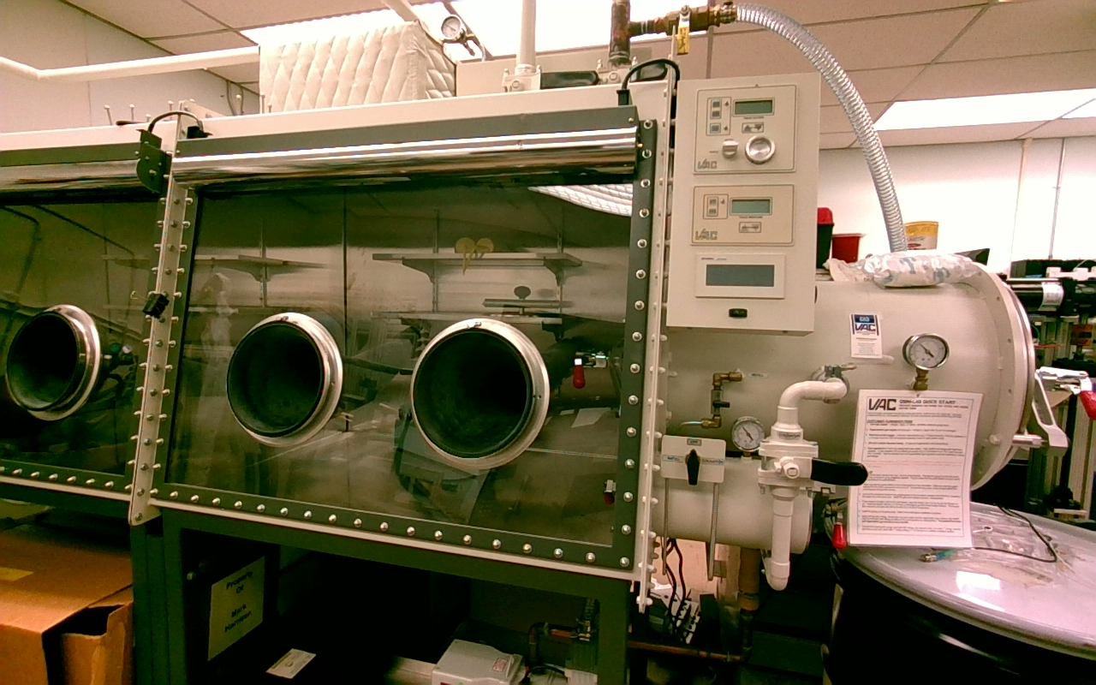
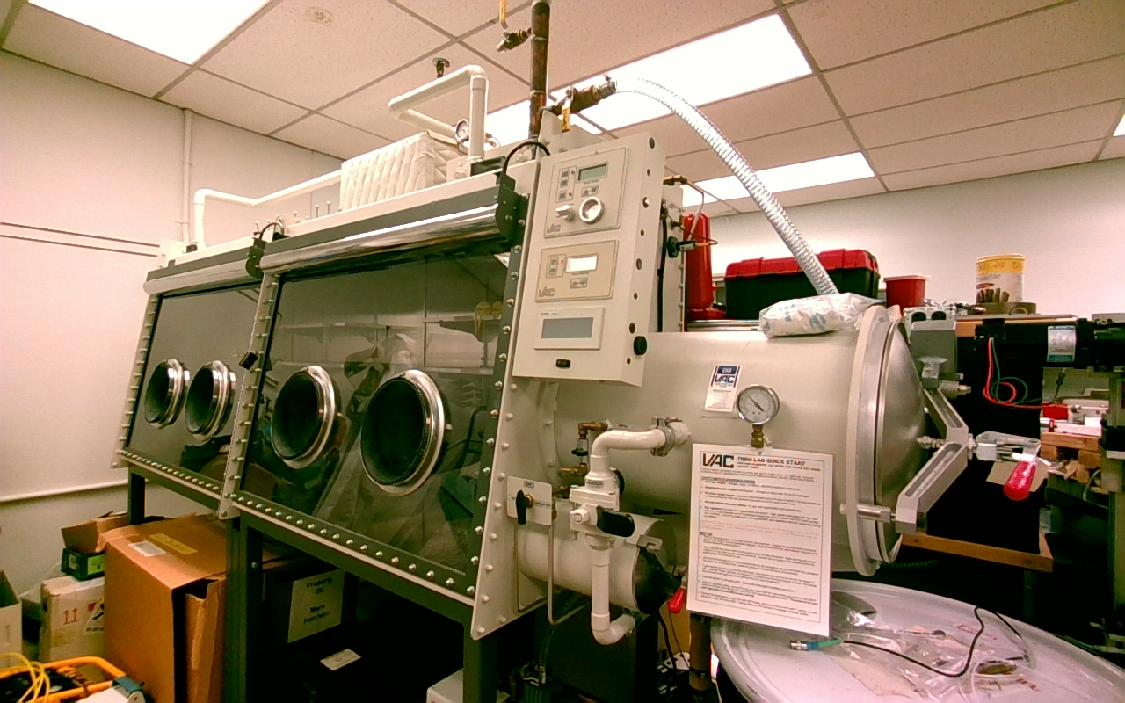
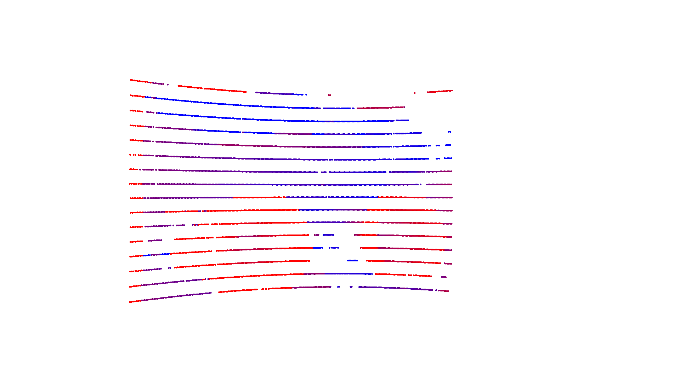
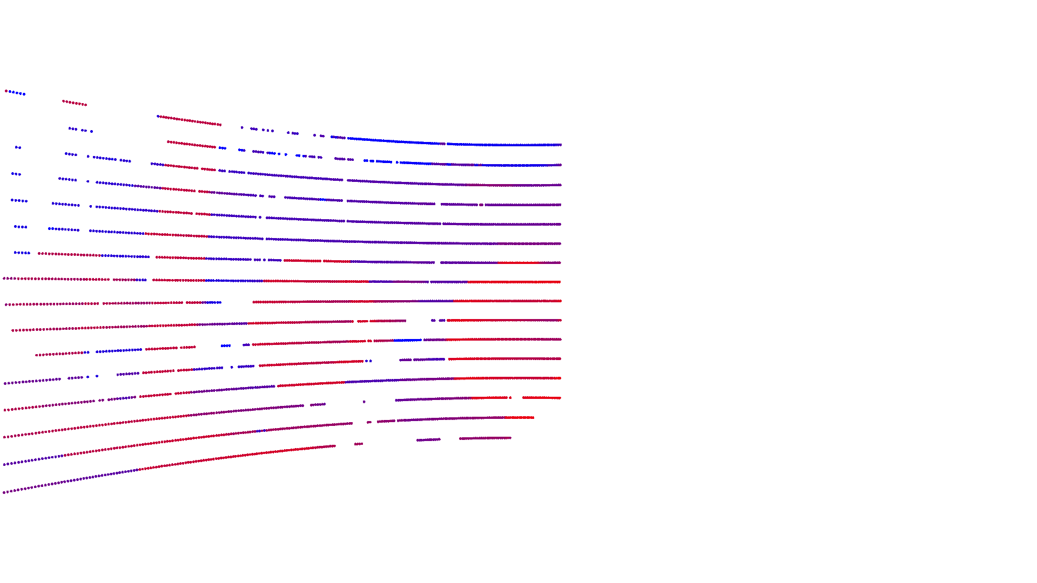
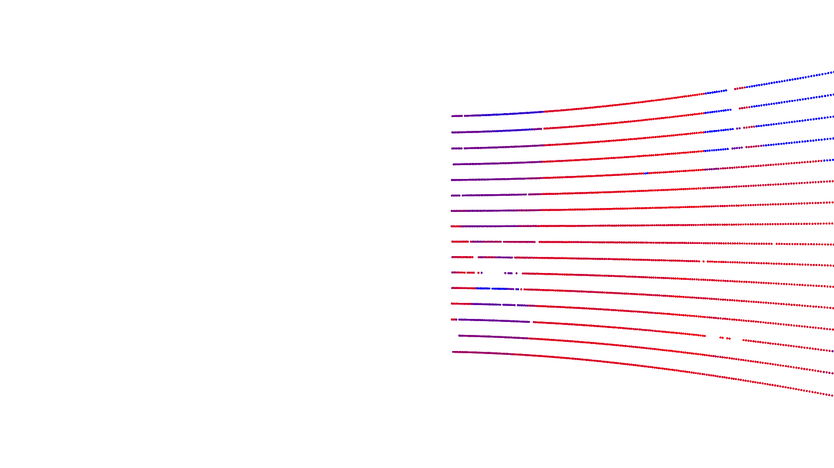
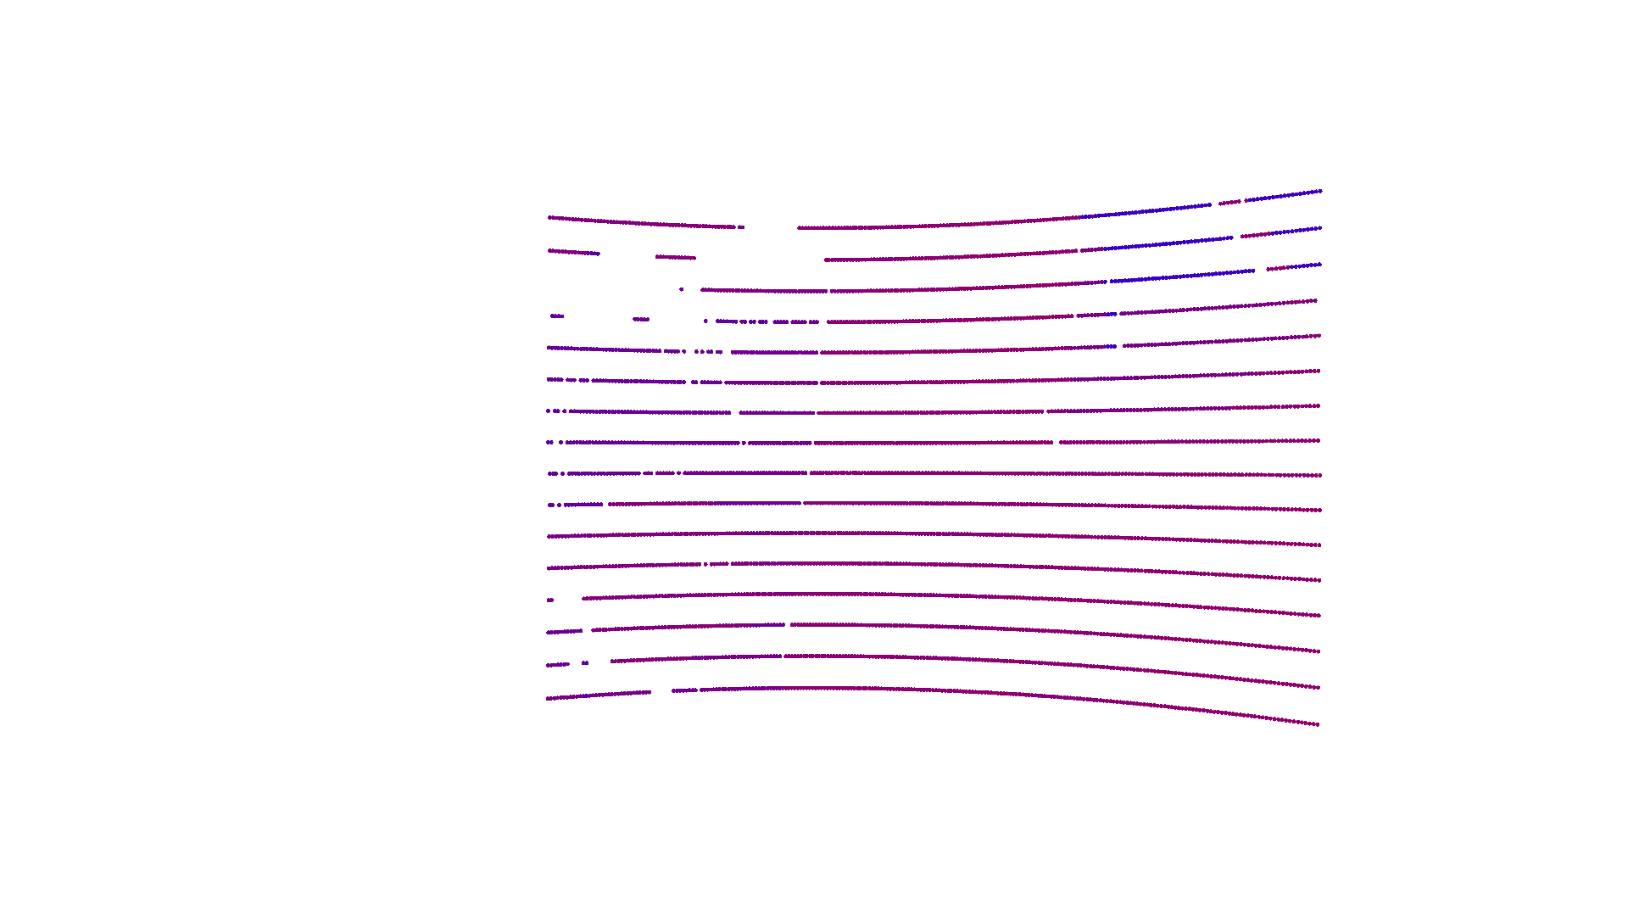
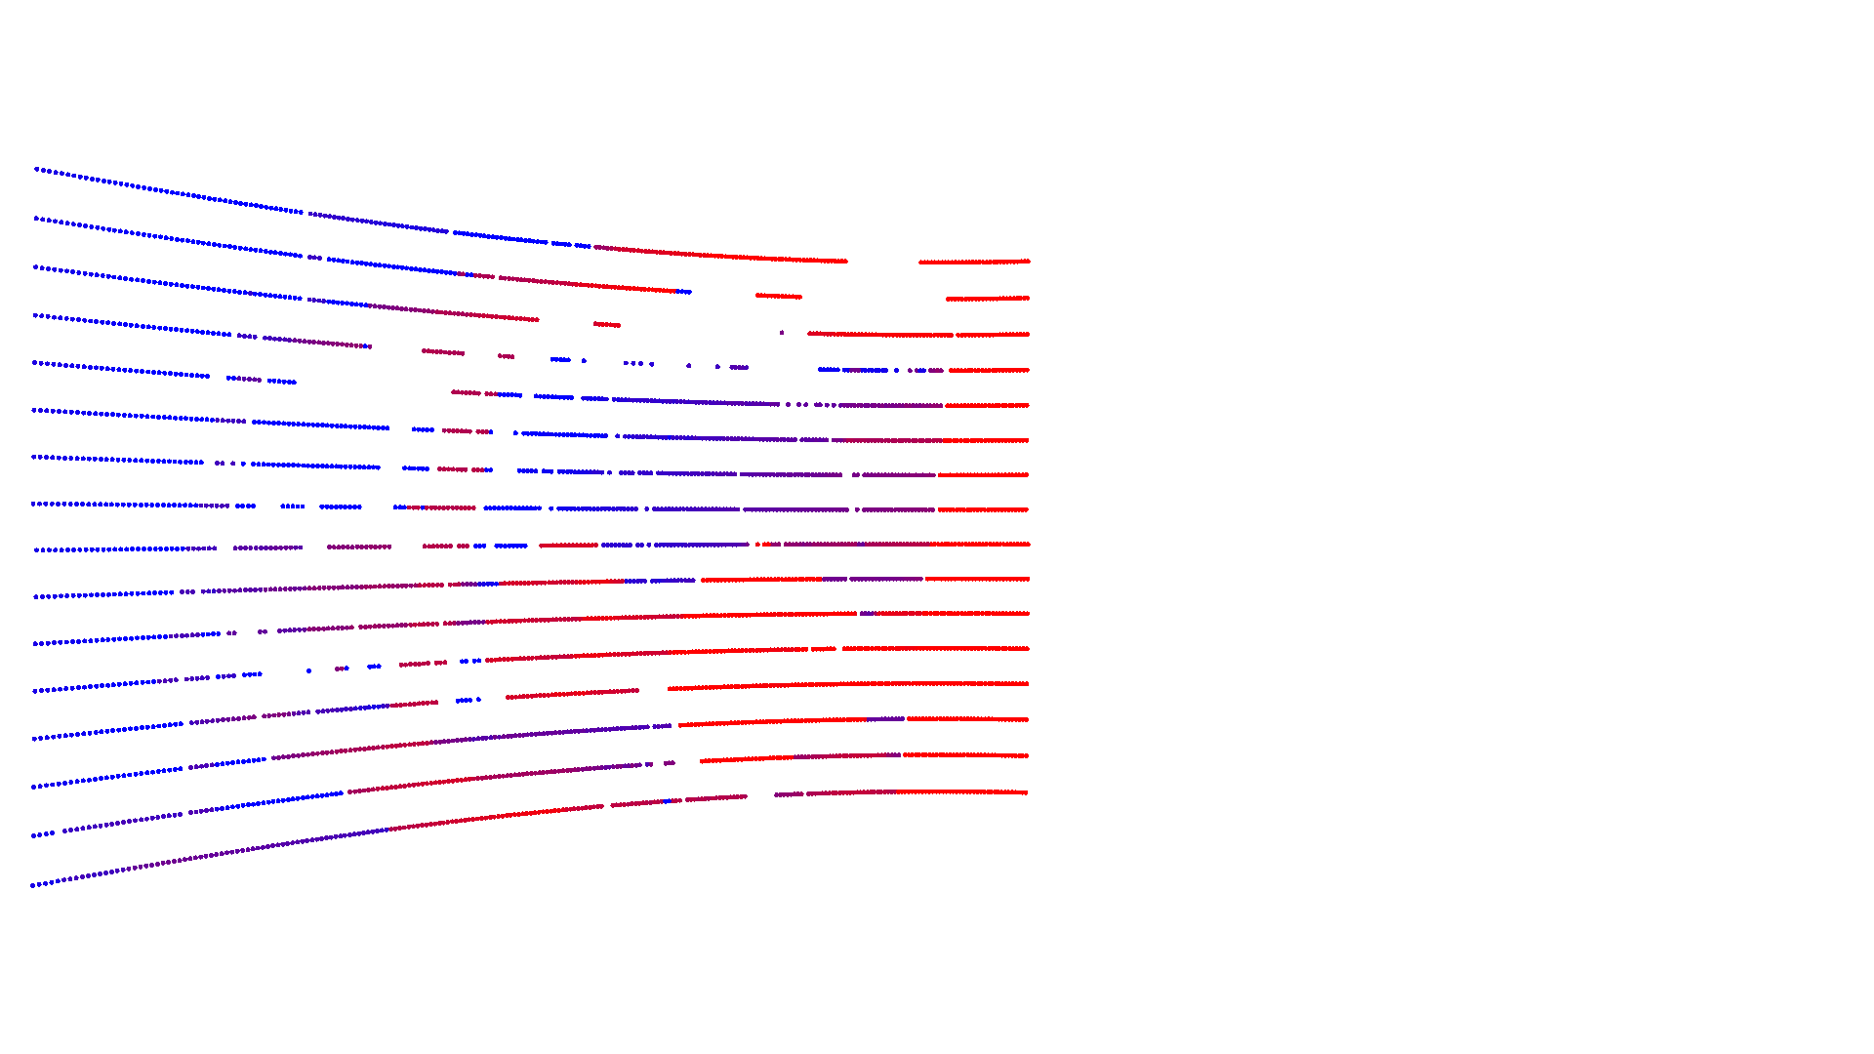
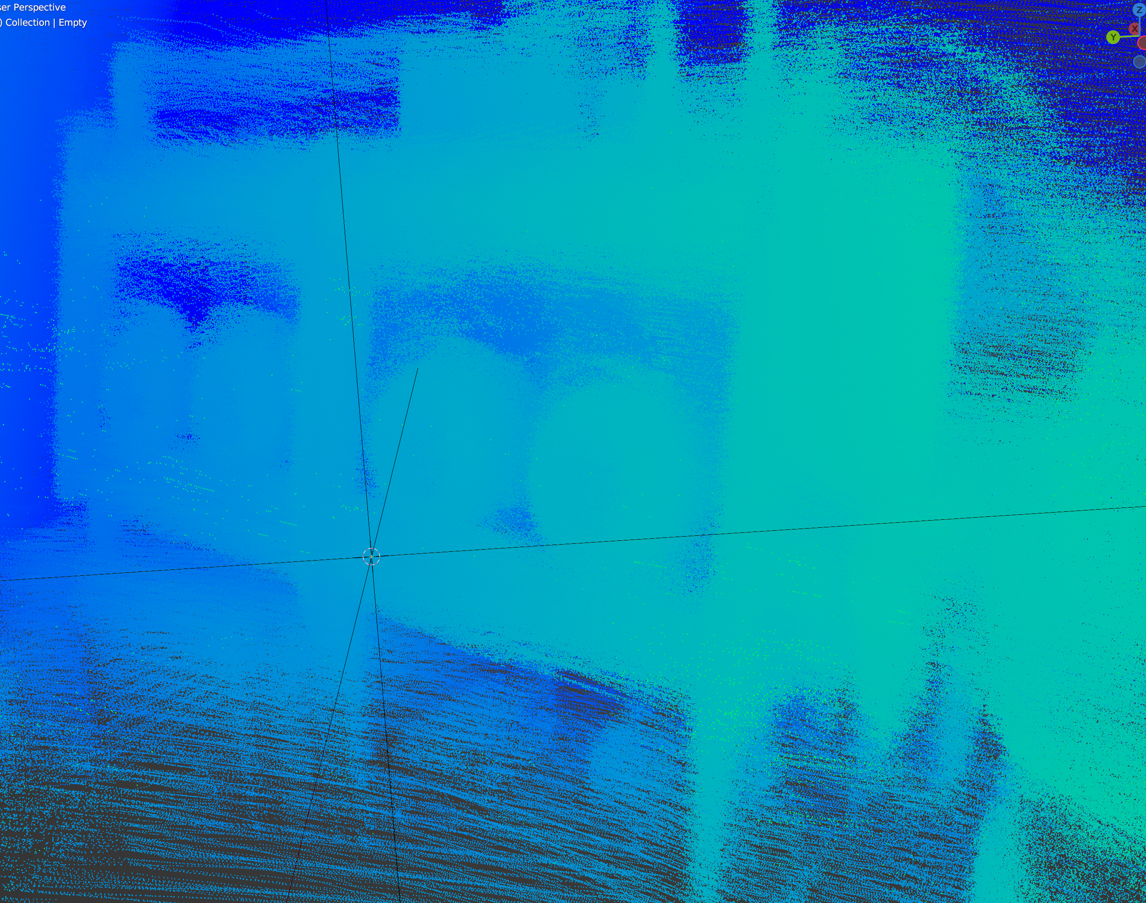
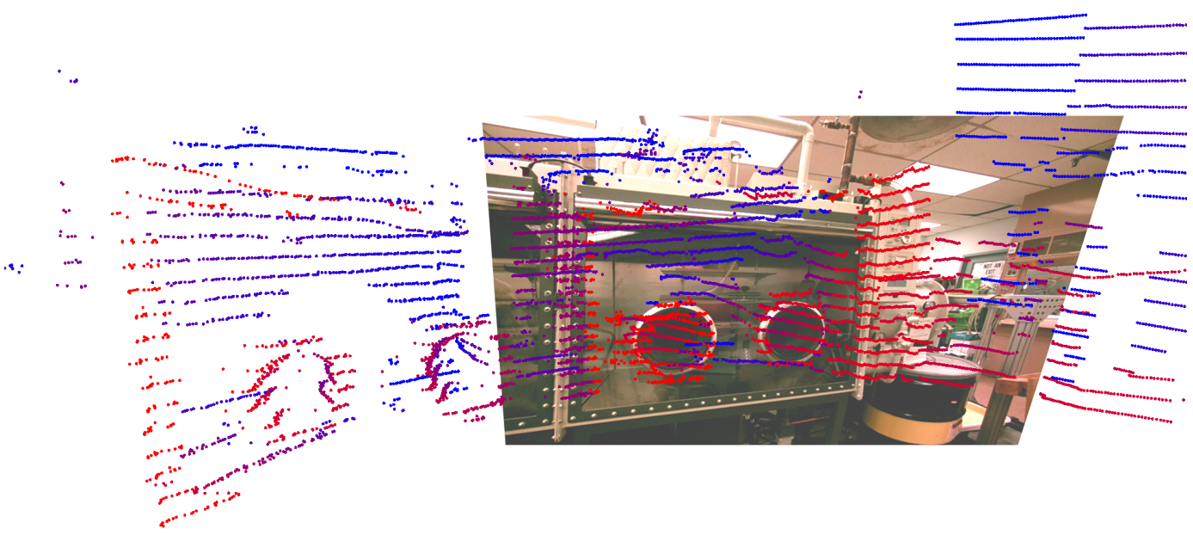
SLAM
Start with LIDAR point cloud on a single image.
Move to new locations.
At each location match the same points to allow connecting point clouds.
Build full point cloud by scanning.

Slide 15
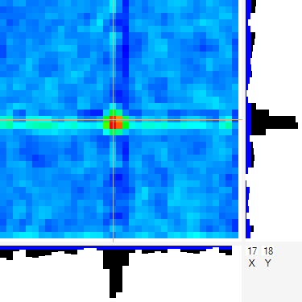
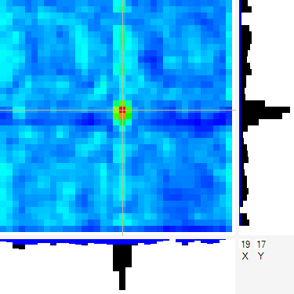
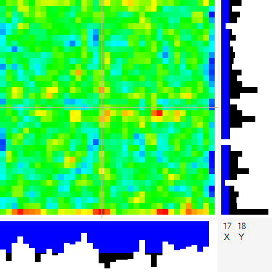
From fixed locations collect gamma-ray data
Need longer dwell for fixed statistics.
Contextual information from SLAM provides pose of imager.
Informs location and distance to objects in the image.

Slide 16
General Approach
Measurement procedure:
Map measurement region with contextual sensors.
Select a few directions for long dwell measurements.
Need good counting statistics for accurate quantitation.
Voxelize the measurement region.
Perform MLEM analysis.
Integrate the amount of material.
Issues
Using a large voxel set and MLEM is computationally expensive.
Few-view data can be underdetermined for tomography (ghost sources).
Matching precomputed response maps to measurement voxels.

Slide 17
“Early-Fusion” Data Projection
Directly use the detector data and system response matrix to project data onto the scene.
Use maximum likelihood expectation maximization (MLEM).
Pre-generate response matrix from calibration data and simulations.
Response matrix provides a quantitative link between each 3D voxel in the field of view and each detector pixel.
No initial deconvolution.
Can include subtle effects such as:
Partial shadow shift if moving less than a full resolution element,
Source distance information (magnification of shadowgram),
Detector imperfections (If you can map them),
Attenuation of intervening materials (if known).

Slide 18
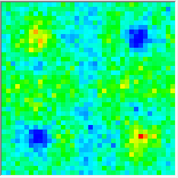
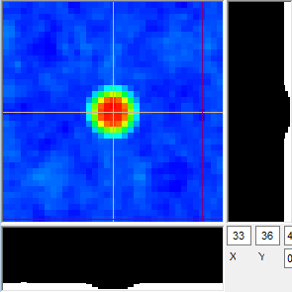
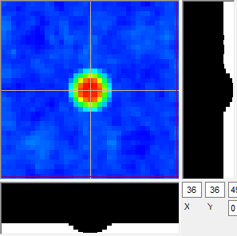
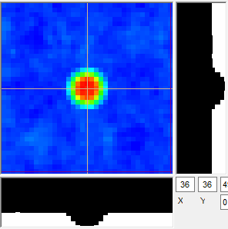
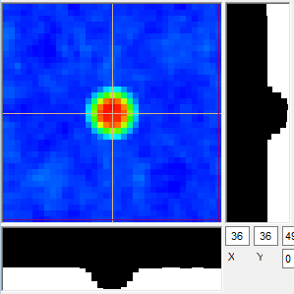
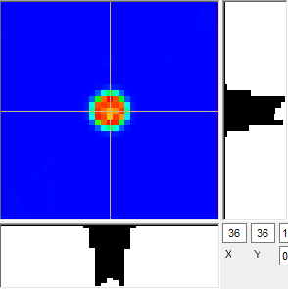
Iterative Reconstruction (MLEM)
Start with the detector data and system response
$$f_{j}^{(s+1)}=\frac{f_{j}^{(s)}}{\sum_{i=1}^{n}{R_{ij}}}\sum_{i=1}^{n}{\frac{R_{ij}d_{i}}{\sum_{k=1}^{m}{R_{ik}f_{k}^{(s)}}}}$$
Current Image
Im to Det
Trial Data
Applicaton
Compare
Data
1
2
Delta Image
Det to Im
Det Mod

Slide 19
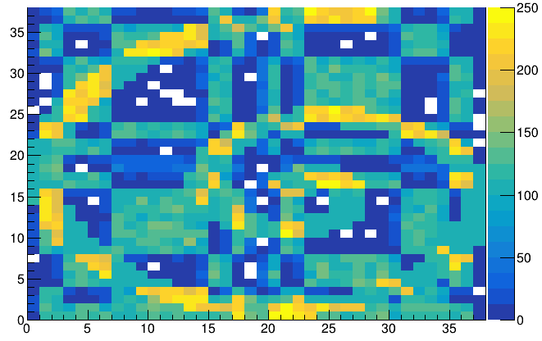
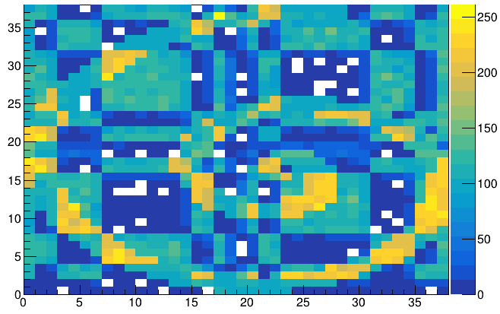
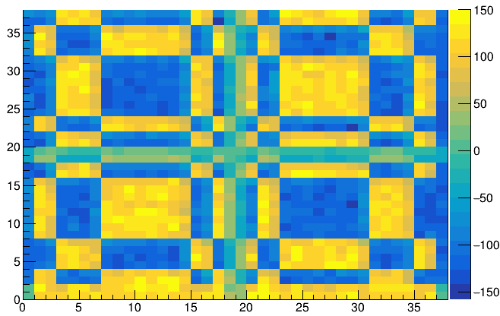
MLEM Can Be Computationally Expensive
Need a response for every voxel in the field of view.
Want Mask/Anti-Mask images.
Allows for location-dependent varying count rates not due to the mask.
Normally subtracted, but MLEM cannot handle negative values.
Expand response to include separate mask and anti-mask data.*
Add linked data that is the same for mask and anti-mask detector pixels (background).
Add same for each view angle, and energy.
(Mask + background) -
(Anti-mask + background) =
Mask - Anti-mask
* E. Brubaker, IEEE NSS/MIC, 2013, doi.org/10.1109/NSSMIC.2013.6829618.

Slide 20
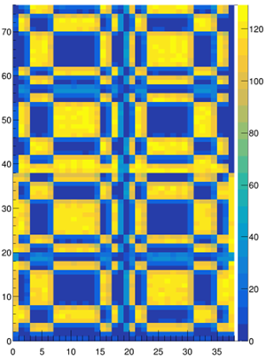
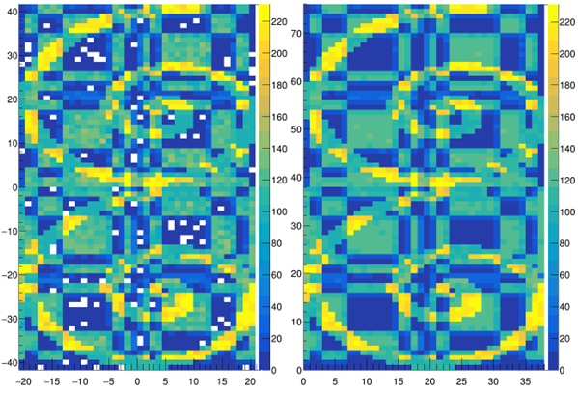
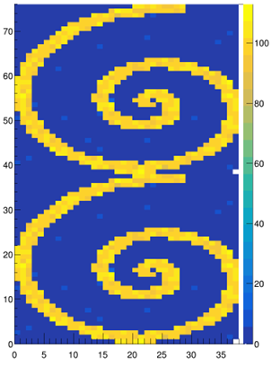
Sample MLEM results
Simulated “data” Individual detector
MLEM Fit Results
“True Signal”
(simulated point source response functions)
Mask
Anti
“Unmodulated Background” (single-pixel response functions)
Additional Views and energies

Slide 21
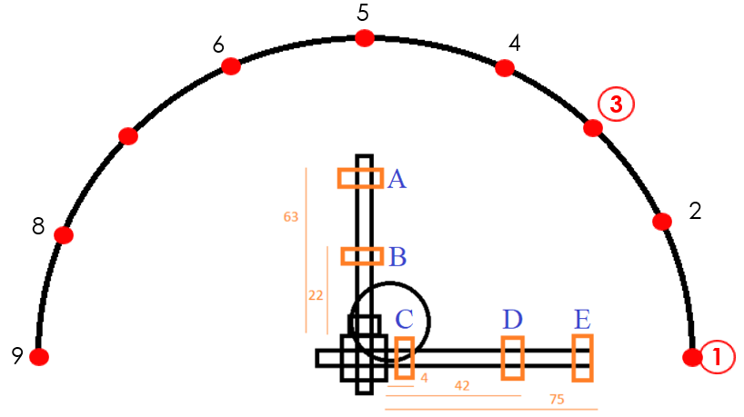
Config 1 – Single source, center field of view

Slide 22
Apply prior knowledge to analysis
Source material can only exist:
On surfaces,
In closed volumes.
Segmentation and labeling can be used to identify voxels where source can exist.
Only such voxels need to be included in the MLEM iteration.
Reducing allowed source voxels also reduces locations where ghost sources can appear.

Slide 23
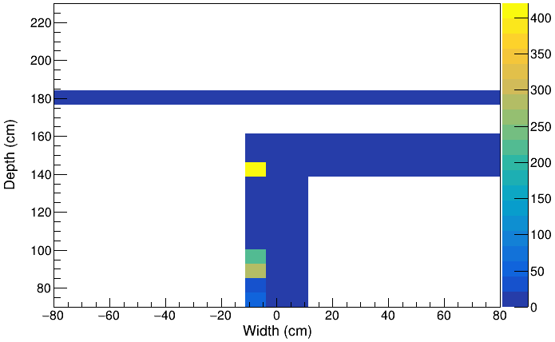
Preliminary Results – Configuration 1+3
Restrict source voxels
Lie near source holder
Added back wall
Source 1:
419 µCi
~9 cm from expected location
Source 2:
590 µCi
~17 cm from expected location

Slide 24
Voxel alignment
Each imager will have a precomputed response map to a set of voxels.
These need to be mapped to the scene voxels.
With multiple views, alignment to contextually generated voxels will be imperfect.
We need a simple way to shift the response maps to match the global voxel set.
Small transverse source shifts handled as shift to pattern phase.
Small distance changes handled as changes to the pattern magnification.

Slide 25
Summary
Gamma-ray imagers suitable for holdup measurements are commercially available’
Contextual data provides measurement geometry needed for accurate quantitation.
Combined system provides:
Background immunity,
Systematics are reduced because one knows material location,
Material mapped to hardware (improved attenuation corrections).
Imager can reduce manpower.
Require fewer long-dwell (unattended) measurements.
Analysis can be automated.
This work was supported by several offices in the National Nuclear Security Administration.
It was performed by UT-Battelle, LLC, under Contract No. DE-AC0500OR22725 with the U.S. Dept. of Energy.

