Slide 1
Object Detection and Tracking, Source Object Attribution, and Application in Sensor Networks
Ren Cooper
Lawrence Berkeley National Laboratory
Radiological Data Fusion Workshop
August 15th, 2023
RJCooper@lbl.gov

Slide 2
Outline
Radiological Source Object Attribution
Application to City-scale Networked R/N Detection
Research Needs

Slide 3
Motivation
Contextual information allows us to measure/quantify the factors that influence the measurements we make with radiation detectors
This helps to inform and/or constrain the inversion from measured counts to actionable information
When the detector is moving, we track its motion and the environment it is moving through
When the detector is stationary, we measure the world around it
E.g., presence, nature, strength location of an anomaly
E.g. tracking objects that could be carrying a source
Leverage inverse square law to provide localization and situational awareness
Improve detection sensitivity by optimizing integration time

Slide 4
Motivation
Contextual information allows us to measure/quantify the factors that influence the measurements we make with radiation detectors
This helps to inform and/or constrain the inversion from measured counts to actionable information
When the detector is moving, we track its motion and the environment it is moving through
When the detector is stationary, we measure the world around it
E.g., presence, nature, strength location of an anomaly
E.g. tracking objects that could be carrying a source
Leverage inverse square law to provide localization and situational awareness
Improve detection sensitivity by optimizing integration time
Disclaimer: We are not the first to leverage object tracking for radiation detection (e.g. Roadside Tracker) but we are now doing it in 3D, in real-time, and in ~complex or unconstrained environments

Slide 5
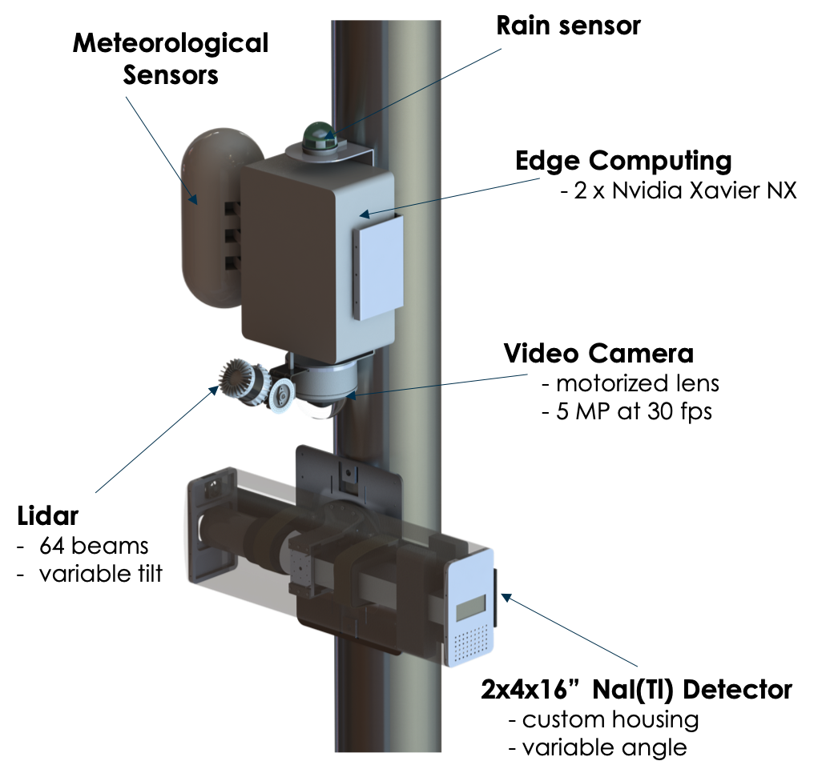
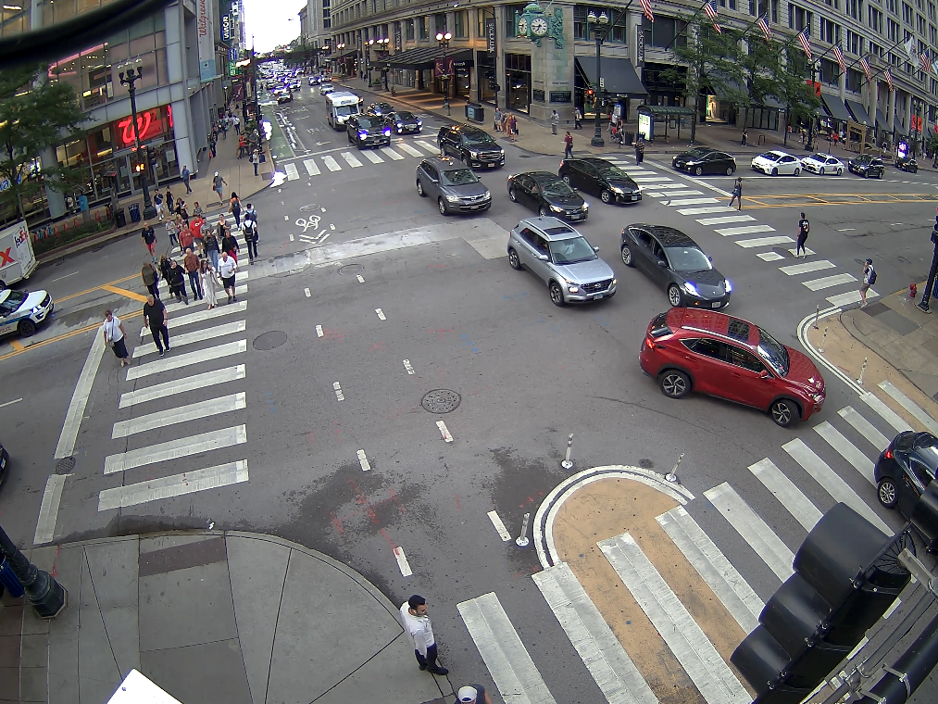
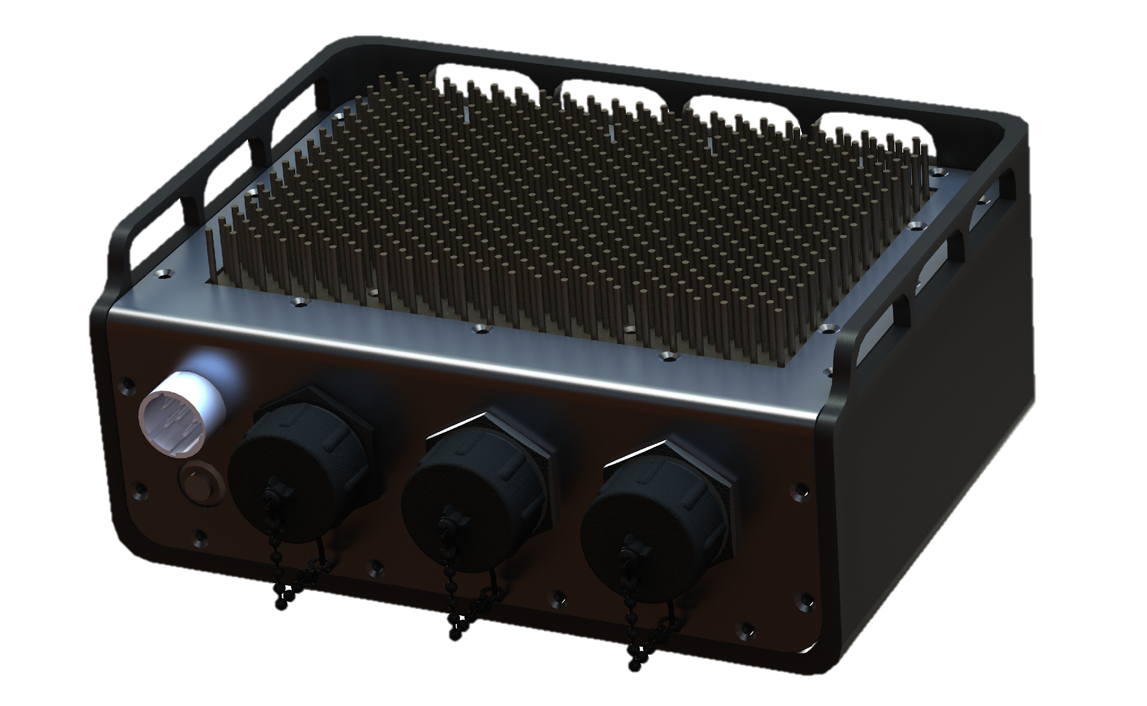
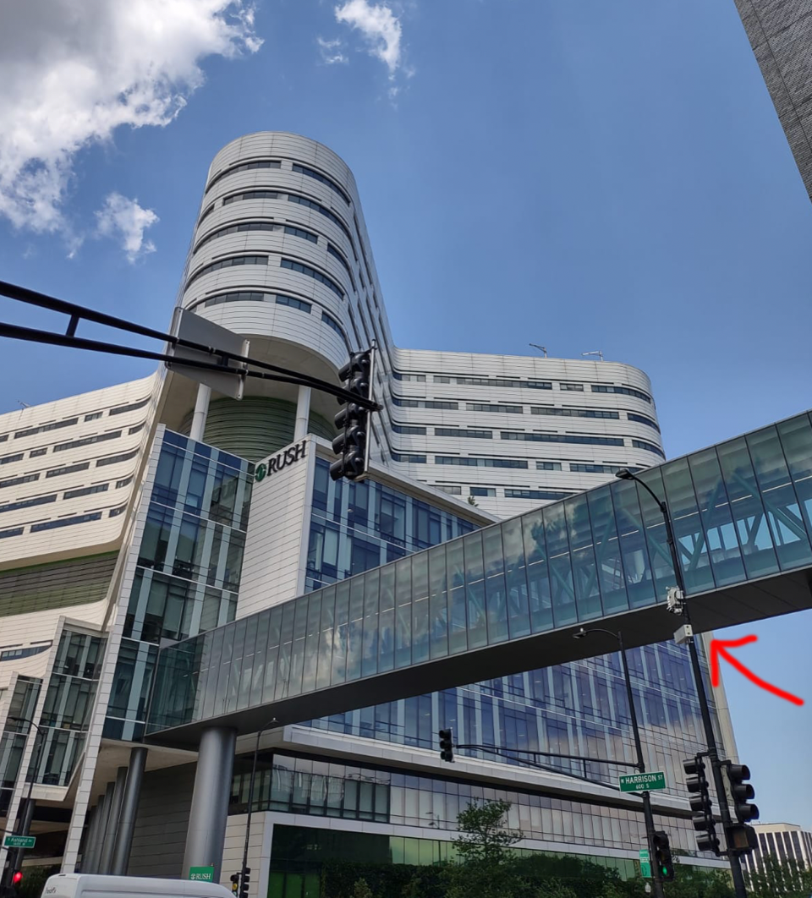
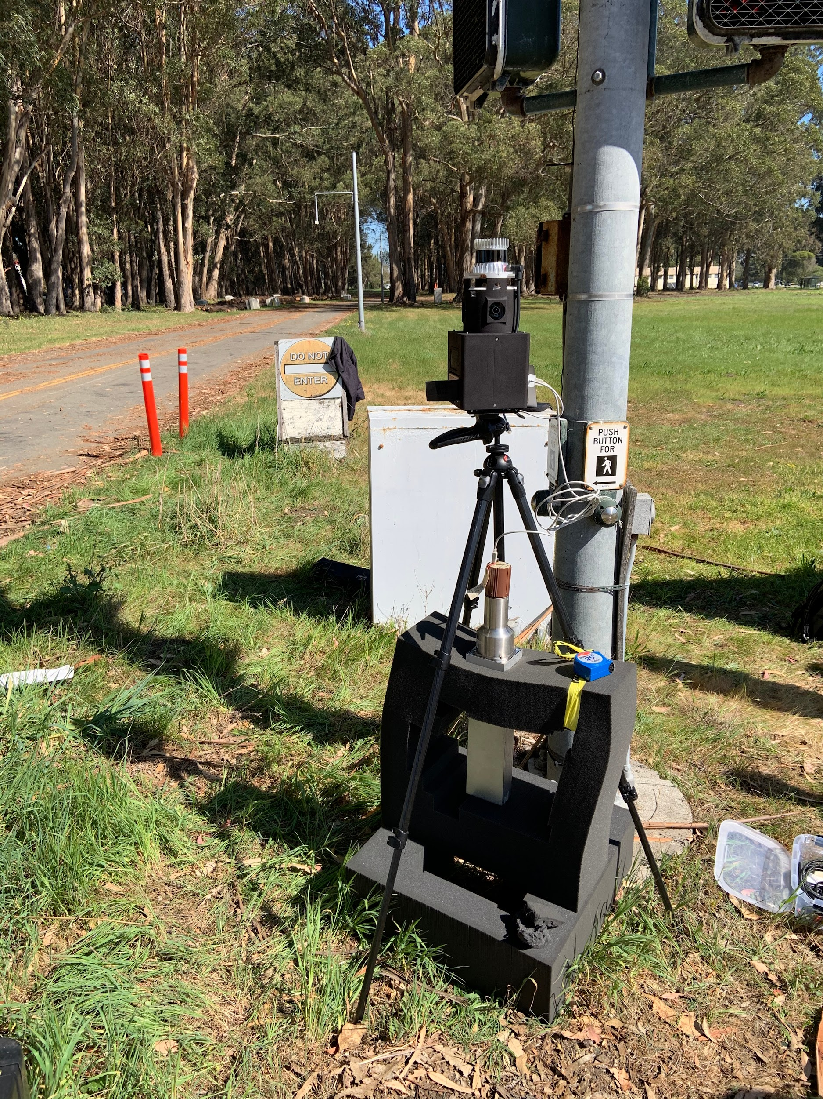
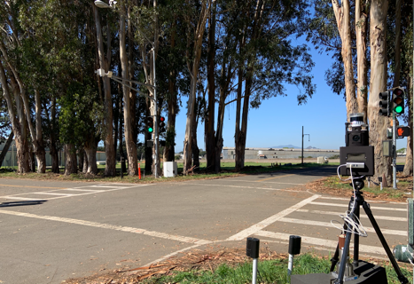
Static ”SDF” Systems
Fixed Installation
Compact, redeployable
40 cm

Slide 6
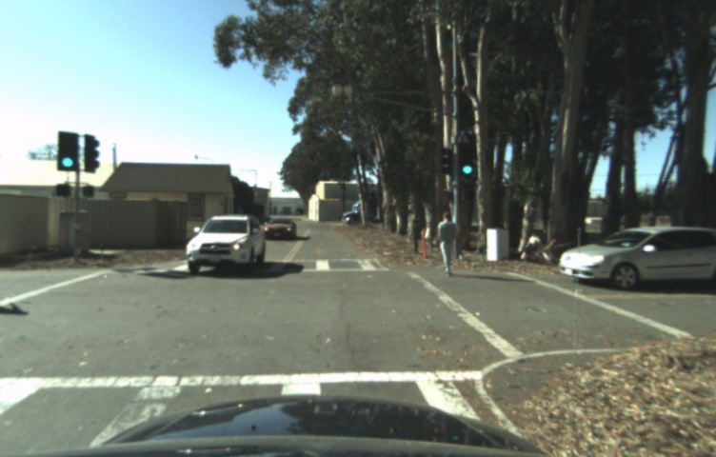
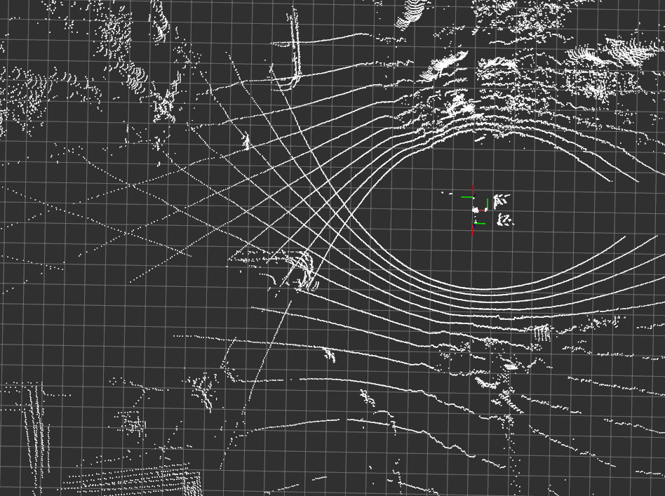
Methodology
Image Frame
Acquire Video and/or Lidar Data in Real Time
M.R. Marshall et al., IEEE TNS(2020), DOI: 10.1109/TNS.2020.3047646

Slide 7
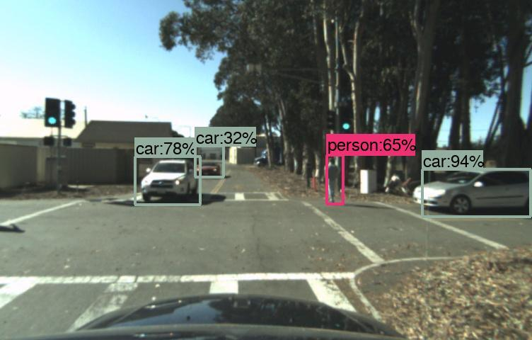
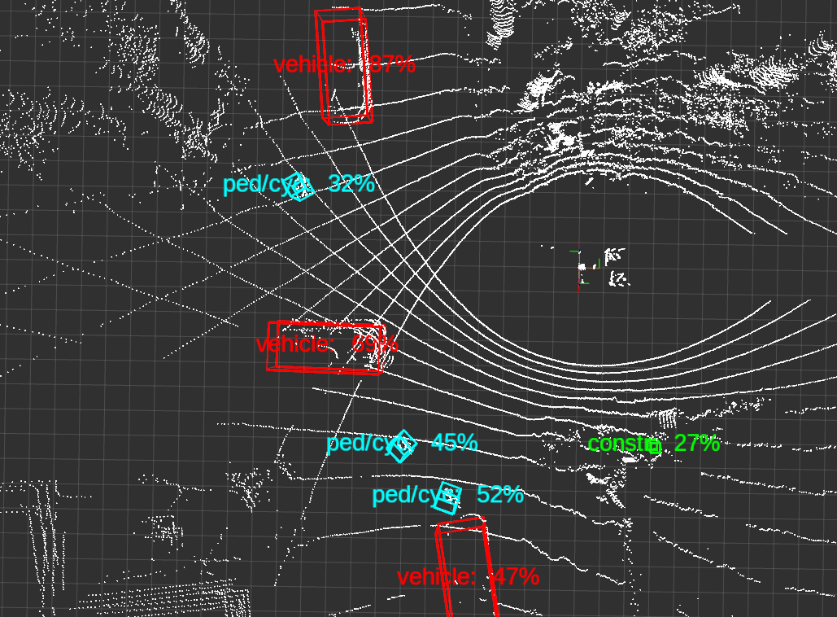
Methodology
Object
Detection
CNN
Image Frame
Obj. Positions
Detect and Classify Objects
(Return positions)
M.R. Marshall et al., IEEE TNS(2020), DOI: 10.1109/TNS.2020.3047646

Slide 8
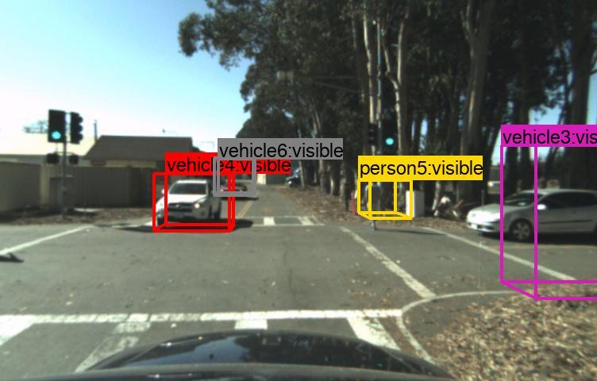
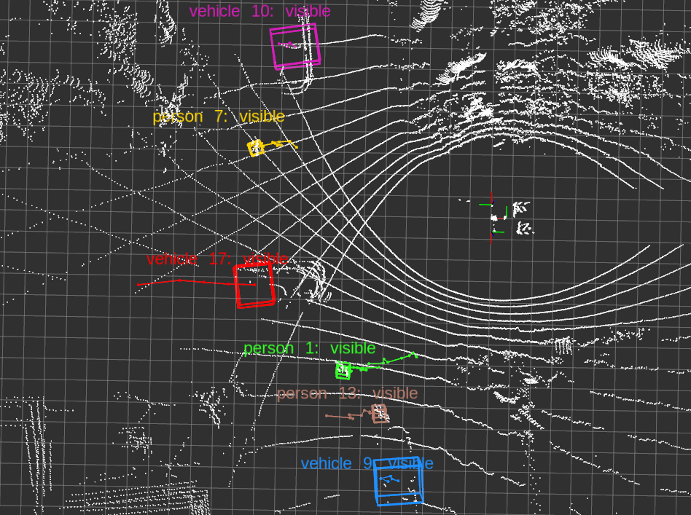
Methodology
Object
Detection
CNN
Kalman
Filter
Tracker
Image Frame
Obj. Positions
Tracks
Track Objects in 3D
M.R. Marshall et al., IEEE TNS(2020), DOI: 10.1109/TNS.2020.3047646

Slide 9
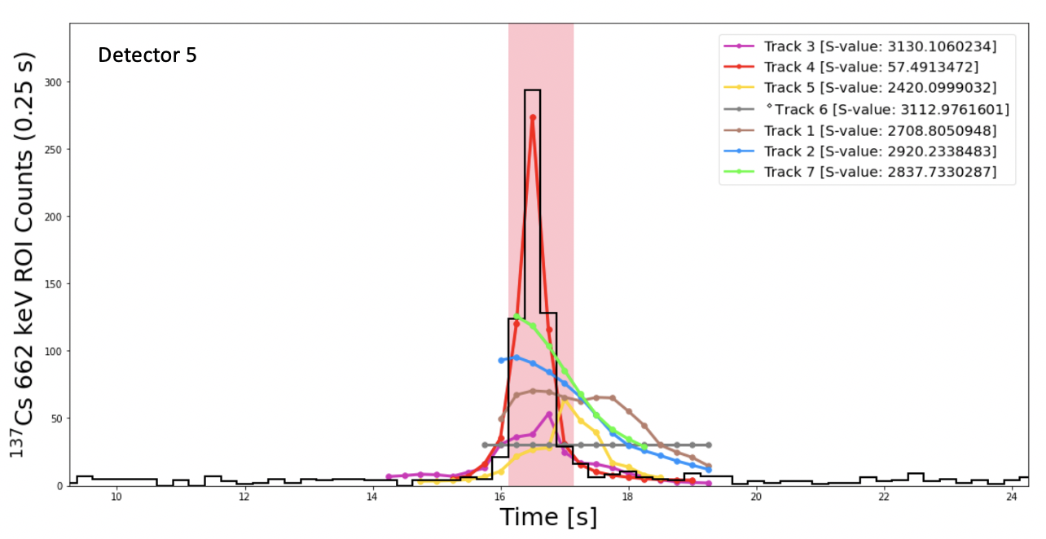
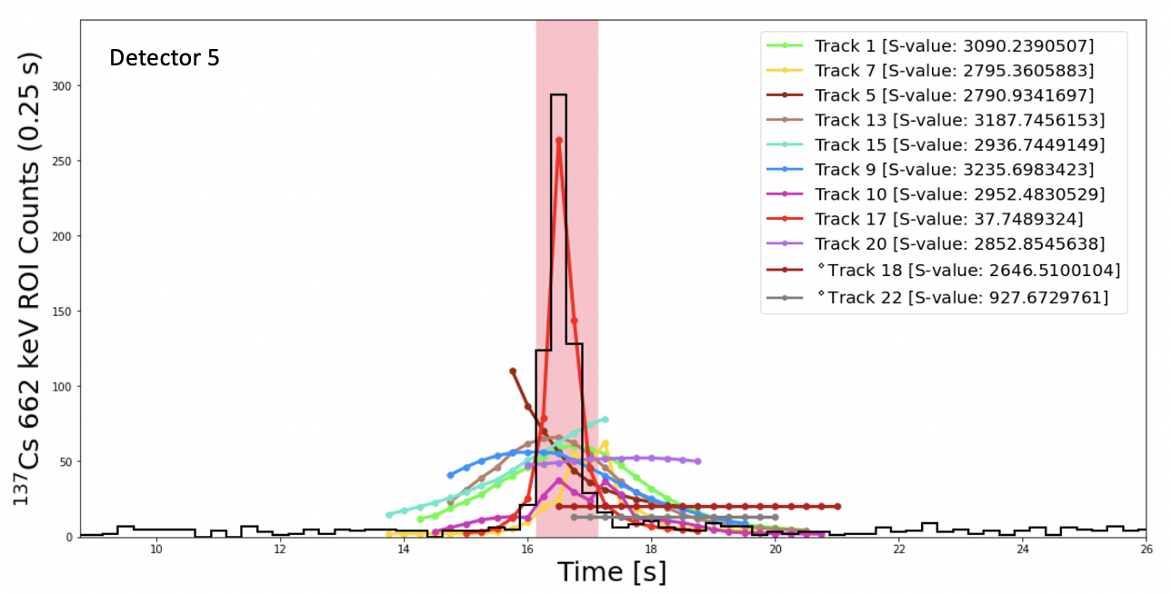
Methodology
Object
Detection
CNN
Kalman
Filter
Tracker
Poisson
Attribution
Detection
Image Frame
Obj. Positions
Tracks
Attribution
Rad Data
Upon alarm:
Build track-informed model of time-series peak count rate for each object
Fit tracks to data (maximize Poisson likelihood)
Compute “exclusion metrics” e.g. p-value or s-value
Spectral Alarm
$${c(E)}_{i}= \frac{ε(Ω,E)αe^{−μ\left(E\right)r_{i}}}{4πr_{i}^{2}}∗Δt_{i}+b$$
Video
Lidar
M.R. Marshall et al., IEEE TNS(2020), DOI: 10.1109/TNS.2020.3047646

Slide 10
Video vs. Lidar
We have so far observed superior source-object attribution performance when using Lidar
In a mock urban environment: 80% correct attribution Lidar vs. 60% video
Video | Lidar
Information rich | Direct 3D object detection
Human interpretable | Long range
Wealth of open-source detection models | Works in adverse conditions/at night
Depth must be inferred | Performance might degrade in heavy rain
Limited range | Limited object detection models
Doesn’t work at night | Reflections can degrade performance

Slide 11
Video vs. Lidar
We have so far observed superior source-object attribution performance when using Lidar
In a mock urban environment: 80% correct attribution Lidar vs. 60% video
Video | Lidar
Information rich | Direct 3D object detection
Human interpretable | Long range
Wealth of open-source detection models | Works in adverse conditions/at night
Depth must be inferred | Performance might degrade in heavy rain
Limited range | Limited object detection models
Doesn’t work at night | Reflections can degrade performance
We should explore other sensors - Stereo cameras? Acoustic sensors? Radar?

Slide 12
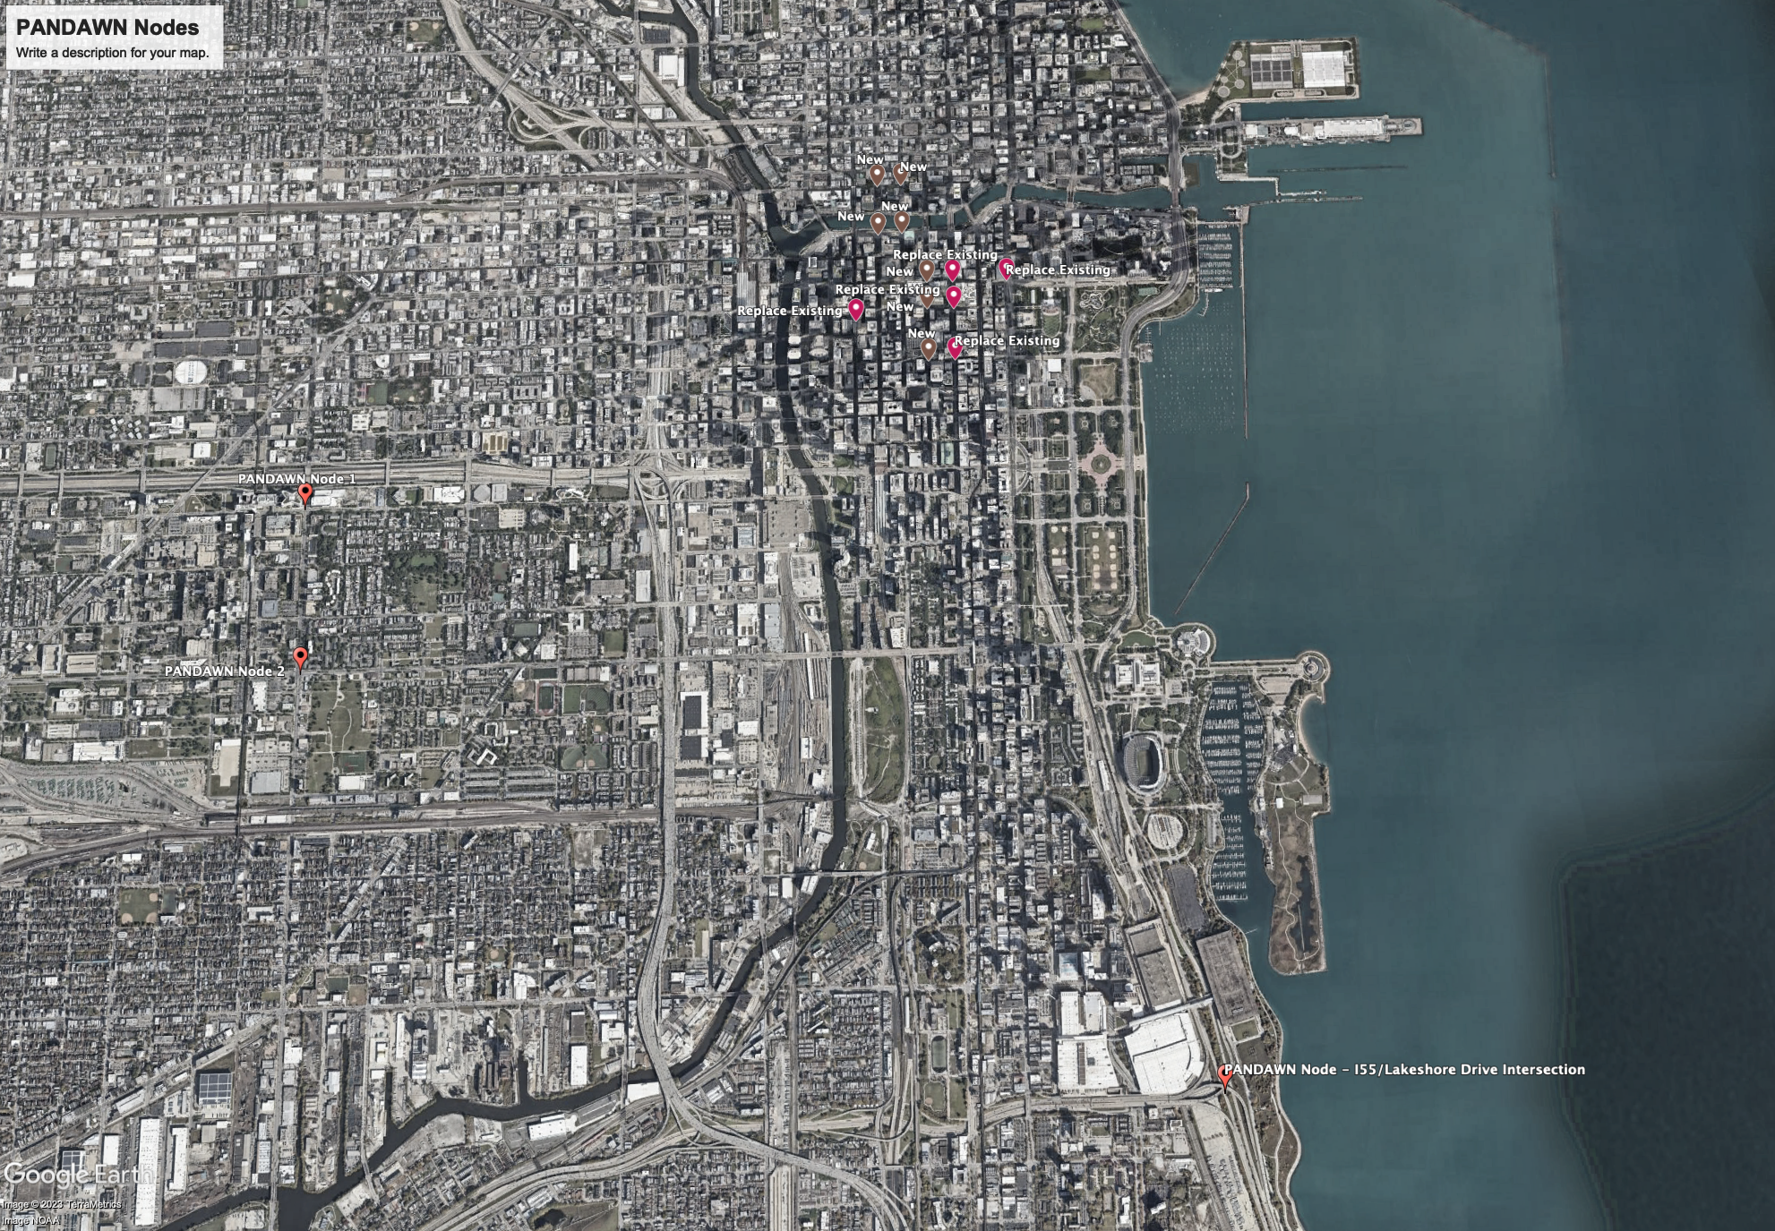
PANDAWN Network
The PANDA and DAWN projects are establishing a city-scale, multi-sensor testbed for networked radiological/nuclear detection
PANDA–DAWN key features:
Contextual sensor integration
Adaptive algorithms
Data fusion
Enabled by:
Edge and cloud computing
Inter-node communication
Achieving:
Improved source detection performance
Increased domain awareness
Inc. source localization and tracking
Increased flexibility and stability
Rich data sets for algorithm development
River-crossing grid
Exiting nodes
hospital region
Downtown Grid
Major Intersection

Slide 13
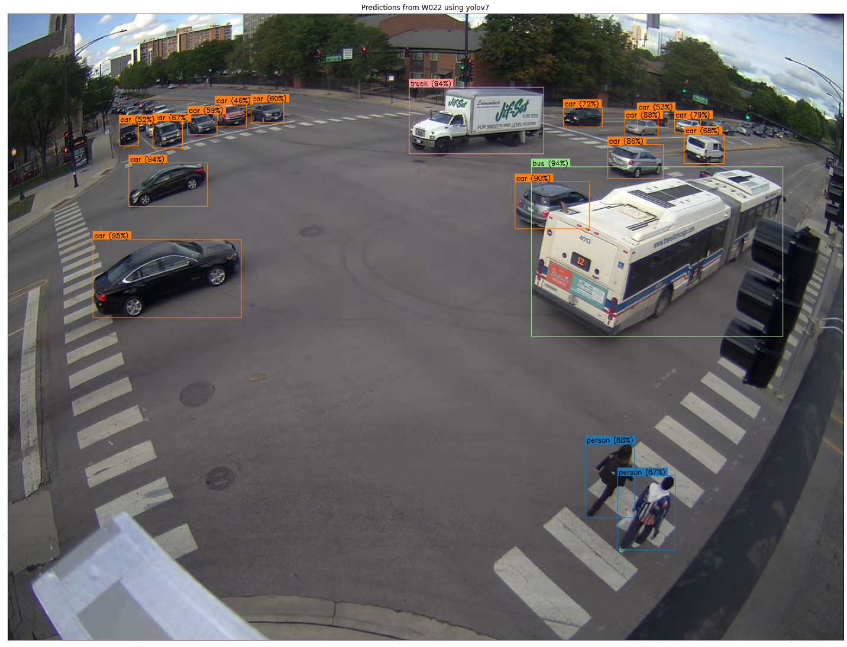
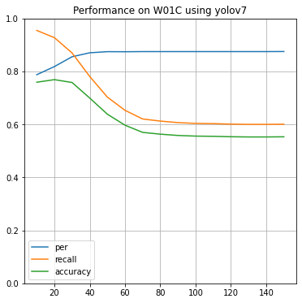
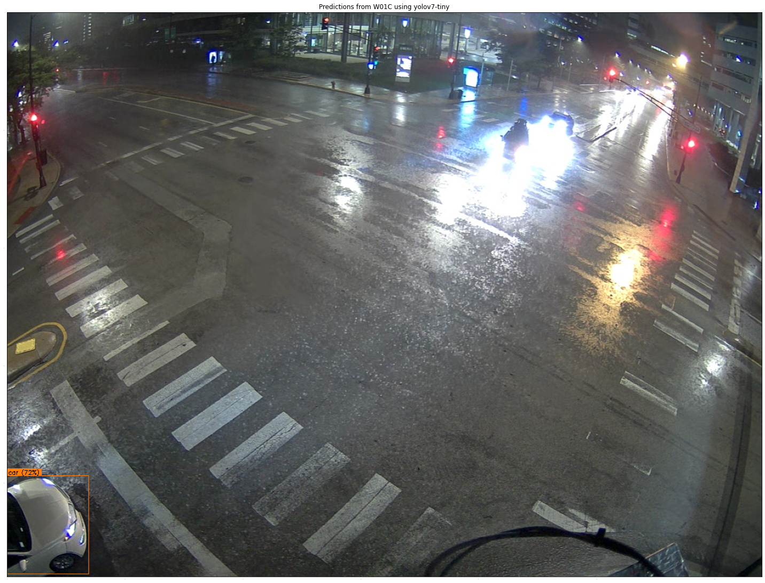
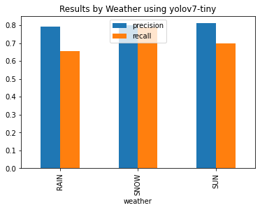
Visual Object Detection Observations From the Field
Real-world object detection performance is very good using YOLOv7-tiny and pre-trained model
Performance falls away at distances > 30 m
Some degradation in poor conditions may be improved with updated training
Tracking and attribution performance TBD
False Negatives
Performance Metric
Precision
Recall
Accuracy
Estimated Distance (m)

Slide 14
Network Data Fusion
Simulations show the potential for networked detection to outperform conventional detection
Increased sensitivity to weak sources
Reduced false positive rates
Reduced detector density
Contextual information is required to identify correlated observations in a sparse network
Vehicle make/model/color, license plate etc.
5 μCi 137Cs source, FAR = 1/8 hours

Slide 15
(Some) Research Needs
Detailed characterization of performance (coming soon…)
Understanding of optimum detector choice for a given CONOP
Comprehensive study of contextual sensor trade-offs?
What about the fusion of multiple sensors?
Depth-extracting CNNs for video?
Methods to more fully account for attenuation
In scene, between tracked objects, and within tracked objects
Better physics model → more well bounded statistical metrics
Use of full spectral information rather than peak counts
Can we apply scene-dependent background models?
Network-level:
Extraction of object characteristics
Object re-detection networks
Other methods to identify and track specific objects

Slide 16
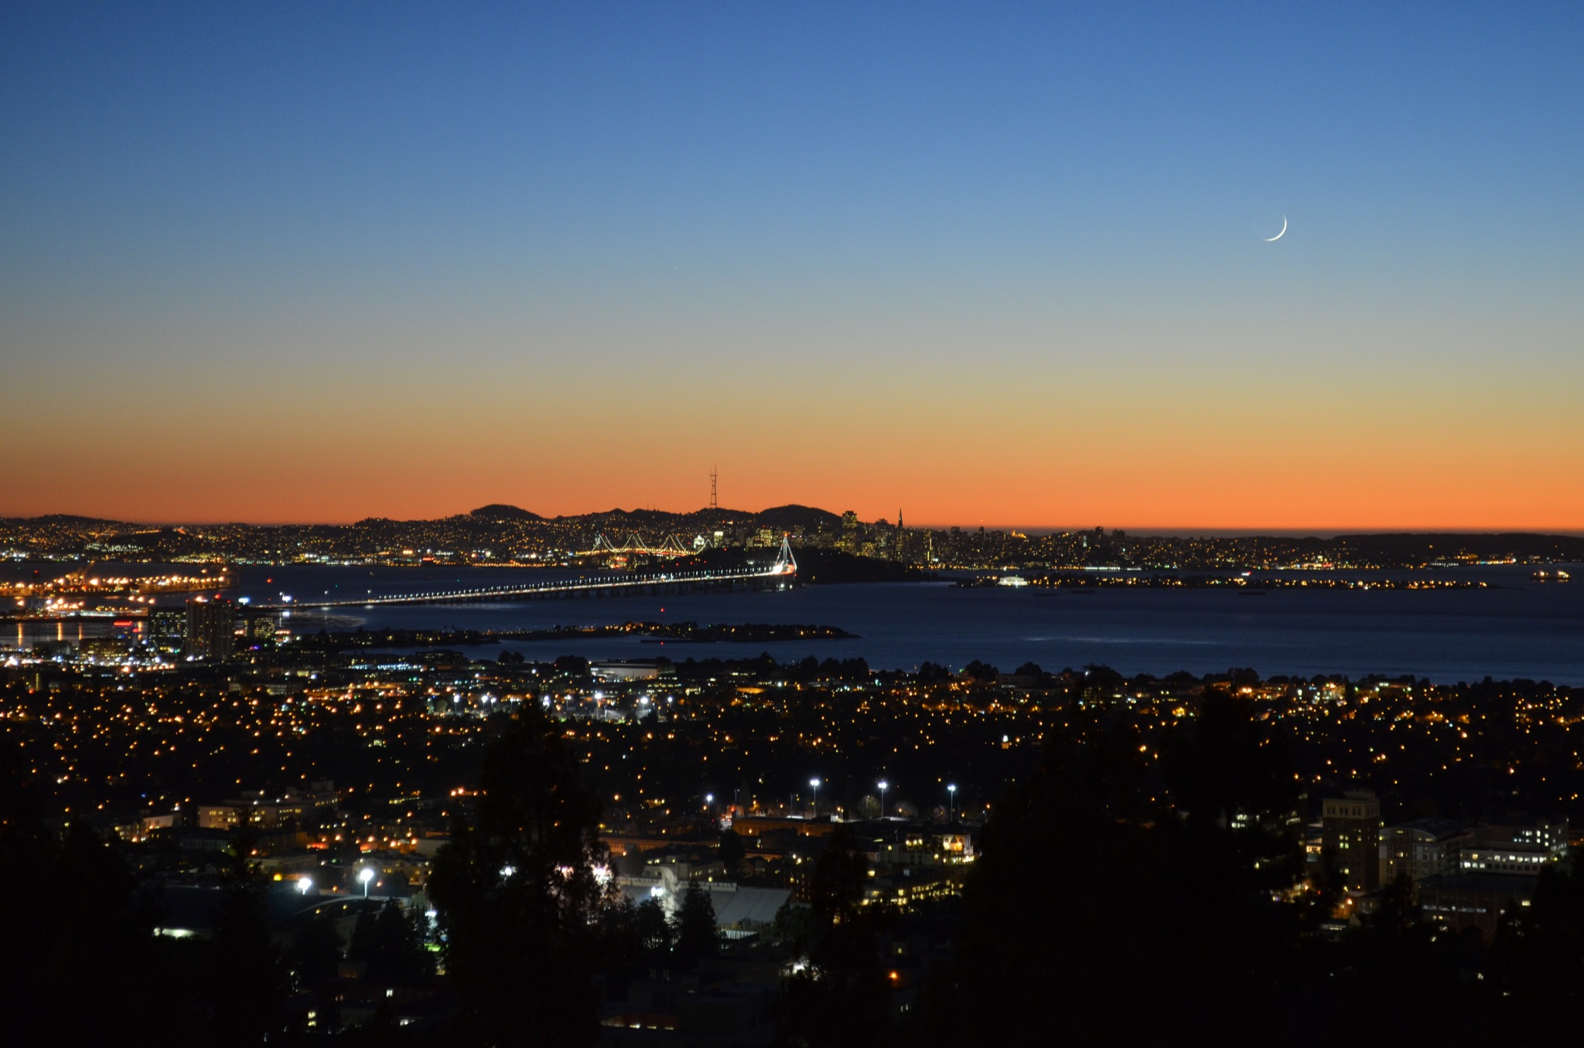
Thank You!
Acknowledgements: Nico Abgrallª, G. Aversanoª, Mark Bandstraª, Xin Chenª, Dan Hellfeldª, Tenzing Joshiª, Matt Marshall^{a,b},Victor Negutª, Brian Quiterª, Marco Salatheª, Kai Vetter^{a,b}, Pete Beckman^{c}, Charlie Catlett^{c}, Yongho Kim^{c}, Raj Sankaran^{c}, Sean Shahkarami^{c}
ª Lawrence Berkeley National Laboratory
^{b} University of California, Berkeley
^{c} Argonne National Laboratory
Funding: DOE NSSA NA22, DOE NNSA NA84, DHS CWMD, DTRA
Photo Credit: Mark Bandstra, ANP

Slide 17
Optimization of Integration Time

Slide 18
Pattern-of-Life Analysis and Predictive Analytics

