Slide 1
Peeling the Onion: From Gamma-rays to Gravity
Radiological Data Fusion Workshop
Tyler Guglielmo
Hema Chandrasekaran
Manoj Prasad
Neal Snyderman
Sean Walston
This work was supported by the Office of Defense Nuclear Nonproliferation Research and Development within the U.S. Department of Energy’s National Nuclear Security Administration under the Sequential Bayesian Approach to Warhead Verification project.
August 15, 2023

Slide 2
What’s in the Box?
Given a black box, can we figure out what is inside (non-destructively)?
Radiation is being emitted – how much information is there?
Besides material information, what can we learn about the geometry of the object?
Using any one particular data stream is highly degenerate.
Combining data such as neutrons and gamma counting will eliminate large amounts of degeneracy.
Can add gravity to obtain a total mass budget and further constrain the object.

Slide 3
Typical 1D Object?
Interested in “onions” of various complexity; concentric shells that may be separated by gaps or voids.
Generally, the first layer is SNM.
Outer layers can be quite diverse.
More data = More layers constrained.
Think of constraining inner and outer radii, thicknesses, or volumes and density.
SNM layer is producing neutrons and gammas.
  Geometry will sometimes favor one or the other based on count rate.
Reflectors and Moderators
SNM

Slide 4
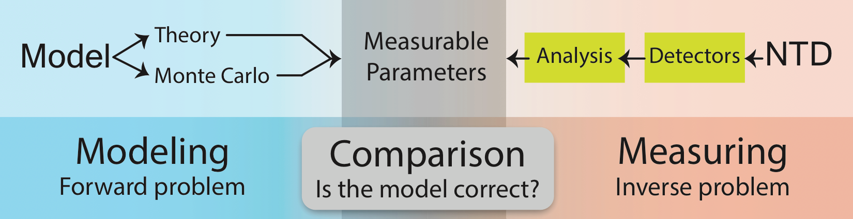
The Scientific Method
Measuring—the inverse problem
Modeling—the forward problem
Meet in the middle—the measurables
Iterative
Black Box
Notes:
Detectors give measurable parameters

Slide 5
Neutronics – SNM can Sustain a Fission Chain
What information can we get from neutrons?
Use a theory that predicts the time evolution of fission chains to match data.
  First done by Feynman, but theory has evolved significantly since then.
Theory relies on parameters that get fitted to data.
Most basic theory predicts:
  Multiplication
  Spontaneous fission rate
  Time constant
Can add complications to learn about bare multiplication, alpha-n rates, etc.
Given these parameters, what can we infer about the geometry?

Slide 6
Geometry from Neutron Multiplicity
During the Manhattan Project, Dirac reduced the neutron transport equation to a form that depends on the geometric properties of the system:
  Started with the neutron transport equation
  Assumed the neutron density was constant
  Took the system to be exactly critical
    Allows one to remove the time dependence
  Calculated the size of a critical ball of Pu
Picking up where Dirac left off, Neal Snyderman has derived a closed-form analytic formula for k_{eff}
Depends on the escape probability
Neal and Manoj Prasad Extended Dirac’s work to include shells.
  We have now included reflectors

Slide 7
Comparison of the Dirac/Snyderman Theory to Measured Data
Comparison of the Dirac/Snyderman theory to the 4.484 kg α-phase WGPu BeRP Ball in copper reflectors of various thickness (the LANL SCRaP Experiment)♱
  LANL benchmark measurements
  OSANTC algorithm results
  Dirac/Snyderman theory calculation using the configuration’s geometry
♱ Theresa Cutler and Jennifer Arthur, Copper- and Polyethylene-Reflected Plutonium-Metal-Sphere Subcritical Measurements, International Criticality-Safety Benchmark Evaluation Project, March 30, 2019.

Slide 8
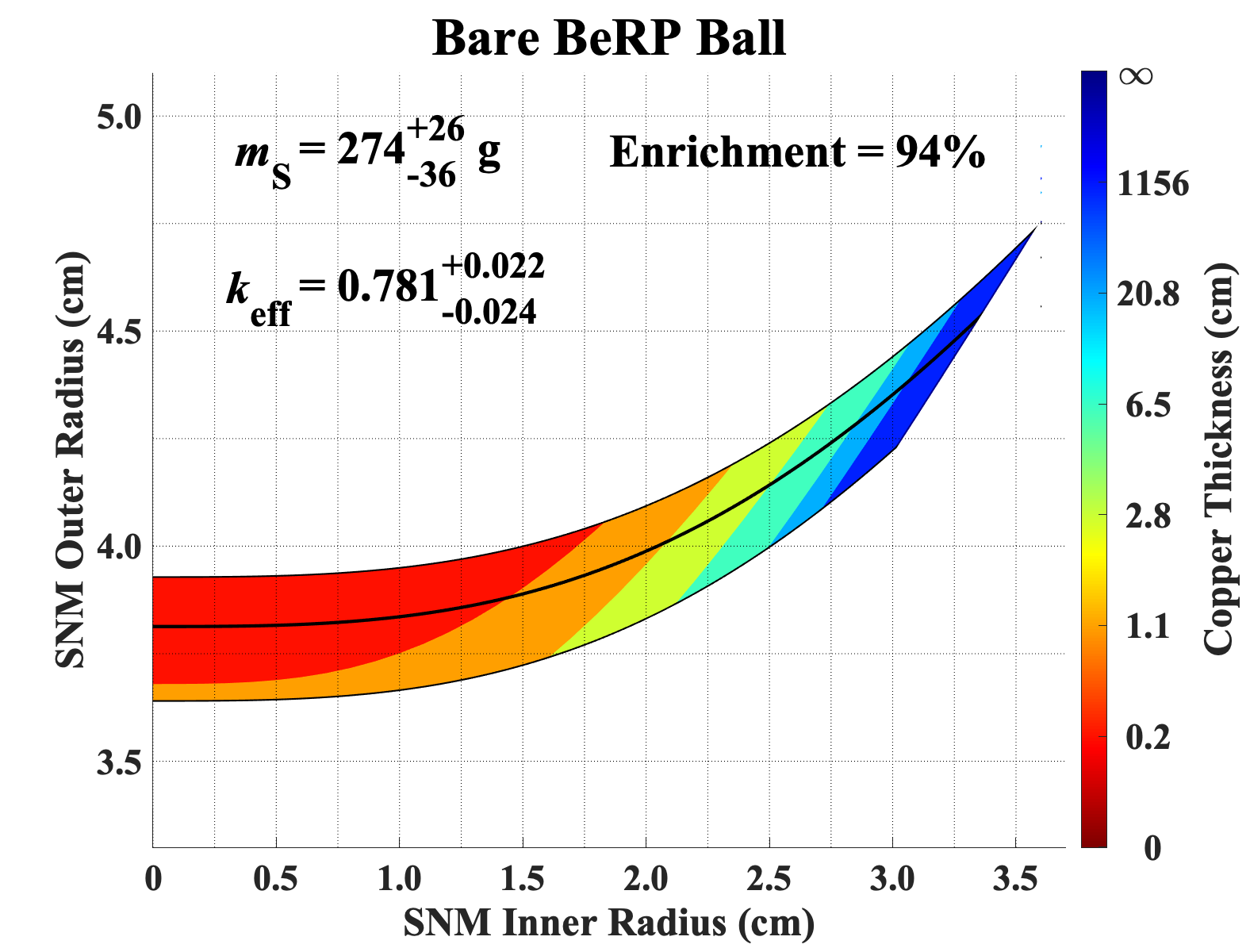
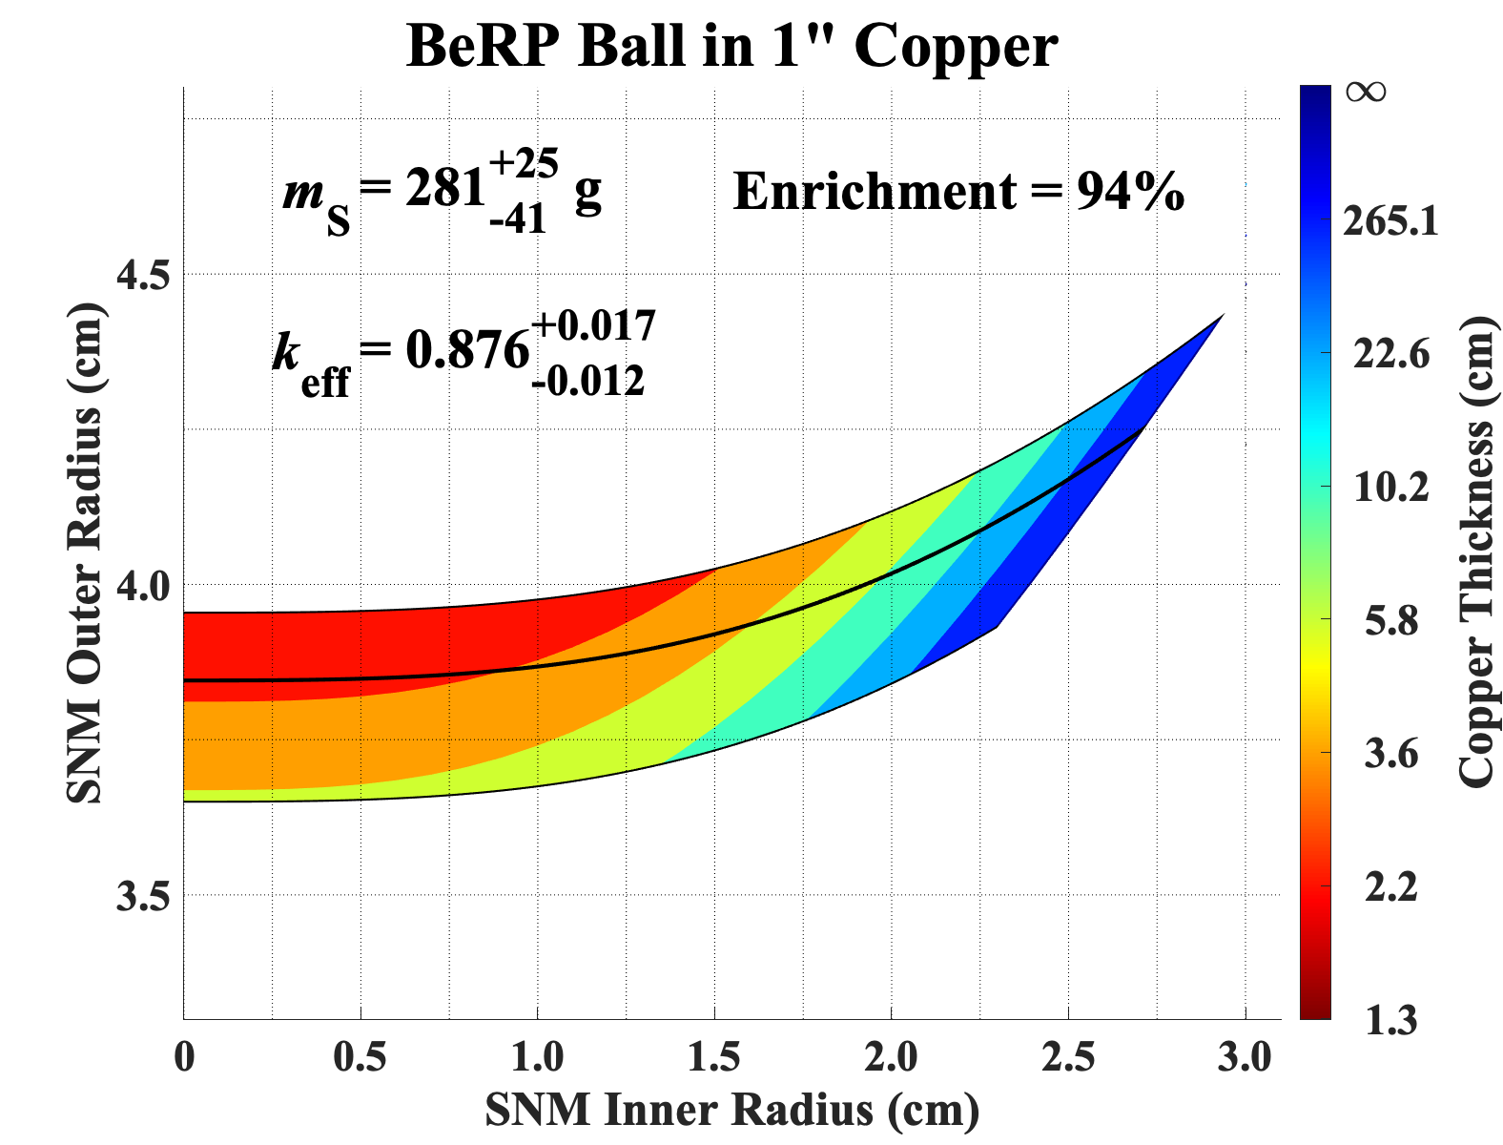
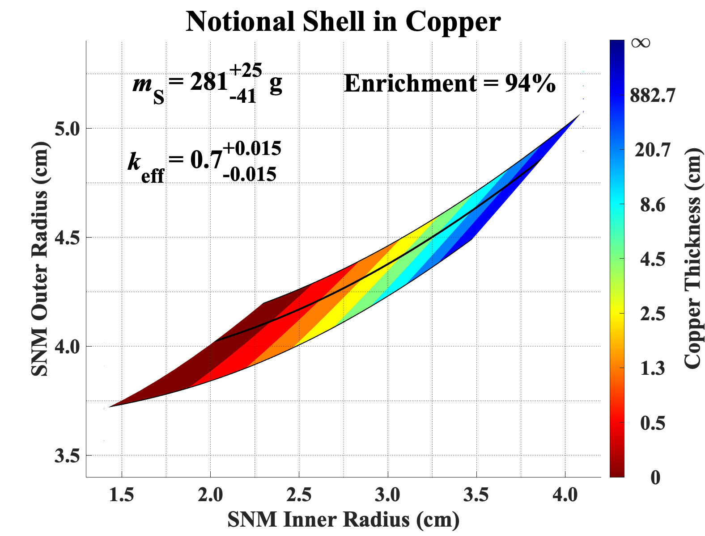
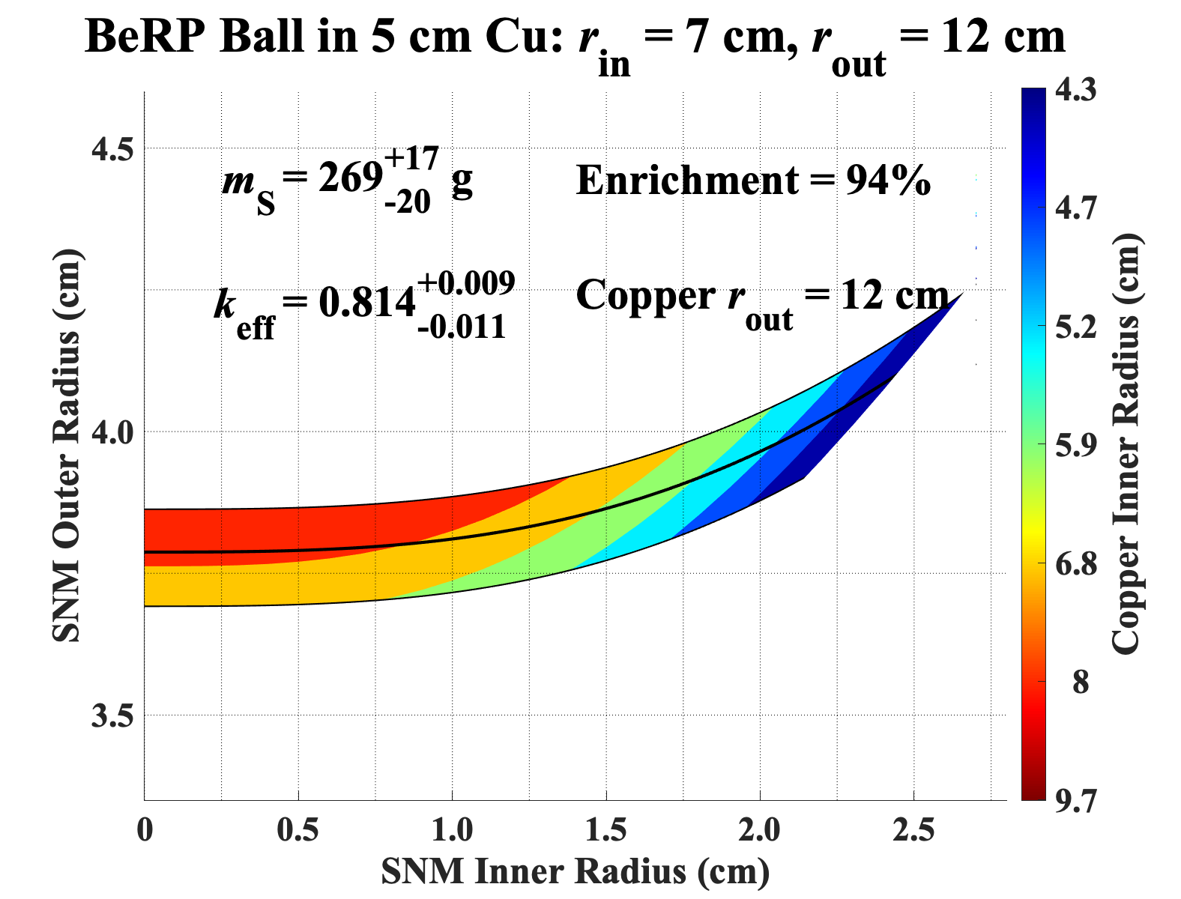
SNM and reflector dimensions from neutron multiplicity
Allowed geometries shown:
  SNM inner and outer radii and Reflector thicknesses or inner radius
Each color represents the uncertainty range in k_{eff}
  Lowest number on the color bar is the minimum reflector thickness the data can support
If the reflector’s outer radius is known, we estimate the reflector’s inner radius.
True value: r_{out} = 3.79 cm
True value : r_{out} = 3.79 cm
Cu thickness = 2.45 cm
2.45
True value: SNM r_{out} = 3.79 cm
Copper r_{in} = 7 cm

Slide 9
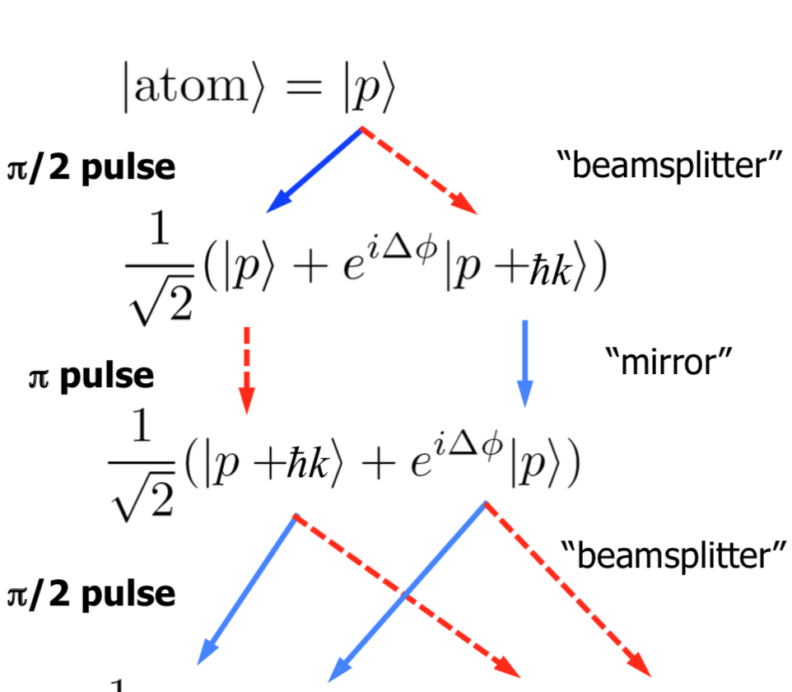
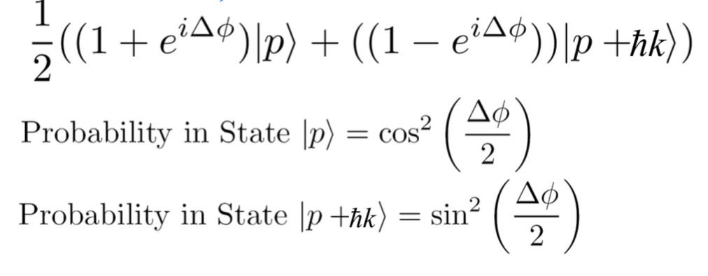


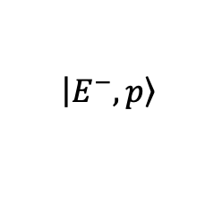
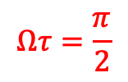

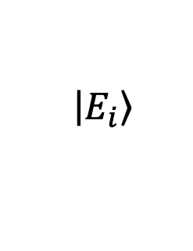
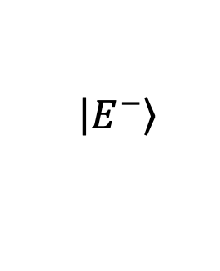
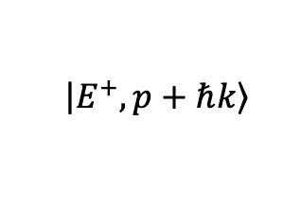

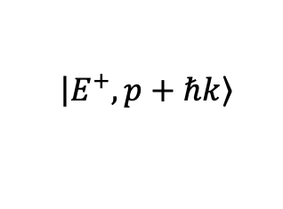
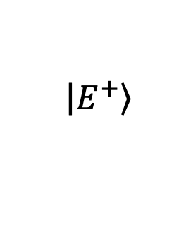


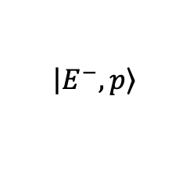

Atom Interferometry
“Beam
Splitter”
“Beam
Splitter”
Laser pulses act as beam splitters and mirrors for the atomic wavefunction
Highly sensitive to accelerations (e.g. gravity…)
Mirror
$$Ωτ=π$$
$$\left|\left.E^{+},p+ℏk\right\rangle \right.$$
  $$\left|\left.E^{−},p\right\rangle \right.$$
Vertical Distance
$$Ωτ=\frac{π}{2}$$
$$\left|\left.E_{i}\right\rangle \right.$$
Δ
$$Ωτ=\frac{π}{2}$$
  $$\left|\left.E^{−},p\right\rangle \right.$$
$$ω_{1}$$
$$ω_{2}$$
$$\left|\left.E^{+},p+ℏk\right\rangle \right.$$
$$\left|\left.E^{+}\right\rangle \right.$$
δ
$$\left|\left.E^{−}\right\rangle \right.$$
$$t_{0}$$
$$t_{0}+T$$
$$t_{0}+2T$$
Time

Slide 10
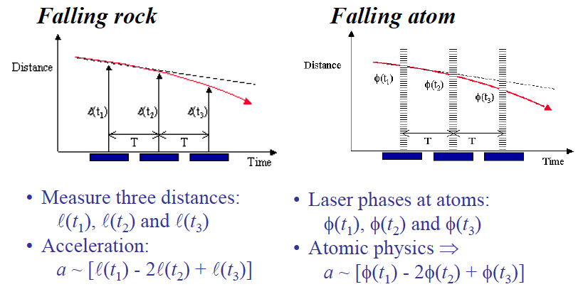
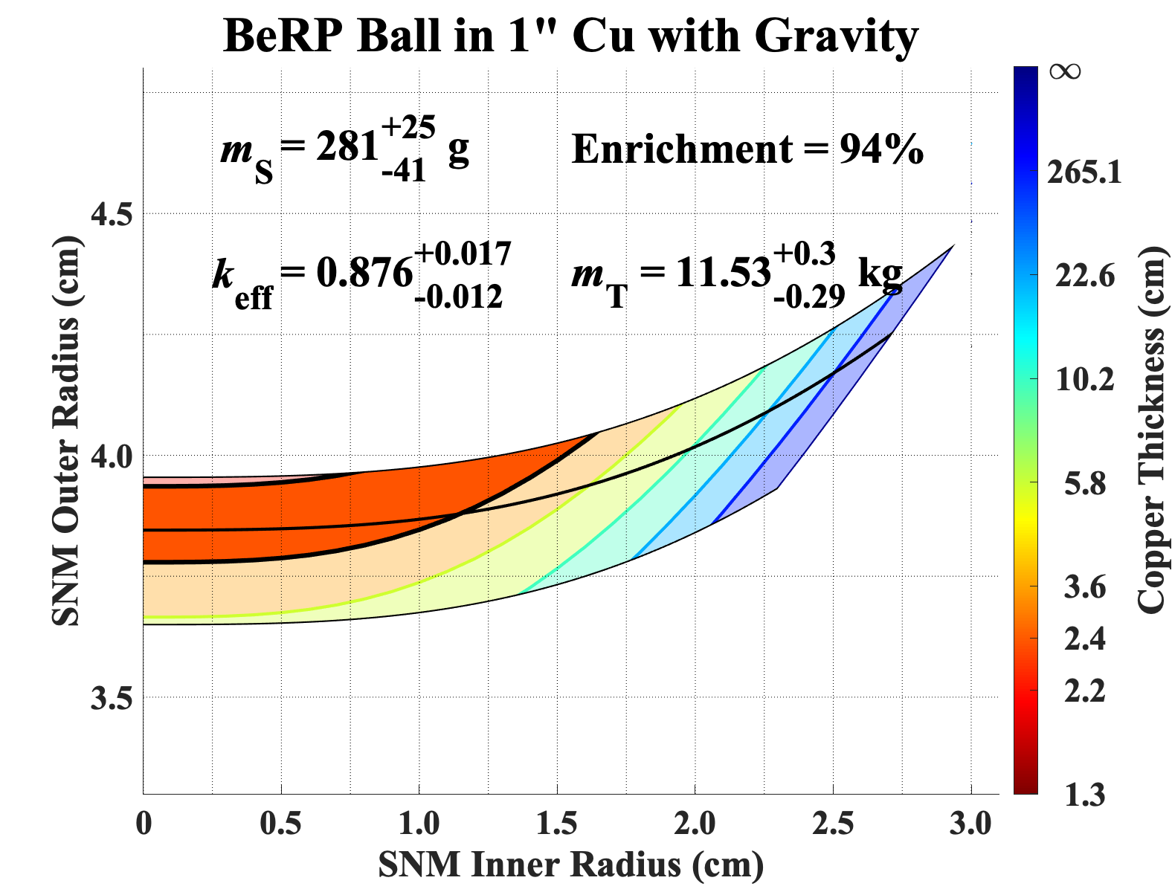
Enhanced Characterization with Gravity Tomography
Neutron Multiplicity Only
Works analogously to how the acceleration of a falling rock is measured classically
Neutron Multiplicity + Gravity provides
constraints on the possible geometries
Neutron Multiplicity + Gravity

Slide 11
Summarizing Neutrons and Gravity
So far, only considered up to four layers (parameter space is unwieldy and hard to visualize for more layers)
We treat the cases of no void or void between the SNM and reflector separately.
Depends on if the outer reflector radius is known.
  Void
  SNM
  Void
  Reflector
Current level of transport theory is tough and less accurate past this configuration.
  Recently integrated a multi-group 1D deterministic transport solver into the optimization which can handle any onion.
Most onions will be more complicated…. What to do?

Slide 12
Adding Gammas to the Constraint Model
We can use the SNM’s alpha decay lines to infer radii and thicknesses.
Manoj Prasad and James Wong have created “Photo-peak Optimizer.”
From an analytic formula for gamma escape probability both the
  SNM outer radius
  Shell thicknesses can be inferred if the number of layers and their compositions are known.
Only the SNM outer radius can be inferred as alpha decay lines from within the SNM are attenuated very fast.
If statistics are good enough, we can estimate every non-void layer’s thickness (and SNM outer radius).

Slide 13

Merging Neutrons and Gammas
We can estimate more layer thicknesses from gammas but voids will not be constrained.
Folding neutron information into the picture constrains the gamma model.
SNM mass + SNM outer radius = Full SNM characterization.
Given multiplication and total mass budget, we can now constrain the thickness of any void.
We got an extra layer that can be easily optimized and visualized.
Unknowns to be constrained

Slide 14
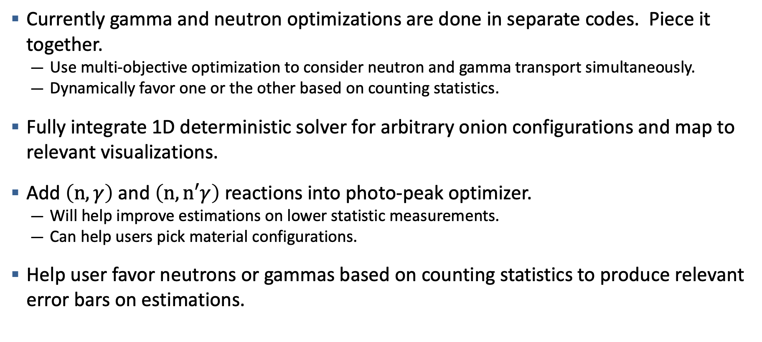
Future Directions
Currently gamma and neutron optimizations are done in separate codes. Piece it together.
  Use multi-objective optimization to consider neutron and gamma transport simultaneously.
  Dynamically favor one or the other based on counting statistics.
Fully integrate 1D deterministic solver for arbitrary onion configurations and map to relevant visualizations.
Add $\left(n,γ\right)$ and $\left(n,n′γ\right)$reactions into photo-peak optimizer.
  Will help improve estimations on lower statistic measurements.
  Can help users pick material configurations.
Help user favor neutrons or gammas based on counting statistics to produce relevant error bars on estimations.

Slide 15
Disclaimer
This document was prepared as an account of work sponsored by an agency of the United States government. Neither the United States government nor Lawrence Livermore National Security, LLC, nor any of their employees makes any warranty, expressed or implied, or assumes any legal liability or responsibility for the accuracy, completeness, or usefulness of any information, apparatus, product, or process disclosed, or represents that its use would not infringe privately owned rights. Reference herein to any specific commercial product, process, or service by trade name, trademark, manufacturer, or otherwise does not necessarily constitute or imply its endorsement, recommendation, or favoring by the United States government or Lawrence Livermore National Security, LLC. The views and opinions of authors expressed herein do not necessarily state or reflect those of the United States government or Lawrence Livermore National Security, LLC, and shall not be used for advertising or product endorsement purposes.

