Slide 1
Quantitative source estimation
Jaideep Ray

Slide 2
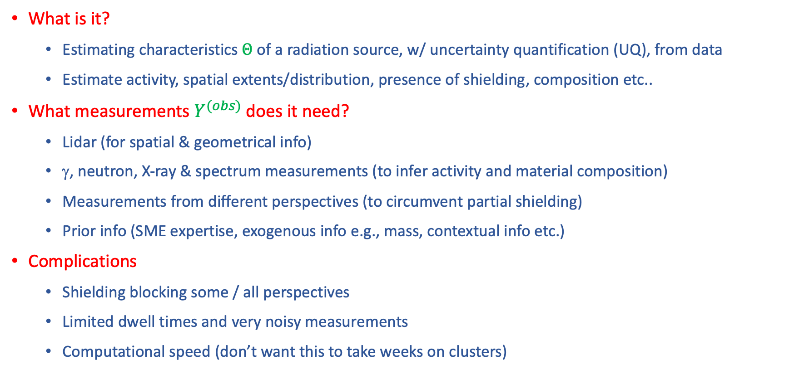
Bare bones
What is it?
  Estimating characteristics $Θ$ of a radiation source, w/ uncertainty quantification (UQ), from data
  Estimate activity, spatial extents/distribution, presence of shielding, composition etc..
What measurements $Y^{(obs)}$does it need?
  Lidar (for spatial & geometrical info)
  γ, neutron, X-ray & spectrum measurements (to infer activity and material composition)
  Measurements from different perspectives (to circumvent partial shielding)
  Prior info (SME expertise, exogenous info e.g., mass, contextual info etc.)
Complications
  Shielding blocking some / all perspectives
  Limited dwell times and very noisy measurements
  Computational speed (don’t want this to take weeks on clusters)

Slide 3
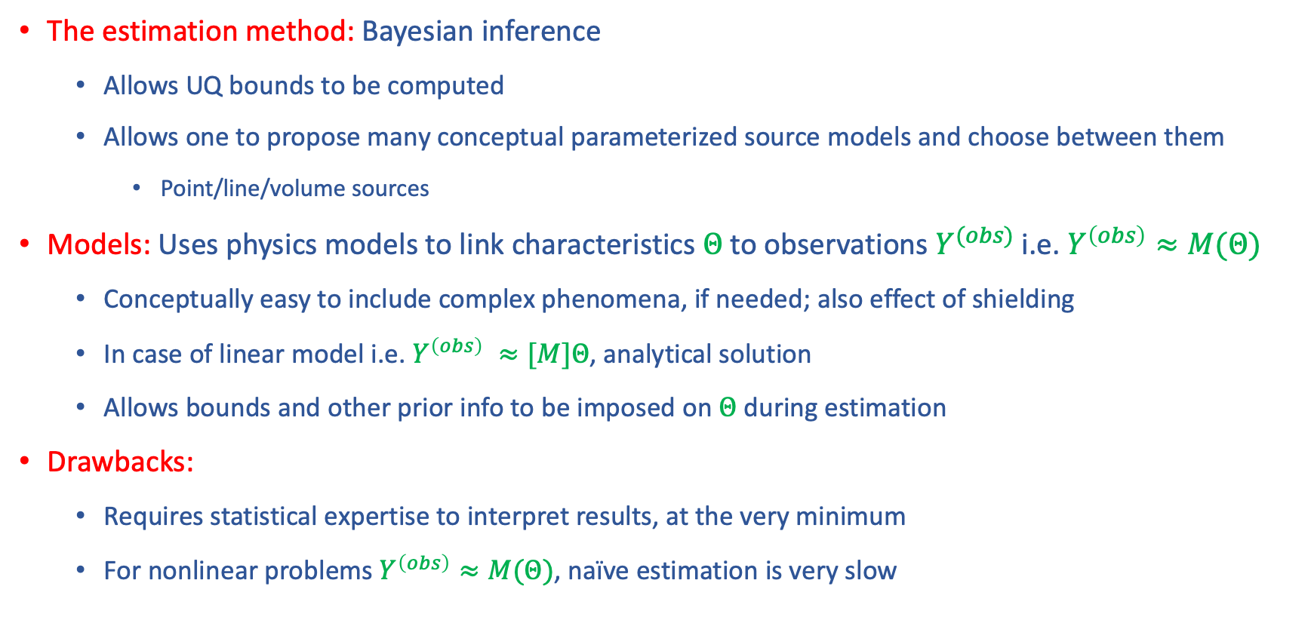
The basic technology
The estimation method: Bayesian inference
  Allows UQ bounds to be computed
  Allows one to propose many conceptual parameterized source models and choose between them
    Point/line/volume sources
Models: Uses physics models to link characteristics $Θ$ to observations $Y^{(obs)}$ i.e. $Y^{\left(obs\right)}≈M(Θ)$
  Conceptually easy to include complex phenomena, if needed; also effect of shielding
  In case of linear model i.e. $Y^{\left(obs\right)} ≈[M]Θ$, analytical solution
  Allows bounds and other prior info to be imposed on $Θ$ during estimation
Drawbacks:
  Requires statistical expertise to interpret results, at the very minimum
  For nonlinear problems $Y^{\left(obs\right)}≈M(Θ)$, naïve estimation is very slow

Slide 4
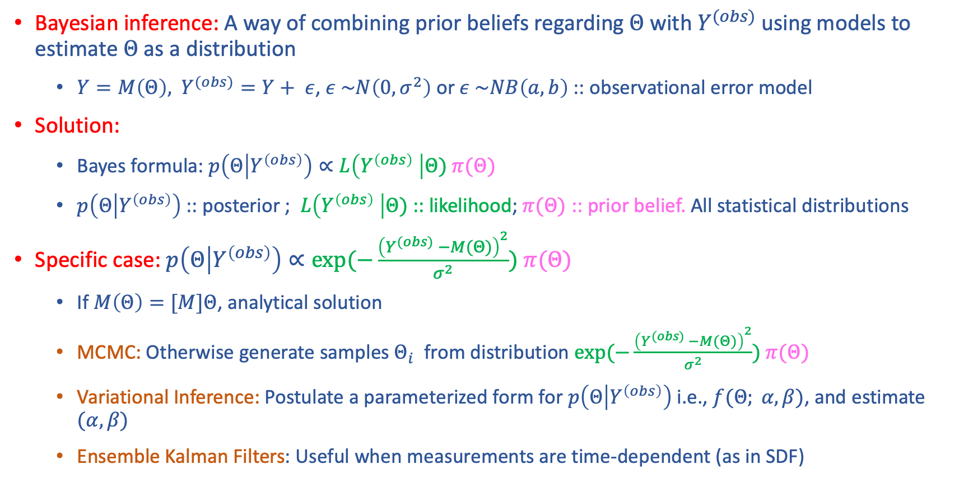
So what is Bayesian inference
Bayesian inference: A way of combining prior beliefs regarding $Θ$ with $Y^{(obs)}$using models to estimate $Θ$ as a distribution
  $Y=M\left(Θ\right),$ $Y^{(obs)}=Y+ ε$, $ε \sim N\left(0, σ^{2}\right)$ or $ε \sim NB\left(a, b\right)$:: observational error model
Solution:
  Bayes formula: $p\left(Θ | Y^{\left(obs\right)}\right)∝L\left(Y^{\left(obs\right)} \right|Θ) π(Θ)$
  $p\left(Θ | Y^{\left(obs\right)}\right)$ :: posterior ; $L\left(Y^{\left(obs\right)} \right|Θ)$:: likelihood; $π(Θ)$ :: prior belief. All statistical distributions
Specific case: $p\left(Θ | Y^{\left(obs\right)}\right)∝exp⁡(−\frac{{\left(Y^{(obs)} −M(Θ)\right)}^{2}}{σ^{2}}) π(Θ)$
  If $M\left(Θ\right)=[M]Θ$, analytical solution
  MCMC: Otherwise generate samples $Θ_{i}$ from distribution $exp⁡(−\frac{{\left(Y^{(obs)} −M(Θ)\right)}^{2}}{σ^{2}}) π(Θ)$
  Variational Inference: Postulate a parameterized form for $p\left(Θ | Y^{\left(obs\right)}\right)$ i.e., $f(Θ; α, β)$, and estimate $(α, β)$
  Ensemble Kalman Filters: Useful when measurements are time-dependent (as in SDF)

Slide 5
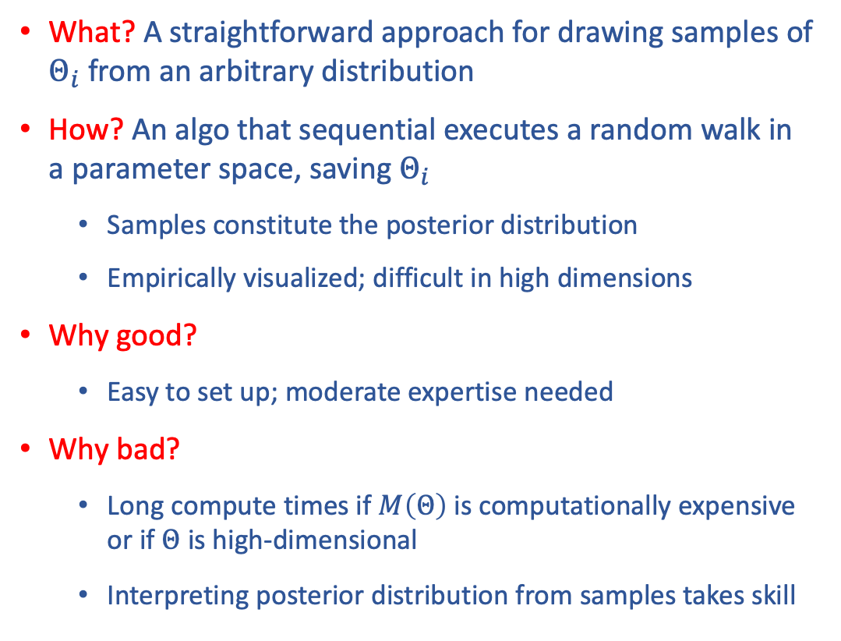
Markov Chain Monte Carlo (MCMC)
What? A straightforward approach for drawing samples of $Θ_{i}$ from an arbitrary distribution
How? An algo that sequential executes a random walk in a parameter space, saving $Θ_{i}$
  Samples constitute the posterior distribution
  Empirically visualized; difficult in high dimensions
Why good?
  Easy to set up; moderate expertise needed
Why bad?
  Long compute times if $M\left(Θ\right)$ is computationally expensive or if $Θ$ is high-dimensional
  Interpreting posterior distribution from samples takes skill
b
“good” values of (a, b)
b
a
Proposal distribution
a
a

Slide 6
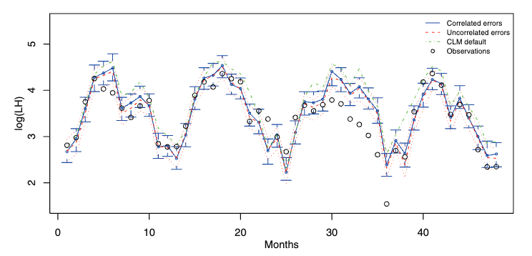
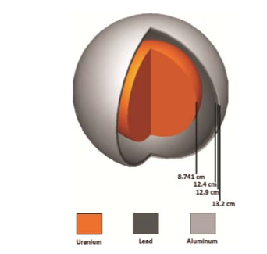
MCMC examples
Example 1: Estimate 5 parameters of the Community Land Model
  Data: Time-series of latent heat measurements over 5 years
  Model cost: ~600 CPU-hrs per run
  Acceleration: Replace CLM with a surrogate, trained on 280 CLM runs
  MCMC samples needed: 105; ~ 2 hours
  Details: Ray et al, SIAM J. Sc. Comput. 2015; DOI: 10.1137/140957998
Example 2: Estimate location of material interfaces in Godiva geometry (U²³⁵/Pb/Al)
  Data: total unscattered leakage at 4 principal emission lines for U and daughters
  Model cost: Real-time ray tracing for gamma rays
  MCMC samples: 2000
  Details: Bledsoe et al, IEEE Trans. Nuc. Sc., 2021. DOI: 10.1109/TNS.2021.3089018

Slide 7
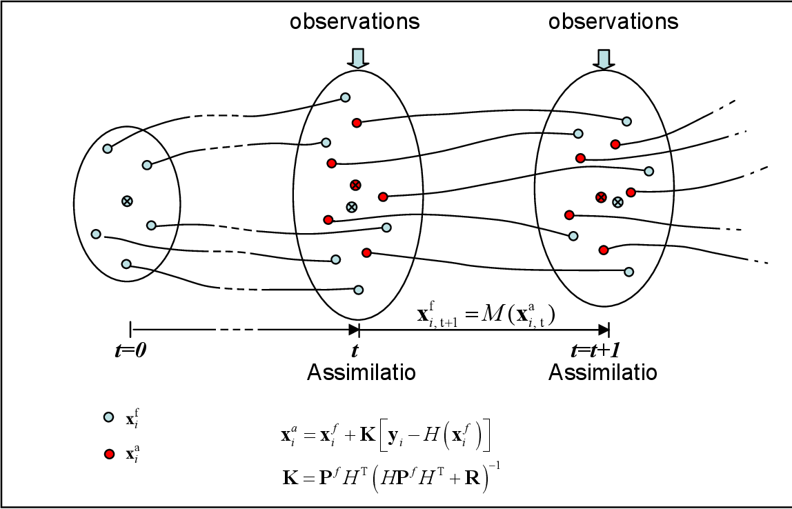
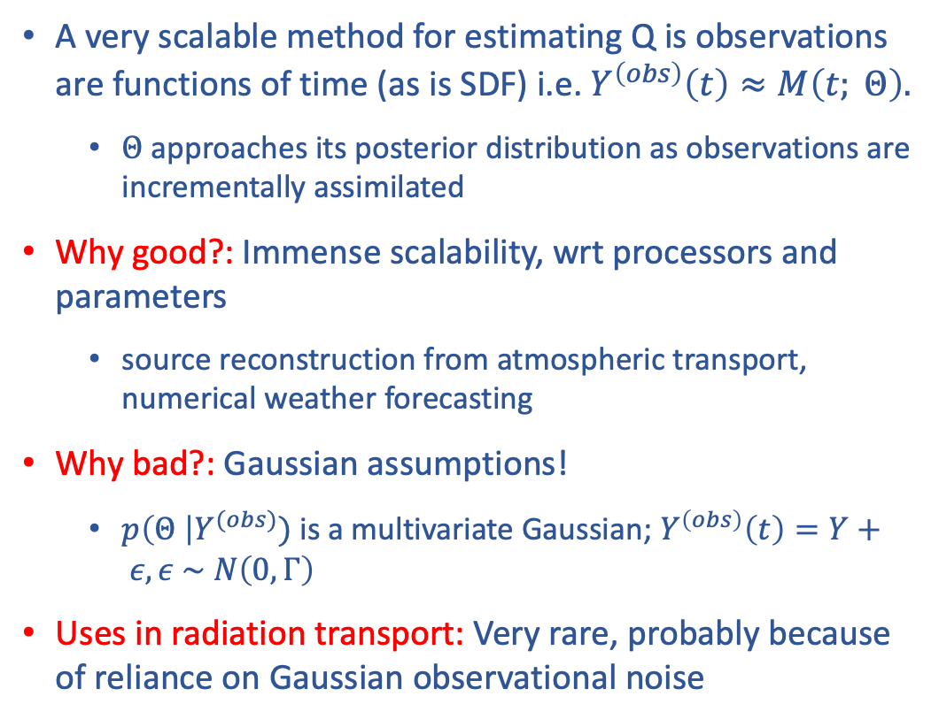
Ensemble Kalman Filters
A very scalable method for estimating Q is observations are functions of time (as is SDF) i.e. $Y^{\left(obs\right)}\left(t\right)≈M\left(t; Θ\right).$
  $Θ$ approaches its posterior distribution as observations are incrementally assimilated
Why good?: Immense scalability, wrt processors and parameters
  source reconstruction from atmospheric transport, numerical weather forecasting
Why bad?: Gaussian assumptions!
  $p\left(Θ \right|Y^{(obs)})$is a multivariate Gaussian; $Y^{\left(obs\right)}\left(t\right)=Y+ ε, ε \sim N\left(0, Γ\right)$
Uses in radiation transport: Very rare, probably because of reliance on Gaussian observational noise

Slide 8
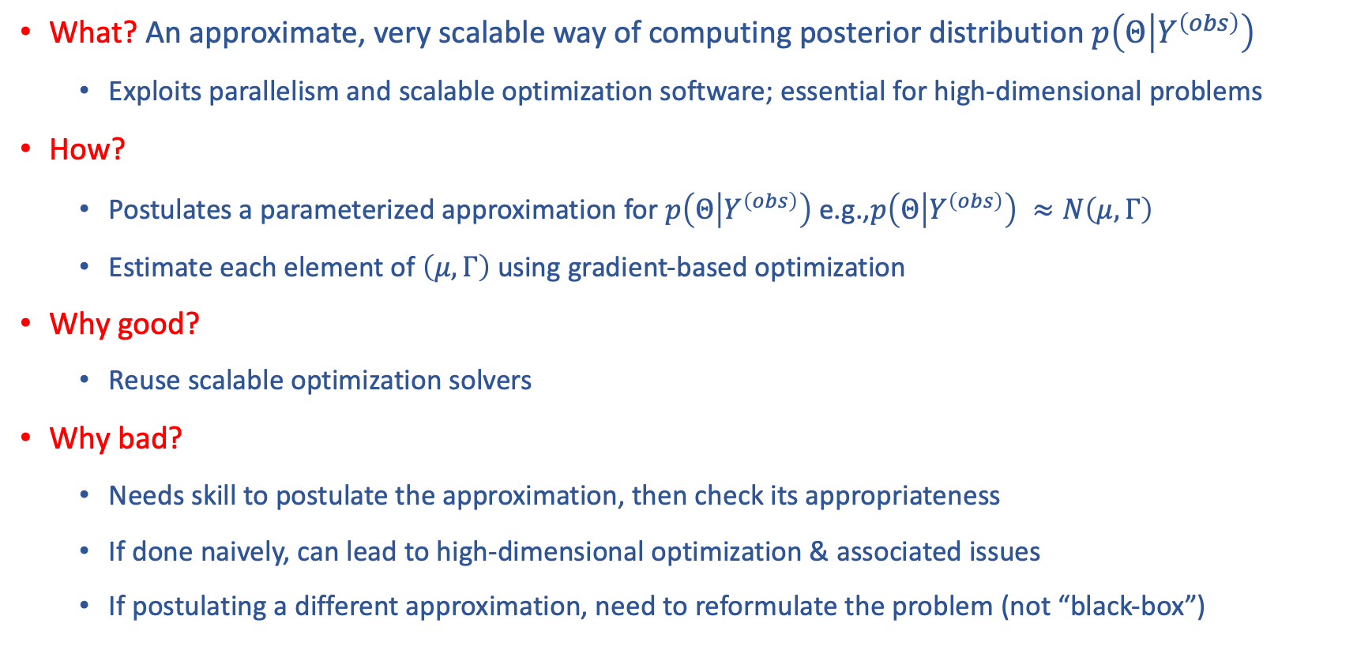
Mean-field variational Inference (VI)
What? An approximate, very scalable way of computing posterior distribution $p\left(Θ | Y^{\left(obs\right)}\right)$
  Exploits parallelism and scalable optimization software; essential for high-dimensional problems
How?
  Postulates a parameterized approximation for $p\left(Θ | Y^{\left(obs\right)}\right)$ e.g.,$p\left(Θ | Y^{\left(obs\right)}\right) ≈N\left(μ, Γ\right)$
  Estimate each element of $\left(μ, Γ\right)$ using gradient-based optimization
Why good?
  Reuse scalable optimization solvers
Why bad?
  Needs skill to postulate the approximation, then check its appropriateness
  If done naively, can lead to high-dimensional optimization & associated issues
  If postulating a different approximation, need to reformulate the problem (not “black-box”)

Slide 9
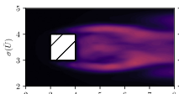
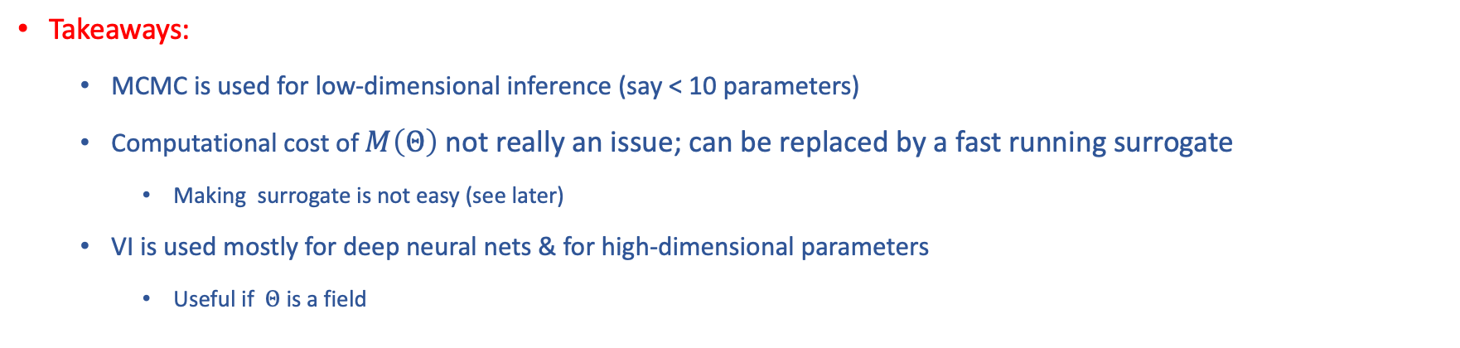
VI examples
Example: Estimate the ~700 parameters of a deep neural net turbulence model inserted in RANS
  Data: stress predictions from a LES simulation
  Model cost: 1 second (neural net)
  Training data samples: 10,000
  Postulate: NN parameters are independent and Gaussians
  Details: Geneva & Zabaras, J. Comp. Phys., 2019; DOI:10.1016/j.jcp.2019.01.021
Takeaways:
  MCMC is used for low-dimensional inference (say < 10 parameters)
  Computational cost of $M\left(Θ\right)$ not really an issue; can be replaced by a fast running surrogate
    Making surrogate is not easy (see later)
  VI is used mostly for deep neural nets & for high-dimensional parameters
    Useful if $Θ$ is a field

Slide 10
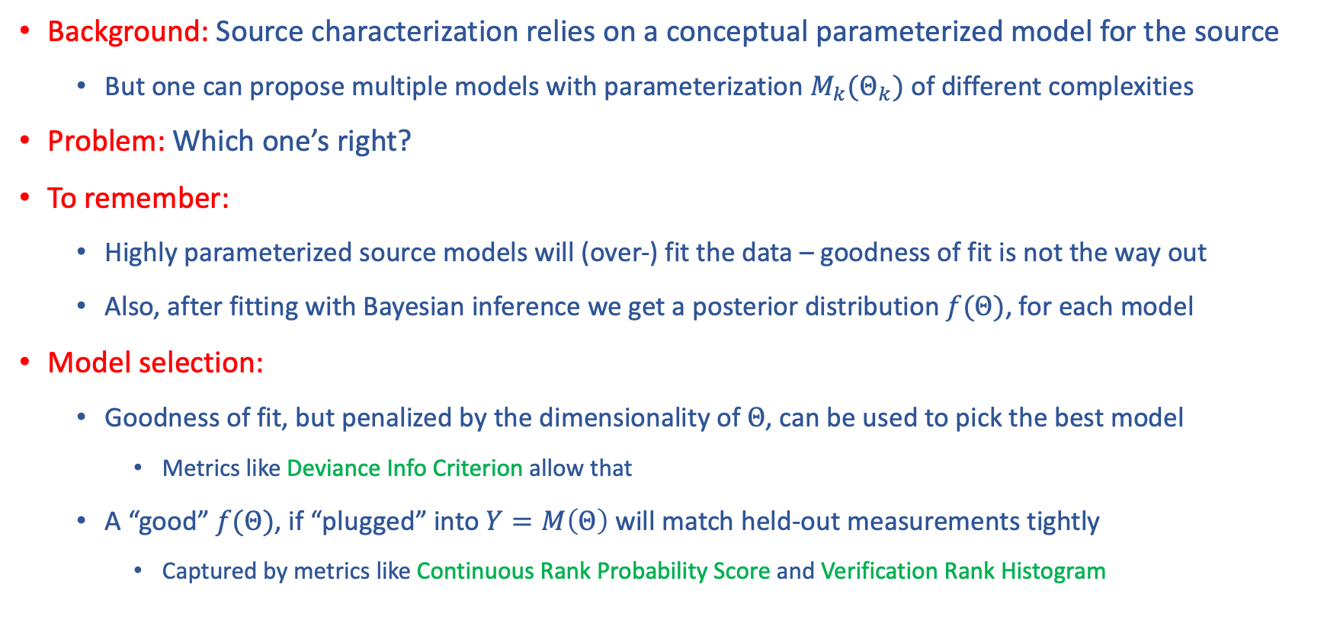
Model selection
Background: Source characterization relies on a conceptual parameterized model for the source
  But one can propose multiple models with parameterization $M_{k}(Θ_{k})$ of different complexities
Problem: Which one’s right?
To remember:
  Highly parameterized source models will (over-) fit the data – goodness of fit is not the way out
  Also, after fitting with Bayesian inference we get a posterior distribution $f(Θ)$, for each model
Model selection:
  Goodness of fit, but penalized by the dimensionality of $Θ$, can be used to pick the best model
    Metrics like Deviance Info Criterion allow that
  A “good” $f(Θ)$, if “plugged” into $Y=M\left(Θ\right)$will match held-out measurements tightly
    Captured by metrics like Continuous Rank Probability Score and Verification Rank Histogram

Slide 11
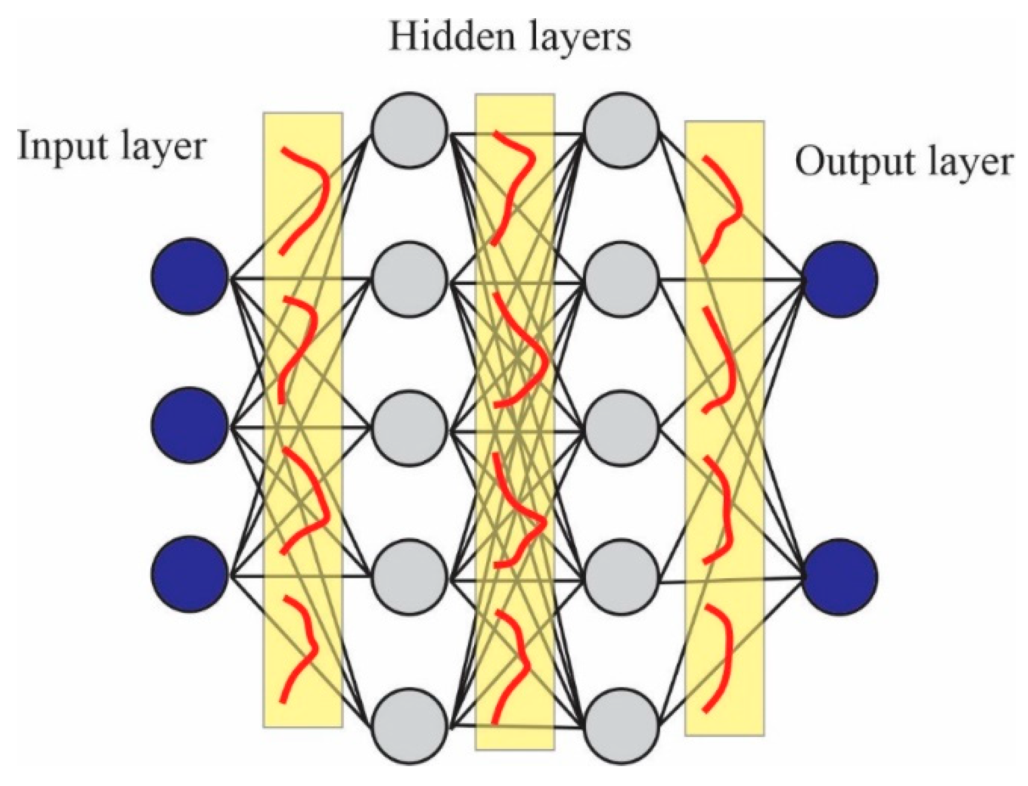
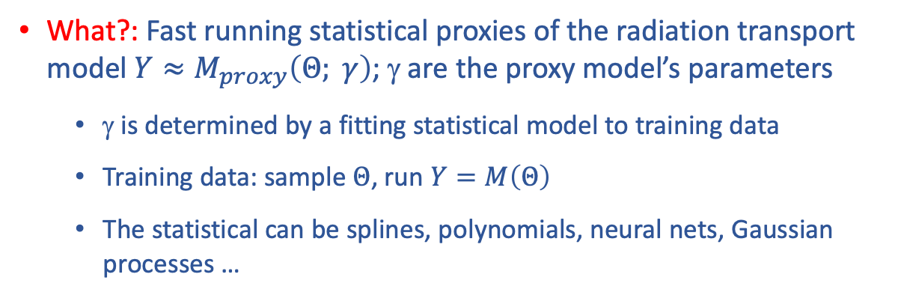
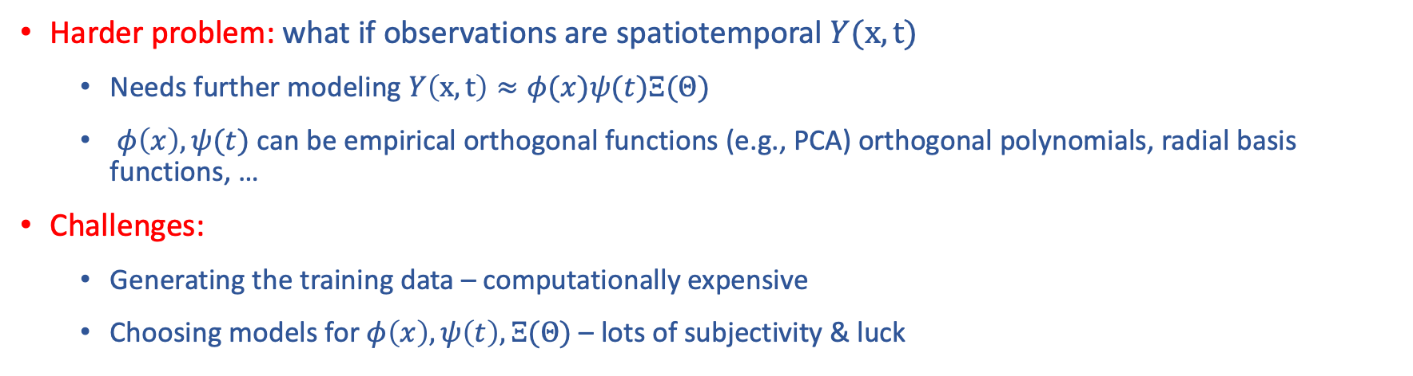


Surrogate models
What?: Fast running statistical proxies of the radiation transport model $Y≈M_{proxy}\left(Θ; γ\right)$; γ are the proxy model’s parameters
  γ is determined by a fitting statistical model to training data
  Training data: sample $Θ$, run $Y=M\left(Θ\right)$
  The statistical can be splines, polynomials, neural nets, Gaussian processes …
$$Θ$$
$$Y$$
Harder problem: what if observations are spatiotemporal $Y(x,t)$
  Needs further modeling $Y\left(x,t\right)≈φ(x)ψ(t)Ξ(Θ)$
  $φ\left(x\right), ψ(t)$ can be empirical orthogonal functions (e.g., PCA) orthogonal polynomials, radial basis functions, …
Challenges:
  Generating the training data – computationally expensive
  Choosing models for $φ\left(x\right), ψ\left(t\right), Ξ(Θ)$ – lots of subjectivity & luck

Slide 12
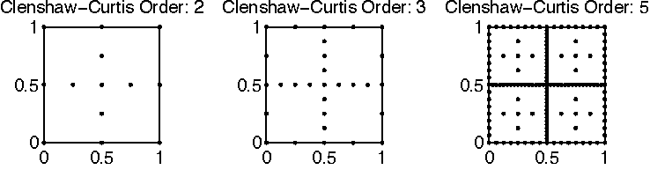
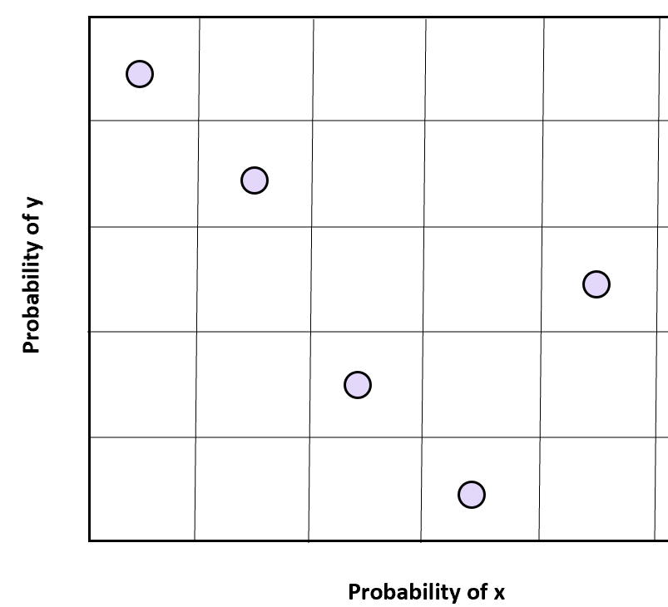
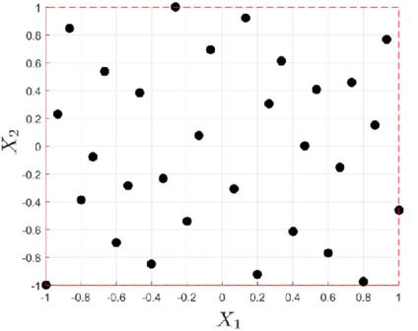
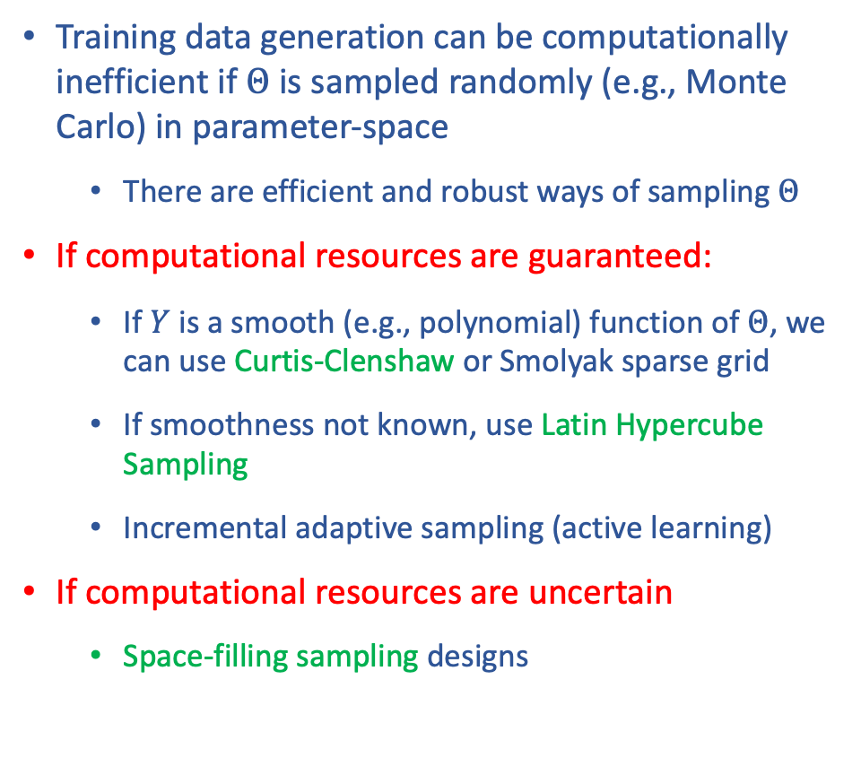
Sparse grid sampling
Training data generation can be computationally inefficient if $Θ$ is sampled randomly (e.g., Monte Carlo) in parameter-space
  There are efficient and robust ways of sampling $Θ$
If computational resources are guaranteed:
  If $Y$ is a smooth (e.g., polynomial) function of $Θ$, we can use Curtis-Clenshaw or Smolyak sparse grid
  If smoothness not known, use Latin Hypercube Sampling
  Incremental adaptive sampling (active learning)
If computational resources are uncertain
  Space-filling sampling designs
Curtis-Clenshaw grids for 2D sampling
Latin Hypercube sampling
in 2D
Space-filling design

Slide 13
Quantitative source reconstruction with SDF?
Safeguard scenarios: Which ones should we consider?
  Hold-ups in ductwork, contents of cylinders & containers, ….
Source models: What types of source parameterization should we consider in Safeguards?
  Point/line/volumetric(?)
Multimodal observations: What observables should we consider? Gamma, neutron, Lidar, ….
Noise models: Do we consider short dwell times? Should we consider low count measurements?
  Will we need Poisson or negative binomial observational error models? Or will Gaussians work?
Surrogate models: Is it feasible to make surrogate models ahead of time?
Inference algorithms: How accurate do we need the UQ to be? Can we live with fast, if approximate, VI algos?

