Slide 1
Leveraging contextual data for enhanced radiological data fusion
Marco Salathe, Berkeley Lab
Radiological Data Fusion Workshop / Detecting Radiation Algorithms Group (DRAG) Meeting

Slide 2
Overview
How can contextual data inform/improve scene data fusion?
Simultaneous localization and mapping
Semantic image segmentation
Object detection, tracking, and attribution
Conclusion

Slide 3
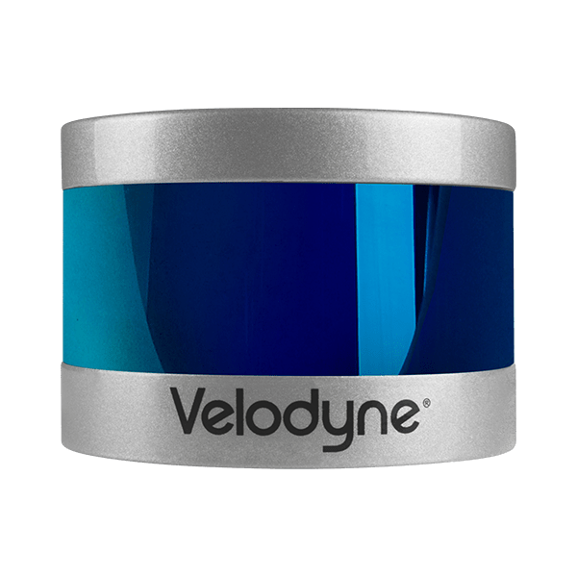
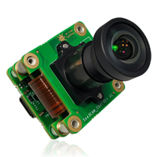
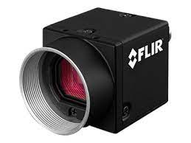
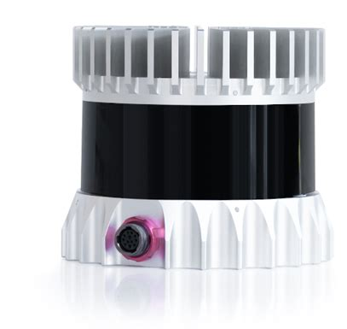
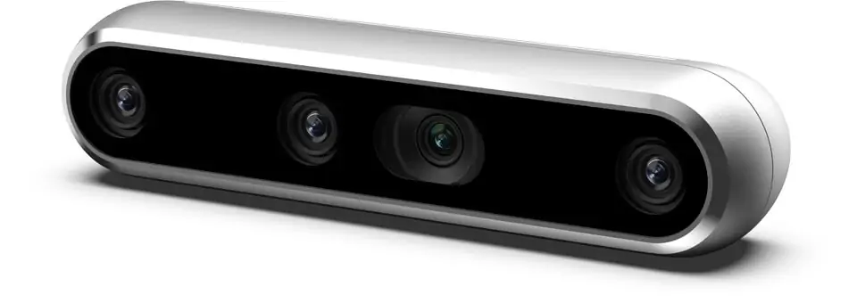
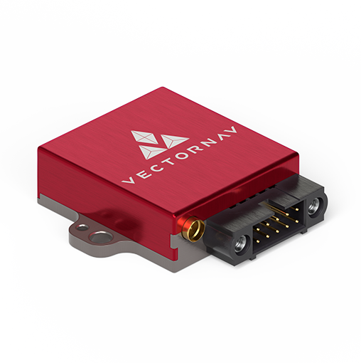
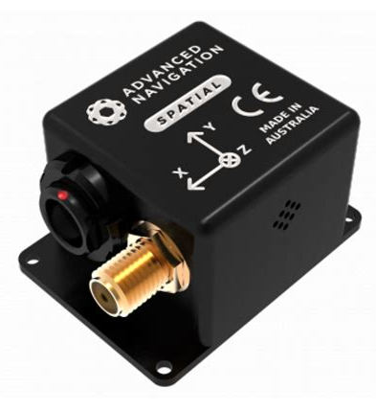
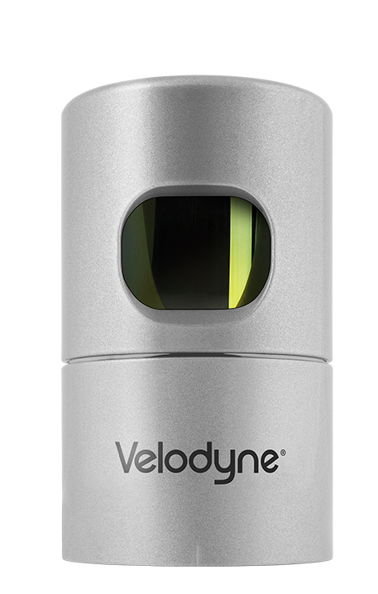
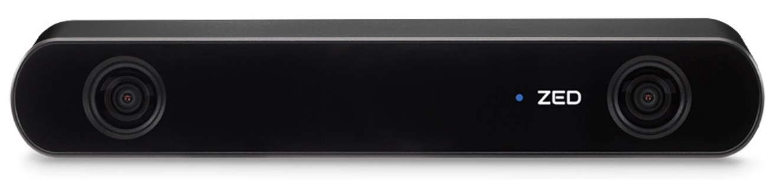
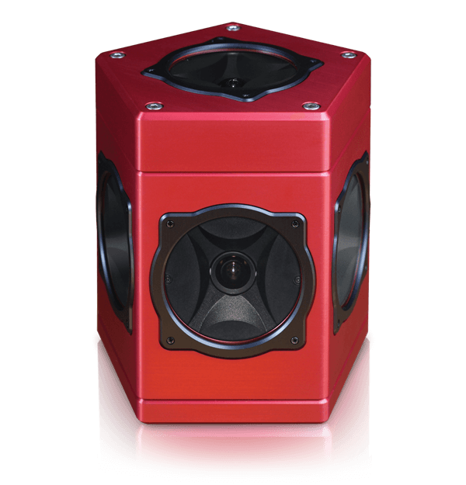
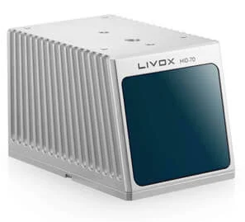
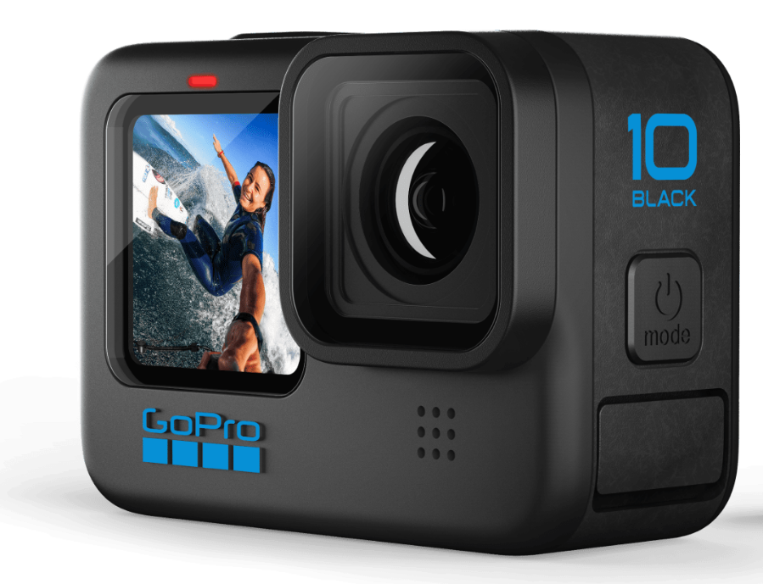
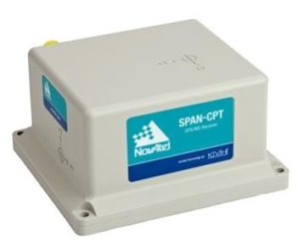
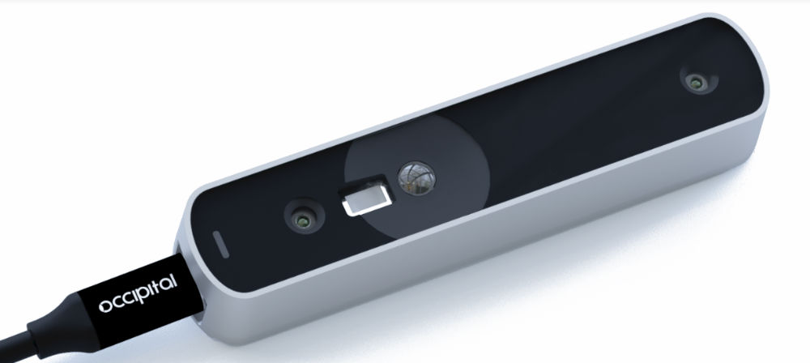
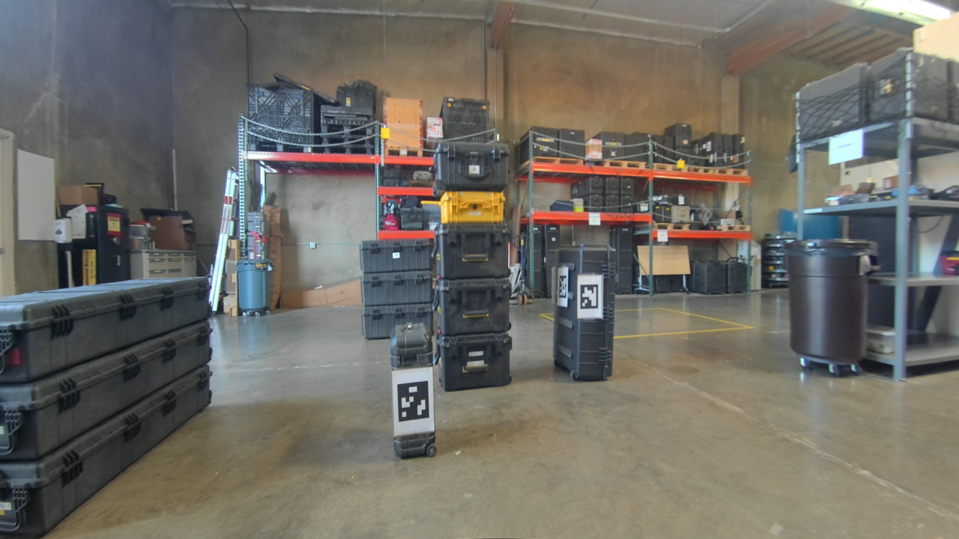
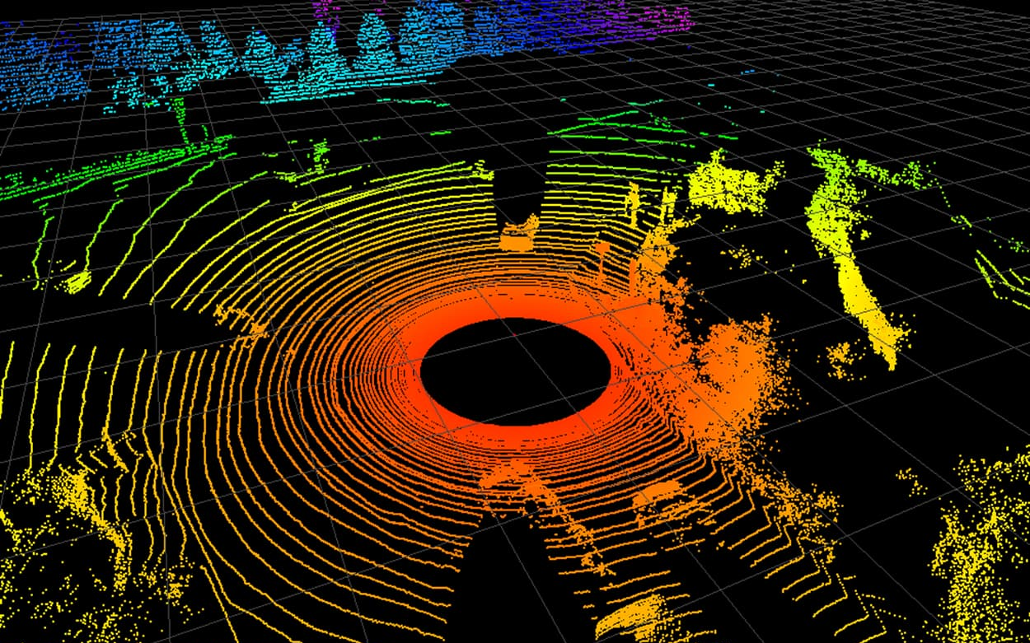
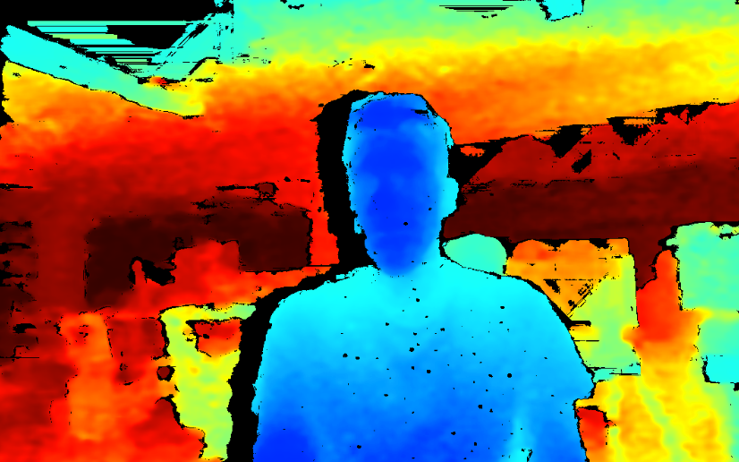
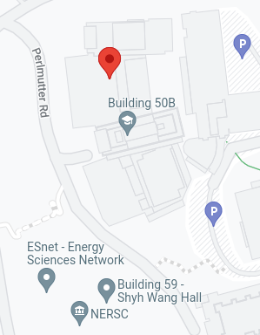
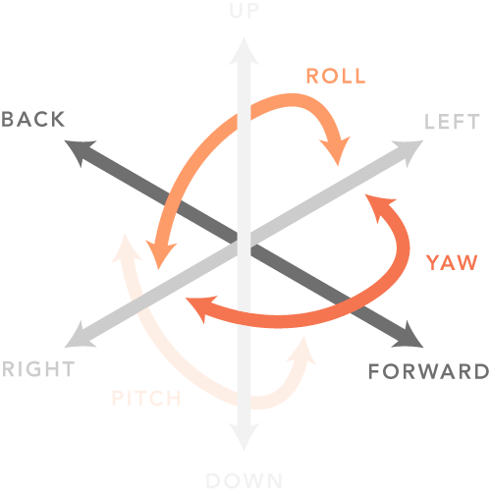
Contextual sensors and their data products
Visual cameras
LiDARs
RGB-D cameras
Inertial Navigation Systems
RGB images
Point clouds
RGB/Depth images
RGB/Depth images

Slide 4
Simultaneous localization and mapping

Slide 5
Contextual sensors and their data products
Visual cameras
LiDARs
RGB-D cameras
Inertial Navigation Systems
RGB images
Point clouds
RGB/Depth images
RGB/Depth images

Slide 6
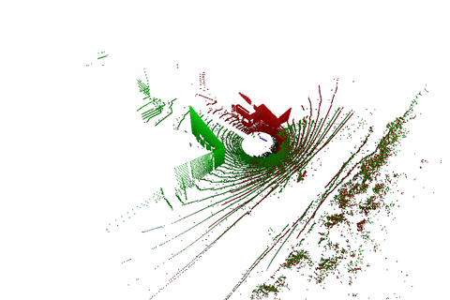
Simultaneous Localization and Mapping (SLAM)
Mostly LiDAR based (~10 scans per second)
  Minimize cost function between
  current data and representation of
  map from past data
Inertial Measurement Unit (IMU)
  Dead reckoning between
  LiDAR packages
  Motion correction of LiDAR data
Outputs
  Trajectory of the system
  A map of the scene (Point cloud)
In the past mostly using google cartographer
We continuously try to “find” better SLAM algorithm, open source and commercially available
  Research better left to computer vision researcher and companies
W. Hess, et al., “Real-Time Loop Closure in 2D LIDAR SLAM”, 2016 IEEE International Conference on Robotics and Automation (ICRA), pp. 1271–1278 (2016). https://github.com/googlecartographer/cartographer

Slide 7
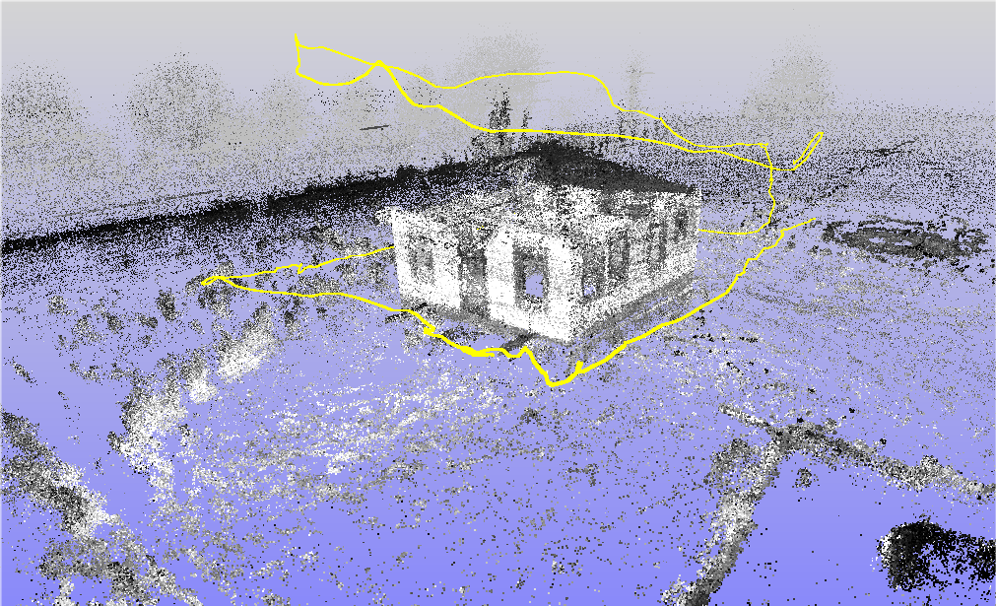
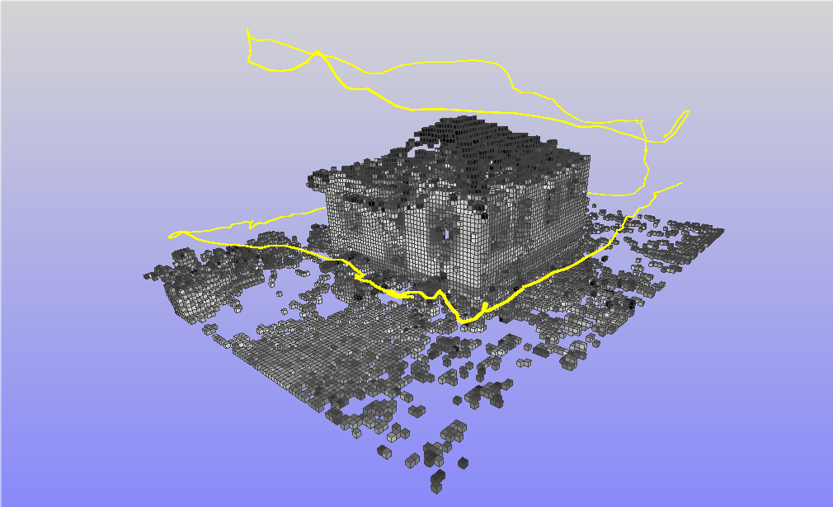
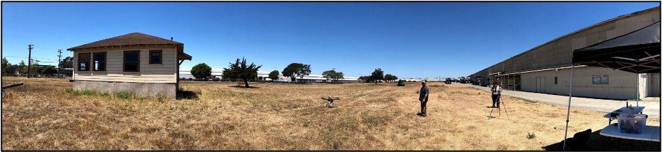
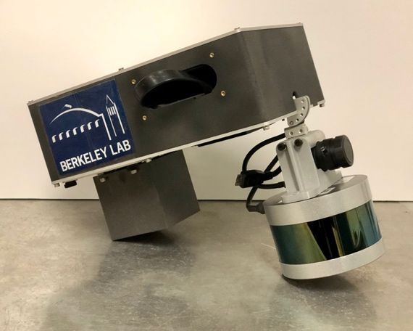
Voxelization of point cloud
voxelization (15 cm)
NG-LAMP on UAS
VLP-16 LIDAR on NG-LAMP

Slide 8
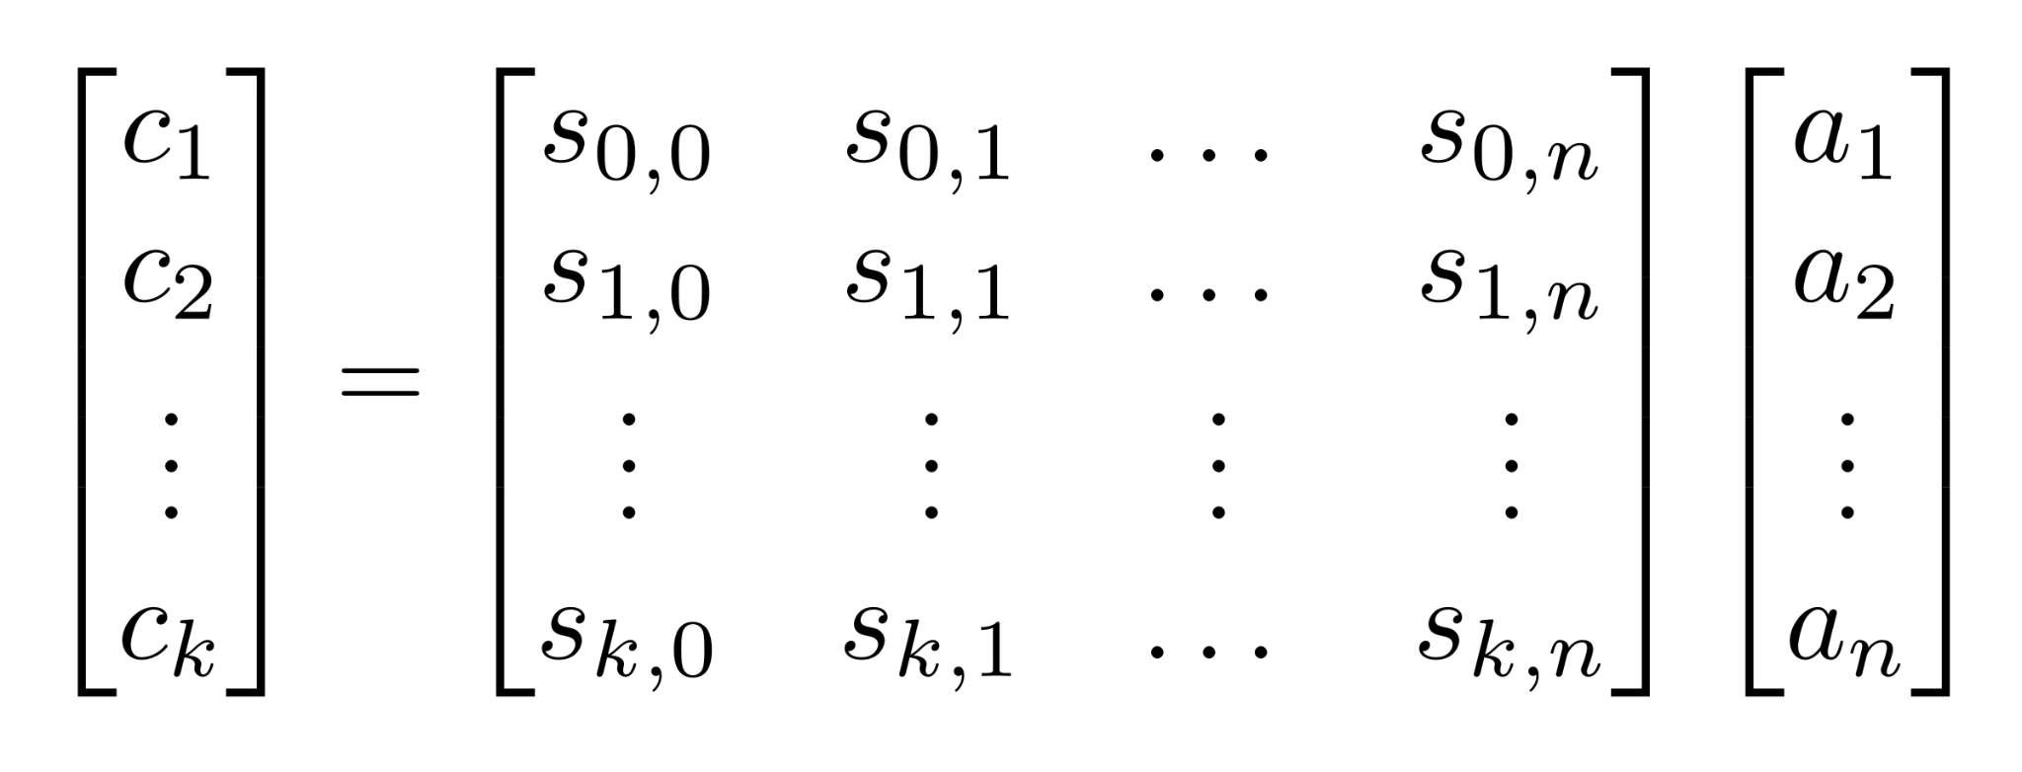
Linking radiation data with scene data
System matrix:
Sensitivity of voxel n seen from position k
(Angular detector response, distance, attenuation in scene, down scattering, etc.)
Radiation data (e.g. counts) at position k
Activity observed from voxel n

Slide 9
Linking radiation data with scene data
Inverting an underdetermined system of equations!
Solvable (to some extent) with Maximum Likelihood Estimation Maximization (MLEM).
Some additional constraints might be necessary in many situations – defined based with additional contextual data!
System matrix:
Sensitivity of voxel n seen from position k
(Angular detector response, distance, attenuation in scene, down scattering, etc.)
Radiation data (e.g. counts) at position k
Activity observed from voxel n

Slide 10
Contextual sensors and their data products
Visual cameras
LiDARs
RGB-D cameras
Inertial Navigation Systems
RGB images
Point clouds
RGB/Depth images
RGB/Depth images

Slide 11
Semantic image segmentation

Slide 12
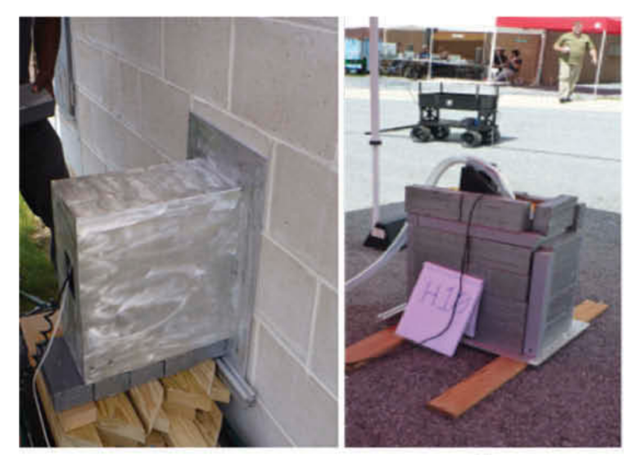
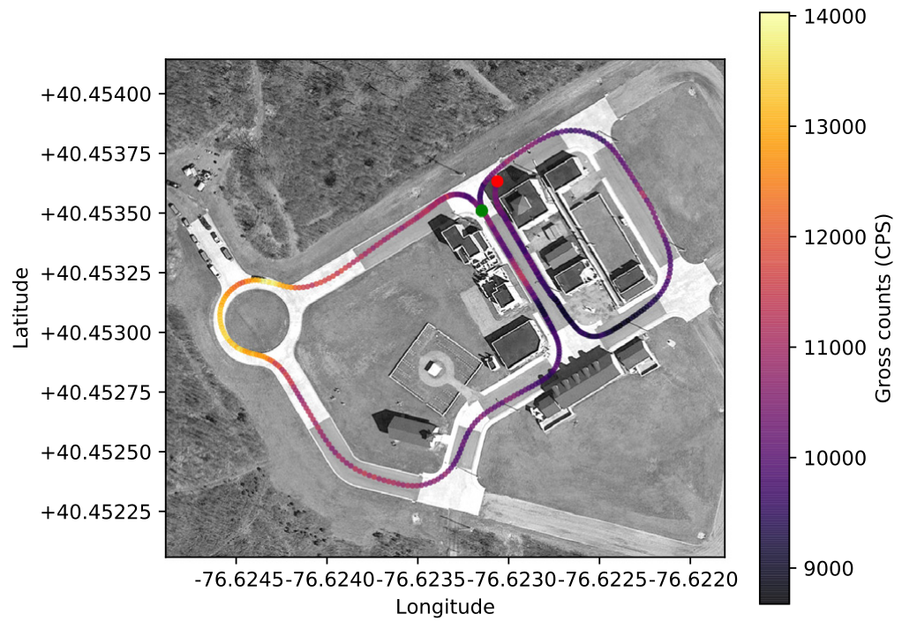
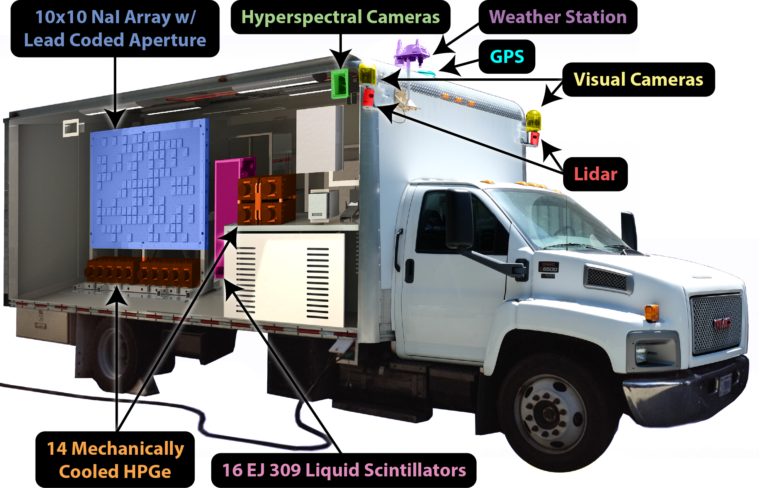
Can we infer background sources in urban areas?
RadMAP at the Fort Indiantown Gap (FtIG) National Guard Base (2016)
Extensive HPGe detector measurements gamma-ray spectra emitted
by various materials in the facility have been performed (ground truth)
RadMap: Contextual sensors + array of 100 NaI detectors
Can we reproduce HPGe result with a short mobile measurement?
Point Grey Ladybug 3
Velodyne HDL-32E

Slide 13
Can we infer background sources in urban areas?
RadMAP at the Fort Indiantown Gap (FtIG) National Guard Base (2016)
Extensive HPGe detector measurements gamma-ray spectra emitted
by various materials in the facility have been performed (ground truth)
RadMap: Contextual sensors + array of 100 NaI detectors
Can we reproduce HPGe result with a short mobile measurement?
Brute force approach impossible: Too many parameters!
Large facility with millions of voxels
Various isotopes per naturally occurring material
Spectral information is important
Short measurement (126 seconds of data)
Additional constraints are inevitable!
Point Grey Ladybug 3
Velodyne HDL-32E

Slide 14
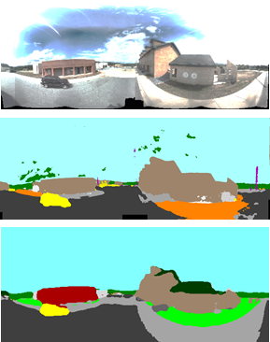
Semantic image segmentation of panoramic images
Original image
Off the shelf semantic image segmentation neural network
  Google’s DeepLabv3+ model & Cityscapes dataset
Hand-labeled 45 images with 11 custom classes
  Asphalt
  Building red
  Building brown
  Building white
  Building roof
  Concrete
Applied transfer learning by retraining last, fully-connected neural layer
Labelled all available images from the measurement
Cityscapes dataset available at: https://www.cityscapes-dataset.com
L.Chen, et. al., “Encoder-Decoder with Atrous Separable Convolution for Semantic Image Segmentation”, ECCV, 2018, https://github.com/tensorflow/models/tree/master/research/deeplab
  Forest
  Grass
  Gravel
  Sky
  Vehicle
DeepLabv3+ segmented result
DeepLabv3+ with Transfer Learning

Slide 15
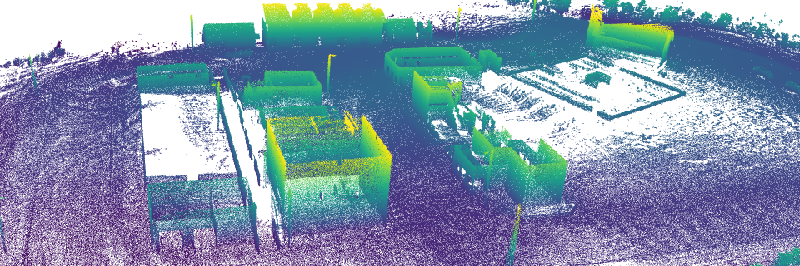
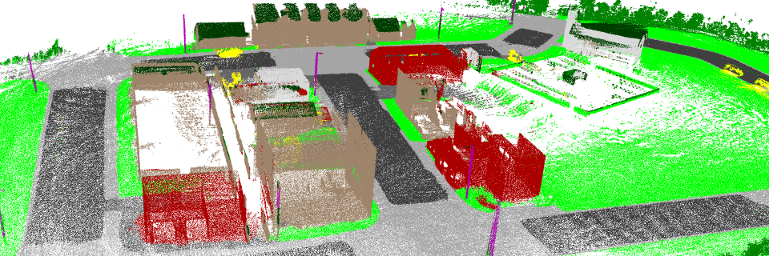
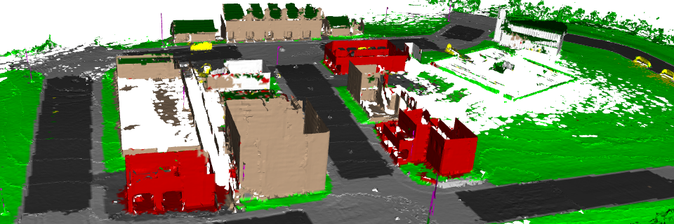
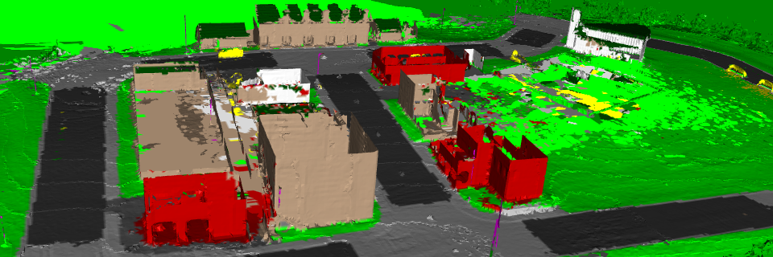
Construction of a 3D model of the facility
Initial point cloud
Labeled point cloud
Labeled and simplified mesh
Mesh with patched holes
Project labeled images to point cloud and pick the label that is observed most often
Convert labeled point cloud into a triangular mesh (based on ball pivoting algorithm)
Simplify mesh to reduce number of vertices by a factor of ~10
Patch remaining holes using nearest neighbor interpolation
S. Katz, et al., “Direct visibility of point sets”, ACM Trans, Graph. 26, 3, Article 24, 2007
Q. Zhou, et al., “Open3D: A Modern Library for 3D Data Processing”, arXiv:1801.09847, 2018, http://www.open3d.org

Slide 16
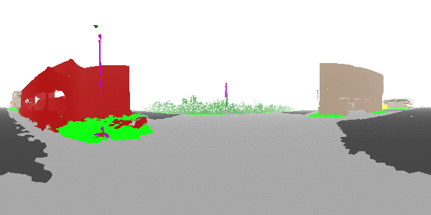
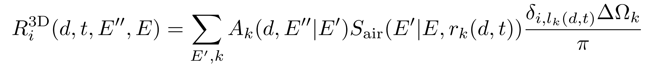
System matrix formulation
The distance and material class of all surfaces can be calculated relative to the radiation detector
  Spherical field of view
  Alpha channel is distance between 0 (transparent) and 80 meter (white)
Leverage additional information for construction of system matrix
90°
0°
-90°
-180°
0°
180°
System matrix (dependent on emitted energy E and detected energy E’’)
Detector sensitivity (simulations)
Attenuation in air for distance r (simulations)
Solid angle elements k
Constraints from segmentation label

Slide 17
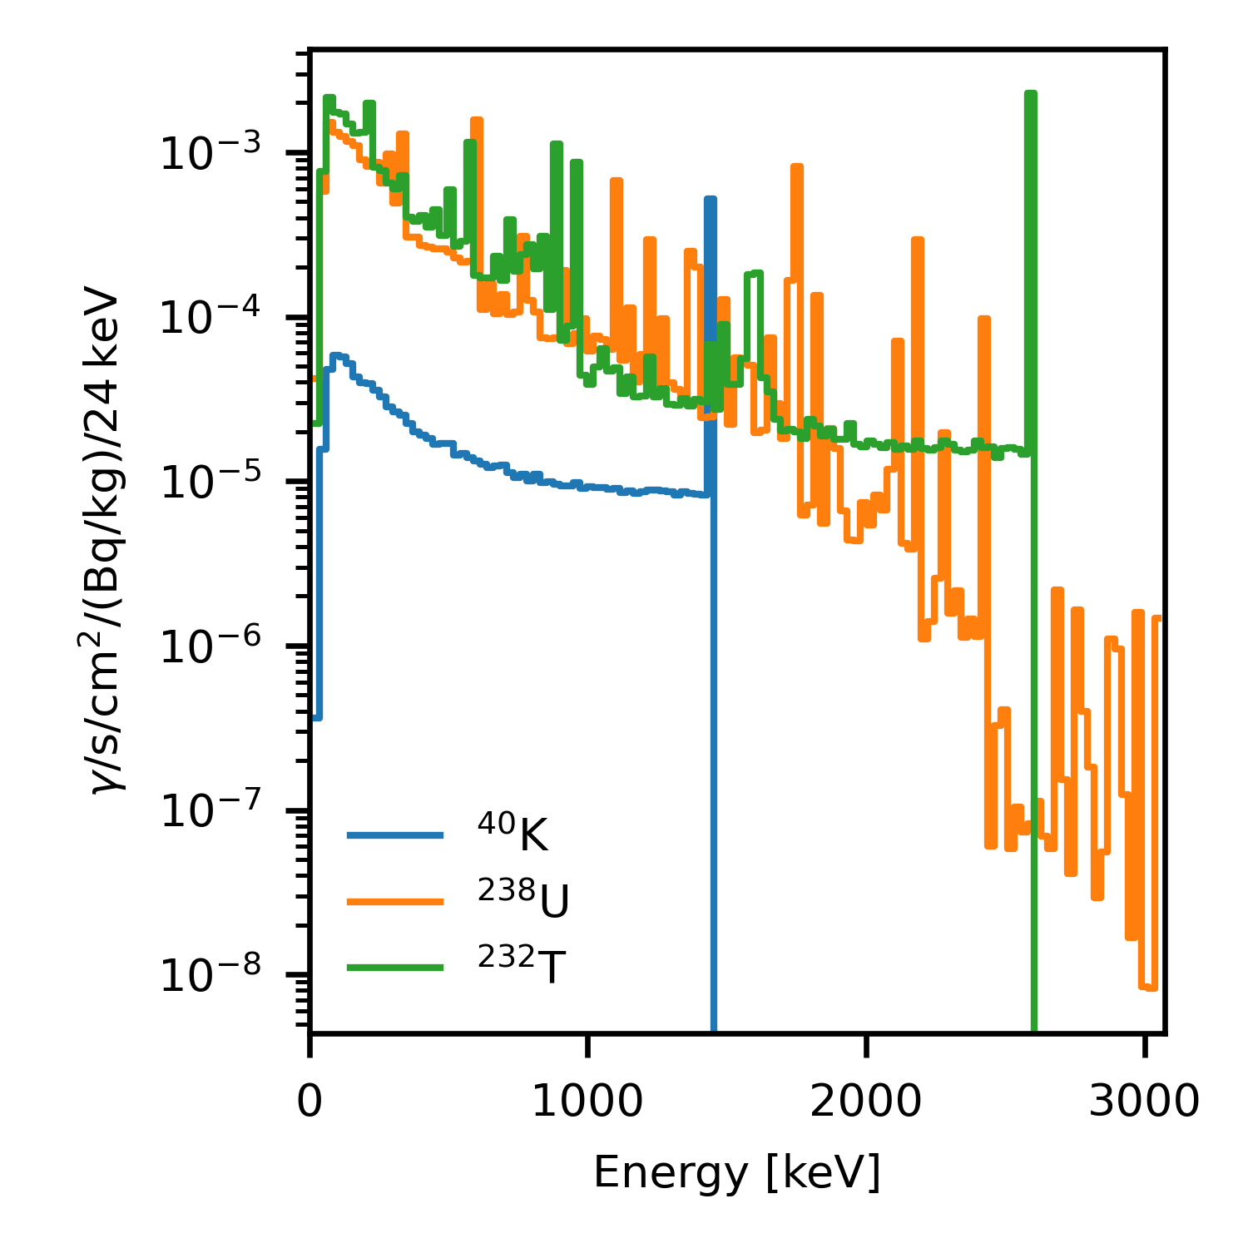
Additional constraints on possible background sources
Main sources of naturally occurring radioactive materials (NORM):
  Terrestrial — K-40, U-238 series, Th-232 series (KUT)
  Airborne — radon, skyshine
  Cosmic — continuum, 511 keV from positrons
Approximated with:
  3 terrestrial components (K/U/T), derived from
  simulations
  1 airborne/cosmics component (unconstrained)
Reduction to 152 free parameters
  3 amplitudes of each component x 11 labels = 33
  119 bins for airborne/cosmics modeling
Converted an underdetermined problem into
an overdetermined one that can be easily solved with
MLEM

Slide 18
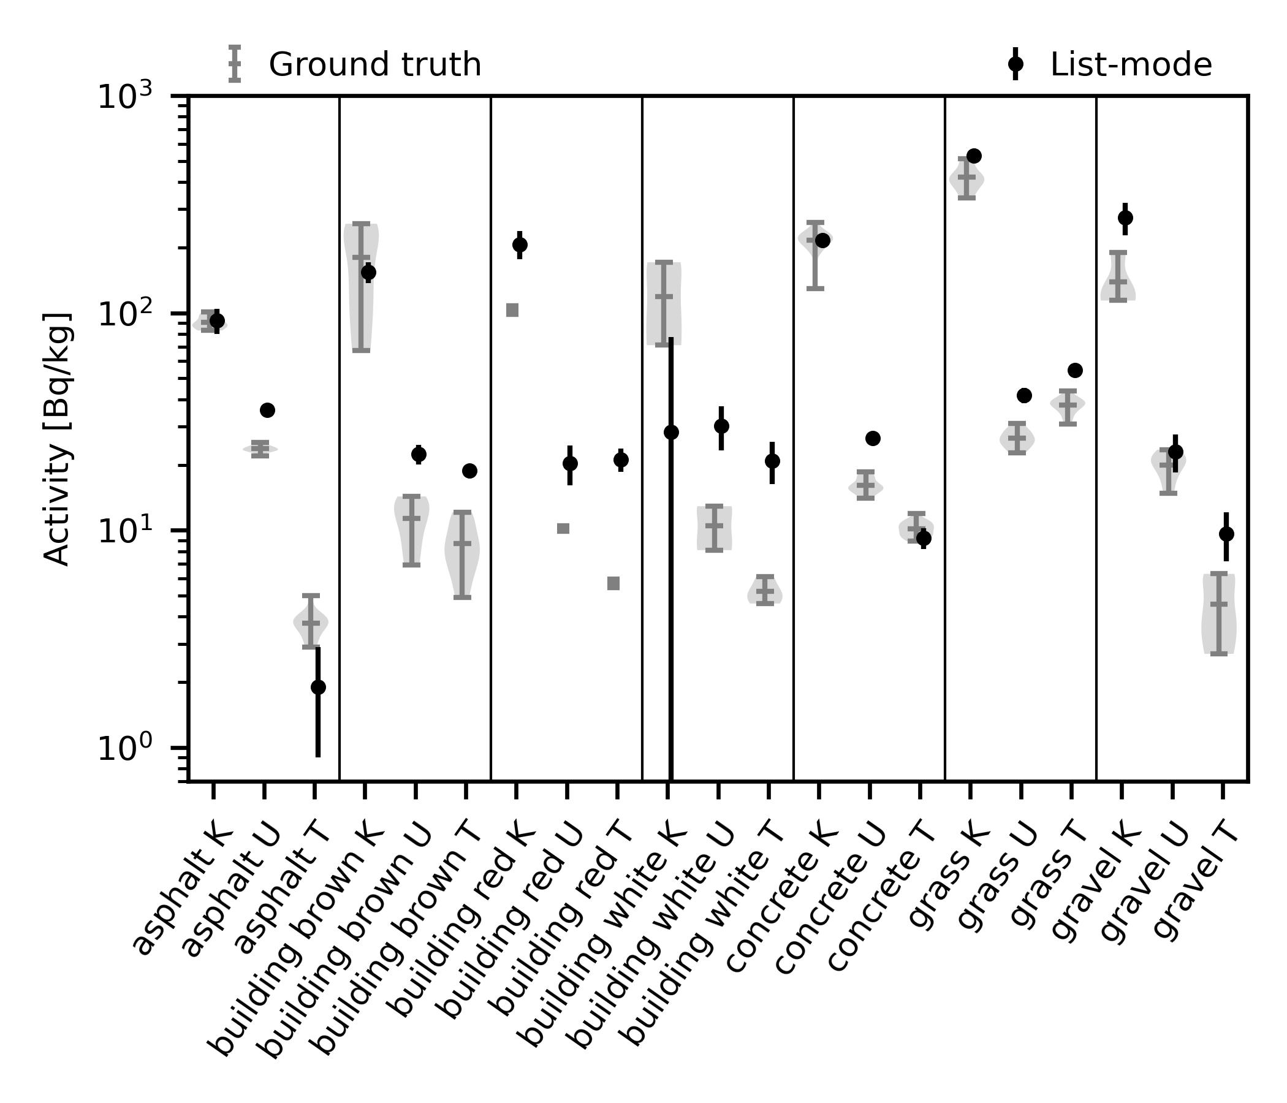
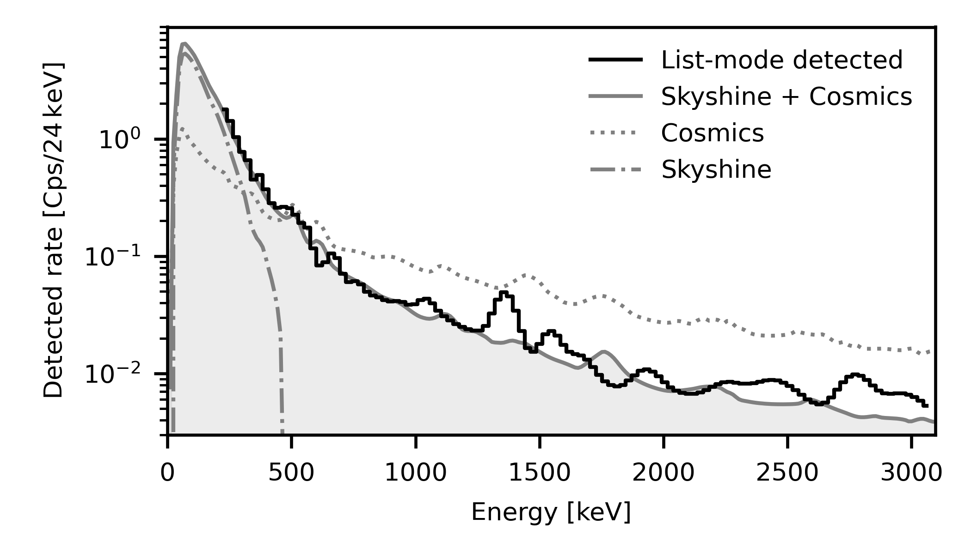
Predict natural occurring radioactive materials
Ability to predict radiological composition of materials at facility
Properly attribute fraction of radiation observed from sky
M. Salathe et al., “Determining urban material activities with a vehicle-
based multi-sensor system”, Physical Review Research 3 (2021).

Slide 19
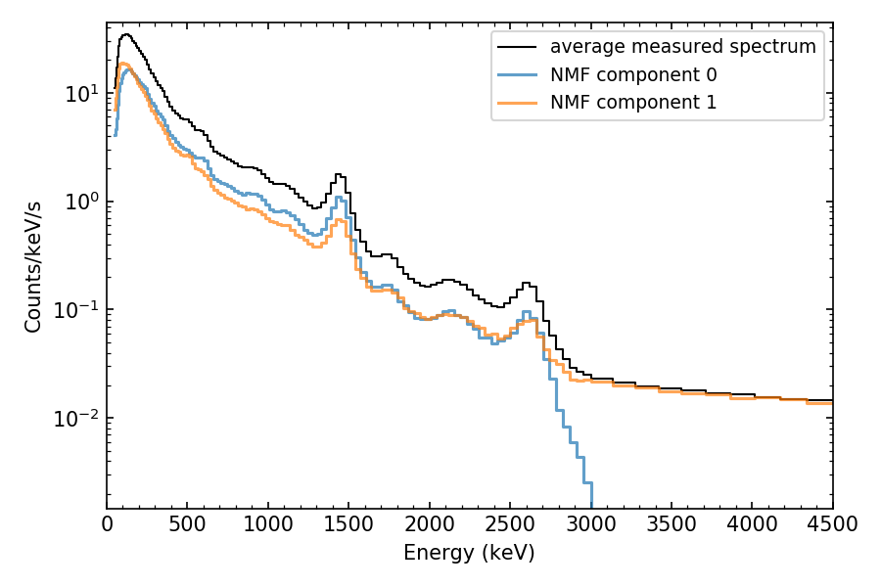
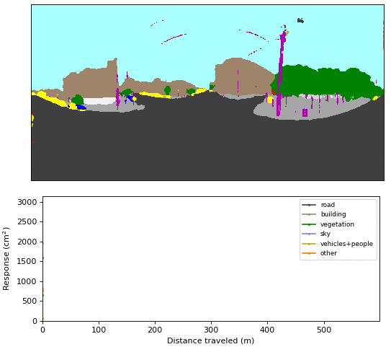
Correlations between labels and gamma-ray data
Bi-214 (U)
scattering
cosmics
K-40
Tl-208 (T)
40min dataset collected in downtown Oakland with RadMap
Non-negative matrix factorization to “simplify” radiation data (2 components only)
Semantic segmentation of images

Slide 20
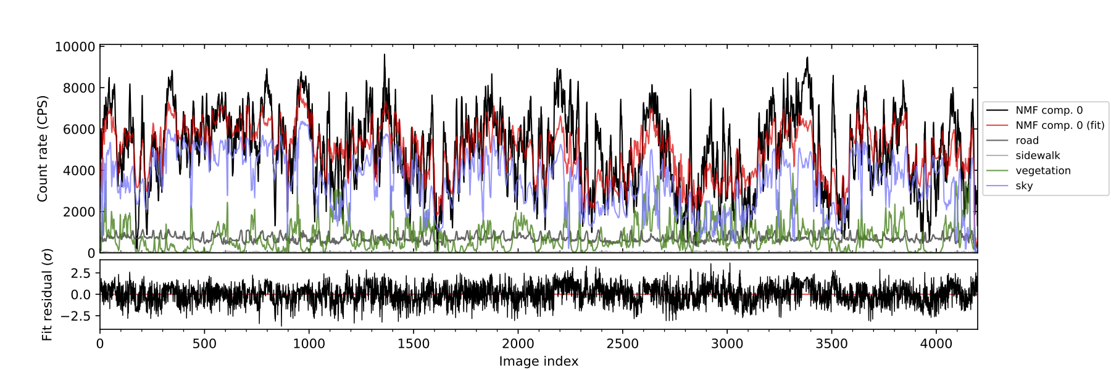
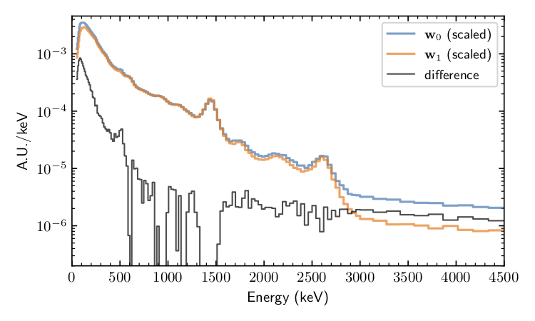
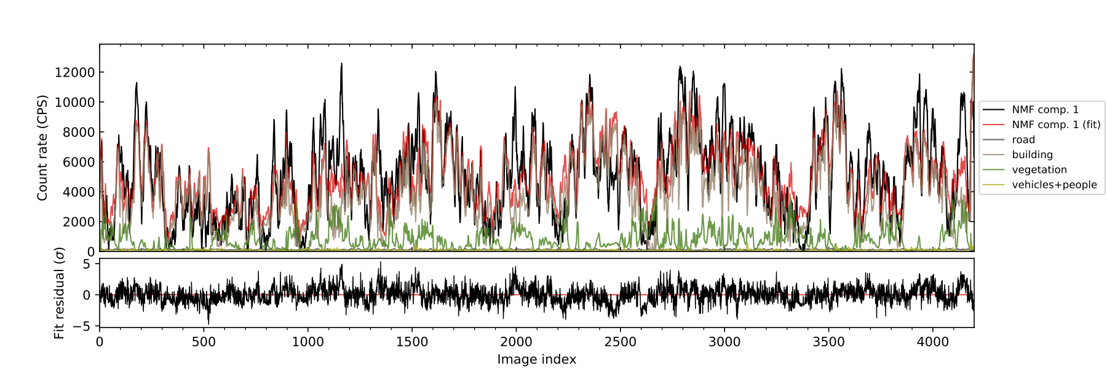
Correlations between labels and gamma-ray data
One NMF feature correlates with
the “sky”, and the second
with “buildings”
Difference between the components
is cosmic emission and scattering
M.S. Bandstra, B.J. Quiter, K.J. Bilton, J.C. Curtis, S. Goldenberg, T.H.Y. Joshi, and M. Salathe, “Correlations between Panoramic Imagery and Gamma-Ray Background in an Urban Area,” IEEE Trans. Nuc. Sci., 68(12), 2021.
scattering
511 keV line (cosmic-induced positrons)
cosmic continuum

Slide 21
Object detection, tracking and attribution

Slide 22
SDF typically restricted to static environments
Moving objects such as vehicles, pedestrians, etc. might carry important information
  They are usually present in most urban areas!
  They might carry the radioactive materials that we try to measure!
SDF is poorly equipped to deal with them
  Usually moving objects are removed in voxel grids (snail trails)
  Temporal pattern (non static): they moves over time
Relating a radiological alarm to a moving object present in a video feed or on scene is hard!
  The temporal pattern of a moving object and of the radiological signature observed in the detector can provide additional information
  Improve situational awareness
New Scene Data Fusion paradigm!
Relate radiological data to the path of moving objects

Slide 23
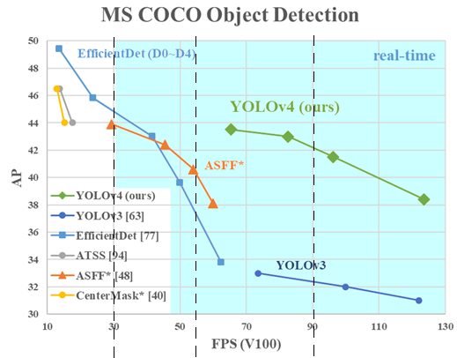
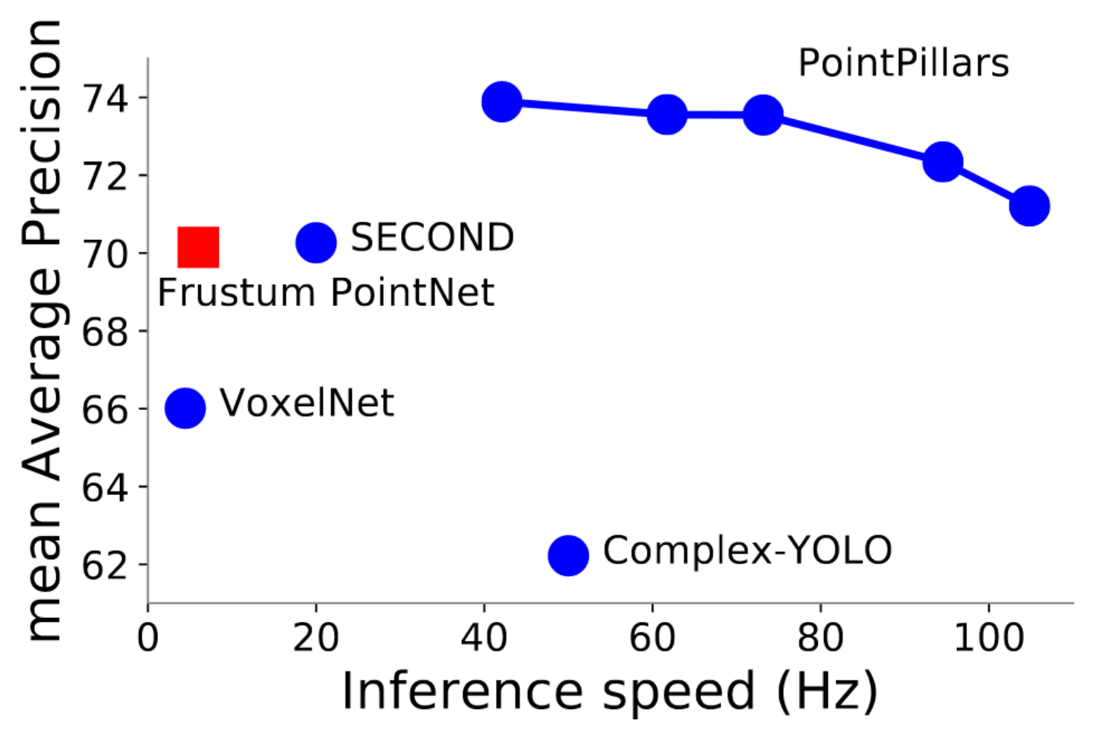
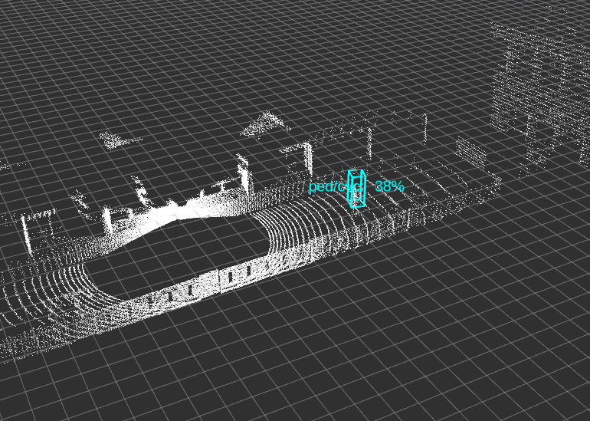
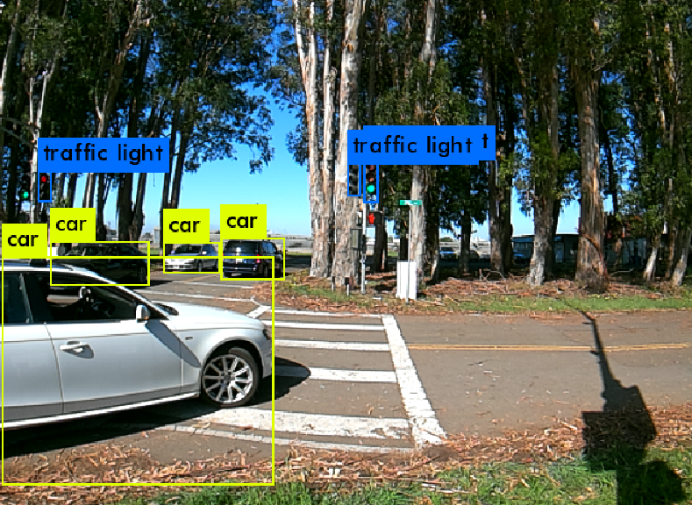
Object detection in images with neural networks
Image based
A. Bochkovskiy, et al, “YOLOv4: Optimal Speed and Accuracy of Object Detection,” arXiv:2004.10934v1
LiDAR based
A. H. Lang, et. al, "PointPillars: Fast Encoders for Object Detection From Point Clouds," doi:10.1109/CVPR.2019.01298
Predicts 2D/3D bounding boxes
Real time object detection on the edge (battery operated)
  Yolov4-tiny/ Yolov7-tiny:
  ~45 images / sec
  PointPillars:
  ~10 scans / sec
Notes:
Object detection in real time on a NVIDIA Jetson NX
Yolov4-tiny (2020) for image based detection
Use TensorRT for increased performance
~45 images / second
PointPillars (2018) for LiDAR based detection
PyTorch based implementation with speed tweaks
~10 scans / second

Slide 24
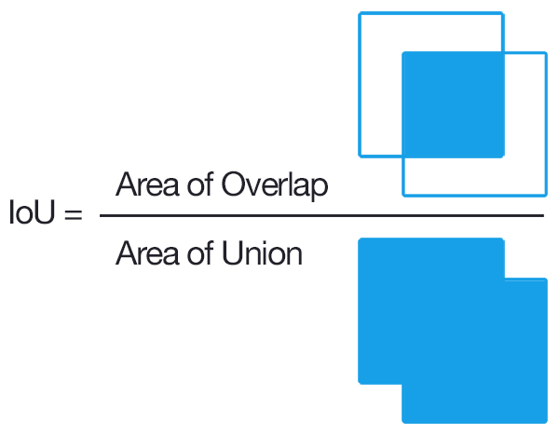
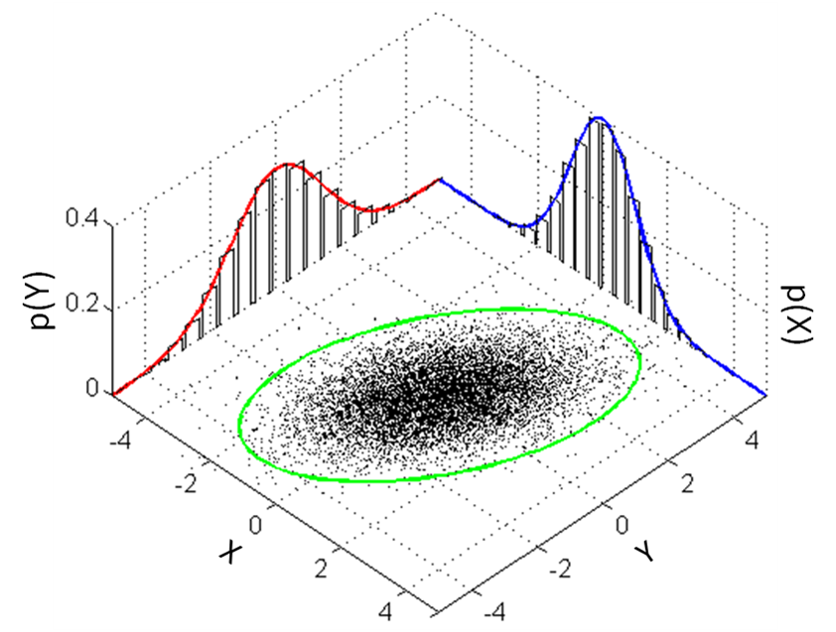
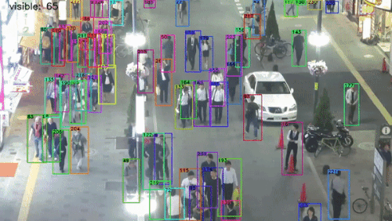
Object tracking over time
Simple Online and Realtime Tracking (SORT)
Based on bounding boxes in image coordinates
Kalman filter used to predict the next likely location of a given bounding box
Intersection over Union comparison
A. Bewley, et. al, "Simple online and realtime tracking," doi: 10.1109/ICIP.2016.7533003
Extension to 3D
Use 3D position (x, y, z) in Kalman filter
Multivariate Normal: 3x3 matrix encodes x, y and z uncertainties
Hellinger distance as matching criteria
M. R. Marshall et al., "3-D Object Tracking in Panoramic Video and LiDAR for Radiological Source–Object Attribution and Improved Source Detection," doi:10.1109/TNS.2020.3047646
FastMOT
Omni-scale network (OSNet) feature vectors CNN for object re-identification
Optical flow for tracking between detections (allows for slower more performant object detection network)
Limited to images
Y. Yang, “FastMOT: High-Performance Multiple Object Tracking Based on Deep SORT and KLT”, doi:10.5281/zenodo.4294717
Kaiyang Zhou, et. al, “Omni-Scale Feature Learning for Person Re-Identification”, arXiv:1905.00953

Slide 25


Attribution (track-based data fusion)
Model the number of gamma rays estimated from a source moving along a trajectory (r):
⍺ (source strength and b (background) are fit parameters
Calculate Poisson log-likelihood and p-value of observing data given the optimal model
Exclusion metric to quantify most likely source (s-value defined as -log₂[p-value])
S. Greenland, “Valid P-Values Behave Exactly as They Should: Some Misleading Criticisms of P-Values and Their Resolution With S-Values”, doi:10.1080/00031305.2018.1529625

Slide 26


Attribution example in real time
Measurement at Richmond field station with Nvidia Xavier based system
Both, camera or lidar
based object detection
and tracking in real time

Slide 27

Impact of track-based SDF
Object
Detection
CNN
Kalman
Filter
Tracker
Attribution
Image Frame
Tracks
Obj. Positions
LiDAR Scan
Spectral Alarm
Rad Data
Improve situational awareness of operators
Enhance source detection performance:
Limit radiological searches to time windows where an object is (sufficiently) close to a detector
  Increased sensitivity
  Reduced false alarm rate
M. R. Marshall et al., “3-D Object Tracking in Panoramic Video and LiDAR for Radiological Source–Object Attribution and Improved Source Detection,” doi: 10.1109/TNS.2020.3047646.

Slide 28
Conclusion

Slide 29
Conclusion and Outlook
Simultaneous localization and mapping is a central technology enabling scene data fusion
However, the result of SDF attributions are rarely unique
  Due to underdetermined and/or ill-conditioned system of equations
Camera data can be used to derive additional constraints
  Semantic image segmentation
  Object detection and tracking
Such constraints have been shown to enable:
  Finding correlation with radiological backgrounds in urban area and making predictions
  Attributing radiological alarms to moving objects in a scene
Further research opportunities
  Reduction of SDF to objects of interest (holdup can only by in pipe or duct)
  Inferring information about semantically-identified objects (walls aren’t infinitely thick)
  Merging different approaches (background estimation, moving objects and static SDF)
  Autonomy (“optimize” a trajectory based on contextual information)

Slide 30
Thanks
Image segmentation
B. J. Quiter
M. S. Bandstra
J. C. Curtis
R. Meyer
C. H. Chow
T. H. Y. Joshi
K. J. Bilton (UC Berkeley)
S. Goldenberg (The College of William and Mary, Williamsburg, VA, USA)
This work was performed under the auspices of the U.S.
Department of Energy by Lawrence Berkeley National Laboratory under Contract DE-AC02-05CH11231. The project was funded by the U.S. Department of Energy, National Nuclear Security Administration, Office of Defense Nuclear Nonproliferation Research and Development (DNN R&D). This research used resources of the National Energy Research Scientific Computing Center (NERSC), a U.S. Department of Energy Office of Science User Facility operated under Contract No. DE-AC02-05CH11231.
Object detection, tracking and attribution
M. R. Marshall (UC Berkeley)
D. Hellfeld
T. H. Y. Joshi
M. S. Bandstra
K. J. Bilton (UC Berkeley)
R. J. Cooper
J. C. Curtis
V. Negut
A. J. Shurley (UC Berkeley)
K. Vetter
This work was supported by the U.S. Department of Homeland Security through competitively awarded under Contract 16DNARI00026. This support does not constitute an expressed or implied endorsement on the part of the United States Government.

