Slide 1
Data-Driven Autonomous Radiation Source Search
Emil Rofors, Mark S. Bandstra, Daniel Hellfeld, Tenzing H.Y. Joshi, Alex Moran, Marco Salathe, Jayson R. Vavrek, Kai Vetter, Brian J. Quiter
Applied Nuclear Physics, LBL
DRAG RDF22
Radiological Data Fusion (RDF) Workshop 2023
Berkeley, 15-16 August 2023
Notes:
1

Slide 2
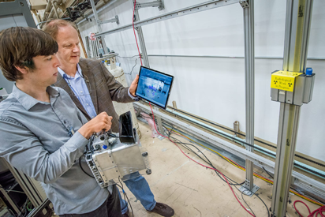
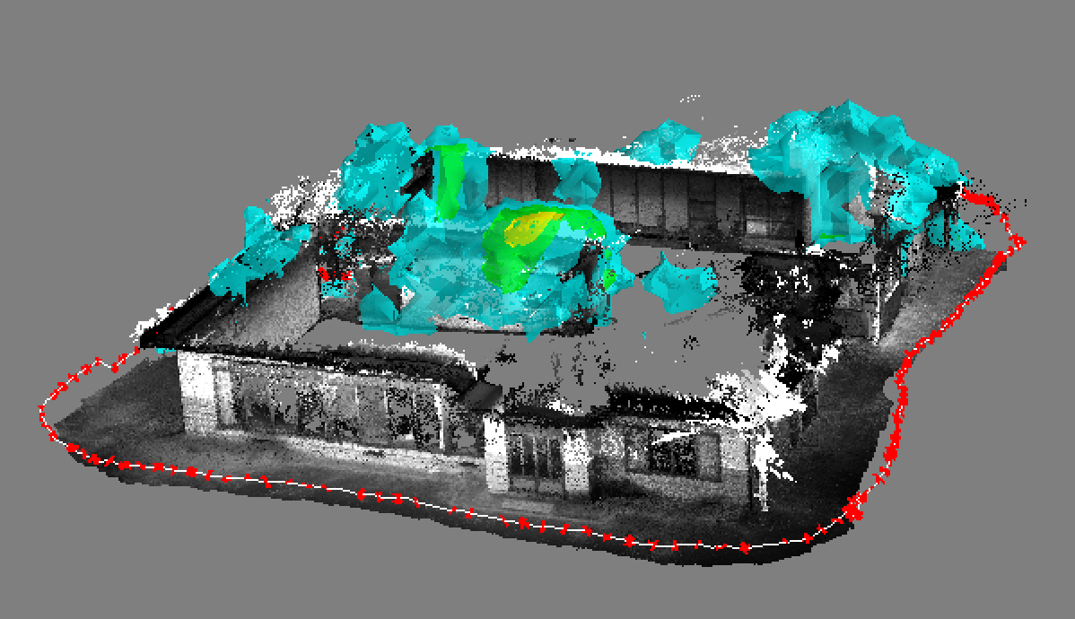
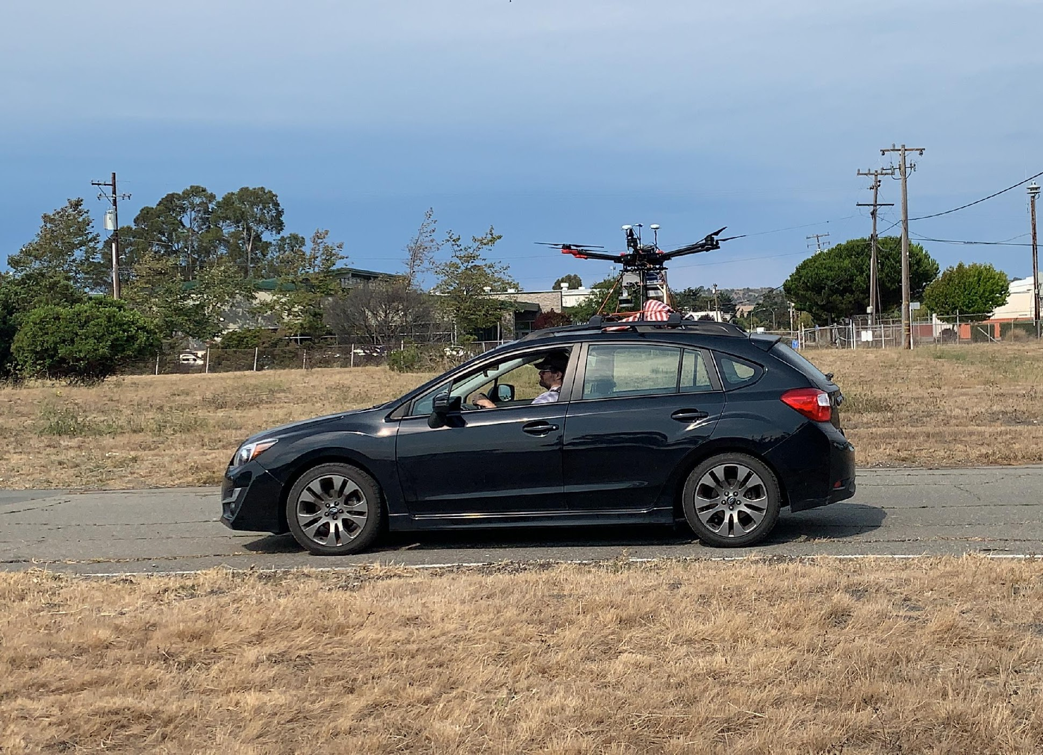
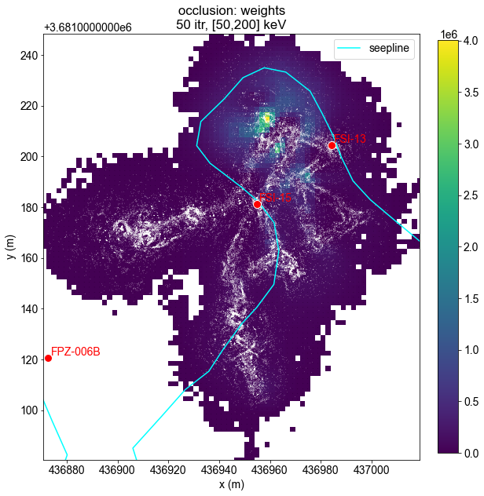
Outline
Autonomy scale
Path-planning
Behavior trees for autonomy
SDF & autonomy
Origins of SDF – handheld qualitative gamma-ray imaging
SDF Concept: R Barnowski et al., “Scene data fusion: Real-time standoff volumetric gamma-ray imaging,” NIM A, 800, 65–69 (2015).
First SFD examples: A Haefner et al., “Handheld real-time volumetric 3-d gamma-ray imaging,” NIM A, 857, 42–49 (2017).
2021-2022: Quantitative SDF at km scales using a variety of platforms
Notes:
Scene data fusion is

Slide 3
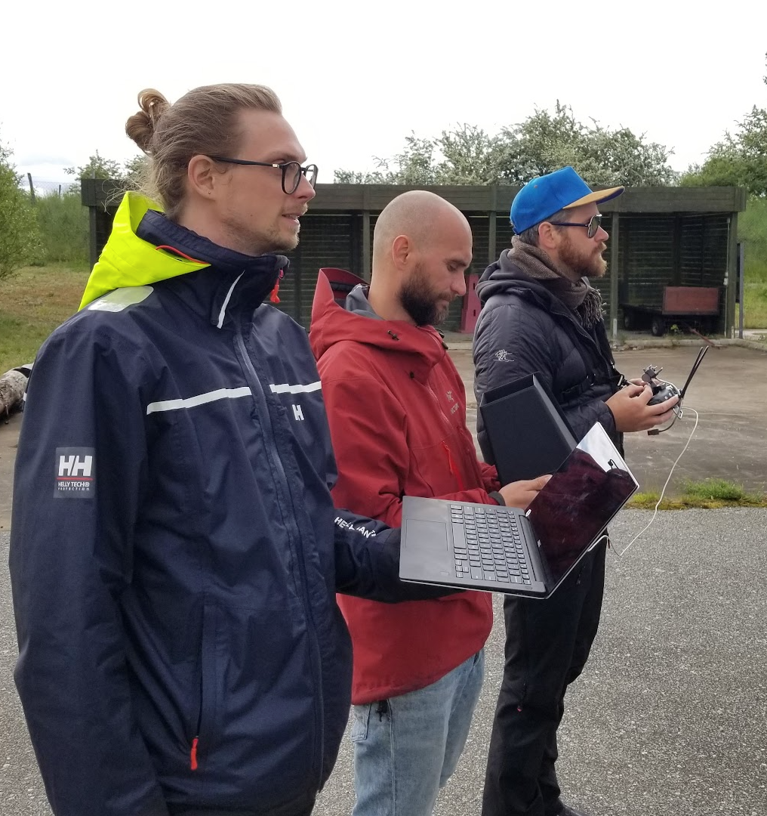
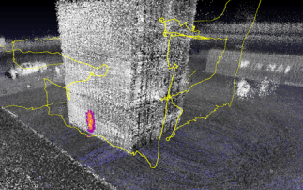
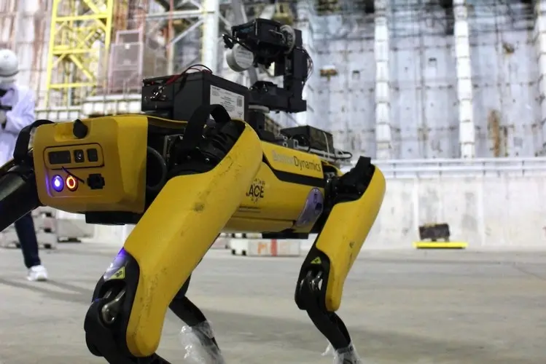
Autonomy-scale
Less human interaction
Manual
Portable
Cost-effective
Remote-controlled
Lower exposure
Hard-to-reach areas
Pre-programmed
Consistency
Coverage
Autonomy
Simple
Speed
Cs¹³⁷

Slide 4
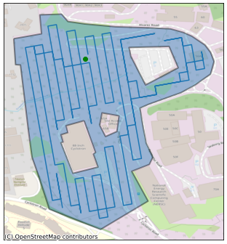
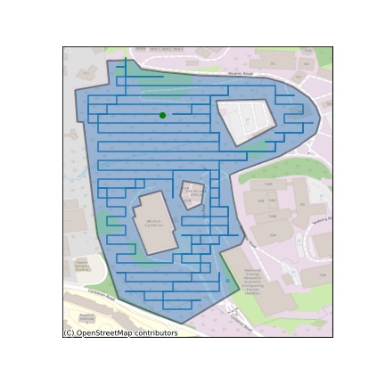
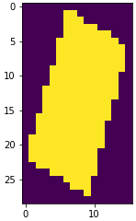
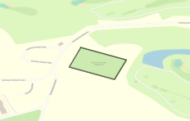
Path planning 2D coverage
Generate gridded flight paths for manually drawn shapes
Boustrophedon pattern (lawn mower)
Based on https://github.com/18alantom/CoveragePathPlanning
Select shortest solution
Downsample shape to grid-sized pixels
Calculate coverage pattern
Draw region on map
Run for all angles
Notes:
time per calculation
can add and account for obstructions online

Slide 5
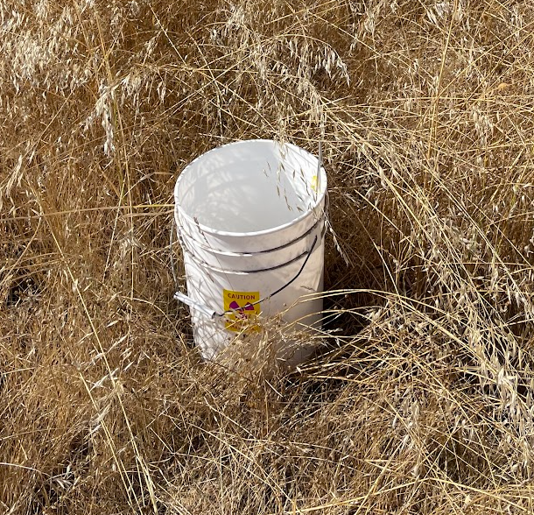
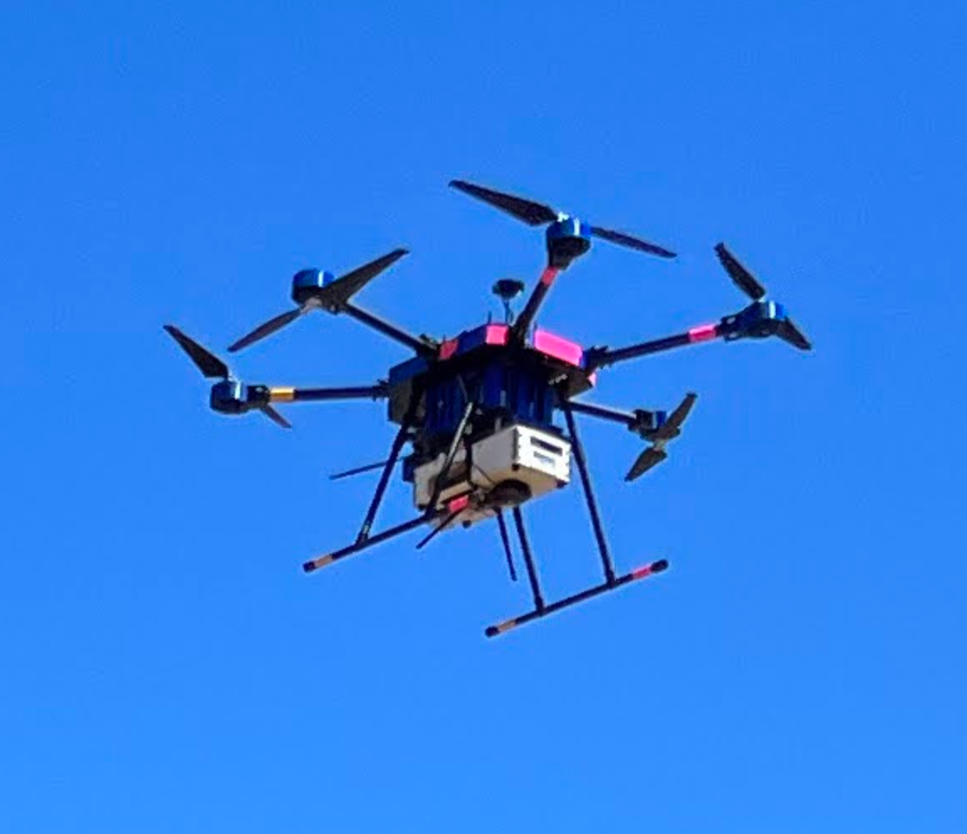
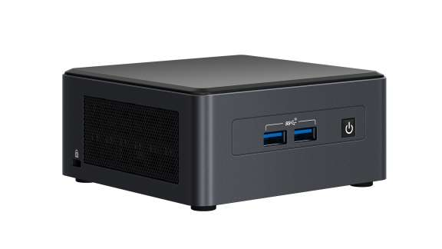
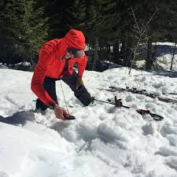
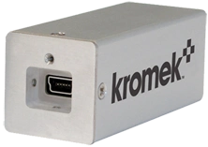
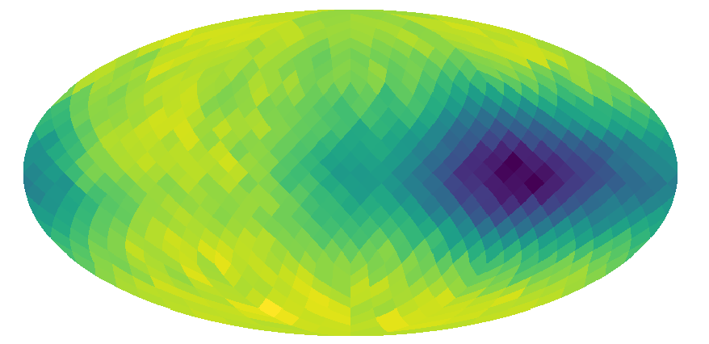
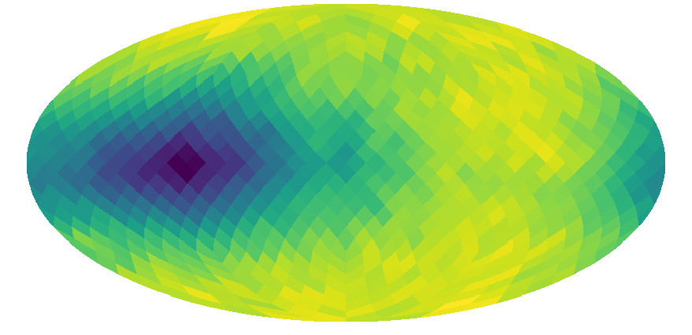
Autonomous system used
Theiss hexacopter
Up to 12 lb payload
~20 min flight time
Source: 1.4 mCi Cs¹³⁷
Autonomy behaviour:
Pre-program a grid
Prioritize suspected sources
Intel NUC running Ubuntu
Kromek Sigma50,
CsI(Tl) 1x1x2”³ (300 grams)
Skier searching after an avalanche
Notes:
cross to maximize 1/r2 information

Slide 6
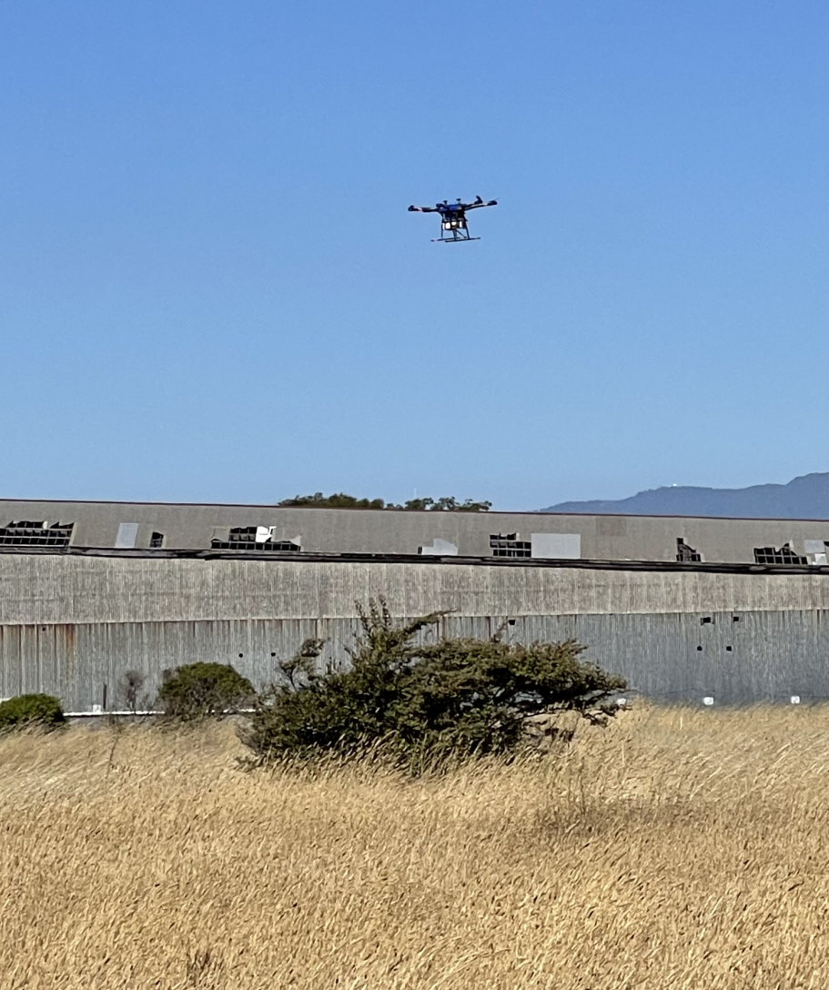
SDF & Autonomy
LAMP detector payload communicating with UAV
Instructed to fly in grid, prioritize any source found on the way
Logic implemented via a behaviour tree
Notes:
Now that we have all this quantitative information about the surroundings in real-time we can use that to guide robots. We then have the ability if there seems to be a source over there say to a drone - go fly over there and if that estimation changes as it moves it’s very fast to rethink its path.

Slide 7
SDF & Autonomy
LAMP detector payload communicating with UAV
Instructed to fly in grid, prioritize any source found on the way
Logic implemented via a behaviour tree
Take off
Scan area
Return home
Sequence, move to next if child succeeds
Text
Action, do something
Notes:
Now that we have all this quantitative information about the surroundings in real-time we can use that to guide robots. We then have the ability if there seems to be a source over there say to a drone - go fly over there and if that estimation changes as it moves it’s very fast to rethink its path.

Slide 8
SDF & Autonomy
LAMP detector payload communicating with UAV
Instructed to fly in grid, prioritize any source found on the way
Logic implemented via a behaviour tree
Return home
Scan area
Return home
Sequence, only does next if previous succeed
arm
liftoff
Sequence, move to next if child succeeds
Text
Text
Action, do something
Action, do something
Notes:
Now that we have all this quantitative information about the surroundings in real-time we can use that to guide robots. We then have the ability if there seems to be a source over there say to a drone - go fly over there and if that estimation changes as it moves it’s very fast to rethink its path.

Slide 9
SDF & Autonomy
LAMP detector payload communicating with UAV
Instructed to fly in grid, prioritize any source found on the way
Logic implemented via a behaviour tree
Return home
?
Return home
arm
liftoff
Battery low
Sequence, move to next if child succeeds
Scan area
Selector, move to next if child succeeds or fails
?
Text
Condition, true or false
returns success or fail
Text
Action, do something
Notes:
Now that we have all this quantitative information about the surroundings in real-time we can use that to guide robots. We then have the ability if there seems to be a source over there say to a drone - go fly over there and if that estimation changes as it moves it’s very fast to rethink its path.

Slide 10
SDF & Autonomy
LAMP detector payload communicating with UAV
Instructed to fly in grid, prioritize any source found on the way
Logic implemented via a behaviour tree
Return home
?
Return home
arm
liftoff
Battery low
Sequence, move to next if child succeeds
Scan area
Selector, move to next if child succeeds or fails
?
Text
Condition, true or false
returns success or fail
Text
Action, do something
Notes:
Now that we have all this quantitative information about the surroundings in real-time we can use that to guide robots. We then have the ability if there seems to be a source over there say to a drone - go fly over there and if that estimation changes as it moves it’s very fast to rethink its path.

Slide 11
SDF & Autonomy
LAMP detector payload communicating with UAV
Instructed to fly in grid, prioritize any source found on the way
Logic implemented via a behaviour tree
Return home
?
Return home
arm
liftoff
Battery low
Sequence, move to next if child succeeds
Scan area
Selector, move to next if child succeeds or fails
?
Text
Condition, true or false
returns success or fail
Text
Action, do something
Notes:
Now that we have all this quantitative information about the surroundings in real-time we can use that to guide robots. We then have the ability if there seems to be a source over there say to a drone - go fly over there and if that estimation changes as it moves it’s very fast to rethink its path.

Slide 12
SDF & Autonomy
LAMP detector payload communicating with UAV
Instructed to fly in grid, prioritize any source found on the way
Logic implemented via a behaviour tree
Return home
?
Return home
arm
liftoff
Battery low
Sequence, move to next if child succeeds
Scan area
Selector, move to next if child succeeds or fails
?
Text
Condition, true or false
returns success or fail
Text
Action, do something
Notes:
Now that we have all this quantitative information about the surroundings in real-time we can use that to guide robots. We then have the ability if there seems to be a source over there say to a drone - go fly over there and if that estimation changes as it moves it’s very fast to rethink its path.

Slide 13
SDF & Autonomy
LAMP detector payload communicating with UAV
Instructed to fly in grid, prioritize any source found on the way
Logic implemented via a behaviour tree
Return home
?
Return home
arm
liftoff
Battery low
Sequence, move to next if child succeeds
Scan area
Selector, move to next if child succeeds or fails
?
Text
Condition, true or false
returns success or fail
Text
Action, do something
Notes:
Now that we have all this quantitative information about the surroundings in real-time we can use that to guide robots. We then have the ability if there seems to be a source over there say to a drone - go fly over there and if that estimation changes as it moves it’s very fast to rethink its path.

Slide 14
SDF & Autonomy
LAMP detector payload communicating with UAV
Instructed to fly in grid, prioritize any source found on the way
Logic implemented via a behaviour tree
Return home
?
Return home
arm
liftoff
Battery low
Sequence, move to next if child succeeds
Scan area
Selector, move to next if child succeeds or fails
?
Text
Condition, true or false
returns success or fail
Text
Action, do something
Notes:
Now that we have all this quantitative information about the surroundings in real-time we can use that to guide robots. We then have the ability if there seems to be a source over there say to a drone - go fly over there and if that estimation changes as it moves it’s very fast to rethink its path.

Slide 15
SDF & Autonomy
LAMP detector payload communicating with UAV
Instructed to fly in grid, prioritize any source found on the way
Logic implemented via a behaviour tree
Return home
?
Return home
arm
liftoff
Battery low
Sequence, move to next if child succeeds
Scan area
Selector, move to next if child succeeds or fails
?
Text
Condition, true or false
returns success or fail
Text
Action, do something
Notes:
Now that we have all this quantitative information about the surroundings in real-time we can use that to guide robots. We then have the ability if there seems to be a source over there say to a drone - go fly over there and if that estimation changes as it moves it’s very fast to rethink its path.

Slide 16
SDF & Autonomy
LAMP detector payload communicating with UAV
Instructed to fly in grid, prioritize any source found on the way
Logic implemented via a behaviour tree
Return home
?
Return home
arm
liftoff
Battery low
Sequence, move to next if child succeeds
Scan area
Selector, move to next if child succeeds or fails
?
Text
Condition, true or false
returns success or fail
Text
Action, do something
Notes:
Now that we have all this quantitative information about the surroundings in real-time we can use that to guide robots. We then have the ability if there seems to be a source over there say to a drone - go fly over there and if that estimation changes as it moves it’s very fast to rethink its path.

Slide 17
SDF & Autonomy
LAMP detector payload communicating with UAV
Instructed to fly in grid, prioritize any source found on the way
Logic implemented via a behaviour tree
Return home
Return home
?
Return home
?
Sequence, only does next if previous succeed
arm
Sequence, move to next if child succeeds
arm
liftoff
liftoff
Battery low
Battery low
Go check any suspected source
Follow raster
Selector, move to next if child succeeds or fails
?
Selector, tries one by one, even on fail
?
Text
Text
Condition, true or false
returns success or fail
Condition, true or false
returns success or fail
Text
Text
Action, do something
Action, do something
Notes:
Now that we have all this quantitative information about the surroundings in real-time we can use that to guide robots. We then have the ability if there seems to be a source over there say to a drone - go fly over there and if that estimation changes as it moves it’s very fast to rethink its path.

Slide 18
SDF & Autonomy
LAMP detector payload communicating with UAV
Instructed to fly in grid, prioritize any source found on the way
Logic implemented via a behaviour tree
Return home
Return home
?
Return home
?
Sequence, only does next if previous succeed
arm
Sequence, move to next if child succeeds
arm
liftoff
liftoff
Battery low
Battery low
?
Follow raster
Selector, move to next if child succeeds or fails
?
Selector, tries one by one, even on fail
?
No suspected sources
Text
Text
Condition, true or false
returns success or fail
Condition, true or false
returns success or fail
Go to unidentified source
Go down and fly X-pattern
Text
Text
Action, do something
Action, do something
Notes:
Now that we have all this quantitative information about the surroundings in real-time we can use that to guide robots. We then have the ability if there seems to be a source over there say to a drone - go fly over there and if that estimation changes as it moves it’s very fast to rethink its path.

Slide 19
SDF & Autonomy
LAMP detector payload communicating with UAV
Instructed to fly in grid, prioritize any source found on the way
Logic implemented via a behaviour tree
z-score
Return home
Return home
?
Return home
?
arm
arm
liftoff
liftoff
Battery low
Battery low
?
Follow raster
No suspected sources
Go to unidentified source
Go down and fly X-pattern
Notes:
Now that we have all this quantitative information about the surroundings in real-time we can use that to guide robots. We then have the ability if there seems to be a source over there say to a drone - go fly over there and if that estimation changes as it moves it’s very fast to rethink its path.

Slide 20
SDF & Autonomy
LAMP detector payload communicating with UAV
Instructed to fly in grid, prioritize any source found on the way
Logic implemented via a behaviour tree
z-score
Return home
Return home
?
Return home
?
arm
arm
liftoff
liftoff
Battery low
Battery low
?
Follow raster
No suspected sources
Go to unidentified source
Go down and fly X-pattern
Notes:
Now that we have all this quantitative information about the surroundings in real-time we can use that to guide robots. We then have the ability if there seems to be a source over there say to a drone - go fly over there and if that estimation changes as it moves it’s very fast to rethink its path.

Slide 21
SDF & Autonomy
LAMP detector payload communicating with UAV
Instructed to fly in grid, prioritize any source found on the way
Logic implemented via a behaviour tree
z-score
Return home
Return home
?
Return home
?
arm
arm
liftoff
liftoff
Battery low
Battery low
?
Follow raster
No suspected sources
Go to unidentified source
Go down and fly X-pattern
Notes:
Now that we have all this quantitative information about the surroundings in real-time we can use that to guide robots. We then have the ability if there seems to be a source over there say to a drone - go fly over there and if that estimation changes as it moves it’s very fast to rethink its path.

Slide 22
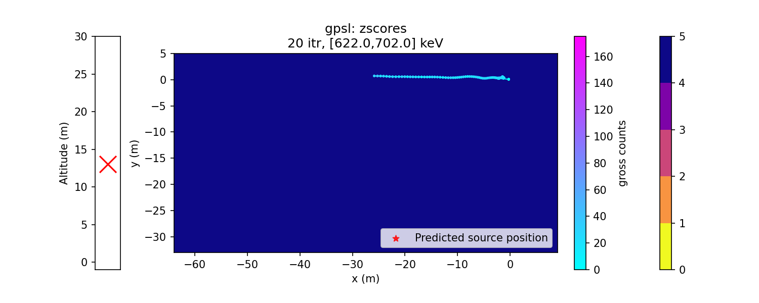
SDF & Autonomy
LAMP detector payload communicating with UAV
Instructed to fly in grid, prioritize any source found on the way
Logic implemented via a behaviour tree
z-score
Return home
Return home
?
Return home
?
arm
arm
liftoff
liftoff
Battery low
Battery low
?
Follow raster
No suspected sources
Go to unidentified source
Go down and fly X-pattern
Notes:
Now that we have all this quantitative information about the surroundings in real-time we can use that to guide robots. We then have the ability if there seems to be a source over there say to a drone - go fly over there and if that estimation changes as it moves it’s very fast to rethink its path.

Slide 23
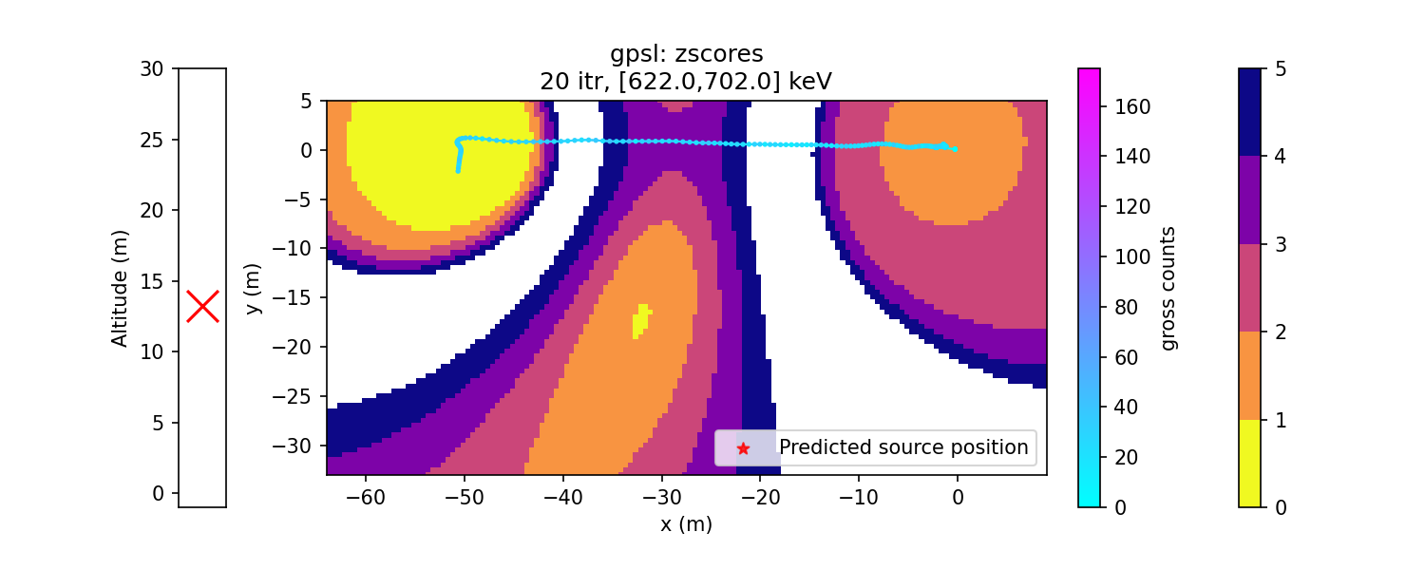
SDF & Autonomy
LAMP detector payload communicating with UAV
Instructed to fly in grid, prioritize any source found on the way
Logic implemented via a behaviour tree
z-score
Return home
Return home
?
Return home
?
arm
arm
liftoff
liftoff
Battery low
Battery low
?
Follow raster
No suspected sources
Go to unidentified source
Go down and fly X-pattern
Notes:
Now that we have all this quantitative information about the surroundings in real-time we can use that to guide robots. We then have the ability if there seems to be a source over there say to a drone - go fly over there and if that estimation changes as it moves it’s very fast to rethink its path.

Slide 24
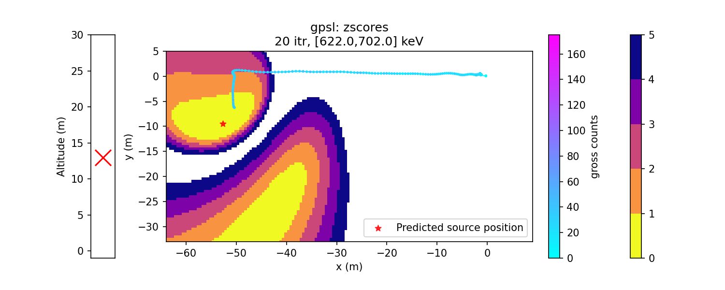
SDF & Autonomy
LAMP detector payload communicating with UAV
Instructed to fly in grid, prioritize any source found on the way
Logic implemented via a behaviour tree
z-score
Return home
Return home
?
Return home
?
arm
arm
liftoff
liftoff
Battery low
Battery low
?
Follow raster
No suspected sources
Go to unidentified source
Go down and fly X-pattern
Notes:
Now that we have all this quantitative information about the surroundings in real-time we can use that to guide robots. We then have the ability if there seems to be a source over there say to a drone - go fly over there and if that estimation changes as it moves it’s very fast to rethink its path.

Slide 25
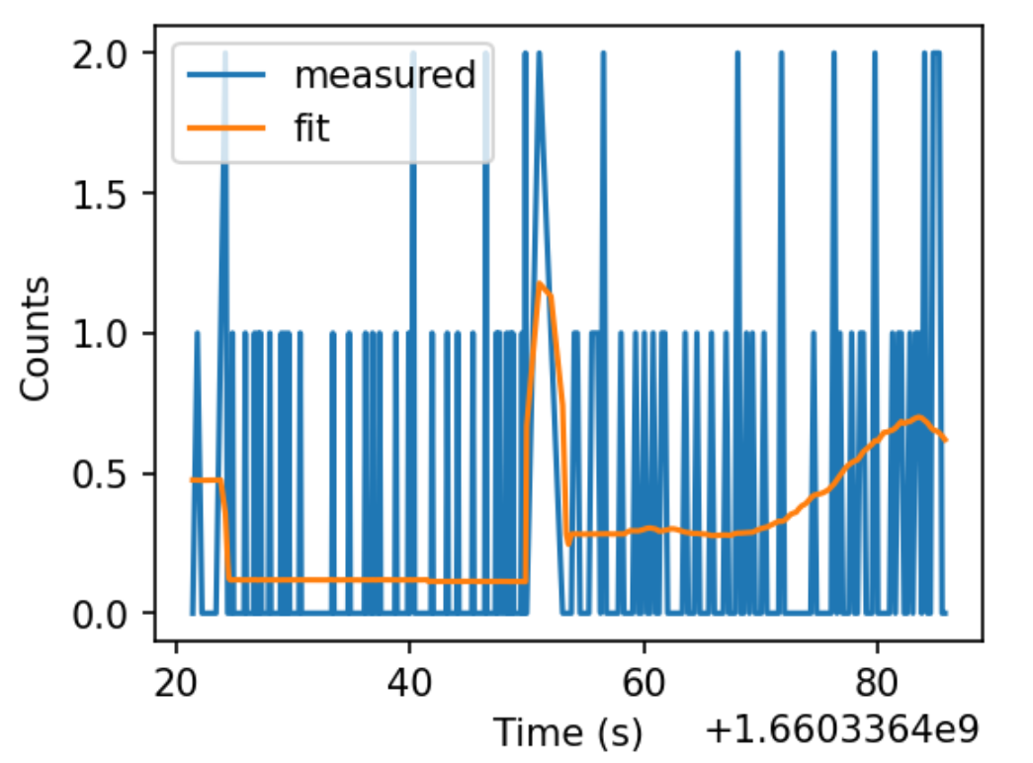
SDF & Autonomy
LAMP detector payload communicating with UAV
Instructed to fly in grid, prioritize any source found on the way
Logic implemented via a behaviour tree
z-score
Return home
Return home
?
Return home
?
arm
arm
liftoff
liftoff
Battery low
Battery low
?
Follow raster
No suspected sources
Go to unidentified source
Go down and fly X-pattern
Notes:
Now that we have all this quantitative information about the surroundings in real-time we can use that to guide robots. We then have the ability if there seems to be a source over there say to a drone - go fly over there and if that estimation changes as it moves it’s very fast to rethink its path.

Slide 26
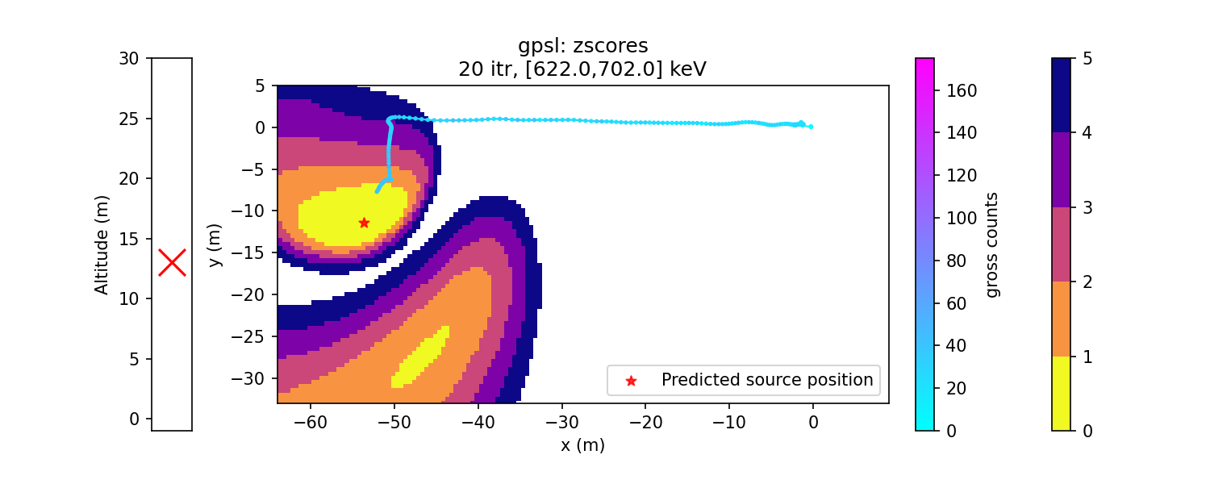
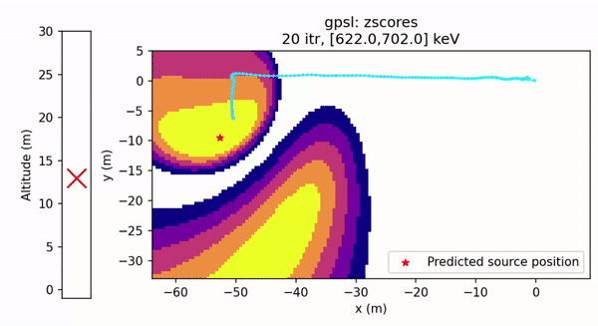
SDF & Autonomy
LAMP detector payload communicating with UAV
Instructed to fly in grid, prioritize any source found on the way
Logic implemented via a behaviour tree
z-score
Return home
Return home
?
Return home
?
arm
arm
liftoff
liftoff
Battery low
Battery low
?
Follow raster
No suspected sources
Go to unidentified source
Go down and fly X-pattern
Notes:
Now that we have all this quantitative information about the surroundings in real-time we can use that to guide robots. We then have the ability if there seems to be a source over there say to a drone - go fly over there and if that estimation changes as it moves it’s very fast to rethink its path.

Slide 27
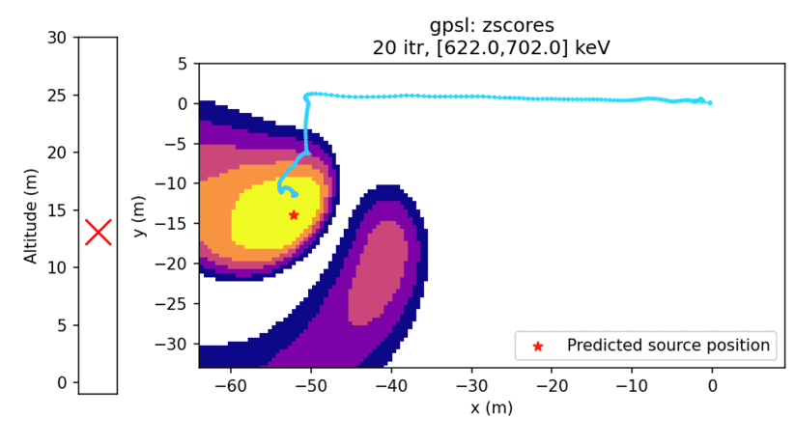
SDF & Autonomy
LAMP detector payload communicating with UAV
Instructed to fly in grid, prioritize any source found on the way
Logic implemented via a behaviour tree
z-score
Return home
Return home
?
Return home
?
arm
arm
liftoff
liftoff
Battery low
Battery low
?
Follow raster
No suspected sources
Go to unidentified source
Go down and fly X-pattern
Notes:
Now that we have all this quantitative information about the surroundings in real-time we can use that to guide robots. We then have the ability if there seems to be a source over there say to a drone - go fly over there and if that estimation changes as it moves it’s very fast to rethink its path.

Slide 28
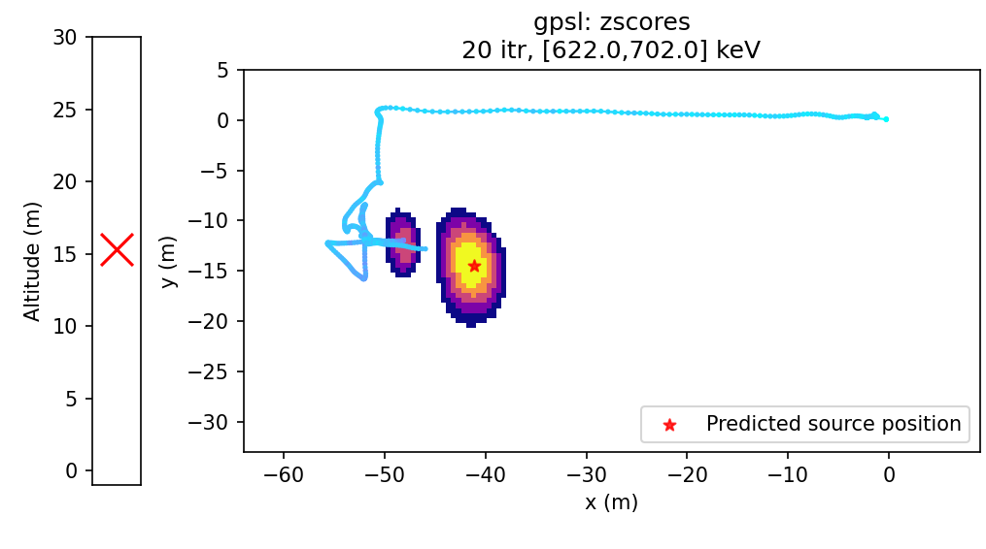
SDF & Autonomy
LAMP detector payload communicating with UAV
Instructed to fly in grid, prioritize any source found on the way
Logic implemented via a behaviour tree
z-score
Return home
Return home
?
Return home
?
arm
arm
liftoff
liftoff
Battery low
Battery low
?
Follow raster
No suspected sources
Go to unidentified source
Go down and fly X-pattern
Notes:
Now that we have all this quantitative information about the surroundings in real-time we can use that to guide robots. We then have the ability if there seems to be a source over there say to a drone - go fly over there and if that estimation changes as it moves it’s very fast to rethink its path.

Slide 29
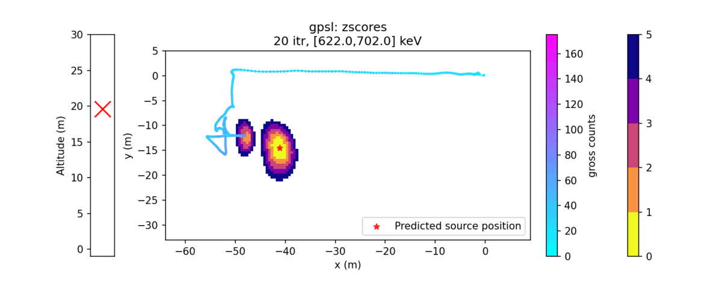
SDF & Autonomy
LAMP detector payload communicating with UAV
Instructed to fly in grid, prioritize any source found on the way
Logic implemented via a behaviour tree
z-score
Return home
Return home
?
Return home
?
arm
arm
liftoff
liftoff
Battery low
Battery low
?
Follow raster
No suspected sources
Go to unidentified source
Go down and fly X-pattern
Notes:
Now that we have all this quantitative information about the surroundings in real-time we can use that to guide robots. We then have the ability if there seems to be a source over there say to a drone - go fly over there and if that estimation changes as it moves it’s very fast to rethink its path.

Slide 30
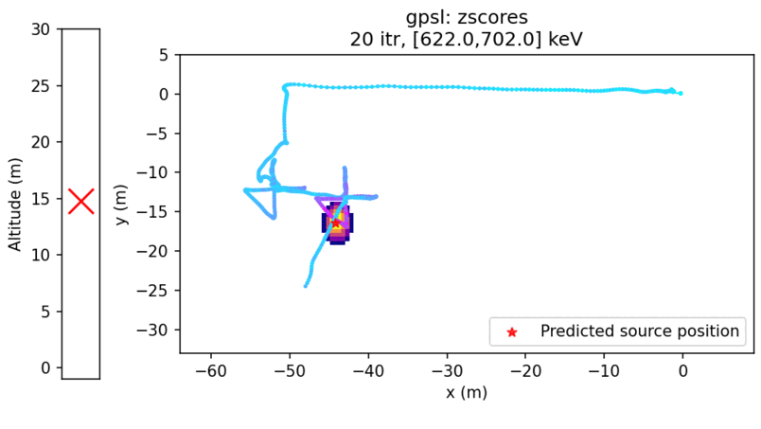
SDF & Autonomy
LAMP detector payload communicating with UAV
Instructed to fly in grid, prioritize any source found on the way
Logic implemented via a behaviour tree
z-score
Return home
Return home
?
Return home
?
arm
arm
liftoff
liftoff
Battery low
Battery low
?
Follow raster
No suspected sources
Go to unidentified source
Go down and fly X-pattern
Notes:
Now that we have all this quantitative information about the surroundings in real-time we can use that to guide robots. We then have the ability if there seems to be a source over there say to a drone - go fly over there and if that estimation changes as it moves it’s very fast to rethink its path.

Slide 31
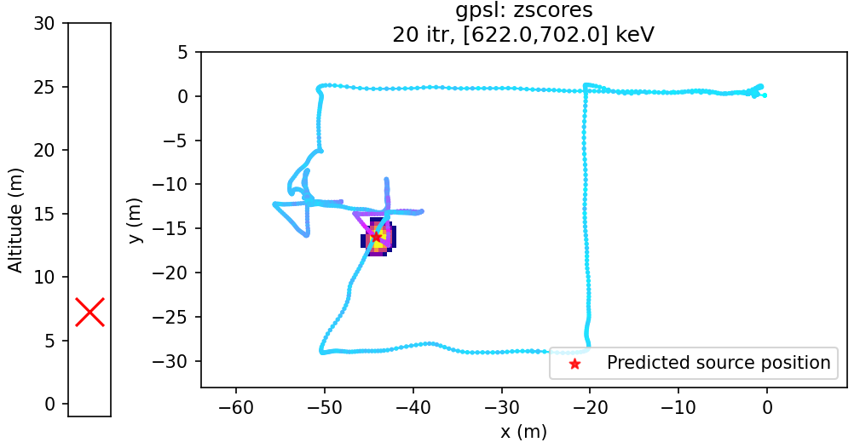
SDF & Autonomy
LAMP detector payload communicating with UAV
Instructed to fly in grid, prioritize any source found on the way
Logic implemented via a behaviour tree
z-score
Return home
Return home
?
Return home
?
arm
arm
liftoff
liftoff
Battery low
Battery low
?
Follow raster
No suspected sources
Go to unidentified source
Go down and fly X-pattern
Notes:
Now that we have all this quantitative information about the surroundings in real-time we can use that to guide robots. We then have the ability if there seems to be a source over there say to a drone - go fly over there and if that estimation changes as it moves it’s very fast to rethink its path.

Slide 32
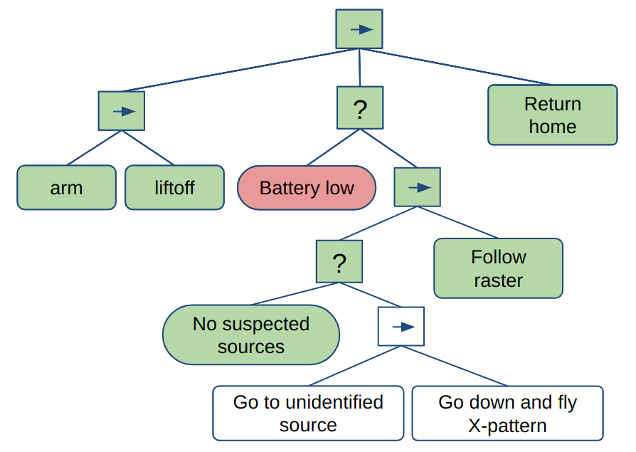
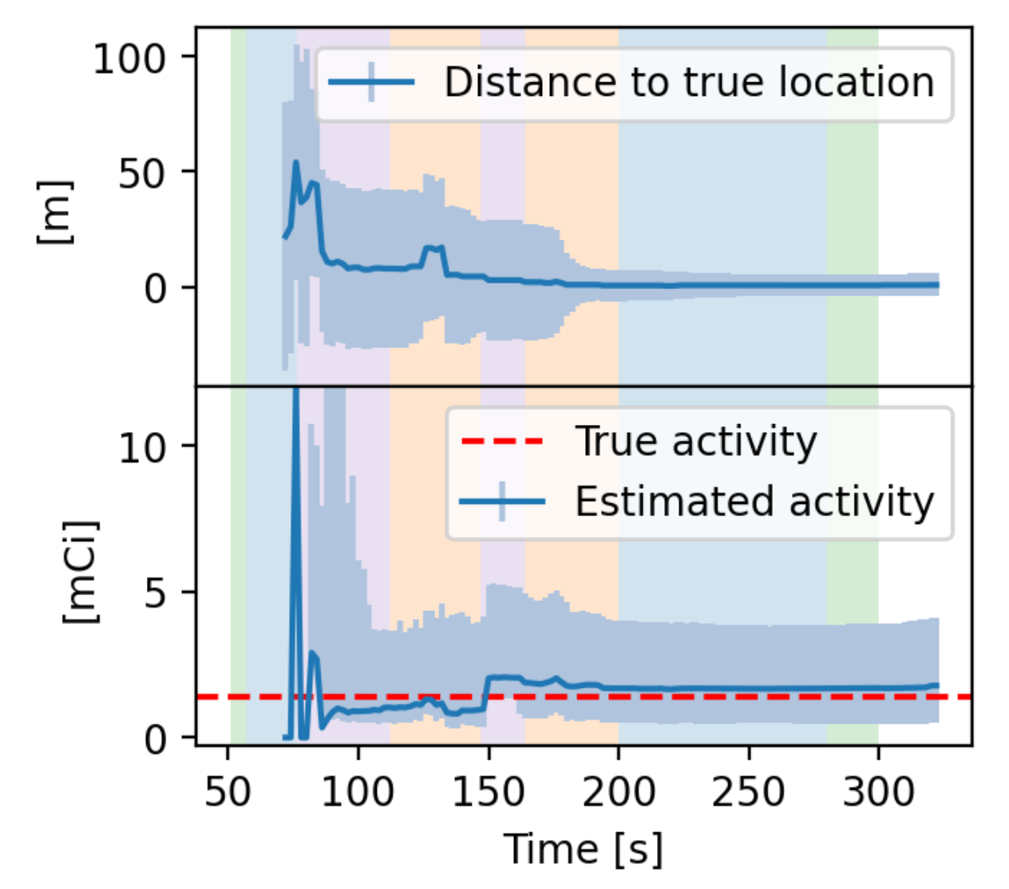
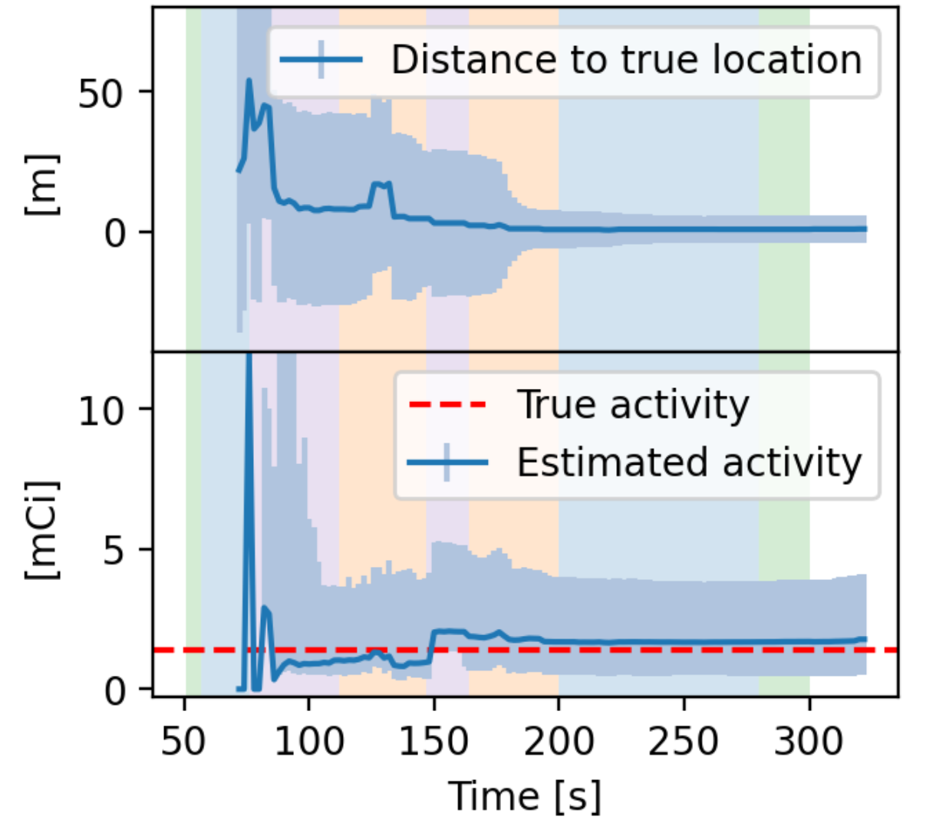
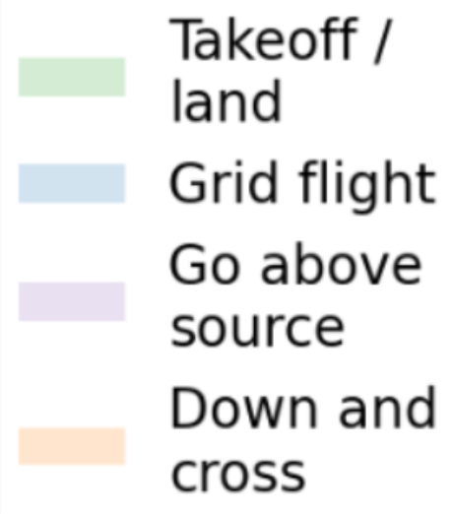
SDF & Autonomy
LAMP detector payload communicating with UAV
Instructed to fly in grid, prioritize any source found on the way
Logic implemented via a behaviour tree
z-score
Notes:
Now that we have all this quantitative information about the surroundings in real-time we can use that to guide robots. We then have the ability if there seems to be a source over there say to a drone - go fly over there and if that estimation changes as it moves it’s very fast to rethink its path.

Slide 33
SDF & Autonomy
LAMP detector payload communicating with UAV
Instructed to fly in grid, prioritize any source found on the way
Logic implemented via a behaviour tree
z-score
Future work
Mission-tailored behaviors
Multiple sources
Distributed sources
MDA-minimization
Contour mapping
Algorithms at different update frequency in parallel
Notes:
Now that we have all this quantitative information about the surroundings in real-time we can use that to guide robots. We then have the ability if there seems to be a source over there say to a drone - go fly over there and if that estimation changes as it moves it’s very fast to rethink its path.

Slide 34
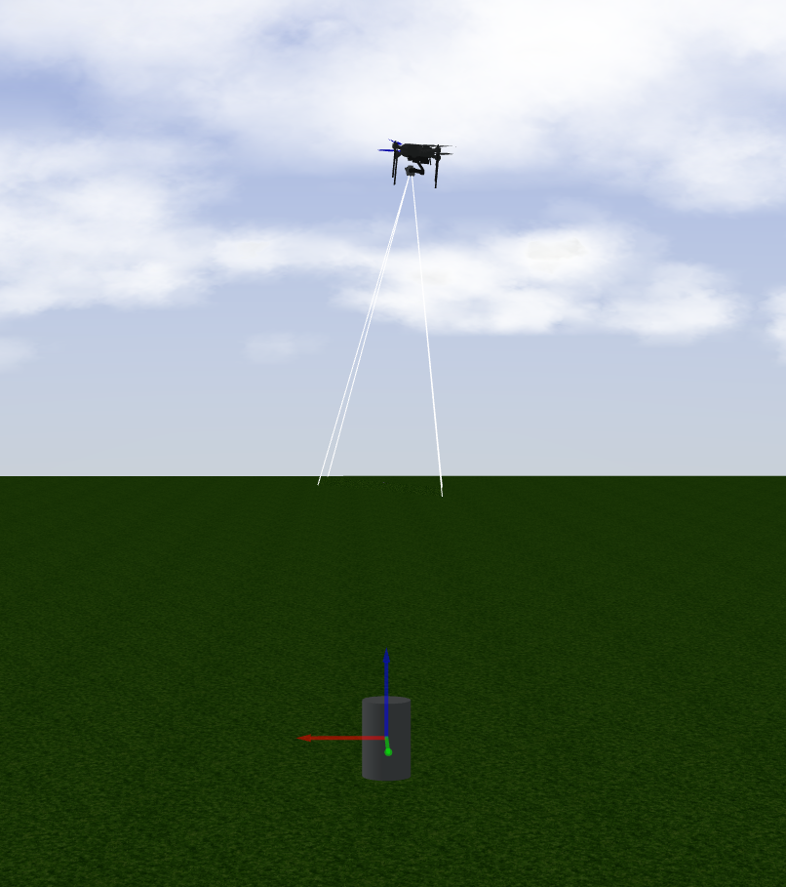
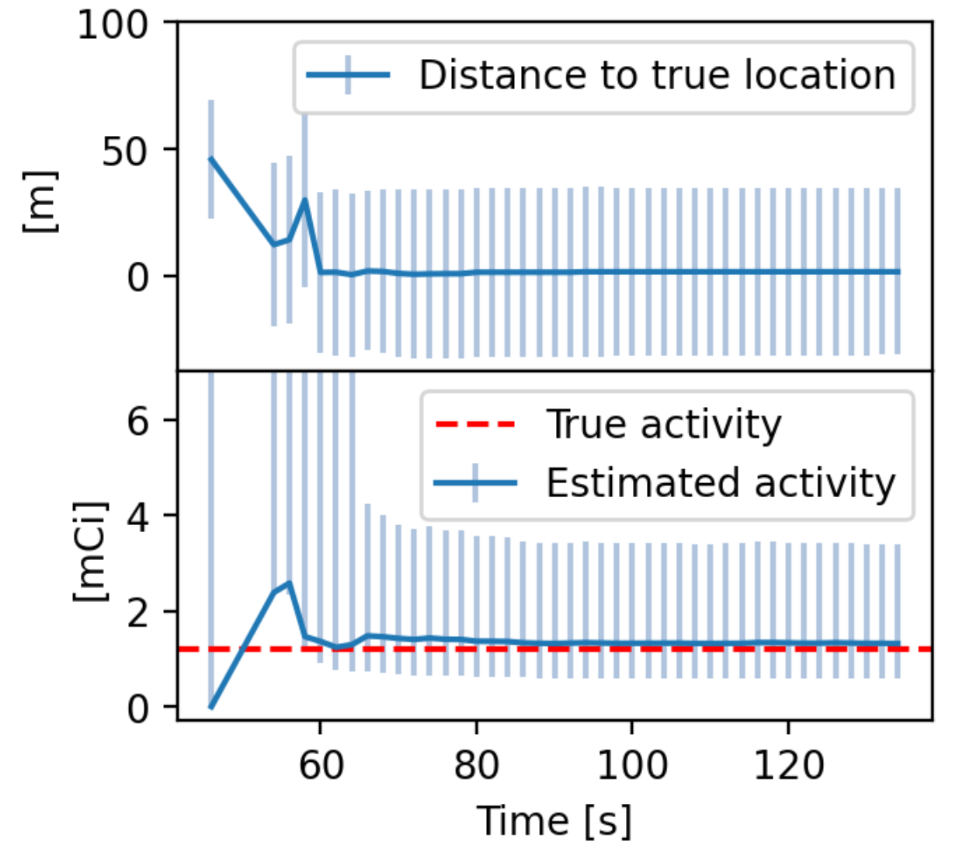
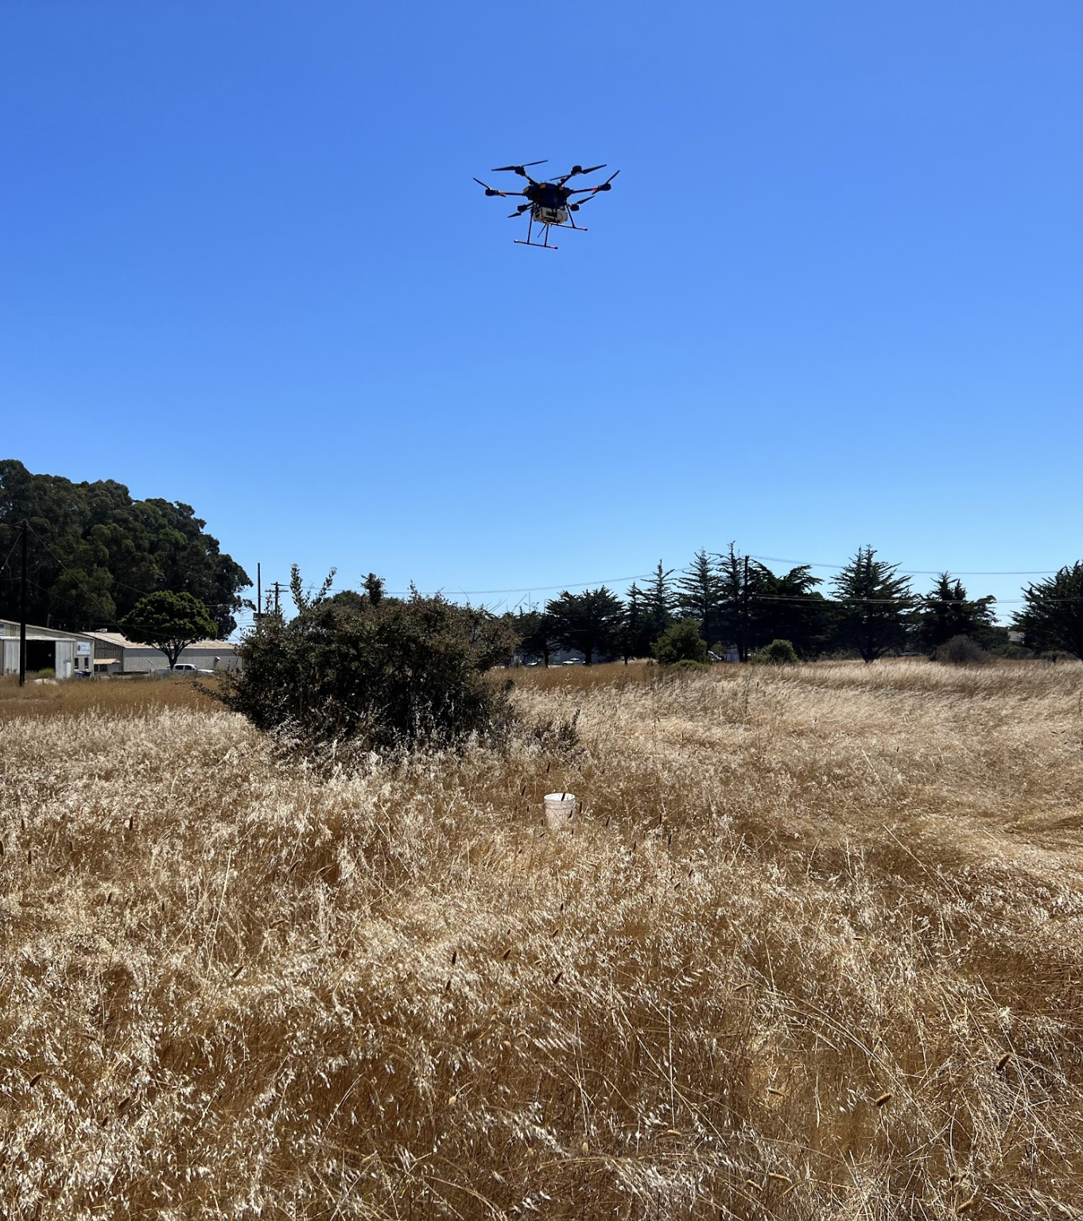
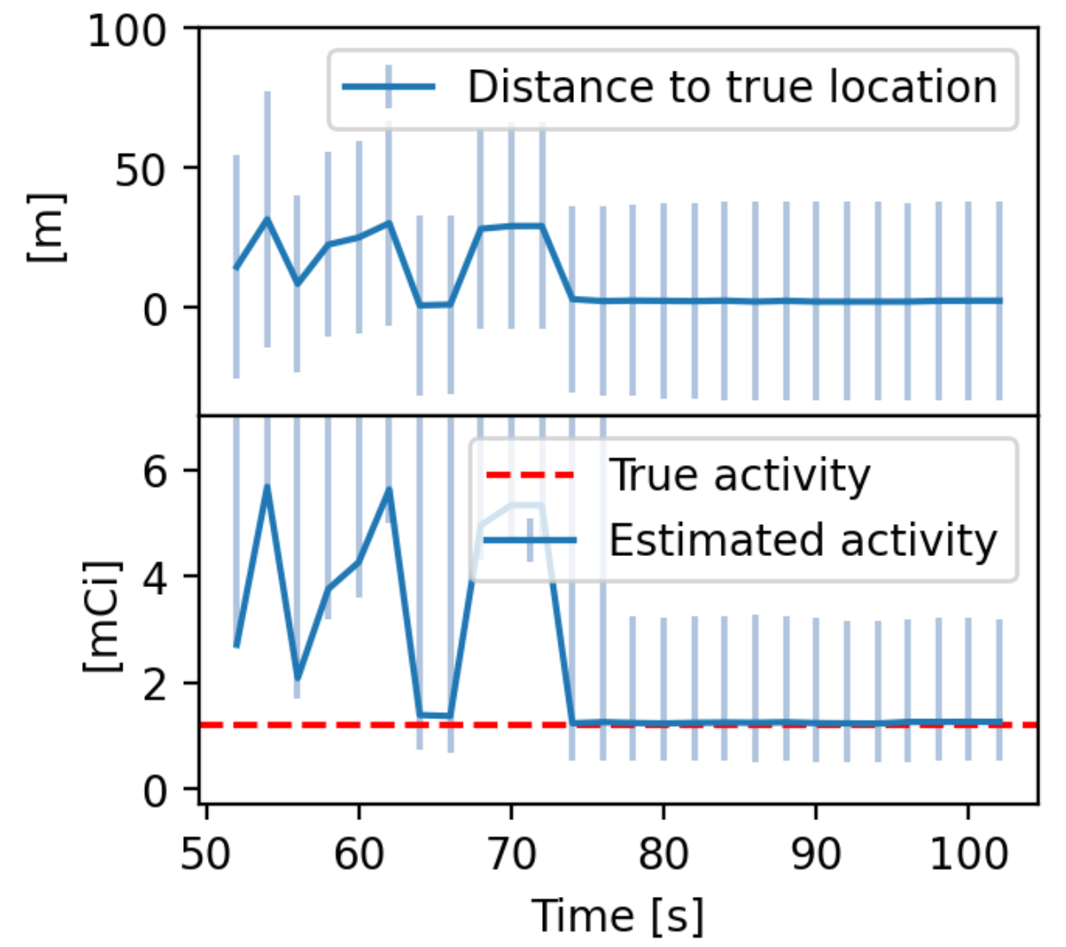
Simulated autonomy
Gazebo environment
Full real-time simulation
Test-bench for behaviors before real flights
Photo from flight

Slide 35
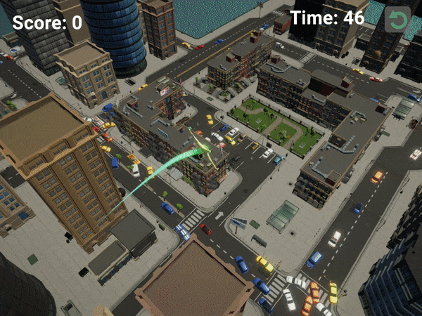
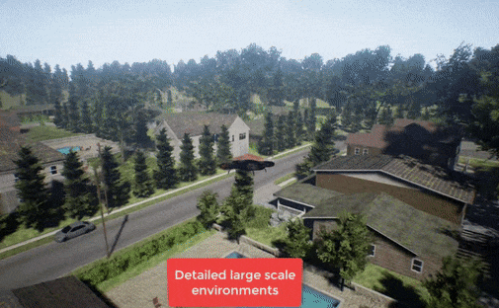
Simulated autonomy
Game engines offer realistic, interactive worlds for simulations
Ground truth segmentation, LIDAR, radiation et. c. available
Microsoft Airsim in Unreal Engine
Radiation source search game, 2023

Slide 36
Emerging capabilities with large language models (LLMs)
Tell the robot:
Look under that bridge
Follow the pipe
Follow him with the hat
The robot communicates with the operator:
The area is cleared
Suspected source by the house, need to go closer.
https://aka.ms/ChatGPT-Robotics

Slide 37
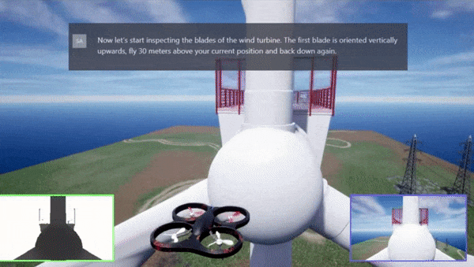
Emerging capabilities with large language models (LLMs)
Tell the robot:
Look under that bridge
Follow him with the hat
The robot communicates with the operator:
The area is cleared
Suspected source by the house, need to go closer.
https://aka.ms/ChatGPT-Robotics

Slide 38
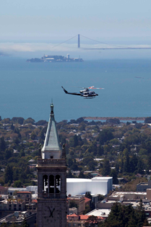
Conclusions
Autonomy developing hand-in-hand with SDF.
Real-time running SDF enables responsive autonomy
Faster localization
Efficient use of battery / time
Lower MDA / larger area covered
Behaviour tree design is versatile and simple for autonomy
Simulations developed that can test new functions and speed-up development
Future work span beyond source search shown here
Notes:
Look up NNSA

Slide 39
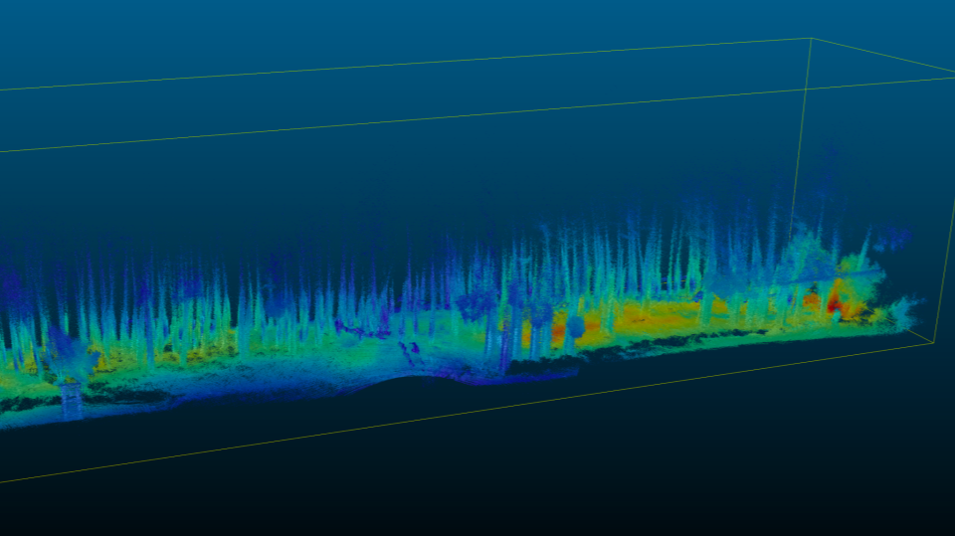
Acknowledgments & Disclaimer
This work was performed under the auspices of the U.S. Department of Energy by Lawrence Berkeley National Laboratory under Contract DE-AC02-05CH11231 funded by the U.S. Department of Energy/National Nuclear Security Administration’s (DOE/NNSA’s) Office of Defense Nuclear Nonproliferation R&D (DNN R&D) and in support of the DNN R&D-supported Consortium for Enabling Technologies and Innovation (ETI).
The point source likelihood algorithm development was supported by the Defense Threat Reduction Agency under HDTRA 10027- 21370, 10027- 28018, 10027- 30529, 10027- 23334, 10027-28546, 10027- 28022. This support does not constitute an express or implied endorsement on the part of the United States Government.

Slide 40
Thank you! Questions?
Contact: erofors@lbl.gov
40

Slide 41
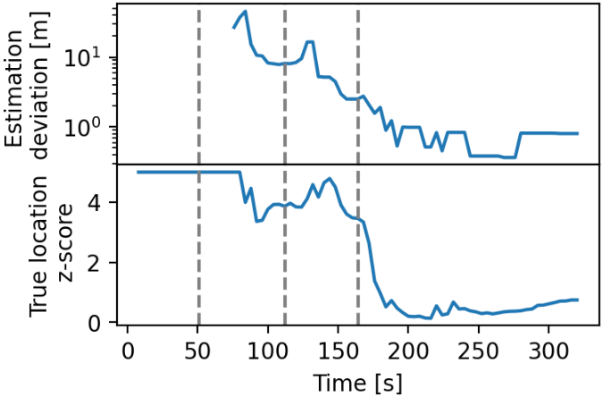
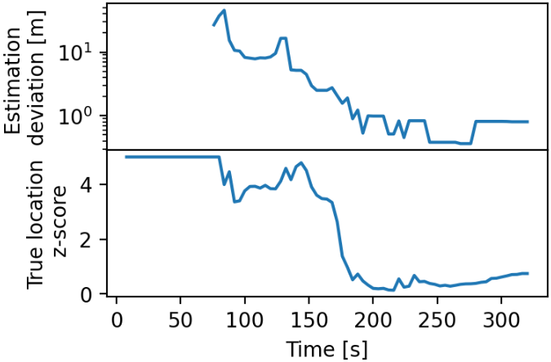

Slide 43
Return home
Return home
?
Return home
?
arm
arm
liftoff
liftoff
Battery low
Battery low
?
Follow raster
No suspected sources
Go to unidentified source
Go down and fly X-pattern

