Slide 1
Summary of the Annual International Muon Collider Collaboration Meeting
Steve Gourlay
19 July 2023

Slide 2
Why a Muon Collider?
Muons are elementary particles – all their collision energy is used
  X7 mass reach compared to protons at the same energy
  More compact – less expensive – can fit on FNAL site
200 times heavier than electrons
  Negligible synchrotron radiation – energies to many TeV compared to 300 – 500 GeV for electrons
  Lower energy spread – higher precision
  Larger cross sections for certain interactions
And . . . some people living now may see it built and operated!

Slide 3
Acknowledgment
Input based on presentations prepared/given by
Daniel Schulte, Roberto Losito, Lionel Quettier, Luca Bottura, Alfredo Portone, Marco Statera, Siara Sandra Fabbri, Bernardo Bordini, Carlotta Accettura, Marco Breschi, Fulvio Boattini, Barbara Caiffi, Samuele Mariotto, Stefania Farinon

Slide 4

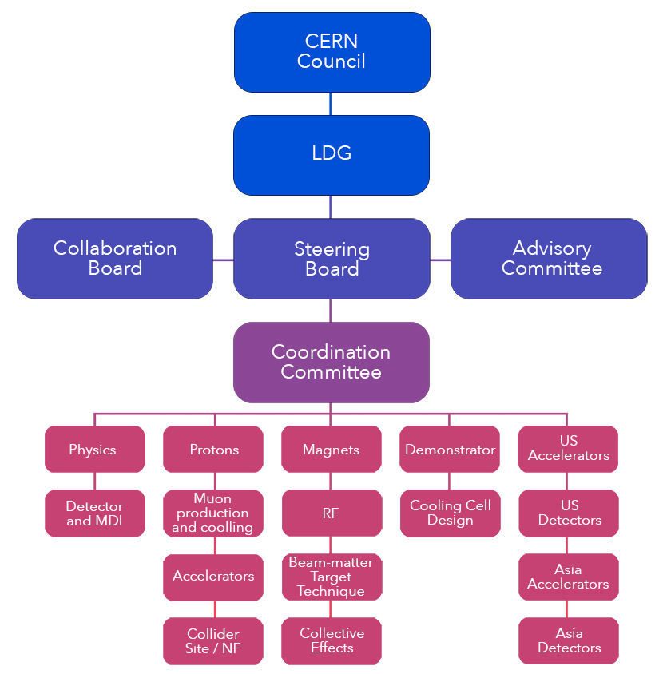
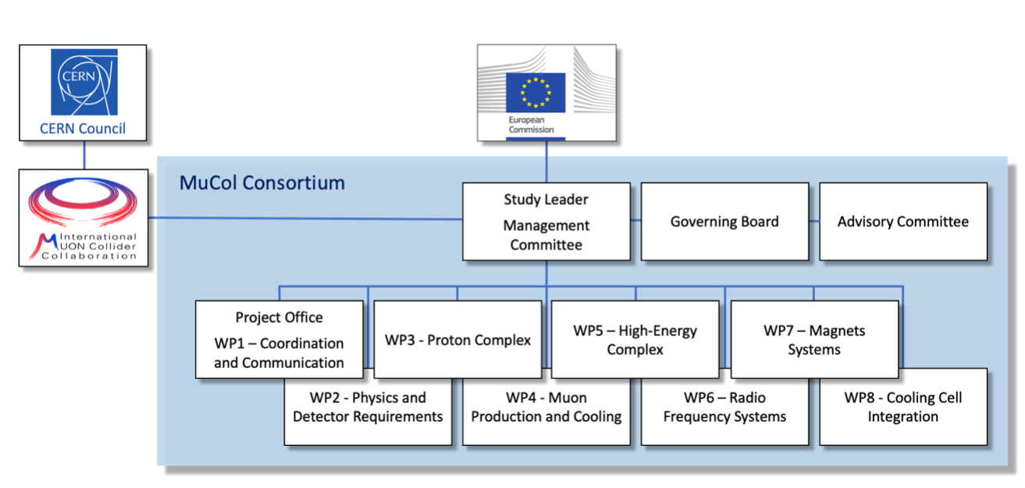

Project organization
International Muon Collider Collaboration
MuCol EU Design Study
The magnet work packages of IMCC and MuCol are in essence the same, with identical tasks and workplan.
Activities are followed-up mainly through the “muons magnets Working Group” (mmWG)

Slide 5
MuCol Status and Goals
MuCol was created to coordinate the efforts of the International Muon Collider Collaboration towards the specific goal of providing comprehensive input for the next European Strategy for Particle Physics Update
The main deliverables will be yearly progress reports
  Basis for a report that will be submitted to the ESPPU in 2025/26 as input from the Collaboration.
MuCol proposal was submitted in April ‘22 and approved with an excellent evaluation.
The consortium includes 31 Institutes:
  CERN as coordinator and beneficiary
  11 more Beneficiaries (no UK Institutes)
  19 Associated Partners

Slide 6
Accelerator R&D Roadmap
No insurmountable obstacles found for the muon collider
  BUT . . . Needs significant R&D
Aim at 10+ TeV with a potential initial stage at 3 TeV
Full scenario deliverables by next ESPPU/other processes
  Project Evaluation Report
  R&D Plan that describes a path toward the collider and allows informed decisions
  Interim report by end of 2023
Reduced scenario
  Significantly reduced scope and lacks most preparations for a demonstration program
Do not yet have the resources of the reduced scenario
  Are approaching ~ 40 – 50 FTE for the accelerator
  Looking for more

Slide 7
Overarching theme of the meeting . . .
Cost, Performance and Sustainability

Slide 8
Cost and Sustainability
Increasing luminosity per beam power promises power efficiency
Compactness promises cost effectiveness
And low CO₂ footprint for construction
Staging is possible
Synergies exist (neutrino/higgs)
Unique opportunity for a high-energy, high-luminosity lepton collider
D. Schulte

Slide 9
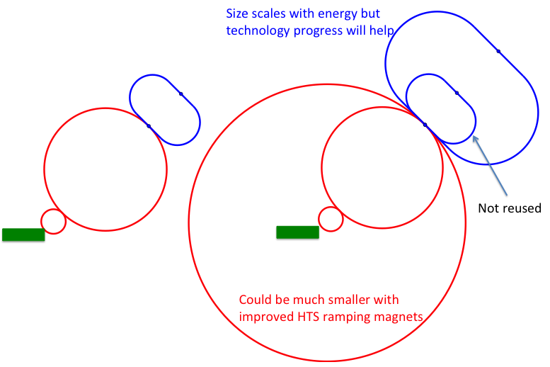
Staging
Ideally would like full energy right away, but
staging could lead to faster implementation
Substantially less cost for a first stage
Can make technical compromises
  e.g. 8 T Nb-Ti magnets would increase collider ring from 4.5 to 6 km and reduce luminosity by 25%
Timeline might be more consistent with human lifespan
Upgrade adds one more accelerator and new collider ring
only first collider ring is not being reused
D. Schulte

Slide 10
Muon Collider magnet “specs”
Accelerator magnets
Field: ±1.8 T (NC), < 10 T (SC)
Rate: 400 Hz (NC), SS (SC)
Bore: 100 mm(H) x 30 mm(V)
Length: 3 m … 5 m (x 1500)
Radiation heat: ≈ 3 W/m
Radiation dose: TBD
Target solenoids
Field: 20 T… 2T
Bore: 1200 mm
Length: 18 m
Radiation heat: ≈ 4.1 kW
Radiation dose: 80 MGy
6D Cooling solenoids
Field: 4 T … 19 T
Bore: 90 mm … 600 mm
Length: 1 km (x 2)
Radiation heat: TBD
Radiation dose: TBD
RCS
Final Cooling solenoids
Field: > 40 T (ideally 60 T)
Bore: 50 mm
Length: ≈ 500 mm (x 17)
Radiation heat: TBD
Radiation dose: TBD
Collider ring magnets
Field: 16 T peak (IR 20 T)
Bore: 150 mm
Length: 10 m … 15 m (x 700)
Radiation heat load: ≈ 5 W/m
Radiation dose: ≈ 20…40 MGy
D. Schulte

Slide 11
Muon Collider magnet “team”
CERN
INFN
CEA
CNRS
PSI
UniGE
SO’TON
uniTwente
INFN
CERN
UniMI
KIT
CERN
UniBO
TUDa
UniTwente
INFN
UniMI
CERN
TUT
CERN
F4E (Barcelona)
F4E (Garching)
RCS
Task 7.2
Task 7.3
Task 7.4

Slide 12
Target and Capture
MAGNET SPECS
Field: 20 T… 2T
Bore: 1200 mm
Length: 18 m
Radiation heat load: ≈ 4.1 kW
Radiation dose: 80 MGy

Slide 13
Target and Capture: Magnet Technologies
Technology | Pro’s | Con’s
ALL Resistive | Known technology (TRL 9) | Large dimension and mass Very large electric power consumption o(100MW)
LTS + Resistive | Known technology (TRL 9) | Large dimension and mass Electric power consumption ο(10 MW)
LTS + HTS, Insulated | Known design principles Synergy with other fields of science application Can profit from development by others (e.g. NHMFL) | Large dimension and mass Developmental technology (TRL 6/7)
ALL HTS, Insulated | More compact than LTS/HTS Allows for operation at higher temperature | R&D at low readiness (TRL 4/5)
ALL HTS, Non-insulated | Most compact magnet winding Synergies with other fields of science and societal applications Can profit from development by others (e.g. NHMFL) | R&D at low readiness (TRL 3/4/5) Ramping time and field stability need to be demonstrated

Slide 14
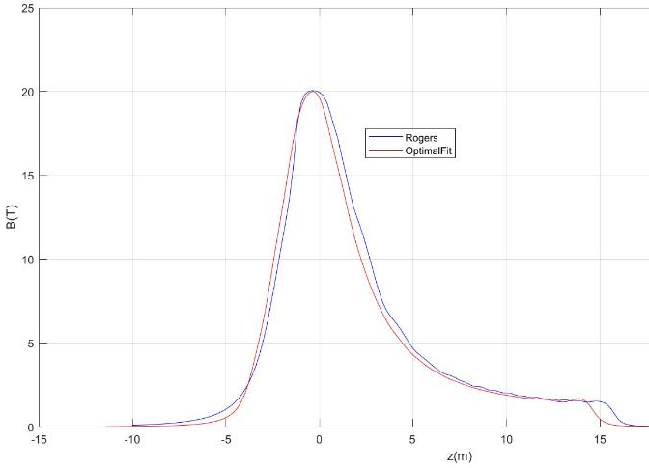
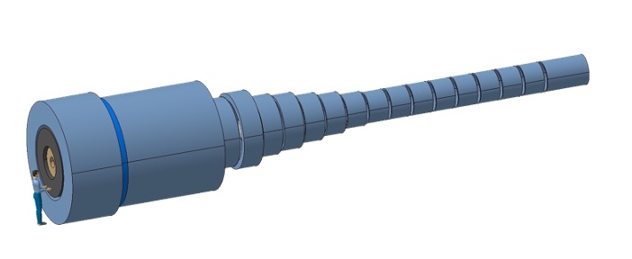
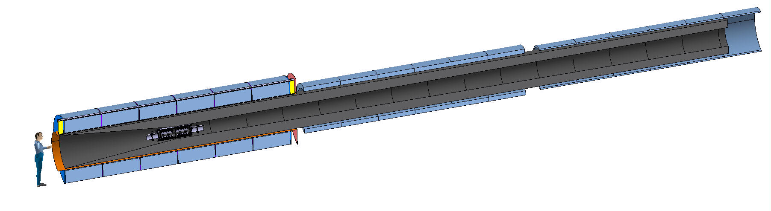
Target and Capture: Magnet specifications
E_{M} = 2.9 GJ
T_{op} = 4.2 K
M_{coils} = 200 tons
M_{shield} = 300 tons
P = 12 MW
Field profile matches the requirements from beam optics
US-MAP
Proposal
Remove resistive insert (10 MW), HTS to achieve field of 20 T
Reduce shield thicknes, accepting higher heat load at 20 K
E_{M} = 1 GJ
T_{op} = 10…20 K
M_{coils} = 110 tons
M_{shield} = 196 tons
P = 1MW

Slide 15
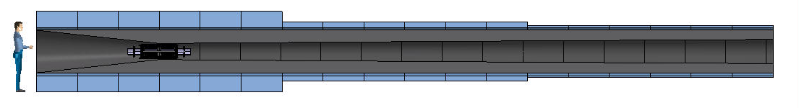
Target and Capture Design Considerations
Main design drivers are power consumption and heat deposition
Hybrid US-MAP (5 resistive coils and 19 SC coils, 2.4 m bore ∅) OR
Alternative - All HTS, 1.2 m bore ∅ and operating at 10 – 20K
Strong synergy with requirements on magnets for tokamak nuclear fusion devices
  Central Solenoid Coils: Higher B_{op}→ higher flux → higher reactor availability factor
  Toroidal Field Coils: Higher T_{op}→ larger acceptable heat load → compact shielding → cost

Slide 16
Target and Capture: Magnet Design Highlights
VIPER-like cable (HTS tapes, central cooling hole, steel jacket) with I_{max}≈61 kA
Set of 23 coils in 3 sections (300 mm gap between sections, 20 mm gap between coils)
Peak field B=20.9 T, magnetic energy 1.1 GJ, cable length ≈ 8.7 km, winding mass ≈ 115 t
Field on axis within 4% accuracy of Sayed-Berg formula over 16 m channel length
Stresses in structural elements within 316 LN limits (s_{Y} ≈1000 MPa)
Stresses in tapes being investigated to be minimized (t_{xy}≈30 MPa)
Coils operating at 20 K, ≈20 bar, ≈15 W pumping power, ≈150 W heat removal
High conductor stability (DT≥10 K!)
Detection & dump for quenches in low field/current most challenging (→long detection times) but seems compatible with hot-spot temperature limit (T_{HS} ≈ 150-200 K)

Slide 17
6D Cooling
6D Cooling solenoids
Field: 4 T … 19 T
Bore: 90 mm … 600 mm
Length: 1 km (x 2)
Radiation heat: TBD
Radiation dose: TBD

Slide 18
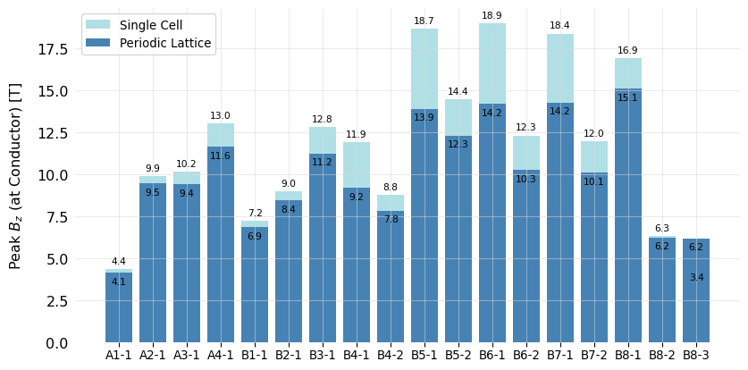
Cooling Channel
Full list based on original US MAP design (field on axis)
HTS
12 unique stages:
  4 cooling stages before bunch recombination (A1-A4)
  8 cooling stages after bunch recombination (B1-B8)
Each stage has a repeating series of a cell type
High field, very compact solenoids
Each cell has symmetric solenoids of opposite polarity
Some stats:
Fields on axis: 2 to 14 T
Cell Lengths: 0.8 to 2.7 m
Total length of all Stages: ~ 1 km
Total number of solenoids: 2432
Nb₃Sn
NbTi
By S. Fabbri and J. Pavan

Slide 19
Technologies within cells
Three technologies at lower temperature (4 K) or one technology at 20 K
By S. Fabbri

Slide 20
To be investigated
We are defining technologies
Conductor
Operating conditions, i.e. temperature and cooling method
To be investigated
Conductor performance
Conductor configuration
Field quality
Thermal/mechanical configuration

Slide 21
Technologies 6D cooling solenoids
Technology | Pro’s | Con’s
LTS | Known technology (TRL 9) | Operating temperature
HTS ReBCCO Insulated | More compact than LTS/HTS Allows for operation at higher temperature Batch above 100 m demonstrated | R&D at low readiness (TRL 4/5) Quench detection protection Production of km batches to be demostrated
HTS ReBCCO Non-insulated | Most compact magnet winding Synergies with other fields of science and societal applications Batch above 100 m demonstrated Can profit from development by others (e.g. NHMFL) | R&D at low readiness (TRL 3/4/5) Ramping time and field stability need to be demonstrated Quench detection and protection Production of km batches to be demostrated
HTS BiSSCO/IBS | Round wire demonstrated for BiSSCO | R&D at low readiness (TRL 3/4) for IBS Production lengths (?)

Slide 22
Muon Collider magnet “team”
CERN-EP
  Contribution to development of HTS technology for UHF solenoids
  Contact person: A. Dudarev
  Baseline studies for HF solenoids
  Engineering design
  R&D pancakes
PSI
  Contribution to target and cooling solenoids design and technology R&D
    Instrumentation and analysis of NI coils (in synergy with other projects that provide the coils)
    Powered samples to test mechanical limitations (NOTE: need to brainstorm)
    Integrated conceptual target-magnet design, in close iteration loops with particle-shower simulations
  Contact person: Dr. B. Auchmann
  Instrumentation for test coils (vtap, protection schemes and devices)
  R&D pancakes
University of Geneva
  Measurements in support to R&D on HTS
    Electro-Mechanical characterization and limits at high field (NOTE: need to brainstorm)
  Contact person: Prof. C. Senatore
  Characterization measurements and conductor review
INFN LASA
  Critical current measurement
  Contact person: Dr. Marco Statera
  Coordination
  Define reference geometries fo r small coils (L. Bottura)
  Design of test coils devices (together with CERN, CEA…)
  R&D pancakes
  Test of small coils
University of Southampton
  Design of solenoids and measurement of HTS properties
  Test in background field (10 T, 110 mm)
  Contact person: Prof. Y. Yang
  Review of material options REBCO, Bi-2212, Bi-2223, IBS
  Evaluate current distribution in multi tape windings
  Mechanical and electro-mechanical properties
  R&D pancakes
  Test of small coils
University of Twente
  Contribute to the design and conductor effort
    HTS conductor design (both ReBCO and B2223) at the level of basic strand/tape, shape optimization and reinforcements
    HTS smart innovative cabling to allow for higher current, current sharing redundancy and quench protection
    HTS conductor characterization/review for limiting strain and cycling degradation
    HTS coil windings with controlled resistance to smartly balance conflicting requirements of ramp loss and quench stability
  Contact person: Prof. A. Kario
  Mechanical and electro-mechanical properties
KIT
  R&D on coils and tests
  Contact person: Dr T. Arndt
  Test coils winding and test, model development

Slide 23
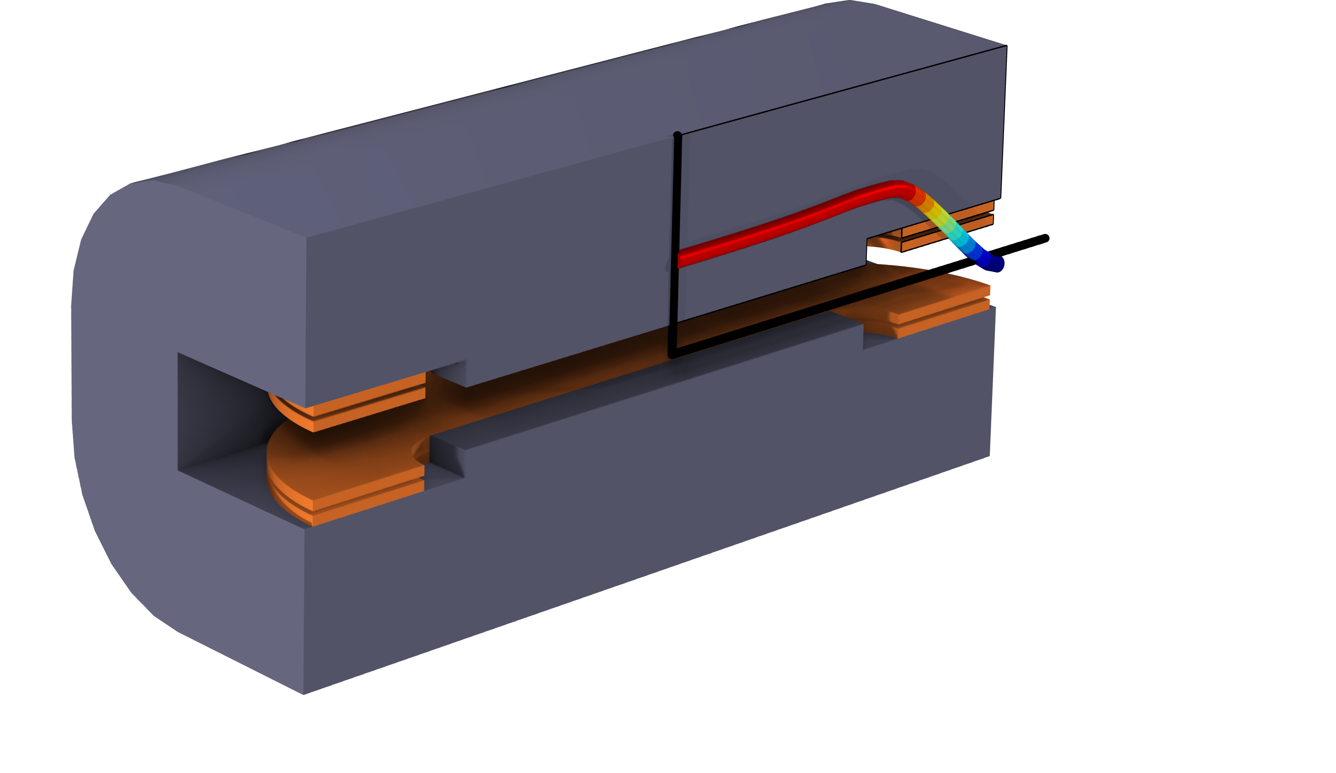

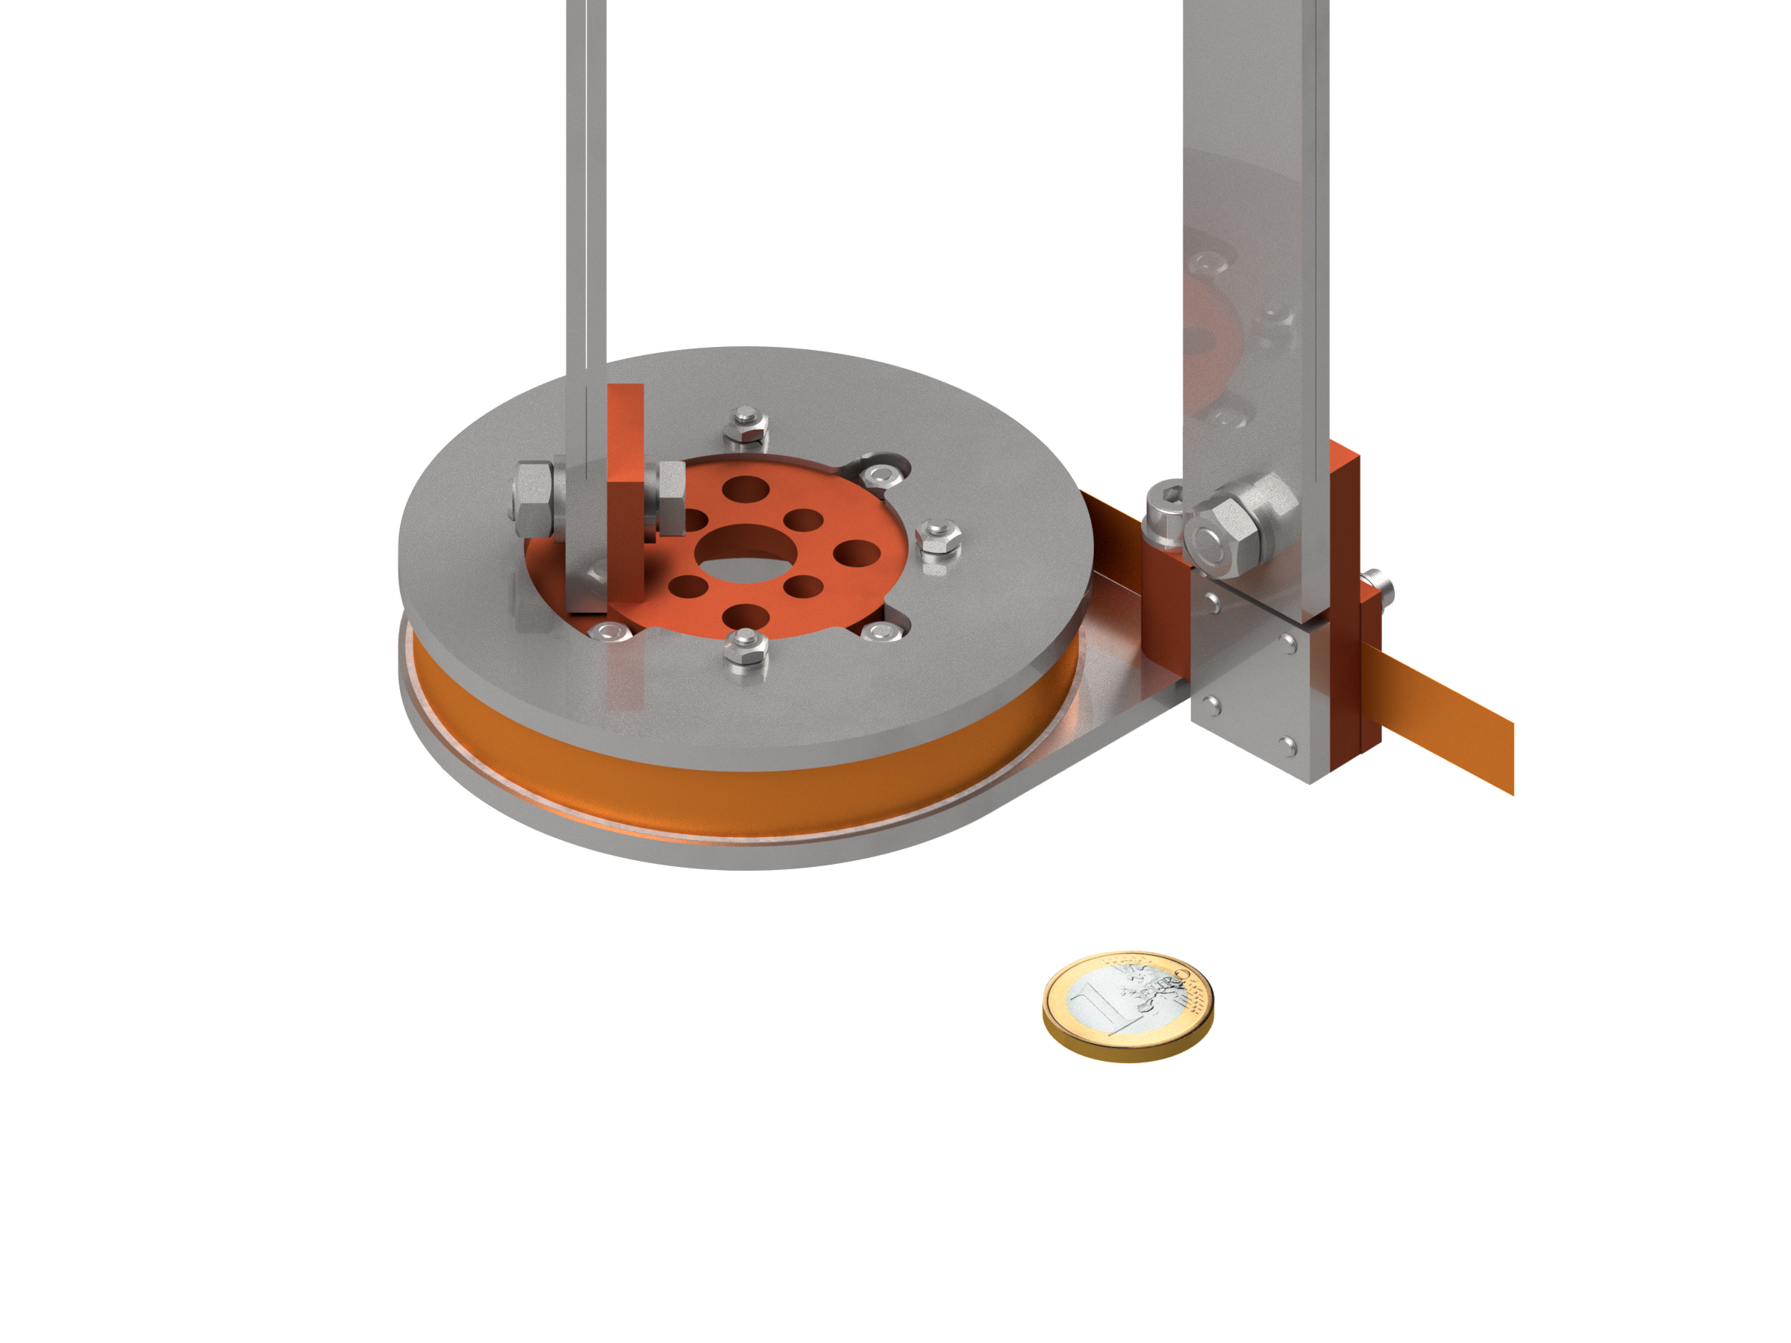
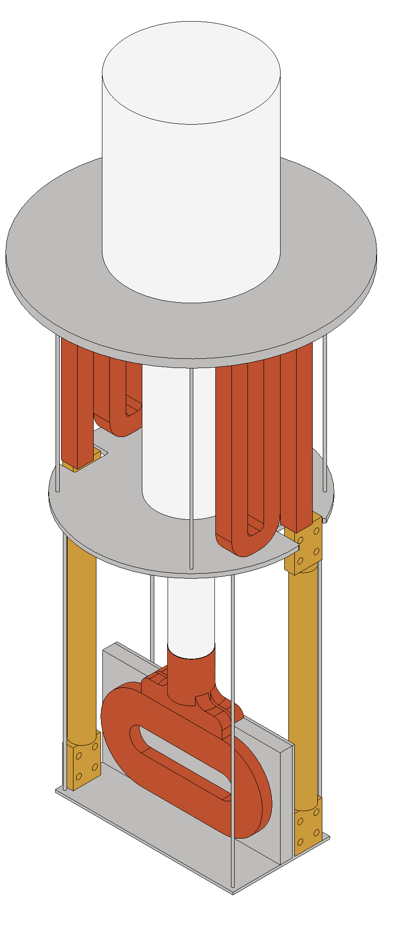
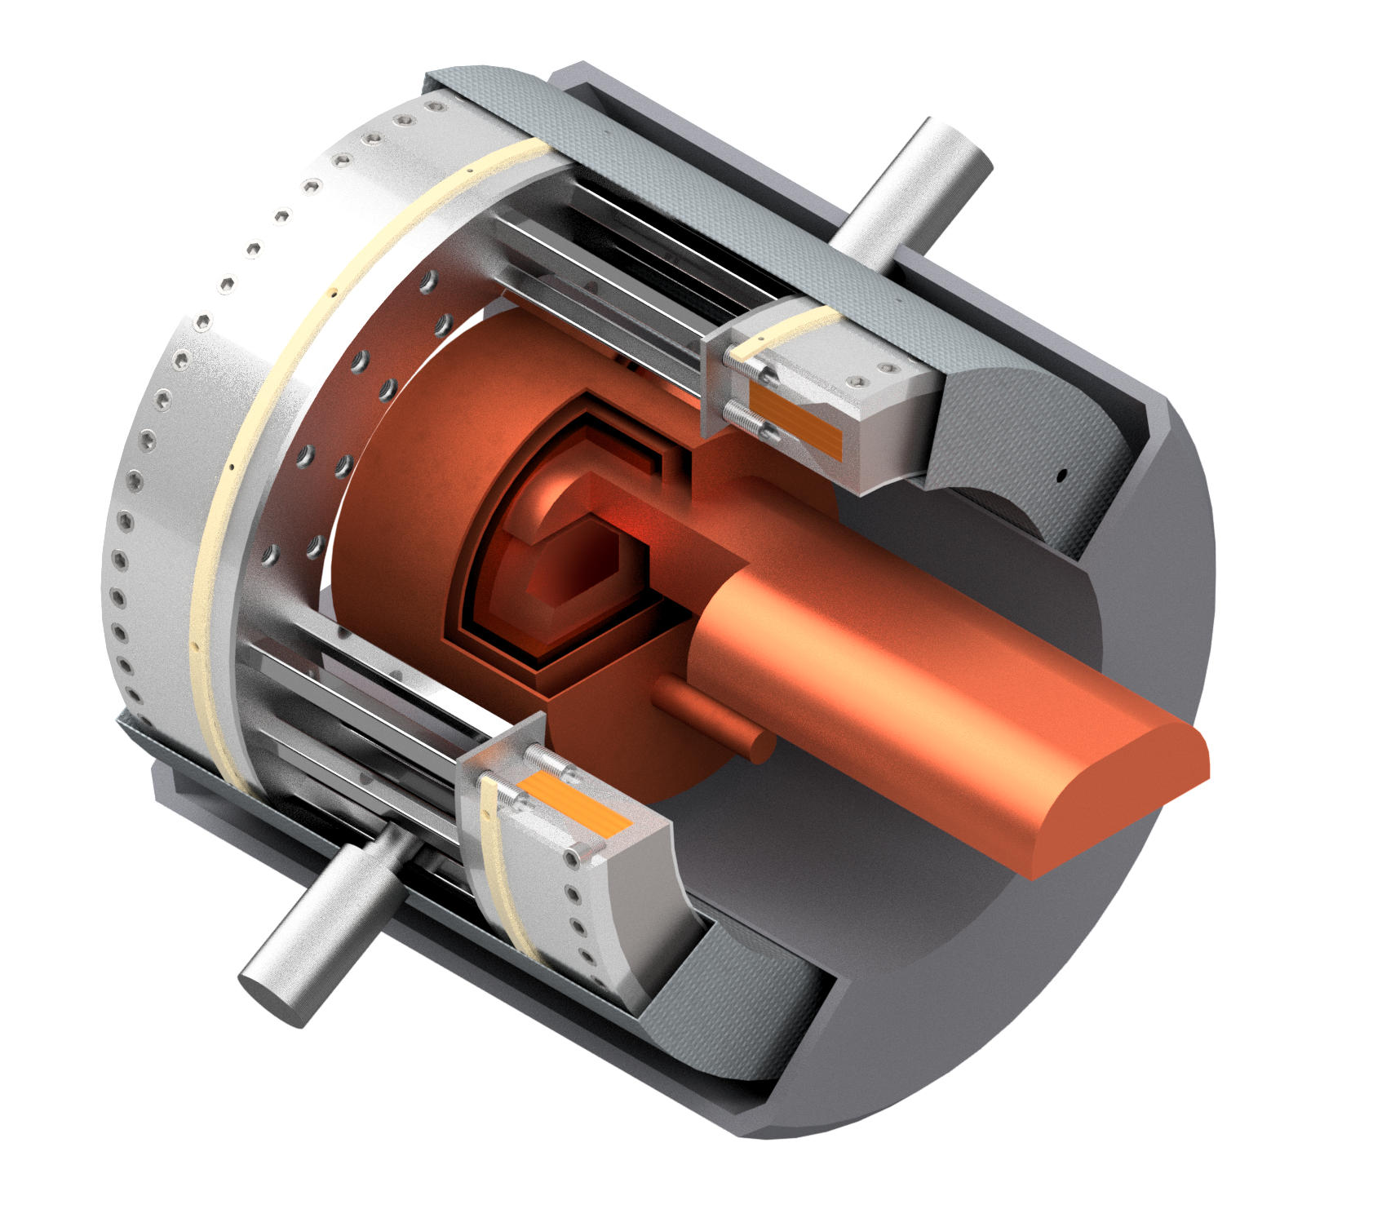
Ongoing activities
Tape characterization
Preliminary design of coils and cell
  Design of a HTS dipole for IRIS, Next Gen EU
  Winding tests of small pancakes
  Test of small pancakes (also in field)
  Design of the RF test station (in collaboration with WP8)
Coil design for the cells
  Field and forces
  Integration of cooling system
  Field quality definition and optimization

Slide 24
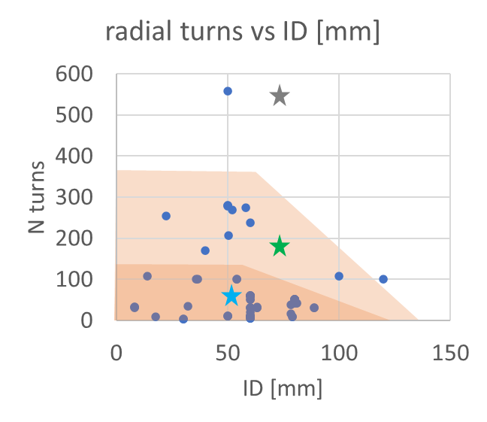
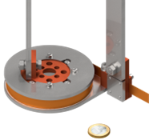
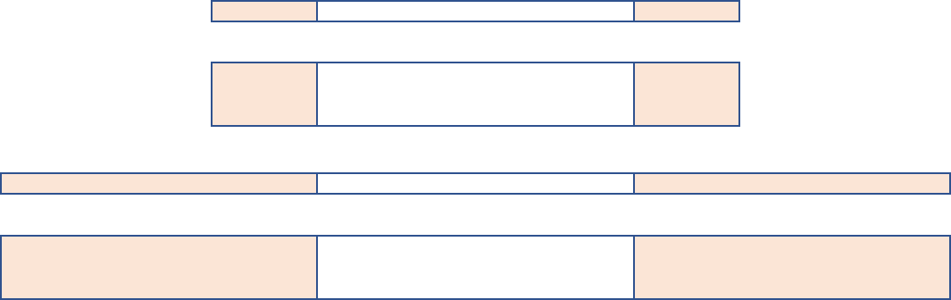
Test coils
60 mm inner diameter
20 mm and 60 mm thickness
4 mm and 12 mm tape width
Single and double pancakes winding
One- and two-in-hand winding
Pancakes can be stacked in mini-coils
Test coils Identical/similar configurations used at CERN, INFN, PSI
Geometry
Configuration
Tests self field and in field
Validate handling procedures and models
By S. Sorti

Slide 25
Conductor configurations
Explore the Controlled-Insulation vs non-insulation solutions.
Multi-tape winding is foreseen, including different materials and technologies to impact the inter-turn resistance.
The goal of this campaign is to asses and improve the TRL of such technologies in magnet-like conditions.
Examples of target technologies:
Metal-Insulated (MI), multi-tape NI, multi-tape resistive layer + stabilizer.
High RRR
metal
metal
Cu
substrate
HTS

Slide 26


Test of small coils
Draft of Variable Temperature system for small coils test
Synergies with IRIS (NextGenerationEU)
  Operation at T in the range 10 K – 30 K;
  Induction of flux densities in the tesla range
  Test in field up to 20+ T
  Non-round geometries (PNRR-IRIS project)
The goal is to test magnet-like conditions for NI coils and further validate models.
Target time: begin 2024
Coils are tested in CERN, INFN LASA, PSI, LNCMI, CEA

Slide 27
RF test station
Select and validate a technology and design options
Design and commission a real size cell-like magnetic system
Synergy between two WPs
Two stage
cryocooler
Coil support structure
Thermal shield
600 mm RT bore for RF
7 T (to 10 T)
+- 5 Tons range forces
RF cavity
Tie rods for repulsion and compression forces
Vacuum vessel
Sc magnet/cryostat sketch by M. Castoldi & Stefano Sorti, UMIL & INFN-LASA
(RF drawing by Guillaume Ferrand –CEA
SC HTS coils

Slide 28
Conclusion
An overview of the required coils
  12 cells
  18 different coils
  1 km of 6D cooling
We set the driving parameters and the technology we are aiming to
A full R&D program for tape characterization and conductor development
Focus on modeling (magnetization, current distribution…)
Many synergies in the project and in other applications
Performance-Cost-Sustainability together with compatibility with series production

Slide 29
Final Cooling Channel
Final Cooling solenoids
Field: > 40 T (ideally 60 T)
Bore: 50 mm
Length: ≈ 500 mm (x 17)
Radiation heat: TBD
Radiation dose: TBD

Slide 30
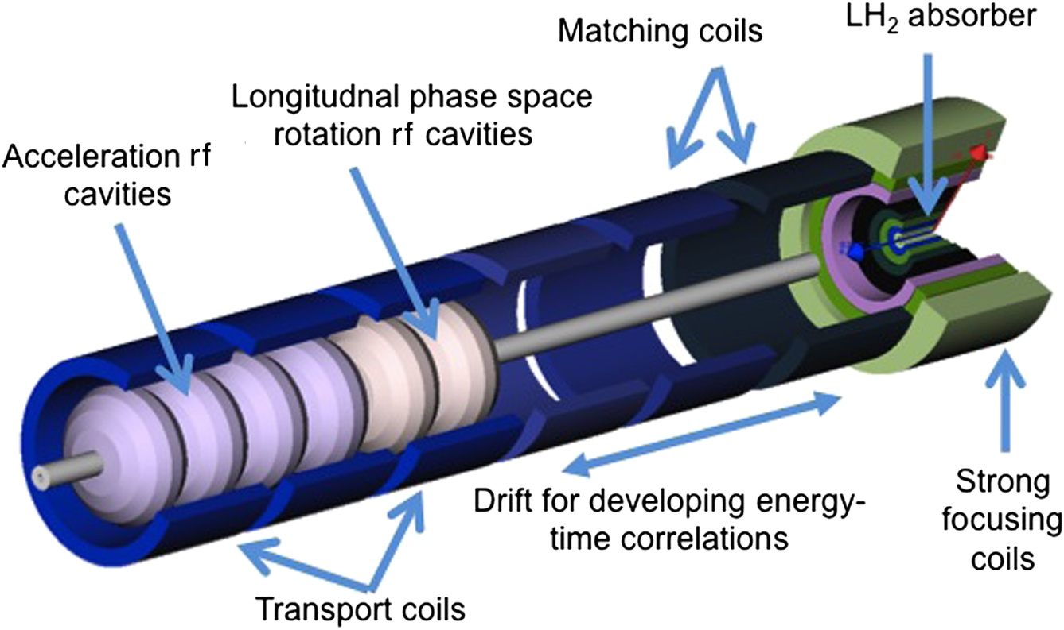
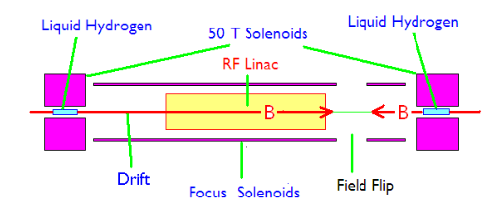
Ionizing Cooling Cell
16 Cells (MAP)
  Set of eight superconducting coaxial coils
  Peak field of 50T, 50 mm diameter
  Sayed et al. Phys. Rev. ST Accel. Beams 18, 091001
14 Cells (CERN)
  B > 40T, 50 mm diameter
3.5 T
R. Palmer, BNL

Slide 31
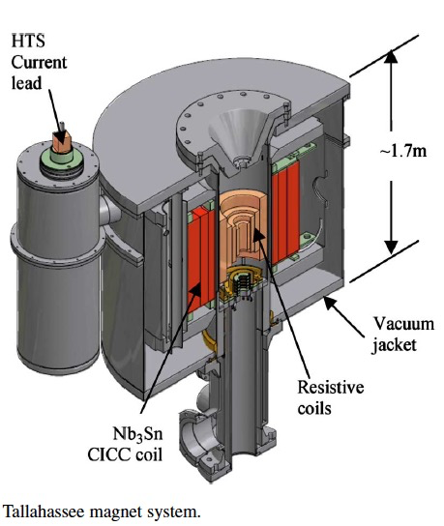
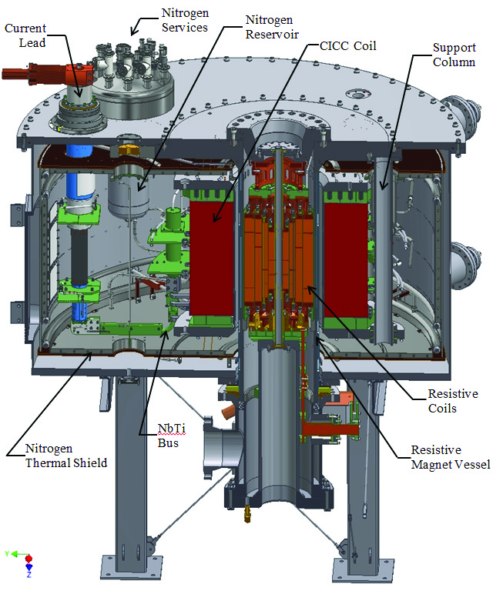
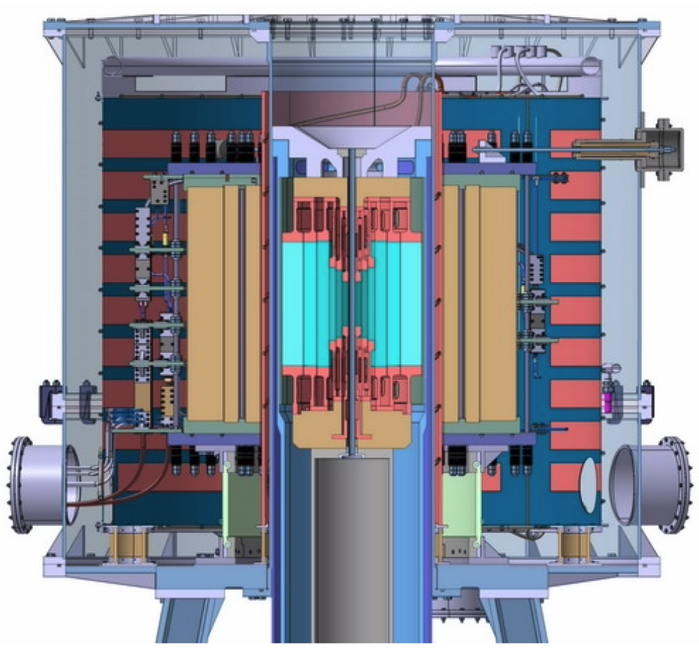
Not exactly starting from scratch on high field solenoids – but . . .
https://nationalmaglab.org/user-facilities/dc-field/magnets-instruments/
http://english.hmfl.cas.cn/uf/ms/202202/t20220224_301451.html
Cross section of 45 T, 32 mm NHFML user facility solenoid
Hybrid Magnet 33.5 T from resistive insert, 11.5 T by superconducting outsert
30 MW power comsumption
Cross section of 36 T, 48 mm NHFML user facility (NMR) solenoid
Hybrid Magnet 23 T from resistive insert, 13 T by superconducting Nb₃Sn CICC outsert
14 MW power comsumption
Cross section of 40*/37 T, 32/50 mm CHMFL user facility solenoid
Hybrid Magnet 29/26 T from resistive insert, 11 T by superconducting Nb₃Sn CICC outsert
20 MW power comsumption
B. Bordini, CERN

Slide 32
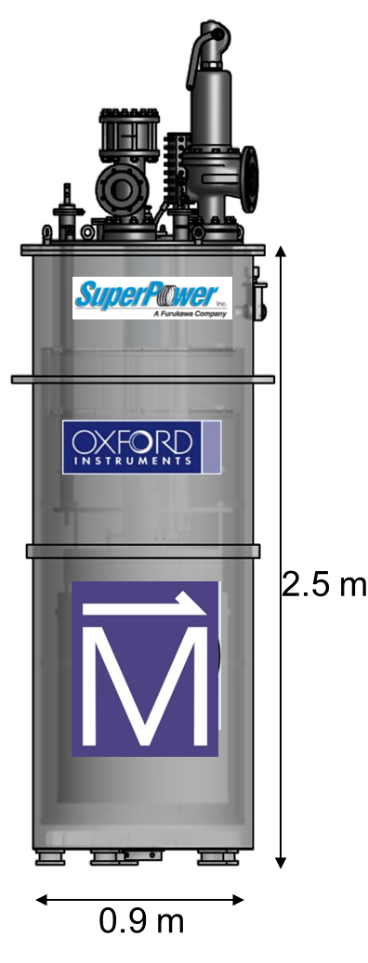
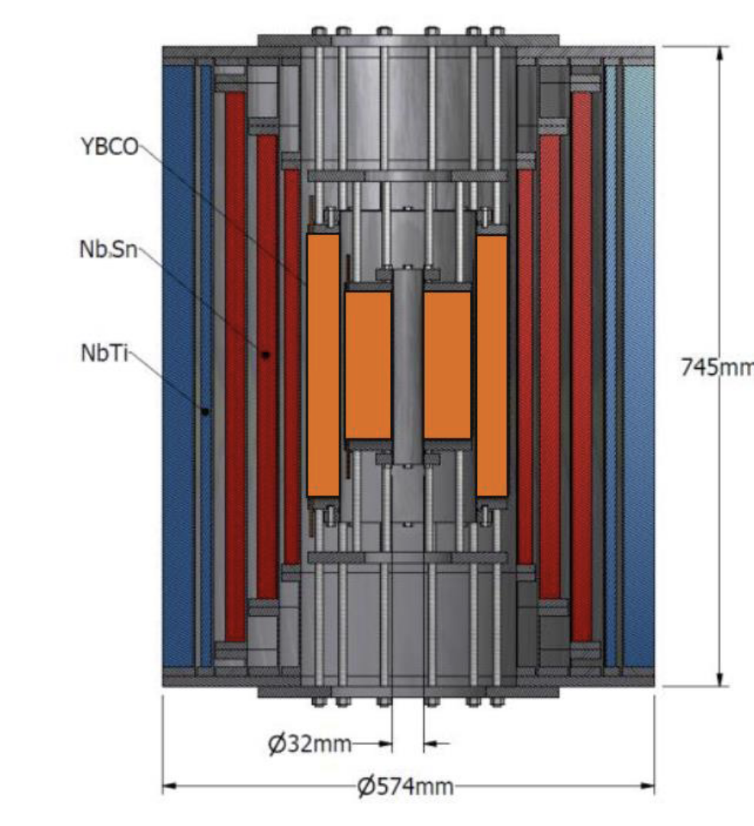
Getting closer
Cross section of 32 T (15 T LTS, 17 T two ReBCO double pancake coils), 32 mm user facility solenoid https://nationalmaglab.org/user-facilities/dc-field/magnets-instruments/
Just increase the field and bore
Operate REBCO coils at 20K?
And then the 40T
But will nested coils work for MC?
Low J, mechanical challenges, QP
B. Bordini, CERN

Slide 33
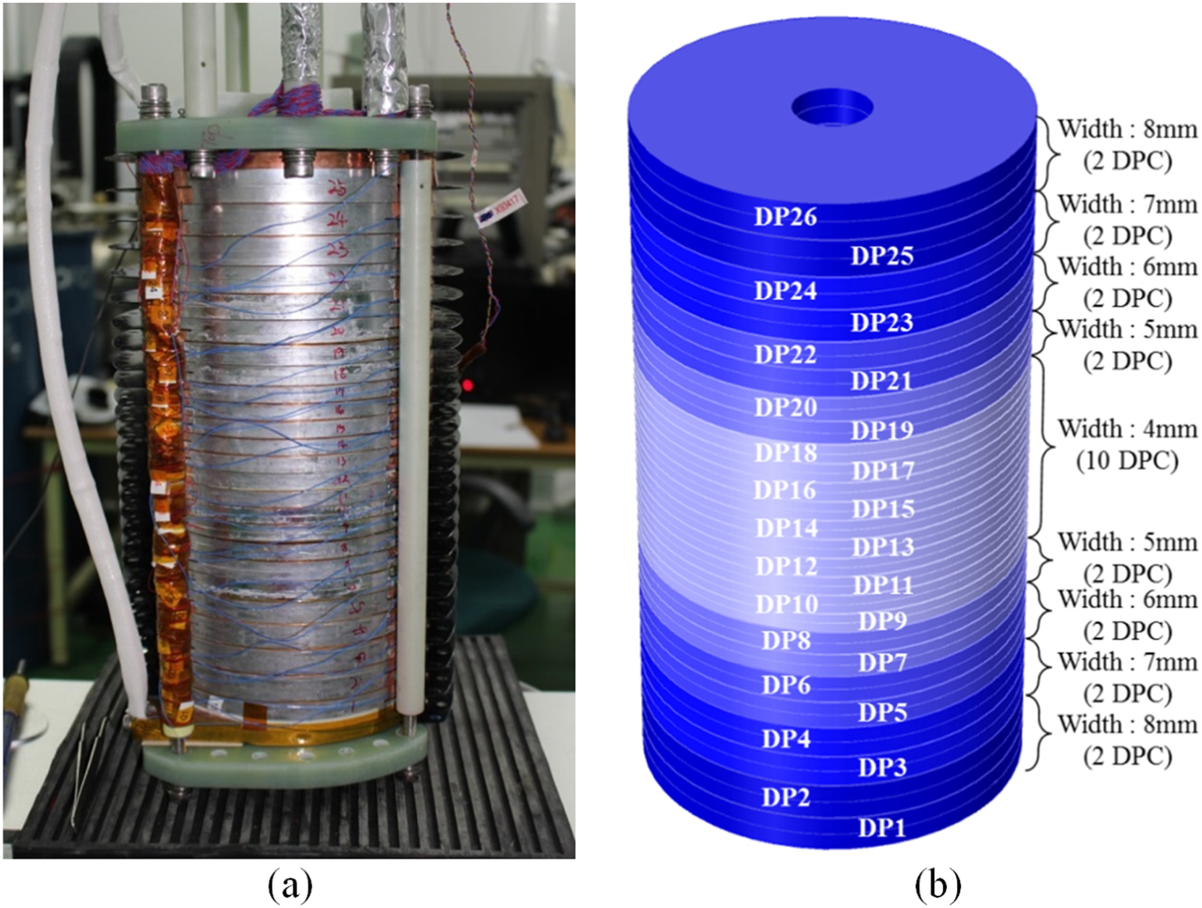
CERN approach
Sunam NI one-body ReBCO magnet
26.4 T in 35 mm, J central pancake 404 A mm⁻² (26.4 T HTS multi-width)
overall diameter and height: 172 and 327 mm
Single coil, high J_{e}
  40T, 50 mm bore
Need higher field – but higher tensile radial stress
Apply precompression to all-HTS NI/MI single coil.
High potential for future particle accelerators and other societal applications
Substantial progress on design
Challenges
  High stresses
  Magnet protection – transients to control
  Charging time
S. Yoon et al. Supercond. Sci. Technol. 29 (2016) 04LT04
B. Bordini, CERN

Slide 34
Accelerator Ring
Accelerator magnets
Field: ±1.8 T (NC), < 10 T (SC)
Rate: 400 Hz (NC), SS (SC)
Bore: 100 mm(H) x 30 mm(V)
Length: 3 m … 5 m (x 1500)
Radiation heat: ≈ 3 W/m
Radiation dose: TBD

Slide 35
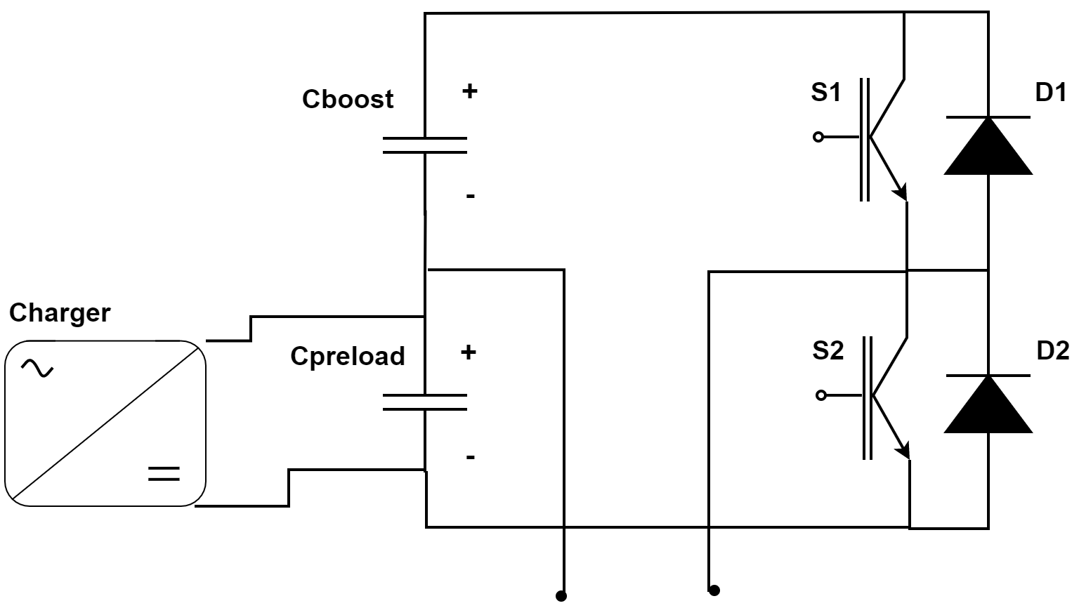
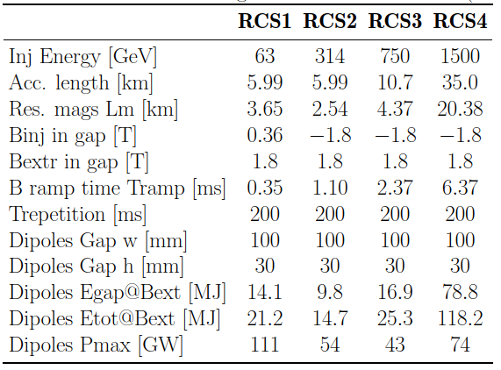
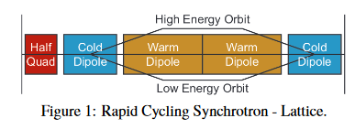
Critical systems and main- specifications
The powering system is very interlinked with the resistive magnets design
The key performance drivers are directly related to the total energy and power to be delivered to the magnets, but also to the tracking accuracy that will have to be guaranteed.
This input should come from the beam studies
F. Boattini

Slide 36
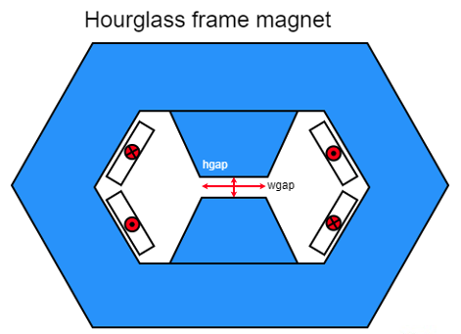
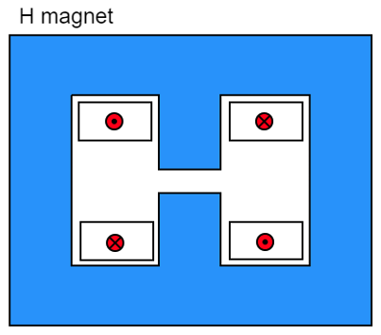
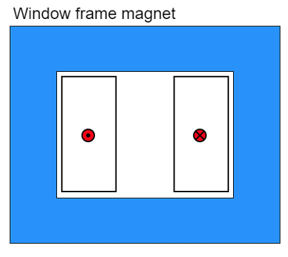
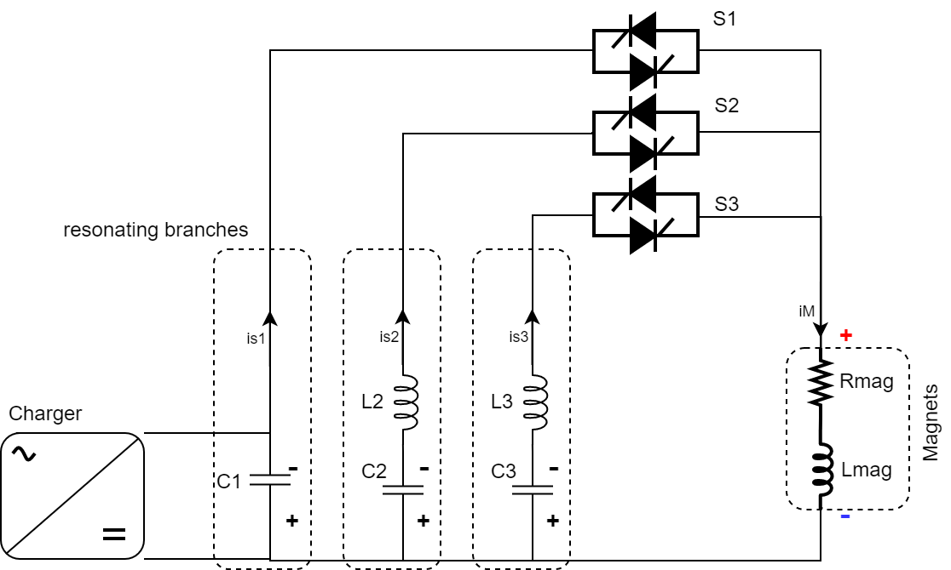
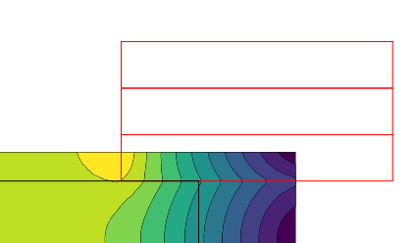
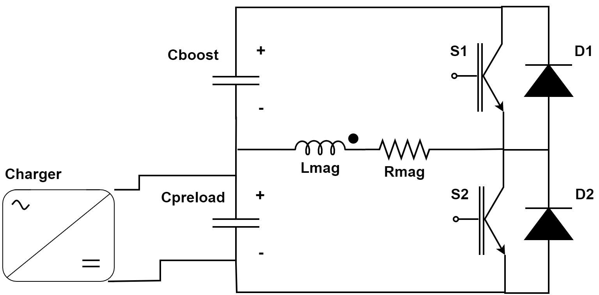
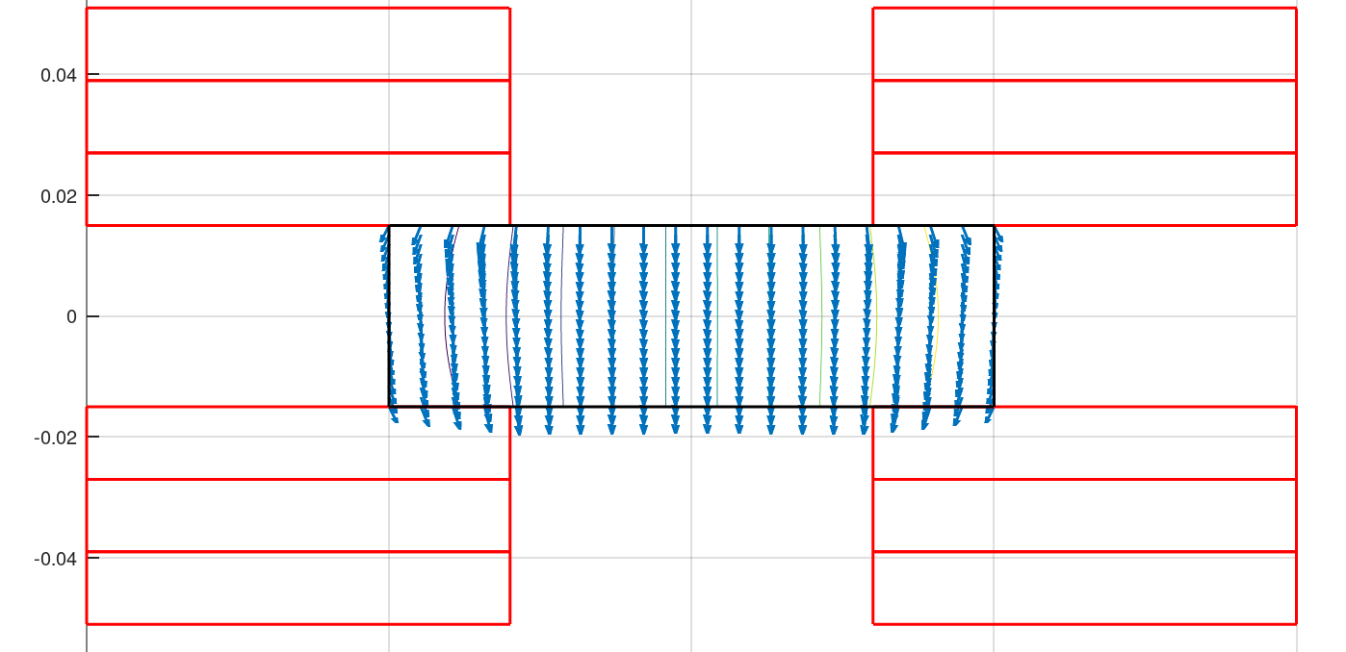
Fast-ramping Magnets
Differerent power converter options investigated
Full wave resonance
5.07 kJ/m
5.65…7.14 kJ/m
5.89 kJ/m
Main challenge is management of the power in the resistive dipoles (several tens of GW):
Minimum stored magnetic energy
Highly efficient energy storage and recovery
Simple HTS racetrack dipole could match the beam requirements and aperture
Commutated resonance (new)
HTS flat racetracks
F. Boattini et al.
1.8T RC with 10T SC
Rectangular magnet bore 100 mm x 30 mm

Slide 37
Collider Magnets
Collider ring magnets
Field: 16 T peak (IR 20 T)
Bore: 150 mm
Length: 10 m … 15 m (x 700)
Radiation heat load: ≈ 5 W/m
Radiation dose: ≈ 20…40 MGy
10 TeV Option

Slide 38
Working Group
INFN Milano
S. Mariotto, M. Statera, M. Prioli, E. De Matteis, R. Valente, S. Sorti
INFN Genova
B. Caiffi, A. Bersani, S. Farinon, D. Novelli
CERN
L. Bottura, A. Lechner
Tampere University
T. Salmi

Slide 39
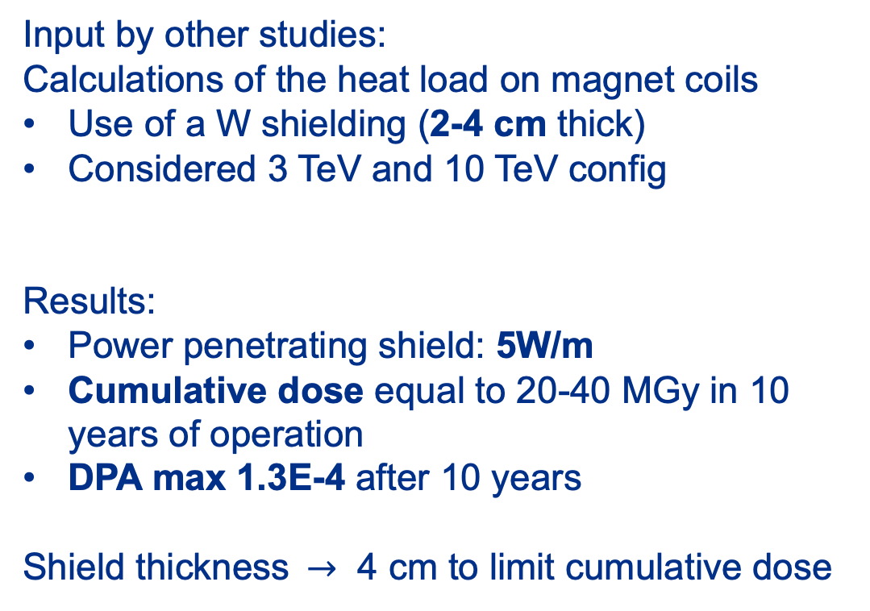
Heat Load and Radiation
Input by other studies:
Calculations of the heat load on magnet coils
Use of a W shielding (2-4 cm thick)
Considered 3 TeV and 10 TeV config
Results:
Power penetrating shield: 5W/m
Cumulative dose equal to 20-40 MGy in 10 years of operation
DPA max 1.3E-4 after 10 years
Shield thickness$→$ 4 cm to limit cumulative dose
Courtesy of
Anton Lechner
See “Shielding design and requirements”
A. Lachner, https://indico.cern.ch/event/1183573

Slide 40
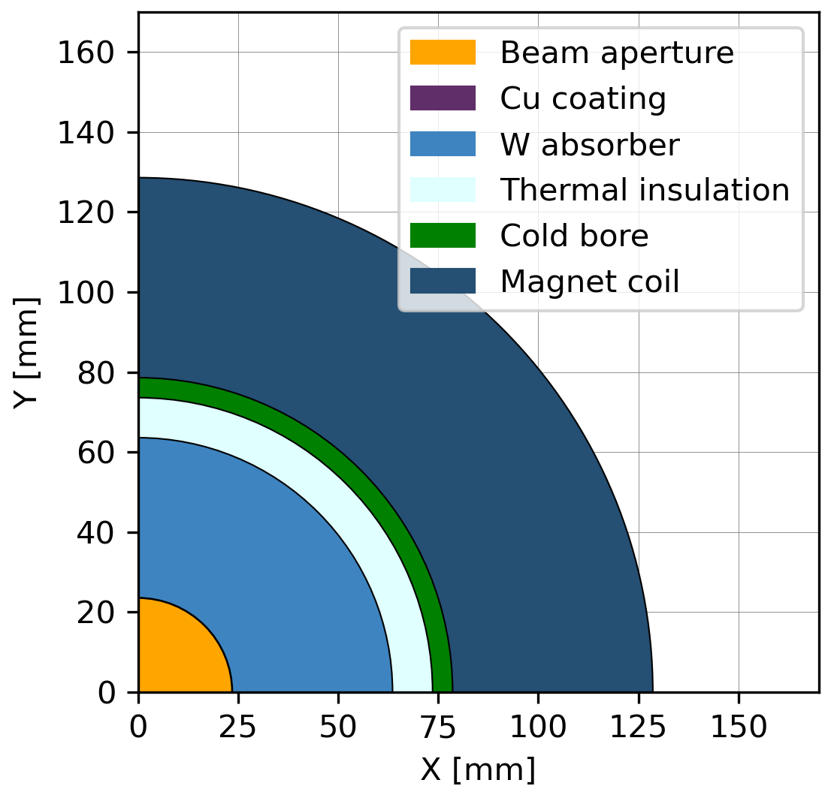
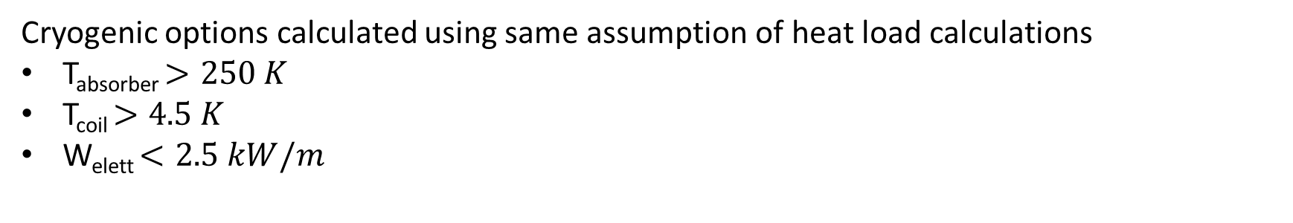
Radial Build-up
Cryogenic options calculated using same assumption of heat load calculations
T_{absorber} $>250 K$
T_{coil} $>4.5 K$
W_{elett} $<2.5 kW/m$
Heavily dependent from geometry and heat loads
How to share last update designs?
Radial Building
Beam aperture (5σ) 23.5 mm radius
Cu layer beam screen 0.01 mm thick
Tungsten absorber 40 mm thick
Thermal insulation 11 mm thick
Cold bore 3 mm thick
Coil pack 50 mm thick
See “Cryogenics options for future accelerators”
Patricia Borges De Sousa, https://indico.cern.ch/event/1240043
Courtesy of Patricia Borges De Sousa

Slide 41
Material Options
Technology |  | Pro’s | Con’s
LTS (Nb-Ti) |  | Known and well developed technology (TRL 8) | Probably do not meet all magnet requirements
LTS (Nb₃Sn) |  | Known technology, reaching demonstration level in accelerators (TRL 6/7) | Probably do not meet all magnet requirements Brittle/stress limited
Hybrid (LTS Nb₃Sn) + (HTS) |  | Lower cost Exploit potential of both materials | Low readiness level for HTS insert (TRL 3/4) LTS/HTS joints and integration to be developed Temperature limited by LTS
All-SC (HTS) | Insulated | Most compact solution Allows operation at high temperature Profit from on-going R&D activities on insulation/no-insulation windings | R&D at low readiness (TRL 3/4) Quench protection to be demonstrated Field delay and field stability in case of NI winding
 | Controlled Insulated
 | Non Insulated

Slide 42
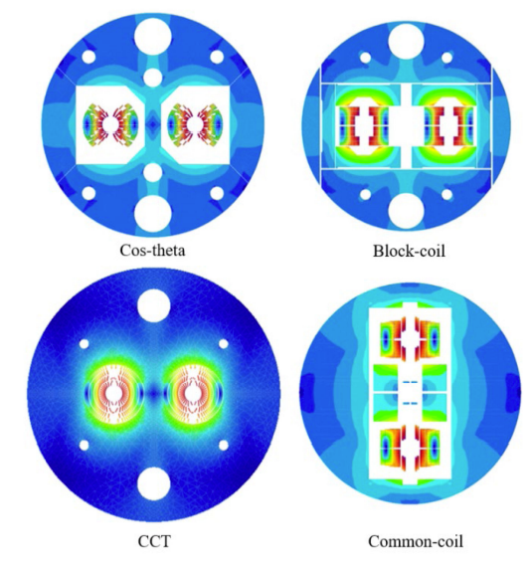
Design Options (1/2)
Technology | Pro’s | Con’s
Cos-theta Design | Well known design Wound around a cylindrical mandrel, end shape already suitable for beam tube insertion | Mechanical structure can be complex Not most easy winding geometry for HTS tapes
Block Coil Design | Known design principles Mechanical structure simplify stress management Easier geometry for HTS-tapes | Difficult stress management on coil ends Higher ratio conductor length/produced field
Canted Cos-theta Design | Intrinsic stress management Low number of parts and tools Easy winding procedure | Requires more cable than the other layouts Quench protection more difficult R&D needed

Slide 43
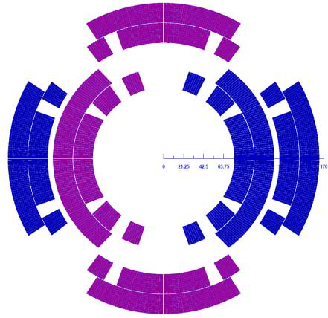
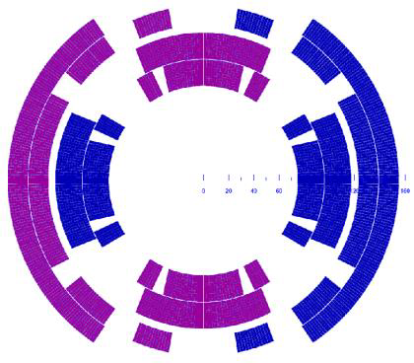
Design Options (2/2) Combined function
A. Zlobin
Technology | Pro’s | Con’s
NESTED Configuration | Separate Powering Dipole/Quadrupole Inherit experience on Nb₃Sn magnets for HiLumi and LARP-US development program | High Stress on Internal Coil Alignment Higher Costs
Asymmetric Coil Design | Single type of coil Optimized margin and field quality | Fixed Dipole/Quadrupole ratio Stress on the supporting structure is not balanced
Fields for 3 TeV are high, but 10 TeV very high!
Important negotiation point with machine designers
T. Ogitsu

Slide 44
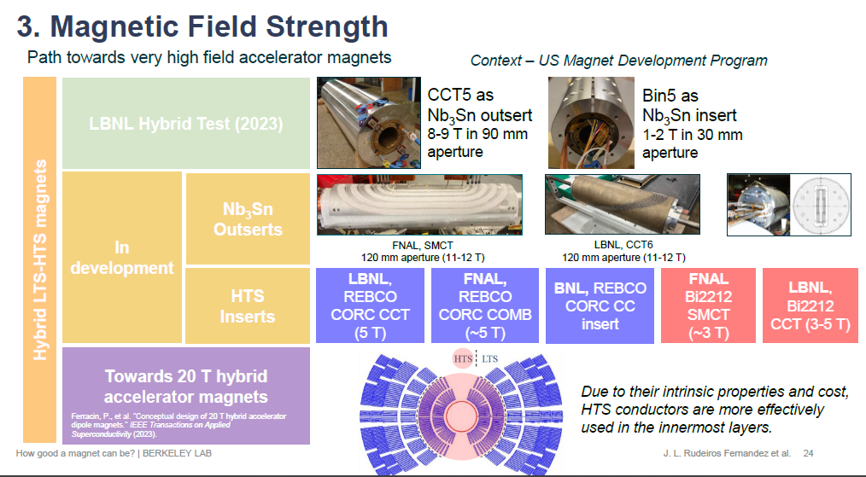
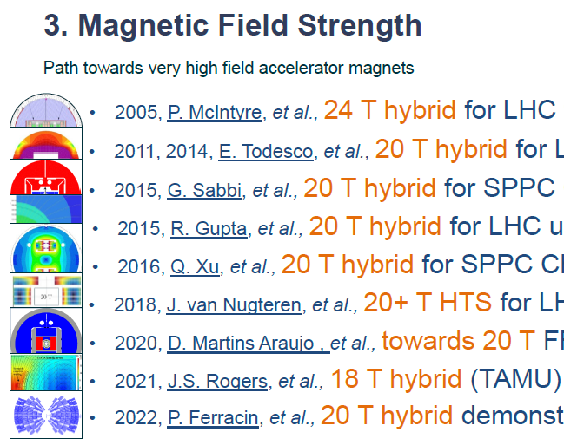

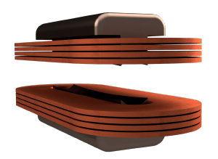
Synergies
Courtesy of
Jose Luis Rudeiros
Huge help and feedback will come from:
20T+ development program in the US
CERN – HFM
Possible feedback loop also inside INFN
PNRR-IRIS project (see L. Balconi 20-05-2023) and small HTS coil pancake program
10 T of dipolar field
Bore dimensions 80x50 mm²
Operating temperature 20 K
Physical L < 1 m

Slide 45
Cooling Options for the collider ring

Slide 46
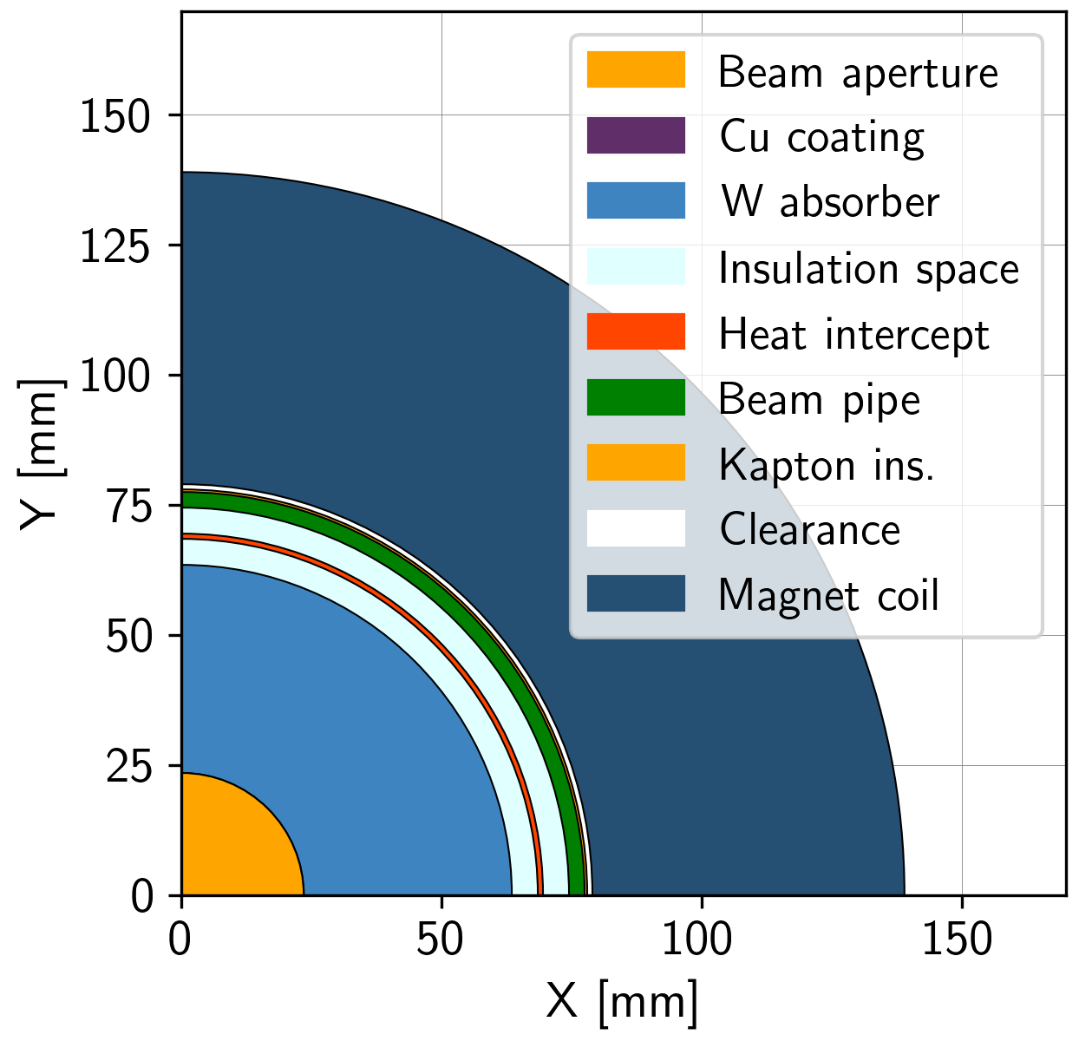
Updated radial build for collider arc magnets
Radial build has evolved to include a heat intercept between the absorber and the coil
Beam aperture (5σ) 23.5 mm radius
Cu layer beam screen 0.01 mm thick
Tungsten absorber 40 mm thick
Insulation space 5 mm thick
Heat intercept 1 mm thick
Insulation space 5 mm thick
Beam pipe 3 mm thick
Kapton insulation 0.5 mm thick
Clearance 1 mm thick
Coil pack* (60 mm thick)
*thickness TBD, placeholder
P. Borges de Sousa
Coil aperture 158 mm

Slide 47
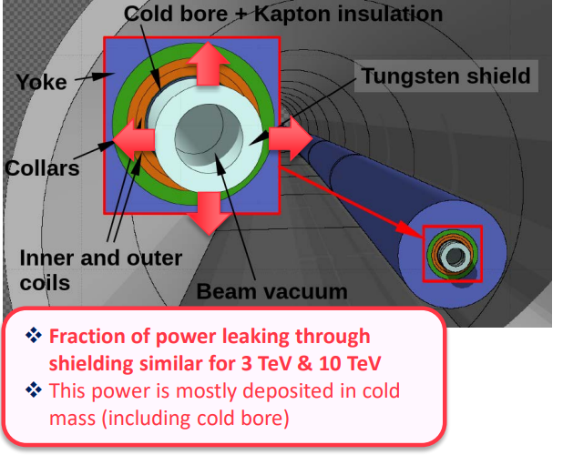
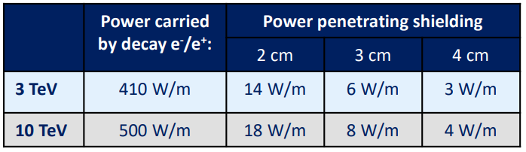

Updated radial build for collider arc magnets
Radial build has evolved to include a heat intercept between the absorber and the coil
Baseline for heat load estimation/power consumption is 10 TeV machine
To absorber
To cold mass
From muon decay; total heat load will include substantial contributions, e.g. conduction, thermal radiation…
Source: Informal meeting on muon collider absorber, vacuum and cryogenics integration (18 January 2023) · Indico (cern.ch)
P. Borges de Sousa

Slide 48
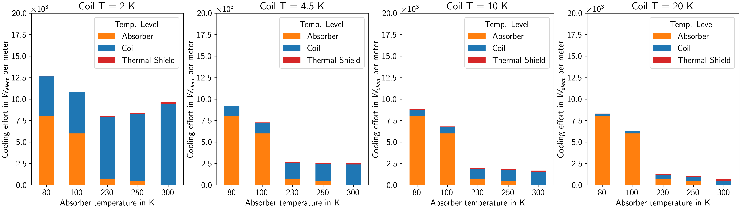

Power Consumption with heat intercept
Power consumption estimated for shown heat loads at various coil and absorber temperatures
Shown: Cooling effort at refrigerator I/F, absorber thickness 4 cm, shield and heat intercept 80 K
Target:
25 MW for Cryo
in collider
(2.5 kW_{el}/m)
$T_{coil}$ ≥ 4.5 K
$T_{abs}$ ≥ 200 K
Message: 25 MW total for 10 km collider ring →
P. Borges de Sousa
48

Slide 49
Considerations for coil cooling options
Cooling mode (and temperature) will depend on the choice of conductor, which depends on the maturity level of the technology and on the timescale of construction
3 TeV machine
Construction in ~15 years
Magnetic fields within Nb₃Sn capabilities
Nb₃Sn matured, usable
Cooling at 4.5 K – 5.5 K using SC He
Cooling at 4.5 K using He two-phase flow
10 TeV machine
Construction in ~25-30 years
HTS preferred for sustainable collider
Needs development
Cooling at 10 K – 15 K or above
He or H₂ possible; in-depth study needed
P. Borges de Sousa

Slide 50
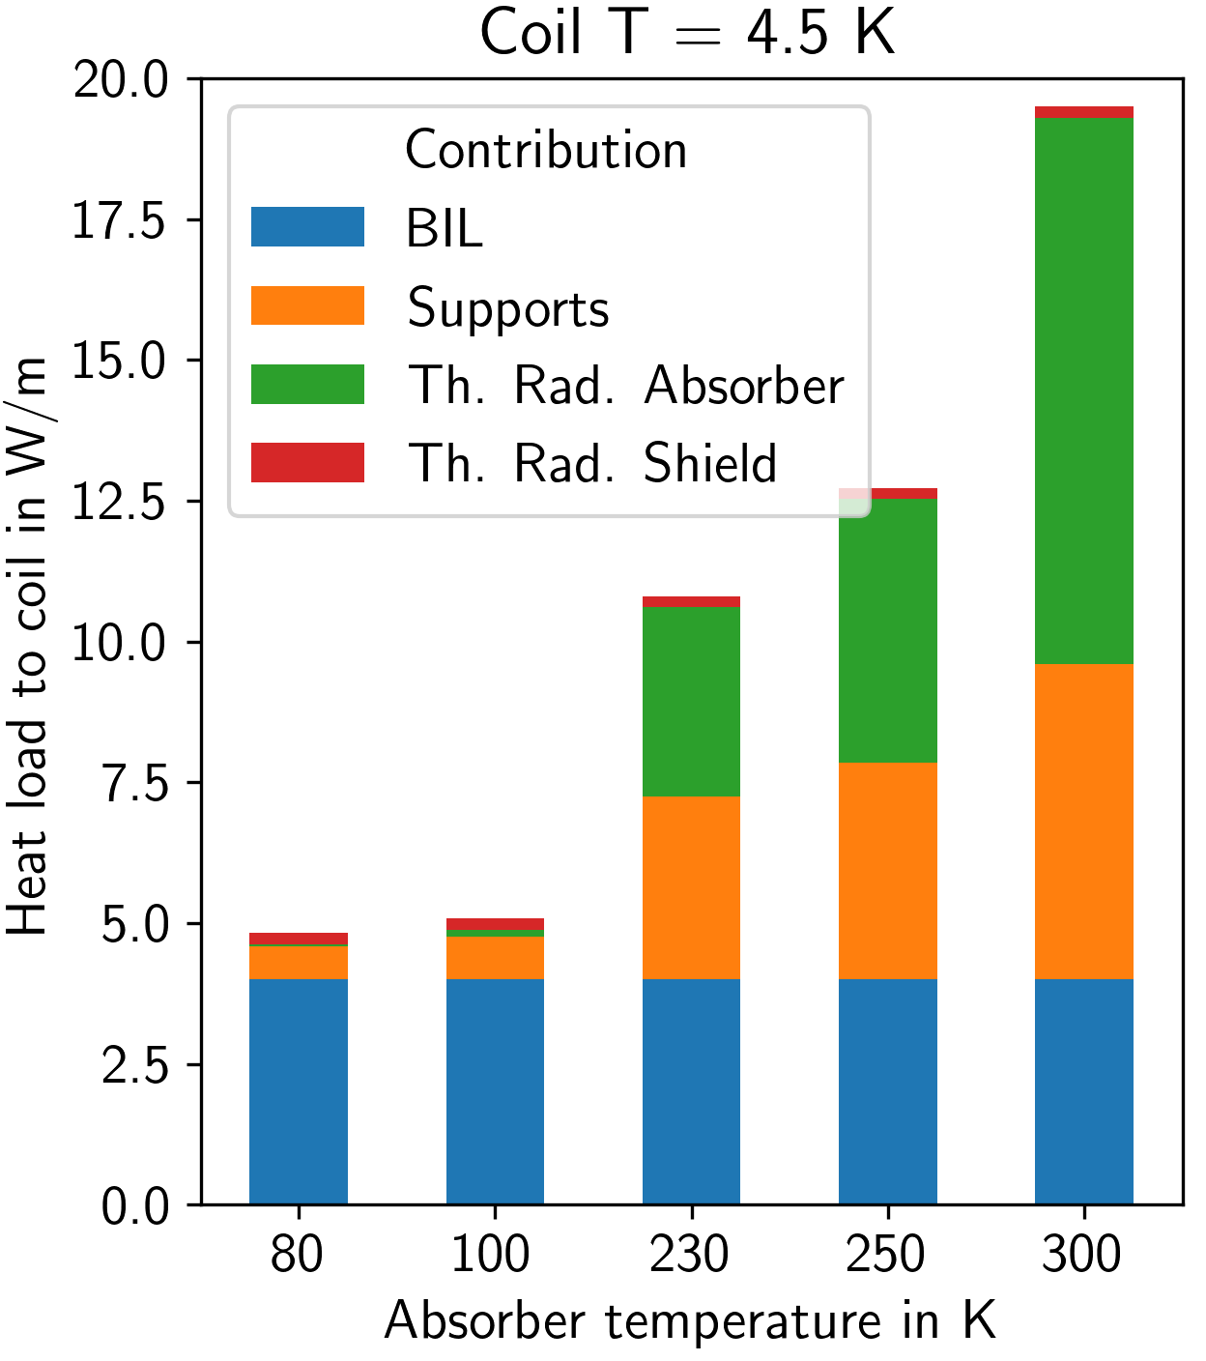
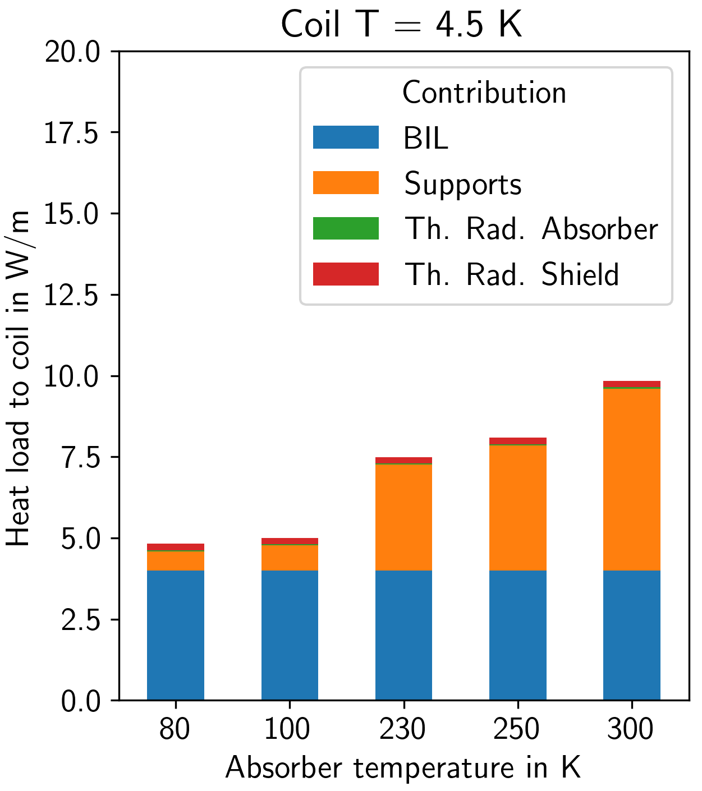
Evaluation of technology options for Collider Ring magnet cooling
Progress summary
Critical contributors to total heat load deposited on the coil identified
Absorber must operate at or above 250 K (overall cooling effort, distr. losses)
Heat intercept between coil and absorber is a necessity
Electrical power consumption of collider ring cryogenics estimated
Coil must operate at or above 4.5 K
Preliminary evaluation of possible cooling schemes, limitations
With 80K thermal shield between absorber and coil

Slide 51
Evaluation of technology options for magnet cooling
Collider Ring
Needs attention:
Contribution from absorber supports considered disproportionate → effort should be put into the design of an optimized support for the MC absorber conditions
Preliminary cross-section of the coil (and absorber) should be outlined to estimate max. cooling tube size, number, position → allows for some boundaries to cooling scheme layouts
Cooling options for LTS (around 5 K) examined, promising → need R&D to explore the limits of two-phase flow and supercritical cooling in confined geometries
Cooling options for HTS (if 10K+) need in-depth study → He gas cooling does not provide efficient heat transfer; H₂ cooling needs demonstration and change of mindset, safety assessment
Cooling of absorber with CO₂/water needs in-depth review of the base assumptions, esp. risk-related
Current leads: neither heat loads nor cooling options have been addressed

Slide 52
Summary
Current effort is inadequate for even the minimal scenario, much less preparation for a demonstration project in a reasonable timeframe.
What is missing now is a dialogue between magnet folks and machine designers. Many trade-offs to explore.
IMCC contends that a 3 TeV Muon Collider could be ready shortly after LHC shutdown in 2041. Technically limited schedule and will need substantial increase in resources on both sides of the Atlantic.
Now we wait for P5 and OHEP

Slide 53
Muon Collider magnet “catalog”
M
a
g
n
e
t
R
a
m
p
B
e
a
m
p
o
w
e
r
C
o
m
p
l
e
x
S
e
c
t
o
r
B
a
s
e
l
i
n
e
M
a
g
n
e
t
T
y
p
e
t
e
c
h
n
o
l
o
g
y
F
i
e
l
d
G
r
a
d
i
e
n
t
A
p
e
r
t
u
r
e
G
a
p
W
i
d
t
h
L
e
n
g
t
h
N
u
m
b
e
r
t
i
m
e
F
i
e
l
d
r
a
t
e
H
o
m
o
g
e
n
e
i
t
y
P
e
r
s
i
s
t
a
n
c
e
d
e
p
o
s
i
t
i
o
n
C
o
m
m
e
n
t
s
(
T
)
(
T
/
m
)
(
m
m
)
(
m
m
)
(
m
m
)
(
m
)
(
-
)
(
s
)
(
T
/
s
)
/
(
T
/
m
/
s
)
(
u
n
i
t
s
)
(
u
n
i
t
s
/
s
)
(
k
W
/
m
)
b
a
s
e
l
i
n
e
1
5
T
,
2
.
4
m
b
o
r
e
d
e
s
i
g
n
,
a
s
s
u
m
e
h
s
6
o
u
r
s
r
a
m
p
-
u
p
t
i
m
e
a
n
d
5
k
W
d
e
p
o
s
i
t
e
T
d
a
r
g
e
t
a
n
d
C
a
p
t
u
r
e
T
a
r
g
e
t
b
a
s
e
l
i
n
e
s
o
l
e
n
o
i
d
L
T
S
1
5
2
4
0
0
2
1
2
1
6
0
0
0
.
0
0
0
7
1
0
0
1
t
o
t
a
l
p
o
w
e
r
b
a
s
e
l
n
e
s
o
l
e
n
o
i
d
N
C
5
1
5
0
0
.
5
1
1
5
.
0
0
0
0
1
0
0
1
0
0
b
a
s
e
l
i
n
e
5
T
r
e
s
i
s
t
i
v
e
i
n
s
e
r
t
o
p
t
i
o
n
b
a
s
e
d
o
n
a
H
T
S
c
a
b
l
e
,
r
e
d
u
c
e
d
b
o
r
o
e
p
t
i
o
n
s
o
l
e
n
o
i
d
H
T
S
2
0
6
0
0
1
.
5
1
2
1
6
0
0
0
.
0
0
0
9
1
0
0
0
.
1
5
a
n
d
s
h
i
e
l
d
i
n
g
,
o
p
e
r
a
t
i
n
g
a
t
1
0
…
2
C
0
K
a
p
t
u
r
e
a
n
d
d
e
c
a
y
c
h
a
n
n
e
l
s
o
l
e
n
o
i
d
T
B
D
C
o
o
l
i
n
g
I
o
n
i
z
a
t
i
o
n
C
o
o
l
i
n
g
b
a
s
e
l
i
n
e
s
o
l
e
n
o
i
d
T
B
D
2
.
2
6
0
0
2
6
6
2
1
6
0
0
0
.
0
0
0
1
1
0
0
0
.
1
c
e
l
l
A
1
b
a
s
e
l
i
n
e
s
o
l
e
n
o
i
d
T
B
D
3
.
4
5
0
0
1
.
3
2
1
3
0
2
1
6
0
0
0
.
0
0
0
2
1
0
0
0
.
1
c
e
l
l
A
2
b
a
s
e
l
i
n
e
s
o
l
e
n
o
i
d
T
B
D
4
.
8
3
8
0
1
1
0
7
2
1
6
0
0
0
.
0
0
0
2
1
0
0
0
.
1
c
e
l
l
A
3
b
a
s
e
l
i
n
e
s
o
l
e
n
o
i
d
T
B
D
6
2
6
4
0
.
8
8
8
2
1
6
0
0
0
.
0
0
0
3
1
0
0
0
.
1
c
e
l
l
A
4
b
a
s
e
l
i
n
e
s
o
l
e
n
o
i
d
T
B
D
2
.
2
5
6
0
2
.
7
5
2
0
2
1
6
0
0
0
.
0
0
0
1
1
0
0
0
.
1
c
a
l
l
B
1
b
a
s
e
l
i
n
e
s
o
l
e
n
o
i
d
T
B
D
3
.
4
4
8
0
2
3
2
2
1
6
0
0
0
.
0
0
0
2
1
0
0
0
.
1
c
a
l
l
B
2
b
a
s
e
l
i
n
e
s
o
l
e
n
o
i
d
T
B
D
4
.
8
3
6
0
1
.
5
5
4
2
1
6
0
0
0
.
0
0
0
2
1
0
0
0
.
1
c
a
l
l
B
3
b
a
s
e
l
i
n
e
s
o
l
e
n
o
i
d
T
B
D
6
2
8
0
1
.
2
7
5
0
2
1
6
0
0
0
.
0
0
0
3
1
0
0
0
.
1
c
a
l
l
B
4
b
a
s
e
l
i
n
e
s
o
l
e
n
o
i
d
T
B
D
9
.
8
1
8
0
0
.
8
0
6
9
1
2
1
6
0
0
0
.
0
0
0
5
1
0
0
0
.
1
c
a
l
l
B
5
b
a
s
e
l
i
n
e
s
o
l
e
n
o
i
d
T
B
D
1
0
.
5
1
4
4
0
.
8
0
6
7
7
2
1
6
0
0
0
.
0
0
0
5
1
0
0
0
.
1
c
a
l
l
B
6
b
a
s
e
l
i
n
e
s
o
l
e
n
o
i
d
T
B
D
1
2
.
5
9
8
0
.
8
0
6
5
0
2
1
6
0
0
0
.
0
0
0
6
1
0
0
0
.
1
c
a
l
l
B
7
b
a
s
e
l
i
n
e
s
o
l
e
n
o
i
d
T
B
D
1
3
.
6
9
0
0
.
8
0
6
6
1
2
1
6
0
0
0
.
0
0
0
6
1
0
0
0
.
1
c
a
l
l
B
8
F
i
n
a
l
C
o
o
l
i
n
g
b
a
s
e
l
i
n
e
s
o
l
e
n
o
i
d
H
T
S
3
0
5
0
0
.
5
1
7
2
1
6
0
0
0
.
0
0
1
4
0
b
a
s
e
l
i
n
e
d
e
s
i
g
n
f
r
o
m
U
S
-
M
A
P
m
i
n
i
m
a
l
o
p
t
i
o
n
s
o
l
e
n
o
i
d
H
T
S
4
0
6
0
0
.
5
1
7
2
1
6
0
0
0
.
0
0
1
9
1
0
0
0
.
1
0
H
T
S
N
I
o
p
t
i
o
n
,
i
n
c
l
u
d
i
n
g
a
p
e
r
t
u
r
e
m
a
r
g
i
n
t
a
r
g
e
t
o
p
t
i
o
n
s
o
l
e
n
o
i
d
H
T
S
6
0
6
0
0
.
5
1
7
2
1
6
0
0
0
.
0
0
2
8
1
0
0
0
.
1
0
H
T
S
N
I
o
p
t
i
o
n
,
i
n
c
l
u
d
i
n
g
a
p
e
r
t
u
r
e
m
a
r
g
i
n
A
c
c
e
l
e
r
a
t
o
r
R
C
S
1
d
i
p
o
l
e
N
C
1
.
8
3
0
1
0
0
8
.
0
8
4
3
2
7
.
3
5
E
-
0
4
2
4
4
8
.
9
8
0
1
R
0
C
S
2
d
i
p
o
l
e
L
T
S
1
0
1
0
0
2
.
4
2
8
8
1
0
0
0
0
.
0
1
0
1
d
0
i
p
o
l
e
N
C
1
.
8
3
0
1
0
0
6
.
0
6
4
3
2
1
.
8
0
E
-
0
3
1
0
0
0
.
0
0
0
1
R
0
C
S
3
d
i
p
o
l
e
L
T
S
1
0
1
0
0
2
.
6
2
8
8
1
0
0
0
0
.
0
1
0
1
d
0
i
p
o
l
e
N
C
1
.
8
3
0
1
0
0
5
.
0
5
4
3
2
1
.
8
0
E
-
0
3
1
0
0
0
.
0
0
0
1
R
0
C
S
4
d
i
p
o
l
e
L
T
S
1
0
1
0
0
2
.
6
2
8
8
1
0
0
0
0
.
0
1
0
1
d
0
i
p
o
l
e
N
C
1
.
8
3
0
1
0
0
5
.
0
5
4
3
2
8
.
4
6
E
-
0
3
2
1
2
.
7
1
6
1
0
C
o
l
l
i
d
e
r
A
r
c
d
i
p
o
l
e
H
T
S
1
0
3
0
0
1
5
0
1
0
0
0
0
.
0
1
0
1
0
0
.
5
I
R
q
u
a
d
r
u
p
o
l
e
H
T
S
4
6
6
.
3
2
1
7
1
.
4
2
4
1
0
0
0
0
.
0
0
0
1
0
I
Q
F
1
q
u
a
d
r
u
p
o
l
e
H
T
S
3
7
6
.
9
3
2
1
2
.
2
2
4
1
0
0
0
0
.
0
0
0
1
0
I
Q
F
1
a
q
u
a
d
r
u
p
o
l
e
H
T
S
3
0
0
.
7
1
2
6

