Slide 1
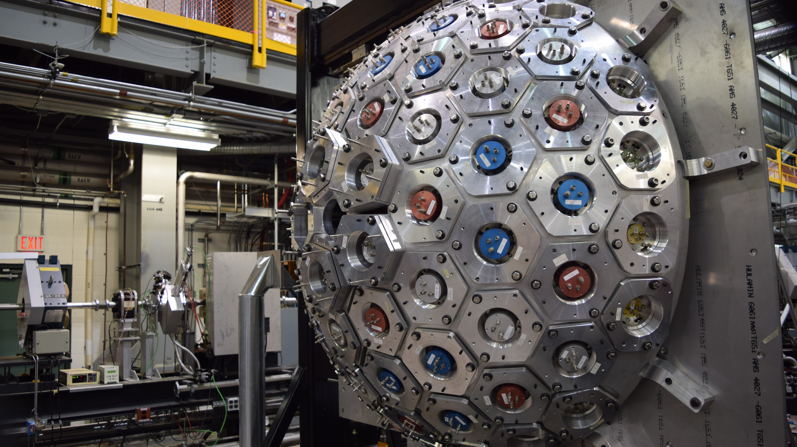
Investigating the Nuclear Shell Evolution in Neutron-Rich Calcium
Robin Coleman – University of Guelph
Nuclear Structure 2022

Slide 2
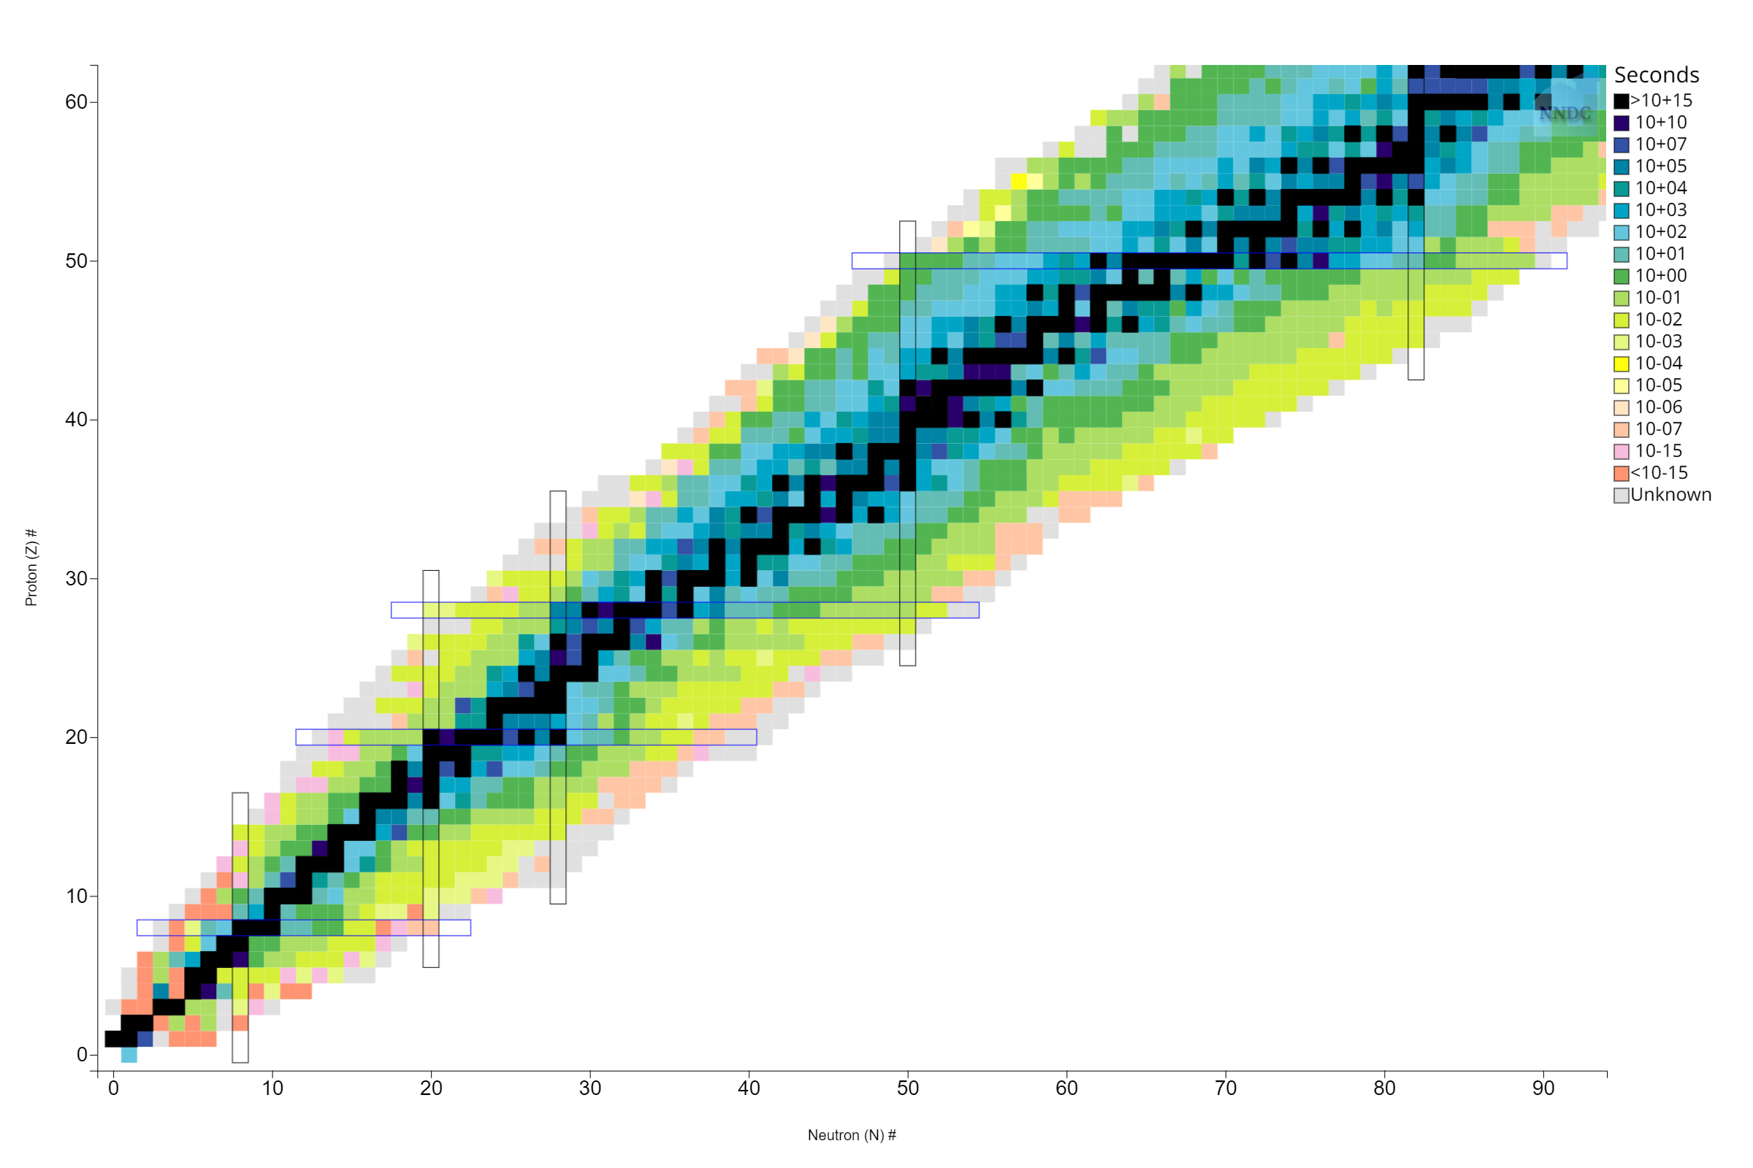
Shell Model Evolution
Single particle energies drift away from β-stability
Creates new magic numbers

Slide 3
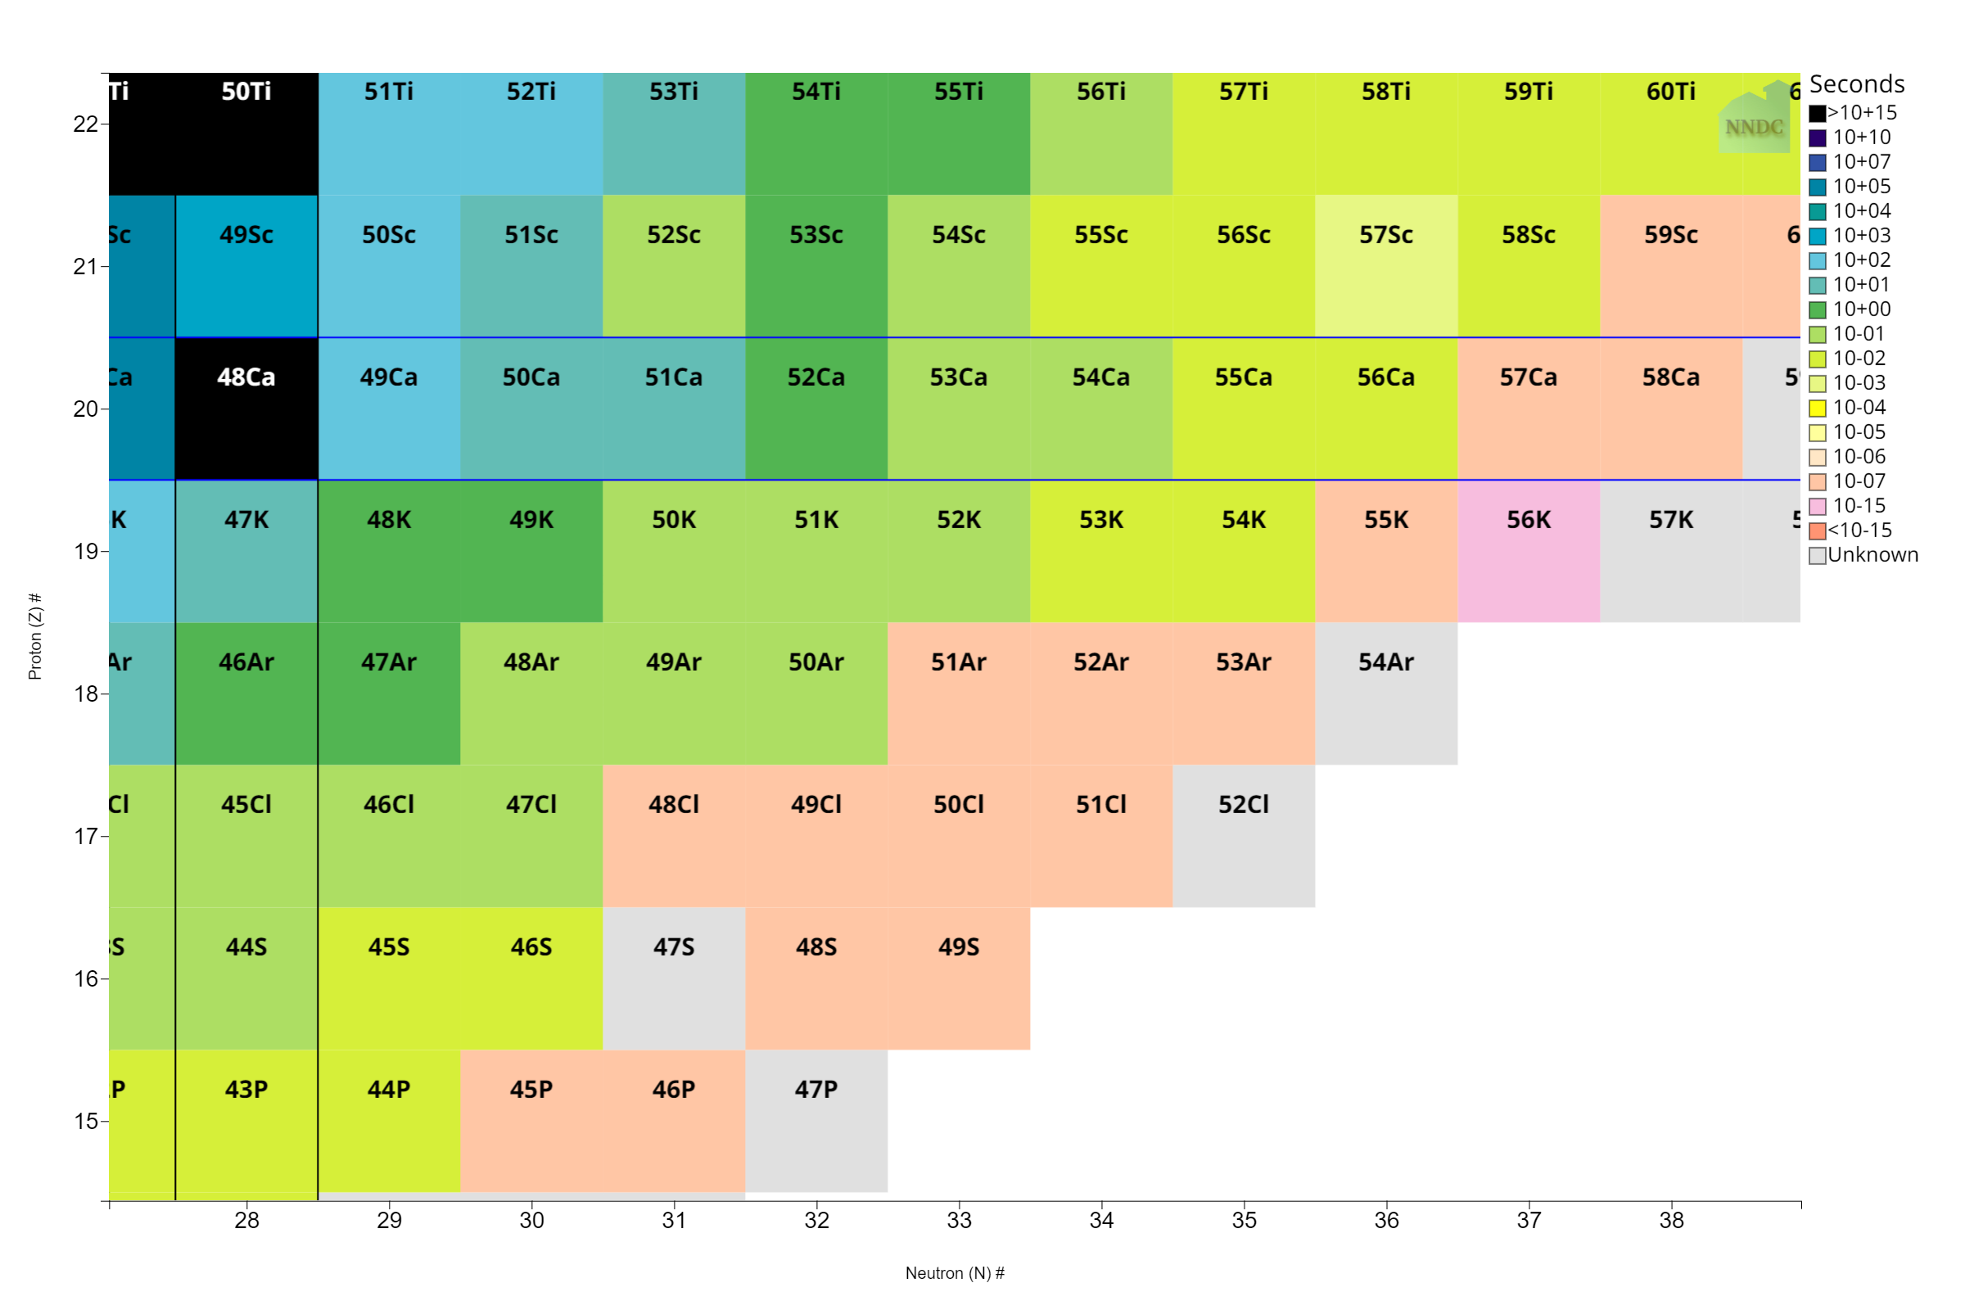
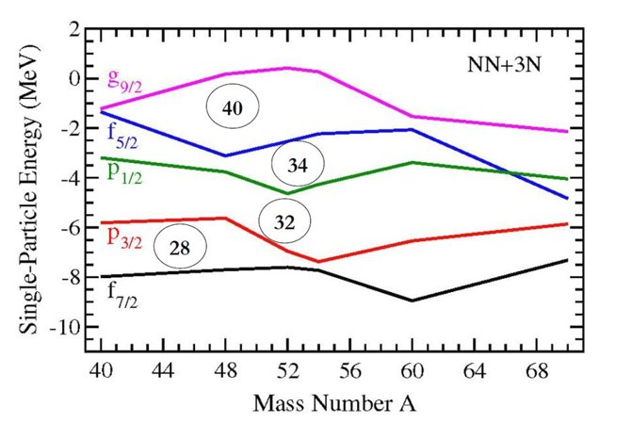
Shell Model Evolution
J. D. Holt, J. Menéndez, J. Simonis, and A. Schwenk, Physical Review C 90 (2014).​

Slide 4
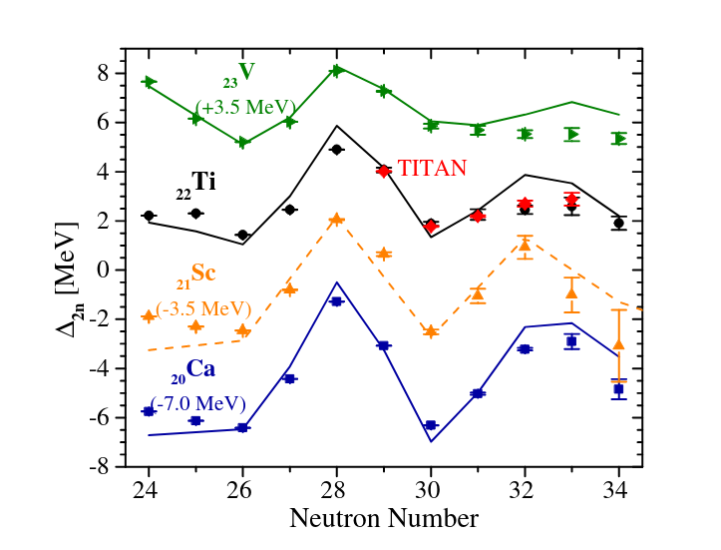
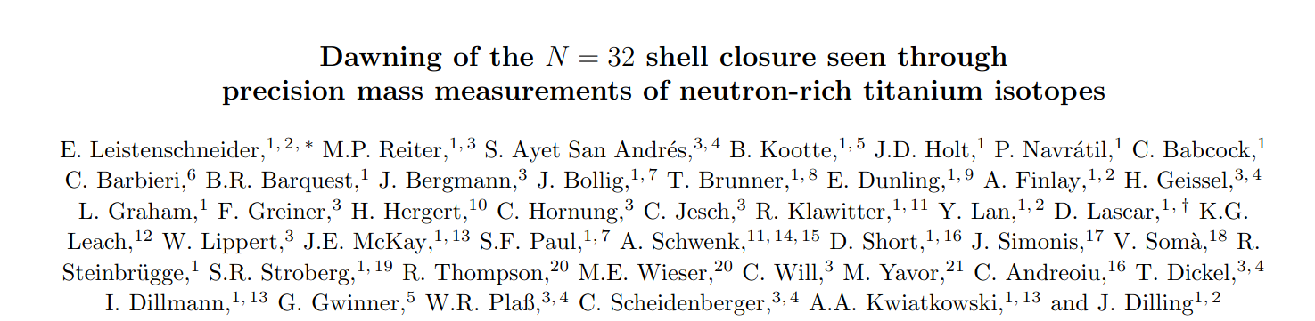
Shell Model Evolution
E. Leistenschneider et al. Phys. Rev. Lett. 120, 062503 (2018)

Slide 5
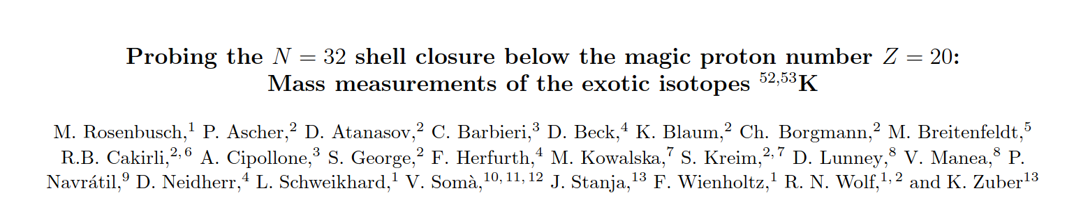
Shell Model Evolution
E. Leistenschneider et al. Phys. Rev. Lett. 120, 062503 (2018)
M. Rosenbusch et al. Phys. Rev. Lett. 114, 202501 (2015)

Slide 6
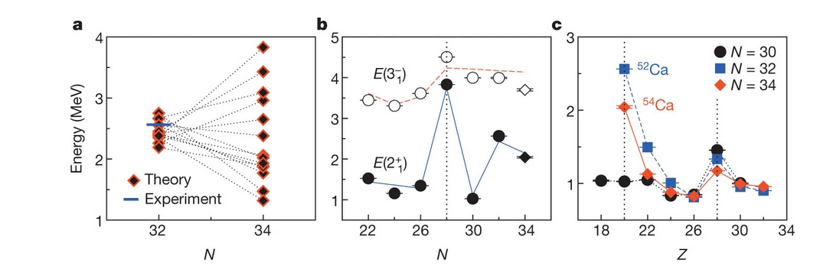
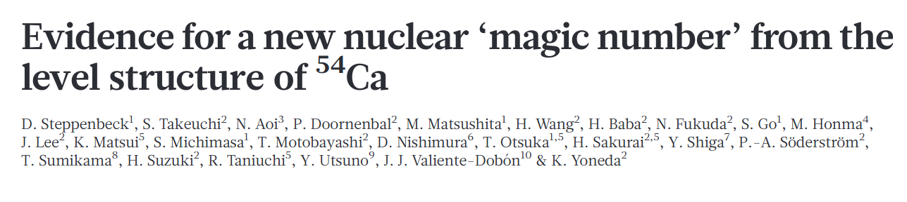
Shell Model Evolution
E. Leistenschneider et al. Phys. Rev. Lett. 120, 062503 (2018)
M. Rosenbusch et al. Phys. Rev. Lett. 114, 202501 (2015)
D. Steppenbeck et al., Nature 502, 207 (2013).

Slide 7
Shell Model Evolution
Clear evidence for a new shell closure at N=32 and sub-shell closure at N=34

Slide 8
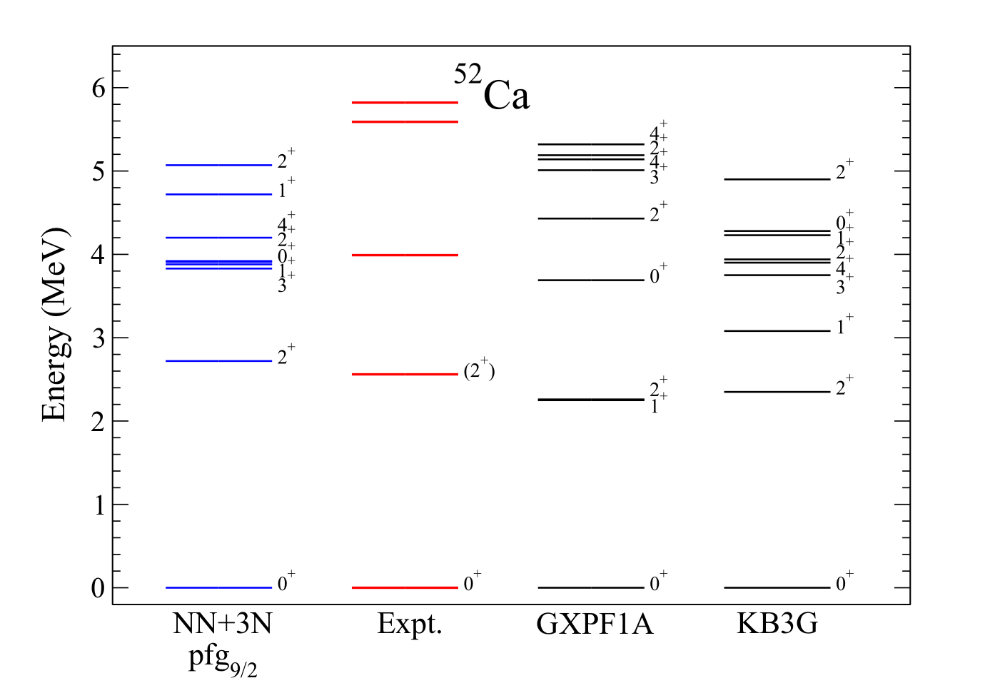
Shell Model Evolution
Various Interactions can describe this behavior
Phenomenological models require spectroscopic validation
J. D. Holt, J. Menéndez, J. Simonis, and A. Schwenk, Physical Review C 90 (2014).​

Slide 9
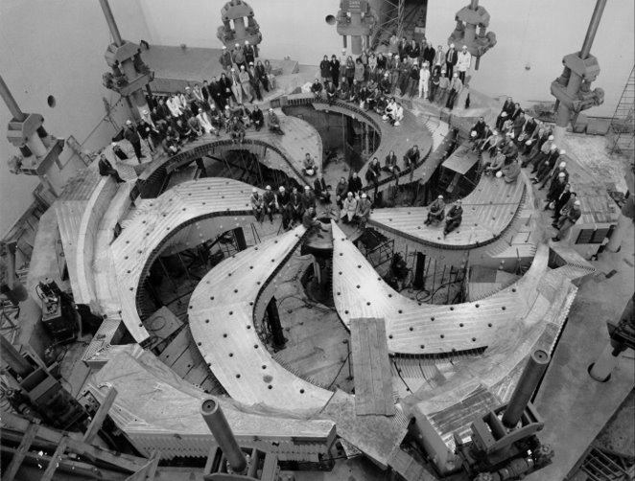
TRIUMF
TRI-University Meson Facility
Isotope Separation On Line (ISOL) Facility
520 MeV Cyclotron
UCx Target
“GRIFFIN Collaboration,” triumf.ca

Slide 10
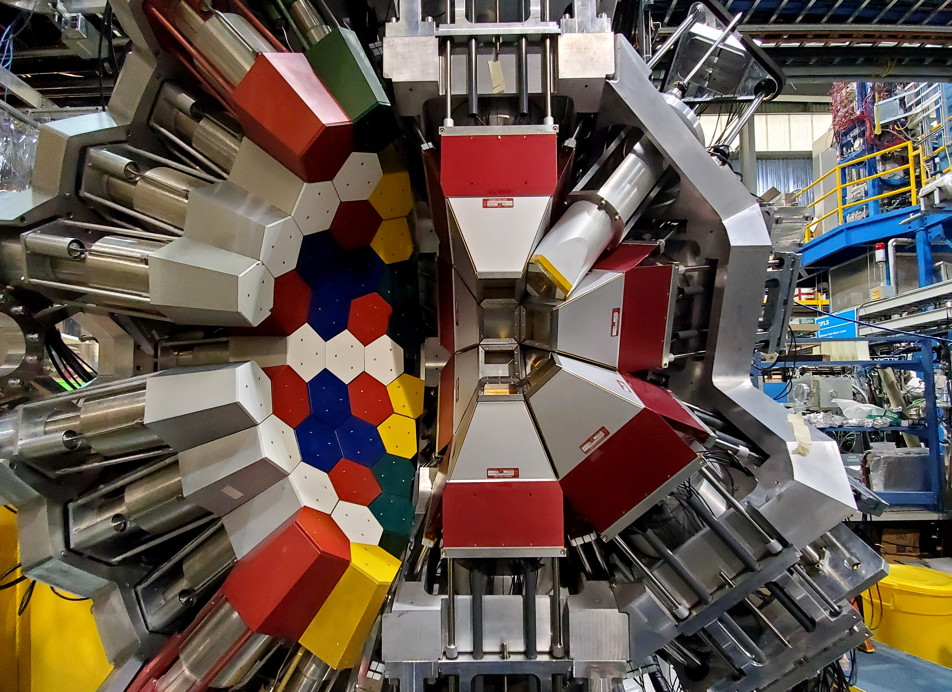
GRIFFIN + DESCANT
Gamma-Ray Infrastructure For Fundamental Investigation of Nuclei (GRIFFIN)
  12 HPGe clover detectors
DEuterated SCintillator Array for Neutron-Tagging (DESCANT)
  69 detectors installed downstream

Slide 11
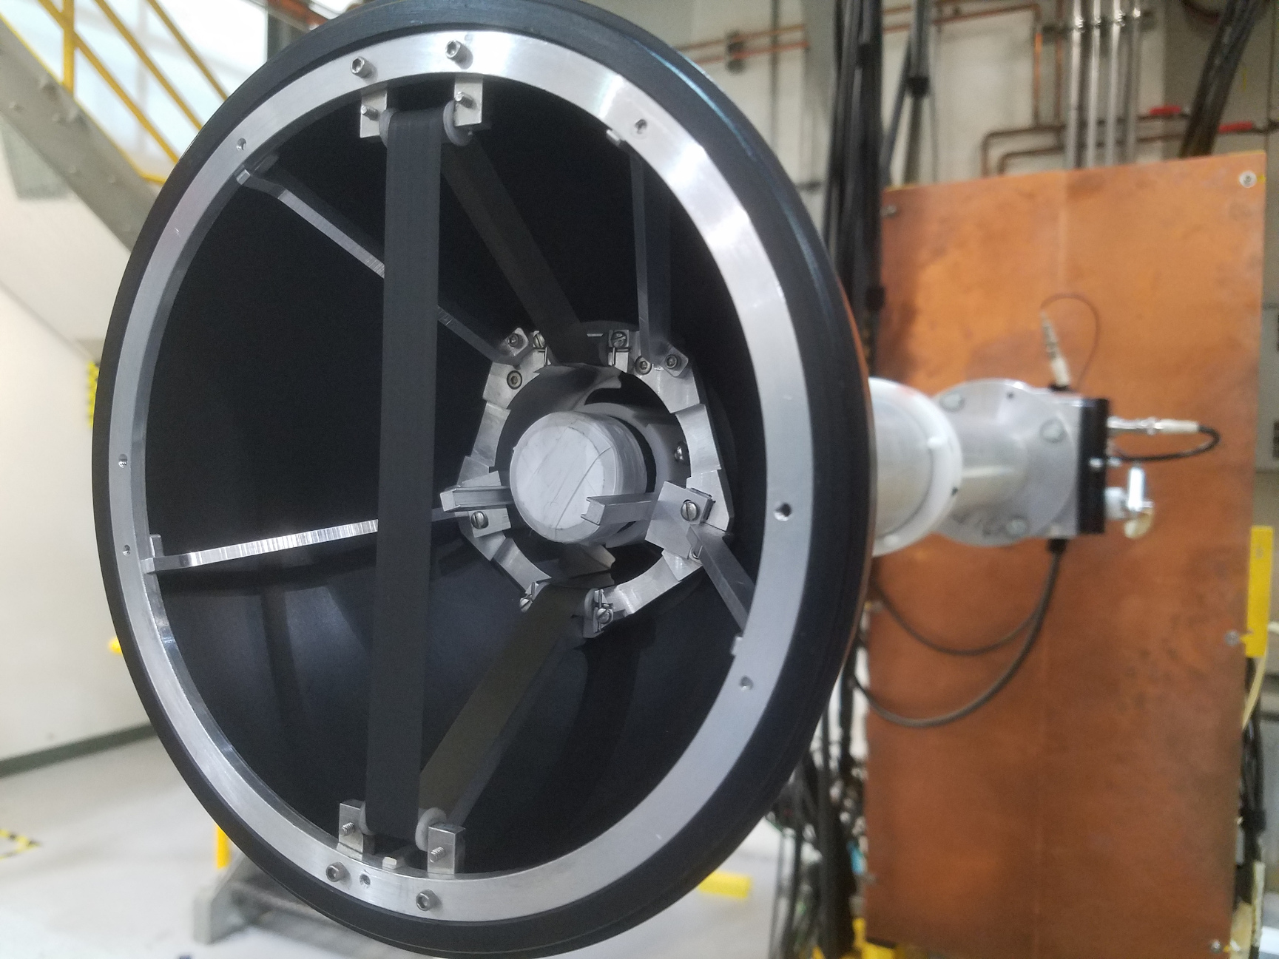
Beta Detectors
Beta Detectors
  SCintillating Electron Positron Tagging ARray (SCEPTAR)
  Zero Degree Scintillator (ZDS)
Isotopes Delivered
  ⁵²K ~ 200pps
  ⁵³K ~ 20 pps
  ⁵⁴K ~ 2 pps

Slide 12
Isotopes Produced
⁵¹Cr
⁵²Cr
Neutron emission probabilities are >70% for all potassium isotopes delivered
Large Q-value of beta-n branch can kick some of the daughter nuclei out of mylar tape
⁵¹V
⁵²V
Beta Decay
Neutron Emission
⁵⁰Ti
⁵¹Ti
⁵²Ti
⁵⁰Sc
⁵¹Sc
⁵²Sc
⁵⁰Ca
⁵¹Ca
⁵²Ca
⁵²K

Slide 13
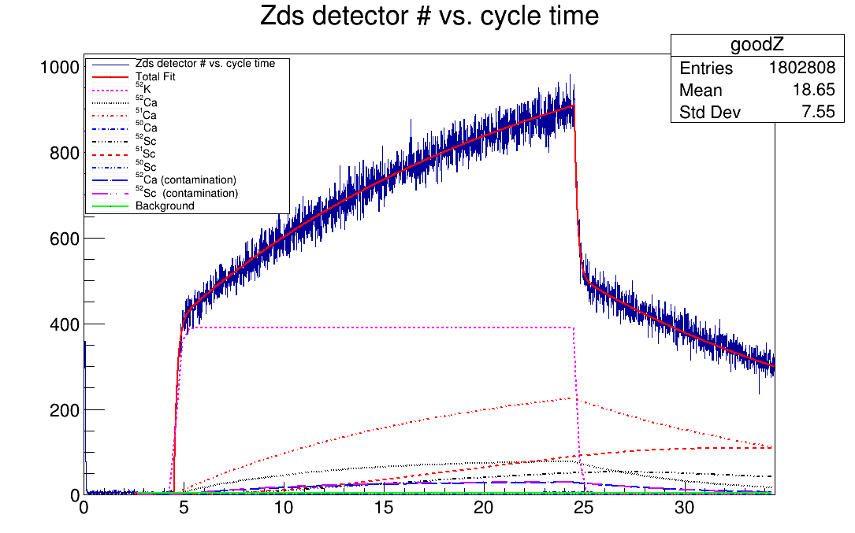
Beta Data
Dependent on
  Half lives
  β-n probabilities
  Relative efficiencies for nuclei
Cycle Time (s)

Slide 14
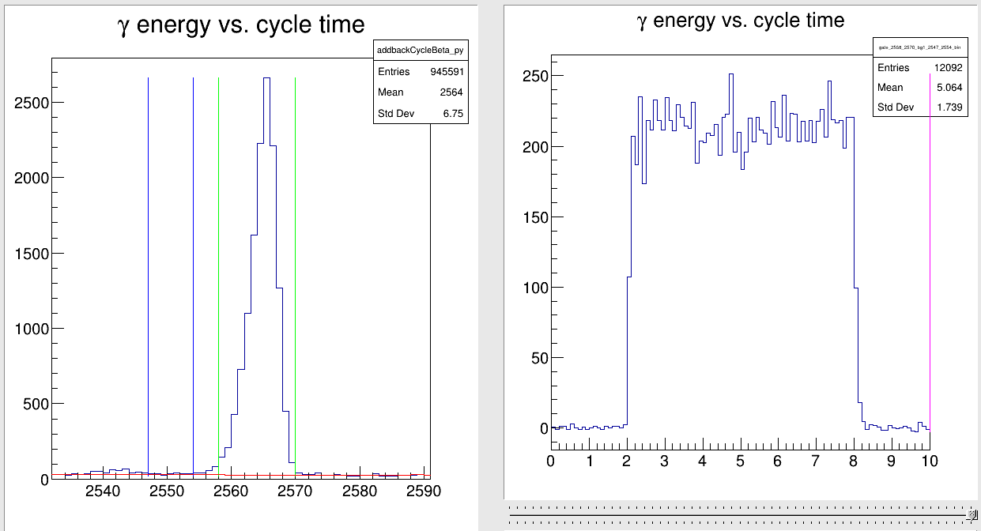
Beta Data
Dependent on
  Half lives
  β-n probabilities
  Relative efficiencies for nuclei

Slide 15
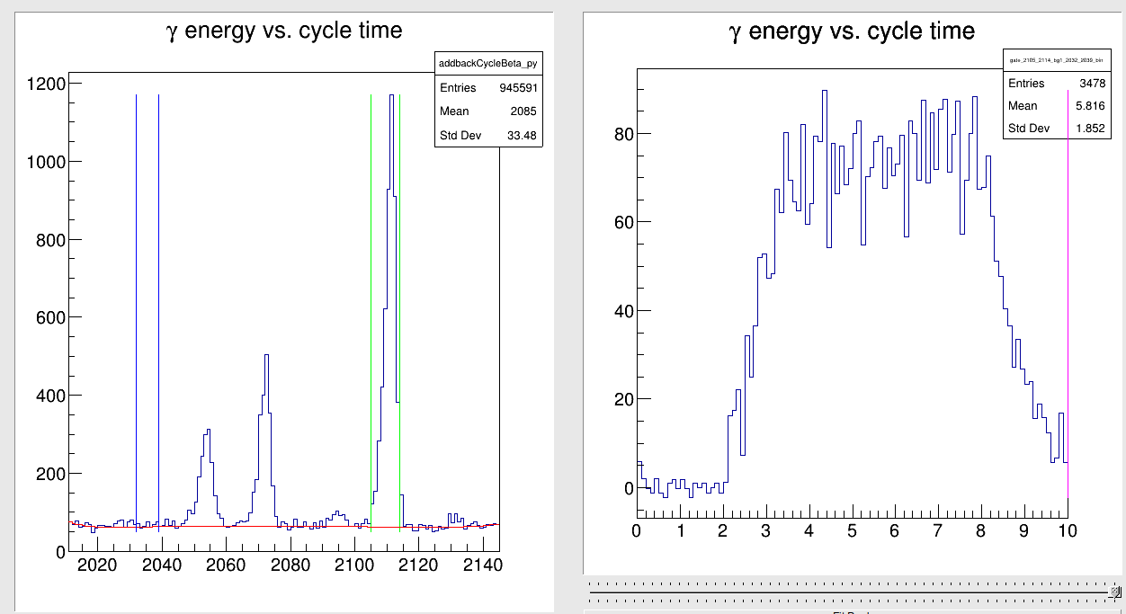
Beta Data
Dependent on
  Half lives
  β-n probabilities
  Relative efficiencies for nuclei

Slide 16
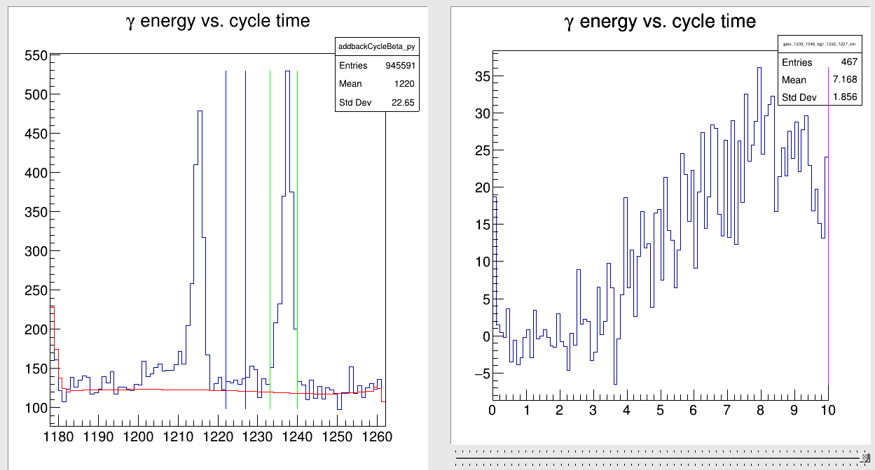
Beta Data
Dependent on
  Half lives
  β-n probabilities
  Relative efficiencies for nuclei

Slide 17
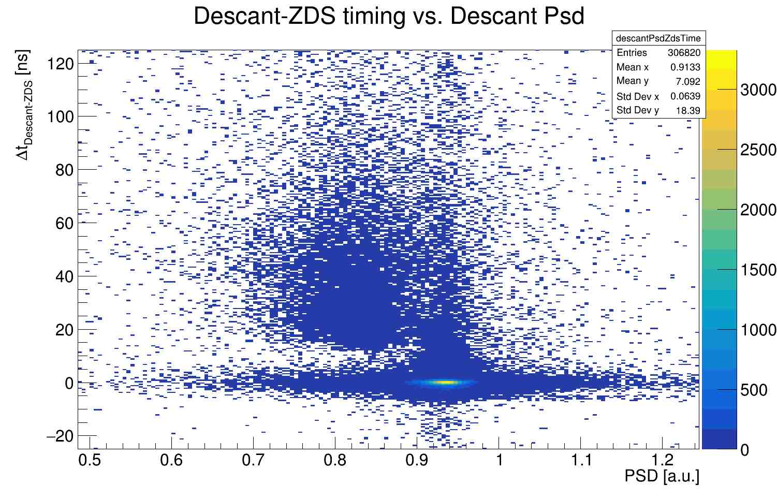
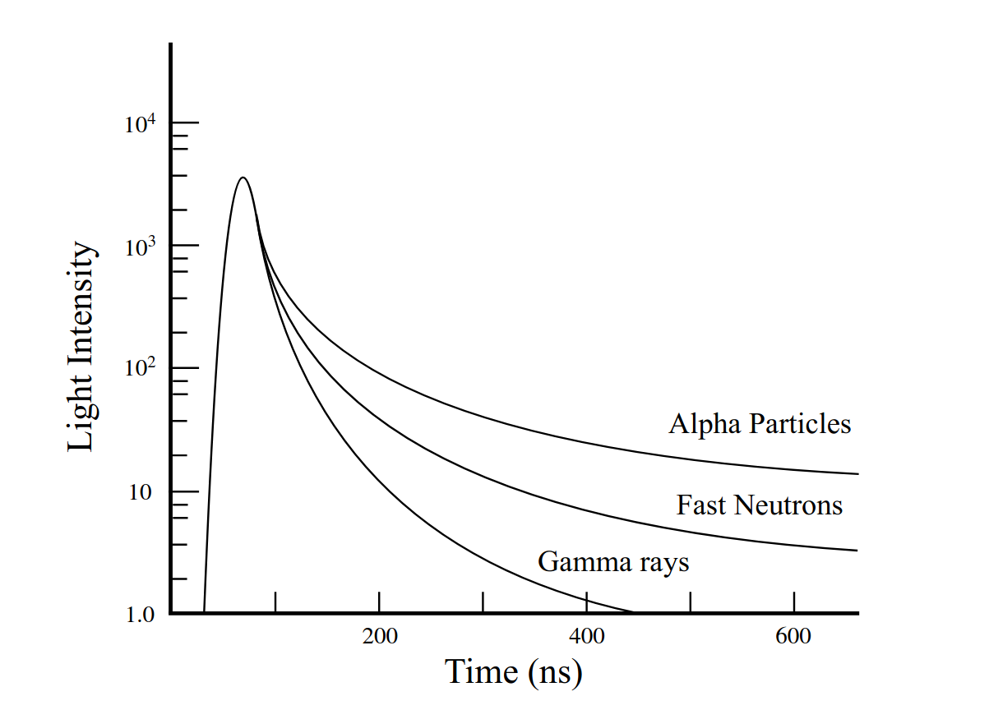
Neutron Selection
Time of Flight
  ZDS starts the clock
Pulse Shape Discrimination

Slide 18
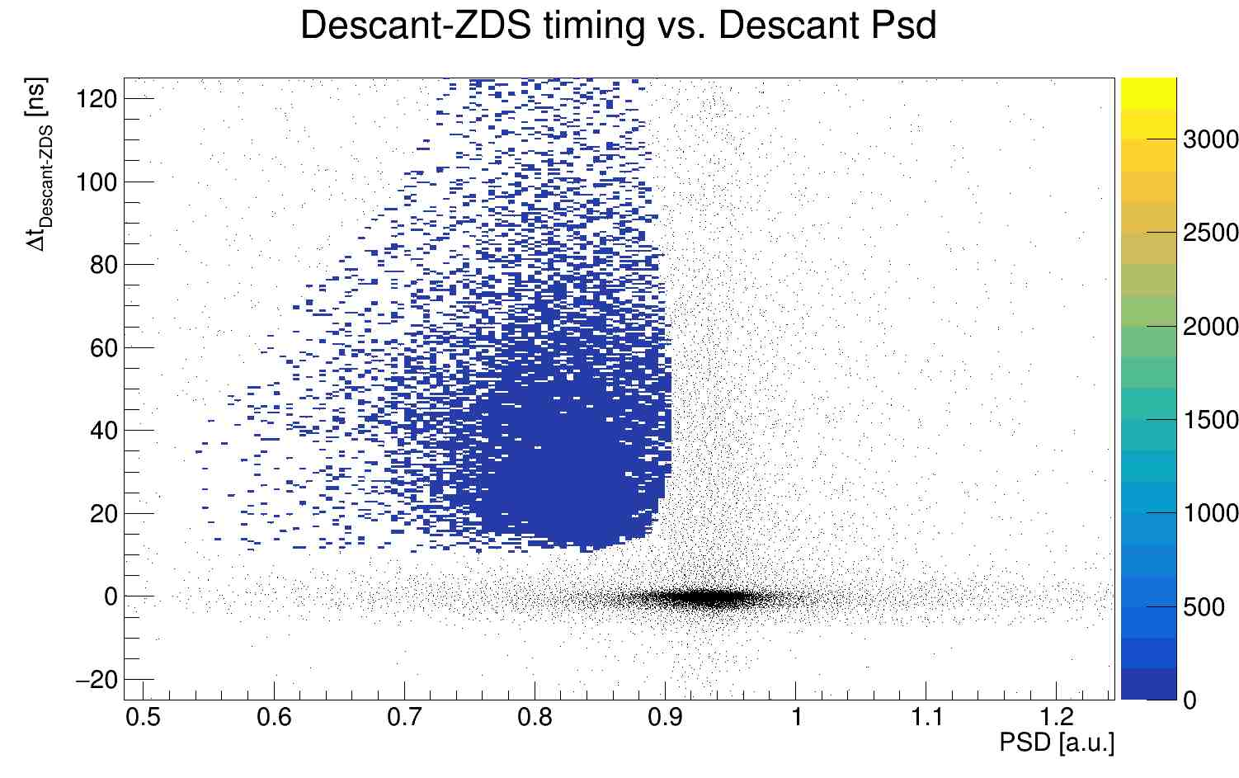
Neutron Selection
Time of Flight
  ZDS starts the clock
Pulse Shape Discrimination

Slide 19
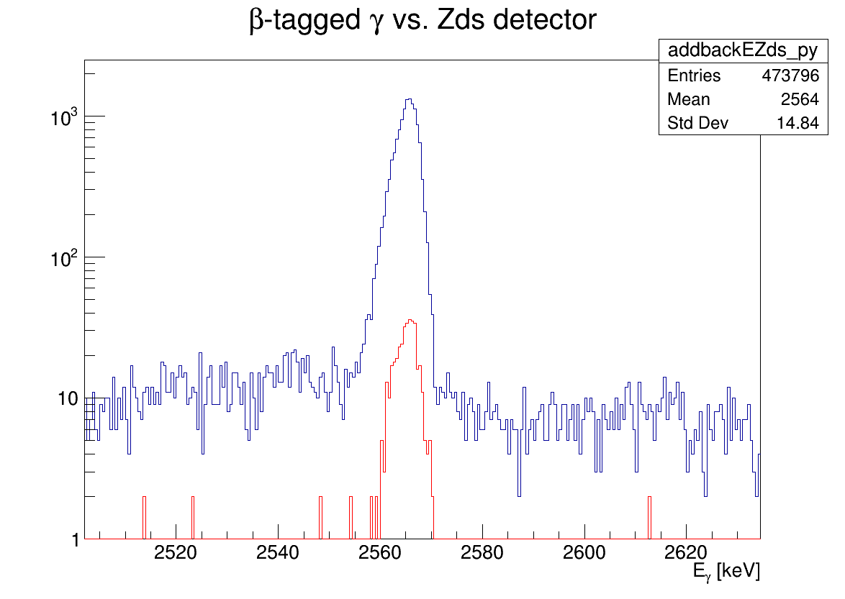
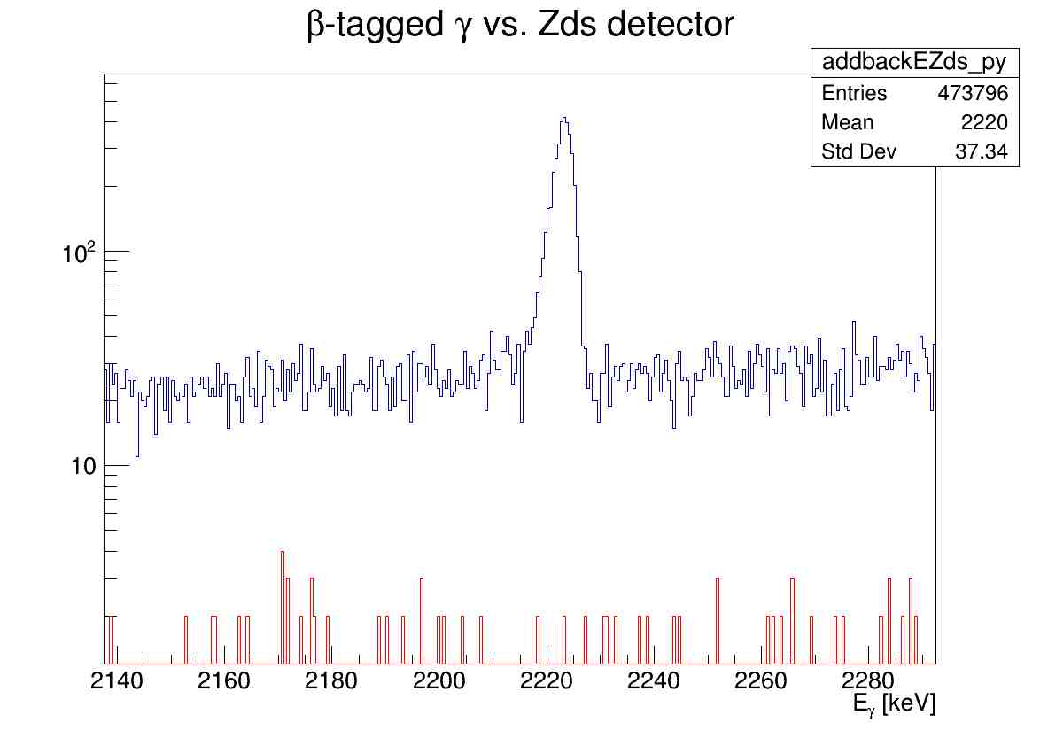
GRIFFIN Results
⁵³K Beam
⁵²Ca Peak
ZDS tagged
⁵³K Beam
⁵³Ca Peak
ZDS tagged
Neutron tagged
Neutron tagged

Slide 20
Level Schemes

Slide 21
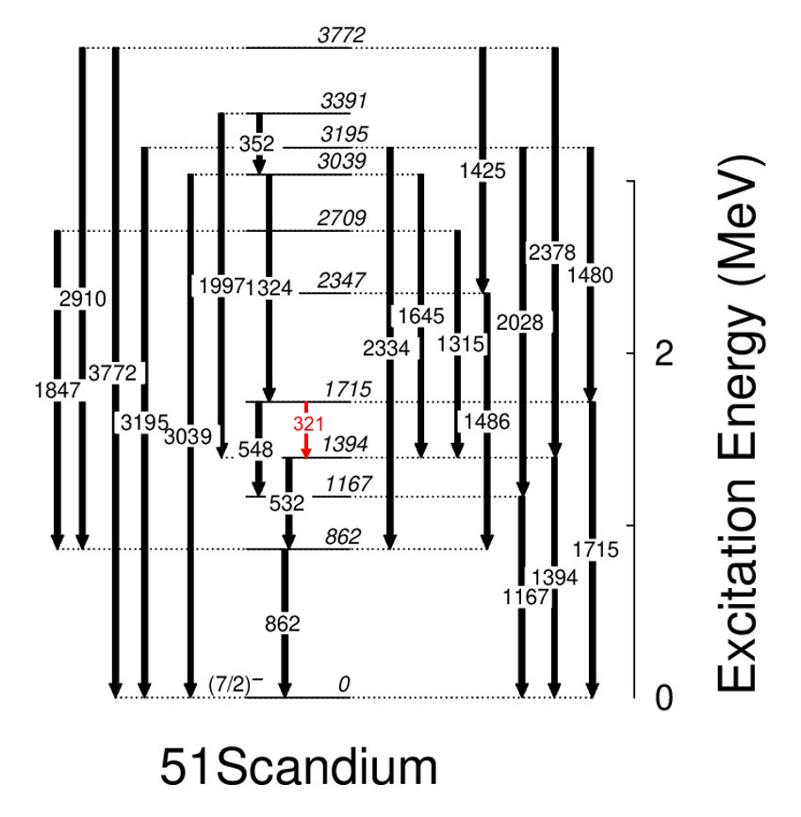
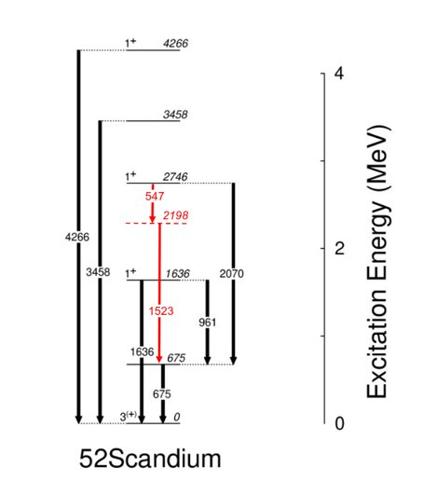
Level Schemes
⁵¹Sc
⁵²Sc

Slide 22
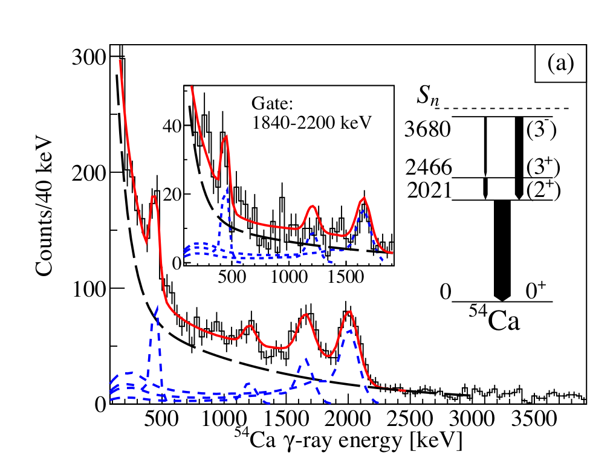
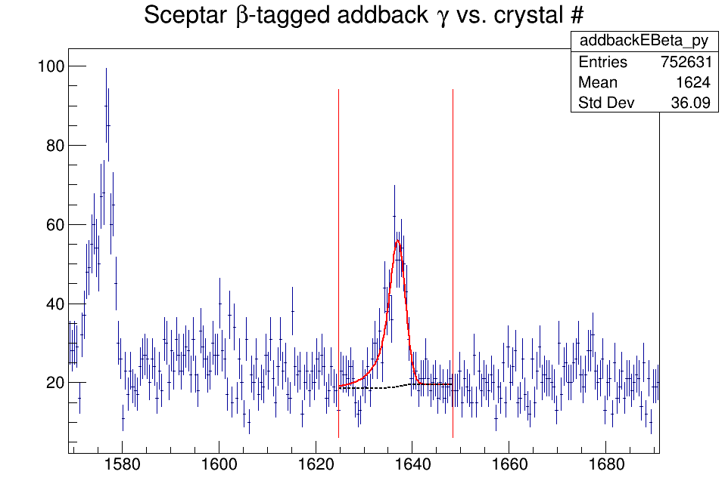
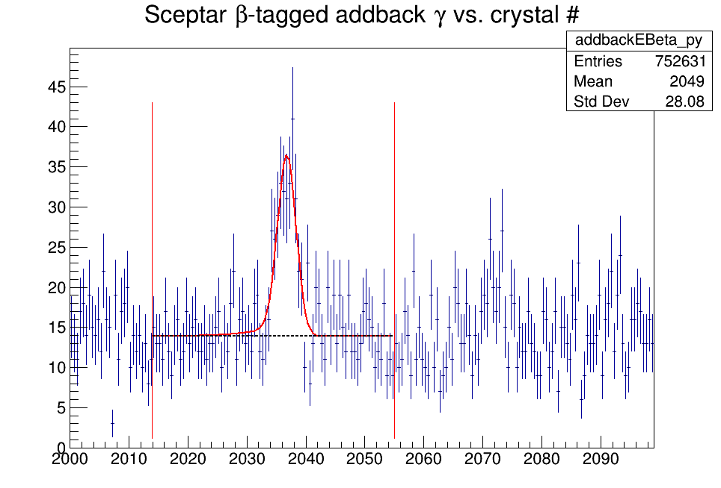
Shell Model Evolution
F. Browne et al. PHYSICAL REVIEW LETTERS 126, 252501 (2021)

Slide 23
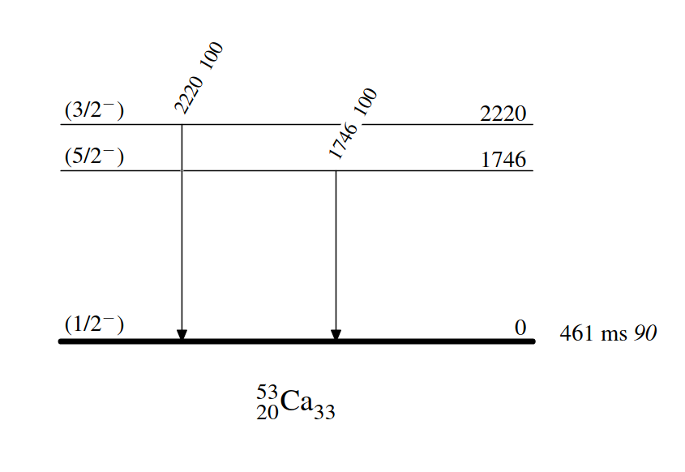
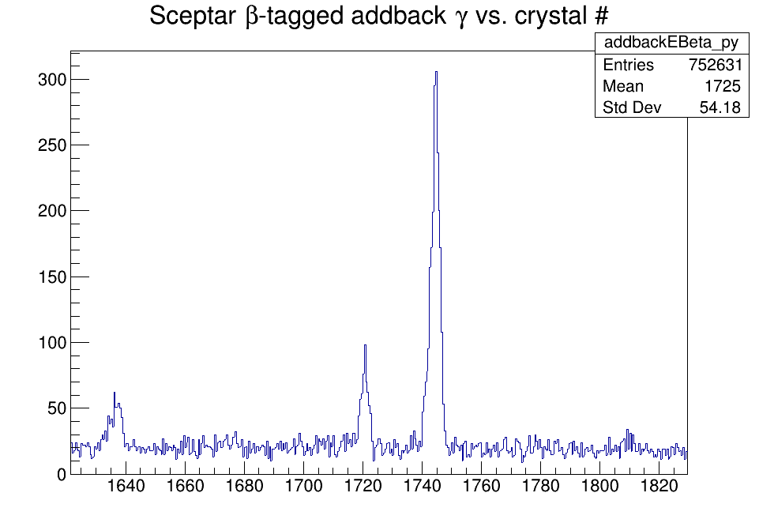
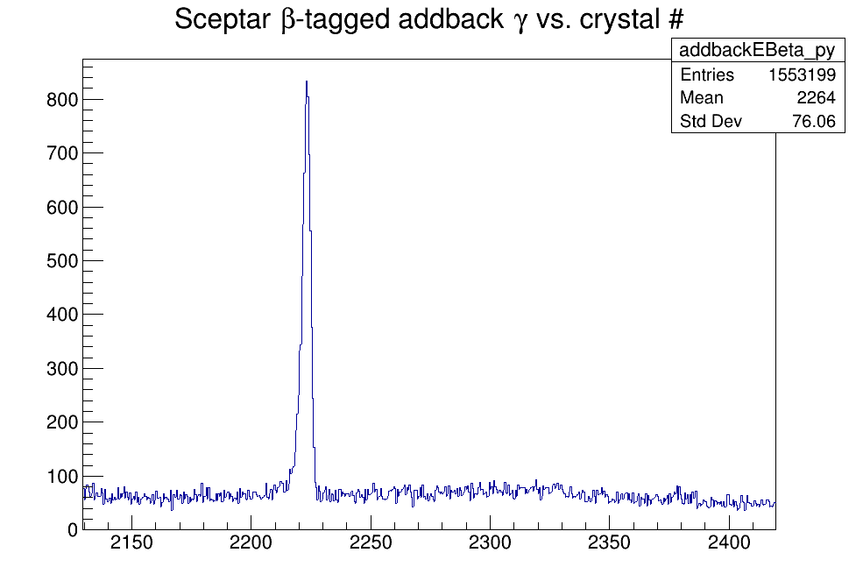
Level Schemes
54K
⁹Be(⁵⁵Sc,⁵³Caγ)
Source: ENSDF
53K

Slide 24
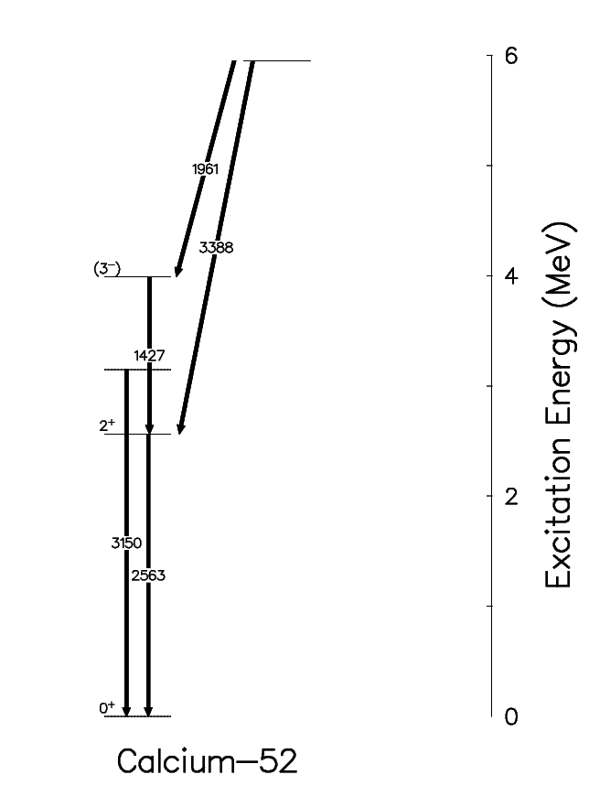
Shell Model Evolution
5951
5034
4102
PRELIMINARY
3990
3153
2563
2563
⁵²Ca

Slide 25
Summary and Next Steps
5951
Expanded Level Schemes
  ⁵²Ca
  Scandium Isotopes
Beta and Beta-n population of states in ⁵³Ca and ⁵⁴Ca
Next Steps
  Assign Spins where possible through angular correlations
Adapted from J.D. Holt, J. Menéndez, J. Simonis, and A. Schwenk, Physical Review C 90 (2014).​

Slide 26





Acknowledgements
G.C. Ball
S.S. Bhattacharjee
G. Carpenter
A.B. Garnsworthy
C. Griffin
R.S. Lubna
R. Lafleur
B. Olaizola
C. Paxman
C. Porzio
V. Vedia
D. Yates
C. Andreoiu
F.H. Garcia
M.S. Martin
K. Whitmore
F. Wu
G.F. Grinyer
S. Sharma
A. Talebitaher
M. Hanley
C.R. Natzke
F. Sarazin
S. Shadrick
C.E. Svensson
H. Bidaman
V. Bildstein
S. Buck
P.E. Garret
A.T. Laffoley
A.D. MacLean
A.J. Radich
M. Rocchini
T. Zidar

Slide 27
Thank You
Any Questions?

Slide 28
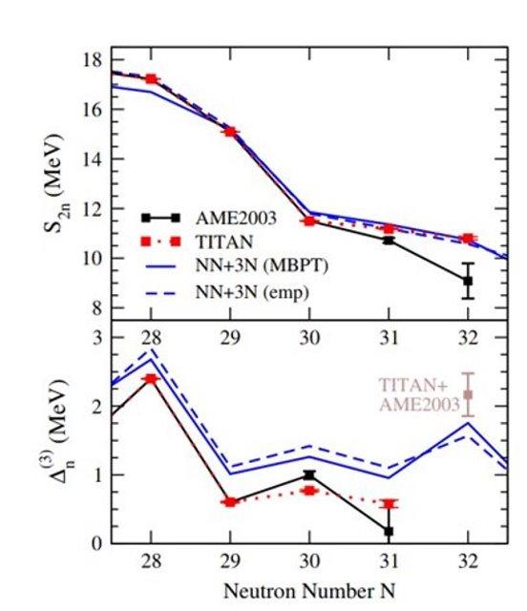
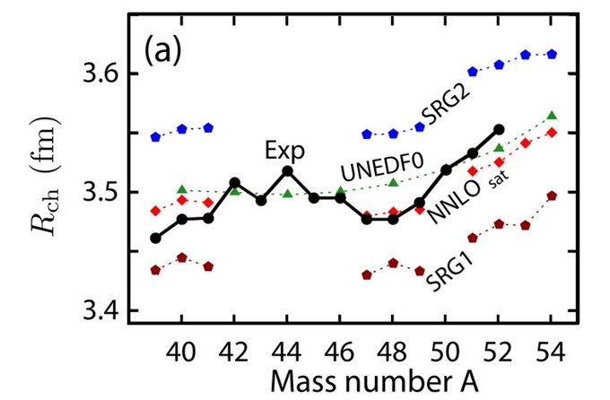
Observables
R.F. Garcia Ruiz et al., Nature 12, 594 (2016).​
A. T. Gallant et al. Physical Review Letters 109, 032506 (2012)​

Slide 29
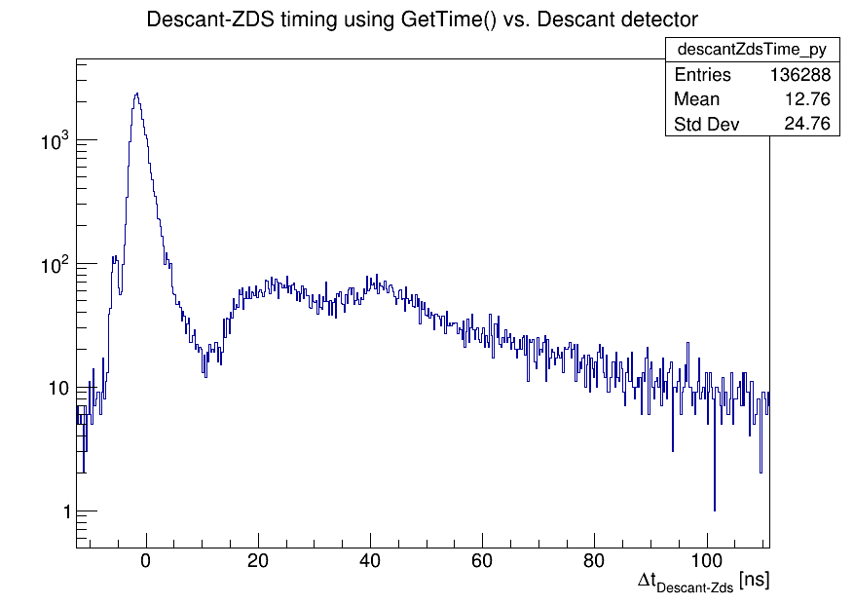
DESCANT ToF
53K Data
Target to Detector Distance: 50cm
18 ns ~ 4 MeV
24 ns ~ 2.5 MeV
40 ns ~ 0.8 MeV
Qβ-Sn = 9.1 MeV

