Slide 1
Example Projects: FRIB ECR and LCLS II Undulators
D. Arbelaez
Lawrence Berkeley National Laboratory

Slide 2
Introduction
Considerable project experience within BCMT with a wide range of project size and scope
Recent examples of projects for other facilities:
FRIB ECR source magnet (~$2.5M)
  Sextupole magnet inside of structure containing three solenoid coils
  Design, fabrication (mostly at LBNL), and testing done at LBNL
  Magnet was shipped to FRIB in Dec. 2017
LCLS-II undulators (~$40M)
  LBNL is in charge of design, fabrication, and tuning (for ~ 1/3) of the undulators for the LCLS-II facility at SLAC
  21 Soft X-Ray + 32 Hard X-ray Undulators
  Design and prototyping was performed at LBNL
  Fabrication of undulators is done in industry
  Undulators are tuned at LBNL, SLAC, and ANL
  Undulator production is ~80% complete (all units will be done in March 2019)

Slide 3
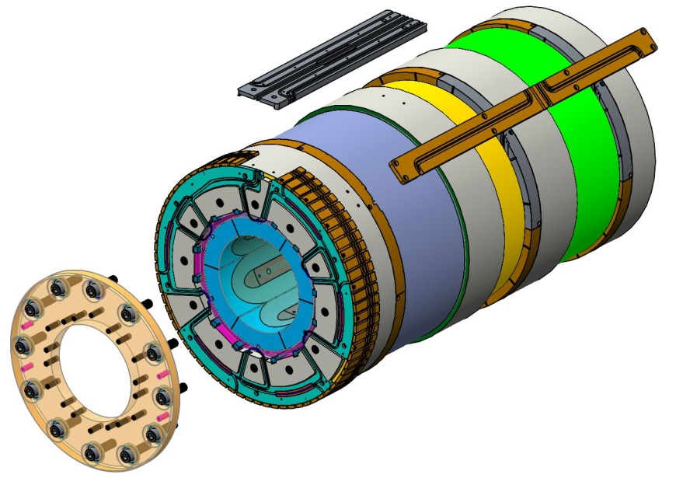
Description Of FRIB ECR Source Magnet
NbTi Sextupole-in-solenoid configuration similar to VENUS source at LBNL
Implementation of shell based structure with bladder-and-key loading method
  Provides pre-load to the sextupole coils which experience asymmetric forces at ends due to solenoid field
  Allows for fine tuning of magnet pre-load
  Allows for assembly and dissasembly of magnet
Shell also acts as winding mandrel for the three solenoids
Four independent power supplies
Extraction Solenoid
Minimum Solenoid
Injection Solenoid
Sextupole coils
End pre-load plate

Slide 4
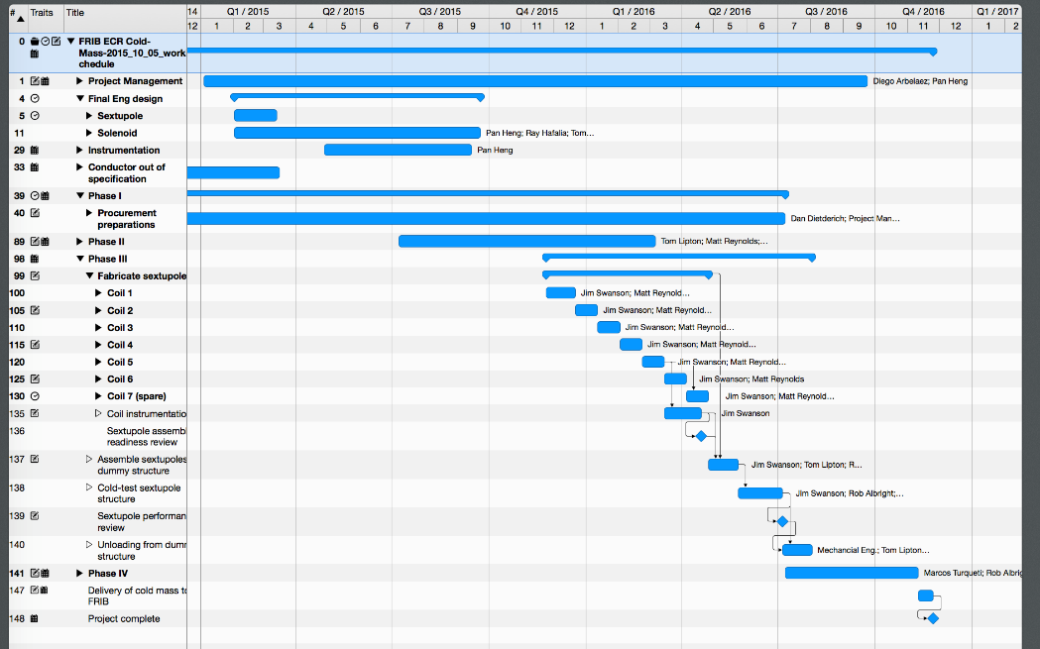
Project Organization
Resource loaded schedule with milestones
Weekly meetings with FRIB group
Monthly meetings with FRIB and LBL management
Tracked variances and work complete on project schedule
Contingency held by FRIB project (used ~10% out of 30%)

Slide 5
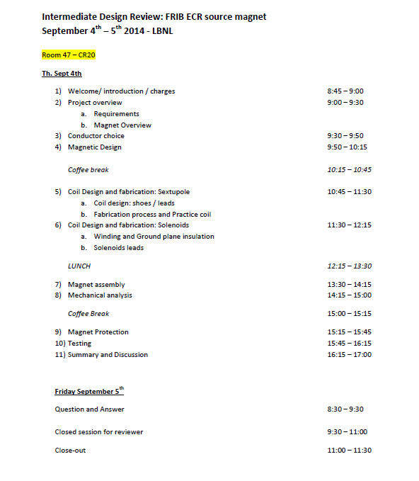
Project Reviews
Conceptual and Final Design Reviews were held covering:
  Conductor choice
  Magnetic design
  Coil design and fabrication
  Magnet Assembly
  Mechanical Analysis
  Magnet Protection
  Testing

Slide 6
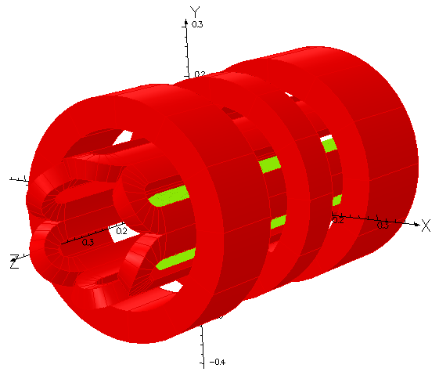
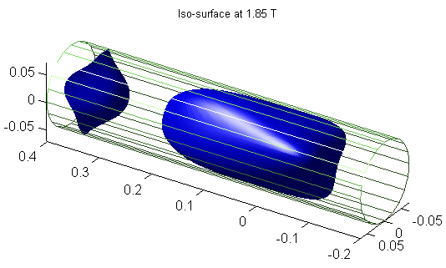
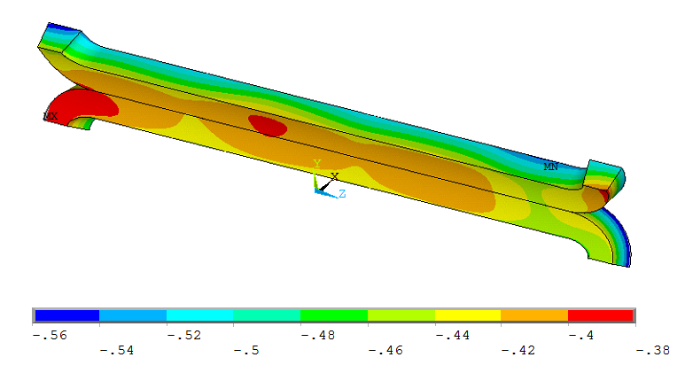
Magnet Design Performed At LBNL
Magnetic and mechanical FEA
CAD design and drawings (released in version controlled Windchill system)
Magnetic Model
Iso-Surface Calculation
Mechanical Model

Slide 7
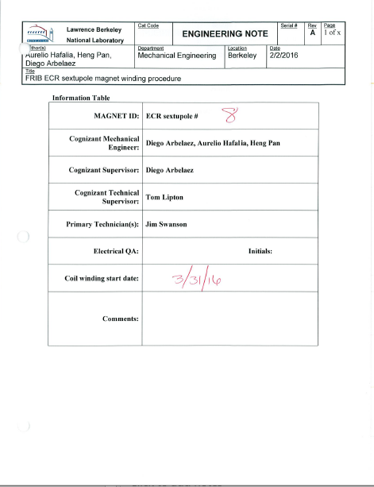
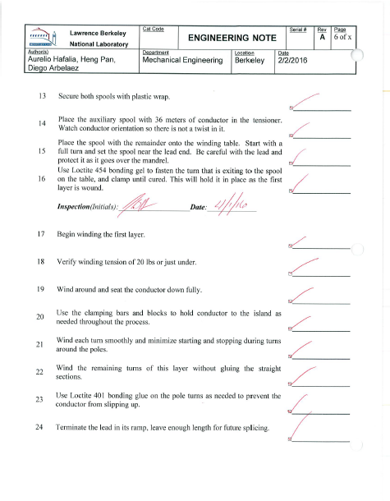
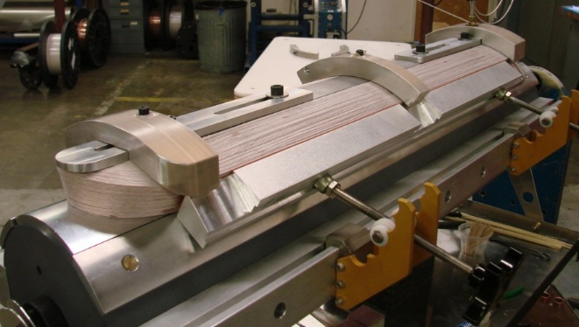
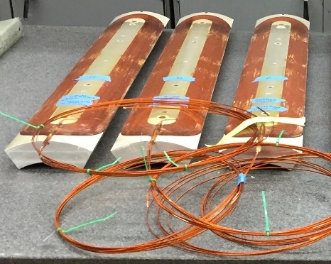
Sextupole Coil Fabrication
Practice coil was used to develop procedures and to identify possible issues early on
Existing coil winding and potting infrastructure was used
Work instructions and travelers were produced to control the winding process
Coil Winding
Finished Coils

Slide 8
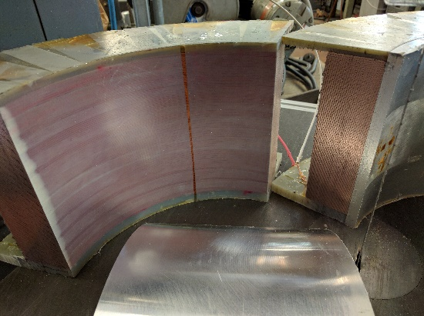
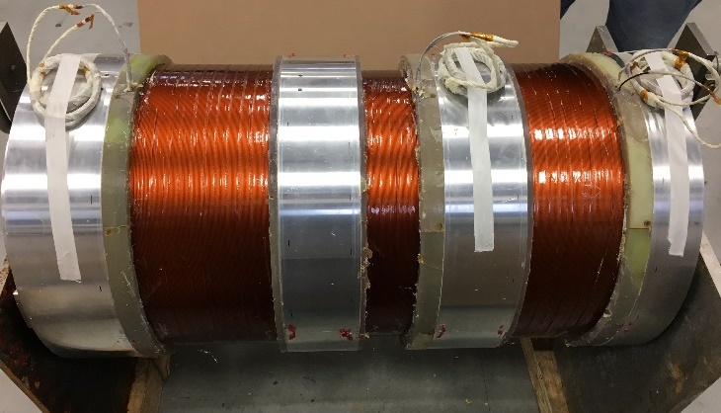
Solenoid Fabrication
Winding mock-up done at LBL to understand winding process and develop slip-plane procedures
Solenoid winding and impregnation was performed by an outside company (Everson Tesla)
Build to print contract
Close interaction with the vendor including visits and phone meetings
Cross-section of mock-up coil
Completed Solenoids at Vendor Facility

Slide 9
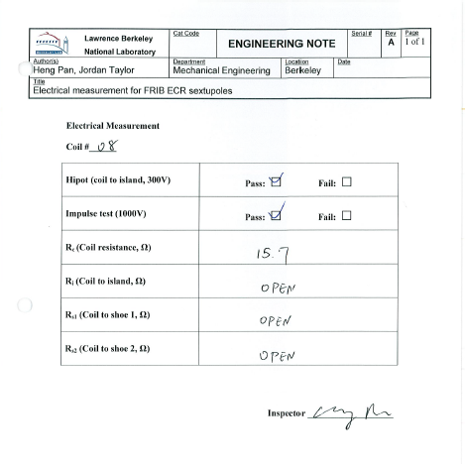
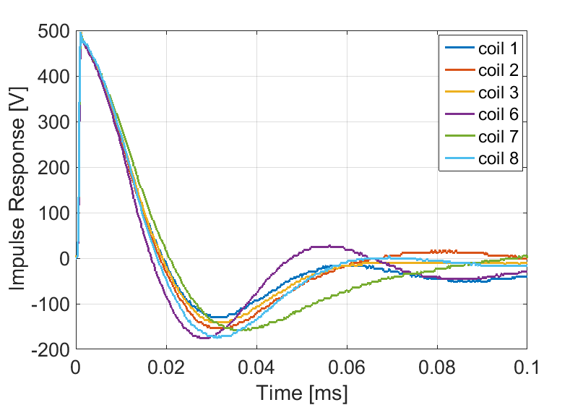
QA Procedures
Electrical QA procedure was performed on all coils
Values were recorded on sign-off sheet and relevant data is recorded and stored
Initial measurements were found to be insufficient to identify small electrical problems (turn-to-turn shorts)
Implemented more stringent testing after finding electrically “weak” coil
Impulse Test

Slide 10
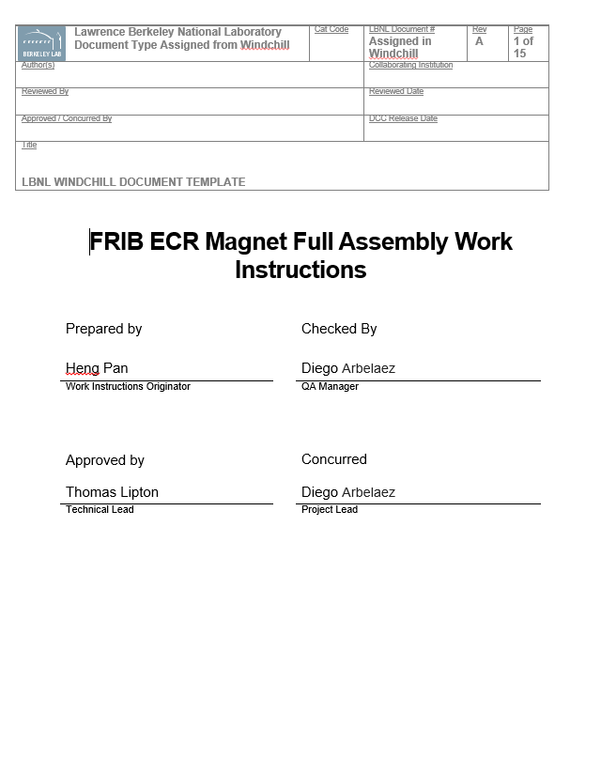
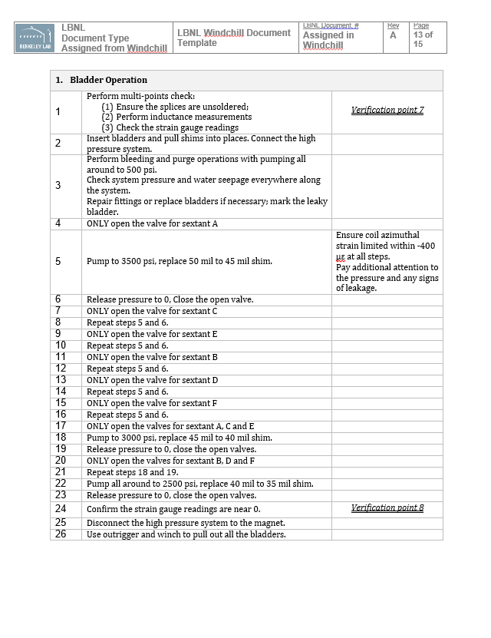
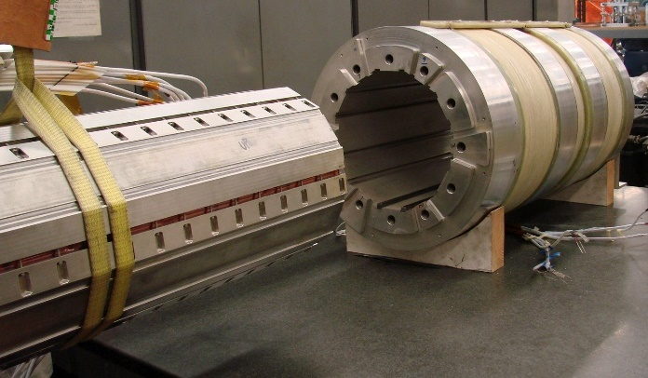
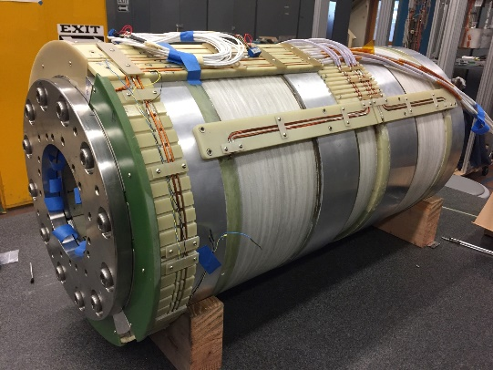
Assembly
Magnet Assembly was performed at LBL
Available infrastructure for magnet loading was used
Written procedures with check-points were developed and used for the process

Slide 11
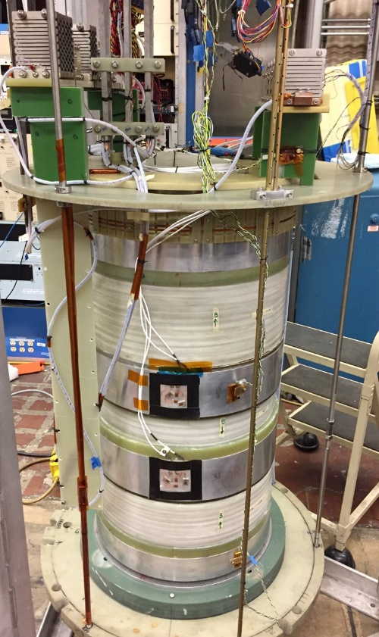
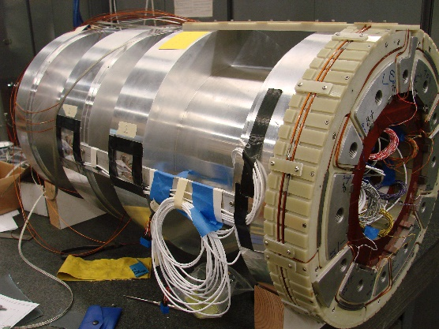
Magnet Tests
Test #1: Test of only sextupoles was first performed to verify the sextupole performance as early as possible in the project
  “Weak” Coil was replaced due to excessive training after this test
Test #2: Full magnet test including solenoids was performed with replacement coil
  The magnet exceeded the magnetic field requirements, however the replacement coil showed anomalous electrical behavior
Test #3: Full magnet test with final coils
  The magnet exceeded the magnetic field requirements and showed no anomalous behavior

Slide 12
Magnetic Field Requirements Are Satisfied
Delivered a 28GHz ECR source magnet meeting magnet performance specifications
  Phase I: Design effort
  Phase II: coil prototype and final design
  Phase III: final magnet fabrication and test
Issues encountered, but addressed and delivered within budget and on schedule
Magnetic Field Measurements
I_{sext} = 450 A
I_{inj} = 215 A
I_{min} = 172 A
I_{ext} = 215 A

Slide 13
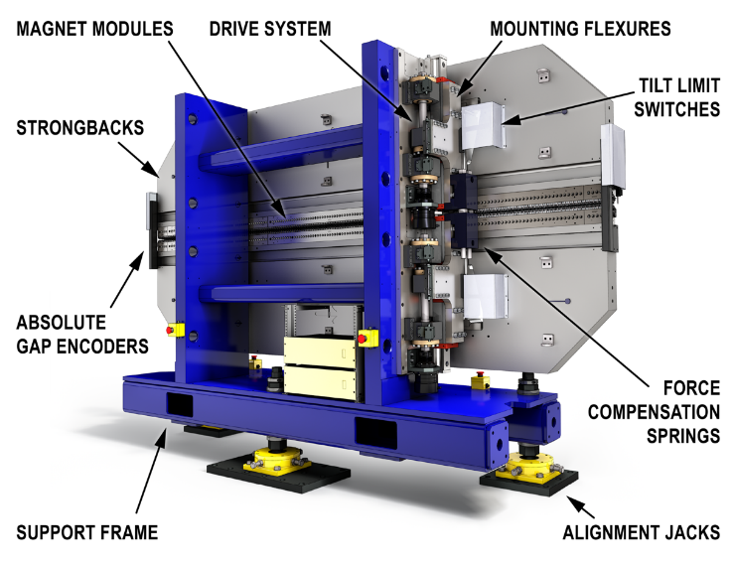
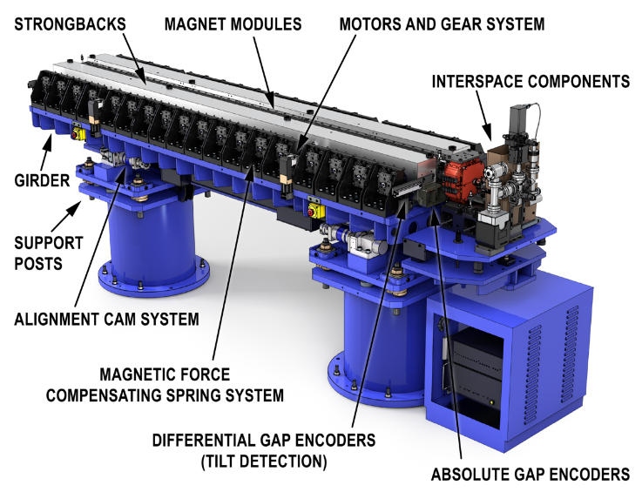




LBNL Supplies 21 Soft X-Ray And 32 Hard X-Ray Production Undulator Segments To LCLS-II
SXR – Completed
HGVPU – In Production

Slide 14
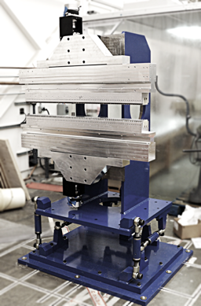
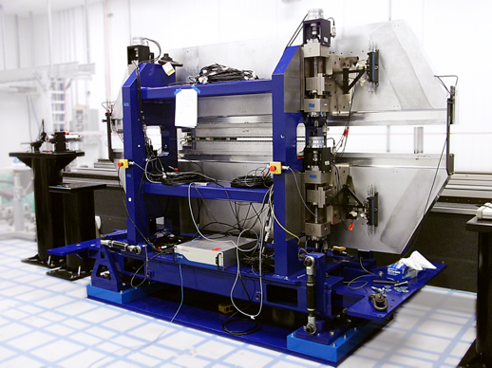
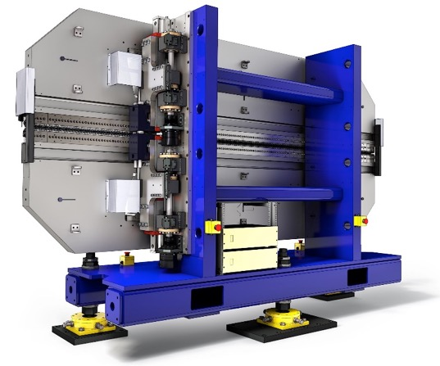
LBNL Has Followed A Rigorous Validation And Prototyping Path Followed By Transfer Of Knowledge To Fabrication Vendors
Small-Scale Prototype
Undulator Prototype (“HXU-32”)
Final Design
2013
2014 / 2015
HGVPU Prototype was designed and built at ANL
HXR period: 26 mm (Production Undulator)
HXU-32 period: 32 mm (Prototype Undulator)
SXR period: 39 mm (Production Undulator)

Slide 15
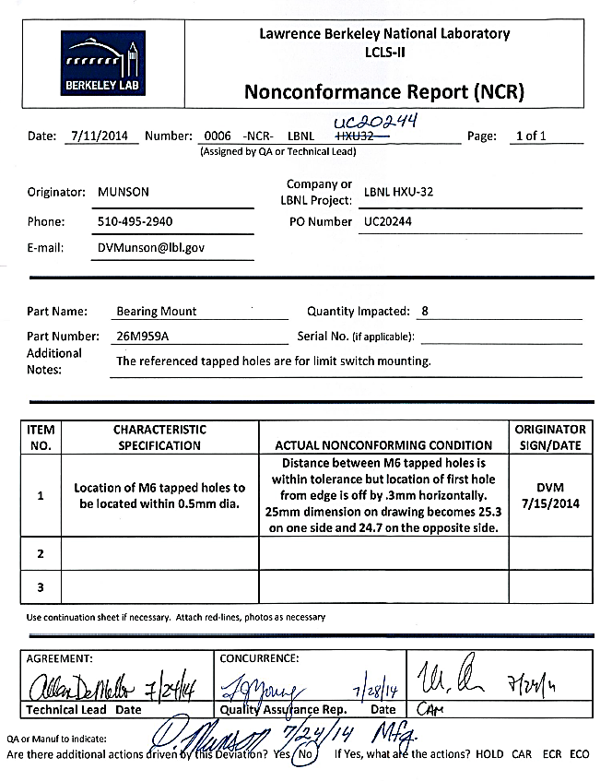
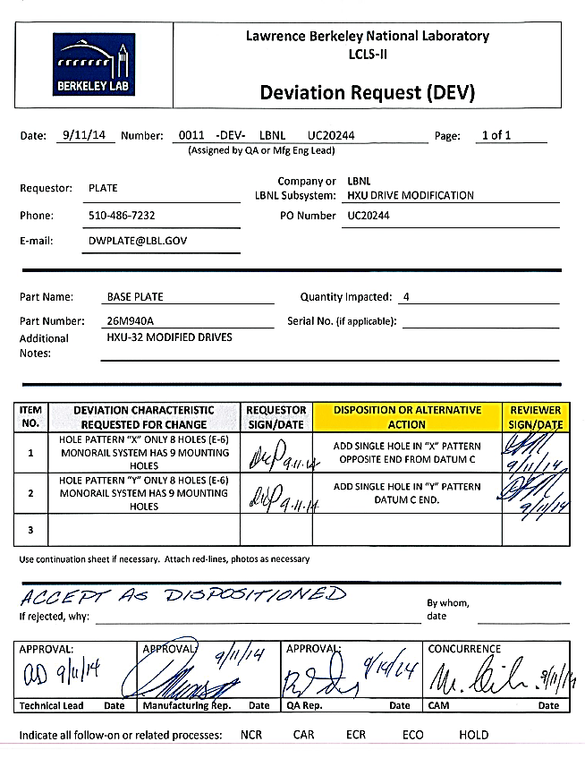
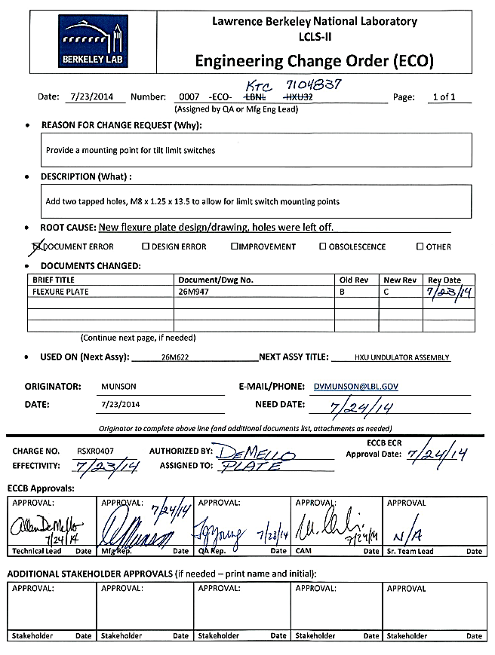
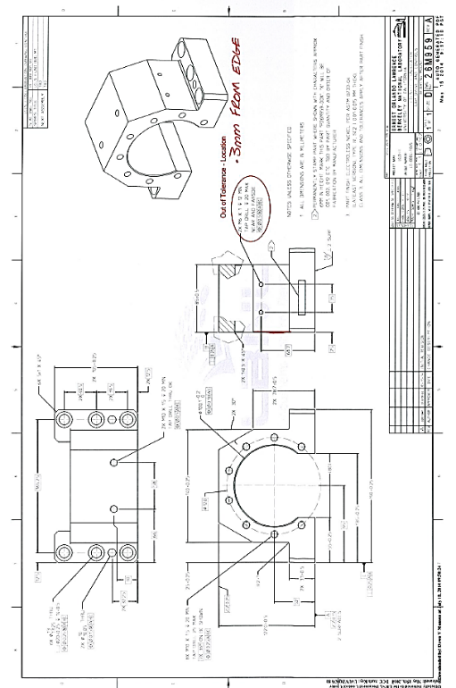
Stringent Manufacturing Processes Are Applied
Product Quality And Product Configuration Are Actively Controlled
Red-Lined Drawing
(Revision Controlled)

Slide 16
For All Procurements We Developed
Dedicated Manufacturing And QA Documents
Each Procurement Has Dedicated
Work Instructions
ACLs

Slide 17
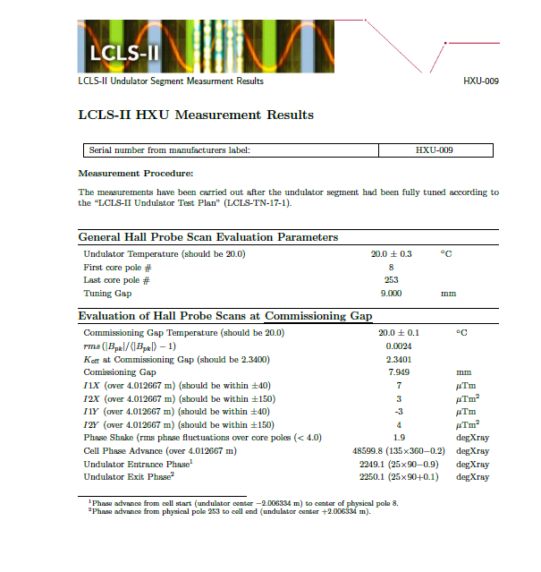
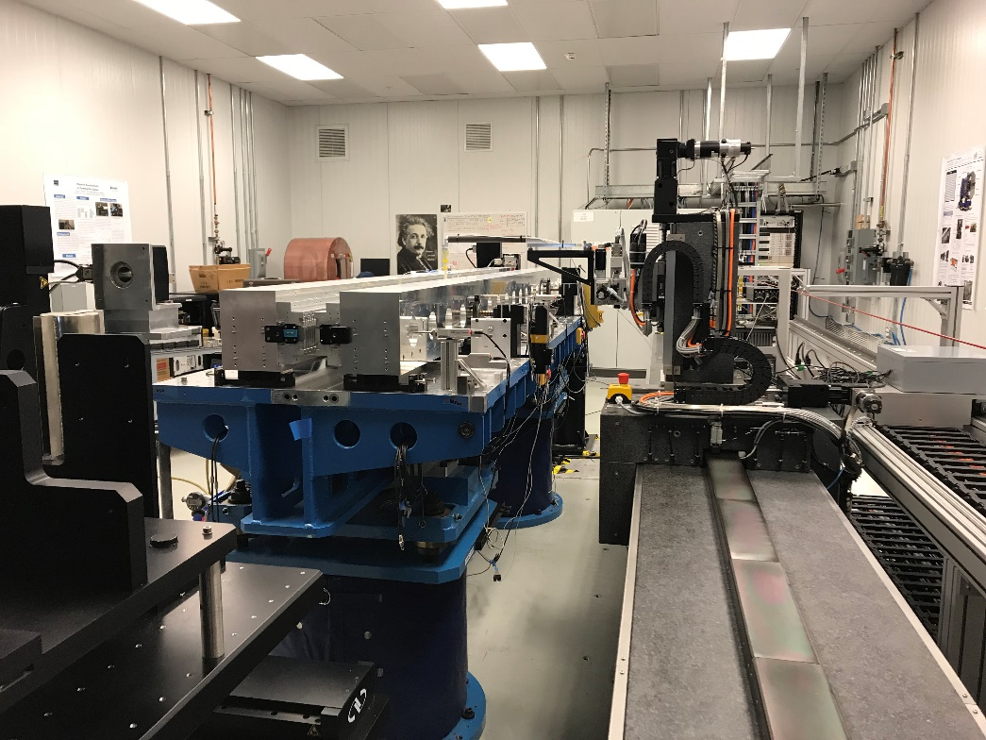
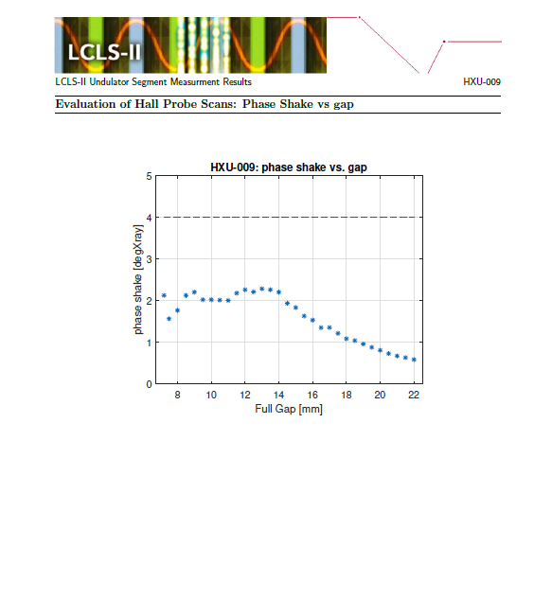
Undulators Are Qualified And Tuned In The LBNL Undulator Measurement Facility
Tuning Reports Are Generated For All Undulators

Slide 18
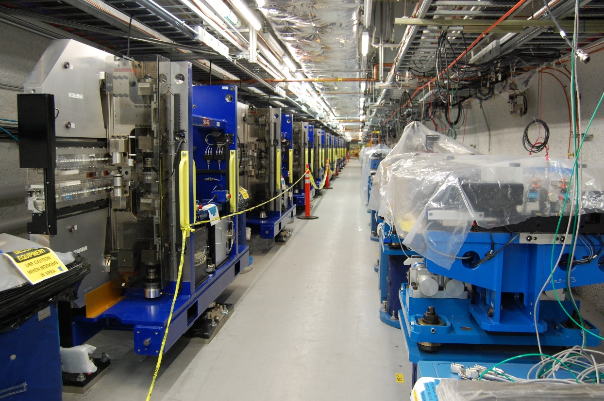
Undulator Installation Is Under Way
All SXR Undulators Have Been Installed
Production of HGVPU Undulators is ~80% complete

Slide 19
Conclusions
Considerable project experience within BCMT with a wide range of project size and scope
FRIB ECR source magnet was successfully delivered
  Magnet exceeds all magnetic requirements
  Single magnet fabrication mostly done in-house
LCLS-II Undulator production is in final stages
  Undulators meet all specifications
  Large quantity production with outside vendors

