Slide 1
HTS Cable Test Facility Magnet:
Conductor – Wire and Cable
Ian Pong
Research Scientist
Lawrence Berkeley National Laboratory

Slide 2
Outline
About me
Some Terminology
    Conductor, Strand, Wire, IT, RRP®, Subelements, Filaments, Cable, Keystone…
The Team
Equipment
Strand Procurement and Inventory Management
Cabling process
Our work “repertoire”
    R&D, 413.3b Project, WFO
Beyond LBNL: collaboration

Slide 3
About me
MEng in Aerospace Materials Engineering (2005)
PhD in Materials Science / Applied Superconductivity (2008)
CERN: Advanced Characterization of Prototype Nb₃Sn (2009-10)
ITER-IO: Worldwide Superconductor QC Facility Benchmarking & Production Monitoring (2011-2012)
LBNL: Rutherford Cabling for LARP and AUP (2013-now)

Slide 4
Some Terminology
Conductor, Superconductor
Strand = Wire

Slide 5
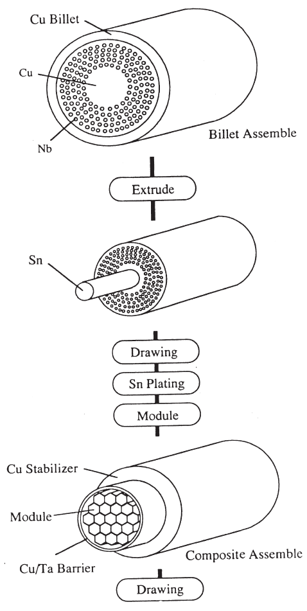
Wire Manufacturing Process – ITER type Internal Tin Nb₃Sn
Subelement billet
Final billet assembly
Gun-drilled Cu billet
Sn or Sn alloy rod into subelement core
Cu stabilizer
Cu core
Subelements
Nb rods inserted into the gun-drilled holes
Diffusion barrier
Single Barrier
Shape machining, deburring, hole brushing, cleaning, electron beam welding front and back end caps
Multi-step drawing, straightening, cutting into stacking length
Bench drawing, bull block, multi-die drawing, twisting, final drawing
Hot isostatic pressing, surface machining, extrusion
Cleaning subelements, spacers, barrier
Cutting into appropriate lengths, straightening, deep hole drilling to make subelement core, hole brushing, cleaning
Final billet assembly
Plating, HT, QC

Slide 6
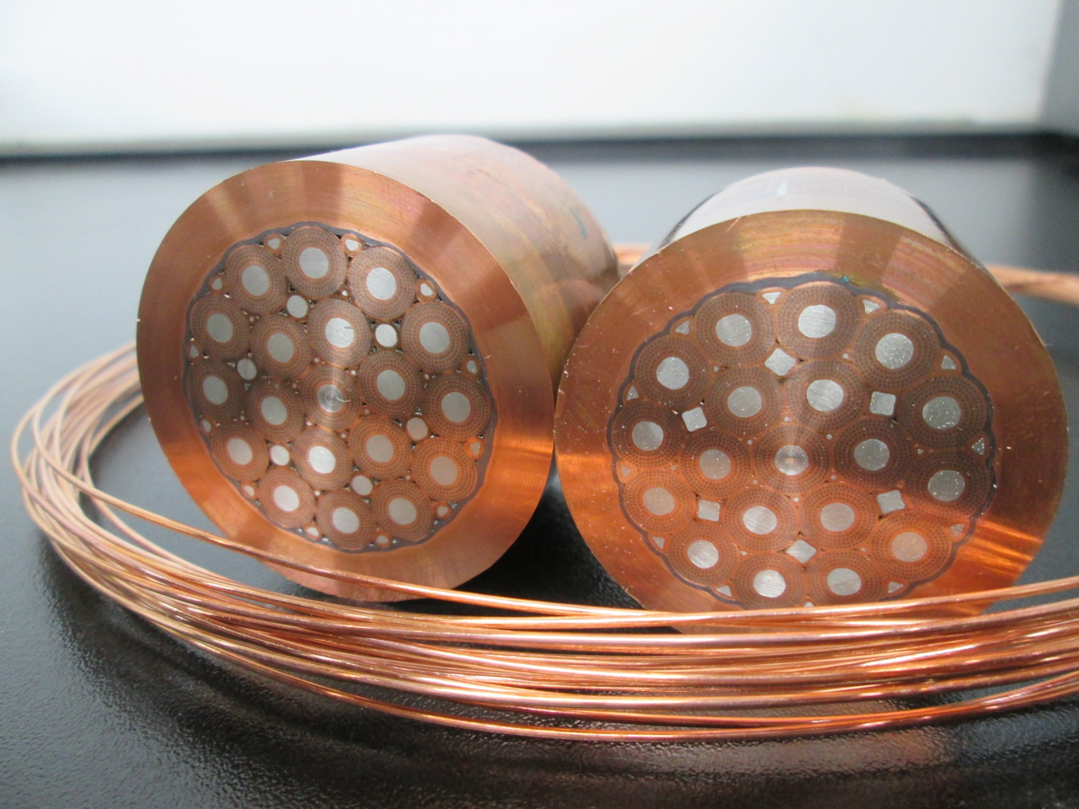
Wire Manufacturing Process – ITER type Internal Tin Nb₃Sn

Slide 7
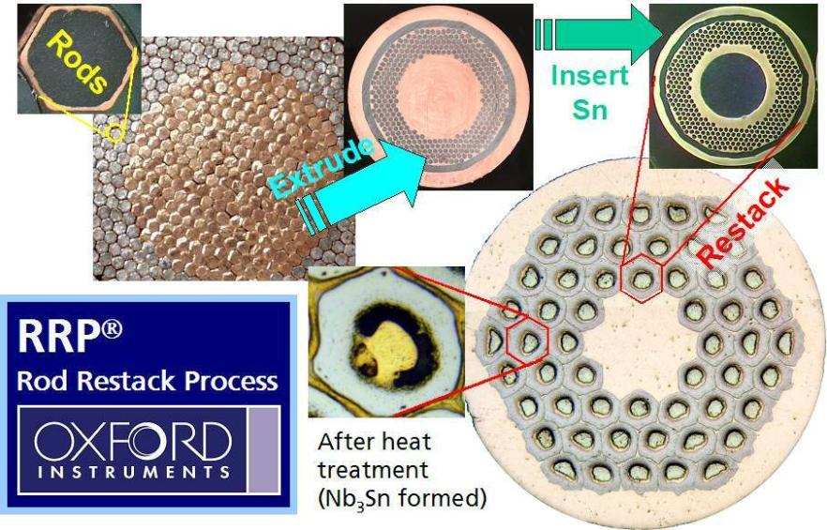
Wire Manufacturing Process – Accelerator Type RRP®
Subelements
with diffusion
barrier
Filaments
Wire

Slide 8
Wire Manufacturing Process – Accelerator Type RRP®
5
5
5
Stacking Layer/Ring | No. of Elements in the Stacking Layer/Ring | Total No. of Elements in the Structure
1st | 1 | 1
2nd | 6 | 7
3rd | 12 | 19
4th | 18 | 37
5th | 24 | 61
6th | 30 | 91
7th | 36 | 127
8th | 42 | 169
… | … | …
n^{th} | (n-1) x 6 | 3n² – 3n + 1
5
4
5
5
4
4
5
5
4
3
4
5
4
3
3
4
5
3
2
3
5
4
2
2
4
5
3
1
3
5
4
2
2
4
5
3
2
3
5
4
3
3
4
5
4
3
4
5
5
4
4
5
5
4
5
5
5
5

Slide 9
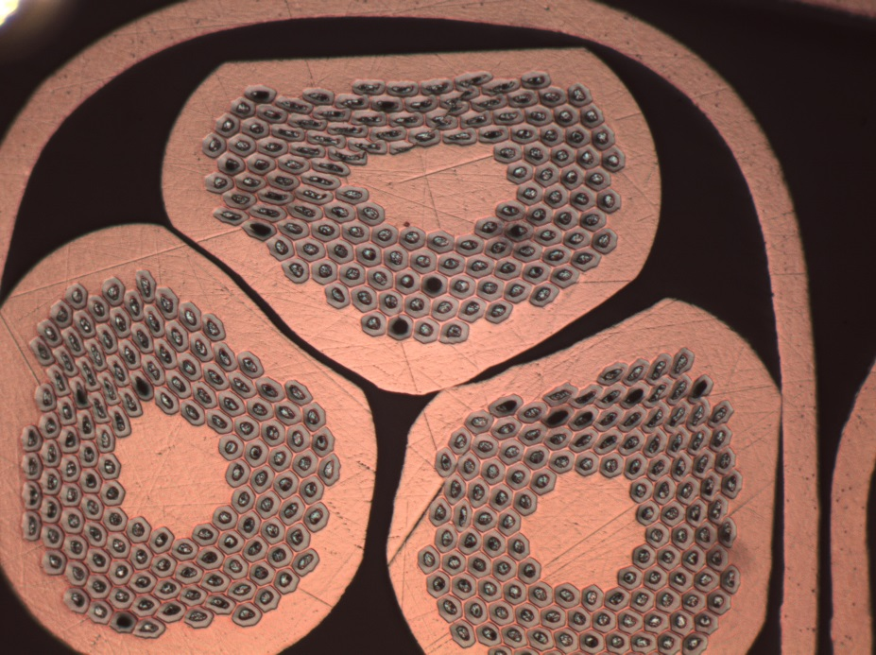
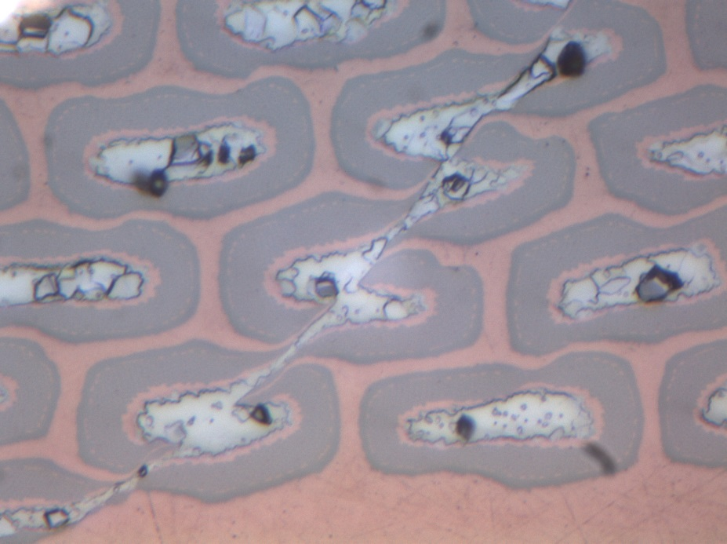
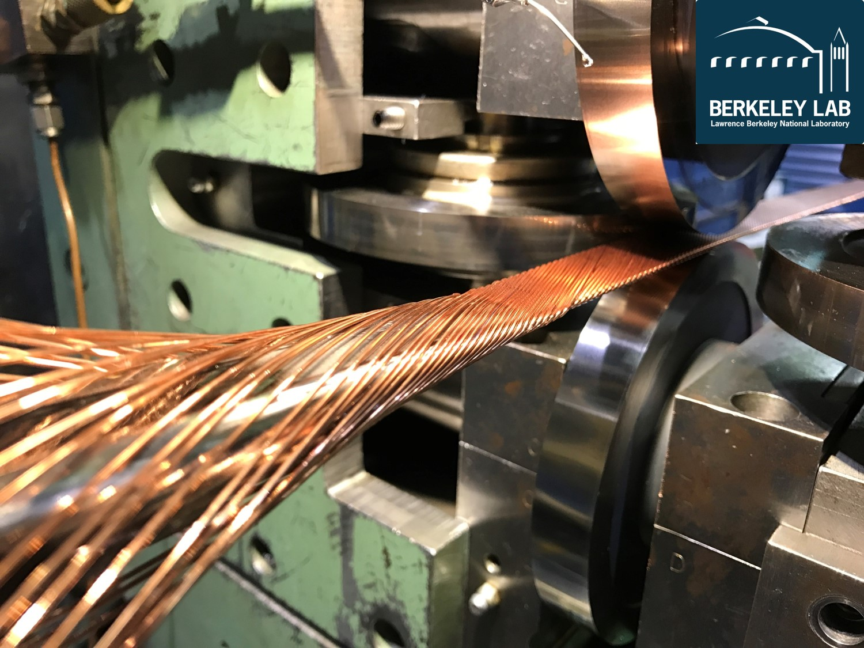
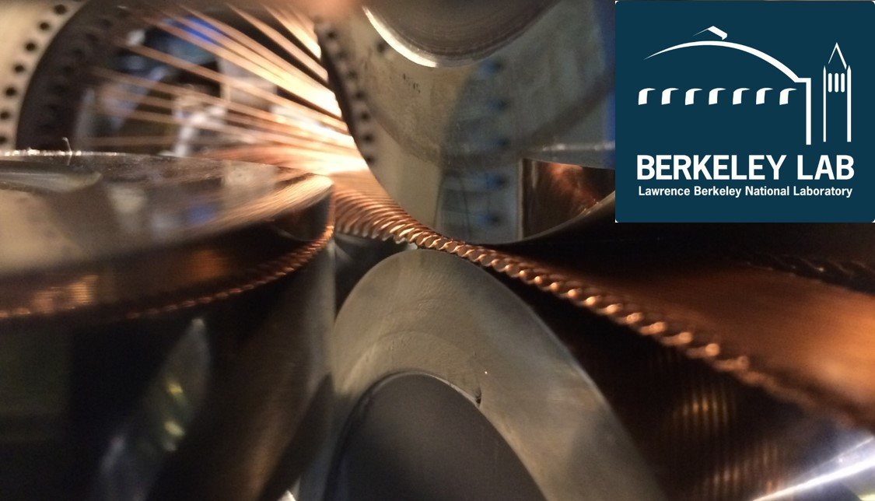
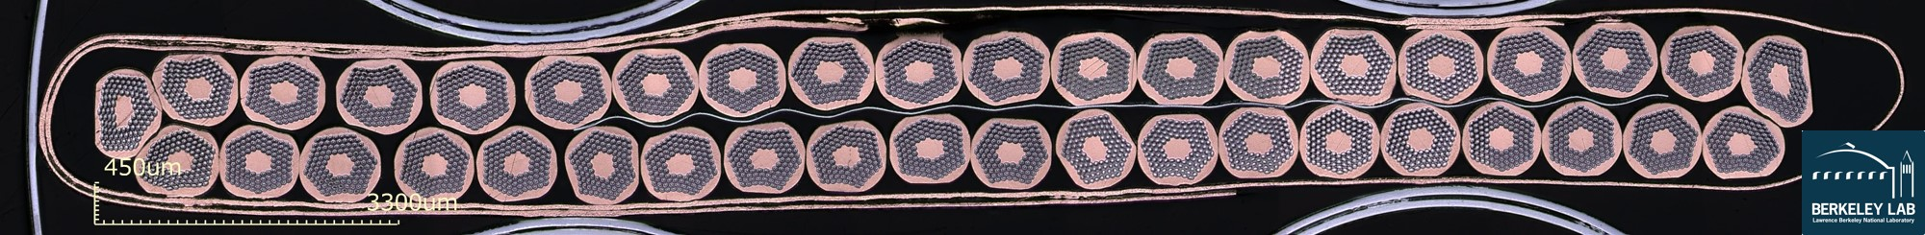
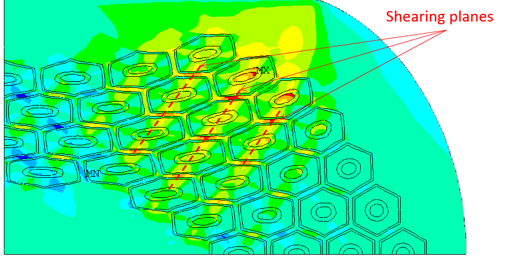
Rutherford Cable
400 μm
0.90
0.75
0.59
0.44
0.29
0.13
-0.02
-0.18
-0.33
-0.48

Slide 10
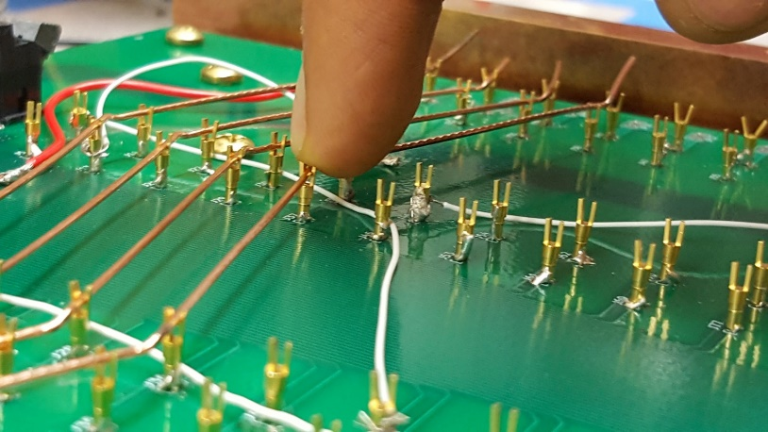

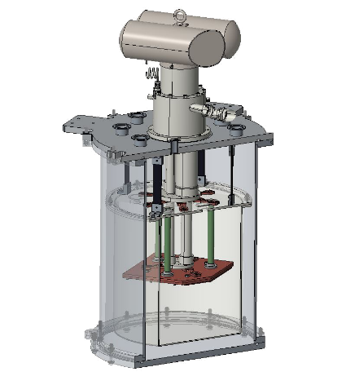
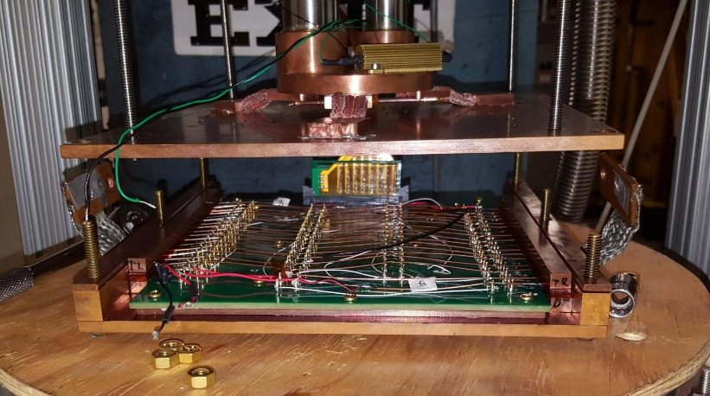
RRR: Residual Resistance Ratio
QXF cable
Major edge
Major edge
“kink”
Minor edge
“straight”
“straight”
Minor edge
“kink”
Extracted wire
V₁
Voltage taps
V₂
V₃
Cabled (extracted)
wire
V₄
Cryocooler system
(2nd stage ~3.9 K @ full power)
Printed circuit board
(up to 18 cabled samples)

Slide 11
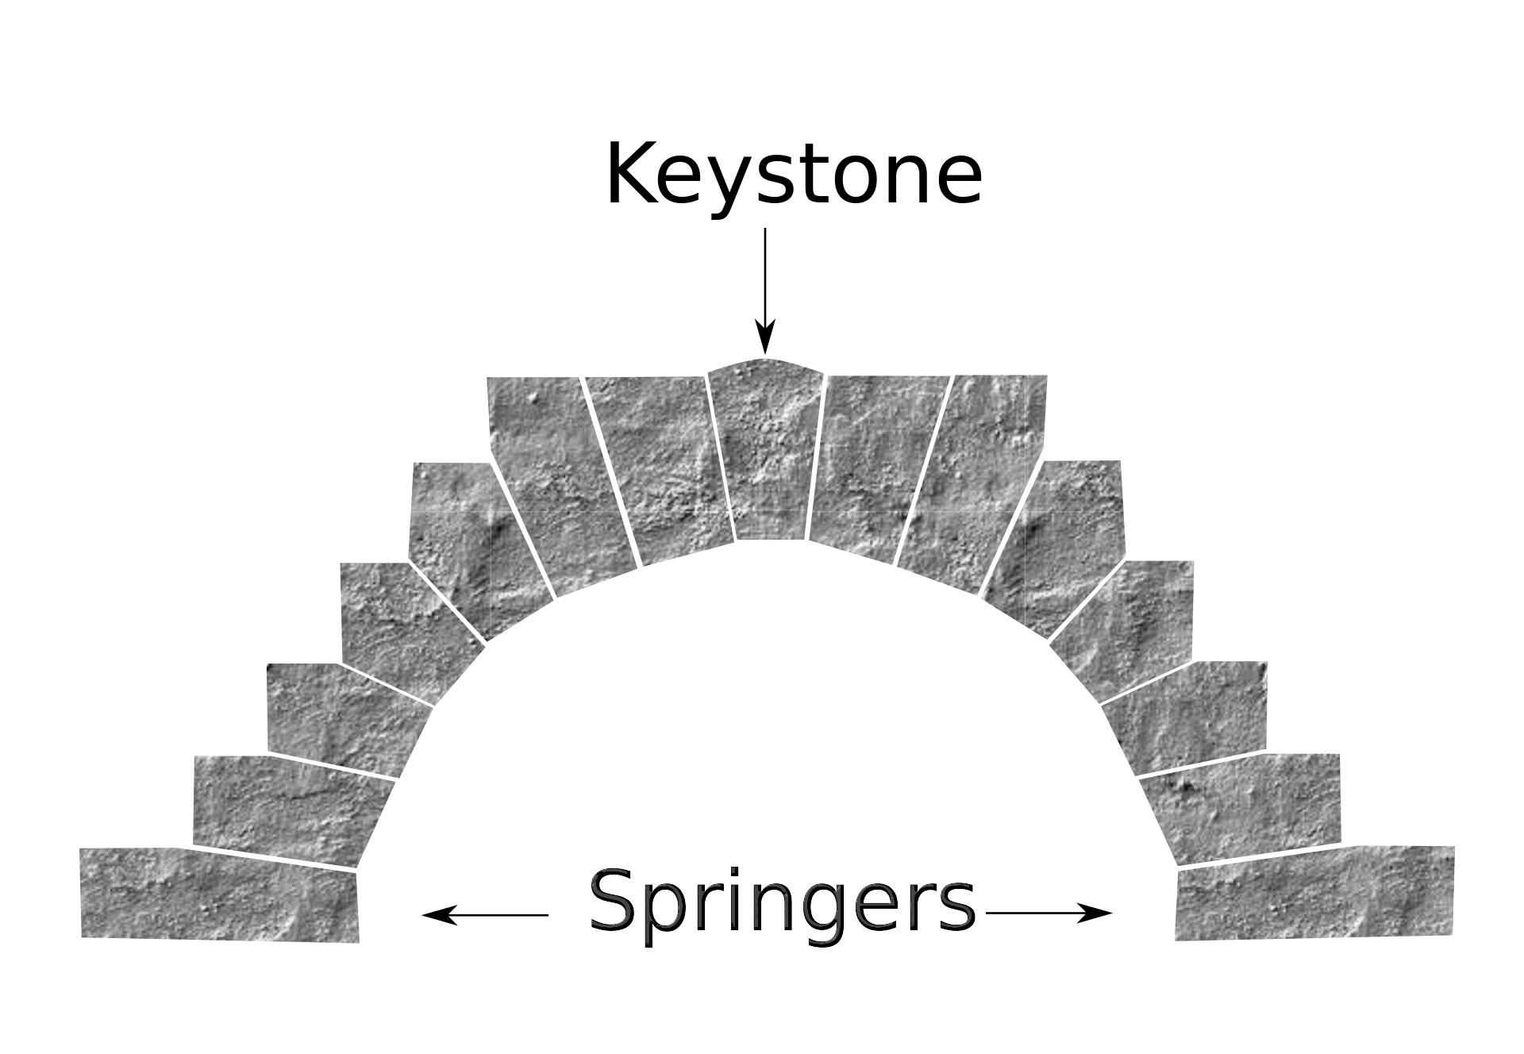
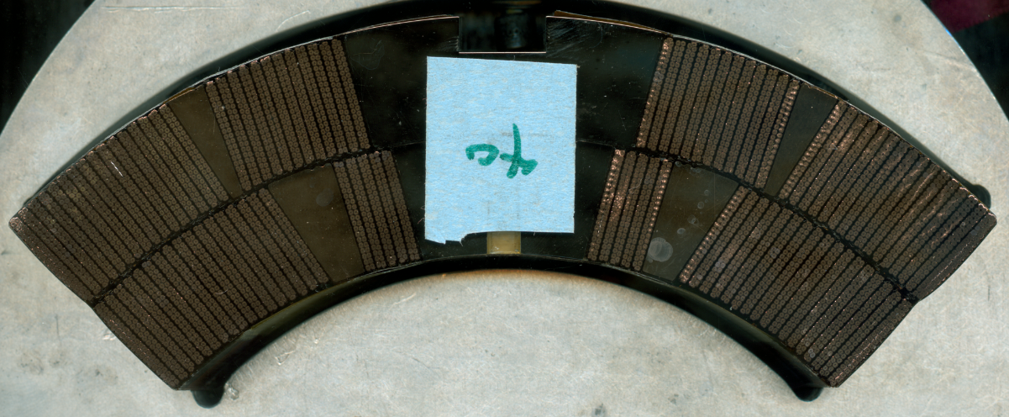
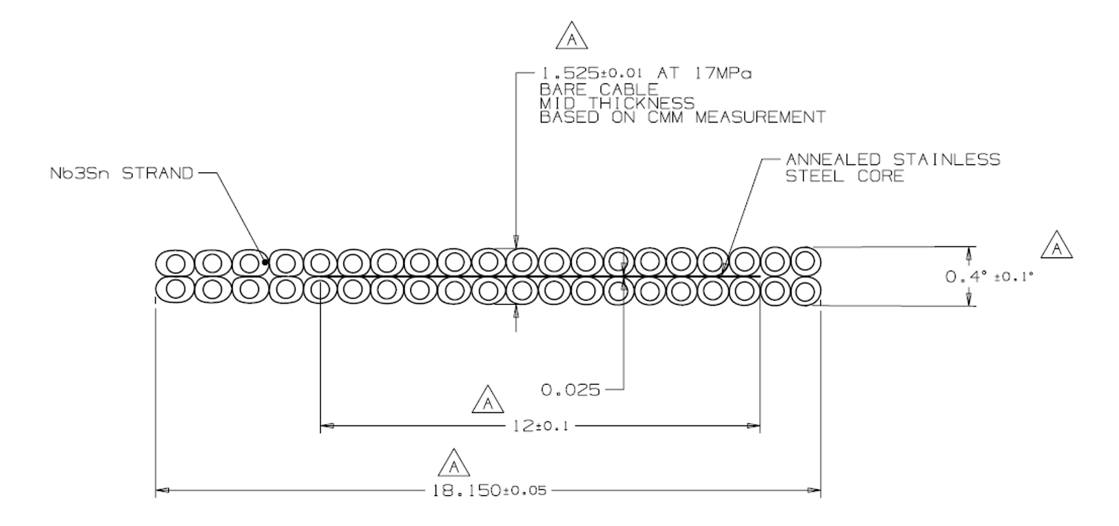
Cable Parameters: Keystone angle

Slide 12
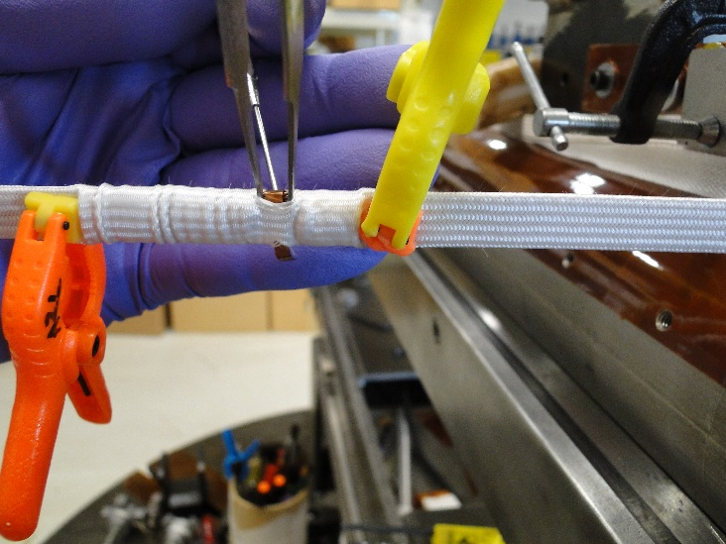
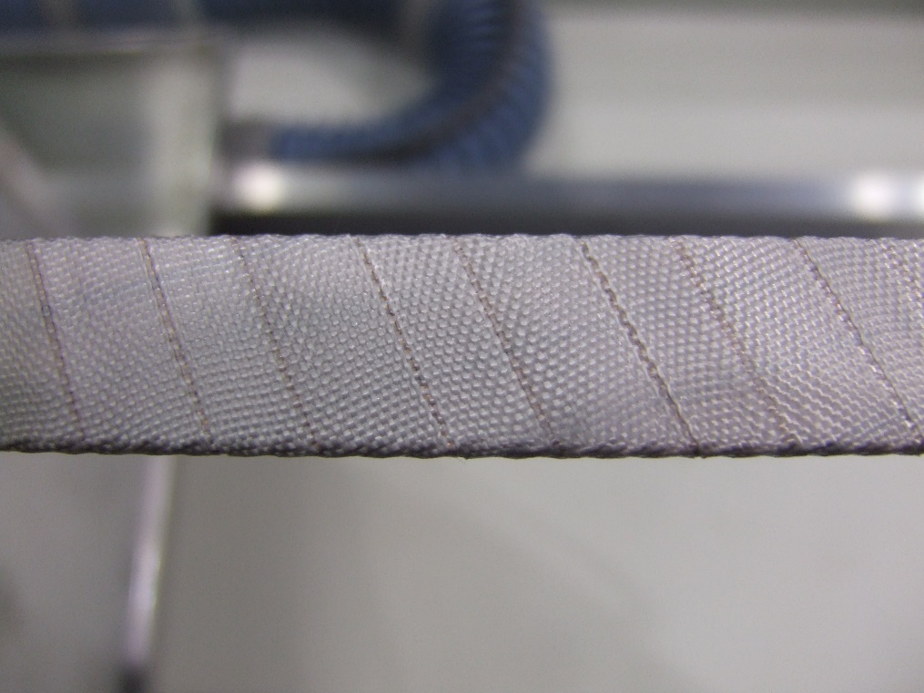
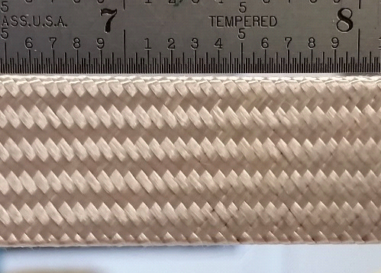
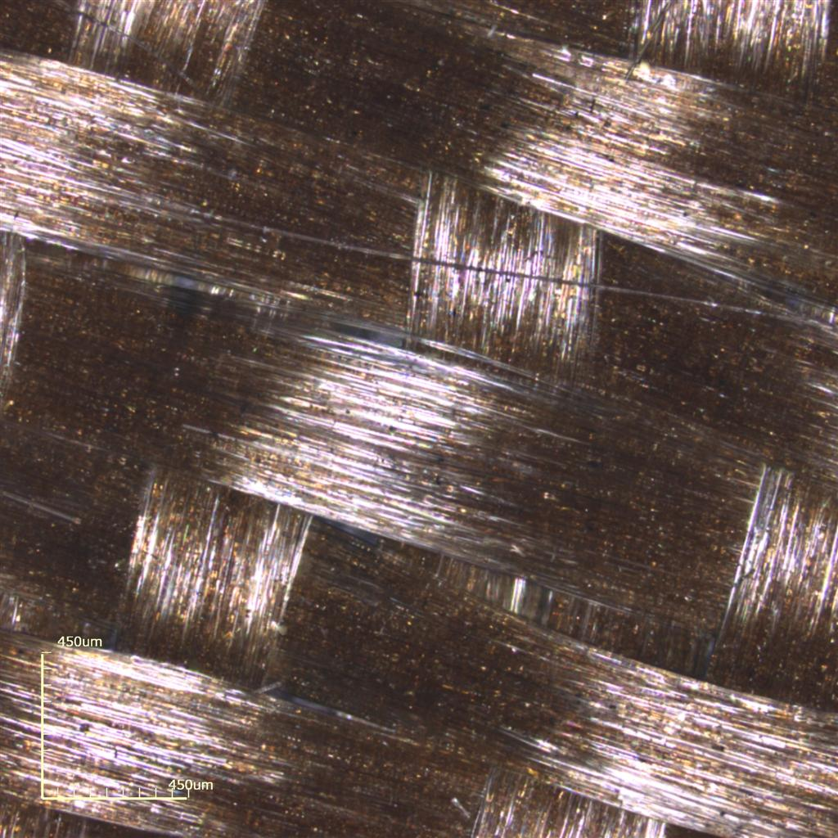
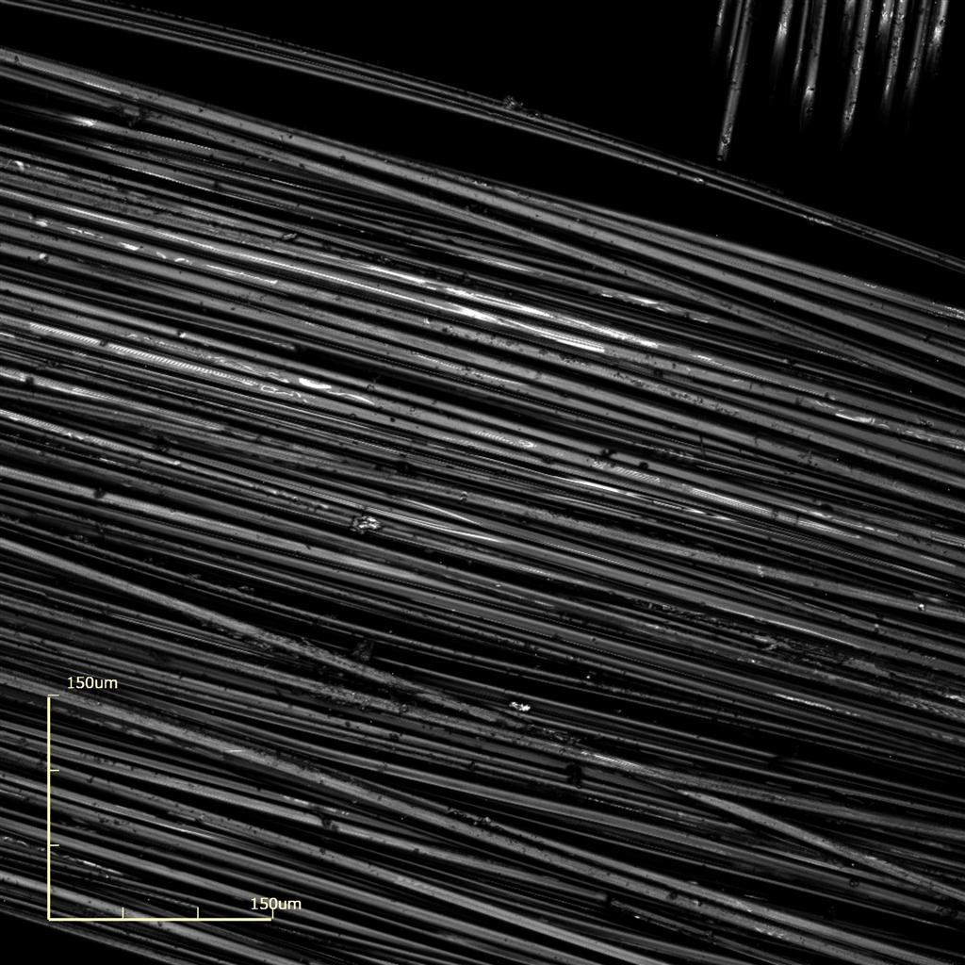
Insulation
(a)
(b)
(c)
Pitch Angle
Pitch Length

Slide 13
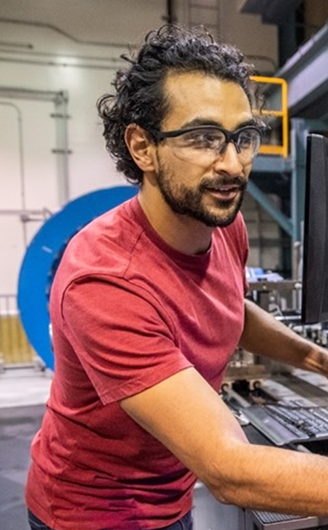
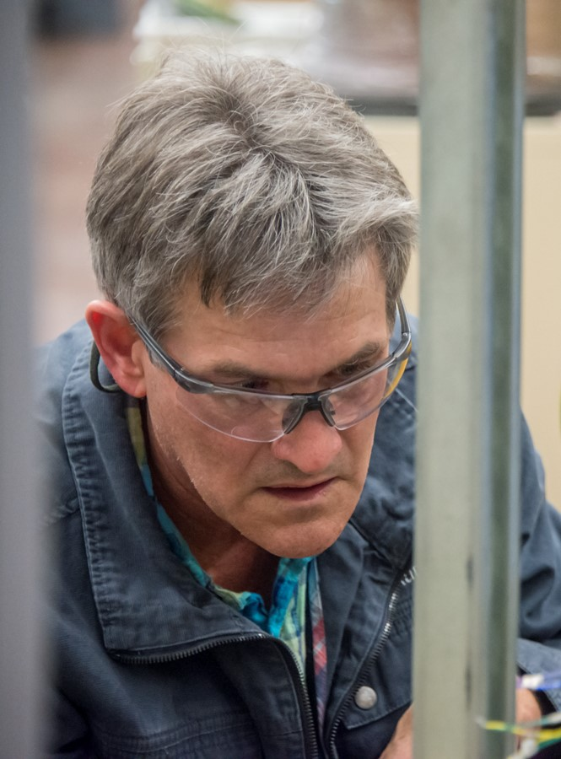
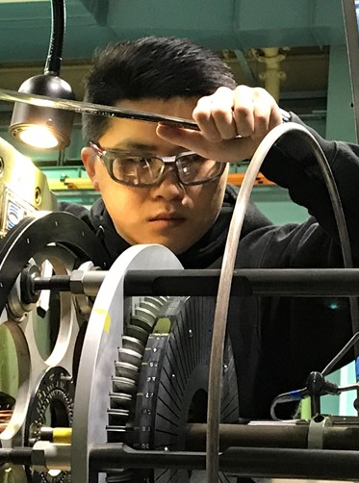
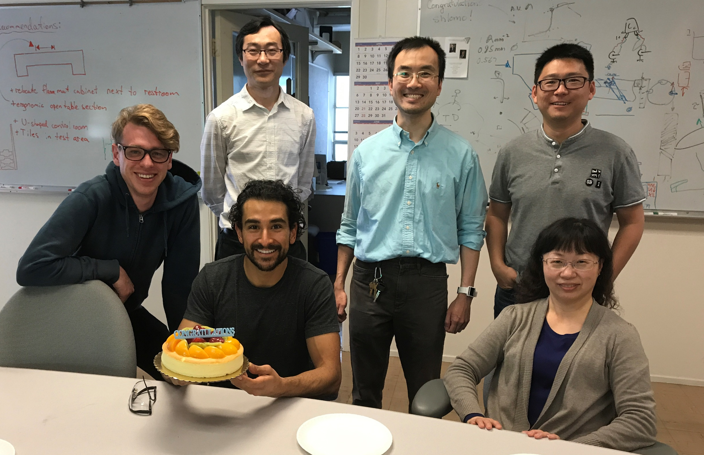
The Team
Further assisted by:
Cryogenic engineers
Designer
QEWs
Retirees
Professional colleagues
Lead: Ian Pong
Deputy: tbc, formerly Charlie Sanabria
QA Engineer: tbc
Technician:
  Hugh Higley (retiring)
  Andy Lin
  Juan Rodriguez
  Tbc
Intern students:
  Jonathan Lee
  Edward Stafford

Slide 14
Equipment
Cabling machine
Dual-axis optical micrometer
CME (a.k.a. CMM)
Residual twist rig
10-stack machine
Keyence imaging system
Metallographic sample grinder/polisher
Optical microscope
SEM with BEI and EDS

Slide 15
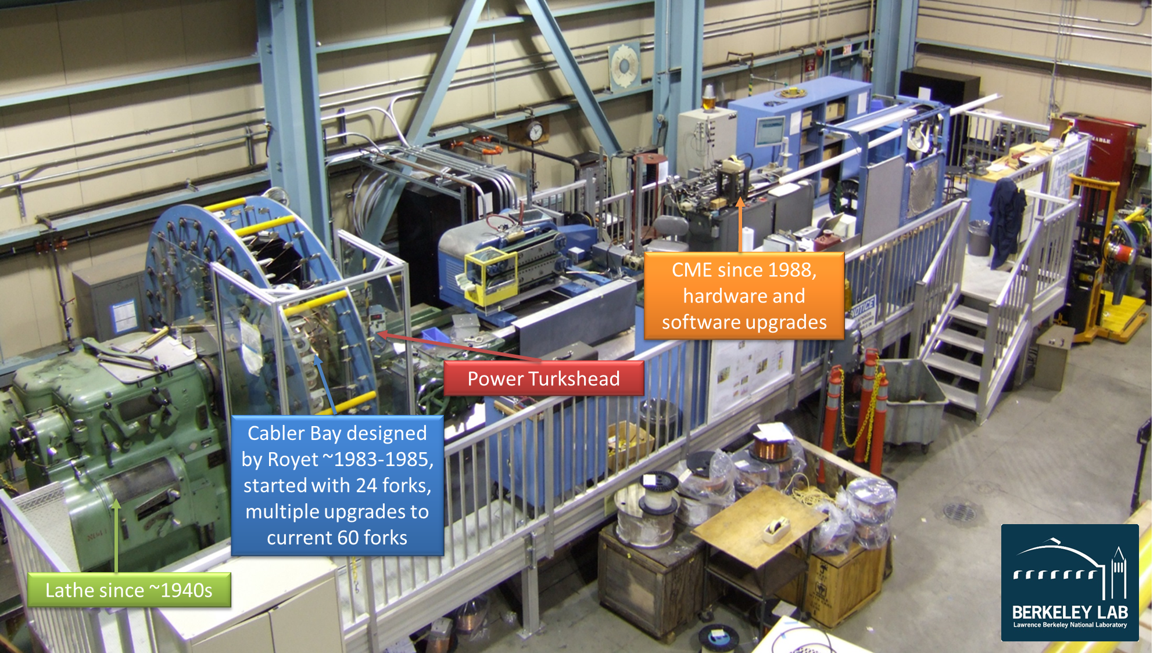
Cabling Machine

Slide 16
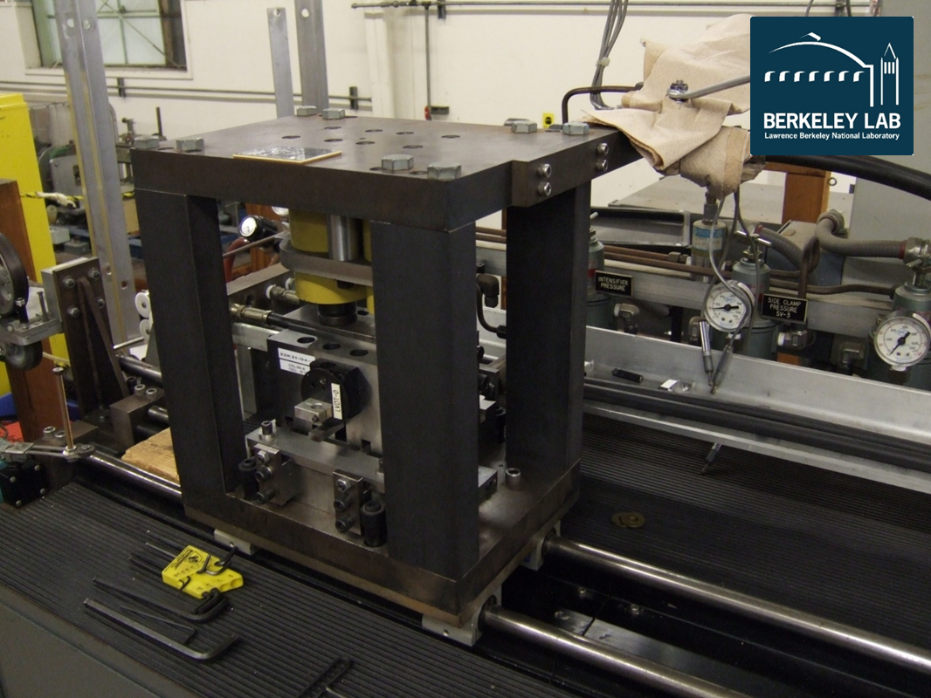
CME (a.k.a. CMM)

Slide 17
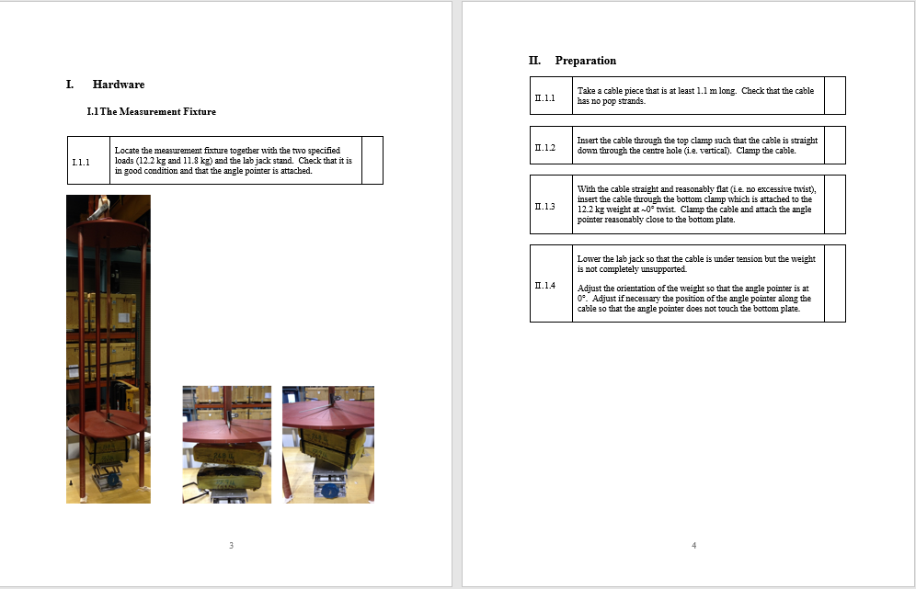
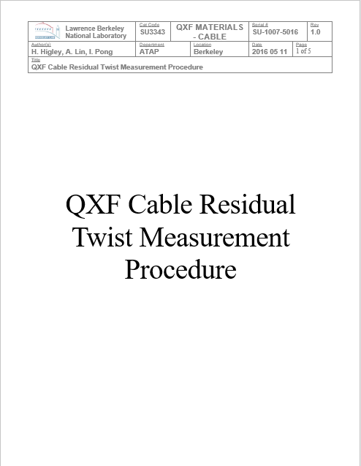

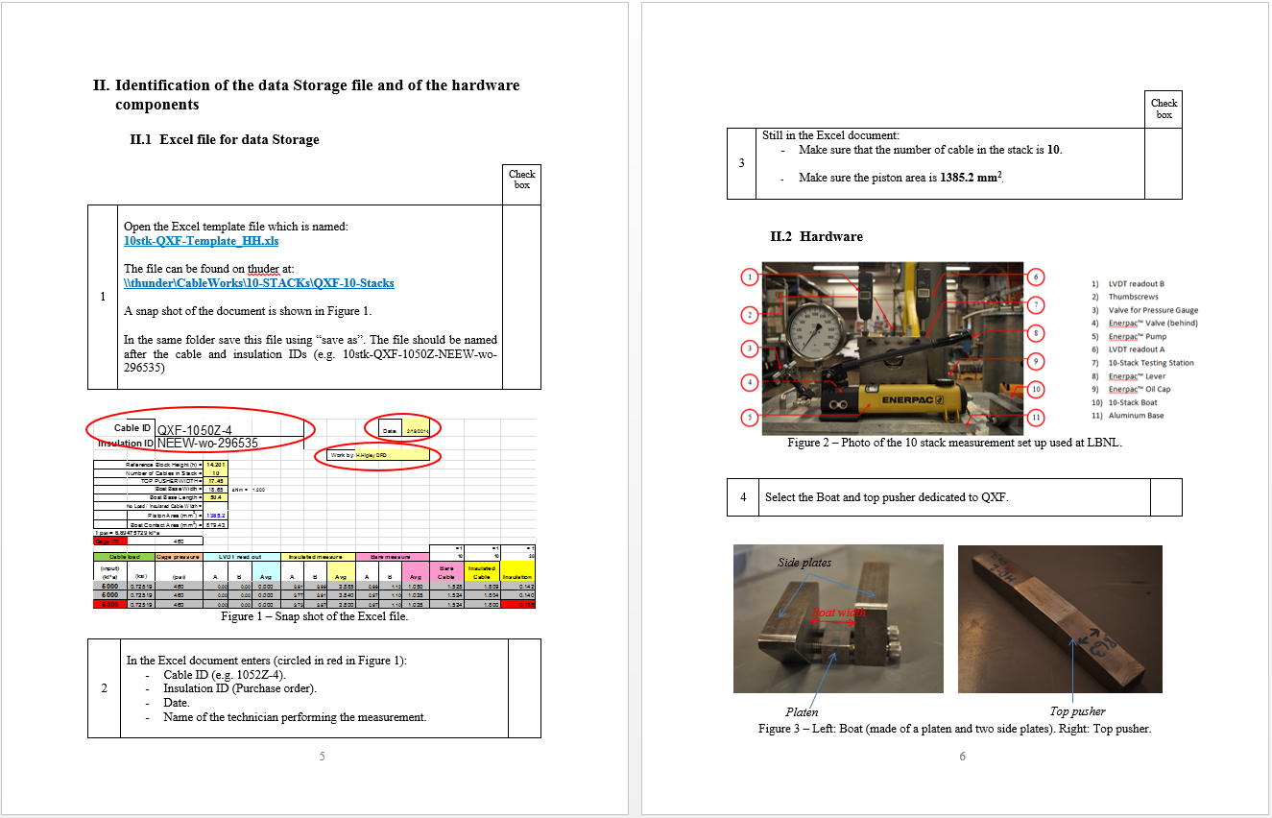
Residual Twist and 10-Stack Measurements

Slide 18
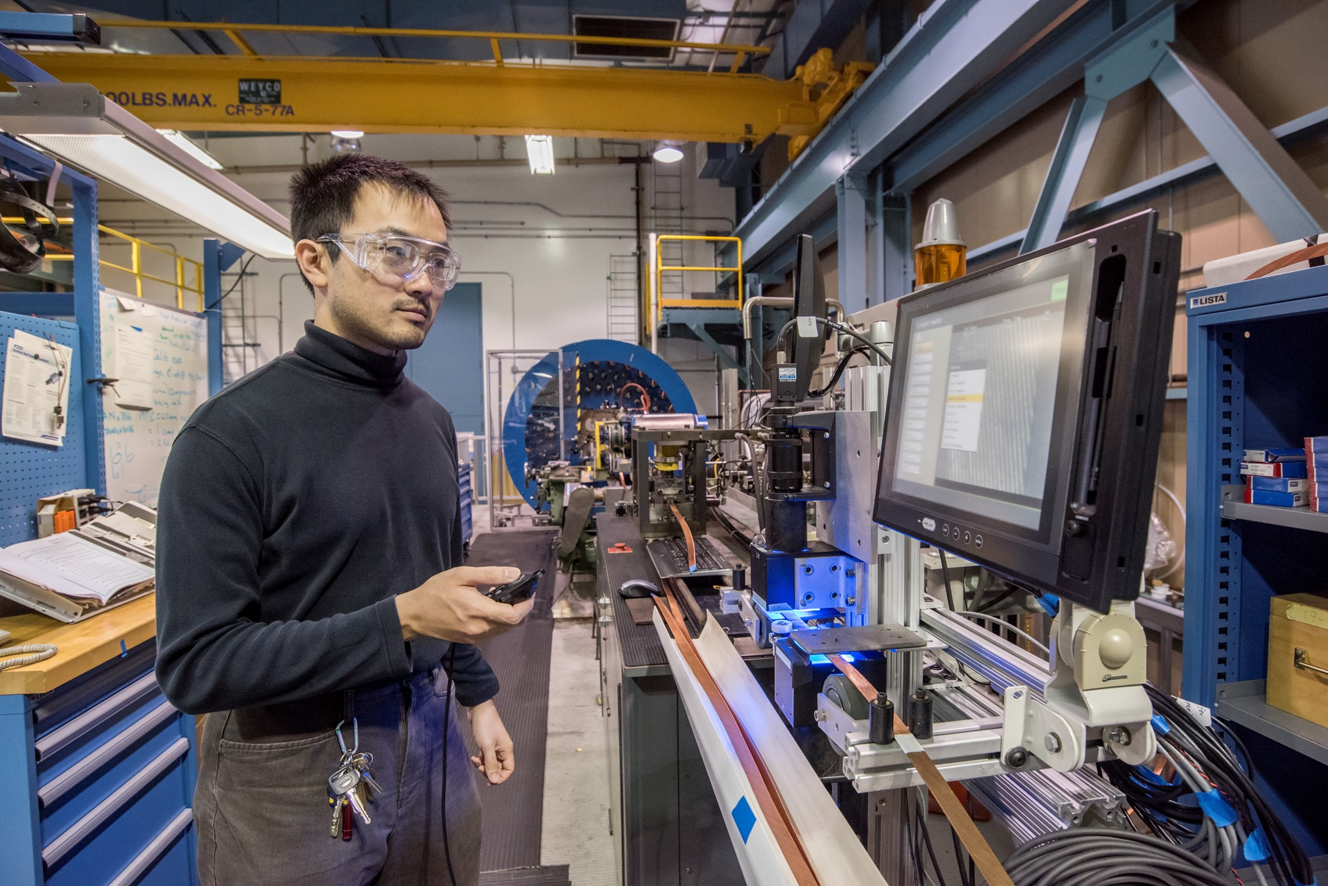
Keyence Imaging System

Slide 19

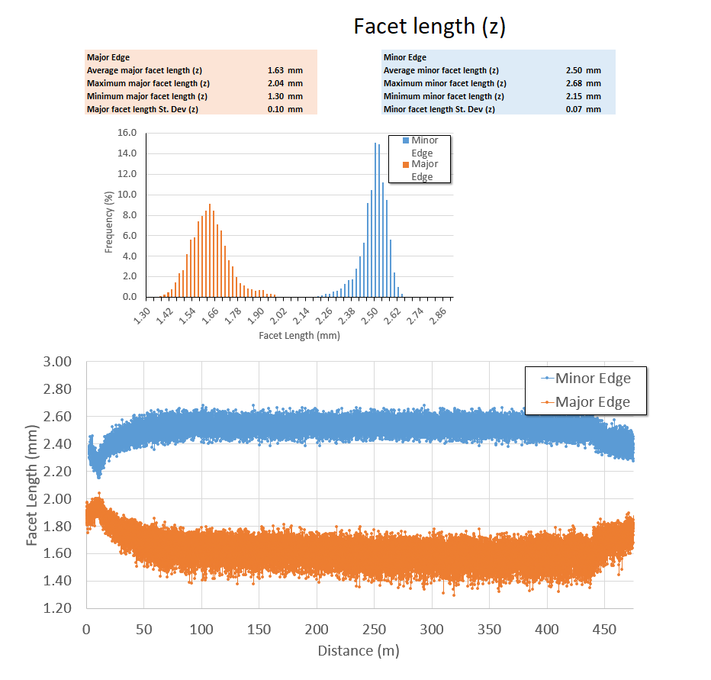
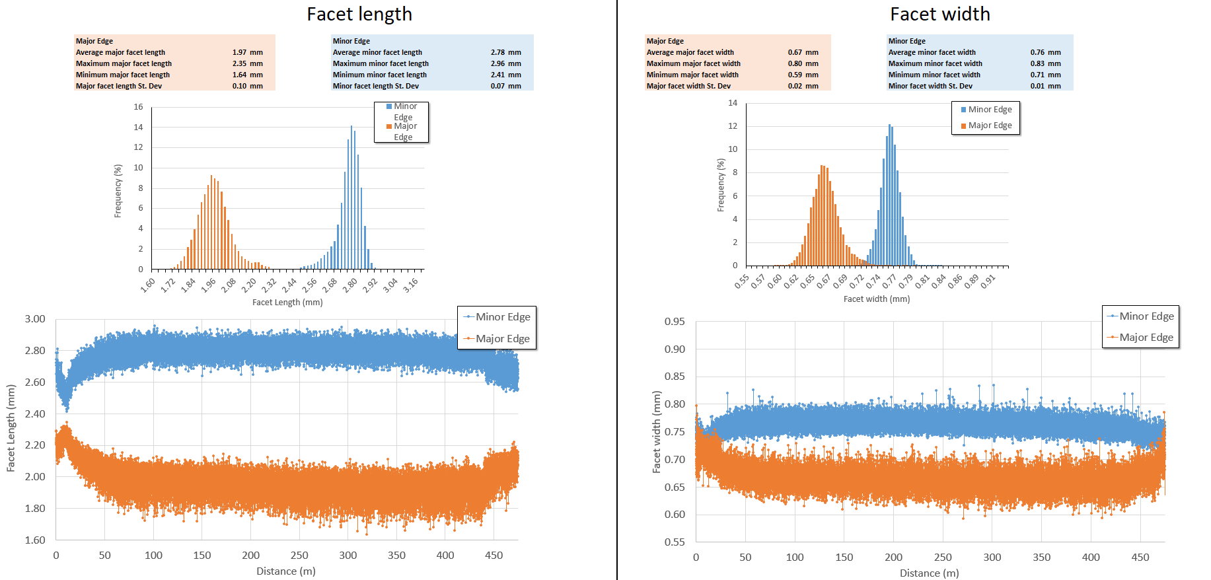
Keyence Analysis
Length (z)
Length
Width

Slide 20
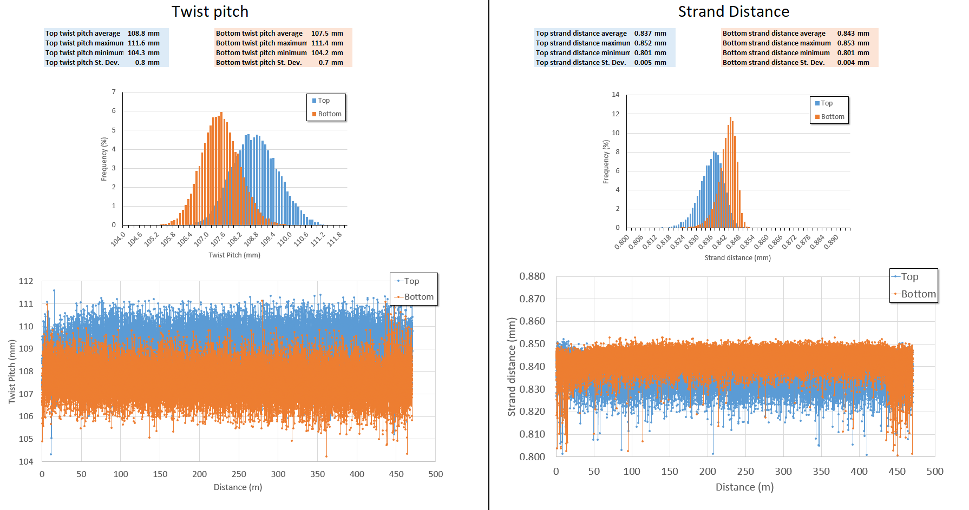
Keyence Analysis
P43OL1117AA00A

Slide 21


Keyence Analysis

Slide 22
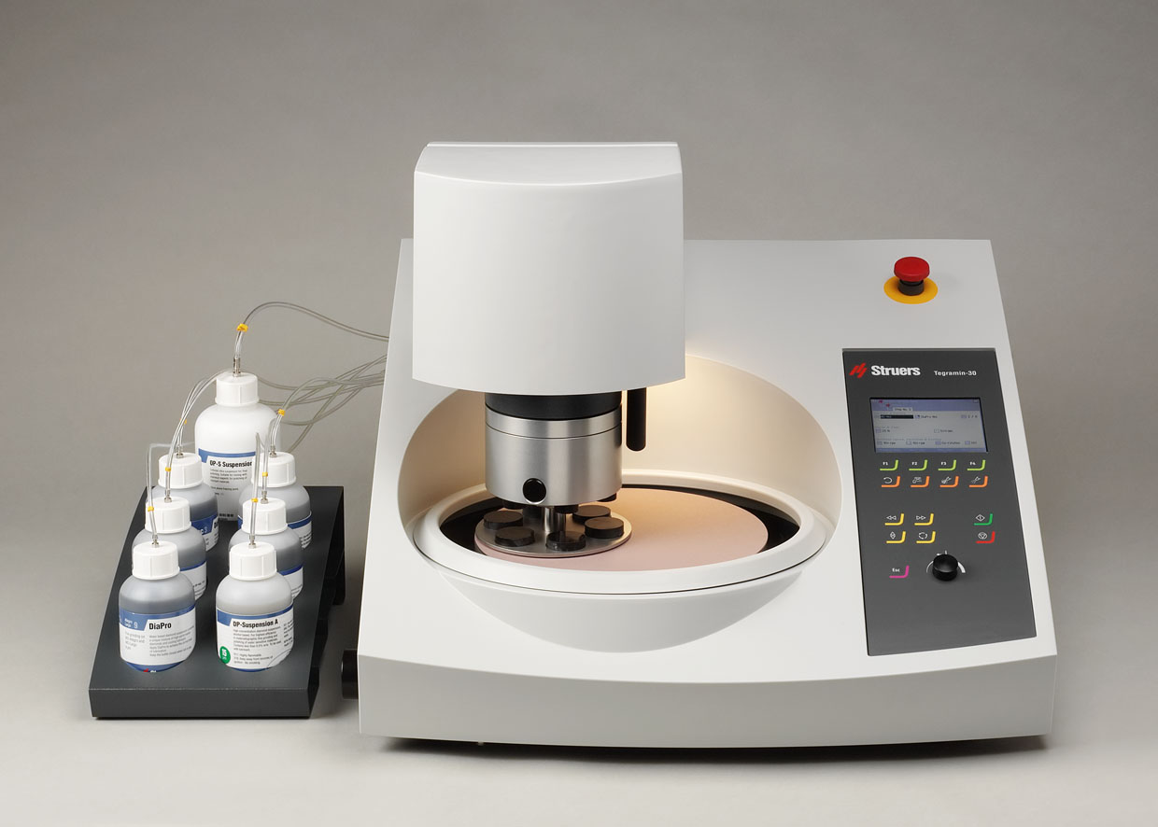
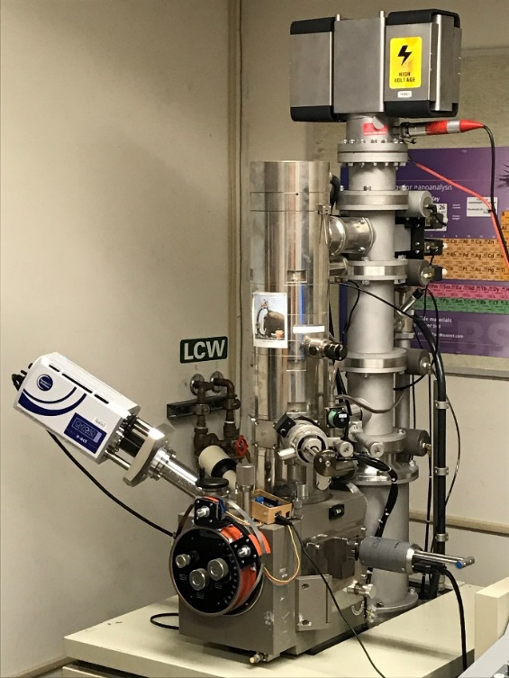
Metallographic Equipment

Slide 23
Strand Procurement
Our experience include
  ITER production monitoring (~600 t)
  LARP and CDP procurement at LBNL (Nb₃Sn, 2212, etc.)
  AUP procurement at LBNL (~1 million USD)
  Handling NCRs, DRs, CAPAs, QA/QC assessment
LBNL Procurement Department support
  Experienced buyer, helped AUP resolve contract issues
  Advanced acquisition alert
  Sole source justification preparation
  Source evaluation and contract review
  Master Agreement (phase procurement)

Slide 24
Inventory and Record Management
Established the Naming Scheme with barcode system adopted by AUP and its supplier, as well as by other labs and collaborators
Specimen identification, procedures, HT records, archive samples all systematically managed
Database for wire spools and cables
Record of cabling machine hardware components history

Slide 25
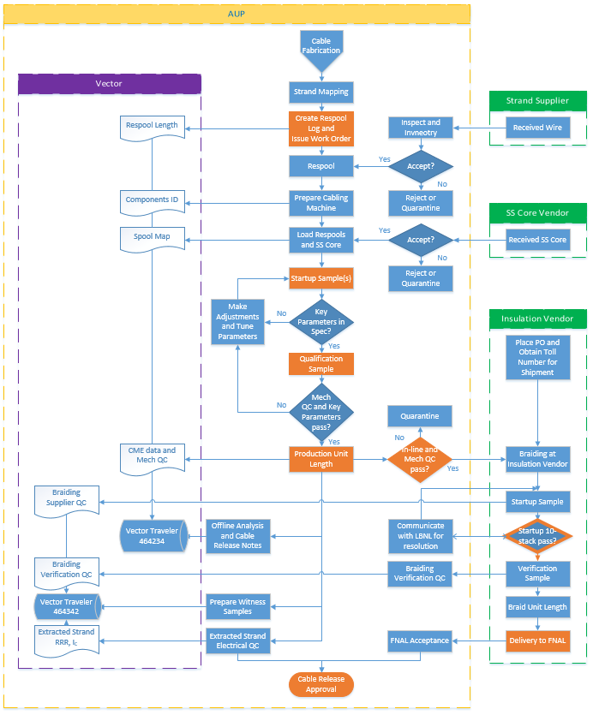
Cabling Process
Work order issuance
Respooling
Loading wire and hardware
Alignment
Stringing
ATPP: startup and qualification
ATPP: Production run
ATPP: sample cutting
QC and Documentation

Slide 26
Cable Fabrication – Our “Repertoire”
Lists of different cables types:
    CCT
    LARP→AUP
    HTS Bi-2212
    WFO
For a variety of projects:
    Programmatic R&D
    One-off deliverable projects
    413.3b projects
We specialize in custom Rutherford and 6-around-1 cables in support of our HEP research program and projects

Slide 27
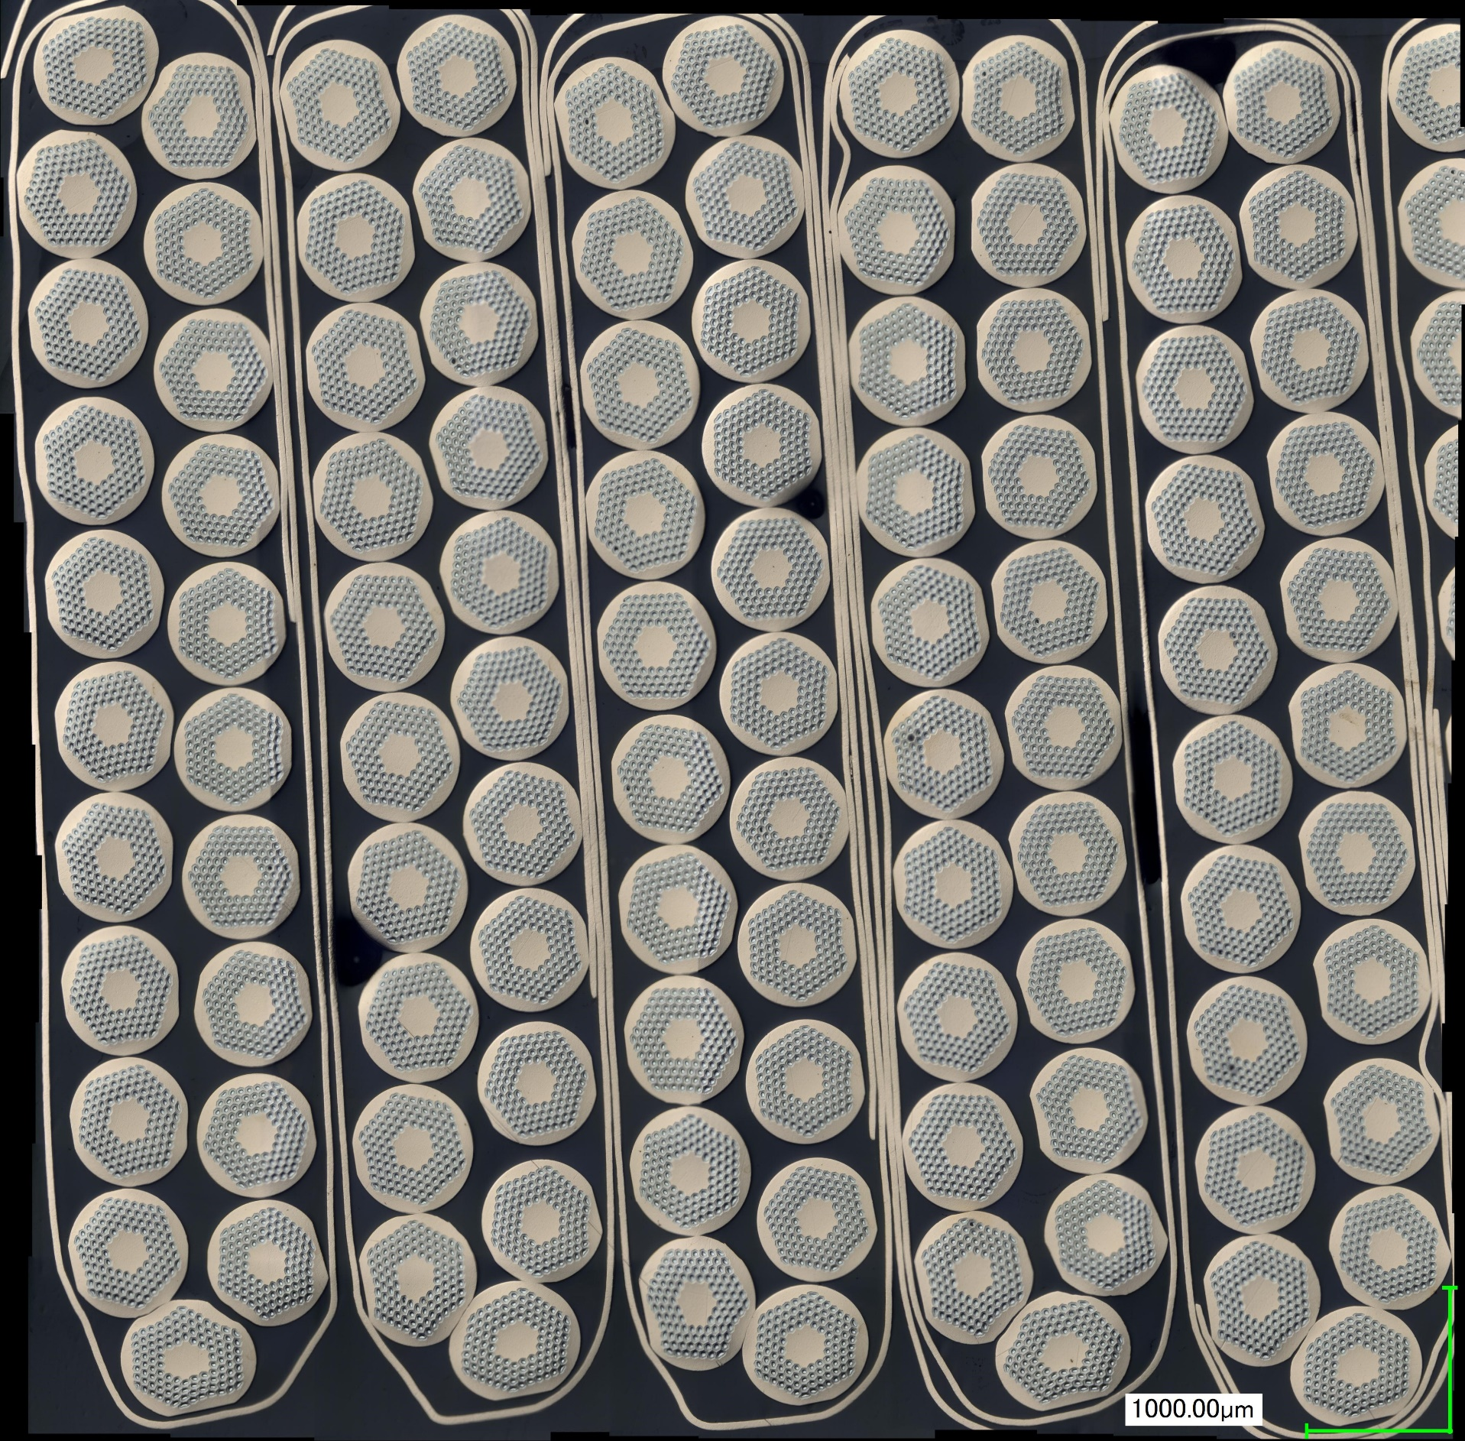
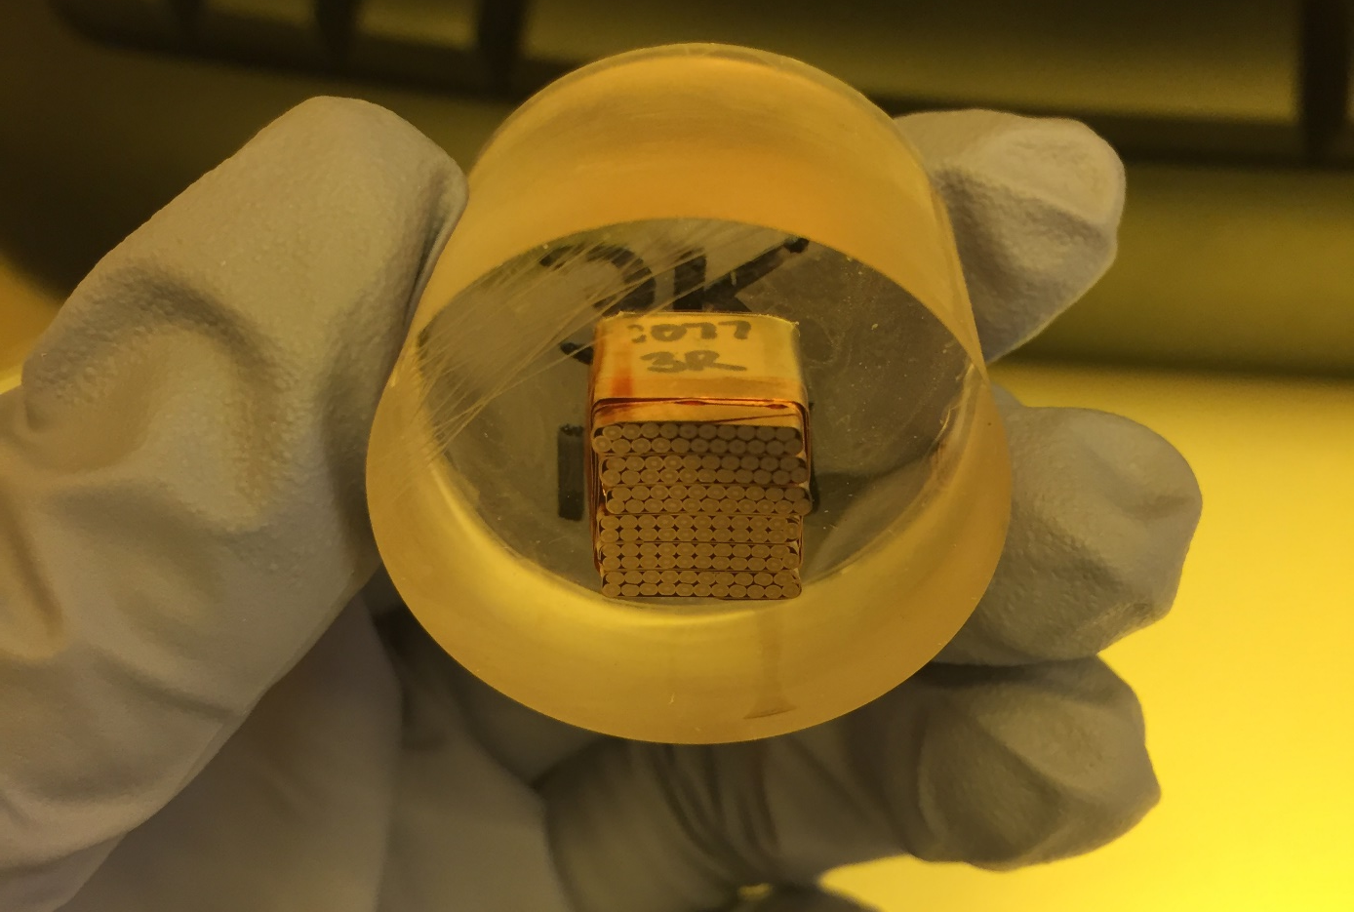

Developing Cables To Support MDP Research
CCT
LARP
LARP/AUP
HTS
WFO
CCT
LARP
LARP/AUP
HTS
WFO
List of Rutherford cable types fabricated in the past 5 yrs
1. LTS CCT Program
B11 | Nb-Ti CCT cable | CCT1, 2
B12 | Nb₃Sn 23-strand CCT cable, 2-pass | CCT3
B13 | Nb₃Sn 21-strand CCT cable, 2-pass | CCT4, 5
B14 | Nb₃Sn 21-strand CCT cable, 1-pass | CCT5b
B21 | Nb₃Sn 11-strand subscale CCT cable, 1-pass | CCT-sub

Slide 28

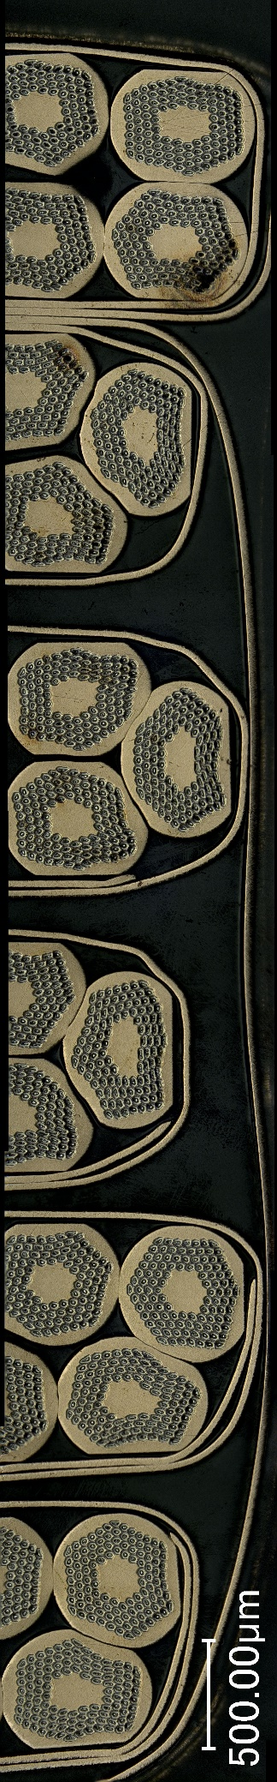
Setting Foundation For LARP Success
CCT
LARP
LARP/AUP
HTS
WFO
CCT
LARP
LARP/AUP
HTS
WFO
List of Rutherford cable types fabricated in the past 5 yrs
2. LARP
P03 | Nb₃Sn 40-strand R&D cables
P22 | Nb₃Sn 40-strand 1st generation LARP cable, w/o core using unannealed 108/127 strands
P23 | Nb₃Sn 40-strand 1st generation LARP cable, with core using unannealed 108/127 strands
P32 | Nb₃Sn 40-strand 1st generation LARP cable, w/o core using pre-annealed 108/127 strands
P33 | Nb₃Sn 40-strand 1st generation LARP cable, with core using pre-annealed 108/127 strands
P35 | Nb₃Sn 40-strand 1st generation LARP cable, w/o core using pre-annealed 132/169 strands
Collings et al., Effects of Core Type, Placement, and Width on Estimated Interstrand Coupling Properties of QXF Cables, IEEE Trans Appl Supercond., Vol 25 https://doi.org/10.1109/TASC.2015.2390628

Slide 29

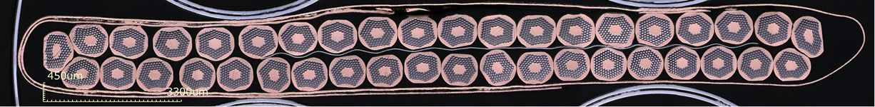
One Main Activity – But Not The Only;
CCT
LARP
LARP/AUP
HTS
WFO
CCT
LARP
LARP/AUP
HTS
WFO
List of Rutherford cable types fabricated in the past 5 yrs
3. LARP→AUP
P43 | Nb₃Sn 40-strand 2nd generation LARP/AUP cable, with core using unannealed 108/127 strands
P45 | Nb₃Sn 40-strand 2nd generation LARP/AUP cable, with core using unannealed 132/169 strands
P47 | Nb₃Sn 40-strand 2nd generation LARP/AUP cable, with core using unannealed 144/169 strands
Critical Role: 102 Cables

Slide 30
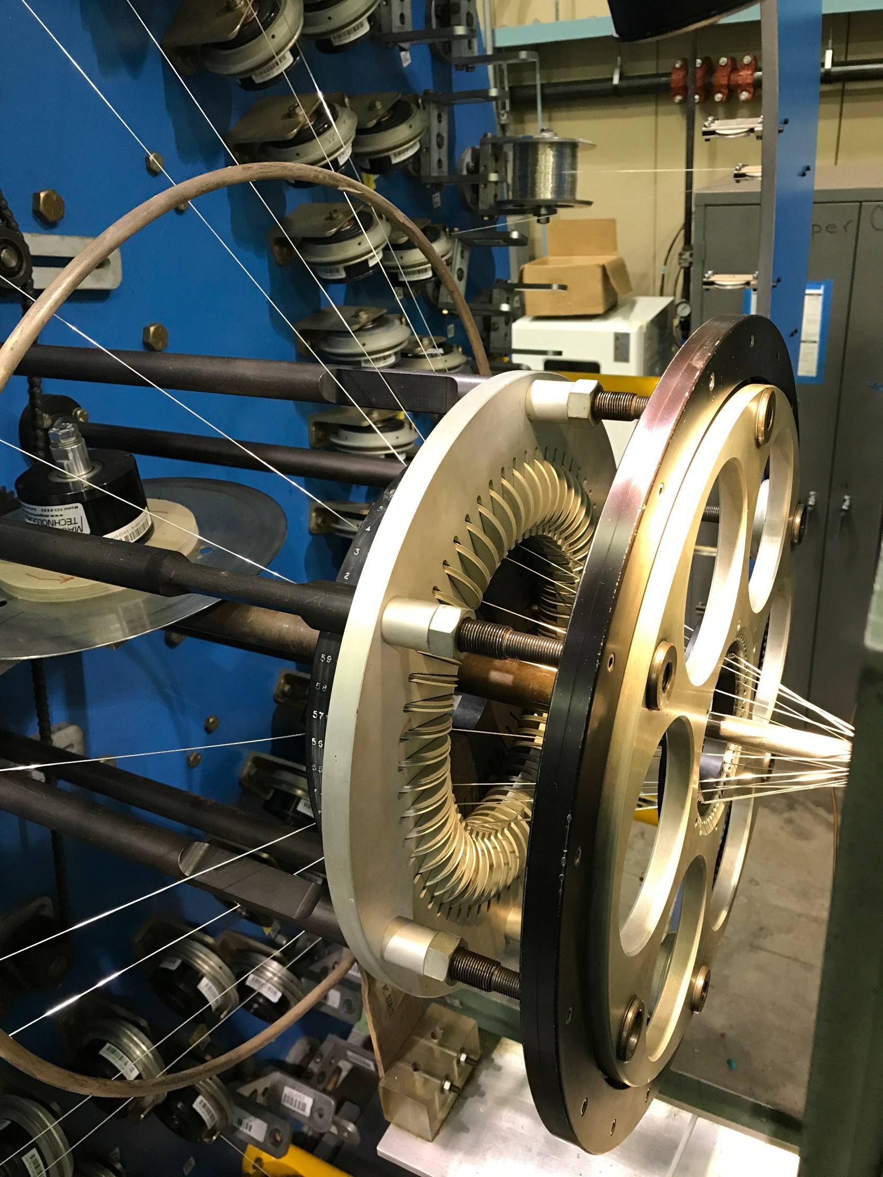
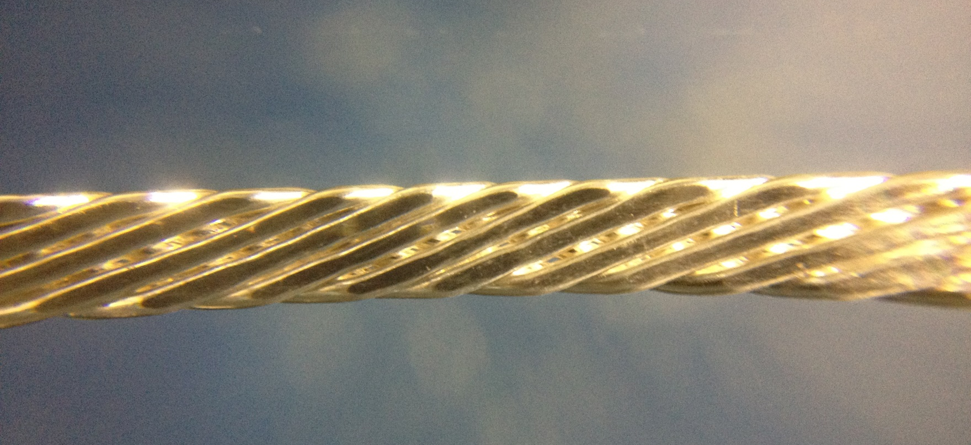
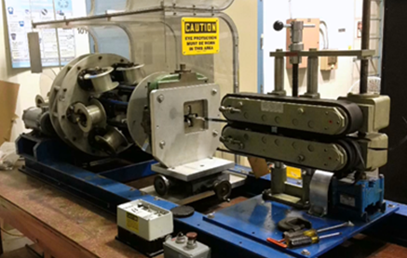
Leading The Field And Setting Records
CCT
LARP
LARP/AUP
HTS
WFO
List of Rutherford cable types fabricated in the past 5 yrs
4. HTS cables
Y80 | Bi-2212 R&D cable
Y81 | Bi-2212 9-strand Rutherford cable
Y82 | Bi-2212 17-strand Rutherford cable
Y90 | Bi-2212 6-around-1 cable

Slide 31
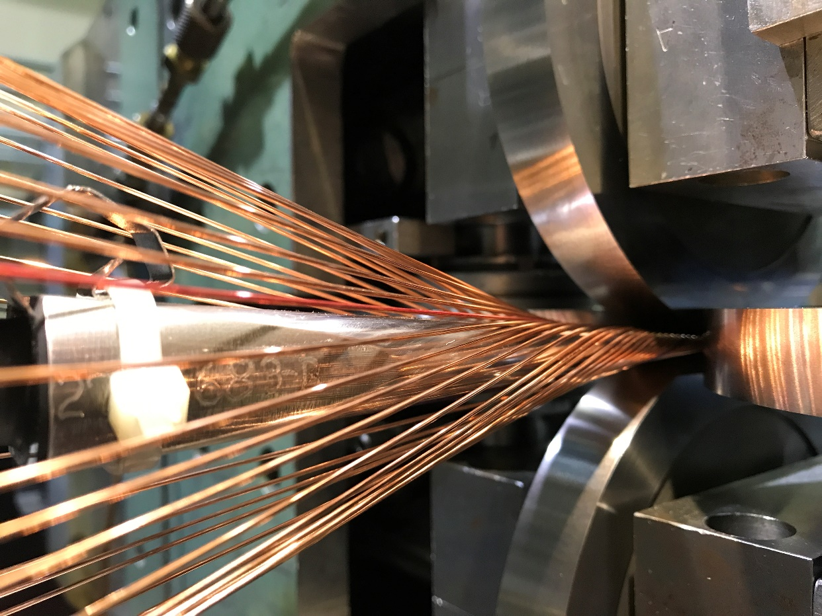


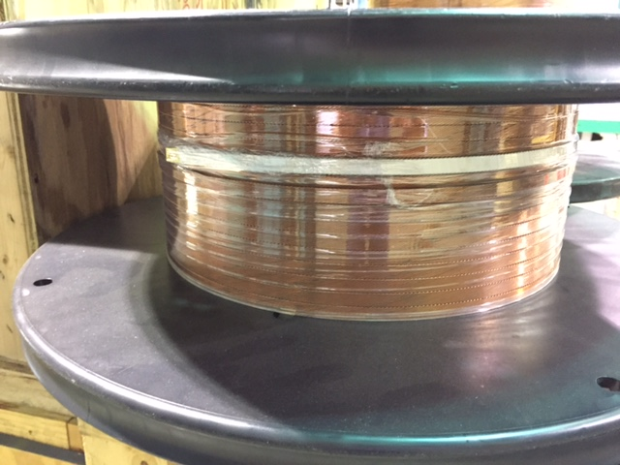
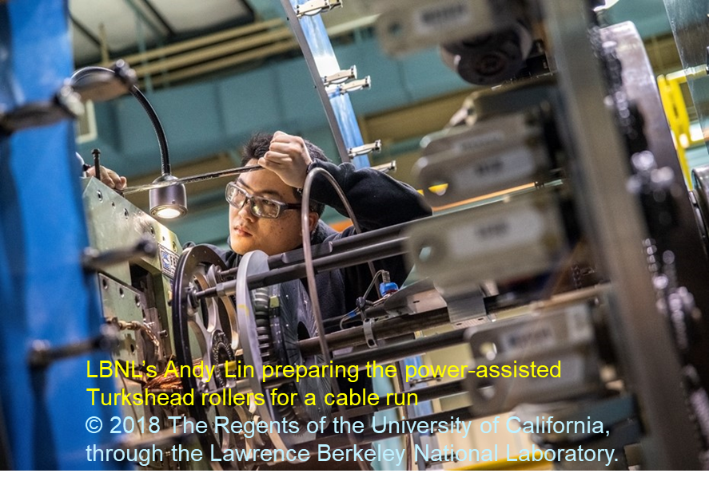
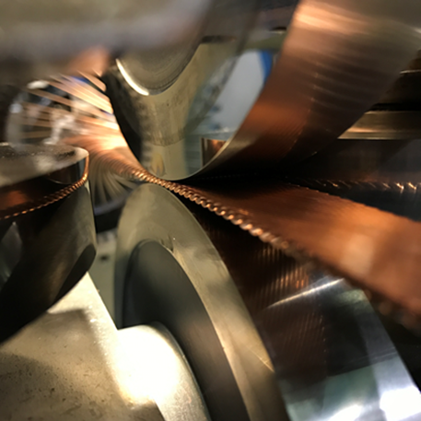
Helping The Community – We Are A Go-To Place
CCT
LARP
LARP/AUP
HTS
WFO
List of Rutherford cable types fabricated in the past 5 yrs
5. Other cables
P42 | Nb₃Sn 40-strand 0.40° keystone cable for USIPO/ITER, w/o core using unannealed 108/127 strands
B13 | Nb₃Sn 21-strand cable, 2-pass

Slide 32
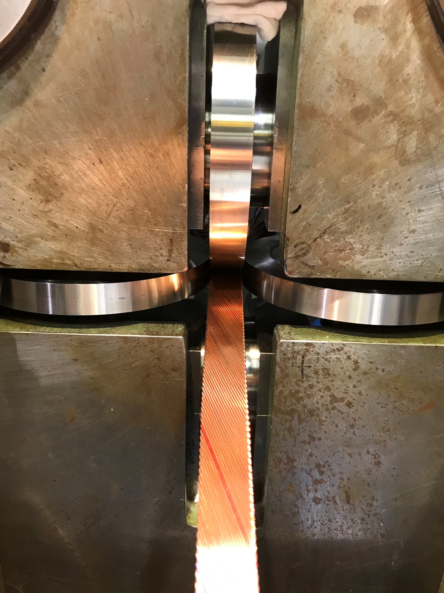
Summary
Relevant wire procurement experience
Infrastructure, software, people with technical skills
A range of cable designs
    Nb-Ti, Nb₃Sn, Bi-2212; Rutherford type, 6-around-1
    With / without core
    With / without pre-cabling annealing
    Single-pass / 2-pass (with intermediate annealing)
    Insulation: sleeve, tape, direct braiding
Supporting a range of activities
    For LBNL Base Program→MDP, LARP→AUP, WFO
    Total number of cables in past 5 years: >80
    Approximately: ~20 km or ~4 tons
    Value-added ~$3.5 M
Both scientific knowledge and project QA/QC rigor

Slide 33









Beyond LBNL: Collaboration, Inter-lab Comparison
BNL
CERN
FNAL
NHMFL
UC Berkeley
…

Slide 34
Extra Slides

Slide 35
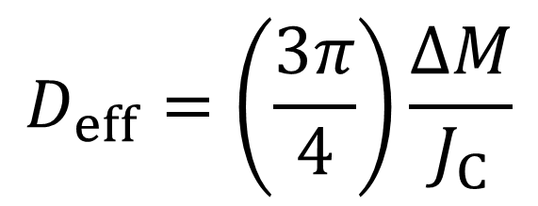
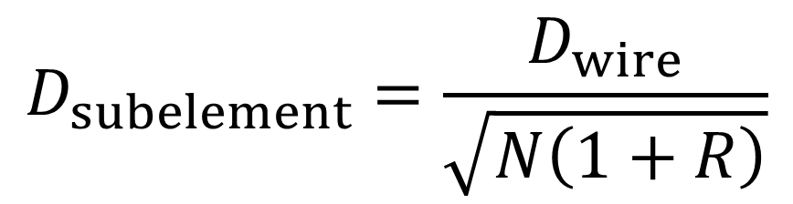
D_{eff} Equation and Table
$$D_{eff}=\left(\frac{3π}{4}\right)\frac{∆M}{J_{C}}$$
$$D_{subelement}=\frac{D_{wire}}{\sqrt{N\left(1+R\right)}}$$
Subelement diameter in μm of some common combinations of restack counts and wire diameters, assuming R=1.15.
D_{wire} (mm)

Slide 36













Present LARP Strand and Cable QA
Comparison: Procurement, Strand, Cable
QA: Overall, Cable, Strand
QC: Strand, Cable, HT
Database
Conductor ready for coil winding at FNAL/BNL
Wire annealed at LBNL
Insulation performed at NEWT
SS Core provided by Brown Metals
Cable fabricated at LBNL
Wire manufactured by OST
QC: OST Quality Plan;
ISO 9001:2008 certified
Spec: LARP-MAG-M-8007
ISO 9001:2008 certified
OST DCD; LARP Verify; acceptance
Certificate of Test/Conformance
QC: Wire Annealing Proc.; Spec: LARP-MAG-M-8005
ISO 9001:2008 certified;
Spec: LARP-MAG-R-8006
Annealing Control Point
QC: Cable Fabrication Proc.; Spec: LARP-MAG-M-8005
Cable Release Note
LARP Extracted Strand
10-Stack Measurement
Notes:
OST QP: 1. Description of raw materials selection and inspection; 2 vendor selection and monitoring; 3 project organization; 4 in-process testing and controls; 5 employee training; 6 final product testing

Slide 37











LARP Cable QA
Corrective Action
Comparison: Procurement, Strand, Cable
QA: Overall, Cable, Strand
QC: Strand, Cable, HT
Database
Wire Annealing
Technician re-spools wires, prepares spools, brakes, rolls, mandrel and SS core; barcode scans the spool map; strings the wires and adjusts the total brakes tension
Start-up check; Start-up runs; Parameter tuning;
QC tests
Cable Fabrication, online quality monitoring
Post cable run wire tension verification;
Leftover material labelling & archiving
Sample labelling, shipment,
QC tests
Documentation, Reporting, and Final control point sign off
Release note review and approval by Task Leader
Strand map and SS core selection, Respool Log creation
ATPP
Authorization To Proceed Point
NP
Notification Point

