Slide 1
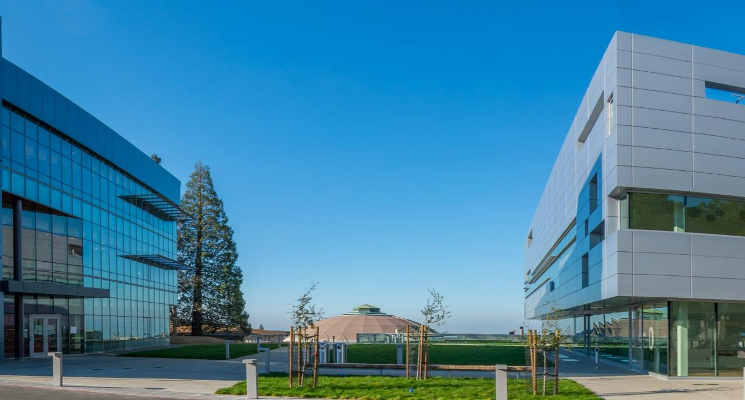
REBCO R&D results and plans
Xiaorong Wang
Presented to Mr. Barry Sullivan and Mr. Daniel Clark, FES Program Managers
Lawrence Berkeley National Laboratory
October 22, 2019

Slide 2
Outline
Our vision of contributing towards developing HTS magnet technology for fusion
Current program activities and impactful outcomes
Highlight of recent results with significant impact on HTS fusion magnet technology
Next steps and summary

Slide 3
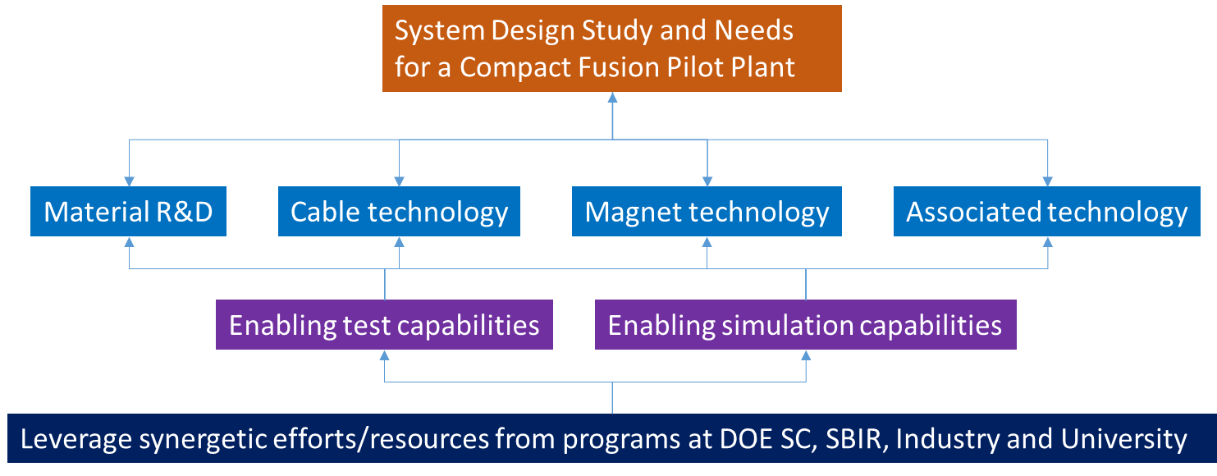
Our vision for a fusion high-field magnet development program
Fusion
Magnet Program
More details in High Field Fusion Magnet and Conductor Development by R. Duckworth, S. Gourlay, S. Prestemon, P. Titus, X. Wang, and Y. Zhai, submitted to the upcoming APS-DPP Knoxville workshop

Slide 4
We are focused on addressing the issues described in our FES scope of work aiming to lay the foundation for the fusion magnet program
 | FWP Scope Element | Progress
I | Understand conductor and cable performance and its impact on magnet design and performance | Yes. Developing test capabilities and appropriate performance metrics
II | Develop fundamental HTS magnet technologies with a focus on advanced tools for integrated design and analysis of magnetics and mechanics; magnet fabrication and test; and quench detection and protection | Yes. Systematically addressing magnet technology issues: modeling and design, magnet fabrication techniques, magnet protection, etc.
III | Produce subscale coils that mimic the essential magnetic and mechanical features of TF and PF coils and understand their behavior | Just starting; mainly leveraging HEP geometries to-date; mimic features and some conditions of fusion coils
IV | Feedback to conductor and cable manufacturers on parameters that will improve magnet performance | Yes. Working closely with industry via SBIRs; providing feedback on tape and cable performance
V | Evaluate the feasibility and next steps for development of high-field HTS fusion magnets | Yes. Working with the community to develop technology roadmaps for application of HTS to fusion
[Maxim’s presentation on diagnostics]
[GianLuca’s presentation on cable facility]

Slide 5
LBNL FES efforts on HTS magnet technology leverage expertise and facilities from HEP
FY17-19 programmatic funds:
Focus on aspects critical to FES and relevant to HEP
    REBCO tape and cable transport properties as a function of T, B, ε
    HTS magnet technology development
    HTS magnet modeling and diagnostics
FY16
$1000k
FY17 | FY18 | FY19
$333k | $333k | $333k
In FY18 funds were obligated for CORC® cable ($230k) and a graduate student ($184 k)
Addressing FWP elements I, II, III
FY18 end-of-year funds:
  Focus on aspects novel quench detection methods and magnet protection paradigms
    Active acoustics - first demonstration on cable architectures
FY18
$400k
FY19
$500k
[Maxim’s presentation on diagnostics]
Addressing FWP element II

Slide 6
The FES magnet program at LBNL is generating high impact in the area of HTS for fusion
5 peer-reviewed journal papers
  Measurements of the Strain Dependence of Critical Current of Commercial REBCO Tapes at 15 T between 4.2 and 40 K for High Field Magnets, https://doi.org/10.1109/TASC.2019.2902458
  Finite element analysis of the strain distribution due to bending in a REBCO coated conductor for Canted Cosine Theta dipole magnet applications, https://doi.org/10.1109/TASC.2019.2897708
  A 1.2-T canted cosΘ dipole magnet using high-temperature superconducting CORC® wires, https://iopscience.iop.org/article/10.1088/1361-6668/ab0eba
  Engineering current density over 5 kA mm-2 at 4.2 K, 14 T in thick film REBCO tapes, https://doi.org/10.1088/1361-6668/aad844
  Summary of the FESAC Transformative Enabling Capabilities Panel Report, https://doi.org/10.1080/15361055.2019.1565912
3 white papers on the needs of a national HTS fusion magnet program
  National Academy of Science panel on the Magnetic Fusion Research Strategic Directions
  FESAC Transformative Enabling Capabilities Subcommittee
  National Fusion Magnet and Conductor Development Initiative for the Madison and Knoxville Workshops, APS DPP Community Planning Process
9 presentations in relevant international conferences and workshops: 2017- now
  International Conference on Magnet Technology
  Workshop on HTS accelerator magnets
  National Academies Panel: Strategic Plan for US Burning Plasma Research
  IAEA DEMO Programme Workshop
  Applied Superconductivity Conference
  WAMHTS (invited)
  “Back to the Future” (invited)
  23rd Topical Meeting on the Technology of Fusion Energy (TOFE) (invited)
  Transformative Enabling Capabilities for the ISFNT conference (co-author of A. Lumsdaine’s invited talk/paper)

Slide 7

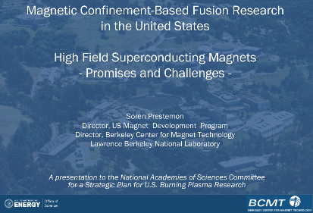
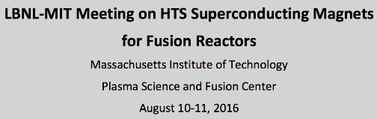
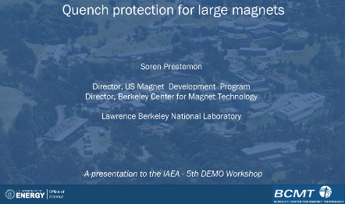
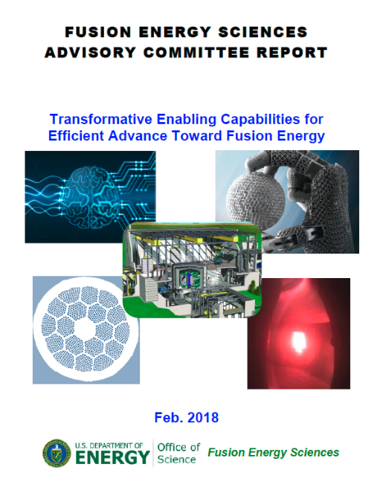
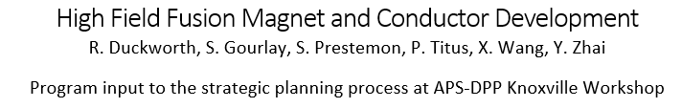
We continue to work hard to support strategy development for HTS fusion technology program
Addressing FWP element V

Slide 8
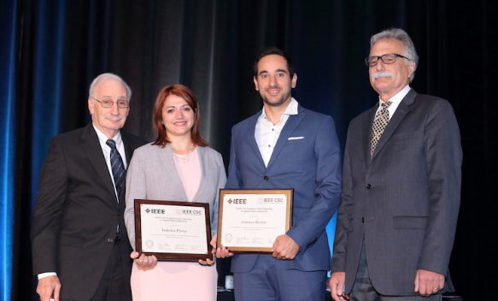

The FES magnet program at LBNL also provides excellent opportunity for graduate students to pursue their research and career in fusion technology development
Federica Pierro who recently earned her PhD from Tufts University under the supervision of Prof. Luisa Chiesa, performed her study at LBNL
  Characterization of the impact of mechanical strain on the performance of commercial HTS conductors
Federica’s research was recognized by several highly-selective awards
  Best Student Paper, 1st Prize (Materials)
  The Victor Keilin Memorial Prize (Materials)
  IEEE Council on Superconductivity Graduate Fellowship
We continue to host students pursuing their graduate studies as part of the FES magnet programs
  Aurora Cecilia Araujo Martinez, Master Student from University of Guanajuato, Mexico
Dr. Pierro with the best student paper award at the Applied Superconductivity Conference, October 2018
Dr. Pierro with the IEEE Graduate Fellowship award, September 2019

Slide 9
Highlights of recent research activities
supported by the FES investment and next steps

Slide 10
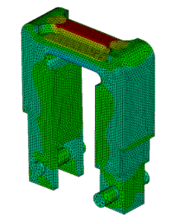
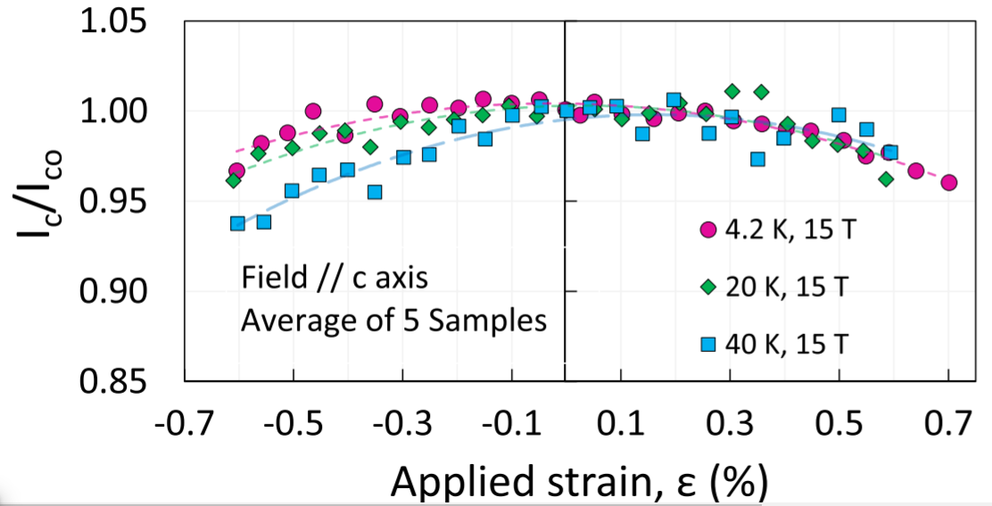
The investigation of the impact of mechanical strain on commercial REBCO tapes provides critical input to develop robust high-current fusion cables
REBCO is brittle and subject to strain during the cabling process, magnet fabrication and operation
Our driving questions:
  What’s the impact of strain on REBCO tapes relevant for fusion magnet applications?
  What’s the mechanism of strain dependence?
  How to optimize strain dependence for fusion cables and magnets?
Measured the strain dependence with a U-spring setup
First data at 15 T and 4.2, 20 and 40 K. Reversible strain dependence up to 0.7% in tension
Critical input for the development of HTS fusion cables and magnets
Federica Pierro
Measurements of the Strain Dependence of Critical Current of Commercial REBCO Tapes at 15 T between 4.2 and 40 K for High Field Magnets,
IEEE Trans. Appl. Supercond. https://doi.org/10.1109/TASC.2019.2902458
Addressing FWP elements I, IV

Slide 11
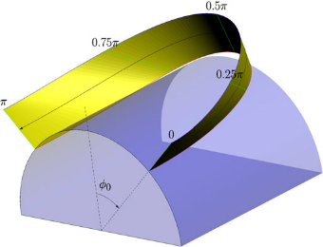
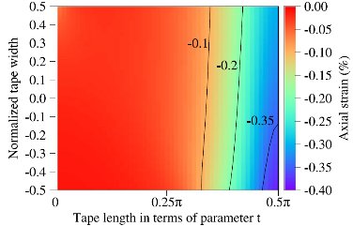

Develop optimal cable and magnet geometry to manage strain in REBCO cables and magnets based on the measured strain dependence on single REBCO tapes
What’s the best cable and magnet design that can minimize the bending strain?
  Use constant-perimeter geometry to enable easy-way bending and manage the strain distribution in REBCO tapes
What’s the strain for specific HTS fusion cable design (e.g., CORC® and twisted-stack architecture)?
A helical winding used in CORC® cable
A bending mode relevant for stacked cable
Strain in REBCO layer for the bend
Strain Distribution in REBCO Coated Conductors Bent with the Constant-Perimeter Geometry, IEEE Trans. Appl. Supercond., 6604010, 2017. https://doi.org/10.1109/TASC.2017.2766132
Addressing FWP elements I, II, IV

Slide 12
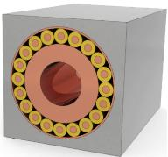
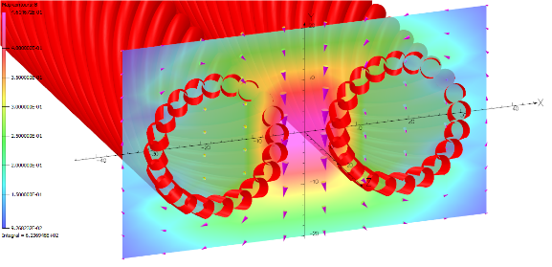

The program collaborates with leading HTS cable manufacturers to develop viable HTS cable technology through SBIR programs
Addressing FWP elements I, II, IV
Collaborate with Advanced Conductor Technologies to develop high-current HTS fusion cable based on CORC® wires – a concept different from the main stream cable-stack approach
Analyzed on mechanics and magnetics in a background field of 20 T. Provided feedback to the vendor on the cable optimization
Will help fabricate the cable samples to be tested at the SULTAN facility in Switzerland later this year
Mechanical and magnetic analysis for operations with 50 kA, 20 T
A one-strand model cable to measure the quench behavior
CORC®-CICC concept
Supported by the DOE FES SBIR programs

Slide 13
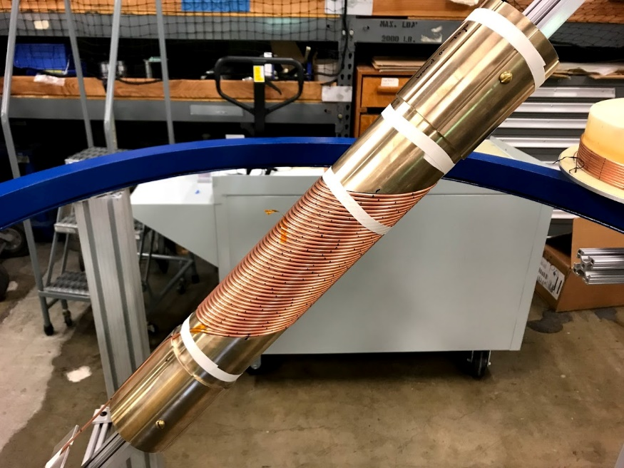
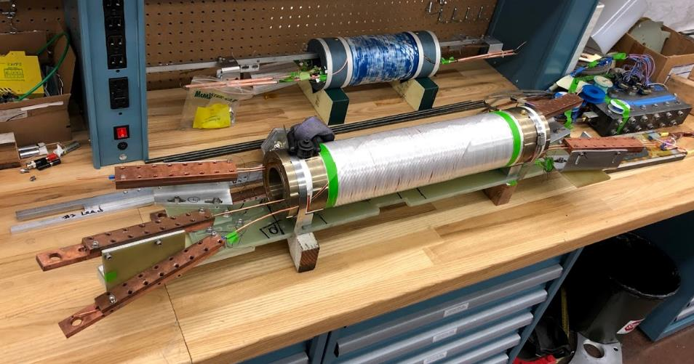
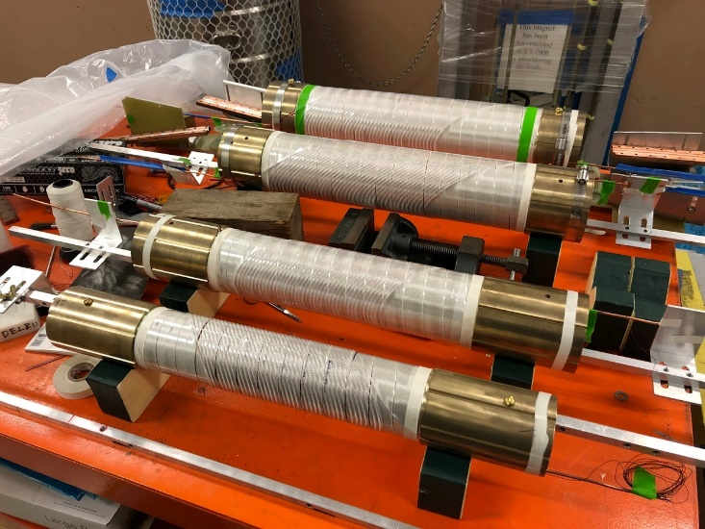

Leveraging HEP effort to develop high-field REBCO magnet technology for HTS fusion magnets
Strong synergies between FES and HEP high-field REBCO magnets: cable and magnet fabrication, impact of Lorentz loads, quench detection and protection, …
Dipole magnets can help establish the technology and provide early feedback for fusion applications
Addressing FWP elements II, III, IV

Slide 14
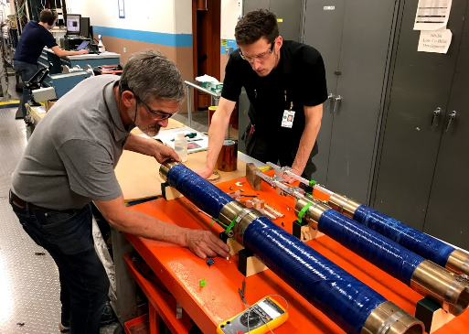
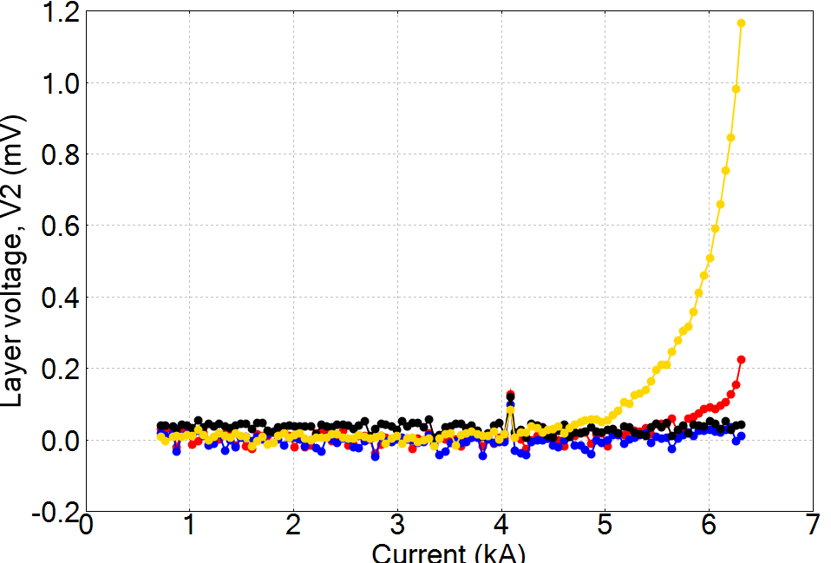
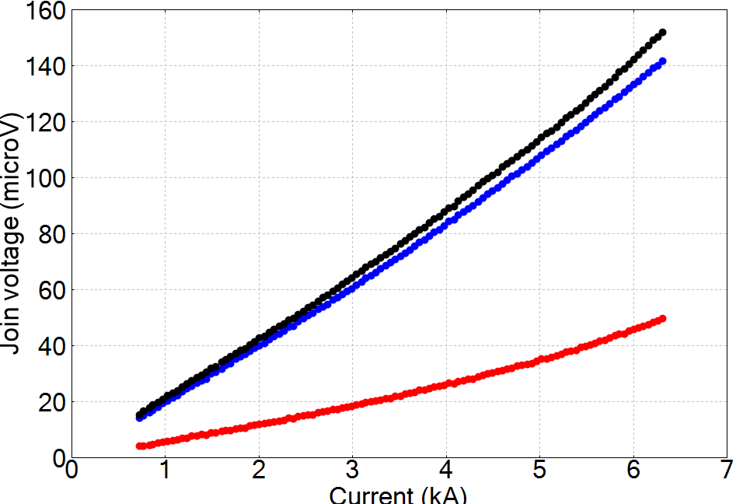
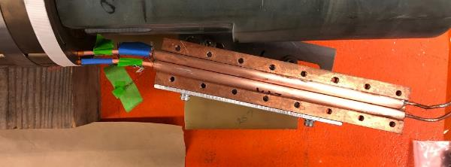
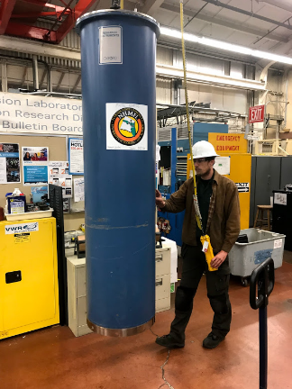
The latest REBCO dipole magnet using CORC® cables reached 2.9 T, laying a solid foundation towards our immediate next goal of 5 T with higher fields planned
Wire J_{e} = 595 A/mm² at 6.3 kA
Our goal is to provide critical technologies and expertise to fusion cables and magnets:
Coil winding and fabrication using REBCO conductors
Operation and quench detection at high current density (1000 A/mm²)
Low joint resistance 8 – 24 nΩ at 4.2 K (< 1 nΩ)

Slide 15
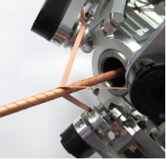
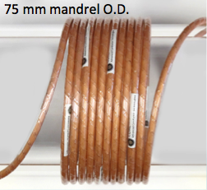
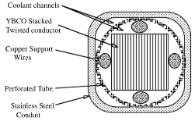
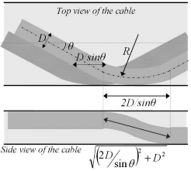

Next Step: Cable degradation is a critical concern, and LBNL is well-positioned to help understand HTS cable behavior
All HTS cables tested at SULTAN have experienced degradation of some sort after thermal and/or in-field cycling (Bruzzone, WAMHTS 2019, Budapest)
Statistics are low
Sources of degradation not yet clear
Critical area where we can help the community
Corresponds to proposed program element “Systematically evaluate and compare various concepts for HTS fusion cables”
Starting point: systematically study and understand the behavior of the building blocks of HTS CICC cables
M. Takayasu, L. Chiesa, L. Bromberg, and J. V. Minervini, SUST, vol. 25, no. 1, Jan. 2012.
D. van der Laan, Advanced Conductor Technologies LLC
W. Goldacker et al., TAS 17 3396–401
D. Uglietti, R. Wesche, and P. Bruzzone, TAS, vol. 24, no. 3, pp. 1–4.
G. Celentano et al., TAS, vol. 24, no. 3, pp. 1–5.
Addressing FWP elements I, IV, V

Slide 16
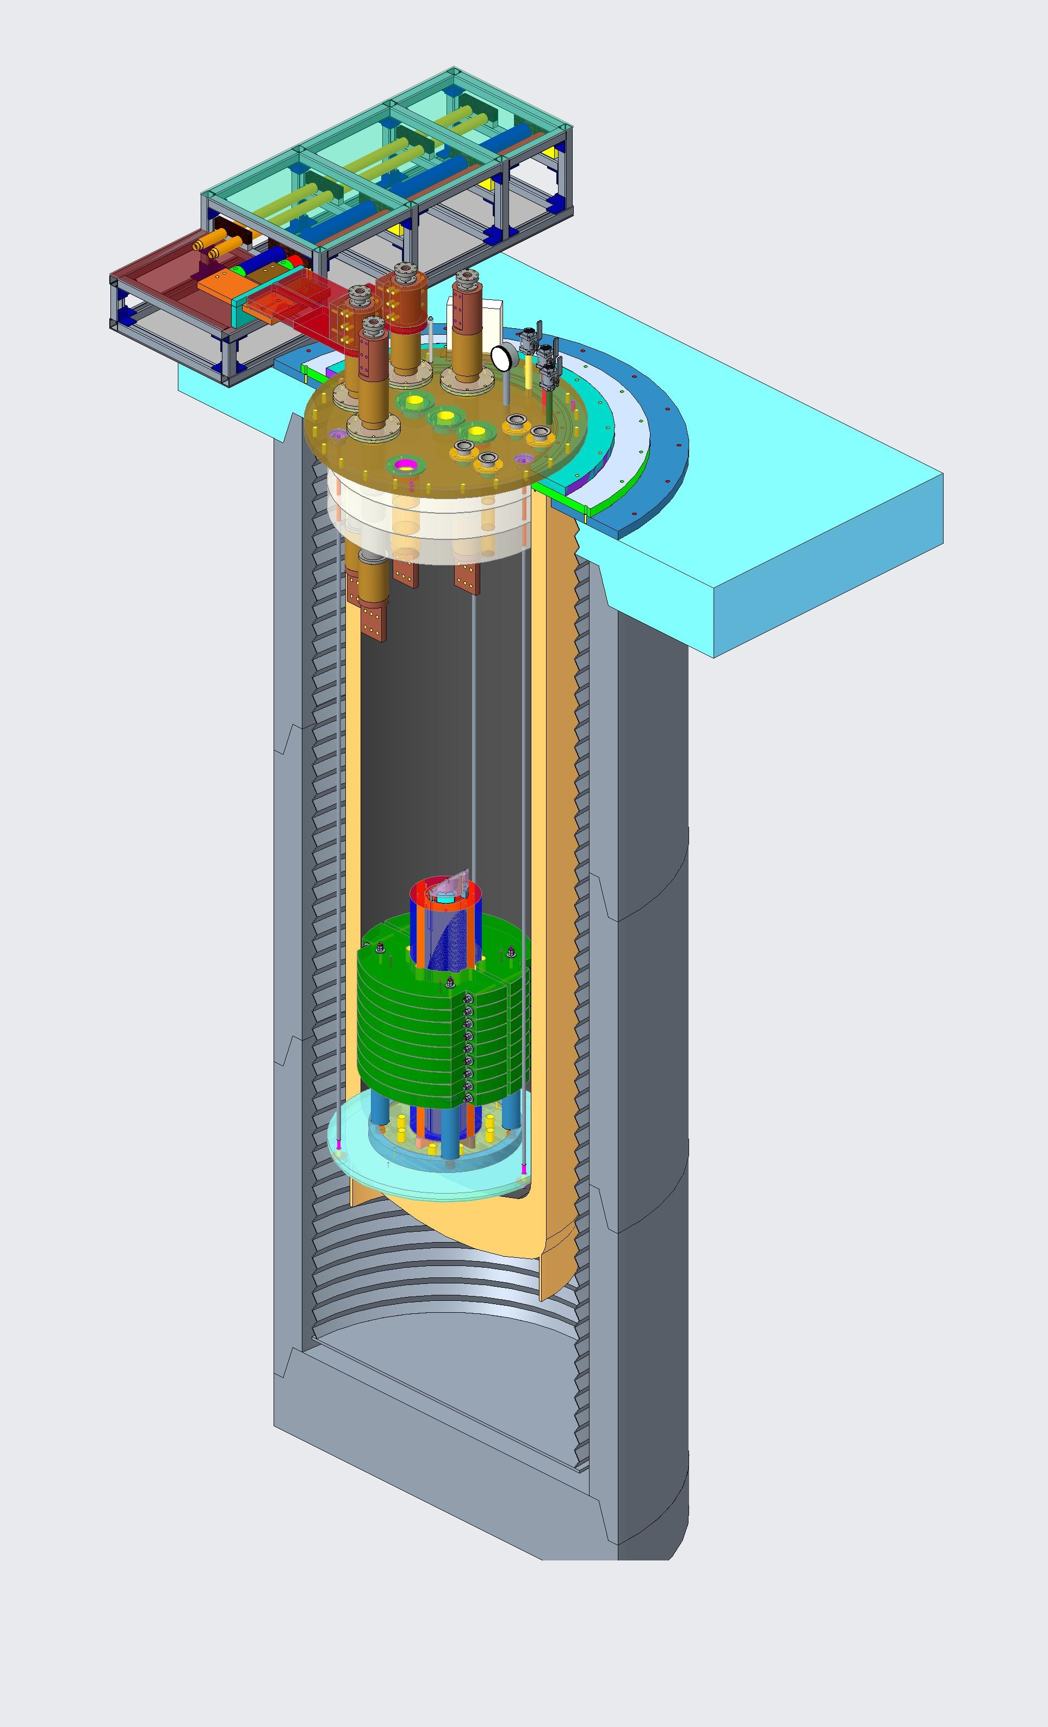
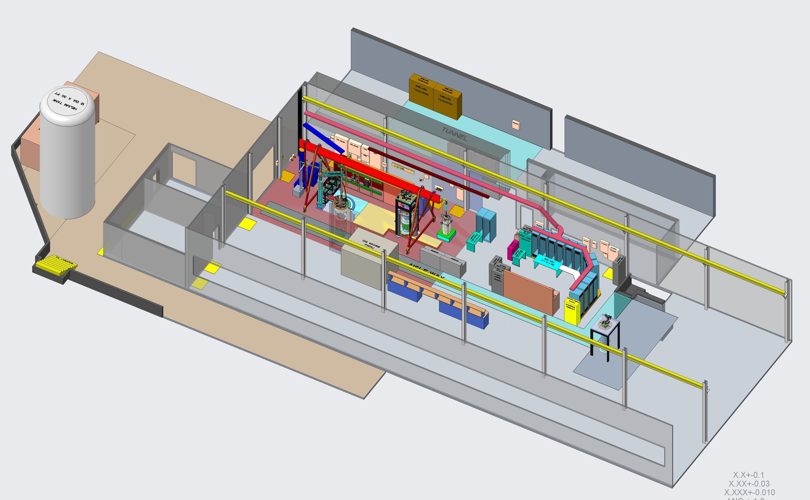
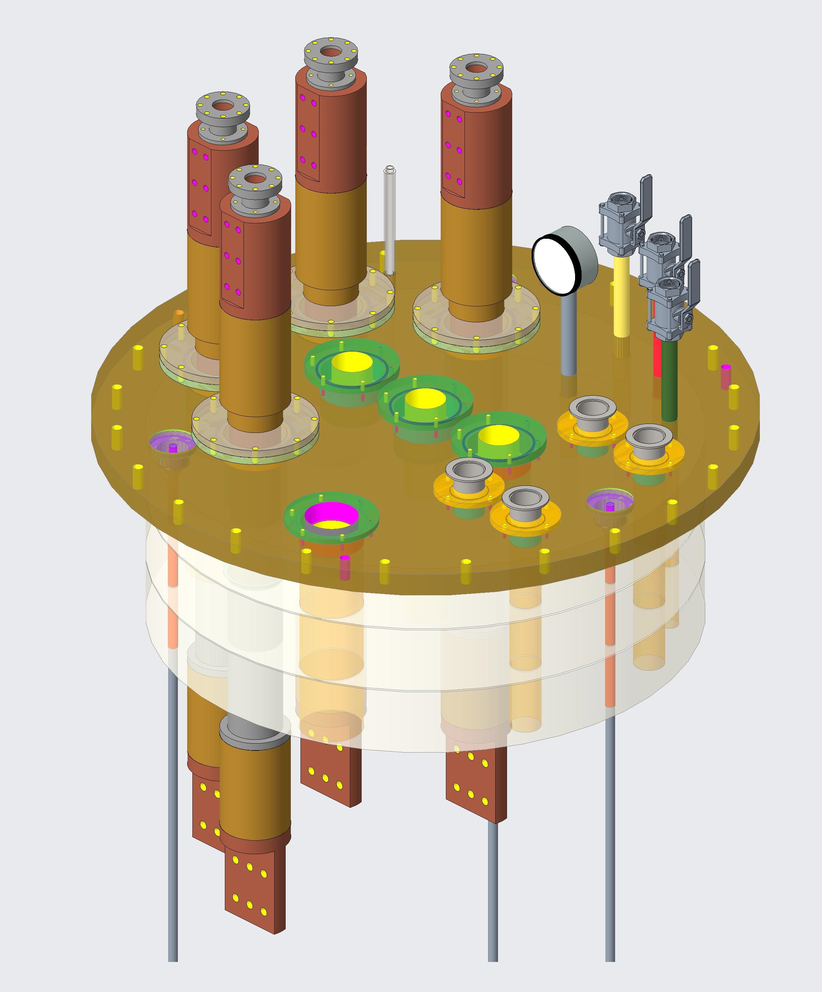
Leveraging LBNL’s test infrastructure and expertise, we are developing a test platform to evaluate the impact or Lorentz load on HTS fusion cable strands
Use an existing 8 T, 90 mm aperture dipole magnet and two 25 kA power supplies to provide up to 200 kN/m on single cable strand
Measure impact of cycling Lorentz load on various strand and cable designs
Understand mechanisms of degradation and provide feedback to tap/cable manufacturers
Allow other experiments relevant to fusion such as quench studies
Test in the background field of CCT5
A new header to be made
Building 58 test facility

Slide 17
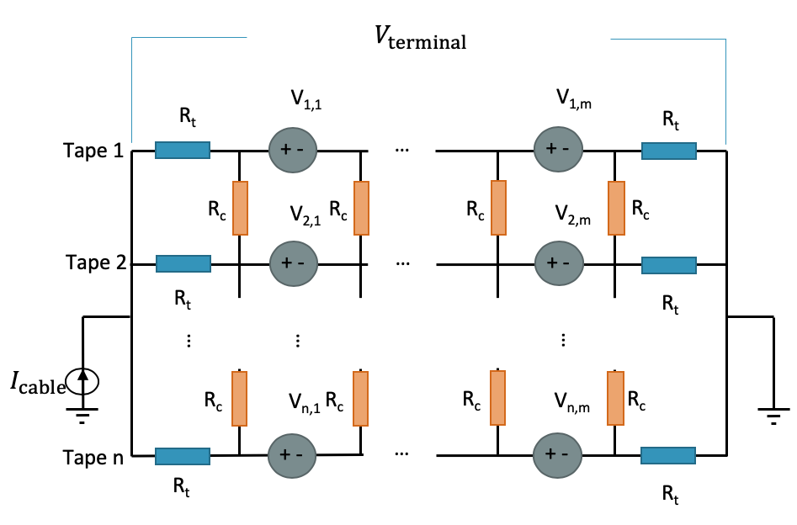
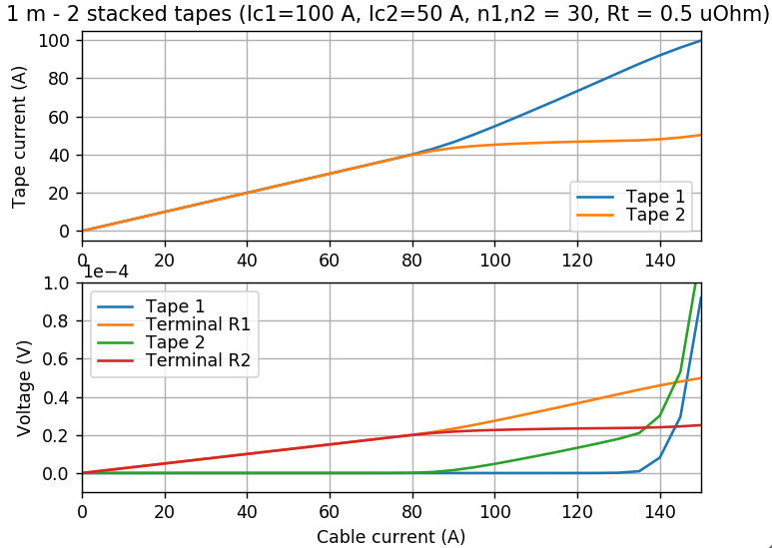
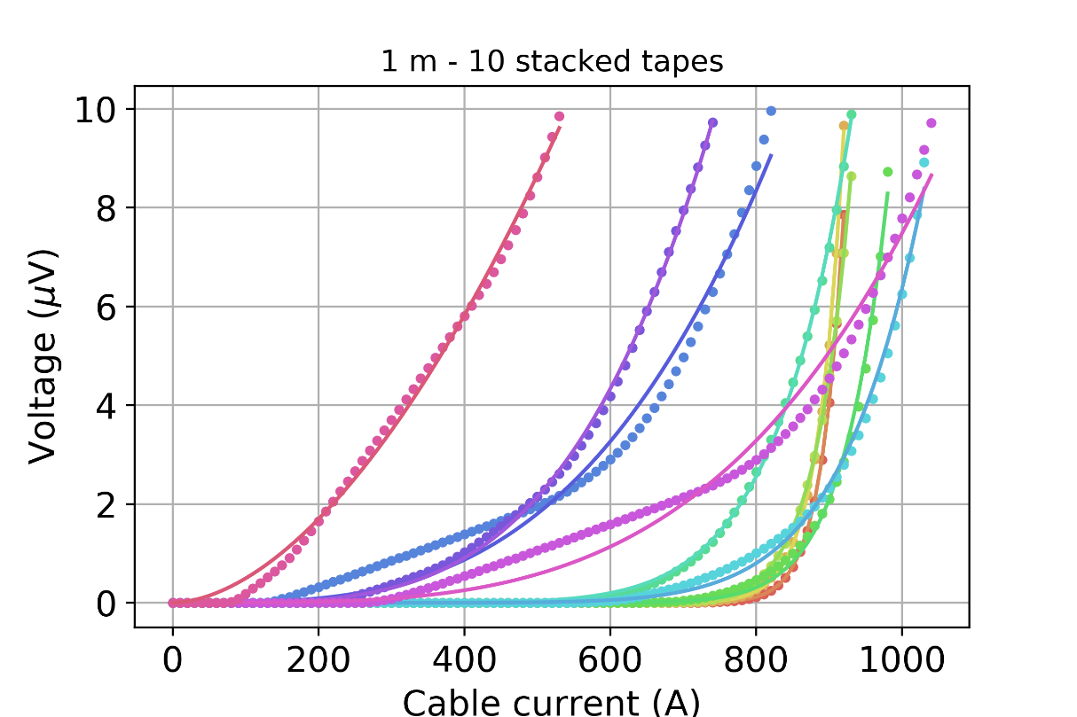
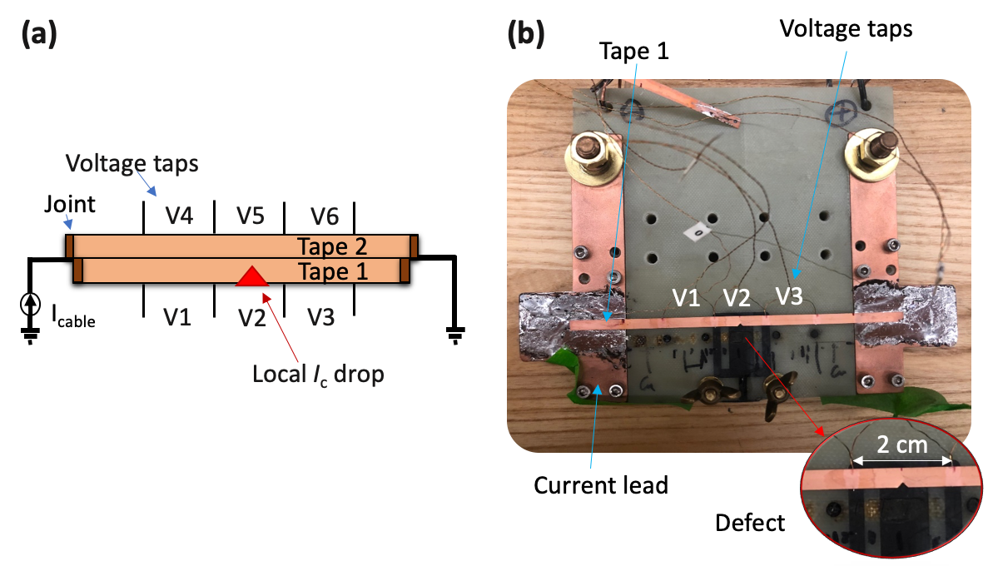

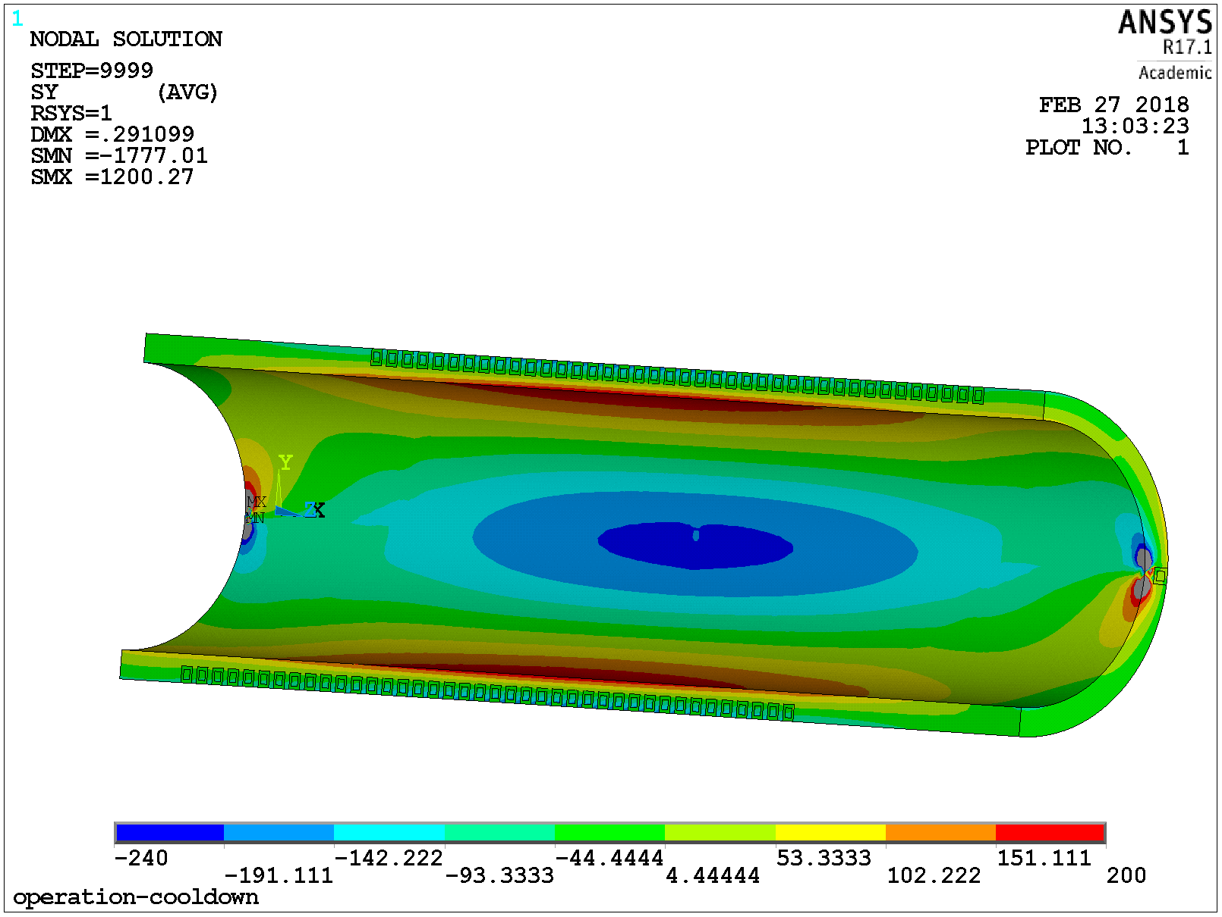
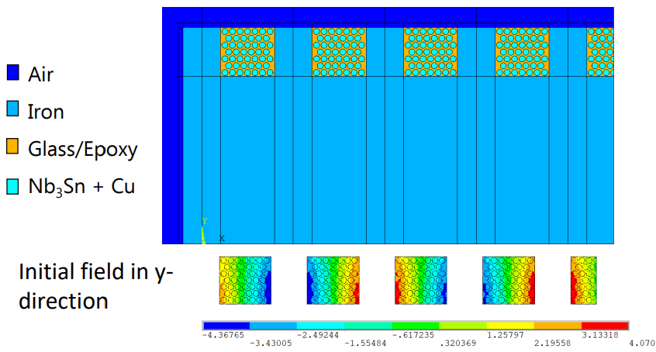
Leveraging the significant in-house expertise, we are developing comprehensive simulation capabilities to help understand current sharing and develop robust fusion cables and magnets
Approach 1: simple network circuit models – get to the first-order physics and gain insight
σ=60%
σ= 0%
An Electric-Circuit Model on the Inter-Tape Contact Resistance and Current Sharing for REBCO Cable and Magnet Applications, submitted to IEEE Trans. Appl. Supercond., 2019
Approach 2: multi-scale multi-physics simulation suites – high-fidelity tools to cover broader performance/behavior to help design fusion cables and magnets
Development of a modeling toolbox for CORC® cable performance evaluation
Addressing FWP elements I, II

Slide 18

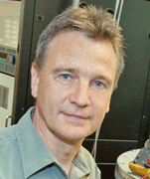


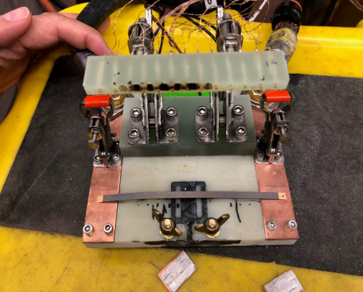
We are exploring the feasibility of coating with variable resistivity to enable current sharing between HTS tapes
We demonstrated V₂O₃ coating on short REBCO tapes using cathodic arc plasma deposition as a first step to enhance protection capability for REBCO cables and magnets
Collaborating and leveraging the coating expertise at ATAP division under the support of FES investment and LDRD
Qing Ji, Andre Anders, Zhenhuai Yang from Plasma Coating Group and Cecilia Araujo Martinez from University of Guanajuato
ρ(T) with various O₂ flow rates, 3 orders increase from RT to 77 K
Negligible impact on I_{c}
Setup to measure current sharing with the coating
voltage contact
REBCO tape with coating
Heater
Cu lead
Addressing FWP elements I, II

Slide 19
HTS activities are progressing well… and we are highly motivated to move faster
Priorities are:
  Improved understanding of REBCO cables for fusion
    Leverage existing infrastructure
    Development of new test capabilities as needed
  Advanced modeling & diagnostics
    New FEA techniques under development with superconductor-specific physics properties built-in
      Further leverage computer clusters with FEA
    Development of analytic models to guide cable and magnet design
    Active acoustic techniques for quench detection and magnet characterization
  Develop, characterize and compare competing cable architectures
  Characterize and understand the degradation of HTS fusion cables under cycling loads
  Demountable joint technology
Current research effort is scaled to the funding provided
Staff available to move more rapidly if funding allowed
Highly leveraged with HEP MDP
FES magnet focused

Slide 20
LBNL can contribute to a national HTS fusion magnet program to accelerate and propel the technology development towards fusion electricity generation
System Design Study and Needs for a Compact Fusion Pilot Plant
Material R&D
Cable technology
Magnet technology
Associated technology
Enabling test capabilities
Enabling simulation capabilities
Leverage synergetic efforts/resources from programs at DOE SC, SBIR, Industry and University
LBNL can play a major role to ensure the success of such a program
Notes:
Back to the future

Slide 21
Summary
We are working hard to support FES in the exploration, development, and application of HTS for Fusion
  Progress on conductor characterization and initial feedback to cabling
  Progress in investigating novel diagnostics for quench detection/protection [see Maxim’s presentation]
We are very active in the community to support FES in a major role in this arena
  Working closely with FES and the fusion community to develop plans for a test facility [see GianLuca’s presentation]
  Actively engaged with the research community to identify, understand, and address technical hurdles
  Actively engaged with industry to identify how DOE-FES / laboratories can best interact to advance the field
  Support the development of next-generation fusion scientists and engineers
We have identified the primary elements of an efficient and effective research program for FES
  Maximizes leveraging of other DOE programs (e.g. MDP). Tailored to LBNL’s expertise and capabilities, aligned with the communities needs
  Next step is to characterize and understand the degradation behavior of HTS cables under cycling loads
Are we effective to help DOE-FES evaluate/develop the feasibility of HTS fusion magnet technology?
How can we better address the technology needs/missions for DOE-FES?
Anything else we can contribute to a successful technology program at DOE-FES?

Slide 22
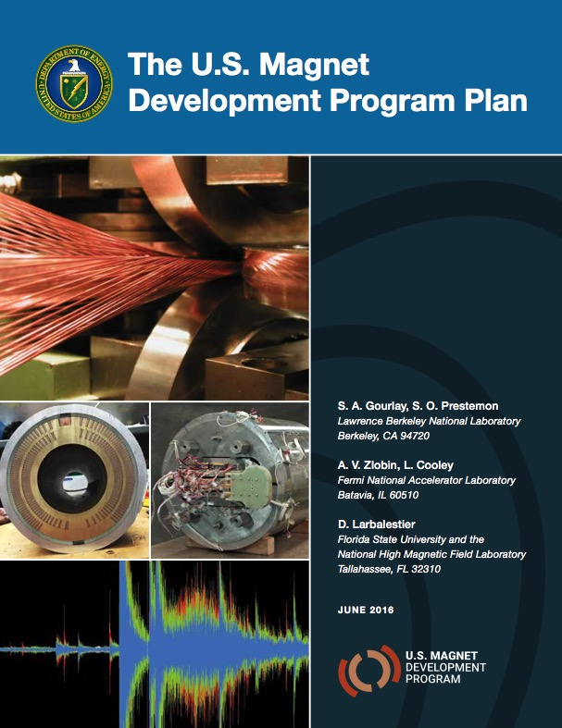
As stated in our NAS presentation, we are convinced…
“There is strong potential for partnerships with related science and technology programs within the U.S. Department of Energy and other institutions"
Strong synergy between FES and HEP
  in superconductor R&D and industrialization
    The Low Temperature Superconductor Workshop has been extremely successful in mapping science needs to industry developments - 35 years of work demonstrating value
    Continue to leverage “LTSW” for common HEP/FES goals for HTS
  in high field superconducting magnet technology
    HEP has initiated the US Magnet Development Program with clear goals and a roadmap to achieve them
    A similar programmatic roadmap for FES magnet development would clarify areas of unique investment and areas of overlap (synergy)
Strong synergy with the (largely NSF-funded) National High Magnetic Field Laboratory
  Leading the development of HTS for high field in a solenoid configuration
  Deep expertise in conductor development and characterization
  significant expertise and infrastructure to support HTS technology development
  Coordination/integration of DOE/NSF HTS technology capabilities and development roadmaps would lead to enhanced efficiency and speed up technology development
The international community has growing interest in exploring HTS for fusion
  Many areas where facilities and expertise can be leveraged/coordinated
  Collaboration with the international community is essential - access to expertise, facilities

Slide 23
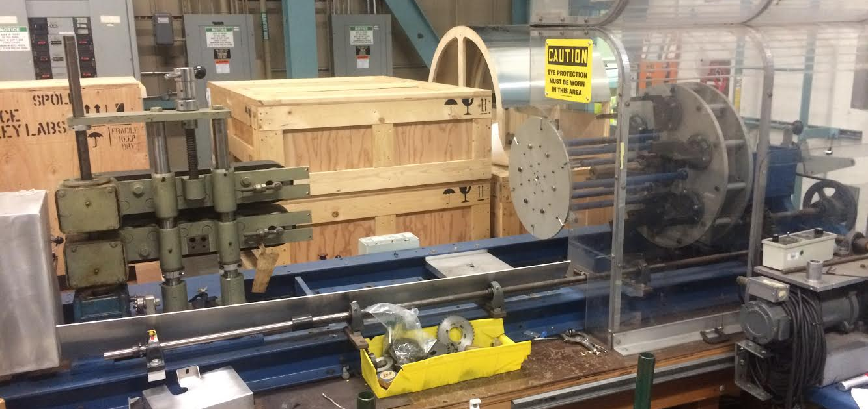
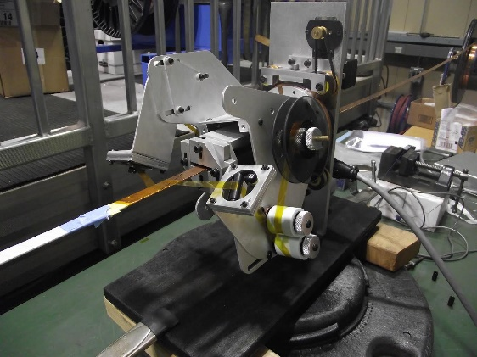
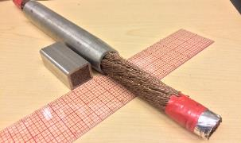
The world-class cabling facility and expertise at LBNL can contribute to the development of HTS fusion cables
LBNL 6-around-1 cabling machine. It can be adjusted for use with CORC® wires and cables
Tape wrapper to apply insulation or make cables
LBNL made NbTi CICC fusion cables

Slide 24
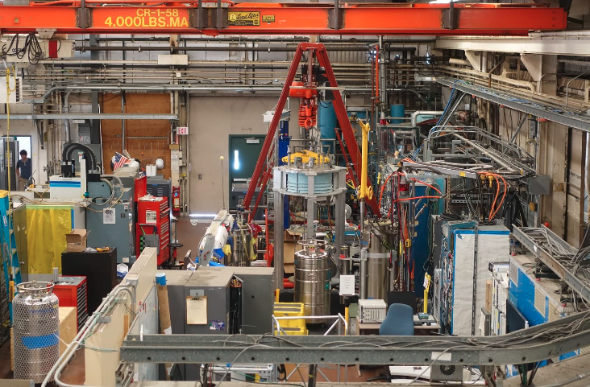
Strong test infrastructure and capability for high-field superconducting conductors and magnets will benefit the development of HTS fusion cable and magnet technology
Magnet Test Facility (Building 58)
24 kA DC power supply
Fast data acquisition (500 kHz, 16-bit)
Advanced quench detection and protection
Short-sample Test facility (Building 58)
15 T magnet
Test temperature 4.2 – 50 K
5 kA power supply

