Slide 1
Welcome and Logistics
Eric Prebys
Director, Crocker Nuclear Lab

Slide 2
Practical Details
Restrooms and water fountains
Back towards the elevator, just after you turn left
Wireless
Eduroam or UCD Guest (must register)
Lunch/Crocker Tour
We’ll walk over to Crocker Lab at noon for a tour.
Pizza will be delivered
$10/pp cash or paypal (eric.prebys@gmail.com)
Dinner (no host)
Bistro 33 at 6:30
Leave plenty of time for parking!

Slide 3
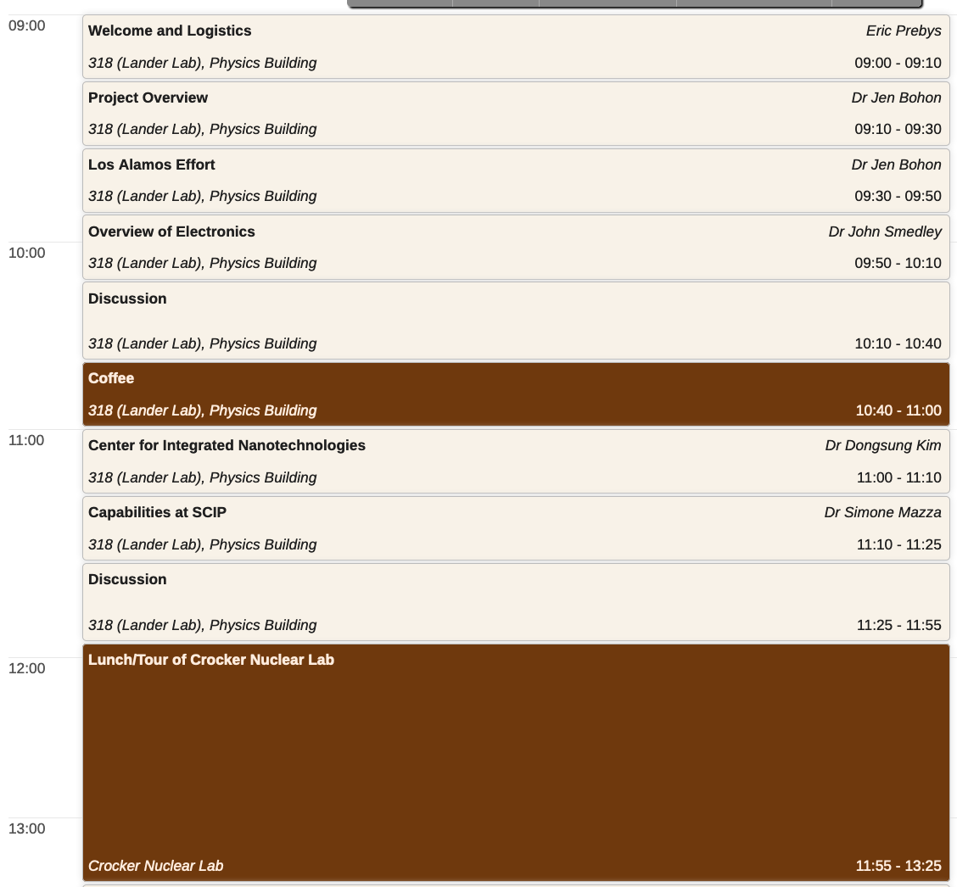
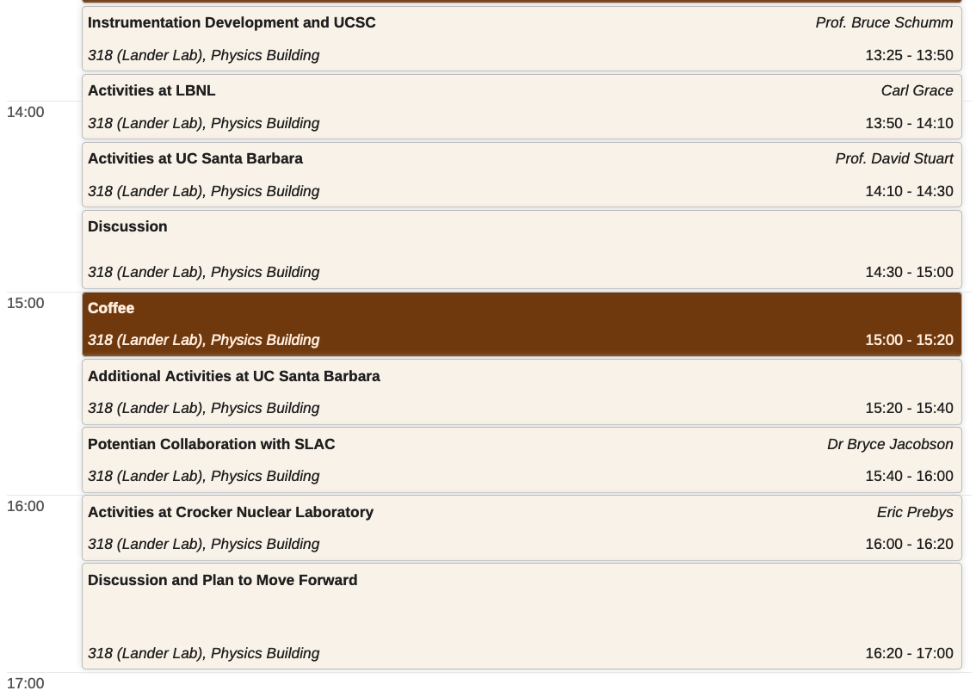
Timetable (very approximate)

