Slide 1
Advanced Diamond Diagnostics and Detectors for Accelerators
John Smedley
Jen Bohon
UC Davis
UC Fees Diagnostics Program Kickoff
1/25/2020
LA-UR-20-20731

Slide 2
LANL Interest
Diagnostics Challenges:
  GHz detection for photons & protons
    Flux, position, timing, IMAGING
  Expanding dynamic range - measuring the full X-FEL beam flux (in addition to pre-lasing beam)
  Shot to shot beam imaging for X-FEL beams
LANL Development Direction:
  Diamond sensors (single crystal and polycrystalline electronic grade diamond)
Partners needed for electronics development

Slide 3
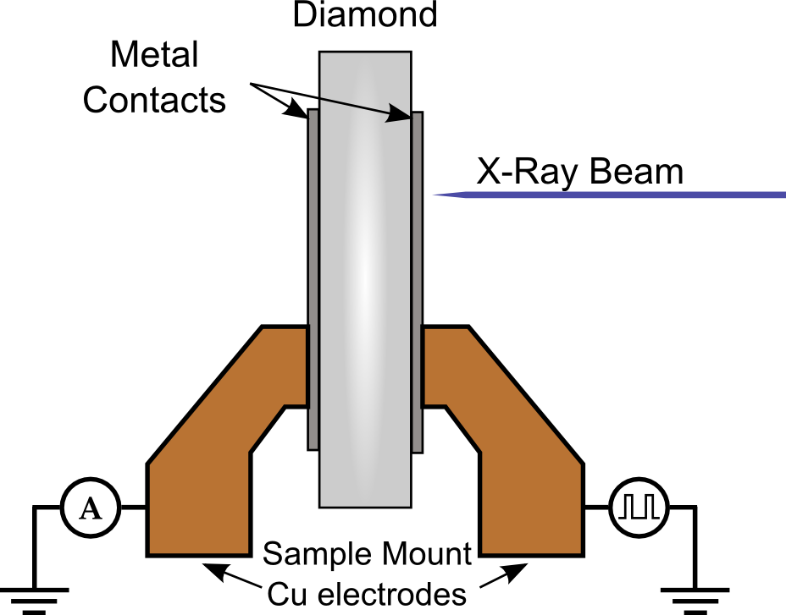
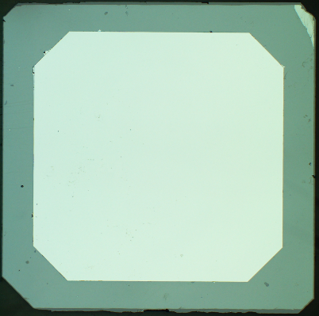
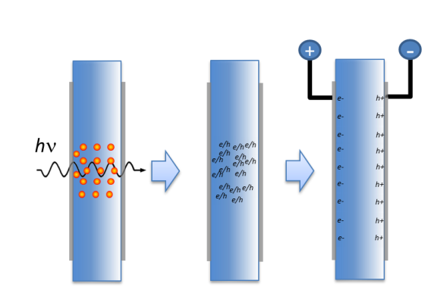
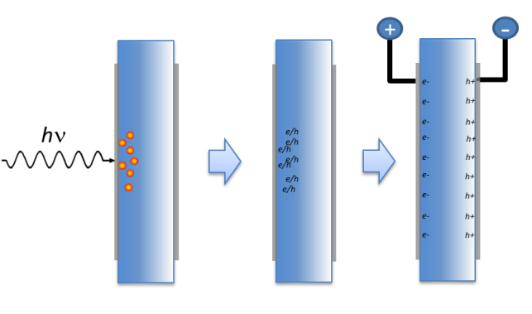
Diamond as an X-ray Sensor
Diamond Advantages:
Low X-ray Absorption
High Thermal Conductivity
Mechanical Strength
Radiation Hardness
Indirect bandgap
Sample Information:
Electrical grade CVD single crystal diamond
  (100) surface orientation
  ~1 ppb nitrogen impurity
Typical size: 4mm x 4mm x 50µm
X-ray generated charge carriers
Low energy x-ray
High energy x-ray
Electron hole pairs created near incident electrode: must move entire thickness of the diamond
Electron hole pairs created throughout the thickness creating a column of electron-hole pairs

Slide 4
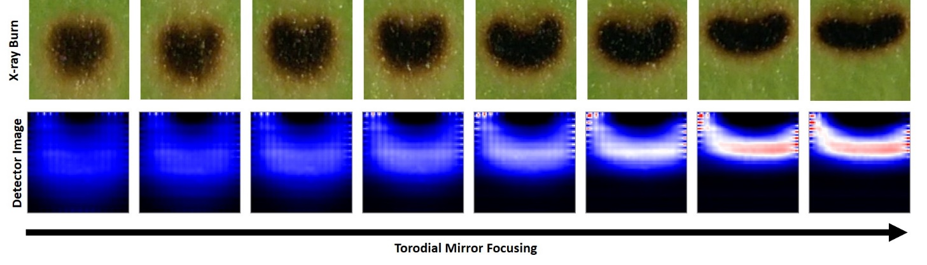
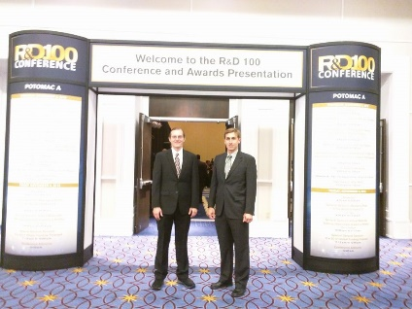
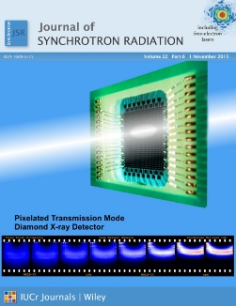
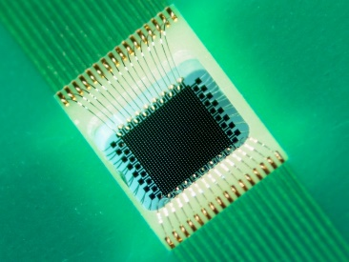
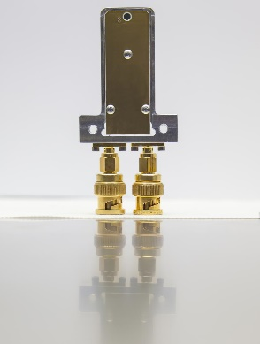
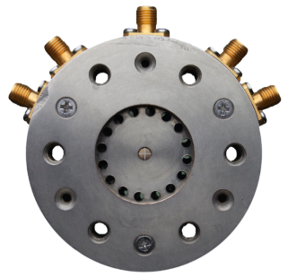
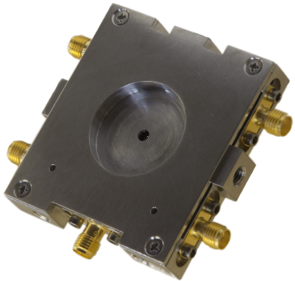
Diamond Sensors
Diamond Applications:
Synchrotron beam diagnostics
  White and Monochromatic
  Nondestructive, High power
  Flux, Position and Timing
  Beam Imaging
Medical beam diagnostics
  Gamma Ray Therapy
  Proton and Ion beam Therapy
FEL beam diagnostics
  Promising – current R&D effort
Diamond Properties:
Low X-ray Absorption
High Thermal Conductivity
Mechanical Strength
Radiation Hardness
Indirect bandgap (no radiative recombination)
Full charge collection at modest bias (0.1 V/µm)
Fast - carrier mobility 4500/3800 cm²V⁻¹s⁻¹ (e/h)
Flux linearity over more than 11 orders of magnitude!
1k pixel transparent camera
R&D100 2016 Finalist
Zhou et al. (2015)
JSR 22 :1396
(cover article)
Sensors in use at synchrotron beamlines around the world

Slide 5
Response vs Flux and Bias
“Clean” Single Crystal
Polycrystalline
Response to incident flux linear over 11 orders of magnitude
Under 0.1 V/µm required for full collection
300 µm thick plate
210 µm thick plate

Slide 6
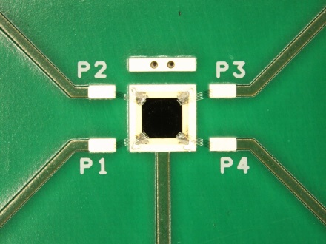
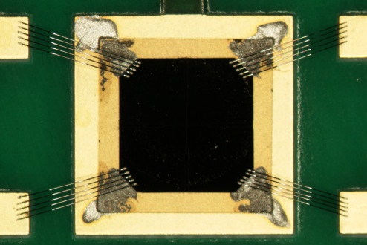
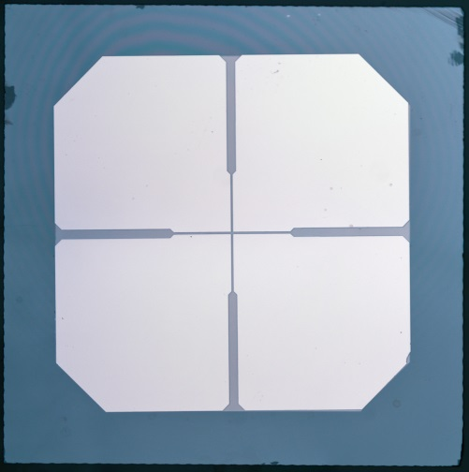
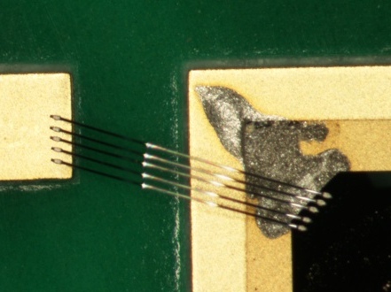
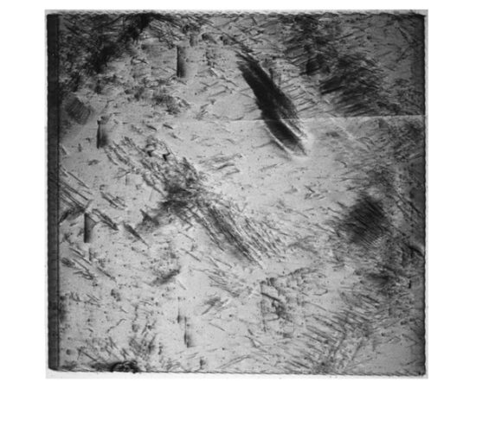
Fabrication
Lithography @ CFN
Wire Bonding - Instrumentation
75µm
20µm
25 µm aluminum wirebonds
5 bonds per pad
Conductive epoxy for backside/bias contacts
3.1mm
4.0mm
Topography – NSLS/CHESS
Electronic grade single crystal (100) diamond
30-50 µm thick
20 µm street over a 1mm center region
Metalization: 25 nm Pt
White beam topography
Prior to slicing

Slide 7
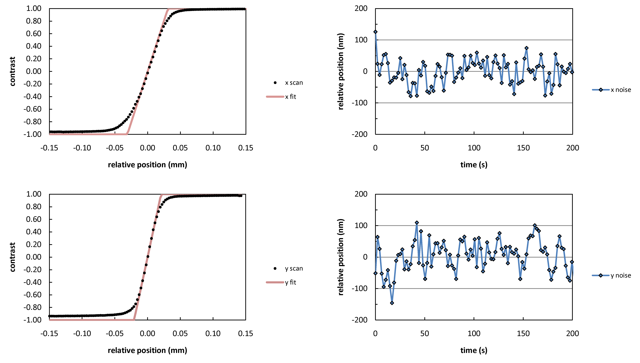
Beam Position Monitors
4mm
A
B
50 µm
C
D
3.5mm
RMS ~ 38 nm

Slide 8
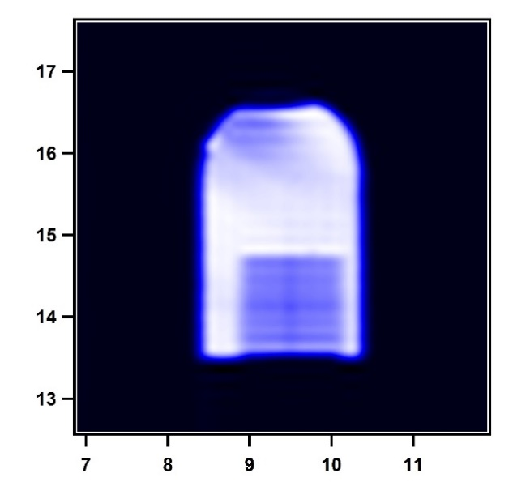

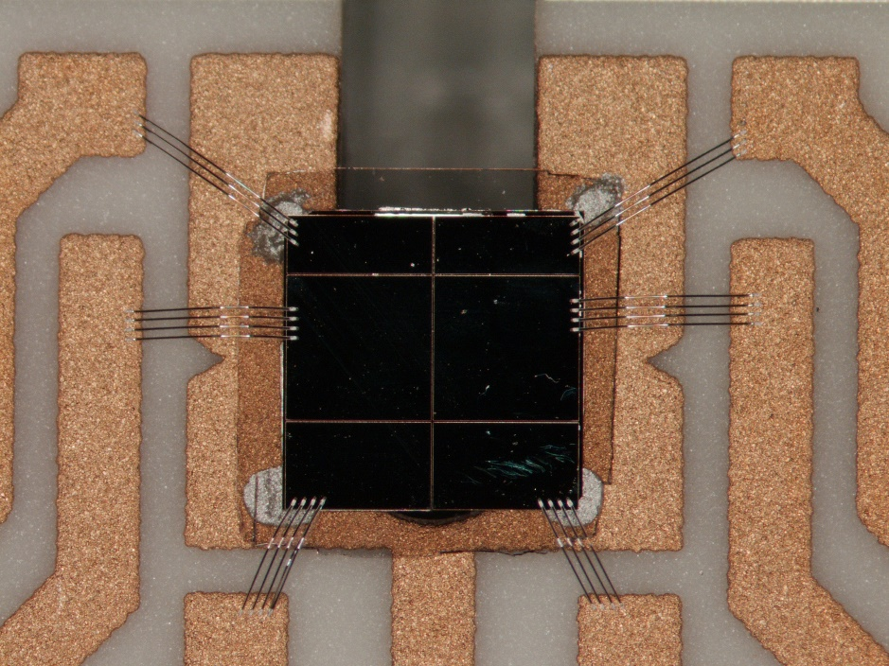
Thin Detectors
RIE ultrathin layers
4 µm membranes
Transmits 2 keV photons
Potentially much faster response
4 devices in use at SMI
5V

Slide 9
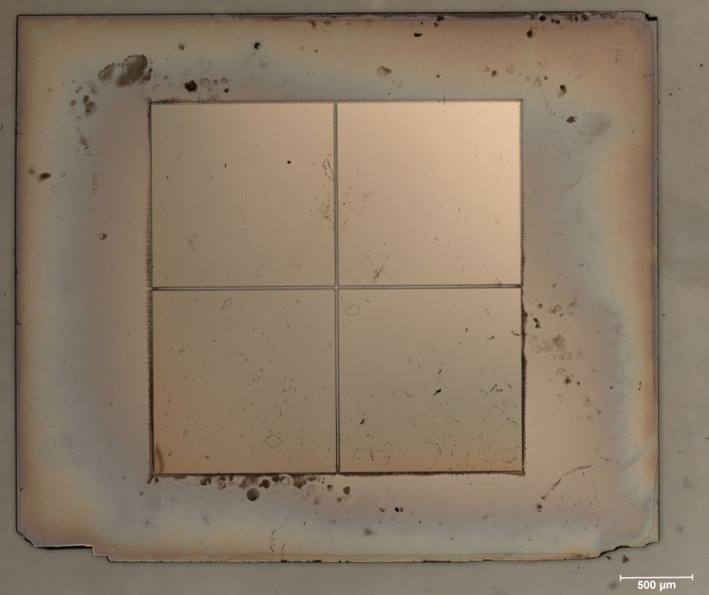
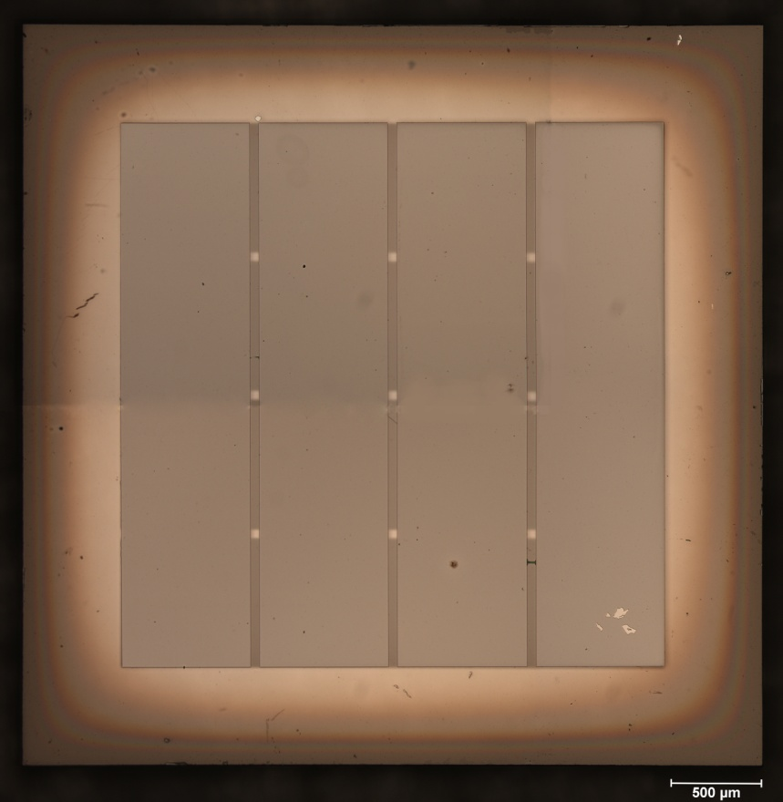
All Diamond Detectors
Patterned UNCD Contacts
Diamond Contacts – no longer the weakest link
UNCD Grown at ANL
Lithographically masked RIE
No fluorescent lines

Slide 10
Conduction comes from sp-2 content (along grain boundaries)
Flux linearity limited at very high flux (>10¹³) due to lower contact conductivity
J. Synchrotron Rad. (2018). 25, 1060–1067

Slide 11
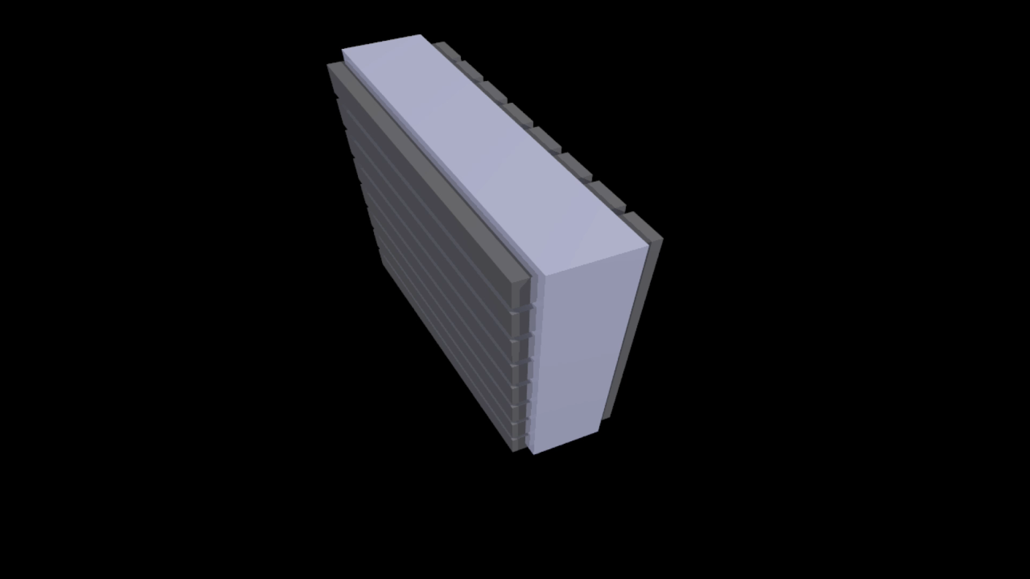
Transmission-mode Diamond Imaging Detector
readout animation
Pixels are created by metalizing one side of the diamond with horizontal stripes and the other with vertical stripes. As the x-rays pass through the diamond, the induced current is collected in each vertical stripe, while the bias is applied to individual stripes on the other side. This bias is cycled, allowing readout of one line of “pixels” at a time.
Image Readout
32 x 32 stripes, yielding 1024 pixels
Only one row is active at a time minimizing ohmic heat generation.
Imaging at 32 Hz
Dynamic range from 50nA to ~10mA per “pixel”
Applications
Freestanding detector provides beam shape, flux and position during optics adjustment and/or during experiment
Imaging window: diamond sensor brazed to a stainless steel vacuum flange serves as both window and beam diagnostic

Slide 12

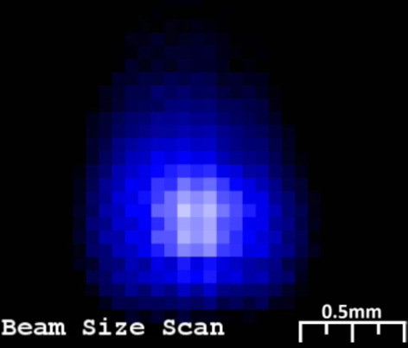
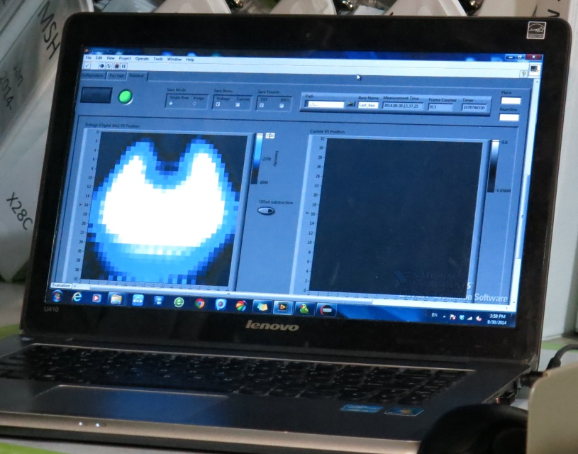
Beam Imaging
CHESS G3 Beam
NSLS X28C Beam

Slide 13

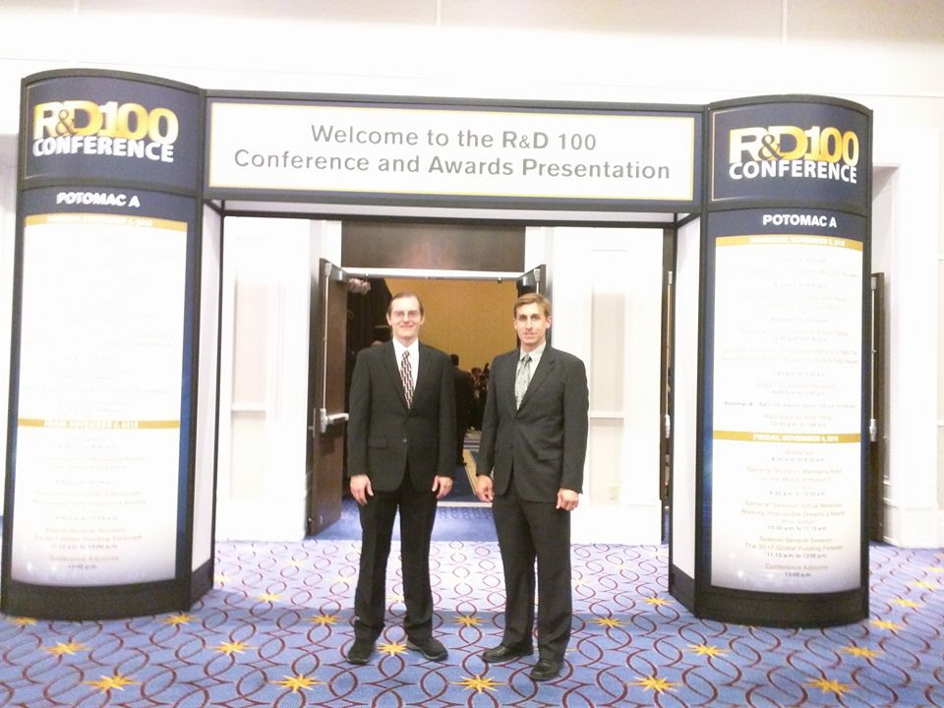
Beam Imaging
R&D100 2016 Finalist
Zhou et al. (2015) JSR 22 :1396 (cover article)

Slide 14
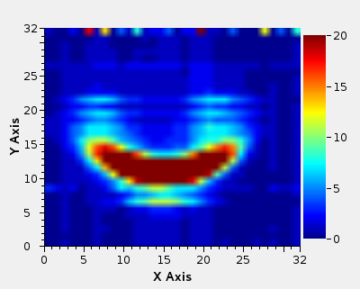
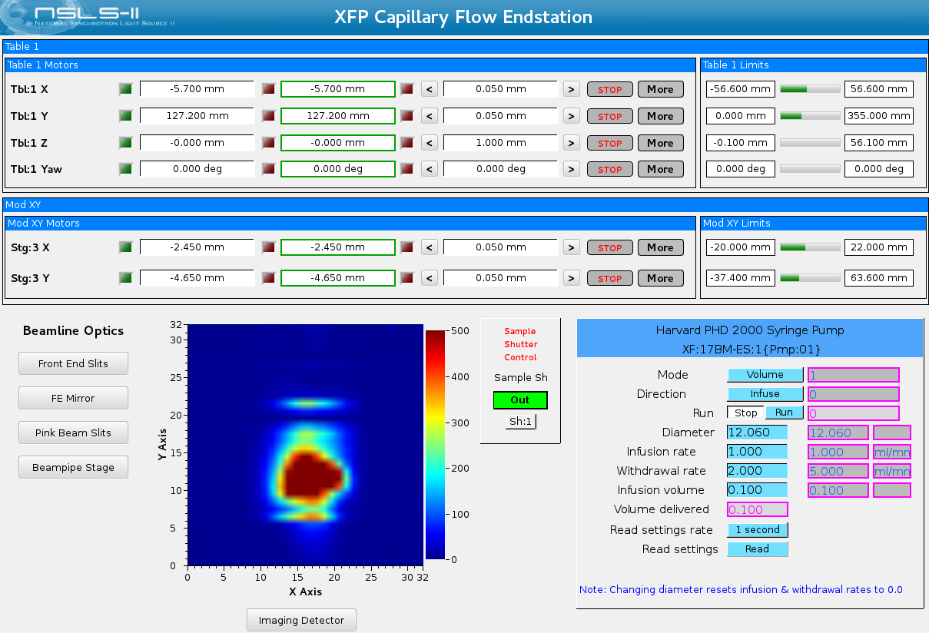
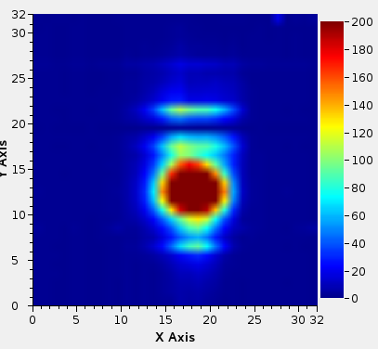
Imaging Detector at NSLS-II XFP
Integrated into XFP Beamline Controls System (EPICS/CSS)
Used to align XFP toroidal focusing mirror (beamline commissioning)
Beam Images at Different Mirror Settings
Pitch 4.72 Focus: 3
Pitch: 4.78 Focus: 2.6
Center for Synchrotron Biosciences

Slide 15
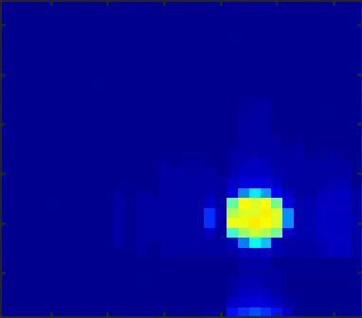
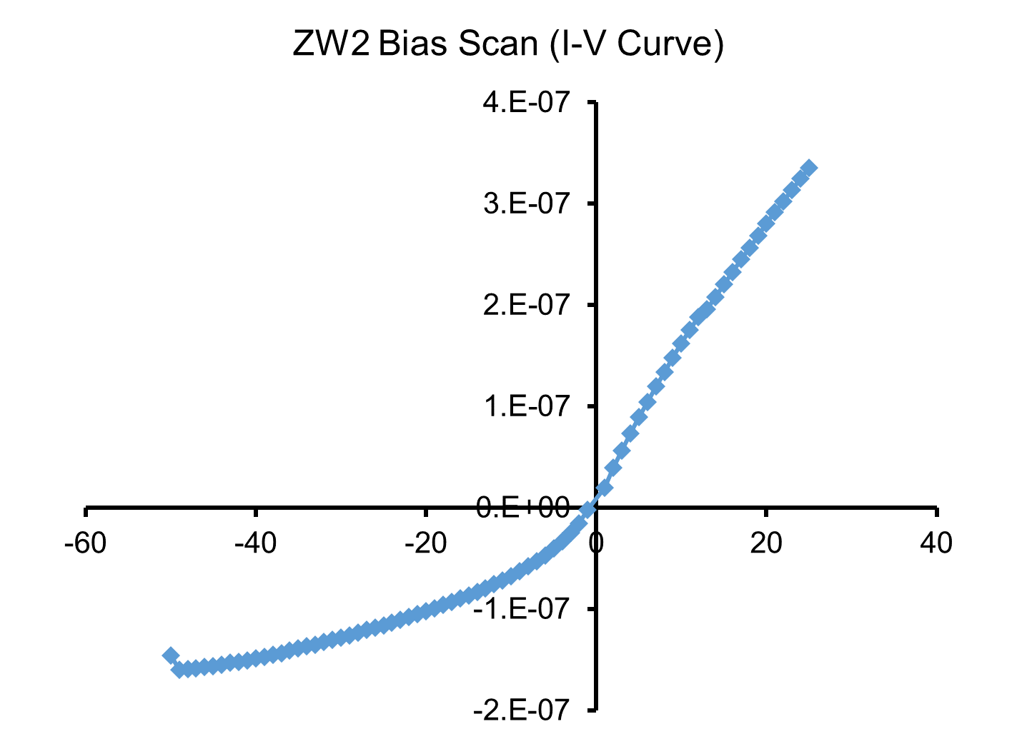
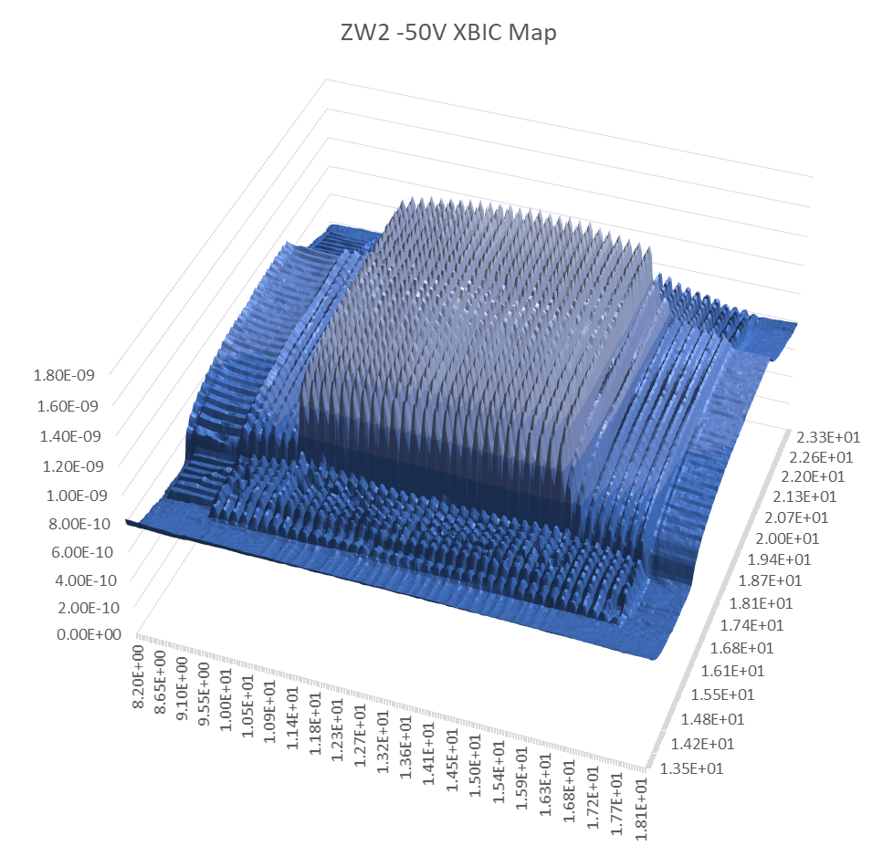
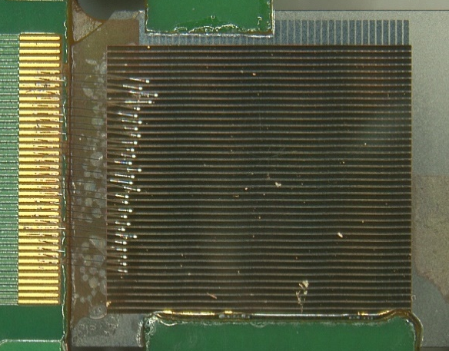
Polycrystalline Diamond Imaging Detector Results are Promising
ZW2: 50 µm thick Polycrystalline “Electronic Grade” Diamond (low nitrogen content) - material and contacts fabricated by Applied Diamond, attached to PC board with high-vacuum epoxy
Cr/Au contacts, with ~400 nm Au (very thick!)
200 µm pitch for “pixels”, only 28/40 wire bonded (5.6 x 5.6 mm² active area)
Bias scan – 1 mm pinhole (leakage on the order of 100 pA) – photoconductive under positive bias, but nicely saturates at ~ full collection (similar to previous E6 poly) in negative
Flux scan – 1 mm pinhole (results still in analysis)
Response map (uniformity) – 30 µm pinhole
Image – used 1 mm diameter pinhole to define the beam (of ~ 3 mm beam)

Slide 16
Application to FELs
Can not rely on pulse to pulse stability
Can get shot by shot line out by measuring current on all detector channels
Need to redesign electronics to allow FPGA to measure current and/or bias strips independently
Can also be configured as a variable-center quad, expanding the spatial dynamic range of the device for small beams

Slide 17
Pulse Mode Beam Position 11-ID-D, APS
Ring mode “hybrid fill, top up”.
102mA total, 16mA in first bunch, 86mA in remaining pulse train.
Separated by 1.594 µs
Ratio of ring currents matches very closely to measured charge ratio
Current Ratio: 86mA/16mA = 5.38
Measured Q Ratio: 0.91nC/0.17nC = 5.35

Slide 18
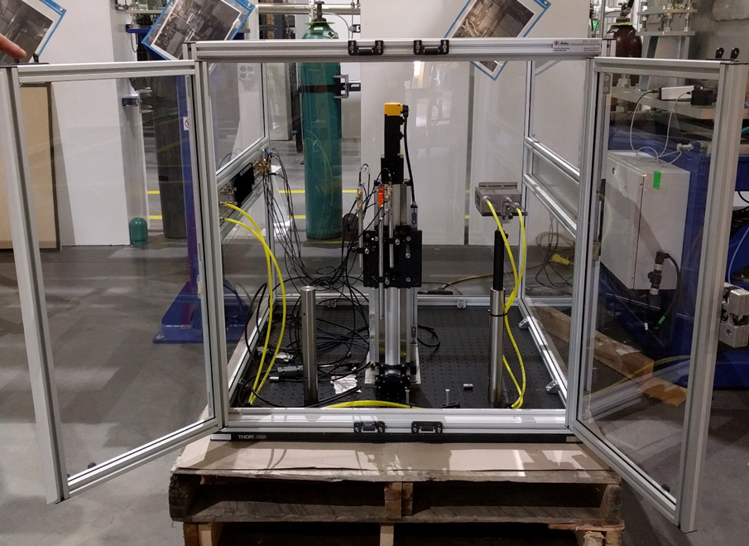
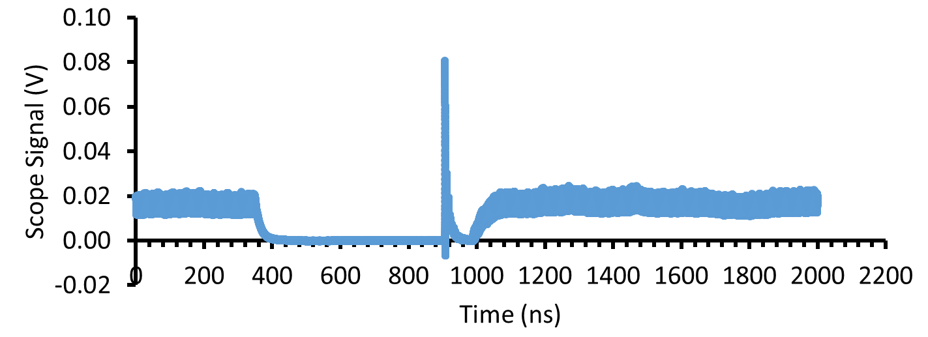
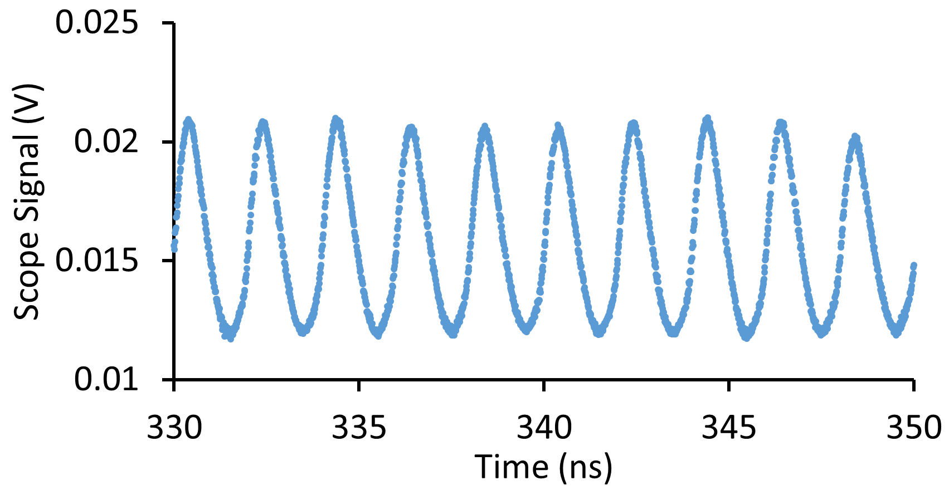
NSLS-II Properties and Capabilities for Detector Calibration and Testing
XBIC (X-ray Beam Induced Current) Endstations
2 endstations (ISS 8-ID, XFP 17-BM) for detector calibration at NSLS-II
ISS: Damping wiggler source; Mono (4.9 – 36 keV), up to 10¹⁴ ph/s in ~0.5 x 0.5 mm beam
XFP: Focused white beam (5 ~ 16 keV), up to 2x10¹⁶ ph/s in variable 120 µm x 450 µm to 2.7 mm x 2.7 mm beam
Capabilities
3 x 3 x 3 ft³ nitrogen environment with cable pass-thru (or old style 1 x 2 x 2 ft³ compact “fishtank” if space is limited)
Integrated motion control for XBIC mapping, optical mounting
Multiple calibration options (Ion chamber, diamond detectors, copper block calorimeter)
Pinholes 25 µm and up, attenuators
Pulsed or standard DC biasing
Current measurement from pA to 100s of mA
Unique prototype electronics and epics/python-based readout and controls for diamond imaging detector
Can attach fast scope for timing measurements
NSLS-II Ring Parameters
Energy | 3 GeV
Current | 500 mA (400 mA currently)
Pulse length | 30 ps
Time between bunches | 2 ns (500 MHz)
Average bunch current/charge | 0.47 mA/ 1.25 nC
# of buckets filled/total | 1056/1320
Note: one timing pulse available in ion cleaning gap, NSLS-II working on varying up to 5 mA in that pulse; period of 2.64 µs.
Funded through a BNL LDRD project

Slide 19
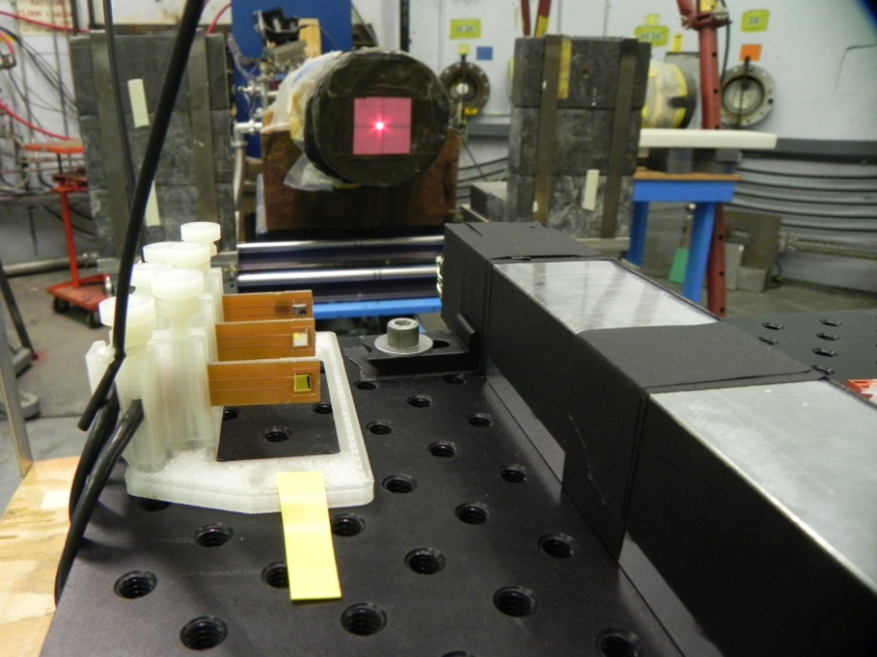
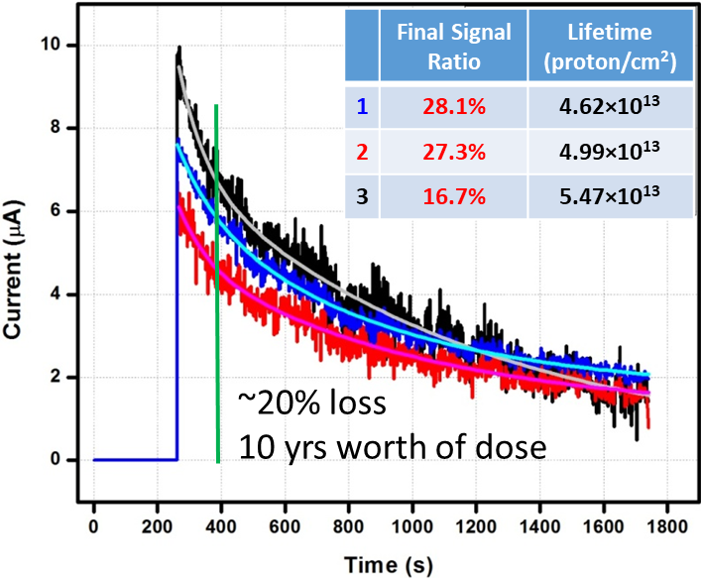
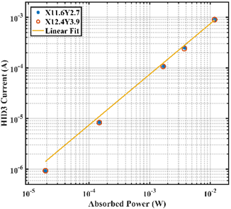
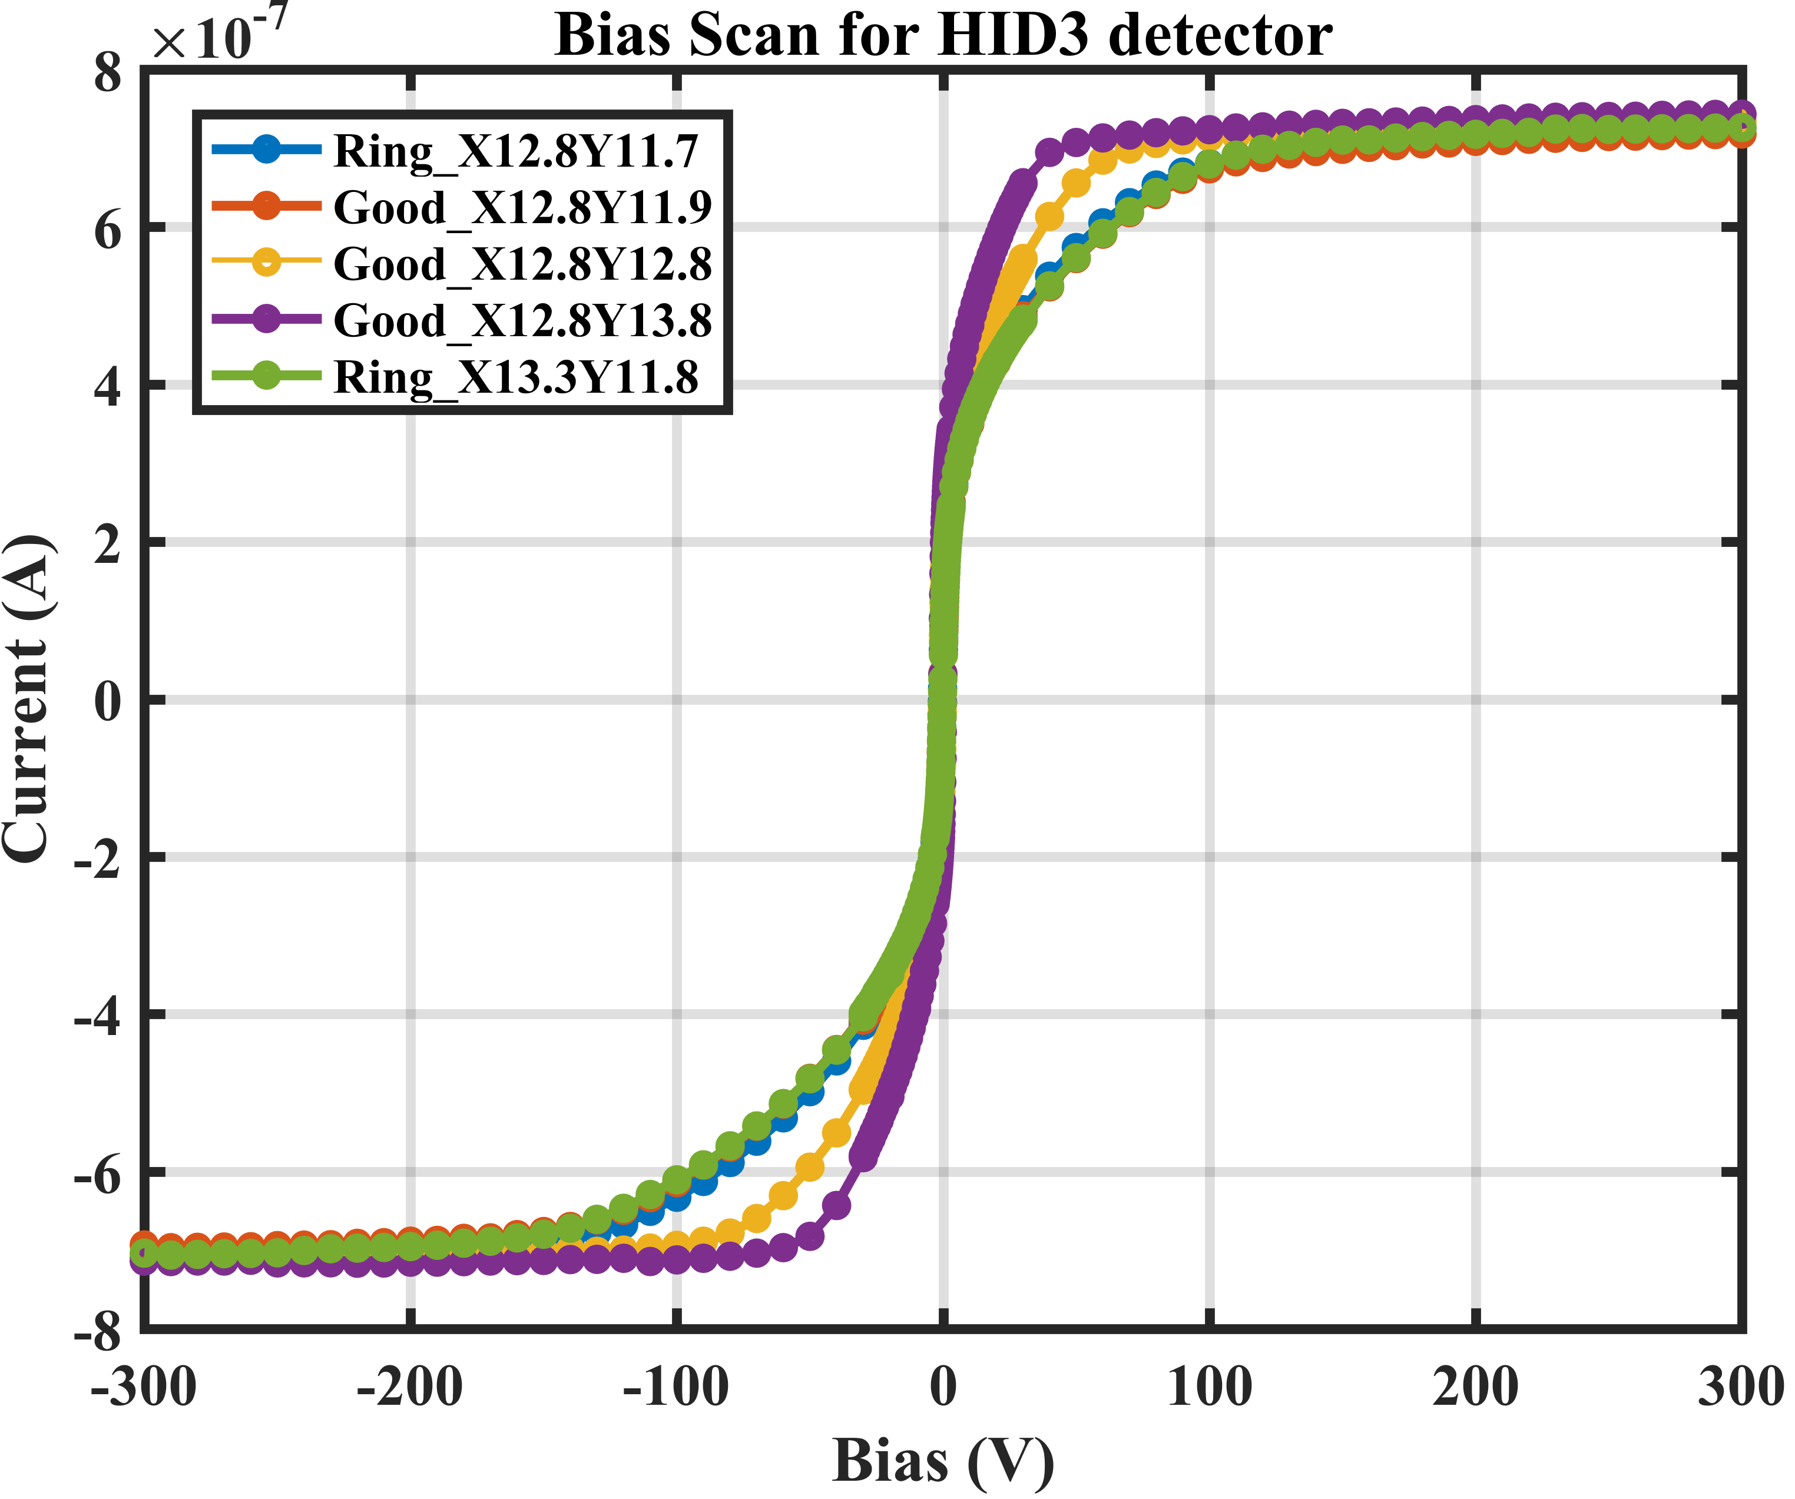
Proton Irradiation at LANSCE
Real-time IBIC Monitoring
#3
#2
#1
Response Linearity
I-V curve
Incident Proton Beam
0.6 V/µm
LANSCE blue room setup
Proton Energy: 800 MeV
Beam Flux: 10¹¹ proton/(cm²·s)
Beam Size: diameter ~ 2.5 cm
Exposure Time: 2180 seconds
Incident Energy: 4.486 kJ
Electrical Field: +0.1 V/µm
W=13.4±0.04 eV
Charge collection in the material changes – 20% loss in efficiency with 10yrs of dose
Damaged detectors retain linearity with flux (but with longer charge collection distances)
Performed at WNR target site: additional LANSCE capabilities available

Slide 20
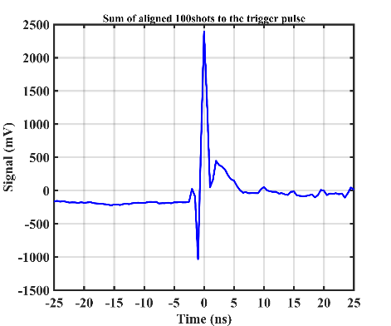
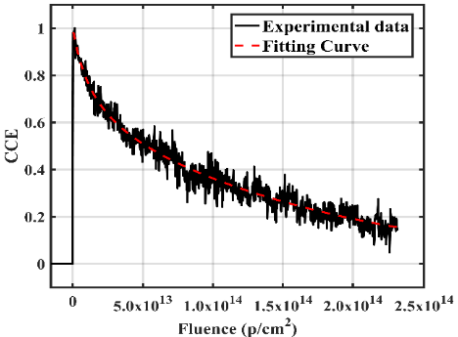
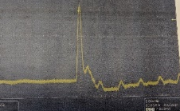
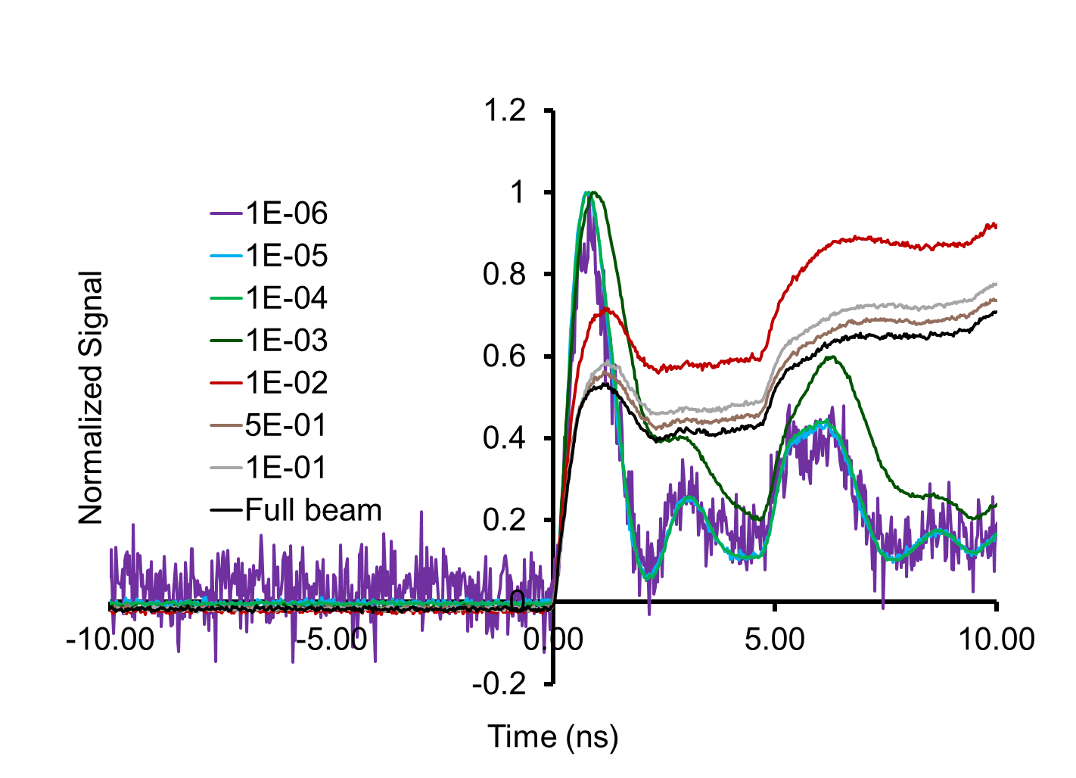
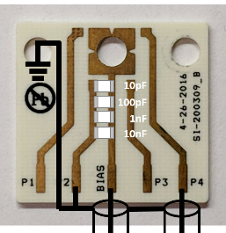
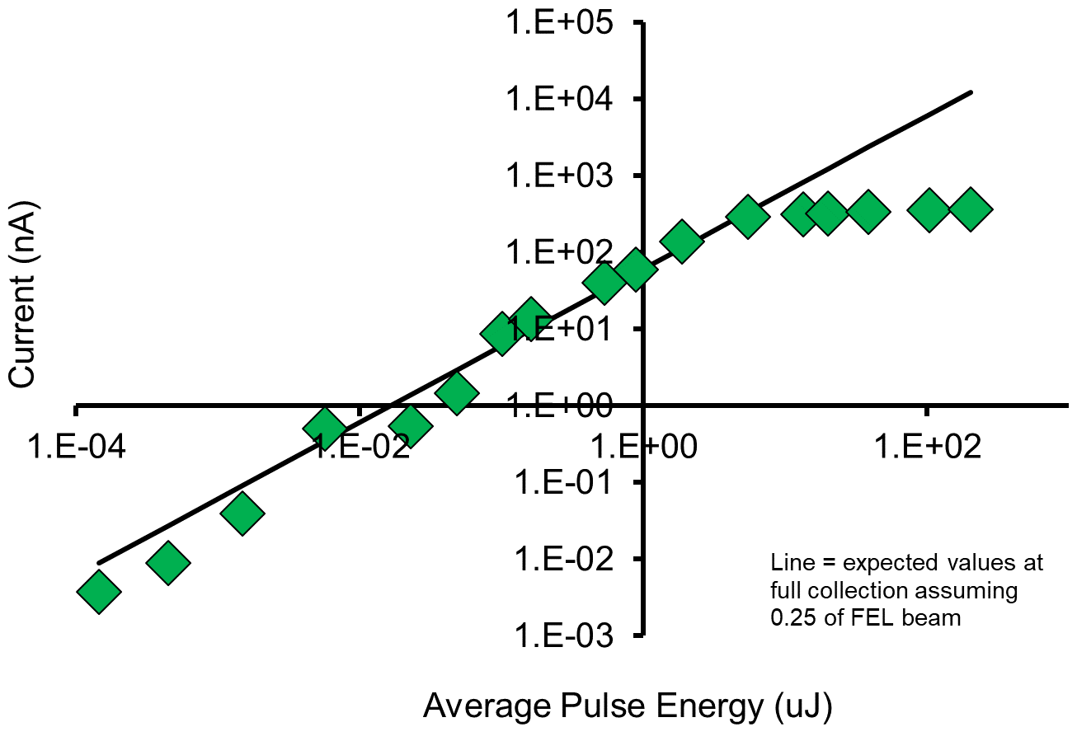
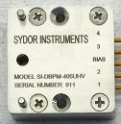
Diamond Detector Research Program
LANSCE (Target 4) Proton Beam Measurements
Proton/ion beams
  Improved diagnostics for LANSCE
  Improved targeting of beam on patients for medical dosimetry (DOE HEP)
  Anticipate same spatial and temporal resolution as for x-rays
FELs
  Improved beam targeting (< beam size)
  Achieve linearity over full gain curve (10⁴ – 10¹¹ ph/pulse)
  Diagnostics for future FELs (DMMSC) enabling full gain curve optimization
  Beam profiling: shot to shot profiles (flux, position, horizontal and vertical distribution)
LANSCE ICT
Lifetime measurement (100 years of therapeutic dose) – 20% reduction in efficiency after 10 years of dose
Timing measurement reproduces LANSCE pulse structure
Flux Linearity (SwissFEL Bernina Measurements)
(Integrated current)
(Shot-by-shot)
Beam attenuation
Response linear to ~3% of full beam
Individual pulse measurement, pulse broadening beyond linear regime
Energy: 6080 eV
Circuit board design
External case (similar)
Looking for collaborations to continue this development and calibration effort

Slide 21
LANL Work Packages
WP 1 – diamond device fabrication
  Sensor for full FEL gain curve
  Sensor for FEL beam imaging
  Sensor for proton imaging
  Sensor for Dynamic materials science
WP 2 – Device testing (not just diamond)
  NSLS-II/CHESS
  SwissFEL/LCLS
  LANSCE
LoE – Jen (0.25), Postdoc (0.5), 20k travel – 200k/yr
UC support – materials purchase (diamonds) – 20k/yr, student participation?

Slide 22
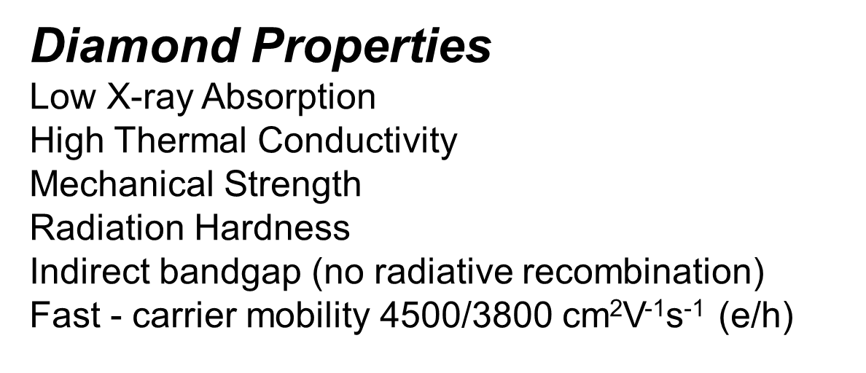
Expanding the scope of photophysics beyond photoemission: x-ray detector development
Goal: to achieve linearity over full gain curve (10⁴ – 10¹¹ ph/pulse)
  Improved beam targeting (< beam size)
  Diagnostics for future FELs (DMMSC) enabling full gain curve optimization
  Beam profiling: shot to shot profiles (flux, position, horizontal and vertical distribution)
So far: Modified detector with additional capacitance, achieves linearity up to 3% of full beam
  Detector performance unchanged by FEL beam (no damage)
  Limit caused by geometry and charge pileup – we have engineering solutions in mind
Looking for collaborations to continue this development and calibration effort
Flux Linearity (SwissFEL Bernina Measurements)
J. Bohon, P. Juranic, E. Muller, M. Zou, A. Sumant, U. Jastrow, K. Tiedtke,
T. Tanaka, S. Owada, R. Follath,
C. Arrell, Y. Arbelo, M. Degenhardt,
A. Sorokin, J. Smedley
Response linear to ~3% of full beam
Individual pulse measurement, pulse broadening beyond linear regime
Circuit board design
External case (similar)
Diamond Properties
Low X-ray Absorption
High Thermal Conductivity
Mechanical Strength
Radiation Hardness
Indirect bandgap (no radiative recombination)
Fast - carrier mobility 4500/3800 cm²V⁻¹s⁻¹ (e/h)

Slide 23
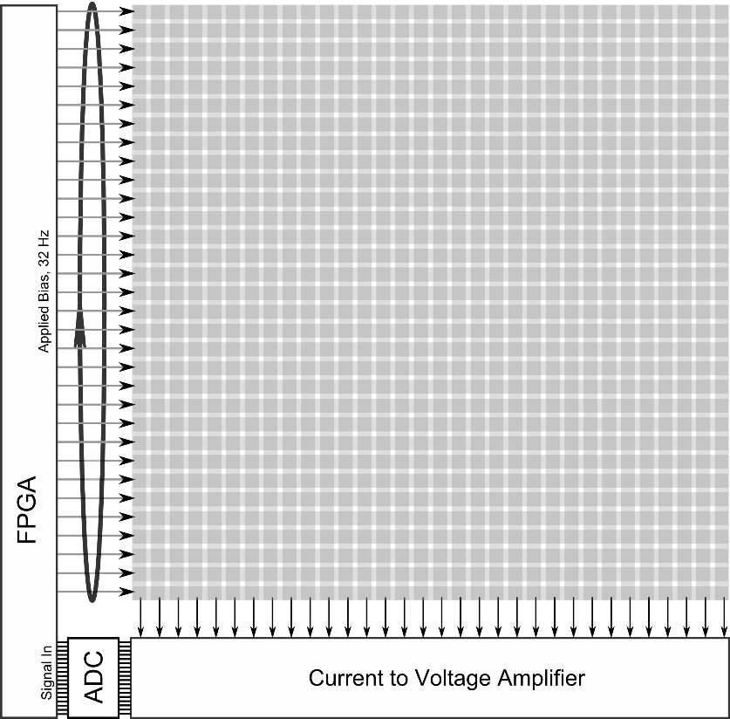

Diamond Beam Imager
Development of a diamond window which will provide position, flux and morphology of high flux x-ray beams while simultaneously acting as the vacuum-air interface.
X-ray footprinting (XFP) at NSLS-II
Focused white beam
Variety of beam sizes/shapes needed
Feedback and control systems for optical elements or sample positioning stages.
Image Readout
32 x 32 stripes, yielding 1024 pixels
Only one row is active at a time minimizing ohmic heat generation.
Real-time imaging at 32 Hz, FPGA control
Allows for feedback control of beamline components.
Major Challenges for high flux beamlines
Heat load management in optics (including beryllium windows)
Real-time volumetric measurement of beam properties such as flux, position, and morphology.

Slide 24
Temporal Response, Hard X-rays
J. Bohon, E. Muller and J. Smedley, J. Synchrotron Rad. 17, 711-718 (2010)

Slide 25
Temporal Response, Soft X-rays

Slide 26
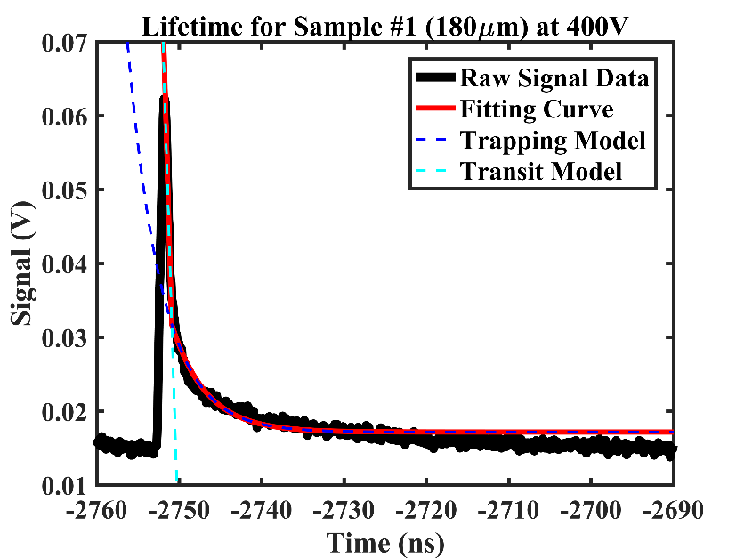
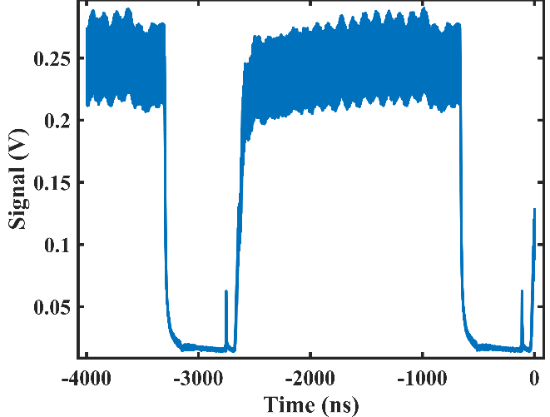

Radiation Damage effect on Temporal Response
NSLS II synchrotron beam timing
Real-time IBIC Monitoring @0.1 V/µm
Sample #1
Sample #2
Sample #3
Fitting Curve #1
Fitting Curve #2
Fitting Curve #3
After 10¹⁴ protons (100 years of therapeutic dose), detector bulk response ~30% of initial
Carrier property (at 400V):
Transit time: ~ 0.67 ns
→ carrier velocity ~1209 cm²/(V∙s)
Trapping time: ~ 4.18 ns
=> Charge collection is significantly delayed by radiation damage

