Slide 1
LANSCE Beam Diagnostic Needs
John Smedley
Jen Bohon
Rod McCrady
UC Davis
UC Fees Diagnostics Program Kickoff
1/25/2020
LA-UR-20-20730

Slide 2
Talk Outline
LANSCE overview
  Diamond diagnostic experience
Proton Beam Imaging
  SWIM
  Laser slicing for 3D beam imaging
X-ray spectrometer
Beam Halo/Electron cloud

Slide 3

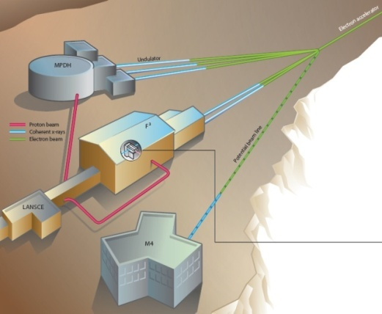
LANSCE accelerator overview
MW class proton accelerator and H⁻ , 800 MeV
Proton Radiography, Neutron scattering and cross section, isotope production
Proton and Neutron beamlines for user projects
Operational in 1972!
Includes a proton storage ring (PSR)
Upgrade plans include high energy proton radiography and
A Hard X-ray, variable pulse format Free Electron Laser
Notes:
NNSA’s accelerator laboratory: make sure we know and achieve the hallmarks of our role: builders / designers; operators / maintainers / accelerator physicists

Slide 4
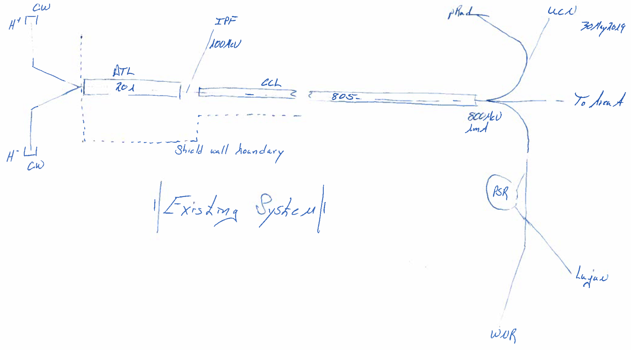
ASET: 10-Year End State
LANSCE Facility
CW
pRad
UCN
H⁺
IPF
100 MeV
DTL
CCL
201
805
To Area A
800 MeV
1mA
Shield Wall Boundary
H⁻
CW
Existing System
PSR
NSC
WNR

Slide 5
ASET: 10-Year End State
LANSCE Facility
CW
Tunnel Cross Section
pRad
UCN
H⁺
Operational as stand alone system
IPF
25 GeV electrons
Keep Optional
805 linac
100 MeV – 300 MeV
20 GeV protons
800 MeV
1mA
DTL
CCL
201
805
To Area A
H⁺
RFQ
100 MeV
H⁻
300 MeV
20 GeV Protons and 25 GeV e– to Area A
RFQ
Shield Wall Boundary
805 Injector System
25 GeV C-band e– linac FEL Driver stacked above proton linac
Phase 5: 25 GeV e– FEL Driver
  High Gradient C-Band System
    High shunt impedance
    Beta = 1
    Stacked above pRad Machine
    Waveguide switching to ”existing” C-band power
    Multi Hz, variable pulse format over 1 ms
High brightness e– injector
PSR
Updated Version
Phases 1 – 5 implemented
NSC
(1L High Power Version)
  FEL
    ~ 80 m undulator system in Area A
    >50 keV fully coherent ultrashort
    Building extension required for experimental hall
WNR

Slide 6
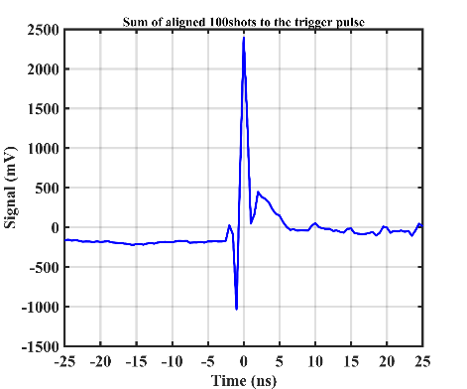
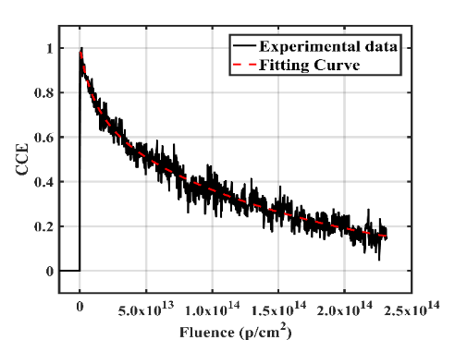
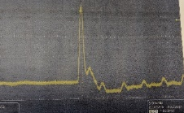
Diamond work ongoing at LANSCE
LANSCE ICT
Lifetime measurement (100 years of therapeutic dose) – 20% reduction in efficiency after 10 years of dose
Timing measurement reproduces LANSCE pulse structure
Anticipate next beam opportunity in ~October

Slide 7
Proton Beam Imaging
  Similar to X-ray beam imager
  x-y Pulse Mode (separation of 5 ns)
  Imaging mode
  In addition to general beam imaging, two unique applications
  In combination with a laser beam slicer which will photo-deionize H⁻, generate 3D beam images
  Submersible Wireless Monitor (SWIM)

Slide 8
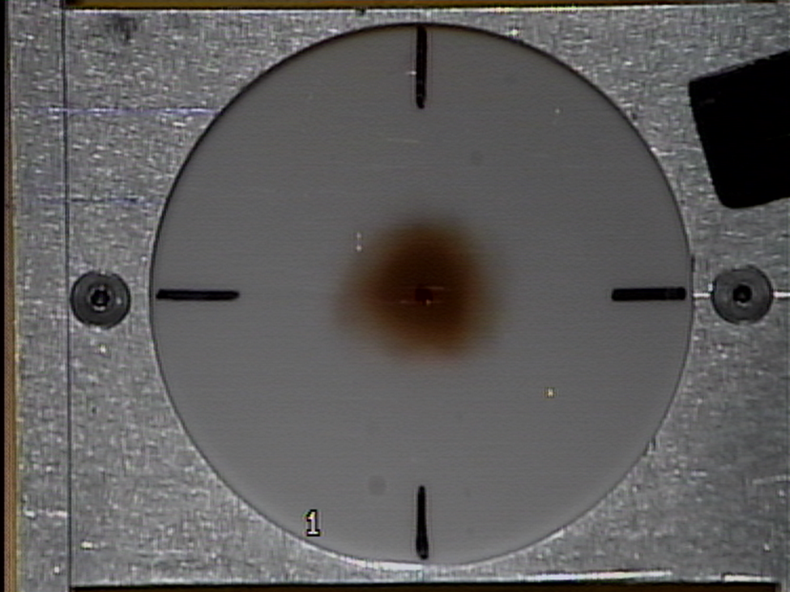
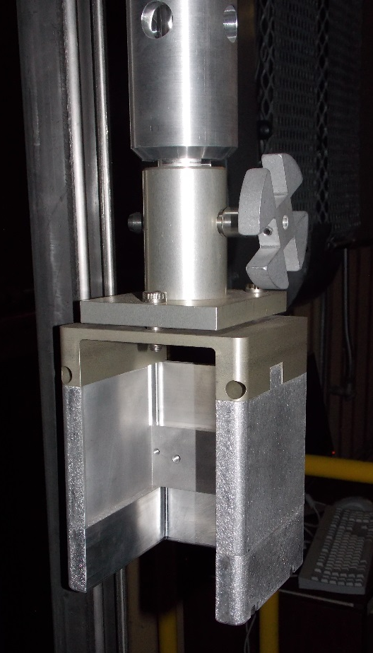
Isotope Production Facility at LANSCE
Hot cell
Presently:
Plastic film
∼ 1 hour per measurement
Chain drive mechanism
Water-filled transfer tube
Preferred:
Electronic
Seconds per measurement
Beam pipe
Target carrier

Slide 9
Isotope Production Facility at LANSCE
Hot cell
Low maintenance
Chain drive mechanism
Water-filled transfer tube
Wireless
Submersible
Beam pipe
Target carrier

Slide 10
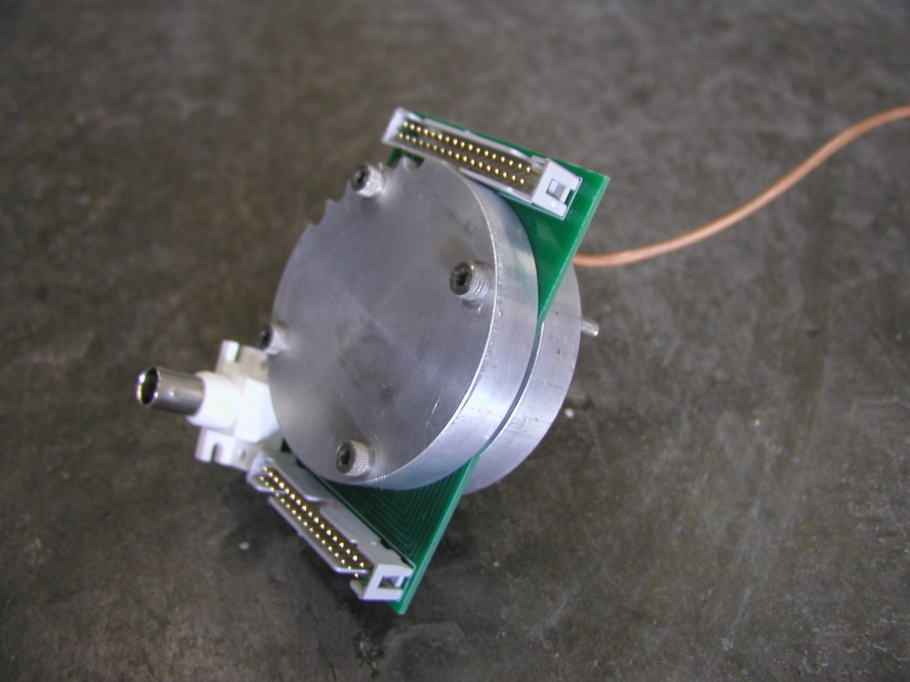
Ion chamber prototype
Helium
1 atm.
Horizontal
&
Vertical signals
Variable bias

Slide 11
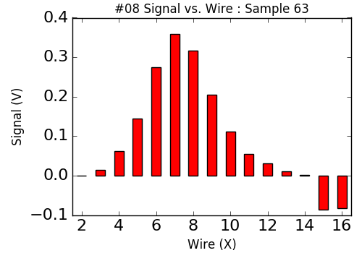
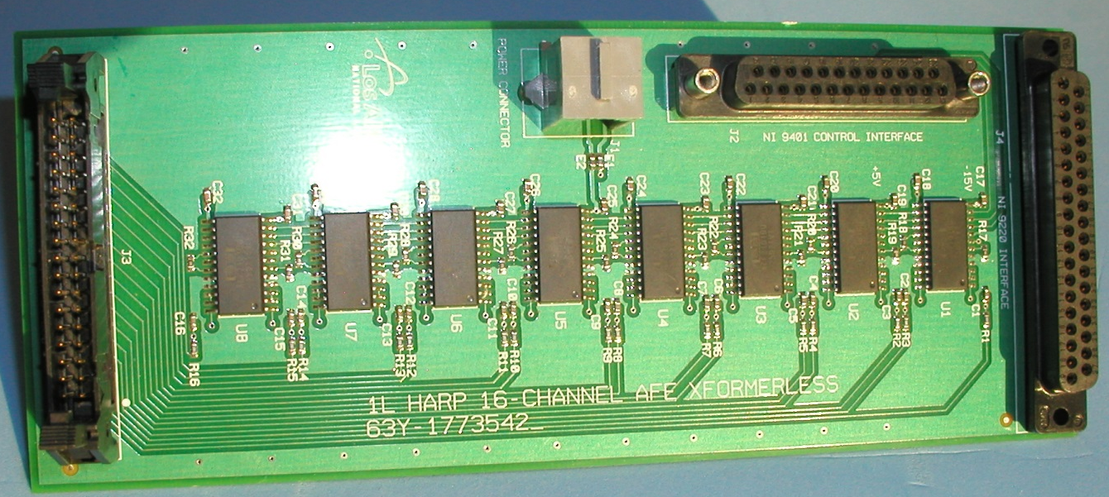
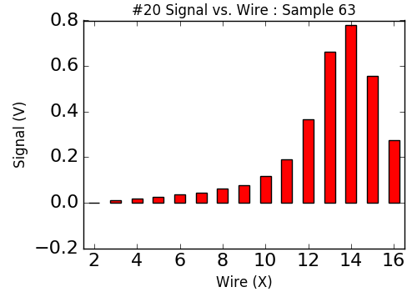
Ion chamber prototype
V = + 4 V
Horizontal
Tested at pRad with 800 MeV proton beam
V = - 4 V
Vertical

Slide 12
Bremsstrahlung X-ray cutoff monitor
  Measure ~60 keV photons with 1% or better resolution
  Currently use cryo-cooled Ge
  Replacement without cryogens would be a big improvement
  Used to measure the electric field in the DTL gaps

Slide 13
Beam halo and electron cloud monitor
  Goal to measure proton beam halo and electron cloud, and to discriminate electrons from protons. A variable bias on a retarding grid would allow electron cloud spectrum measurement. Each element would be a diamond imager to localize halo/cloud, and 4 such devices enable vertical and horizontal characterization.
Low energy e-
p only
p & e-

Slide 14
Beam halo and electron cloud monitor
  Goal to measure proton beam halo and electron cloud, and to discriminate electrons from protons. A variable bias on a retarding grid would allow electron cloud spectrum measurement. Each element would be a diamond imager to localize halo/cloud, and 4 such devices enable vertical and horizontal characterization.

Slide 15
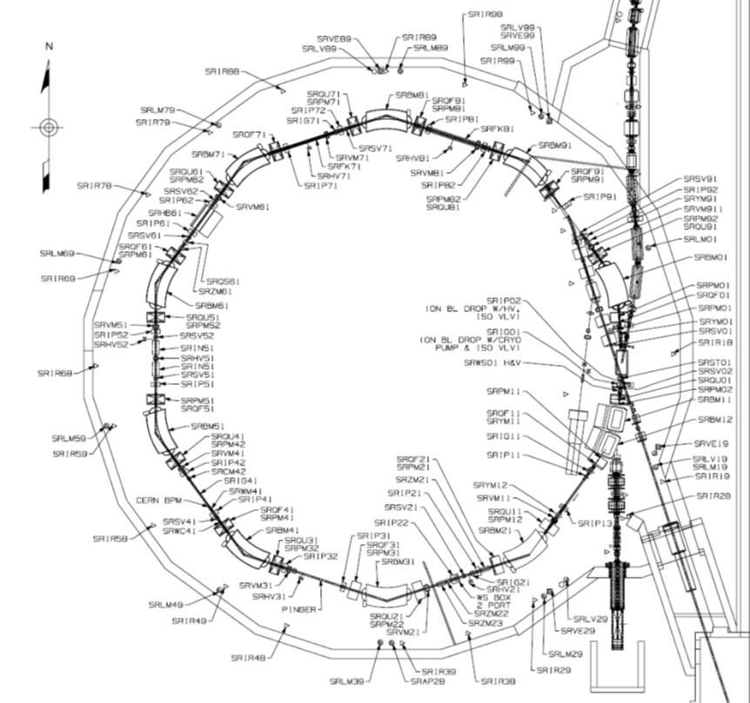
PSR

