Slide 1


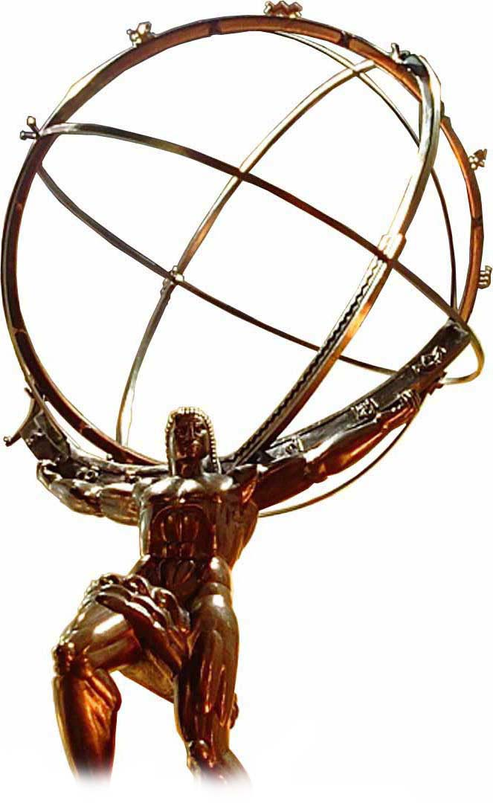


UC Santa Cruz
SCIPP laboratories
Advanced Detectors for XFELs and Proton Accelerators
Dr. Simone M. Mazza (SCIPP, UC Santa Cruz),
on behalf of the SCIPP UCSC group

Slide 2
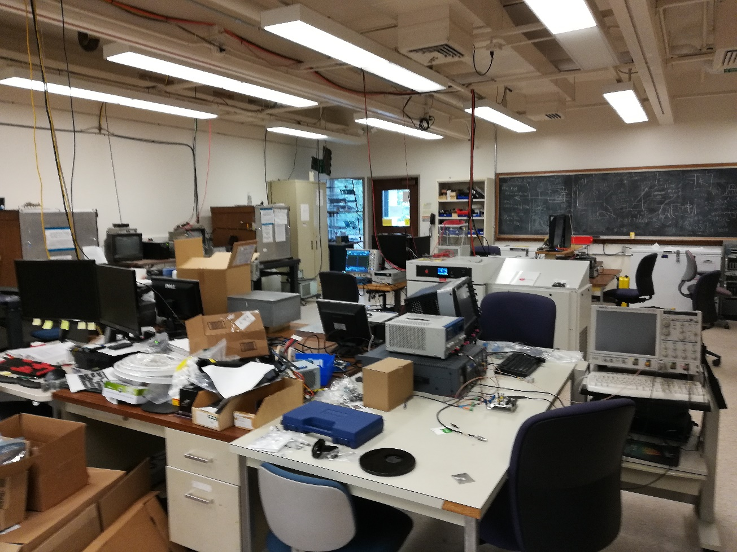
UC Santa Cruz SCIPP group
SCIPP is involved in several hardware projects
  Production site for ATLAS Strips in the ITk project
  ATLAS HGTD (timing layer) sensor R&D
  ATLAS Pixel readout for (ITk)
HGTD group (us)
  Extensive LGAD (Low Gain Avalanche Diodes) sensors testing for the ATLAS timing layer
  Following production of sensors and irradiation campaigns
  Involved in several additional R&D project (like this one)
Group is composed by
  3 P.I., support of 4 Technician (part-time), 1 Post-Doc (me), 3 PhD students, Several undergraduate students
Directly following this project (for now):
  1P.I., 1 Post-Doc, 1 PhD student

Slide 3
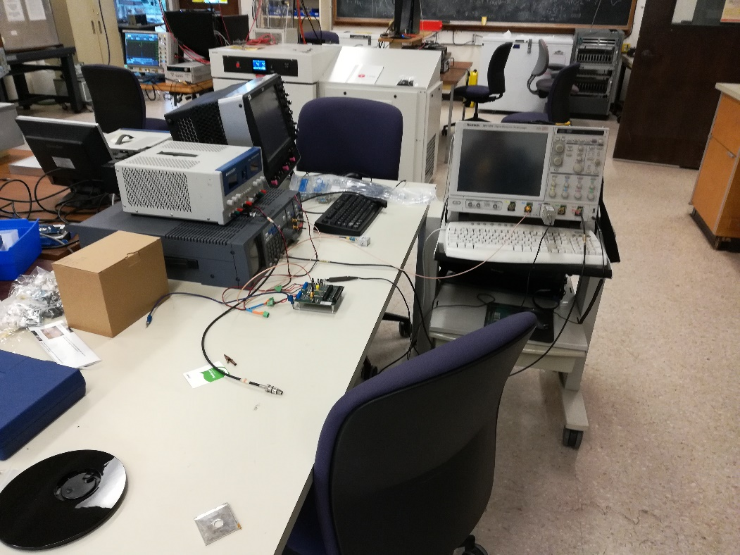
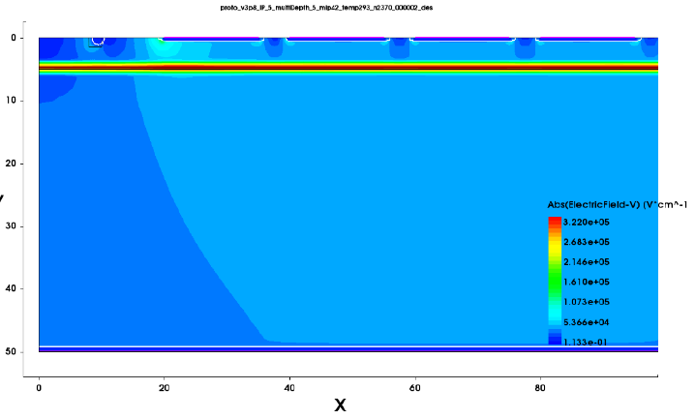
UC Santa Cruz SCIPP expertise
Large experience in silicon sensor testing techniques
  Electric characterization (probe stations)
  Dynamic characterization (β-particles, laser TCT, X-rays)
  Experience with test-beams at SLAC, SSRL, APS
Development of analog electronics for fast sensors, spice simulations
  We developed the 1ch board for fast sensors now in use everywhere
Sensors design and production in industry
  (mostly HPK, FBK, CNM)
Following irradiation in several facilities
  (neutrons, protons, pions)
Simulation of sensors with Weightfield2 and TCAD Sentaurus
  We are working with industries and national labs for the fabrication of DJ-LGAD (patent pending at UCSC)

Slide 4
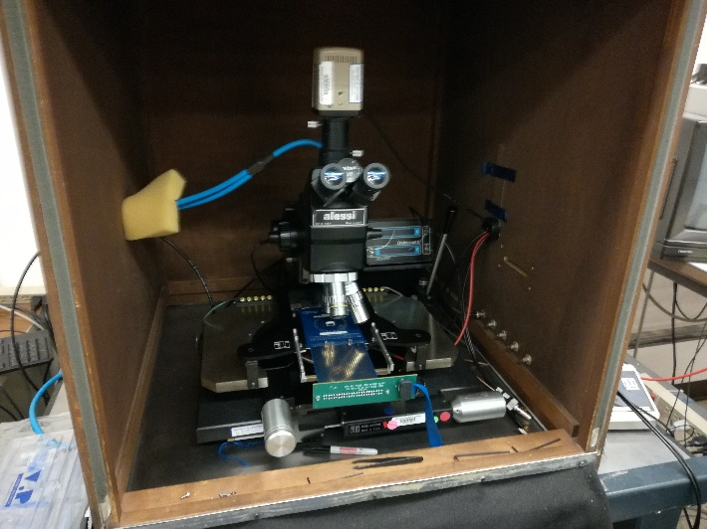
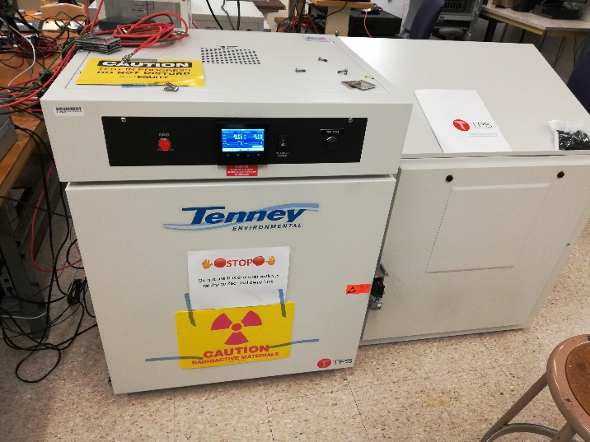
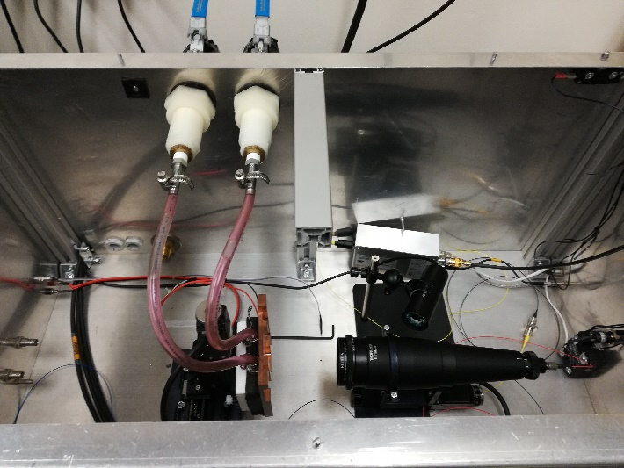
UC Santa Cruz SCIPP laboratories
2 Probe station working with single needles or probe cards
β-telescope in climate chamber (down to -60C)
TCT-laser station that can be cooled (down to -10C)
Analog electronics readout boards (1ch, 2ch, 4ch, 16ch)
3x GHz oscilloscope + 1x 16ch digitizer
Soldering station for board loading
Machine workshop (lathe, mill, drill)
~30 m² Clean room
Electronic and manual microscopes
2x fully automatic wire bonders
Smart-scope for precision position measurements

Slide 5
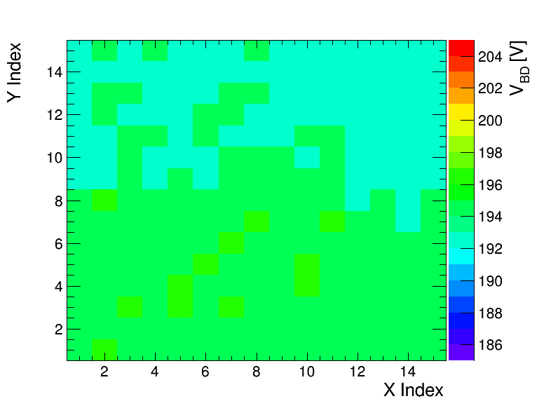

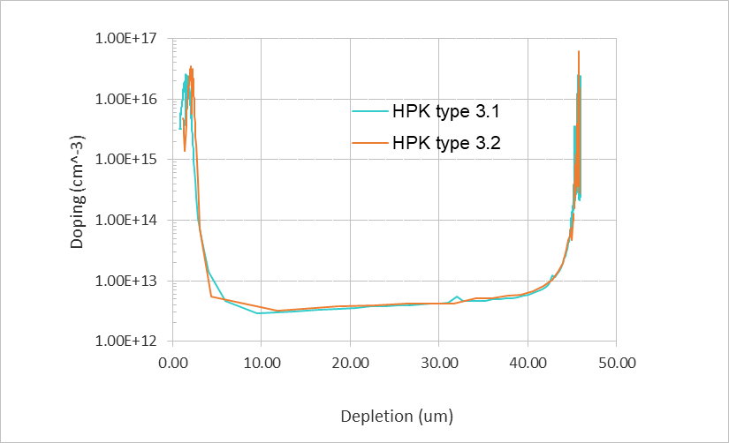
Probe station
Current over voltage (IV)
  Verify LGAD performance, breakdown voltage
  Also done with probe cards (15x15)
Capacitance over voltage (CV)
  Study doping concentration profile and full depletion of the sensor
Study of the “foot” for LGADs on 1/C²:
  1/C² is flat until depletion of multiplication layer because of the high doping concentration
  Proportional to gain layer active concentration
Bulk doping concentration proportional to the slope in 1/C²

Slide 6
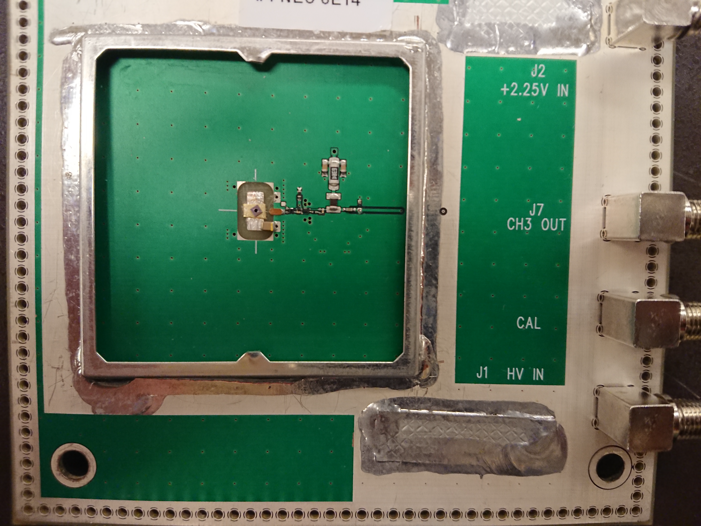
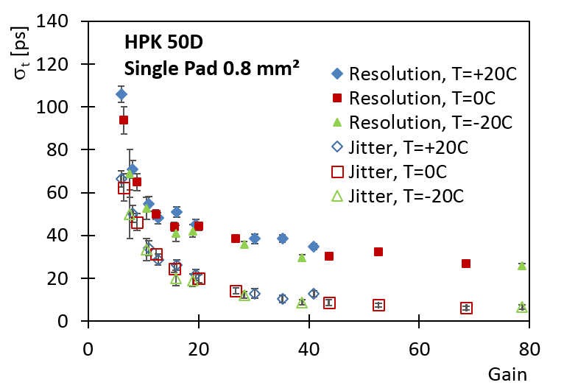

Sr90 telescope
  Dynamic laboratory testing
    Using MiP electrons Sr90 β-source
    Signal shape, noise, collected charge, gain, time resolution
β-telescope
  Sensors mounted on analog readout board designed at UCSC (Ned Spencer, Max Wilder, Zach Galloway) with fast amplifier (22 ohm input impedance, bandwidth > 1GHz)
  Trigger sensor (fast timing trigger) on the back
    DUT (Device Under Test) is read in coincidence
  Setup in climate chamber to run cold and dry
  Readout with a GHz oscilloscope
LGAD

Slide 7
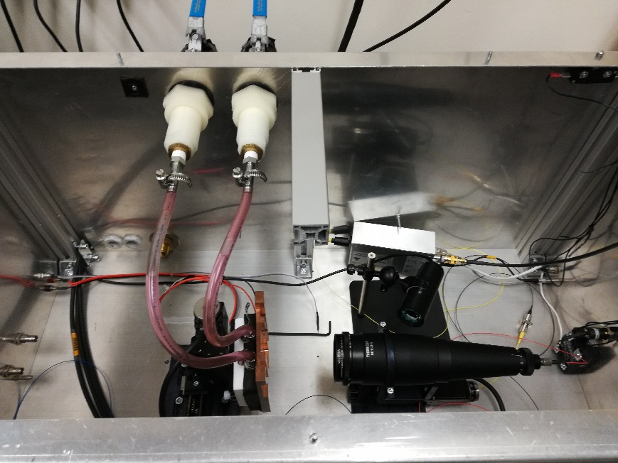
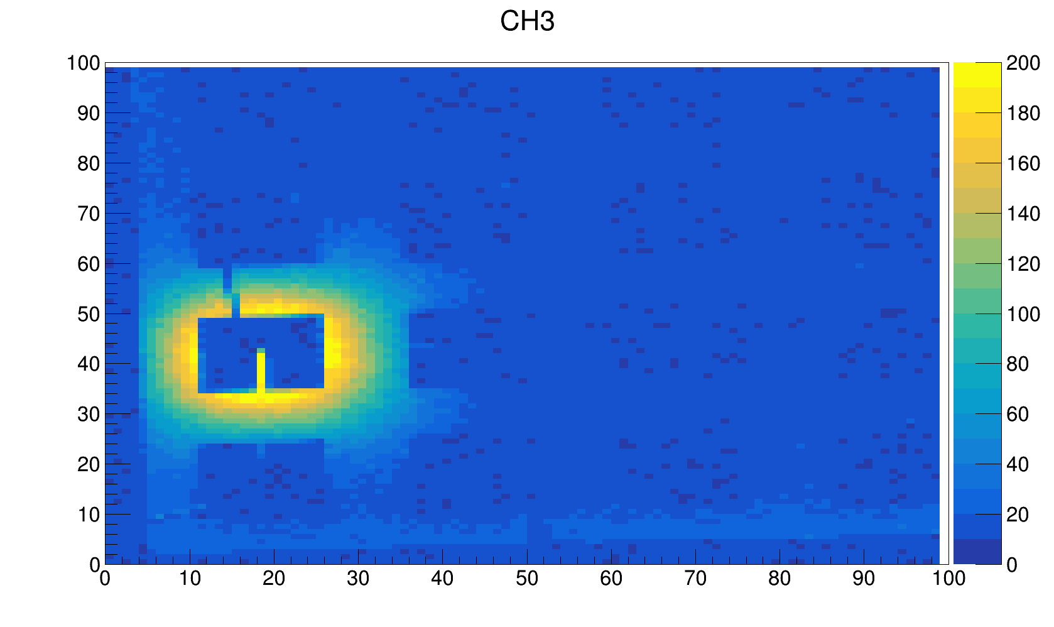
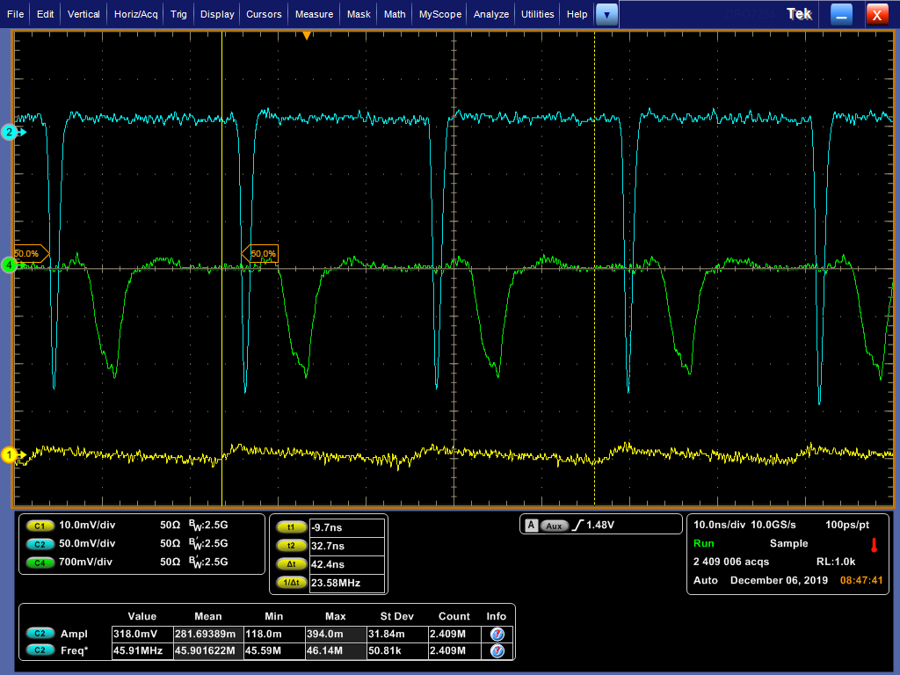
Laser TCT
TCT laser scan to have position dependent sensor response
  Laser spot size ~10um
Sensor mounted on X-Y motors
With a cooled plate (chiller + Peltier cell)
  Can go down to -10C
Laser repetition rate up to 50MHz
Sensor
~20ns
Laser Trigger
Photodiode

Slide 8
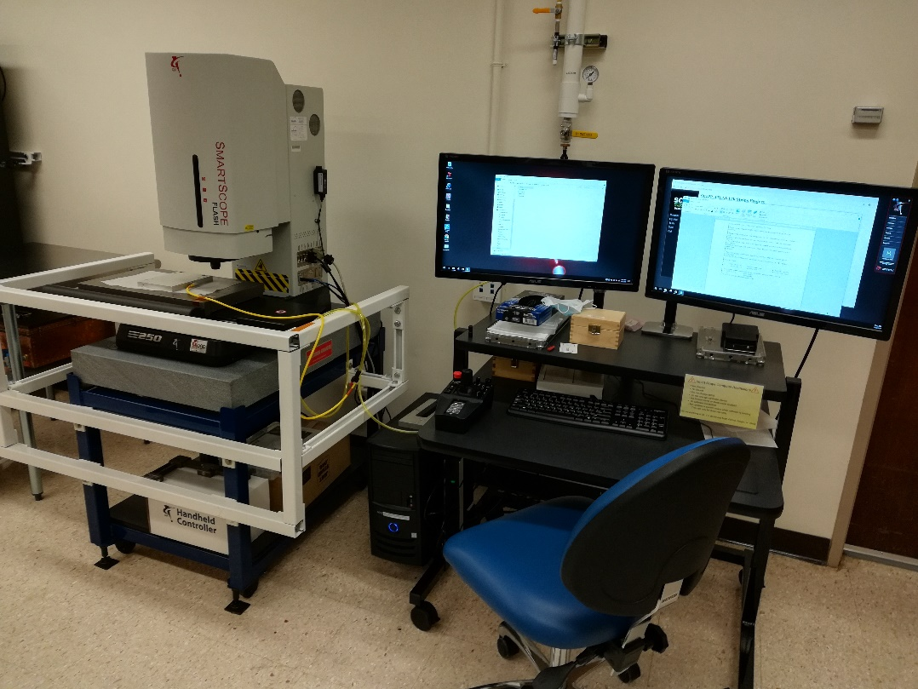
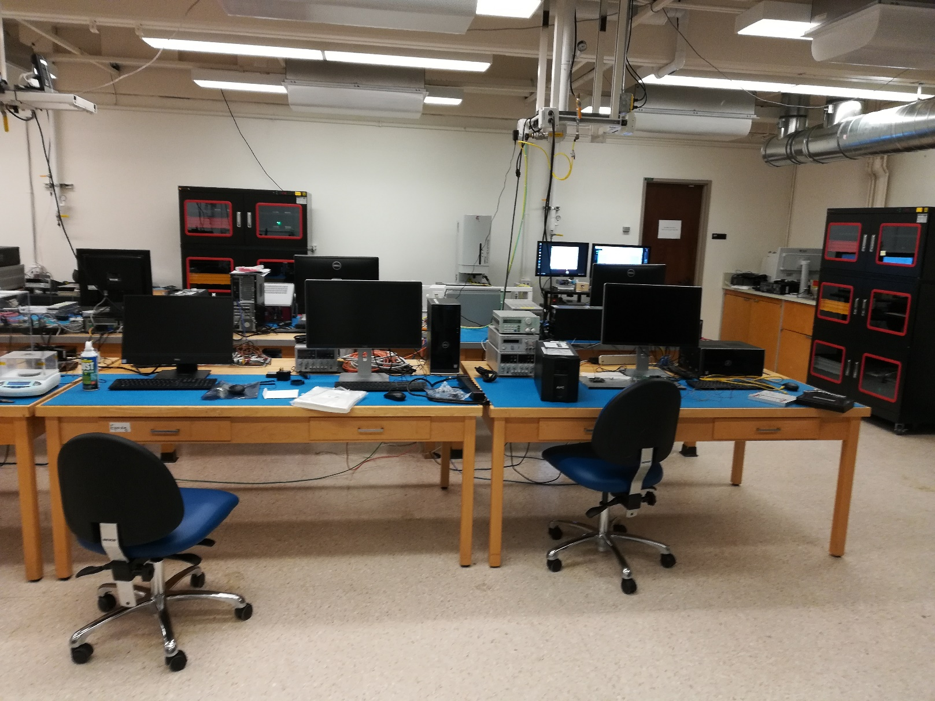
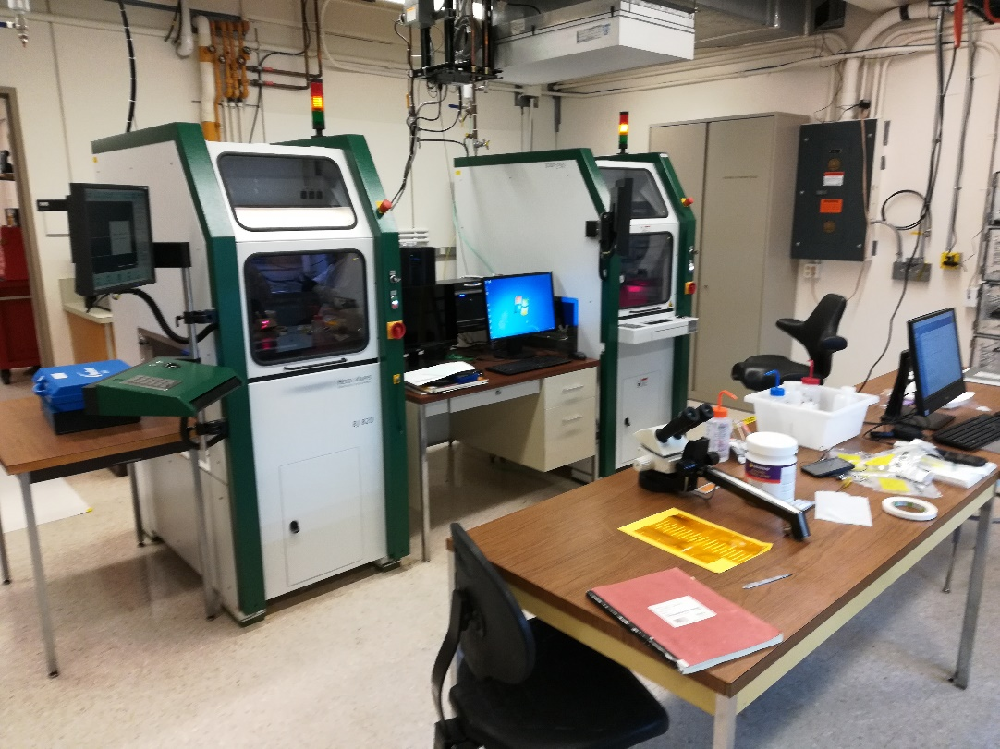
SCIPP clean room
Smartscope
Automatic bonders

Slide 9
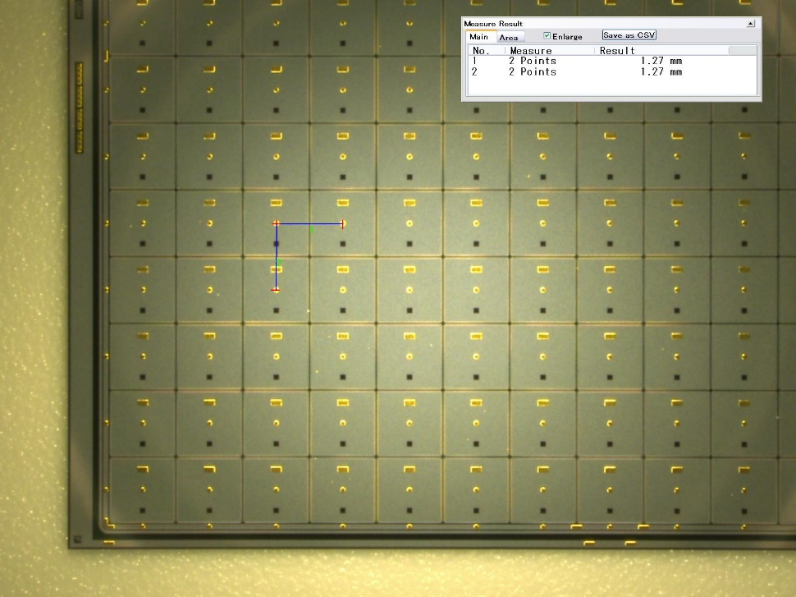
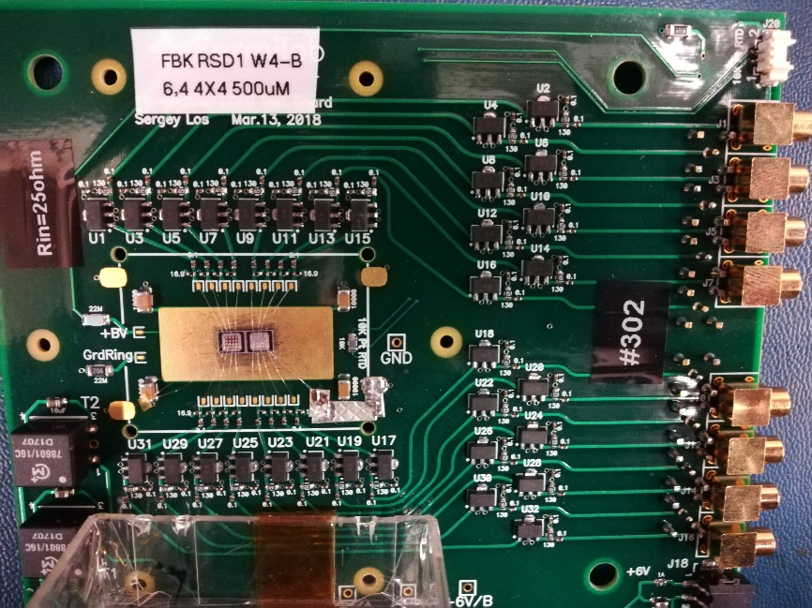
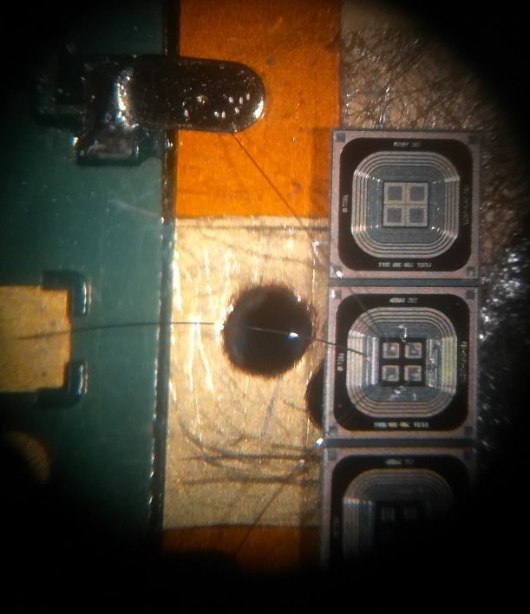
Sensor available
At SCIPP we have availability of a large number of sensors produced for HGTD (large pad size)
  Producer: HPK
  Pitch: 1.3x1.3m² pad size and pitch
  Geometry: single pads, 2x2, 3x3, 5x5 and 15x15
  Thickness: 50um and 35um, plus 20um (prototype)
  Gain: up to 30 (collected charge ~15fC), time resolution ~30ps
  Radiation hardness: working up to 3E15 Neq and 2 Mgy
We’re working on several R&D project form small pad LGADs
AC-LGAD (UCSC patented)
  Producer: FBK, BNL, CNM
  Pitch: 500um, 300um, 200um, 100um, 50um
    With different pad sizes
  Geometry: 5x5, 4x4, 2x2, 64x64
  Thickness: 50um
In the future: DJ-LGAD (UCSC patent pending), TI-LGAD (FBK, prototypes)

Slide 10
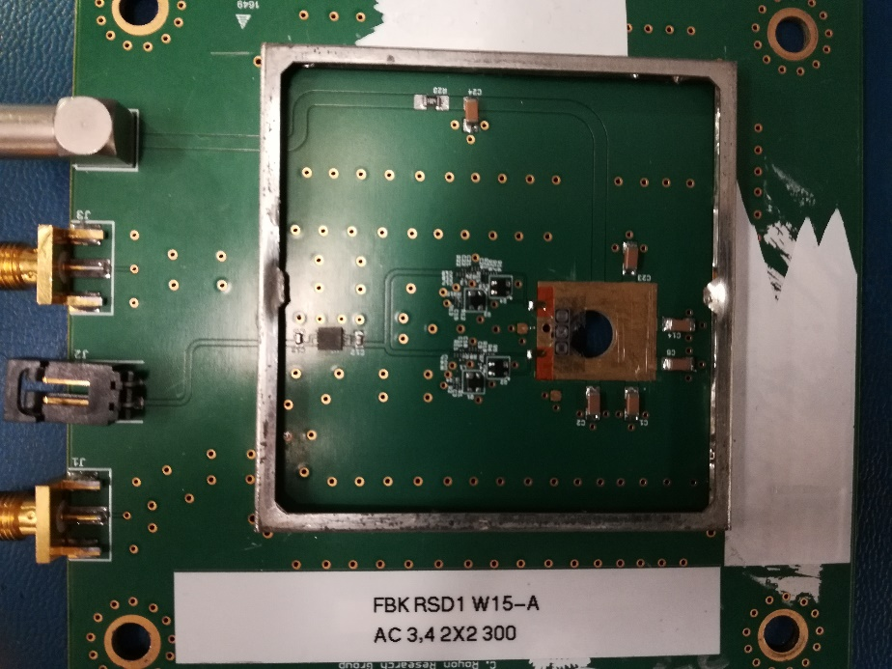
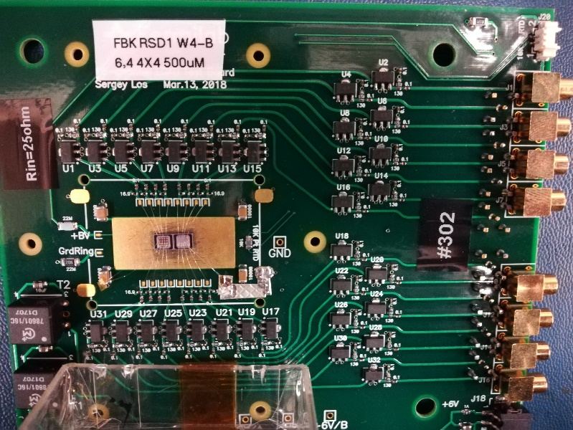
Sensor readout
1Ch board
Sensors are read out with analog boards
Si-Ge fast amplifier (bandwidth > 1GHz)
We have boards with 1ch, 2ch, 4ch, 16ch
Readout with GHz oscilloscope or 16ch digitizer
2Ch board
16Ch board

Slide 11
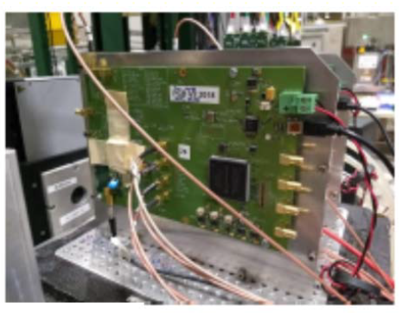
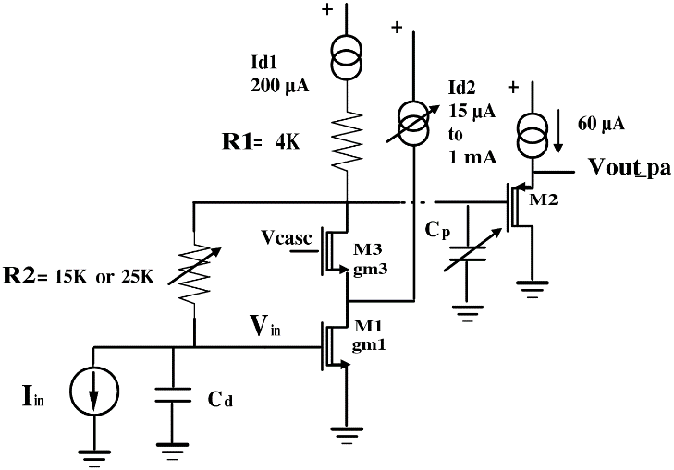
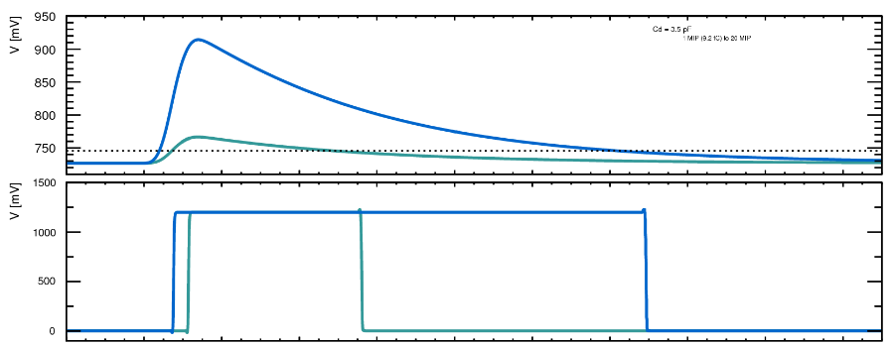
ASIC sensor readout
UCSC is not directly involved in ASIC development
  However we’re following the technology closely!
ASIC is being developed for HGTD: ALTIROC chip
Bump bonded to a sensor
  Bump bonding was done at a Chinese company for 5x5 sensor arrays to 5x5 chips
TOT (Time Over Threshold) correction on the TOA (Time Of Arrival)
  Observed time resolution (after correction) of ~35ps of chip bump bonded to a sensor
Several other chips are in development for fast timing
  E.g. for application in medical science
  See next slide

Slide 12
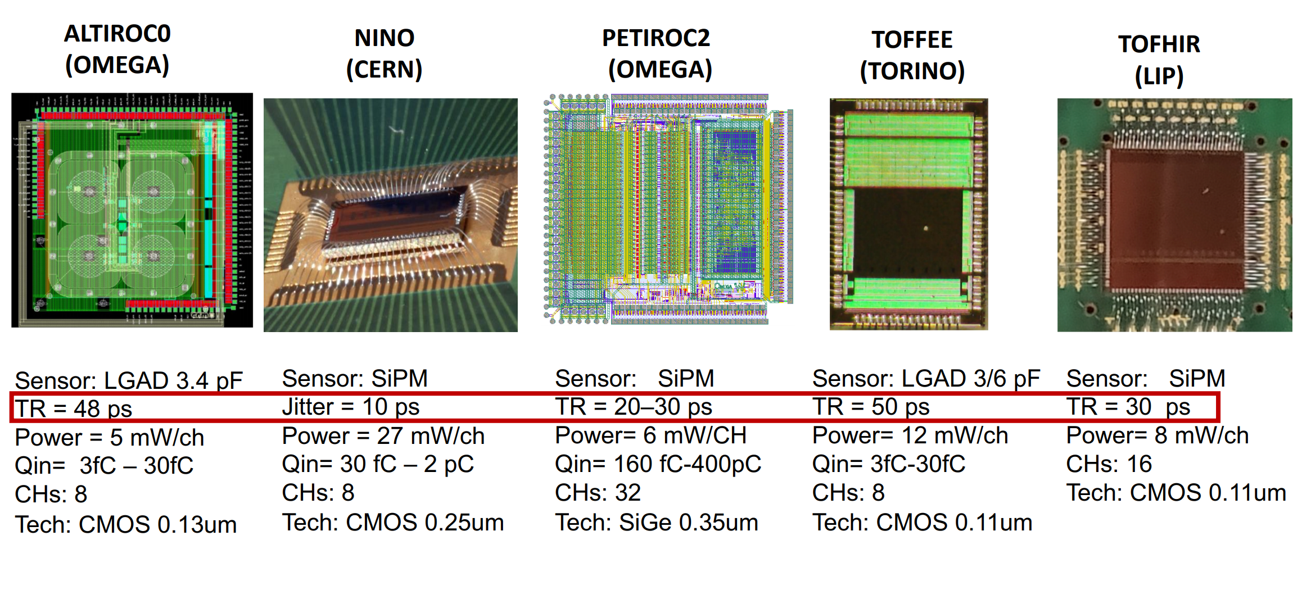
Thanks to Federico Fausti (Torino)

Slide 13
Conclusions
SCIPP has great experience in silicon sensors
  Production, simulation and testing
  We have all the key instrumentation
  Contacts with industry and irradiation sites
  We have patented innovative devices:
    AC-LGAD (Patent 9613993, issued 4/29/2017)
    Slim edge sensors (Patent 8841170, issued 9/23/2014)
    Plus patent pending of DJ-LGAD (Patent App. SC 2019-978)
Leading the R&D effort on LGADs for HGTD and participating other R&D projects (AC-LGAD, TI-LGAD, DJ-LGAD)
SCIPP is also a production site for the ATLAS ITk strip project
  We have a good amount of equipment that we can “borrow”
  Clean room, wire bonders, smart-scope ecc…

Slide 14
This work was supported by the United States Department of Energy,
grant DE-FG02-04ER41286
This project was supported in part by a Launchpad Grant awarded by the Industry Alliances & Technology Commercialization office from the University of California, Santa Cruz.
This work was partially performed within the CERN RD50 collaboration.
Part of this work has been financed by the European Union’s Horizon 2020 Research and Innovation funding program, under Grant Agreement no. 654168 (AIDA-2020) and Grant Agreement no. 669529 (ERC UFSD669529), and by the Italian Ministero degli Affari Esteri and INFN Gruppo V.

Slide 15
Backup

Slide 16
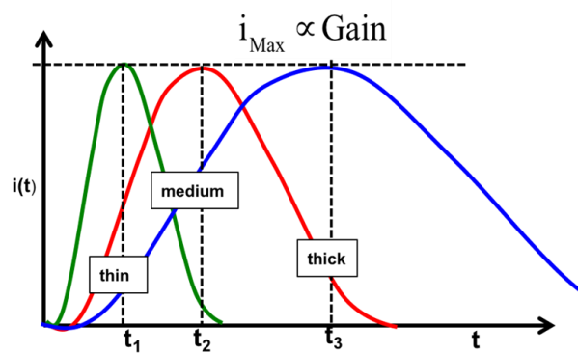
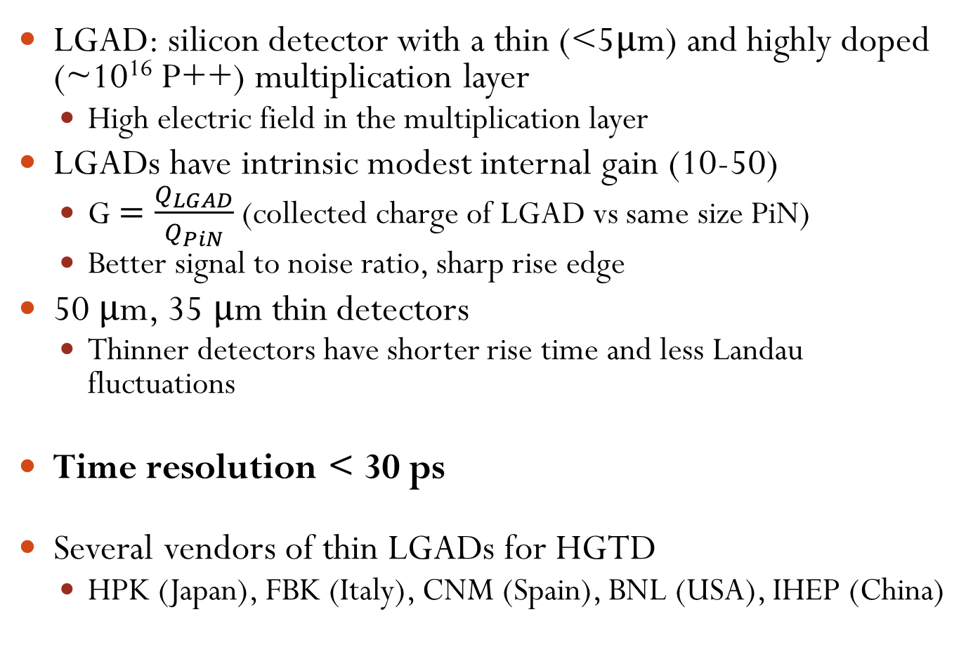
HGTD sensors - LGADs
LGAD: silicon detector with a thin (<5μm) and highly doped (~10¹⁶ P++) multiplication layer
  High electric field in the multiplication layer
LGADs have intrinsic modest internal gain (10-50)
  G $=\frac{Q_{LGAD}}{Q_{PiN}}$ (collected charge of LGAD vs same size PiN)
  Better signal to noise ratio, sharp rise edge
50 μm, 35 μm thin detectors
  Thinner detectors have shorter rise time and less Landau fluctuations
Time resolution < 30 ps
Several vendors of thin LGADs for HGTD
  HPK (Japan), FBK (Italy), CNM (Spain), BNL (USA), IHEP (China)

Slide 17
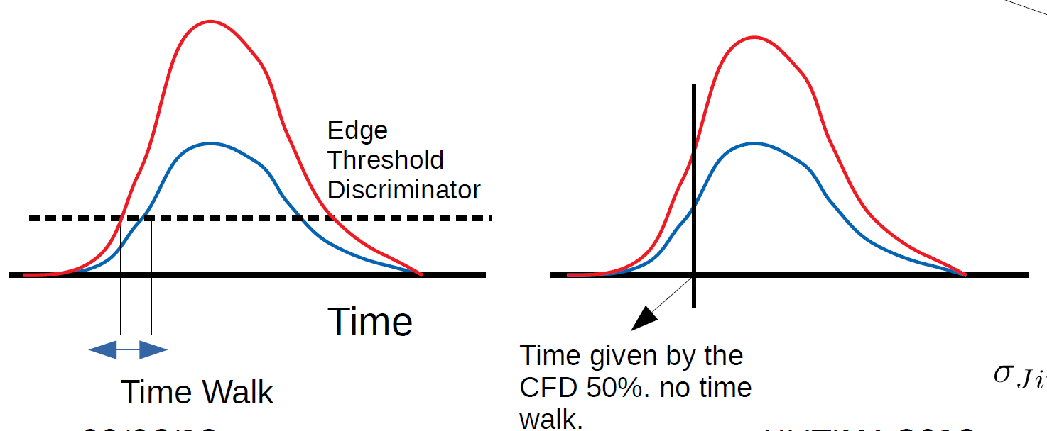
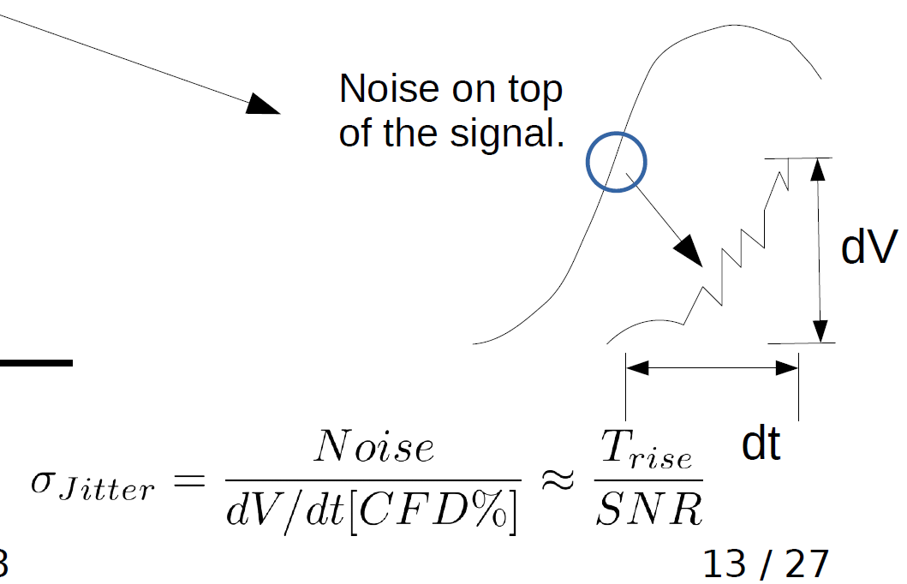
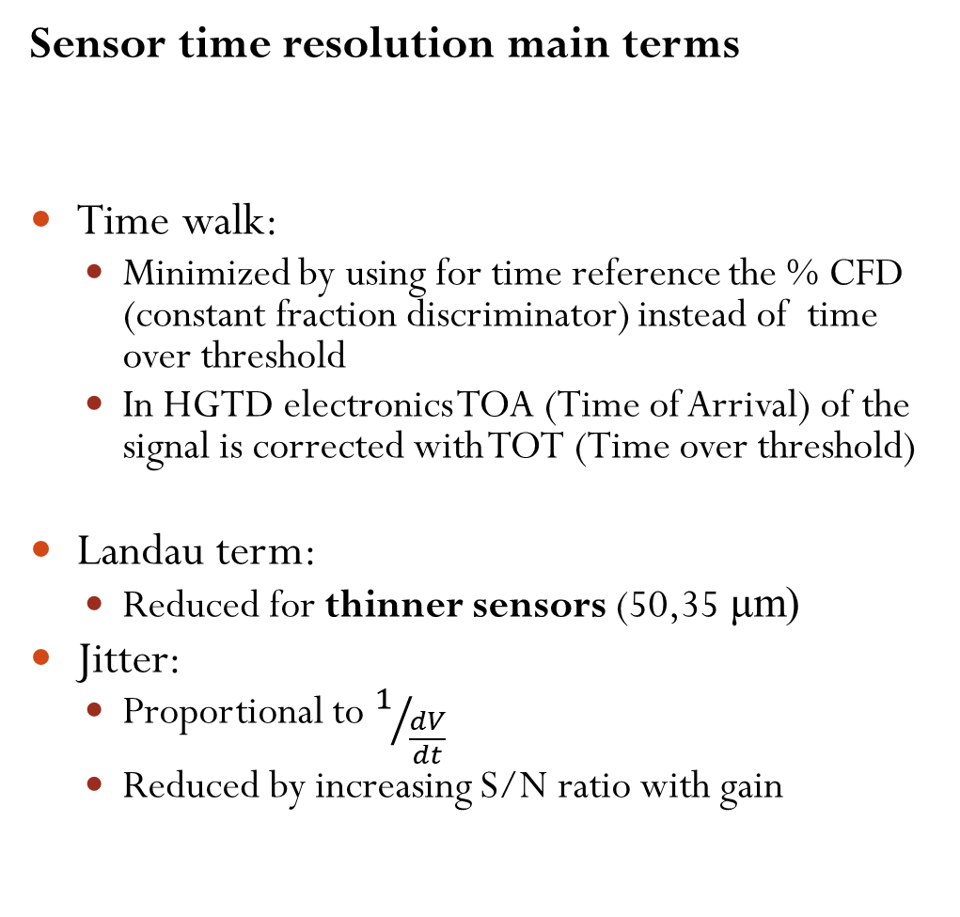
LGADs timing resolution
Sensor time resolution main terms
Time walk:
  Minimized by using for time reference the % CFD (constant fraction discriminator) instead of time over threshold
  In HGTD electronics TOA (Time of Arrival) of the signal is corrected with TOT (Time over threshold)
Landau term:
  Reduced for thinner sensors (50,35 μm)
Jitter:
  Proportional to $1/{\frac{dV}{dt}}$
  Reduced by increasing S/N ratio with gain

Slide 18
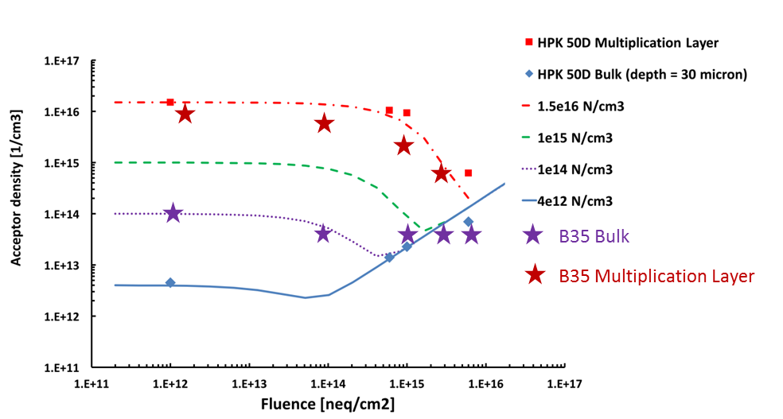
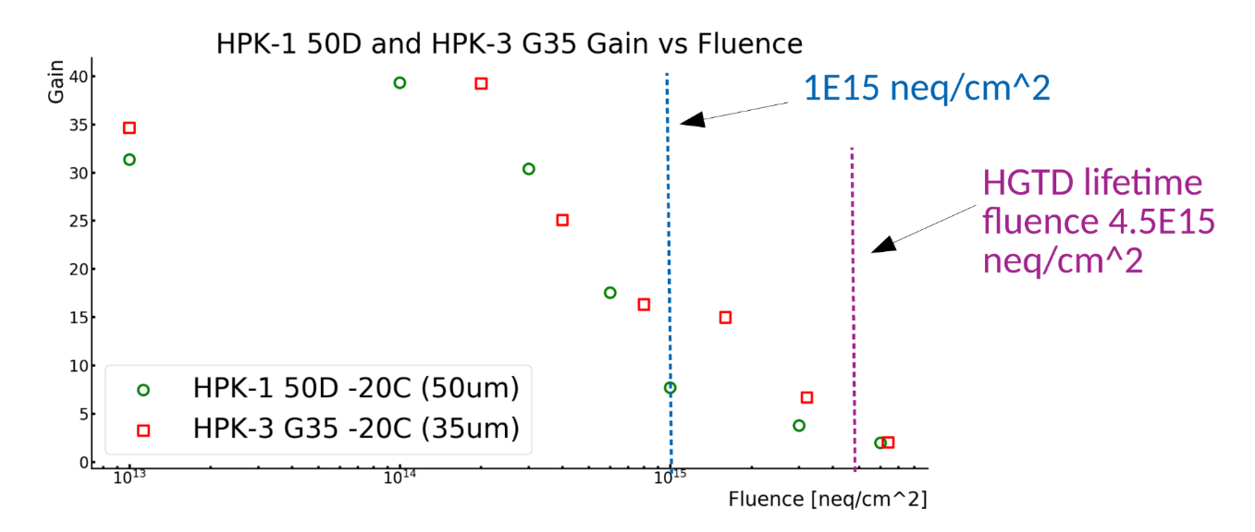
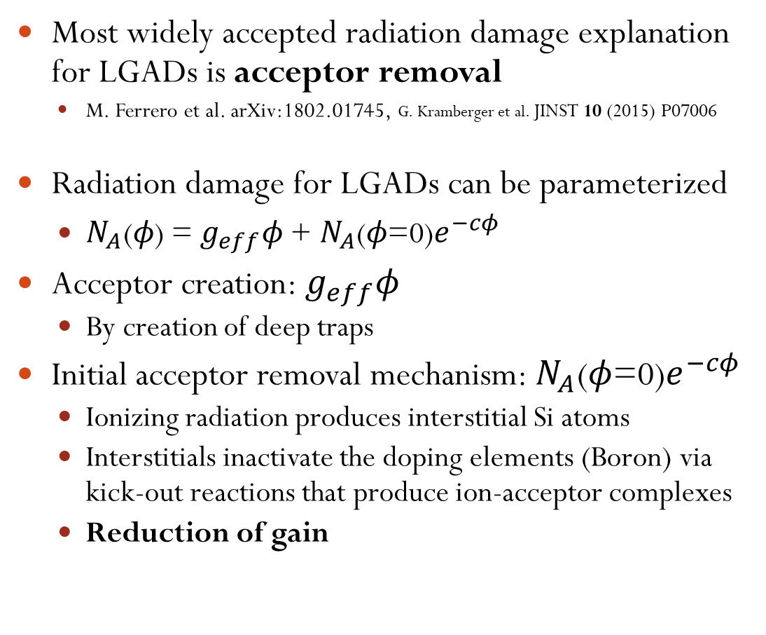
Radiation damage on LGADs
Most widely accepted radiation damage explanation for LGADs is acceptor removal
  M. Ferrero et al. arXiv:1802.01745, G. Kramberger et al. JINST 10 (2015) P07006
Radiation damage for LGADs can be parameterized
  $N_{A}\text{(}φ\text{) = }g_{eff}φ\text{ + }N_{A}\text{(}φ\text{=0)}e^{−cφ}$
Acceptor creation: $g_{eff}φ$
  By creation of deep traps
Initial acceptor removal mechanism: $N_{A}\text{(}φ\text{=0)}e^{−cφ}$
  Ionizing radiation produces interstitial Si atoms
  Interstitials inactivate the doping elements (Boron) via kick-out reactions that produce ion-acceptor complexes
  Reduction of gain
Multiplication layer
Bulk
Y. Zhao et al. 10.1016/j.nima.2018.08.040
Pre-rad
5E15 Neq/cm²
Y. Zhao presentation at ULITIMA conference
https://indico.fnal.gov/event/ANLHEP1390/session/8/contribution/68/material/slides/0.pdf

Slide 19
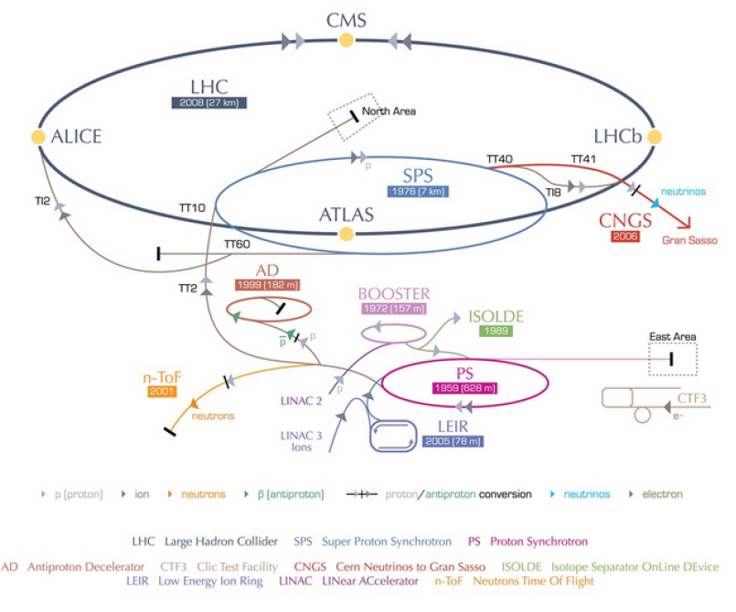
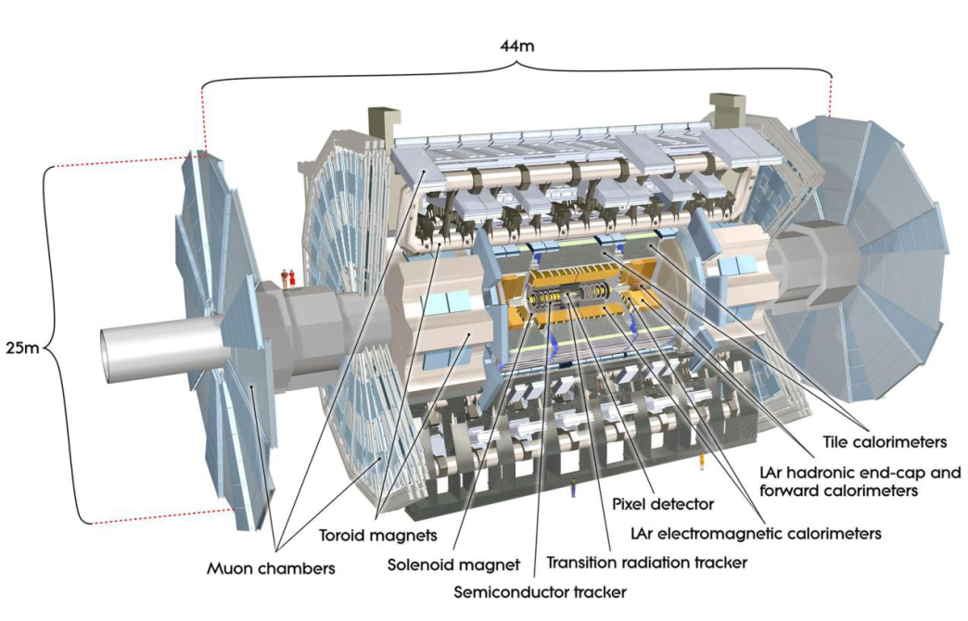
ATLAS and LHC high luminosity
LHC: 14 TeV proton-proton collider at CERN, Geneva
ATLAS: one of the four main experiments at the LHC
  General purpose detector for discovery of new physics and precise measurements
  Layered detector: tracker, electromagnetic calorimeter, hadronic calorimeter, Muon spectrometer
LHC will be upgraded in 2024-2026 to High Luminosity LHC
  HL-LHC
  Instantaneous luminosity higher than present conditions
To maintain performance ATLAS will be upgraded (phase-II) for HL-LHC
  The inner detector will be replaced (ITk project)
  New readout electronics for EM and Hadronic calorimeters
  Upgraded muon detector
  TDAQ system will be completely re-worked
  New end-cap timing pixel detector: HGTD

Slide 20
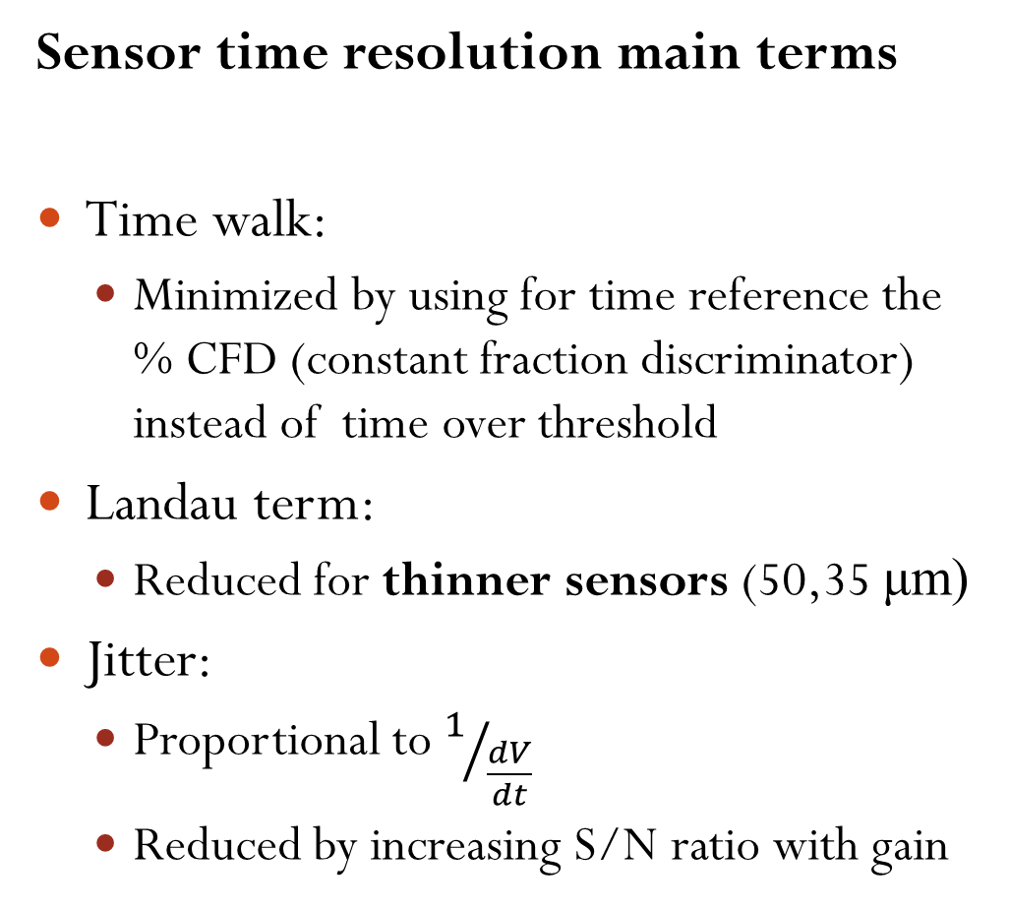
LGADs timing resolution
Sensor time resolution main terms
Time walk:
  Minimized by using for time reference the % CFD (constant fraction discriminator) instead of time over threshold
Landau term:
  Reduced for thinner sensors (50,35 μm)
Jitter:
  Proportional to $1/{\frac{dV}{dt}}$
  Reduced by increasing S/N ratio with gain

Slide 21




Irradiation campaigns on LGADs
Irradiation campaign on LGADs
Sensors were irradiated at
  JSI (Lubiana) with ~1 MeV neutrons
  PS-IRRAD (CERN) with 23 GeV protons
  Los Alamos (US) with 800 MeV protons
  CYRIC (KEK, Japan) with 70 MeV protons
  X-rays at IHEP (China)
Neutron irradiation for fluence
  From 1E13 Neq/cm² → 1E16 Neq/cm²
Proton (and X-ray) irradiation for fluence and ionizing dose
  Up to 4MGy

