Slide 1
Some Thoughts about the “Exploring Limits” Portion of our Work
“Lab Fees” Meeting
1/25/20
Bruce Schumm, SCIPP, UC Santa Cruz

Slide 2
Organizational Things?
Just to introduce – not to be resolved now
Collaboration name?
Maybe “UCAAD”?
Advisory board?
  Yes/no?
  Who on it?
  How often to meet?

Slide 3
Exploring Limits
As I see it, we proposed two major thrusts to pursue in this area
Frame or Repetition Rate
  How fast can we read out a signal and then be ready to receive the next one?
Dynamic Range
  For a given frame rate, how small a signal can we efficiently detect
  How large a sensitive range can we obtain before saturation of either the electronics or the device itself (space charge effects)?
We have proposed to explore this for both Diamond and Si, both independently and in combination.

Slide 4
LGADs and High Frame-Rate Applications

Slide 5
LGADs and Ultra-High Frame Rate
Next-generation photon sources will likely strive towards multi-GHz frame rate
C. Barnes, The Dynamic Mesoscale Materials Capability, P/T Colloquium, Los Alamos National Laboratory, Feb 14, 2019, https://204.121.60.11/science-innovation/sciencefacilities/dmmsc/_assets/docs/PTColloq%2020190214_public.pdf
Q: Do LGADs provide any advantage at high frame rate? Note that impact ionization is a secondary process, so takes time to develop
Consider signal development in the “saturated” regime (essentially uniform e/h plasma deposited instantaneously in the detector bulk)
B. Schumm, Signal Development for Saturated Ultrafast Sensors with Impact Ionization Gain, arXiv:1908.04953, August 2019; (re)-submitted to JINST

Slide 6
Signal Development in Saturated Regime
Consider flux Φ of X-rays of energy E_{γ} (eV) incident on a sensor of thickness d with attenuation length λ and e/h drift speed v^{s}_{e/h}. At leading order the signal charge collected after time t contains two terms: A linear direct term and a quadratic term from impact ionization (gain):
If amplified with a circuit with collection time τ, the total collected charge will be approximately
where K ≅ 1 relates the circuit shaping time to the effective charge collection time. If the circled term is greater than 1 then the gain provides a benefit.
Impact ionization factor = number pf e/h pairs created per cm of travel of extant carrier
Gain contribution
arXiv:1908.04953

Slide 7
Saturated Sensors: Elemental Simulation
Develop elemental simulation with
Planar 50µm thick sensor
saturated drift speed
v_{e/h}=100/60 µm/nsec
2µm thick gain layer
α=0.61µm mean free path per
impact ionization in gain layer
leads to a gain of 30.
arXiv:1908.04953
➔ LGADs would seem to provide benefit (relative to PINs) to beyond 10 GHz frame rate

Slide 8
Possible LGAD Advantages to Advance Accelerator Diagnostics
Y. Zhao (SCIPP), ULITIMA 2018
As shaping time τ goes to 0, signal falls linearly and noise rises as √τ; so S/N ∝ τ^{-3/2} ➔ LGAD gain can be important for low-signal regime
Tunable gain can extend dynamic range by 1-2 orders of magnitude

Slide 9
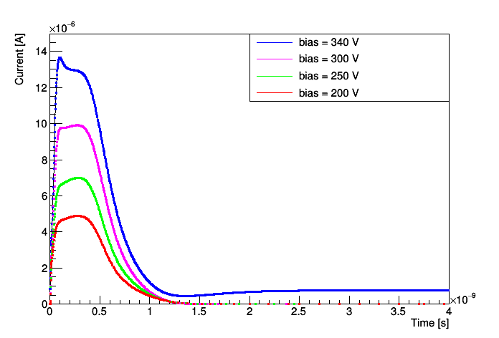
What might an LGAD signal look like?
This “signal” should be thought of, I believe, as what you would see come out of a unit-gain, 0 input impedance, infinite bandwidth amplifier imposed upon the AC circuit path between the biasing nodes
At 1 GHz, easy: just let the all signal charge complete its AC path and you’re ready to go again!
At 10 GHz, completely different picture: the leading edge, dI/dt, is significant for 100 psec but you need to ignore the rest!
Pole-zero cancellation?
Fast reset?
Depends on specifics of signal development
True also for PIN, Diamond
➔ R&D!!!
Simulated signal from a “Deep Junction” LGAD;
50 µm bulk thickness

Slide 10
Frame-Rate “Work Plan” Ideas
Simulation of signal development for Diamond, PIN, LGAD
  Ramo’s Theorem and intrinsic cross-talk limitations for fast signals
  Input into electronic front-end design
  Granular (low flux) vs. uniform (many quanta per frame) deposition
Empirical confirmation of signal development models at 10 GHz (high-bandwidth TZ amplifier?)
Simulation-based electronic design
Characterization with high repetition-rate excitation (pulser, laser, intense source, beam …?)
Note: A high-bandwidth waveform generator is on our equipment list
Refinement of design; production of multi-channel device

Slide 11
Frame-Rate R&D Parameter Space
Sensors
Differing properties of Diamond, PIN, LGAD sensors, including LGAD gain
Saturated (uniform) vs. granular (single quantum or landau-fluctuating) signal
Element capacitance
Bulk thickness (collection time, capacitance and Ramo’s Theorem considerations)
Operating temperature
…
Electronics
TZ, voltage sensitive, charge sensitive
Detector capacitance
Pulse shaping strategy
CMOS, SiGe
Analog measurement (ADC, TOT, …)

Slide 12
Ramo’s Theorem and Fast-Shaping
Cross talk can arise even when all charge is eventually collected on the pad of interest
Must integrate to 0 for infinite collection time
➔ Bandwidth-dependent
Slide Credit: Ron Lipton CPAD 2019

Slide 13
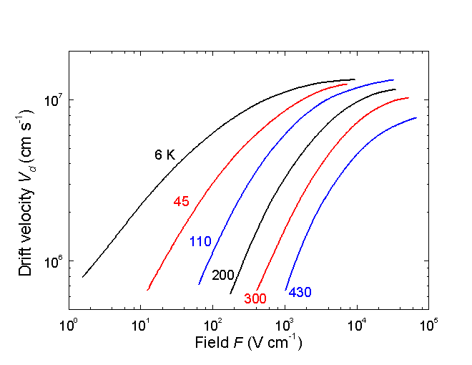
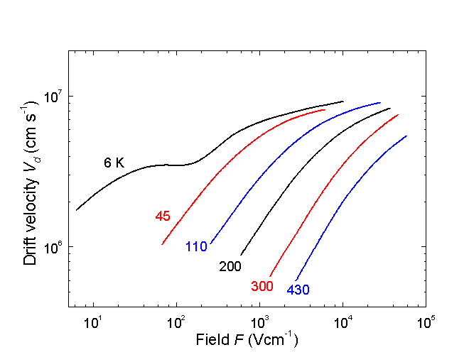
Basic Properties: Drift Velocity
Jacoboni, C., C. Canali, G. Ottaviani, and A. A. Quaranta, Solid State Electron. 20, 2(1977) 77-89.
Electrons
Holes
Note that 10⁴ V/cm over 100 µm is 100 V
For fields approaching 10⁴ V/cm, velocity saturates at ~10⁷ cm/s
Saturated transit time for 100 µm of silicon is ~1 nsec
Transit time and temporal resolution not one and the same, but it sets a scale
Thinner sensors generally associated with more precise timing

Slide 14
Dynamic Range “Work Plan” Ideas
Exploration of capabilities of simulation packages to model saturation effects
Closed-form calculations to guesstimate approximate linear range?
Literature search?
Bench or testbeam studies to produce and characterize saturation effects
Saturation effects as a function of LGAD gain
Electronic design (may involve amplifiers with fractional gain)
Low-end (single quantum) loss of frame rate performance (again, in view of LGAD gain for the case of Si)
Interplay with radiation damage (application dependent; photons vs. neutral hadrons vs. charged hadrons).

Slide 15
Challenges
What are the relevant directions within the parameter space?
  Some guidance from accelerator visionaries may be needed
  Signal flux, granularity, coverage, field environment
Developing 10 GHz infrastructure: can it even be done with discrete elements, rather than going right to IC technology?
Approaches to empirical studies of fundamental sensor saturation effects and confirmation of possible mitigations
Lorentz (B-field) effect?
Silicon sensor fabrication (but we have many contacts in this area)
Electronics
Simulation of signal development for Diamond, PIN, LGAD
Bandwidth, radiation hardness
Suppression of “current tail”
Many channels (3D integration, etc): do we want this to be within our scope? (nascent LANL, BNL, SCIPP SBIR activity)

Slide 16
Initial Steps
Identification and commissioning of professional-level simulation package for Silicon and Diamond, including impact ionization, weighting fields (Ramo’s theorem), transport, etc.
Establishment of 10 GHz working environment/technique
Understand testing/characterization needs; acquisition of equipment (significant funding was anticipated in the proposal!)
Consultation with accelerator physics community, especially for expected properties of diagnostic signals for next-generation facilities
What do we want to produce after 3 years (list of concrete goals?)

Slide 17

BACKUP

Slide 18
Towards Higher Frame Rate: LGADs vs. PIN
As I see it, we proposed two major thrusts to pursue in this area
Need electronics that can “follow the pulse” to as high bandwidth as possible
Transition from saturated to non-saturated regime (frame rate could worsen; maybe thinner detectors better; ionizing vs. neutral radiation)

Slide 19
Data!!
Sensors
Simulation of signal development for Diamond, PIN, LGAD
Electronics
Simulation of signal development for Diamond, PIN, LGAD

