Slide 1
Potential SLAC Collaboration
LCLS, SSRL, UED, Linacs…
25 January, 2020
Bryce Jacobson – Diagnostics & HLA Group Leader (AD-LFD)
Phil Heimann – Matter in Extreme Conditions (LCLS)
Alan Fisher – Diagnostics & HLA Group (AD-LFD)

Slide 2
Sharing the SLAC Linac
Soft x-ray undulator
Experiments
Soft x-ray undulator
Users
Beam transport
Beam transport
Beam switchyard
1-km linac
Experimental area
LCLS
2-km linac
1-km linac
RF gun
Users
RF gun
Users
Superconducting linac
Undulator
Thermionic
gun
FACET-2
Hard x-ray undulator
FACET
SLAC linac
3 km
LCLS-2 HE
Bypass beamlines
RF gun
LCLS-2
Bypass beamline
Linac Tunnel and Klystron Gallery, 3 km 1962–
LCLS, the first hard x-ray FEL, 3rd km 2009–2018, 2019–
FACET, advanced acceleration tests, 1st and 2nd km 2010–2016
LCLS-II, 4-GeV superconducting linac, 1st 700 m 2021–
FACET-II, 2nd km 2020–
LCLS-II HE, 8-GeV upgrade, 1st km ≈ 2026–

Slide 3
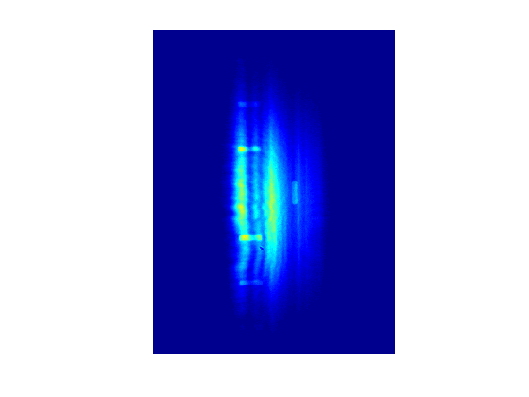
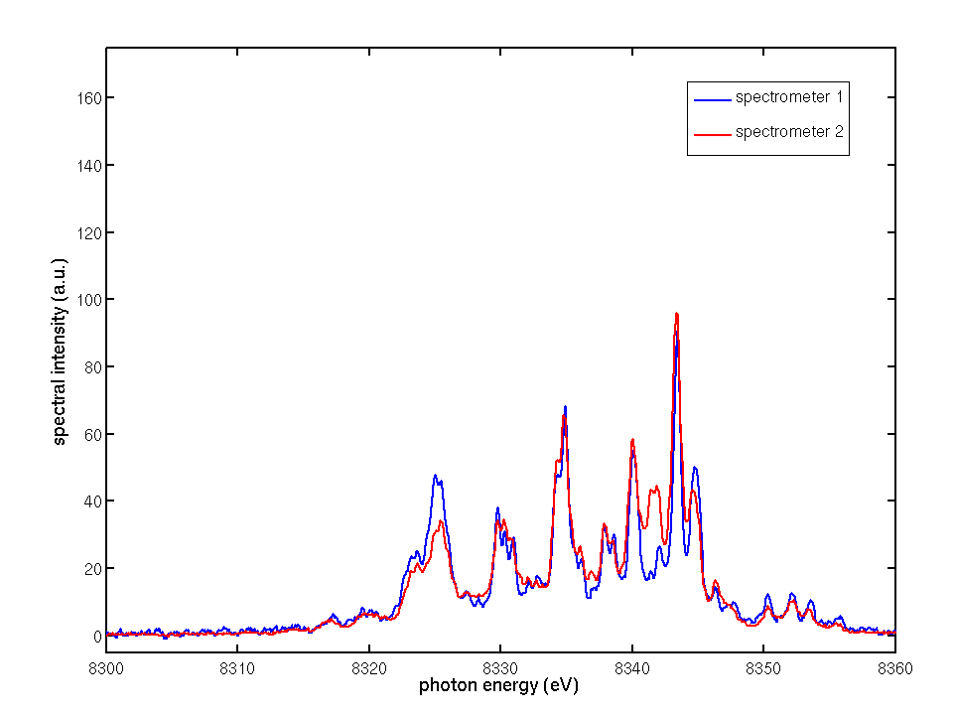
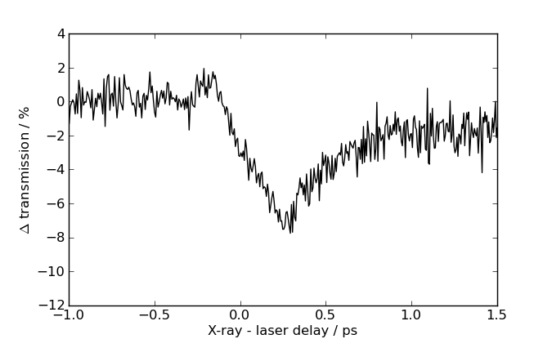
X-ray FEL Source Fluctuations
Spatial
Spectral
Temporal
Every pulse is different and must be diagnosed individually
Can be done “off-line” in analysis (XTCAV, TimeTool)
Two linacs – 120 Hz copper and CW SC
Up to ~ 1 MHz rates – or any structure at 1 MHz
Energy Recover Linacs up to 1.3 GHz
Future XFEL oscillators
Stabilize the accelerator!! – Feedbacks, Optimizers, Machine Learning, “Virtual Diagnostics”…

Slide 4
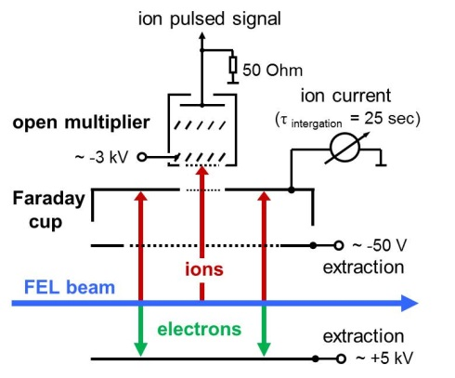
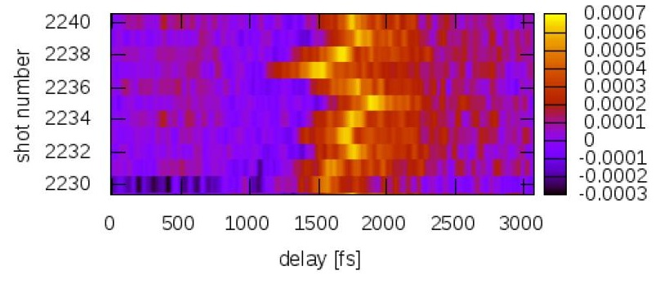
LCLS-II Diagnostics Challenges vs. LCLS Solutions
Repetition rate 0.9 x 10⁶ Hz. Power up to 200 W.
Instrument | TMO | TXI | 2.2
Photon energy (eV) | 250 - 2000 | 250 – 7000 | 250 – 1600
Pulse energy min (μJ) | 10 | 30 | 0.2
Pulse energy max (mJ) | 12 | 8 | 0.03
Repetition rate max (Hz) | 0.93x10⁶ | 10⁵ | 0.93x10⁶
Gas Monitor Detector
Device | Primary Function
Profile Monitor (PM) | X-ray beam alignment
Gas Monitor Detector (GMD) | I₀
Fluorescence Intensity Monitor (FIM) | I₀
Arrival Time Monitor (ATM) | X-ray / optical laser timing
Wavefront Sensor | X-ray optics alignment Focal spot characterization
X-ray Spectrometer | X-ray spectrum
Arrival Time Monitor

Slide 5
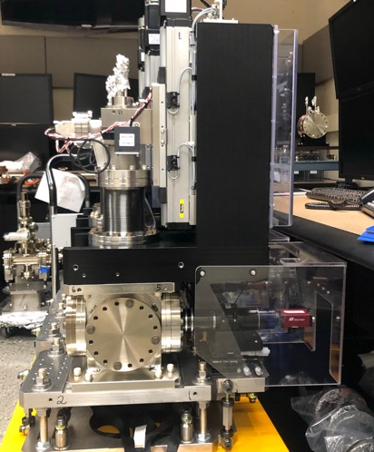
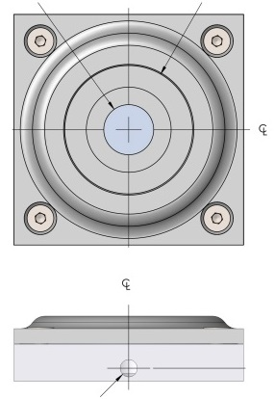
Profile Monitor & Power Meter
Purpose: X-ray beam alignment, to observe the centroid and profile of the X-ray beam.
Power requirement: operate the accelerator at a low repetition rate or use the gas attenuator in the front end enclosure.
The average X-ray intensity along the beamline will be measured by power meters from Gentec, positioned below the YAG crystals.
Ce:YAG is not compatible with power > ~1 W.
Power Meter

Slide 6
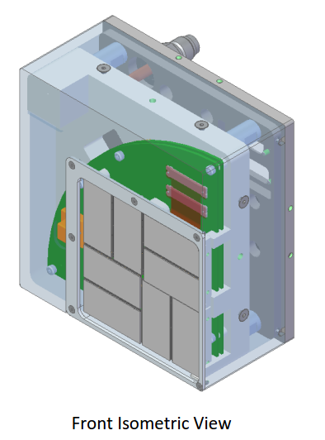
LCLS Detector: ePix 10k
 | ePix 10k Quad
2D pixel array detector | 0.5-1 mm thick Si
Pixel size | 100x100 µm²
Maximum range | 10,000
Readout | 5-120 Hz, single shot
Tile size/ total active chip area size | 40x40 mm / 80x80 mm, Gap ~similar to cspad
X-ray coverage | 4-24 keV

Slide 7
Point and Long Beam-Loss Monitors
PBLM Point Beam-Loss Monitor
Placed at likely loss sites
To prevent damage to collimators, stoppers, dumps
LBLM Long Beam-Loss Monitor
To span the full machine in segments, from gun to beam dumps
To detect losses in less likely places
To identify loss locations
To protect people
In the Klystron Gallery, above penetrations from the linac tunnel
Outside the linac-to-undulator (LTU) transport line
A concrete bunker that is above ground and so less shielded than the linac tunnel

Slide 8
LCLS-II Beam-Loss Monitors Serve Three Functions
BCS Beam Containment System
Stops the machine if beam goes outside its intended location or power
Simple trip logic, without software, without knowledge of timing or rate
MPS Machine Protection System
Halts or rate-limits a beam path if losses exceed the threshold for machine damage
Trips before BCS: Threshold generally set 10 times lower
More intelligent: Uses software, knows beam timing and beam paths
Diagnostic Signals
Help operators to tune: Display losses below trip threshold, indicate loss location
Reduce radiation on beamline components and outside the tunnel
Detect loss signals from fast wire scanners
EPS Equipment Protection System
Not implemented (see FE monitors)

Slide 9
Beam-Loss Requirements for LCLS-II
Loss detection at SLAC had always used ionization chambers, but:
Ionization chambers can have a nonlinear response to high loss power (IBIC 2016)
High losses at BCS thresholds: 100 W for PBLMs, and 35 to 1000 W for LBLMs
Dynamic range: Continuous RF may cause field-emission with significant power
 | LCLS | LCLS-II | LCLS-II HE
Repetition rate | 0.12 | 929 | 929 | kHz
Allowed beam power | 0.5 | 120 | 250 | kW
“Maximum credible” power | 0.5 | 1100 | 2200 | kW
Loss integration time | 1 | 0.5 | 0.5 | s
Trip time | 8.3 | 0.2 | 0.2 | ms

Slide 10
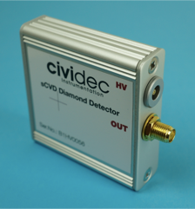
A Diamond Detector as a Point BLM
Metallized diamond chip, 4×4×0.5 mm³ for the single-crystal (B1) type
Radiation creates electron-hole pairs, which are collected by a bias voltage
Electrons and holes have high mobilities and cross the thin chip quickly
Like a solid-state ionization chamber, but fast: Few-ns pulses
Large dynamic range
1 to 10⁶ MIPs (minimum ionizing particles)
Unlike ionization chambers (SLAC’s old PBLMs):
No pile-up from prior pulses
No gas: low maintenance, high reliability
Cividec B1HV

Slide 11
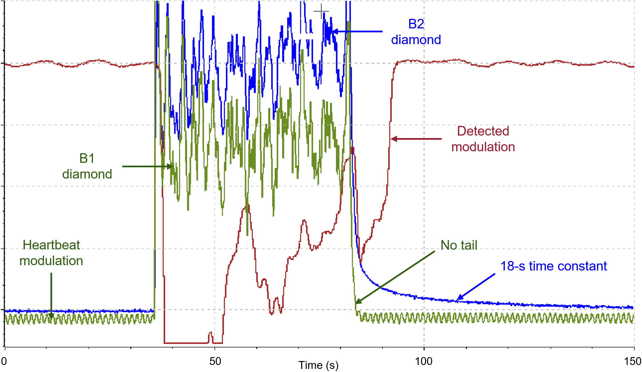
Polycrystalline versus Single-Crystal Diamond Detectors
≈1 W of beam (<< MPS trip level) scraped at energy collimator (LCLS BC2)
Beam rate quickly toggled between 0 and 120 Hz
Cividec B2, polycrystalline
18-s decay tail
Cividec B1, single crystal
Much better: No tail
Also, first test of heartbeat
Modulating B1 bias voltage

Slide 12
Modeling the Diamonds: Area Coverage
Protection collimators are used after the linac and transport lines, where two or more beamlines are close together
Extension to FLUKA computes B1 diamond signal from a loss shower
Uses Cividec data on creation of e-h pairs
Signal is nearly constant downstream of loss on protection collimator, for >20 m
Diamond is 1.5 to 2 m from beamline
Experimental test in End Station A
Each diamond can cover an area, rather than a single protection collimator
Beam-Loss Model
Beampipe
Protection collimator

Slide 13
2017-01: Field-Emission Test on CEBAF at JLab
Last cryomodule in the north linac of CEBAF (Jefferson Lab)
1L26, a high-gradient C100 type
RF was on in all linac cryomodules, but without photocurrent
Cavity gradients in 1L26 were raised sequentially in steps of 1 MV/m
RF in other modules held constant
Fiber with PMT:
12 m of fiber strung along the side of the tank
Uncooled blue PMT placed at upstream end and shielded with lead
Before the red-sensitive, cooled PMT was selected
Diamonds:
Diamond detector at each end of the tank, above warm beampipe
A known loss point, since the warm pipe has a smaller diameter
BLMs:
JLab BLMs are PMTs (without scintillators), at each end of the tank.

Slide 14
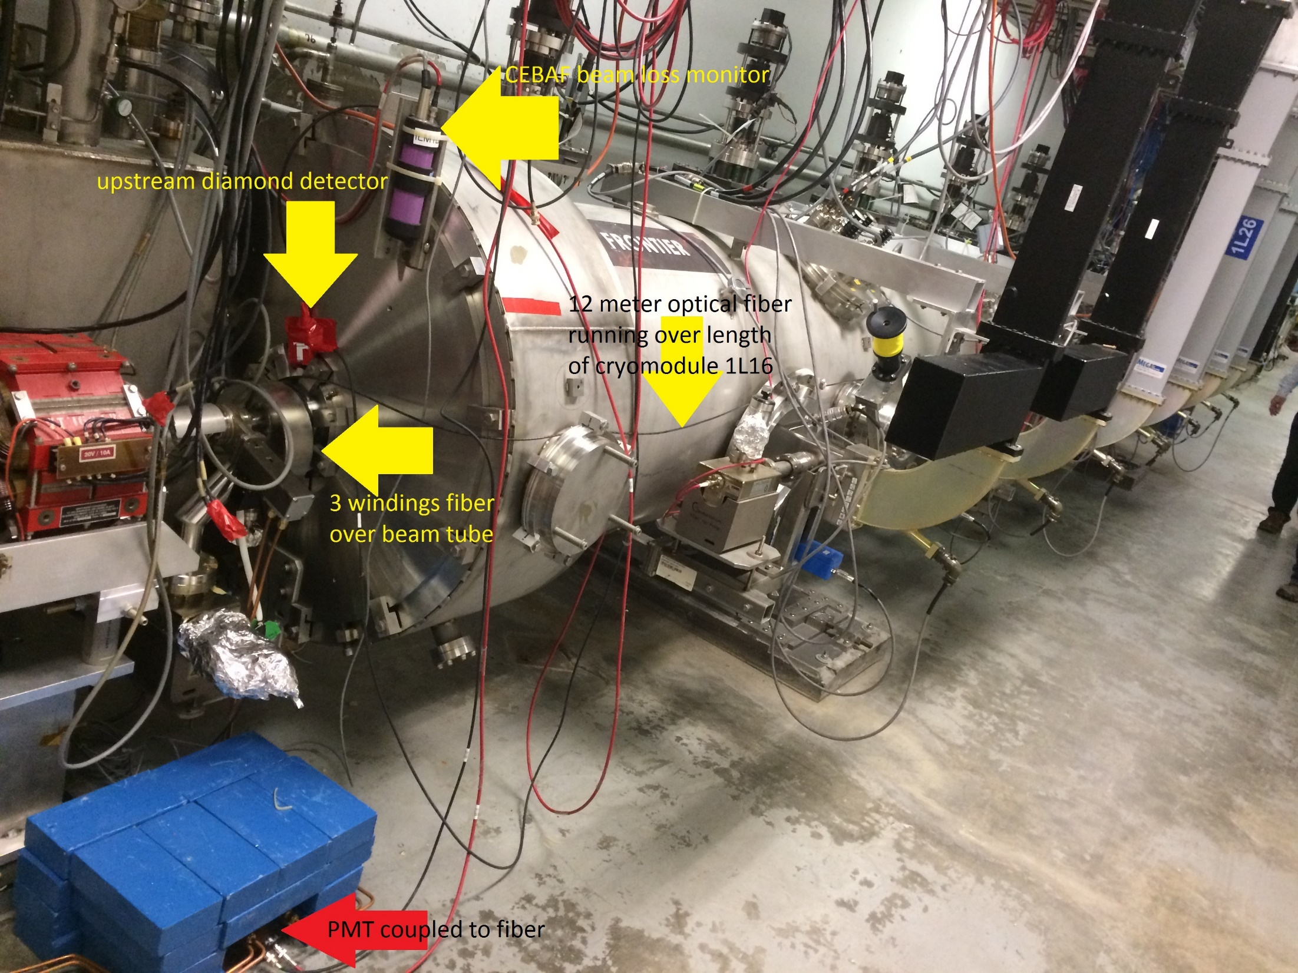

Slide 15
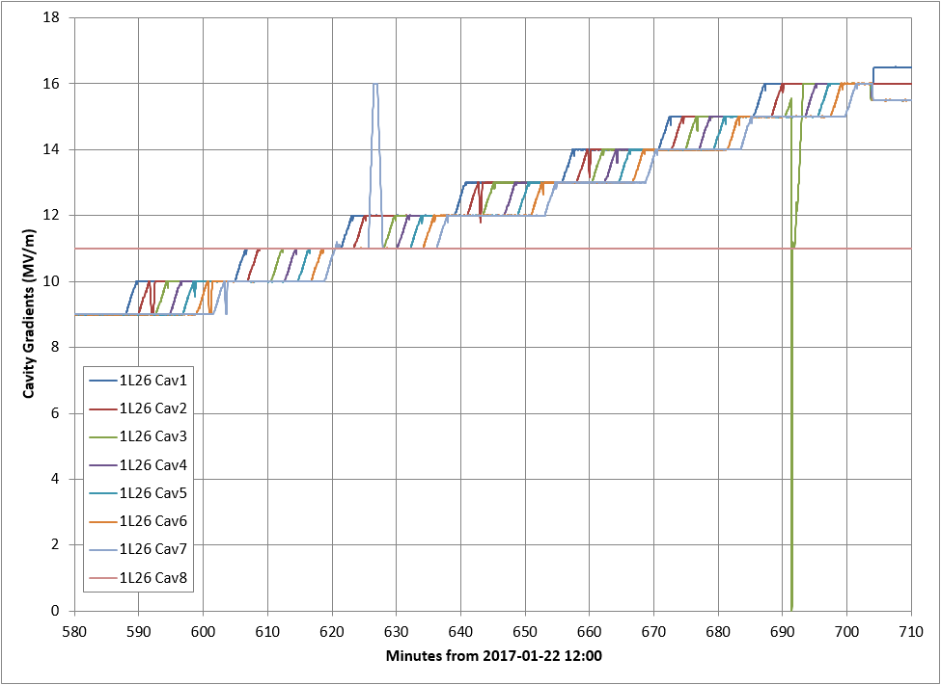
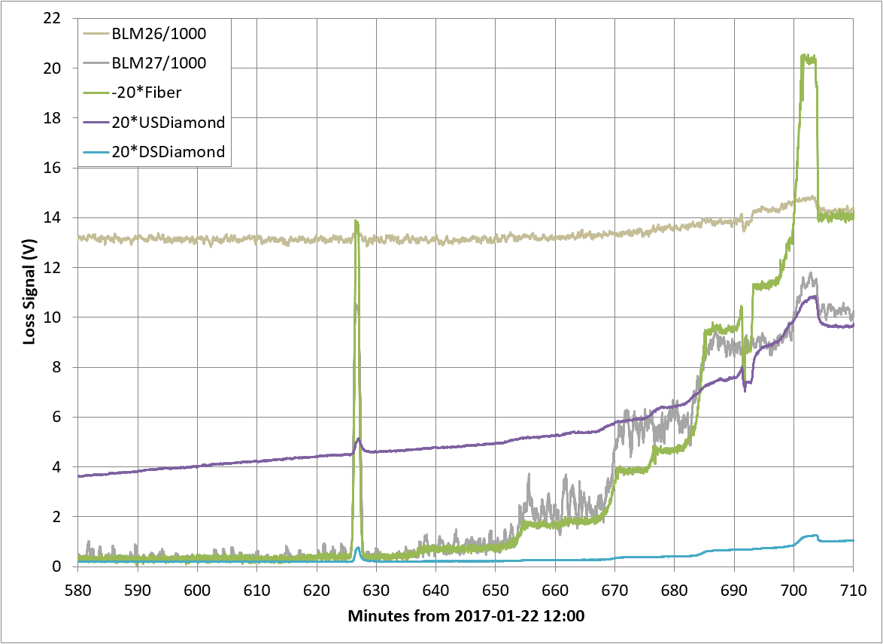
2017-01: Stepping CEBAF Cryomodule Gradients
Loss Signals
Cav 7
Fiber
Cav 8
Upstream BLM
Steps of 1 MV/m
Cav 3
Upstream Diamond
Cavity Gradients (MV/m)
Downstream BLM
Downstream Diamond
Fiber displays growth of field emission with increasing cryomodule gradients
Fiber is far more sensitive to the inner cavities: spike in cavity 7, drop-out of cavity 3
Downstream diamond (high-rad B4 types, less sensitive) and BLM show steps of cavity RF
Upstream BLM and diamond dominated by losses from upstream (1L25); weak response to 1L26

