Slide 1
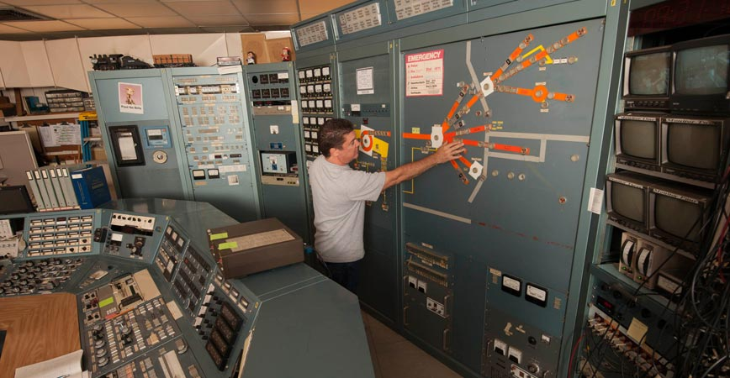
Crocker Nuclear
Laboratory
Eric Prebys
Professor of Physics, UC Davis
Director, Crocker Nuclear Laboratory

Slide 2
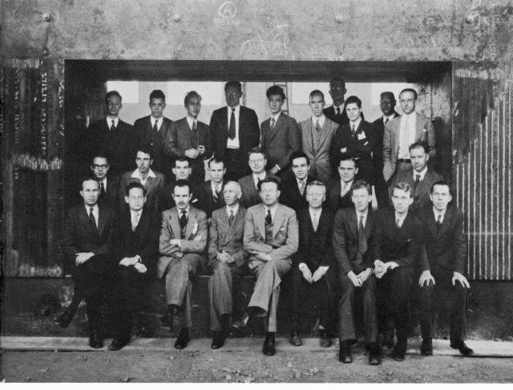
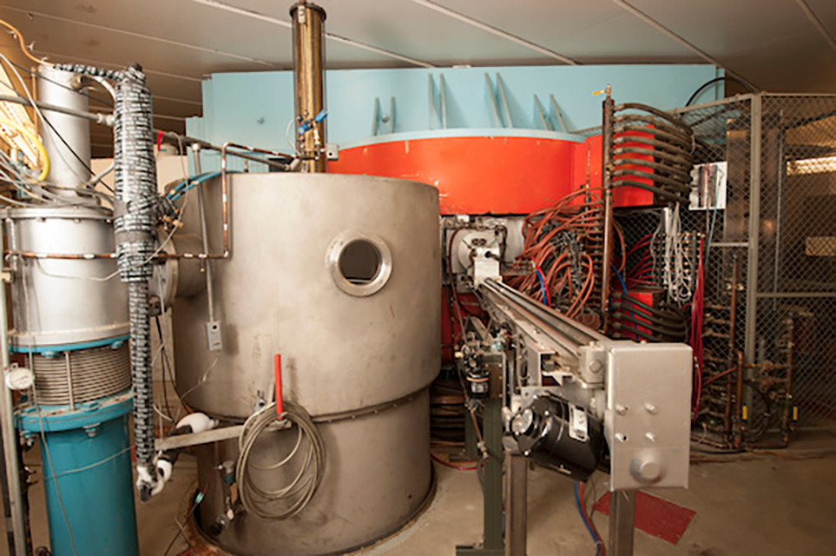
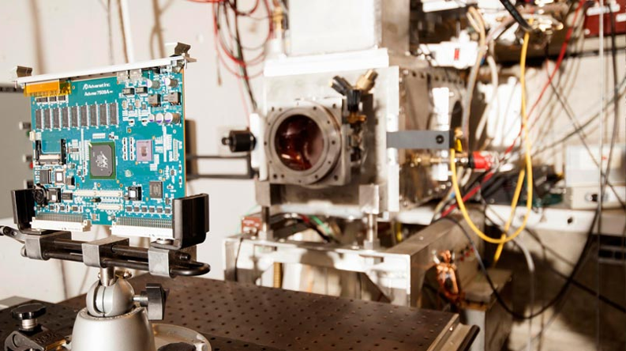
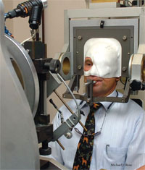
Crocker Nuclear Laboratory, UC Davis
History:
  Commissioned in 1966 using steel from Lawrence’s 60” cyclotron (1939)
  Variable energy protons, deuterons, and alpha particles up to 67 MeV for protons.
  Originally used for nuclear physics, it spent many years doing environmental and other research using proton induced X-ray emission (PIXE)
Now used primarily for
  Radiation effects in electronics
  proton therapy for eye cancer

Slide 3
Future of Crocker
Historically, the cyclotron has been part of the Air Quality Research Center, and the terms AQRC and CNL were interchangeable.
The cyclotron consistently breaks even financially by charging hourly fees to the medical and external users
  I’ll say more about this shortly
A few years ago, the university decided that the we shouldn’t be in the business of simply providing a service for a fee, so the option was to expand the scientific mission or close it down.
The AQRC Director wasn’t interested in expanding the mission of the cyclotron, so three years ago, “Crocker Nuclear Lab” was split off from the AQRC
  Includes the cyclotron and the machine shop
I was brought in in 2017 with the broad mandate to “do science”. So far
  DOE grant to develop ²¹¹At production
  TRISH (NASA) grant to study effects of radiation on synthetic human tissue on a mission to Mars.
  Gamma camera effort at UCB
  Funded PIXE studies of environmental samples from Greenland and California
  Instrumentation project for FNAL IOTA accelerator physics storage ring
  UC Fee grant to study high speed diamond-based accelerator diagnostics.
As long as we pay the bills, we will continue to have total control over our schedle and priorities.

Slide 4
Crocker Layout
Beam probe (proposed internal target carrier)
Line 6
(currently unused)
Cyclotron
Eye Therapy Facility (line 3)
Historical isotope production (line 0)
Commercial radiation effects line (line 2)
Secondary neutron line (line 5)/experimental counting area
Charged beam experimental lines:
(1a, 1b, 1c)
Can develop dedicated experiments here!

Slide 5
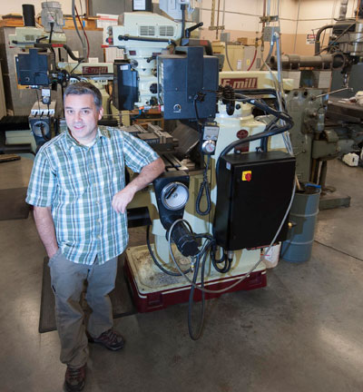
CNL Machine Shop
CNL is home to the consolidated machine shop for the UCD College of Letters and Science.
  Full suite of manual and CMS machines
  Four full time machinists
  “student” shop that faculty can use
Subsidized rate of $26/hr
  Will go up to ~$31/hr
Machine shop administratively
part of CNL, but separate
accounting for the two

Slide 6
Application to Project
Use 1a Beam Line in North Cave to benchmark detector timing and data acquisition
  22 MHz 67 MeV (~4x minimum ionizing) proton bunches
    Intensity from 1 every four bunches to 30k/bunch
  Can use low intensity to measure timing resolution and more intense bunches to measure single particle resolution within bunch (bunch width ~3 ns).
  Can also deliver lower energy, heavily ionizing protons and alphas
Developing new line within vault for high radiation exposures
  100 MRad in 30 minutes
Develop diamond-based diagnostic tools for use within the cyclotron
  This is the part I’m the most excited about
  Detector can be incorporated into our existing probe head assembly
    Probe has an airlock, so probe heads can be swapped in without breaking vacuum.

Slide 7
Beam Evolution in AVF Cyclotrons
AVF Cyclotrons are very old, but still fill a useful niche
  Low energy (10 MeV-1 GeV), high current (up to mAs or higher)
  (can be) highly reliable
  Relatively inexpensive
  Applications
    Low current (turnkey technology)
      Hadron therapy
    High current (pushing limits)
      Isotope production
      Nuclear physics
      Muon and neutrino physics
      ADS systems (AVF cyclotron = 0th order FFAG)
Validation of simulation tools pretty sparse
  Not a lot of data about space charge, etc, effects during the acceleration cycle.

Slide 8
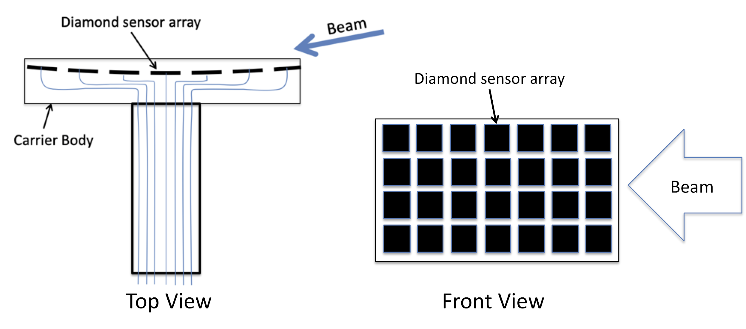
Probe head

Slide 9
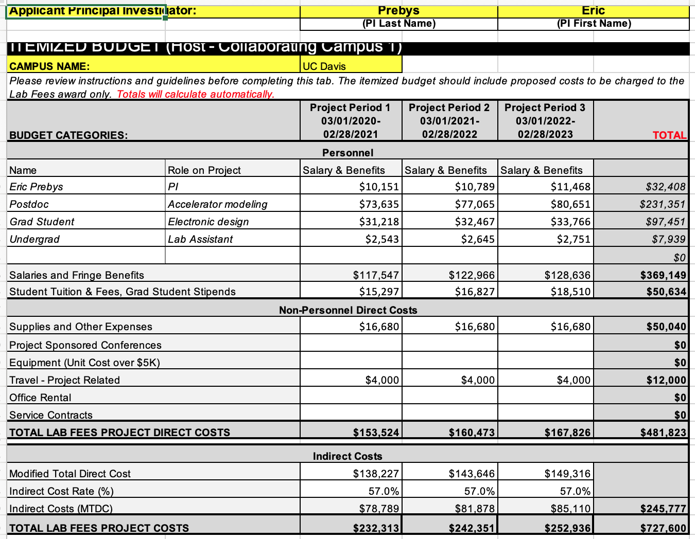
UC Davis Budget

Slide 10
Non-personnel, non-travel Expenses
Budget request included
  2 8-hour beam shifts/year @$655/hr = $31,920
    This won’t be enough, but we can be creative about this
  40 hrs/yr of machinists’ design and fabrication time @$26/hr = $3,120
  $5k/year for materials and supplies = $15k

Slide 11
Cyclotron Finances/Operational Considerations
The $665/hr UC rate is calculated to break even, billing time 8 hours/day, five days/week
  Includes
    Full time staff of 4.5
    Cyclotron maintenance
  Doesn’t include
    Building cost
    Power
    Most of me
    Major improvements
Our higher non-profit and commercial rates provide a $200-300k/yr capital fund for major repairs or improvements.
Time outside of this is “negotiable”
  I can’t arbitrarily give away time from free, but
  Activities that help us study the cyclotron can certainly be supported
Working to bring things to the point where less qualified (and less expensive) operators can run the machine after hours and weekends.

