Slide 1
Fun4All on Cori
Dhruv Dixit

Slide 2
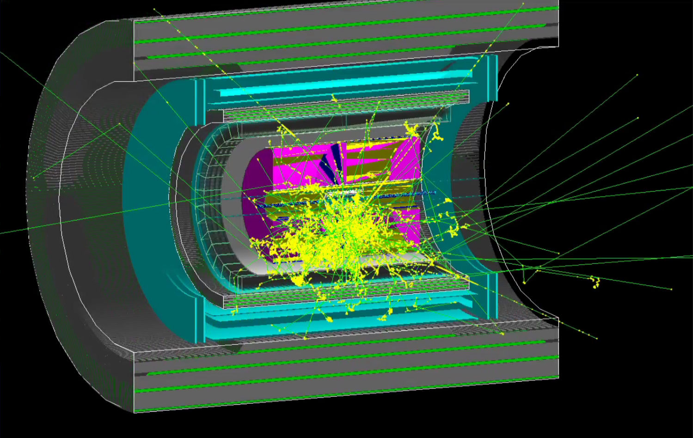
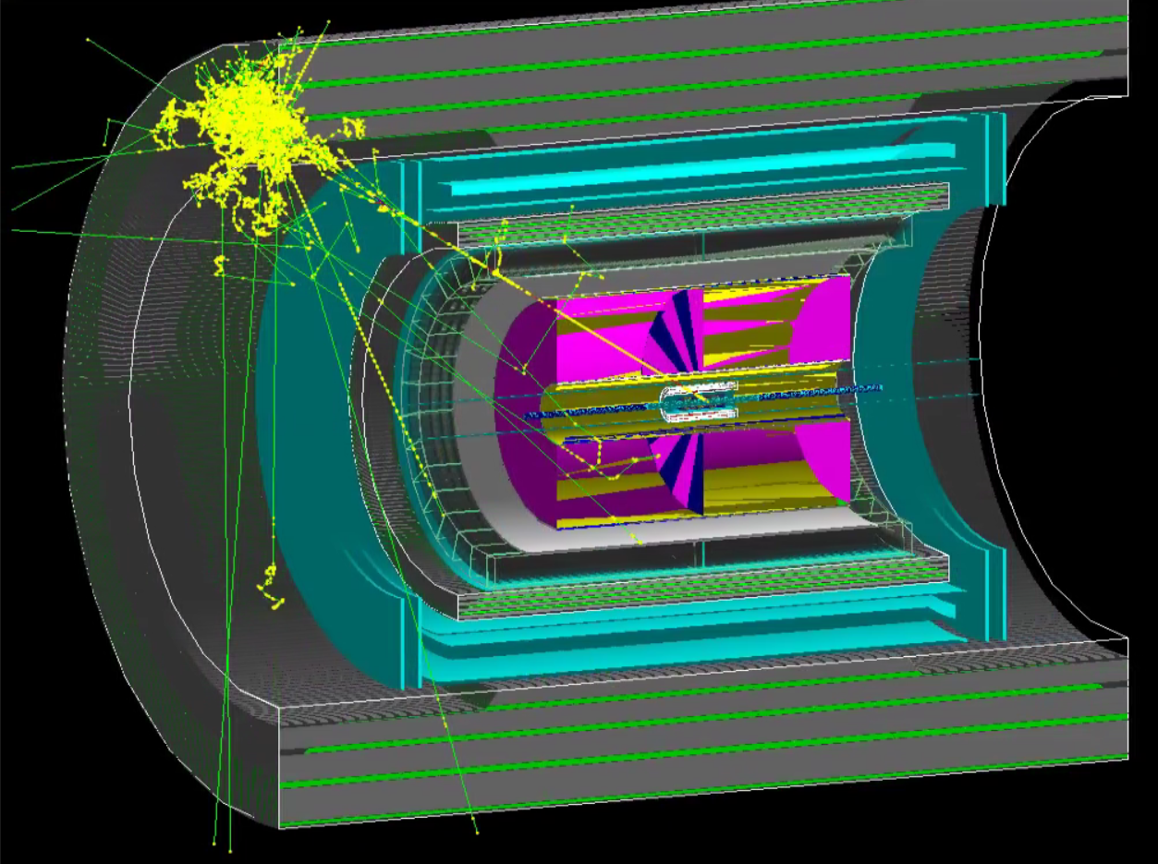
Status & Next Steps
Current status:
Fun4All works on Cori.
This was tested using a small event display tutorial.
Next Steps:
Trying to run Fernando’s e+p jet analysis.
If e+p analysis works smoothly, the plan is to switch out the SPHENIX detector with the All-Si design. Chis Pinkenburg has provided the instructions on how to do so.
Winston is trying to get Fun4All working now. This lets us test if there are user specific changes we need to worry about while setting up Fun4All.
Two different event displays created using Fun4All on Cori.

