Slide 1
MDP Technical Meeting # 3 on
20 T hybrid magnet and comparative analysis
Paolo Ferracin, Giorgio Ambrosio, Lance Cooley, Ramesh Gupta, Vadim Kashikhin, Alexander Zlobin
US Magnet Development Program

Slide 2
Outline
Definition of the goals of the working group
Design criteria for a 20 T hybrid magnet
Overview of current hybrid work
Action items

Slide 3
1st goal of the working group
Conceptual design of a 20 T hybrid HTS-LTS magnet
  Comparative analysis of different design options for a 20 T hybrid
    Cosϑ design and its stress-management options
      “Traditional” Cosϑ
      Canted Cosϑ (CCT)
      Stress management Cosϑ (SMCT)
    Block-type coil design
    Common-coil design
  Definition of general design criteria: aperture, field, margin…..
  Analysis of challenges specifically of hybrid magnets
    Integration of LTS/HTS, mechanics, protection, powering, diagnostics, test facility…..

Slide 4
1st goal of the working group
The goal should not be, or does not necessarily have to be
  reaching a consensus on a particular design
Instead, more realistically, the working group could aim at
  Discussing and reviewing the different designs and listing pluses and minuses or open issues….grounding on “objective” criteria
  Providing inputs to the other areas (in particular area I and area II) to better define their roadmaps and overall directions, and avoid inconsistencies

Slide 5
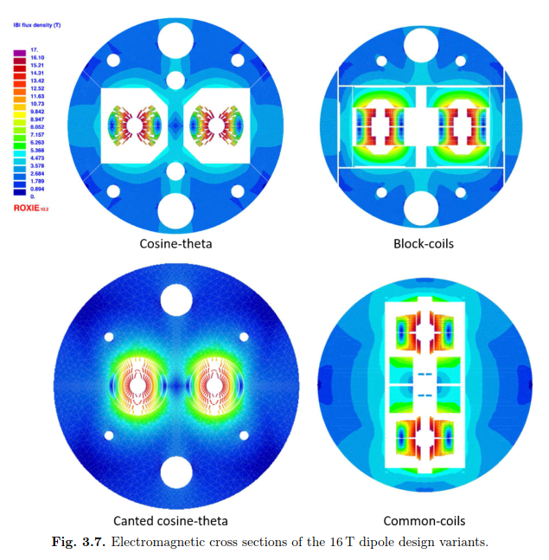
1st goal of the working group
An example: 16 T dipole magnets for FCC
Ideally the goal should be to carried out the full 2D design and analysis of a 20 T hybrid for all the design options considered
    Cosϑ design and its stress-management options, Block-type design, Common-coil design

Slide 6
2nd goal of the working group
Review and follow-up of current work towards 9-15 T hybrid magnets
  This current work can be divided in two steps
    Step 1: the 9-12 T field level
      It involves the use of existing Nb₃Sn magnets as background for low field HTS inserts
      The time frame is the 2020-2021
    Step 2: the 13-15 T field level
      It involves the fabrication of a new Nb₃Sn magnet generating a about 11 T in a large aperture for 3-5 T insert coils
      The time frame is the 2021-2023
  The goal is to collect and organize information from these programs (responsibility of area I and area II) to provide inputs for 20 T hybrid design

Slide 7
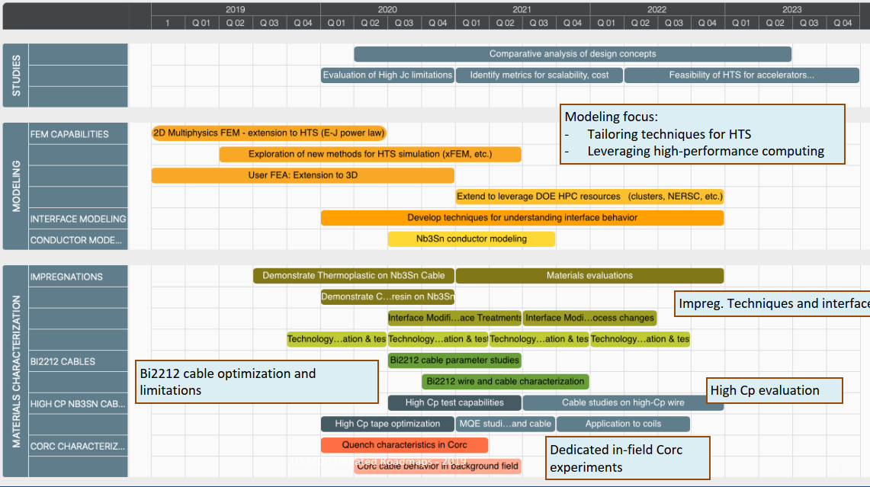
Proposed design studies roadmap
Time frame: 2020 – 2023
Methods
  Modeling effort
    “classical 2D/3D” mechanical, magnetic and QH simulations
      Developing new modeling techniques is not part of this task
      However, if new tool/analysis is required → feed-back to Technology area (III), modeling and simulations

Slide 8
Outline
Definition of the goals of the working group
Design criteria for a 20 T hybrid magnet
Overview of current hybrid work
Action items

Slide 9
Design criteria for a 20 T hybrid magnet
Previous work within MDP on a 16 T dipole magnet
  GianLuca Sabbi, Alexander Zlobin, MDP General meeting – May 17, 2017
  See appendix for additional comments

Slide 10
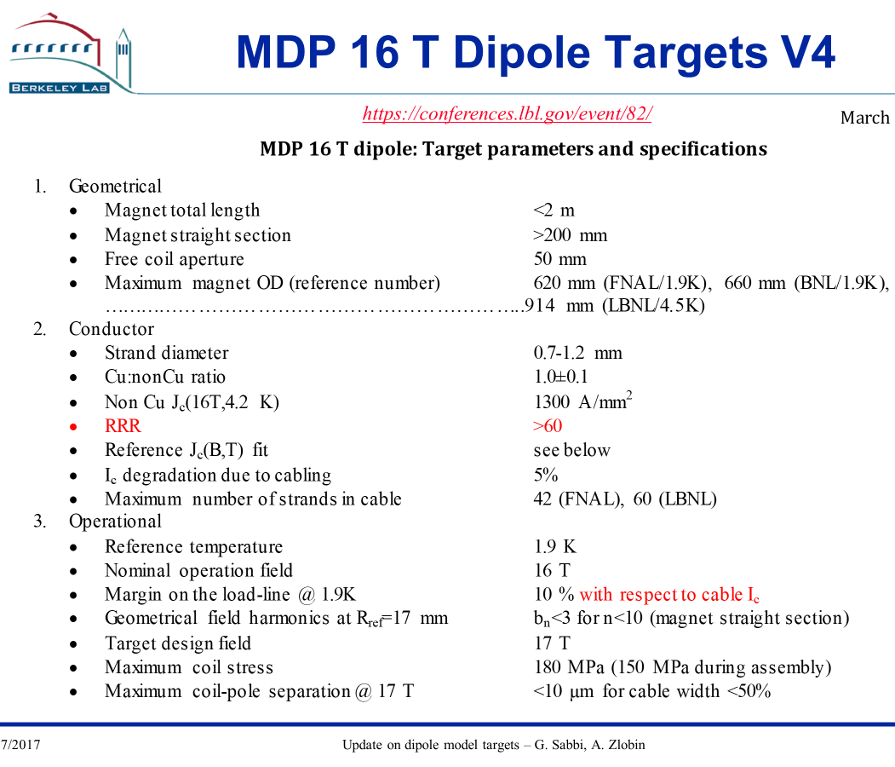
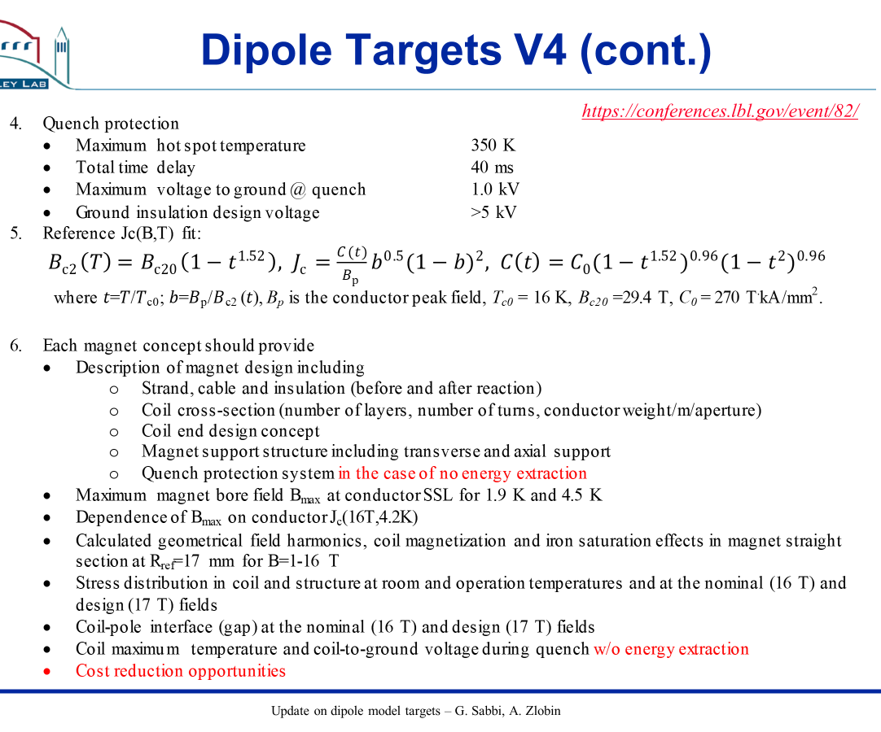
Design criteria for a 20 T hybrid magnet

Slide 11
Design criteria for a 20 T hybrid magnet
Previous work within FCC collaboration on a 16 T dipole magnet

Slide 12
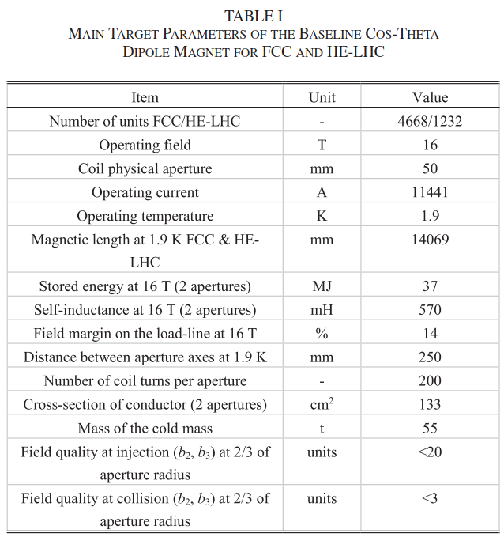
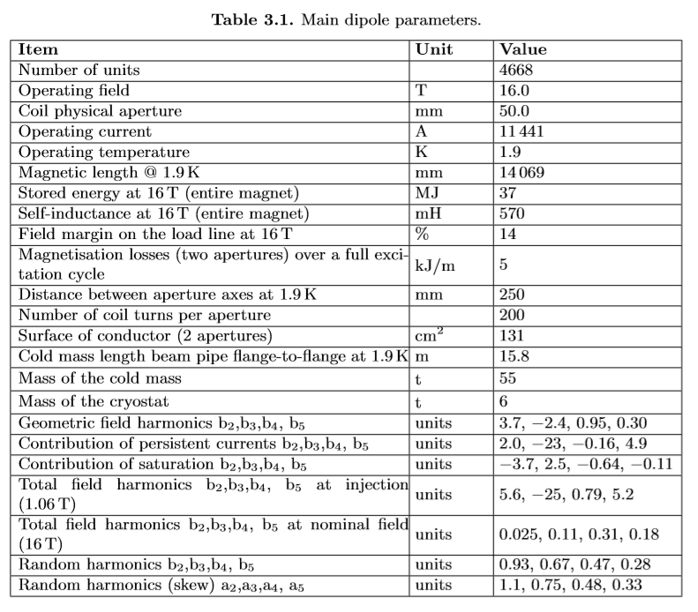
Design criteria for a 20 T hybrid magnet

Slide 13
Design criteria for a 20 T hybrid magnet
Action items
  Review parameters and modify, simplify, reject/accept
  Add parameters for HTS insert, both REBCO and Bi2212
    Do we use educated guess of critical current in 5 years from now or current values ?

Slide 14
Outline
Definition of the goals of the working group
Design criteria for a 20 T hybrid magnet
Overview of current hybrid work
Action items

Slide 15
Overview of current hybrid work
Step 1: the 9-12 T field level
  It involves the use of existing Nb₃Sn magnets as background for low field HTS inserts
  The time frame is the 2020-2021

Slide 16
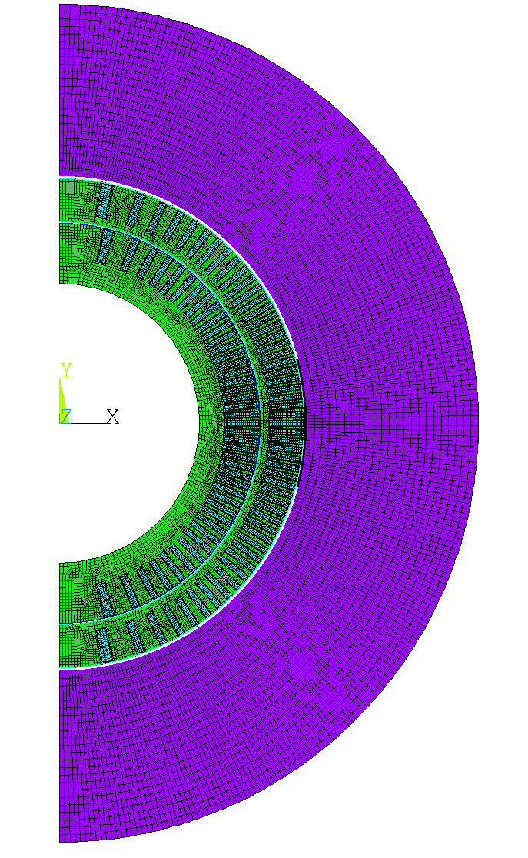
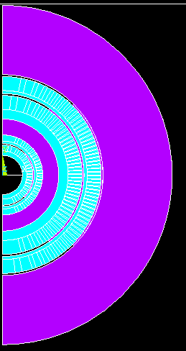
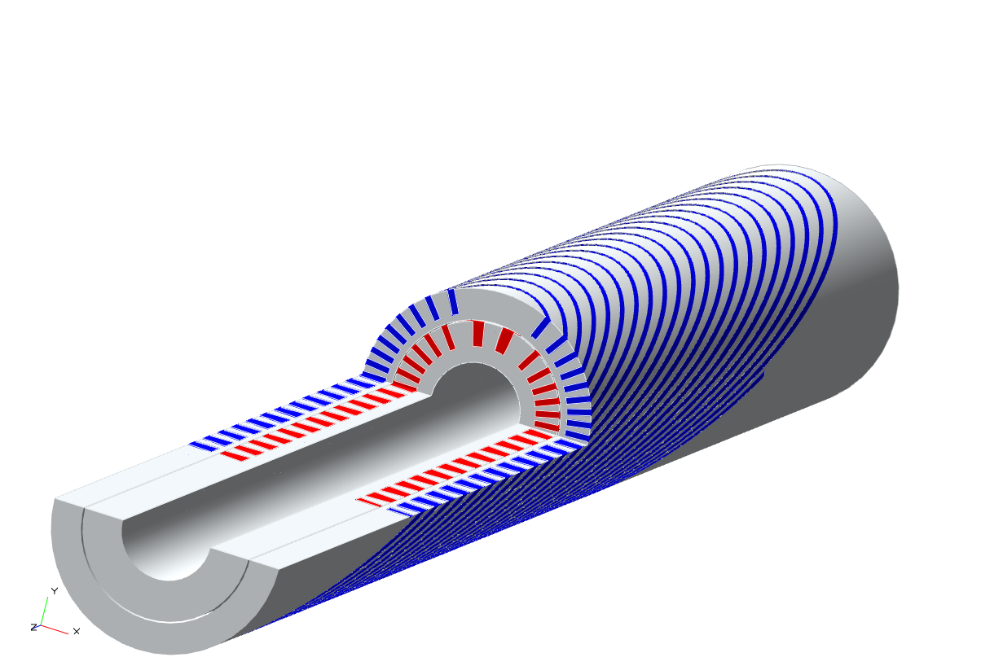
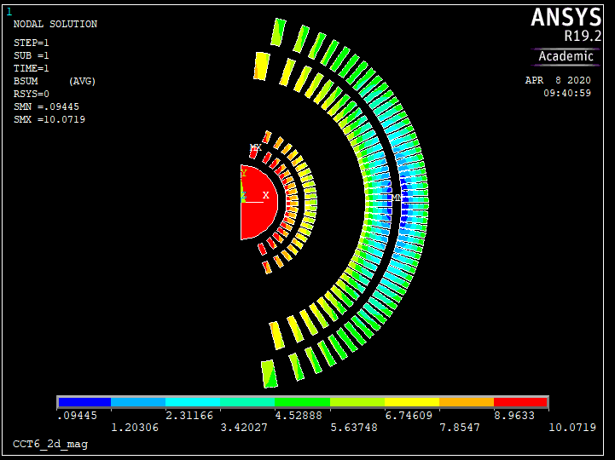
Step 1: the 9-12 T field level
LBNL
  Bi2212 insert Bin5c_2 (2.4 T stand alone) in CCT5 (8-9 T)
    Mechanical and magnetic analysis in progress

Slide 17
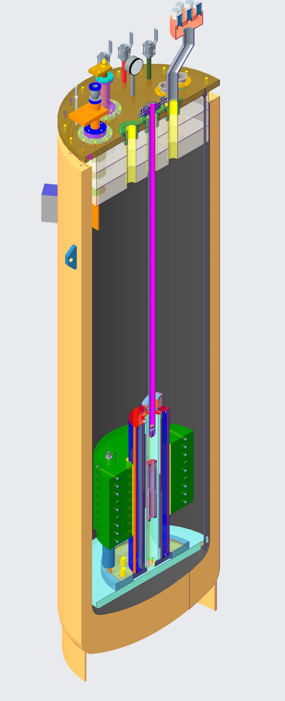
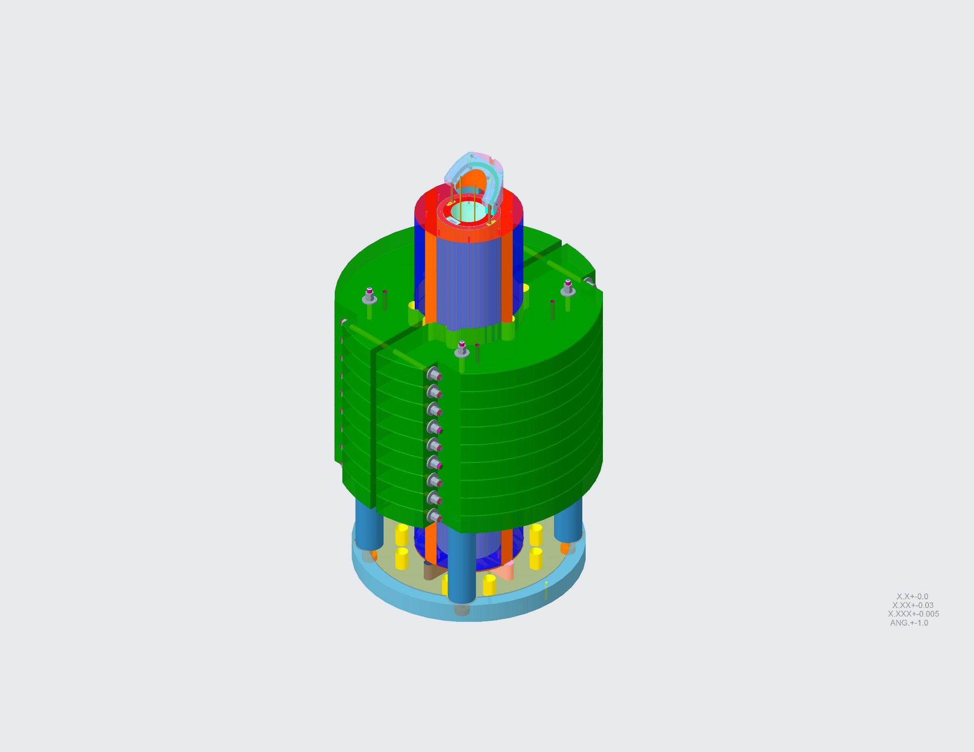
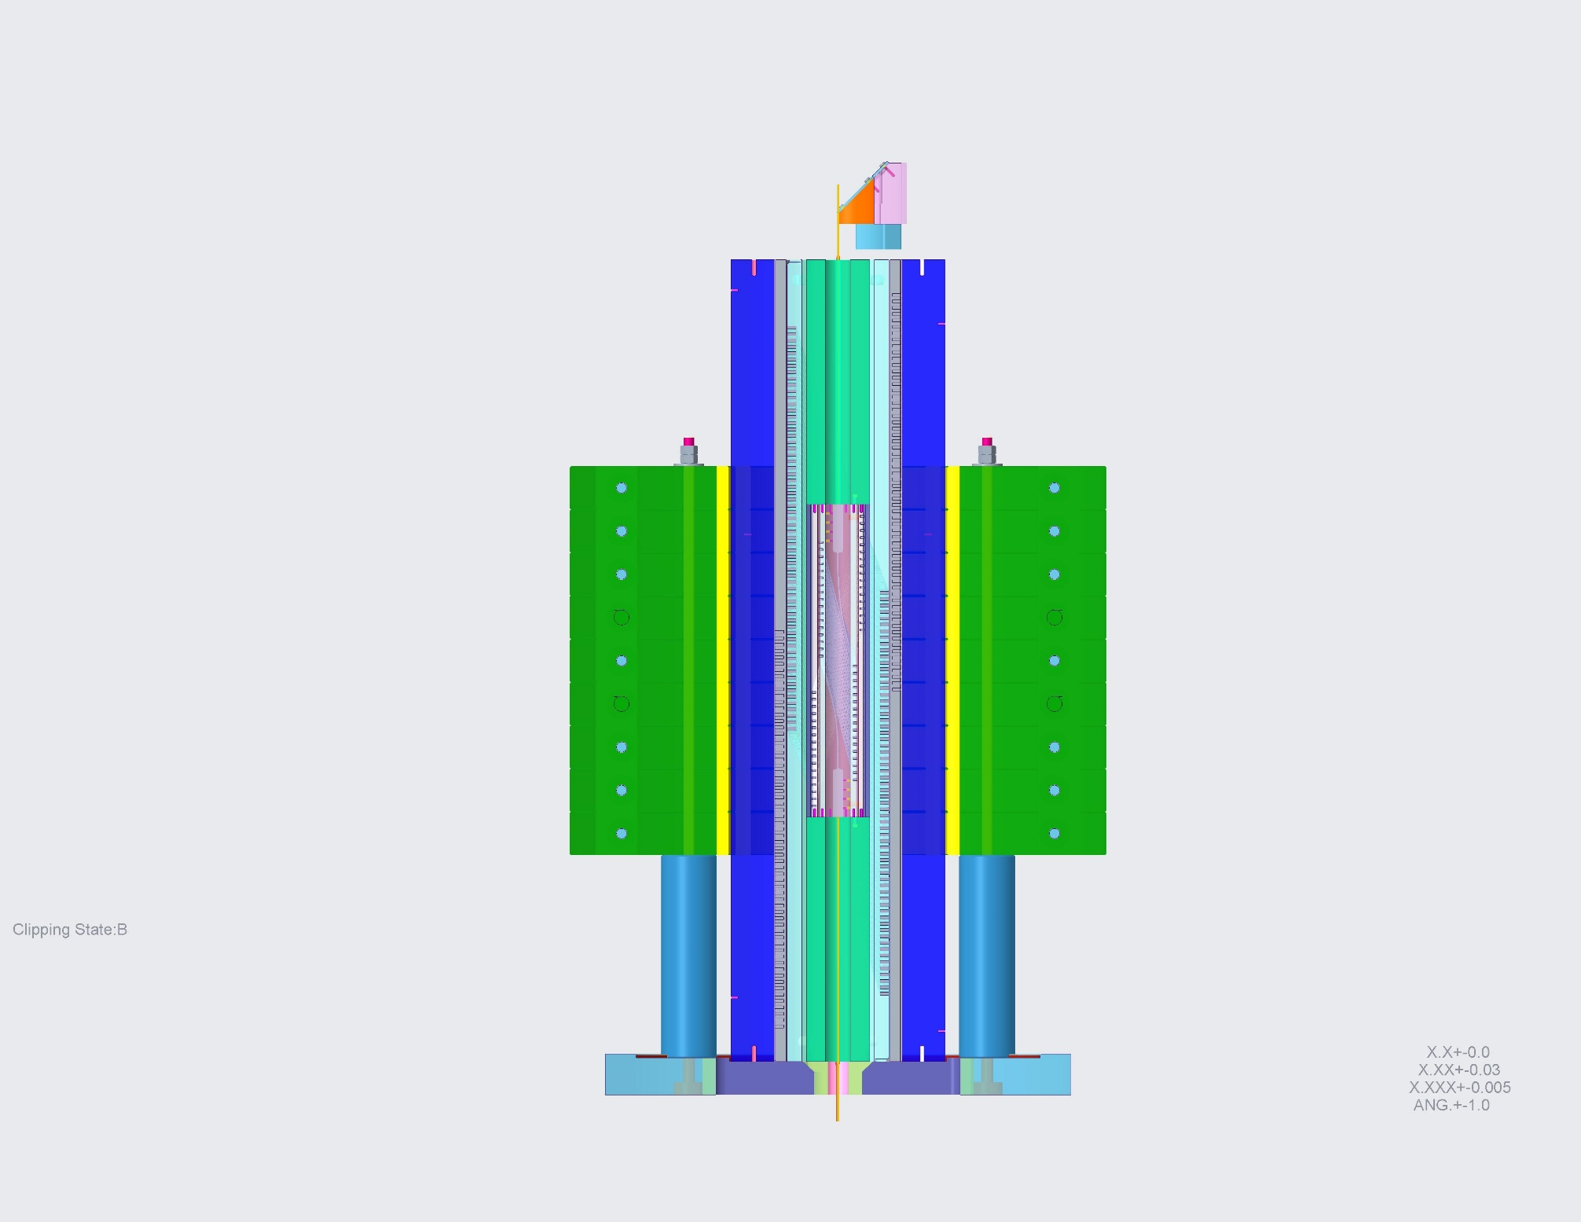
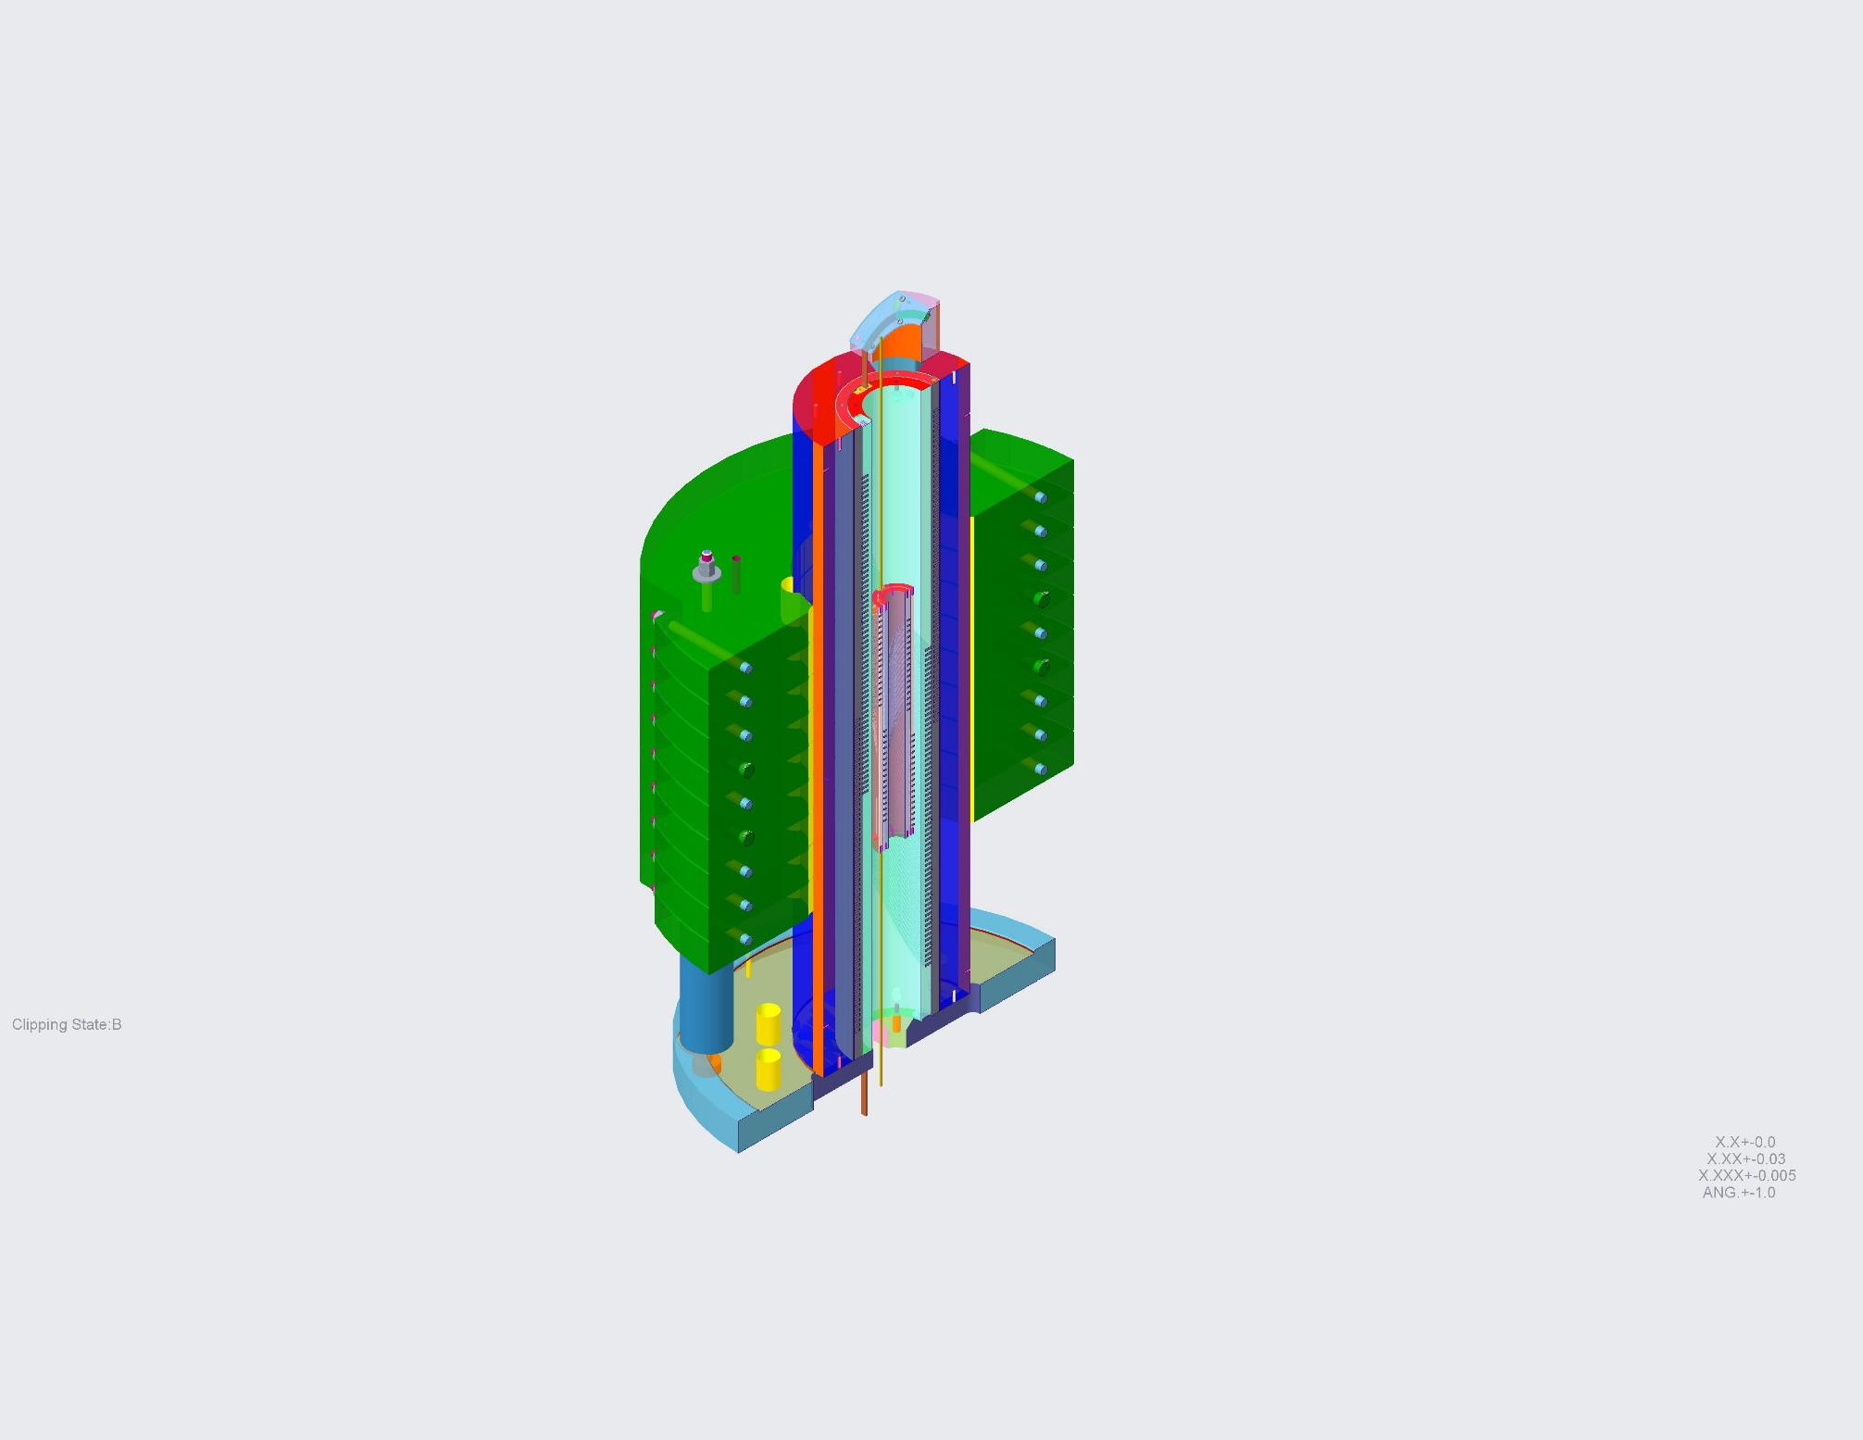
Step 1: the 9-12 T field level
LBNL
  Bi2212 insert Bin5c_2 (2.4 T stand alone) in CCT5 (8-9 T)
    Engineering analysis of integration in progress

Slide 18
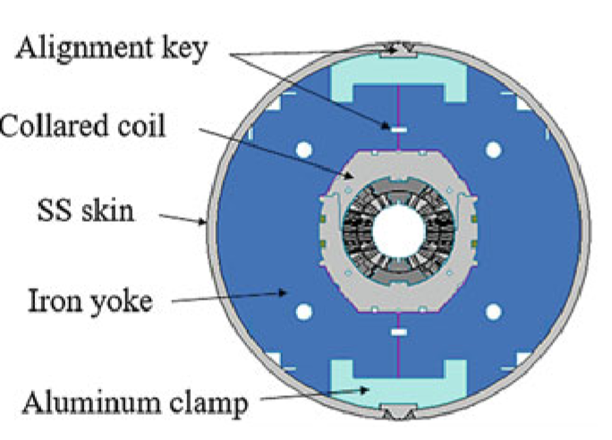
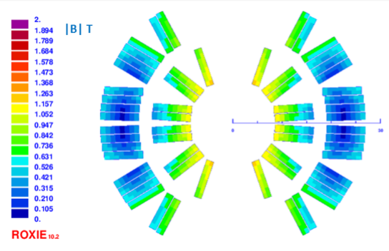
Step 2: the 9-12 T field level
FNAL
  Bi2212 insert SMCT (1.2 T stand alone) in 11T dipole

Slide 19
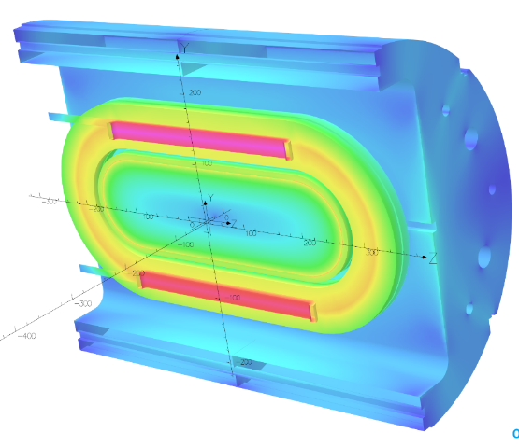
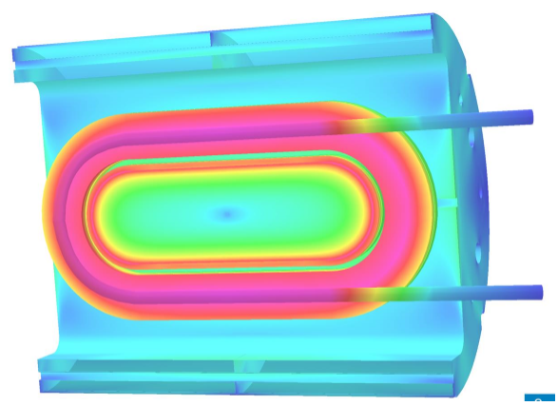
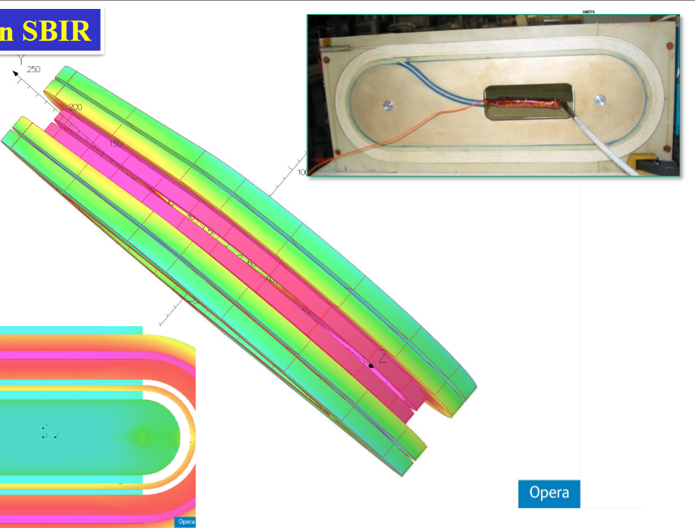
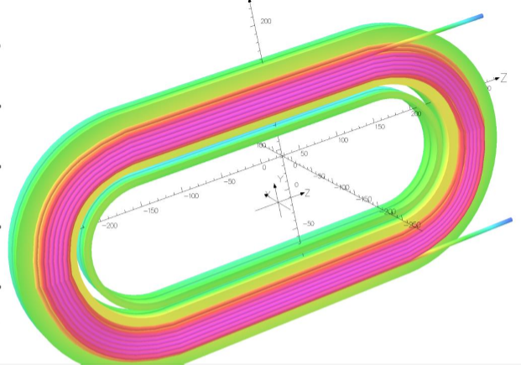
Step 2: the 9-12 T field level
BNL
  Coils wound with REBCO tape or CORC (1-3 T) inside DCC017 common coil Nb₃Sn dipole (10.2 T)
Tape perpendicular to field
Tape parallel to field
CORC

Slide 20
Overview of current hybrid work
Step 2: the 13-15 T field level
  It involves the fabrication of a new Nb₃Sn magnet generating a about 11 T in a large aperture for 3-5 T insert coils (FNAL/LBNL)
  BNL DCC017 with a racetrack ~5 T insert can also reach the 13-15 T level
  The time frame is the 2021-2023

Slide 21
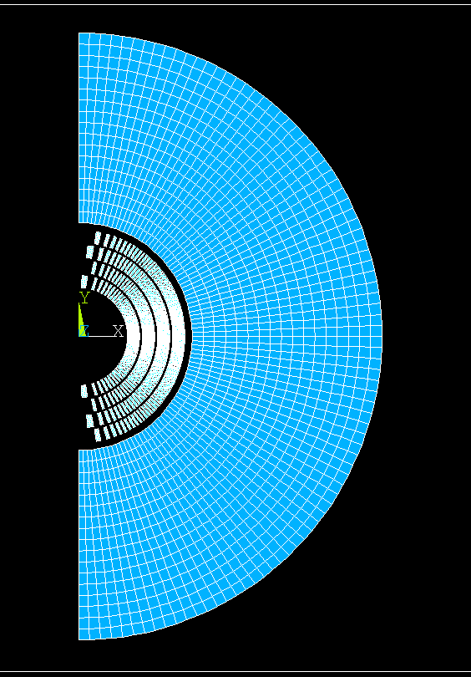
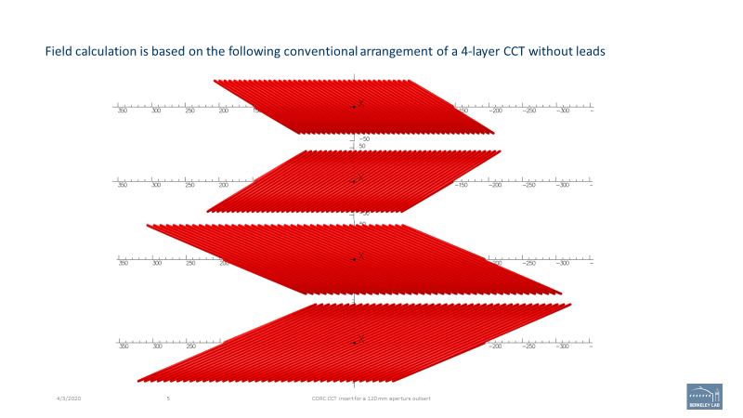
Step 2: the 13-15 T field level
LBNL
  Bi2212 or REBCO CCT insert (5 T stand alone) in CCT6 (2 or 4 layers, 11 T)
    Mechanical and magnetic analysis of CCT6 in progress
    Insert design in progress

Slide 22
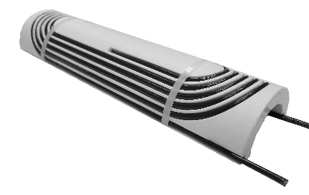
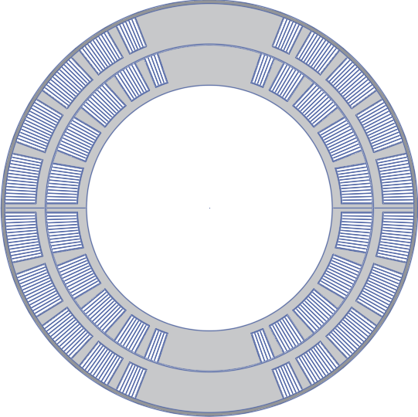
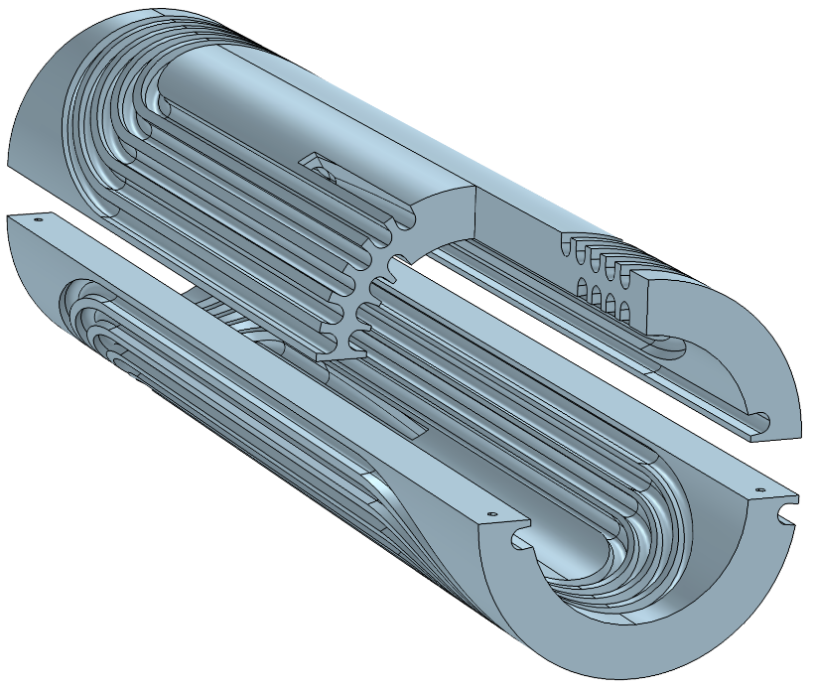
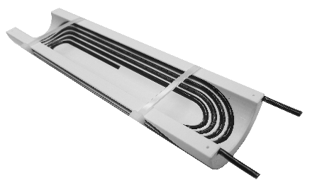
Step 2: the 13-15 T field level
FNAL
  REBCO COMB insert (4.4 T stand alone) in SMCT (2 layers, ~11 T)
    Fabrication of first SMCT Nb₃Sn coil in progress
    Development of COMB started
    What about the SMCT Bi2212?

Slide 23
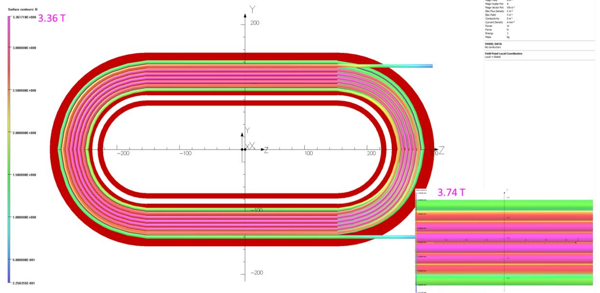
Step 2: the 13-15 T field level
BNL
  5 T insert in inside DCC017 common coil Nb₃Sn dipole (10.2 T) ?

Slide 24
Action items
Start working on the parameters of the 20 T hybrid dipole
Define list of strands/cables and fix their critical current
Continue updating on the current work on hybrids

Slide 25
Appendix

Slide 26
Update on Dipole Model Targets
GianLuca Sabbi, Alexander Zlobin
MDP General meeting – May 17, 2017

Slide 27
MDP 16 T Dipole Targets V4
https://conferences.lbl.gov/event/82/

Slide 28
Dipole Targets V4 (cont.)
https://conferences.lbl.gov/event/82/

Slide 29
Objectives and Timeline
Purpose: the list of target parameters has been formulated for the next MDP dipole model which will be fabricated and tested after the 15 T dipole demonstrator being developed at FNAL and the CCT program at LBNL.
Comments for discussion and clarification:
MDP is primarily a technology development program. As such, there is flexibility in choosing the R&D objectives at each step. Therefore,
  A specific proposal may focus on a subset of the targets (this should be clarified and explained as part of the proposal)
  The targets are not intended as a specification for the high field accelerator dipole, although they need to be closely connected to the requirements and priorities of the ultimate application
Timeline:
Model fabrication in FY19+ per MDP plan.
Design studies, selection and initial procurements in FY17-18.

Slide 30
How to structure the targets
For each area (mechanical, field quality, protection etc.) there are significant complexities which are difficult to reduce to a single number
There is also some mixing between core R&D objectives and practical (not fundamental) constraints related to current component availability or existing infrastructure
It might be useful to separate in different sections
  Keep simple/direct criteria when possible (e.g. target field)
  More complex topics can be described as optimization goals (e.g. hot spot temperature, design goals vs failure case limits)
  Practical constraints may be grouped separately and their relevance should be discussed on a case-by-case basis (e.g. no. strands in cable, cold mass diameter)
  In some case, more detailed definitions need to be included to correctly interpret the numbers provided (e.g. length of straight section)

Slide 31
Magnet Straight Section
If the study of field quality is among the main goals, a uniform field region of 50-100 cm (“magnet straight section”) should be provided
  From other programs, we have evidence of significant variations in as-built harmonics over several 10s of cm. Therefore a shorter magnet section would not provide a sufficient basis to assess field quality.
  Also once a short uniform field region is provided, it can generally be increased at a marginal cost in terms of total length
A clear definition of the uniform region or “straight section” for the purpose of field quality studies should be provided
  Proposal: define the straight section based on design harmonics (from 3D model) being within a small delta (e.g. <0.1 units) relative to the central ones.
A criterion on the transfer function may also be added, again based on the 3D magnetic model calculation (e.g. <0.05% from central)

Slide 32
Conductor Parameters
Values listed seem too restrictive - even for a near term procurement, there is some flexibility in the choice of the conductor layout and parameters like non-Cu fraction, etc.
  Is the goal to normalize different designs to the same conductor properties, for example in terms of meeting the 16 T target?
  Would it be better to allow for some ranges, compatible with available products, so that the design can be optimized to meet specific goals? Some examples:
    Copper fraction is one of the key parameters for quench protection, a given design may need more Cu to meet protection requirements
    Cable degradation is largely dependent on cable design but we have been able to keep it at the level of 1-2%
RRR is driven by fabrication rather than design, and aim should be for >>60. Suggesting to include this as an optimization goal, aiming to avoid RRR degradation during the fabrication process

Slide 33
Infrastructure constraints
Examples: cold mass diameter, number of strands in cable, magnet length
Mixing R&D goals and practical constraints can be confusing
Suggestion: list practical constraints at different facilities in a separate section, and request that any proposal includes a fabrication and test plan compatible with existing infrastructure, both in terms of physical constraints and schedule/resource availability
There is also a cost element to be considered, pushing toward the smallest size compatible with the stated objectives. This could be listed as an optimization goal.

Slide 34
Field Quality Targets (Geometrical)
Need to separate between design targets and as-built targets:
  Assuming that the focus is on design targets, for the geometric and saturation <1 unit should be a reasonable objective
  For as-built harmonics, one could simply request to explain which steps are being taken to ensure accurate positioning through the various steps, and evaluate on a case by case basis
    If some guidelines are formulated for the as-built, it should be done with the usual approach (average, uncertainty on the average, random) and the values adjusted depending on the harmonic order

Slide 35
Field and Stress
Definition of target design field (17 T): all requirements (mechanical stress, protection) should be met up to 17 T.
  Is 17 T too ambitious? Should this be treated as an optimization goal?
  If on the other hand all design requirements are to be met up to 17 T, what is the purpose of the 16 T target?
Mechanical stress: there are different implications of having high stress during pre-load vs. excitation, and in high field vs. low field areas. There are also different criteria and implications for reversible vs. permanent degradation. Different designs will be affected in different ways by these effects, and the practical limits on the uniformity that can be achieved in construction also play a role.
  Due to these complexities, it might be easier to request that a stress analysis is included as part of the design and evaluated on a case by case basis
ANSYS boundary conditions, bonding vs, no bonding – also a complex topic, again may evaluate different options on a case-by-case basis

Slide 36
Quench Protection
Hot spot temperature: 350 K may be acceptable as a limit hot spot temperature, but we really want 250-300 K and perhaps reserve 350 K as a worst/failure case scenario
The request to show that the magnet can be protected without extraction is relevant to the , this seems to be in conflict with the statement that these goals are intended for a technology test
Total delays and maximum voltages: this again is a complex topic, depending on the protection scheme used different limits may apply. Again, might be better to request that a protection analysis is provided, and evaluate on a case by case basis

