Slide 1
STAR wire
REBCO Working Group Meeting #3
Anis Ben Yahia
4/23/2020

Slide 2
Introduction and Outline
Helical wrapping around a central support: Isotropic properties, transposition of tapes.
The use of a Cu core reduces significantly J_{e}. The core diameter determined by the tape width and strain tolerance.
While adding more tapes/layers increases the J_{e}, it also reduces the wire flexibility which in turn limit the possible use in a magnet.
Outline:
Unique features of STAR wires.
Current wire performance and challenges.
Potential future wire development.

Slide 3
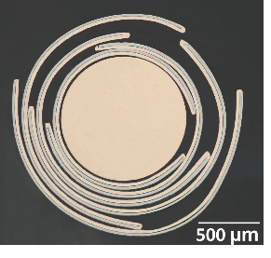
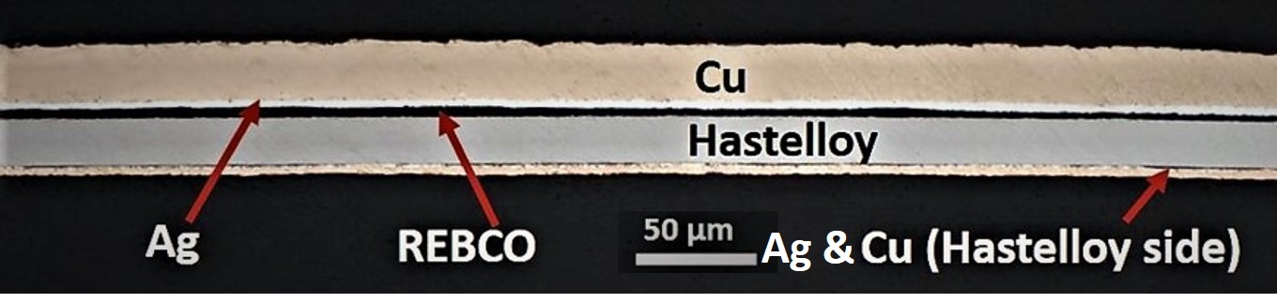
Symmetric Tape Round (STAR) Wire
In addition to the substrate thickness, a key difference is the stabilizer layer.
Standard REBCO Tapes:
REBCO asymmetrically positioned far away from
neutral plane
Symmetric REBCO Tape:
  Copper stabilizer primarily on REBCO side.
  Minimizes the strains in the REBCO layer.
20μm Cu
50μm Hastelloy
20μm Cu
Symmetric REBCO tapes used to make STAR wires on 0.5, 0.8 and 1 mm diameter copper former. Final wire OD<2mm

Slide 4
Laser slitting instead of mechanical cutting
Laser slitting eliminates the cracks created by conventional shear cutting.
An important factor to consider especially with narrower tape width.
Cracks tend to propagate when the wire under repetitive loads.
Nate Hartnett et al, “Characterization of REBCO Superconducting Tape Damage
Induced by Various Sample Preparation Methods”
W. Luo, “FABRICATION AND ELECTROMECHANICAL STUDY OF SYMMETRIC TAPE ROUND (STAR) REBCO WIRES,” 2019.

Slide 5
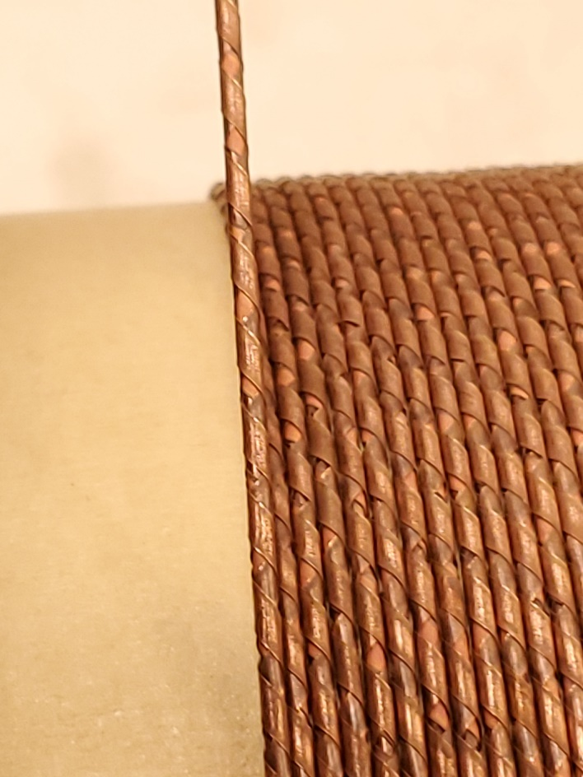
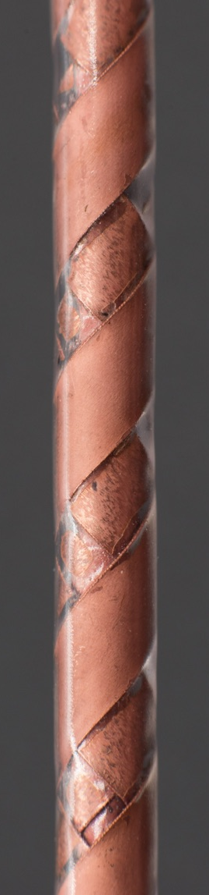
The gaps in the windings
These gaps are important for the wire flexibility.
While using wider tapes would increase the wire total current, without any gaps in the winding the wire would degrade 30~40% at 15mm bend radius while in this configuration the degradation is less than 10%.

Slide 6
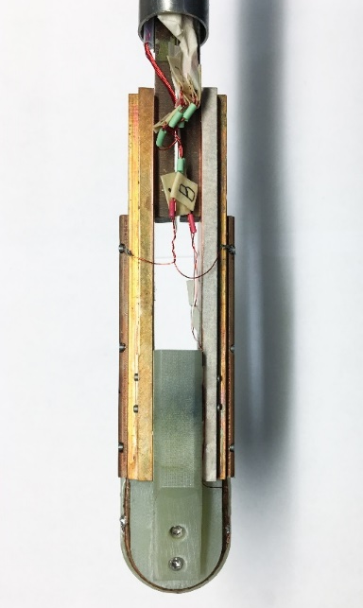
J_{e} ~ 600 A/mm² at 20 T in STAR wires
1.67 mm diameter STAR wire bent to a radius of 15 mm
STAR wires tested at NHMFL
30 mm dia.
At a bend radius of 15 mm, using REBCO tapes with 1.7µm thick films,
2018 STAR wire: 438 A/mm² at 20 T and 299 A/mm² at 31.2T
2019 STAR wire: 729 A/mm² at 15 T and 584 A/mm² at 20 T

Slide 7
Example of wire configurations

Slide 8
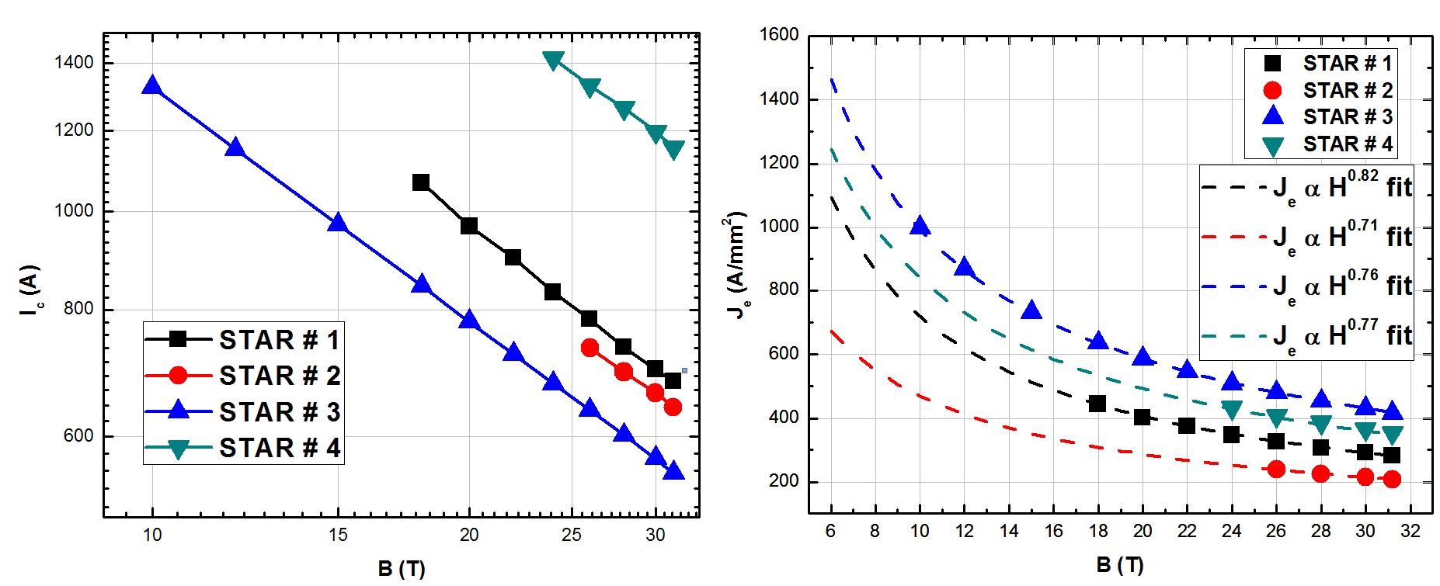
4.2 K, in-field performance of high J_{e} STAR™ wires at 15 mm bend radius
4.2 K
4.2 K
J_{e} of 586.4 A/mm² at 20 T, 4.2 K at 15 mm bend radius

Slide 9
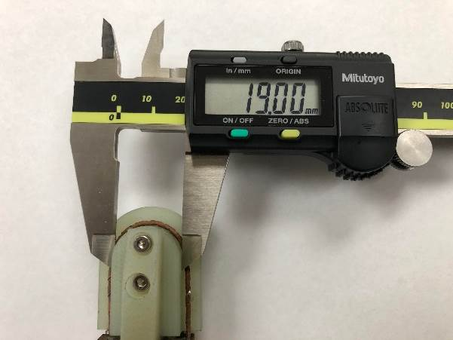
1.3 mm STAR wires for < 10 mm bend radius

Slide 10
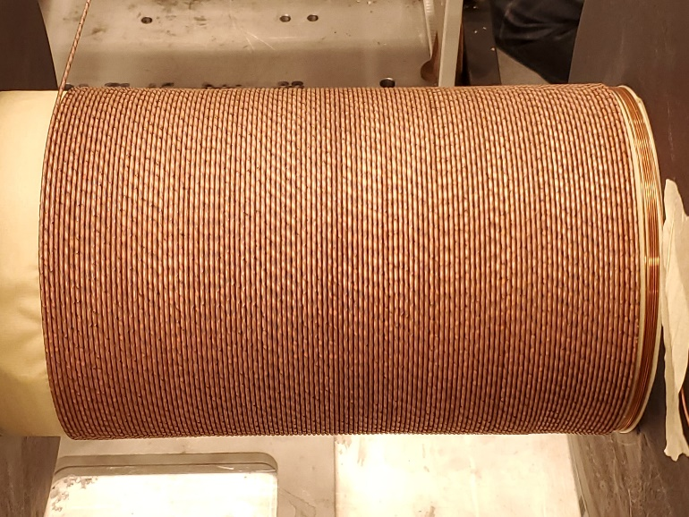
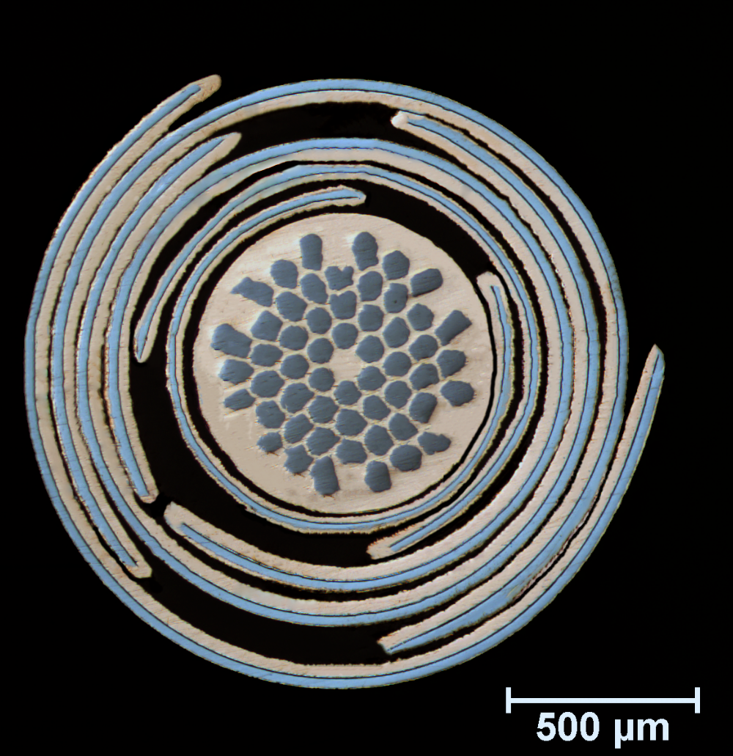
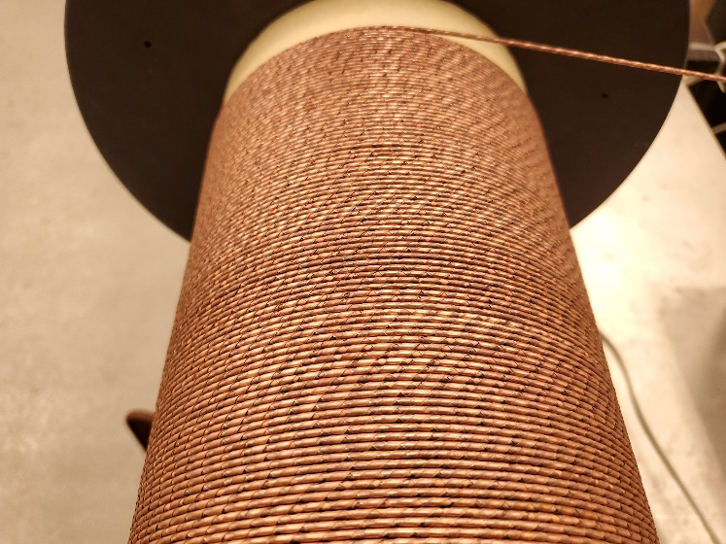
60 meters of SuperSTAR wires
Wound on a NbTi/Cu former
OD: 1.84 mm

Slide 11
In-field performance of short sections of 60 m SuperSTAR wire at 15 mm bend radius

Slide 12
Challenges
The wire robustness under repetitive high magnetic forces needs further investigation, especially given this wire configuration (the gaps between the tapes). The limited testing already performed is promising but more tests are needed.
Lack of current sharing between the tapes:
  In these wires (and the CORC also), the current is distributed between tapes only through the current leads.
  During the development stages, there was little to no evidence of “true” current sharing (from tape to tape locally).
Voltage monitoring on these wires is hard to interpret since you don’t have voltage taps on all the tapes.

Slide 13
Potential future wire development
Since most of the tape processing is done in-house, there is more flexibility in term of wire configuration.
AMPeers is willing to explore other wire configuration to meet the requirement of the magnets.
But they need some targets for J_{e}, wire OD, bending radius and they are limited in testing capabilities (for higher current cables).

Slide 14
References
Next-generation highly flexible round REBCO STAR wires with over 580 A mm− 2 at 4.2 K, 20 T for future compact magnets
Symmetric tape round REBCO wire with J e (4.2 K, 15 T) beyond 450 A mm− 2 at 15 mm bend radius: a viable candidate for future compact accelerator magnet applications
Ultra-small diameter round REBCO wire with robust mechanical properties
Fabrication and electromagnetic characterization of ultrasmall diameter REBCO wires

