Slide 1
MDP Technical Meeting # 4 on
20 T hybrid magnet and comparative analysis
P. Ferracin, G. Ambrosio, L. Cooley, R. Gupta, V. Kashikhin, A. Zlobin
US Magnet Development Program

Slide 2
Outline
Design criteria for a 20 T hybrid magnet
  Changes with respect to previous MDP table for 16 T magnet
  120 mm aperture for the next Nb₃Sn magnet
Action items
In appendix
  Definition of the goals of the working group
  Overview of current hybrid work

Slide 3
Design criteria for a 20 T hybrid magnet
Previous work within MDP on a 16 T dipole magnet
  GianLuca Sabbi, Alexander Zlobin, MDP General meeting – May 17, 2017
https://conferences.lbl.gov/event/82/

Slide 4
Design criteria for a 20 T hybrid magnet
Geometrical
  Number of apertures 1
  Free coil aperture 50 mm
Comments
  The common coils will naturally provide 2 apertures
    This will be taken into account on the comparison
  No “strong” constraints on
    Magnet total length (<2 m)
    Magnet straight section (>200 mm)
    Maximum magnet OD
      Reference numbers: 620 mm (FNAL/1.9K), 660 mm (BNL/1.9K), 914 mm (LBNL/4.5K)

Slide 5
Design criteria for a 20 T hybrid magnet
Operational
  Reference temperature 1.9 K
  Operational field 20 T
  Margin on the load-line @ 1.9K 15 %
    With respect to cable I_{c} including self field and 5% cabling degradation
  Geometrical field harmonics at R_{ref}=17 mm b_{n}<5 for n<10
    Magnet straight section
  Target design field 20 T
  Maximum Nb₃Sn coil stress >200 (<150) MPa at 1.9 (293) K
    What about HTS?
  Conditions of coil-pole or rib interfaces at 20 T
    If bonded 20 MPa max. tension
      ‘Corner spikes’ (~1 contact element, 1 mm) neglected
    If separation allowed < 50 micron gap

Slide 6
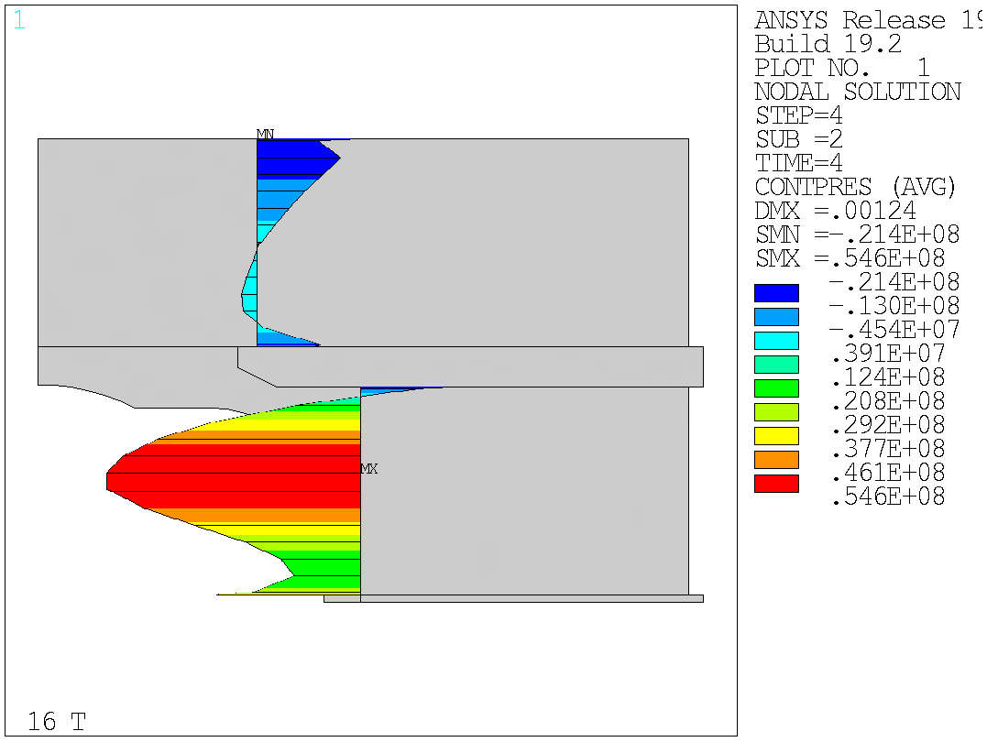
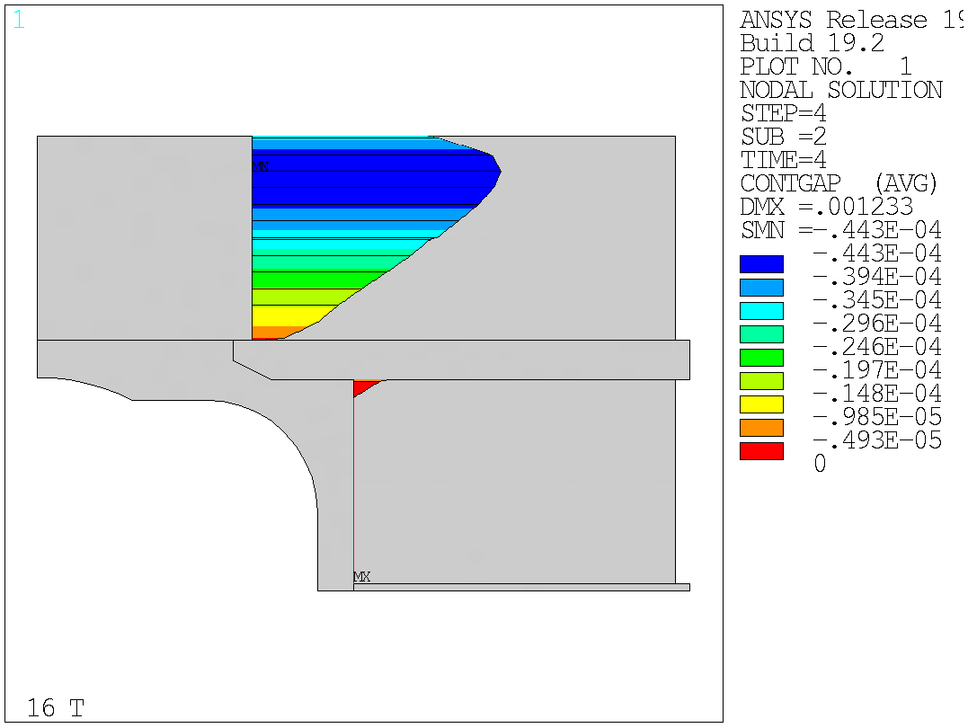
Design criteria for a 20 T hybrid magnet
Bonded vs separation-allowed
  Test Facility Dipole (by G. Vallone)

Slide 7
Material limits
(by Giorgio Vallone)

Slide 8
Design criteria for a 20 T hybrid magnet
Nb₃Sn Conductor and cable
  Strand diameter 0.7-1.1 mm
  Cu:non-Cu ratio 0.8-2.0
  Non Cu J_{c}
    12 T, 4.2 K 3000 A/mm2
    15 T, 4.2 K 1600 A/mm2
    16 T, 4.2 K 1250 A/mm2
  RRR (after cabling) >100
  I_{c} degradation due to cabling 5%
  Maximum number of strands in cable 51

Slide 9
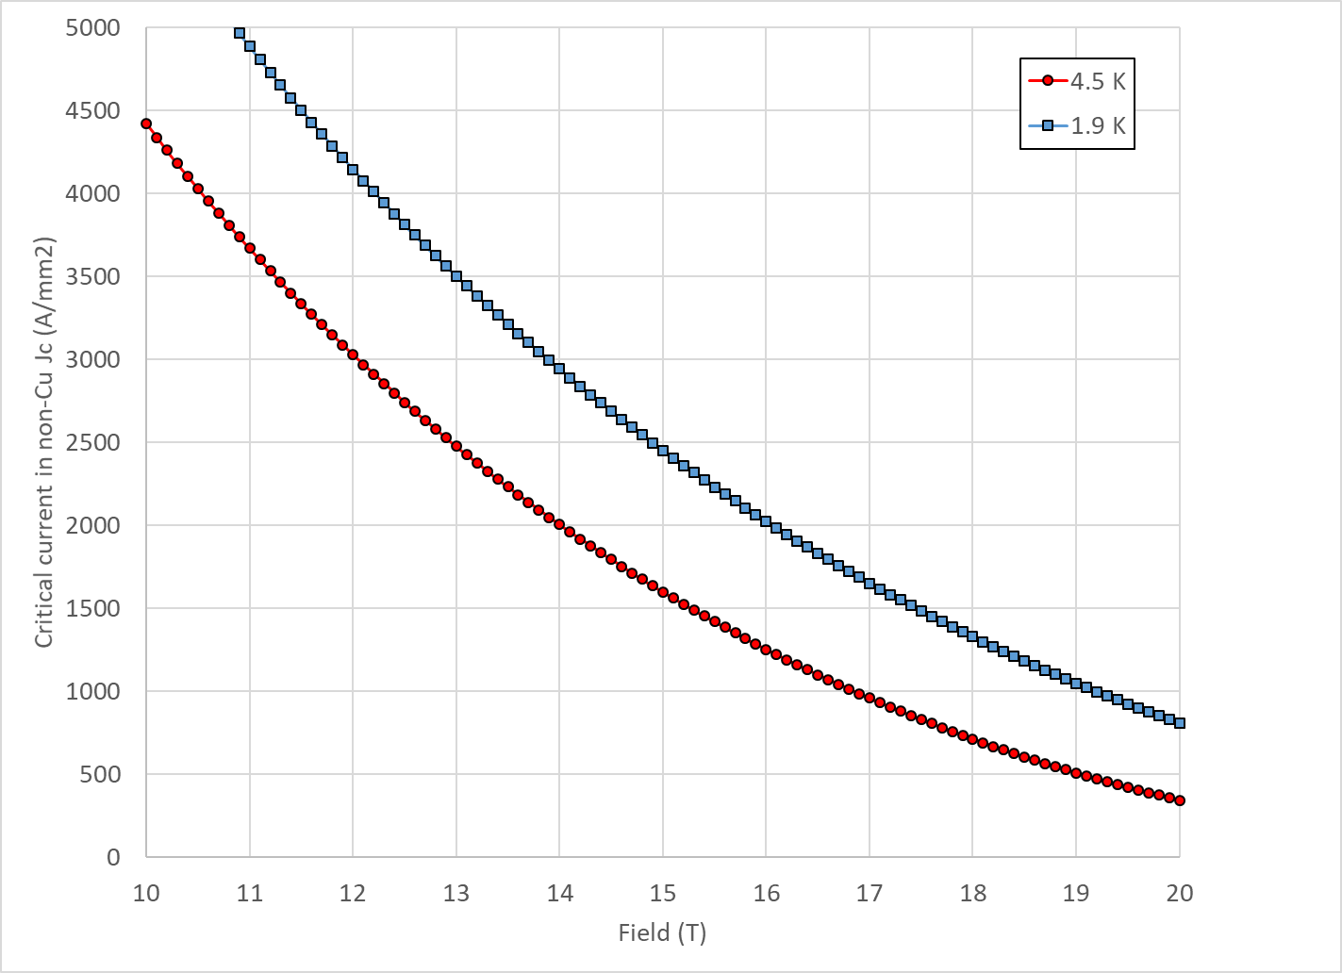
Design criteria for a 20 T hybrid magnet
Nb₃Sn Conductor and cable
  “3000” A/mm² kind of conductor
    Data from test facility dipole strands (1.1 mm, 1.1 Cu/non-Cu)

Slide 10
Design criteria for a 20 T hybrid magnet
Nb₃Sn Conductor and cable
  Comments
    Stand diameter not bigger than 1.1 mm
    Increased range of Cu/non-Cu ratio from original 1.0±0.1
      From FCC experience, HF conductor with 0.8, low field conductor 2.0
    Increased RRR from original 60

Slide 11
Design criteria for a 20 T hybrid magnet
Nb₃Sn Conductor and cable
  Cable summary
    Dimension before reaction
      In MQXF, assumed expansion during reaction is 4.5 % (th), 1.2 % (w)

Slide 12
Design criteria for a 20 T hybrid magnet
Bi2212 Conductor and cable

Slide 13
Design criteria for a 20 T hybrid magnet
Bi2212
  Record performance strand RC5/6 about 20% higher than what is currently “comfortably” produced.

Slide 14
Design criteria for a 20 T hybrid magnet
REBCO Conductor and cable
  Work in progress

Slide 15
Design criteria for a 20 T hybrid magnet
Quench protection
  Maximum hot spot temperature 350 K
    Failure scenarios?
  Total time delay 40 ms
  Maximum voltage to ground @ quench 1.0 kV
  Ground insulation design voltage >5 kV
  Powering in series or independent?

Slide 16
Outline
Definition of the goals of the working group
Design criteria for a 20 T hybrid magnet
  Changes with respect to previous MDP table for 16 T magnet
  120 mm aperture for the next Nb₃Sn magnet
Overview of current hybrid work
Action items

Slide 17
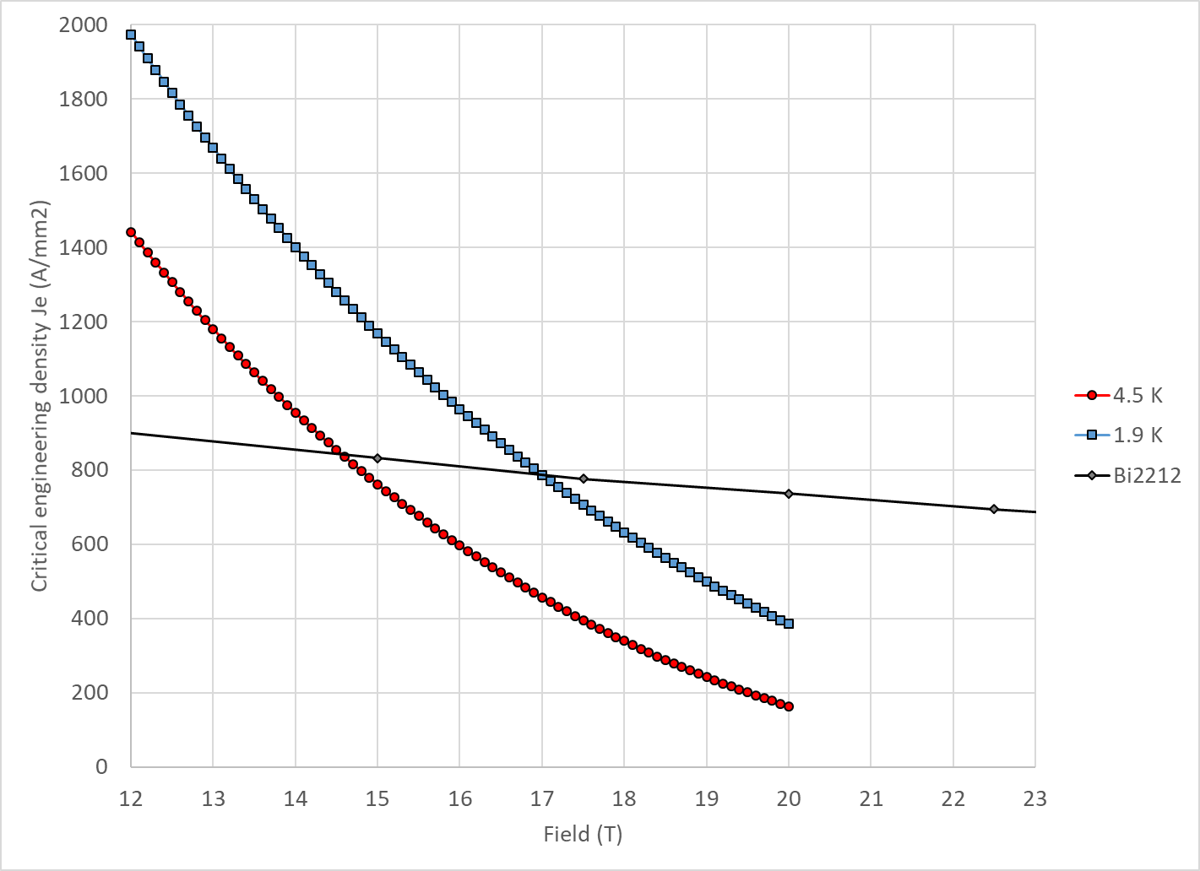
Nb₃Sn aperture in a 20 T hybrid
With properties describe above Nb₃Sn and Bi2212 cross at 14.5 T at 4.5 K and 17 T at 1.9 K

Slide 18
Nb₃Sn aperture in a 20 T hybrid
Analytical model
  by Lucas Brouwer
Thick shell with cosϑ distribution
  Bore field = conductor peak field
2 CCT winding layers
  Bi2212 and Nb₃Sn
  From J_{c} to J_{overall} keeping into account spar and ribs

Slide 19
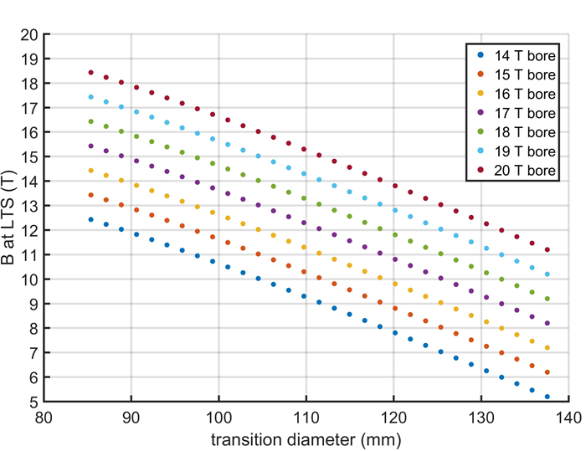
Nb₃Sn aperture in a 20 T hybrid
23 T short
sample
Results
  Let’s assume 1.9 K
    So crossing at 17 T
  For a 19 T short sample B_{bore}
    90 mm aperture Nb₃Sn
  For a 20 T short sample B_{bore}
    95-100 mm aperture Nb₃Sn
  For a 23 T short sample B_{bore}
    115-120 mm aperture Nb₃Sn

Slide 20
Nb₃Sn aperture in a 20 T hybrid
So, for the assumed conductor properties, and according on a simplified analytical model, the 120 mm aperture chosen for the next Nb₃Sn magnet seems a reasonable number also for a future 20T hybrid magnet
120 mm has been a “practical” choice
  Input from HTS program (in particular REBCO one)

Slide 21
Action items
Update criteria based on feedbacks
Complete CORC inventory and Je
Refine Aperture/thickness analysis
Continue the update of current hybrid program (input from Ramesh and Sacha)

Slide 22
Appendix

Slide 23
1st goal of the working group
Conceptual design of a 20 T hybrid HTS-LTS magnet
  Comparative analysis of different design options for a 20 T hybrid
    Cosϑ design and its stress-management options
      “Traditional” Cosϑ
      Canted Cosϑ (CCT)
      Stress management Cosϑ (SMCT)
    Block-type coil design
    Common-coil design
  Definition of general design criteria: aperture, field, margin…..
  Analysis of challenges specifically of hybrid magnets
    Integration of LTS/HTS, mechanics, protection, powering, diagnostics, test facility…..

Slide 24
1st goal of the working group
Conceptual design of a 20 T hybrid HTS-LTS magnet
  Comparative analysis of different design options for a 20 T hybrid
    Cosϑ design and its stress-management options
      “Traditional” Cosϑ
      Canted Cosϑ (CCT)
      Stress management Cosϑ (SMCT)
    Block-type coil design
    Common-coil design
  Definition of general design criteria: aperture, field, margin…..
  Analysis of challenges specifically of hybrid magnets
    Integration of LTS/HTS, mechanics, protection, powering, diagnostics, test facility…..

Slide 25
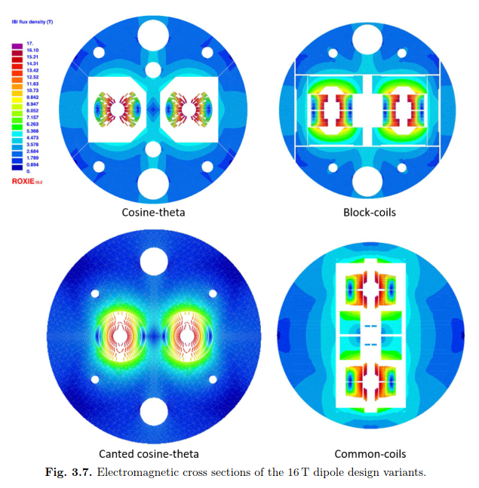
1st goal of the working group
An example: 16 T dipole magnets for FCC
Ideally the goal should be to carried out the full 2D design and analysis of a 20 T hybrid for all the design options considered
    Cosϑ design and its stress-management options, Block-type design, Common-coil design
In addition, 3D considerations will be included in the comparison

Slide 26
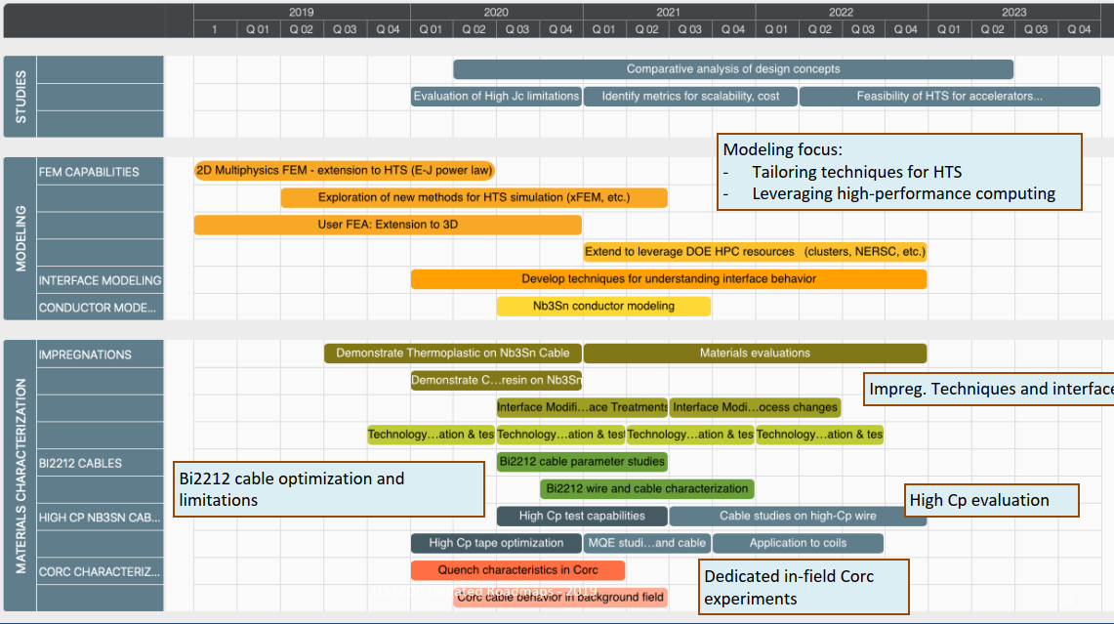
1st goal of the working group
Time frame: 2020 – 2023
Methods
  Modeling effort
    “classical 2D/3D” mechanical, magnetic and QH simulations
      Developing new modeling techniques is not part of this task
      However, if new tool/analysis is required → feed-back to Technology area (III), modeling and simulations

Slide 27
2nd goal of the working group
Review and follow-up of current work towards 9-15 T hybrid magnets
  This current work can be divided in two steps
    Step 1: the 9-12 T field level
      It involves the use of existing Nb₃Sn magnets as background for low field HTS inserts
      The time frame is the 2020-2021
    Step 2: the 13-15 T field level
      It involves the fabrication of a new Nb₃Sn magnet generating a about 11 T in a large aperture for 3-5 T insert coils
      The time frame is the 2021-2023
  The goal is to collect and organize information from these programs (responsibility of area I and area II) to provide inputs for 20 T hybrid design

