Slide 1
FIBER OPTICS AND ACCELERATOR MAGNETS
M. Baldini (FNAL) and P. Joshi (BNL)

Slide 2
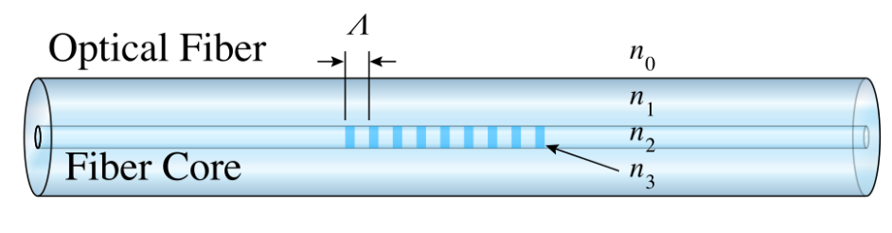
FBG SENSORS
FBG’s are fabricated by inscribing a permanent periodic refractive index change in the optical fiber core along the length of the optical fiber.
  n = index of refraction
  Λ = grating period

Slide 3
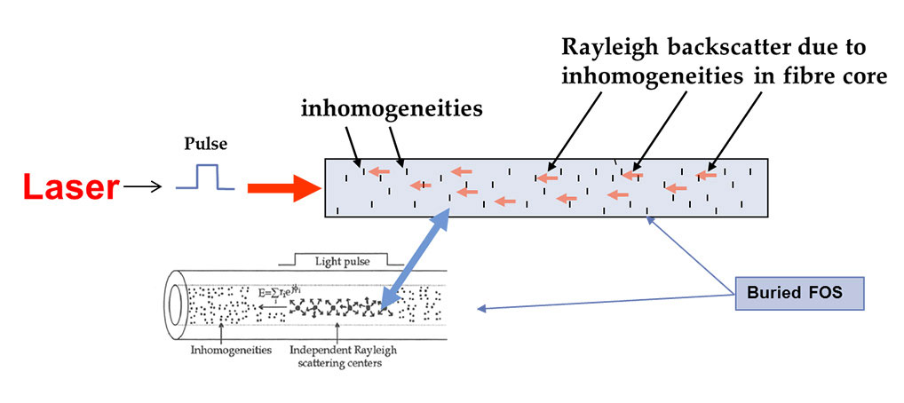
Rayleigh backscattering sensors
Continuous probe along the length of the fiber: promising for quench detection

Slide 4
FIBER optics
ADVANTAGES
No sensitivity to magnetic field: no electromagnetic noise
Multiple sensors in one fiber: reduced number of wires
Multiplex technology
Fiber diameter <200um: possibility to embed fibers with coil
Temperature sensors
Strain sensors
Quench sensors

Slide 5
Fibers and MDP goals
MDP GOALS
Develop a novel diagnostic tool and analysis technique based on fiber optics sensors.
FBG: point sensors
Rayleigh/Raman continuous sensors
  Explore the performance limits of niobium-tin (Nb₃Sn) accelerator magnets with a focus on minimizing the required operating margin and significantly reducing or eliminating training.
  Develop and demonstrate a high-temperature superconductor (HTS) accelerator magnet with a self-ﬁeld of 5 T or greater compatible with operation in a hybrid LTS/HTS magnet for ﬁelds beyond 16 T
  Investigate fundamental aspects of magnet design and technology that can lead to substantial performance improvements and magnet cost reduction.

Slide 6
Strain
CCT and cost: Explore the performance limits of niobium-tin (Nb₃Sn) accelerator magnets….
Obtain clean shell and coil strain data during quench.
Map azimuthal strain variation at different position along the coil during prestress cooldown and magnet training.
Study strain variations across the strain management structures (CCT and 15T)
Localize the 3D quench position (tip, middle or bottom) across a wounded cable
GOAL: Optimize prestress and significantly reduce the number of quenches.

Slide 7
Temperature
Investigate fundamental aspects of magnet design and technology that can lead to substantial performance improvements…..
measure the disturbance spectrum
Measure minimum quench energy
GOAL: Understanding the training process, get quantitative data/ reduce number of quenches.

Slide 8
Quench
Develop and demonstrate a high-temperature superconductor (HTS) accelerator magnet….
Measure strain or temperature variations
Identify quench position along the HTS coil
GOAL: Develop a reliable quench detection system in HTS coil

Slide 9
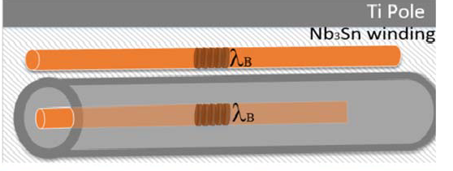
FBG FIBER: what has been done so far
Strain measurements in MQXFS magnet
Coil and shell azimuthal strain
Feasibility of embedding a fiber in a coil has been demonstrated.
Open issues: data interpretation/reproducibility of the results
M. Esposito et al. / Sensors and Actuators A 189 (2013) 195– 203
A. Chiuchiolo et al., IOP Conf. Series: Materials Science and Engineering 278 (2017) 012082
R. RajiniKumar et al. IEEE TRANSACTIONS ON APPLIED SUPERCONDUCTIVITY, VOL. 16, NO. 2, JUNE 2006
Temperature sensitivity
Several coating materials have been tested
OPEN ISSUE: sensitivity below 50 K/ decoupling T and strain
M. Zaynetdinov et al., IEEE SENSORS JOURNAL, VOL. 15, NO. 3, 2015
A. Chiuchiolo et al., IEEE Transactions on Appl. Superc. 26, 9000705 (2016)
Chiucolo et al.IEEE TRANSACTIONS ON APPLIED SUPERCONDUCTIVITY, VOL. 28, 4, 2018
A. Chiuchiolo et al., IEEE Photonics Journal 6, 0600310 (2014)

Slide 10
RAYLEIGH FIBER: what has been done so far
Feasibility has been demonstrated
OPEN ISSUES:
T sensitivity
Bonding and gluing
T and strain decoupling
Spatial and temporal resolutions
Scurti et al., Supercond. Sci. Technol. 29 (2016) 03LT01
Scurti et al., Supercond. Sci. Technol. 30 (2017) 114002 (13pp)

Slide 11
FNAL and BNL STATUS

Slide 12
MDP R&D: FBG fibers for strain data
Install FBG fibers on pole and shell: measure azimuthal and longitudinal strain during quench in MDP magnets
Map azimuthal strain at several positions along the coil
Extend this new diagnostic technology to MDP program
SHORT TERM MILESTONES @FNAL
  Learn Handling and bonding of the fibers
  Test different commercial fiber coating
  Fiber calibration on known materials: Cu, Ti, Al simulating prestress condition, cooldown and powering with a small cryostat @FNAL

Slide 13
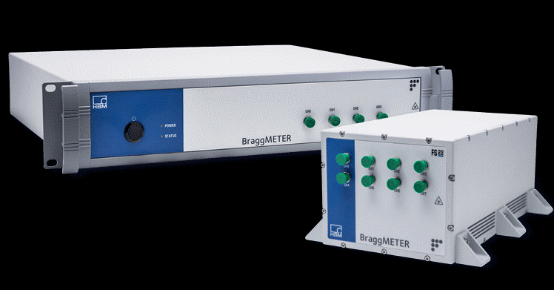
FBG: FNAL STATUS
WHAT HAS BEEN PURCHASED AND TIME LINE
4 fibers with 4 FBG sensors
8-ch interrogator
Functional TEST for fiber calibration by the end of summer 2020
Large scale magnet test facilities (see Piyush discussion about BNL activities)

Slide 14
Quench: Rayleigh fibers
Greater Capabilities: continuous strain and temperature data in real time
Tradeoff between temporal and spatial resolution
Promising for detecting quench starting point in superconductive magnets
Technical challenges
How to bond the fiber
How to measure T: test different coating
How to decouple strain and T measurements
How to wind the fiber on coil: bonding

Slide 15
Rayleigh fiber: FNAL roadmap
By the first half of 2021
Purchase interrogator and bare fibers/coated fibers
Proof of principle experiment in a small cryostat (4 K/ 50 K): 10 stack sample
Identify trade off between spatial and temporal resolutions for MDP need.
Identify if limitation exists for
Verify reproducibility of data
Start to install Rayleigh fiber in MDP magnet (HTS and low T) (second half of 2021)

Slide 16
ACTIVITIES @BNL

Slide 17
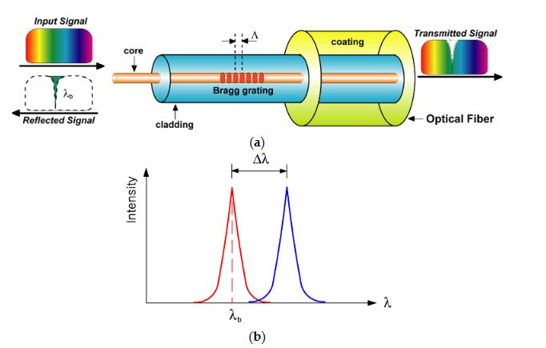
Principle of FBG

Slide 18
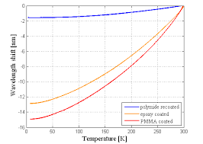

Practical application of FO Sensors
FBGs are proven to be good sensors for strain measurement up to 4.2K. No data available for 1.8K
FBGs are not very sensitive below 50K for absolute temperature measurement
FBGs need special coating to increase sensitivity at cryogenic temperature.
FBGs can be effectively used up to 550K on high side
𝜂 = the thermo-optic coefficient which represents the temperature dependence of the refractive index
𝛼 = thermal expansion of silica
$\frac{{∆λ}_{B}}{λ_{B}}$ = $(\text{η}+\text{α})∆T$
P. Joshi

Slide 19
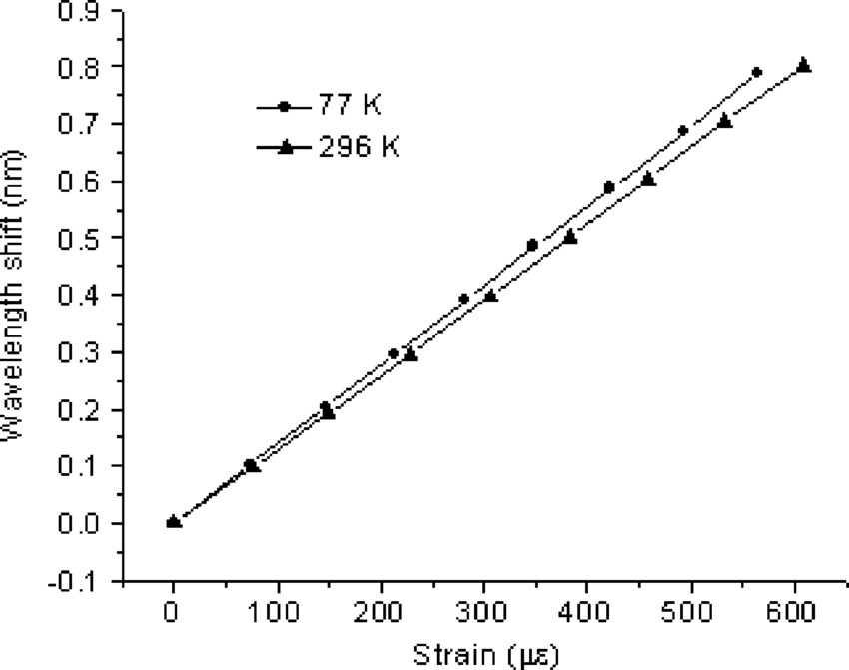
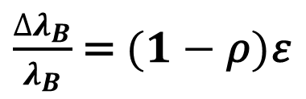
Strain Sensitivity
$\frac{{∆λ}_{B}}{λ_{B}}$ = $(1−\text{ρ})\text{ε}$
(-𝜌)𝜀 = photo-elastic coefficient. This term is negative because the index of refraction in optical fiber decreases with expansion due to a decrease in density of the material
𝜀 = longitudinal strain
P. Joshi

Slide 20
Technology validation test setup
Aluminum rod ~3ft
Strain Gages
Strain FBGs
Optical Fiber
Cernox Temp Sensors
Spot heaters
Temp FBGs
This assembly will be placed in test dewar with temperature control from 300K to 4.2K
Conventional strain gage readings will be compared with Strain FBG readings during cooldown
Cernox temperature sensor readings will be compared with Temp FBGs
Spot heaters will be used to see thermal response and sensitivity
P. Joshi

Slide 21
Cryogenic Test Setup

Slide 22
Test setup budget
Eight channel Interrogator ($22,000)
Three 2m long coated fiber with pair of Strain FBGs and Temp FBGs ($3000)
Three 5m long extension fibers. ($500)
Assortment of fiber connectors and feedthroughs ($1200)
Design and fabrication of adhesive dispensing tool and develop process of installing fiber and sensor ($15000)
Modify existing Top Plate of small test dewar to accommodate fiber feedthrough. ($1600)
Labor Cryo technician: $6,400
Labor professional (two) : $ 19,200
Liquid He : $5000
Total estimate: $ 73,900.
P. Joshi

Slide 23
Future application on real magnet
Experience gained from technology validation test will be used on real magnets.
BNL will be testing High Gradient Quad as a part of EIC project in late Fall or winter of 2020/21
BNL will be testing “Sweet spot” magnet for EIC project just after High Gradient Quad
AUP Series magnets: MQXFA06 or MQXFA07
HTS magnets and coils for Fusion Science projects
Application of fiber temp sensors to precisely map temperature uniformity during impregnation
Explore Rayleigh scattering for precise temperature measurement up to 4.2K and below.
P. Joshi

Slide 24
SUMMARY
Fiber optics have been demonstrated to be a very promising tool for diagnostic in superconducting magnets
The entire MDP program can benefit from the development of this diagnostic capability
Short term plan:
  Perform a functional test for FBG fiber validation and calibration @FNAL
  Use FNAL results to scale up to large magnet, developing and validating the use of FBG for the magnet test facility @BNL

Slide 25
Back Up Slides

Slide 26
