Slide 1
MDP Technical Meeting #5 on
20 T hybrid magnet and comparative analysis
P. Ferracin, G. Ambrosio, E. Barzi, L. Cooley, R. Gupta, V. Kashikhin, V. Marinozzi, I. Novitski, A. Zlobin
US Magnet Development Program

Slide 2
Outline
Definition of the goals of the working group
Design criteria for a 20 T hybrid magnet
Some preliminary estimates of radiuses and dimensions
Overview of current hybrid work
Action items

Slide 3
1st goal of the working group
Conceptual design of a 20 T hybrid HTS-LTS magnet
  Comparative analysis of different design options for a 20 T hybrid
    Cosϑ design and its stress-management options
      “Traditional” Cosϑ
      Canted Cosϑ (CCT)
      Stress management Cosϑ (SMCT)
    Block-type coil design (block with flared ends)
    Common-coil design (block with racetrack coil)
  Definition of general design criteria: aperture, field, margin…..
  Analysis of challenges specifically of hybrid magnets
    Integration of LTS/HTS, mechanics, protection, powering, diagnostics, test facility…..

Slide 4
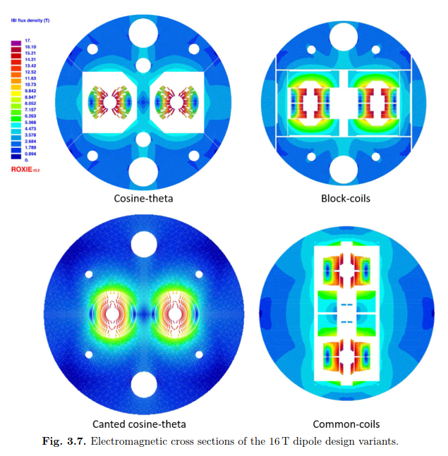
1st goal of the working group
An example: 16 T dipole magnets for FCC
Ideally the goal should be to carried out the full 2D design and analysis of a 20 T hybrid for all the design options considered
    Cosϑ design and its stress-management options, Block-type design, Common-coil design
In addition, 3D considerations will be included in the comparison

Slide 5
1st goal of the working group
The goal of the comparison should not be, or does not necessarily have to be
  reaching a consensus on a particular design
Instead, more realistically, the working group could aim at
  Discussing and reviewing the different designs and listing pluses and minuses or open issues….grounding on “objective” criteria
  Providing inputs to the other areas (in particular area I and area II) to better define their roadmaps and overall directions, and avoid inconsistencies

Slide 6
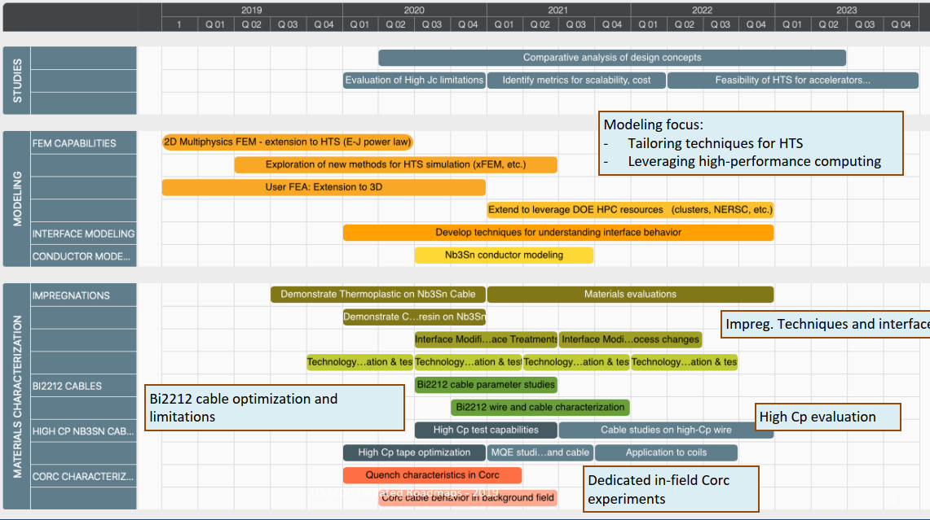
1st goal of the working group
Time frame: 2020 – 2023
Methods
  Modeling effort
    “classical 2D/3D” mechanical, magnetic and QH simulations
      Developing new modeling techniques is not part of this task
      However, if new tool/analysis is required → feed-back to Technology area (III), modeling and simulations

Slide 7
2nd goal of the working group
Review and follow-up of current work towards 9-15 T hybrid magnets
  This current work can be divided based on the field level
    9-10 T
    11-12 T
    13-14 T
    Beyond 15 T
  The goal is to collect and organize information from these programs (responsibility of area I and area II) to provide inputs for 20 T hybrid design

Slide 8
Outline
Definition of the goals of the working group
Design criteria for a 20 T hybrid magnet
Some preliminary estimates of radiuses and dimensions
Overview of current hybrid work
Action items

Slide 9
Design criteria for a 20 T hybrid magnet
Previous work within MDP on a 16 T dipole magnet
  GianLuca Sabbi, Alexander Zlobin, MDP General meeting – May 17, 2017
https://conferences.lbl.gov/event/82/

Slide 10
Design criteria for a 20 T hybrid magnet
Geometrical
  Number of apertures 1
  Free coil aperture 50 mm
Comments
  The common coils will naturally provide 2 apertures
    This will be taken into account on the comparison
  No “strong” constraints on
    Magnet total length (<2 m)
    Magnet straight section (>200 mm)
    Maximum magnet OD
      Reference numbers: 620 mm (FNAL/1.9K), 660 mm (BNL/1.9K), 914 mm (LBNL/4.5K)

Slide 11
Design criteria for a 20 T hybrid magnet
Operational
  Reference temperature 1.9 K
    4.5 K option can be considered: it would impact the ratio of HTS vs LTS
  Operational bore field 20 T
  Margin on the load-line @ 1.9K 15 %
    With respect to round strand I_{c} including self field and 5% cabling degradation
  Short sample bore field 23.5 T
  Geometrical harmonics at R_{ref}=17 mm and 20 T: b_{n}<5 for n<10
    Magnet straight section
  Target design field 20 T

Slide 12
Design criteria for a 20 T hybrid magnet
Operational
  Maximum Nb₃Sn coil stress >180 (<150) MPa at 1.9 (293) K
  Conditions of coil-pole or rib interfaces at 20 T
    If bonded 20 MPa max. tension
      ‘Corner spikes’ (~1 contact element, 1 mm) neglected
    If separation allowed: Half cable width in contact or < 50 µm max gap
      Conditions may be different depending on the design

Slide 13
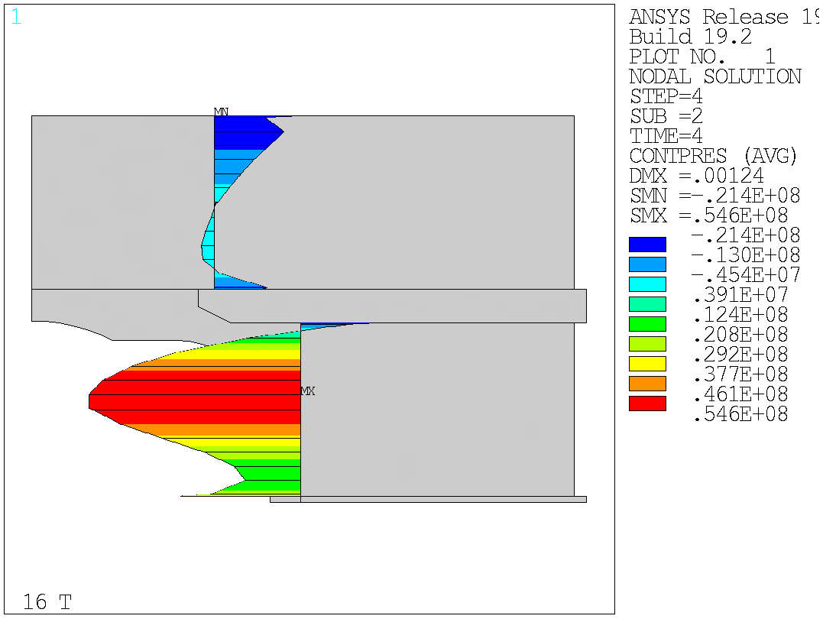
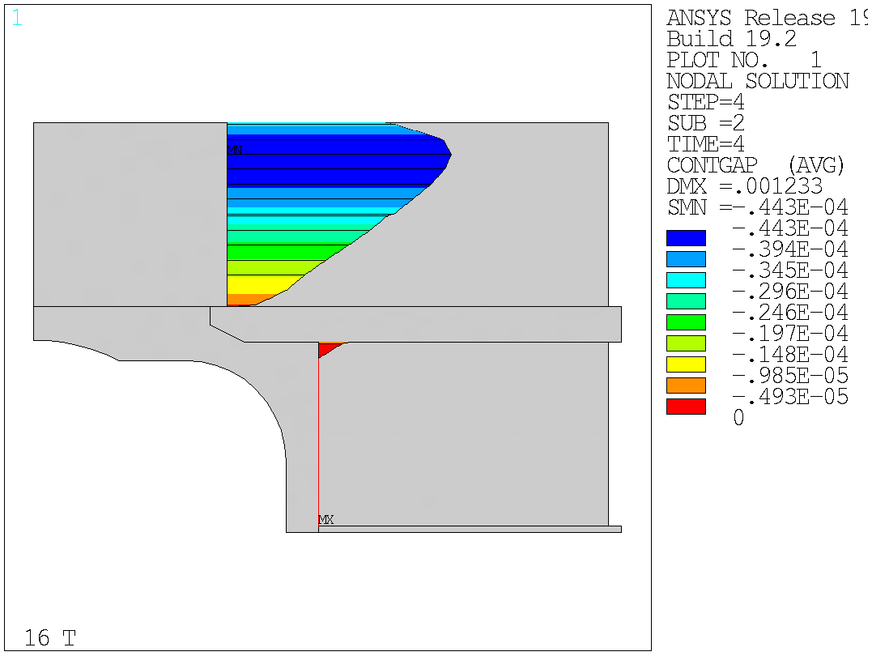
Design criteria for a 20 T hybrid magnet
Bonded vs separation-allowed
  Test Facility Dipole (by G. Vallone)

Slide 14
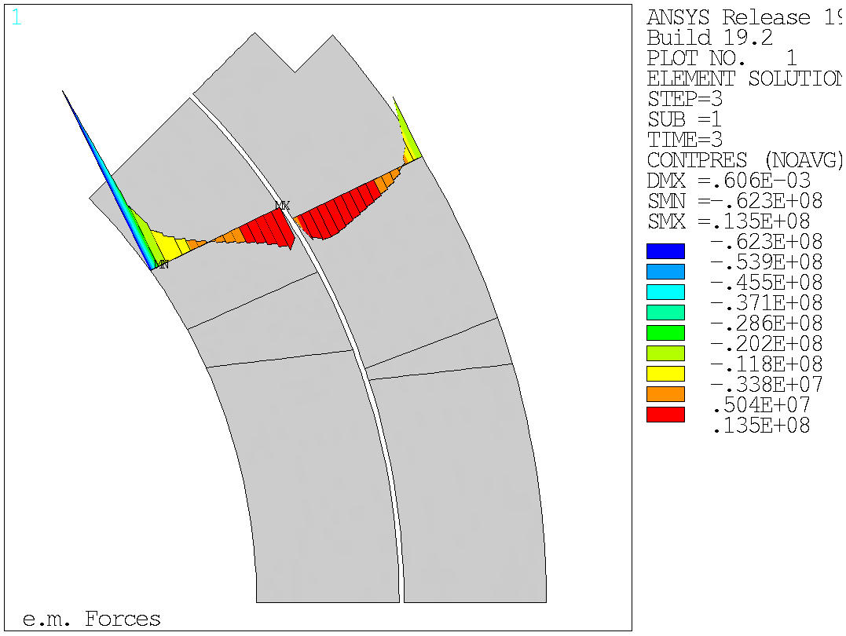
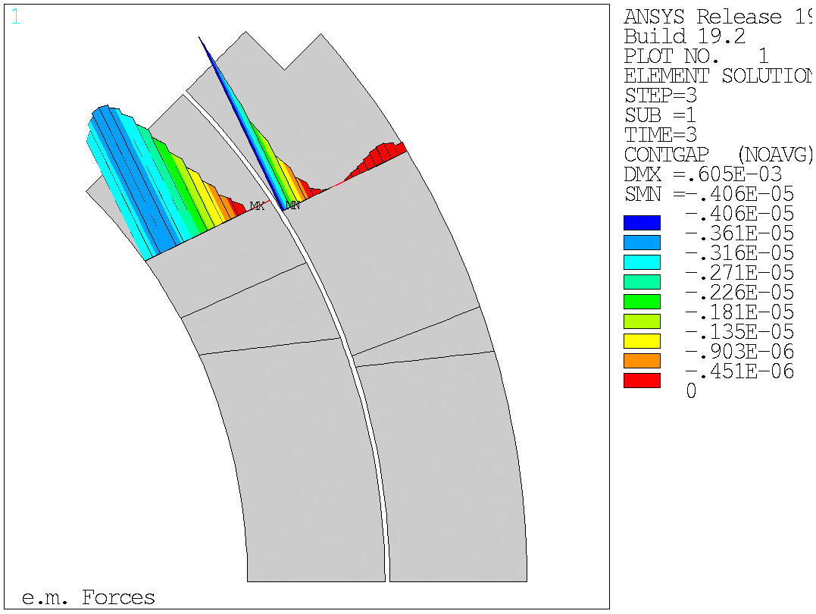
Design criteria for a 20 T hybrid magnet
Bonded vs separation-allowed
  MQXF (by G. Vallone)

Slide 15
Material limits
(by Giorgio Vallone)

Slide 16
Design criteria for a 20 T hybrid magnet
Nb₃Sn Conductor and cable
  Strand diameter 0.7-1.2 mm
  Cu:non-Cu ratio 0.8-2.0
  Non-Cu J_{c} round strand with self-field
    12 T, 4.2 K 2980 A/mm2
    15 T, 4.2 K 1640 A/mm2
    16 T, 4.2 K 1250 A/mm2
      See next slide for reference fit
      It may be difficult to achieve this in small diameter strands…..
  RRR (after cabling) >50
  I_{c} degradation due to cabling 5%
  Maximum number of strands in cable 60
  Cable Insulation thickness 0.150 mm

Slide 17
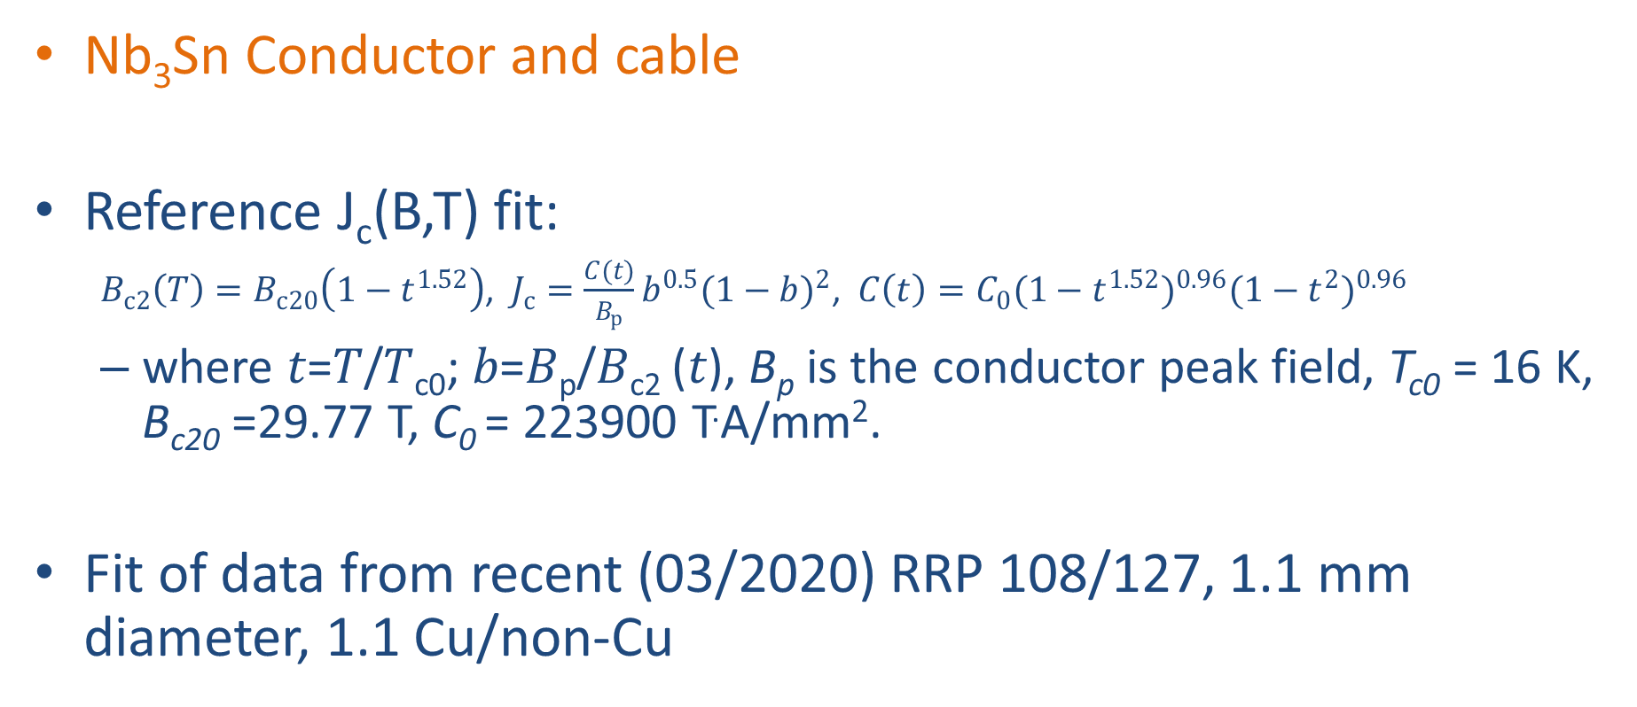
Design criteria for a 20 T hybrid magnet
Nb₃Sn Conductor and cable
Reference J_{c}(B,T) fit:
  $B_{c2}\left(T\right)=B_{c20}\left(1−t^{1.52}\right)$, $J_{c}=\frac{C(t)}{B_{p}}b^{0.5}{(1−b)}^{2}$, $C\left(t\right)=C_{0}{(1−t^{1.52})}^{0.96}{(1−t^{2})}^{0.96}$
  where 𝑡=𝑇/𝑇_{c0}; 𝑏=𝐵_{p}/𝐵_{c2} (𝑡), B_{p} is the conductor peak field, T_{c0} = 16 K, B_{c20} =29.77 T, C₀ = 223900 T.A/mm².
Fit of data from recent (03/2020) RRP 108/127, 1.1 mm diameter, 1.1 Cu/non-Cu

Slide 18
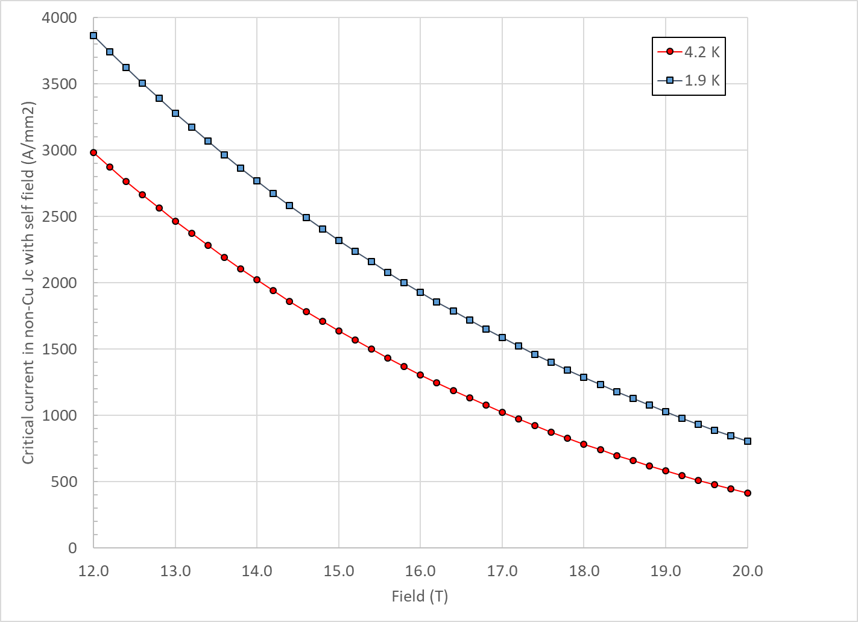
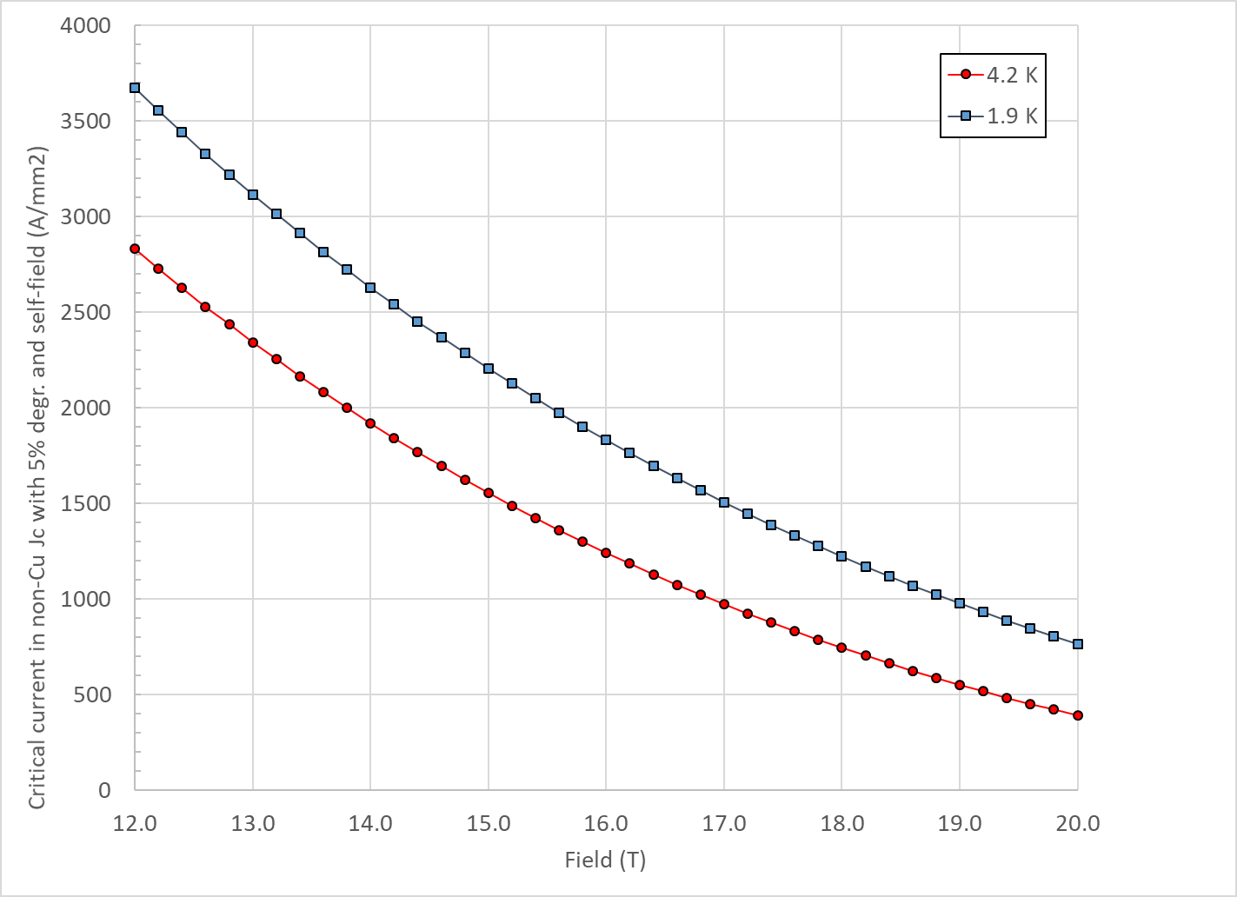
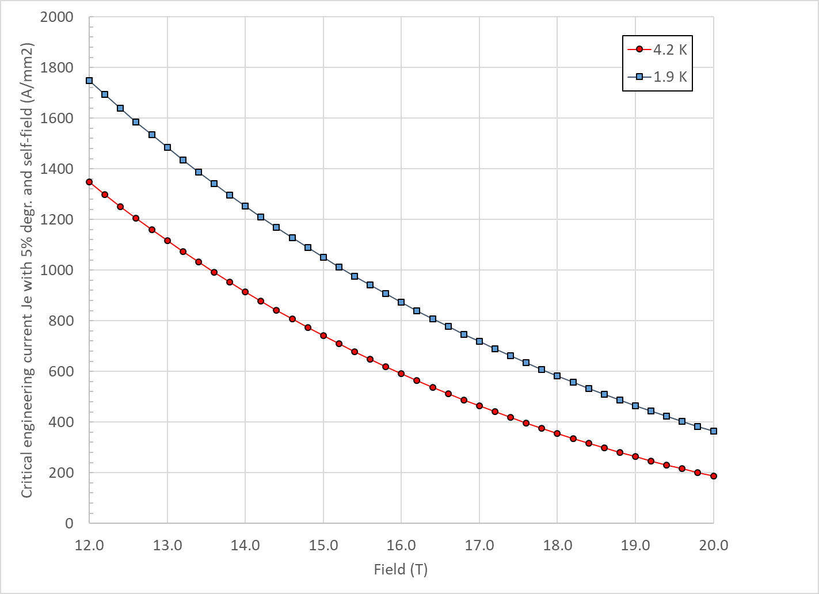
Design criteria for a 20 T hybrid magnet
Nb₃Sn Conductor and cable
  “3000” A/mm² kind of conductor, round, with self field
J_{c} round
J_{c} , 5% deg.
J_{e} , 5% deg.

Slide 19
Design criteria for a 20 T hybrid magnet
Nb₃Sn Conductor and cable
  In general, it would be better to stay within already tested parameters (min, max)
Dimension before reaction; In MQXF, assumed expansion during reaction is 4.5 % (th), 1.2 % (w)

Slide 20
Design criteria for a 20 T hybrid magnet
Bi2212 Conductor and cable (input from T. Shen and L. Garcia Fajardo)
  The wire diameter:
    from 0.6 mm to 1.5 mm
  Cable width: basically same possibilities as with Nb₃Sn cables

Slide 21
Design criteria for a 20 T hybrid magnet
Bi2212 Conductor and cable (input from T. Shen and L. Garcia Fajardo)
  Record performance strand RC5/6 about 20% higher than what is currently “comfortably” produced.

Slide 22
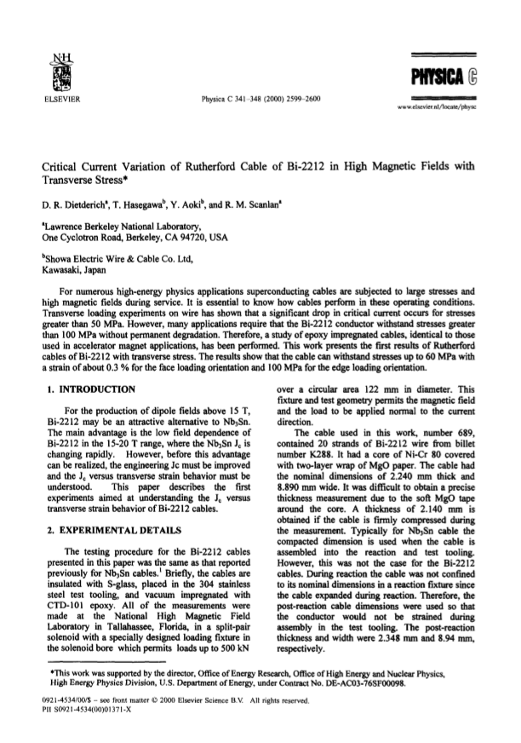
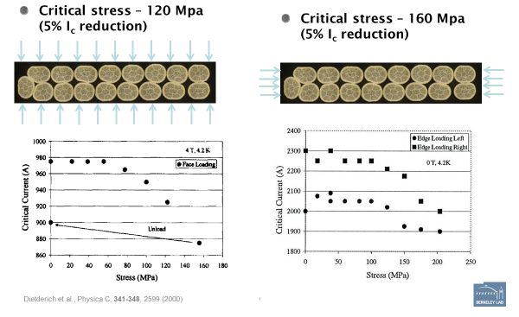
Design criteria for a 20 T hybrid magnet
REBCO Conductor and cable
  Maximum Nb₃Sn coil stress: <120 MPa (293) K

Slide 23
Design criteria for a 20 T hybrid magnet
Quench protection
  Maximum hot spot temperature 350 K
    Failure scenarios?
  Total time delay 40 ms
  Maximum voltage to ground @ quench 1.0 kV
  Ground insulation design voltage >5 kV
  Powering in series or independent?
    I would propose in series
  What about a maximum J in the Cu of 1500 A/mm² ?
    It would provide a quick/easy check and limits of the grading options

Slide 24
Outline
Definition of the goals of the working group
Design criteria for a 20 T hybrid magnet
Some very preliminary estimates of radiuses and dimensions
Overview of current hybrid work
Action items

Slide 25
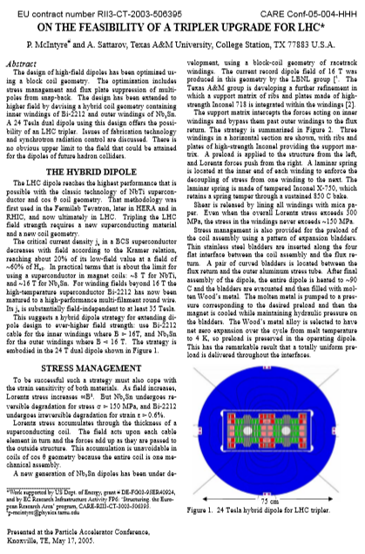
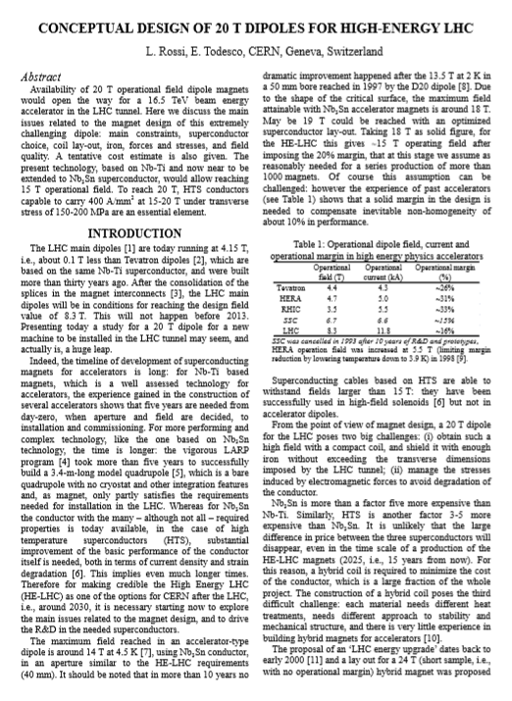
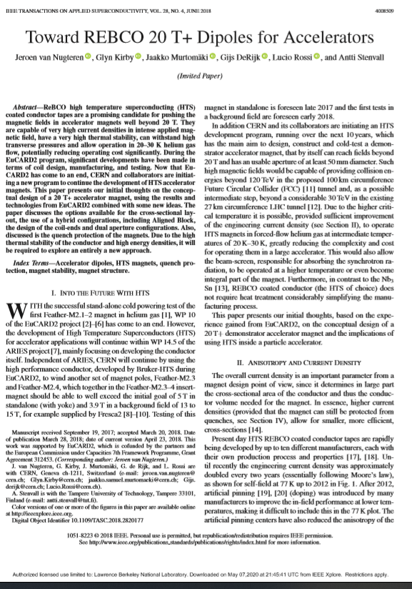
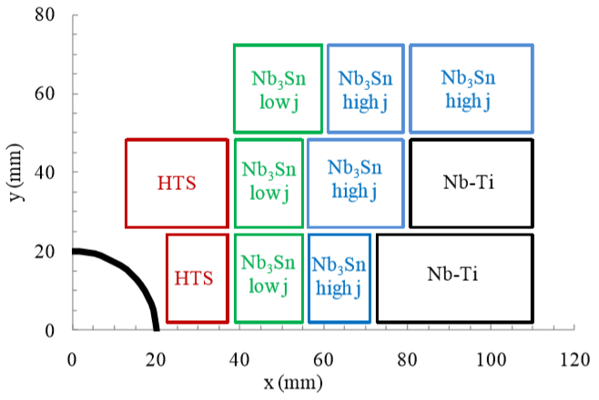
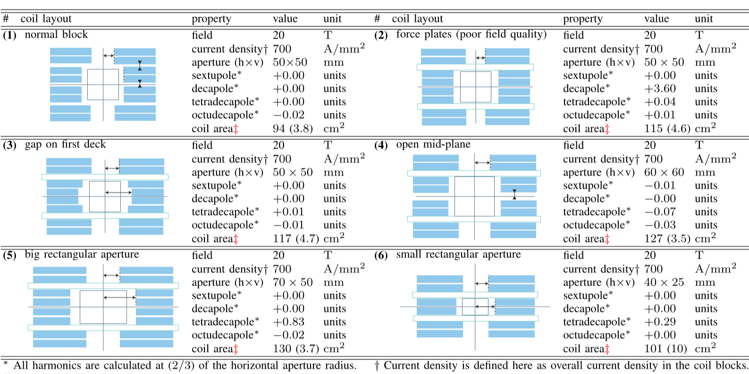
First some references (20 T B_{op})

Slide 26

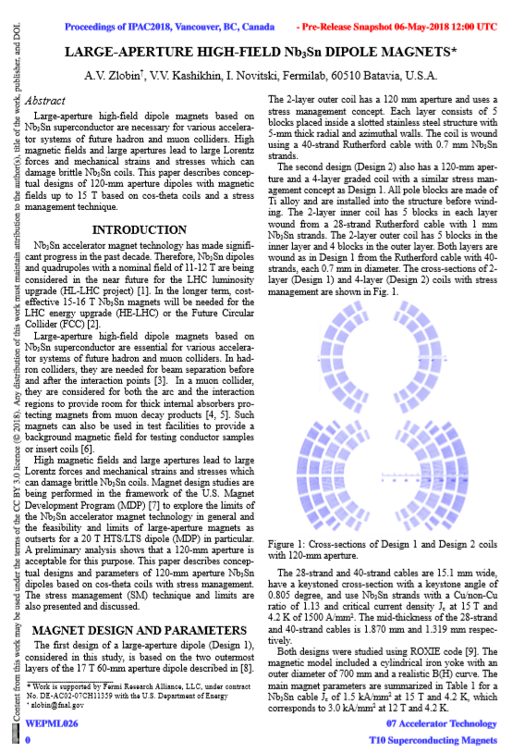
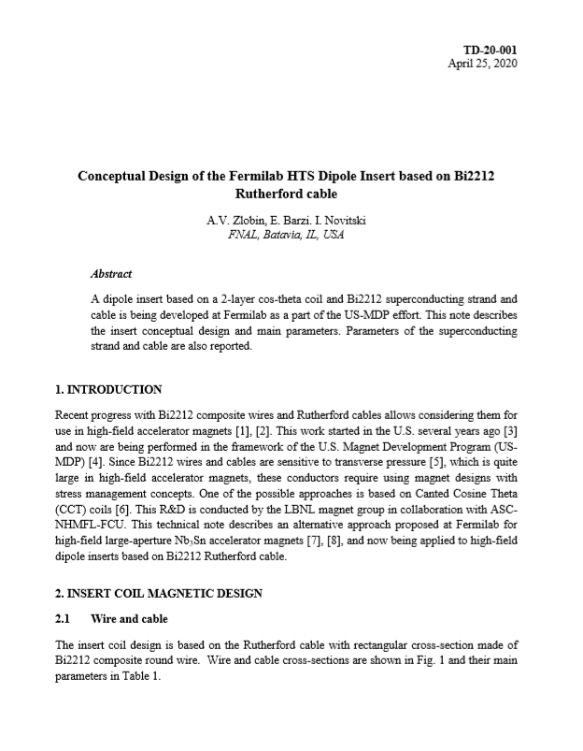
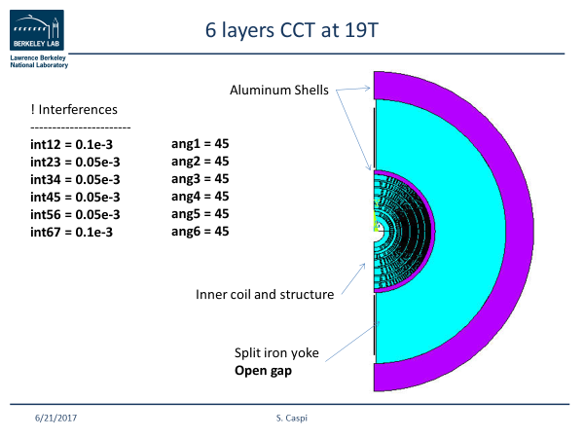
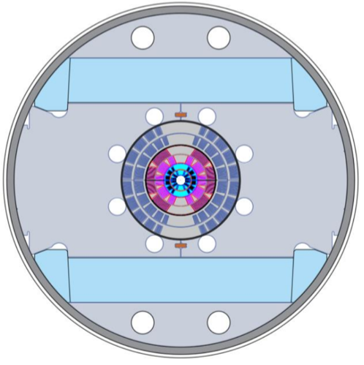
First some references (“towards” 20 T)

Slide 27
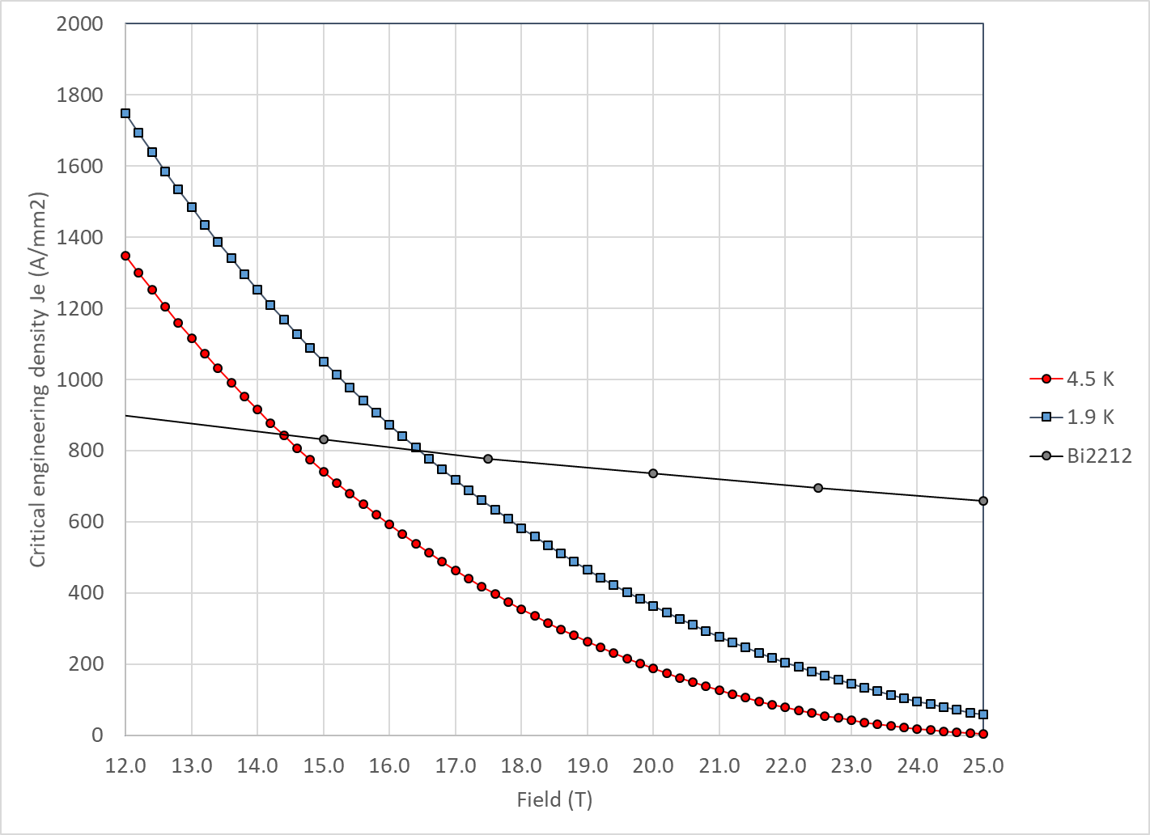
Nb₃Sn aperture in a 20 T hybrid
With properties describe above Nb₃Sn and Bi2212 cross at 14.5 T at 4.2 K and 16.5 T at 1.9 K

Slide 28
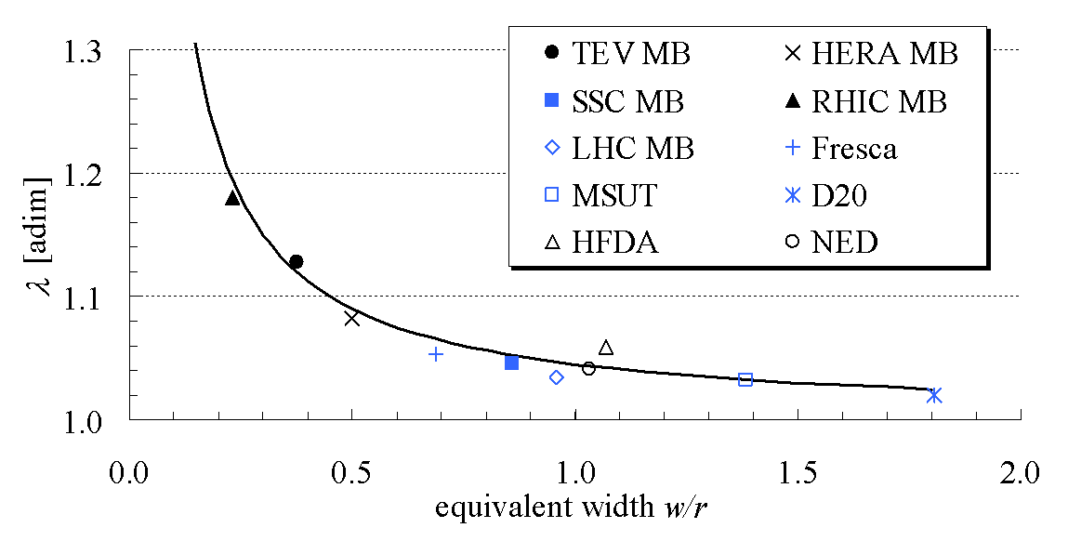
Field in at 20 T dipole
B_{bore_op} = 20 T
B_{peak_op} = B_{bore_op} · 1.04 = 20.8 T
B_{bore_ss} = B_{bore_op} / 0.85 = 23.5 T
B_{peak_ss} = B_{bore_ss} · 1.04 = 24.4 T

Slide 29
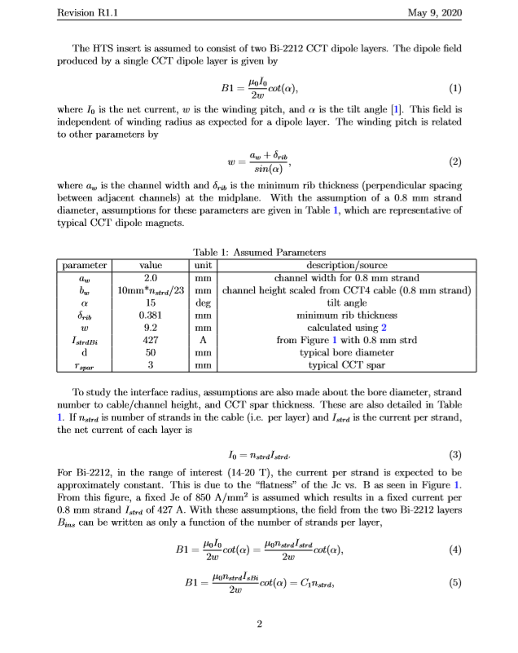
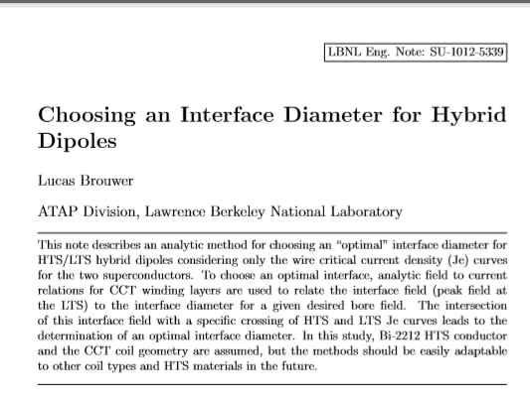
Analysis of interface diameter
Analytical model from Lucas Brouwer

Slide 30
Analysis of interface diameter
Thick shell with cosϑ distribution
  Bore field = conductor peak field
4 CCT winding layers,
  2 of Bi2212 and 2 of Nb₃Sn
Field in Nb₃Sn is given by self field + stray field from Bi2212 insert
From J_{e} to J_{overall} keeping into account spar and ribs

Slide 31
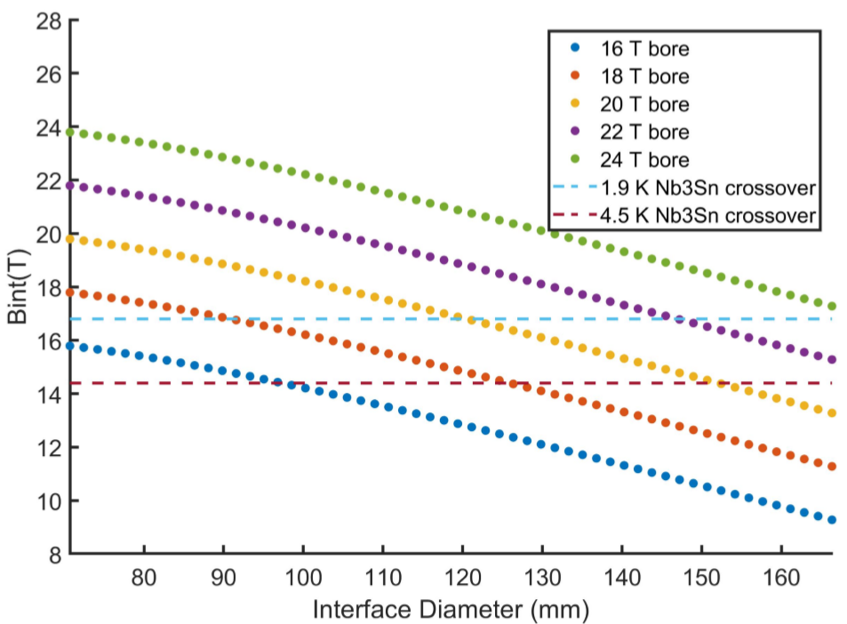
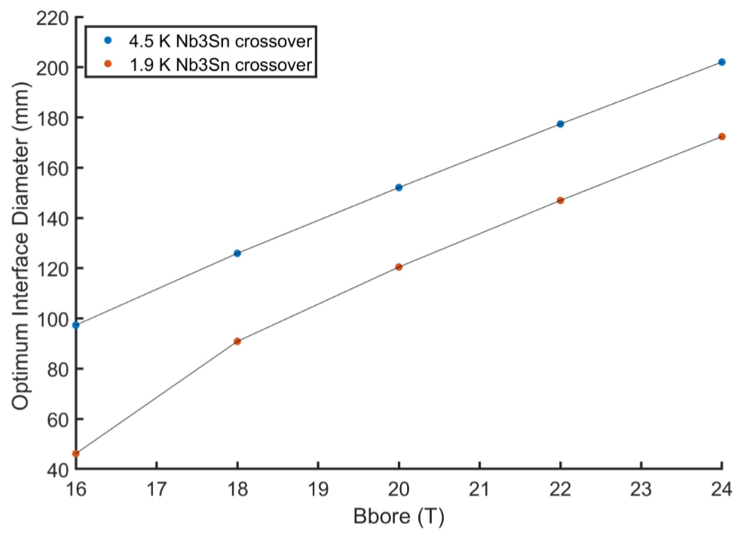
Analysis of interface diameter
Results: 150-160 mm interface diameter for a 23.5 T magnet

Slide 32

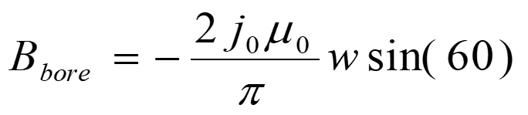
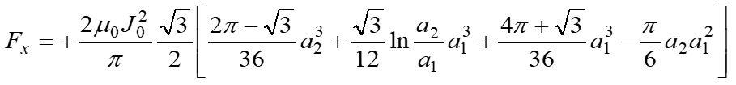
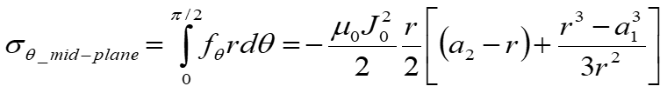
Analysis of coil radius and thickness
Sector coil (60°) with J = J₀ distribution

Slide 33
Analysis of coil radius and thickness

Slide 34
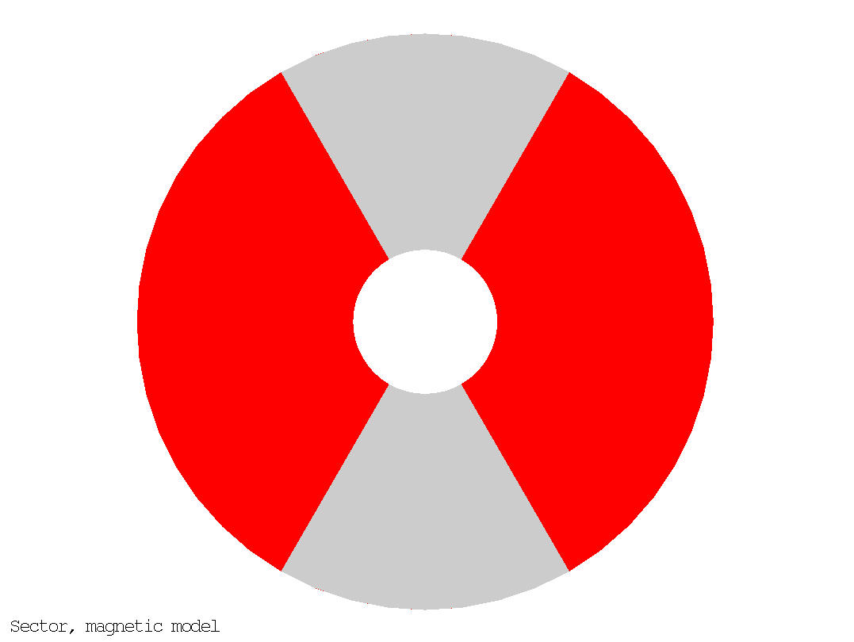
Very…very…preliminary coil size
So, with J_{o_op} = 385 A/mm² and B_{bore_op} = 20 T
  Coil width ~ 75 mm
Very strong assumptions
  constant uniform J_{o},
    same cable….
  No spar/ribs…
75 mm should a first order thickness of only the “cable layers” in a cosϑ distribution

Slide 35
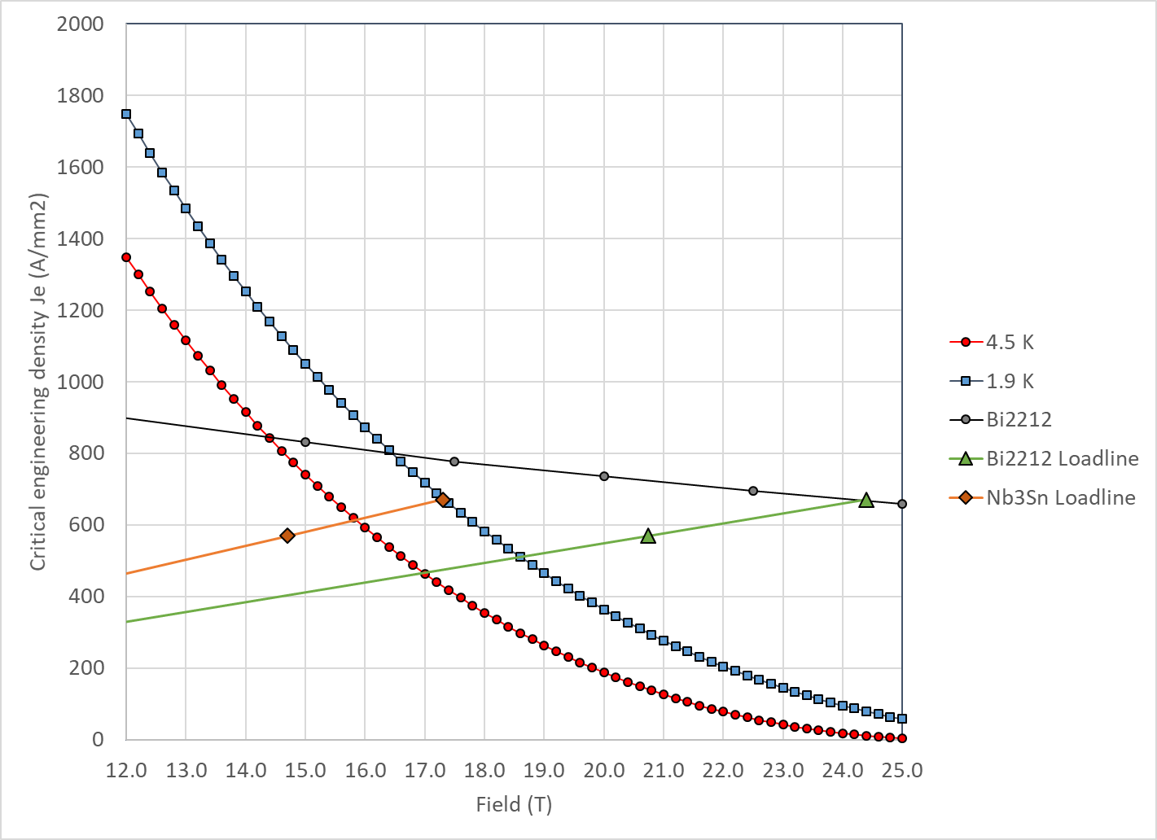
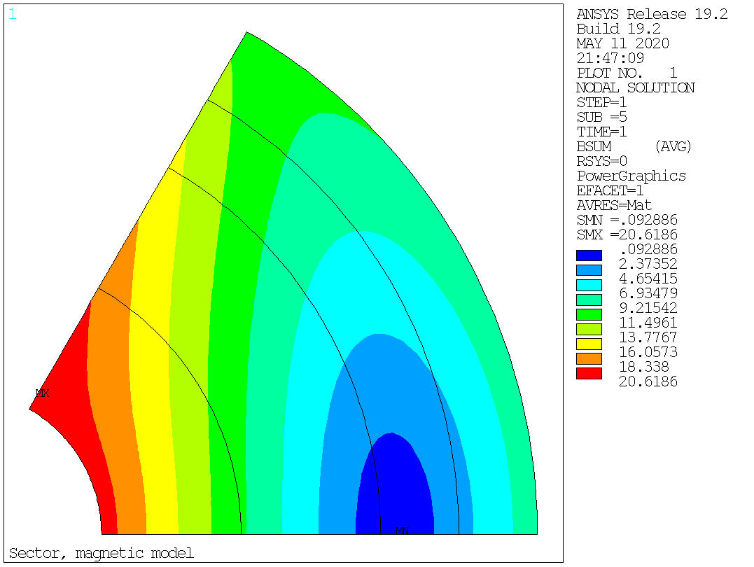
Field in the conductor
At short sample, B_{p_ss} = 24.4 T → J_{e_ss} = 670 A/mm2 → J_{o_ss} = 452 A/mm²
So, at 85% of short sample → J_{e_op} = 570 A/mm2 → J_{o_op} = 385 A/mm²

Slide 36
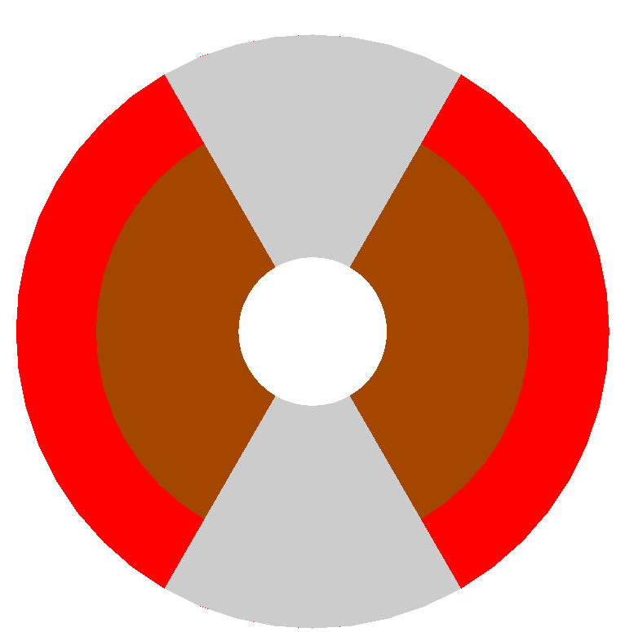
Very…very…preliminary coil size
50 mm aperture
Under the previous assumption (very simple analytical model, no stress management….)
  ID Nb₃Sn = 146 mm
  OD Nb₃Sn = 200 mm
  75 m total coil thickness
    48 mm thick Bi2212 coil
    27 mm thick Nb₃Sn coil

Slide 37
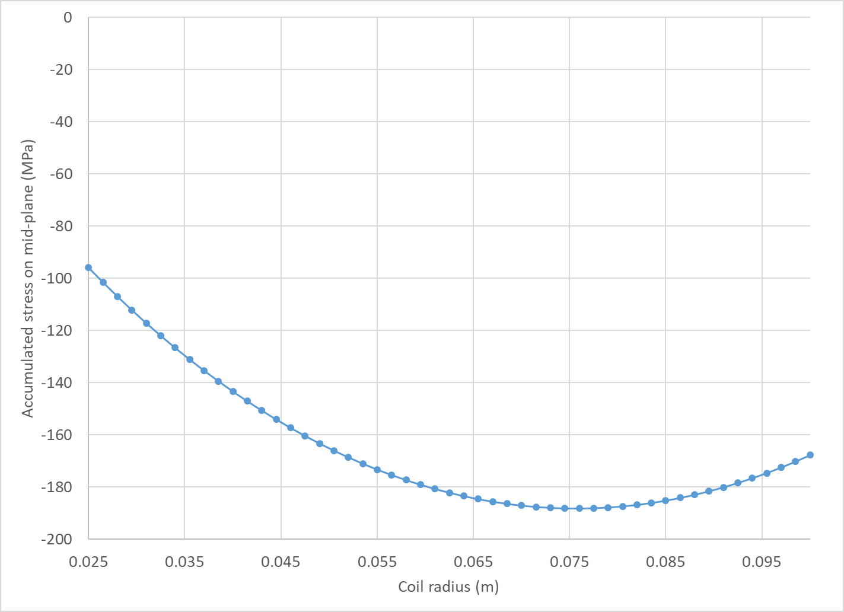
Peak stress
Stress due to accumulated e.m. forces on the mid-plane
  No shear, no bending….

Slide 38
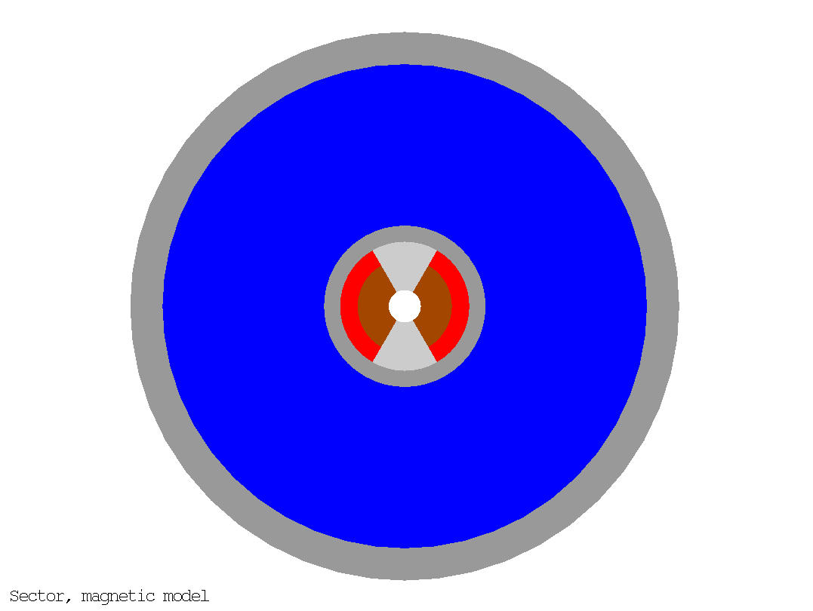
Very…very…preliminary magnet size
20 mm collar
250 mm thick yoke
50 mm thick shell
  F_{x}/t = 200 MPa
OD: 850 mm

Slide 39
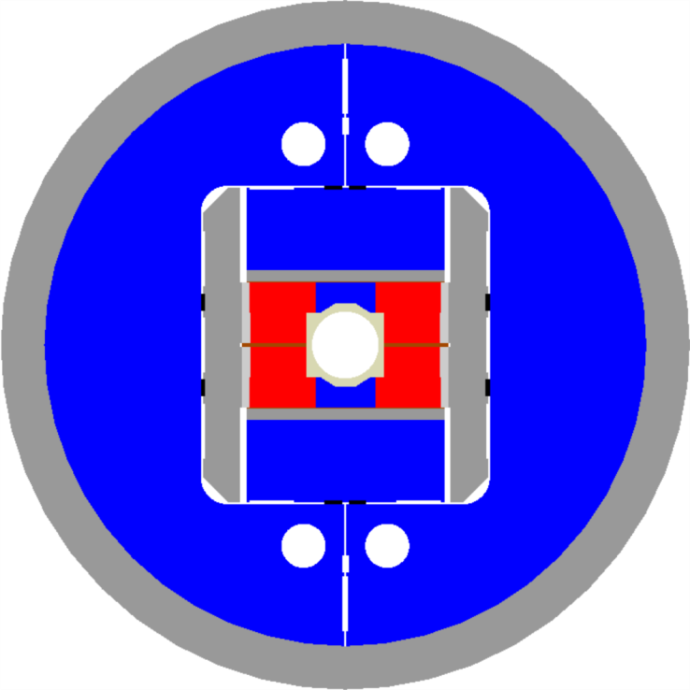
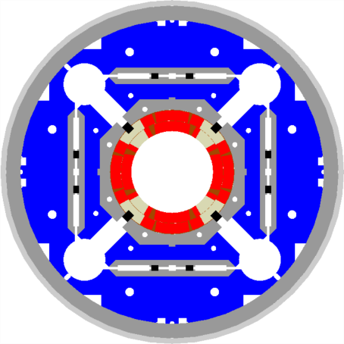
Size comparison
LHC MQXF FRESCA2 ????

Slide 40
Outline
Definition of the goals of the working group
Design criteria for a 20 T hybrid magnet
Some preliminary estimates of radiuses and dimensions
Overview of current hybrid work
  Both conceptual design and “real” development
Action items

Slide 41
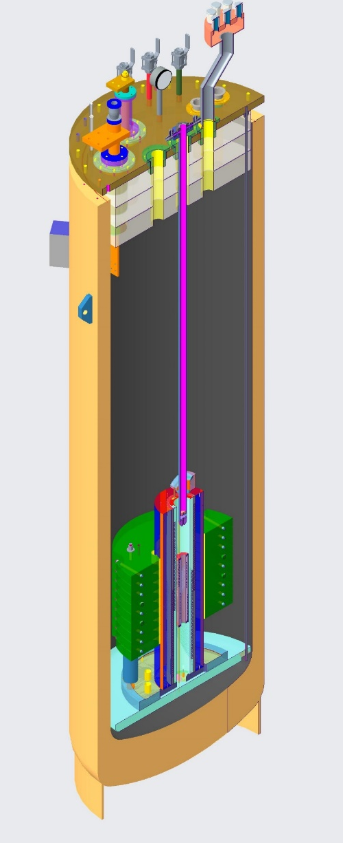
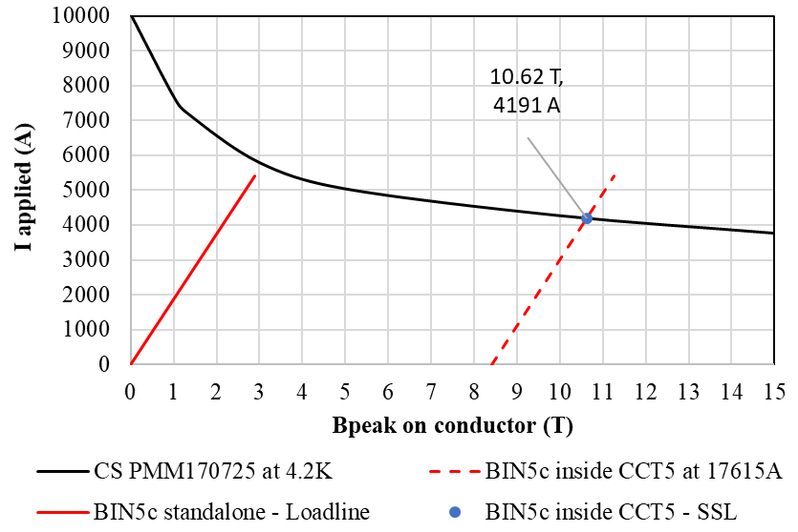
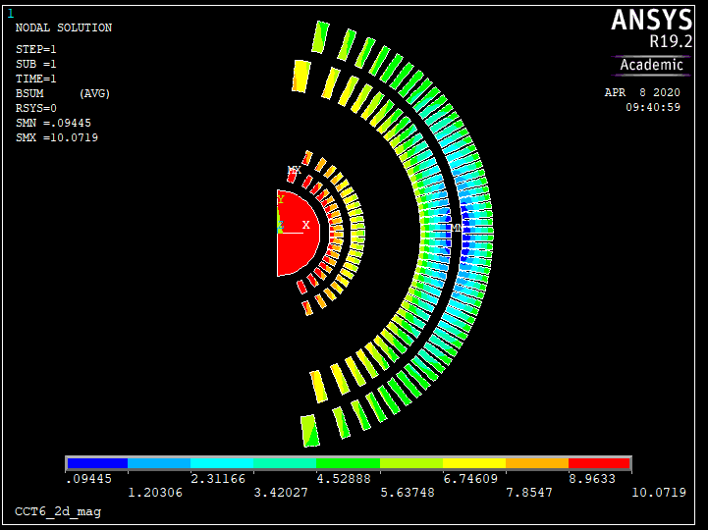
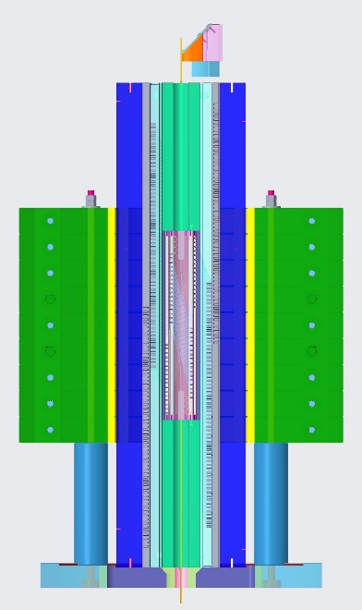
The 9-10 T field level
LBNL
  Bi2212 insert Bin5c_2 (2-3 T stand alone) in CCT5 (8-9 T)
    Test planned in 2021

Slide 42
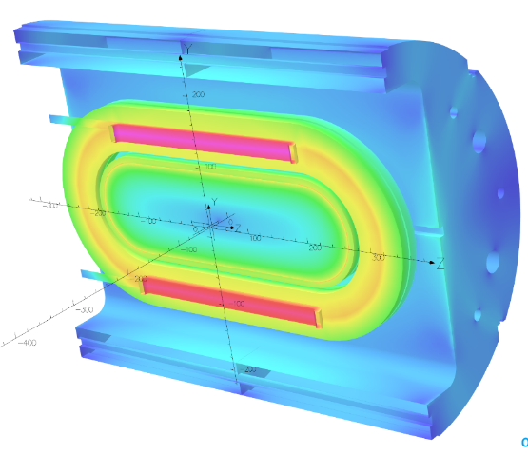
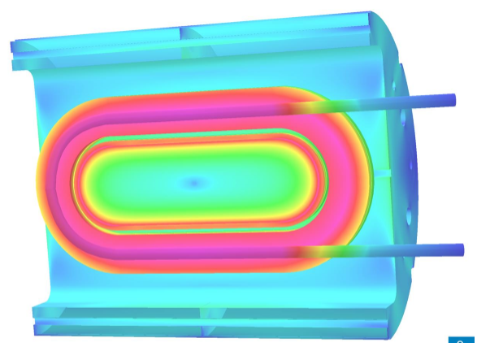
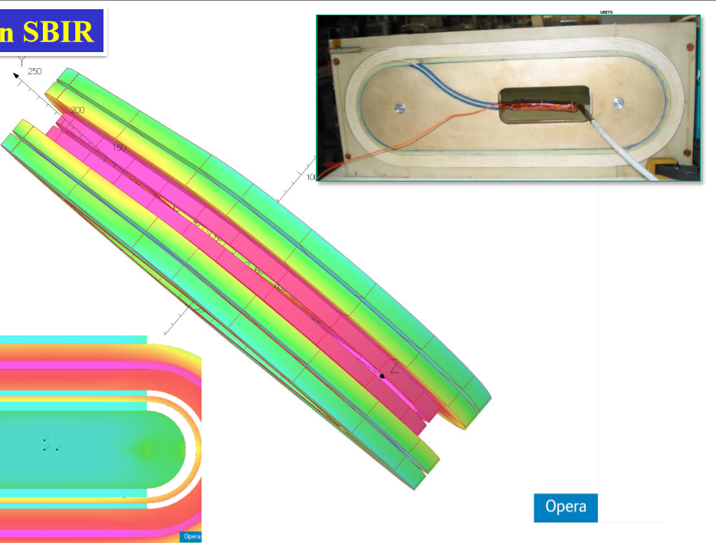
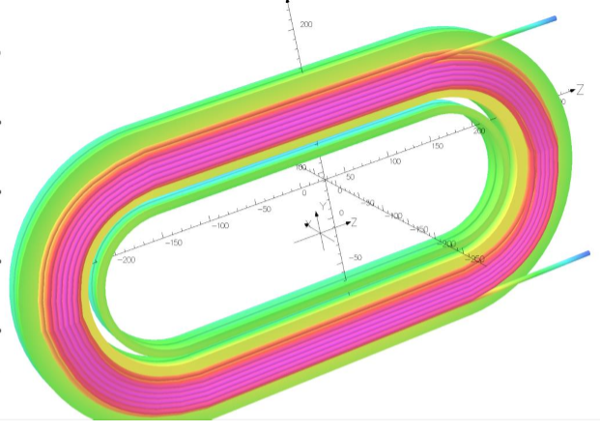
The 11-12 T field level
BNL
  Coils wound with REBCO tape or CORC (1-3 T) inside DCC017 common coil Nb₃Sn dipole (10.2 T)
Tape perpendicular to field
Tape parallel to field
CORC

Slide 43
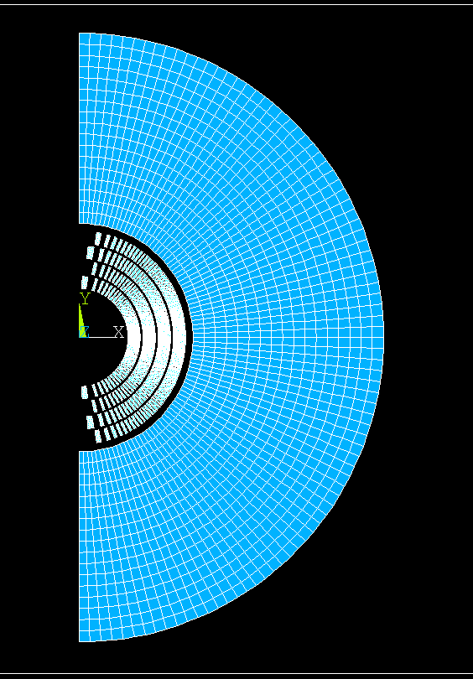
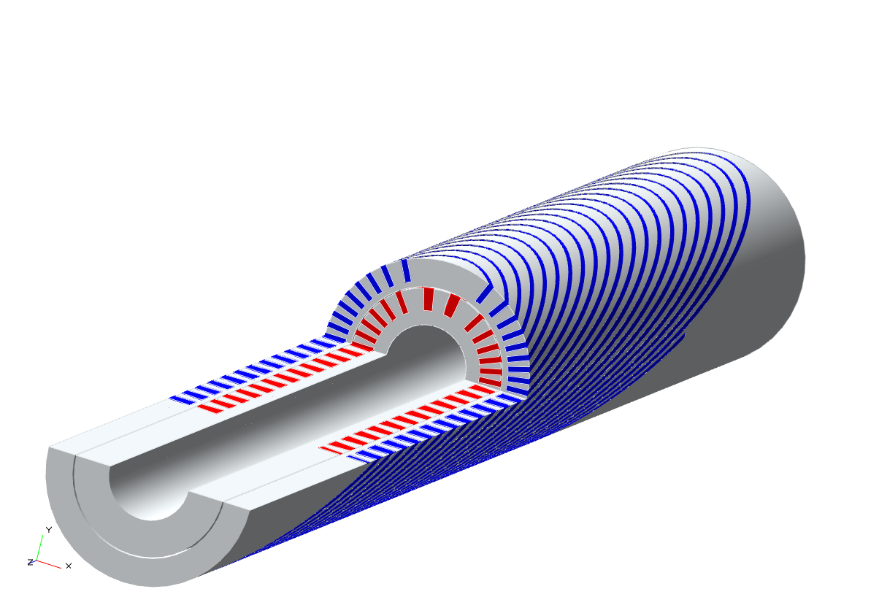
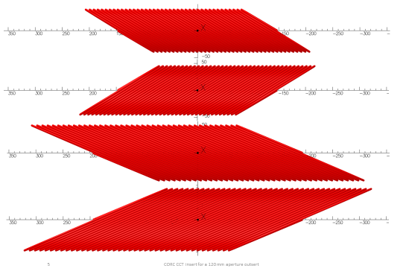
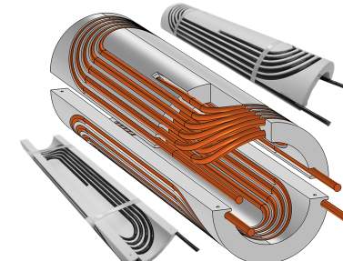
The 13-14 T field level (I)
LBNL
  Bi2212 or REBCO (CCT or COMB) inserts (5-6 T stand alone) in CCT6 (2 or 4 layers, 11 T)

Slide 44

The 13-14 T field level (II)
FNAL
  Bi2212 or REBCO (CCT or COMB) inserts (5-6 T stand alone) in SMCT (2 layers, ~11 T)

Slide 45


The 13-14 T field level (III) and beyond 15 T
FNAL
  Bi2212 insert SMCT (4-5 T stand alone) in 11T dipole coil and then in SMCT coil

Slide 46
Action items
Define “comparison” criteria
Define CORC specs and Je
Continue aperture/thickness/dimension analysis
  Iron, grading
  Move progressively from analytical model to simplified FEM of CT, CCT, SMCT, block and CC designs
Continue the update of current hybrid program

