Slide 1
Project Overview and Review Goals
Soren Prestemon
Director, Berkeley Center for Magnet Technology
Lawrence Berkeley National Laboratory

Slide 2
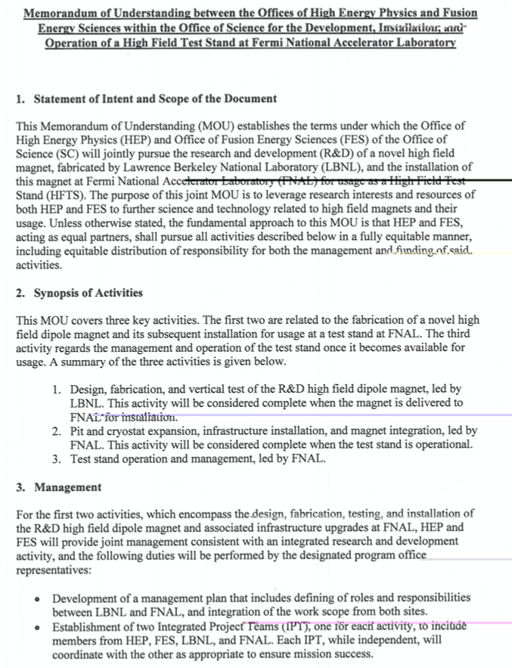
Background
FES and HEP began discussions on US options for an HTS Cable Test Facility
  Join with PSI and CERN for an EDIPO replacement, or
  Build a facility in the US
FES requested SP (aided by Joe Minervini) perform a stakeholder survey to develop specifications – completed July 2018
FES requested SP, GLS and GV provide a cost and schedule evaluation – completed Oct. 2018
DOE HEP and FES agree to fund a facility in the US, to be located at FNAL
  MOU signed November 12th, 2019

Slide 3
Define responsibilities / management for maximum efficiency and minimal risk
LBNL serve as lead for the magnet design / fabrication and test
FNAL serve as the host for the facility
LBNL Lead for magnet design/fab/test
FNAL serve as HTS Cable Test Facility Host
Interface / spec. coordination
FNAL lead for test facility prep

Slide 4
Facility parameters/specifications for FES and HEP needs
(From Conceptual Cost and Schedule document)
The test facility will be constructed in Industrial Building 1, APS-TD, Fermilab. The proposed place is selected based on the proximity to the needed base infrastructure for such a test stand, including cryogenic, power, water and crane.
Minimum operating temperature of the facility is 1.9K for the magnet providing the background field and 4.2-4.3 K *(under discussion) for the test samples.
The test pit cryostat should accommodate a dipole (coldmass) with maximum dimensions of 1.3 m and length of 3.0 m. [now using max length 3.1 m]
The maximum weight of the dipole cold mass should not exceed 22 (Standard) tons, limited by the crane capacity.
The test facility should be efficient and safe, minimizing the time for experiment preparation and no helium losses after quenches.
Operational lifetime of the facility at least 20 years.

Slide 5
Magnet parameters/specifications for FES and HEP needs
(From Conceptual Cost and Schedule document)
Background dipole field > 15T.
Homogeneous field region>500-600mm, preferably>1000mm.
Cryostat to accommodate sufficient sample length to keep sample joint in low field.
Well dimension 90x140, and preferably100x150.
  It would be preferable to make the well compatible with FRESCA2 samples [note EDIPO was actually 94x144]
Field quality in the transverse plane -target is to keep all harmonics below 20 units at 35 mm radius and 15 T field.

Slide 6
Proposed Project Approach for the magnet – minimize project risk while maximizing performance
Leverage DOE-OHEP-developed high field magnet technology
  Build off of HD-series magnets – HD1 (16T, no bore), HD2/3 (~13.8T)
  Leverage early design and development efforts for a large bore magnet – LD1
Build on the design and successful test of FRESCA-II (14.6T, 100mm bore)
  Also leverage significant coil fabrication experience from the Saclay and CERN teams
Leverage efforts of the HEPDipo team and other relevant magnet experience
  Leverage latest RRP conductors
  Strong connections with CERN; build collaboration
Leverage facilities and expertise at the DOE-OHEP laboratories
  LBNL/FNAL/BNL have strong design and analysis teams
    LBNL with expertise and history in block-magnet designs
  US has only cabling machine capable of fabricating the requisite large cables (LBNL)
  Winding / reaction / potting tooling exists at LBNL that are not used by HL-LHC AUP
    BNL and FNAL have additional capabilities should the need arise
Define the project team so as to leverage expertise and facilities without impacting HL-LHC AUP and MDP progress towards goals

Slide 7
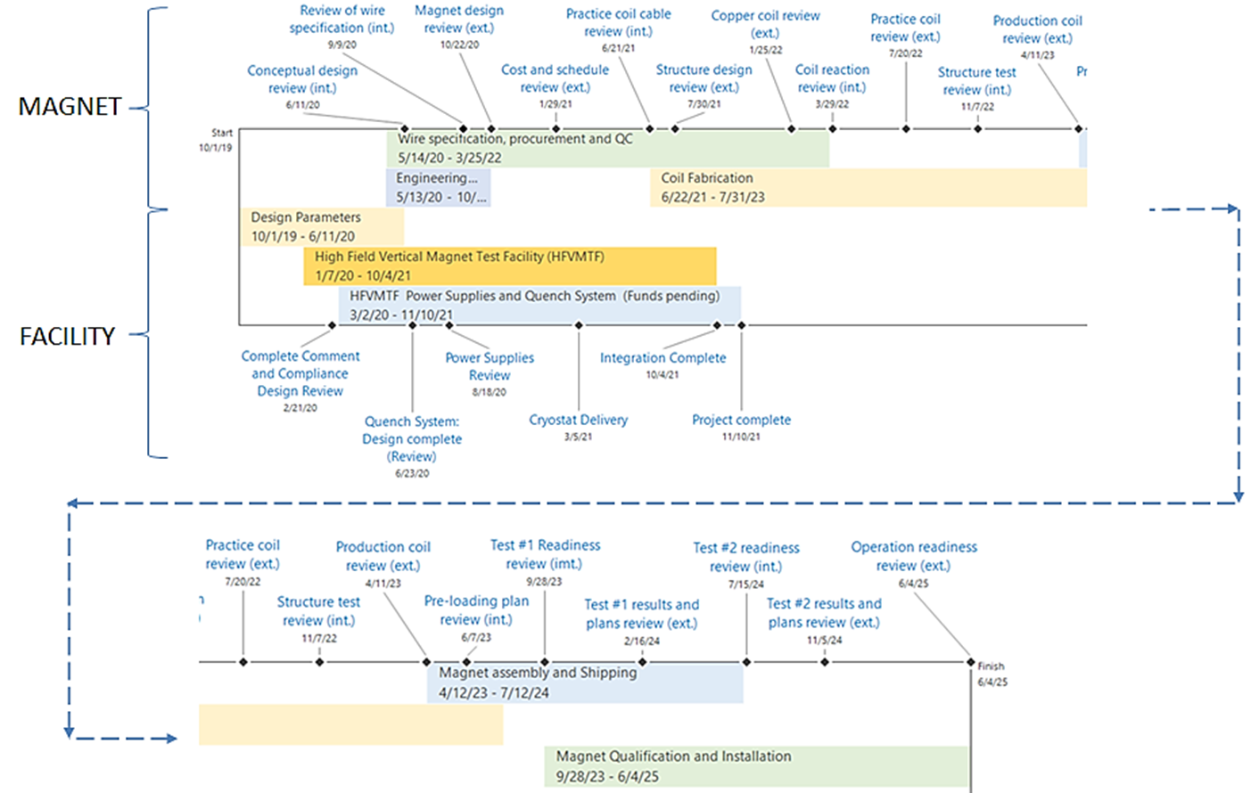
Integrated Timeline and Milestones
We are at the beginning of this large “one-off” magnet project
Want to get the design:
headed in the right direction,
with the right people,
using the right tools,
and with the right performance metrics

Slide 8
Charge to the Review Committee
Are the magnet requirements properly defined and documented? Have interfaces with the final facility been properly documented?
Are conductor options appropriately considered? Are the plans for conductor selection and cable design finalization appropriate for this stage of the project, and have associated risks been identified?
Has the project team properly reviewed and considered design alternatives?
Is the design team using appropriate design and analysis tools?
Is the design at the proper level of maturity for this stage in the design? Is the project managing the design process to meet performance requirements while minimizing project risk?
Have critical technology issues and relevant decision points been identified? Is the team benefitting from all relevant experience from the broader community?
Is the design team properly staffed? Are there areas where additional resources should be provided?

Slide 9
Summary
The planned facility is an important investment from DOE-FES&HEP
This is the first in a series of reviews planned for the magnet project
We are looking to get this off to a solid start technically
We are leveraging significant work by the HEPDipo collaboration
Also leveraging the experience from the FRESCA-II team
We are eager to hear constructive feedback from
the review committee!

