Slide 1
A new Test Facility for the Development of
High-Field Accelerator Magnets
L. Bottura
TFD review
11/6/2020

Slide 2
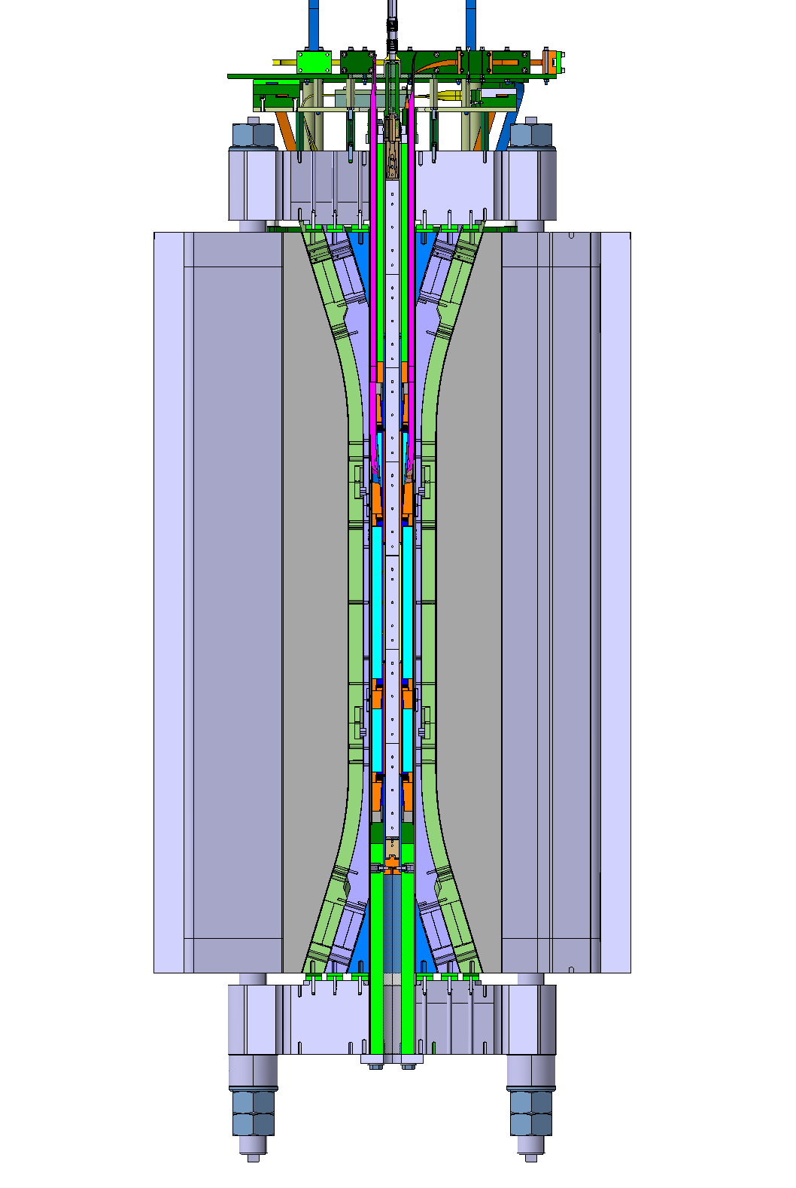
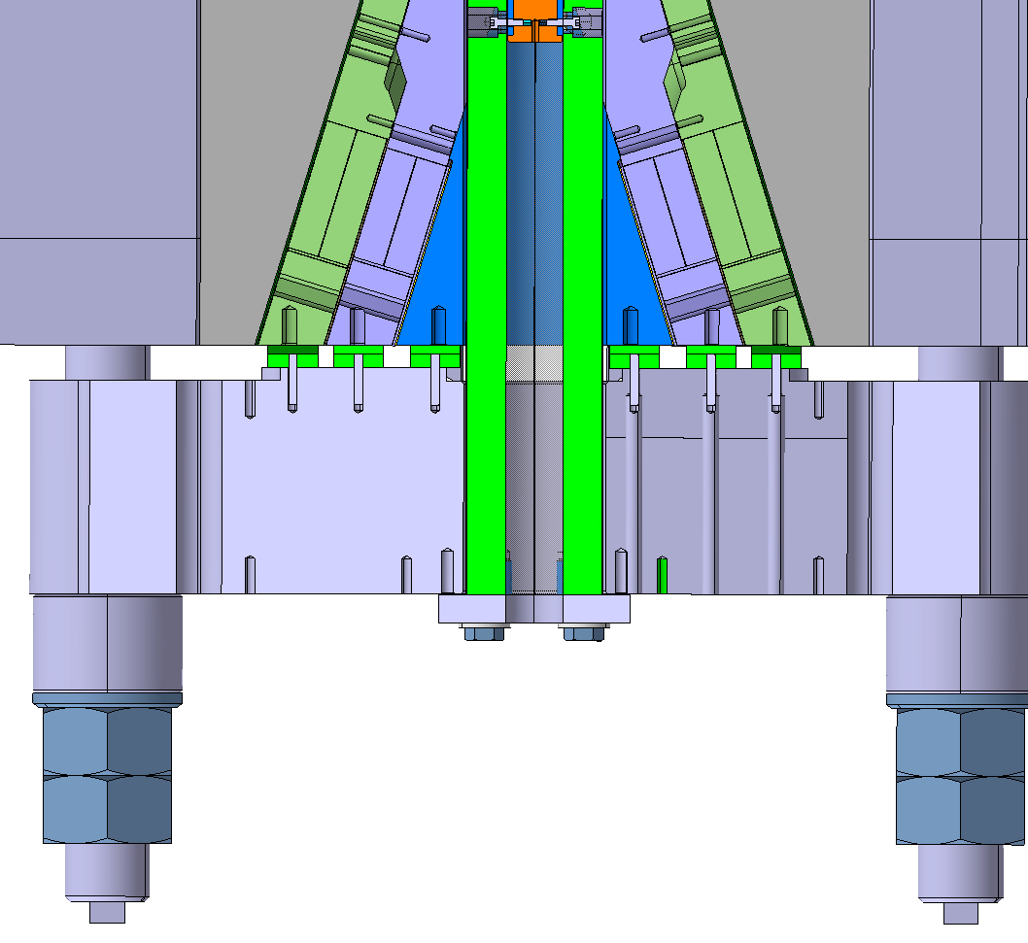
CERN interest in a new facility
After completing testing of EuCARD and EuCARD² insert magnets (2…3 tests in 2020) the FRESCA2 magnet will become part of a new cable test facility
At this point it will no longer possible to mount HTS inserts of significant size in the magnet bore (anti-cryostat)
The only high-field test facility left for insert testing will be SULTAN at EPFL/SPC
FRESCA2 with integrated Feather.M2 insert and magnetic measurement shaft
Detail of bottom mechanical registration
No HTS R&D without a suitable test bed

Slide 3
Specification for a new test facility
Approach operating conditions (B, I, T) set as target for the development of future accelerator HTS magnets:
  B_{bkg} ≈ 15 T
  I_{op} > 20 kA
  T_{op} ≈ 1.9 K … 100 K
  Large aperture (≈ 150 mm)
A test-bed for HTS inserts (possibly cables, and obviously also relevant to LTS) of different configurations (wound samples, hairpin samples, pressure/temperature controlled samples), targeting peak (total) field of the order of 20 T
These are the HEPdipo specifications

Slide 4
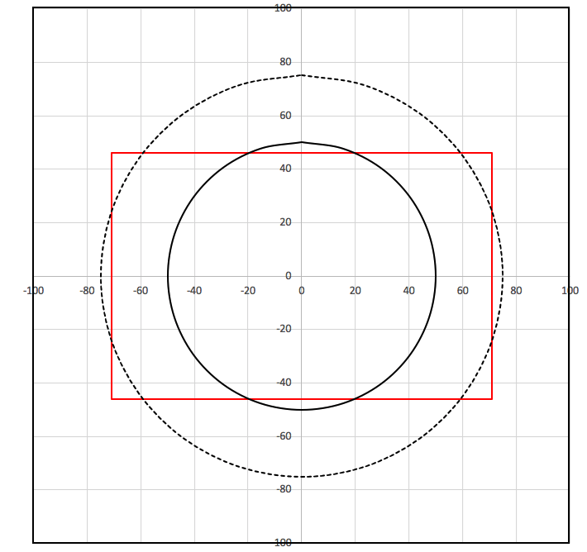
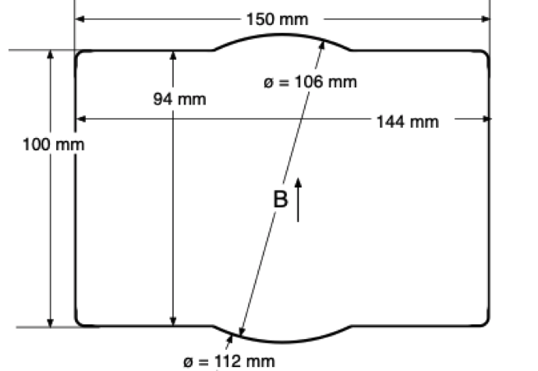
On the magnet bore
D=100
D=150
94x144

Slide 5
The additional benefits (to CERN)
Exploit the investment made in the technology developed for block magnets (SMC, RMC, FRESCA2)
Mutualize the effort with the sequence of model magnets planned towards high-field Nb₃Sn accelerator magnets of the next generation (the CERN DEMO)
Use this construction as an additional R&D vehicle, to implement and test variants that are deemed appropriate and ready for such realization, and leave a significant heritage

Slide 6
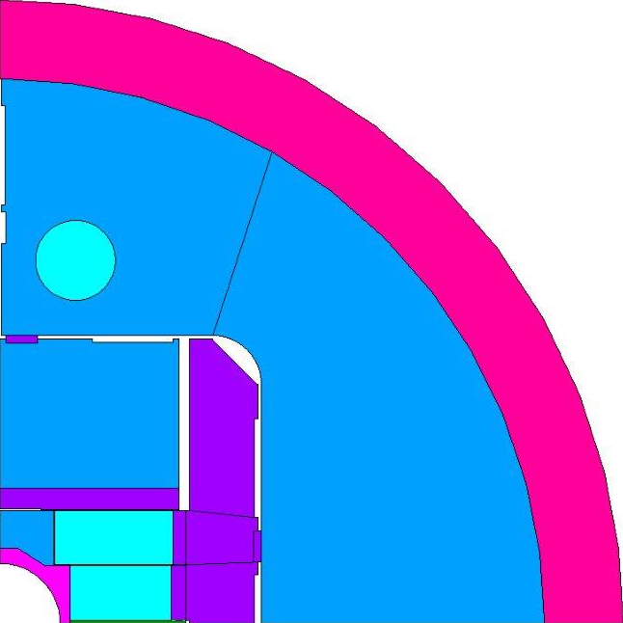
1. from FRESCA2 to HEPdipo
FRESCA2
HEPdipo

Slide 7
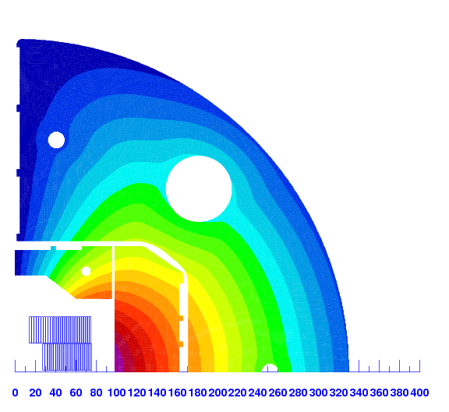
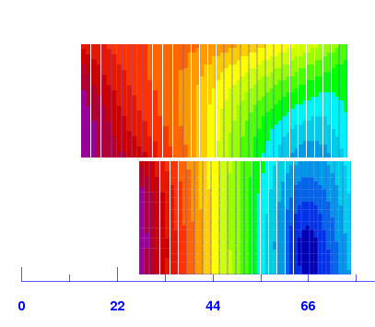
2. relevance to DEMO
R= 13.5 mm
R= 34 mm
 |  | Strands | D_{strand} | CU/SC | Width | Thickness
 |  | (-) | (mm) | - | (mm) | (mm)
Option 1: Same width LF and HF | DEMO HF | 44 | 1.10 | 0.8 | 25.700 | 2.002
 | DEMO LF | 56 | 0.85 | 1.2 | 25.700 | 1.547
Option 2: Best width LF and HF | DEMO HF | 44 | 1.10 | 0.8 | 25.958 | 2.002
 | DEMO LF | 56 | 0.85 | 1.2 | 25.475 | 1.547

Slide 8
HFM – what is it ?
A reinforced, comprehensive R&D programme for superconducting High-Field Magnets, as key technology for future accelerators (hadron colliders, muon colliders, neutrino beams, etc.) and detectors, with great potential for wider societal applications
Budget increased from 2021 to 2024, to reach steady state as of 2026
Covers all SC high-field magnet R&D activities at CERN, including FCC and High-Temperature Superconductors (HTS) under one roof and budget line to maximise synergies
Goals (ambitious) for next ESPP (~2026):
  Nb₃Sn: demonstrate technology for large-scale accelerator deployment
  HTS: demonstrate suitability for accelerator magnet applications

Slide 9






European Strategy for Particle Physics 2018-2020
An Ambitious
LTS Magnet Roadmap
European Strategy for Particle Physics 2025-2027
2020
2021
2022
2023
2024
2025
2026
2027
SMC, RMC, RMM
DEMO
Falcon
R2D2-FD
F2D2
Models and prototypes
RMC-CC
CCT
Gate: Evaluate design options for ultimate Nb₃Sn performance (16 T)
VE dipole
Models and prototypes
Gate: Demonstrate technology for large scale, ultimate Nb₃Sn accelerator magnets

Slide 10

European Strategy for Particle Physics 2018-2020
An Ambitious
HTS Magnet Roadmap
European Strategy for Particle Physics 2025-2027
2020
2021
2022
2023
2024
2025
2026
2027
Conductor R&D (HTS Open Lab ?)
Small Coils Technology R&D
DEMO 20T magnet design
Clover leaf
Stand-alone magnet R&D
Eu2 inserts
Insert magnet R&D
FRESCA2 to Bdg. 163
HTS IR quadrupole magnet design
Eu/Eu2 inserts
HTS magnet R&D
Small coils, HTS tests (Superbend)
New high field test station
Gate: Select options for HTS magnet design
Gate: Assess suitability of HTS for accelerator magnets applications

