Slide 1


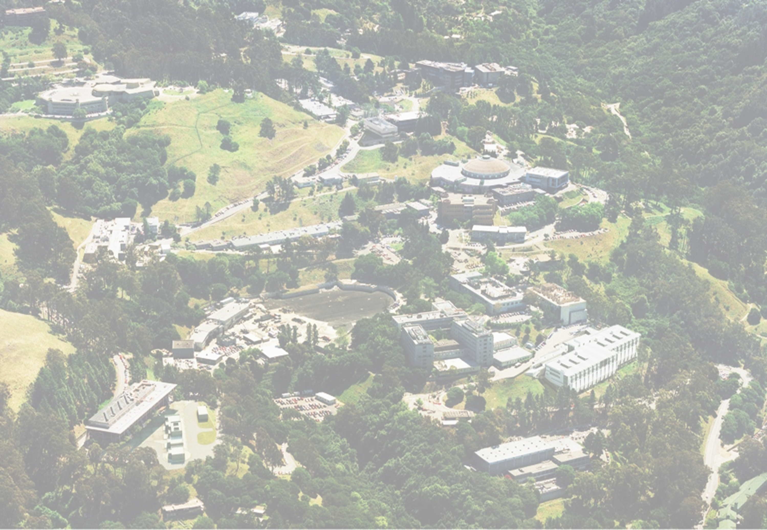
G. Sabbi, LBNL
TFD Conceptual Design Review
June 11, 2020
Test Facility Dipole Design Overview

Slide 2
Presentation Outline
User requirements
Test facility interfaces and specifications
Past development of large bore, high field Nb₃Sn dipoles for HEP and FES
  How we are incorporating this experience to accelerate the TFD development and reduce risk
Performance targets and optimization strategy
Design status and highlights
Summary

Slide 3
User Requirements
Two main sources:
HEPdipo study (EDIPO upgrade at PSI)
US user survey
Key US input on applied magnetic field (§2)
“Highest possible field”: ≥15 T with Nb₃Sn at 1.9 K
Test well geometry:
Aperture: minimum 140x90 (HxV) mm (150x100 mm preferred) with superimposed round 106 mm diam.
Uniform (1%) length: 0.6-1 m
Superimposed AC field and fast-ramped background field are not a priority

Slide 4
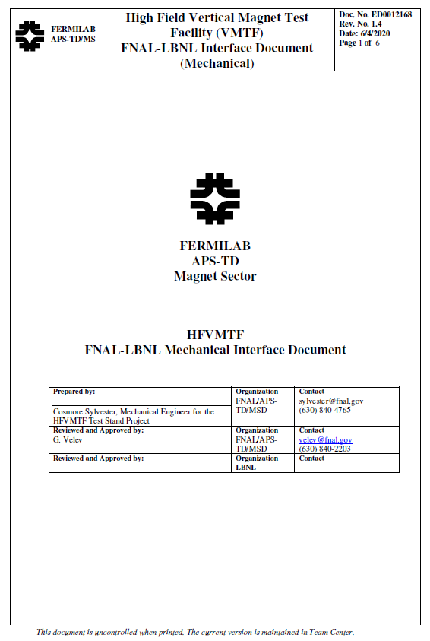
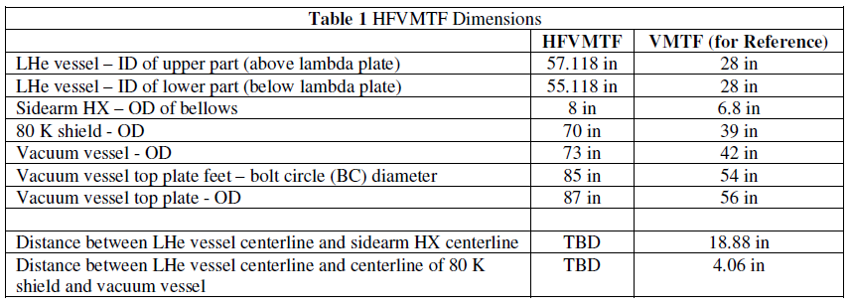
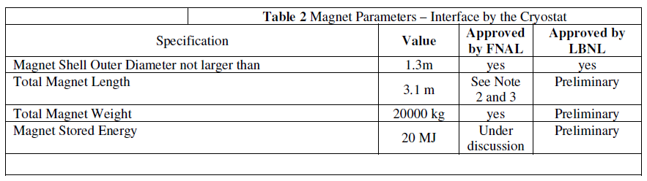
Test Facility Interfaces and Specifications
Discussions between LBNL and FNAL teams are ongoing as the design of magnet and facility is in progress
  Mechanical interfaces (magnet dimensions, weight, supports)
  Electrical interfaces (powering, instrumentation, protection)
Interface document is capturing current status and will evolve in a formal agreement as the design matures and is finalized

Slide 5
Technical Background
The Test Facility Dipole design is based on studies and development of large aperture, high field dipoles over the past 15+ years:
  LARP studies of HL-LHC “Dipole First” IR (LBNL/FNAL/BNL, 2003-04)
  EFTA Dipole (EDIPO) Design Study (EFDA/CEA/CRPP/FZK/LBNL, 2004-06)
  LD1 magnet design (2009-12) at LBNL
  FRESCA2 magnet development (CERN/CEA/EuCARD, 2010-2018)
  HEPdipo design study (CERN/PSI/F4E/LBNL, 2017+)
We are taking full advantage of these efforts and experience to accelerate the TFD development and decrease risk in a broad range of areas, in particular:
  Winding layout and parameters (LARP, EFDA, LD1/HD, FRESCA2, HEPdipo)
  Coil tooling, parts, and fabrication process (FRESCA2, LD/HD)
  Magnetic, mechanical, protection analysis and validation (FRESCA2, HEPdipo)
However, while building on this experience we are also optimizing the design to reflect the specific TFD requirements, in particular the higher field target

Slide 6
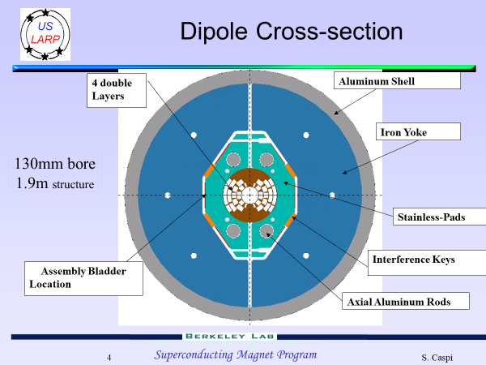
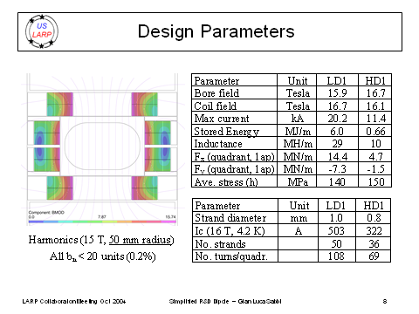
US LARP “Dipole First” IR for HL-LHC
Goal: separate beams next to IP to reduce long range parasitic collisions
Studies performed at the beginning of the LARP program (2003-04)
Operating field 12-13 T with high radiation load (4.5 K, open mid-plane,…)
Large aperture (150x100 mm) for beam separation and radiation absorbers
Alternative coil layouts considered: cosθ, block (LBNL); open mid-plane (BNL)
Discontinued after decision to focus the LARP program on quadrupole R&D
Reference: LARP Collaboration Meeting, Napa, CA, October 2004

Slide 7
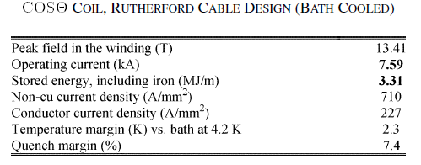
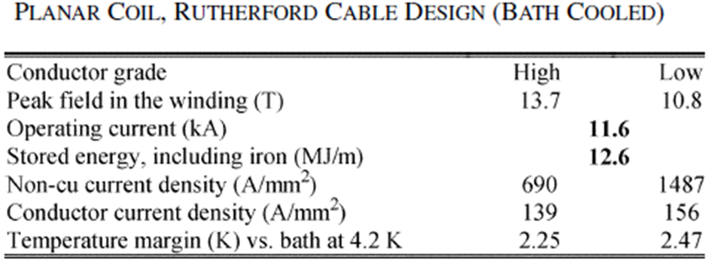
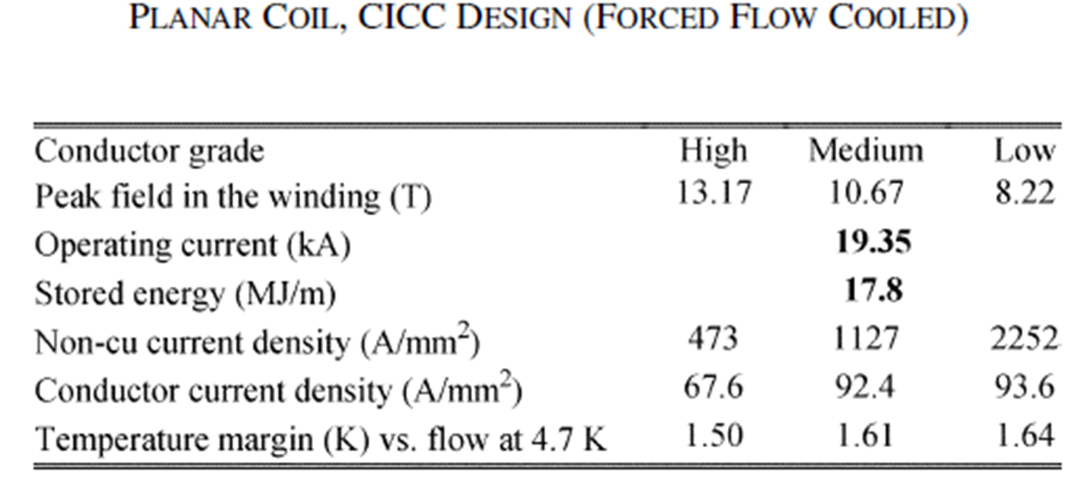
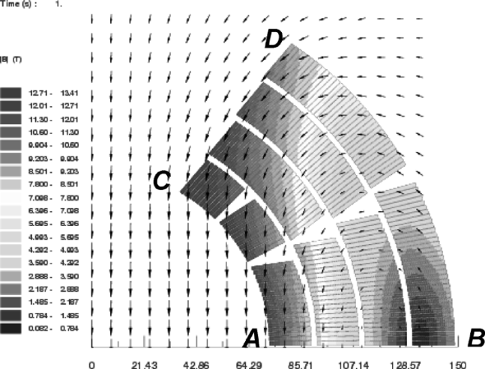
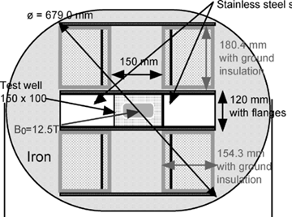
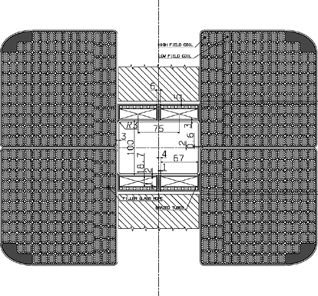
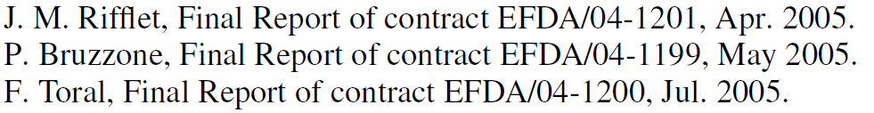
EDIPO Conceptual Design Study
Reference: A. Portone et al., “Conceptual Design of the 12.5 T Superconducting EFDA Dipole” IEEE TASC Vol. 16, No. 2, June 2006, pp. 1312-1315
Three design approaches were considered by a 5-lab team (CEA, LBNL, CRPP, EFDA, FZK/KIT):
Rutherford cable, cosθ coil layout
Rutherford cable, planar (racetrack/block) coil layout
CICC, saddle/block coil layout
Cable in conduit with saddle coil was selected as it was determined that it could provide the required performance with overall lower risk
cosθ
Block
CICC

Slide 8
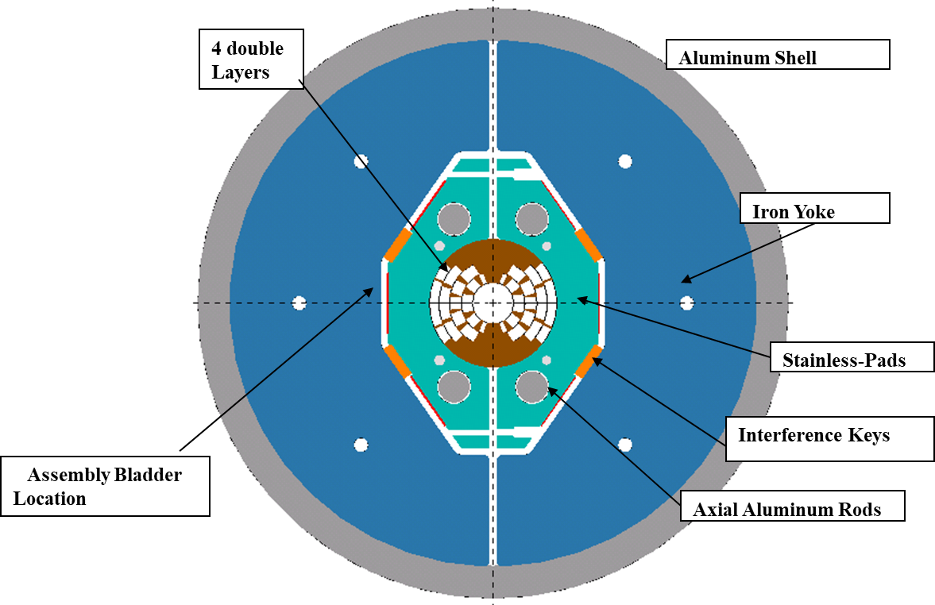
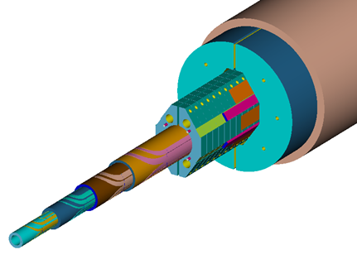
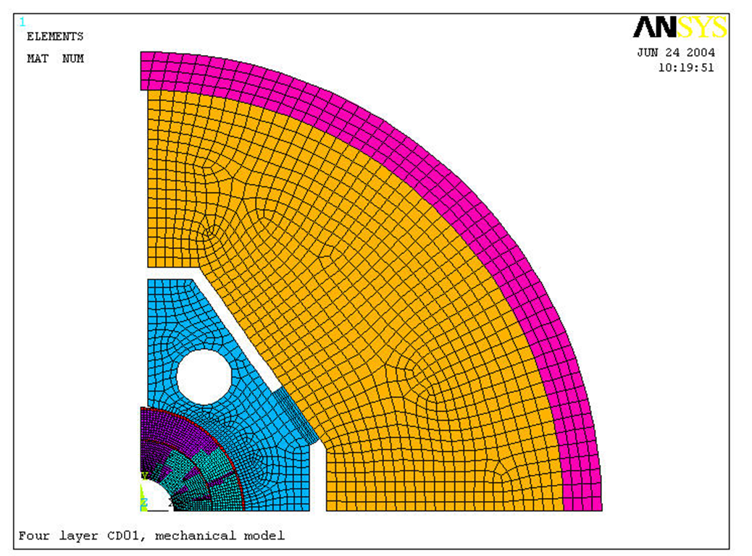
LBNL Cosθ design for “Dipole first”, EDIPO
130 mm round aperture, 15 T target field
Four double-layers of 19 mm wide cable
  Coil stress 140 MPa (cold), 165 MPa (15T)
1.9 m shell diameter, bladder/key structure
References:
S. Caspi et al., “A 14 TESLA DIPOLE for the QA of ITER conductor— conceptual,” LBNL report SC-MAG-840, Jun. 26, 2004.
S. Caspi et al., “Dipole First – A Large bore 15 T Magnet”, LARP CM1, Napa, October 2004
Calculated stress in coils and Al. shell
MPa | Warm | 4.2 K | 15 T
DL 1 | -20 | -42 | -125
DL 2 | -60 | -139 | -105
DL 3 | -30 | -72 | -165
DL 4 | -45 | -105 | -150
Shell | +85 | +195 | +210
S. Caspi, R. Hafalia et al.

Slide 9
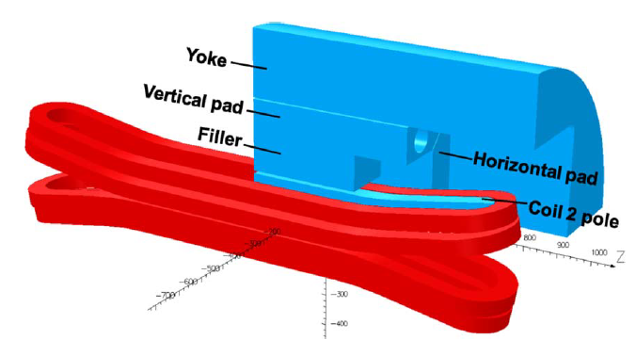
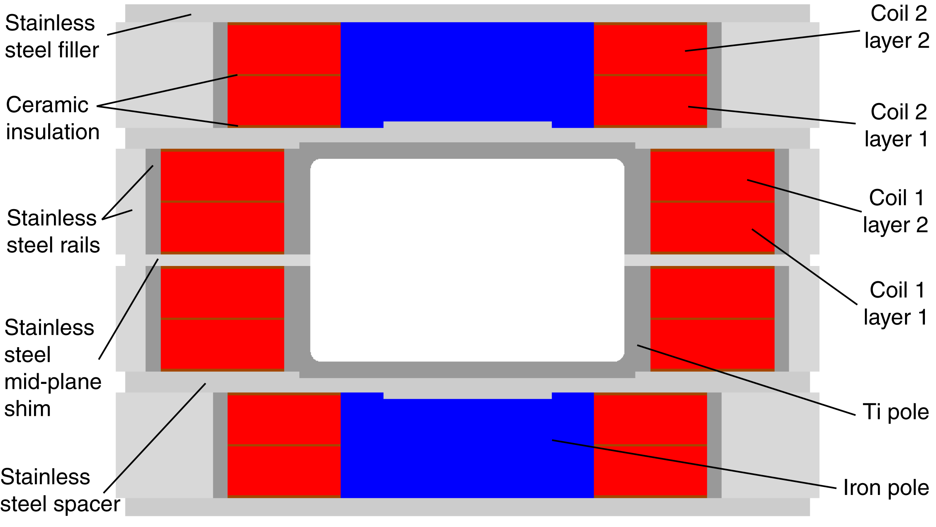
LD1 Design at LBNL
Several proposals for high field cable/insert testing presented to GARD over the years
  LD1 proposal was presented in 2009 and received strong support various HEP and AFRD Reviews
Rectangular bore (144 x 94 mm) for insert coil testing and fusion cable compatibility
Block-coil design was selected because of the rectangular bore and synergies with the ongoing HD2 model development (cable, coil design, fabrication processes)
Received start-up funding from ARRA in 2010 but no follow-up funding
Focus on large coil infrastructure (reaction oven, potting chamber) which now enables fabrication of TFD at LBNL
Also performed magnet design, procured some components (cable, structure)
Ref. P. Ferracin et al., IEEE TASC 22(2), 2012

Slide 10
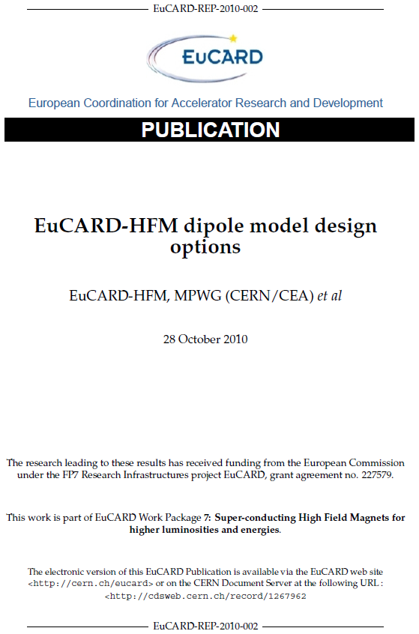
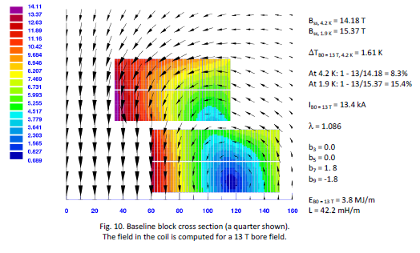
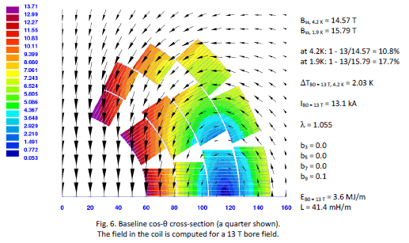
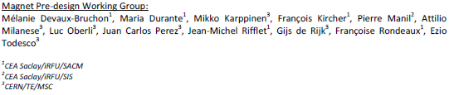
FRESCA2 Design Study
Goal: upgrade of FRESCA facility at CERN
Round bore 100+ mm diameter and 13+ T field
Detailed analysis of cosθ and block design options:
Historical review (in particular D20 and HD2)
Optimization, analysis and comparison of magnetic and mechanical performance based on realistic and consistent (two double-layers) designs of each type
Qualitative comparison: magnetic/mechanical aspects, end geometry, tooling parts and fabrication
Block type layout was selected citing advantages in design and fabrication
Details of design/fabrication/test in P. Ferracin talk

Slide 11
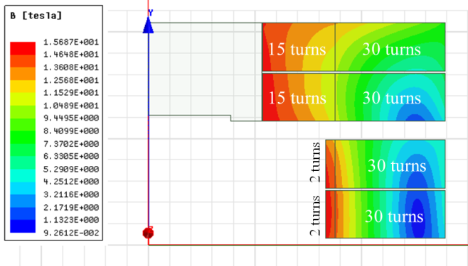
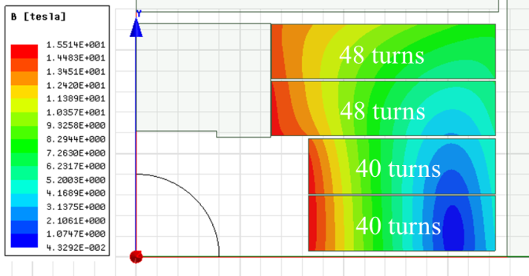
HEPdipo Design Study
The EDIPO magnet was irreversibly damaged in 2017 due to an unprotected quench. The facility infrastructure was not damaged
A collaboration of PSI, CERN, F4E and LBNL was established to study a replacement of EDIPO with a higher field target (14-15 T vs. 12.4 T)
Two main options were considered, both cases used a racetrack (block/saddle) coil layout with either an upgraded CICC or Rutherford cable
  Based on FRESCA2 design choice and further supported by rectangular vs. round bore
Field increase for CICC was found to be limited
Both a graded and non-graded Rutherford cable option were considered: non-graded option was preferred to lower risk
Graded (A_{sc}=64 cm²)
Non-Graded (A_{sc}=105 cm²)
Reference: P. Bruzzone et al., “Conceptual Design of a Large Aperture Dipole for Testing of Cables and Insert Coils at High Field”, IEEE TASC Vol. 28, No. 3, April 2018, Art. # 4005505

Slide 12
Performance Targets and Design Approach
Field: 16 T design target with ~15% margin on the load line at 1.9 K
  Users are interested in the highest possible field, reflected in guidance
  Setting a 16 T goal helps fully optimize the design
  A conservative pre-load target (e.g. 14 T) will be implemented in the first assembly cycle and optimized as needed based on test results
  15 T is used as reference for operation
Coil layout: focusing on block-type, non-graded coil
  Block-coil follows from EDIPO/LD1/FRESCA2 studies, FRESCA2 performance demonstration, and rectangular bore
  Non-graded coil can reach 16 T at 85% SSL (1.9K) with less development time/risk
  Field quality at the ~10 unit level for consistent comparison of options
Coil engineering, parts, tooling and fabrication procedures will be based on FRESCA2 experience (see talks by P. Ferracin and R. Hafalia)
Larger/rectangular aperture and higher field leads to a different design optimization relative to FRESCA2
  Mechanical performance is the main driver and determines the detailed design of the coil geometry, bore structure, inter-coil spacers etc.

Slide 13
Design status
Wire: highest J_{c}/I_{c} desired: considering modified 108/127 or FCC 169 (I. Pong)
Cable: target 44 strands, 1.1 mm; alternative 48 strands, 1 mm as a backup option following FRESCA2 and HD/LD experience (I. Pong)
A non-graded coil layout was selected over graded coil after comparing performance potential and fabrication challenges (D. Arbelaez)
Energy extraction can provide safe magnet discharge after a quench in terms of voltages and hot spot temperatures (D. Arbelaez)
Mechanical optimization resulted in safe coil stresses at all steps with 16 T preload and strict criteria on allowed tension at the pole (G. Vallone)
Two non-graded block coil layouts - “LD” and “FRESCA2” - were compared and the LD layout was selected (D. Arbelaez, G. Vallone)
Bore structural design meets aperture requirements but further optimization will be performed taking into account user feedback (G. Vallone)
CAD models are consistent with dimensional/weight limits agreed upon with the test facility. Some reduction in length is expected with further optimization (R. Hafalia)
FRESCA2 provides a solid basis for TFD design approach, performance expectations, coil tooling and fabrication processes (P. Ferracin, R. Hafalia)

Slide 14
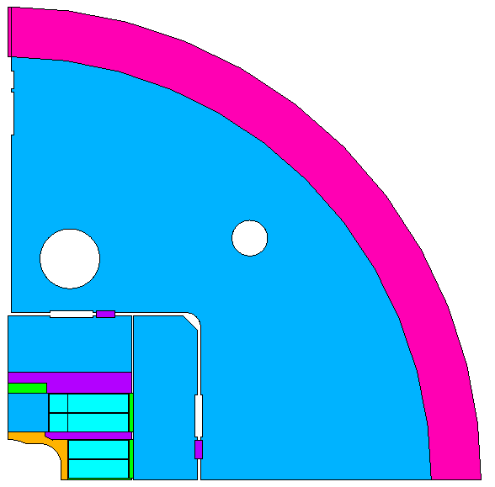
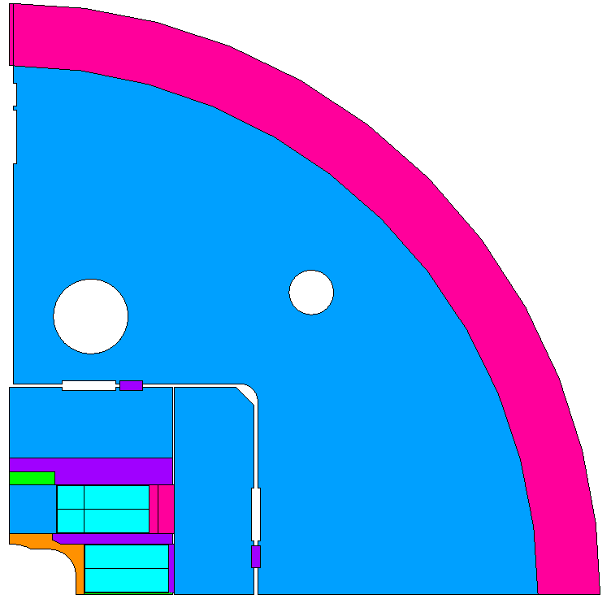
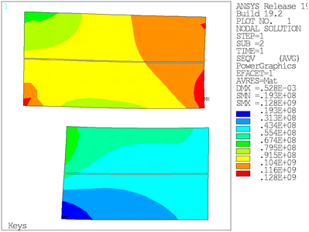
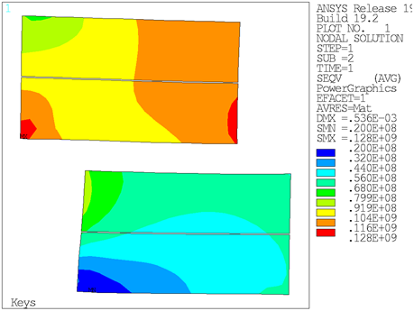
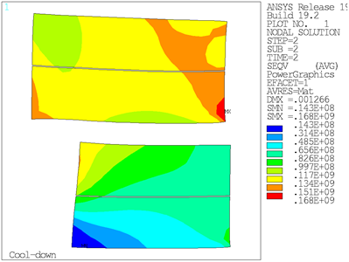
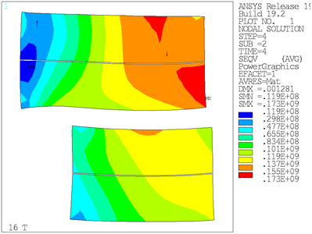
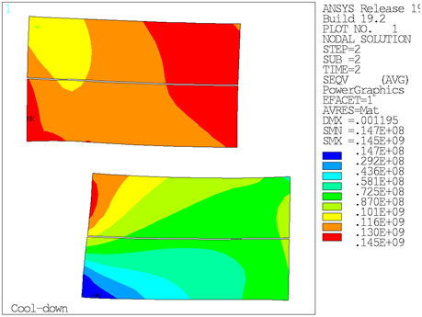
Design Highlights: Mechanical Optimization
With stringent design criteria on coil stress, maximum pole-coil tension and material limits
“FRESCA2”
“LD”
Max stress at R.T.: 128 MPa
Max stress at cold: 168 MPa
Max stress at 16 T, in high field region: 122 MPa
Max stress at 16 T, in low field region: 173 MPa
Max stress at R.T.: 128 MPa
Max stress at cold: 145 MPa
Max stress at 16 T, in high field region: 131 MPa
Max stress at 16 T, in low field region: 166 MPa

Slide 15
Summary
Magnet specifications, performance targets and test facility interfaces have been defined and documented
  Several parameters are still specified as ranges and will be finalized during the final design phase
We are taking full advantage of the extensive technical background provided by previous design and development of large aperture, high field Nb₃Sn dipoles
  Analysis and comparison of different design options
  Design of coil parts, tooling, and fabrication processes
  Support structure
Building on this past work, we have been able to make further improvements in critical areas, particularly regarding coil stress
  16 T pre-load under strict design criteria on allowed tension
  < 150 MPa at cool-down (near pole); < 170 MPa at 16 T (in the low field area)
Review feedback is required to transition from conceptual design phase to detailed/final design and magnet engineering

