Slide 1
FRESCA2 experience
Paolo Ferracin
TFD CDR review
05/11/2020
Lawrence Berkeley National Laboratory

Slide 2
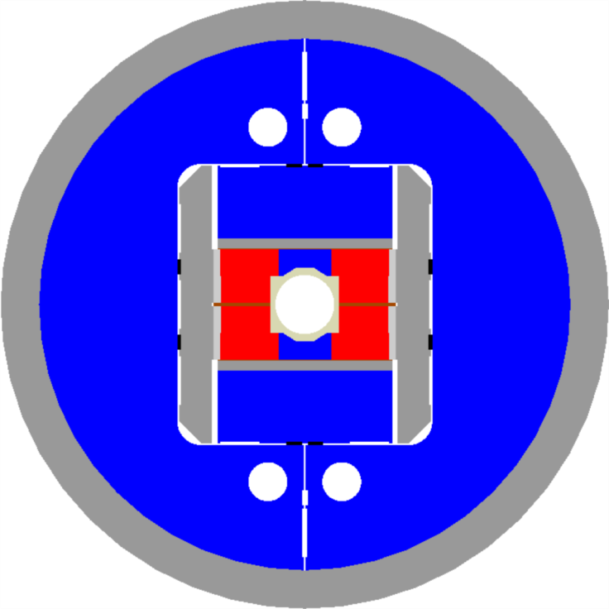
FRESCA2 overview
Developed within a collaboration between CEA Saclay and CERN
  Started within the European project EuCARD (European Coordination for Accelerator R&D)
    R&D on new technologies for future upgrades of the European accelerators
Key objectives
  Nb₃Sn dipole magnet
  13 T
  100 mm clear bore

Slide 3
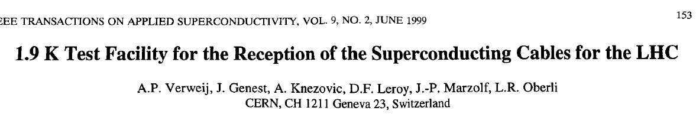
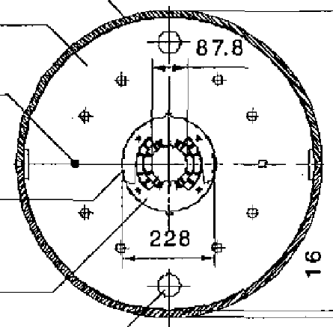
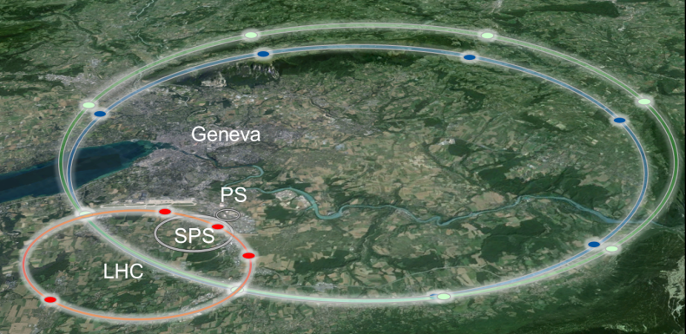
FRESCA2 motivation
Upgrading the cable test facility FReSCa
  88 mm → 100 mm
  10 T → 13 T bore field
  Nb-Ti → Nb₃Sn superconducting technology
Provide the background field for an HTS coil
  R&D towards 16-20 T superconducting magnets
HE/LHC
27 km, 20 T
33 TeV
HE/LHC
80 km, 20 T
100 TeV
HE/LHC
100 km, 16 T
100 TeV

Slide 4
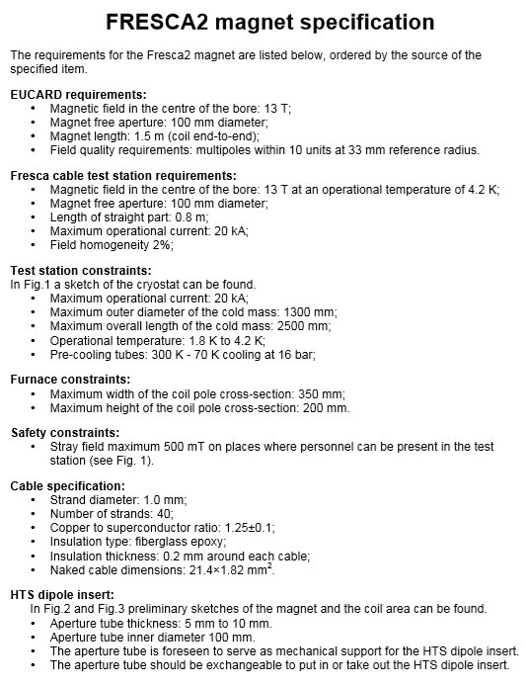
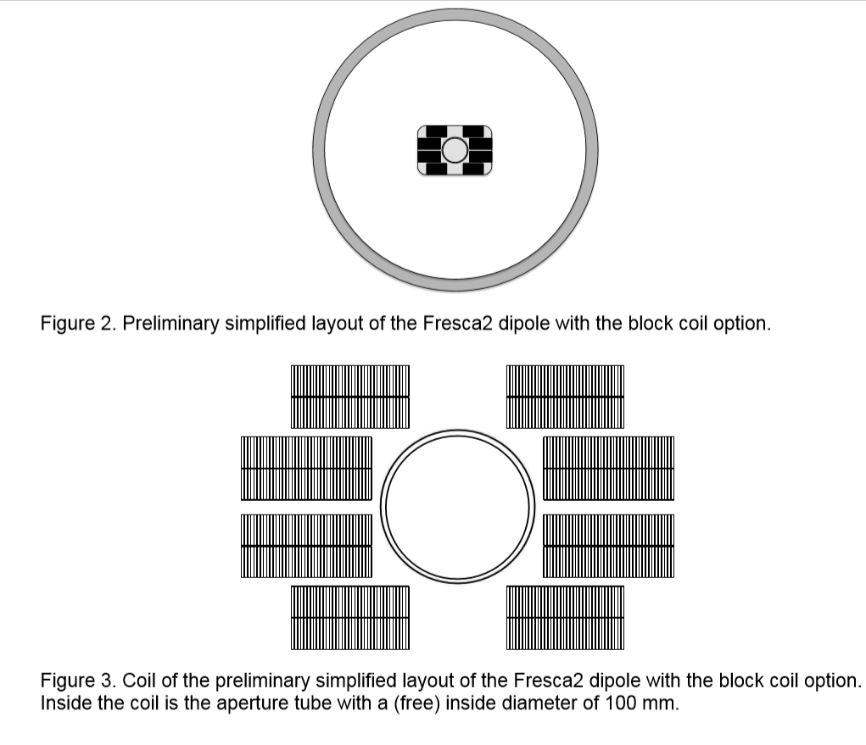
FRESCA2 specifications and early design (02/2010)

Slide 5
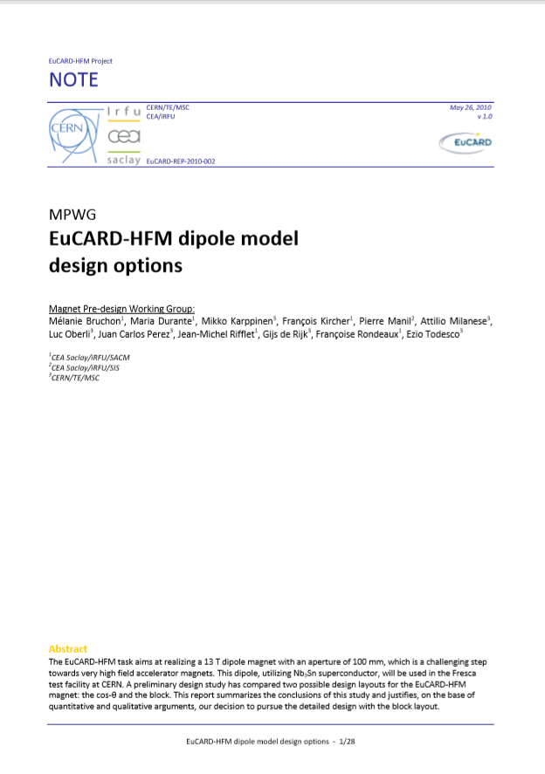
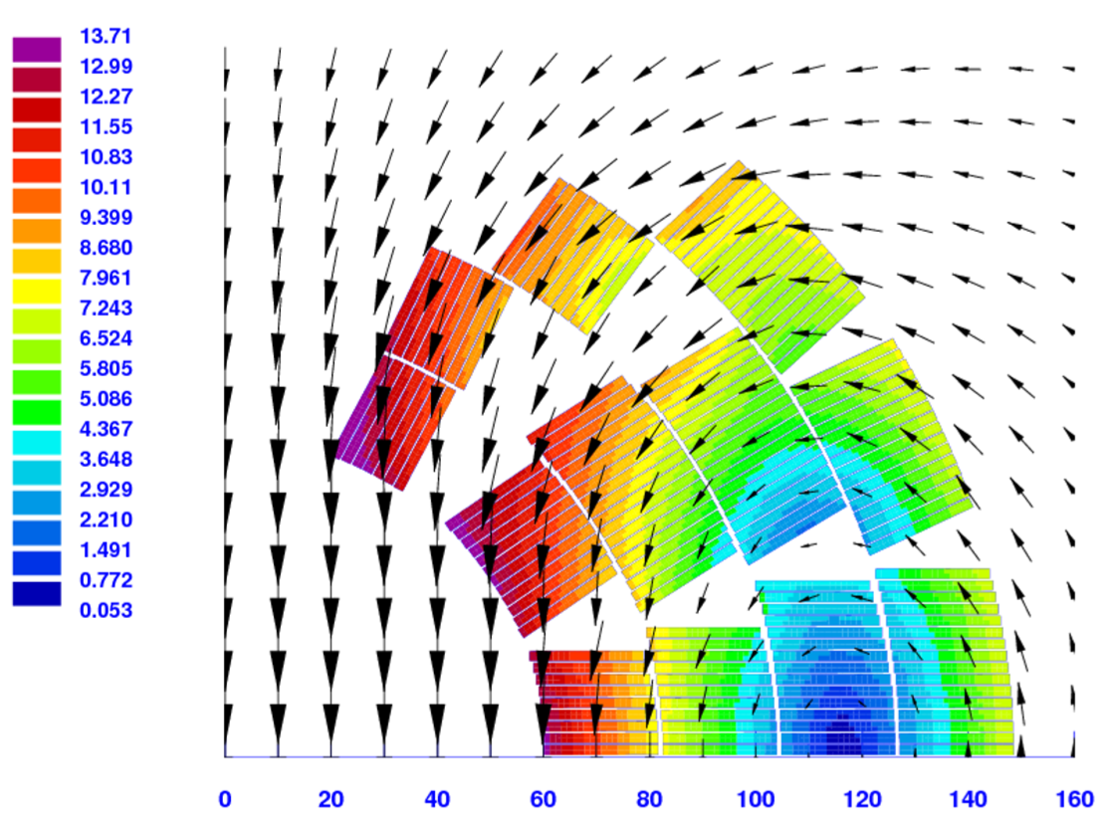
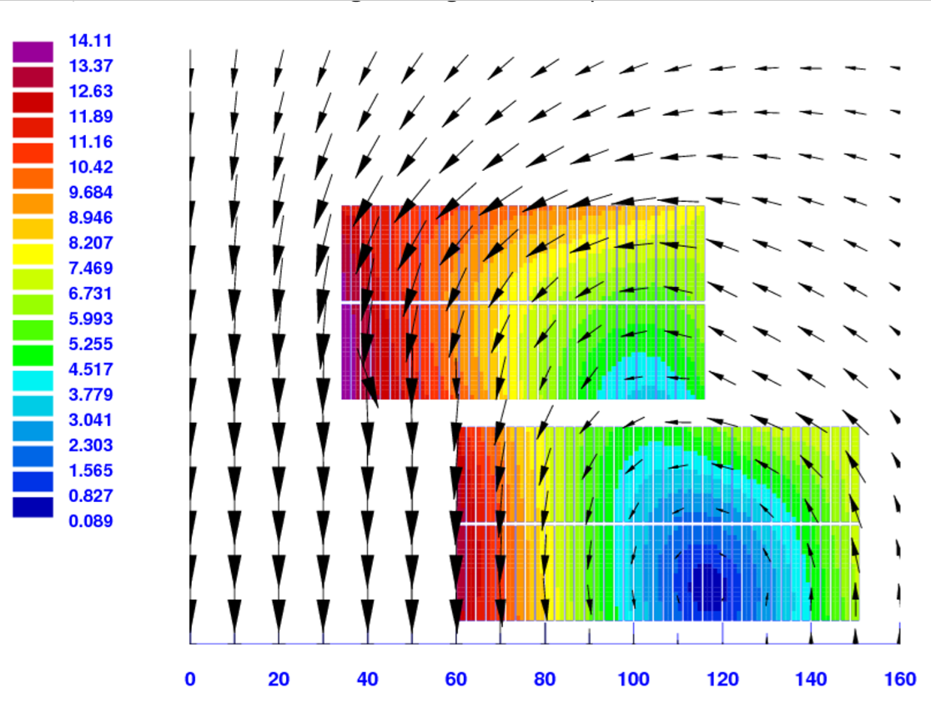
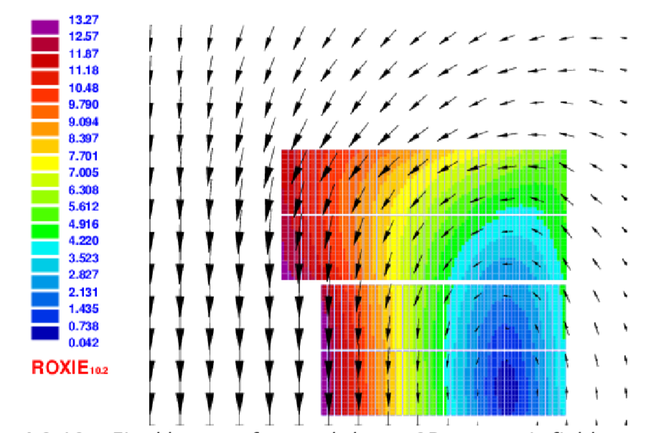
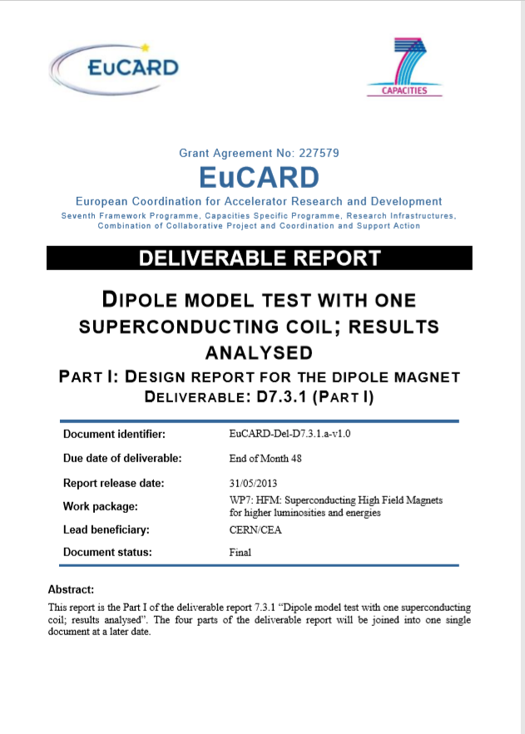
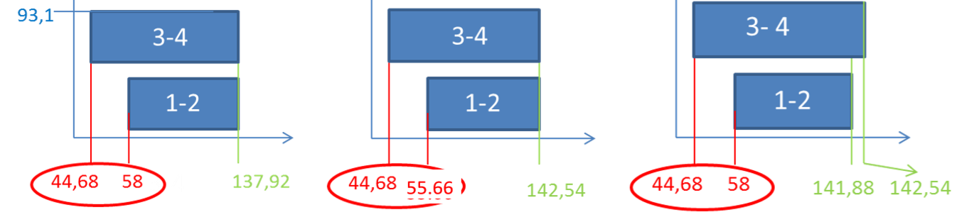
Coil design options investigated
Several coil cross-sections analyzed and compared
  Maximum field, field quality, peak stress
  Fabrication and tooling design
Block-type design (aligned) selected for stress in low field area, tooling design, sensitivity to tolerances, experience from HD2

Slide 6
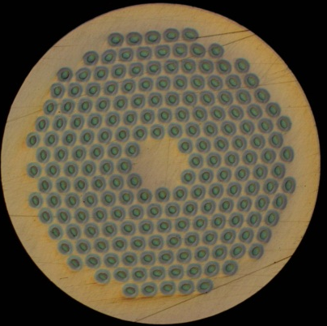
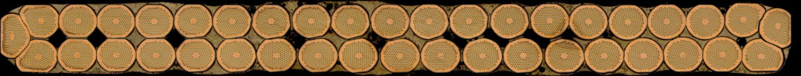
Magnet design and parameters
Superconducting wire and cable
RRP (132/169) and PIT (192)
Strand diameter: 1 mm
Cu/Sc: 1.2 → 54.5% Cu
Strand #: 40
Bare width after cabling
  20.90 mm
Bare thickness after cabling:
  1.82 mm
Braided insulation: 0.16 mm
PIT strand
RRP strand

Slide 7
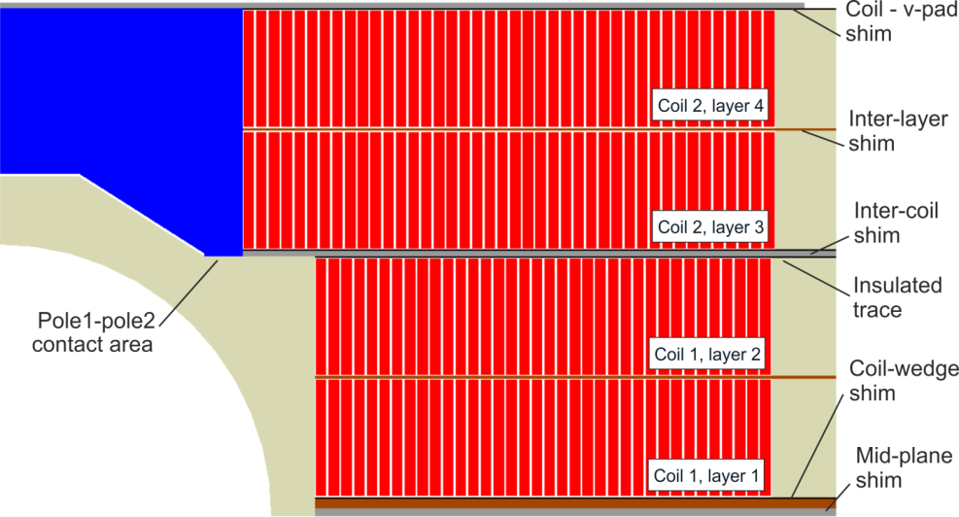
Magnet design and parameters
Coil design
Two double-layers
  36 and 42 turns
Bore aperture 100 mm
Iron and Ti poles
730 mm of straight section
  1% homogeneity over 540 mm and 2/3 of aperture
Hard-way bend of 700 mm minimum radius
  17° inclined ends
Overall coil length of 1.6 m
  Magnetic length 1.2 m

Slide 8
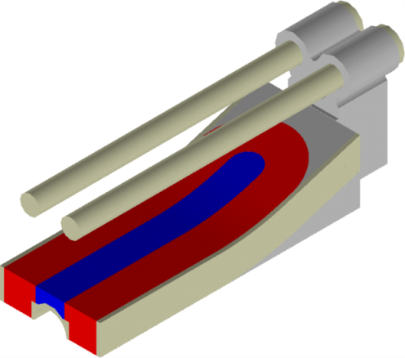
Magnet design and parameters
Support structure
OD: 1.030 m; length: 2.255 m
Al shell, 65 mm thick, 1.6 m long
Bladder and key pre-load
  Similar to LBNL HD2 concept
Iron yoke
  Holes for axial rods
  Bladder slots
Horizontal stainless steel pad
  3 bladders, 75 mm wide
  2 load keys
Vertical iron “boat”
  2 bladders, 60 mm wide
  2 load keys
Al rods and end-plate for axial support

Slide 9
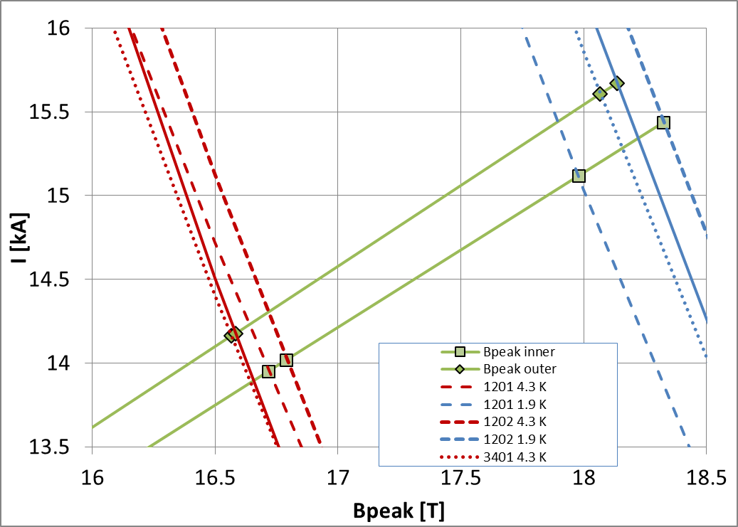
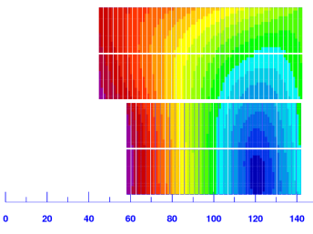
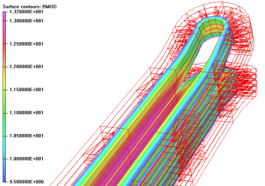
Magnet design and parameters
Operational current and margins
Only RRP coils (5) were tested
J_{c} (4.2 K, 12 T): ~2950 A/mm²
Short sample limits computed with data from extracted and witness samples (with self-field)
Peak field in Layer 1
10% of margin in the ends

Slide 10
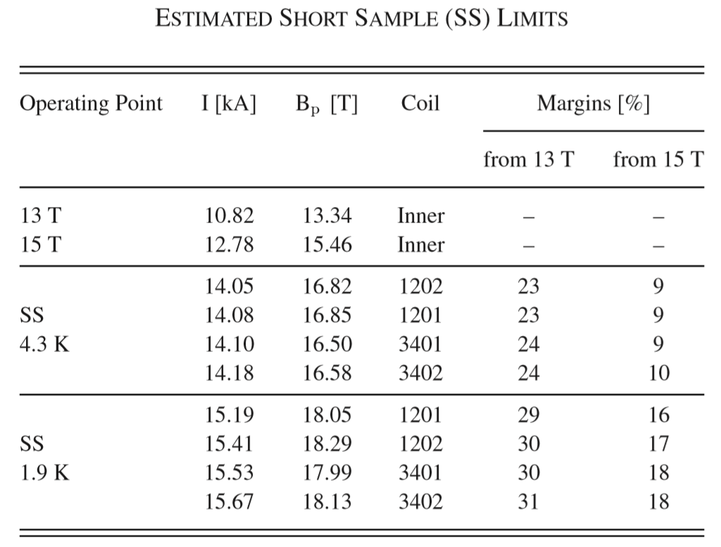
Magnet design and parameters
Operational current and margins
Operational condition (13 T)
  I_{op}: 10.82 kA
  B_{peak_op}: 13.34 T
  77% of I_{ss} at 4.3 K
  71% of I_{ss} at 1.9 K
15 T bore field (“ultimate”)
  I_{ul}: 12.78 kA
  B_{peak_ul}: 15.46 T
  91% of I_{ss} at 4.3 K
  84% of I_{ss} at 1.9 K
Max I reached
  1.9 K: 12.1 kA
  4.3 K: 11.5 kA

Slide 11
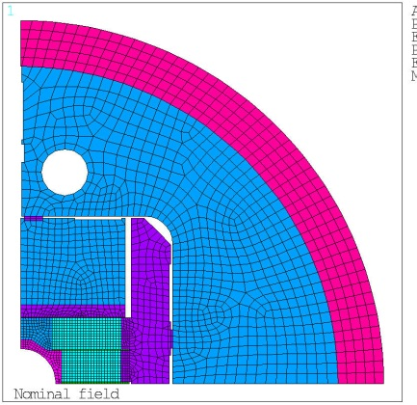
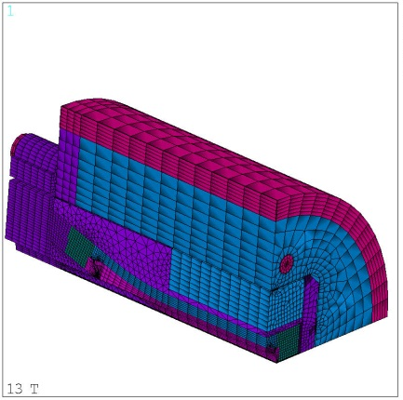
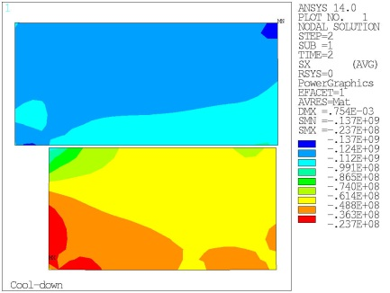
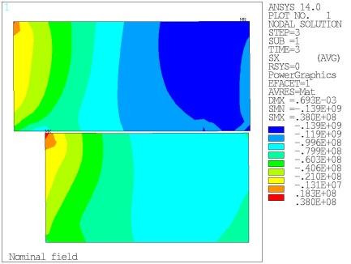
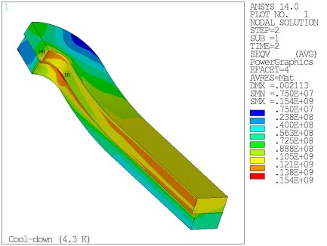
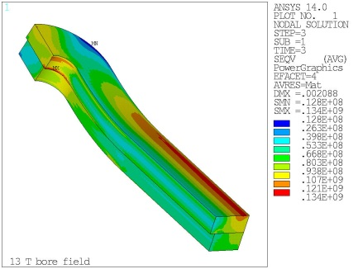
Magnet design and parameters
Mechanics
2D and 3D mechanical model
Goal: contact pressure (or tension <20 MPa) between pole turn and pole pieces
  From straight section to hard-way and easy-way bent
Coil peak (equiv.) stress
  140-150 MPa
  Maximum stress moves to low field region at full field
-137 MPa
-139 MPa
154 MPa
134 MPa

Slide 12
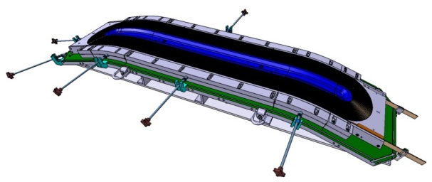
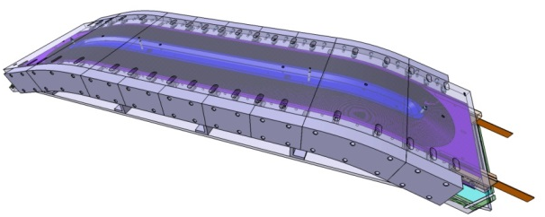
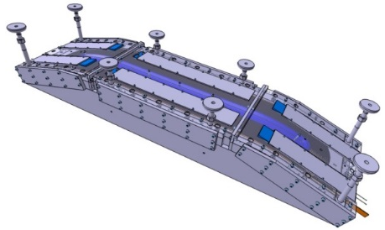
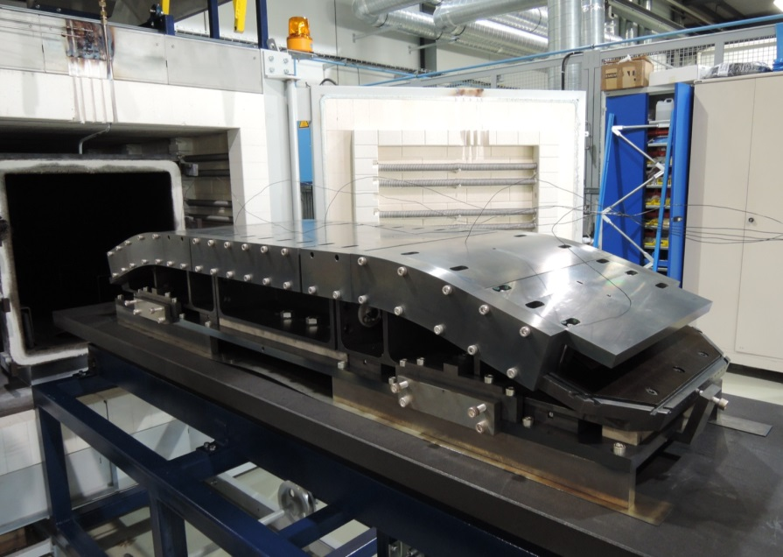
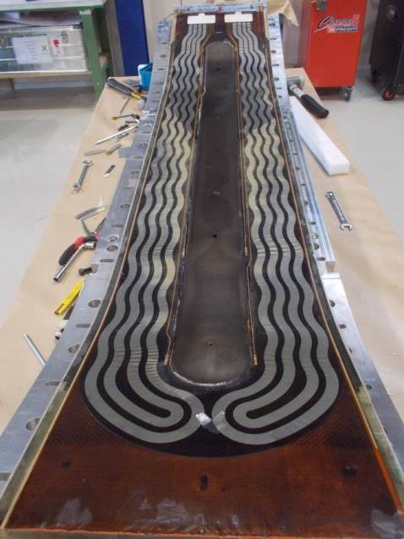
Coil fabrication steps
(See Ray Hafalia’s talk)
Winding (CEA), reaction (CERN),
instrumentation/splicing/impregnation (CERN)

Slide 13
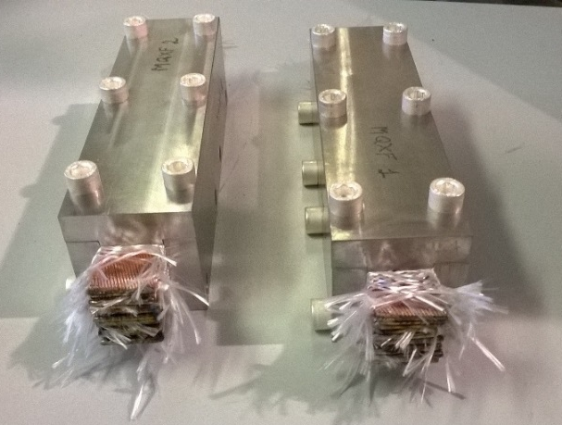
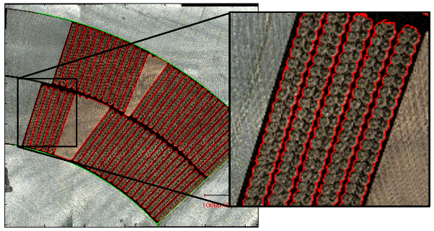
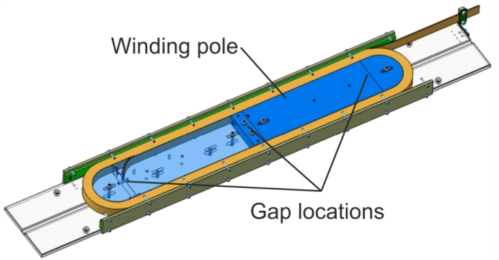
Cable volumetric change during heat treatment
Cable/coil size after reaction is critical
  Issue in HQ01
Studied on single cables, stacks, coil cross-section
  Image analysis of cable contours
Dedicated “few turns” coils
  Specifically for FRESCA2
Consistent data from different set-ups, labs, and coils

Slide 14
Cable volumetric change during heat treatment
Overall volume expansion: +3.0 to 3.5%
Single strand
  +3.5% in volume
    +3.4% in area
    +0.1 in length
Bare cable (or loose insulation)
  +3.5% in volume
    +3.0% in thickness
    +1.0% in width
    -0.5% in length
Braided cable
  +3.0 to +3.5% in volume
    +3.0% in thickness
    +0.0 to +0.5% in width
    -0.2 to 0.0% in length
Dependence on tooling and braiding

Slide 15
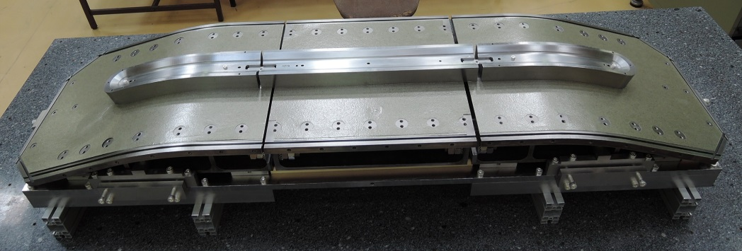
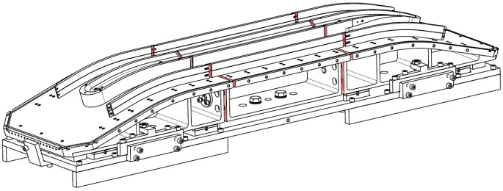
Cable volumetric change during heat treatment
In FRESC2 (and in other magnets) cable dimensional variations during HT included in tooling design
Tests with few turns
Modification of reaction tooling for axial contraction
  2 gaps closed after winding

Slide 16
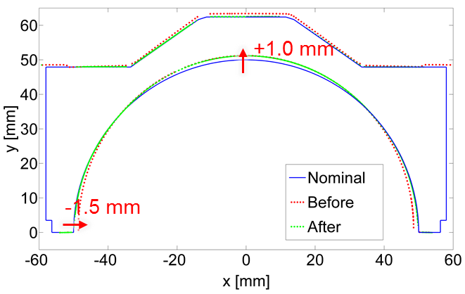
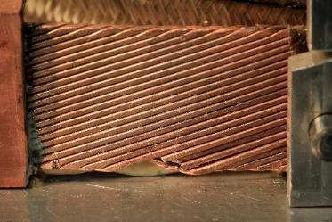
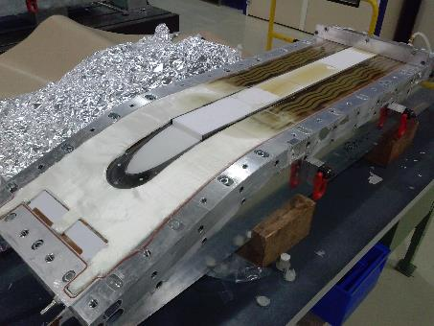
Issues during coil fabrication
Pole deformed after reaction
  Corrective strategy:
    Filler added during reaction
    Re-machined pole
Broken strands during splicing
  Corrective strategy:
    Added Cu stabilizer in damaged area
    Review of splicing procedures
Incomplete impregnation of 2 coils
  Corrective strategy:
    New injection holes and better control of polymerization
    Review of impregnation tooling in the injection area

Slide 17
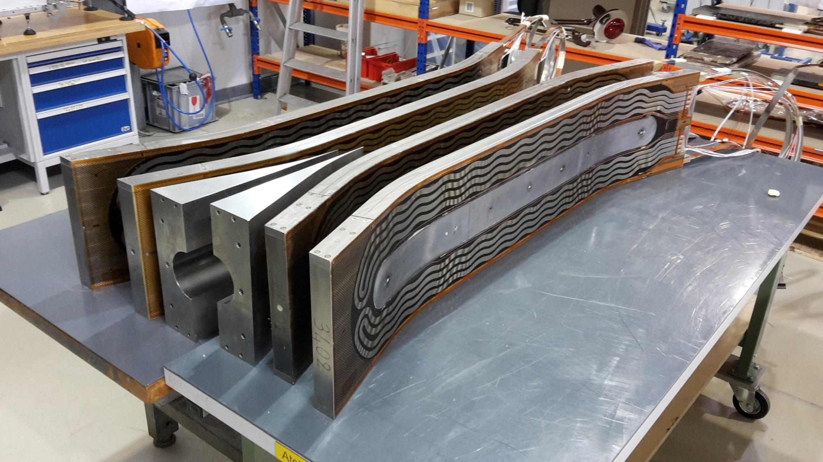
4 coils fabricated and instrumented

Slide 18
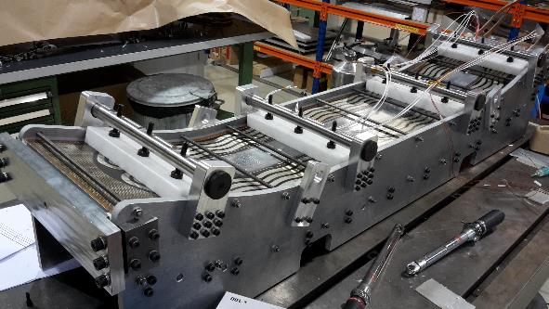
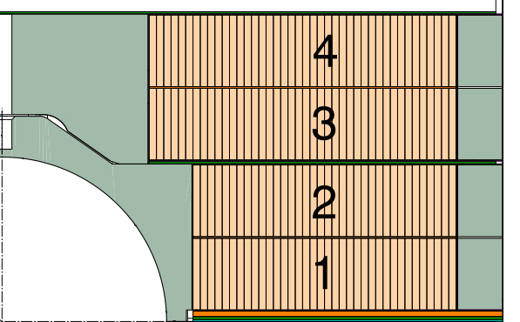
Magnet assembly
Inter-coil tailored shim

Slide 19
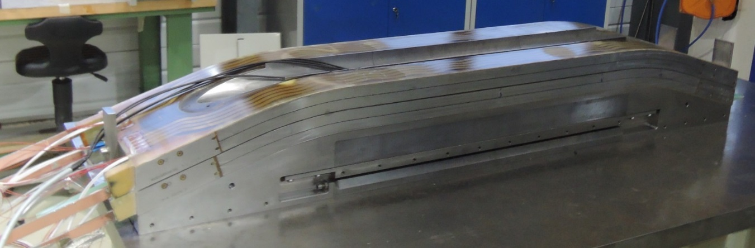
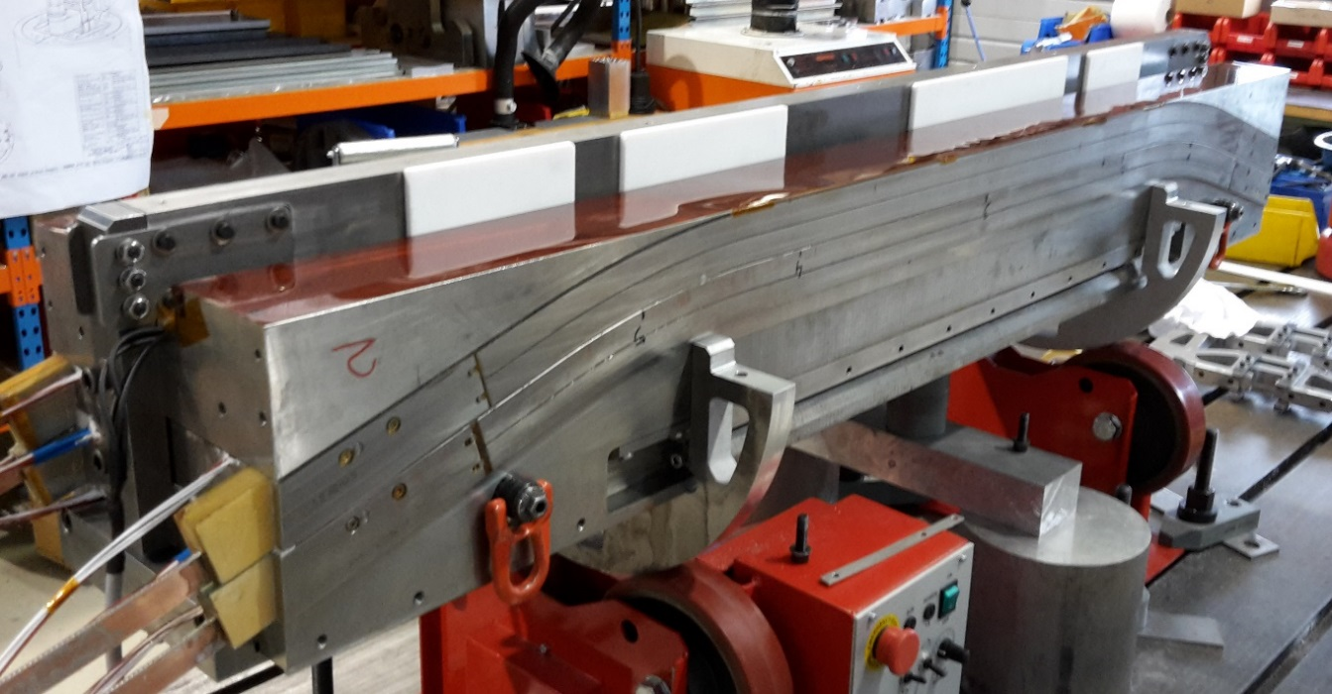
Magnet assembly
1st pole

Slide 20
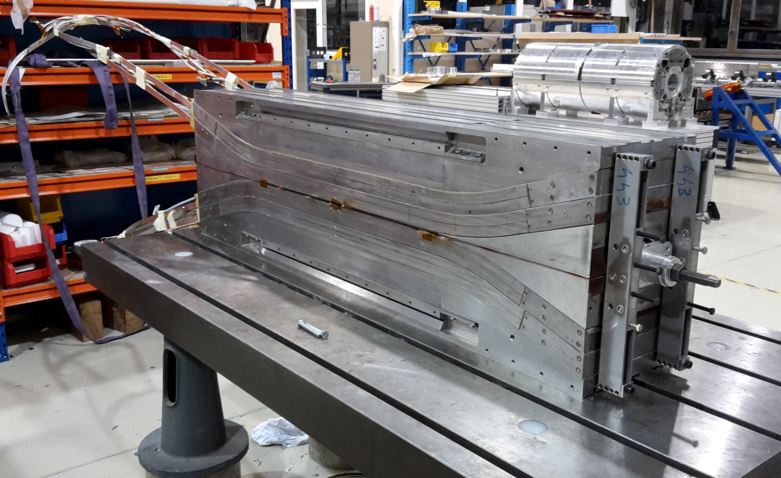
Magnet assembly
Coil pack

Slide 21
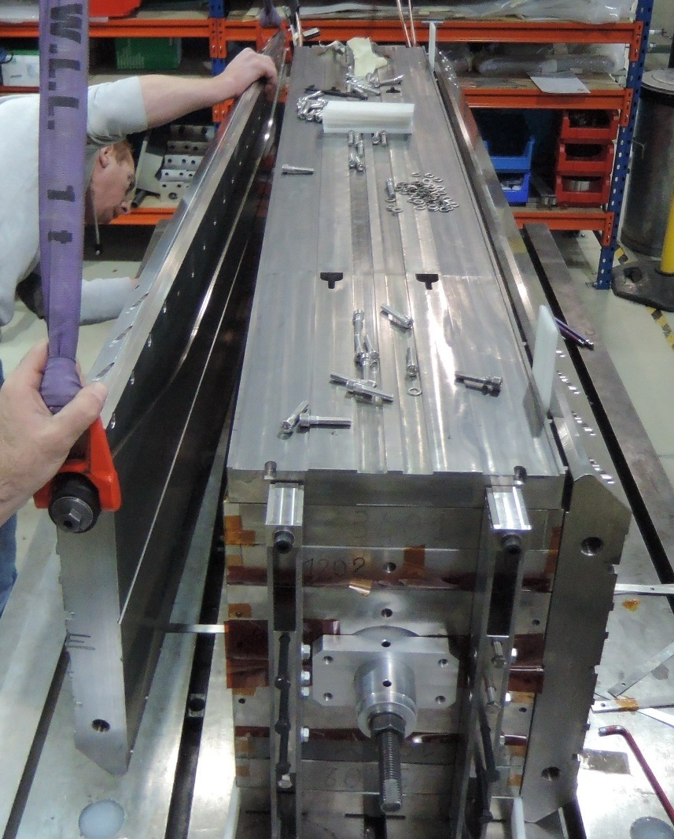
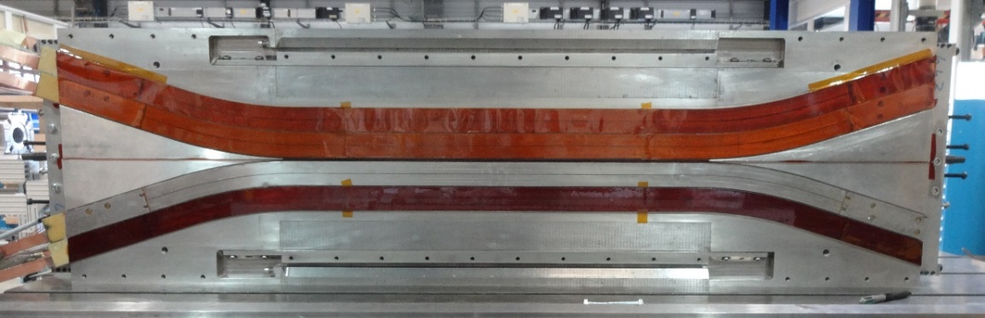
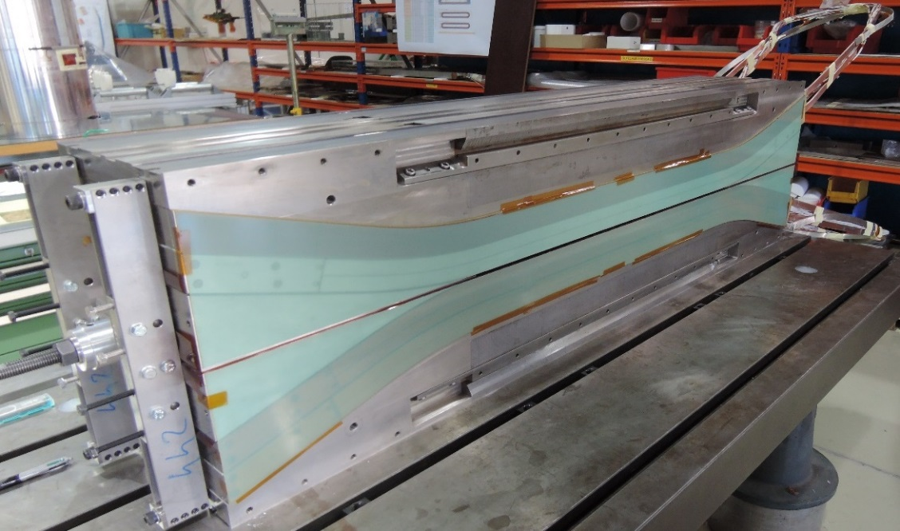
Magnet assembly
Horizontal pads

Slide 22
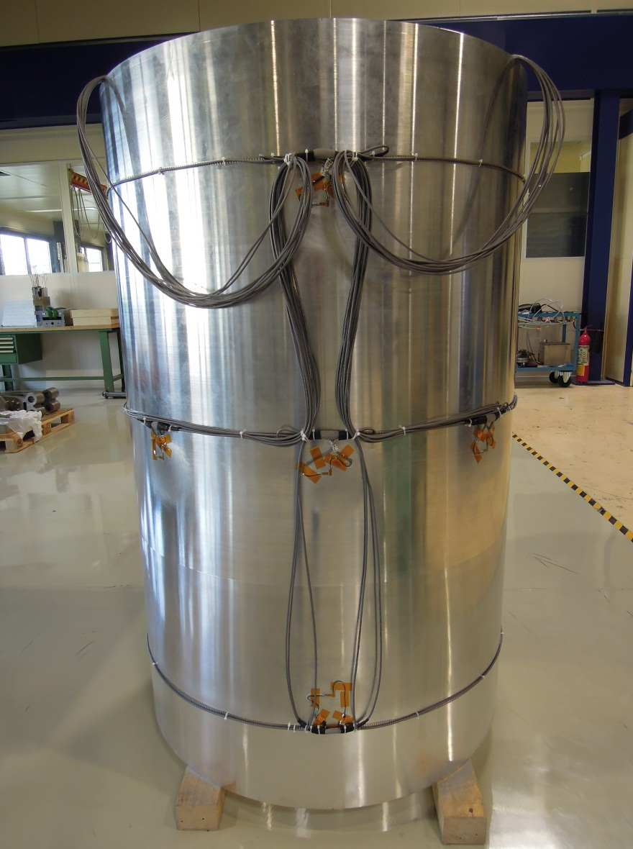
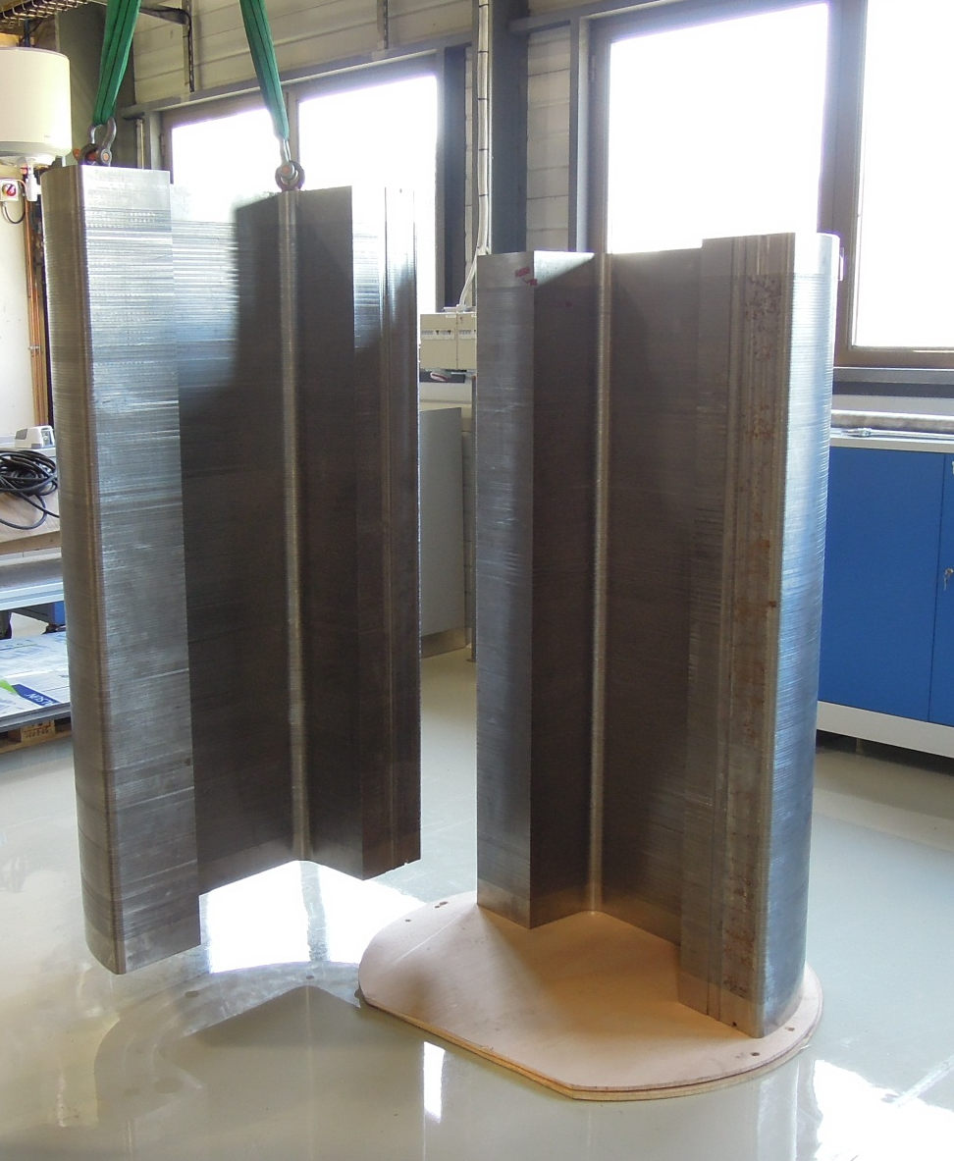
Magnet assembly
Yoke and shell

Slide 23



Magnet assembly
Yoke and shell

Slide 24




Magnet assembly
Coil pack inside the structure

Slide 25


Magnet loading
Transverse loading
bladders & keys
Longitudinal loading
piston & rods

Slide 26

Test results
o 4.2 K
x 1.9 K
Training FRESCA2c at 1.9 K
  3 quenches before reaching 14.4 T
Quench limits
  Quenches with mechanical origin between 14.4 and 14.6 T
Powering at 4.5 K
  Reached 13.9 T
Good memory after thermal cycle
  1 training quench to reach coil limit
Assembly | Date | Preload | Field reached | Comments
FRESCA2a | 02/2017 | 13 T | 12.2 T | Coil 3401 with damaged strands (splice) QH failure in Coil 3401
FRESCA2b | 08/2017 | 13 T | 13.3 T | Coil 3401 replaced by 3403
FRESCA2c | 04/2018 | 15 T | 14.6 T | Full re-assembly Preload increased

Slide 27
Conclusions
The FRESCA2 magnet was successfully tested in 2017
  A record field of 14.6 T at 1.9 K in a 100 mm bore was achieve
The experience of FRESCA2 (and the design work on LD1) has become the basis for HEPdipo conceptual design
FRESCA2 represented an unique opportunity to go from design studies and “small demo” magnets to a complete high-field large aperture magnet
  Fully engineered
  Fabricated
  Successfully tested
The plan is to take full advantage of the experience gained during FRESCA2 development
  Tooling design
  Coil fabrication process
  Assembly-loading procedures

Slide 28
Additional slides

Slide 29

Magnet design and parameters
Quench protection
Stored energy density of 150 MJ/m³
  Comparable to other Nb₃Sn dipoles and quadrupoles
Protection system: dump resistor and quench heaters on all layers
  50% coverage
150 or 200 K of peak T with t_{detection} of 40 or 100 ms
Traces with 4 heaters
  Wiggling shape for better coverage with 12 mm width
9 voltage taps per layer
  Monitor pole turn and external turns

Slide 30


Pole deformation during reaction
CR1201 (1st): Pole deformed during heat treatment because of cable transverse expansion
Adaptation of the impregnation mould + fiber-glass shims to fill the space
Pole re-machined after impregnation
Next inner coils reacted with fillers placed in the cavity
+1.0 mm
-1.5 mm

Slide 31


Strands damaged in a splice
CR3401 (2nd): strands damaged during the splicing operation
Splice had to be done a second time to adapt the coil length
Excess of solder difficult to remove
Additional Cu stabilizer soldered on the damaged area

Slide 32

Impregation issues
Coils CR1201 and CP3403: the resin did not go through
CR1201: premature polymerization
CP3403: insufficient injection
New injection holes in the mould for 2nd impregnation
Coil CR3401: superficial bubbles
Air trapped in the pole cavity
Local injections of resin
Next outer coils impregnated with fillers placed in the cavity

Slide 33
Electrical tests
Resistance and inductance ok
Dielectric tests:
Insufficient coil-to-pole insulation
Pole-to-pole insulation required
Coil discharge ok
QH discharge ok (except inner upper-layer QH of CR1201)
 | V [kV] | R [GΩ]
 |  | 1201 | 1202 | 3401 | 3402
Coil to end-shoe | 0.5 | 21/8.6 | 17/6.8 | 8.8/19 | 11/6.2
Coil to pole | 0.5 | 1.0e⁻³ | 2.7e⁻⁴ | 3.4e⁻³ | 2.1e⁻³
Coil to QH | 2.5 | 1.8e⁻⁶ | 18 | 12 | 20
QH to end-shoe | 1.5 | 12 | 42 | 17 | 43

Slide 34


Magnet loading
ε_{ϑ} shell
ε_{x} coil
ε_{z} rod

Slide 35


Magnet assembly
Connection box

Slide 36


Magnet assembly
Connection box

Slide 37
Quench locations
1
2
Training 1 to 3 start in a high-field pole turn.
Precise quench localisation due to high number of voltage taps in the pole turns.
3
1
2
3

Slide 38
Quench locations
Quench 4 and further are all in the multi-turn voltage segment of coil 3403 lower layer
Could be in any of the 39 turns measured by the voltage segment.
Since it is a single location that seems to quench, we try to find out if it is due to the conductor or induced by mechanical features.

Slide 39

Quench locations
Vibration analysis fully trained magnet
  Highest activity seen by QA 5, consistent with quench locations in the magnet.

Slide 40


2017: pre-conceptual design
 |  |  | Opt 1 | Opt 2
Operational (85% × short sample) | I_{op} |  | 14.4 | 13.5 | kA
 | B_{center test well} |  | 15.26 | 15.06 | T
 | Max B (HF grade) |  | 15.69 | 15.51 | T
 | Max B (LF grade) |  | 14.18 | - | T
 | Stored energy* |  | 1.3 | 1.5 | MJ/m
 | T_{hs} |  | ~350 | 120 | K
 | Lorentz forces (per quadrant) | Total F_{x}* | +12.8 | +12.9 | MN/m
 |  | Total F_{y}* | -7.1 | -7.5 | MN/m
 |  | Total F_{z}* | N/A | 1.5 | MN
Required cable | Area per quadrant |  | 6415 | 10494 | mm²
 | Total required HF length |  | 265 | 1489 | m
 | Total required HF length |  | 1001 | - | m
Option 1:
Graded (New cable + LD1)
Option 2:
Non-graded (FCC cable)
[1] P. Bruzzone et al., "Conceptual design of a large aperture dipole for testing of cables and insert coils at high field", IEEE Trans. Appl. Supercond., vol. 28, no. 3, 2018, Art. no. 4005505.

Slide 41
2017: pre-conceptual design
Conclusions from the pre-conceptual design:
  All 3 design options seem to be feasible:
    Trade-offs between cost and technical risk
  Grading is perceived as a significant technological challenge
  Since 2018 efforts concentrate only on the non-graded option using the high-aspect-ratio cable based on FCC strands
Strand type | FCC
Diameter | 1.1 | mm
Technology | RRP 108/127
Cu:non-Cu | 1
RRR | >150
Min. J_{c} @ 15 T (12 T), 4.2 K | 1640 (3000) | A/mm²
D_{eff,max} | 60 | µm
Number of strands | 44
Bare width* | 26.2 | mm
Bare thickness* | 1.95 | mm
Compaction | 81 | %
Insulation thickness | 150 | µm
FCC strand parameters
EDIPO cable
parameters
*After reaction

Slide 42

2018: Magneto-static design
 |  | Window frame layout | High aspect ratio rect. coil pack
Number of turns / pole |  | 2×38+2×50 | 3×2×32
A_{conductor} / pole |  | 10494 | 11448 (+9%) | mm²
I_{op} (0.85×I_{ss}) |  | 14.43 | 14.11 | kA
Current density (insulated cable) |  | 242.0 | 236.6 | A/mm²
B_{bore} |  | 15.03 | 15.00 | T
Max B_{cond} |  | 15.34 | 15.42 | T
Stored magnetic energy |  | 6.5 | 6.7 | MJ/m
Homogeneous field length (1%) |  | 975 | 977 | mm
Total coil Lorentz force | F_{x} | 13.9 | 14.2 | MN/m
 | F_{y} | -7.6 | -7.2 | MN/m
 | F_{z} | 1.5 | 1.7 | MN
Reluctance force (Vertical pad+ pusher) | F_{x} | -4.3 | -3.0 | MN/m
 | F_{y} | -2.3 | -2.0 | MN/m
[2] X. Sarasola et al., "Magnetic and Mechanical Design of a 15-T Large Aperture Dipole Magnet for Cable Testing", IEEE Trans. Appl. Supercond., vol. 29, no. 5, Aug. 2019, Art. no. 4001405.

