Slide 1
Test Facility Dipole: Magnetic Layout and Preliminary Quench Protection Analysis
D. Arbelaez, D. M. Araujo, P. Ferracin, A. Hafalia, S. Prestemon, GL. Sabbi, G. Vallone
TFD Conceptual Design Review June 11, 2020

Slide 2
Presentation Outline
Conductor assumptions
Brief HEPdipo design review
Graded Design
Non-Graded Design
LBNL Coil Layout Analysis
Aligned Layers (FRESCA II style)
Shifted Layers (LD style)
Preliminary quench protection analysis

Slide 3
Conductor Assumptions
For CDR analysis conductor assumptions are based on Bruker OST RRP 108/127 1.1 mm diameter test strand (HiLumi-1.1)
Analysis has also been performed with conductor assumptions from HEPdipo for comparison with CERN results
Use of HiLumi-1.1 strand for CDR to have a realistic / conservative baseline but not meant to be a decision on choice of conductor at this point
Further analysis and optimization is required before final selection of conductor

Slide 4
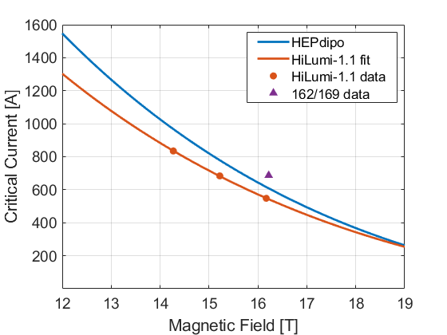
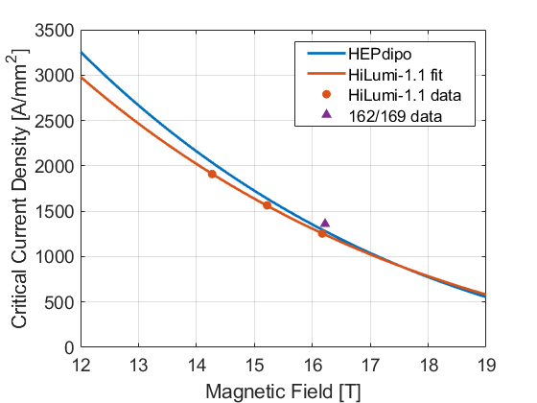
Critical Current Assumptions
Critical Current for 1.1 mm Diameter Wire
Non-Cu Critical Current Density
f_{Non-Cu} = 0.50
f_{Non-Cu} = 0.53
f_{Non-Cu} = 0.46
* Lower performing conductor is used as reference for this stage of the design
* Goal is to achieve higher performance from the conductor

Slide 5
Critical Current Density Scaling Relation
Scaling law from HEPdipo paper is used (IEEE TRANSACTIONS ON APPLIED SUPERCONDUCTIVITY, VOL. 29, NO. 5, AUGUST 2019 4001405)
Fit parameters are derived for OST 108/127 1.1 mm strand using 4.2 K transport current measurements
Critical Current Density Fit Parameters
Parameter | HiLumi -1.1 | HEPdipo
C0 [AT/mm2] | 223900 | 255230
Tc0 [K] | 16.0 | 16.0
Bc0 [T] | 29.8 | 28.8
α | 0.96 | 0.96

Slide 6
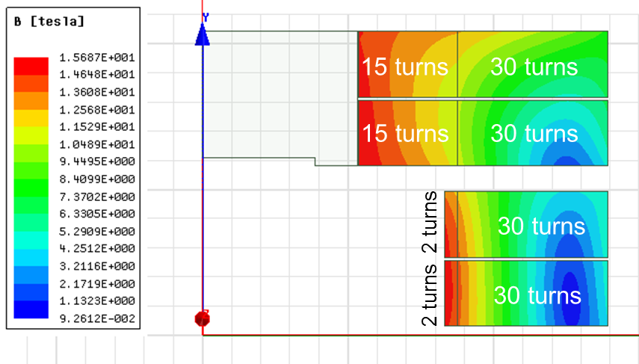
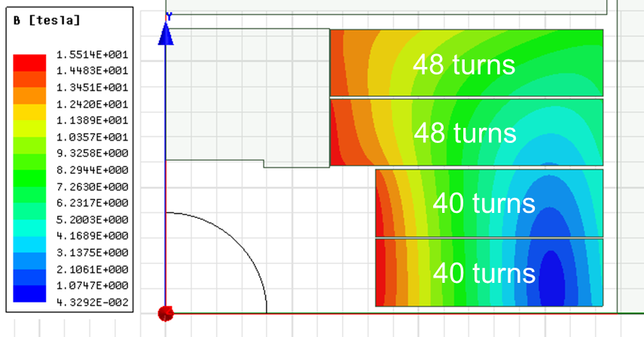
HEPdipo Block Coil Designs
Graded Design
3 options using 2 double-layers per pole were studied [1]
Two graded designs:
New cable (HF) + LD1 (LF)
LD1 (HF) + “MQXF-type” (LF)
One non-graded design:
New high-aspect-ratio Rutherford cable
26.2×1.95 mm cable
44×1.1 mm FCC strands
All 3 design options met the specs
Grading was perceived as a technological risk and was not pursued further
A design option with 3 double-layers per pole was also developed [2]
Non- Graded Design
[1] P. Bruzzone et al., "Conceptual design of a large aperture dipole for testing of cables and insert coils at high field", IEEE Trans. Appl. Supercond., vol. 28, no. 3, 2018, Art. no. 4005505.
[2] X. Sarasola et al., “Magnetic and Mechanical Design of a 15-T Large Aperture Dipole Magnet for Cable Testing", IEEE Trans. Appl. Supercond., vol. 29, no. 5, 2019, Art. no. 4001405.

Slide 7
HEPdipo Option 1: FCC (HF) + LD1 (LF)
Operational (85% × short sample)
I_{op} |  | 14.4 | kA
B_{center test well} |  | 15.26 | T
Max B (HF grade) |  | 15.69 | T
Max B (LF grade) |  | 14.18 | T
Stored energy* |  | 1.3 | MJ/m
Lorentz forces | Total F_{x}* | +12.8 | MN/m
 | Total F_{y}* | -7.1 | MN/m
 | Total F_{z}* | N/A
*Per quadrant
E. Rochepault, X. Sarasola
Required cable
Area per quadrant | 6415 | mm²
HF length required** | 265 | m
LF length required** | 1001 | m
Goals and main features:
Small coil volume, good margin to quench
Reuse LD1 cable units, low Cu/Sc in low field
Challenging mechanics, protection, fabrication
**Refers to the whole magnet

Slide 8
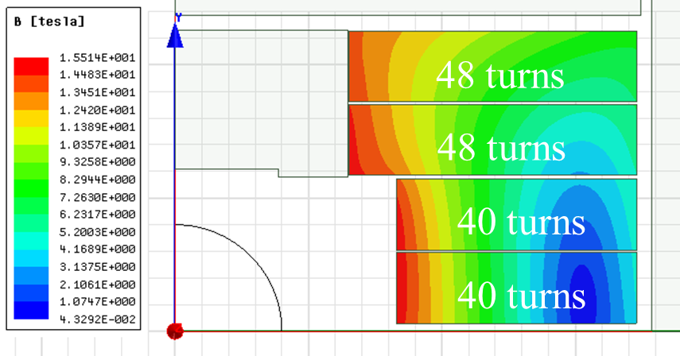
HEPdipo Option 2: FCC, no grading
Operational (85% × short sample)
I_{op} |  | 13.5 | kA
B_{center test well} |  | 15.06 | T
Max B |  | 15.51 | T
Stored energy* |  | 1.5 | MJ/m
Lorentz forces | Total F_{x}* | +12.9 | MN/m
 | Total F_{y}* | -7.5 | MN/m
 | Total F_{z}* | 1.5 | MN
*Per quadrant
E. Rochepault, X. Sarasola
Required cable
Area per quadrant | 10494 | mm²
Length required** | 1489 | m
Goals and main features:
Lower stress, easier protection
No grading, simpler/faster fabrication with lower risk
+60% conductor volume to achieve field/margin
Increased cable UL
**Refers to the whole magnet

Slide 9
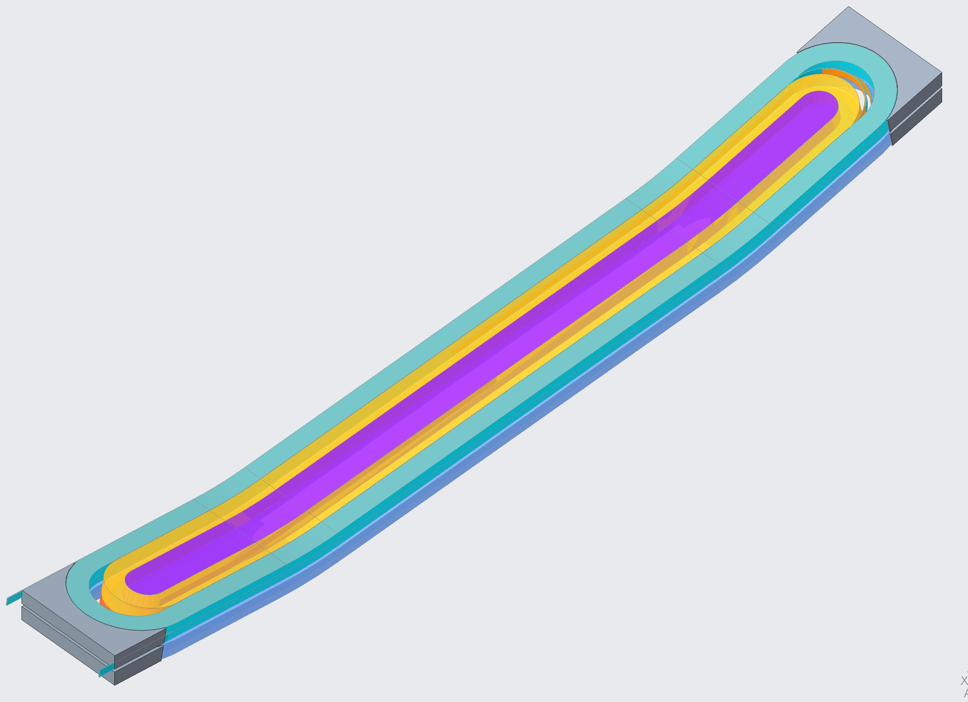
Graded Design Was Not Pursued for Test Facility Dipole Magnet
Advantages of Graded Design
Less conductor is required / smaller volume
Lower stored energy
Disadvantages of Graded Design
More complicated mechanics / fabrication
More challenging quench protection due to high current density in low field conductor
Need additional splice for each single layer
Internal splices add significant risk since they are in high field region
External splices complicate geometry and fabrication also adding risk
Added risk was seen as too high relative to advantages of grading
Internal Splice

Slide 10
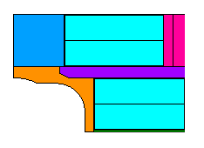
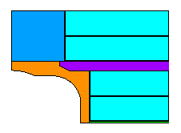
Test Facility Dipole Non-Graded Magnetic Layouts
HEPDipo 2-layers layouts have coils aligned on the right side (FRESCA II style)
Shifted layout with spacer (LD style) was developed by Douglas Martins Araujo at CERN
We have pursued two layouts at LBNL (LD and FRESCA II style) starting from Douglas’ designs and analysis scripts
Two designs have been pursued with similar magnetic results
16 T bore field at 85% of load line short sample (1.9 K)
Same number of total turns
15.5 kA at 16 T for both designs
1.8 MJ/m stored energy per quadrant
Similar field quality (<15 units for both designs)
Both have similar magnetic performance and the mechanical analysis is pursued for both (see talk by G. Vallone on comparison and choice of desired layout)
LD Style
46 turns
46 turns
42 turns
42 turns
FRESCA II Style
50 turns
50 turns
38 turns
Spacer
38 turns

Slide 11
Magnetic Results for LD and FRESCA II Style Layouts
LD Style
B_{mod} [T]
Operational (85% × short sample)
Parameter |  | LD Style | Fresca II style | Units
I_{op} |  | 15.5 | 15.5 | kA
B_{center test well} |  | 15.94 | 15.96 | T
Max B (coil 1) |  | 16.46 | 16.44 | T
Max B (coil 2) |  | 16.05 | 16.02 | T
Stored energy* |  | 1.8 | 1.8 | MJ/m
Lorentz force | Total F_{x}* (coil 1) | +6.3 | +6.3 | MN/m
 | Total F_{y}* (coil 1) | -2.7 | -1.8 | MN/m
 | Total F_{x}* (coil 2) | +10.0 | +9.6 | MN/m
 | Total F_{y}* (coil 2) | -6.9 | -7.6 | MN/m
Coil 2
Layer 4
Layer 3
B_{mod} [T]
Layer 2
Coil 1
Layer 1
FRESCA II Style
B_{mod} [T]
Layer 4
Coil 2
Layer 3
Layer 2
Coil 1
*Per quadrant
Layer 1

Slide 12
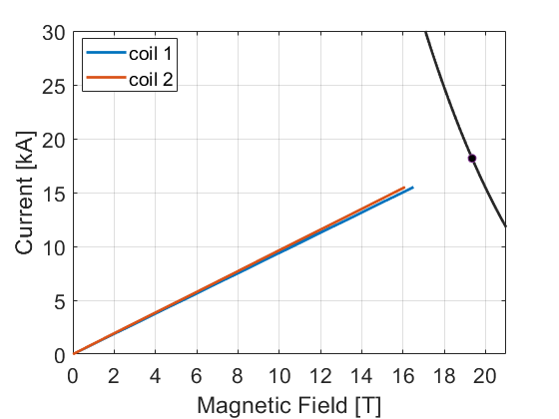
Margin Analysis
Test Facility Dipole Load Line
Margin Analysis (1.9 K)
Parameter | LD Style | Fresca II style | Units
16 T Load Line Fraction | 85.3% | 85.2% | -
15 T Load Line Fraction | 79.7% | 79.6% | -
16 T Temperature Margin | 3.5 | 3.5 | K
15 T Temperature Margin | 4.4 | 4.4 | K
HiLumi-1.1 strand
Load Line Margin Sensitivity to Change in Ic:
1.4% increase in LL margin for 10% increase in Ic

Slide 13
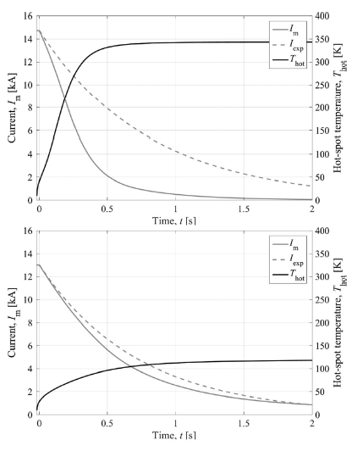
HEPdipo Quench Protection Analysis Results
Quench protection analysis was previously done by E. Ravaioli using LEDET
Accounts for losses due to inter-filament and inter-strand coupling currents
Quench propagation
Strong quench-back effect due to losses is seen for graded design
For non-graded design the quench-back effect is not as strong
Calculated hot spot temperature is 120 K
Graded Design
Non-Graded Design

Slide 14
HEPdipo Quench Protection Analysis Parameters
Iron yoke saturation effects (field, inductance) included
Magnetic length: 1.7 m
Operating (bore) dipole field: 15.0 T
Operating current, peak field: Varying according to selected option
Critical current density: 1500 A/mm2 at 16 T, 4.2 K (same as EuroCirCol)
Bath temperature: 4.2 K
Warm resistance of the circuit: 0.2 mΩ
Quench detection+validation time: 5+10 ms
EE triggering time: 2 ms
Cu/noCu: Varying according to selected option
RRR=100
Filament twist-pitch = 14 mm
Effective transverse resistivity factor =1
E. Ravaioli, IEEE TRANSACTIONS ON APPLIED SUPERCONDUCTIVITY, VOL 28, NO. 3, APRIL, 2018

Slide 15
Test Facility Dipole: Preliminary Quench Protection Analysis
Energy-extraction based protection with dump resistor value set by max voltage of 2 kV (±1kV symmetric to ground)
Conservative exponential decay assumption (τ=L/R)
Inter-filament and inter-strand coupling currents and eddy currents not included
Quench propagation not included
Magnetic field is assumed to decay directly with current
Calculate hot spot temperature with assumed magnetic field and current decay
This analysis is preliminary and leads to conservative results

Slide 16
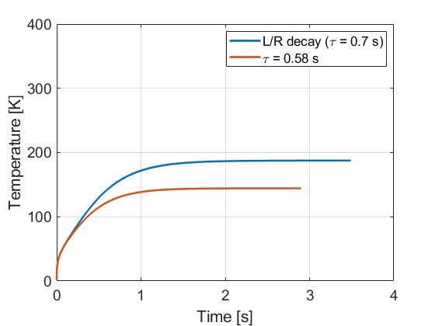
Calculated Hot Spot Temperature with Conservative Exponential Model (HEPdipo Case)
HEPDIPO
HEPdipo analysis performed for 15 T operation
Hot spot temperature calculation was performed for two cases
Calculated for decay based on L/R (leads to hot spot temperature that is 60 K higher than LEDET analysis)
Calculated for decay constant based on IEEE paper (results obtained are ~20 K higher, likely due to adiabatic assumption)
T_{hot-spot} = 180 K
T_{hot-spot} = 140 K
HEPDIPO non-graded
I_{op} | 13.3 | kA
B_{center test well} | 15.0 | T
Stored energy* | 1.5 | MJ/m
Resistor value | 0.15 | Ω
Time constant | 0.70 | s
Assumptions:
RRR = 100
Cu/non-Cu ratio = 1.0
t_{delay} = 17 ms
*Per quadrant

Slide 17
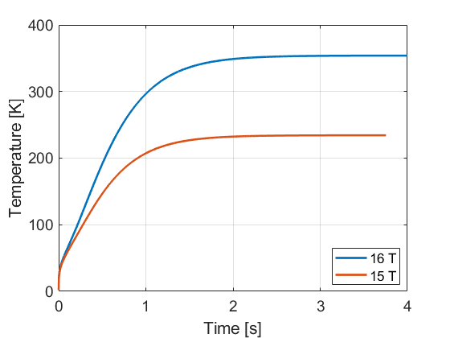
Calculated Hot Spot Temperature with Conservative Exponential Model (Test Facility Dipole)
Test Facility Dipole
Conservative analysis results predict a hot spot temperature of 354 K at 16 T and 234 K at 15 T
From comparison to previous HEPdipo work a substantially lower temperature is expected when the effect of quench propagation, non-adiabatic heat transfer, and coupling and eddy currents are taken into account
T_{hot-spot} = 354 K
T_{hot-spot} = 234 K
Test Facility Dipole
I_{op} | 15.5/14.5 | kA
B_{center test well} | 16.0/15.0 | T
Stored energy* | 1.8/1.6 | MJ/m
Resistor value | 0.13/0.14 | Ω
Time constant | 0.8/0.75 | s
Assumptions:
RRR = 150
Cu/non-Cu ratio = 1.17
t_{delay} = 17 ms
*Per quadrant

Slide 18
Quench Protection Conclusions and Next Steps
Quench protection based on baseline design with HiLumi-1.1 strand and 2 kV EE is suitable based on conservative analysis
Further analysis is needed to determine specific limits on RRR choice of conductor Cu fraction
Next steps
Implement 2D analysis using Ansys with user elements developed by L. Brouwer (implements coupling current losses and quench behavior into Ansys elements)
Include effect from quench propagation
Other quench protection options such as CLIQ+EE will also be considered

Slide 19
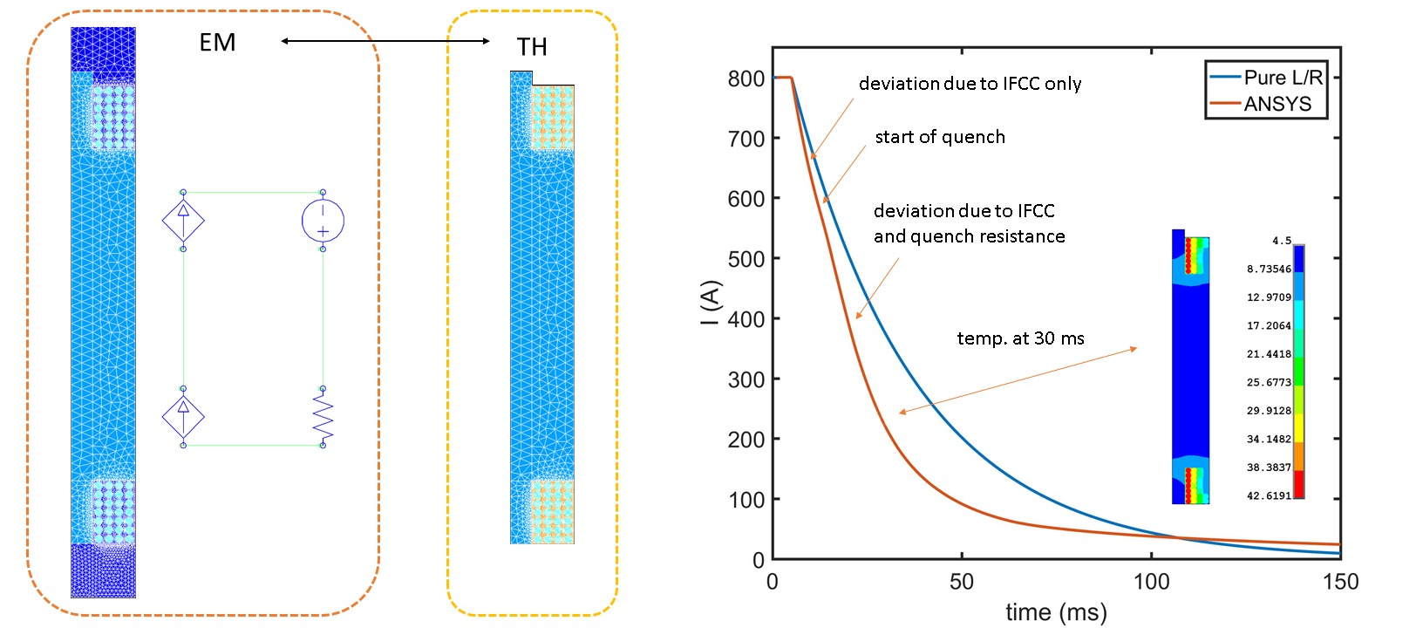
Example Of A Fully Coupled Quench Back Simulation Of A Nb₃Sn Undulator In A Dump Resistor Circuit Using ANSYS User Elements
Extreme current densities require advanced quench protection + modeling (Nb₃Sn at low field)
5100 A/mm^2 in Cu post quench -> energy has to be extracted quickly to avoid burning
accurate prediction of peak temperatures and current decay are critical
https://github.com/lnbrouwer/ANSYS_UEL
L. Brouwer et al., User defined elements in ANSYS for 2D mutiphisics modeling of superconductors, SUST Vol. 32 Num. 9

Slide 20
Conclusions
Decision has been made to proceed with non-graded design
Two different layouts with similar magnetic performance have been considered (see G. Vallone talk for mechanical analysis comparison)
Magnetic requirements can be met with HiLumi-1.1 strand but higher performing strand could provide more margin
Preliminary (conservative) quench protection analysis has been performed
Current plan with dump resistor is sufficient with HiLumi 1.1 strand for 16 T operation
More complete and accurate analysis is needed to investigate options for higher Ic strand that may have lower copper fraction or lower RRR

Slide 21
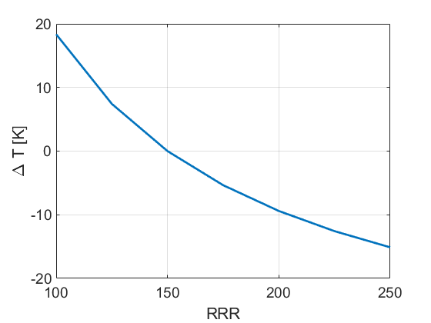
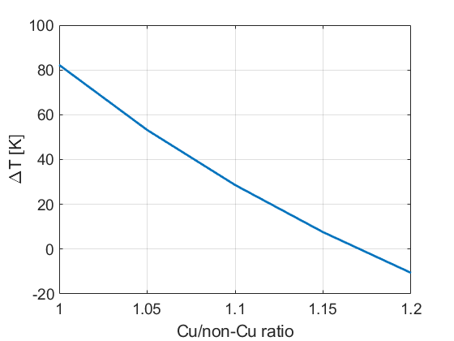
Sensitivity to RRR and Cu fraction
Sensitivity to RRR
Sensitivity to Cu fraction
Baseline Assumptions:
B =16 T
RRR = 150
Cu/non-Cu ratio = 1.17
* Analysis is preliminary and does not account for changes in decay time due to property change

Slide 22
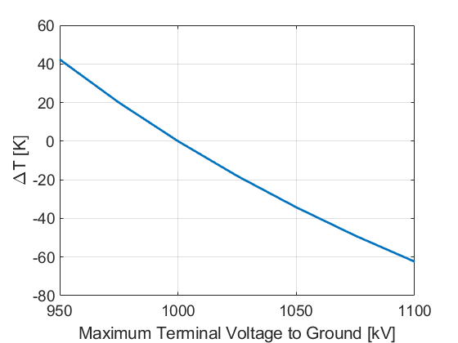
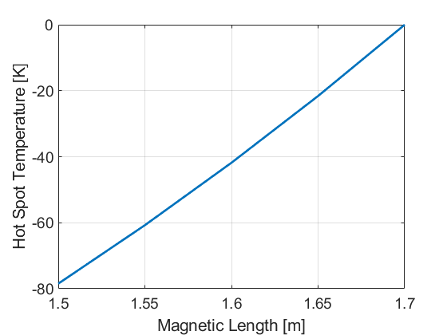
Sensitivity to Maximum Voltage and Magnetic Length
Sensitivity to V_{max}
Sensitivity to L_{mag}
Baseline Assumptions:
B =16 T
RRR = 150
Cu/non-Cu ratio = 1.17
* Analysis is preliminary and does not account for changes in decay time due to property change

