Slide 1
HIGH FIELD TEST FACILITY DIPOLE
ENGINEERING DESIGN
Ray Hafalia
June 11, 2020
Lawrence Berkeley National Laboratory

Slide 2
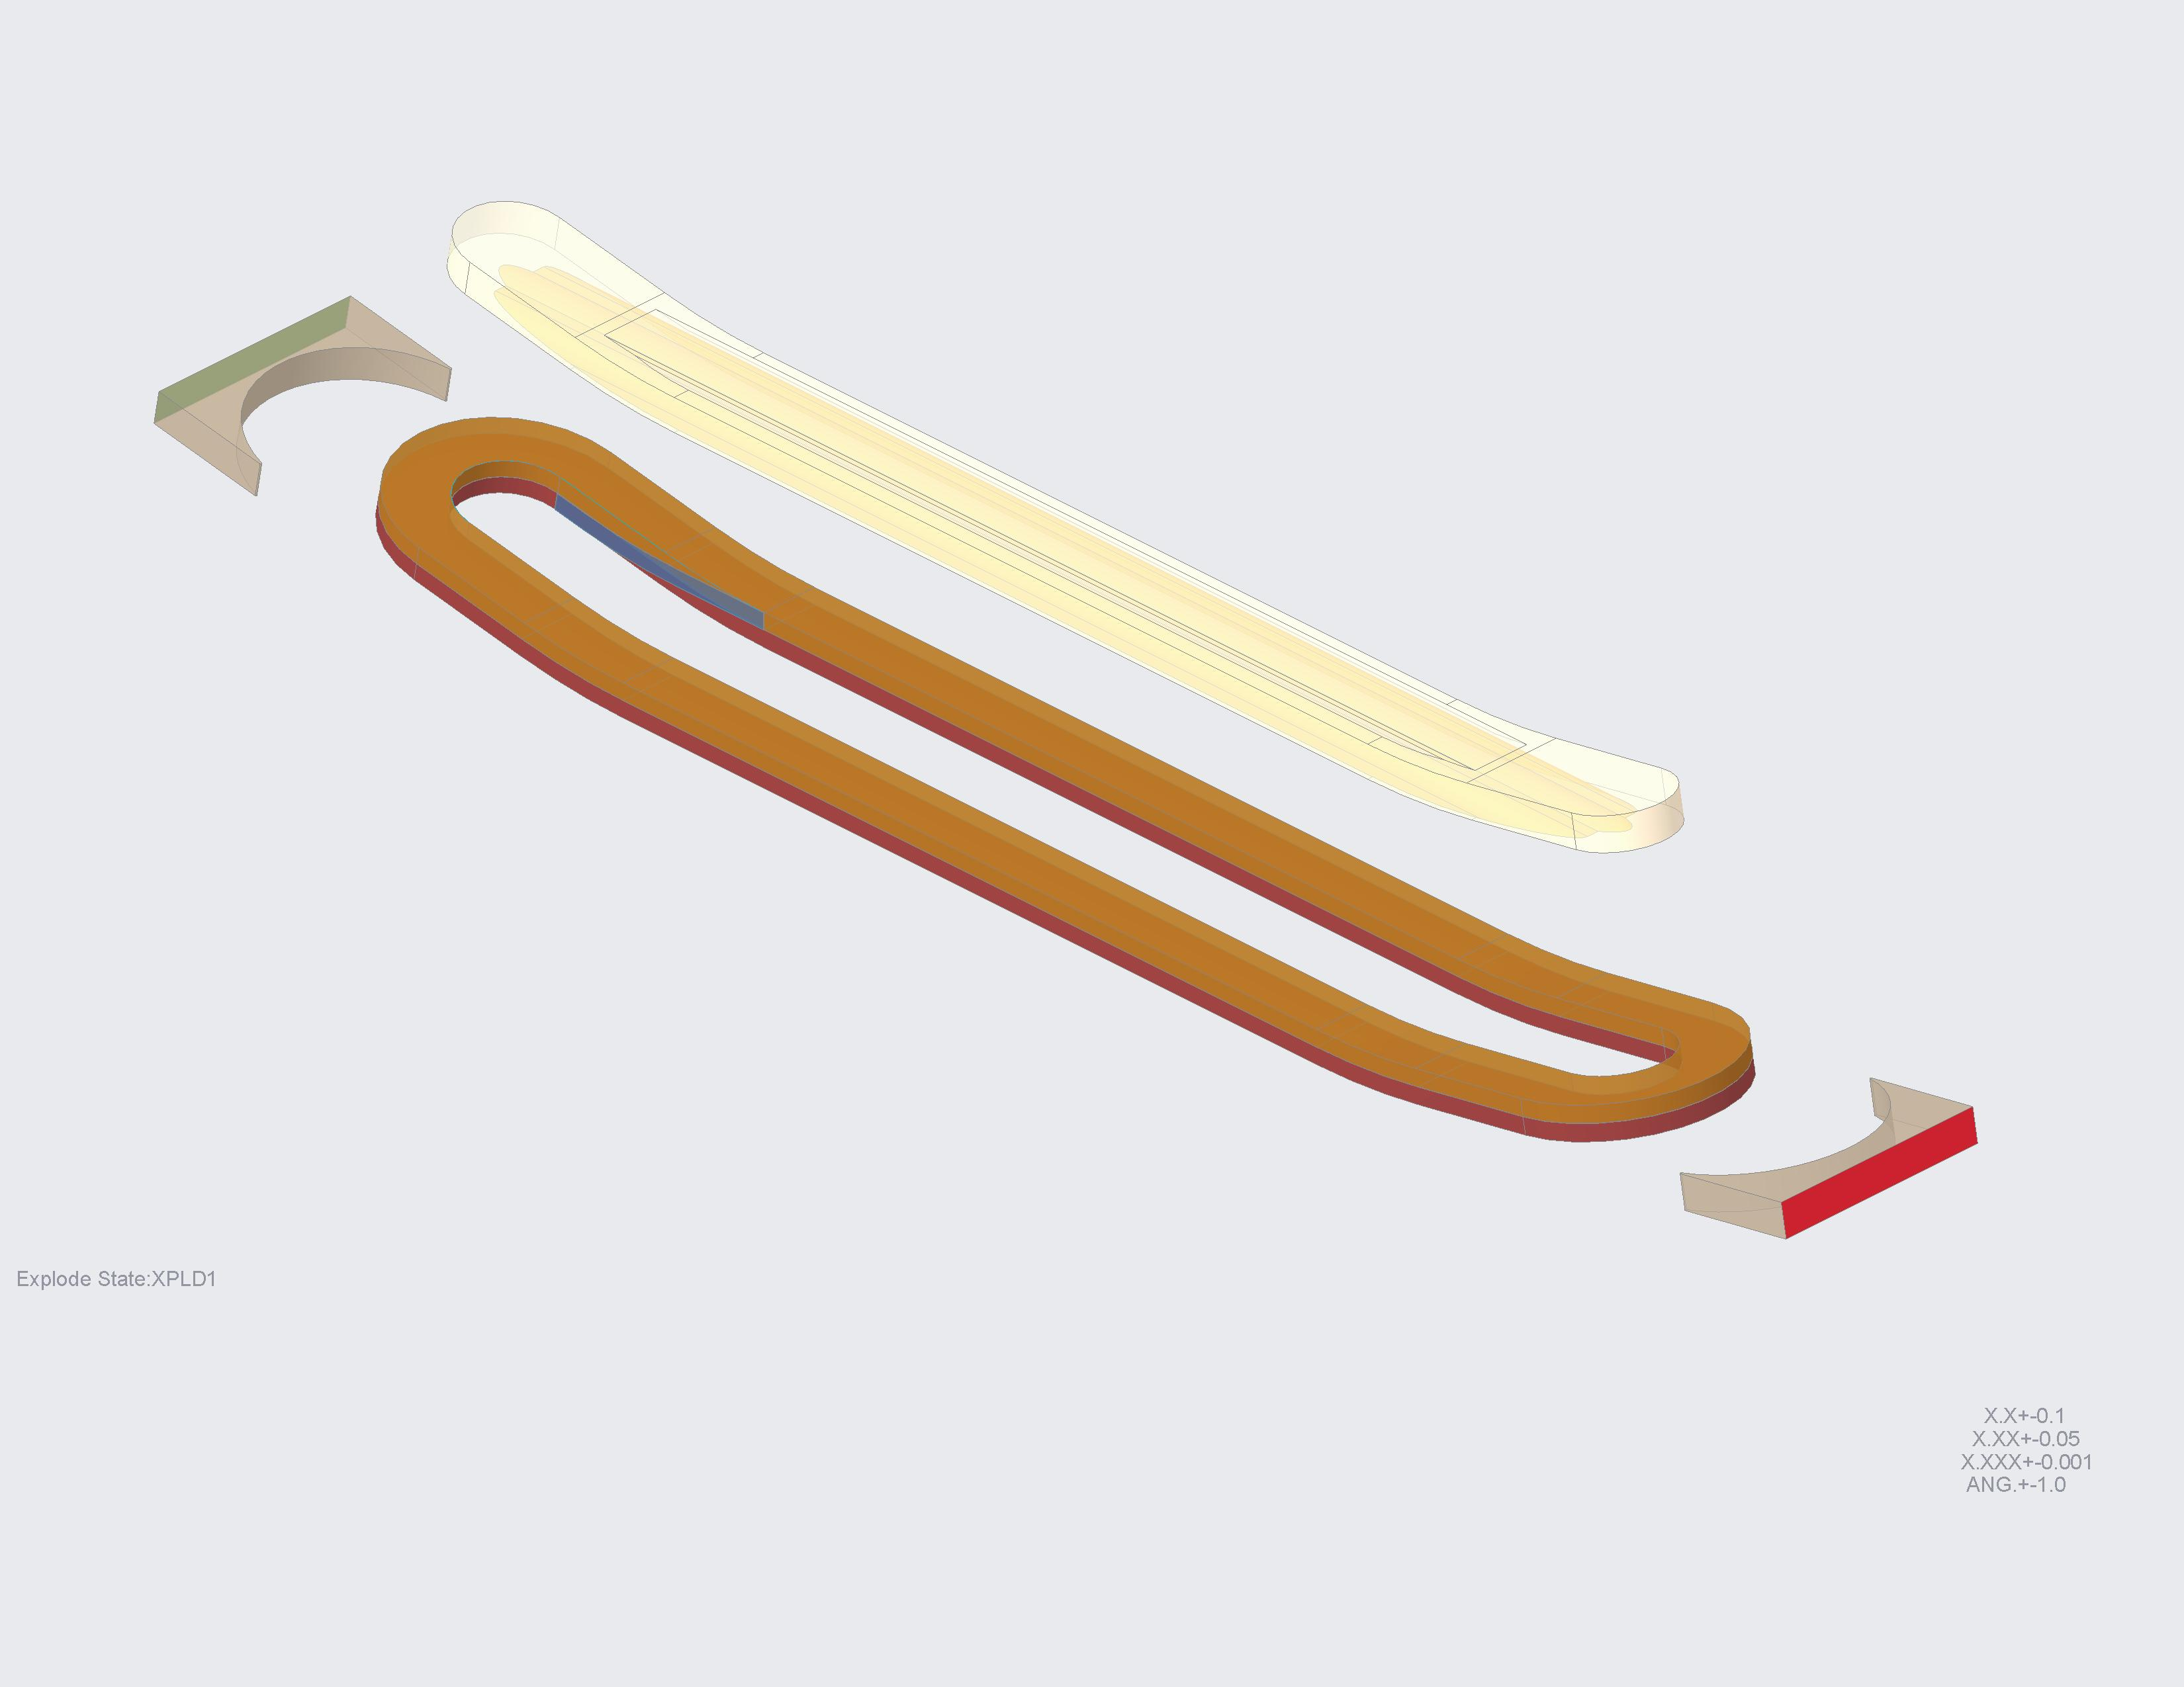
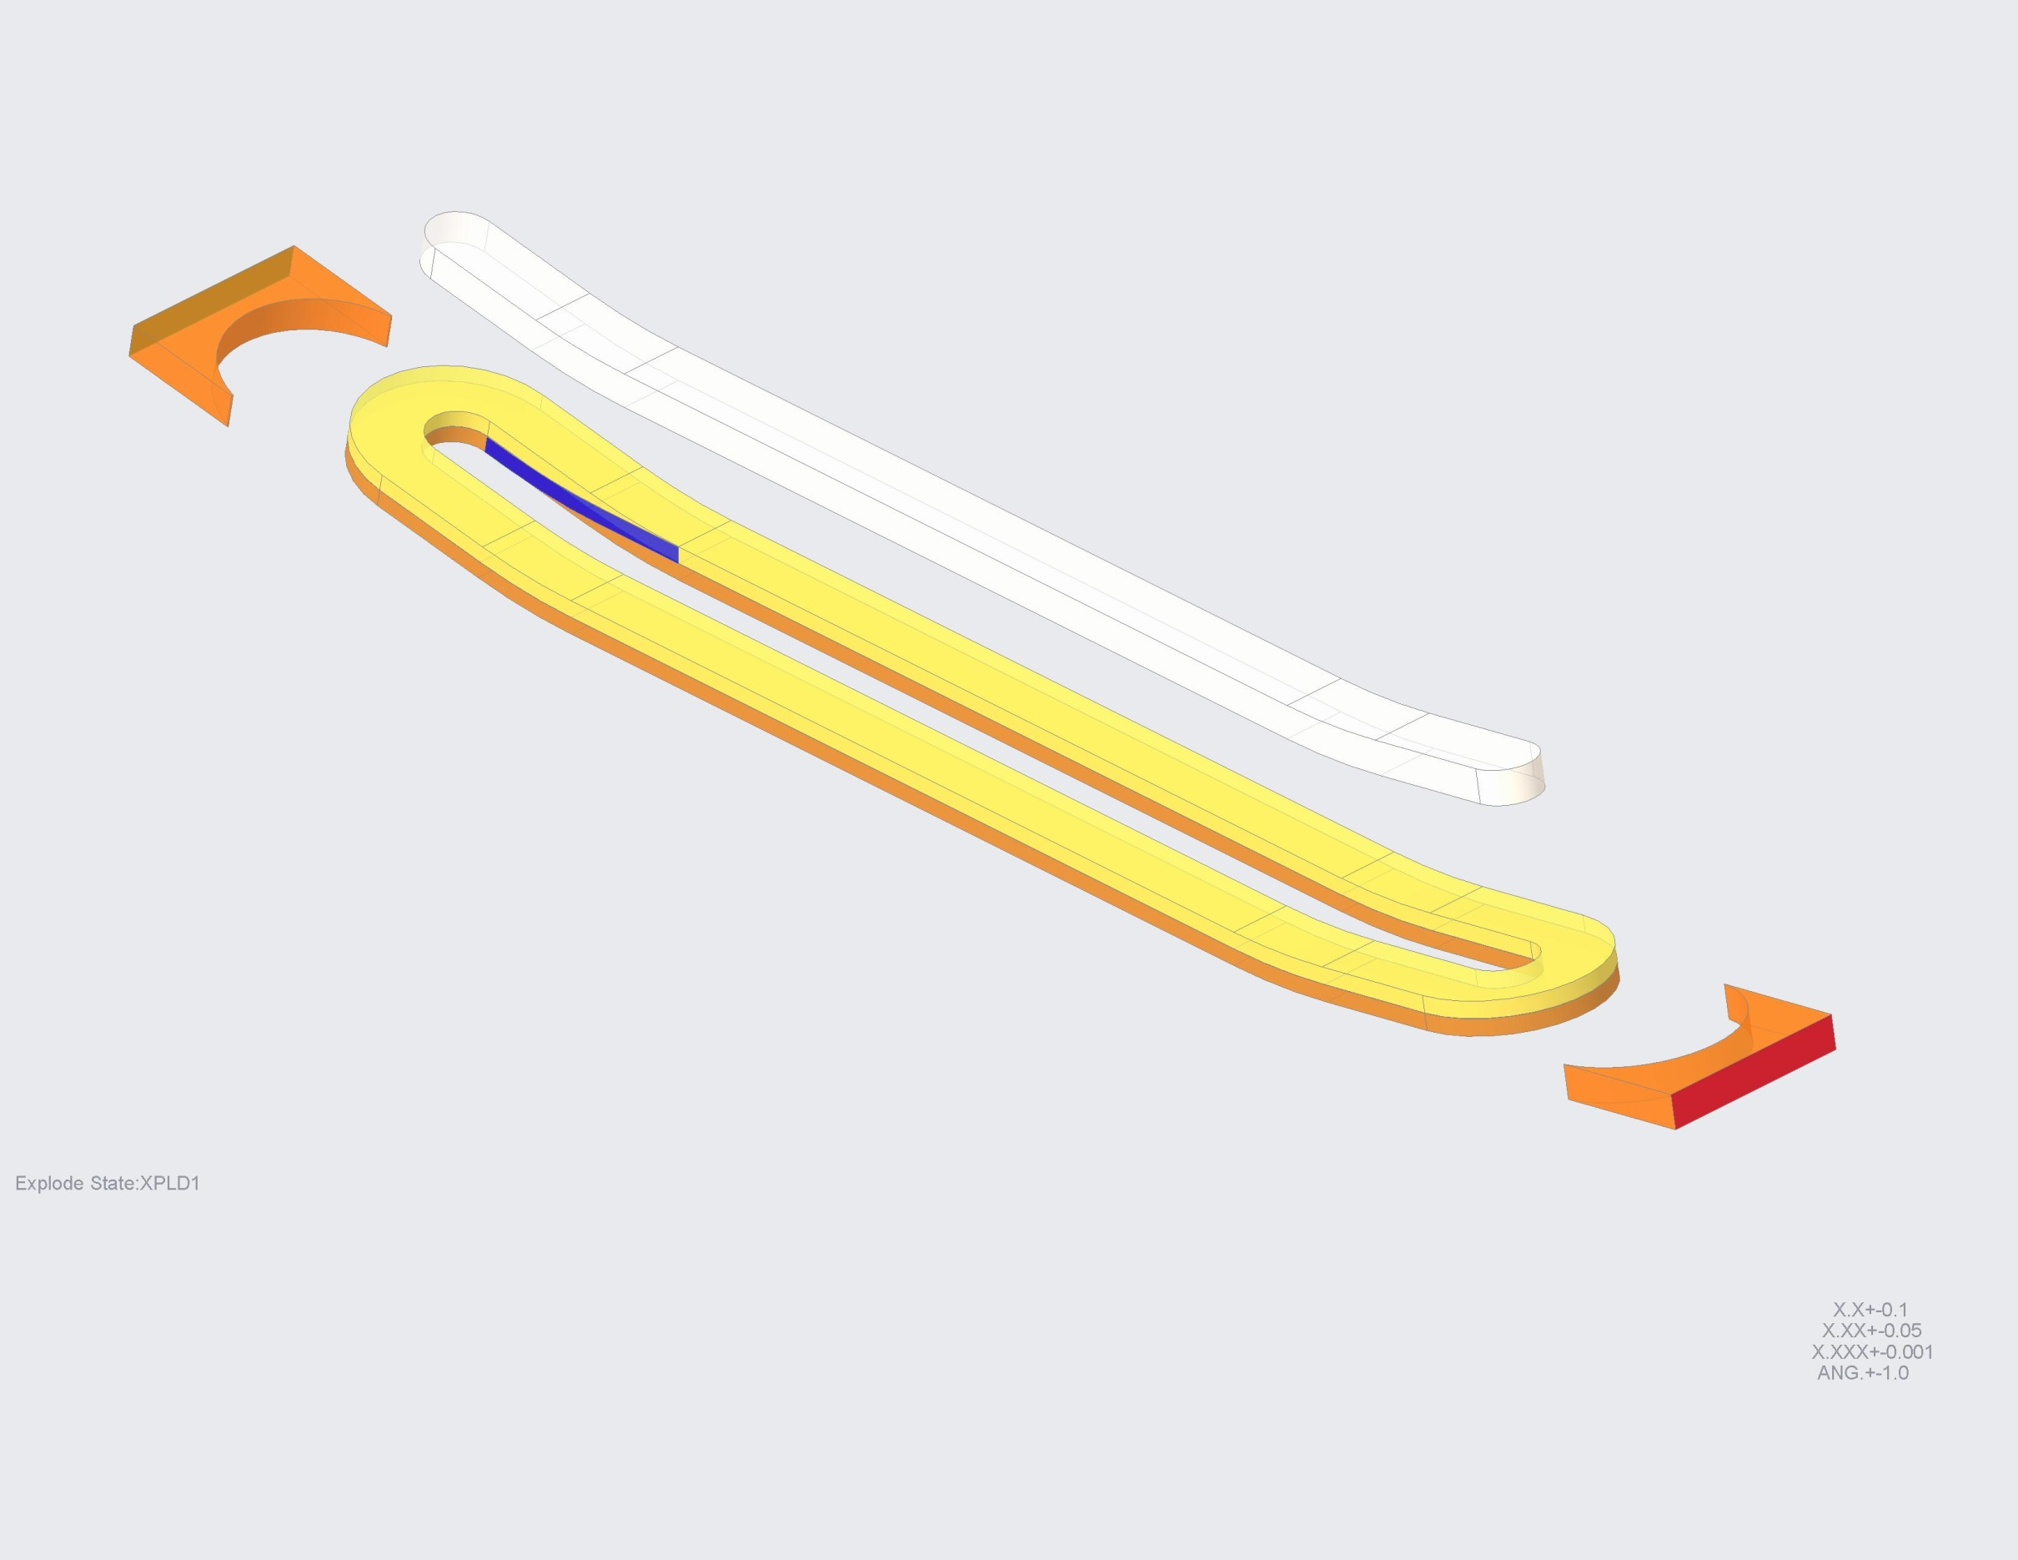
COIL CAD DESIGN
LAYER-TO-LAYER
TRANSITION
LAYER-TO-LAYER
TRANSITION
COIL 1
(LAYERS 1 & 2)
COIL 2
(LAYERS 3 & 4)

Slide 3
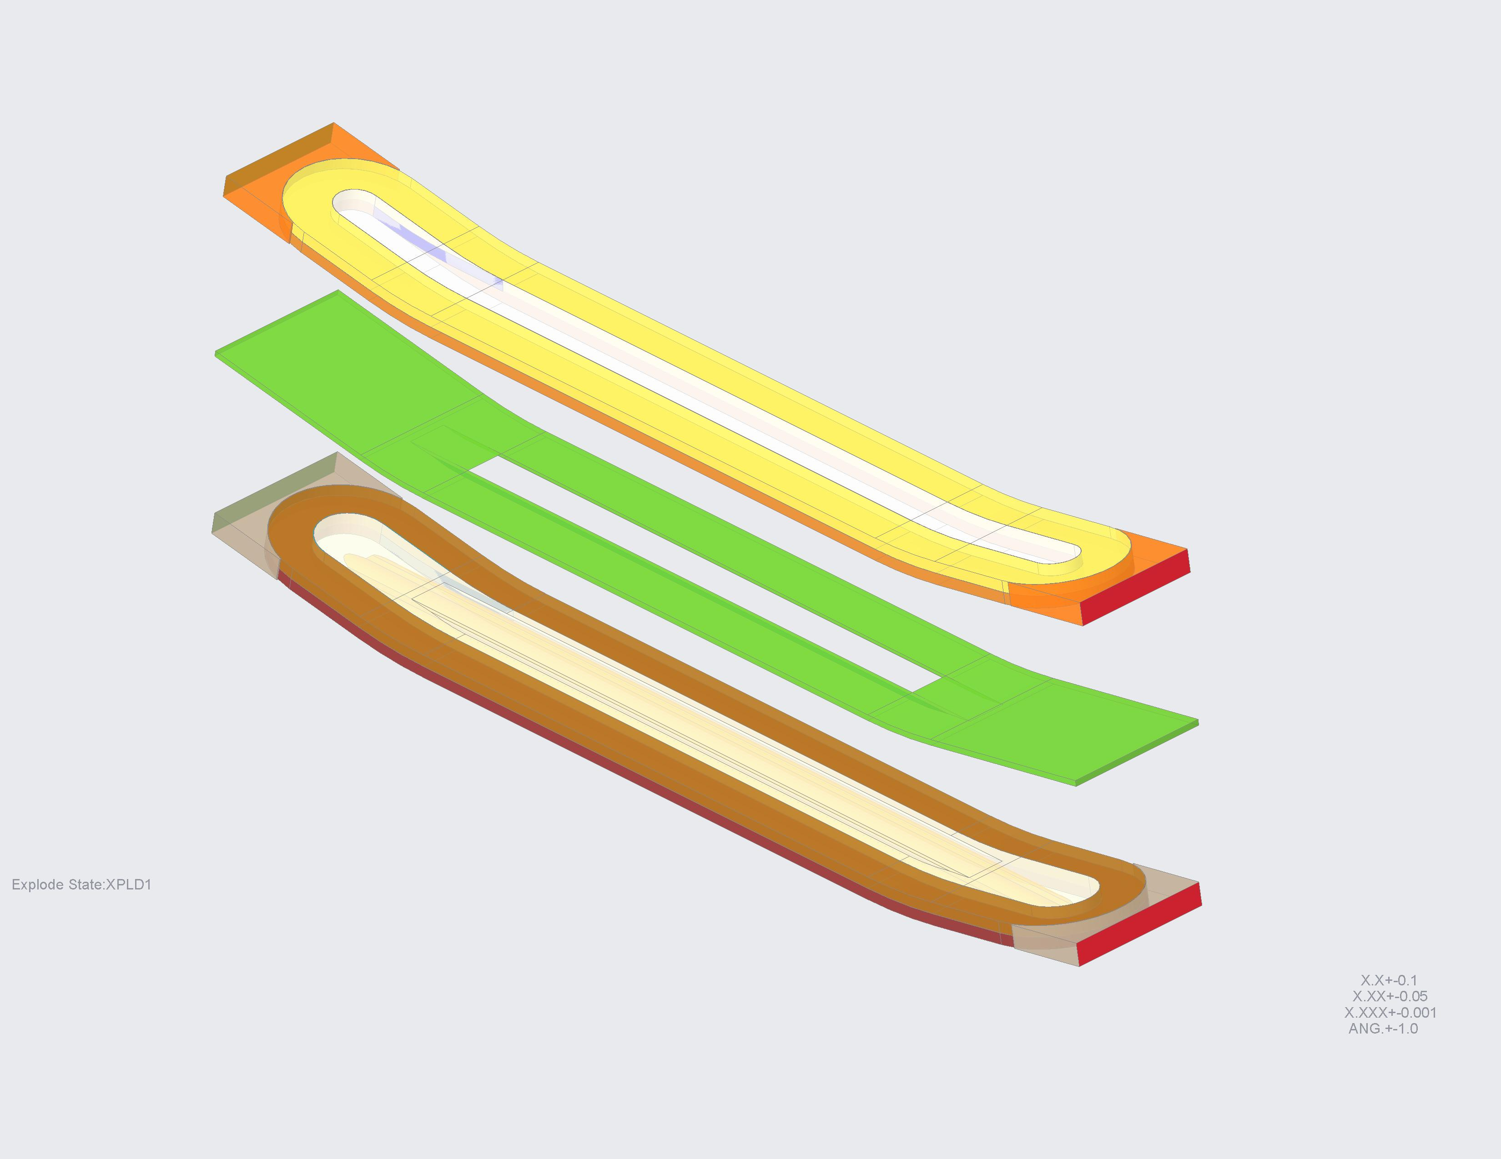
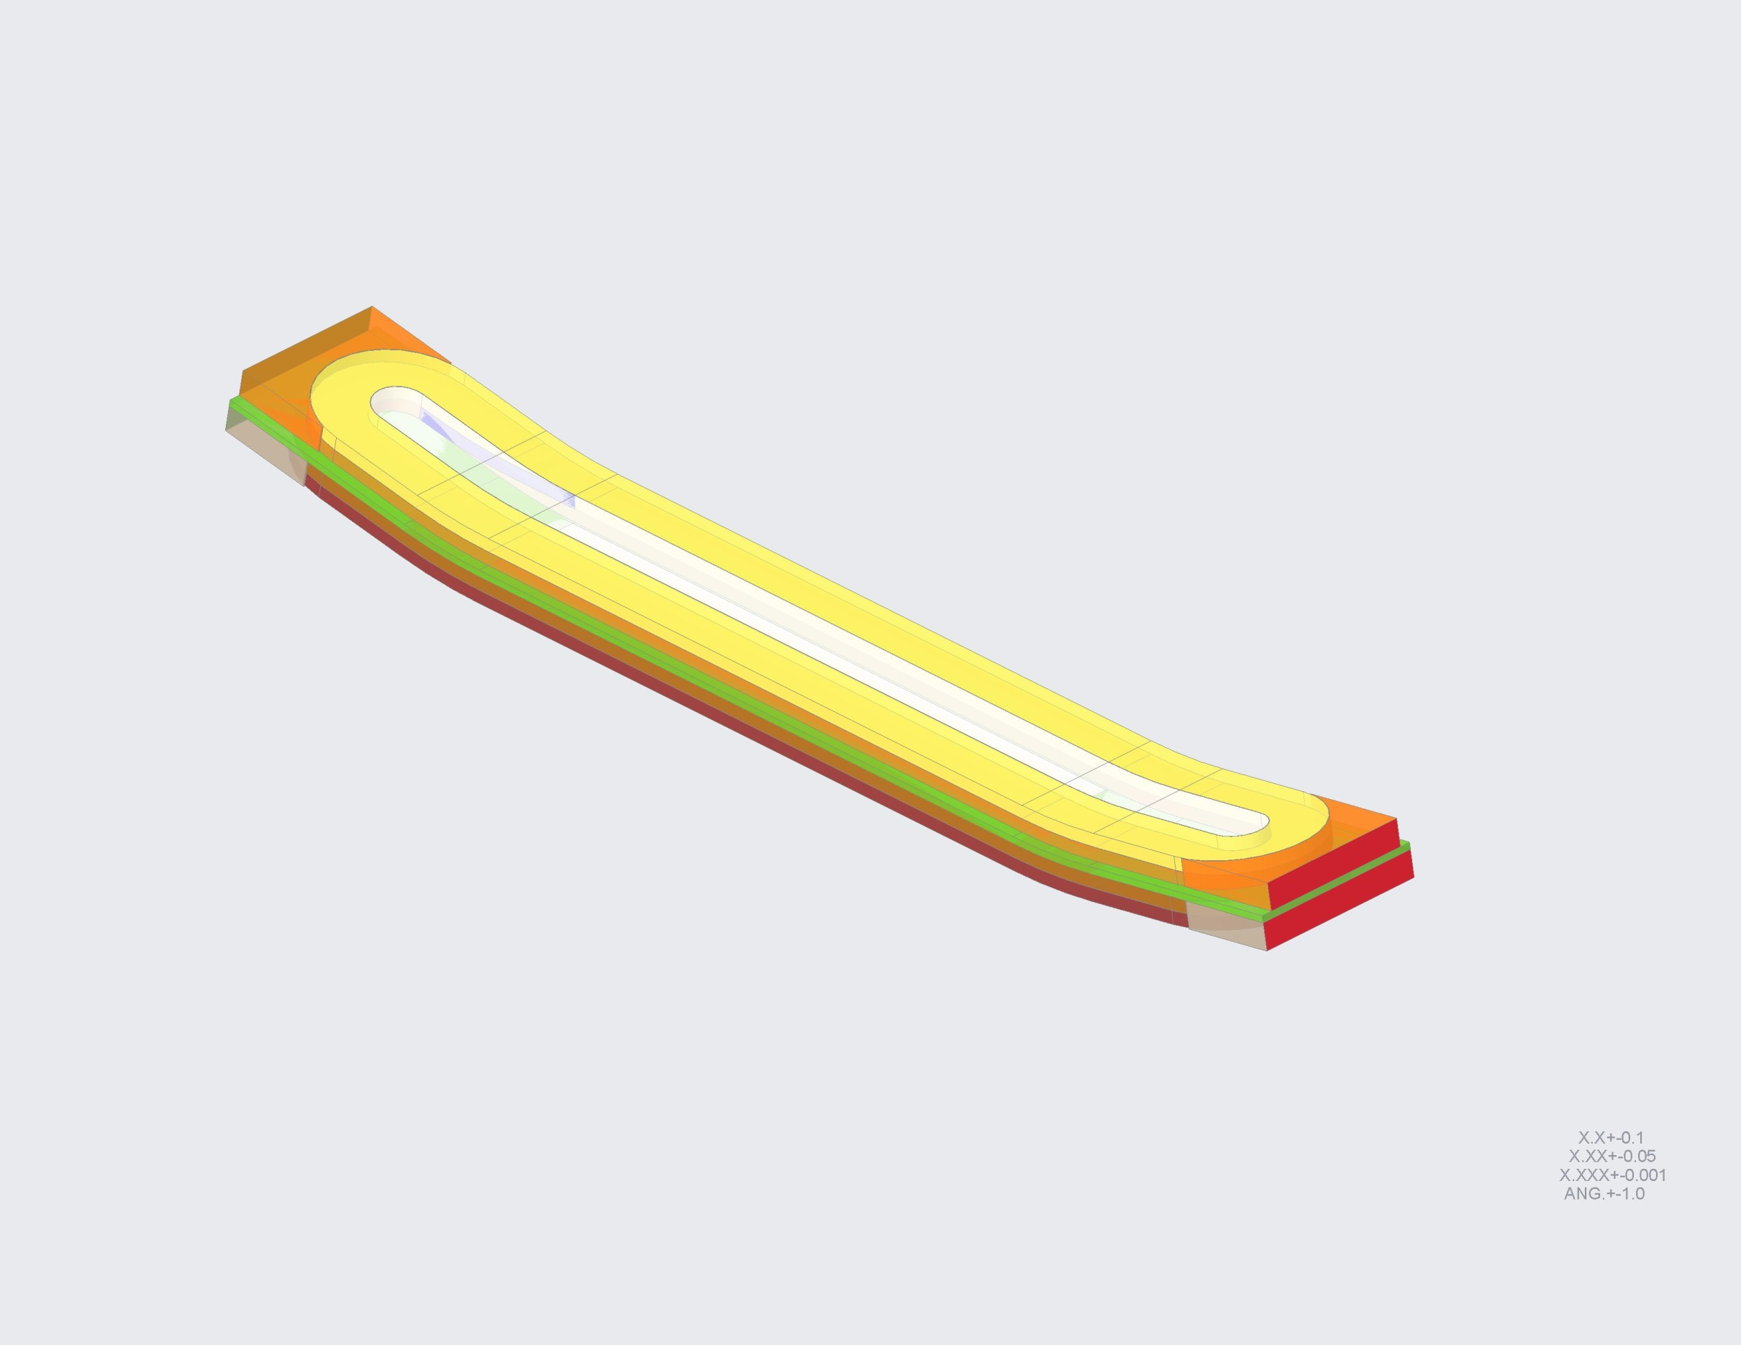
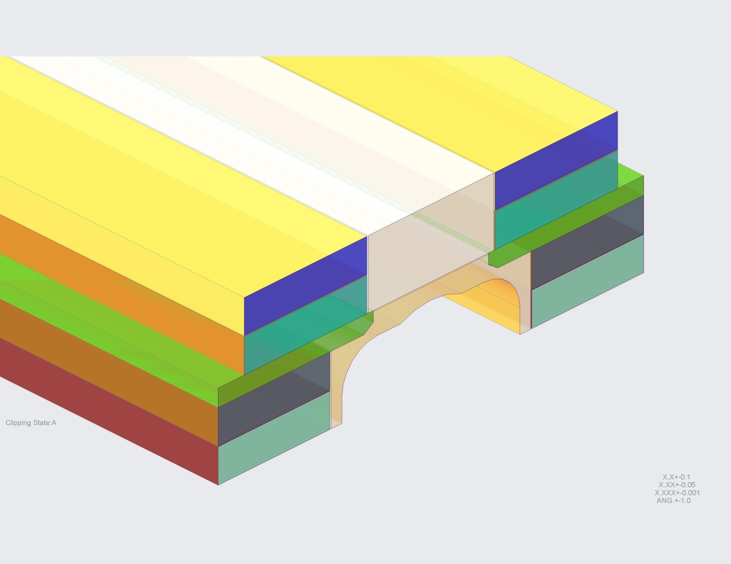
COIL CAD DESIGN
This “LD-style” cross-section shown will be used as the baseline coil geometry for the TFD Dipole Magnet.
COIL 2
(LAYERS 3 & 4)
INTER-COIL SPACER
COIL 1
(LAYERS 1 & 2)

Slide 4
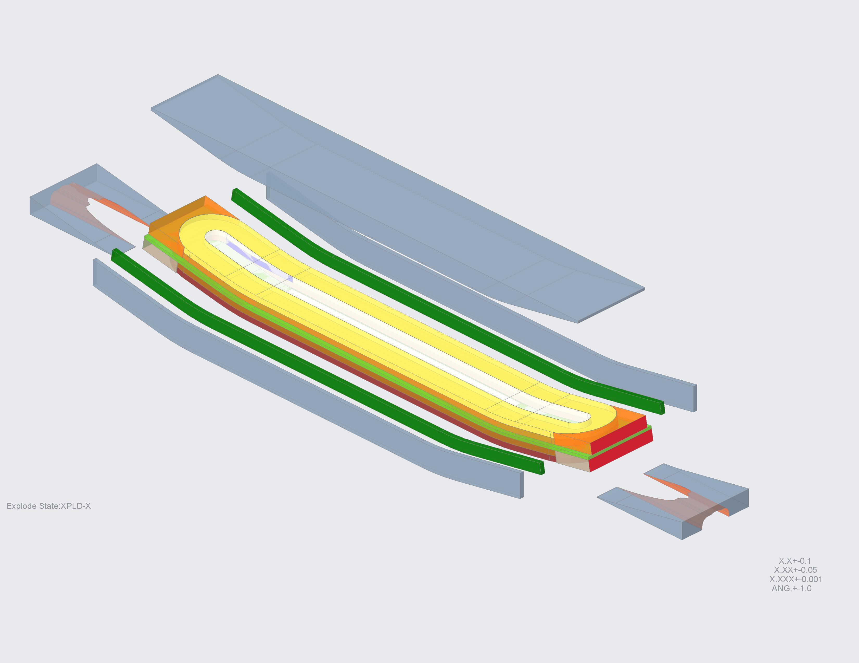
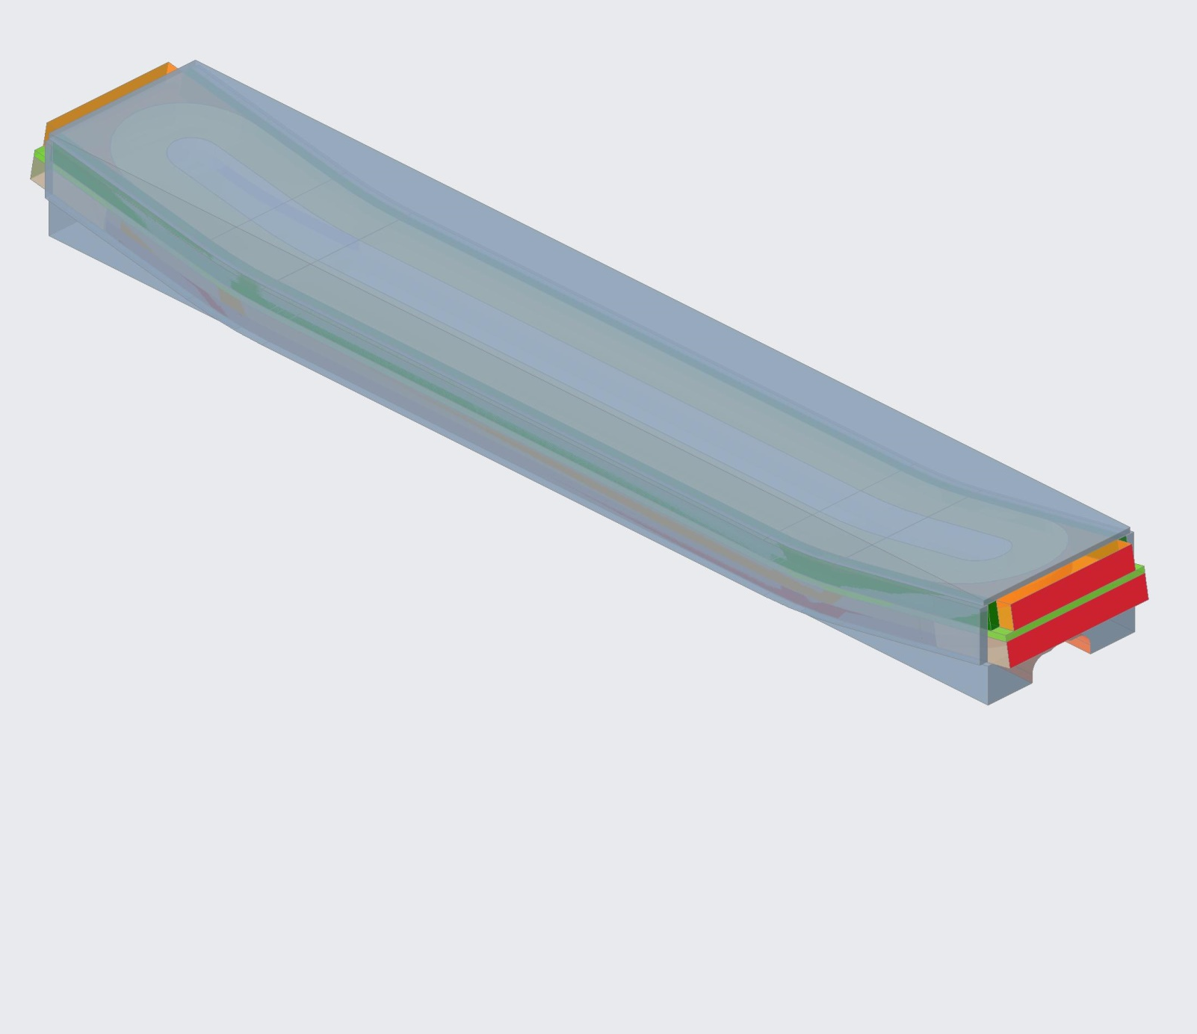
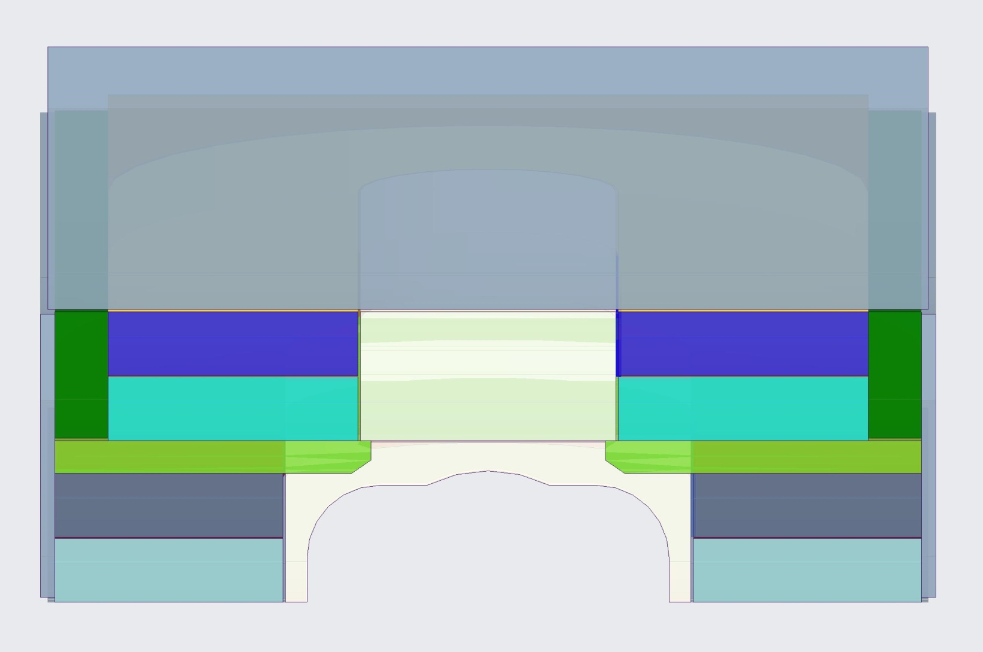
COIL MODULE ASSEMBLY
LEAD END WEDGE
COIL MODULE
VERTICAL SPACER
SIDE PUSHER BARS
COIL SIDE SPACERS
RETURN END WEDGE

Slide 5
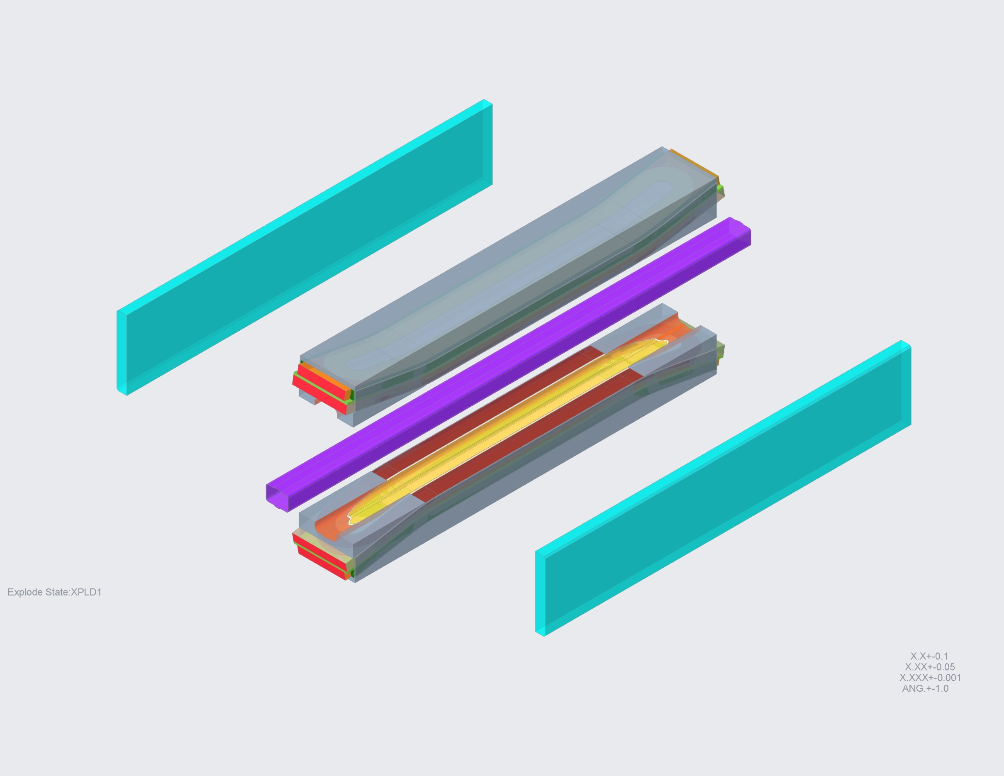
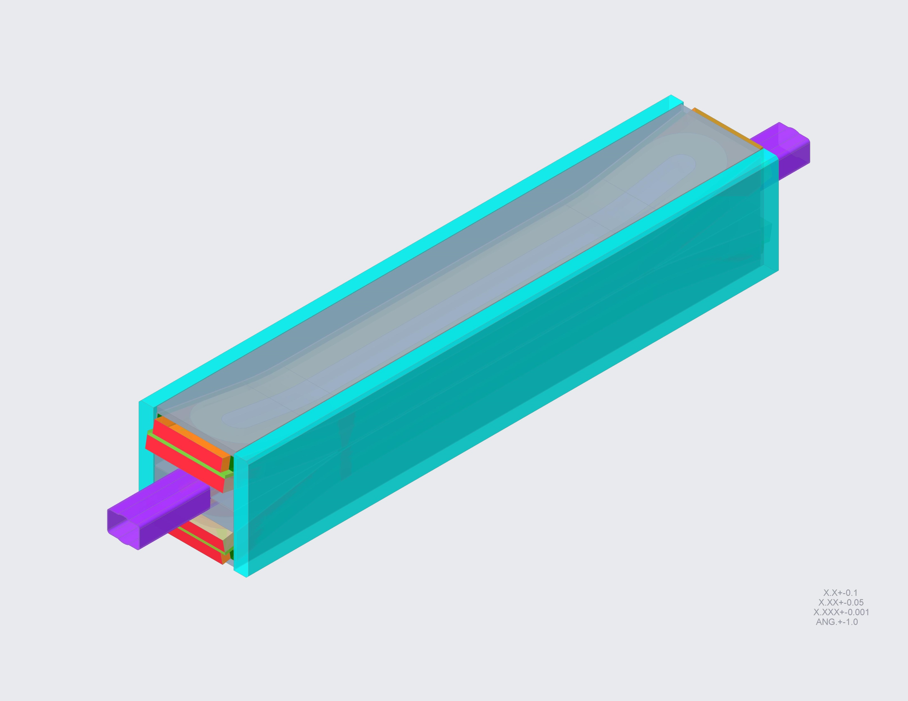
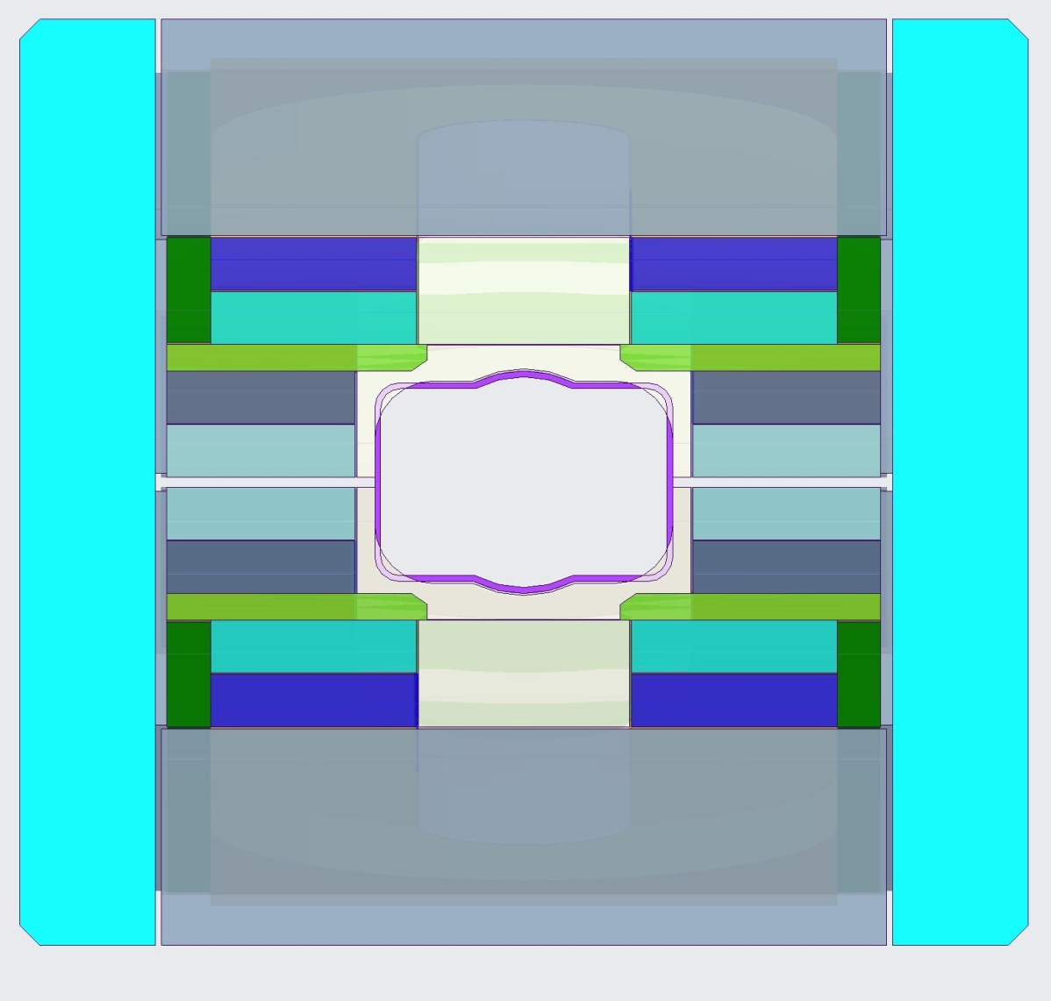
COIL PACK ASSEMBLY
COIL MODULES
HORIZONTAL LOAD PAD
2450 mm
[96.1 inches]
552 mm
[21.7 inches]
TEST WELL
466 mm
[18.4 inches]
HORIZONTAL LOAD PAD
COIL PACK
Weight: 5590 kg [12300 lbs]

Slide 6
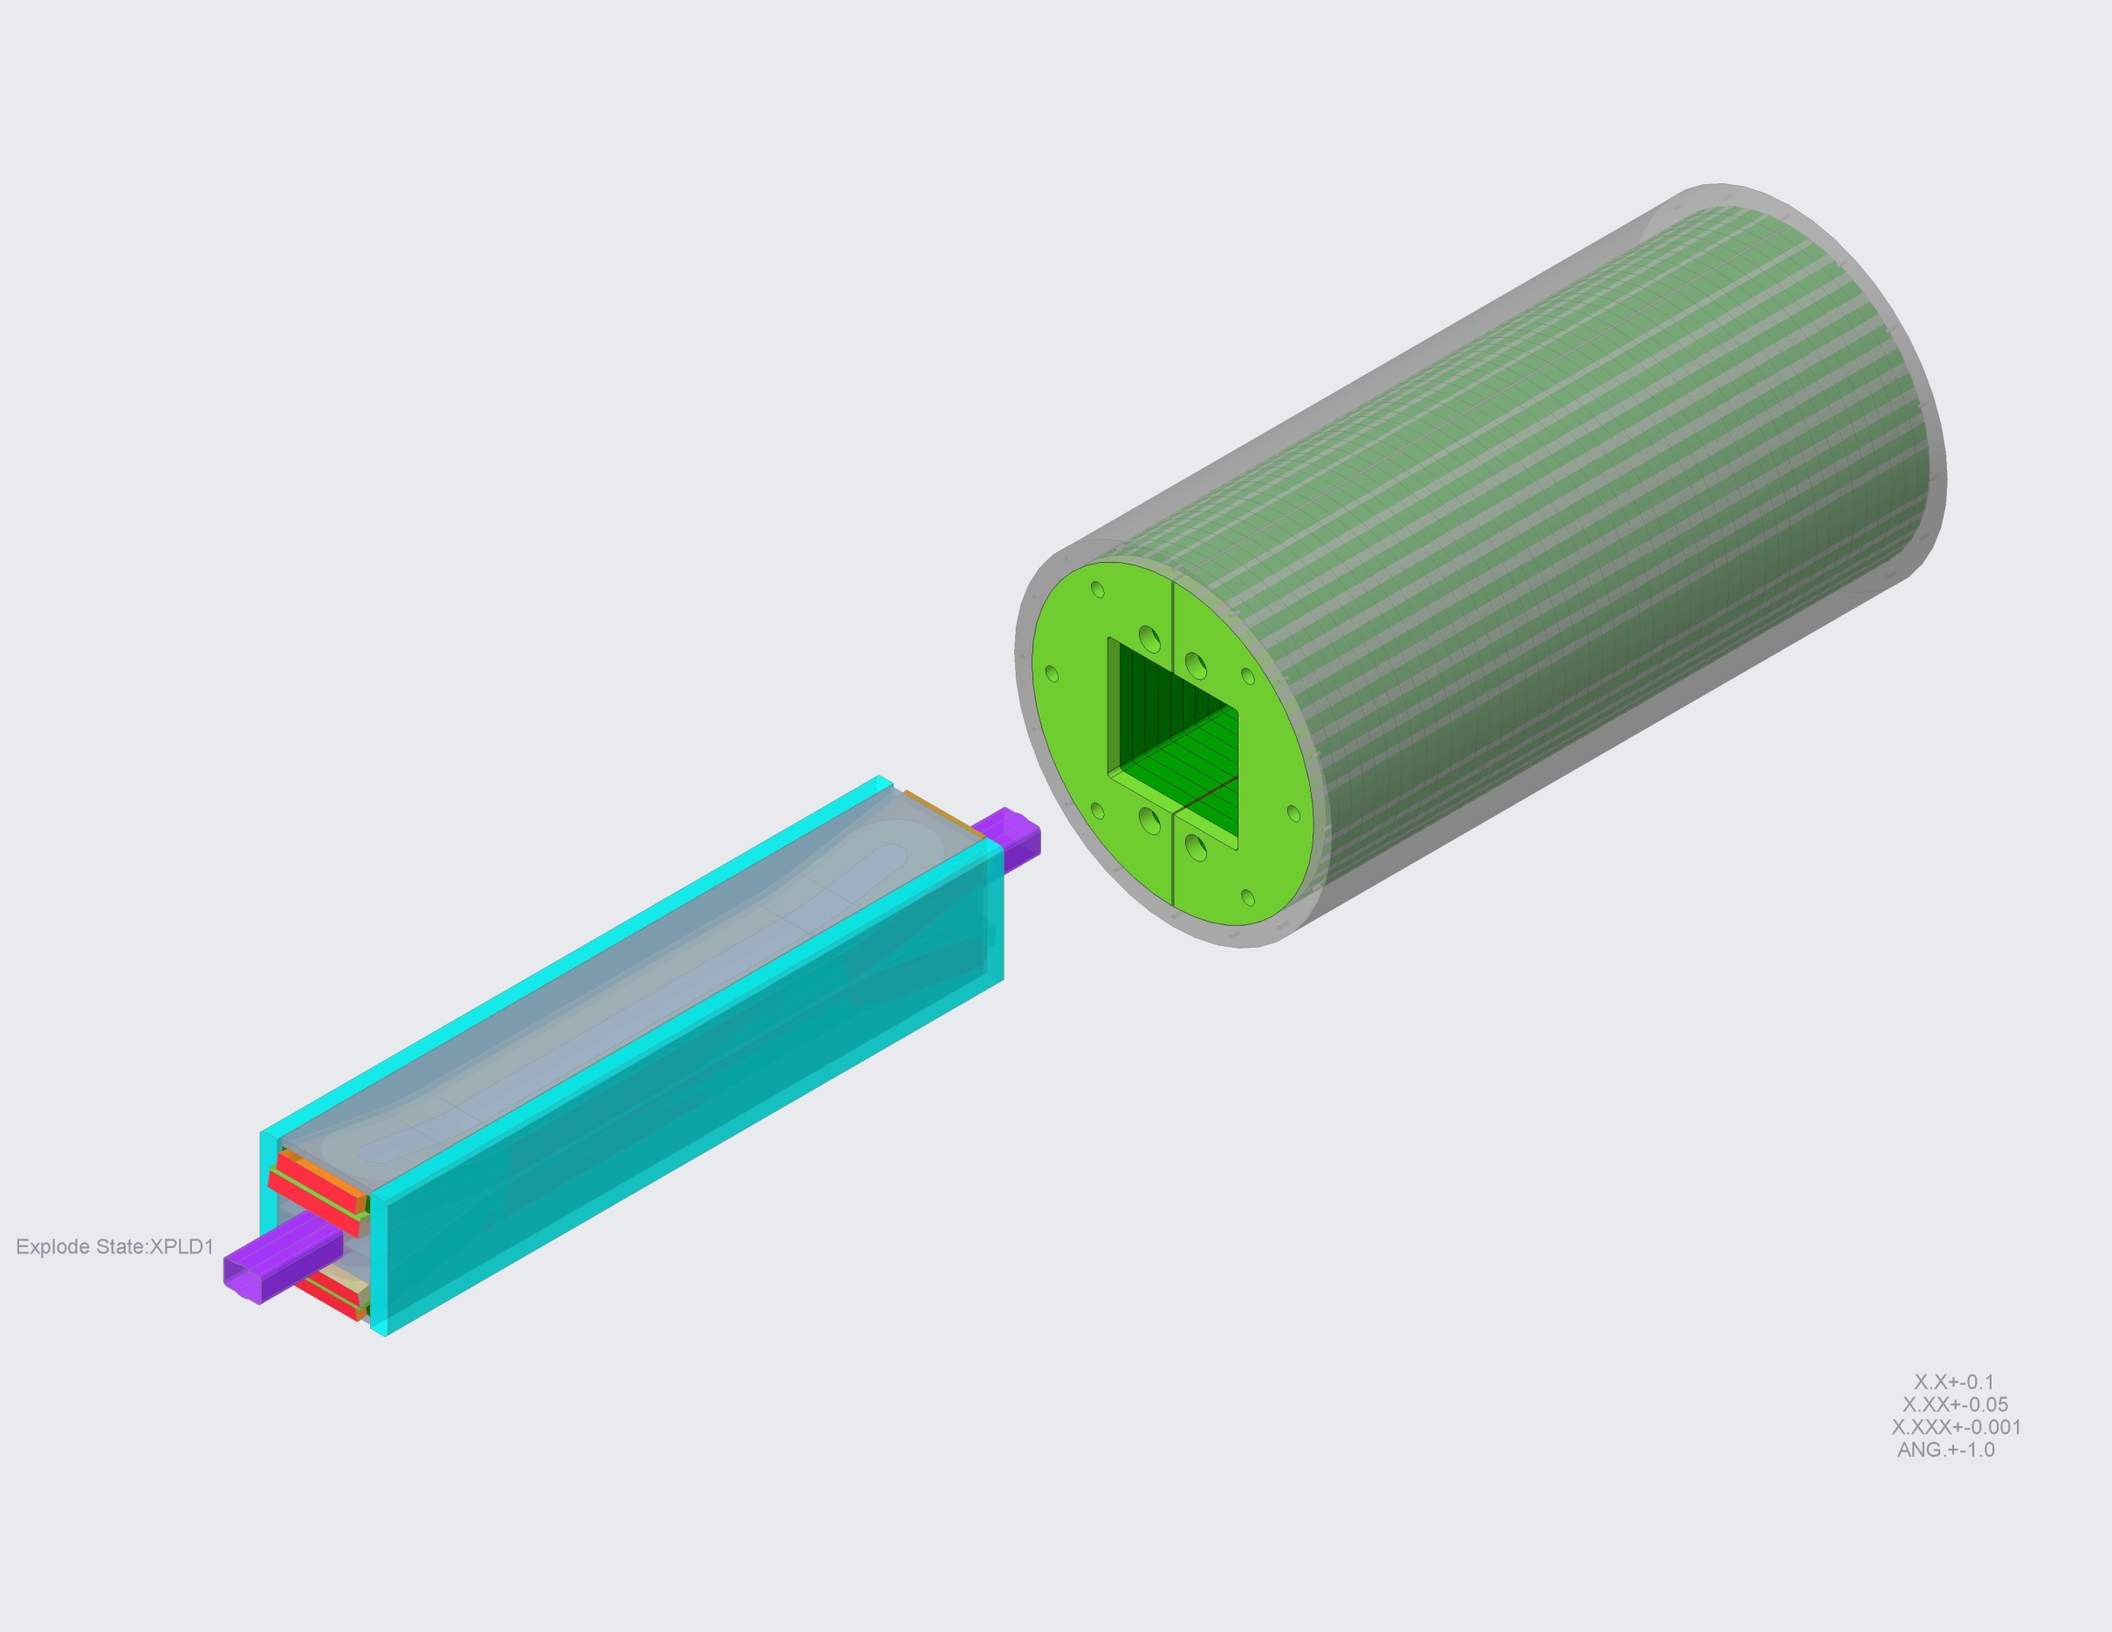
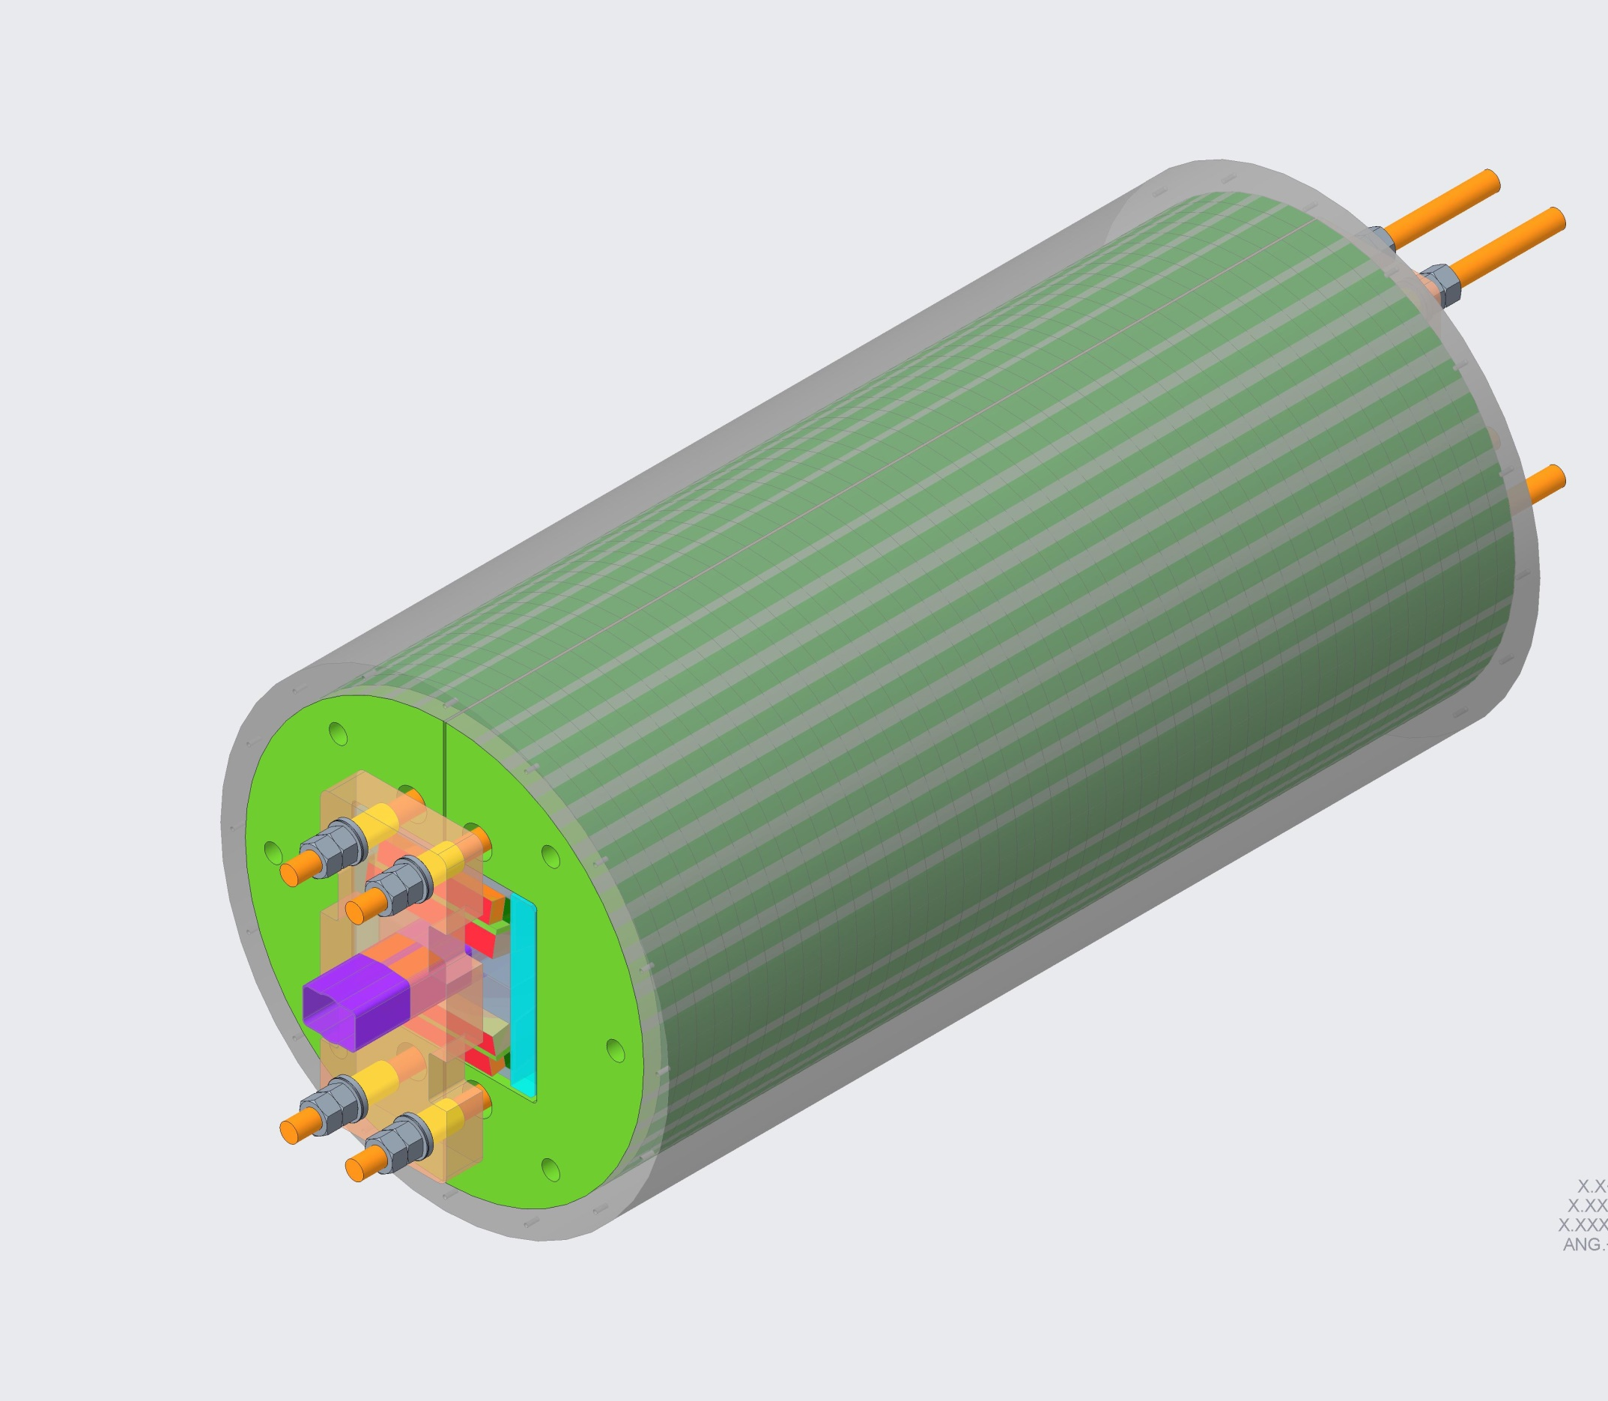
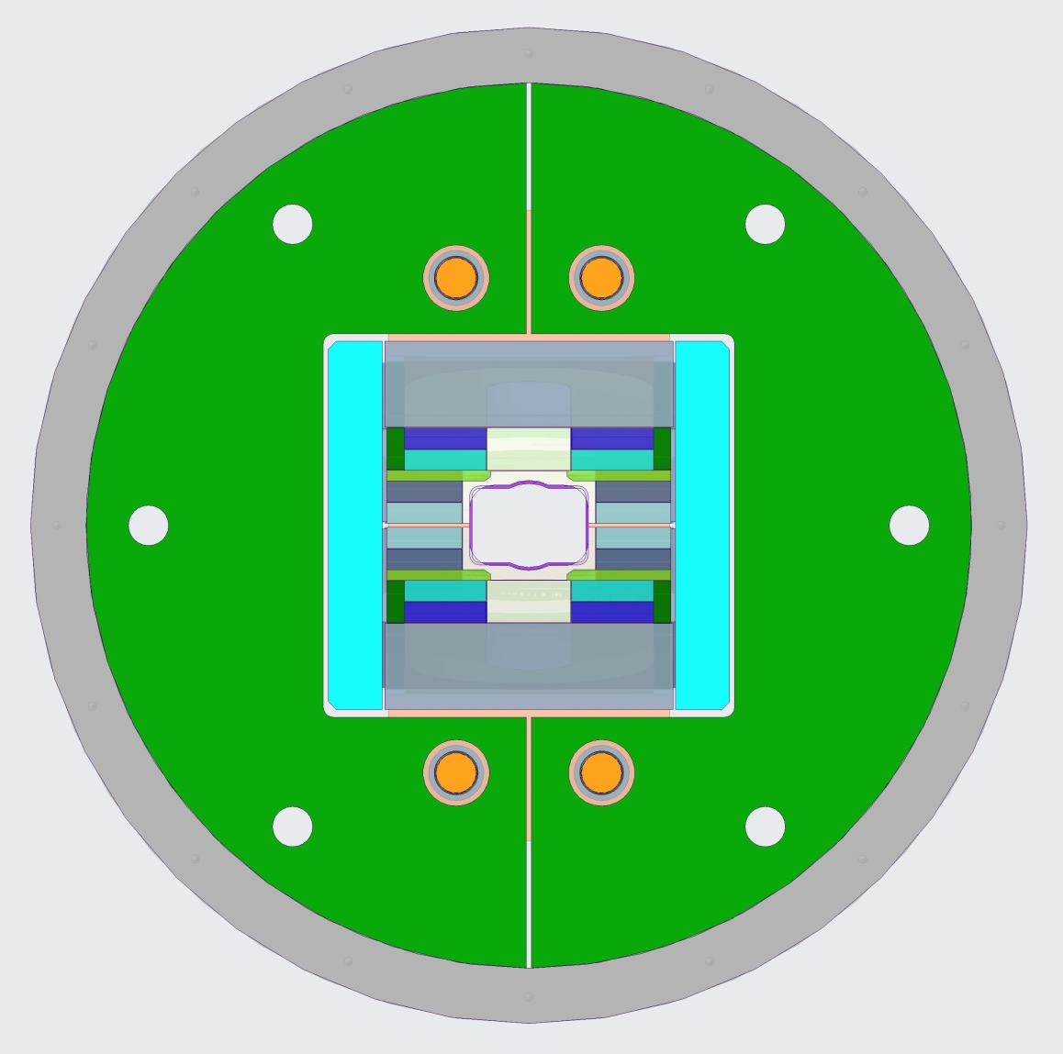
MAGNET ASSEMBLY
Shell dimensions: 1260 mm [49.6”] diameter x 2448 mm [96.4”] long.
Magnet weight: 21220 kg [46800 lbs]
SHELL-YOKE STRUCTURE
COIL PACK ASSEMBLY

Slide 7
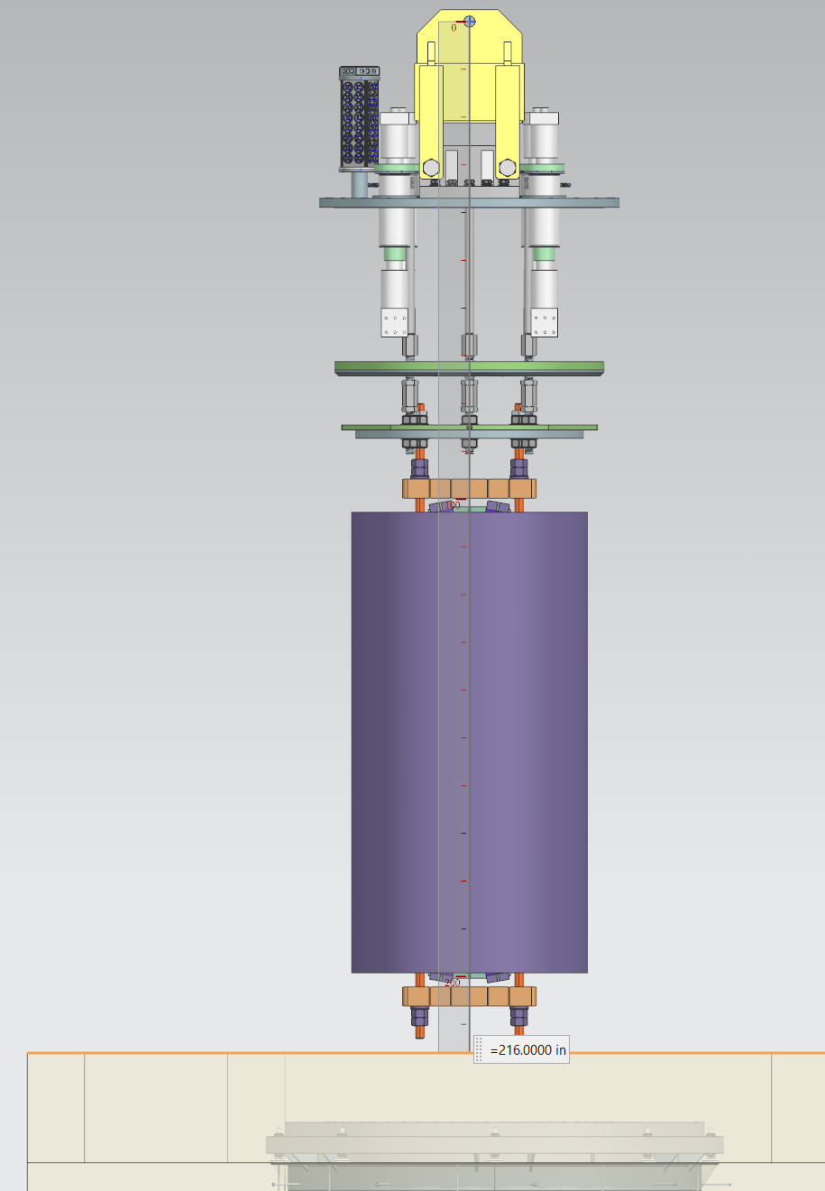
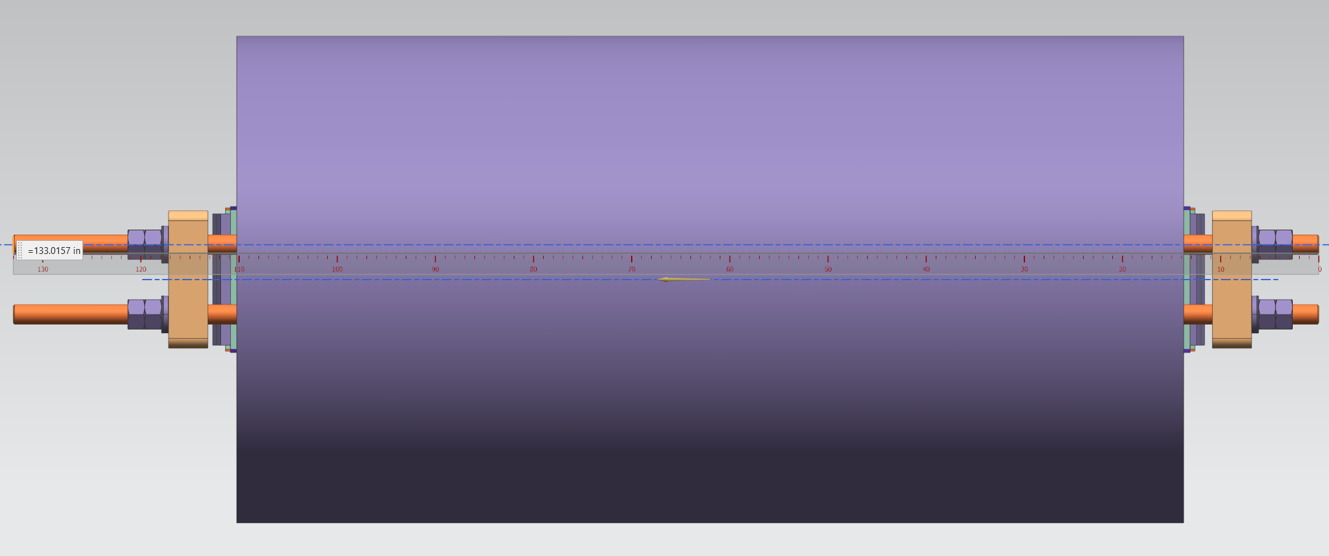
PRELIMINARY TFD MAGNET MODEL provided for Fermilab’s proposed High Field Vertical Magnet Test Facility integration studies
The original TFD Magnet Model provided to Fermilab was the agreed upon length of 3100 mm [122 inches] in total length. Fermilab added 278 mm [11 inches] to facilitate mounting on their header design.
3378 mm
[133 inches]
WEIGHT: 21220 kg [46800 lbs]
1260 mm OD
[49.6 inches]
Images provided by Cosmore Sylvester and Clark Reid, FNAL

Slide 8
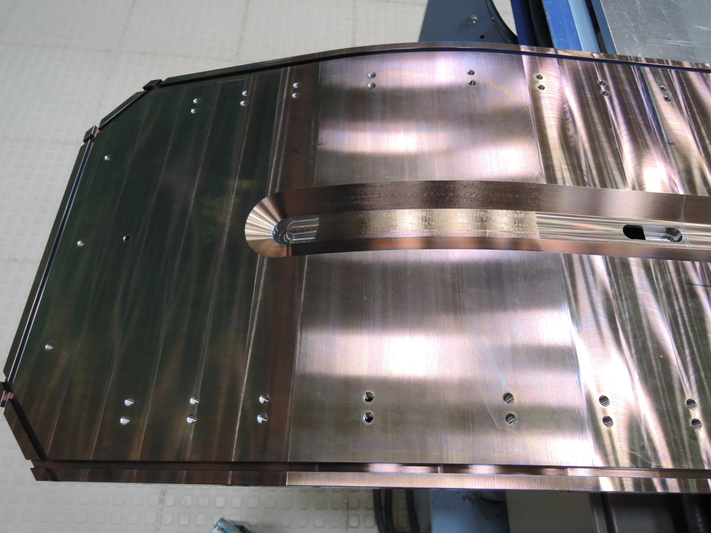
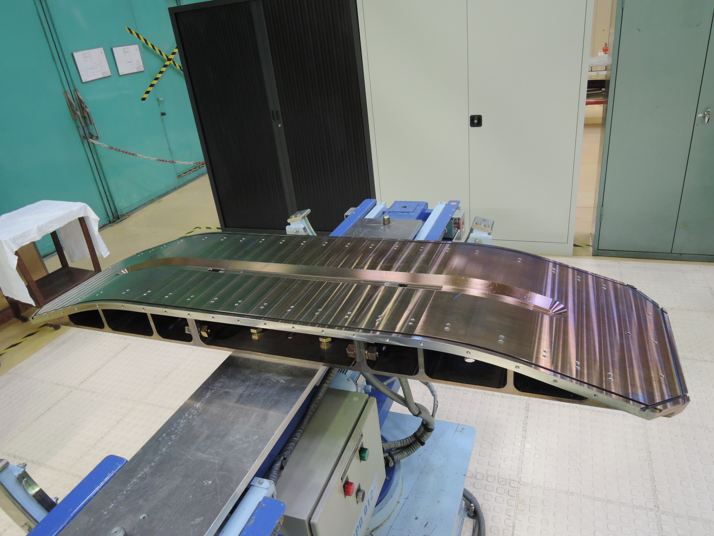
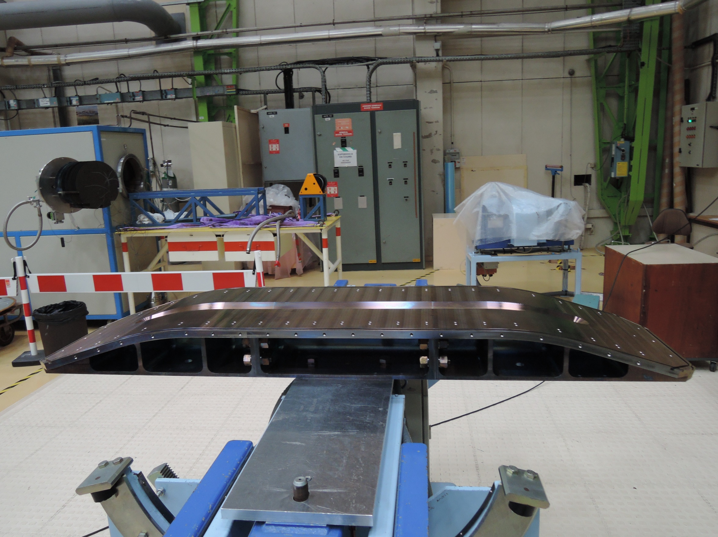
Collaboration with CEA
Coil winding & handling tooling designs as well as winding techniques and overall experiences were shared
Tooling pictures and winding experiences were provided and shared by Françoise Rondeaux and Pierre Manil, CEA

Slide 9
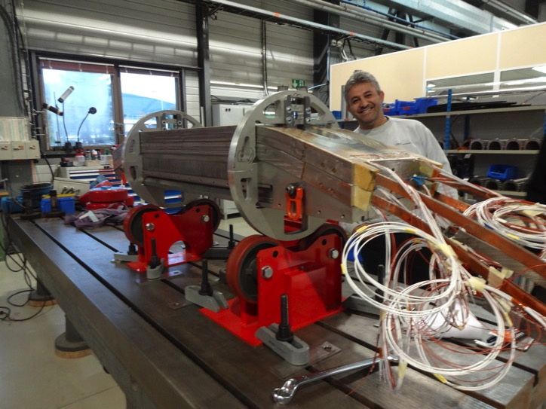
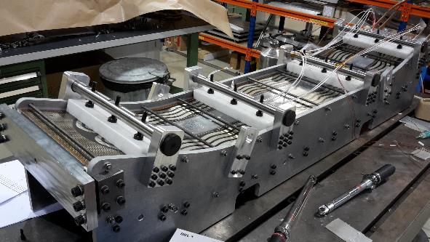
Collaboration with CERN
Coil winding & handling tooling designs as well as winding techniques and overall experiences were shared.
Pictures of Coil Handling fixtures and fabrication experiences were provided by Juan Carlos Perez, CERN

Slide 10
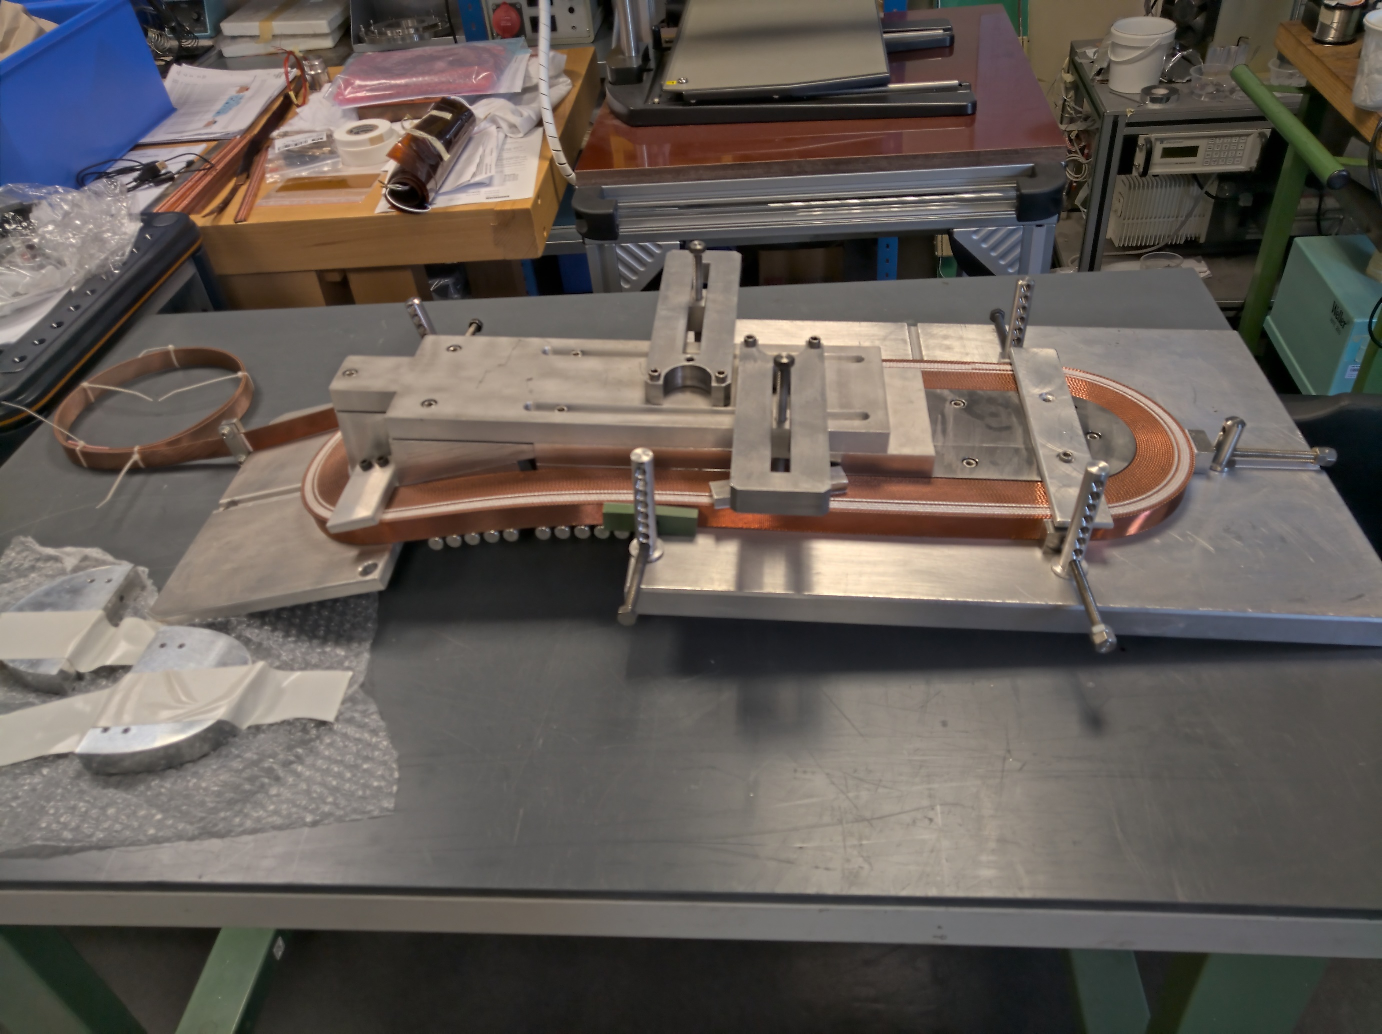
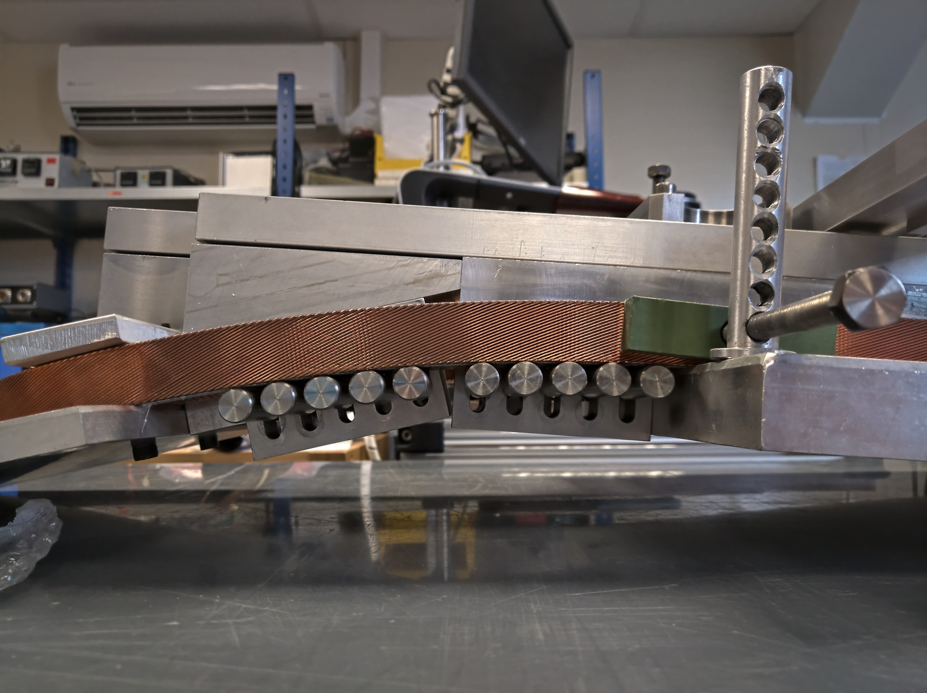
Collaboration with CERN
Coil test winding of preliminary cable made at LBNL and sent to CERN.
Pictures of the preliminary cable that was test wound in the CERN winding fixture - from Juan Carlos Perez, CERN

Slide 11
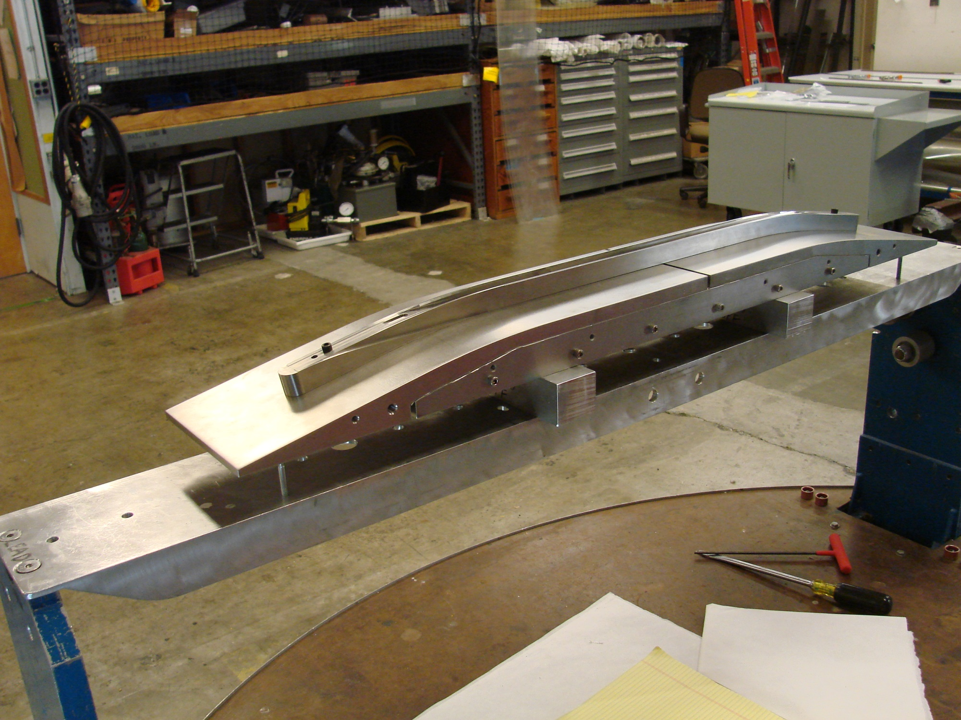
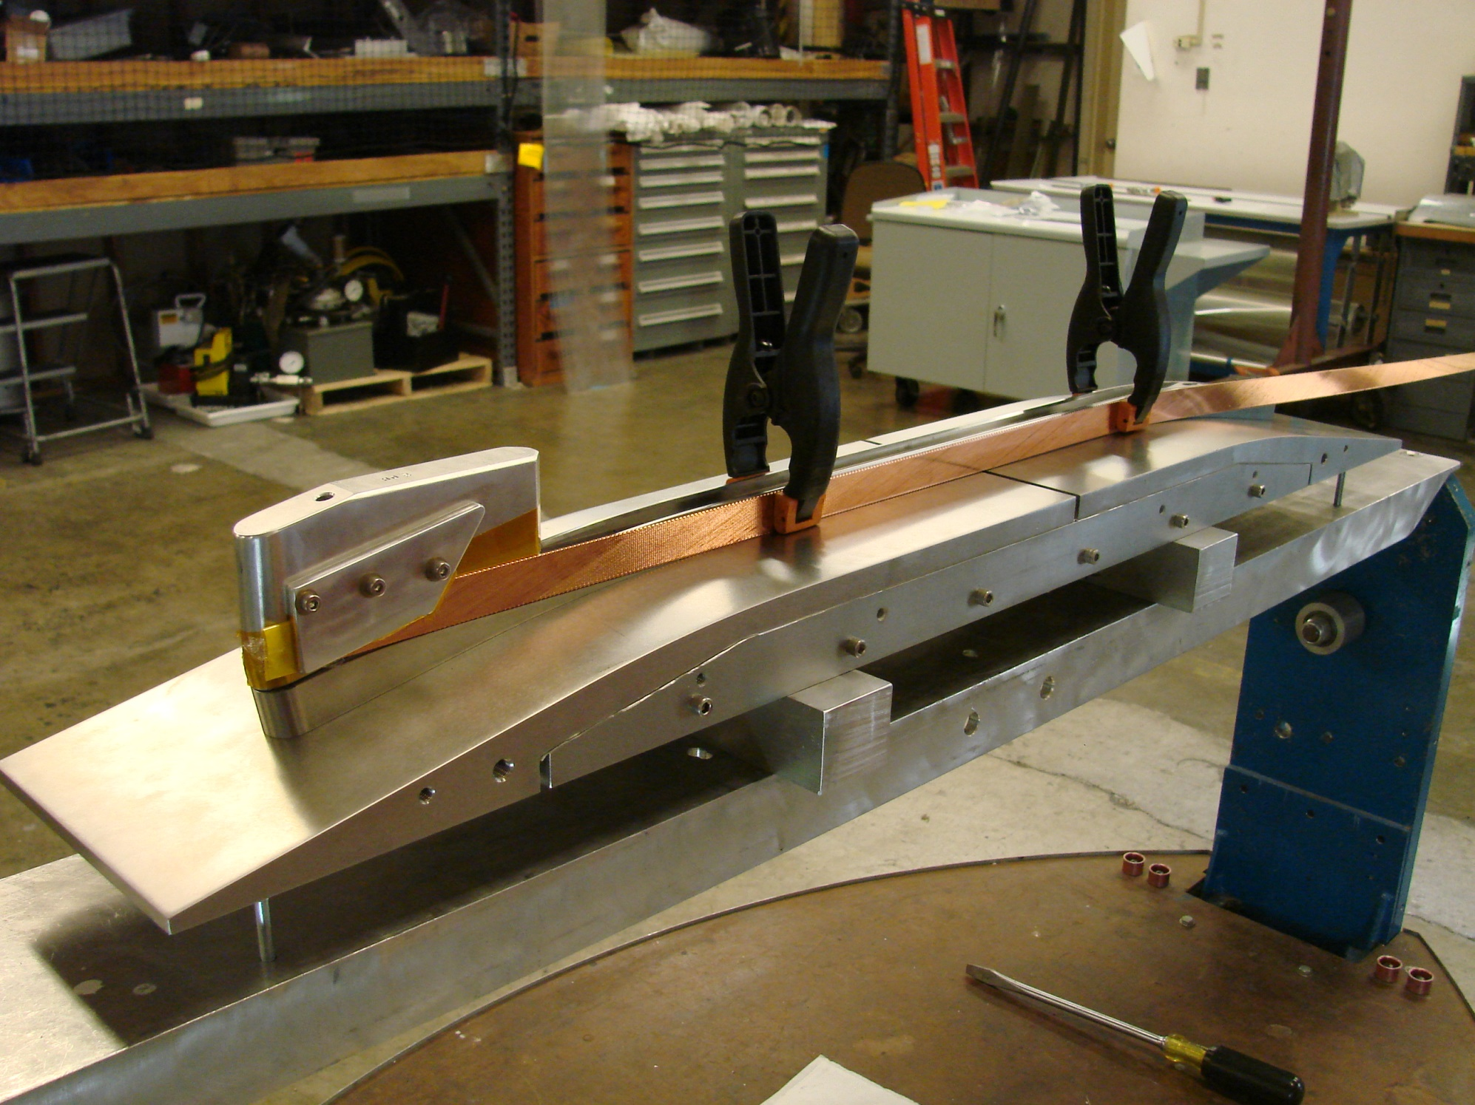
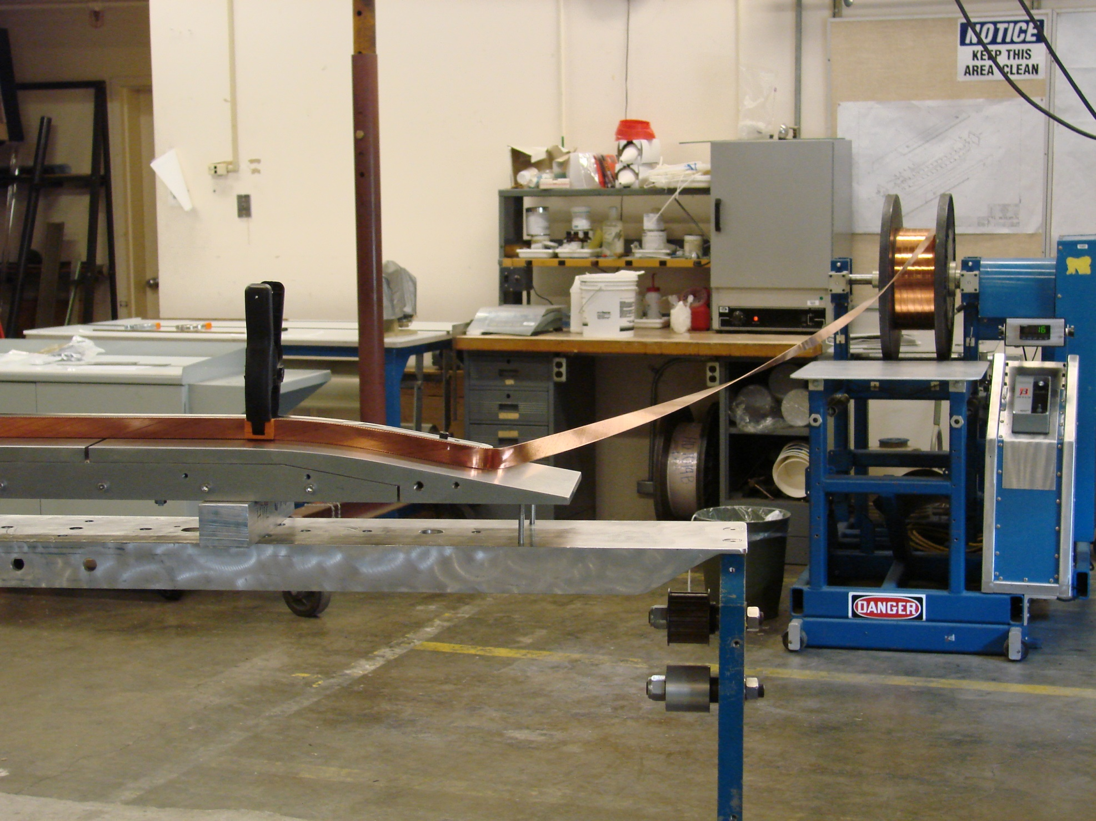
Our fabrication experience on HD2 and HD3 Dipole Magnet Coils
Pictures from HD3 Coil Test Wind (2010)
The conductor cable was wound at 25 lbs [110 N] tension and was twisted, in the “tightening” direction.

Slide 12
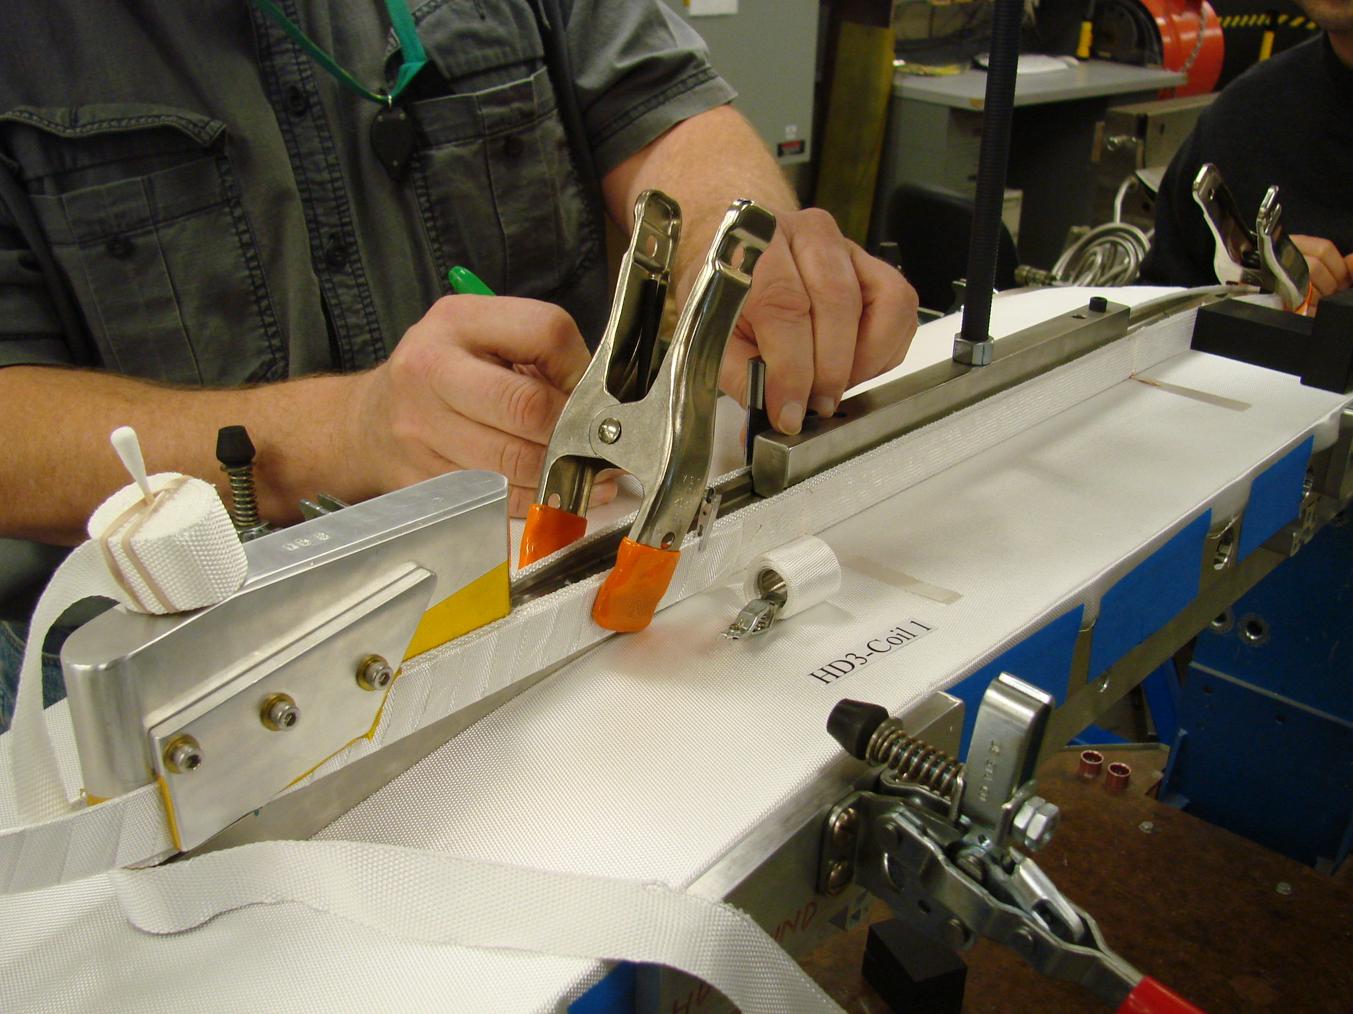
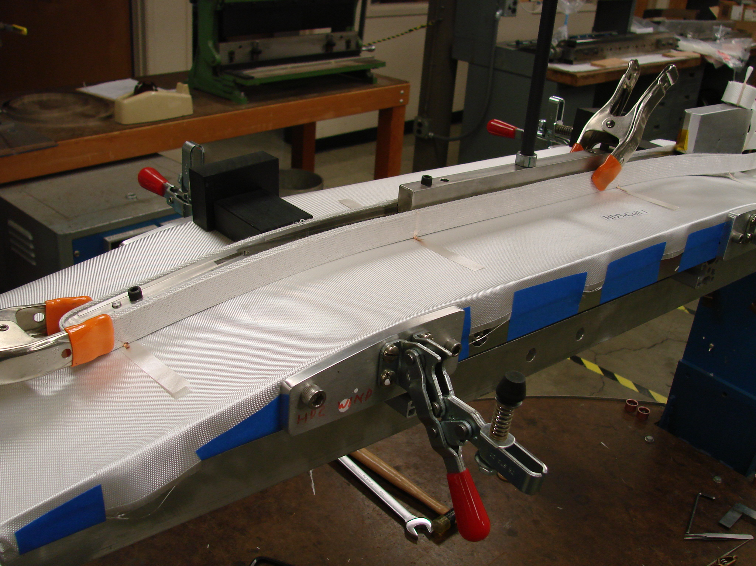
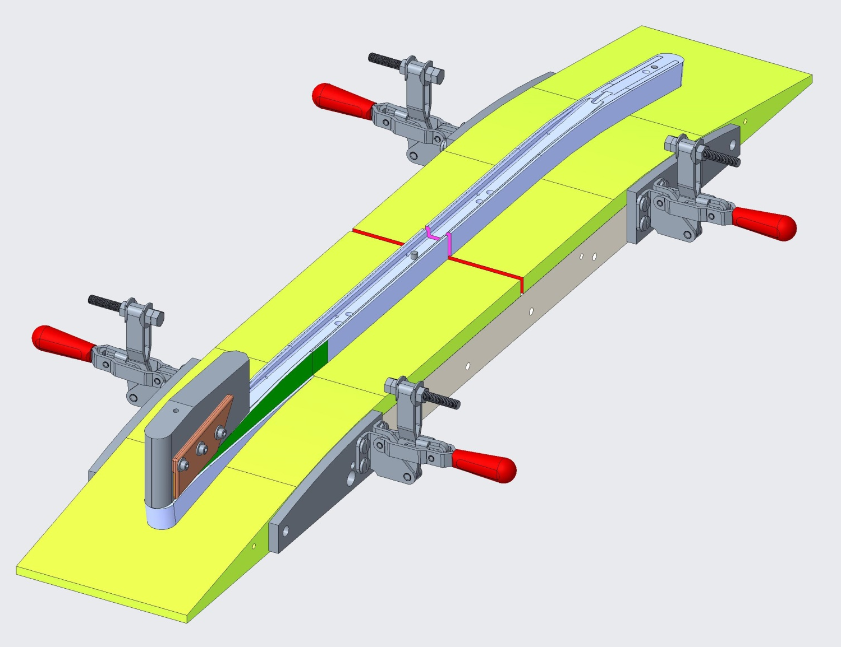
Our fabrication experience on HD2 and HD3 Dipole Magnet Coils
Pictures from HD3 Coil Fabrication effort (2010)

Slide 13
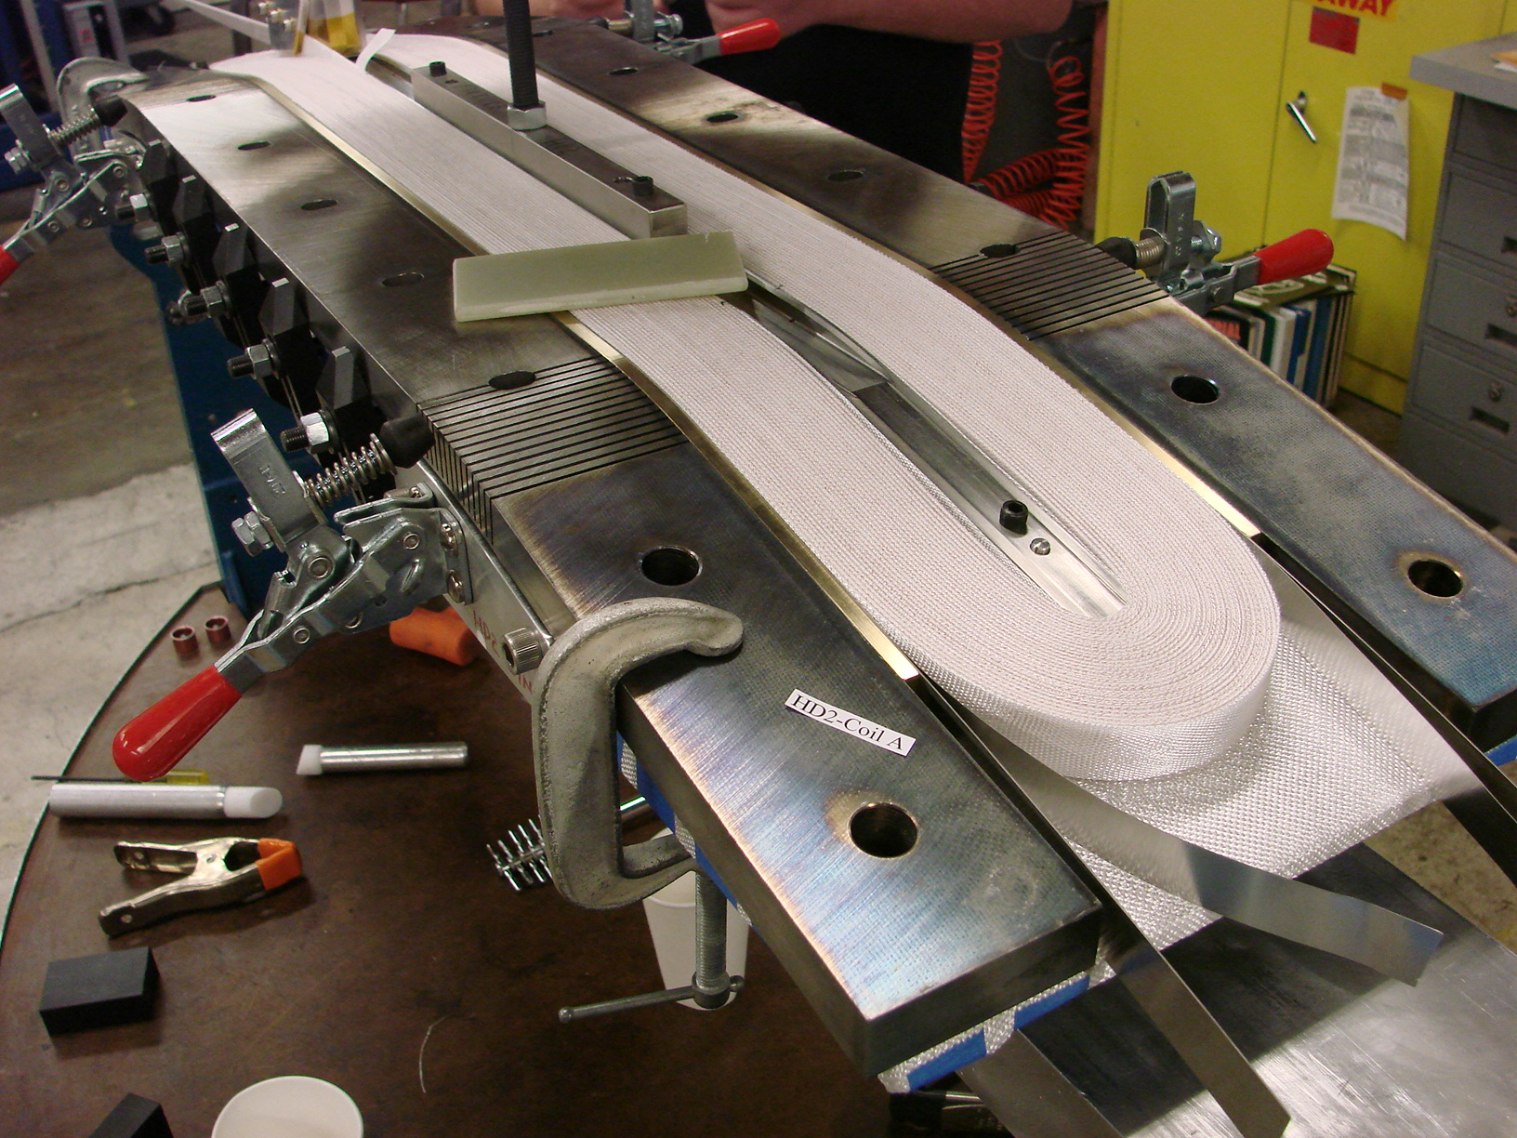
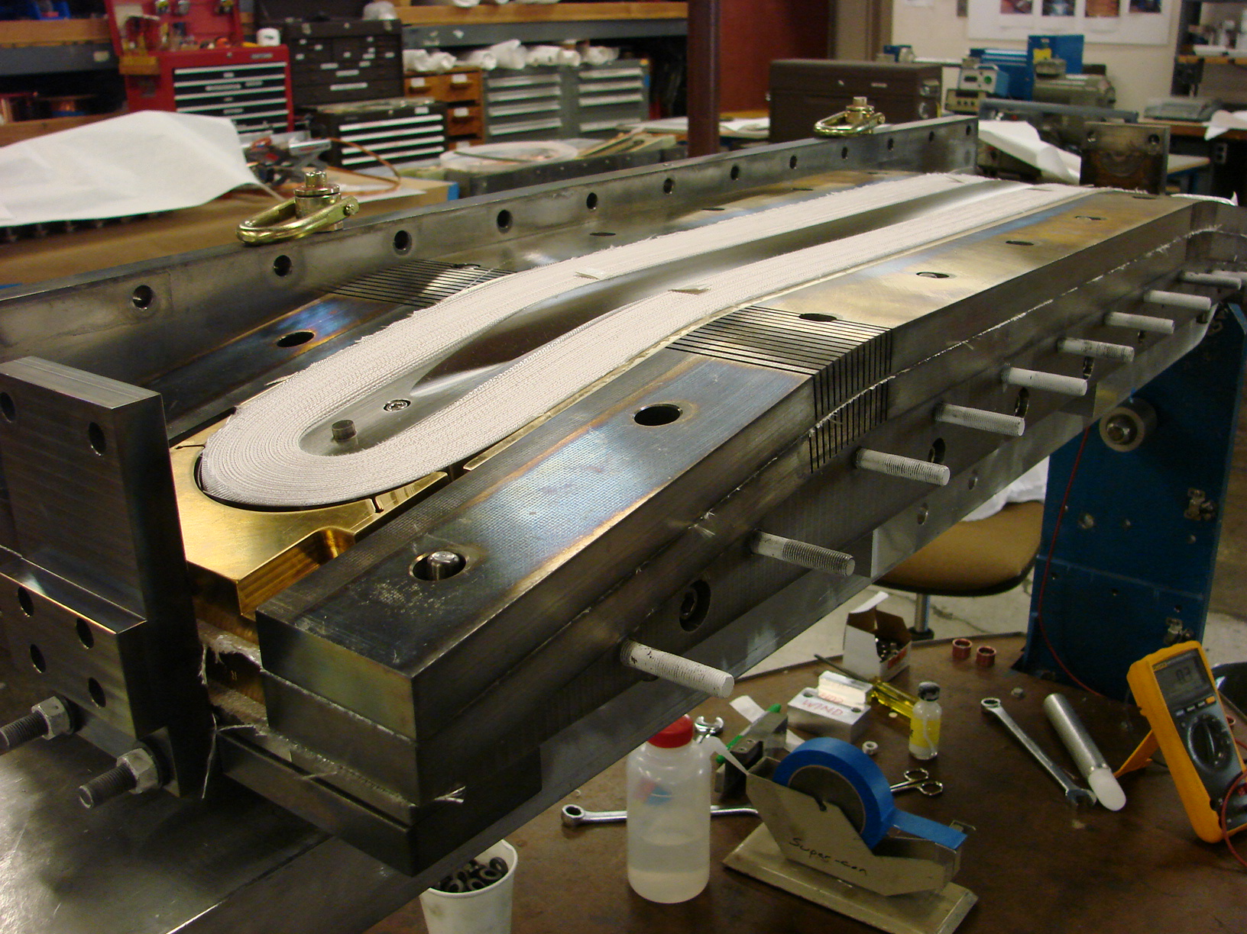
Our fabrication experience on HD2 and HD3 Dipole Magnet Coils
Pictures from HD2 Coil Fabrication effort (2010)
Layer 1 winding complete
Layer 2 winding complete

Slide 14
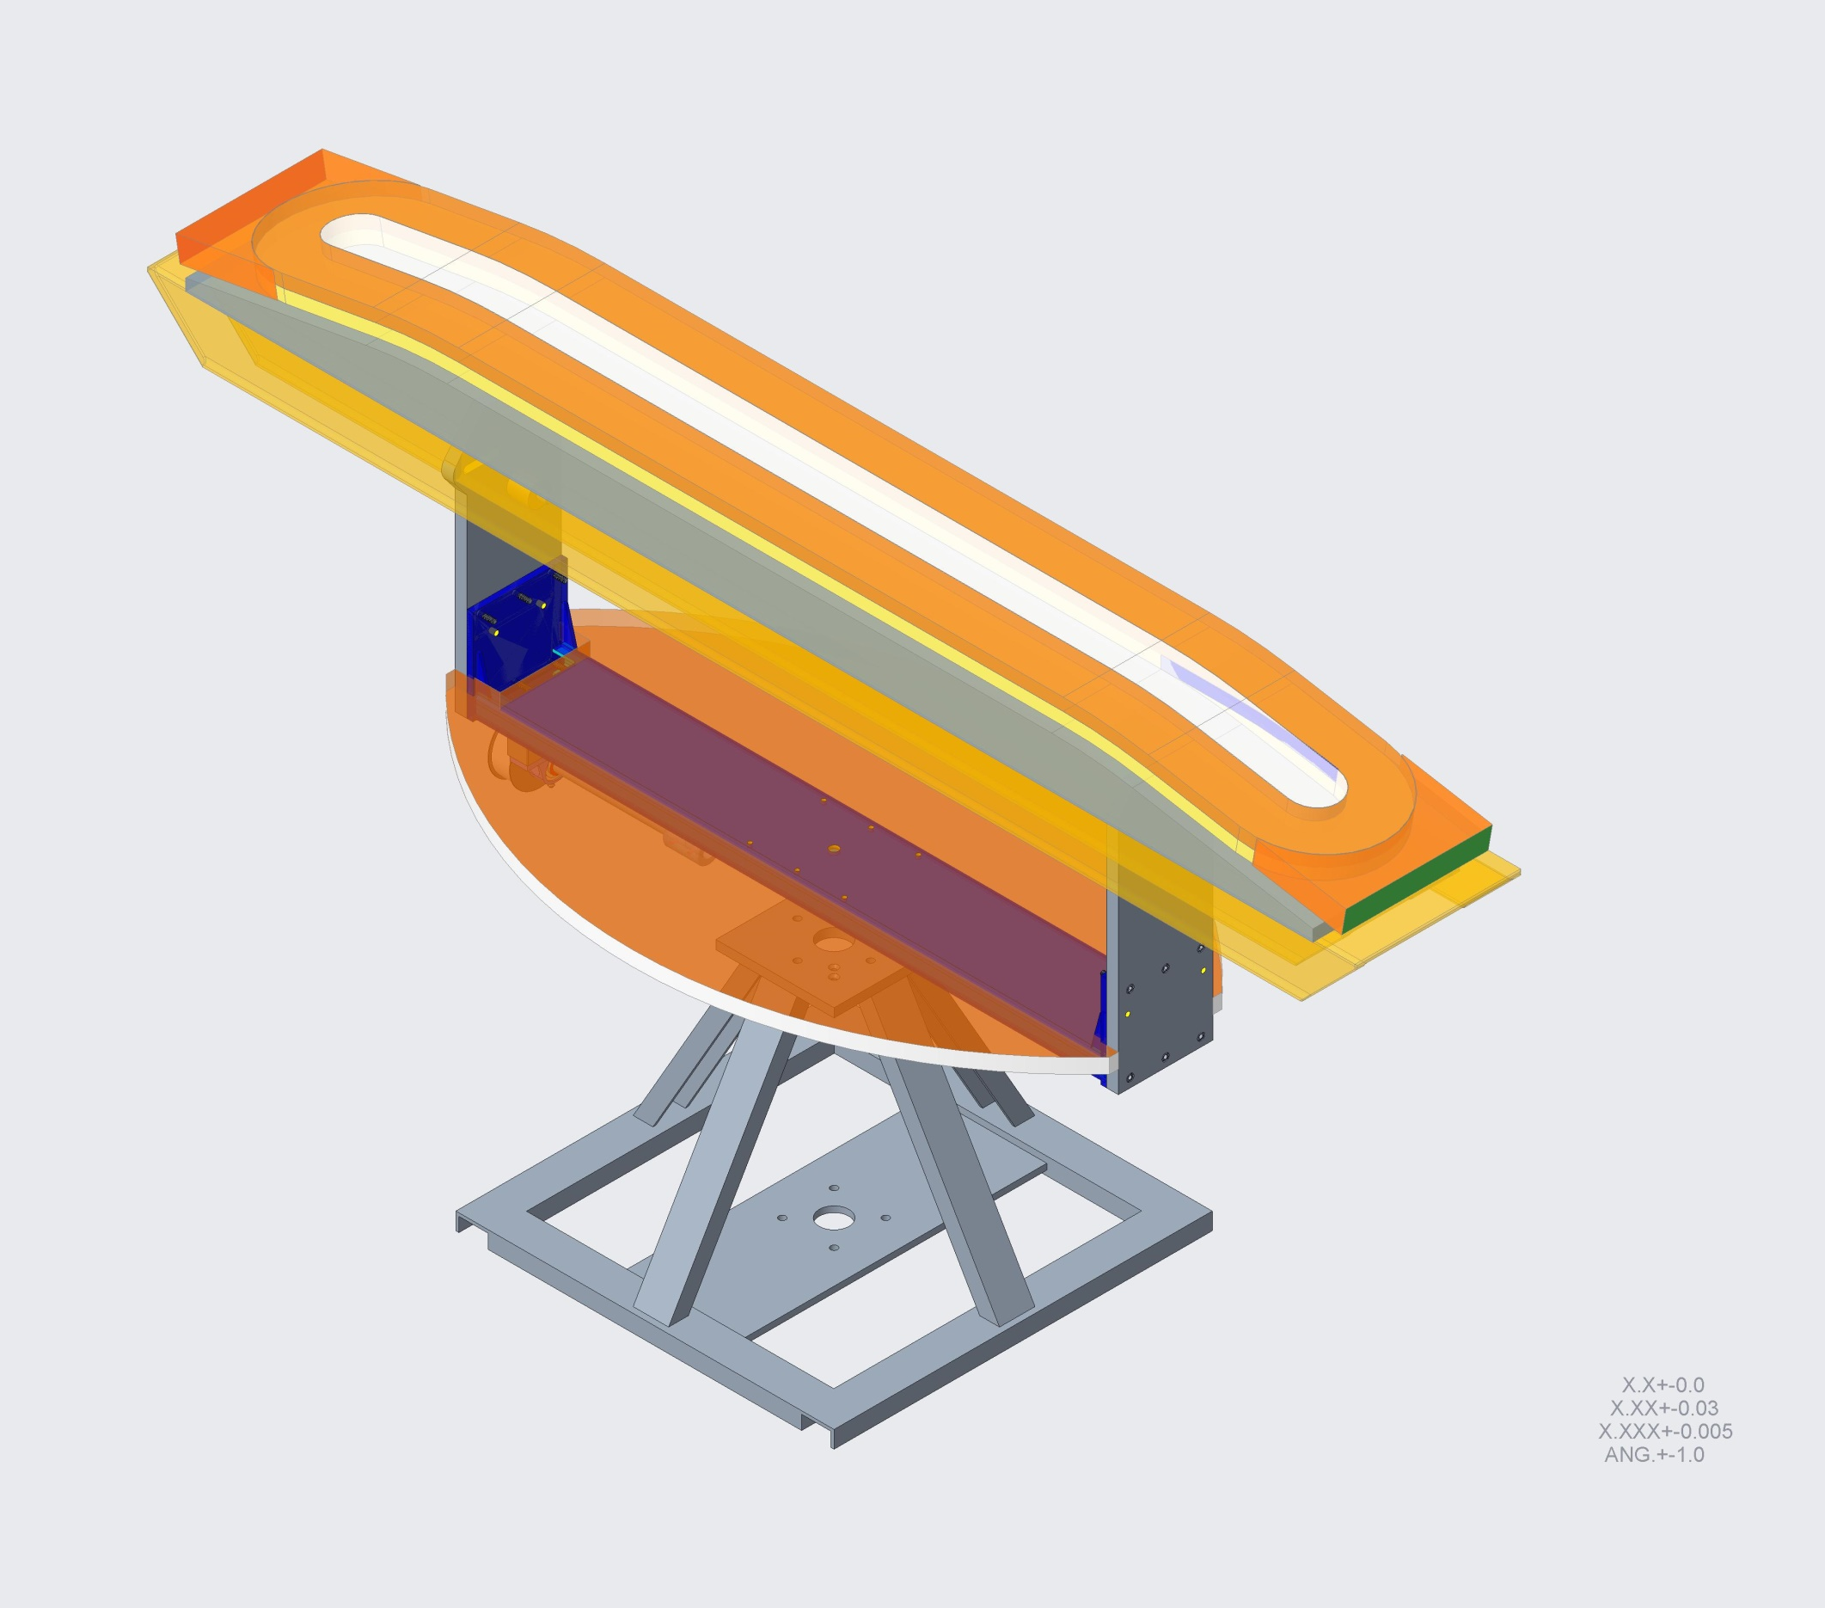
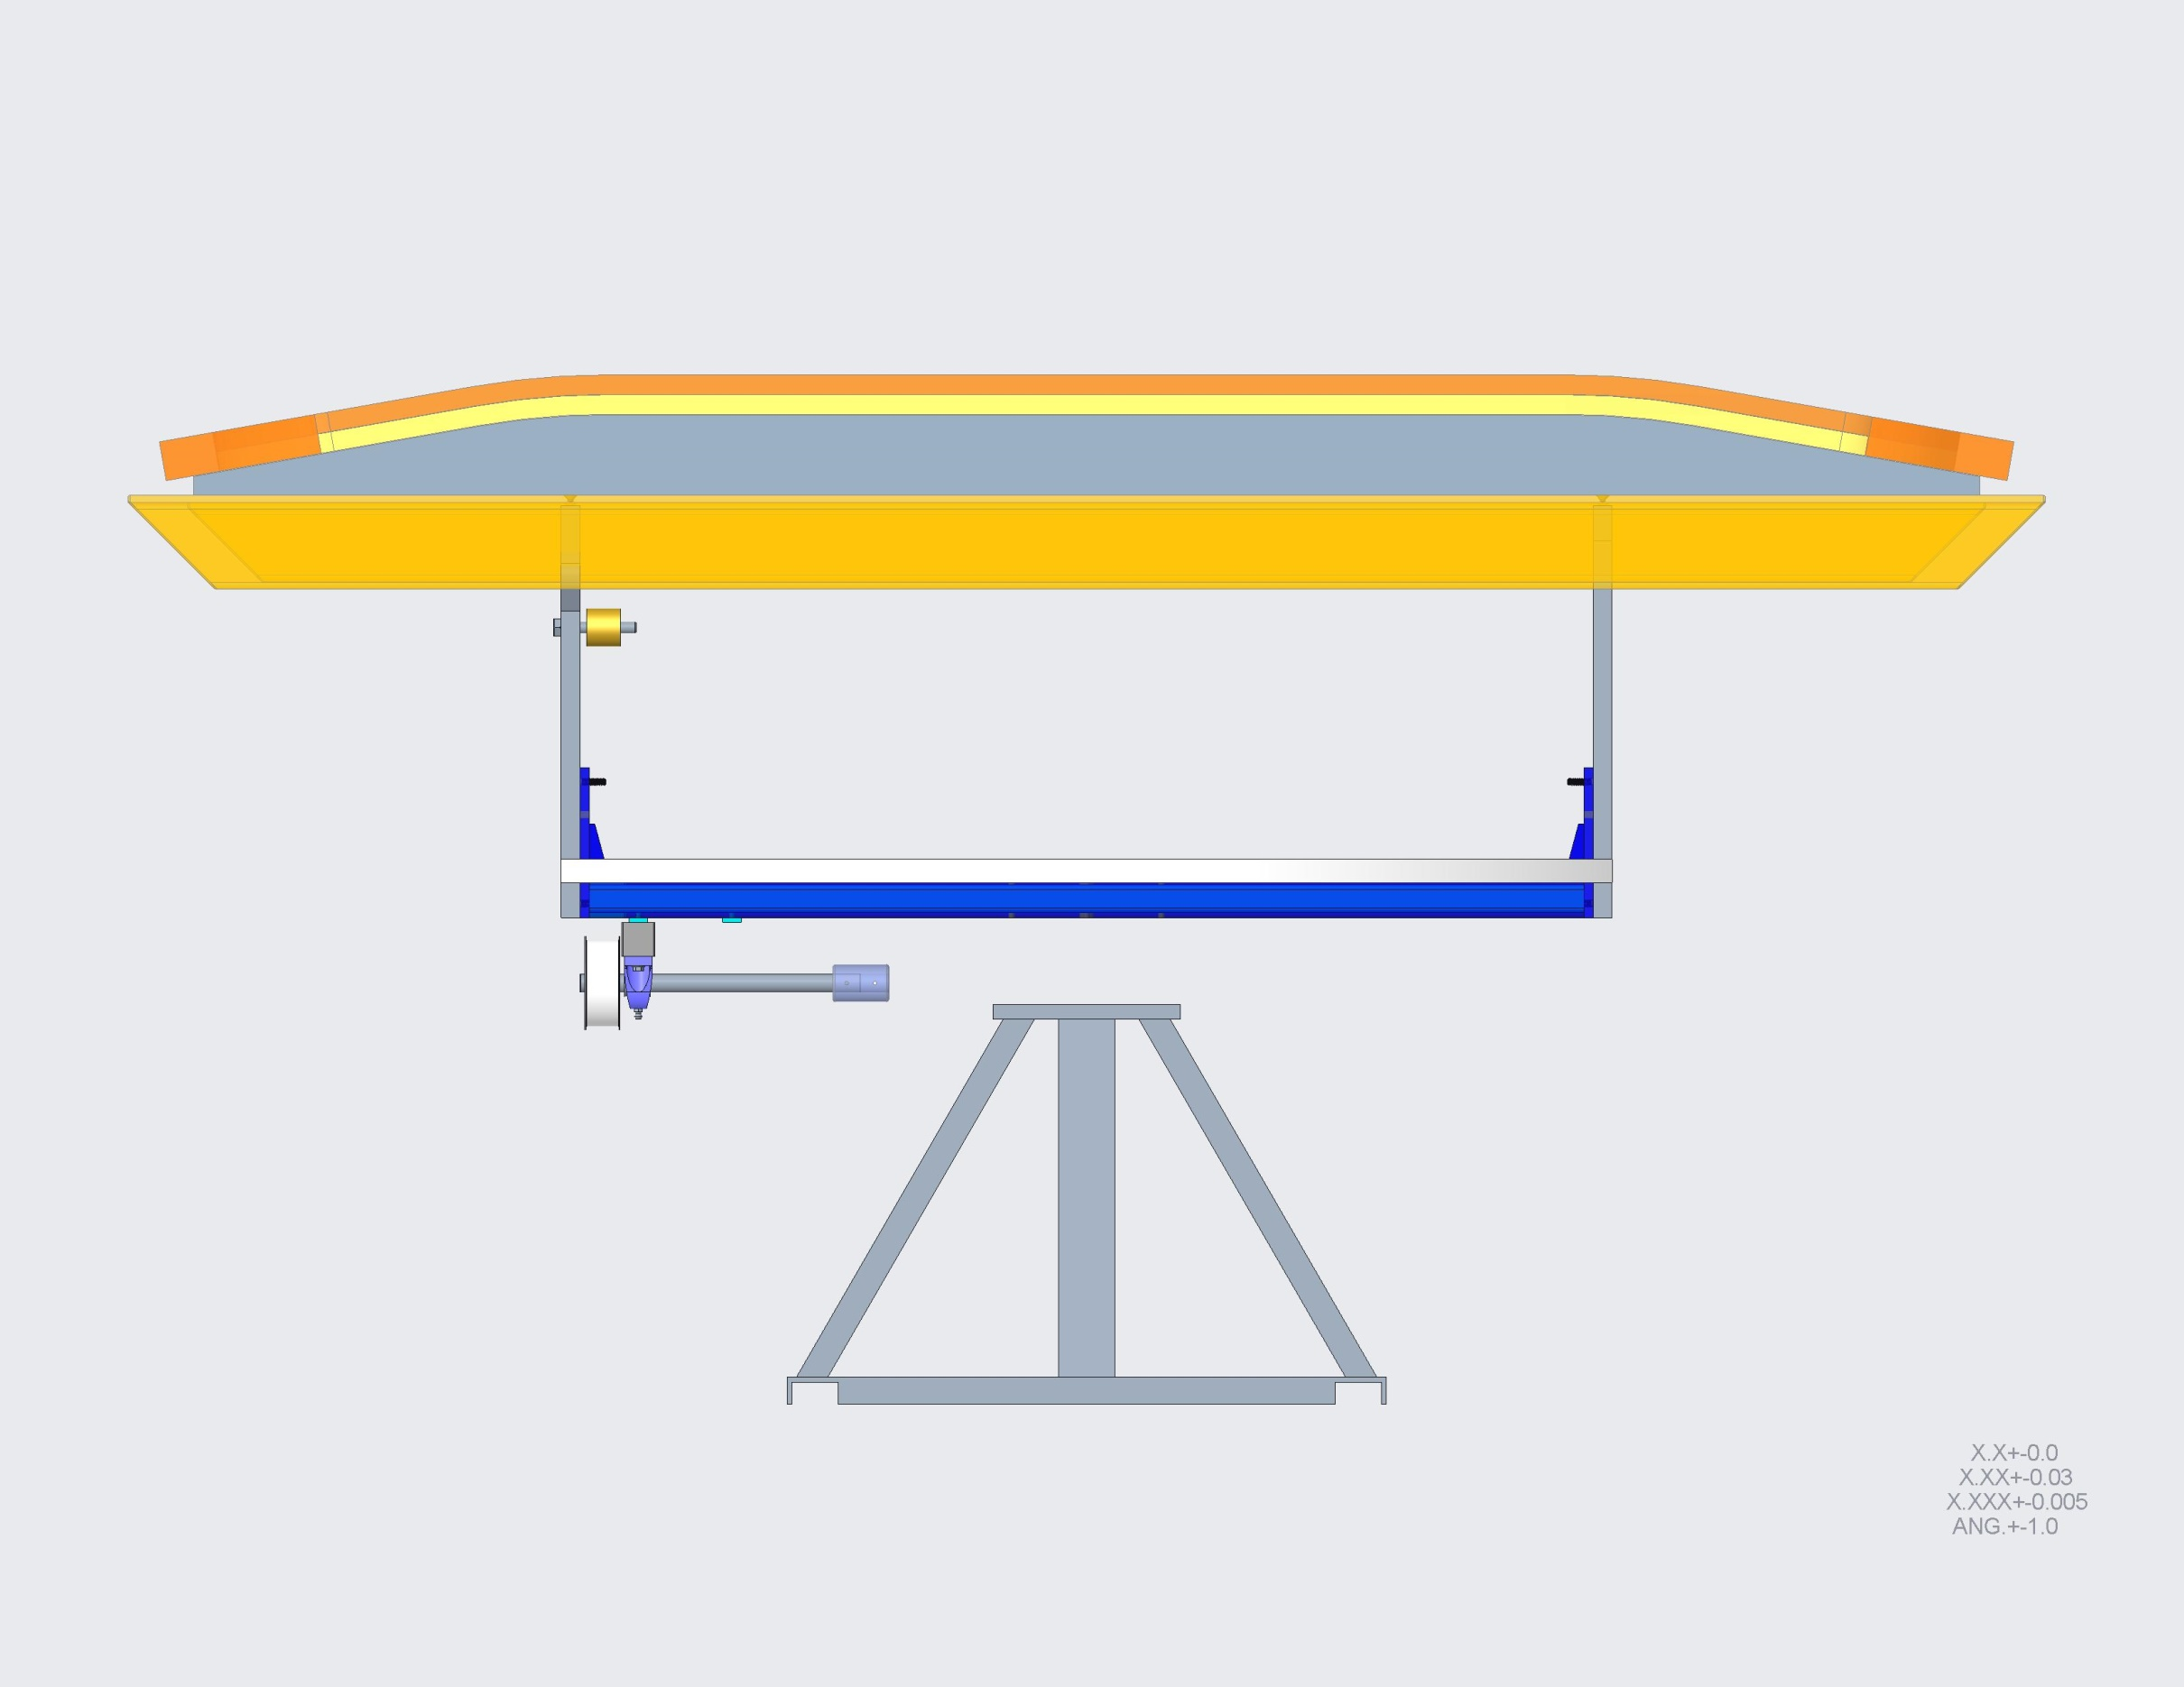
COIL WINDING TABLE
(To be modified or replaced with a more adequate design)
The coil assembly, alone (without tooling), weighs 740 lbs [334 kg]
2515 mm
[99 inches]

Slide 15
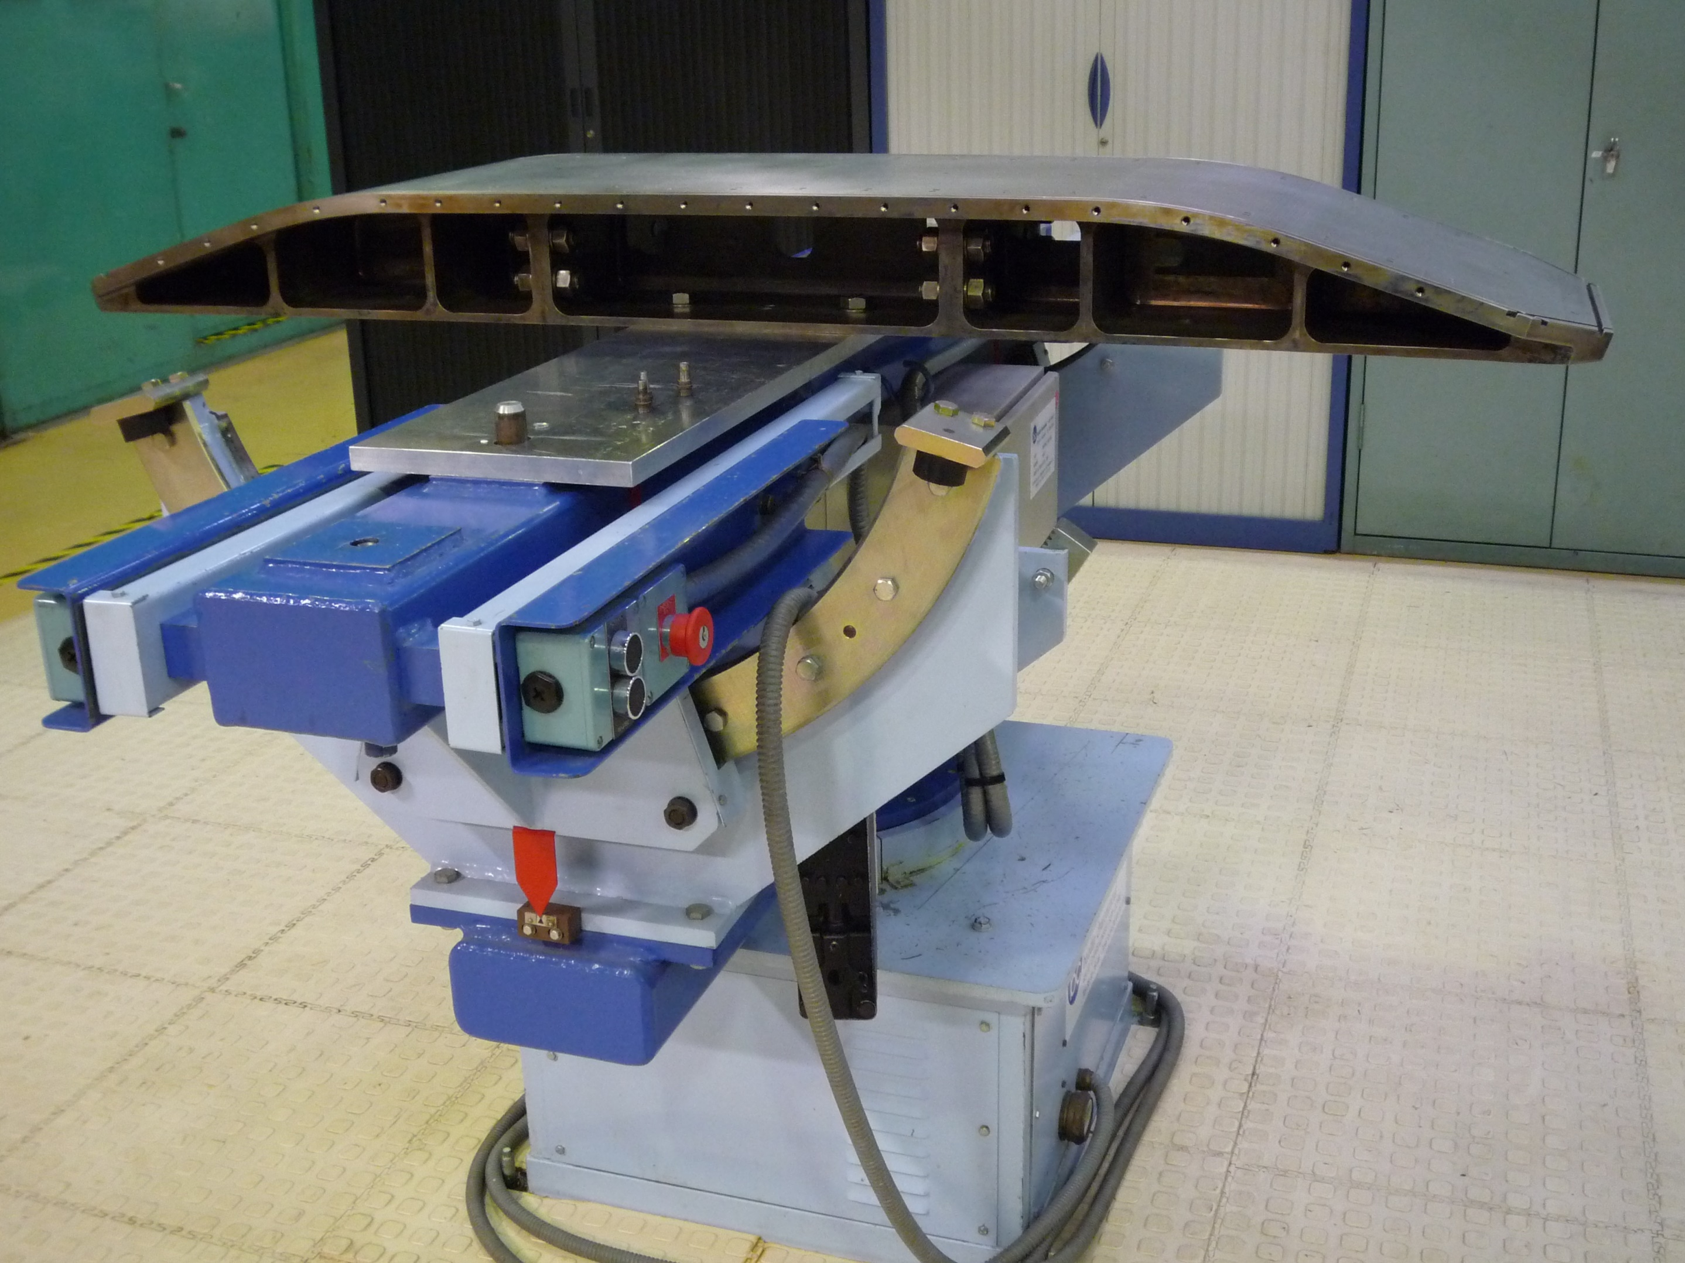
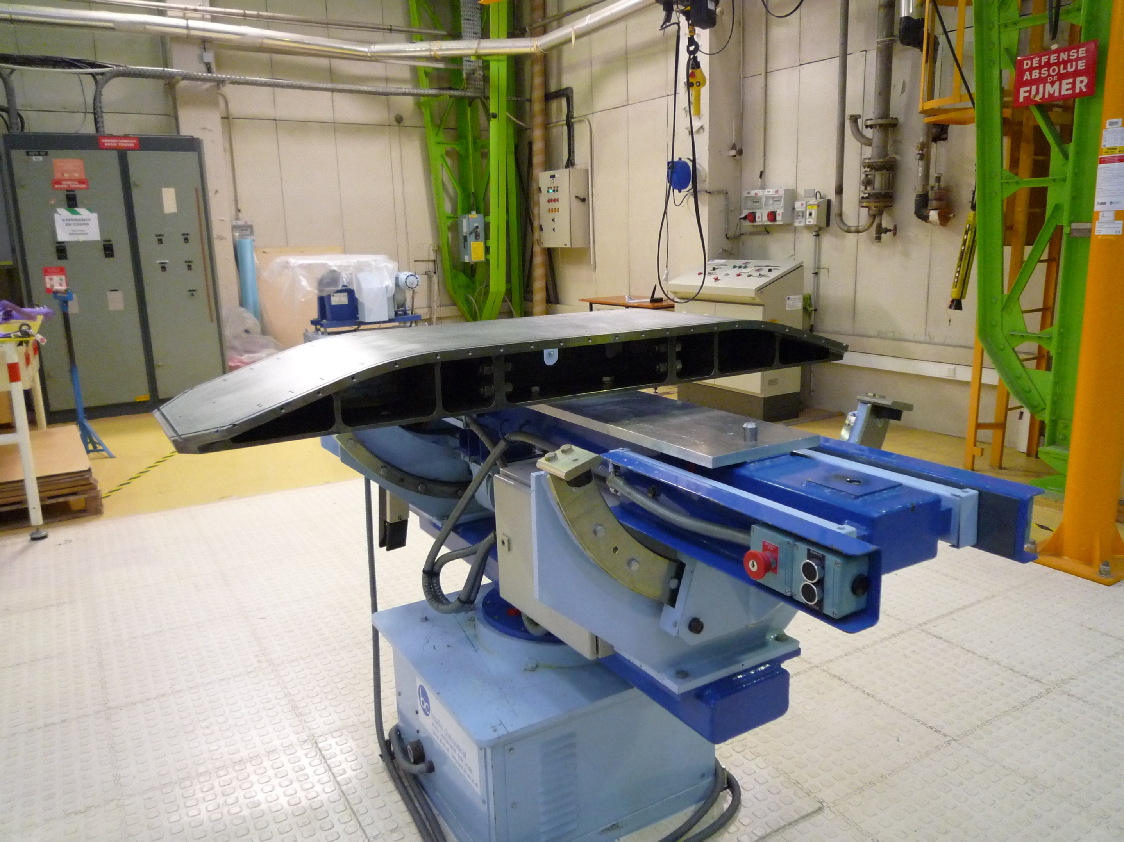
CEA’s COIL WINDING TABLE

Slide 16
WINDING NOTES AND COMPARISONS
> In their coil winding processes, both CEA and CERN employed a tilting operation to align the flare angle to the cable tensioning device.
        When we wound the HD2 coils, we guided the cable down on the winding fixture table as we were winding around the ends. The turns seemed to hold very well in position since we were winding at 25 lb. [111 N] tension and we applied the quick-release clamps to hold tension as the winding made it around the other side of the end.
> The FRESCA2 coil winding tooling utilized 2 gaps to relieve stresses in winding tension.
We plan to replicate the single-gap tooling we had designed for the HD3 coil. This simplifies the reaction tooling and assures alignment.

Slide 17
BACKUP SLIDES

Slide 18
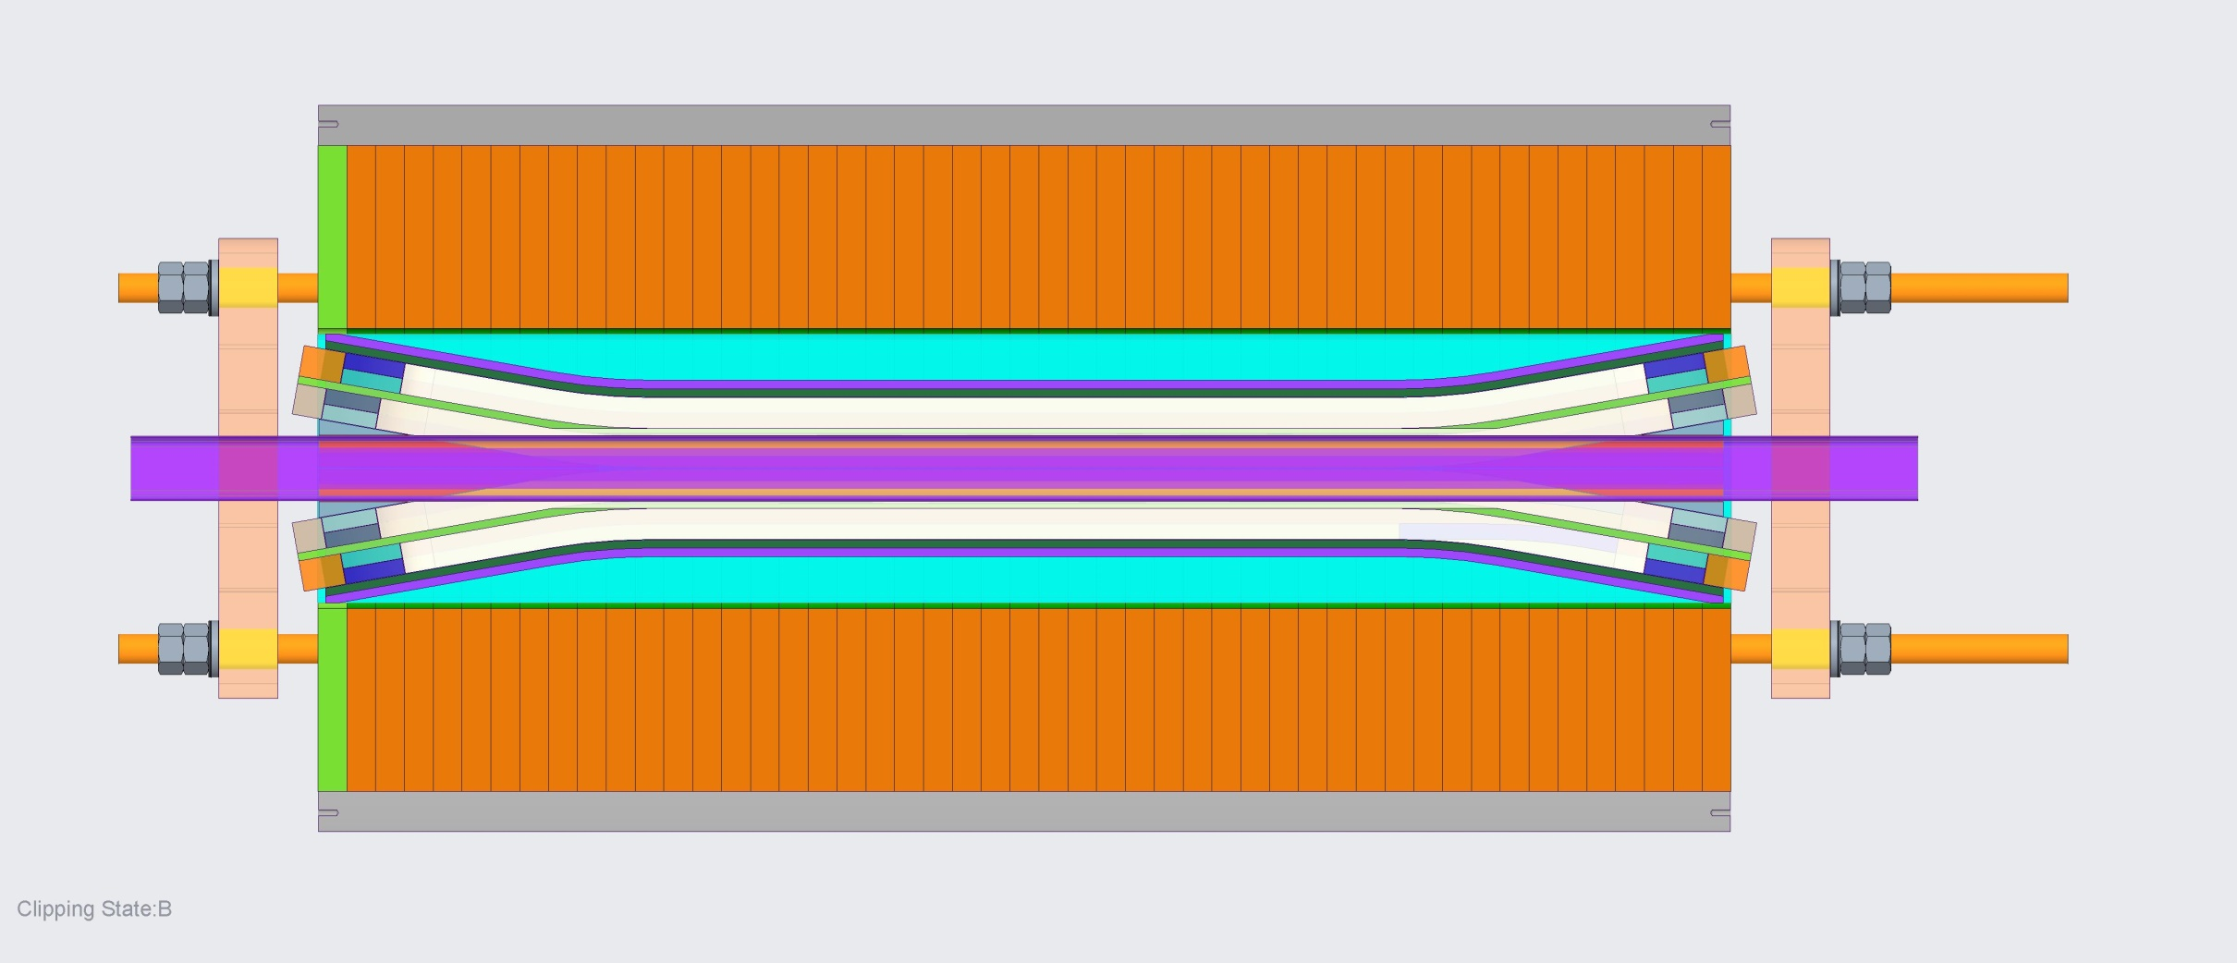
BACKUP SLIDES

Slide 19
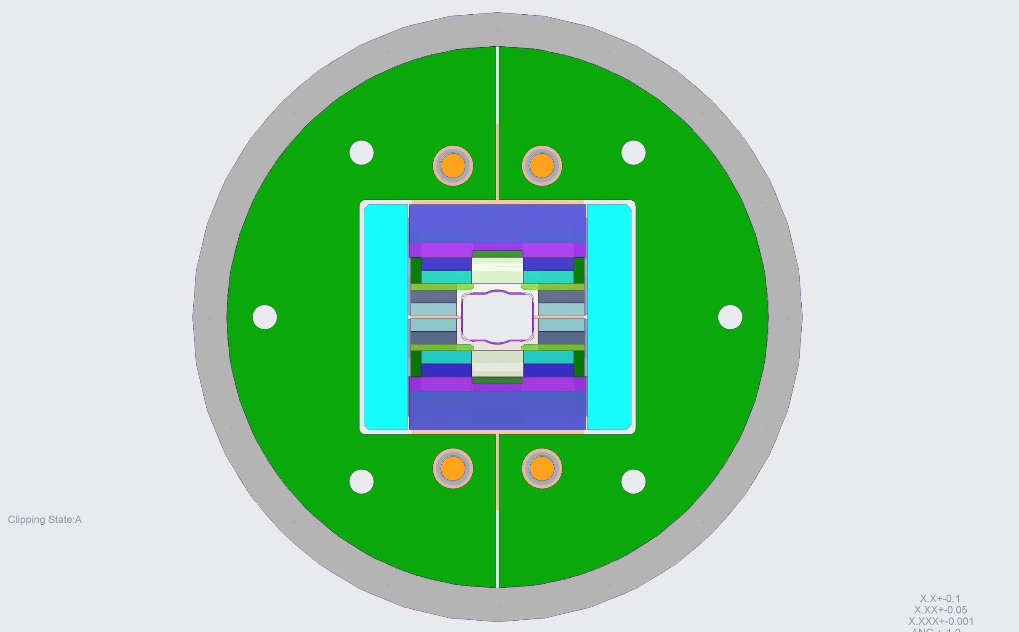
BACKUP SLIDES

Slide 20
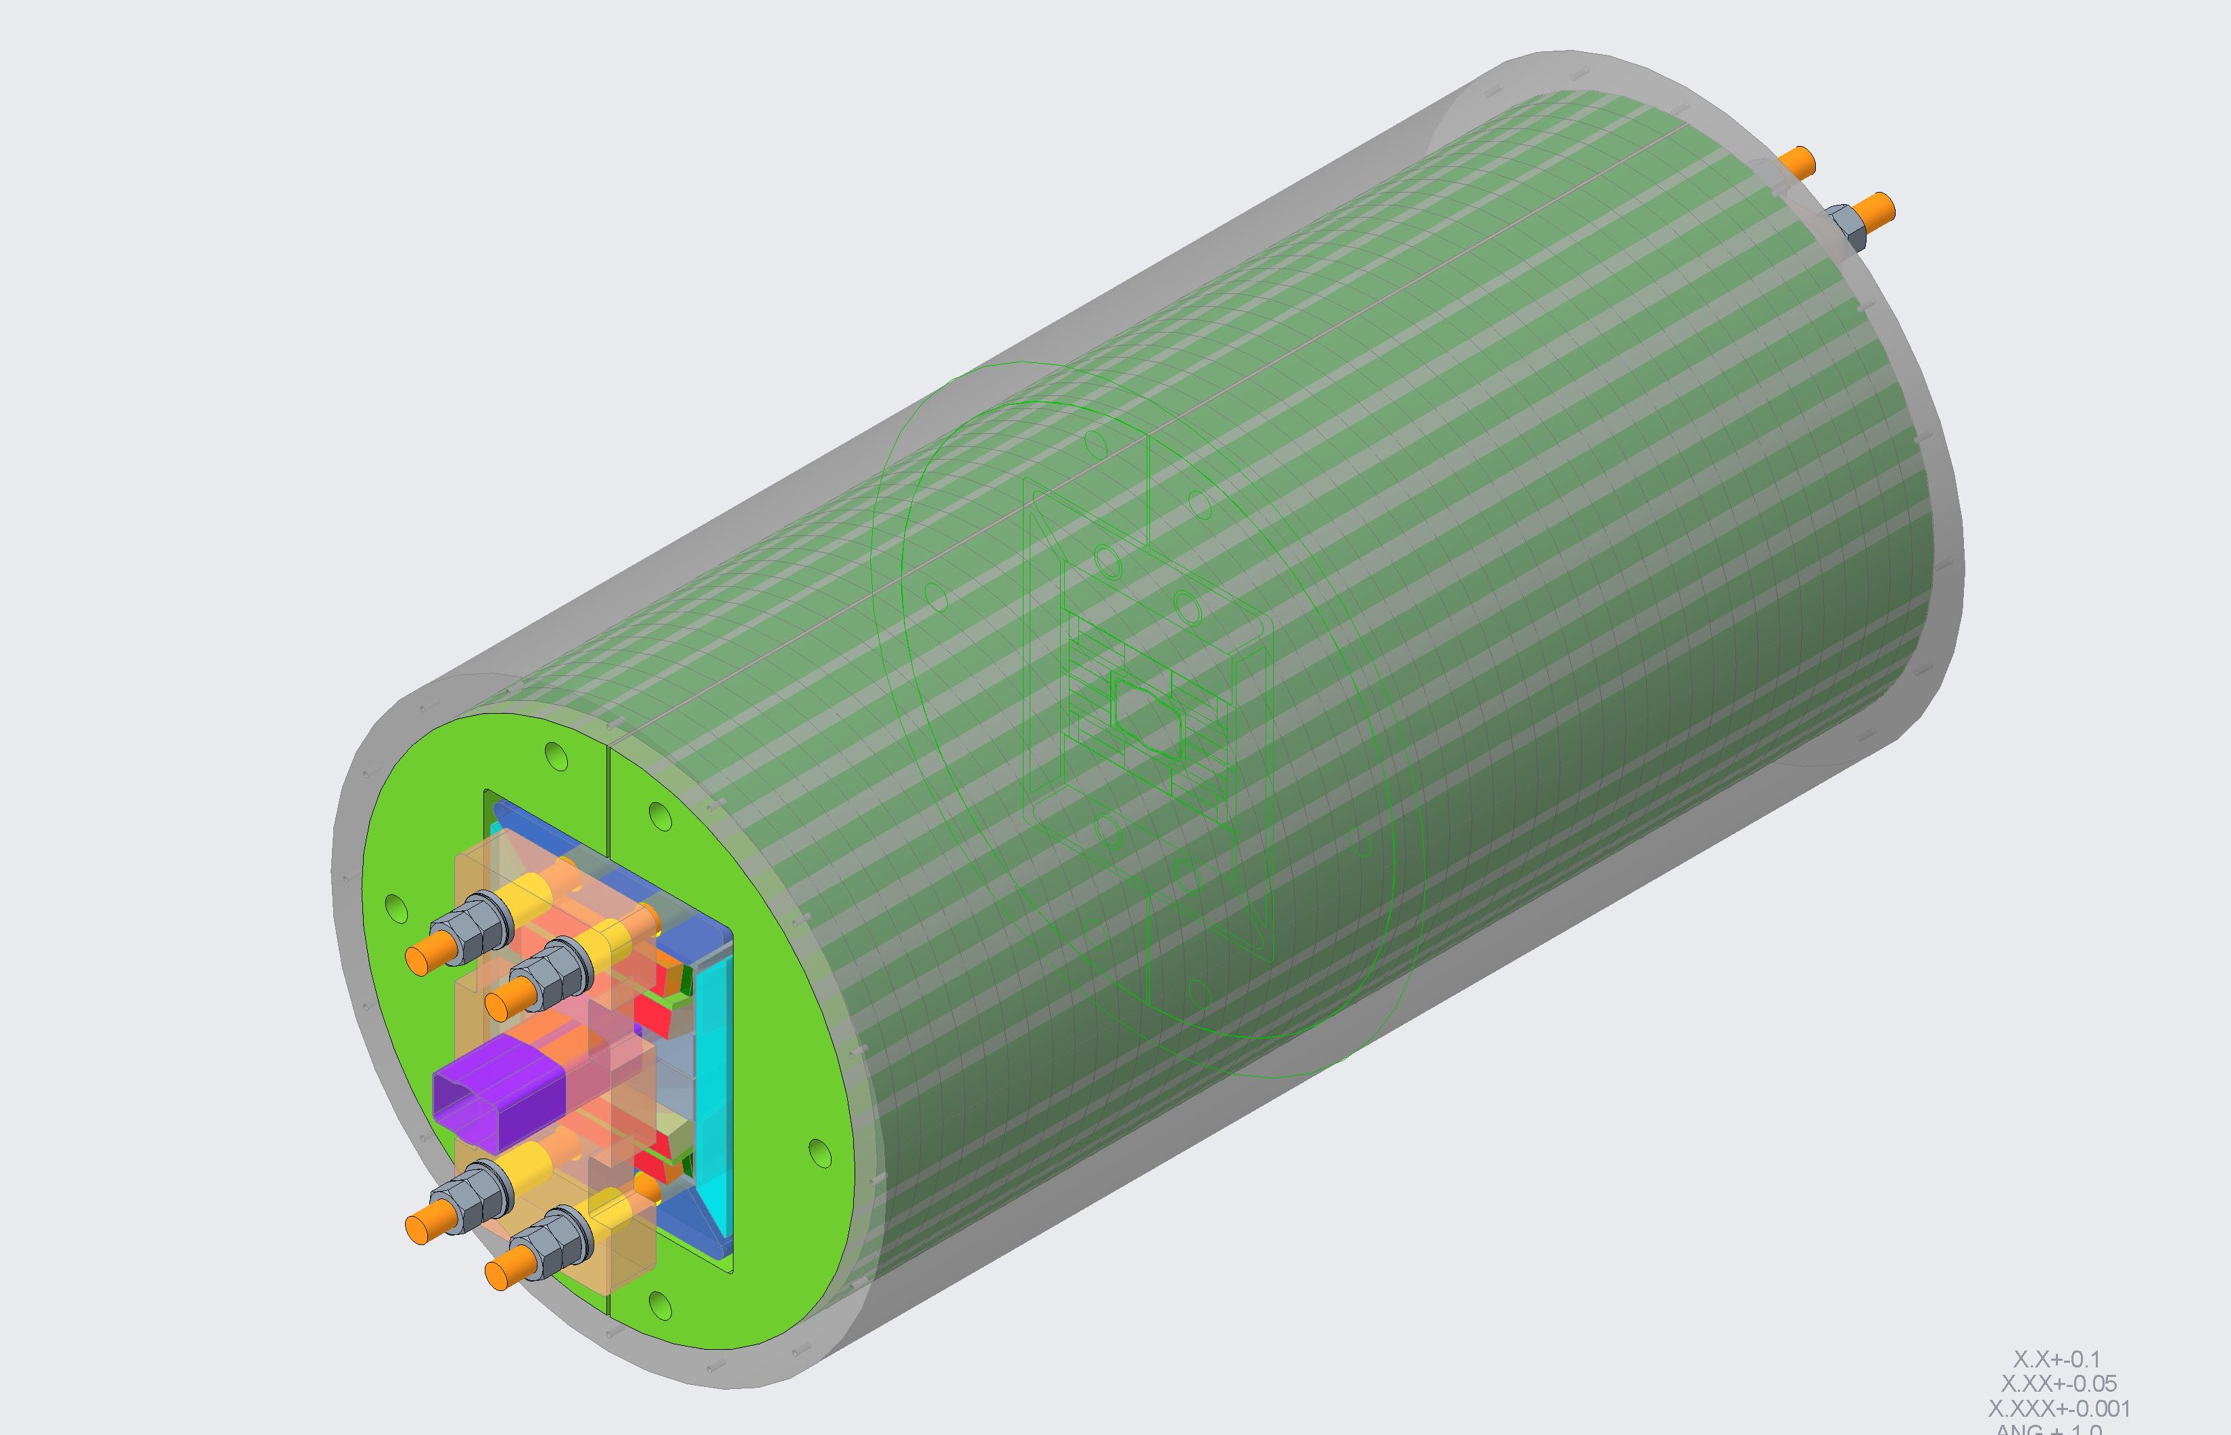
BACKUP SLIDES

