Slide 1



G. Sabbi, LBNL
Integrated Project Team Meeting #4
September 15, 2020
TFD Magnet Updates

Slide 2
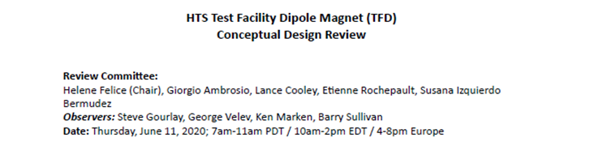
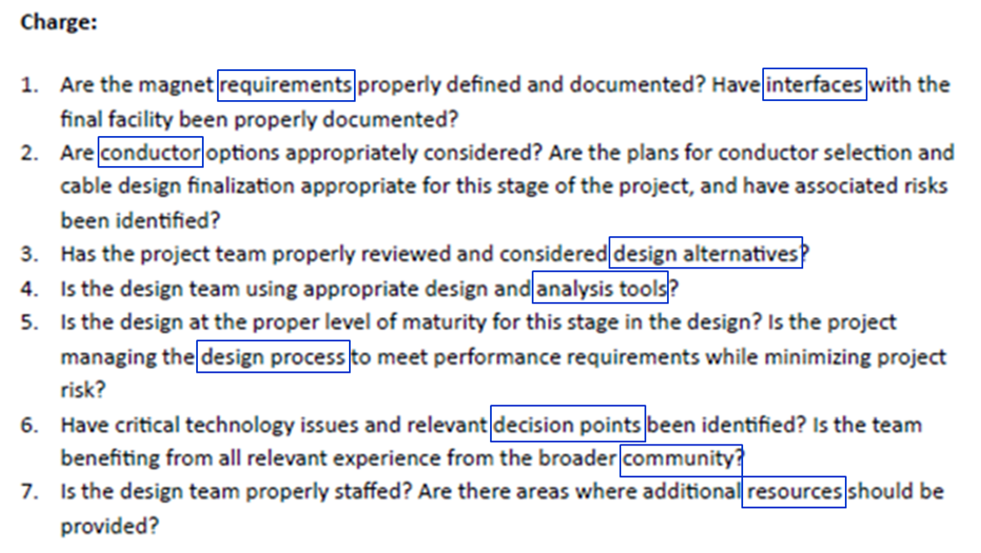
Conceptual Design Review

Slide 3
CDR Outcome/Recommendations
Requirements and interfaces
Clarify magnet and facility requirements and get stakeholder approval
Conductor and cable:
Some preference for higher sub-element design for stability in large diameter wire
Consider a cable with more strands (48 vs 44) and a smaller wire (1 mm vs. 1.1 mm)
Magnet design:
Alternatives have been properly considered and selected design minimizes risk
Main elements of the design fully endorsed by the committee: block coil, non-graded layout, shell-based structure
Consider increased margin to quench (conductor properties and magnetic design)
Consider increased shell thickness for margin (relative to using LD1 shell)
Include CLIQ protection system for added robustness and redundancy
Design tools, resources and collaboration:
Team expertise and analysis capabilities are fully adequate
Continue strong collaboration with FRESCA2/HEPdipo teams and US conductor Labs

Slide 4
Progress after CDR
Interfaces between magnet and facility:
Established regular FNAL/LBNL interface meetings on a bi-weekly basis
Focus on quench protection analysis, mechanical interfaces between magnet and cryostat, design optimization to control magnetic forces due to fringe fields
Conductor and cable:
Protection analysis results allow to confirm selection of the 169 sub-element design
Received 3 km of 169 strand from CERN for preliminary cabling studies
  Preparations for prototype cable run are underway
Started documentation for procurement of ~200 kg of strand for first practice coil
Magnet design
Use of 169 conductor with 0.9 copper ratio allows to increase margin to quench by about 3%, addressing review recommendation without increasing coil volume
Project planning:
Revised development plan and schedule to reflect post-CDR baseline
In progress: budget revision to match the updated plan

Slide 5
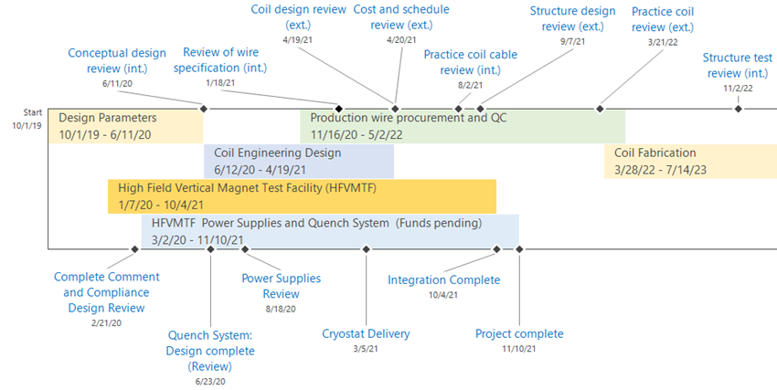
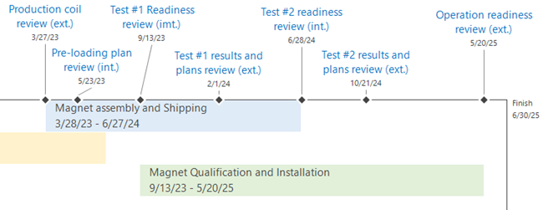
Revised Plan and Timeline after CDR
MAGNET
FACILITY

Slide 6
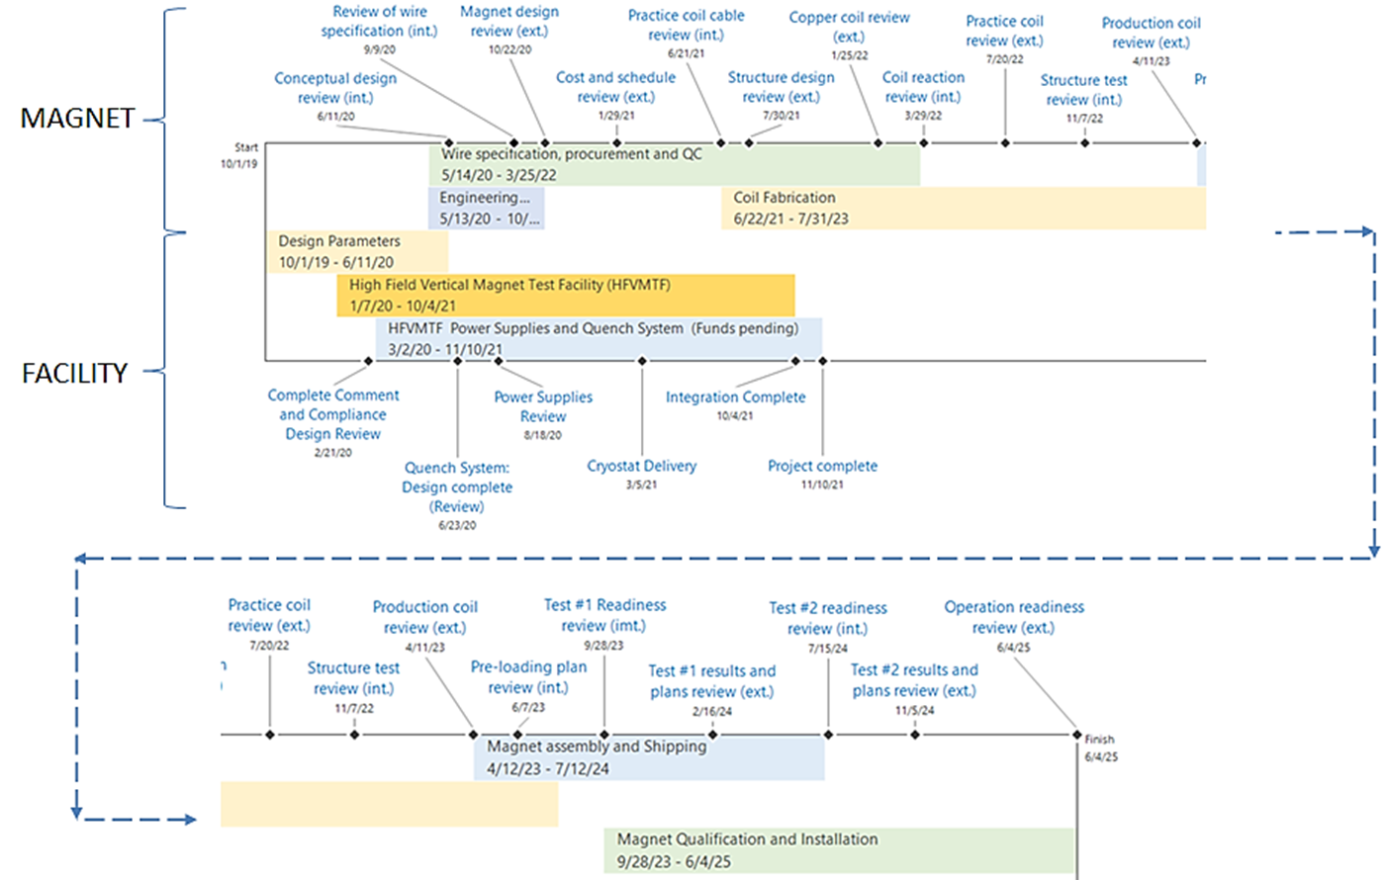
For reference: pre-CDR Plan and Timeline

Slide 7
Design and Prototype Cable

Slide 8
Practice Coils and Production Cable

Slide 9
Production Coil Fabrication

Slide 10
Structure, Assembly and Test

Slide 11
Summary
Design approach and key choices were fully endorsed by CDR, allowing to shift our focus toward the engineering design and prototyping of key components
We agree with all technical recommendations from the review and for the most part, we already addressed them by incorporating the necessary revisions: conductor specification, increased magnetic and mechanical margins, more robust protection using both extraction and CLIQ
  Cable baseline is still assuming 1.1 m diameter wire but we are making preparations to include the 1.0 mm alternative depending on results
Increased focus on LBNL/FNAL discussion of interfaces between magnet and facility
Formal requirements and specifications to be addressed in the context of the advisory board activities
Development plan and schedule is being adjusted to be consistent with the design presented and approved by the CDR
Cost analysis is in progress, with the expectation that we will be able to maintain the same total cost envelope

