Slide 1
HFVMTF project – FES/HEP (G19225)
G.Velev

Slide 2
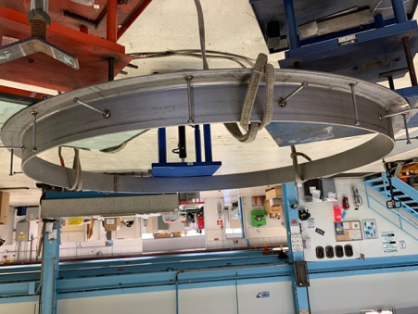
GPP – High Field Vertical Magnet Test Facility
Project #: G19225
Project Phase: Procurement
TPC: $493,668
Contingency: $87,408
Obligated: $52,457
Costed: $52,457
RIP+OH $344,500
Project Status
The contract with the company, Whittaker Construction & Excavating, Inc. (VMTF and VTS1-3 in IB1), is finalized. We had a pre-construction meeting on August 11
Started discussion with the company for the additional scope, adding magnetic shield – more in the next slide
Procurement of the steel shield is in progress.- bidding started
The current plan is to start in late October/November, expected construction time is 4-6 weeks.
The schedule is determined by the Whittaker procurement of the inner liner for the pit
Expecting any moment change of the cost due to the iron shields
Project Team
Project Manager: Cosmore Sylvester
Project Director: George Velev
Project Sponsor: Kate Gregory - COO
Project Sponsor: Sergey Belomestnykh -CTO
Project Sponsor: Karen Kosky - FESS
B&R Owner: Kate Gregory -COO
FSO Liaison: Melissa Mesmer (Steve Neus)
Project Dependencies
Need to completed before the start of production testing of AUP magnets – AUP test is planned for Feb. 2021.
Milestones | Baseline | Revised | Actual
Project Start | Jul – 19 | N/A | Nov – 19
Engineering Start | Oct – 19 | N/A | Oct – 19
Construction Start | June – 20 | Oct-20
Construction Complete | Aug – 20 | Nov- 20
Engineering Complete | Aug – 20 | Nov-20
Project Complete | Aug -20 | Nov-20
Notes:
2. Requisiton for Proposal

Slide 3
What was changed in the design?
We added two cylindrical steel shields to contain the fringe magnetic field.
These shields protect the close-by vertical test SRF stands which are very sensitive to the external fields the closest one is ~ 9m from HFVMTF.
The additional cost is ~ $52k, quote from a local company and 4-weeks delivery
The shielding was not included in the original bidding package for the construction, this we are expecting the company change for original cost estimate - $345k bid from the company

Slide 4
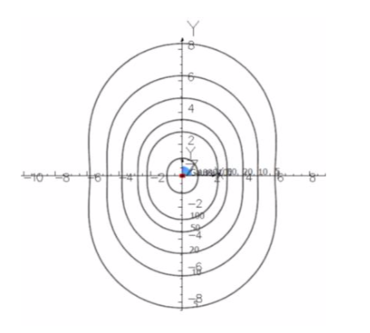
Shielding simulations
Simulated shield configuration, which is used in the design
The fringe magnetic field x-section in X-Y plane

Slide 5
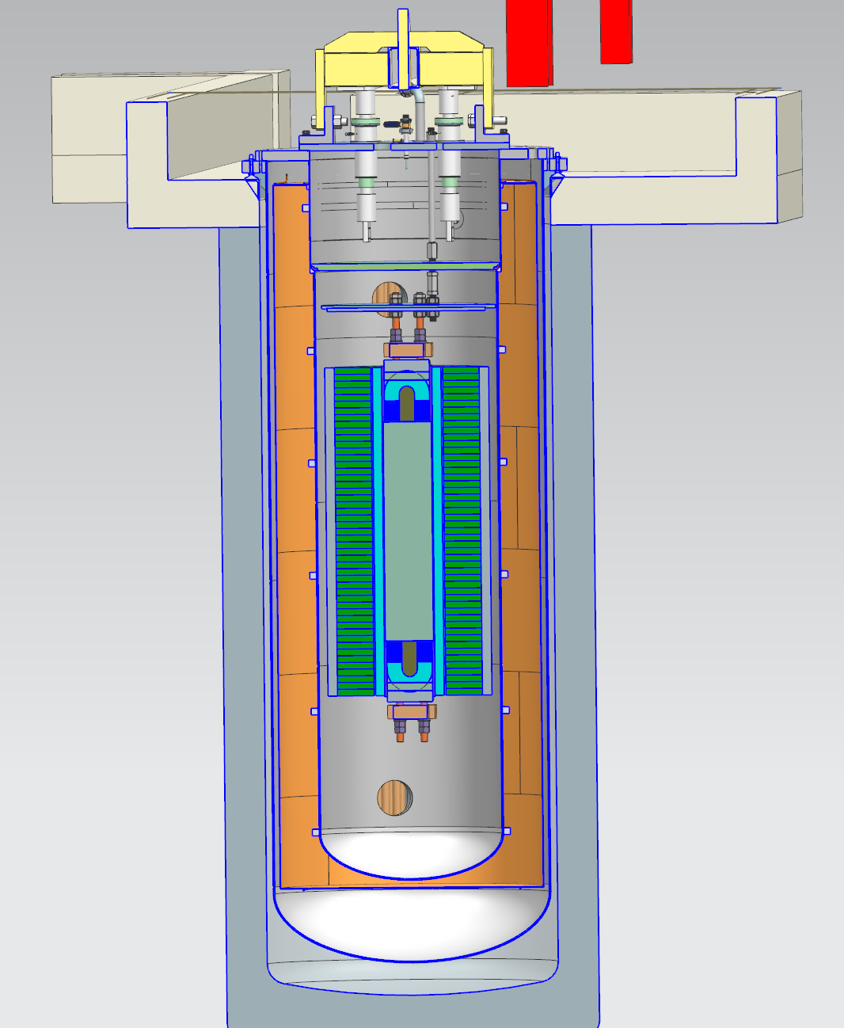
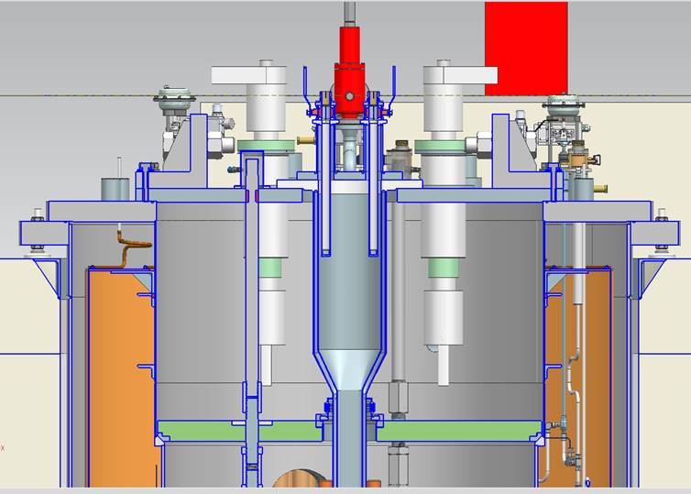
GPP – High Field Vertical Magnet Test Facility (Cryostat)
Project Status
Progressing to finalize the Functional Requirements specifications for the cryostat
Need input for FES community about some specifics for the test sample insert – test sample holder (anti-cryostat).
Realistic cryo design schedule were produced – approximately delay is 8 months. We added a generous production time for the cryostat of 1 year.
Change request is preparation.
Project #: G19225
Project Phase: Design
TPC: $1,055,332
Contingency: $103,000
Obligated: $178,010
Costed: $178,010
RIP+OH $0
Cryostat design
Project Team
Project Manager: Cosmore Sylvester
Project Director: George Velev
Project Sponsor: Kate Gregory - COO
Project Sponsor: Sergey Belomestnykh - CTO
Project Sponsor: Karen Kosky - FESS
B&R Owner: Kate Gregory - COO
FSO Liaison: Melissa Mesmer
Project Dependencies
Need to be completed before the LBNL magnet is ready
Milestones | Baseline | Revised | Actual
Project Start | Jul – 19 | N/A | Nov – 19
Engineering Start | Oct – 19 | N/A | Dec – 19
Procurement Start | July – 20 | May 21
Procurement Complete (delivered) | Mar – 21 | Apr-22
Engineering Complete | May – 21 | June-22
Project Complete | Oct -21 | July-22

Slide 6
What was modified?
The cryostat will be designed in the Lab- pre-final design. After this this it will be made in a company outside. Due to COVID 19 , we have a 2 months delay in the design – not increasing of the scope, only the work is delayed
Additional 2 months we added for the final design of the Cryostat - this task increases the scope. It increases the cost, and it will be cover by the contingency. This is due to the need to redesign the cryostat, making it symmetrical due to the shielding.
In the original schedule we were assuming 6 months production with an USA company, based on the test stands which were built in ~ 2010. The current experience with the IB1 cryoplant and mu2e project cryostats is that we probably will go to overseas companies, and the time is usually ~ 12 months. We added 6 months increase to the schedule. No work is done here … We simply wait for the cryostat.

Slide 7
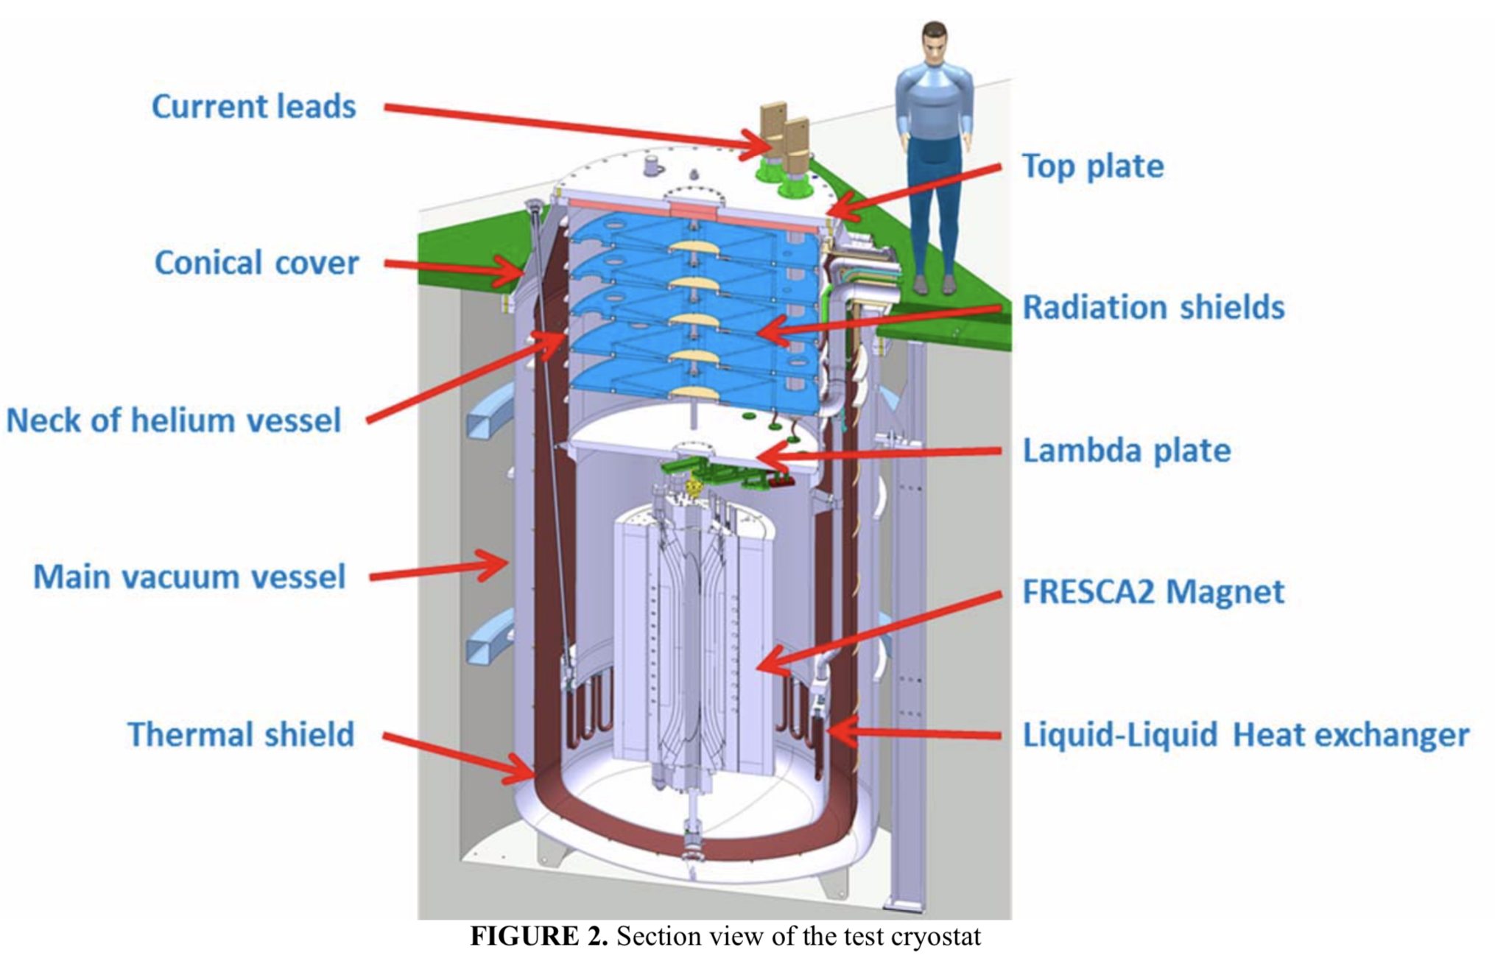
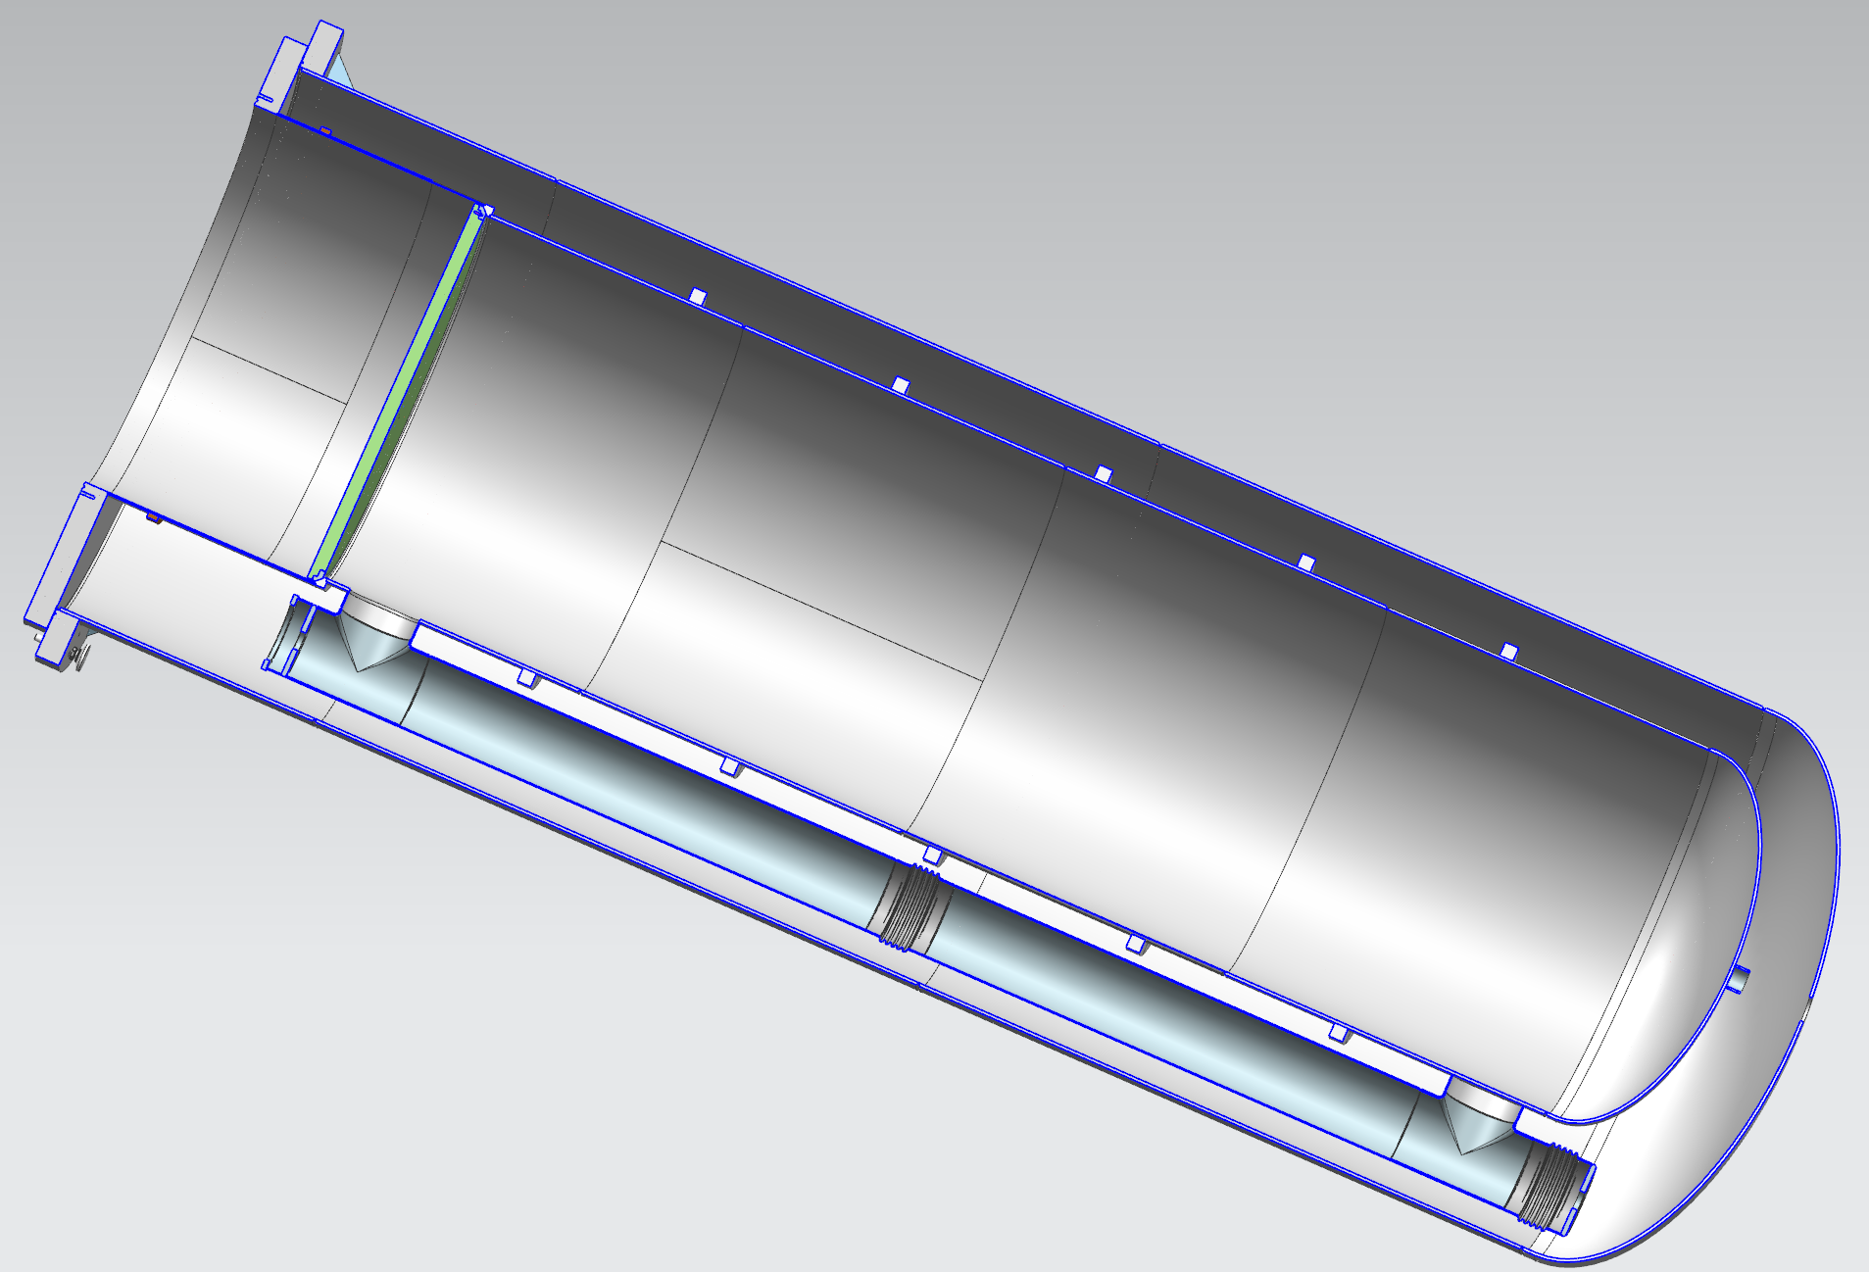
Cryostat new design
Liquid-Liquid Heat exchanger

Slide 8
Anticryostat – the sample holder
For now we are replicating EDIPO sample holder with SC transformer
Needs input from the FES community
Oversight committee
Preliminary design: seal and top plate

Slide 9
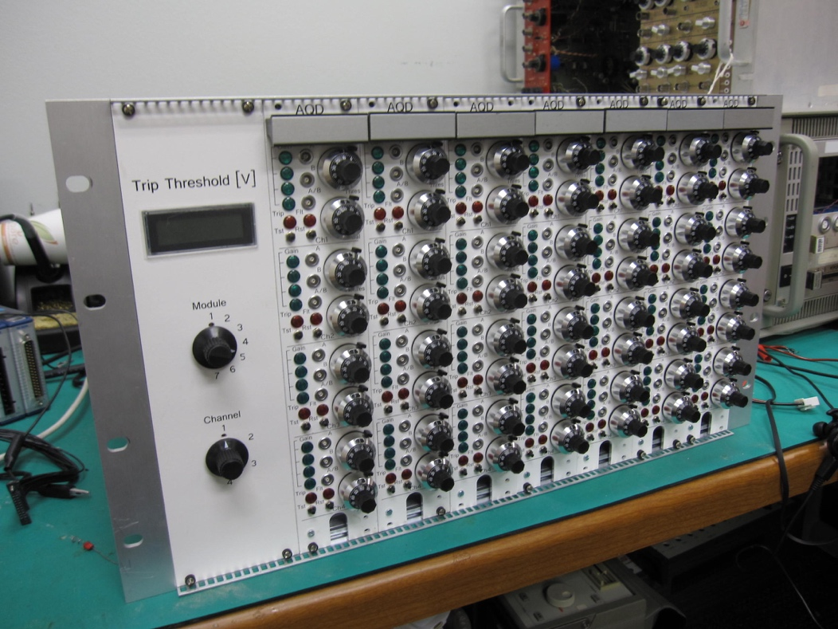
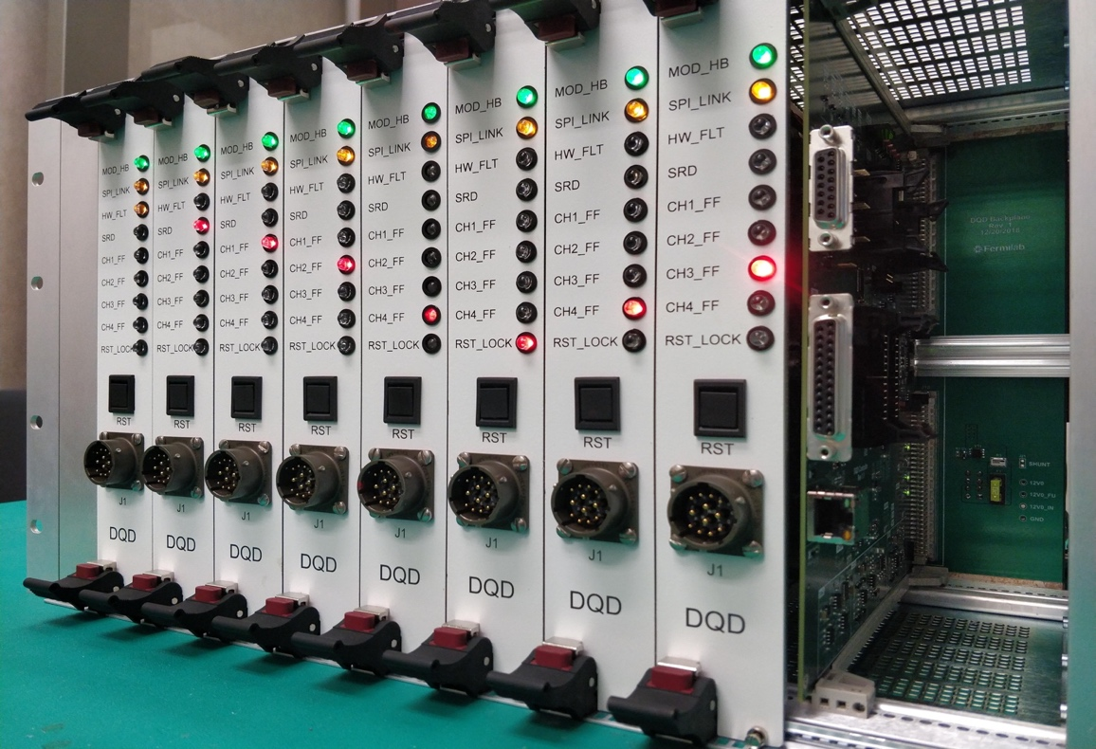
Second phase
We received $650k for the second phase QP/QM systems
They are the same as AUP test stand 4 and Mu2e solenoids
Purchase orders are written
Waiting for the AUP Zero-magnet test, ultimate test for QPs, to give a green light to buy components.
Next Generation of Digital Quench Protection and Monitoring System.
Chassis with 32 Isolated Analog Channels and Digital Controller.

Slide 10
Summary
The project is extended with ~ 8 months
Delay in the cryostat schedule, mainly due to extended manufacturing period
The final date July 2022
Two cylindrical shields were added to protect SRF Vertical test pits
The construction will receive “Notice to Proceed” in week or so, but we are still waiting for the final cost from the contractor – additional cost due to the shield installation.
For now the current contingency ~ 10 % is enough to cover the cost of the design changes.

