Slide 1
Integrated Project Team Meeting 4:
Status update – Oversight Committee formation
Soren Prestemon
Director, US Magnet Development Program
Director, Berkeley Center for Magnet Technology
Lawrence Berkeley National Laboratory

Slide 2
Outline
Review of IPT 3 notes, action items, and responses
Oversight Committee
  Membership status
  Roles and charge
  Meeting scheduling

Slide 3
Review of IPT 3 meeting notes and action items
Attendees:
  DOE: Barry Sullivan, Ken Marken
  LBNL: GianLuca Sabbi, Soren Prestemon
  FNAL: George Velev
Presentations (https://conferences.lbl.gov/event/358/; password IPT3):
Action items:
  Prestemon
    Finalize membership for Oversight Committee
    Get concurrence from DOE HEP & FES
  Sabbi: hold conceptual design review

Slide 4
Collaboration is developing well
Clear, consistent message being sent by us:
  We are eager to collaborate - see strong benefits from expertise, capabilities, and interests
  Collaboration must avoid integrating-in dependencies
  Primary goals of collaboration are risk reduction, maintaining/improving schedule
Main collaborator CERN:
  Very strong interest in pursuing a High Field Dipole for cable testing – “HEPDipo”
  Strong advocacy from Luca Bottura and Gijs de Rijk
  Strong technical contributions from Douglas Martins Araujo (CERN Postdoc)
  CERN has provided 3km of conductor for first cable samples
Also excellent interactions with SACLAY team involved in FRESCA-II
  Held dedicated meeting with CERN and SACLAY May 14th, 2020
Conceptual Design Review was chaired by Helene Felice (CEA), and included Etienne Rochepault (CEA), Susana Izquierdo Bermudez (CERN), as well as “our own” Giorgio Ambrosio (FNAL) and Lance Cooley (ASC/NHMFL)
Regular integration meetings are now held between LBNL and FNAL

Slide 5
Candidates for Oversight Committee
Candidate | Facility experience | Magnet expert | User experience
Joe Minervini (MIT, retired)* | ✔︎ | ✔︎
Peter Titus (PPPL) |  | ✔︎
Nicolai Martovetsky (ITER/LLNL) |  | ✔︎
Luca Bottura (CERN) | ✔︎ | ✔︎
Luisa Chiesa (Tuft) |  |  | ✔︎
David Larbalestier (FSU) | ✔︎ |  | ✔︎
Mark Bird (NHMFL) | ✔︎ | ✔︎ | ✔︎
Antonio Fasoli (EPFL) | ✔︎
Steve Gourlay (LBNL, retired)* | ✔︎ | ✔︎
Danko van der Laan (ACT) |  |  | ✔︎
Ruben Cargagno (FNAL) | ✔︎ | ✔︎
Vittorio Parma (CERN) | ✔︎
Neil Mitchell (ITER) |  | ✔︎ | ✔︎
Cesar Luongo (ITER) |  | ✔︎ | ✔︎
Charge [from last IPT]:
  Provide guidance and oversight for the overall facility development
  Represent user interests in facility plans
  Provide project team guidance on technical progress and issues
  Provide feedback to sponsor on project team performance

Slide 6
Progress on setting up an Oversight Committee
We provided Marken and Sullivan a preferred list of candidate names:
  Joe Minervini (Chair) ✓
  Steve Gourlay (Co-chair / Backup) ✓
  Luca Bottura contacted
  Luisa Chiesa ✓
  Danko van der Laan ✓
  Ruben Carcagno ✓
  Nicolai Martovetsky ✓
Joe has agreed to serve as chair
Steve has agreed to serve as backup (this helped convince Joe…)
Management, HEP&FES community
International collaboration; technical
User community
Facility planning; FNAL operations
Technical expertise

Slide 7
Charge to the Oversight Committee – for discussion
Role of the Oversight Committee (OC):
  Represent user interests in facility plans
  Provide guidance and oversight for the overall facility development
  Provide feedback on performance goals, overall design, and its implementation
  Provide advice to the project management in terms of:
    Responsiveness to community needs
    Coordination and integration of efforts between magnet and facility
    Balance of project risk and cost & schedule
  Provide guidance on:
    Facility operational structure and user needs
    collaboration and coordination with other laboratories
  Provide feedback to sponsors on project team performance
Process:
  Meet (virtually) twice a year
    If possible, one meeting per year will be in-person
  A charge will be drafted for each meeting to provide focus for the committee
    The charge will be discussed with the OC chair and DOE in advance of the meeting

Slide 8
Backup slides

Slide 9
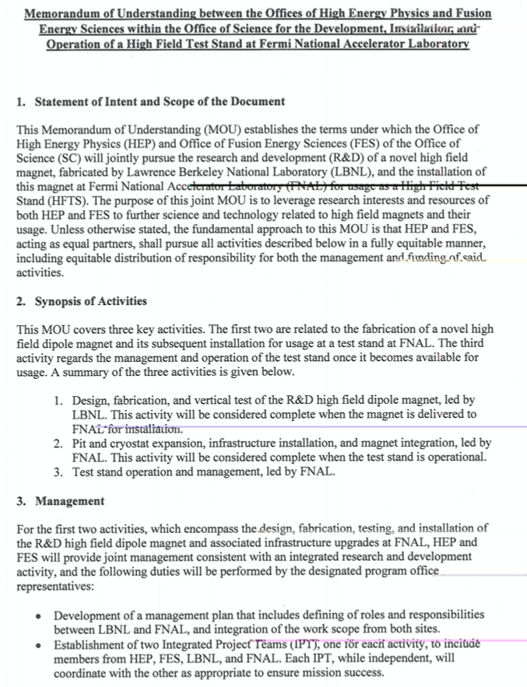
Background
FES and HEP began discussions on US options for an HTS Cable Test Facility
  Join with PSI and CERN for an EDIPO replacement, or
  Build a facility in the US
FES requested SP (aided by Joe Minervini) perform a stakeholder survey to develop specifications – completed July 2018
FES requested SP, GLS and GV provide a cost and schedule evaluation – completed Oct. 2018
DOE HEP and FES agree to fund a facility in the US, to be located at FNAL
  MOU signed November 12th, 2019

