Slide 1
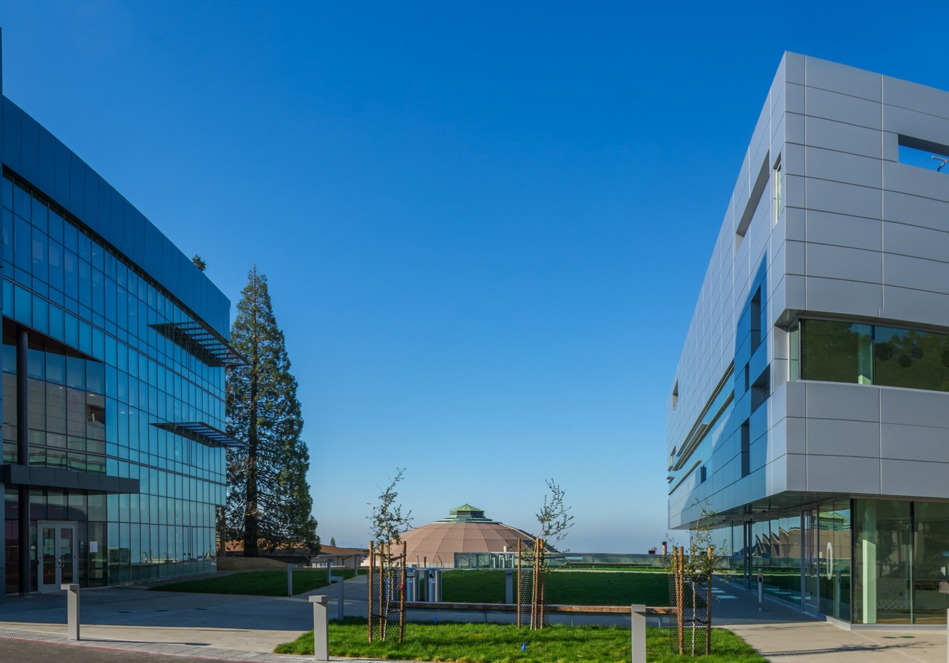
High Temperature Superconductor Cable Test Facility
Overview of the Project
for the
External Advisory Committee
Soren Prestemon
Director, US Magnet Development Program
Director, Berkeley Center for Magnet Technology
Lawrence Berkeley National Laboratory
January 7, 2021
LBNL, Berkeley, CA

Slide 2
Outline
Background
Main specifications for the facility
General project structure
Summary project schedule & cost

Slide 3
Background on Test Facility Dipoles
Fusion facilities: initially directed at ITER cable testing, later broadening to future fusion and HEP projects
  SULTAN@PSI (split solenoid upgrade 1992-94, operation 1994-present)
  EDIPO: development 2004-13, operation 2014-16
HEP facilities: testing of LHC cables, high-field GARD and LARP model magnets, and FCC
  US: NHMFL split dipole testing ~1995-2005
  LD1 (design/procurements 2010-12)
  FRESCA (development 1995-98, operation 1999-present)
  FRESCA2 (development 2009-2018)
HEPdipo development
  Replacement for EDIPO using same infrastructure
  Built by HEP and operated by PSI for both Fusion and HEP
  Design by a collaboration of PSI, CERN, LBNL, F4E

Slide 4
Early history
PSI, CERN, and LBNL worked to develop a conceptual design for a dipole magnet replacement for the EDIPO magnet, leveraging HEP Accelerator magnet technology
FES and HEP began discussions on US options for an HTS Cable Test Facility
FES requested SP (aided by Joe Minervini) perform a stakeholder survey to develop specifications – completed July 2018
FES requested SP, GLS and GV provide a cost and schedule evaluation – completed Oct. 2018
DOE HEP and FES agree to fund a facility in the US, to be located at FNAL
  MOU signed November 12th, 2019

Slide 5
Facility parameters/specifications for FES and HEP needs
(From Conceptual Cost and Schedule document) (1 of 2)
The test facility will be constructed in Industrial Building 1, APS-TD, Fermilab. The proposed place is selected based on the proximity to the needed base infrastructure for such a test stand, including cryogenic, power, water and crane.
Minimum operating temperature of the facility is 1.9K for the magnet providing the background field and 4.2-4.3 K *(under discussion) for the test samples.
The test pit cryostat should accommodate a dipole (coldmass) with maximum dimensions of 1.3 m and length of 3.0 m. [now using max length 3.1 m]
The maximum weight of the dipole cold mass should not exceed 22 (Standard) tons, limited by the crane capacity.
The test facility should be efficient and safe, minimizing the time for experiment preparation and no helium losses after quenches.
Operational lifetime of the facility at least 20 years.

Slide 6
Magnet parameters/specifications for FES and HEP needs
(From Conceptual Cost and Schedule document) (2 of 2)
Background dipole field > 15T.
Homogeneous field region>500-600mm, preferably>1000mm.
Cryostat to accommodate sufficient sample length to keep sample joint in low field.
Well dimension 90x140, and preferably100x150.
  It would be preferable to make the well compatible with FRESCA2 samples [note EDIPO was actually 94x144]
Field quality in the transverse plane -target is to keep all harmonics below 20 units at 35 mm radius and 15 T field.

Slide 7
General structure of the project
LBNL serve as lead for the magnet
  Responsible for design / fabrication and test
FNAL serve as the host for the facility
  Responsible for site prep & infrastructure, sample test capabilities; operation
Our approach, tailored to the project scale:
Process defined in Project Execution Plan
- 1 for LBNL scope, and 1 for FNAL scope
Sets up a management approach with
  - A full project WBS
  - A resource loaded schedule
  We will have the project plan reviewed by an external panel prior to baselining

Slide 8
General strategy for the magnet development, fabrication and test
Leverage DOE-OHEP-developed high field magnet technology
  Build off of HD-series magnets – HD1 (16T, no bore), HD2/3 (~13.8T)
  Leverage early design and development efforts for a large bore magnet – LD1
Leverage efforts of the HEPDipo team (PSI, CERN, LBNL)
  Build on the design and successful test of FRESCA-II (14.6T, 100mm bore)
  Leverage latest RRP conductors
DOE guidance
  Project should not depend on external contributions
  Collaboration is welcome if it allows reduced cost/schedule/risk
We maintain a strong collaboration with CERN
  Very strong interest in pursuing a High Field Dipole for cable testing – “HEPDipo”
  Strong advocacy from Luca Bottura and Gijs de Rijk
  Strong technical contributions from Douglas Martins Araujo (CERN Postdoc)

Slide 9
Overall project schedule

Slide 10
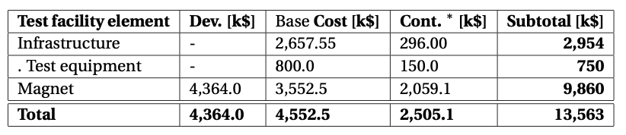
Overall project cost estimate
(From Conceptual Cost and Schedule document)
Costs for advanced project management efforts are not included
“Contingency“ in the table are costed risk mitigation efforts; contingency for unknowns is not included
Appropriate management costs and contingency will be solidified at the planned Cost and Schedule Review

Slide 11
Summary
The DOE Offices of HEP and FES have joined forces to support the development of an unique world-class HTS Cable Test Facility
The facility will support the needs of both offices:
  Provides testing capabilities for future US MDP hybrid magnets
  Enables testing of high-current cables (LTS and HTS), including at variable temperature
We seek advice and feedback from the EOC as the project moves forward:
  collectively you represent broad and deep experience/wisdom in advanced magnets, facilities, and projects

Slide 12
Backup

Slide 13
Charge for the specifications document
Work with stakeholders (from labs, universities, private sector) to develop the specs which will be needed to develop cables for fusion applications.
These should include the magnet strength, size of aperture, length and size of sample volume, and any other specification your working group determines is necessary to meet FES needs.
The specs should exceed those currently available at existing facilities.

Slide 14
Process used to develop the draft specifications document
Initial discussions internally
  Xiaorong Wang – leads REBCO HTS development at LBNL
  GianLuca Sabbi – leads LBNL role in EDIPO replacement magnet design
Followed by detailed discussion with Joe Minervini
I then drafted a the “Cable Test Facility Requirements Questionnaire”
  Reviewed it with Joe Minervini and Xiaorong Wang
Developed a list of stakeholders, with initial guidance from Joe Minervini, and iterated with FES program managers
The stakeholders were then contacted and asked to respond to the questionnaire
Stakeholder responses were then consolidated in the draft specification document, with only minor iteration on the document after the first draft

