Slide 1
HFVMTF: Test facility preparation
G.Velev

Slide 2
Outline
  Overview
      Why a new High Field Vertical Magnet Test Facility (HFVMTF) at Fermilab for conductor, cable testing and high field accelerator magnet R&D
      Synergy with FES
  Current status
      Test facility including the cryostat (classified at Fermilab as GPP)
      Quench protection/monitoring systems and Power Supply Systems
  Schedule
  Open questions for the committee
Summary

Slide 3
Why new Vertical Magnet Test Facility?
Goal: to construct a vertical test facility (pit) with cryostat ID= 1.4 m (cold mass size 1.3 m):
  For FES: will host 15 T large aperture magnet built to serve as a vehicle for HTS cable testing (lead by LBNL)
  For MDP: it will serve for testing HTS, Nb₃Sn coils, hybrid magnets (Nb₃Sn+HTS), utility structures to test magnet components in HF
Fermilab is unique place to build such a facility
  1.8K testing capabilities
  all necessary test facility infrastructure (LHe, LN, water, building power capacity)
  50-ton lifting capability for a single object in vertical direction
  New cryoplant is coming in operation at the end of 2021
This proposed test facility has similar or better parameters, comparing to FRESCA2 at CERN or HEPdipo at PSI

Slide 4
Short list of Specifications
The test facility will be constructed in Industrial Building 1, APS-TD, Fermilab. The proposed place is selected based on the proximity to the needed base infrastructure for a such test stand, including cryogenic, power, water and crane(s).
Minimum operating temperature of the facility is 1.9K for the magnet providing the background field and with min 4.2-4.5 K for the test samples, variable to ~50 K.
The test pit cryostat should accommodate a dipole (cold mass) with maximum dimensions of 1.3 m and length of 3 m
The maximum energy in the test field dipole should be < 20 MJ
The maximum weight of the dipole cold mass should not exceed 20 t
The test facility should be efficient and safe, minimizing the time for experiment preparation and no helium losses.
Operational lifetime of the facility at least 20 years.

Slide 5
Status – test pit and cryostat
The first part of the project started in Nov 2019 with funds received from the Offices of FES and HEP
This part of the project includes only the civil (pit) construction; and the cryostat including top&lambda plates
It was classified as GPP by Fermilab DOE site office
  Pit design was finalized - Dec 2019
  Bidding process – May 2020
  Construction Contract was awarded in Sep 2020
  Pit construction - started in October 2020
  Cryostat design was started in March 2020
Project Execution Plan

Slide 6
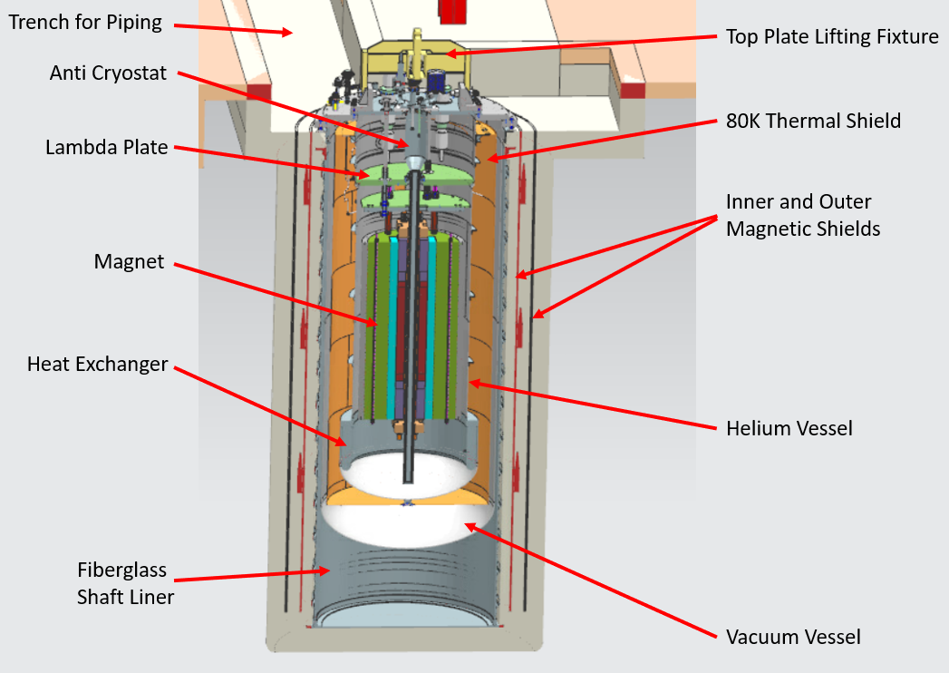
Civil Construction Design
IB1
Current VMTF
HFVMTF

Slide 7
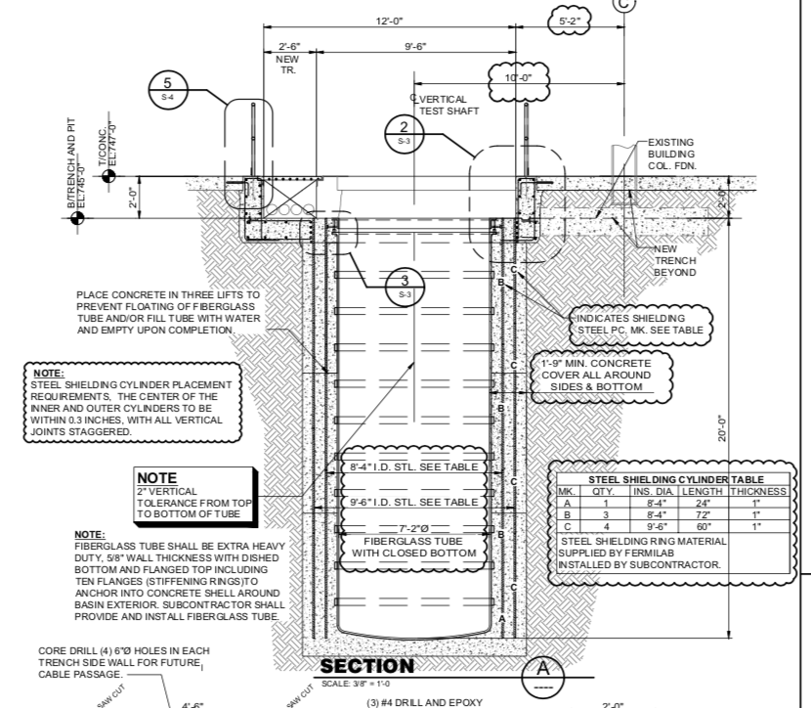
What was changed in the design?
We added two cylindrical steel shields to contain the fringe magnetic field.
  Thickness of the shields is 2’’
  Distance between inner and outer is 5’’
These shields protect the close-by vertical test SRF stands which are very sensitive to any external fields
  the closest one is ~ 9m from.
The shielding was not included in the original bidding package for the construction, this increase the original cost

Slide 8
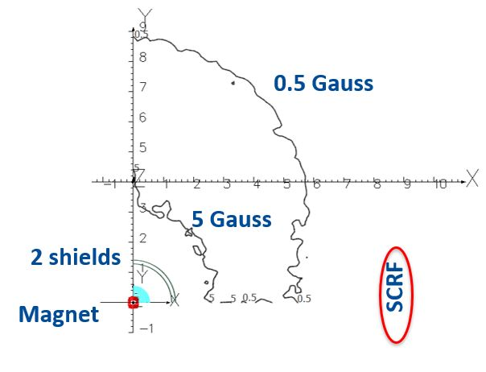
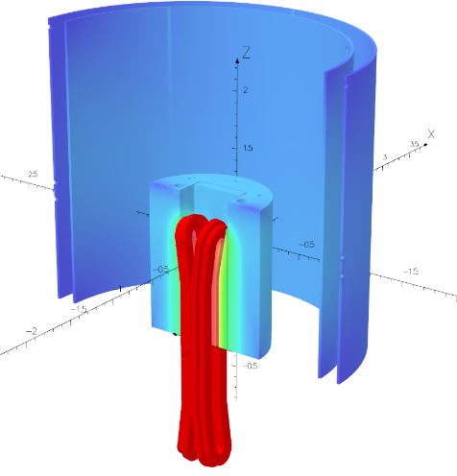
Shielding simulations
Simulated shield configuration, which is used in the design
The fringe magnetic field x-section in X-Y plane with 0.5 5 Gauss lines
Courtesy of Vladimir Kashikhin

Slide 9
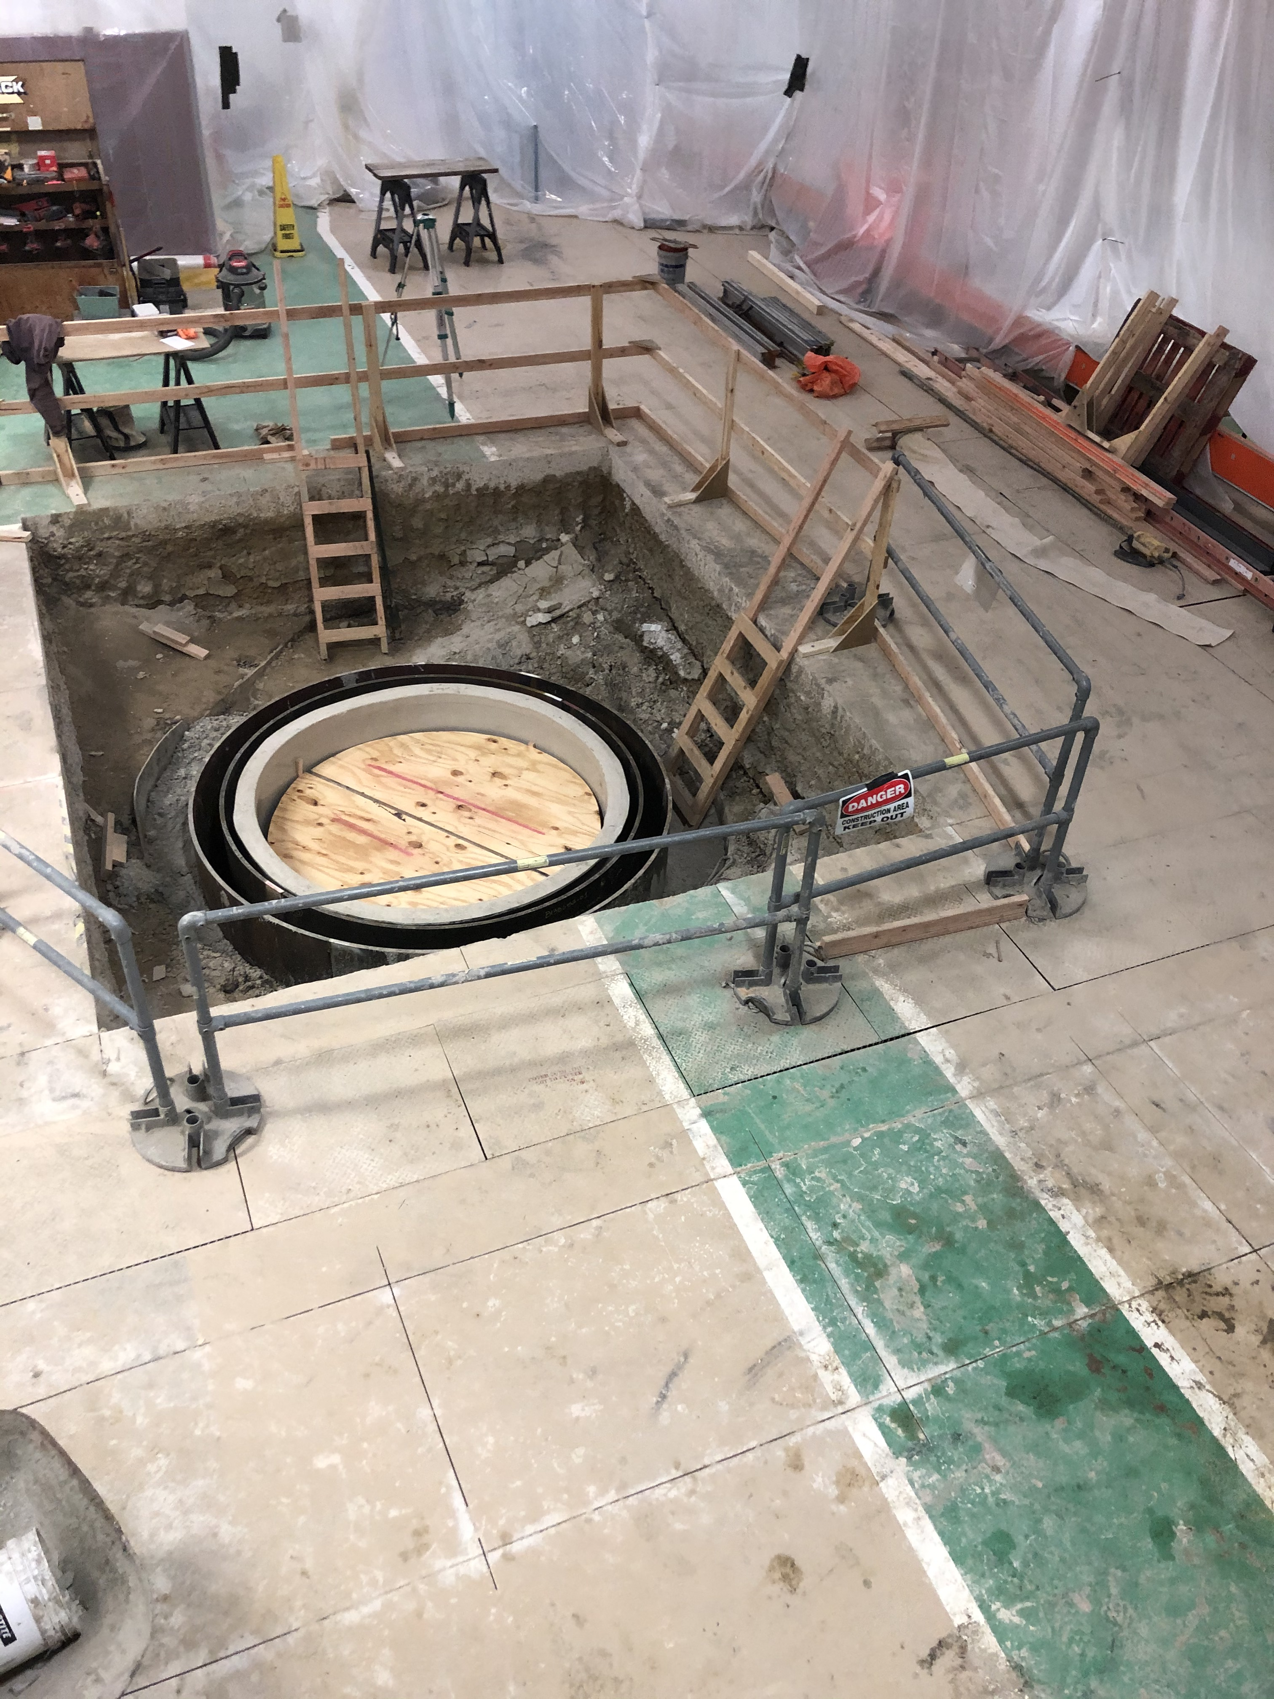
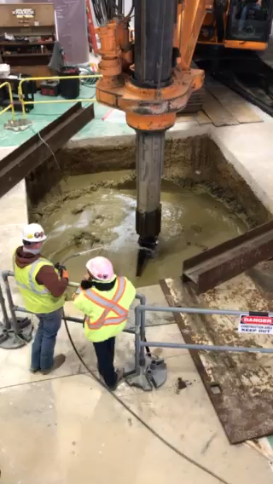
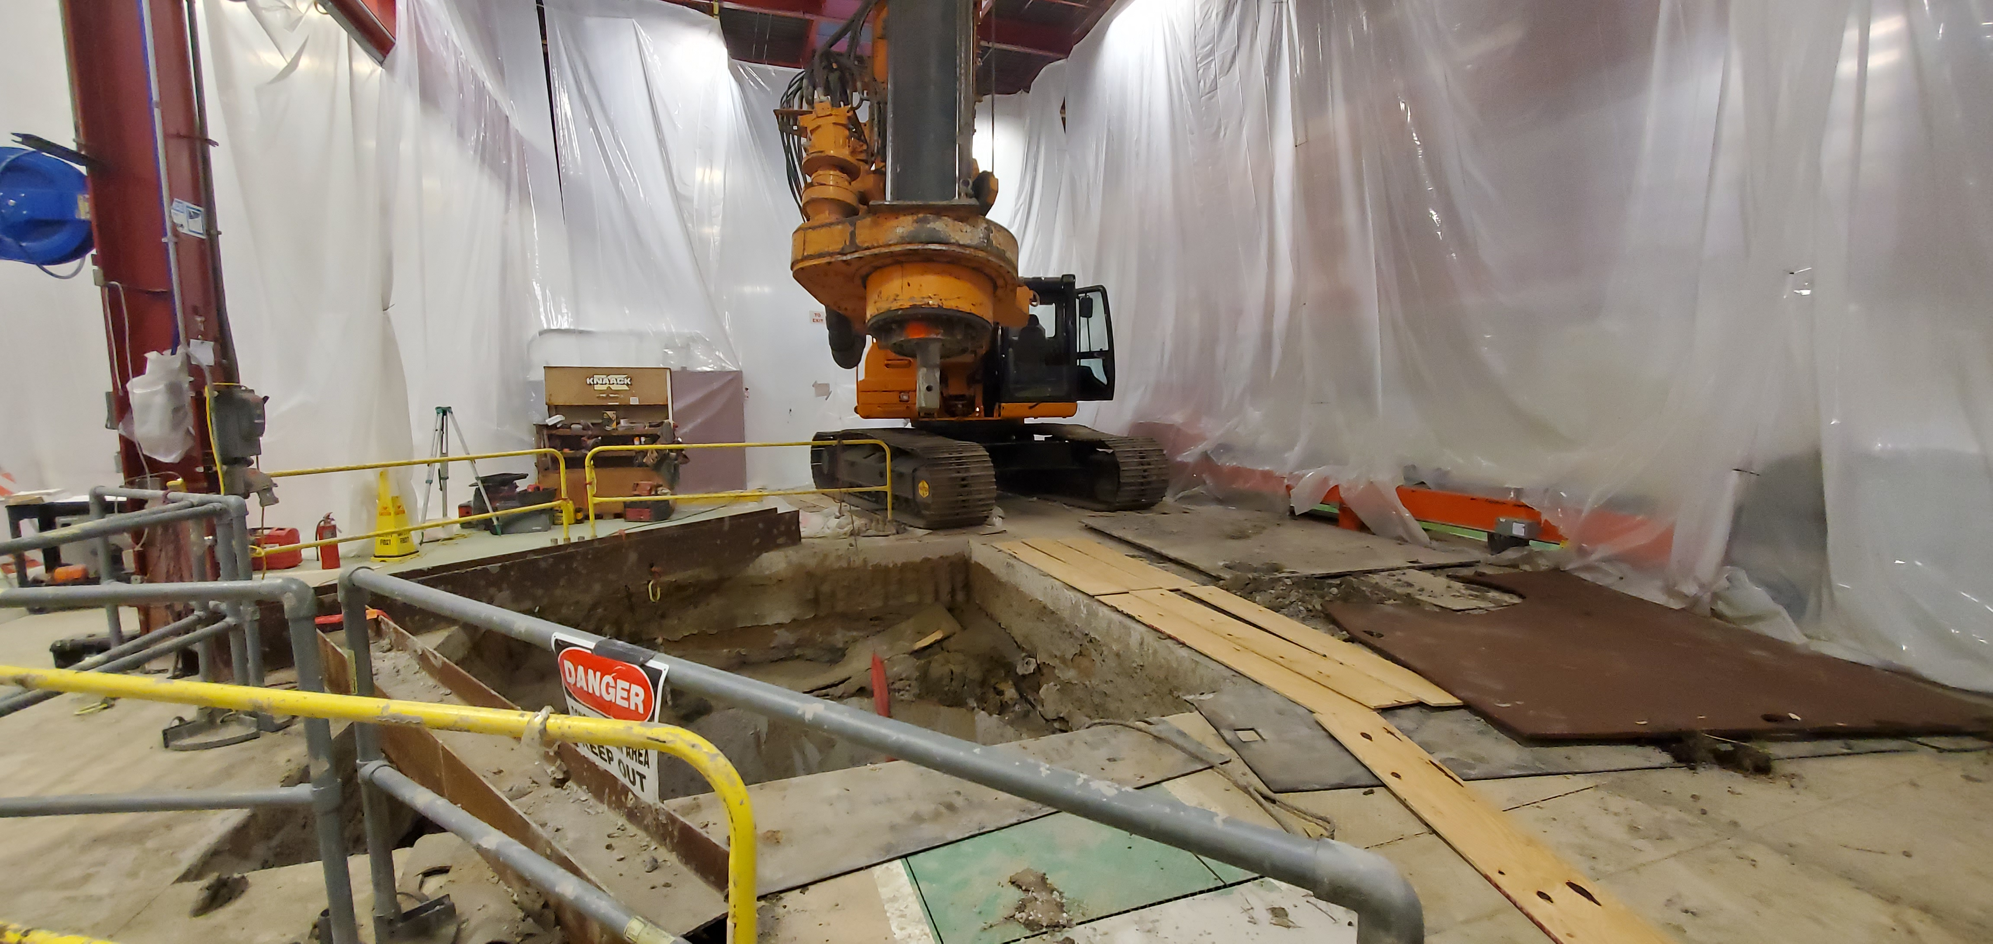
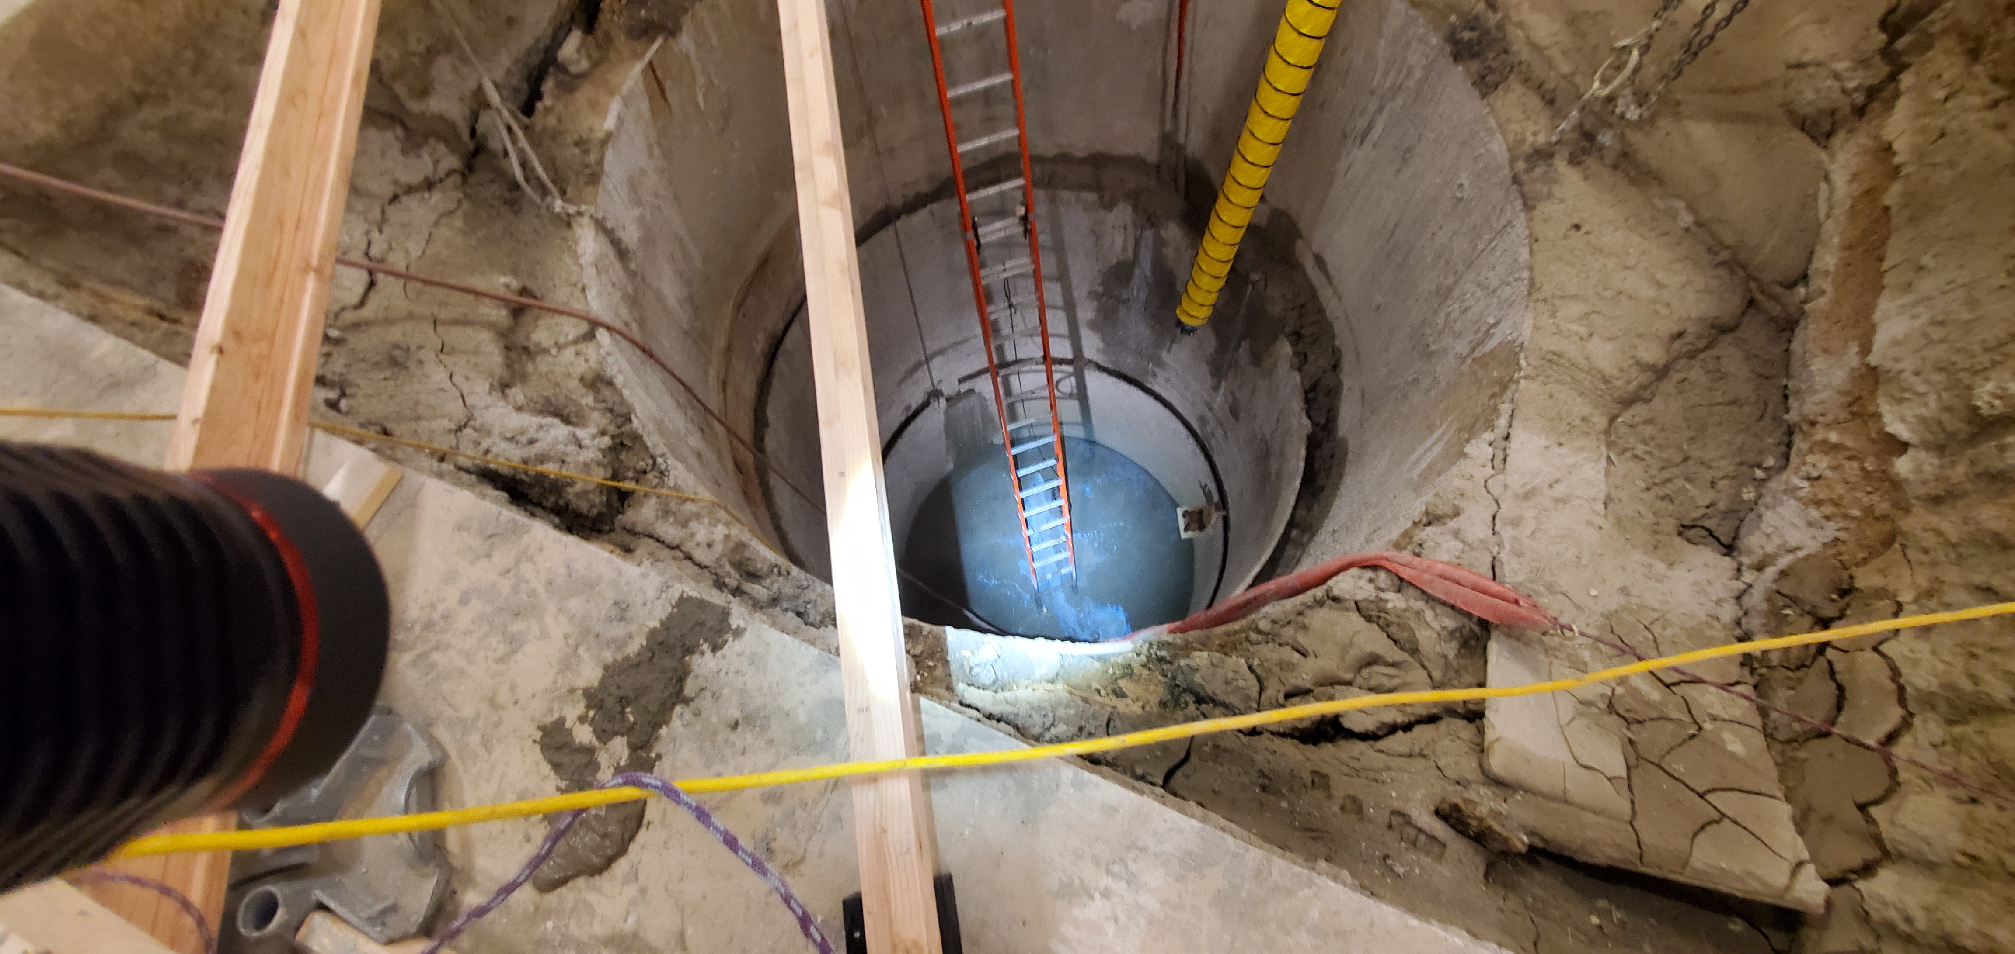
Current Construction Status
Excavation is done
Shields are placed
The inner fiberglass liner is installed.
Concrete pouring is in progress

Slide 10
Current Cryostat Design Status
The cryostat will be designed in the Lab – pre-final design. After this this it will be made in a company outside.
Due to COVID 19 , we have a 3 months delay in the design – not increasing of the scope, only the work is delayed
Additional 2 months we added to redesign the cryostat - this task increases the scope. It increases the cost, and it will be cover by the contingency. This is due to the need to redesign the cryostat, making it symmetrical due to the shielding.
In the original schedule we were assuming 6 months production with an USA company, based on previous orders. The current experience with the IB1 cryoplant and mu2e project cryostats is: we probably will go to overseas companies, and the time is usually ~ 12 months. We added 6 months increase to the schedule – executed change request
We expect to start the procurement in May 2021 and receive it in April 2022

Slide 11
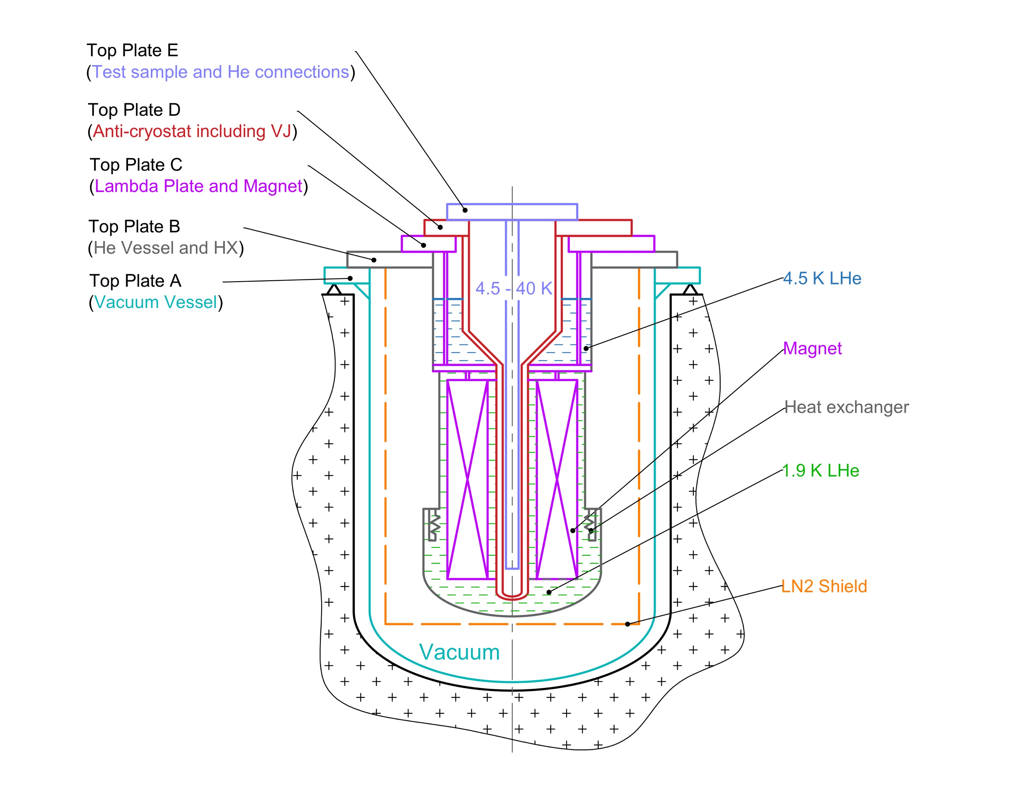
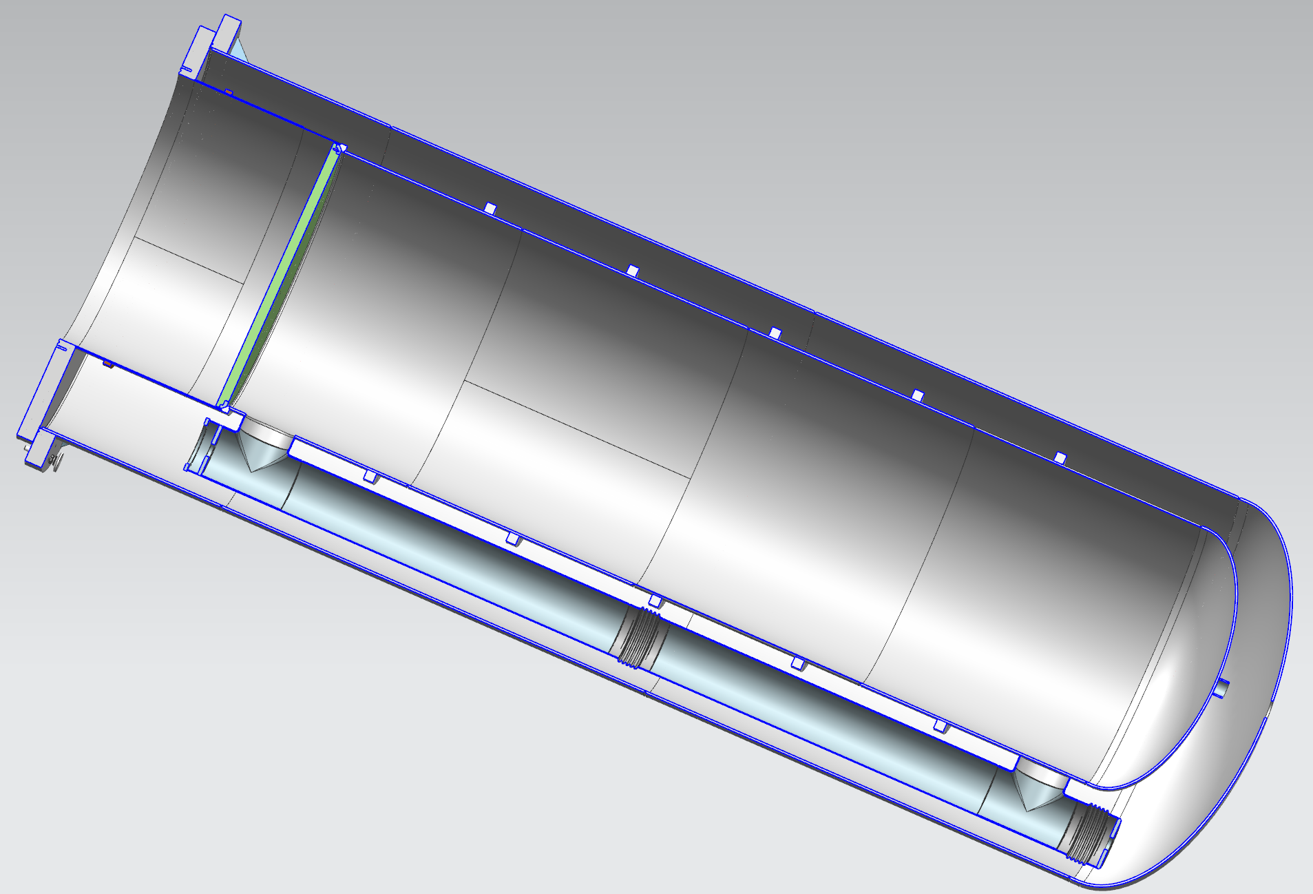
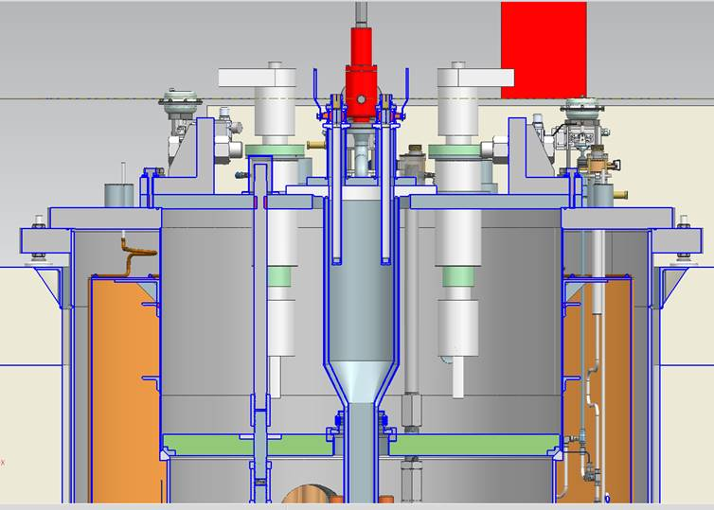
Cryostat old vs new design
HFVMTF Liquid-to-Liquid Heat exchanger
VMTF Liquid-to-Liquid Heat exchanger

Slide 12
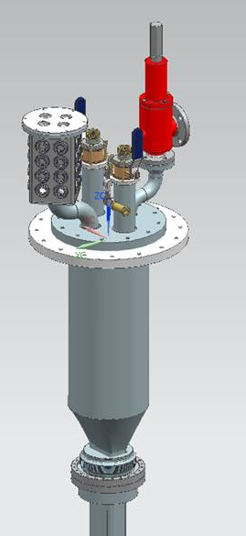
Anticryostat – the sample holder
For now, we are replicating EDIPO sample holder with SC transformer
Needs input from the FES community
  Oversight committee
Preliminary design: seal and top plate

Slide 13
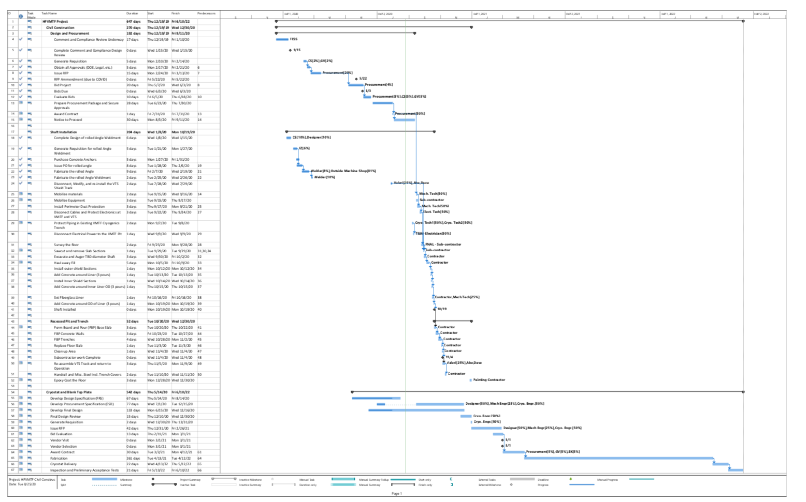
HFVMTF pit and cryostat: Timeline

Slide 14
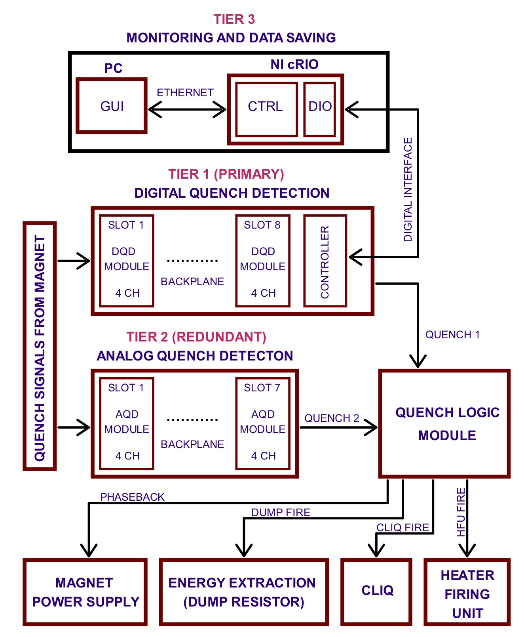
Second phase - QP/QM systems and Power Supplies
We benefit from the development of the QP/QM systems for the ongoing projects
The QP/QM contains two independent branches: simultaneously protects two superconducting objects, their superconducting buses, and their high current vapor- cooled leads.
When testing a hybrid magnet, the two branches of the QPM will simultaneously protect the LTS magnet (usually an Nb₃Sn magnet) and the HTS insert.
When the system is used to test HTS samples for fusion energy R&D, the first branch will protect the main dipole magnet and the second branch the test sample.
We received part of the funds for the second phase of the project
Purchase orders for parts are in progress
Waiting for the AUP cryoassembly test, ultimate test for QPs, to give a green light to buy the components.

Slide 15
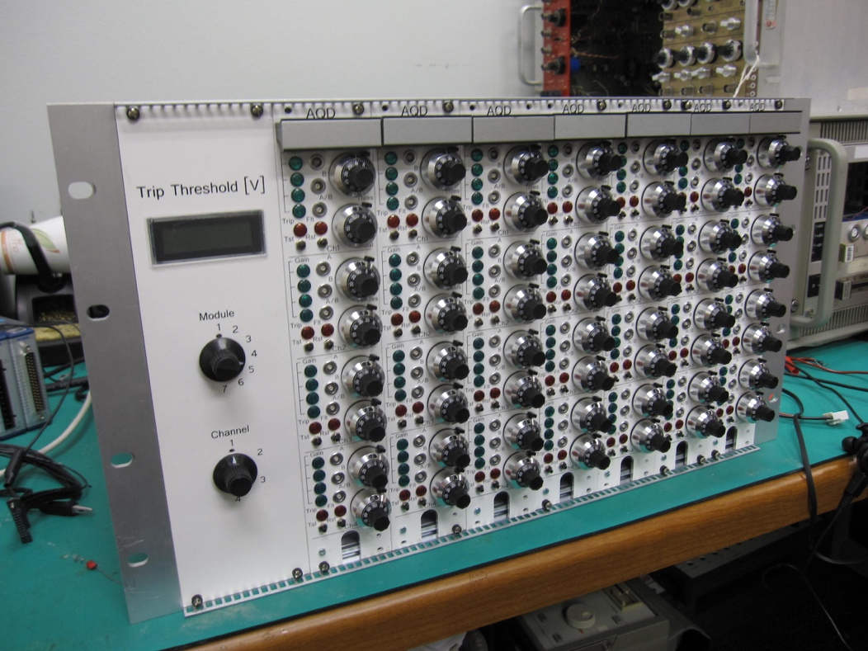
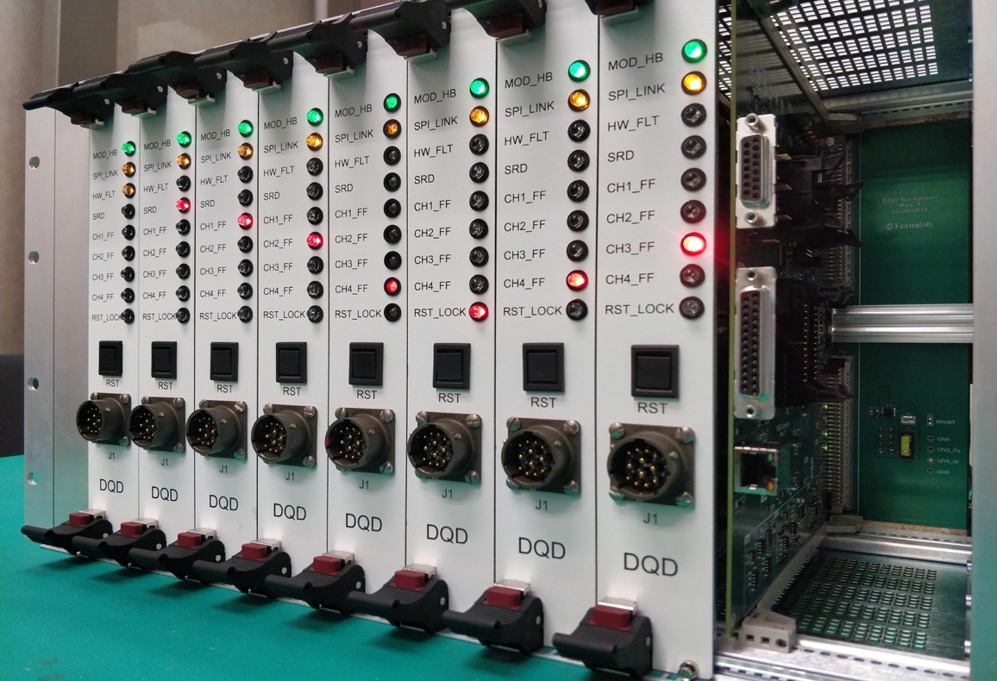
QP/QM system prototypes
Next Generation of Digital Quench Protection and Monitoring System.
Chassis with 32 Isolated Analog Channels and Digital Controller.

Slide 16
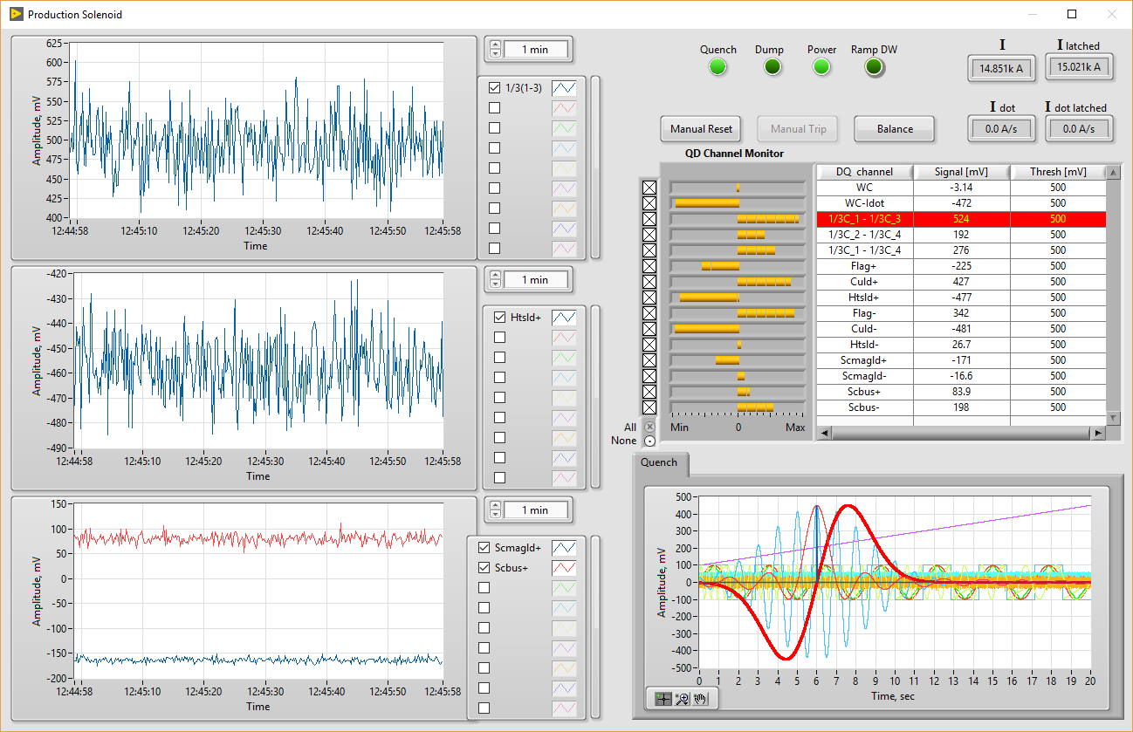
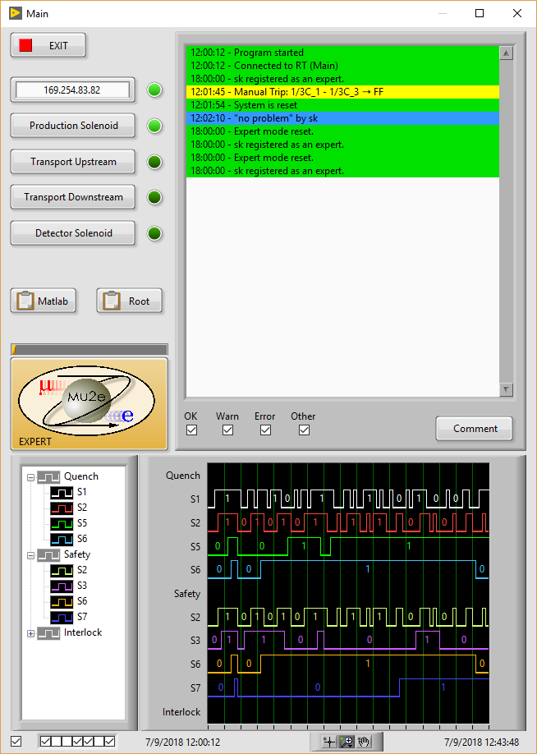
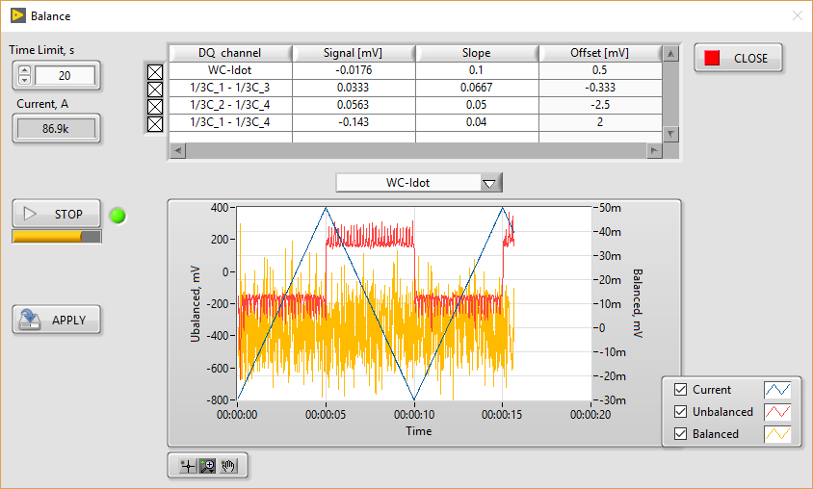
QP/QM system GUI
Main Quench Control Window
1 of 4 Magnet Quench Signal Monitoring Windows
Expert Mode Configuration & Balancing

Slide 17
Power supplies
We are planning to buy 2 sets of modern modular power supplies.
  24 kA&32-40V power supply to power
    the main 15 T dipole for sample testing
    Nb3Sn outer magnet in case of hybrid tests
  15-16 kA&32-40 V power supply to power
    SC transformer for the HTS samples
    HTS insert magnet in case of hybrid test
  Current stability – 10⁻⁵ A
  Accuracy – 10⁻⁴
We are waiting for close-to-final quotes to start the purchasing ( Magna-Power)

Slide 18
Questions to discuss
There are several questions connected mostly with SC test sample cryostat and test sample well for FES
  Assuming EDIPO/Sultan type sample cryostat, is this what we need?
  What are sample dimensions? Constant?
  Any limitations on temperature gradient within the sample during testing?
  Are there any requirements for warmup/cooldown?
  SC transformer, what design we should use? Primary and secondary coil turns?
  Is 100kA what we need?

Slide 19
Summary
A project to build a new a High Field Cable Test Facility (HFVMTF) at Fermilab is in progress
The facility will support future MDP and FES R&Ds
The HFVMTF construction is well advanced
Schedules and cost estimations are in place
Two cylindrical shields were added to protect SRF Vertical test pits - additional to the scope
This triggered the redesign of the cryostat and schedule change
QP/QM systems and PSs purchasing are in the final stages.
The test stand integration is expected in June of 2022.

