Slide 1



G. Sabbi, LBNL
External Oversight Committee
January 7, 2021
Test Facility Dipole: Design, Status and Plan

Slide 2
Presentation Outline
Magnet requirements
Technical background: large bore, high field Nb₃Sn dipole development for HEP and FES
  Recent design studies and TFD approach
Performance targets and optimization strategy
Design status: magnetic, mechanical, quench protection
Conductor and cable development
Engineering design and coil fabrication infrastructure
Test facility interfaces
Project Execution Plan: specifications, WBS, development and fabrication approach, schedule and milestones
Summary

Slide 3
Magnet Requirements
Two main sources:
HEPdipo study (EDIPO upgrade at PSI)
US user survey
Key US input on applied magnetic field (§2)
“Highest possible field”: ≥15 T with Nb₃Sn at 1.9 K
Test well geometry:
Aperture: minimum 140x90 (HxV) mm (150x100 mm preferred) with superimposed round 106 mm diam.
Uniform (1%) length: 0.6-1 m
Superimposed AC field and fast-ramped background field are not a priority

Slide 4
Technical Background
The Test Facility Dipole design is based on studies and development of large aperture, high field dipoles over the past 15+ years:
  LARP studies of HL-LHC “Dipole First” IR (LBNL/FNAL/BNL, 2003-04)
  EFTA Dipole (EDIPO) Design Study (EFDA/CEA/CRPP/FZK/LBNL, 2004-06)
  LD1 magnet design (2009-12) at LBNL
  FRESCA2 magnet development (CERN/CEA/EuCARD, 2010-2018)
  HEPdipo design study (CERN/PSI/F4E/LBNL, 2017+)
We are taking full advantage of these efforts and experience to accelerate the TFD development and decrease risk in a broad range of areas, in particular:
  Winding layout and parameters (LARP, EFDA, LD1/HD, FRESCA2, HEPdipo)
  Coil tooling, parts, and fabrication process (FRESCA2, LD/HD)
  Magnetic, mechanical, protection analysis and validation (FRESCA2, HEPdipo)
However, while building on this experience we are also optimizing the design to reflect the specific TFD requirements, in particular the higher field target

Slide 5
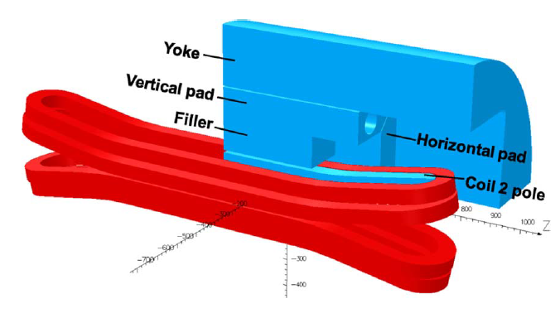
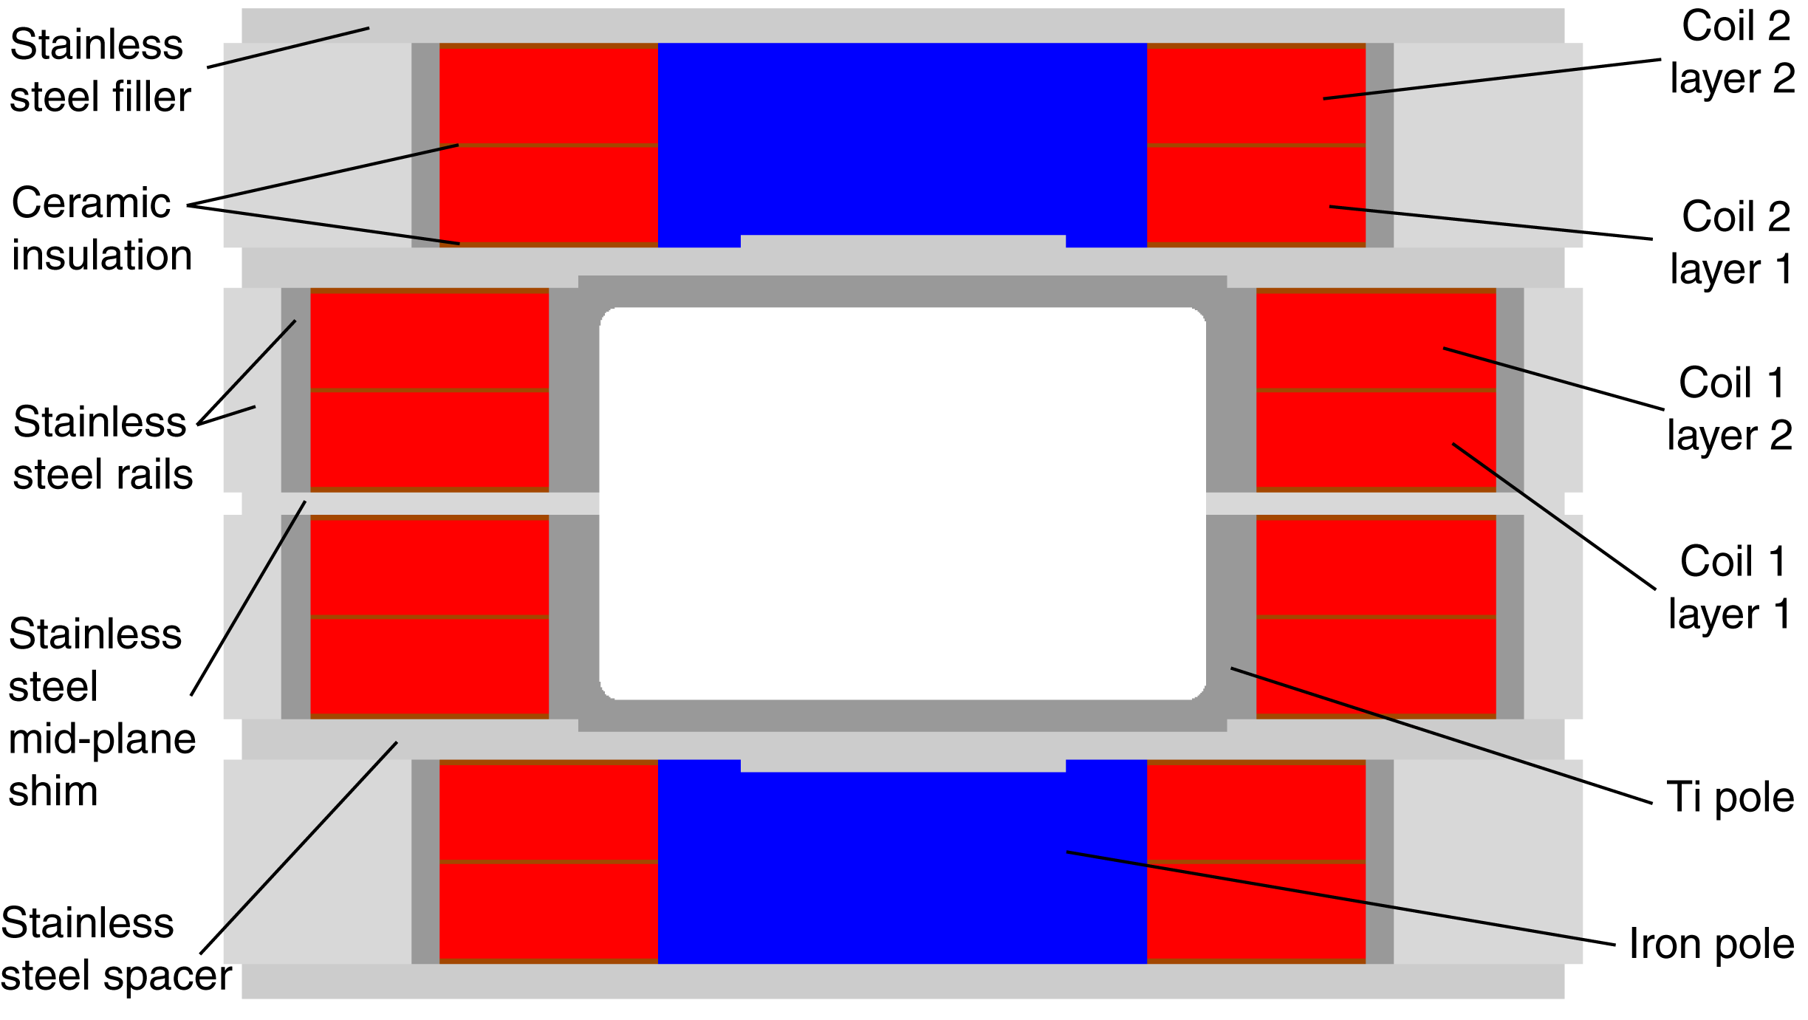
LD1 Design at LBNL
Several proposals for high field cable/insert testing presented to GARD over the years
  LD1 proposal was presented in 2009 and received strong support various HEP and AFRD Reviews
Rectangular bore (144 x 94 mm) for insert coil testing and fusion cable compatibility
Block-coil design was selected because of the rectangular bore and synergies with the ongoing HD2 model development (cable, coil design, fabrication processes)
Received start-up funding from ARRA in 2010 but no follow-up funding
Focus on large coil infrastructure (reaction oven, potting chamber) which now enables fabrication of TFD at LBNL
Also performed magnet design, procured some components (cable, structure)
Ref. P. Ferracin et al., IEEE TASC 22(2), 2012

Slide 6
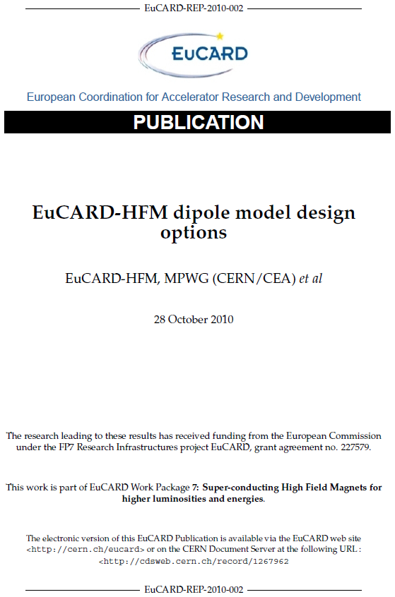
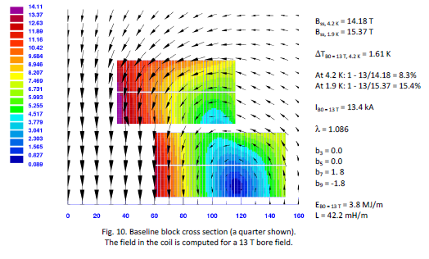
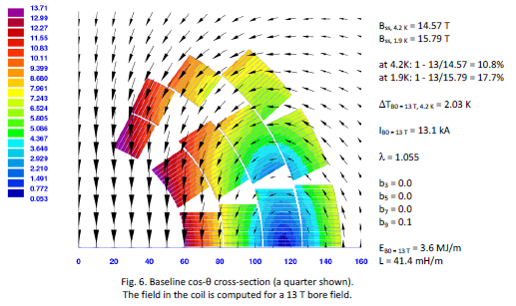
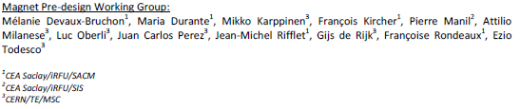
FRESCA2 Design Study
Goal: upgrade of FRESCA facility at CERN
Round bore 100+ mm diameter and 13+ T field
Detailed analysis of cosθ and block design options:
Historical review (in particular D20 and HD2)
Optimization, analysis and comparison of magnetic and mechanical performance based on realistic and consistent (two double-layers) designs of each type
Qualitative comparison: magnetic/mechanical aspects, end geometry, tooling parts and fabrication
Block type layout was selected citing advantages in design and fabrication

Slide 7
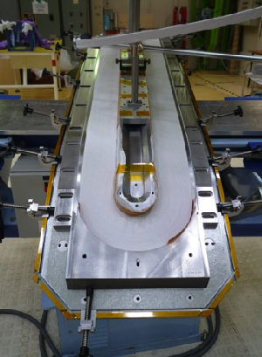
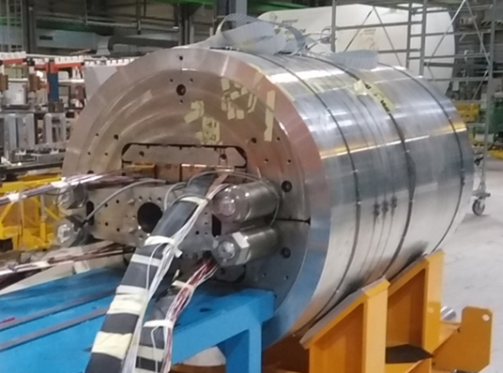
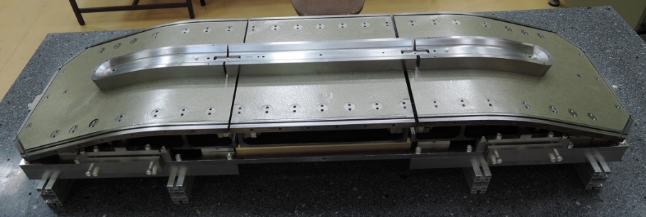
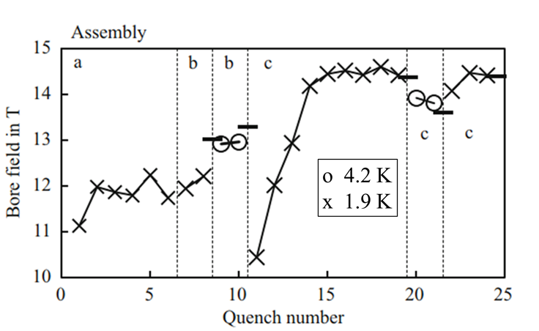
FRESCA2 Fabrication and Test Results
Coil winding: CEA
Coil reaction and impregnation, magnet assembly and test: CERN
Assembly | Preload | Field | Comments
FRESCA2a (2/2017) | 13 T | 12.2 T | Coil 3401: splice damage and QH failure
FRESCA2b (8/17) | 13 T | 13.3 T | Coil 3401 replaced by 3403
FRESCA2c (4/18) | 15 T | 14.6 T | Full re-assembly and Pre-load increase
FRESCA2 provides a solid basis for TFD design approach, performance expectations, coil tooling and fabrication processes

Slide 8
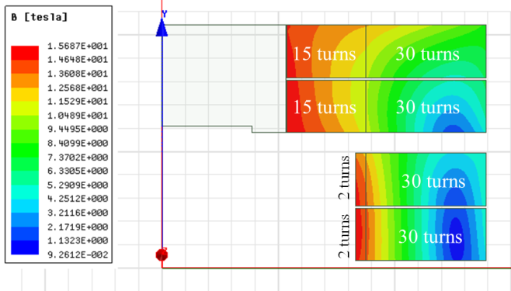
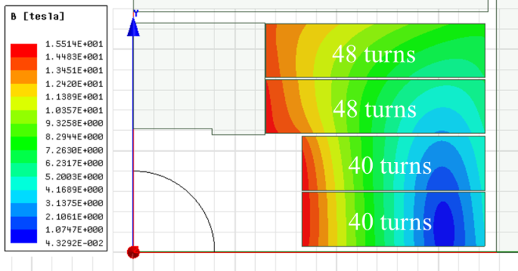
HEPdipo Conceptual Design Study (2018)
The EDIPO magnet was irreversibly damaged in 2017 due to an unprotected quench. The facility infrastructure was not damaged
A collaboration of PSI, CERN, F4E and LBNL was established to study a replacement of EDIPO with a higher field target (14-15 T vs. 12.4 T)
Two main options were considered, both cases used a racetrack (block/saddle) coil layout with either an upgraded CICC or Rutherford cable
  Based on FRESCA2 design choice and further supported by rectangular vs. round bore
Field increase for CICC was found to be limited
Both a graded and non-graded Rutherford cable option were considered: non-graded option was preferred to lower risk
Graded (A_{sc}=64 cm²)
Non-Graded (A_{sc}=105 cm²)
Reference: P. Bruzzone et al., “Conceptual Design of a Large Aperture Dipole for Testing of Cables and Insert Coils at High Field”, IEEE TASC Vol. 28, No. 3, April 2018, Art. # 4005505

Slide 9
TFD Design Targets and Approach
Field: 16 T design target with ~15% margin on the load line at 1.9 K
  Users are interested in the highest possible field, reflected in guidance
  Setting a 16 T goal helps fully optimize the design
  A conservative pre-load target (e.g. 14 T) will be implemented in the first assembly cycle and optimized as needed based on test results
  15 T is used as reference for operation
Coil layout: block-type, non-graded coil
  Block-coil follows from EDIPO/LD1/FRESCA2 studies, FRESCA2 performance demonstration, and rectangular bore
  Non-graded coil can reach 16 T at <85% SSL (1.9K) with less development time/risk
  Field quality at the ~20 unit level for consistent comparison of options
Coil engineering, parts, tooling and fabrication procedures will be based on FRESCA2 experience
Larger/rectangular aperture and higher field leads to a different design optimization relative to FRESCA2
  Mechanical performance is the main driver and determines the detailed design of the coil geometry, bore structure, inter-coil spacers etc.

Slide 10
TFD Design Overview
Wire: highest J_{c}/I_{c} desired: focus on RRP 162/169 under development for FCC
Cable: target 44 strands, 1.1 mm; alternative 48 strands, 1 mm as a backup option following FRESCA2 and HD/LD experience
Coil layout: a non-graded coil layout was selected over graded coil after comparing performance potential and fabrication challenges
Quench Protection: energy extraction can provide safe magnet discharge after a quench in terms of voltages and hot spot temperatures
Mechanical optimization resulted in safe coil stresses at all steps with 16 T preload and strict criteria on allowed tension at the pole
Two non-graded block coil layouts - “LD” and “FRESCA2” - were compared and the LD layout was selected
Bore structural design meets aperture requirements but further optimization will be performed taking into account user feedback
CAD models are consistent with dimensional/weight limits agreed upon with the test facility.
A length reduction may be allowed by design optimization and user requirements

Slide 11
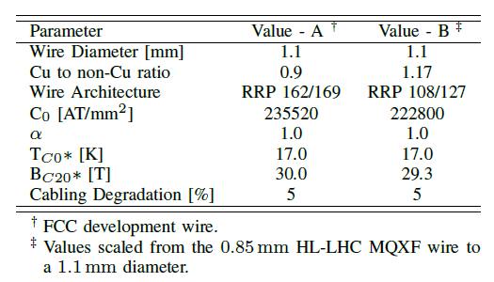
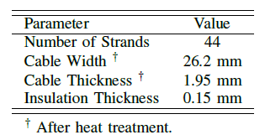
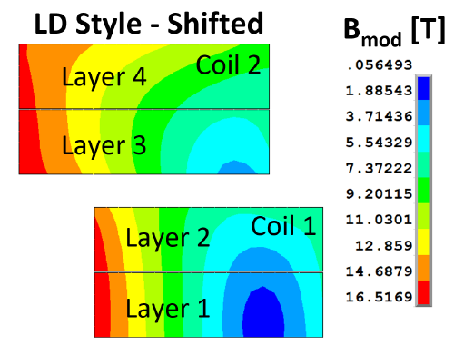
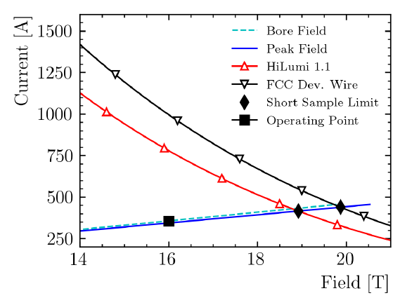
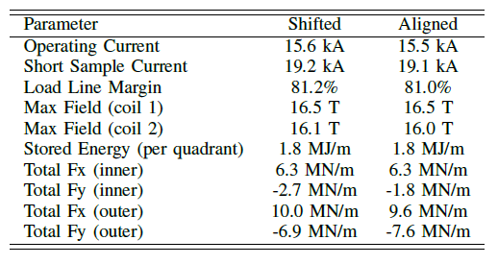
Magnetic Design
Strand parameters
Cable parameters (*)
Coil layout and field map
(*) selected for the conceptual design optimization. A cross-section iteration will be performed with final parameters
Short sample limit
Performance parameters at 16 T
Field quality: < 0.2% at 50 mm radius
D. Arbelaez, P. Ferracin, D. Martins Araujo, I. Pong, G. Vallone et al.

Slide 12
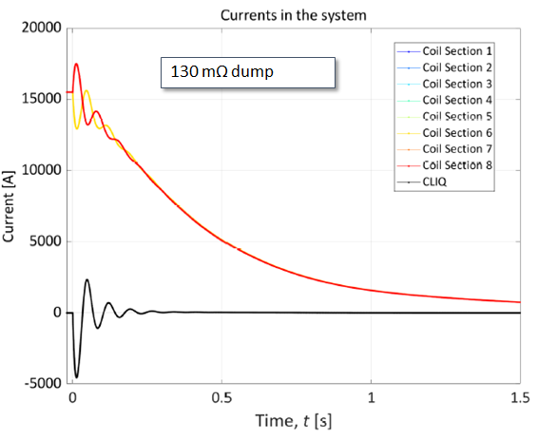
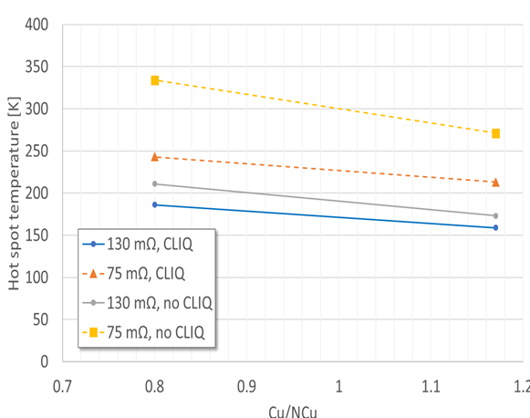
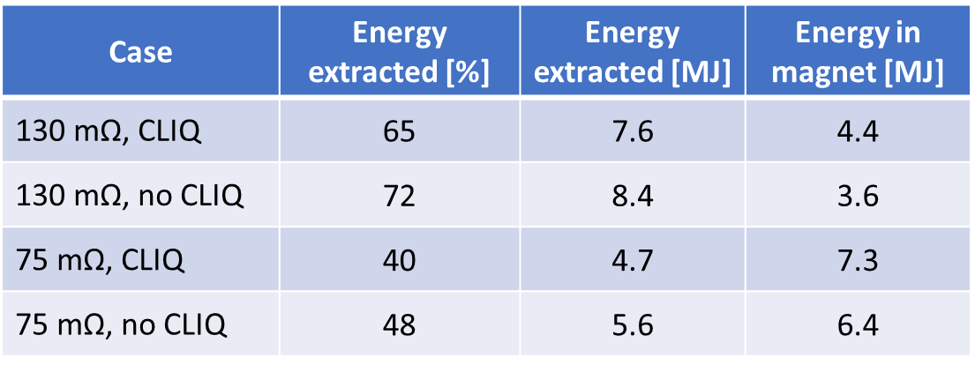
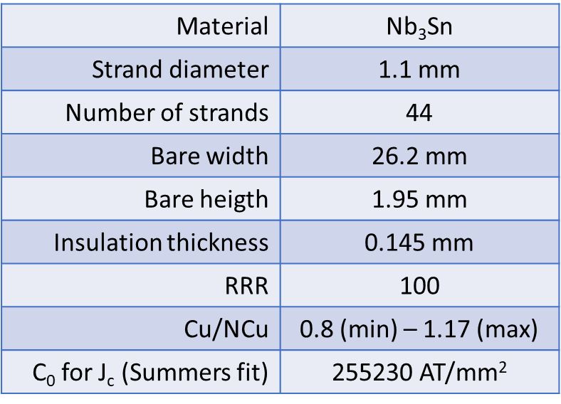
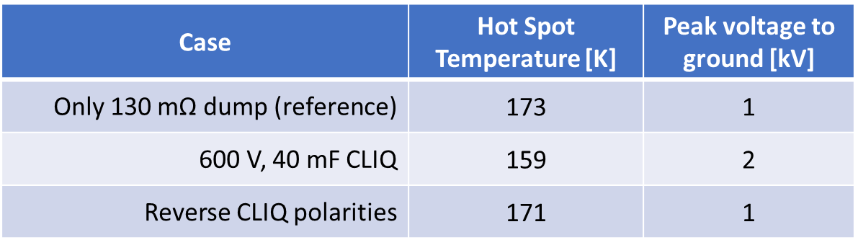
Quench Protection Analysis
Quench protection study parameters:
Analysis performed with STEAM-LEDET
Current: 15.5 kA
Detection + validation time: 15 ms
Voltage limit: ±1 kV with symmetric ground
Dump resistor: 130 mΩ (2 kV) – 75 mΩ (1 kV)
Options with and without CLIQ
CLIQ parameters: 40 mF, 600 V (AUP unit)
No Quench Heaters
Conductor parameters:
Current decay, energy extraction and hot spot temperature
D. Arbelaez, V. Marinozzi, E. Ravaioli et al.

Slide 13
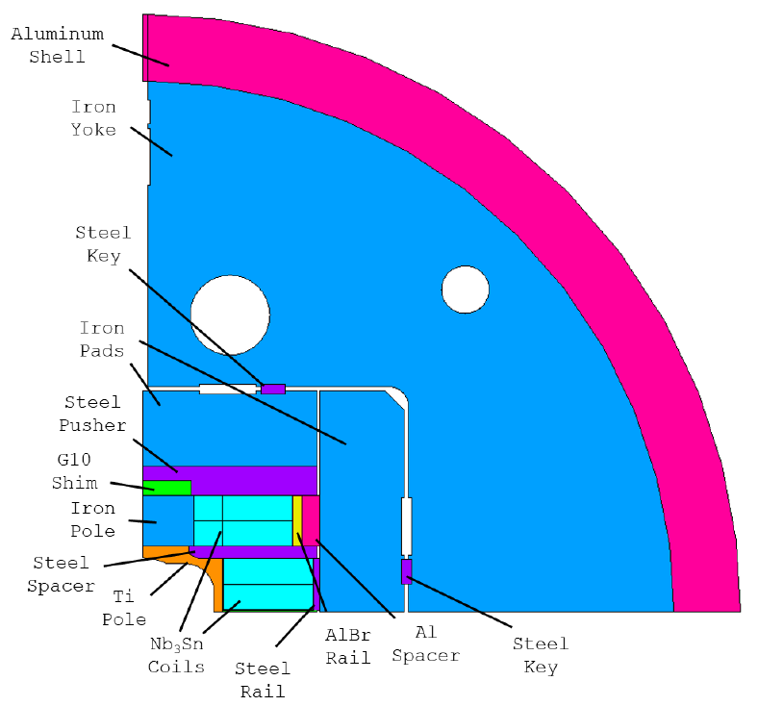
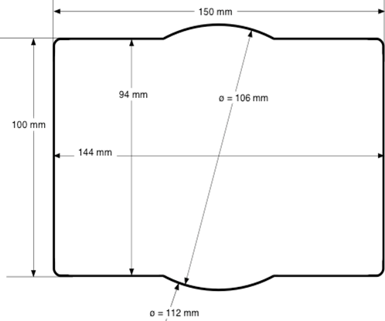
Mechanical Design
Design features to control the coil stress:
Key position defined to limit the max. tension at the pole/coil interface
Al. bronze rail with Al shim
Inner and outer coil individually shimmed
30 mm radius of the inner pole and G10 shim above the pole
  Reduces stress in the pole
  Limits the pole bending, reducing the tension ‘spikes’ at the pole/coil
  May be reduced with further design optimization
HEPdipo
D. Arbelaez, P. Ferracin, R. Hafalia, D. Martins Araujo, G. Vallone et al.

Slide 14
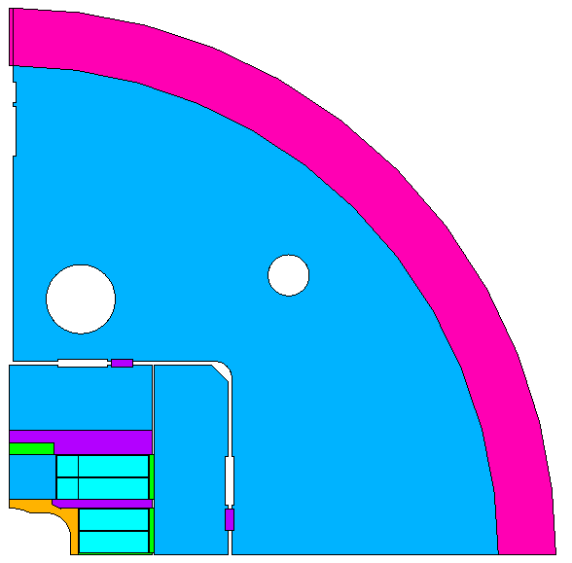
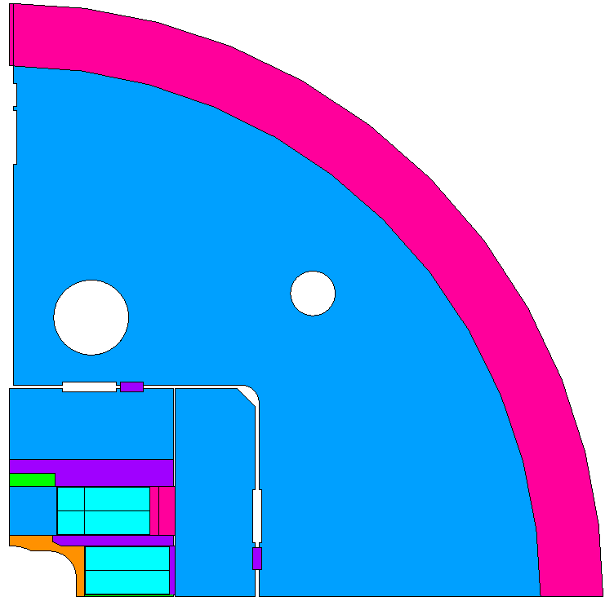
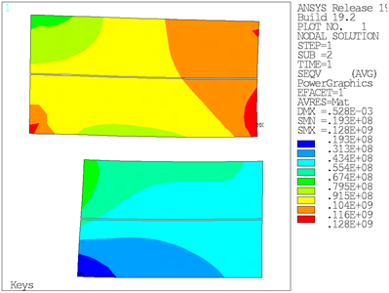
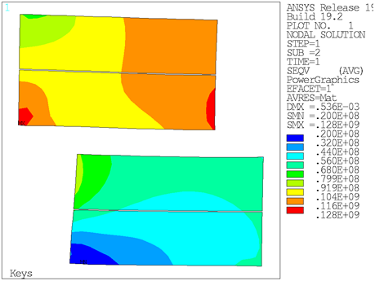
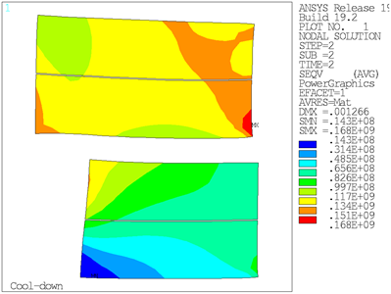
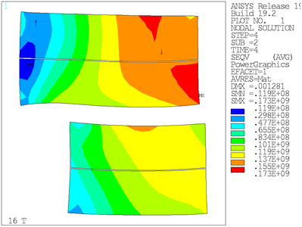
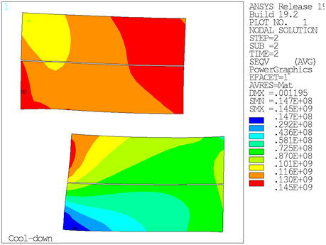
Mechanical Analysis (2D)
Using stringent design criteria on maximum pole-coil tension and material limits
“FRESCA2”
“LD”
Max stress at R.T.: 128 MPa
Max stress at cold: 168 MPa
Max stress at 16 T, in high field region: 122 MPa
Max stress at 16 T, in low field region: 173 MPa
Max stress at R.T.: 128 MPa
Max stress at cold: 145 MPa
Max stress at 16 T, in high field region: 131 MPa
Max stress at 16 T, in low field region: 166 MPa
D. Martins Araujo, G. Vallone et al.

Slide 15
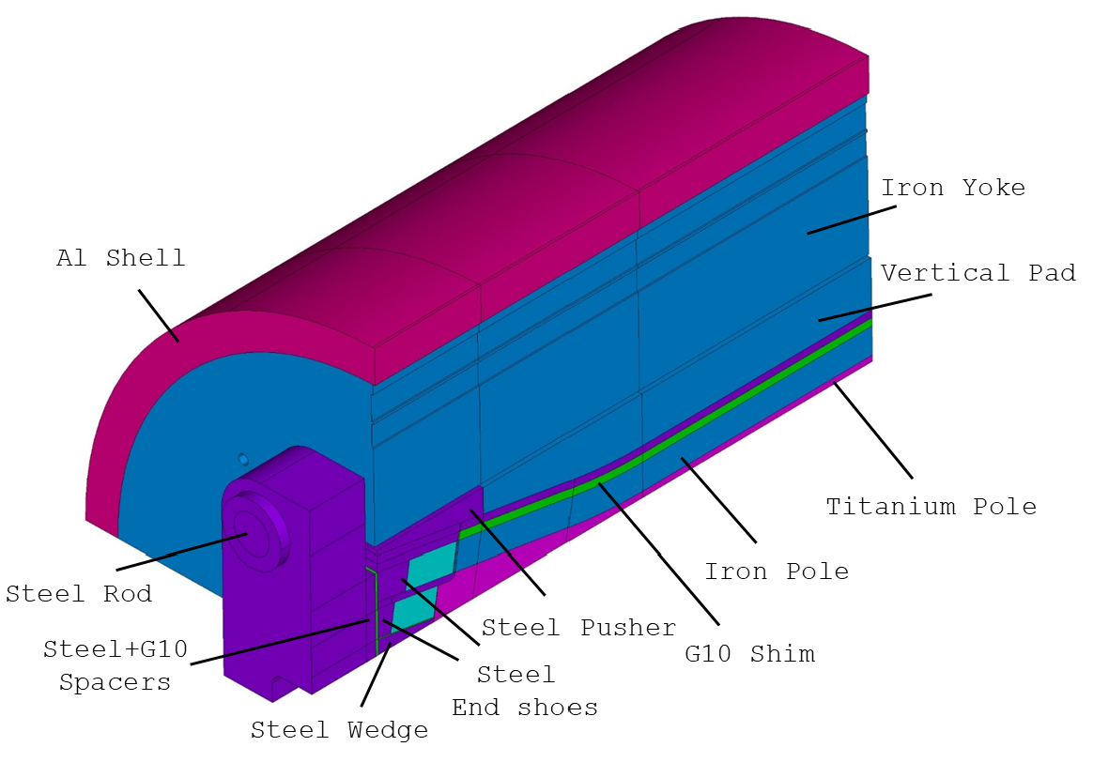
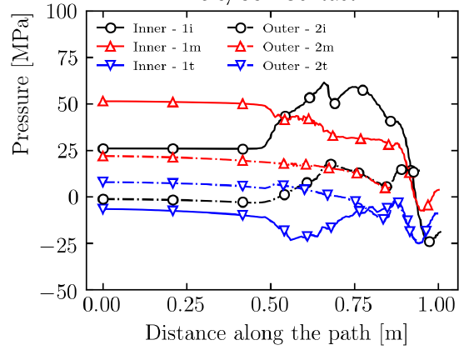
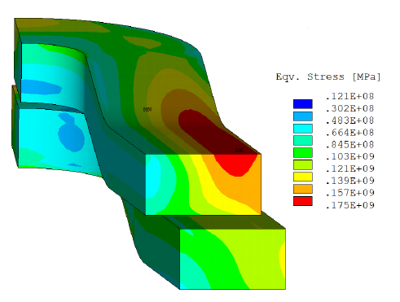
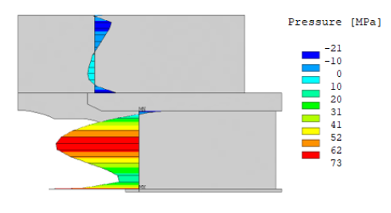
3D Design and Analysis
3D Design and Components
Contact pressure at coil/pole (16 T)
Coil stress at 16 T
Contact pressure at center (2D, 16 T)
3D Field
Magnetic length: 1.7 m
Field homogeneity: <1% over 1 m
D. Martins Araujo, G. Vallone et al.

Slide 16
Conceptual Design Review Feedback (6/20)
Requirements and interfaces
Clarify magnet and facility requirements and get stakeholder approval
Conductor and cable:
Some preference for higher sub-element design for stability in large diameter wire
Consider a cable with more strands (48 vs 44) and a smaller wire (1 mm vs. 1.1 mm)
Magnet design:
Alternatives have been properly considered and selected design minimizes risk
Main elements of the design fully endorsed by the committee: block coil, non-graded layout, shell-based structure
Consider increased margin to quench (conductor properties and magnetic design)
Consider increased shell thickness for margin (relative to using LD1 shell)
Include CLIQ protection system for added robustness and redundancy
Design tools, resources and collaboration:
Team expertise and analysis capabilities are fully adequate
Continue strong collaboration with FRESCA2/HEPdipo teams and US conductor Labs

Slide 17
CDR follow-up and recent progress
Interfaces between magnet and facility:
Focus on quench protection analysis, mechanical interfaces between magnet and cryostat, design optimization to control magnetic forces due to fringe fields
Conductor and cable:
Protection analysis results allow to confirm selection of the 169 sub-element design
Received 3 km of 169 strand from CERN for preliminary cabling studies
Development cable run completed and characterization effort starting
Started procurement of ~200 kg of strand for first practice coil
Magnet design
Use of 169 conductor with 0.9 copper ratio allows to increase margin to quench by about 3%, addressing review recommendation without increasing coil volume
Project planning:
Revised development plan and schedule to reflect post-CDR baseline
In progress: budget revision to match the updated plan

Slide 18
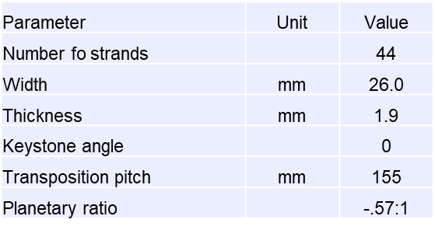
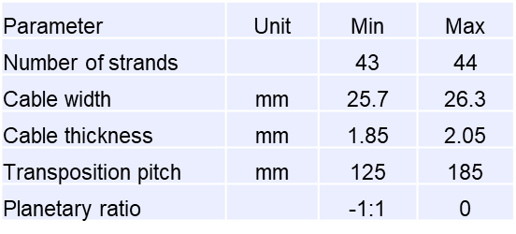
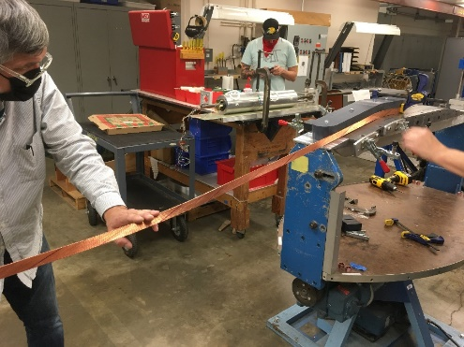
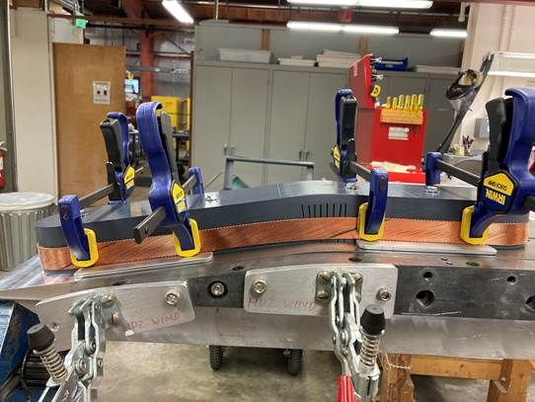
Cable Development
First TFD cable run (“development cable”) was completed in November 2020
Using 3 km of RRP 108/127 wire procured by LBNL, and 3 km of 162/169 wire procured by CERN (sufficient for about 60 m of cable for each type)
108/127 used for initial feedback and broader exploration of parameter space
Tests performed: residual twist, winding properties, micrographs
Four longer sections with different width and thickness made with 162/169
Nominal cabling parameters
Parameter ranges considered
D. Arbelaez, R. Hafalia, H. Higley, D. Martins Araujo, I. Pong, M. Naus et al.

Slide 19
Conductor and Cable: Next Steps
Sample distribution for cable 1302 (162/169 wire)
Cable characterization plan
Virgin strand samples for reference (162/169 wire)
We expect to complete the cable characterization by the end of March
Followed by external review of conductor specification for production orders
In the meantime, a specification has been developed (based on CERN FCC) and internally approved for the “prototype” cable (full length, final parameters)
Procurement of 200 kg of wire for prototype cable has started (issued solicitation, order not yet placed)
Prototype cable will be used for first practice coil

Slide 20
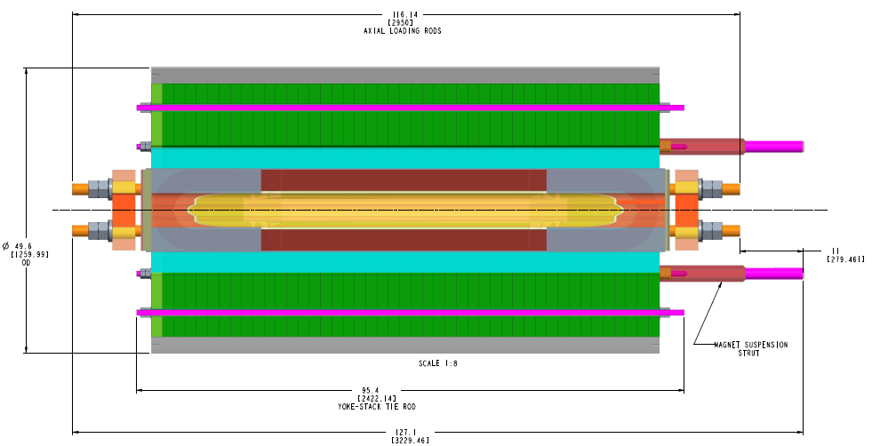
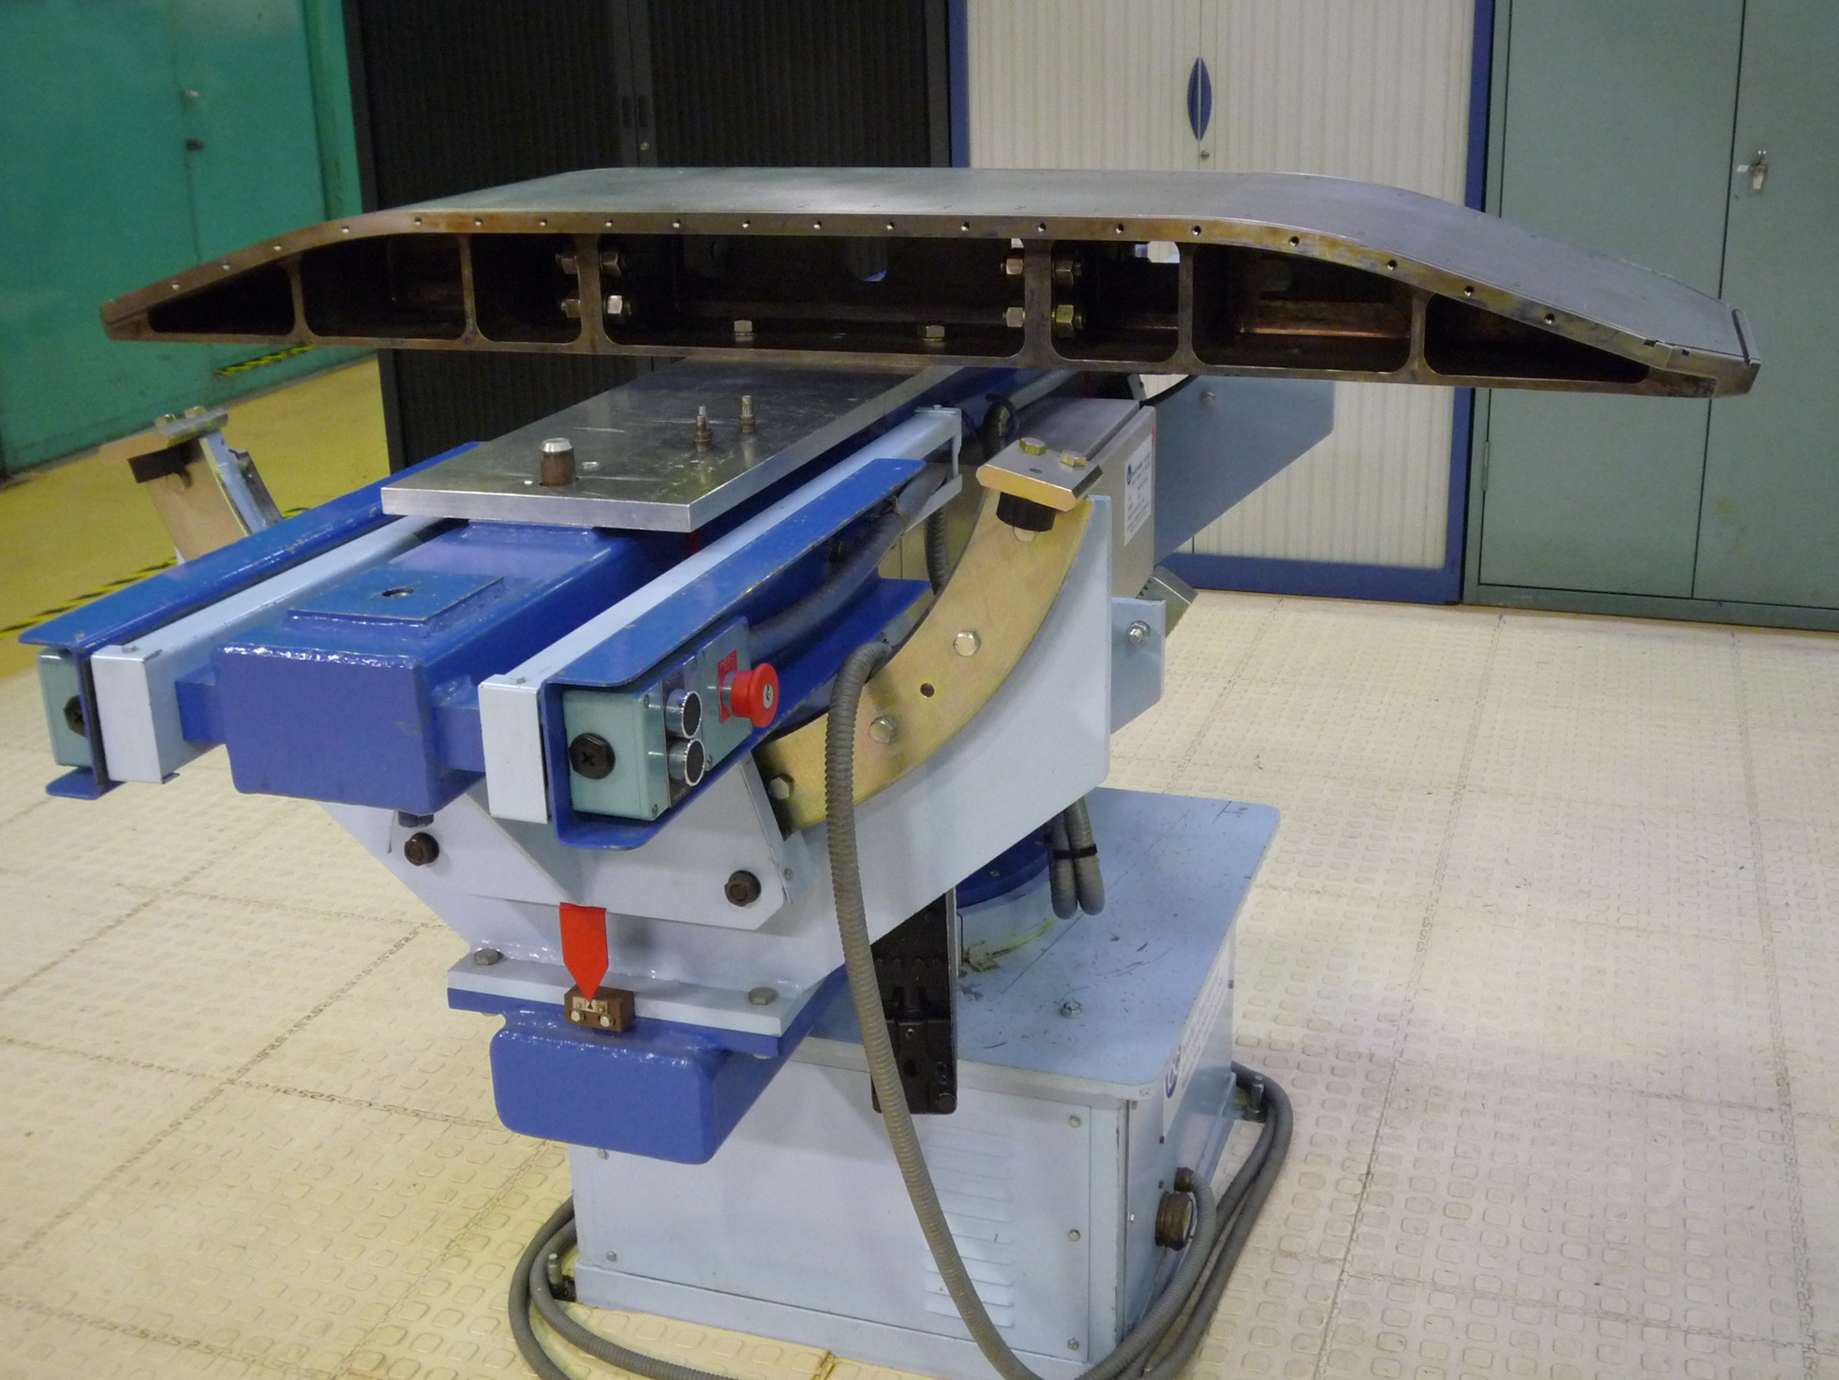
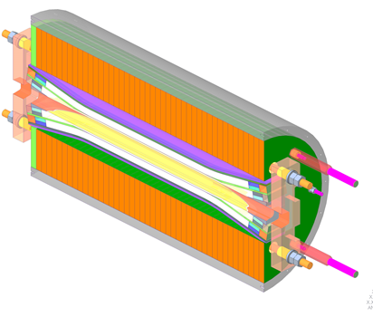
Engineering Design and Coil Tooling
2.95 m
Preliminary CAD models are being implemented in support of magnet design and test facility interfaces
Upgrade coil winding infrastructure to allow transverse mounting of the baseplate
Re-commissioning of reaction oven and potting tooling in a new location may be required
CEA winding setup
D. Arbelaez, R. Hafalia et al.

Slide 21
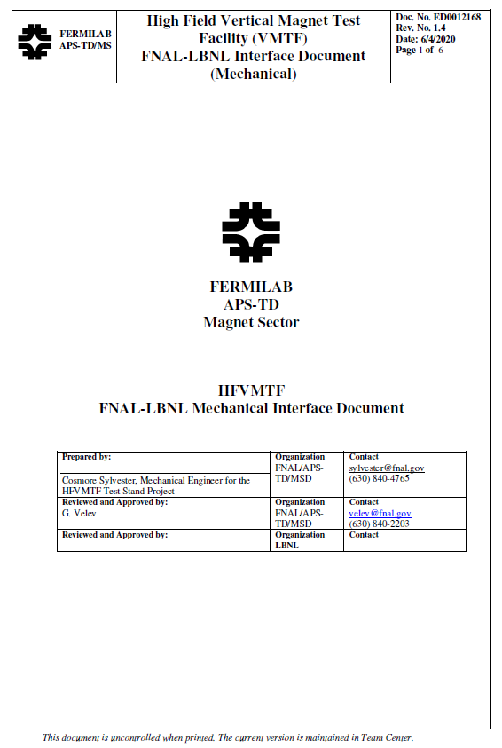
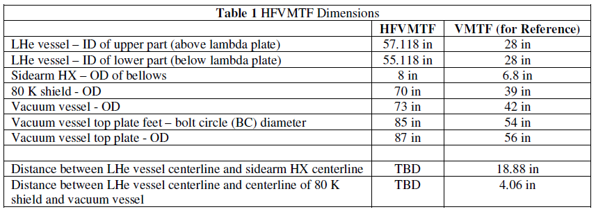
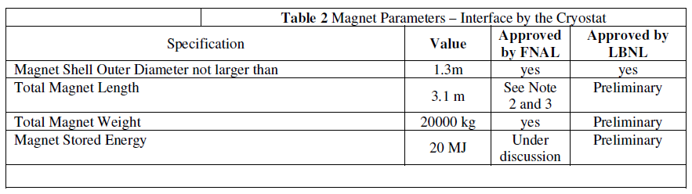
Test Facility Interfaces and Specifications
Discussions between LBNL and FNAL teams are ongoing as the design of magnet and facility is in progress
  Mechanical interfaces (magnet dimensions, weight, supports)
  Electrical interfaces (powering, instrumentation, protection)
Interface document is capturing current status and will evolve in a formal agreement as the design matures and is finalized

Slide 22
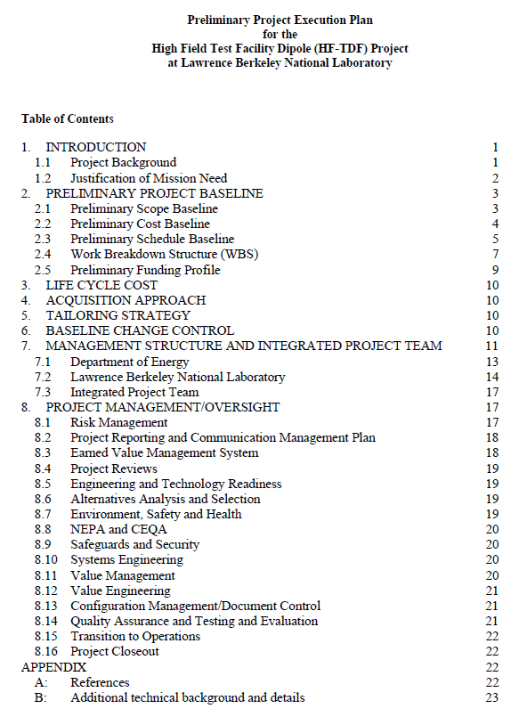
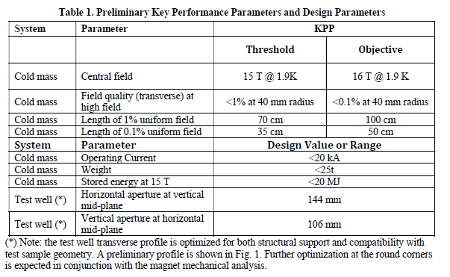
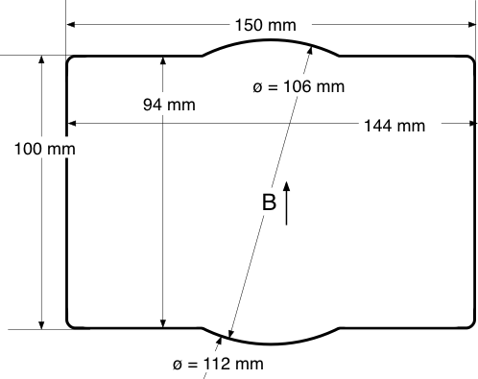
Preliminary Project Execution Plan
A preliminary project execution plan was submitted to DOE
Following the guidelines and structure for 413.3b projects
DOE feedback: ok but simplify in some areas to allow more flexibility in project execution and reduce cost (e.g. key performance parameters, financial reporting, management structure)

Slide 23
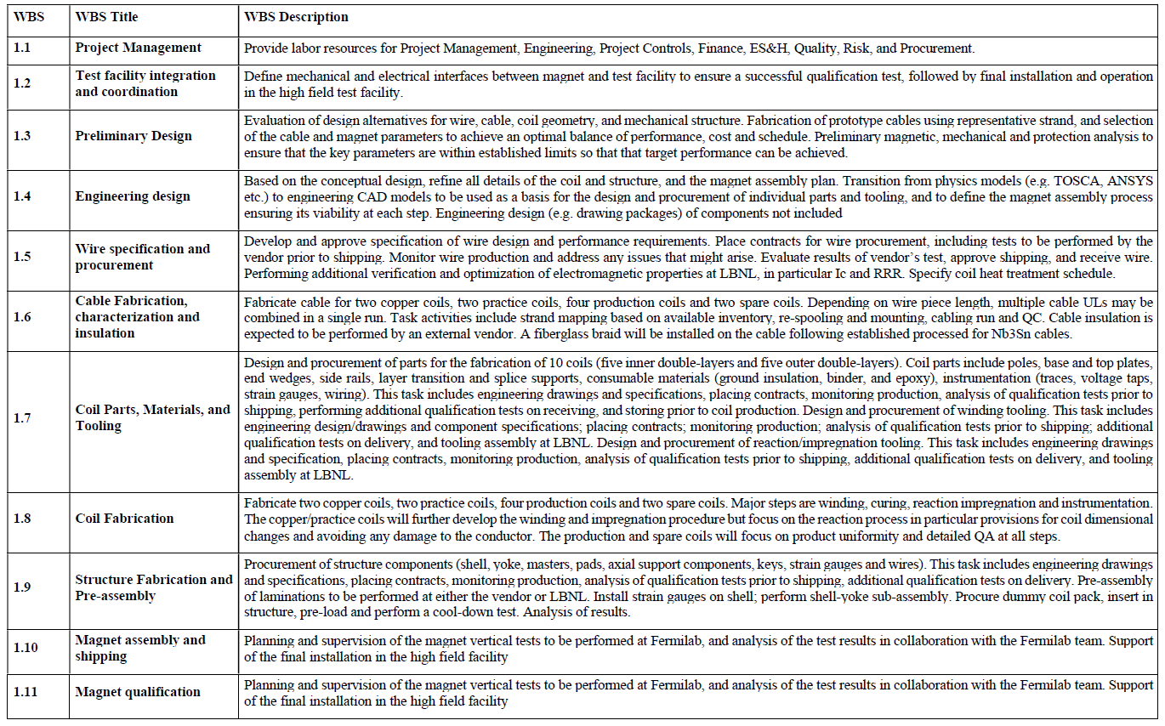
Preliminary Work Breakdown Structure

Slide 24
Magnet Development and Fabrication Plan
The TFD plan follows the approach used in similar high field magnet programs and projects (e.g. LARP/QXF, FRESCA2)
In particular, significant resources are allocated to magnet development and production phase has built-in “scope” contingency to mitigate risk
Development (~46% of total project cost):
  Conceptual design and analysis
  Cable development and characterization
  Nb₃Sn practice coils
  A magnet assembly and cool-down using instrumented aluminum coils to verify design calculations and strain gauge instrumentation
Production (~36% of total project cost)
  Coil fabrication (two inner and two outer), magnet assembly and test
Scope contingency (~18% of total project cost, ~51% of production cost):
  One set of spare coils (one inner and one outer double-layer)
  Two complete cycles of assembly and vertical test to allow for an adjustment of pre-load and/or replacing one or two coils with spares.

Slide 25
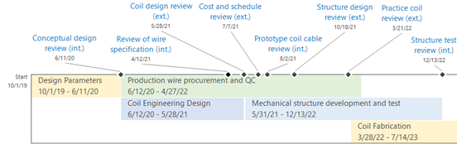

Magnet Schedule

Slide 26
Summary
Magnet specifications, performance targets and test facility interfaces have been defined and documented
  Some key design parameters (e.g. magnet length) still need to be finalized with user/EOB feedback and detailed engineering design and optimization
We are taking full advantage of the extensive technical background provided by previous design and development of large aperture, high field Nb₃Sn dipoles
  Analysis and comparison of different design options
  Design of coil parts, tooling, and fabrication processes
  Support structure
Building on this past work, we have been able to make further improvements in critical areas, particularly regarding coil stress
  16 T pre-load under strict design criteria on allowed tension
  < 150 MPa at cool-down (near pole); < 170 MPa at 16 T (in the low field area)
First cabling run completed and characterization effort starting
Design is sufficiently advanced to support detailed project plan, schedule and cost

