Slide 1
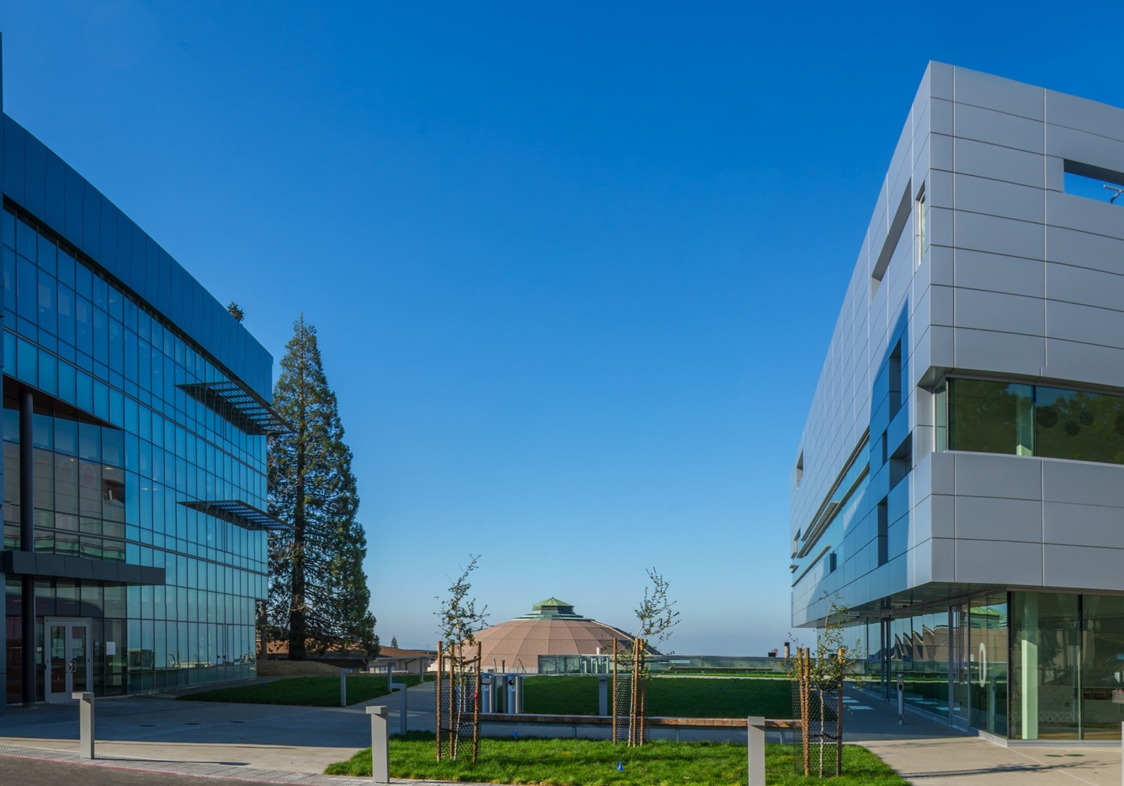
High Temperature Superconductor Cable Test Facility
Summary and Discussion Points
Soren Prestemon
Director, US Magnet Development Program
Director, Berkeley Center for Magnet Technology
Lawrence Berkeley National Laboratory
January 7, 2021
LBNL, Berkeley, CA

Slide 2
EOC Members
  Joe Minervini (Chair)
  Steve Gourlay (Co-chair / Backup)
  Luca Bottura
  Luisa Chiesa
  Danko van der Laan
  Ruben Carcagno
  Nicolai Martovetsky
Role of the Oversight Committee (OC):
  Represent user interests in facility plans
  Provide guidance and oversight for the overall facility development
  Provide feedback on performance goals, overall design, and its implementation
  Provide advice to the project management in terms of:
                - Responsiveness to community needs
    - Coordination and integration of efforts magnet/facility
    - Balance of project risk and cost & schedule
  Provide guidance on:
    - Facility operational structure and user needs
    - Collaboration and coordination with other laboratories
  Provide feedback to sponsors on project team performance

Slide 3
There are several questions connected mostly with SC test sample cryostat and test sample well for FES
  Assuming EDIPO/Sultan type sample cryostat, is this what we need?
  What are sample dimensions? Constant?
  Any limitations on temperature gradient within the sample during testing?
  Are there any requirements for warmup/cooldown?
  SC transformer, what design we should use? Primary and secondary coil turns?
  Is 100kA what we need?
Some key design parameters (e.g. magnet length) still need to be finalized with user/EOB feedback and detailed engineering design and optimization

Slide 4
Summary
The DOE Offices of HEP and FES have joined forces to support the development of an unique world-class HTS Cable Test Facility
The facility will support the needs of both offices:
  Provides testing capabilities for future US MDP hybrid magnets
  Enables testing of high-current cables (LTS and HTS), including at variable temperature
We seek advice and feedback from the EOC as the project moves forward:
  collectively you represent broad and deep experience/wisdom in advanced magnets, facilities, and projects

Slide 5
Overall project schedule

Slide 6
Backup

