Slide 1
Composites Workshop Day 3 Closeout
LBNL Composites Workshop
February 29-March 3, 2016

Slide 2
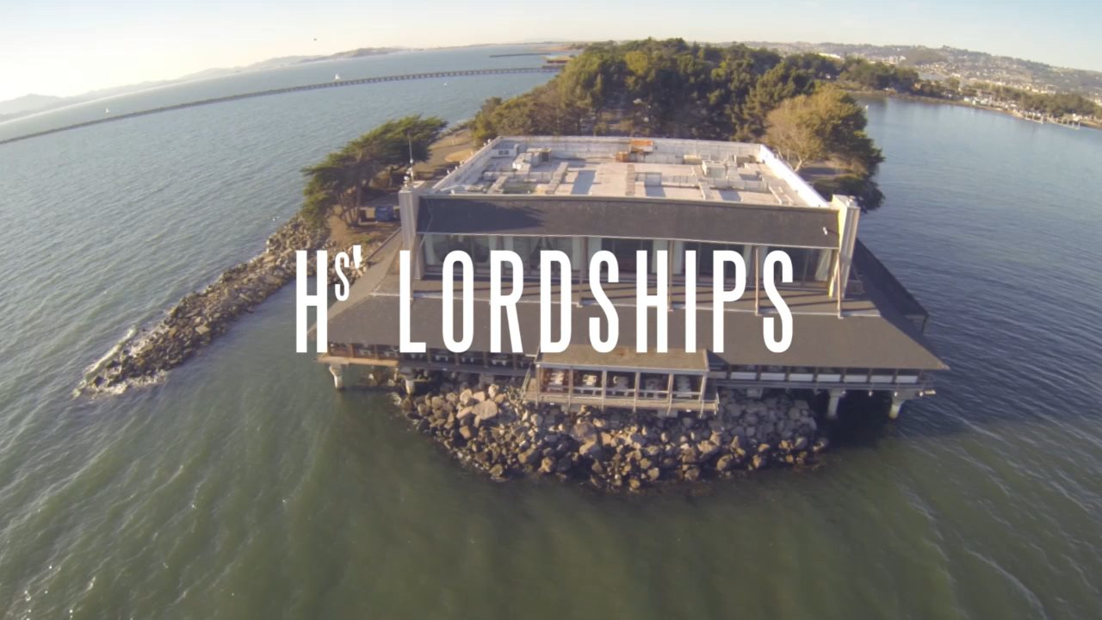
Reminders
Apero 7-8
Dinner 8-10
Who’s driving?

Slide 3
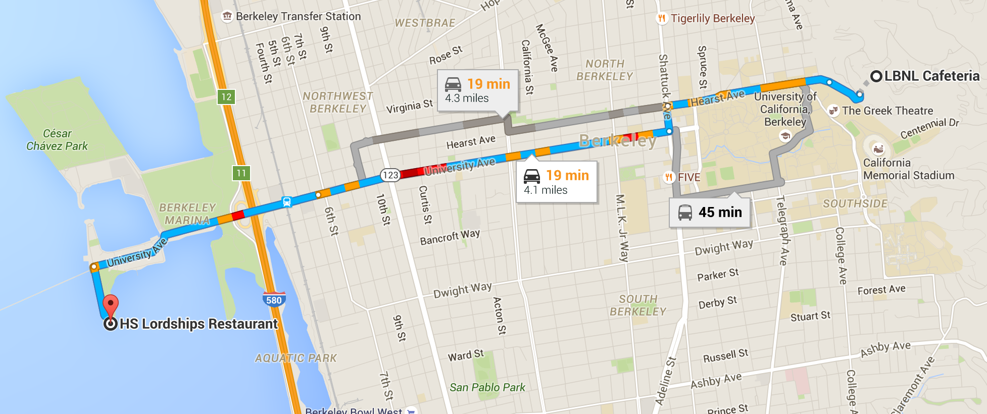
Dinner Venue

