Slide 1
Composites Workshop Overview and Planning
LBNL Composites Workshop
February 29-March 3, 2016

Slide 2
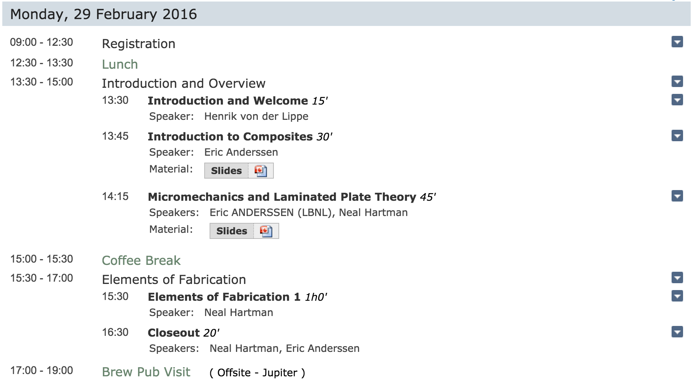
Monday, 29 February

Slide 3
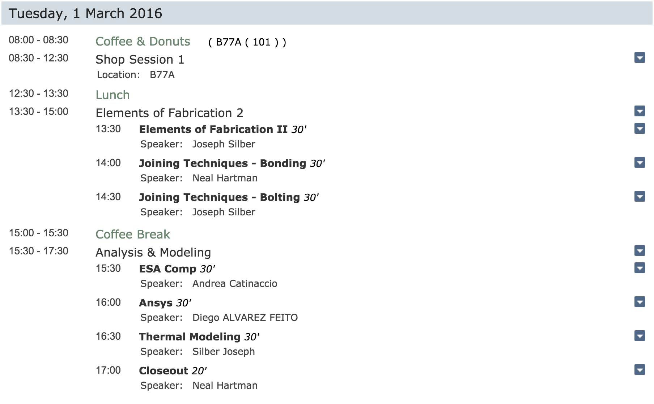
Tuesday, 1 March

Slide 4
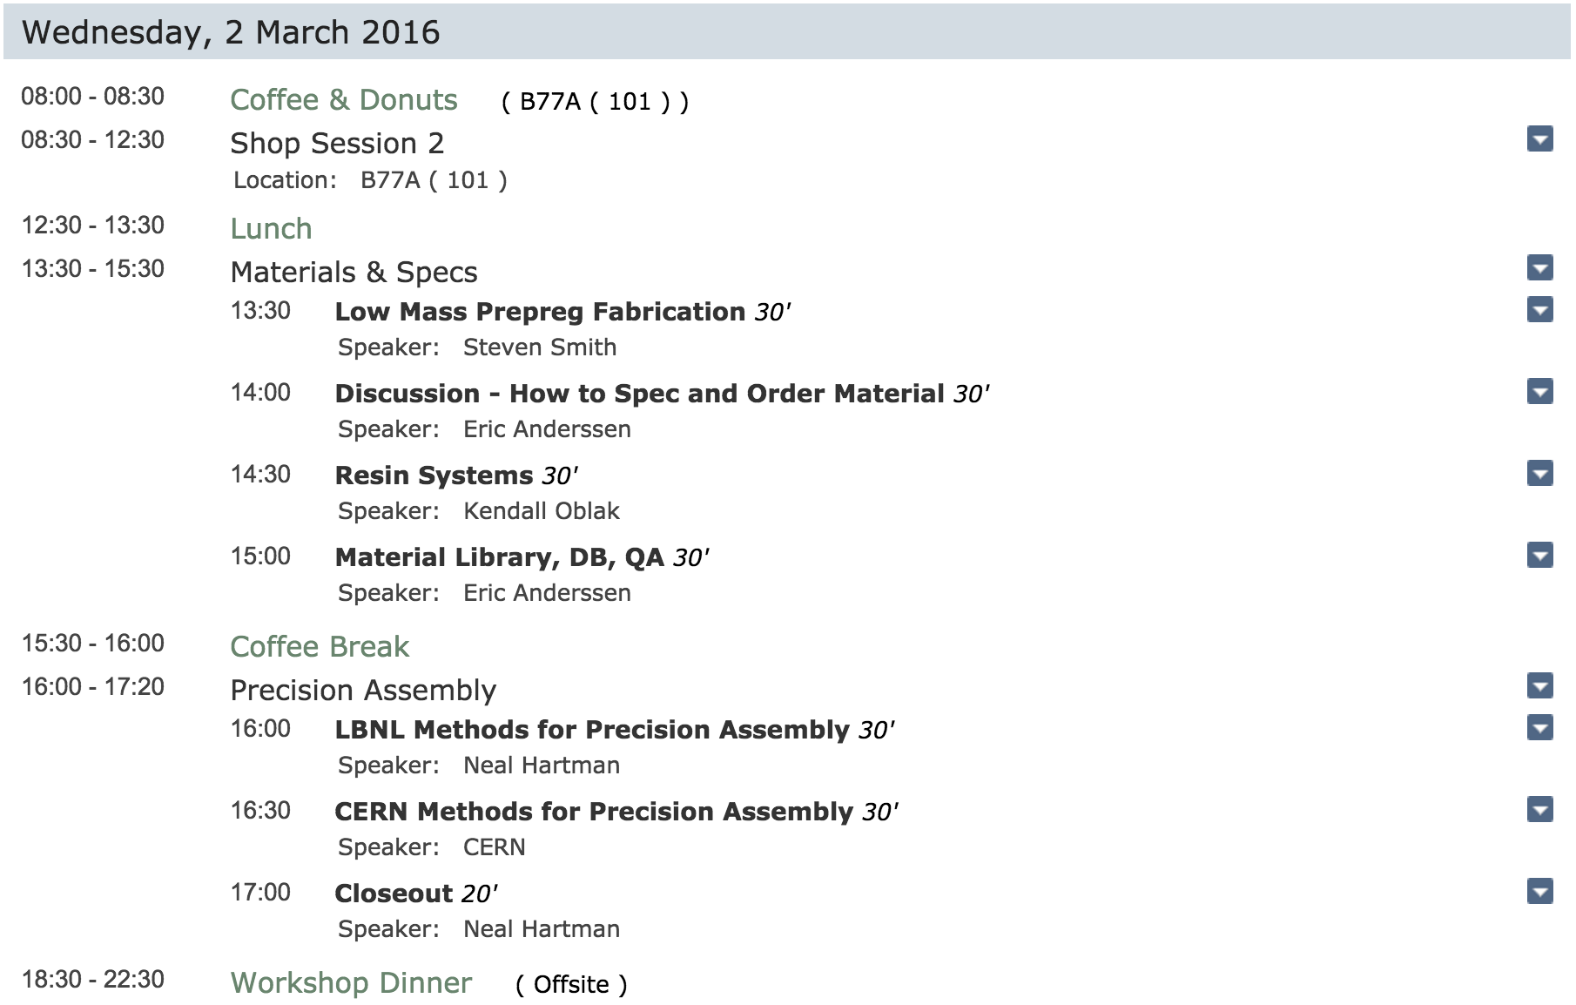
Tuesday, 2 March

Slide 5
Wednesday, 3 March

Slide 6
Tuesday
8am – Breakfast
8h30 – Shop Session Starts
B77A, will walk past now on way down the hill

Slide 7
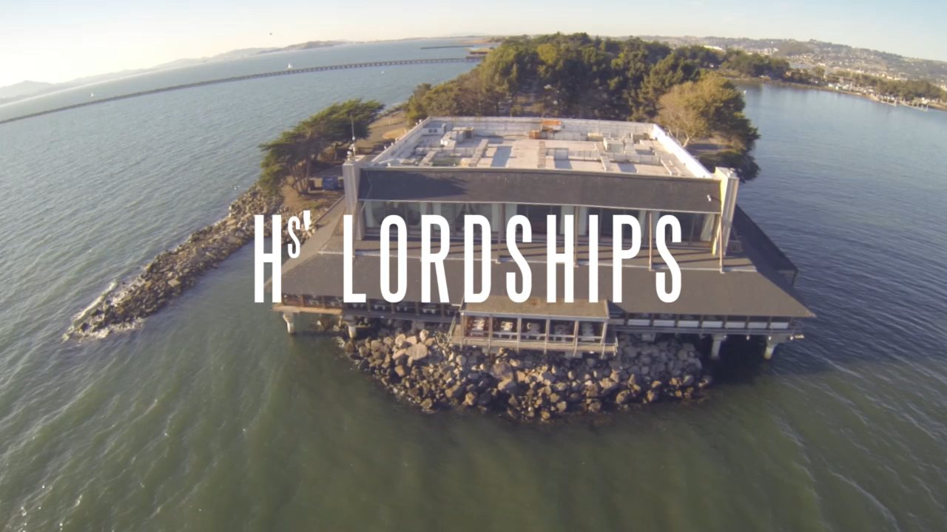
Reminders
Please confirm if you will be coming to the dinner on Wednesday Evening
If you have already confirmed, please pay me $100
Please confirm if you will be taking the tour on Thursday afternoon

