Slide 1

Modelling Composite Materials:
Introduction to ESAComp
A. Catinaccio
CERN EP-DT-EO
LBNL Composites Workshop
Berkley, March 2016

Slide 2
Main topics of the ESAComp introduction
Esacomp as a conceptual design tool. From the micro-mechanics to analytical and FEA more powerful tool.
Some good basic functionalities of the program:
  A good Data Bank of composite material data to start with
  Intuitive ply and laminate creation with friendly UI
  Fundamental laminate design and analysis
  Some example of plate analysis
  Integration with other FEA tools (ie Ansys APDL and ACP)
What is not covered here is micro-mechanics
More advanced options will not be shown here and we point to the EsaComp website for material download, webinars, ets. A specific presentation by Harri Katajisto is also added to the WS material.

Slide 3
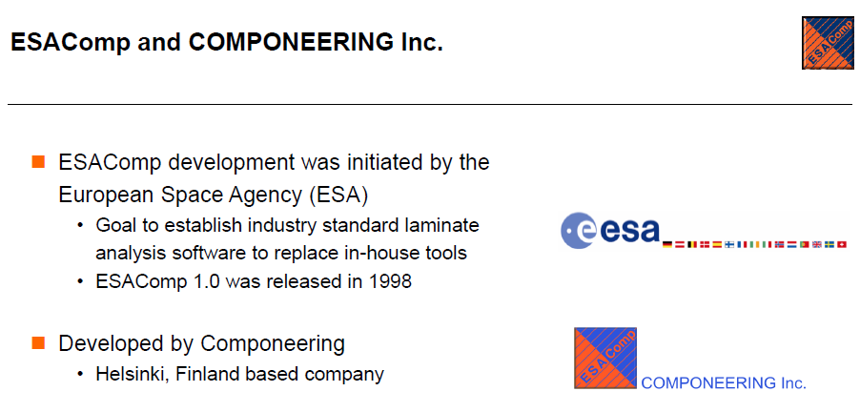
Harri Katajisto

Slide 4
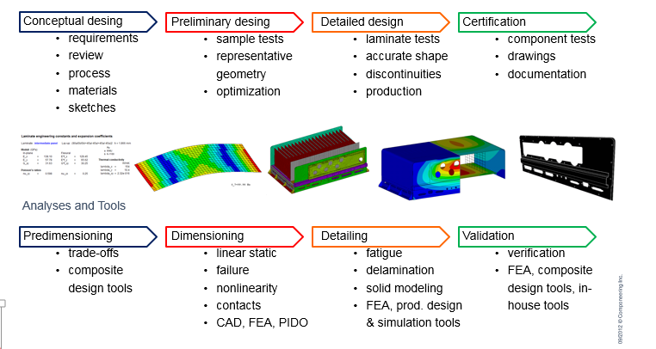
ESAComp Shortly
A toolbox for composite designers and analysts
Conceptual design
Common analyses cover:
  Laminates analysis
  Linear static stress/strain prediction,
  Nonlinearity, buckling
  Failure of laminates and shell structures
https://indico.desy.de/contributionDisplay.py?sessionId=3&contribId=11&confId=6112

Slide 5
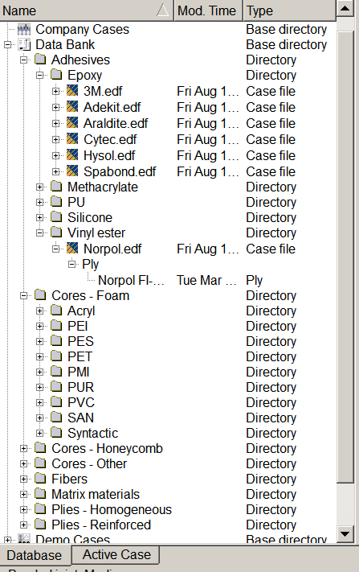

ESAComp Material Data Bank
Updated database of 1000+ material within ESAComp
Types of materials:
  Fibers
  Matrix materials
  Reinforced plies
  Core materials
  Adhesives
  Homogeneous materials (e.g. metals)

Slide 6
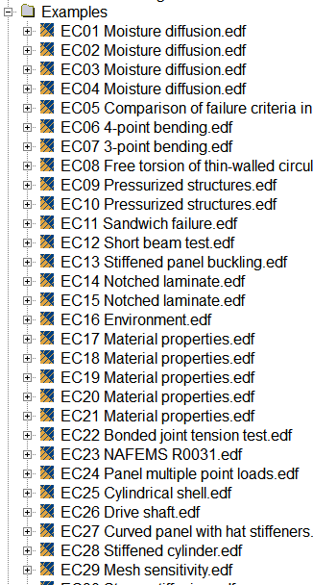
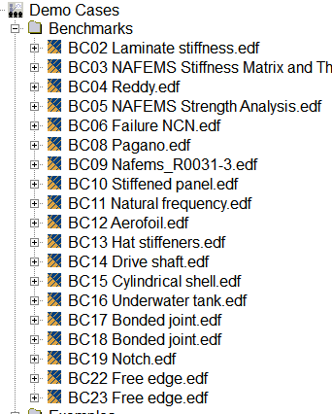
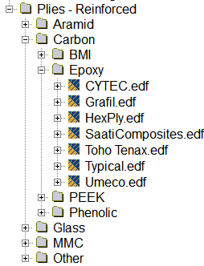
ESAComp Material Data Bank
  About fifty reinforced ply material systems with statistical test data.
  The information has been extracted from Advanced General Aviation Transport Experiments (AGATE) and MIL-HDBK-17-2F material databases.

Slide 7
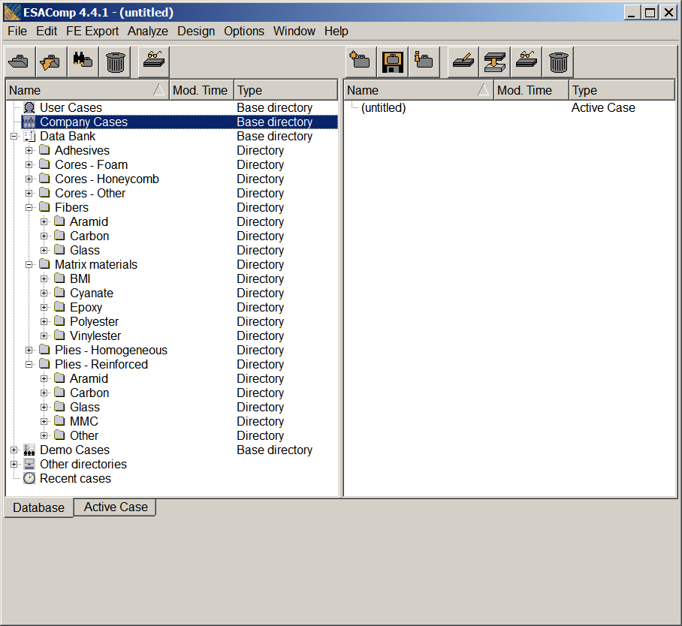
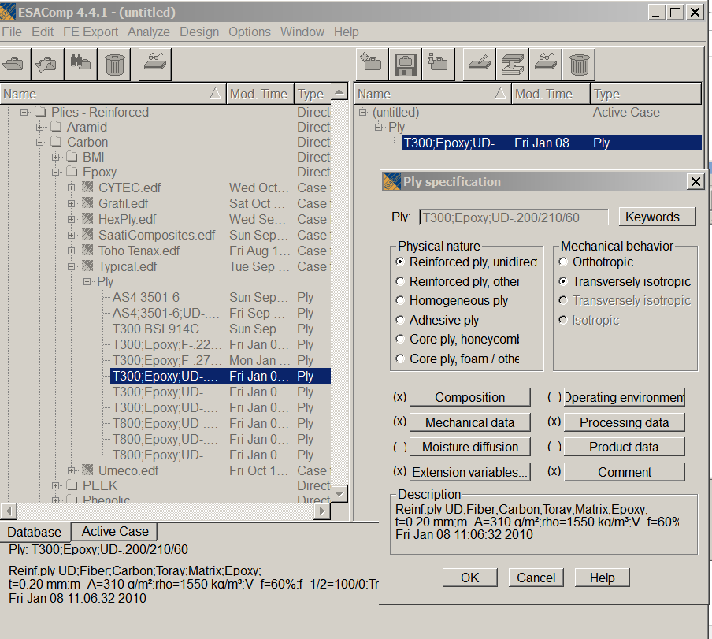
How to Select (or Create) a Ply

Slide 8
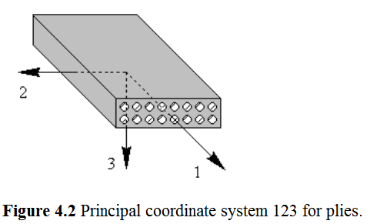
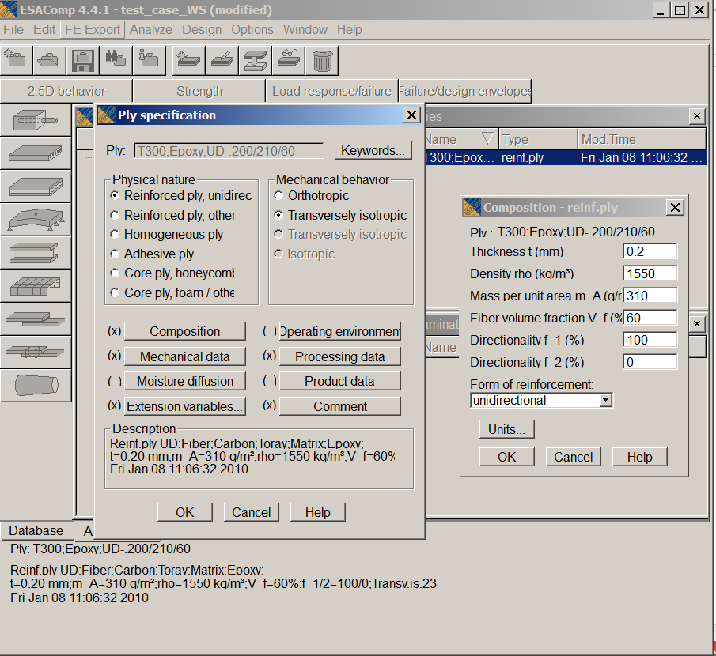
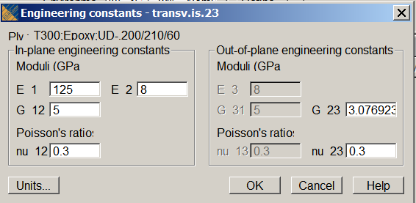
Ply Properties
CPT

Slide 9
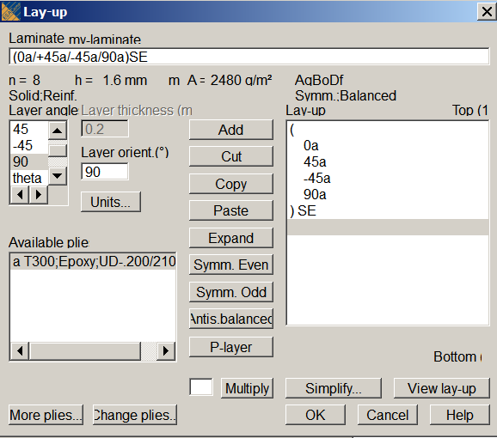
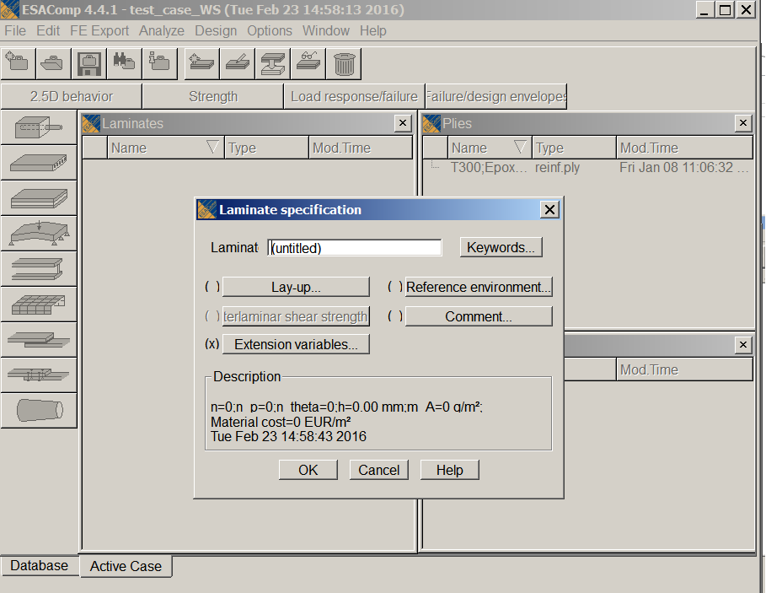
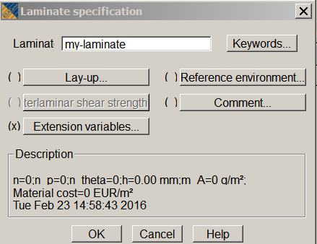
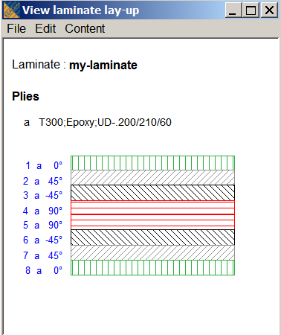
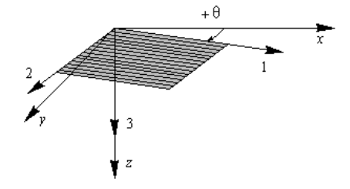
From Ply to Laminate
P-layer: a laminate in which the thickness proportion of the selected p-layer(s) is varied in the analyses.

Slide 10
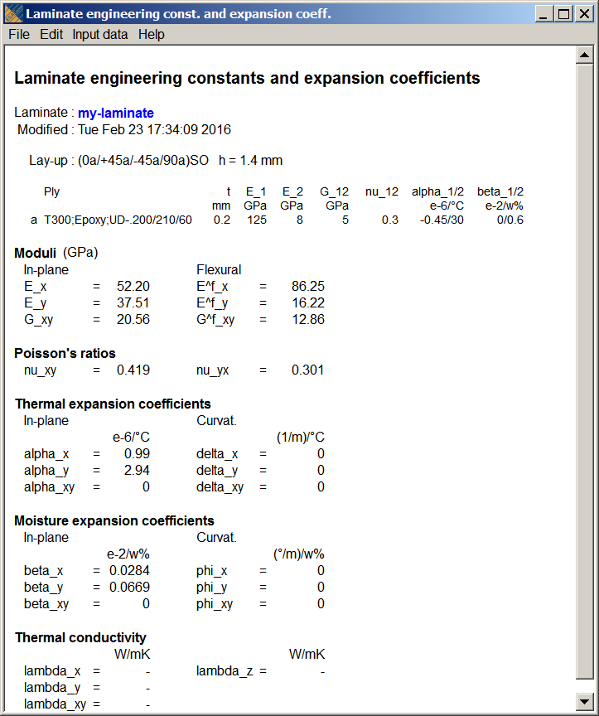
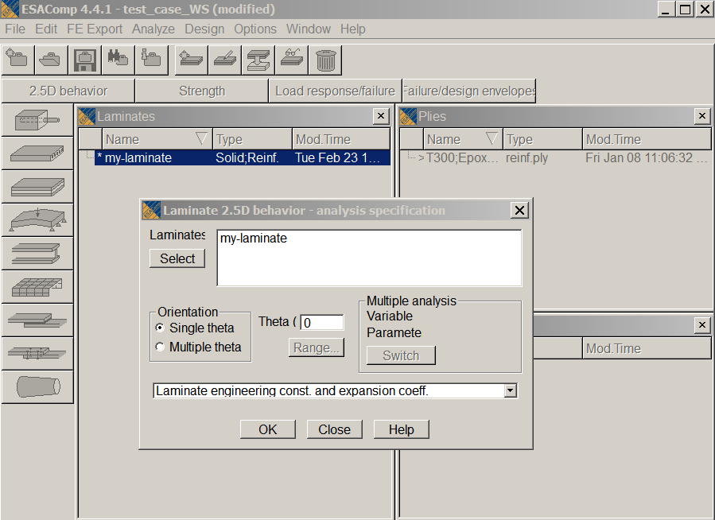
Lay-up Engineering Constants

Slide 11
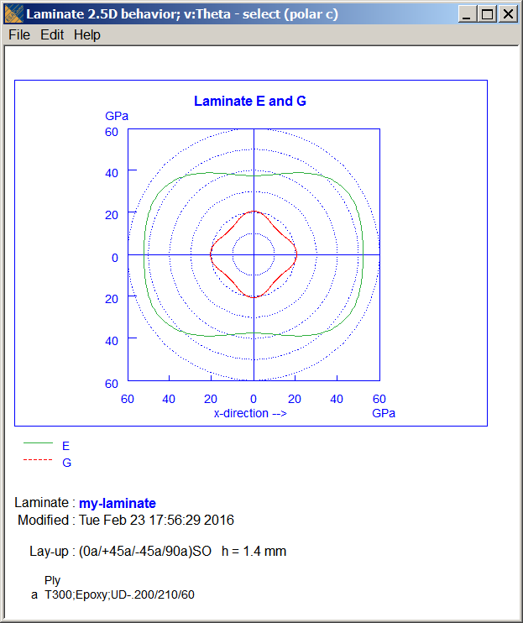
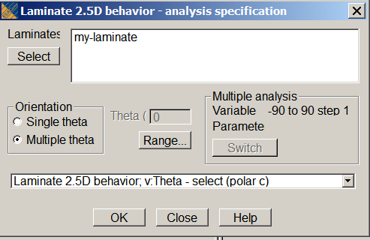
Lay-up Ply Polar Charts

Slide 12
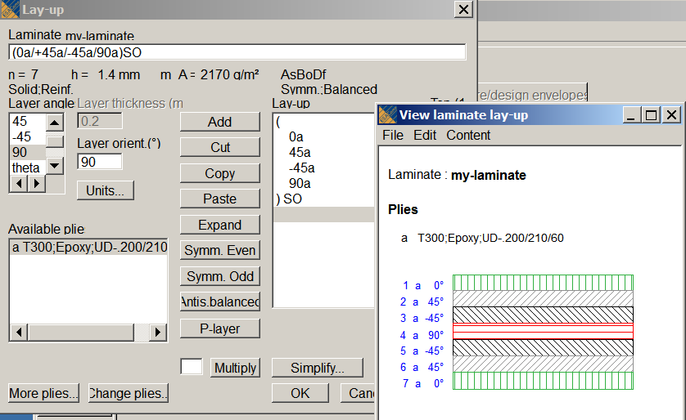
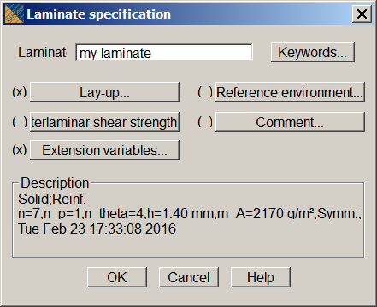
Lay-up Code
The code AsBoDf identifies that the in-plane stiffness matrix has a specially orthotropic form, the coupling stiffness matrix is zero, and the flexural stiffness matrix is full. Symmetric angle-ply laminates, for example, possess this kind of mechanical behaviour.
Page 13

Slide 13
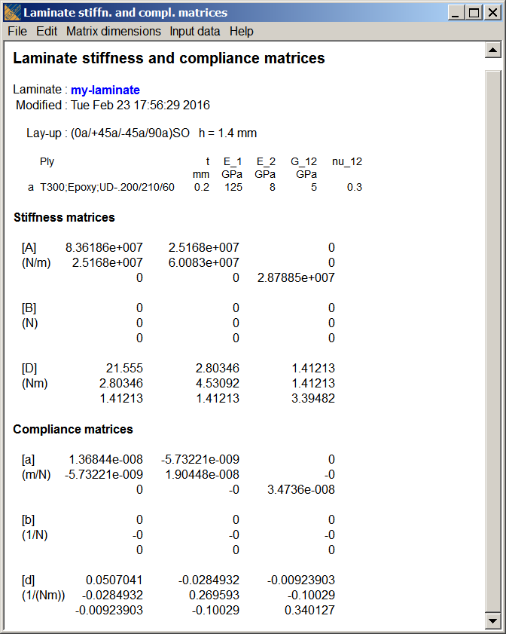
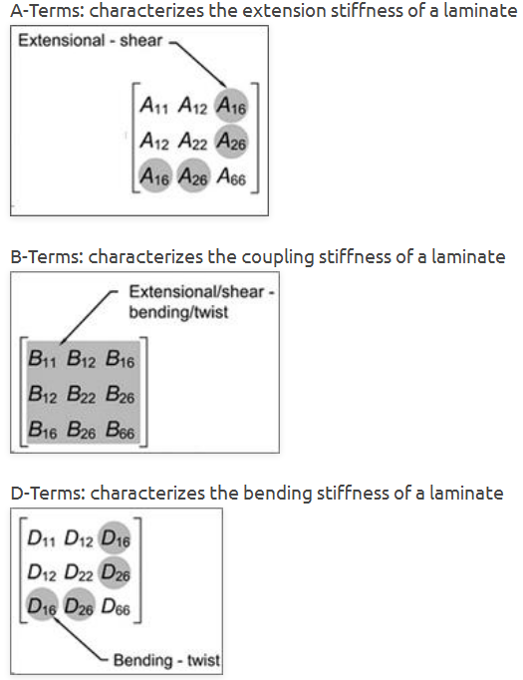
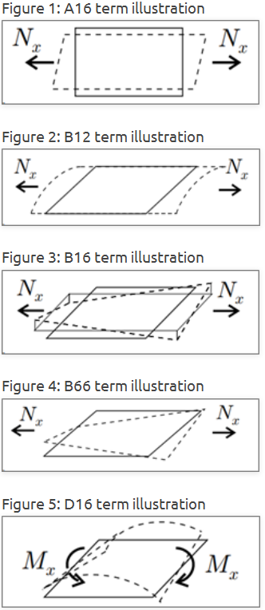
Symmetric and Balanced Laminate
B matrix is zero if you have a symmetric laminate.
A16 and A26 terms (the in-plane normal shear coupling terms ) are zero then you have a balanced laminate.

Slide 14
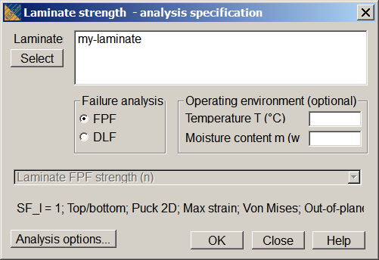
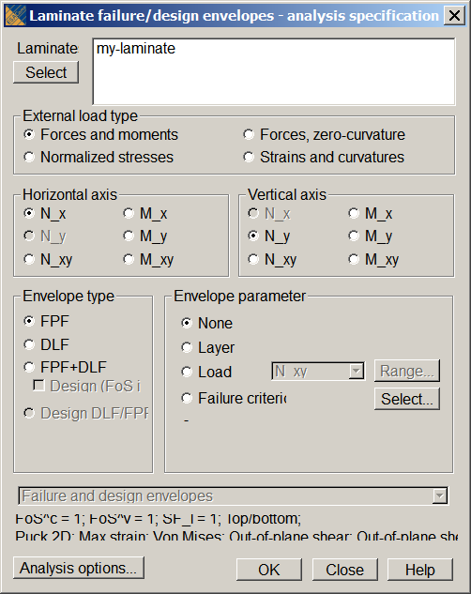
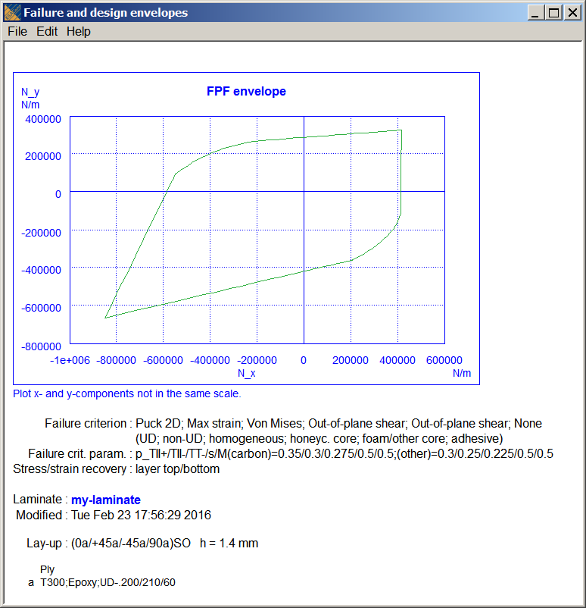
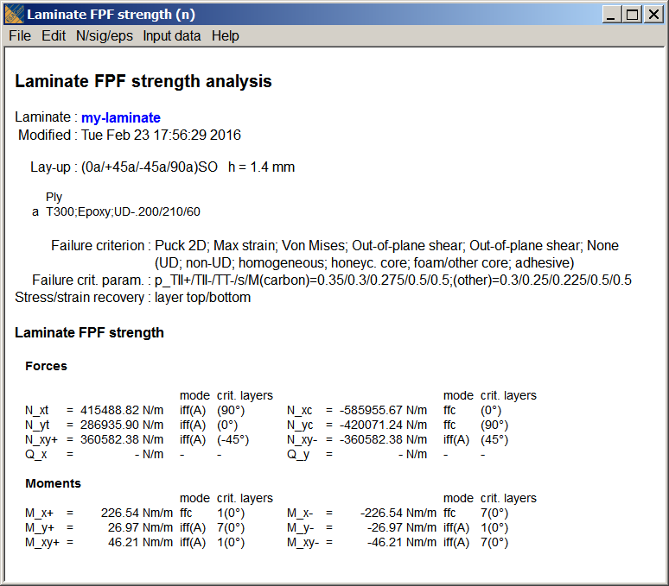
Laminate Strength

Slide 15
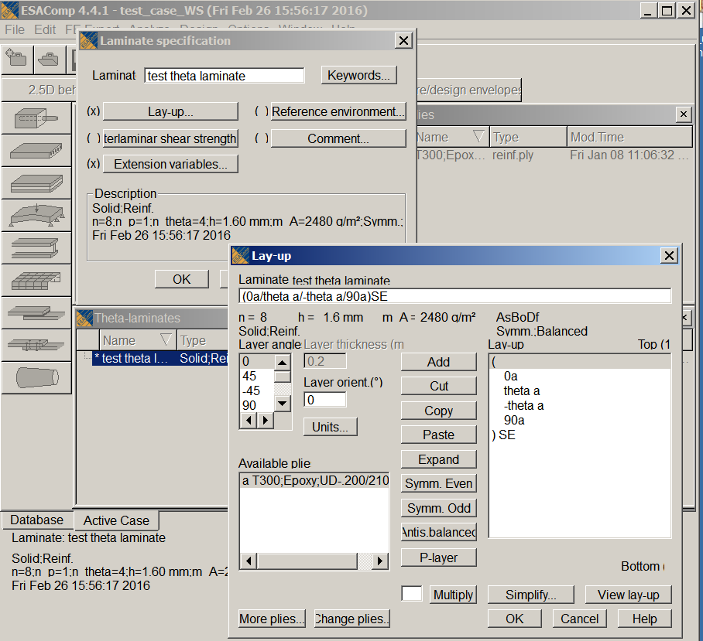
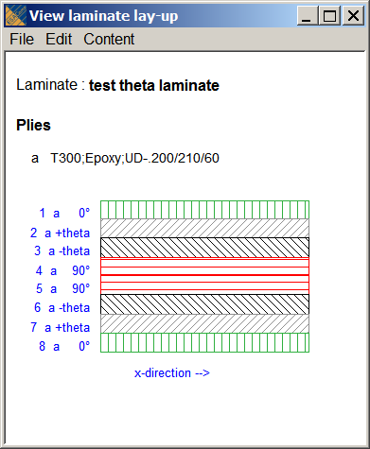
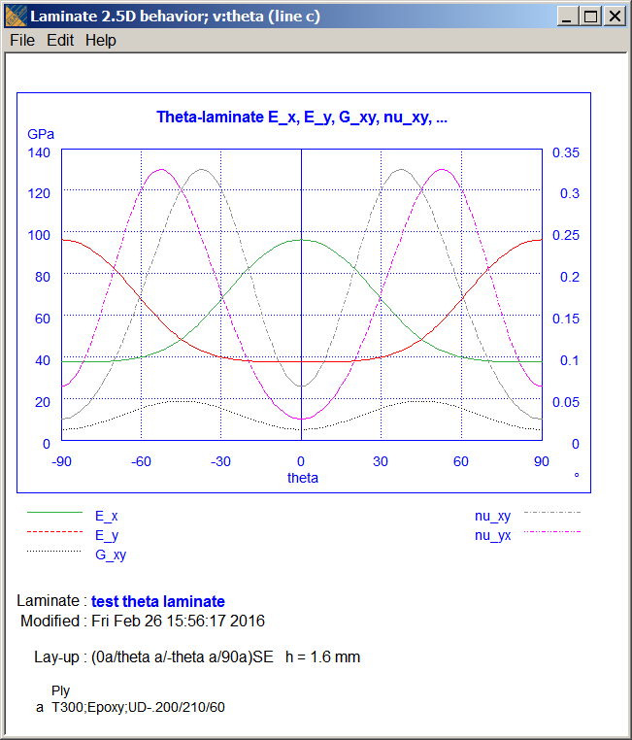
Analysis of Theta Laminates

Slide 16
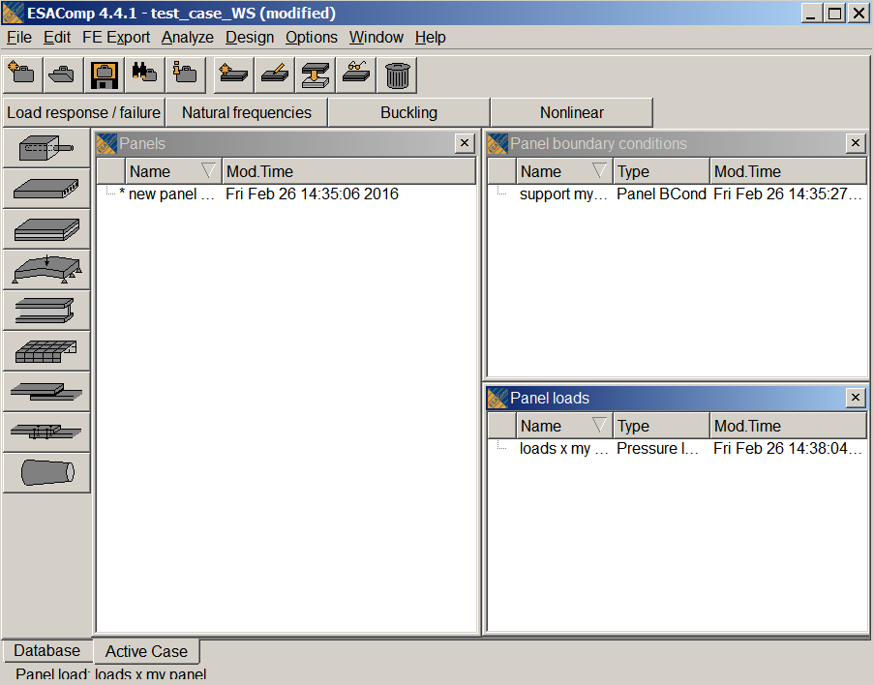
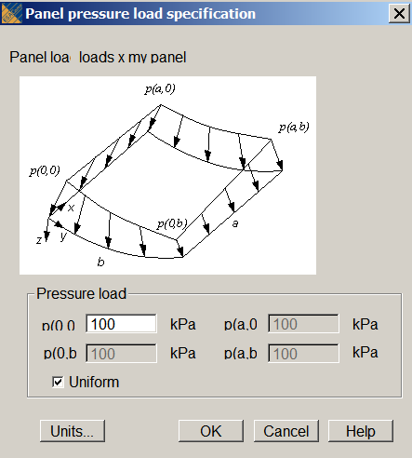
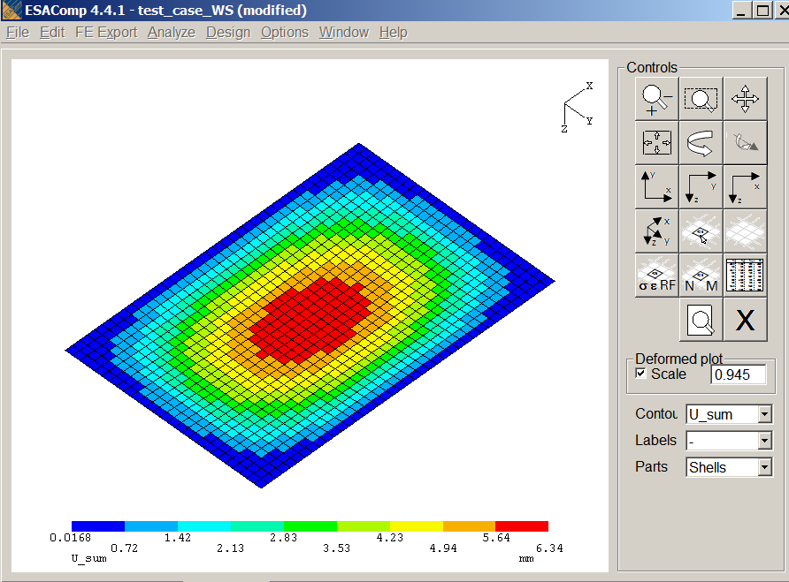
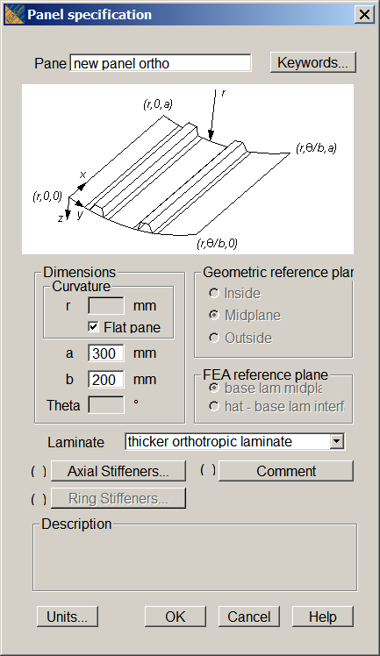
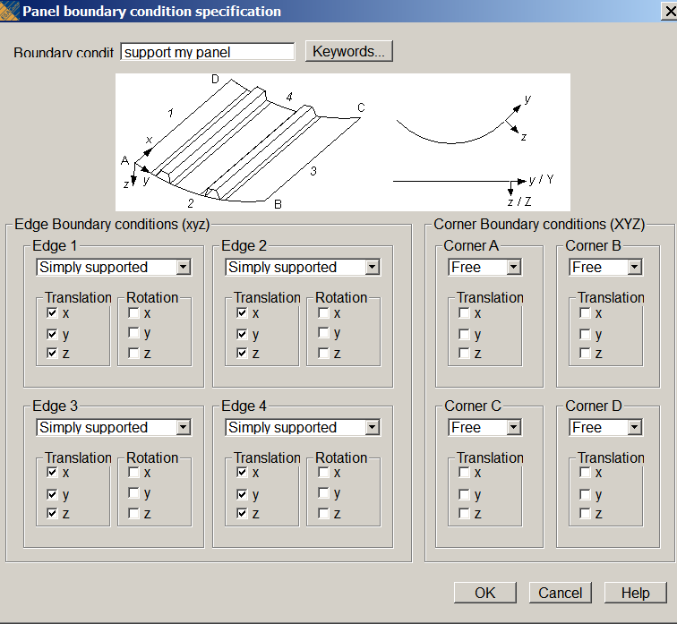
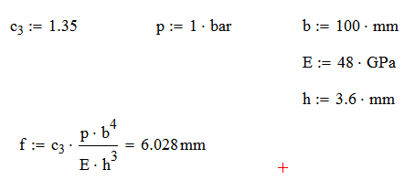
Quasi-Isotropic Laminate Analysis Example

Slide 17
Other Analysis Possible
information briefly
provided today
Beam and shell analysis, bonded joint riveted joint and
cylindrical or conical shells

Slide 18
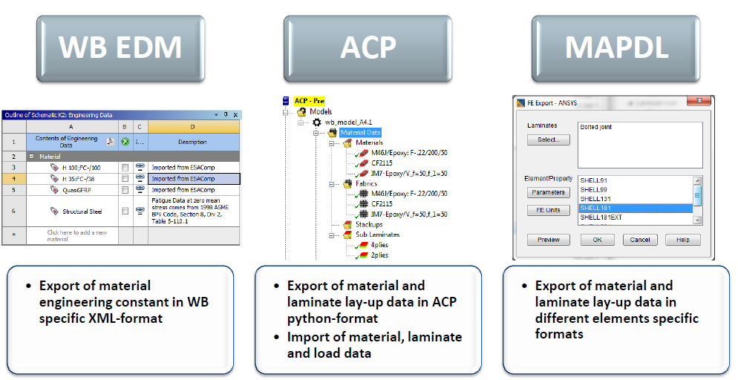
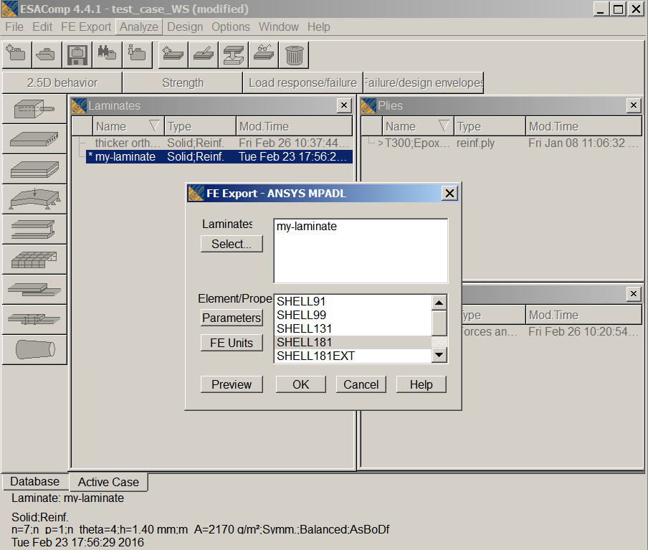
Export Laminate as XML or FEA Input
! ANSYS export file
….
! Lay-up : (0a/+45a/-45a/90a)SO
!
! Ply a T300;Epoxy;UD-.200/210/60
! Fri Jan 08 11:06:32 2010
!
! ----------
! Laminate : my-laminate
!
et, 1, 181
!
keyopt, 1, 1, 0
…
!
! Ply : T300;Epoxy;UD-.200/210/60
mpdele,all,1
mp, ex, 1, 1.25e+011
mp, ey, 1, 8000000000
mp, ez, 1, 8000000000
mp, gxy, 1, 5000000000
mp, gyz, 1, 3076923077
mp, gxz, 1, 5000000000
mp, prxy, 1, 0.3
mp, pryz, 1, 0.3
mp, prxz, 1, 0.3
mp, alpx, 1, -4.5e-007
mp, alpy, 1, 3e-005
mp, alpz, 1, 3e-005
mp, dens, 1, 1550
!
! Failure strains and stresses (first failure)
fcdele,1
fc, 1, epel, xten, 0.0128
fc, 1, epel, xcmp, -0.008
fc, 1, epel, yten, 0.005
fc, 1, epel, ycmp, -0.0275
fc, 1, epel, zten, 0.005
fc, 1, epel, zcmp, -0.0275
fc, 1, epel, xy, 0.016
….
!
sdele,1
sectype, 1, shell, , my-lamin
!
secdata, 0.0002, 1, 0, 3
secdata, 0.0002, 1, 45, 3
secdata, 0.0002, 1, -45, 3
secdata, 0.0002, 1, 90, 3
secdata, 0.0002, 1, -45, 3
secdata, 0.0002, 1, 45, 3
secdata, 0.0002, 1, 0, 3
!
secoffset, mid
!

Slide 19
Additional Material

Slide 20
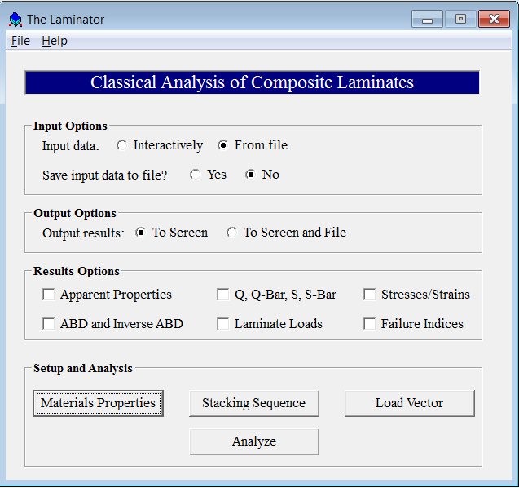
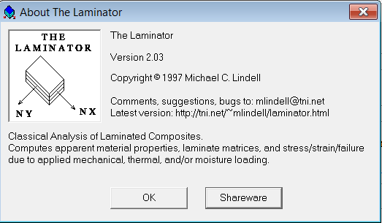
Shareware Laminate Analysis: Laminator

Slide 21
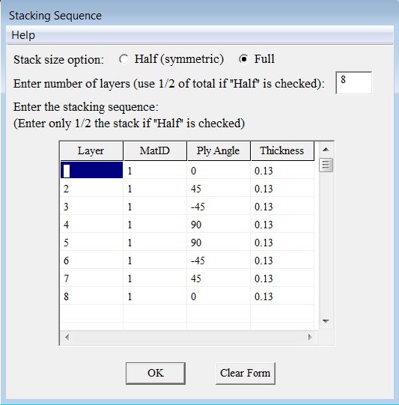
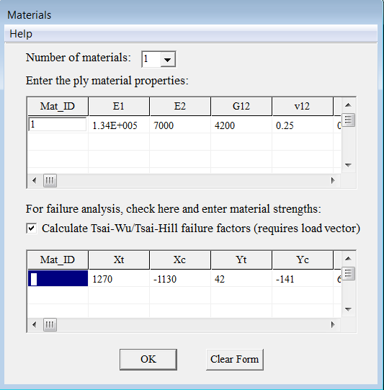
Laminator Input data
Input data interactive or from text file
1
1 1.340e+005 7.000e+003 4.200e+003 0.250 0.000e+000 0.000e+000 0.0000 0.0000
8
1 1 0.0 1.300e-001
2 1 45.0 1.300e-001
3 1 -45.0 1.300e-001
4 1 90.0 1.300e-001
5 1 90.0 1.300e-001
6 1 -45.0 1.300e-001
7 1 45.0 1.300e-001
8 1 0.0 1.300e-001
1
4.4500e+002 0.0000e+000 0.0000e+000 0.0000e+000 0.0000e+000 0.0000e+000
0.000 0.00
1270.0 -1130.0 42.0 -141.0 63.0

Slide 22
Laminator Input data
Input data interactive or from text file
1
1 1.340e+005 7.000e+003 4.200e+003 0.250 0.000e+000 0.000e+000 0.0000 0.0000
8
1 1 0.0 1.300e-001
2 1 45.0 1.300e-001
3 1 -45.0 1.300e-001
4 1 90.0 1.300e-001
5 1 90.0 1.300e-001
6 1 -45.0 1.300e-001
7 1 45.0 1.300e-001
8 1 0.0 1.300e-001
1
4.4500e+002 0.0000e+000 0.0000e+000 0.0000e+000 0.0000e+000 0.0000e+000
0.000 0.00
1270.0 -1130.0 42.0 -141.0 63.0

Slide 23
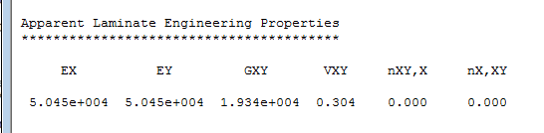
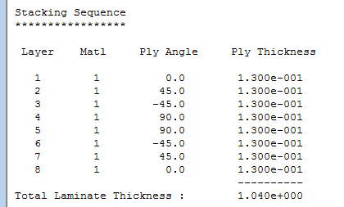
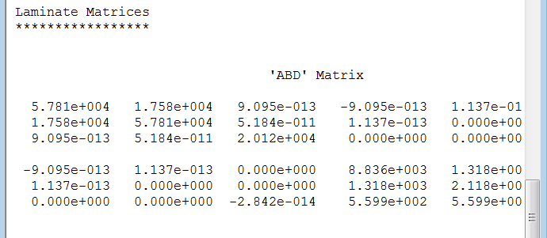
Example of Laminator output

Slide 24
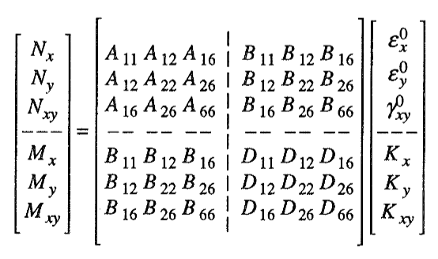
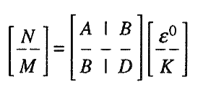
Classic Lamination Theory CLT
The starting point for the laminate analysis is CLT, Classical Laminate Theory
  limitations are valid for thin laminates
ABD-MATRIX: The ABD-matrix characterize the relation between cross-sectional loads - to strains and curvatures of the mid-plane. Solved from ply properties, orientations and stacking sequence
Typically compliance matrices [a], [b] and [d] need to be solved since the loads are input and deformations are calculated

Slide 25
ABD Matrix
Influence of some components of the ABD-matrix:
symmetric laminate: your B matrix is zero, no extensional/shear- bending /twisting
balanced laminate. your A16 and A26 terms are zero: no in-plane extensional to shear coupling terms

Slide 26
Symmetric and Balanced Laminates
Review the laminate’s ABD Matrix stiffness coefficients There EsaComp provides the ABD elements and a laminate code.
Check if your laminate is symmetric and balanced (to avoid plate warping). The non-zero locations will show you whether or not you have a symmetric and/or balanced laminate
Sym/Bal laminate reduces post cure warpage and in-plane axial/bending and shear/bending coupling
The D16 and D26 terms are small compared to the D11 term in the stiffness matrix; if so, you have a flexurally balanced laminate

Slide 27
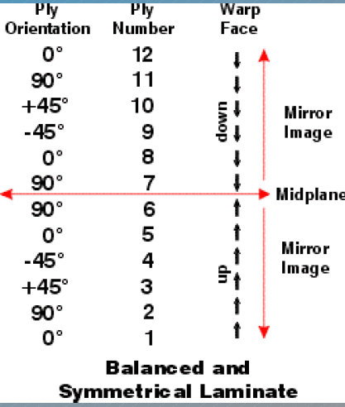
Symmetric and Balanced Laminates
Symmetric laminate
Symmetry: A laminate is symmetric when the plies above the mid-plane are a mirror image of those below the mid-plane.
Symmetrical lay-ups help to avoid thermal twisting of parts as they cool down after curing.
Balanced laminate
Balance: A laminate is balanced when it has equal numbers of –and + angled plies.
Note: If the laminate is balanced and symmetric, the entire [B] matrix is zero and the in-plane normal shear coupling terms A ₁₆ and A₂₆ are also zero.

Slide 28


Quasi-Isotropic Laminate
Isotropic means having the same properties in all directions.
Quasi-isotropic means having is ortropic properties in-plane.
A quasi-isotropic part has either randomly oriented fiber in all directions, or has fibers oriented such that equal strength is developed all around the plane of the part.
Generally, a quasi-isotropic laminate made from woven fabric has plies oriented at 0º, 90º +45º and –45º, with at least 12.5% of the plies in each of these four directions
Quasi-isotropic properties can also be achieved with 0º, 60º and 120º oriented unidirectional plies.

Slide 29
EsaComp Lay-up Code
Examples of Lay-up code
A lay-up code is provided for each intermediate laminate and for the final laminate when the lay-up is being specified. The code identifies layers, layer orientations, and the stacking sequence of layers as follows:
Layer orientations are given in parentheses from the top surface to the bottom surface. A slash (/) separates the layers. For example, the code (+45/-45/-45/+45) defines a four-layer laminate in which the orientations of the top and bottom layers are +45 degrees and the orientations of the middle layers are -45 degrees.
A contracted notation may be used in the lay-up code for a symmetric laminate. In this notation layer orientations are given only for the upper half of a laminate. Symmetry is indicated with the letter S after the parentheses. The letter E or O is further used to identify that the laminate has an even or odd number of layers. Thus, the code for the laminate (+45/-45/-45/+45) may be given in the form (+45/-45)SE. Correspondingly, the code (+45/-45)SO refers to the lay-up (+45/-45/+45).
Codes of antisymmetric balanced laminates may also be contracted to the form that gives layer orientations only the upper half of a laminate. The letters AB after the parentheses specify that the lay-up is antisymmetric balanced. For example, the code (+45/-45)AB defines the lay-up (+45/-45/+45/-45).
Multipliers after the parentheses may be used to indicate that several layers or layer groups are stacked. For instance, a contracted form for the lay-up (+45/-45/+45/ -45/+45/-45) is (+45/-45)3.
Several pairs of parentheses may be used in the code. For instance, the code ((+45/-45)2/0)SE is a contracted form for the symmetric lay-up (+45/-45/+45/-45/0/0/-45/+45/-45/+45).
When a laminate contains different plies, the ply is identified for each layer with a letter that appears after the layer orientation. For instance, the code (+45a/-45b)SE specifies a symmetric four-layer laminate where the ply a is used in surface layers and the ply b in the middle layers.
Concerning the specified practice, it should be noted that slightly different forms of the code can be found in the literature. For instance:
brackets are often used instead of parentheses
multipliers and letters specifying the symmetry or antisymmetry may be subscripts
multipliers often appear in front of the parentheses or brackets.

Slide 30
EsaComp Lay-up Code
Classification based on constitutive behavior
Classification based on constitutive behavior is provided for each intermediate laminate and for the final laminate when the lay-up is being specified. Classification is given by identifying the types of the in-plane stiffness matrix [A], coupling stiffness matrix [B], and flexural stiffness matrix [D] that define the following relations:
the in-plane stiffness matrix [A] relates the resultant in-plane forces to the midplane strains
the flexural stiffness matrix [D] relates the resultant moments to the curvatures
the coupling stiffness matrix [B] relates the resultant in-plane forces to the curvatures and the resultant moments to the midplane strains.
The rows and columns of the matrices are referred to with the indexes 1, 2, and 6 which is the normal practice in mechanics of laminates. The code used in the classification is of the form AfBeDq where the letters f, e, and q identify the types of the preceding matrices:
f : full matrix
e : elements 11 and 22 of the matrix are equal
q : quasi-isotropic form where the elements 16, 26, 61, and 62 are zero, the elements 11 and 22 are equal, and only two of the elements 11, 12 and 66 are independent
s : specially orthotropic form where the elements 16, 26, 61, and 62 are zero
t : only the elements 16, 26, 61, and 62 exist
l : only the elements 11 and 22 exist
o : all elements are zero.
The following examples illustrate the classification:
The code AsBoDs identifies that the in-plane and flexural stiffness matrices have a specially orthotropic form and the coupling stiffness matrix is zero. An example of laminates with such behavior is a symmetric cross-ply laminate.
The code AsBoDf identifies that the in-plane stiffness matrix has a specially orthotropic form, the coupling stiffness matrix is zero, and the flexural stiffness matrix is full. Symmetric angle-ply laminates, for example, possess this kind of mechanical behavior.
The code AfBfDf identifies that all matrices are full. This is the most general form of mechanical behavior. Due to many types of coupling effects, laminates of this type are not normally used.

