Slide 1
RRR measurement system upgrade
Algirdas Baskys (abaskys@lbl.gov)
Research Scientist
Lawrence Berkeley National Laboratory

Slide 2
Outline
Outline of the talk:
The purpose of the system and current state
Measurement procedure
Reasons for upgrade
Upgrades in process
  Channel switch system
  Software
  Temperature control
  Feedthroughs and interconnects
  Sample mounting plates

Slide 3

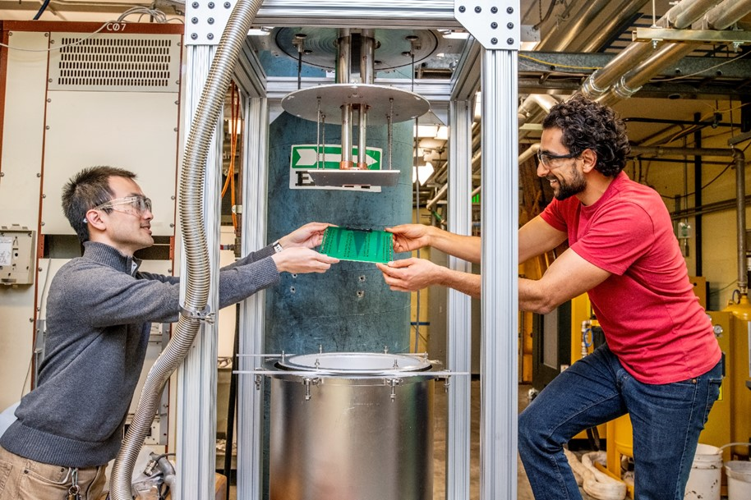
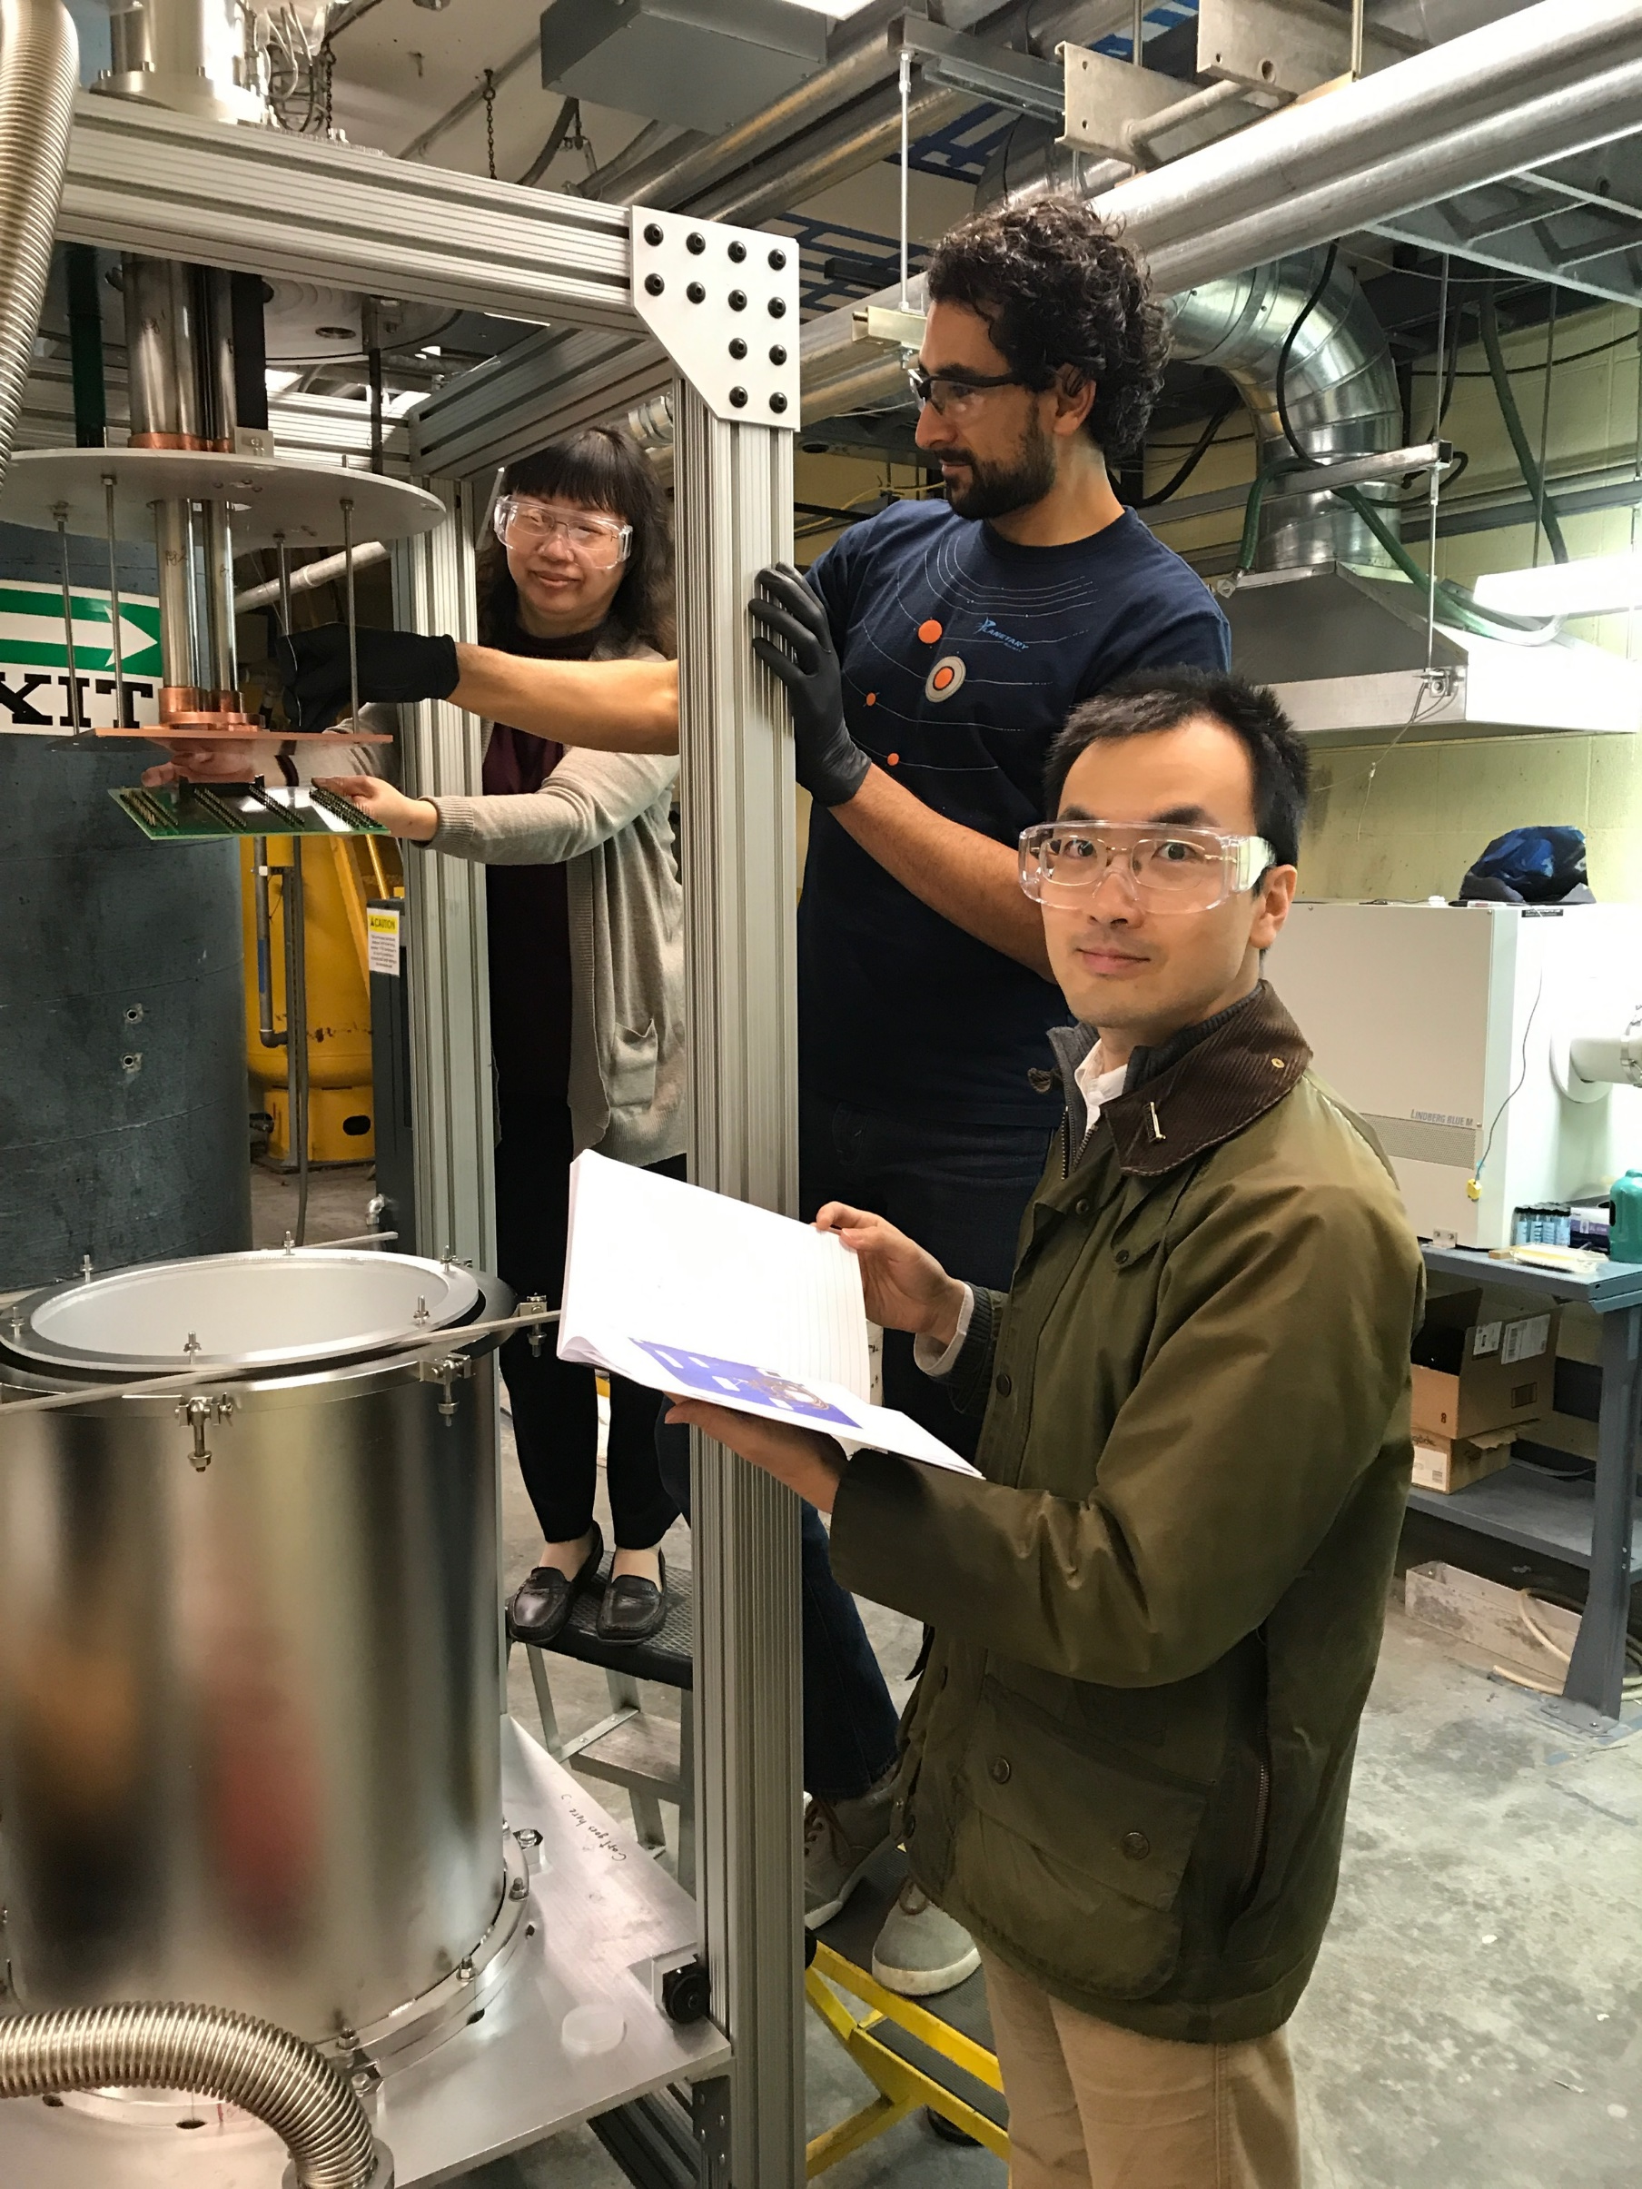
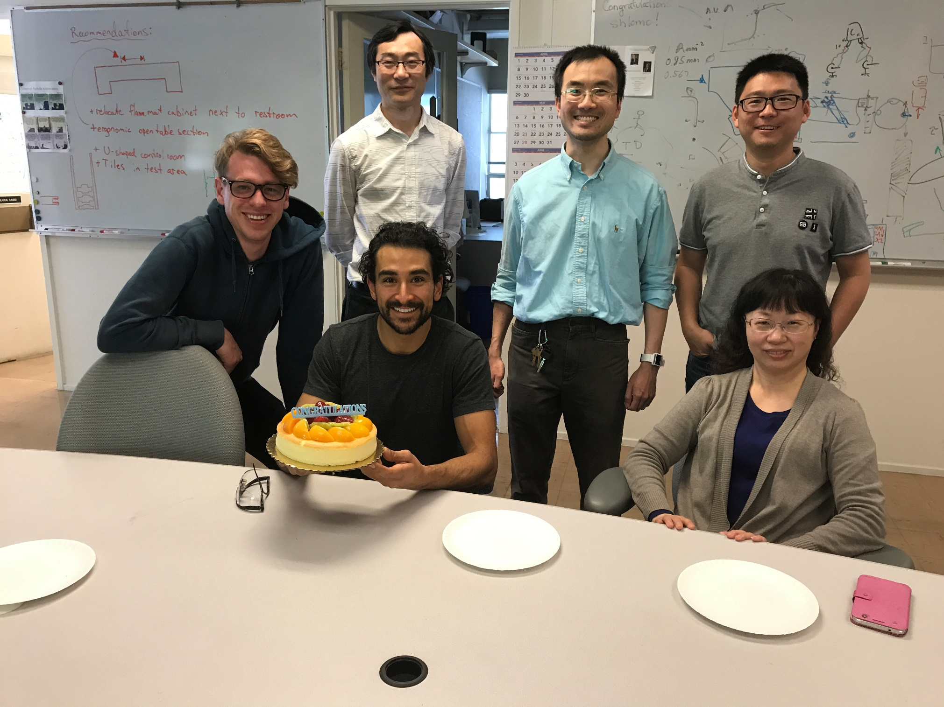
RRR measurement system development
QXF cable
Major edge
Minor edge
The system is in operation since 2018 with a number of people being involved in it’s development with Ian Pong leading the effort:
  CAD: Scott Myers
  Technical help:
  Takeshi Katayanagi
  Adam Balogh
  Xiaorong Wang, Ian Pong, Heng Pan
  Jordan Taylor, Charlie Sanabria, Li Wang

Slide 4
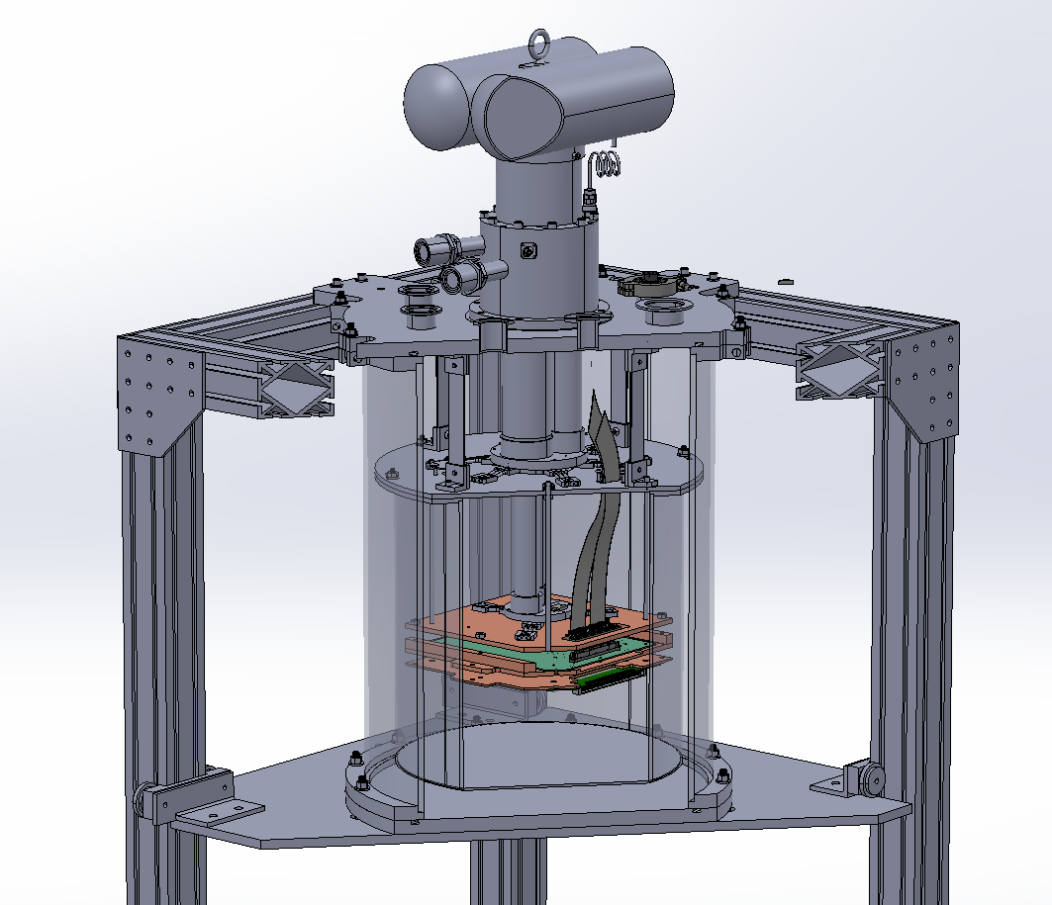
RRR measurement system outline
Thermal design
Conduction cooled system with two stage cryocooler
Stage 1 connected to an aluminum radiation shield
Stage 2 is cooling the samples on a copper plate
Mechanical design
The radiation shield is suspended from the cryostat by carbon fiber strips
The sample assembly is in turn suspended from the radiation shield
Heat transfer to radiation shield and sample assembly is achieved by copper braid linkages.

Slide 5
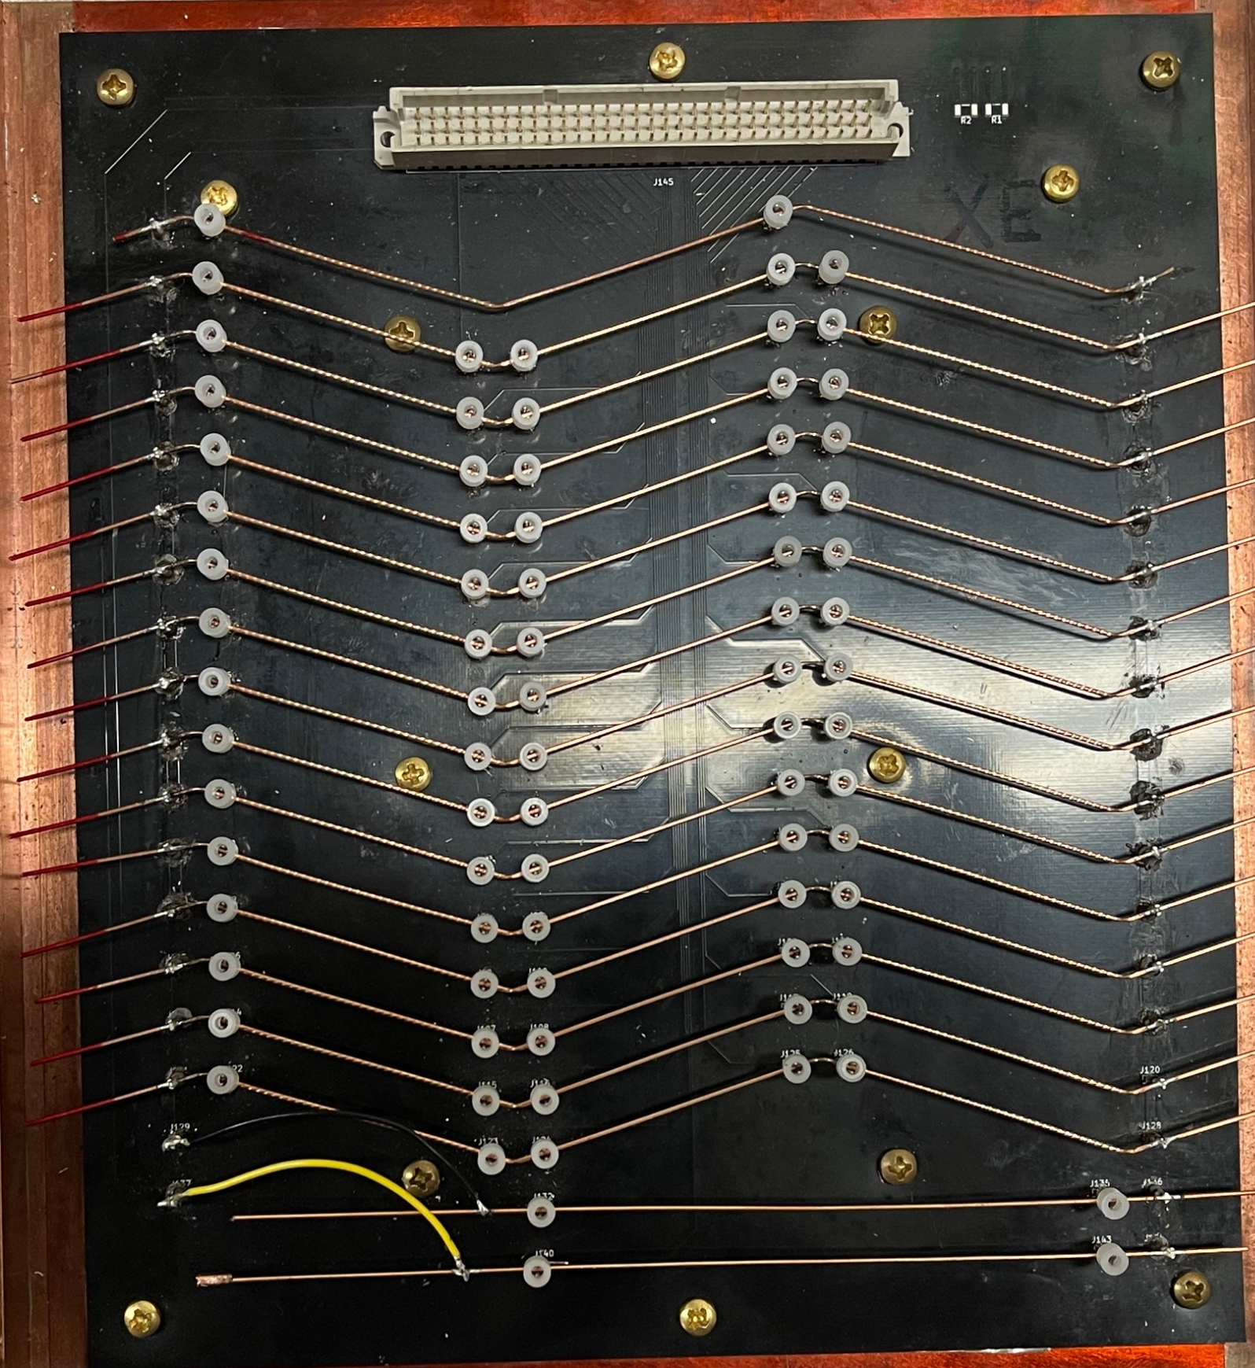
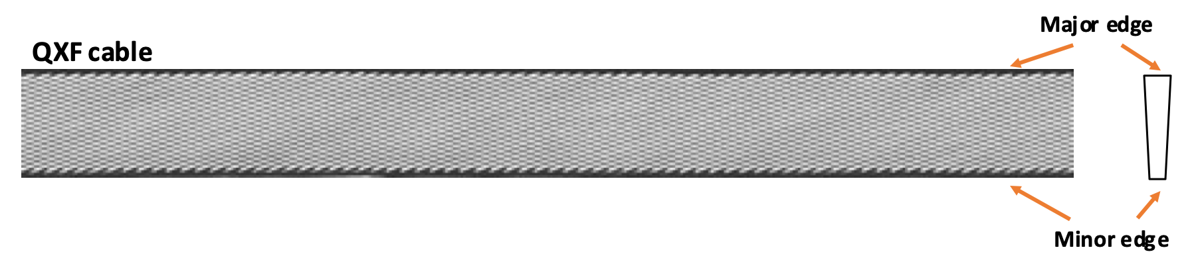
RRR measurement system outline
The system has several unique features:
Possible to measure a large number of samples simultaneously
Possible to mount samples extracted from cable without straightening them first
Measurements of kinked and straight regions of the extracted strands measured separately
Top face
Bottom face
Minor edge
kink
Major edge
kink

Slide 6
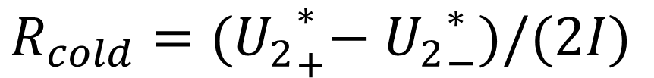
Measurement procedure (IEC 61788-4)
The measurement procedure is modeled according to the IEC 61788-4 standard:
“Residual resistance ratio measurement - Residual resistance ratio of Nb-Ti and Nb₃Sn composite superconductors”
The RRR is defined as the ratio of resistances at 293 K and just above the superconducting transition:
For RT measurement, the measurement is made between 273 K and 308 K, temperature noted and corrected for to obtain a value at 293 K.
The transition is recorded twice with different polarities of test current and the result is subtracted to remove any offsets and to some extent thermoelectric voltages.
Forward current
$$R_{cold}={{(U}_{2}}_{+}^{∗}−{U_{2}}_{−}^{∗})/(2I)$$
This method does not require precise temperature control of samples, however the analysis is more involved, as the resistance at the transition is extrapolated.
Another common method is to measure resistivity at fixed temperature of 20 K instead.
Reverse current
Notes:
International electrotechnical commission

Slide 7
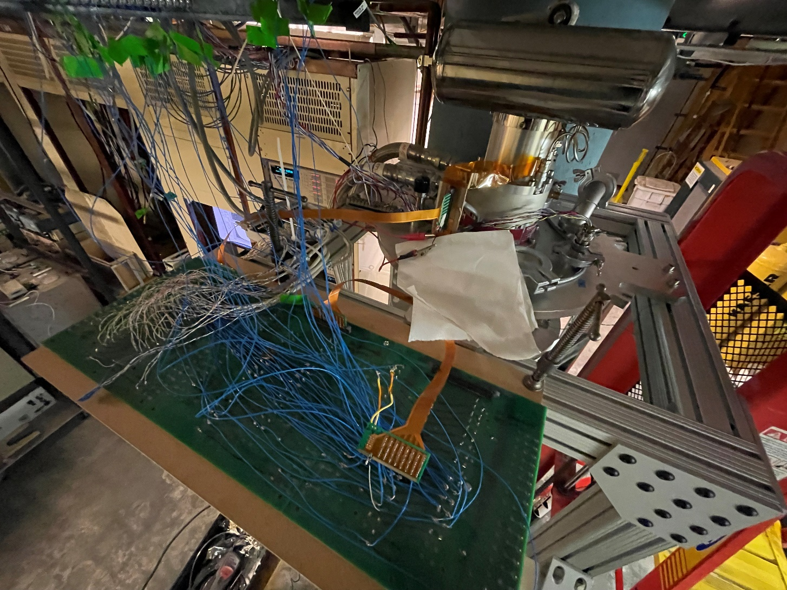
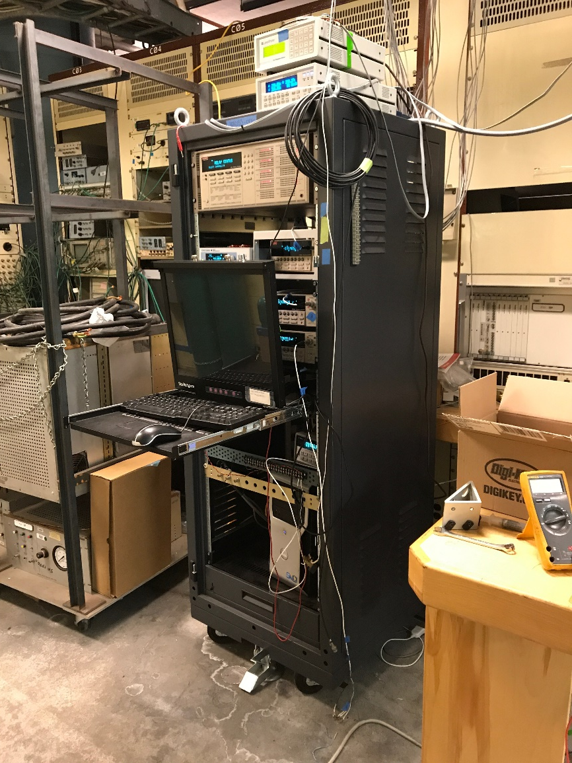
Reasons for upgrades
System was developed and immediately put to use for AUP project, it was now operated since 2018 and some consolidation is necessary to:
improve measurement throughput,
improve reliability,
allow flexibility of integrating other measurements,
and other lessons learned during operation
Specifically:
Only a third of 63 channels required for a fully populated board of 18 samples can be measured simultaneously during one cooldown due to limitations of switching system (3*2=6 cooldowns necessary).
No way to add additional measurement channels
Broken connections are frequent necessitating remeasurement of a subset of samples. The troubleshooting can be time consuming.
There is no active temperature control and sample temperature is not currently measured.

Slide 8
Reasons for upgrades (2)
“Battleship board”
Measurement scheme:
Single ended measurement with common reference
Voltage across the minor edge kink:
∆V_{MinorKink} = V₅-V₄
Top face
Bottom face
Minor edge
kink
However, V₅ and V₄ are not necessarily measured at the same time as the system scans though the channels. This introduces artifacts when the signal is rapidly changing (at the SC transition).
Major edge
kink
V_{ref}
V₁
V₃
V₄
V₅
At the small penalty of having more wiring, a differential measurement of each channel would resolve this as well as reduce common mode noise.
V_{TF}
V_{MK}
V_{BF}
V_{mK}

Slide 9
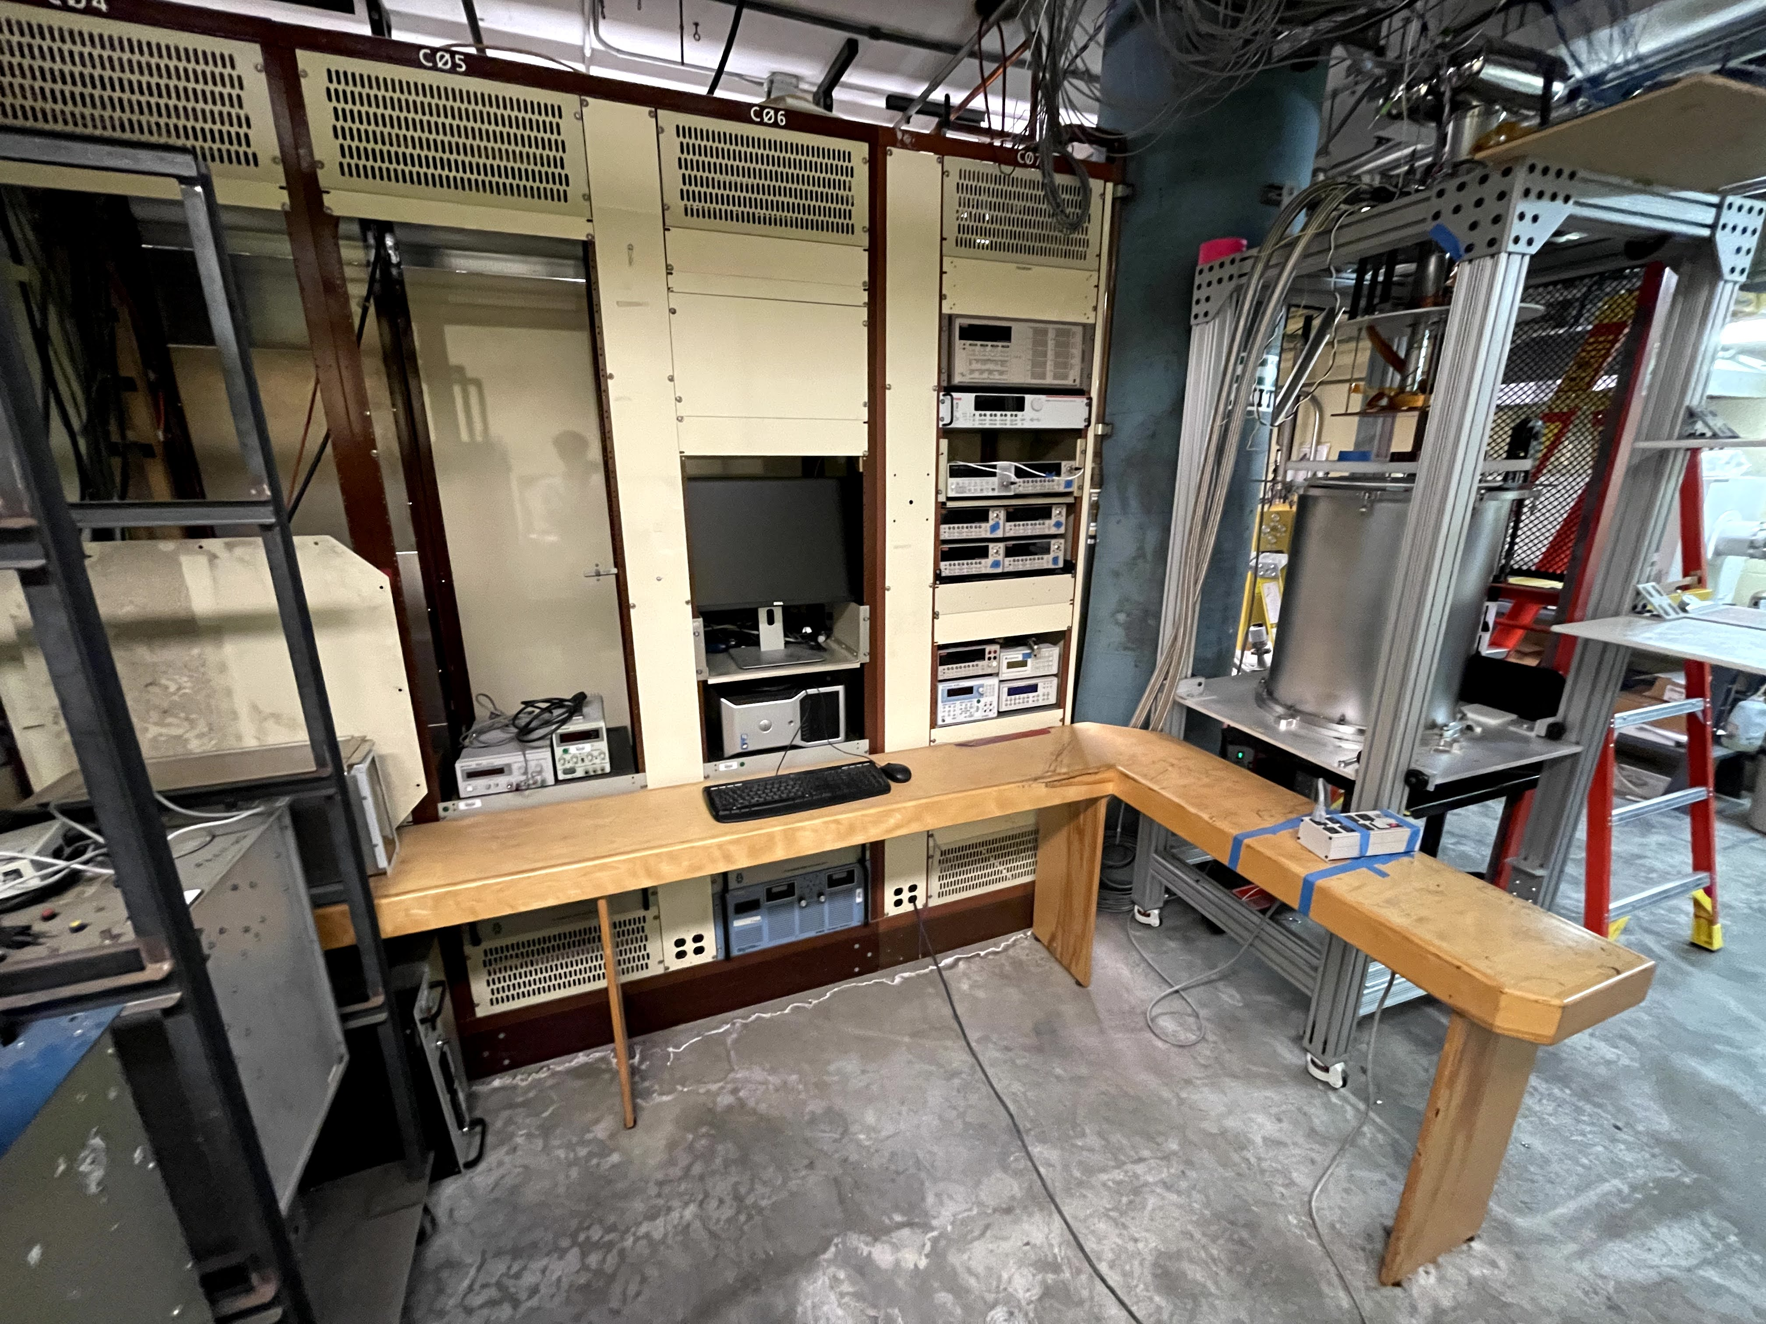
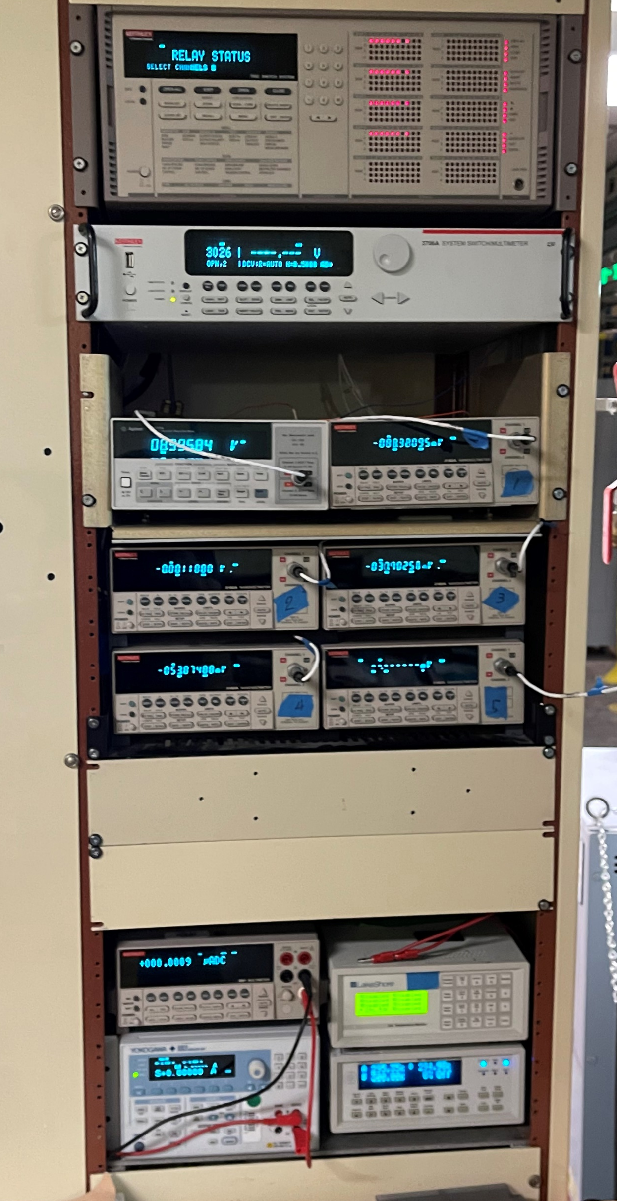
Measurement equipment
With the exception of Keithley 7002 switch system, the rest of the equipment will be reused.
Keithley 7002 switch system (Obsolete. 4 slots x 8 channels, 6 slots unoccupied)
Keithley 3706A switch system (2 slots x 60 channels, 4 slots unoccupied)
5x Keithley 2182 nanovoltmeters
Agilent 34420A nanovoltmeter
Keithley 2001 switch multimeter
Yokogawa GS610 Source meter
Lakeshore 331 Temperature controller
Lakeshore 218 Temperature monitor
Most of the equipment donated by Xiaorong Wang and Heng Pan

Slide 10
Restructuring LabView code (1)
Initialize instruments
Read controls
Await instrument response
Update indicators/data files
Send instructions to instruments
The general code structure on right with a large single loop:
Straight forward to understand
Works well
Simple to maintain*
Inflexible
Can get convoluted when complexity or the number of instruments grows
Data acquisition rate is limited by the slowest instrument
Notes:
Written by Heng Pan

Slide 11
Restructuring LabView code (2)
Messaging Queues
Event handler
Moving to event-based structure (Queued message handler):
Each state machine runs in parallel (not slowing down the rest of the code)
Code can be executed only when required based on the captured events
        (e.g. no need to send PID parameters on each iteration of loop, only when user makes a change).
        Easier to manage large programs
        Captured states allow for easy event logging
        But:
        Additional complexity
        Time overhead to set up
Voltage measurement state machine
Current source state machine
Temperature and pressure state machine
Plotting
state machine
Logger
Notes:
Reduces GPIB bus crowding

Slide 12
Restructuring LabView code (3)
Messaging Queues
Event handler
Captures user input and sends an appropriate message to appropriate queue (as well as a message to logger).
Voltage measurement state machine
States that handle the current source
Current source state machine
Initialization Instrument configuration
Set Current Change current based on msg payload
Measure current Current measurement (loop)
Exit
shut down current and close instrument connection
Temperature and pressure state machine
Temperature and pressure state machine
Using the same mechanism can send messages between state machines
The actions are executed in the order of the queue
If the state involves a loop – can check if queue is empty before start of each iteration
Logger

Slide 13
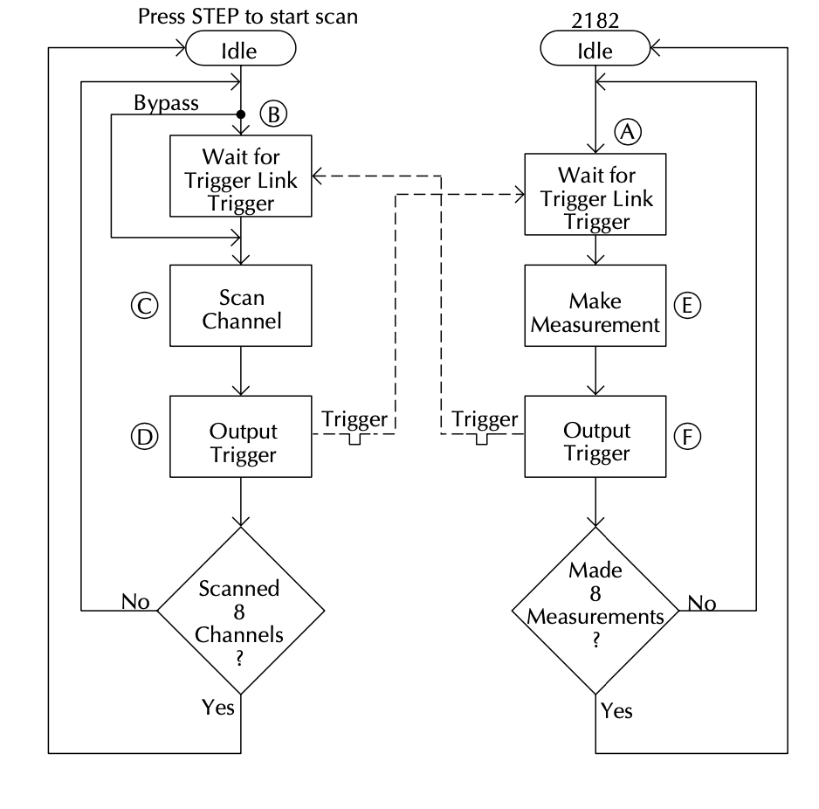
The measurement
Currently the measurements are done using 4 nanovoltmeters, 1 nanovoltmeter per 8 channels. The 4 nanovoltmeters measure in parallel, but for each channel:
Scanner card is instructed to close the appropriate channels
Multimeter is instructed to make a measurement
Measurement value is retrieved
Back to 1.
Each operation involves communication coordination via PC link (GPIB) and although the measurement takes ~20ms (1 PLC) and channel switching (<10ms), one cycle takes ~1s due to communication delays. This equates to ~4 measurements/s.
Keithley 3706A
Using hardware triggers ”Trigger link” we can coordinate the channel closing and measurement between scanner and nanovoltmeter directly:
accumulate the measurements into the internal buffer of the nanovoltmeter.
We can achieve close to 30ms per measurement.
however, depending how often the buffer is retrieved, communication to PC still takes significant fraction of time
n
n

Slide 14
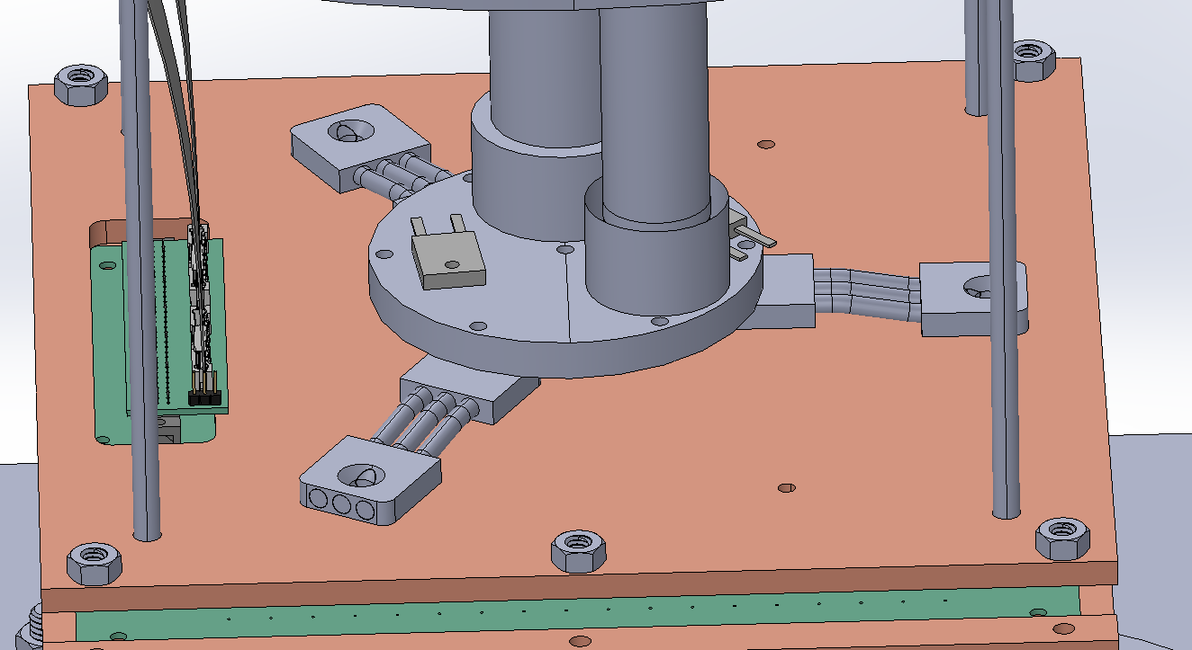
Temperature control
Currently no temperature measurement/control:
Not required for current measurements (resistance measured at ambient and at superconductive transition
There is value to record sample temperature during measurement
Standardize temperature ramp rate during measurement
Slower ramp rate would allow more measurements during the transition making it more defined.
Placing the samples at a thermal dead-end to avoid setting up a temperature gradient
Heaters
Heater
Cold head
We already have the hardware to do this using:
Lakeshore 331 temperature controller
Lakeshore 218 temperature monitor (8 channels)
Calibrated temperature sensors
Notes:
Temperature is controlled by turning the compressor on or off.

Slide 15
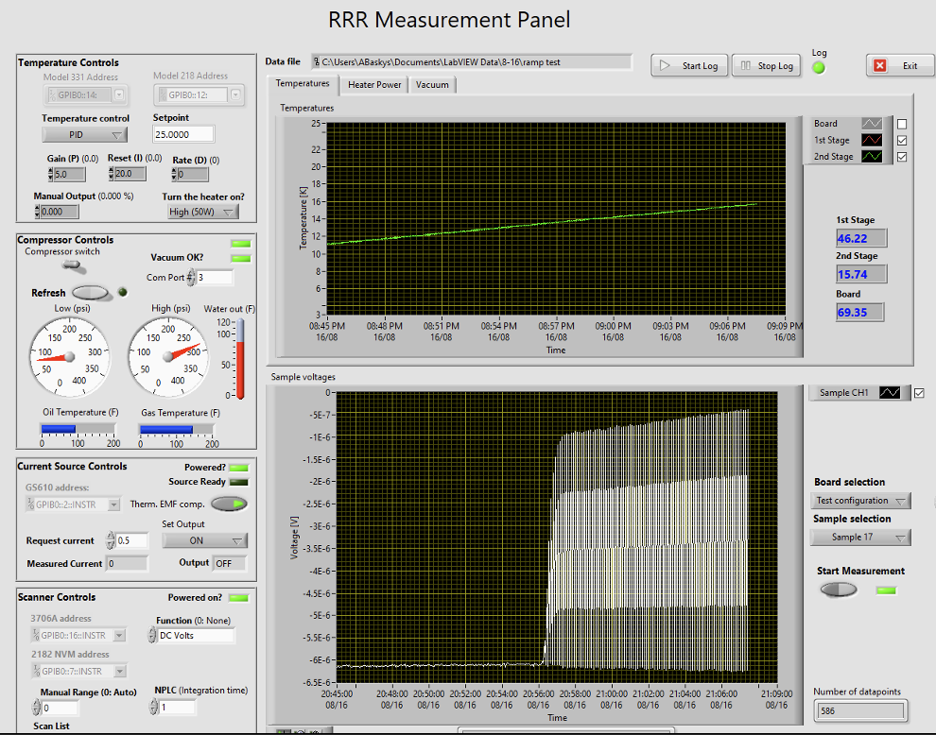
LabView UI
Temperature control
Temperature and vacuum state
Compressor control
Current
source
Sample data graph
Channel scan system and NVM

Slide 16
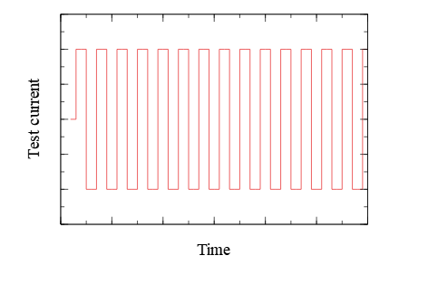
Implementing a different measurement scheme
The current measurement procedure:
requires two thermal cycles for each set of samples
current polarity is switched in during each cooldown
the voltage offsets assumed the same between the two cooldowns
IEC 61788-4 also covers an alternative “Computer-based method”:
Single thermal cycle
Changes in current direction by periodic current reversals or periodic current on and off cycles are used to correct for offset voltages
Measuring using a single thermal cycle saves time but also compensates if voltage offsets vary during cooldown.
+I
-I

Slide 17
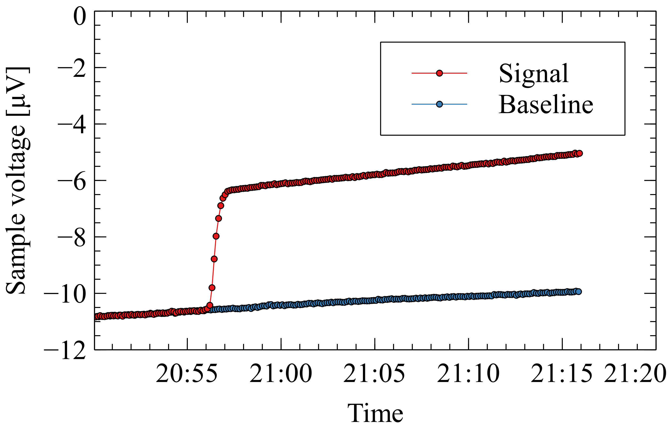
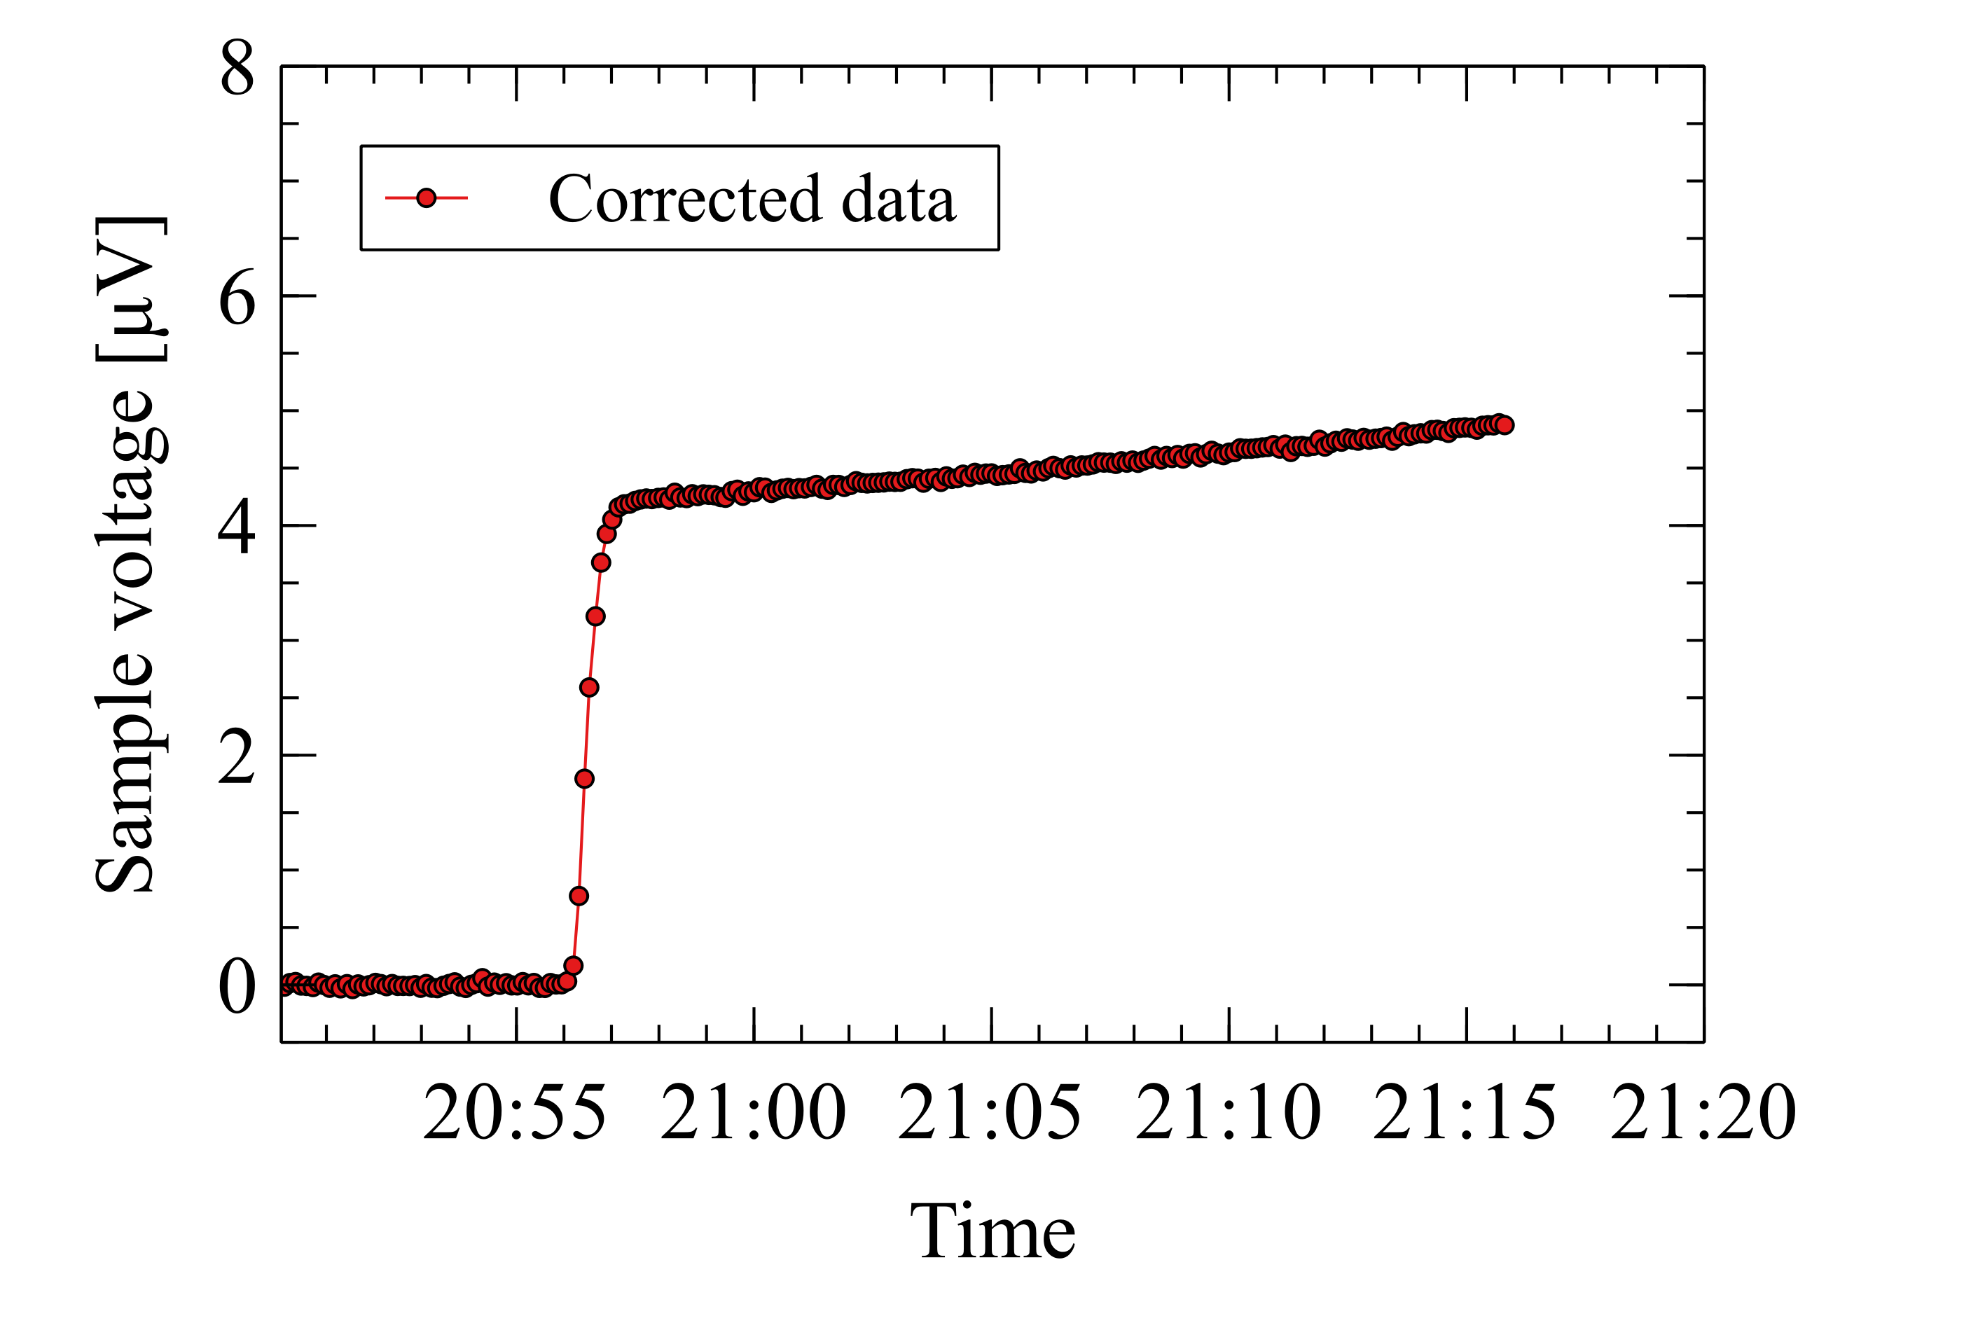
Implementing a different measurement scheme
Measurements taken in an alternating fashion with and without the test current to obtain both the signal and the voltage offset.
The corrected data:
Note the relatively small signal measured
~60 such transitions captured simultaneously

Slide 18
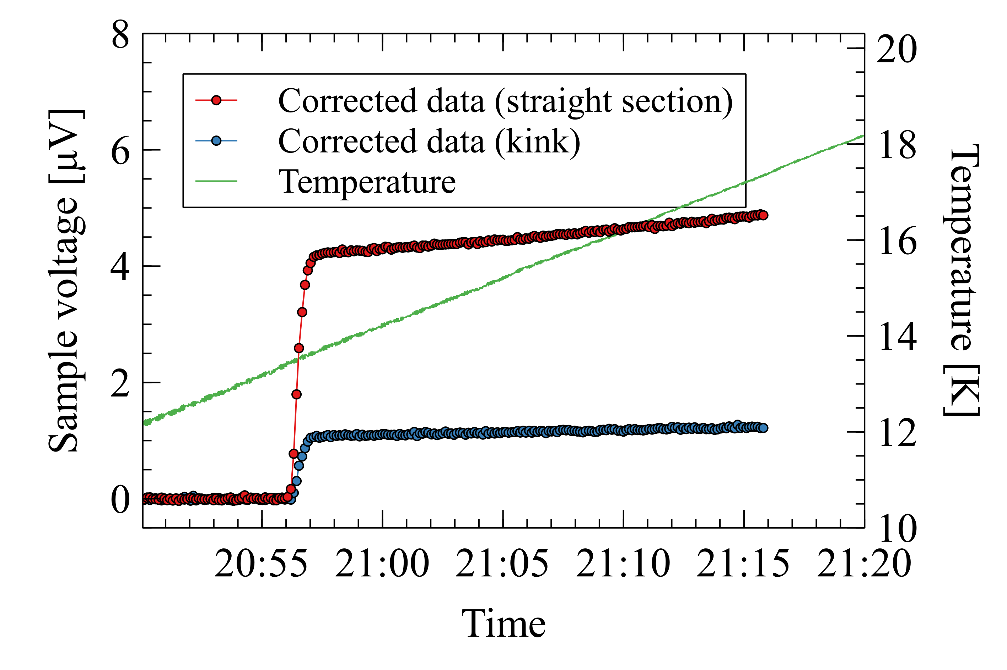
Implementing a different measurement scheme
Comparison of a straight and kinked section on the same strand
Note the size of transition
Overlayed temperature ramp
Temperature measured not on the sample
Top face
Bottom face
Minor edge
kink
Major edge
kink

Slide 19
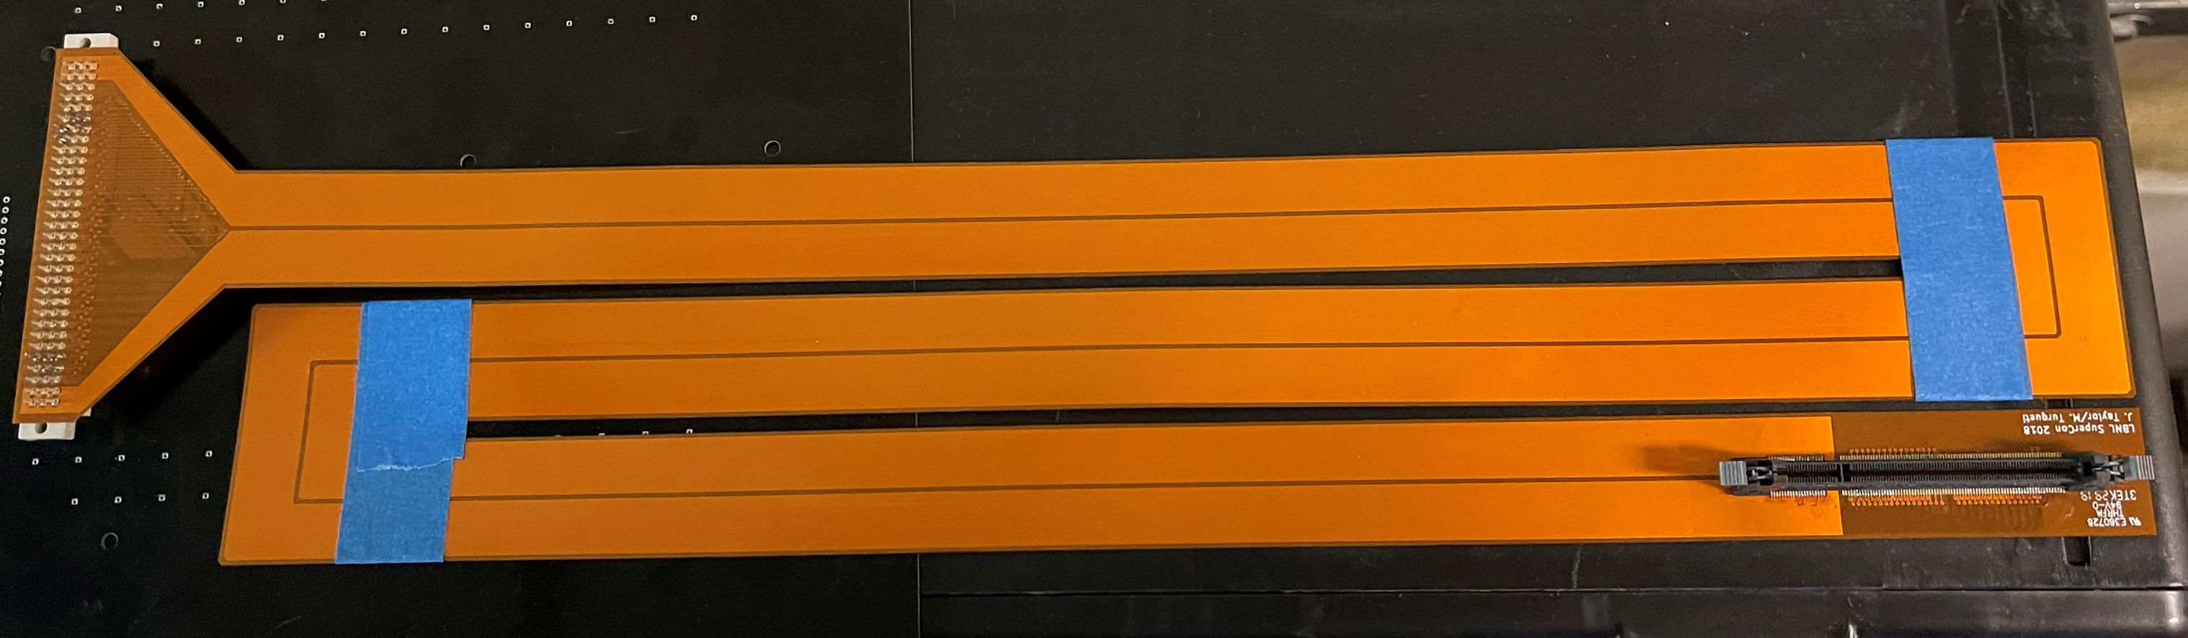
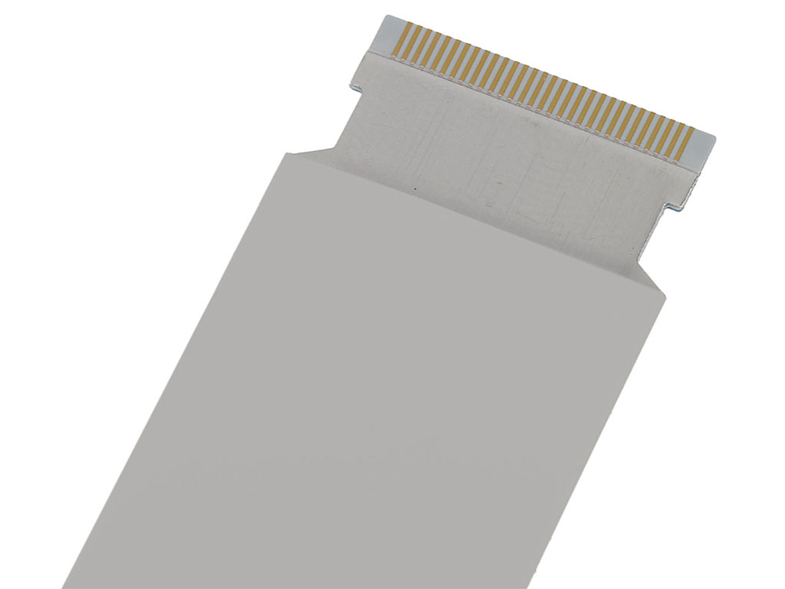
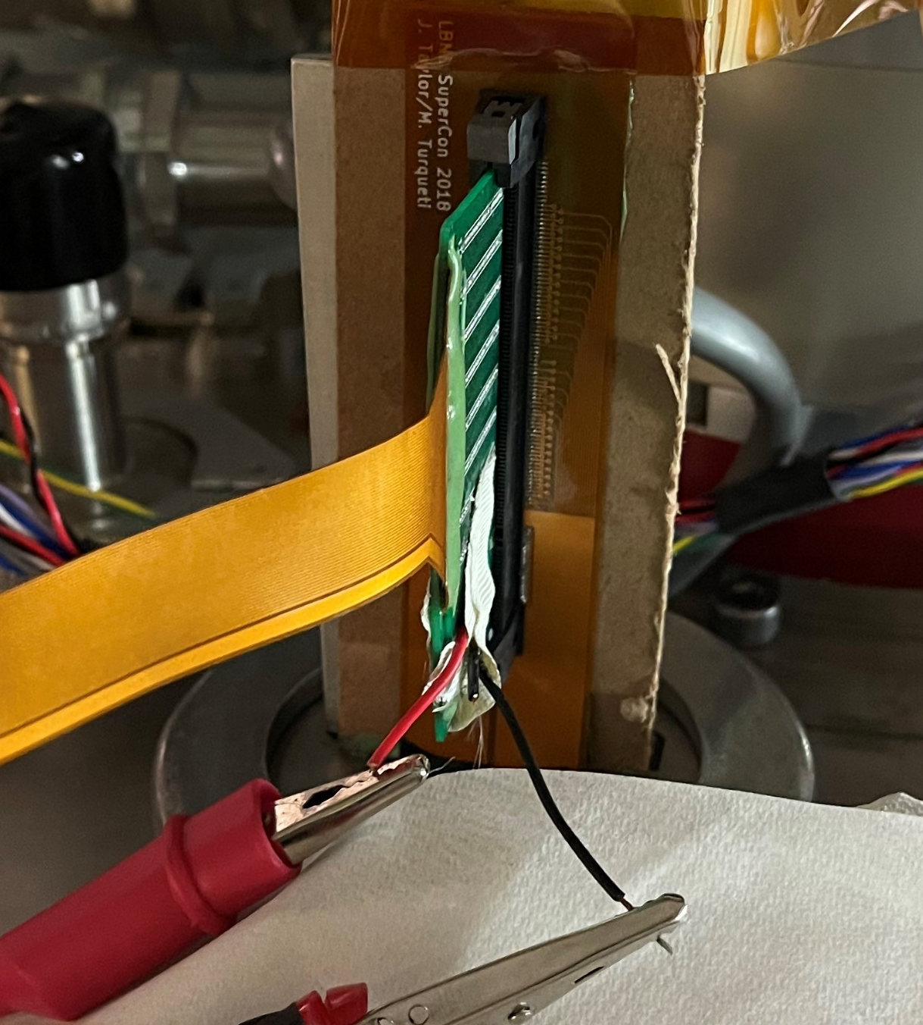
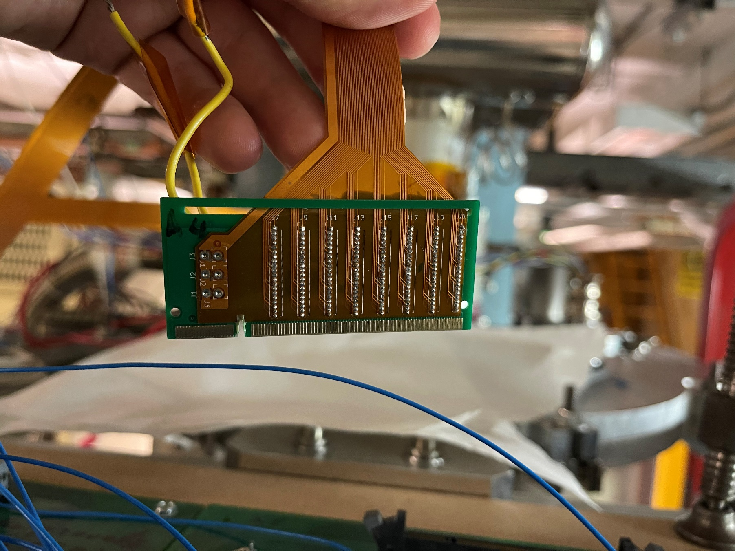
Wiring/feedthroughs
Major difficulty for the system design was the need for ~100 conductor vacuum feedthrough (and more in near future). This was achieved by a custom flexible circuit board through a passed through KF50 flange and sealed with Stycast resin:
Great density of contacts
Can easily stack multiple side by side
But:
Many hand soldered contacts
Can be fragile
Expensive
Will benchmark off the shelf FFC
Low cost
Up to 80 conductors per cable
Variety of connectors available
Up to 61 cm in length

Slide 20
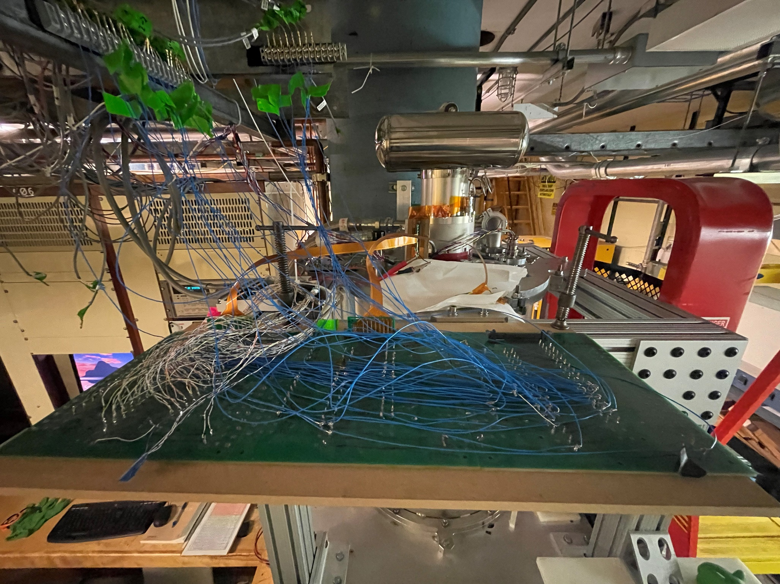
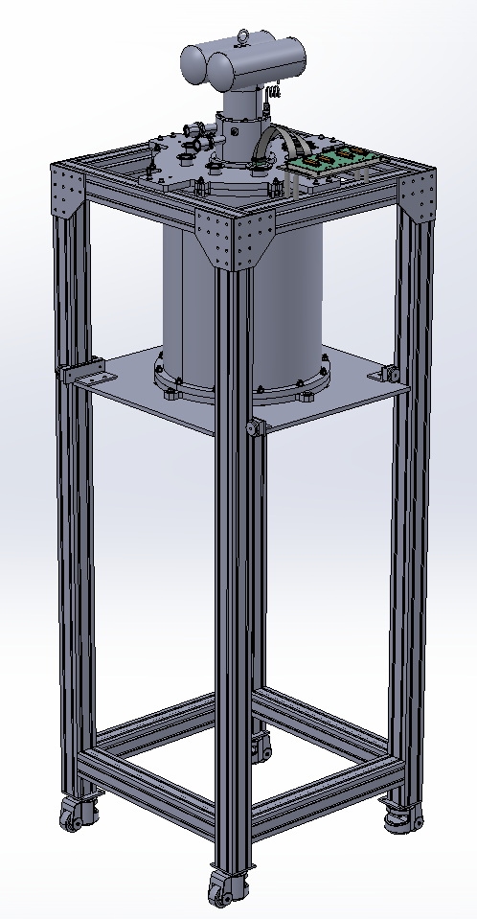
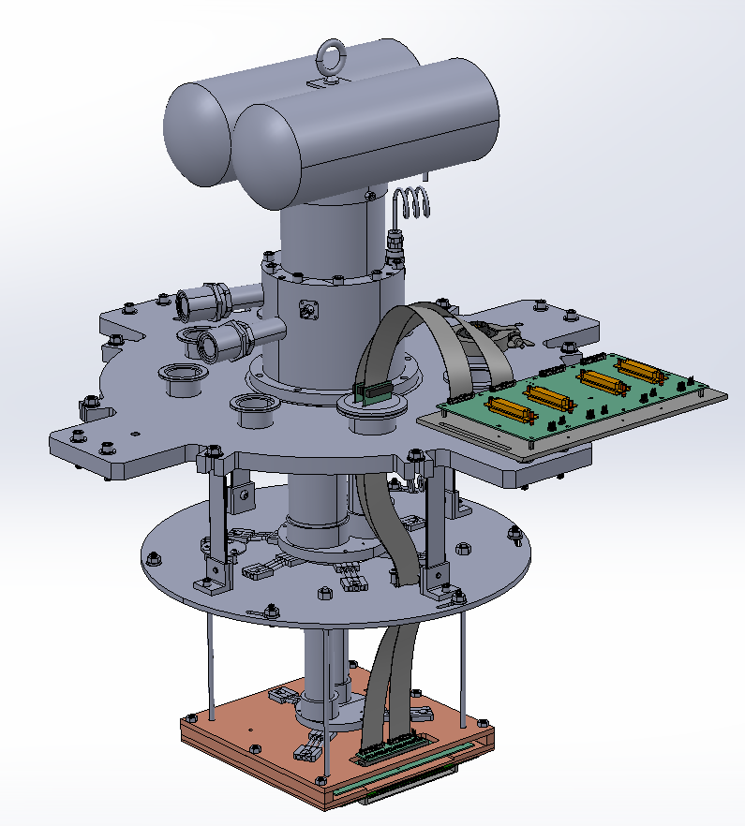
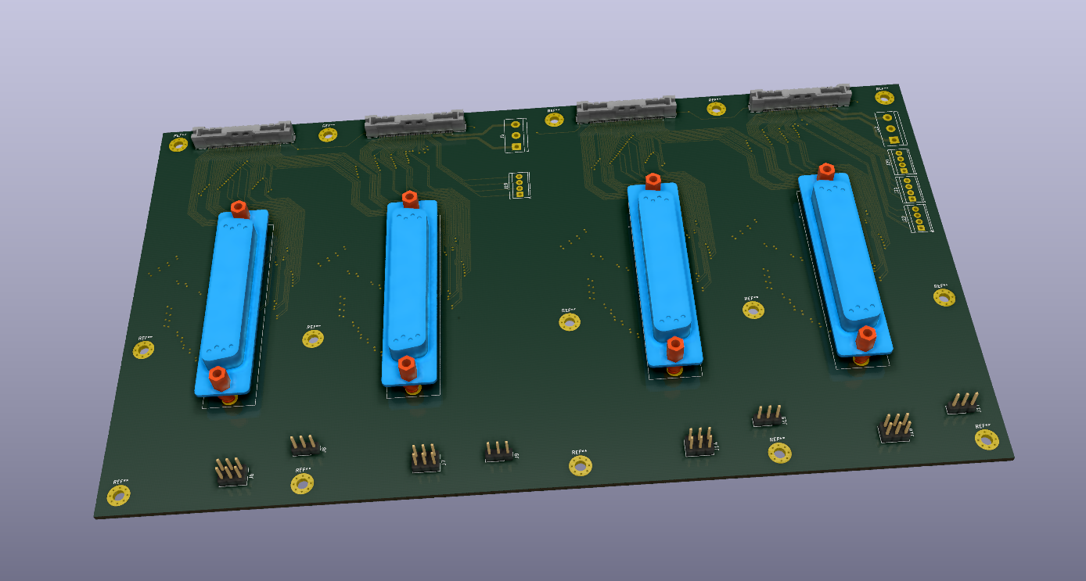
Cable management
“Battleship board”

Slide 21
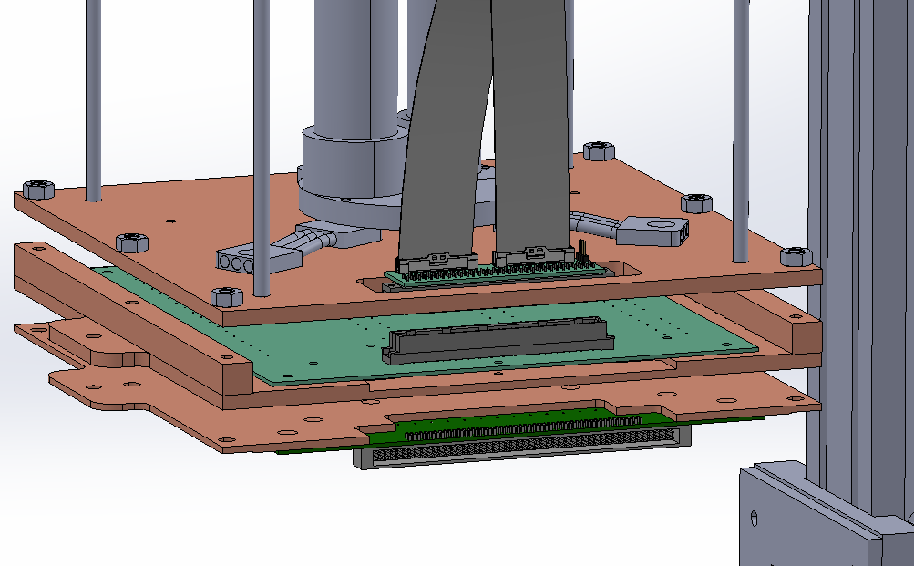
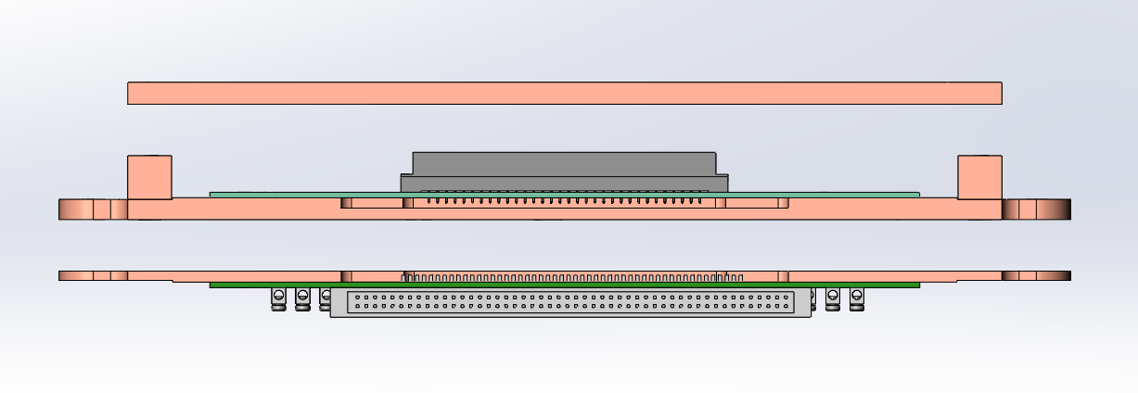
Sample mounting options
1.
2.
3.
Base plate connected to 2nd stage of cryocooler
Extracted strand sample board (currently, 18 samples)
Straight sample board (planned – up to 50 samples)
Flexible sample mounting system, consisting of stacked sample boards
Sample boards can be used separately or together

Slide 22
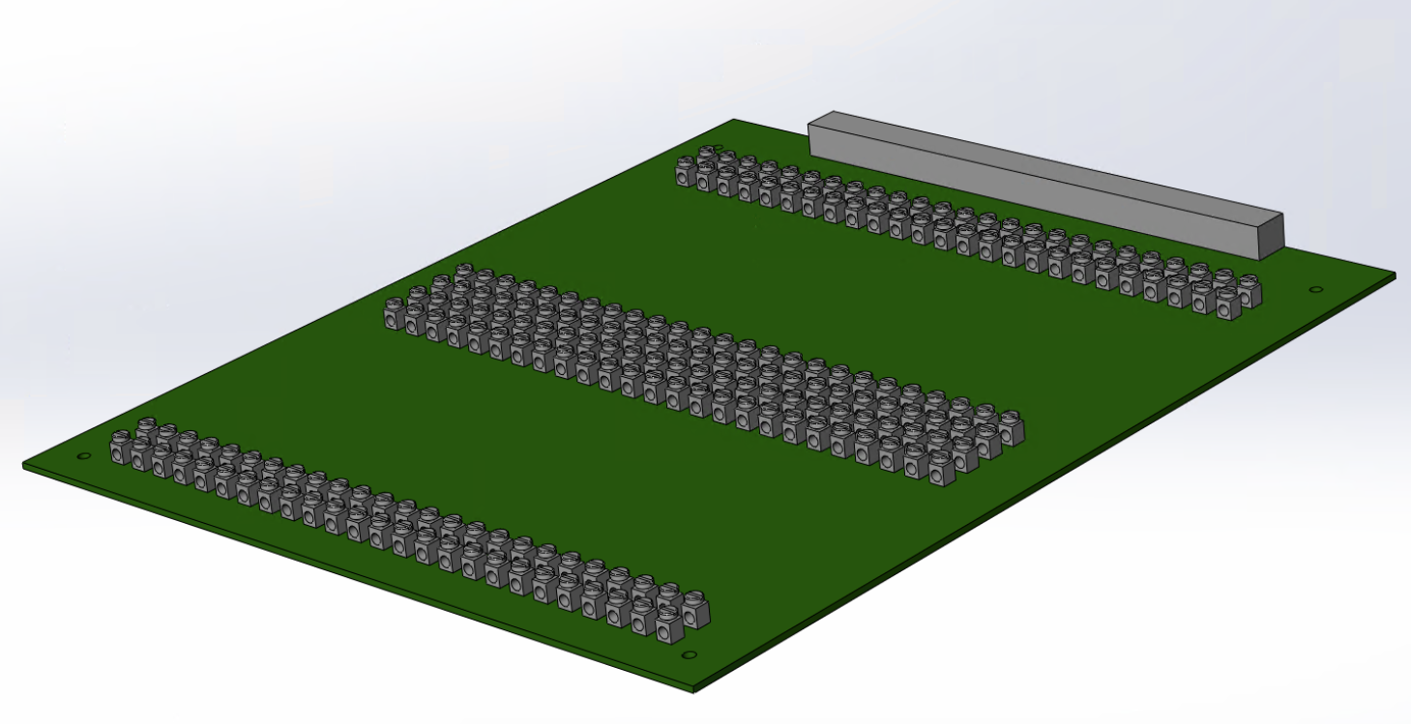
Sample PCBs
Extracted strands
QXFA cable
General sample board for straight samples
Notes:
Move towards a 2 row connector to reduce costs

Slide 23
Questions?

Slide 24
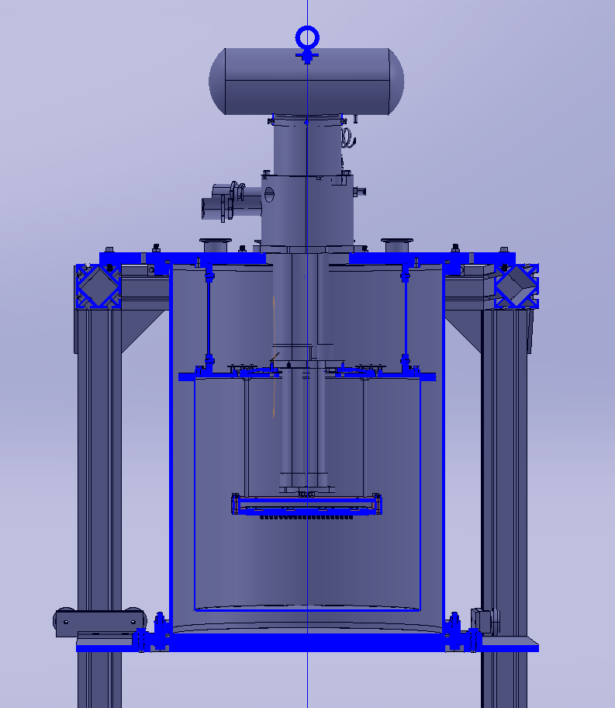
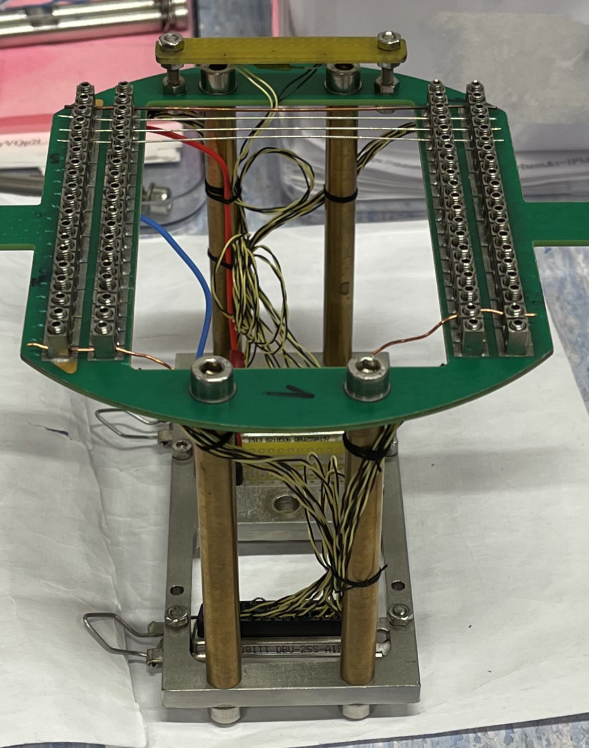
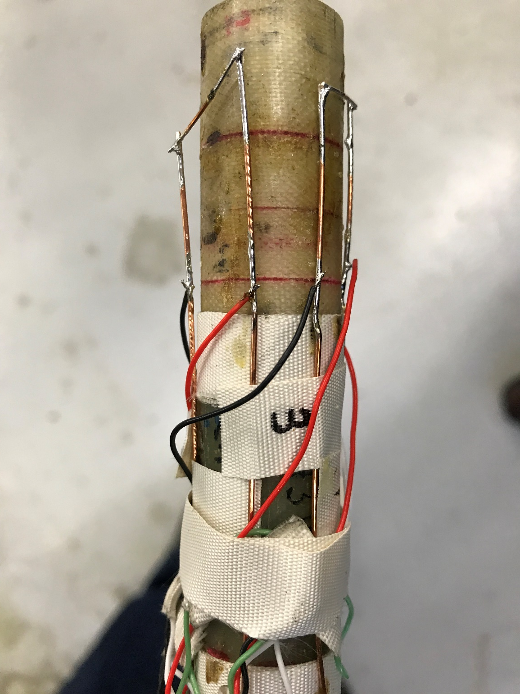
Extra slides
FNAL
CERN

Slide 25
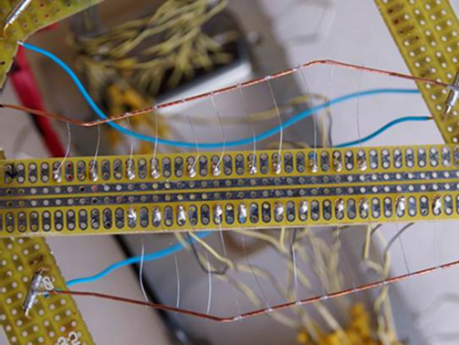
Extra slides (2)
CERN R&D

