Slide 1
Nb₃Sn Scaling Parameterization
An Introduction to “ESE”
Ian Pong (ipong@lbl.gov)
Jack Ekin

Slide 2
Outline
Superconducting surface (a.k.a. critical surface)
Flux Pinning
Scaling
Parameterization
  Graphical Explanation
  Mathematical Explanation

Slide 3
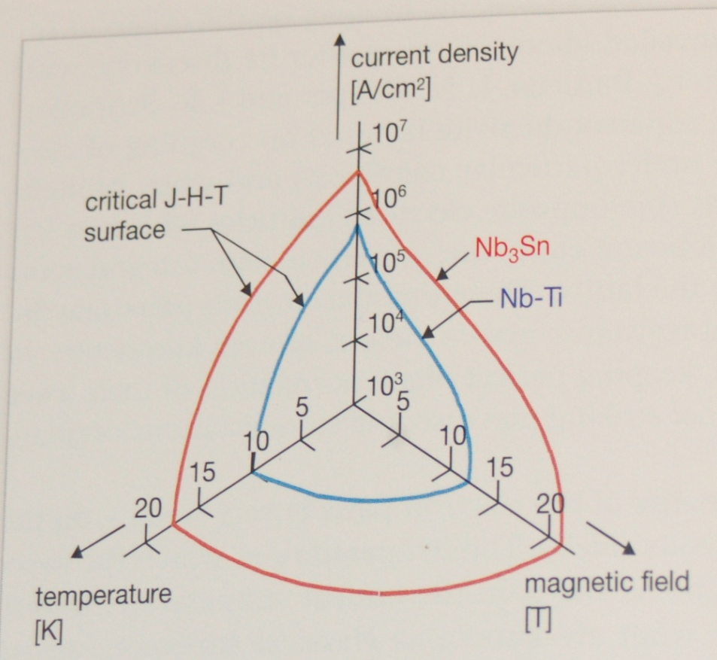
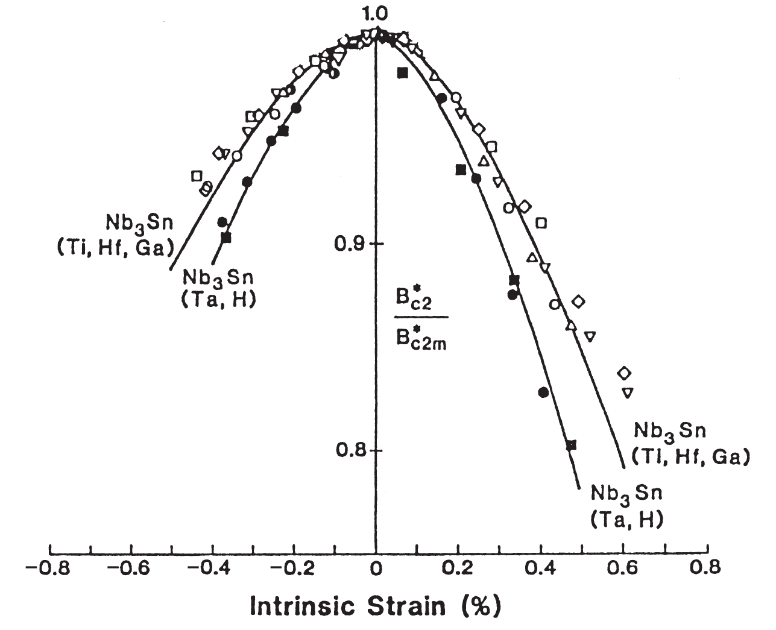
Critical Surface
Recall the three critical parameters: J_{C} B_{C2} T_{C}
The customary plot of J-B-T surface:
In addition, Nb₃Sn is strain (ε) sensitive
J_{C} is a function of (B, T, ε)
B_{C2} is a function of (T, ε)
T_{C} is a function of (ε)
We will ignore strain for now,
and return to it later.
Figure by courtesy of Lyn Evans
Figure from SMH ed. 1

Slide 4
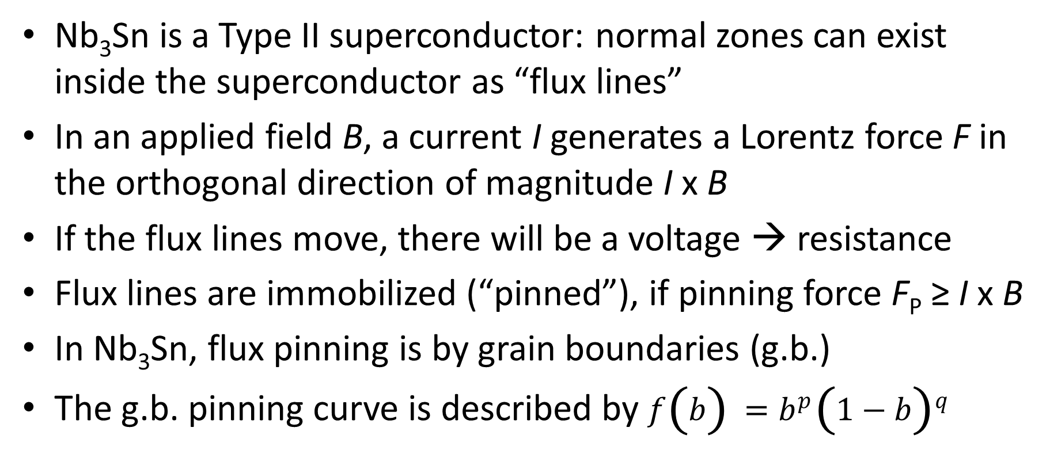
Flux Pinning
Nb₃Sn is a Type II superconductor: normal zones can exist inside the superconductor as “flux lines”
In an applied field B, a current I generates a Lorentz force F in the orthogonal direction of magnitude I x B
If the flux lines move, there will be a voltage → resistance
Flux lines are immobilized (“pinned”), if pinning force F_{P} ≥ I x B
In Nb₃Sn, flux pinning is by grain boundaries (g.b.)
The g.b. pinning curve is described by $f\left(b\right)=b^{p}{\left(1−b\right)}^{q}$

Slide 5
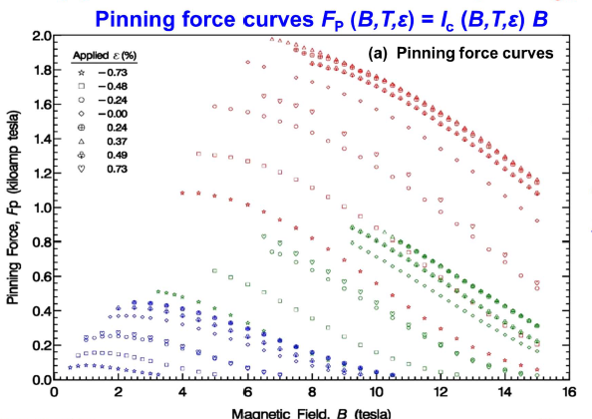
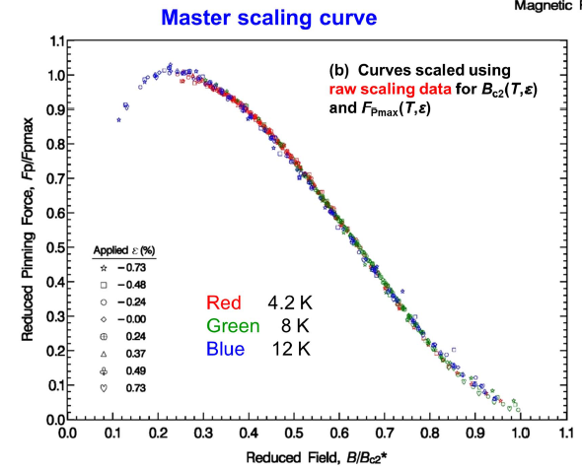

Scaling
Important: scaling is possible because the pinning force curves (F_{P} as a function of B), measured at different temperatures and strains, are shape invariant: $f\left(b\right)=b^{p}{\left(1−b\right)}^{q}$
They can be registered into a single master scaling curve
F → f
B → b
Thousands of I_{C} can be predicted from just a few I_{C}(B) measurements!
Red: 4.2 K
Green: 8.0 K
Blue: 12.0 K
Ekin et al. SUST 29

Slide 6
Power of Scaling: Extrapolation
Such scaling is highly advantageous for practical purposes
From the master scaling curve, the I_{C} at any B, T, or ε values can be generated, iff the scaling parameters are known.
How to find the scaling parameters is the topic of next week’s seminar. Today I will show how the scaling parameters relate to each other and how they define the critical surface.
The power of scaling is in its capability of extrapolation. (Global fitting will only give interpolation.)

Slide 7




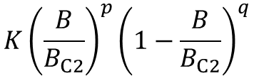


F-B vs. f-b and the exponents p, q
f → F needs F_{P max}
How to get to the actual values?
f → F needs K
$$f\left(b\right)≡\frac{F_{P}}{F_{P max}}=\frac{b^{p}{\left(1−b\right)}^{q}}{f_{max}\left(b\right)}$$
$$K{\left(\frac{B}{B_{C2}}\right)}^{p}{\left(1−\frac{B}{B_{C2}}\right)}^{q}$$
formally
$$I_{C}×B=$$
Pinning-force shape parameters
a.k.a. pinning force exponents
f (b) = b^{p} (1-b)^{q}
$$f\left(b\right)=b^{p}{(1−b)}^{q}$$
p = 0.5
$$\frac{df}{db}=0⟹b=0.2$$
q = 2
For g.b. pinning, defines the shape
$$b=\frac{B}{B_{C2}^{∗}\left(T\right)}$$
$${⟹F}_{P max}=Kf\left(0.2\right)=0.286 K$$
b → B needs B_{C2}

Slide 8
Temperature Dependence of the F_{P} Curve
T = 0 K
Nb₃Sn F_{P} curve is temperature dependent
T = 4.2 K
T = 10 K
T = 16 K
If we plot the pinning force F against the actual field B instead, the curves at increasing temperatures will have a decreasing B_{C2}, but the shape of the curve remains the same.
B_{C2} [T]
4.2
10
16
Now, if we plot the temperature on the third axis, we can see the B_{C2} dependence on T more clearly.
T [K]

Slide 9
B-T and the exponent v
b_{C2}
v defines the shape
temperature dependence of field: b_{C2}(t)
b_{C2} (t) = 1 – t ^{v}
This is one of two ways to determine T_{C}* -- the “effective flux-pinning critical temperature”
t
B_{C2} [T]
t → T needs T_{C}
If we plot reduced field against reduced temperature, we can see a power law relationship.
T [K]

Slide 10

Temperature dependence of K
$$F_{P max}=0.286×K$$
T = 0 K
T = 4.2 K
T = 10 K
T = 16 K
B_{C2} [T]
4.2
This is the other way to determine T_{C}*
10
16
T [K]

Slide 11
K-T and the exponent η
η defines the shape
temperature dependence of F_{P max}
a.k.a. h(t)
$$K\left(t\right)=K\left(0\right)×{\left(1−t^{v}\right)}^{η−μ}{\left(1−t^{2}\right)}^{μ}$$
In “Hybrid2” formulation, µ = η/2

Slide 12
Summarizing (without strain)
F_{P} = I_{C} x B
Critical surface scales in F-B-T space instead of I-B-T space
In F-B space,
  p and q define the pinning curve shape
  b → B through B_{C2}; f → F through K
In B-T space,
  v defines the shape of temperature dependence of field: b_{C2}(t)
  t → T through T_{C}
In K-T space,
  η defines the shape of temperature dependence of F_{P max}: h(t)

Slide 13

F-B-T Graphical Summary
F as a function of B
3D
F as a function of B, T
F or K
B_{C2} as a function of T
p, q
η
K as a function of T
B
T
v

Slide 14
F-B-T-ε Graphical Summary
F as a function of B
3D
F as a function of B, T
F or K
B_{C2} as a function of T
p, q
η
K as a function of T
B_{C2} as a function of ε
ε
3D
B_{C2} as a function of ε, T
T_{C} as a function of ε
B
T
K as a function of ε
K as a function of ε, T
v

Slide 15
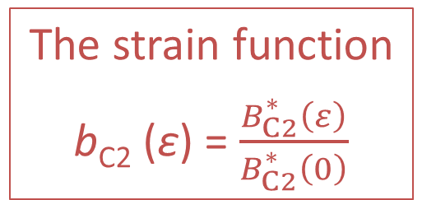
Strain - s(ε) a.k.a. b_{C2} (ε)
  The strain function
  b_{C2} (ε) = $\frac{B_{C2}^{∗}\left(ε\right)}{B_{C2}^{∗}\left(0\right)}$
B_{C2}* (ε₀) [T]
Note: * indicates it is extracted
from I_{C} measurements,
a.k.a. “effective” B_{C2}(ε).
Note: in reality there is irreversibility

Slide 16
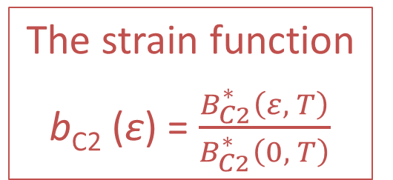
B_{C2}* (ε)
B_{C2}* (ε, T)
  The strain function
  b_{C2} (ε) = $\frac{B_{C2}^{∗}\left(ε, T\right)}{B_{C2}^{∗}\left(0, T\right)}$
B_{C2}* (ε, 0) [T]

Slide 17
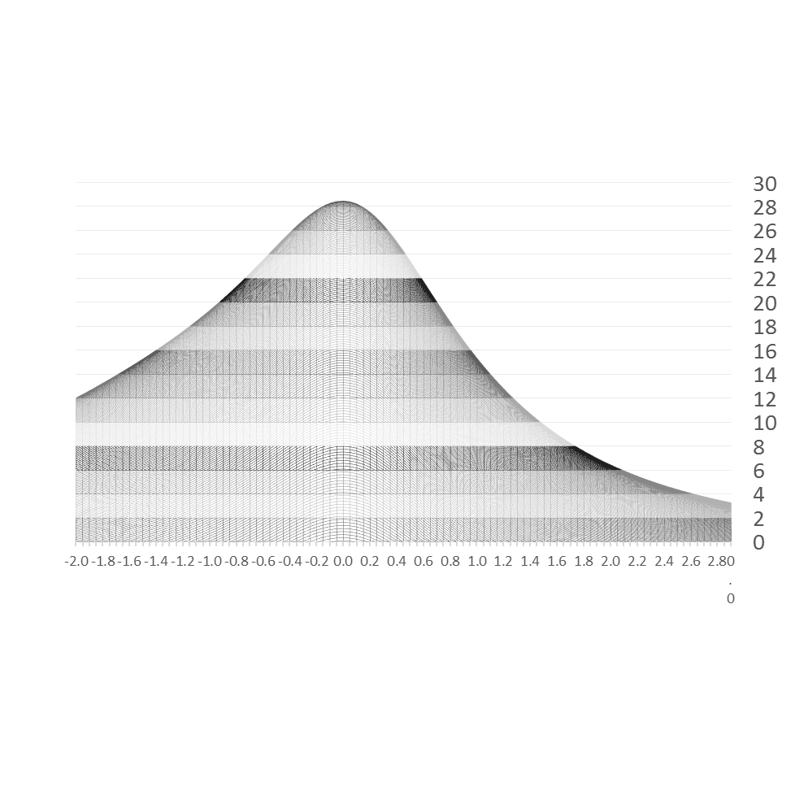
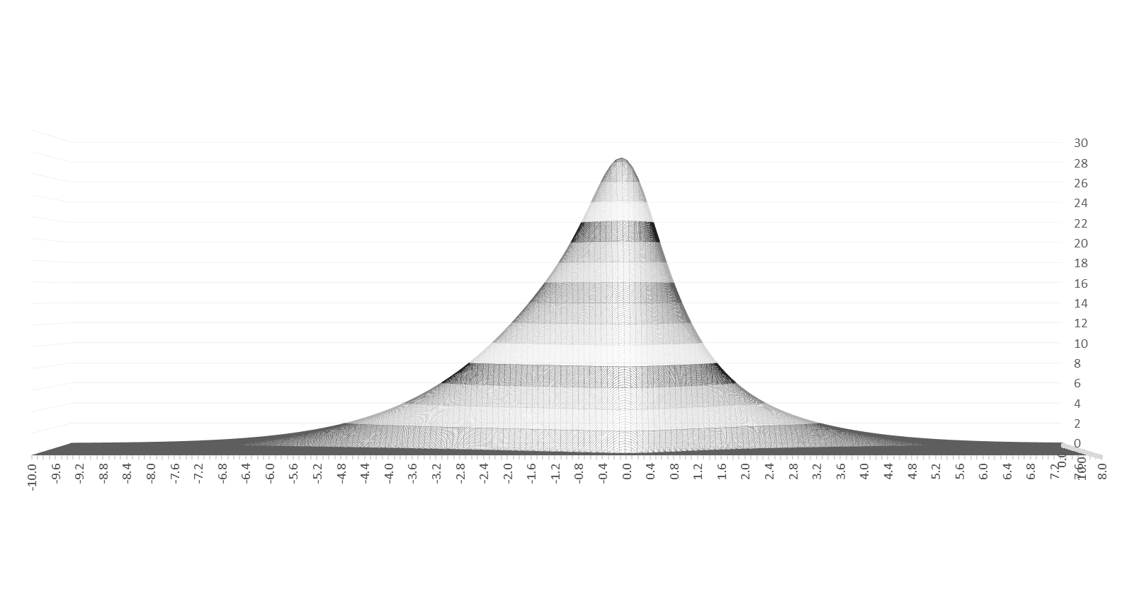


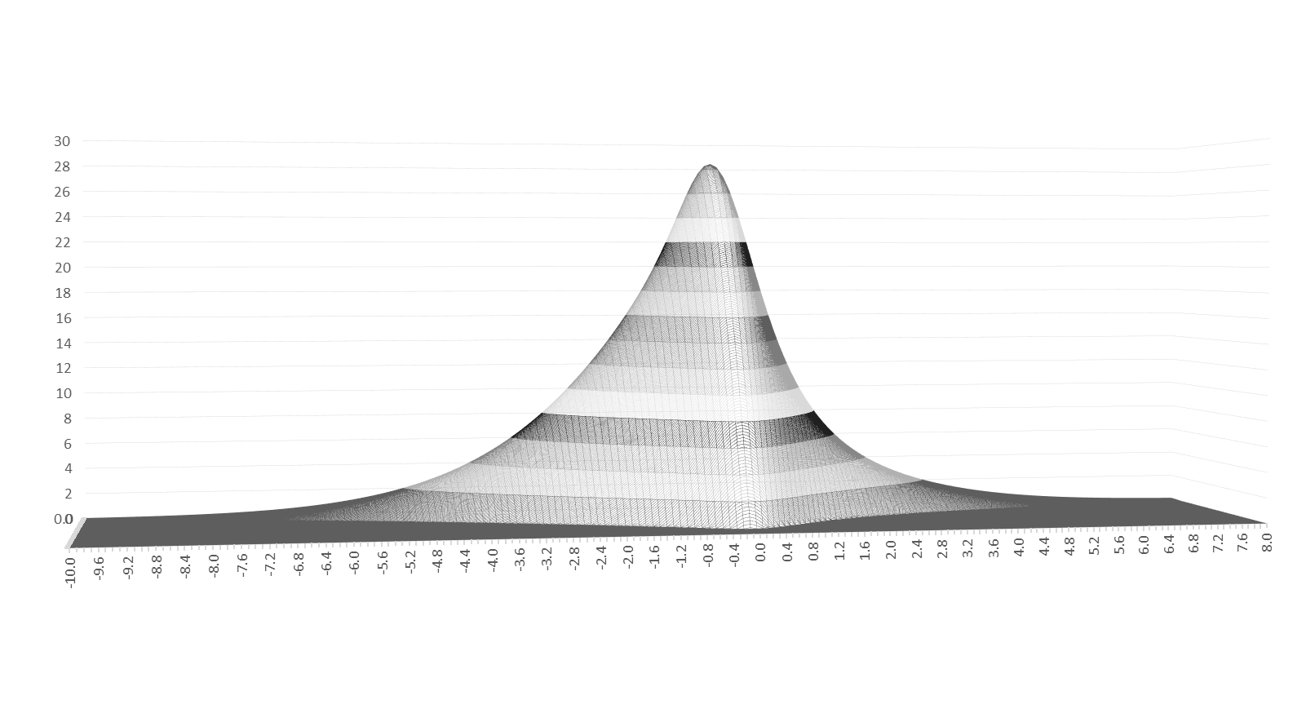
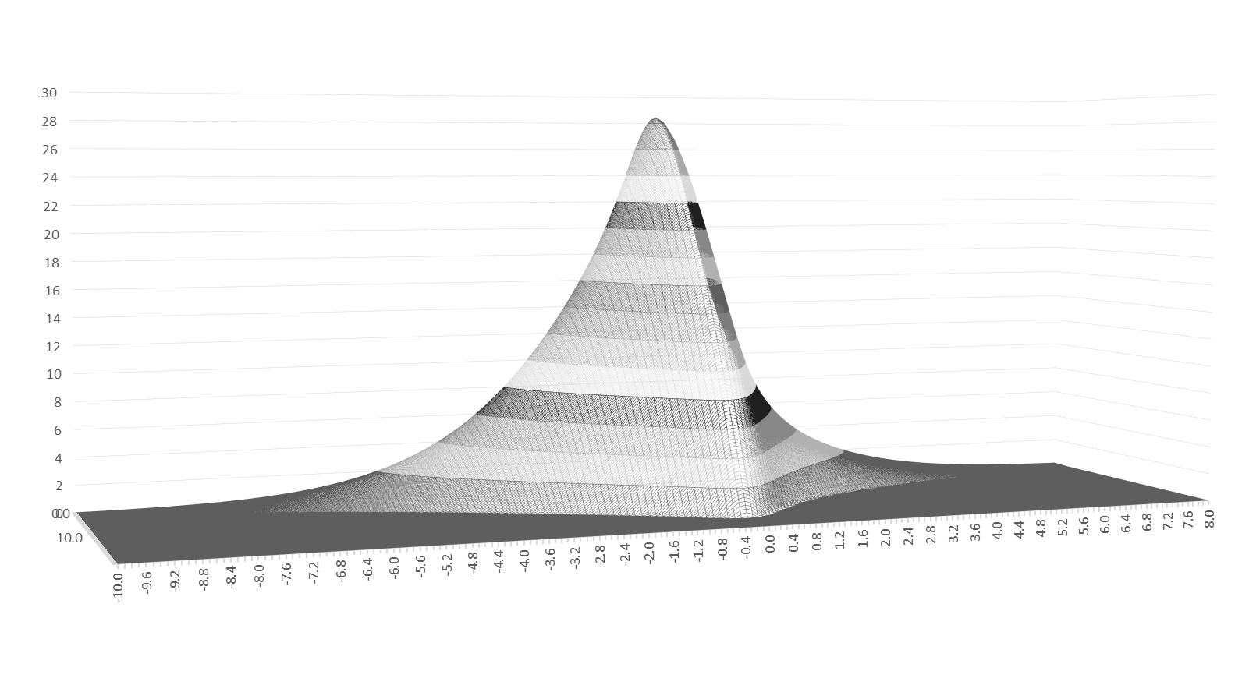

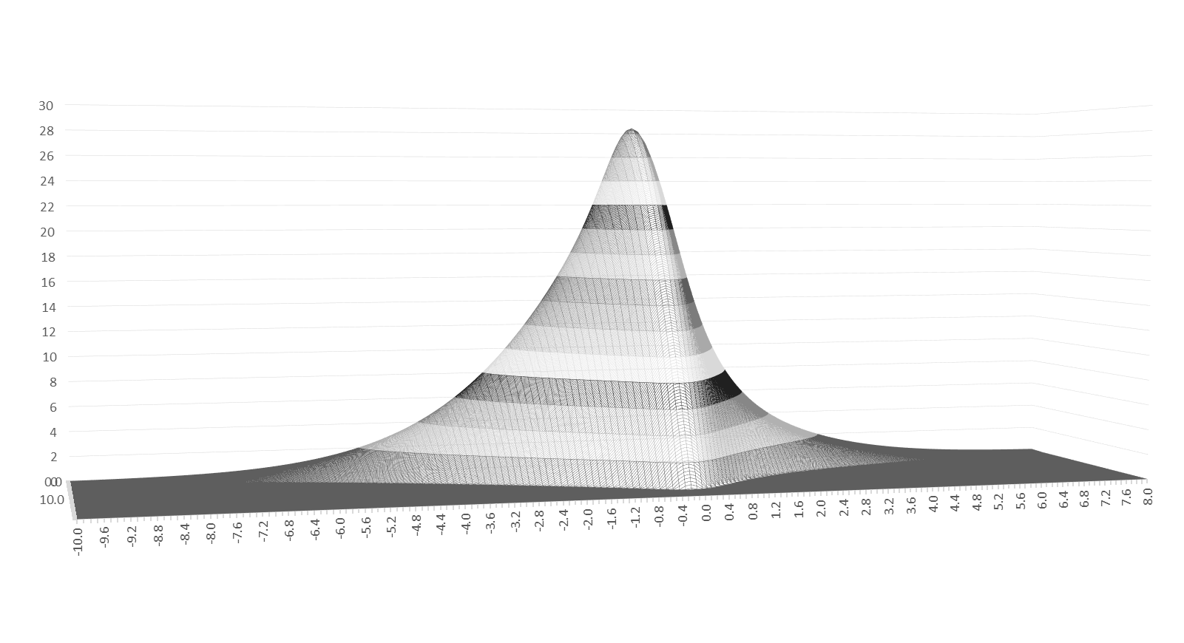
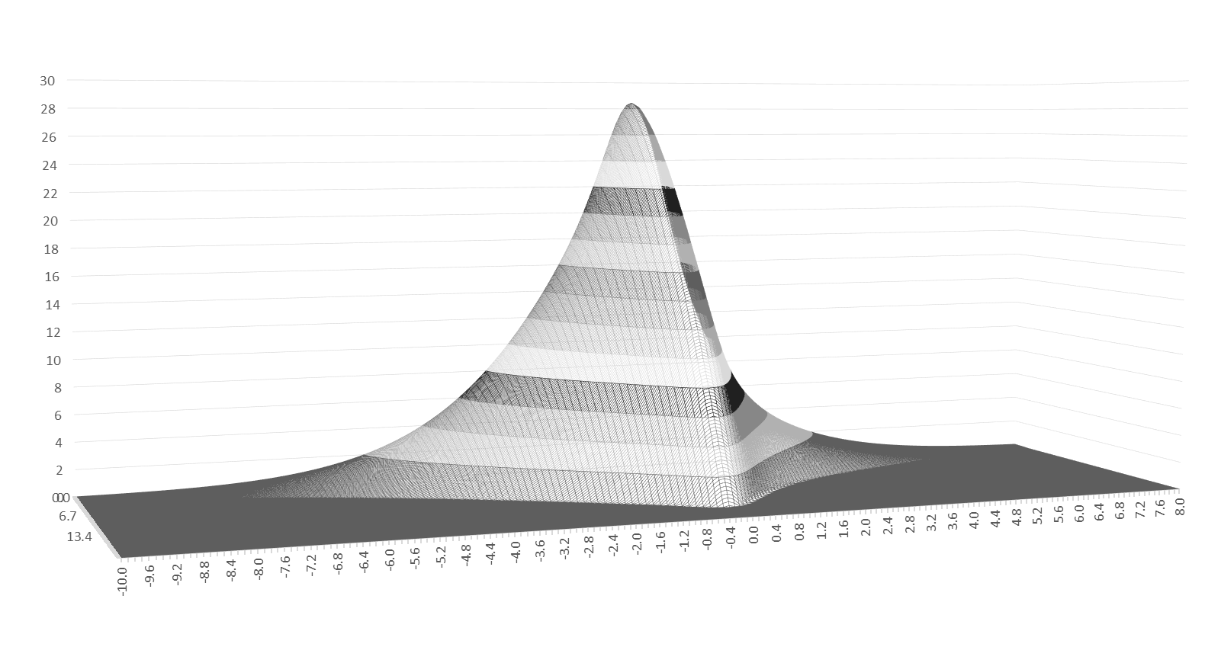
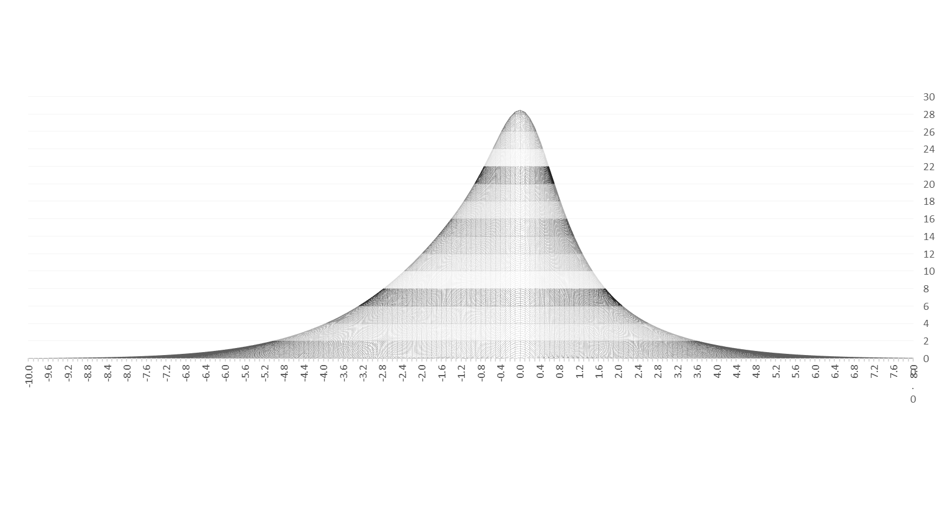
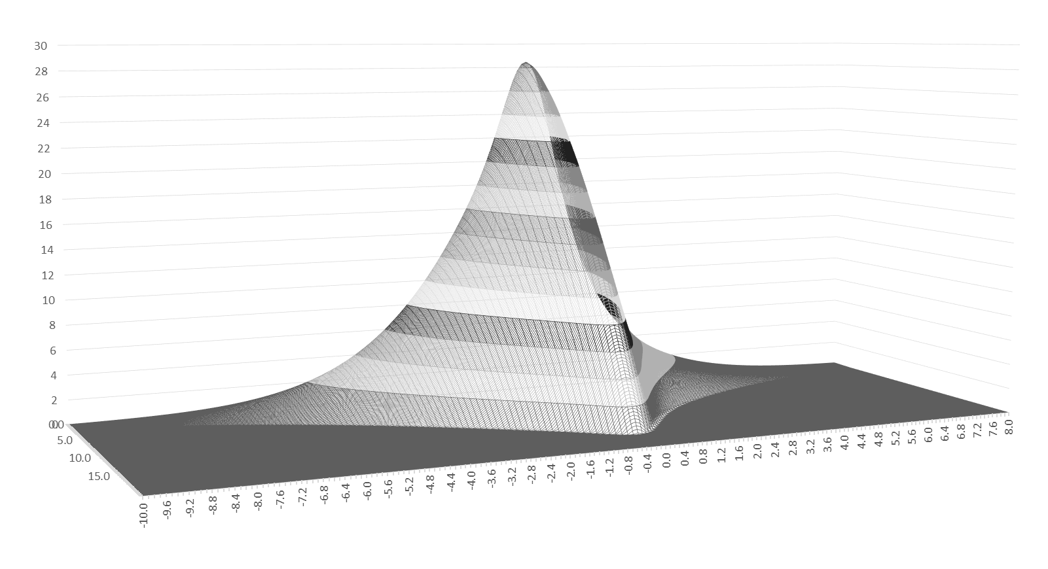
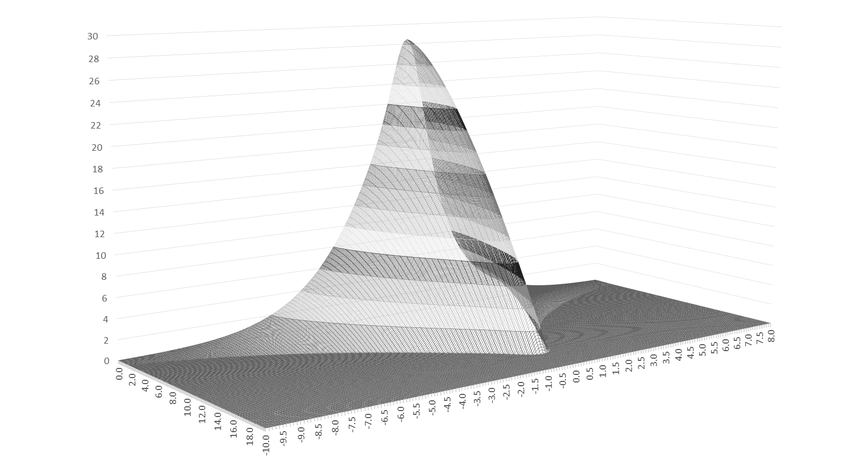
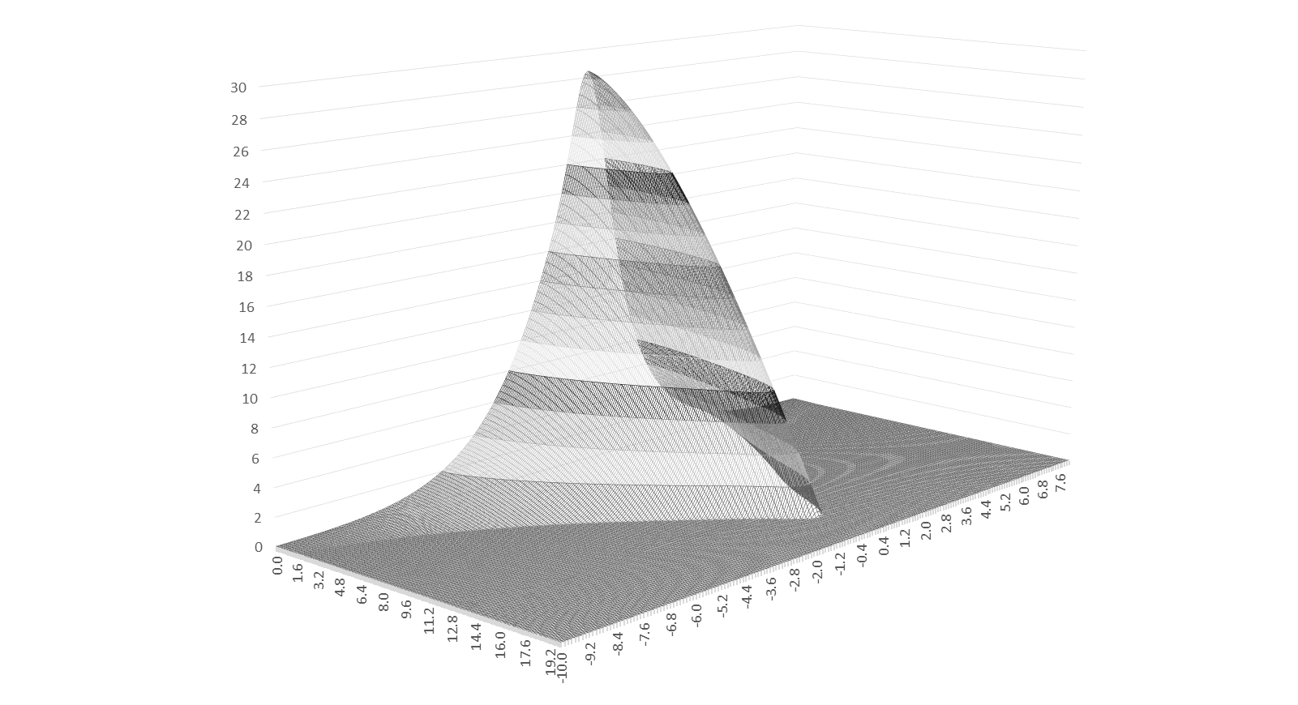

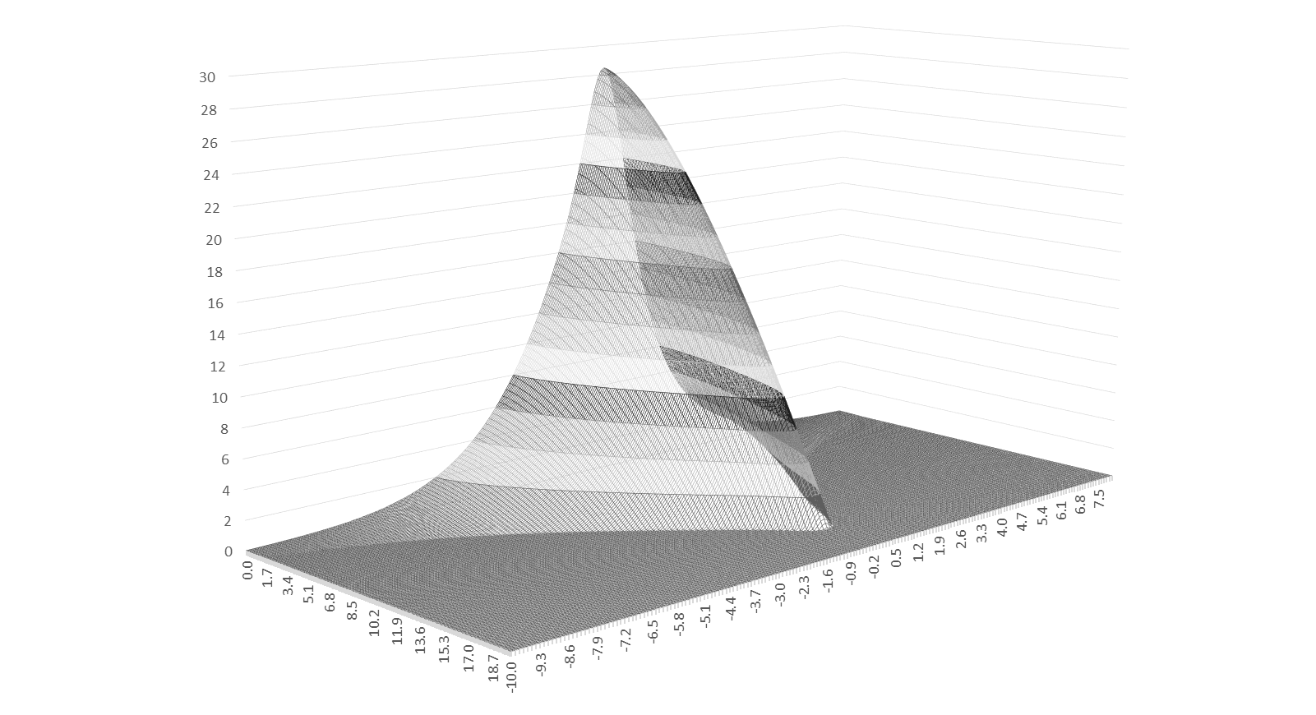
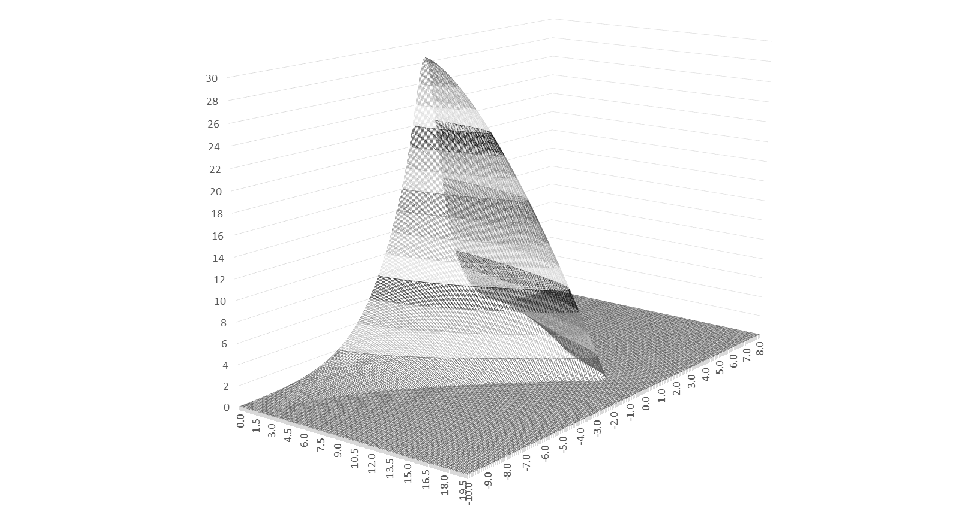
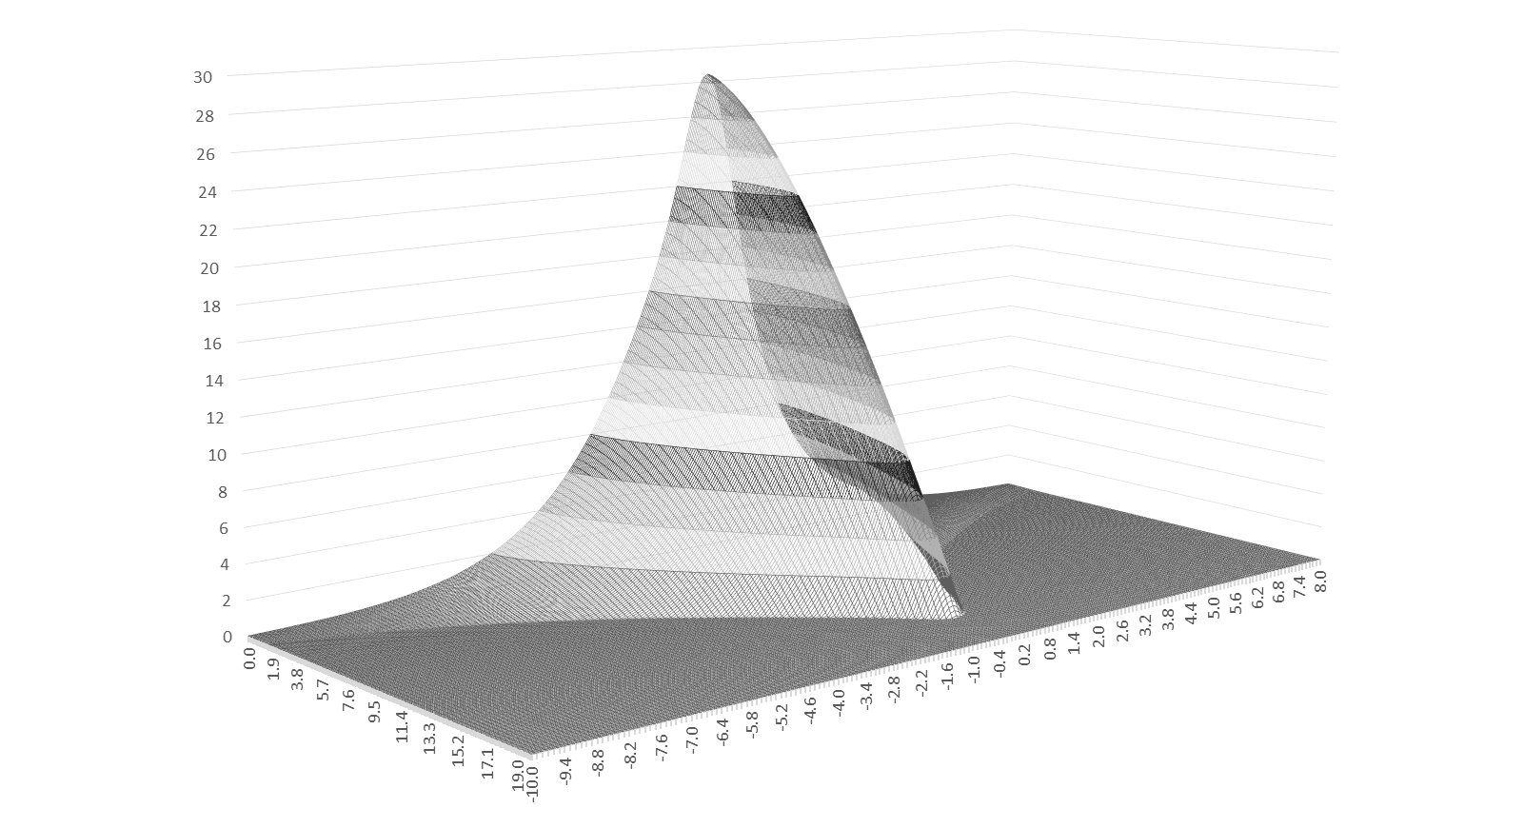
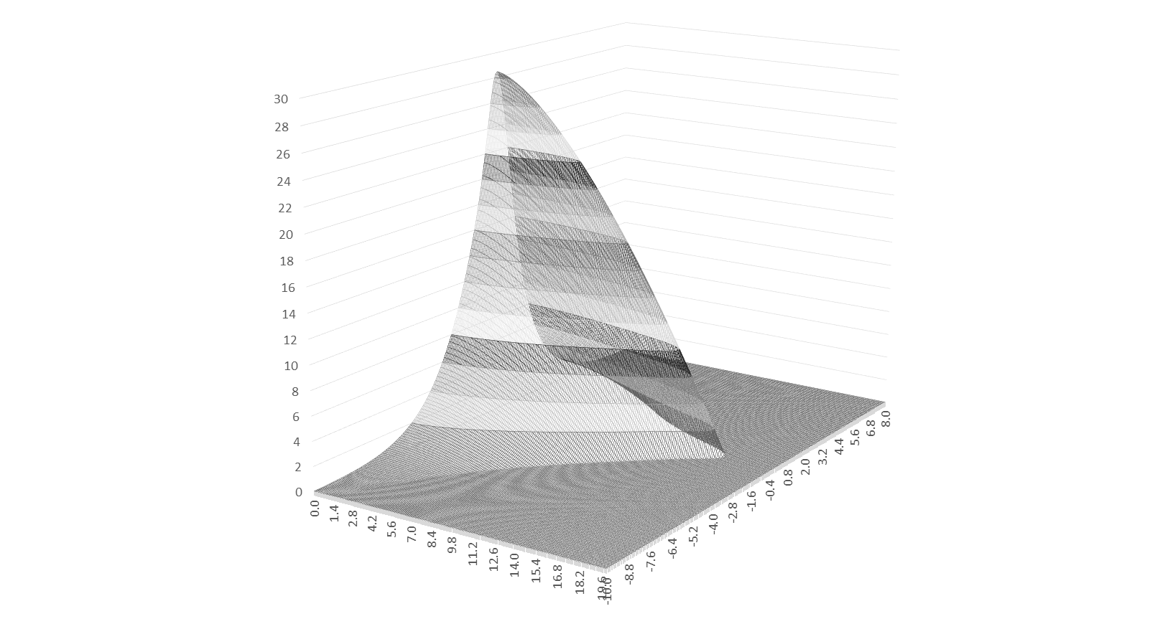
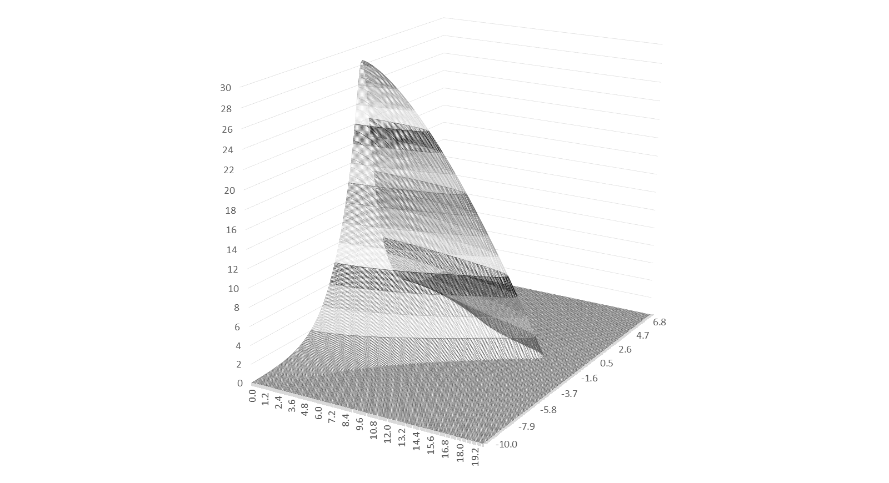
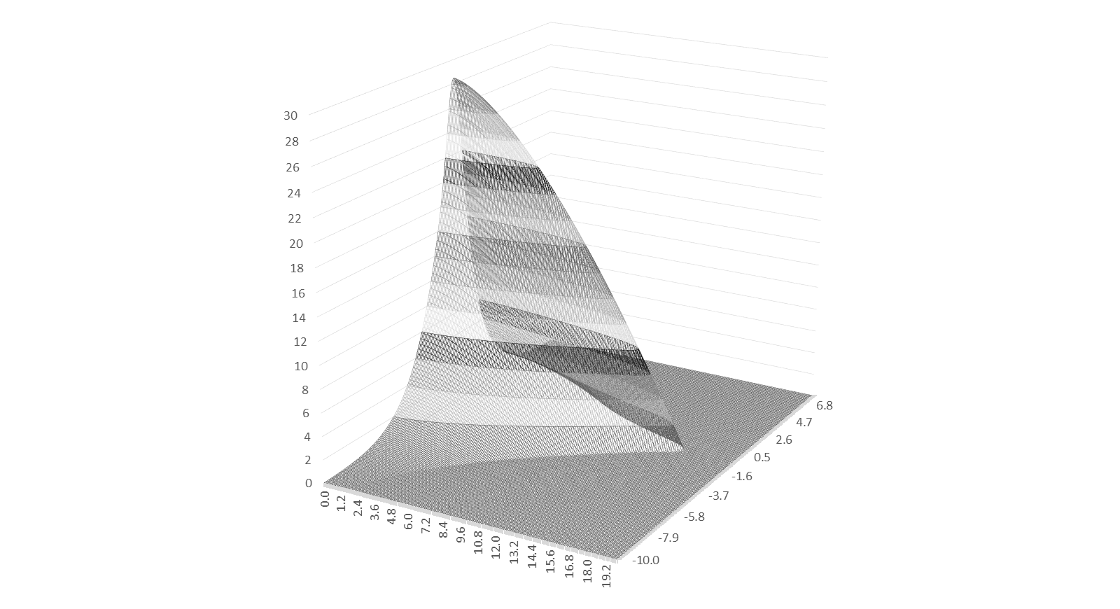

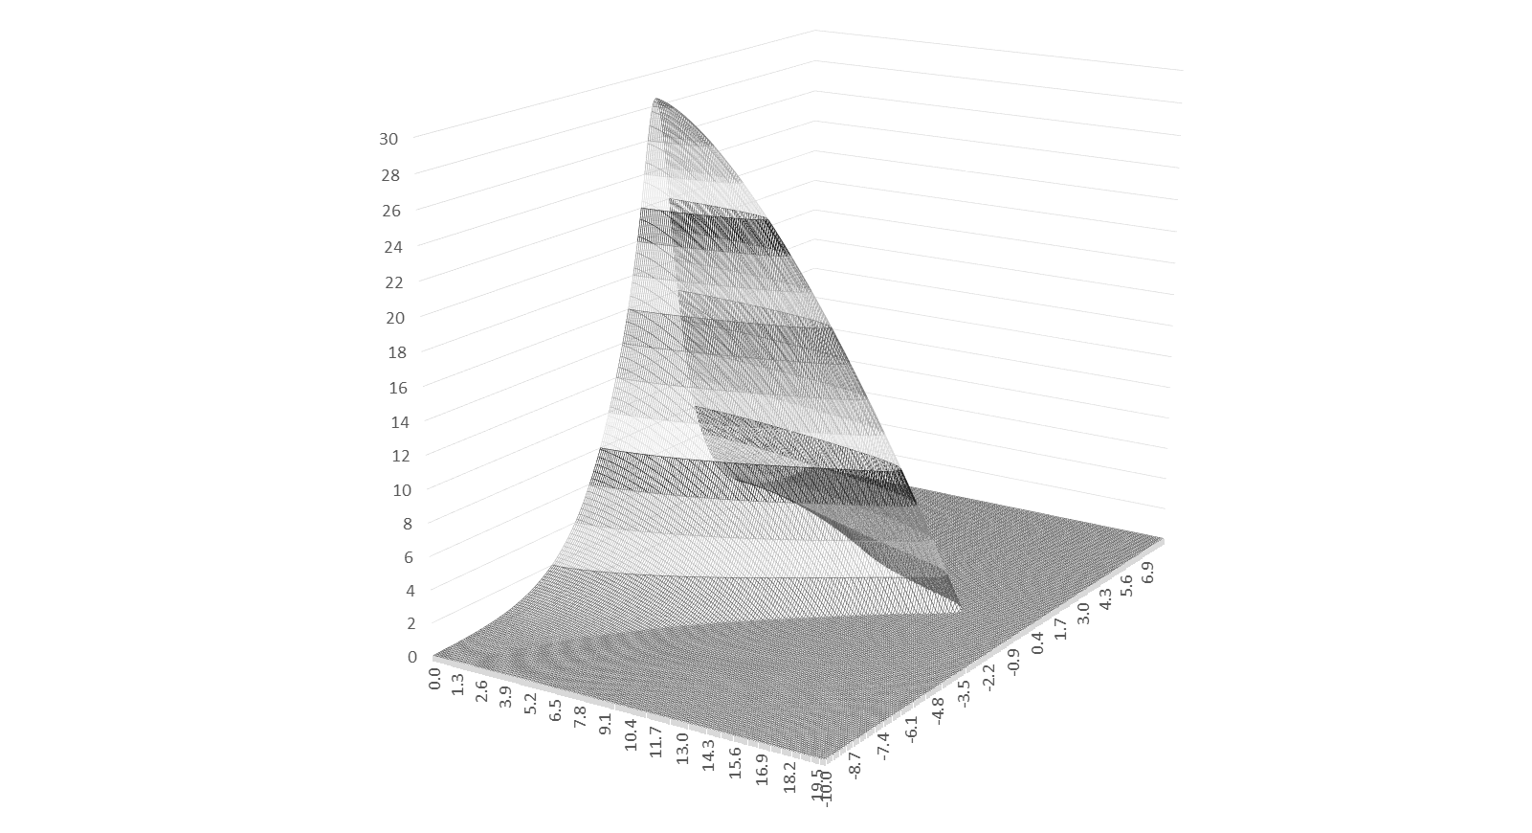
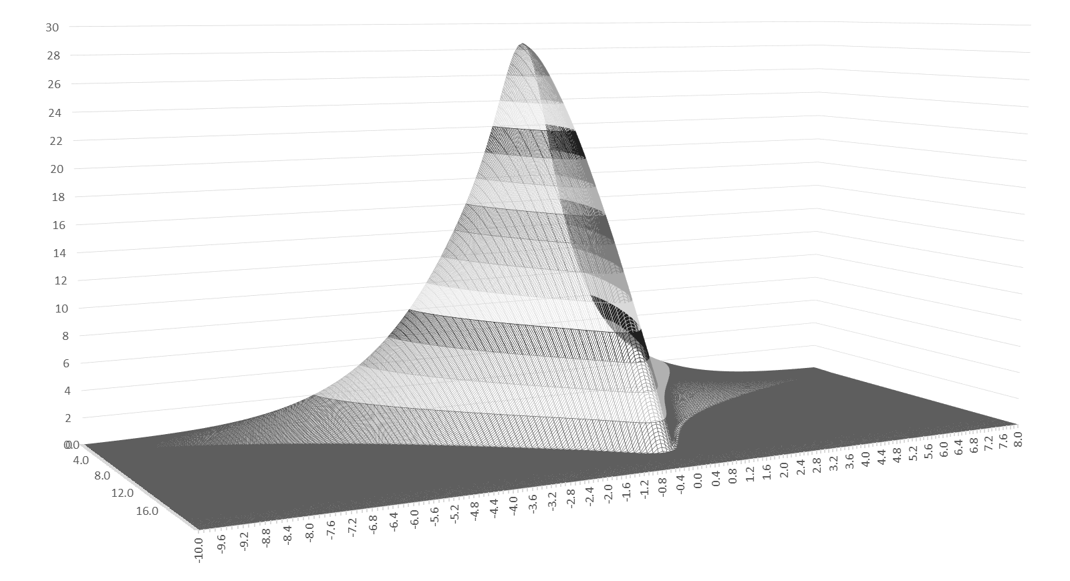
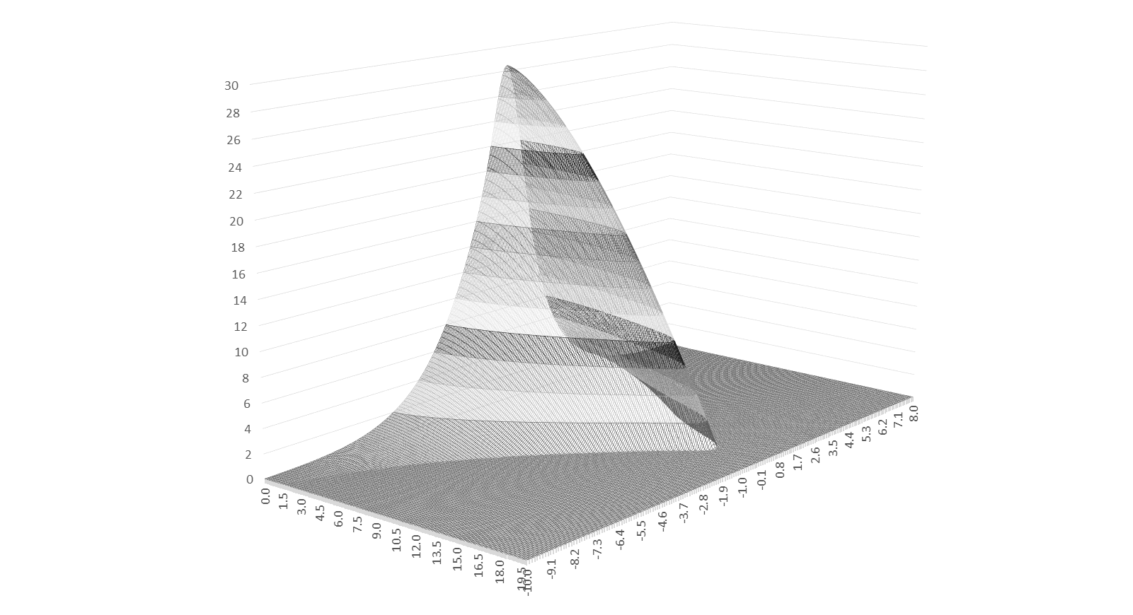
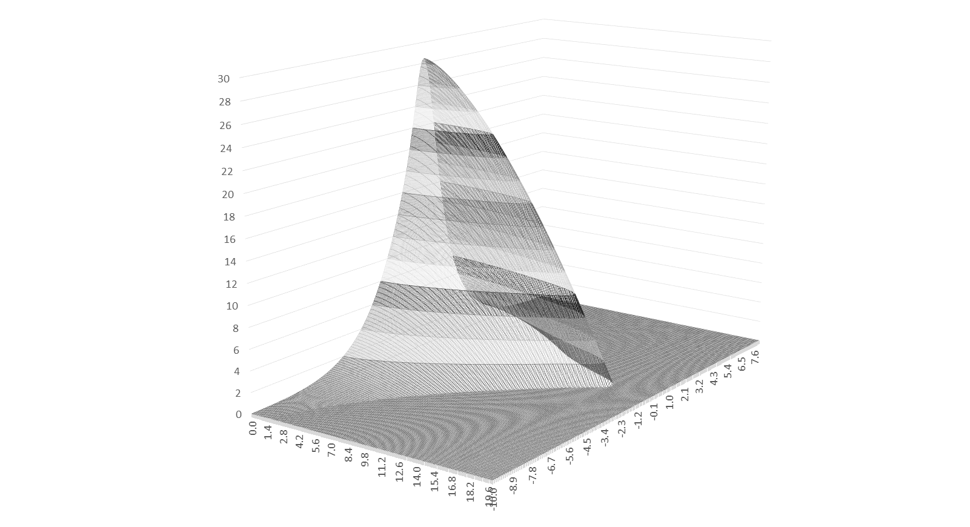
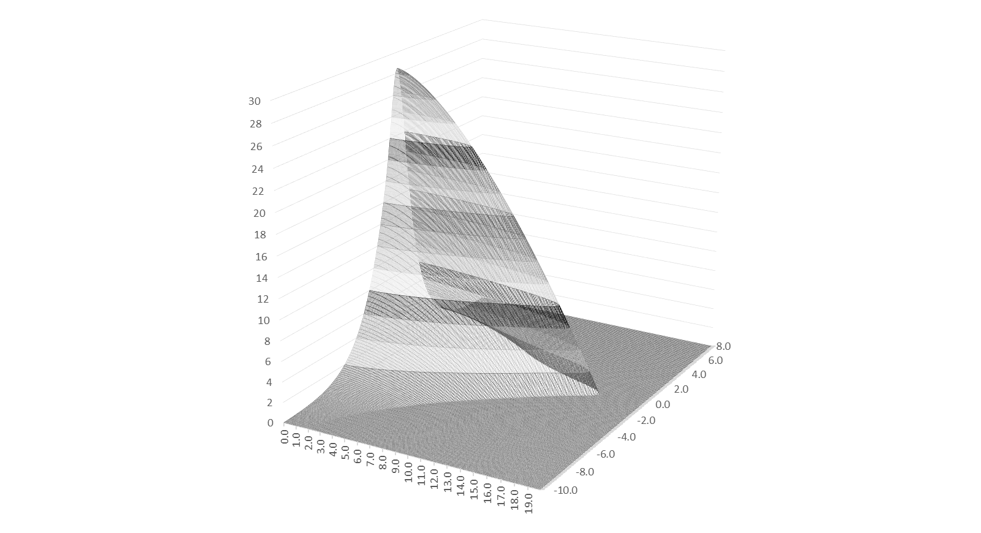

Slide 18
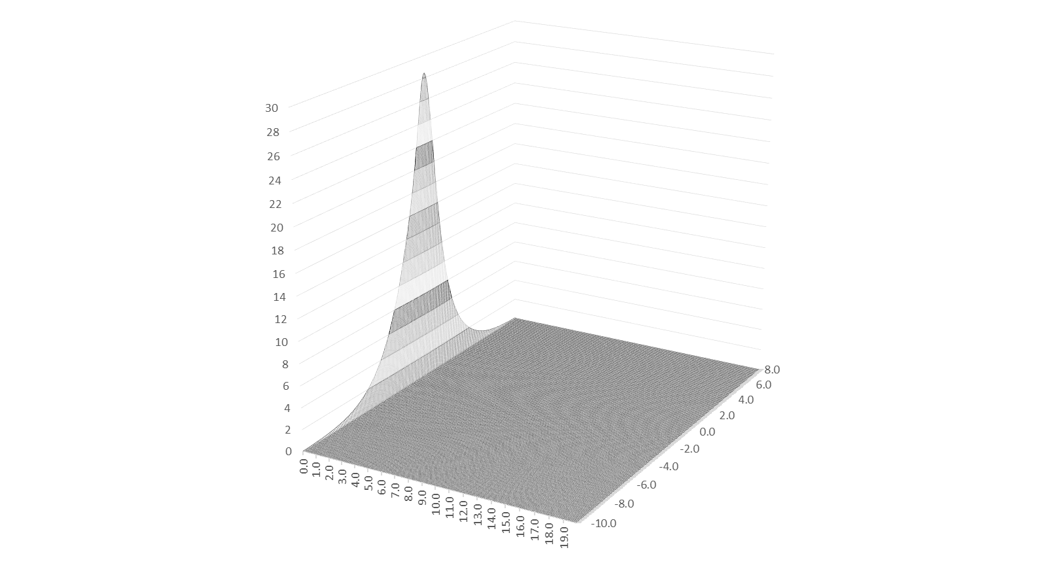
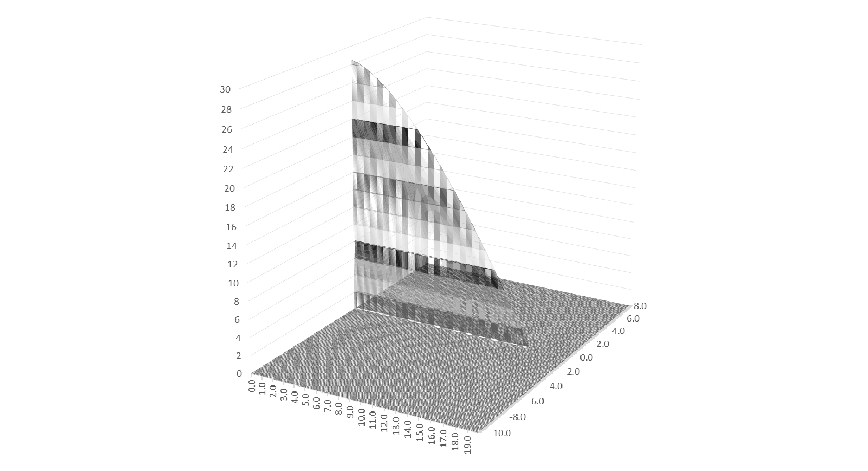
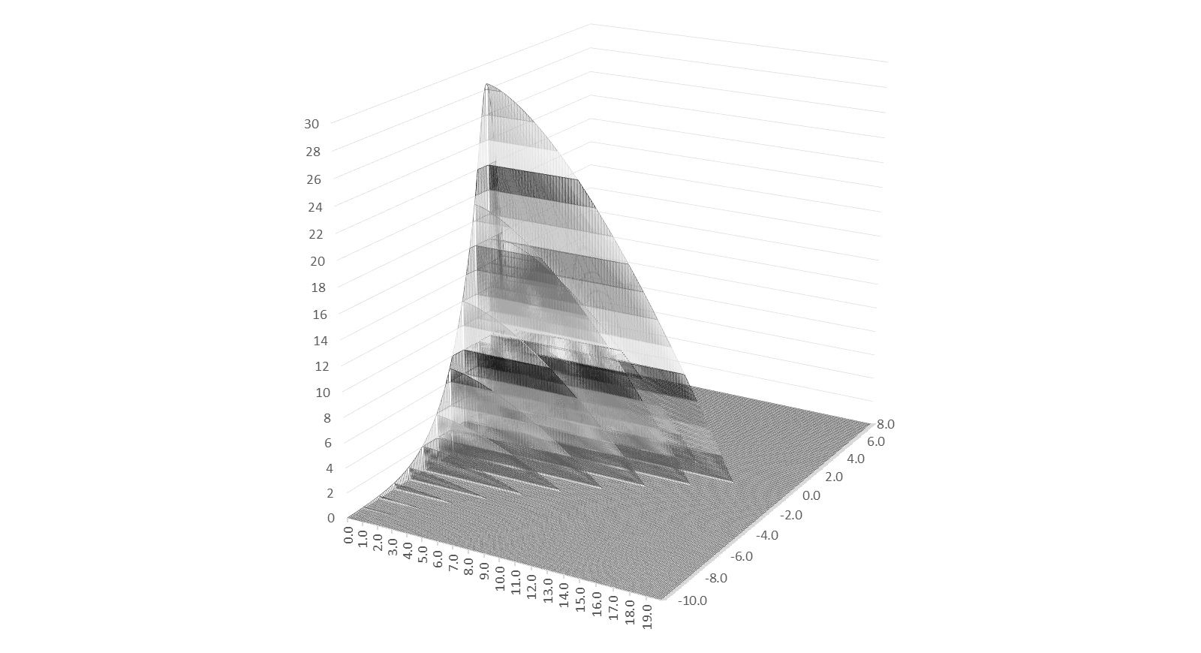


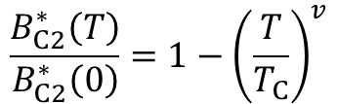


B_{C2}* (ε, T) = B_{C2}* (0, 0) x b_{C2}(ε) x b_{C2}(t)
$$b_{C2}\left(ε\right)=\frac{B_{C2}^{∗}\left(ε\right)}{B_{C2}^{∗}\left(0\right)}$$
$$B_{C2}^{∗}\left(0,0\right)$$
$$B_{C2}^{∗}\left(ε,T\right)=B_{C2}^{∗}\left(0,0\right)×b_{C2}\left(ε\right)×b_{C2}\left(t\right)$$
$$b_{C2}\left(t\right)=1−t^{v}$$
$$\frac{B_{C2}^{∗}\left(T\right)}{B_{C2}^{∗}\left(0\right)}=1−{\left(\frac{T}{T_{C}}\right)}^{v}$$
$$\frac{T_{C}^{∗}\left(ε\right)}{T_{C}^{∗}\left(0\right)}={\left[\frac{B_{C2}^{∗}\left(ε,0\right)}{B_{C2}^{∗}\left(0,0\right)}\right]}^{\frac{1}{w}}$$
B_{C2}* (ε, T) [T]
ε₀ [%]
T_{C} (ε) [K]

Slide 19
Temperature Dependence of F_{P max} a.k.a. h (t)

Slide 20
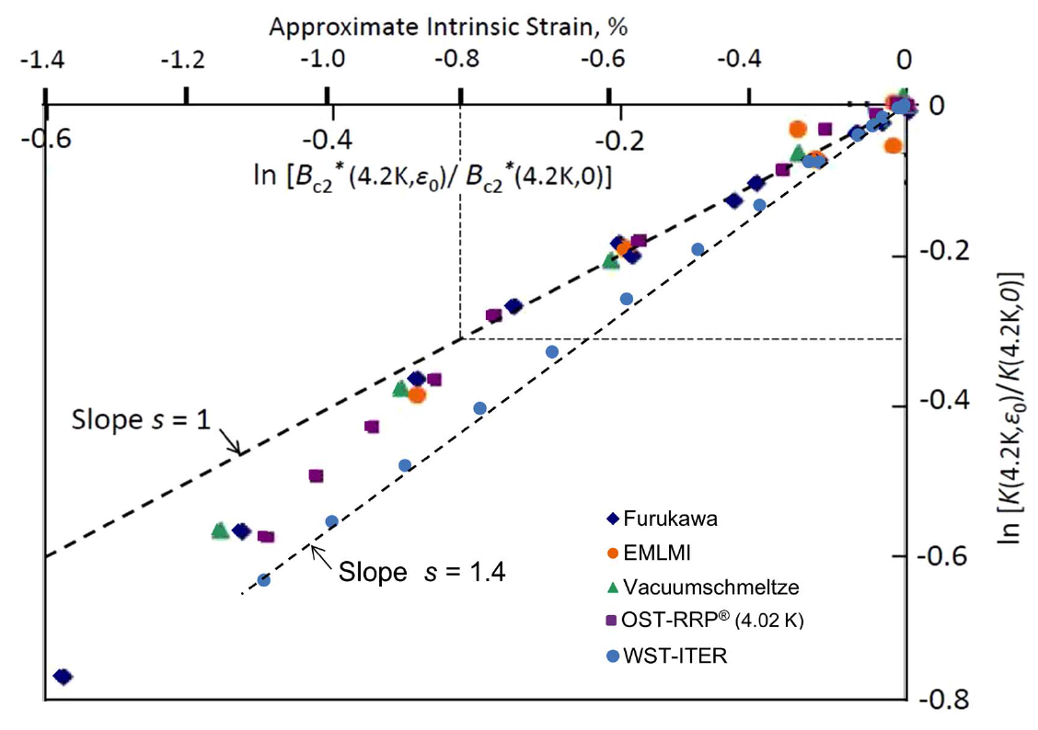
Strain Dependence of F_{P max} a.k.a. g (ε)

Slide 21
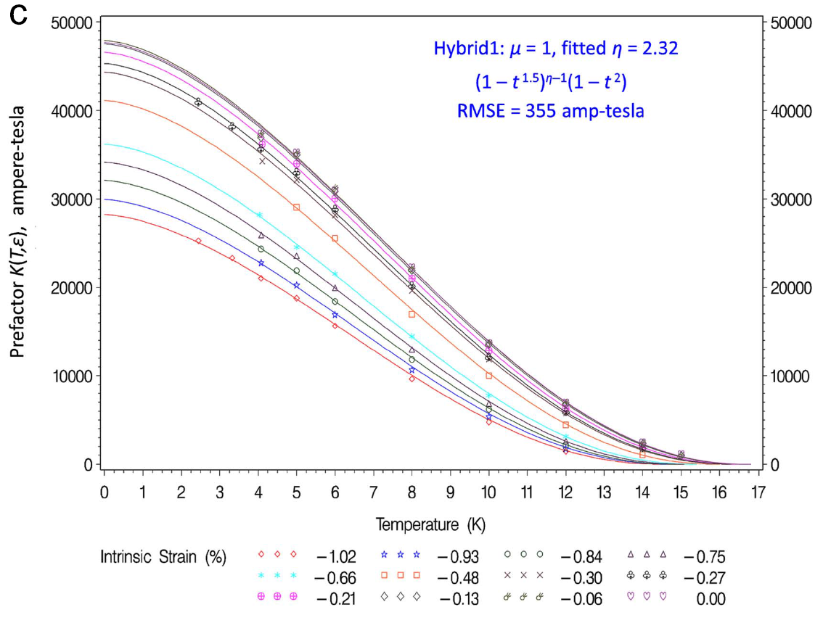
K (t, ε) = K (0, 0) x h (t) x g (ε)
K (0, 0)

Slide 22
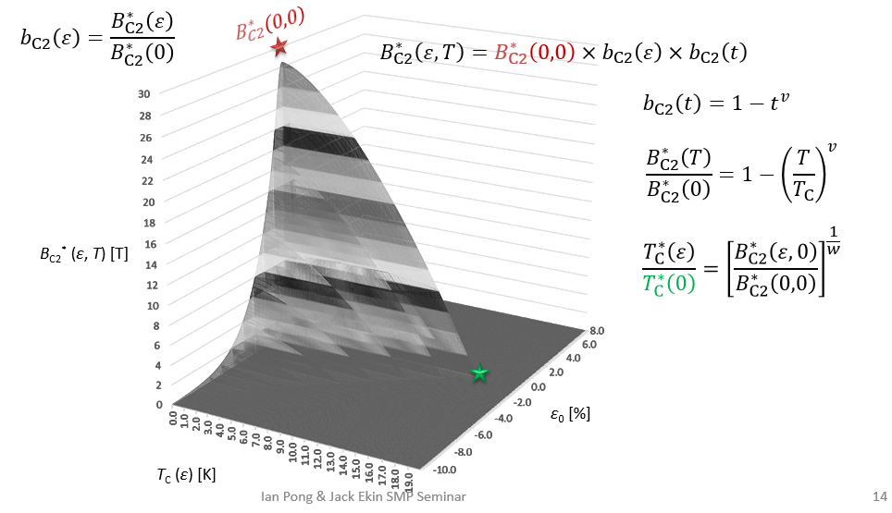
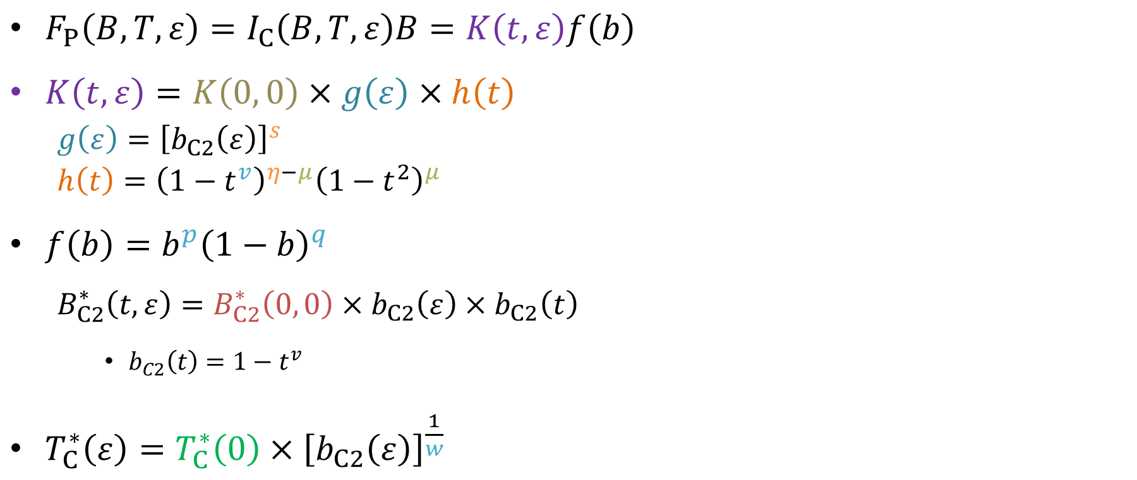
Mathematically…
$F_{P}\left(B,T,ε\right)=I_{C}\left(B,T,ε\right)B=K\left(t,ε\right)f\left(b\right)$
$K\left(t,ε\right)=K\left(0, 0\right)×g\left(ε\right)×h\left(t\right)$
  $$g\left(ε\right)={\left[b_{C2}\left(ε\right)\right]}^{s}$$
  $h\left(t\right)={\left(1−t^{v}\right)}^{η−μ}{\left(1−t^{2}\right)}^{μ}$
$f\left(b\right)=b^{p}{\left(1−b\right)}^{q}$
  $$B_{C2}^{∗}\left(t,ε\right)=B_{C2}^{∗}\left(0, 0\right)×b_{C2}\left(ε\right)×b_{C2}\left(t\right)$$
    $b_{C2}\left(t\right)=1−t^{v}$
$T_{C}^{∗}\left(ε\right)=T_{C}^{∗}\left(0\right){×\left[b_{C2}\left(ε\right)\right]}^{\frac{1}{w}}$

Slide 23
Conclusion
In Nb₃Sn, flux pinning is predominantly by grain boundaries.
The pinning force curves (F_{P} as a function of B), measured at different temperatures and strains, are shape invariant.
From the master scaling curve, the I_{C} at any B, T, or ε values can be generated, iff the scaling parameters are known.
The power of scaling is in its capability of extrapolation.
Today I showed how the scaling parameters relate to each other and how they define the critical surface.

Slide 24

Strain function choice: Exponential
We use the Exponential Scaling Law by Bordini et al. (SuST 26)
Simple to use
Has a theoretical basis (elastic strain energy)
Excellent extrapolation from very few data over extended strain
One fitting parameter in the axial case (C₁)
  The strain function is defined as:
  b_{C2} (ε) = $\frac{e^{−C_{1}^{}\frac{J_{2}+3}{J_{2}+1}J_{2}^{}}+e^{−C_{1}^{}\frac{I_{1}^{2}+3}{I_{1}^{2}+1}I_{1}^{2}}}{2}$
  where $I_{1 axial}=\left(1−2ν\right)ε_{0}+0.2$ OR $I_{1 3D}=ε_{1}+ε_{2}+ε_{3}$
  $J_{2 axial}=\frac{{\left[\left(1+ν\right)ε_{0}−0.1\right]}^{2}}{3}$ OR $J_{2 3D}=\frac{{\left(ε_{1}−ε_{2}\right)}^{2}+{\left(ε_{2}−ε_{3}\right)}^{2}+{\left(ε_{3}−ε_{1}\right)}^{2}}{6}$
  The strain function (> 0 and < 1) has two components:
    hydrostatic s_{D} associated with the first strain invariant I₁, and
    deviatoric s_{H} with the second deviatoric strain invariant J₂
  ε is the 3D strain, and ɛ₀ the intrinsic axial applied strain
  ɛ₀ ≡ Applied axial strain ε_{a} + Residual axial strain ε_{l0}
  (the strain component ε₀ is in I₁ and J₂)
  s_{D} and s_{H} never peak at the same strain component ε₀
  (strain function always < 1, 3D strain ε never equals 0)

Slide 25
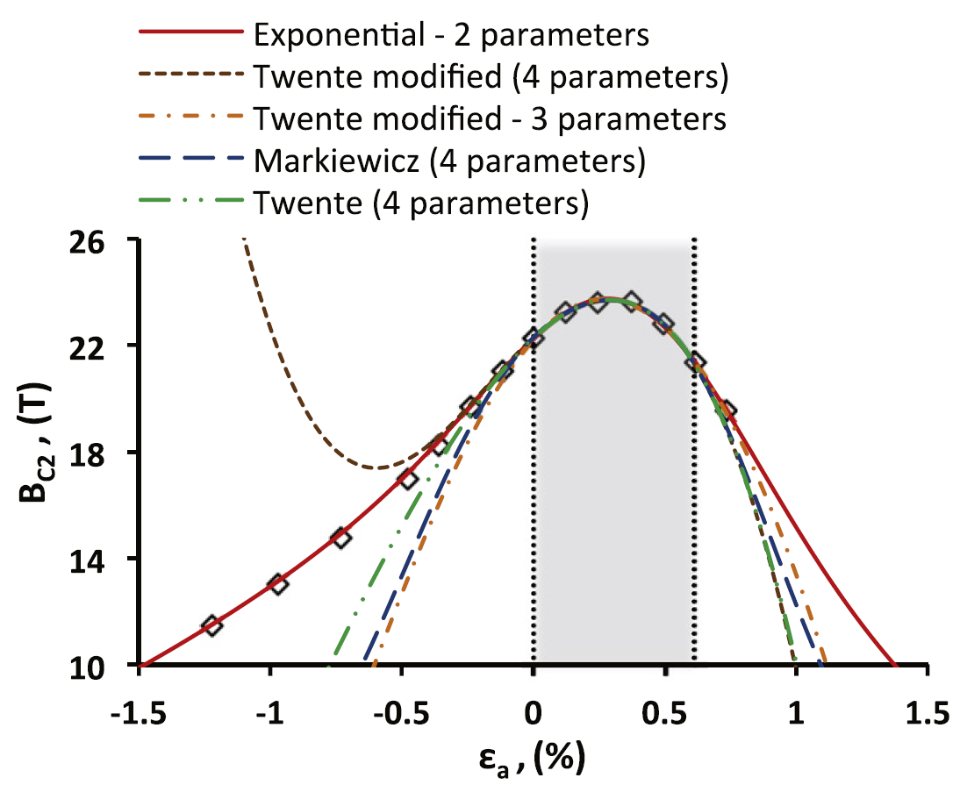
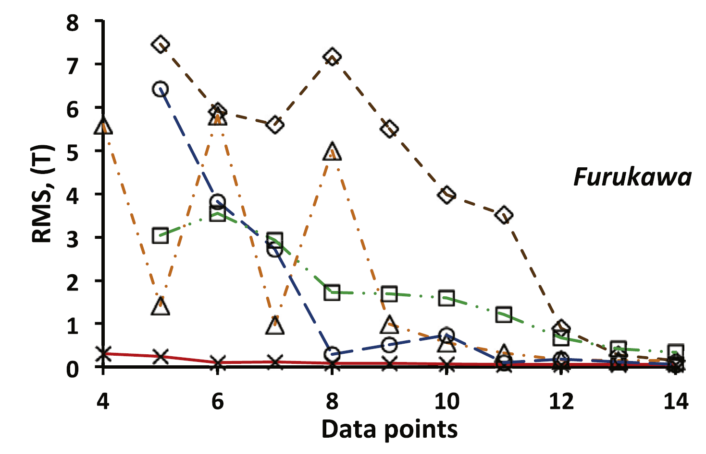
Comparison of B_{C2} (ε) Extrapolation
SuST 26

