Slide 1
Opportunities and Challenges
Presentation to the MDP TAC
Kathleen Amm
For the MDP Team

Slide 2
Resources and Talent – opportunity starts with the right people
Next generation talent/knowledge transfer – successes and challenges
  Strong model for program – FSU/LBL exchange, engagement of post-docs at BNL
  Strong engagement by junior staff
  Significant support from adjacent projects required
  Challenge on focus
  Recruiting remains non-trivial in superconductivity space – especially mid career
  More diversity needed – focusing on pipeline – outreach to HBUs, Kathleen is IEEE CSC rep for WIE
Nimble resource management accelerating
  Constrained funding and need for efficient deployment across multiple projects, multi- office, multi- agency
  Applying agile resource management
Notes:
MDP has made strong progress in bringing in junior staff, typically with significant support from “adjacent” projects and short-term funded projects. A challenge is to provide them sufficient opportunity to focus on MDP research to enable their careers to evolve well. The influx of junior staff bodes well for our field.
Students (undergrad and grad) – attracting student from local Universities, DOE should support local universities through Accelerator Stewardship Program, example: an undergrad working with X.Xu on Nb₃Sn ECA
Lack of postdocs for MDP – independent funding for 2-3 postdoc positions
Young researchers’ time – a strong competition with the projects. This creates disbalance between R&D involvement (R&D time) of the young scientist and engineers and older researchers

Slide 3
European HMF
The newly formed European HFM will begin in earnest in the coming months
This provides excellent opportunities for collaboration to advance the field.
We will need to be vigilant that collaborations are in a larger sense of common value
and that they do not restrict our program’s ability to address our milestones or to adapt to new research opportunities/needs.
Engagement of MDP leader in HFM and HFM participation in MDP discussions
Sharing roadmaps

Slide 4
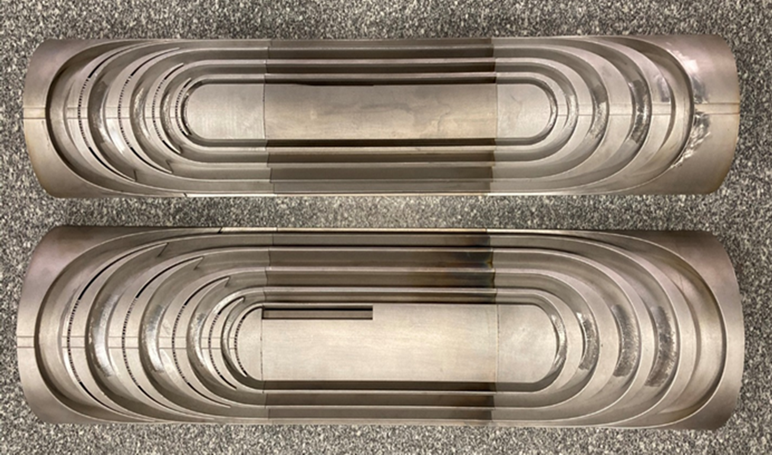
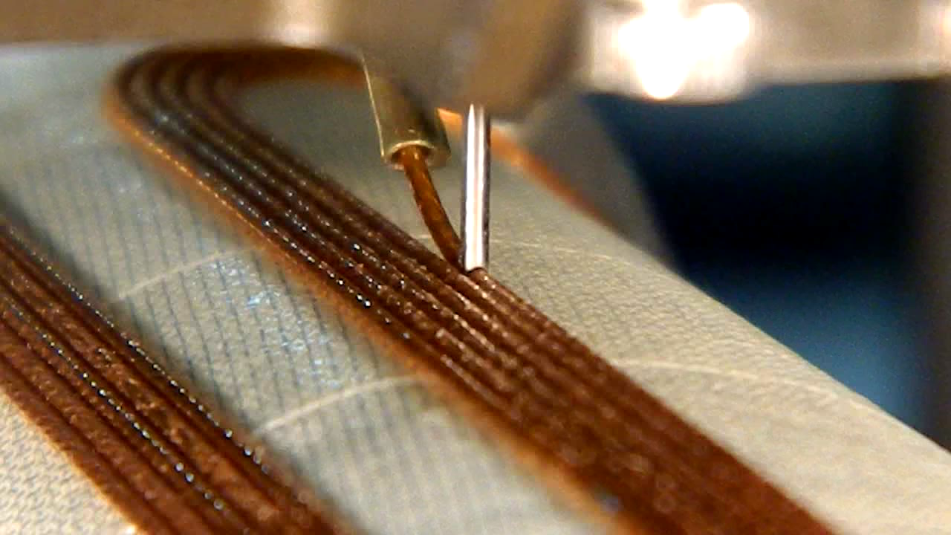
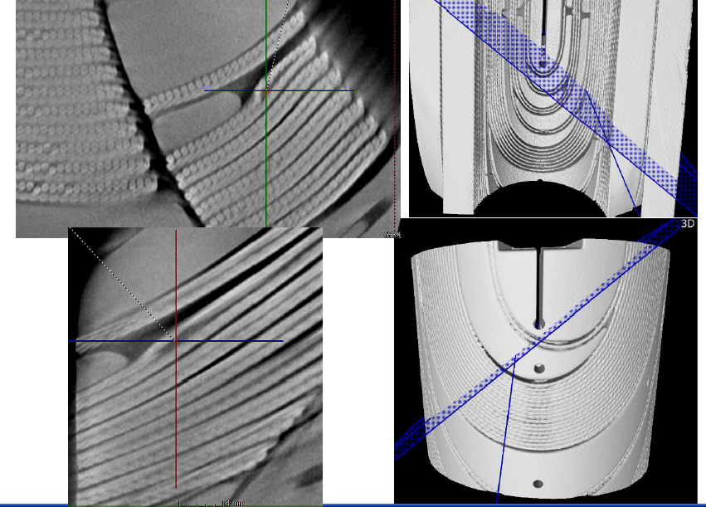
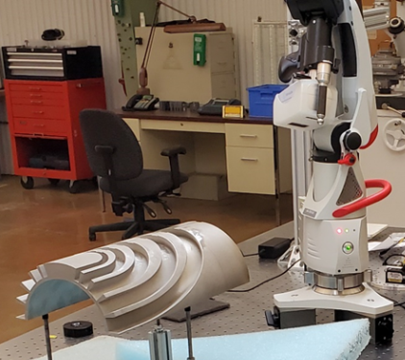
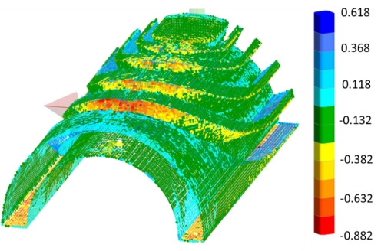
Manufacturing innovations
Additive manufacturing – stress management
Automated winding
  Direct wind - modernization
  Cost out – AUP
Inspection technologies
  Non-invasive studies of coils after testing
  Laser scanning geometry control

Slide 5
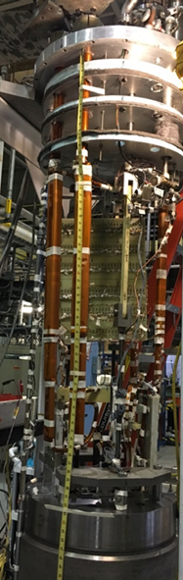
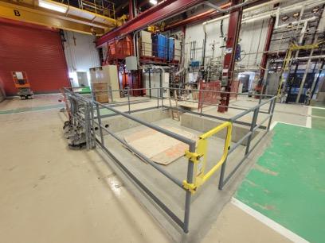
Test Facilities – current and future
Current BNL Dipole test facility
  The current facility provides a field of 0 -10 T at ~4 K and up to 10 kA in cable if connected in series with the magnet
  BNL internal funds are being used to develop
    1-50⁺ kA on cable/joints with superconducting transformer
    4-50⁺ K test temperature for users with a secondary cryostat
    ~40 m long cable in dipole field, 150-500 mm bend diameter
  This 10 T dipole test facility is complimentary to SULTAN (solenoid-based), and a facility available to users in US now while awaiting FNAL facility 5 years out
Future FNAL test facility
  Moving as rapidly as possible to begin Hybrid magnet testing

Slide 6
Superconducting materials – clear opportunity and challenge
The strong interest from all labs in advancing HTS materials and magnets led to a significant number of milestones in that arena in the new roadmaps, requiring a steady stream of conductor to support the developments.
The combination of HTS procurements, coupled with interest in continued modest support for Nb3Sn R&D with industry, significantly exceeds the reach of MDP’s baseline allocation of $500K for superconductors.
Advances in superconductors, particular at their early stage of development, benefit HEP as well as other programs such as FES, NP, and BES.
Investment in superconductors is well suited for ARDAP support, at much more significant level than MDP can currently support.
Notes:
The strong interest from all labs in advancing HTS materials and magnets led to a significant number of milestones in that arena in the new roadmaps, requiring a steady stream of conductor to support the developments. The combination of HTS procurements, coupled with interest in continued modest support for Nb3Sn R&D with industry, significantly exceeds the reach of MDP’s baseline allocation of $500K for superconductors. Advances in superconductors, particular at their early stage of development, benefit HEP as well as other programs such as FES, NP, and BES. Investment in superconductors is well suited for ARDAP support, at much more significant level than MDP can currently support.

Slide 7
Bi-2212 – an integrated conductor and magnet technology
OPPORTUNITIES
All of the essential components of this technology have seen demonstrated success
  Conductor has high J_{E} and is available at 1-2 km/10 kg scale
  ALL essential elements of the Wind-and-React process have been demonstrated in both dipole and solenoid geometry (commercial applications are seen)
  Dipoles have so far all been low field so STRESS MANAGEMENT will soon be needed as is being demonstrated at ASC for solenoids – these requires different approaches for dipoles. CCT (LBL) and CT SM at Fermilab address this issue
CHALLENGES
We could go faster if we had more conductor for which the gate is funding (~$17K/kg) – the price is artificially high as one SBIR vendor has clearly stated – but a 2nd source and commercial solenoid interest can help this)
Bi-2212 is like Nb₃Sn a W&R process which often takes multiple test to debug – more resources can accelerate this debugging, especially towards high fields where high stresses will operate and SM is essential
FSU furnace is a valuable resource that will require challenging coordination among multiple stakeholders
Notes:
Bi2212 continues to advance well and is poised to be the first HTS material to be tested in a hybrid stress-managed configuration. The work at LBNL and FNAL in this arena requires the FSU furnace which was funded and built to support FSU and MDP needs. This will require challenging coordination, both internal to MDP and with the “external” NHMFL needs, in order to maintain progress on all fronts.

Slide 8
Alloyed Nb₃Sn with or without APC
OPPORTUNITIES
Now well demonstrated at R&D level that alloying Nb with Hf or Zr can raise Jc significantly towards FCC Targets and also make small increases in H_{c2}
There are two independent ways of enhancing Jc, A15 grain refinement by alloy grain refinement and by internal oxidation
So far, all demonstrations have used PIT, RIT or university R&D monofilament alloys
CHALLENGES
The challenge now is to evaluate advanced Nb₃Sn with the RRP architecture which is widely recognized to be the most effective high Jc architecture
ATI has made a 1000 lb melt of Nb4Ta1Hf and it has been purchased by various labs and industries world wide
Fabricability and individual manufacturer or lab architecture variations are complicating progress – more R&D money for competitive architectures would be very valuable

Slide 9
Summary
Very exciting time for the magnet community
There are many opportunities for all MDP participants throughout the superconducting magnet ecosystem
Great ideas and opportunities far exceed the available funding and resources
Strongly resource constrained – both labor and materials
We are leveraging synergies across government agencies (DOE, DOD, NASA, NSF …), industry, universities
Utilizing extremely nimble management of resources across multiple programs. Adapting to agile models critical – many small projects require this type of model
And active engagement in talent development

Slide 10

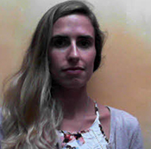

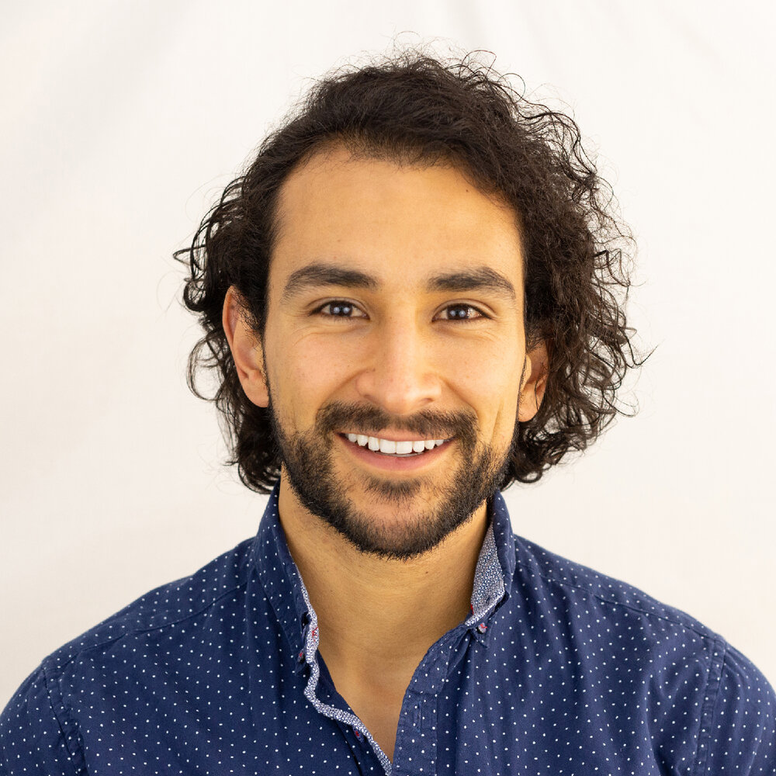
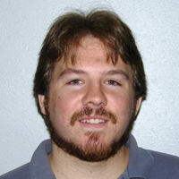



We collaborate on a breadth of critical technology development frontiers, such as … (LBL-ASC-NHMFL)
Magnet Protection
Strain impact on operation
REBCO technology
Development and test of “CLIQ” (Coupling-Loss Induced Quench system) on Bi-2212 common coil, 77 K
Capacitance-based quench detection
Conductor stability and margin – analysis and testing
Measurements of the impact of axial strain on J_{c} at high field
Calculation of operating margin to superconductor phase boundary, taking into account 3D strain state
Measurement of transport current
and degradation with unique ”YateStar” system
Development of CORC™ based magnet technology, and tests in background field
Development of analytic and experimental tools to explore current sharing in REBCO cables
“Implications of the strain irreversibility cliff on the fabrication of particle-accelerator magnets made of restacked-rod-process Nb₃Sn wires, N. Cheggour et al, Scientific Reports 9, 2019
“Quench Protection of Bi2Sr2CaCu2O8+X High Temperature Superconducting Magnets”, D. Davis, Ph.D. thesis
The NHMFL produces outstanding students and early-career scientists, developing novel solutions and collaborating internationally
Recent ASC-LBL exchange examples
Chris Reis
(FSU/ASC UG, now
UCB student)
Virginia
Phifer
(FSU/ASC PhD student)
Chris Segal (FSU/ASC PhD, then CERN post doc
Charlie Sanabria ((FSU/ASC PhD, then LBL post doc, now CFS)
Dan Davis (FSU/ASC PhD and LBL intern, now ASC PD)
Jonathan Lee (UCB UG and LBL intern, now ASC PhD student)
10

