Slide 1
What is “Snowmass?”
“Snowmass is a particle physics
community study”
https://www.snowmass21.org/
Provides input to P5
(Particle Physics Project
Prioritization Panel) which
develops a strategy for
the US HEP program
1.5-2 yrs
Snowmass
~5-7 yrs of
hard work
P5
Strategy
~ 1 yr
DOE/NSF
program
No prioritizations from Snowmass

Slide 3
Accelerator Frontier – Key Questions
  What is needed to advance the physics?
  What is currently available (state of the art) around the world?
  What new accelerator facilities could be available in the next decade (or next next decade)?
  What R&D would enable these future opportunities?
  What are the time and cost scales of the R&D and associated test facilities as well as the time and cost scale of the facilities?

Slide 4
Accelerator Frontier Topical Groups and Conveners
Topical Group |  | Topical Group co-Conveners
AF1 | Beam Phys & Accel. Education | Z. Huang (Stanford) | M. Bei (GSI) | S. Lund (MSU)
AF2 | Accelerators for Neutrinos | J. Galambos (ORNL) | B. Zwaska (FNAL) | G. Arduini (CERN)
AF3 | Accelerators for EW/Higgs | M. Ross (SLAC) | Q. Qin (IHEP, Beijing) | G.Hoffstaetter (Cornell)
AF4 | Multi-TeV Colliders | M. Palmer (BNL) | A. Valishev (FNAL) | N Pastrone (INFN, Torino) | J.Tang (IHEP, Beijing) | J.Tang (IHEP, Beijing)
AF5 | Accelerators for PBC and Rare Processes | E. Prebys (UC Davis) | M. Lamont (CERN) | R.Milner (MIT)
AF6 | Advanced Accelerator Concepts | C. Geddes (LBNL) | M. Hogan (SLAC) | P. Musumeci (UCLA) |  | R. Assmann (DESY)
AF7 | Accelerator Technology R&D
 | Sub-group RF | E. Nanni (SLAC) | S. Belomestnykh (FNAL) | H. Weise (DESY)
 | Sub-Group Magnets | G. Sabbi (LBNL) | S. Zlobin (FNAL) | S. Izquierdo Bermudez (CERN)
 | Sub-Group Targets & Sources | C. Barbier (ORNL) | Y. Sun (ANL) | F. Pellemoine (FNAL)
Plus, the Accelerator Implementation Task Force (ITF) to evaluate and compare various options
9 out of 29 are representatives of Asia and Europe; 5 women

Slide 5
Some Working Group Activities
AF1 – has been running a series on physics of Ultimate Beams and examining the fundamental limits of accelerator technology
AF3 – looking broadly at Higgs factories from e⁺/e⁻, γ/γ, μ⁺/μ⁻
AF4 – considering multiple paths to high energy including e⁺/e⁻, γ/γ, μ⁺/μ⁻ and p/p; lots of enthusiasm for μ⁺/μ⁻ in part because of potential to fill in the gap from 3-14 TeV with US MC Forum and Int. MC Collab.
AF5 – working on many small or moderate scale proposals
AF6 – working to understand options to upgrade a more conventional linear collider as well as limits of plasma acceleration (Multi-TeV)
AF7 – 3 subgroups exploring limits of accelerator technology (many efforts supported in part by US-Japan)

Slide 6
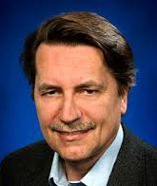
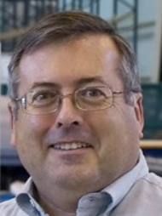

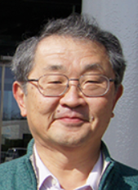
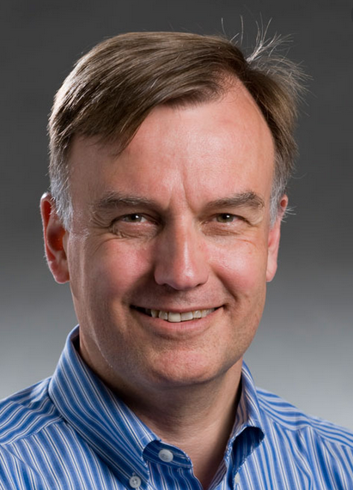
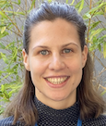
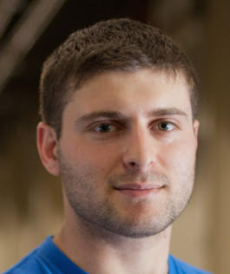
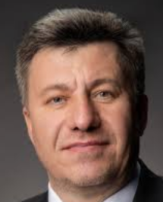
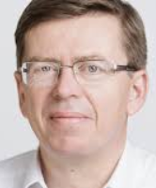
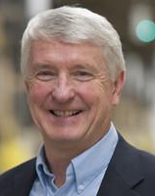
AF Implementation Task Force (ITF)
Key question for Snowmass’21 Accelerator Frontier to address: “…What are the time and cost scales of the R&D and associated test facilities as well as the time and cost scale of the facility?”
A large number of possible accelerator projects: ILC, Muon Collider, gamma-gamma and ERL options, a large circumference electron ring, and a large circumference hadron ring amongst others.
Comparison of the expected costs (using different accounting rules), schedule, and R&D status for the projects.
The Accelerator Implementation Task Force is comprised of 9 world-
renowned accelerator experts from Asia, Europe and US and two representatives of the Snowmass Young; it is chaired by Thomas Roser (BNL) and charged with developing metrics and processes to facilitate a comparison between projects
Focused on HEP Colliders
Thomas Roser (BNL, Chair)
Philippe Lebrun (CERN)
Steve Gourlay (LBNL)
Tor Raubenheimer (SLAC)
Katsunobu Oide (KEK)
Sarah Cousineau (ORNL)
Jim Strait
(FNAL)
Marlene Turner (LBNL)
Spencer Gessner (SLAC)
Vladimir Shiltsev (FNAL)
Reinhard Brinkmann
(DESY)
John Seeman
(SLAC)

Slide 7
Charge to the ITF
Develop the metrics to compare projects’ cost, schedule/timeline, technical risks (readiness), operating cost and environmental impact, and R&D status and plans;
Select the accelerator projects to be evaluated (provided by the AF topical groups);
Work with the proponents of the selected accelerator projects to evaluate them against the metrics from item 1;
Consider the ultimate limits of various types of colliders: e⁺/e⁻, p/p, mu⁺/mu⁻;
Consider limits and timescales due to accelerator technology for various types of colliders: e⁺/e⁻, p/p, mu⁺/mu⁻;
Lead the evaluation of the different HEP accelerator proposals and inform and communicate with the Snowmass’21 AF, EF, NF and TF;
Document the metrics, processes, and conclusions for the Snowmass'21 meeting in the Summer 2022; write and submit a corresponding White Paper.

Slide 8
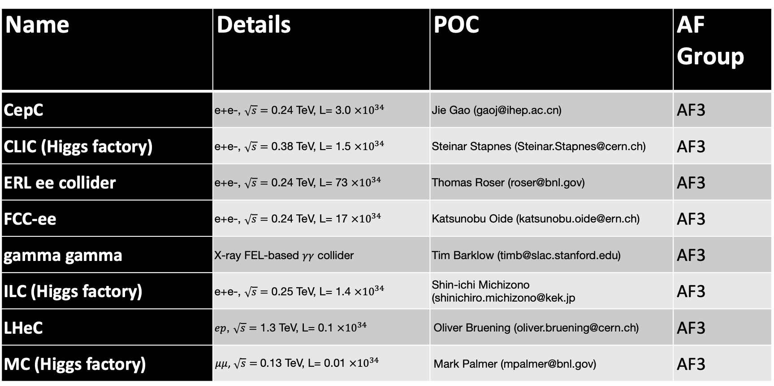
ITF: Higgs Factory Concepts/Proposals (8)
Name | Details | POC | AF Group
CepC | e+e-, $\sqrt{s}=$ 0.24 TeV, L= 3.0 $×{10}^{34}$ | Jie Gao (gaoj@ihep.ac.cn) | AF3
CLIC (Higgs factory) | e+e-, $\sqrt{s}=$ 0.38 TeV, L= 1.5 $×{10}^{34}$ | Steinar Stapnes (Steinar.Stapnes@cern.ch) | AF3
ERL ee collider | e+e-, $\sqrt{s}=$ 0.24 TeV, L= 73 $×{10}^{34}$ | Thomas Roser (roser@bnl.gov) | AF3
FCC-ee | e+e-, $\sqrt{s}=$ 0.24 TeV, L= 17 $×{10}^{34}$ | Katsunobu Oide (katsunobu.oide@ern.ch) | AF3
gamma gamma | X-ray FEL-based $γγ$ collider | Tim Barklow (timb@slac.stanford.edu) | AF3
ILC (Higgs factory) | e+e-, $\sqrt{s}=$ 0.25 TeV, L= 1.4 $×{10}^{34}$ | Shin-ichi Michizono (shinichiro.michizono@kek.jp | AF3
LHeC | $ep$, $\sqrt{s}=$ 1.3 TeV, L= 0.1 $×{10}^{34}$ | Oliver Bruening (oliver.bruening@cern.ch) | AF3
MC (Higgs factory) | $μμ$, $\sqrt{s}=$ 0.13 TeV, L= 0.01 $×{10}^{34}$ | Mark Palmer (mpalmer@bnl.gov) | AF3

Slide 9
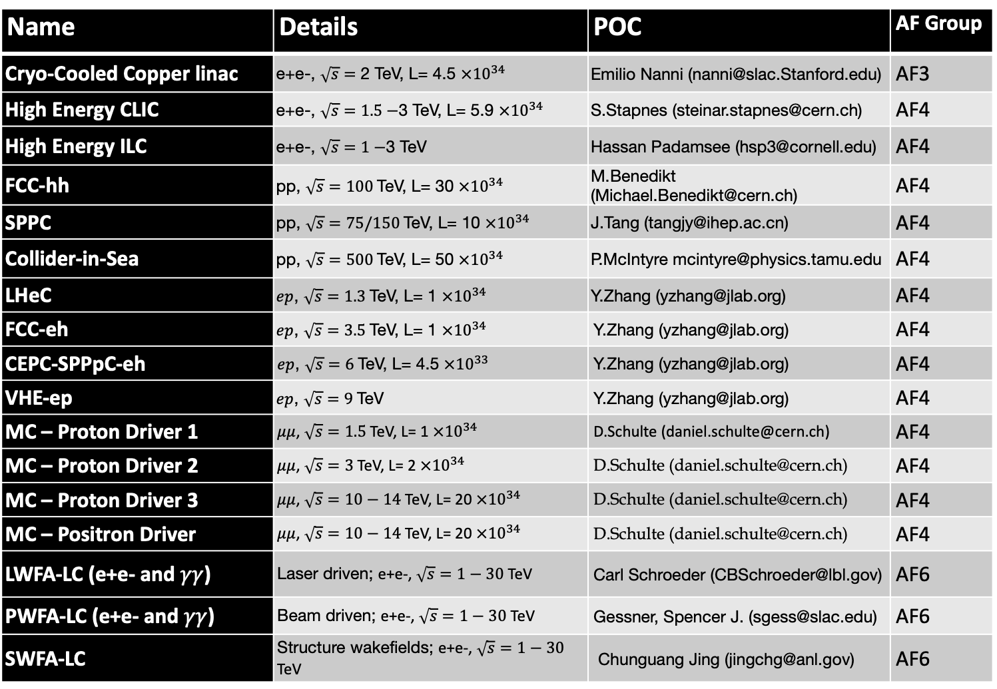
ITF :18 (!) high energy collider concepts/proposals
Name | Details | POC | AF Group
Cryo-Cooled Copper linac | e+e-, $\sqrt{s}=$ 2 TeV, L= 4.5 $×{10}^{34}$ | Emilio Nanni (nanni@slac.Stanford.edu) | AF3
High Energy CLIC | e+e-, $\sqrt{s}=1.5−$3 TeV, L= 5.9 $×{10}^{34}$ | S.Stapnes (steinar.stapnes@cern.ch) | AF4
High Energy ILC | e+e-, $\sqrt{s}=1−$3 TeV | Hassan Padamsee (hsp3@cornell.edu) | AF4
FCC-hh | pp, $\sqrt{s}=100$TeV, L= 30 $×{10}^{34}$ | M.Benedikt (Michael.Benedikt@cern.ch) | AF4
SPPC | pp, $\sqrt{s}=75/150$TeV, L= 10 $×{10}^{34}$ | J.Tang (tangjy@ihep.ac.cn) | AF4
Collider-in-Sea | pp, $\sqrt{s}=500$TeV, L= 50 $×{10}^{34}$ | P.McIntyre mcintyre@physics.tamu.edu | AF4
LHeC | $ep$, $\sqrt{s}=1.3$TeV, L= 1 $×{10}^{34}$ | Y.Zhang (yzhang@jlab.org) | AF4
FCC-eh | $ep$, $\sqrt{s}=3.5$TeV, L= 1 $×{10}^{34}$ | Y.Zhang (yzhang@jlab.org) | AF4
CEPC-SPPpC-eh | $ep$, $\sqrt{s}=6$TeV, L= 4.5 $×{10}^{33}$ | Y.Zhang (yzhang@jlab.org) | AF4
VHE-ep | $ep$, $\sqrt{s}=9$TeV | Y.Zhang (yzhang@jlab.org) | AF4
MC – Proton Driver 1 | $μμ$, $\sqrt{s}=1.5$TeV, L= 1 $×{10}^{34}$ | D.Schulte (daniel.schulte@cern.ch) | AF4
MC – Proton Driver 2 | $μμ$, $\sqrt{s}=3$TeV, L= 2 $×{10}^{34}$ | D.Schulte (daniel.schulte@cern.ch) | AF4
MC – Proton Driver 3 | $μμ$, $\sqrt{s}=10−14$TeV, L= 20 $×{10}^{34}$ | D.Schulte (daniel.schulte@cern.ch) | AF4
MC – Positron Driver | $μμ$, $\sqrt{s}=10−14$TeV, L= 20 $×{10}^{34}$ | D.Schulte (daniel.schulte@cern.ch) | AF4
LWFA-LC (e+e- and $γγ$) | Laser driven; e+e-, $\sqrt{s}=1−30$ TeV | Carl Schroeder (CBSchroeder@lbl.gov) | AF6
PWFA-LC (e+e- and $γγ$) | Beam driven; e+e-, $\sqrt{s}=1−30$ TeV | Gessner, Spencer J. (sgess@slac.edu) | AF6
SWFA-LC | Structure wakefields; e+e-, $\sqrt{s}=1−30$ TeV | Chunguang Jing (jingchg@anl.gov) | AF6

Slide 10
Muon Collider Forum
Joint EF-AF-TF-IF Initiative
Aspirations for energy frontier facility in the US
Based on results of successful US-Muon Accelerator Program (MAP) that ended in 2016 and bold CERN-led initiative in Europe

Slide 11

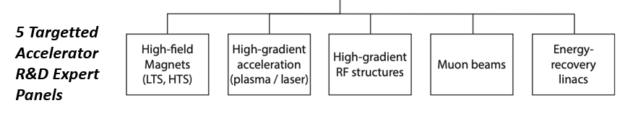
European Planning Influences Snowmass Topics
European Strategy for Particle Physics (ESPP) describes strategy for particle physics in Europe and their contributions world-wide (June 19, 2020)
European National Laboratories Directors Group (LDG) – July 2 (Chaired by Lenny Rivkin)
  Immediate outcome → Accelerator R&D Task Forces reporting to Lab Directors Group (LDG) and CERN Council
Address the question of what are the most promising Accelerator R&D activities for HEP
Snowmass AF participants are
active on all the LDG panels

Slide 12
Steps Toward a Muon Collider in Europe
EU Strategy –International Design Study
High-priority future initiatives . . . In addition to the high field magnets the accelerator R&D Roadmap could contain:
. . . An international design study for a muon collider, as it represents a unique opportunity to achieve a multi-TeV energy domain beyond the reach of e⁺e⁻ colliders, and potentially within a more compact circular tunnel than for a hadron collider. The biggest challenge remains to produce an intense beam of cooled muons, but novel ideas are being explored;
  LDG agrees to start building the collaboration for an international muon collider design study
  Daniel Schulte as interim project leader – with N. Pastrone and L. Rivkin
  Kick-off meeting held – July 3
  > 250 participants – https://indico.cern.ch/event/930508/

